Slide 1
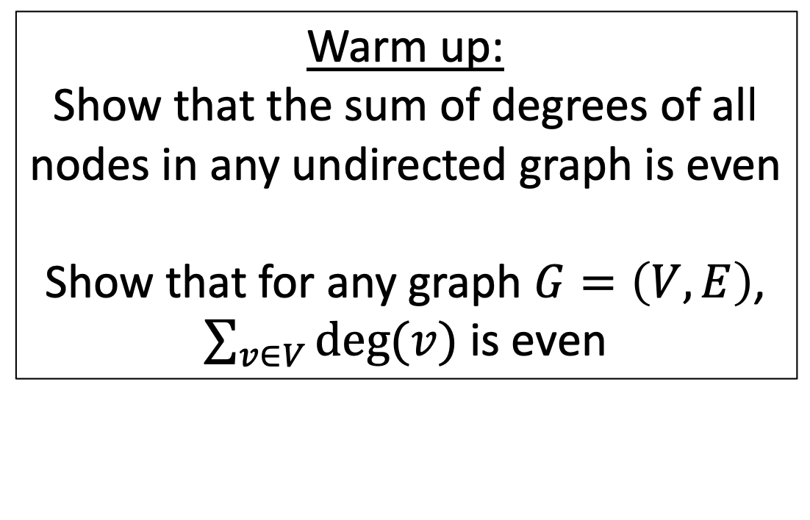
CS4102 Algorithms
Fall 2018
Warm up:
Show that the sum of degrees of all nodes in any undirected graph is even
Show that for any graph $G=\left(V,E\right)$,
$\sum_{v∈V}{deg⁡(v)}$ is even

Slide 2
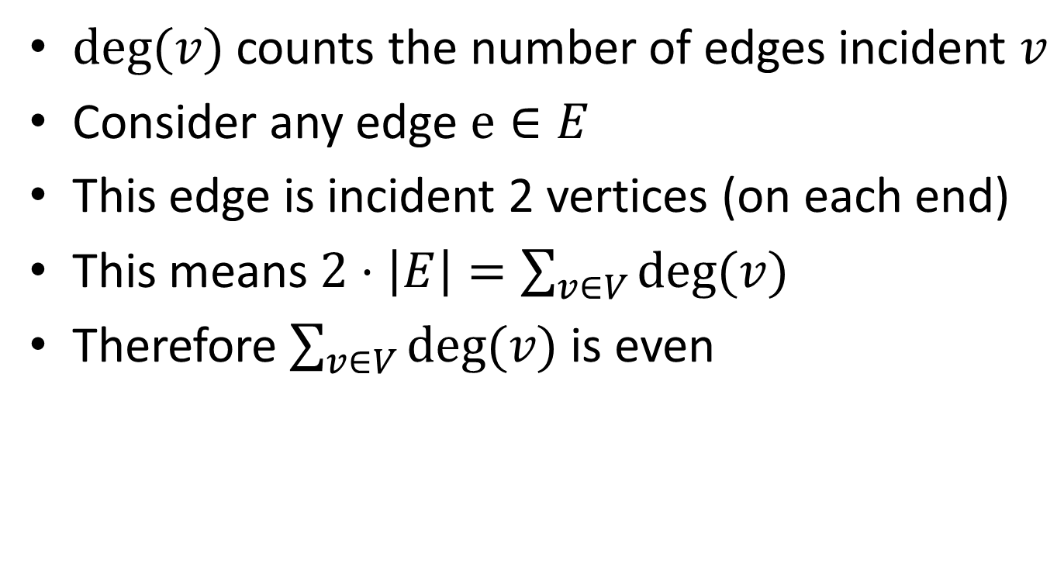

$\sum_{v∈V}{deg⁡(v)}$ is always even
$deg⁡(v)$ counts the number of edges incident $v$
Consider any edge $e∈E$
This edge is incident 2 vertices (on each end)
This means $2⋅\left|E\right|=\sum_{v∈V}{deg⁡(v)}$
Therefore $\sum_{v∈V}{deg⁡(v)}$ is even

Slide 3
Today’s Keywords
Greedy Algorithms
Choice Function
Graphs
Minimum Spanning Tree
Kruskal’s Algorithm
Prim’s Algorithm
Cut Theorem

Slide 4
CLRS Readings
Chapter 22
Chapter 23

Slide 5
Homeworks
HW6 Due Friday Nov 9 @11pm
Written (use latex)
DP and Greedy

Slide 6








ARPANET

Slide 7









Problem
Find a Minimum Spanning Tree
8
10
8
7
2
9
5
9
12
3
3
11
1
6
We need to connect together all these places into a network
We have feasible wires to run, plus the cost of each wire
Find the cheapest set of wires to run to connect all places

Slide 8
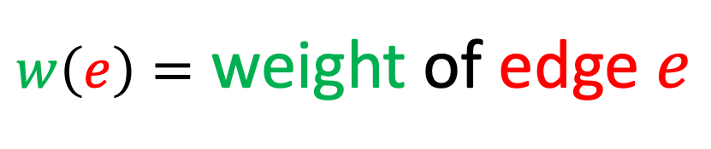
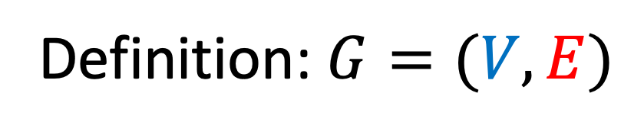


Graphs
Vertices/Nodes
Definition: $G=(V,E)$
$w\left(e\right)=$ weight of edge $e$
Edges
8
$$V=\{A,B,C,D,E,F,G,H,I\}$$
B
E
10
8
$$E=\{\left(A,B\right),\left(A,C\right),\left(B,C\right),…\}$$
7
H
A
2
9
D
5
9
I
12
3
C
3
11
G
1
F
6

Slide 9

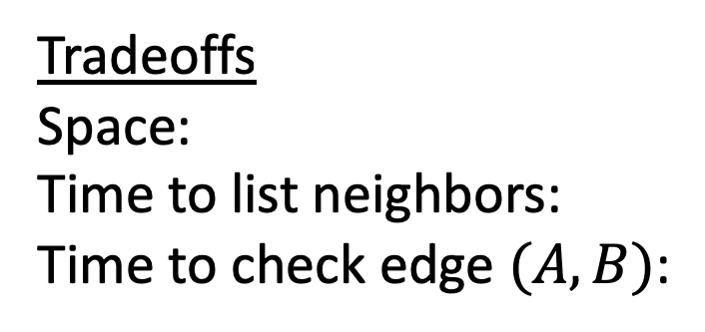


Adjacency List Representation
A
B
C
B
8
B
A
C
E
10
E
8
7
H
C
A
B
D
F
A
9
2
D
5
9
I
D
C
E
F
12
3
C
3
E
B
D
G
H
11
G
1
F
6
F
C
D
G
Tradeoffs
Space:
Time to list neighbors:
Time to check edge $(A,B)$:
G
E
F
H
I
$$V+E$$
H
E
G
I
$$Degree(A)$$
$$Degree(A)$$
I
G
H

Slide 10



Adjacency Matrix Representation
B
8
A
B
C
D
E
F
G
H
I
10
E
8
A
1
1
7
H
B
1
1
1
A
9
2
D
5
C
1
1
1
1
9
I
D
1
1
1
12
3
E
1
1
1
1
C
3
F
1
1
1
11
G
1
1
1
1
G
1
F
6
H
1
1
1
I
1
1
Tradeoffs
Space:
Time to list neighbors:
Time to check edge $(A,B)$:
$$V^{2}$$
$$V$$
$$O(1)$$

Slide 11
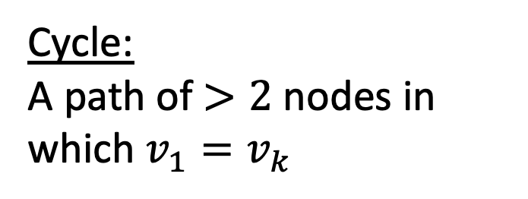
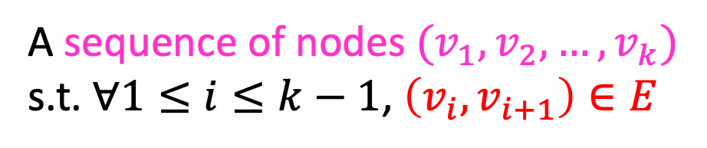
Definition: Path
A sequence of nodes $(v_{1},v_{2},…, v_{k})$
s.t. $∀1≤i≤k−1$, $\left(v_{i},v_{i+1}\right)∈E$
B
8
10
E
8
7
H
A
9
2
D
5
9
I
12
3
C
3
11
G
1
F
6
Simple Path:
A path in which each node appears at most once
Cycle:
A path of $>2$ nodes in which $v_{1}=v_{k}$

Slide 12
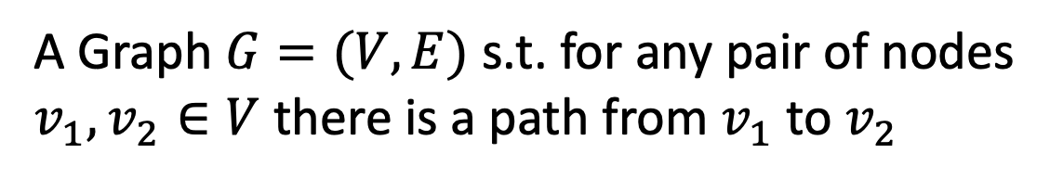
Definition: Connected Graph
A Graph $G=(V,E)$ s.t. for any pair of nodes $v_{1},v_{2}∈V$ there is a path from $v_{1}$ to $v_{2}$
B
8
10
E
8
7
H
A
9
2
D
5
9
I
12
3
C
3
11
G
1
F
6

Slide 13
Definition: Tree
A connected graph with no cycles
10
B
E
7
H
A
D
5
9
I
12
3
C
3
11
G
F

Slide 14
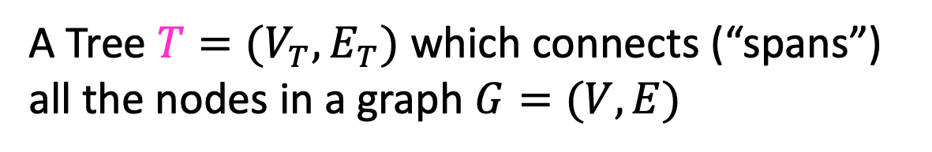


Definition: Spanning Tree
A Tree $T=(V_{T},E_{T})$ which connects (“spans”) all the nodes in a graph $G=(V,E)$
B
8
10
E
8
7
H
A
9
2
How many edges does $T$ have?
D
5
9
$$V−1$$
I
12
3
C
3
11
G
1
F
6

Slide 15
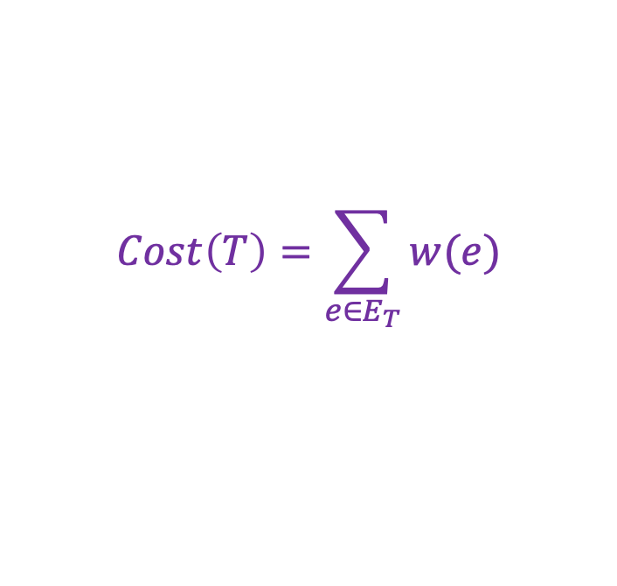
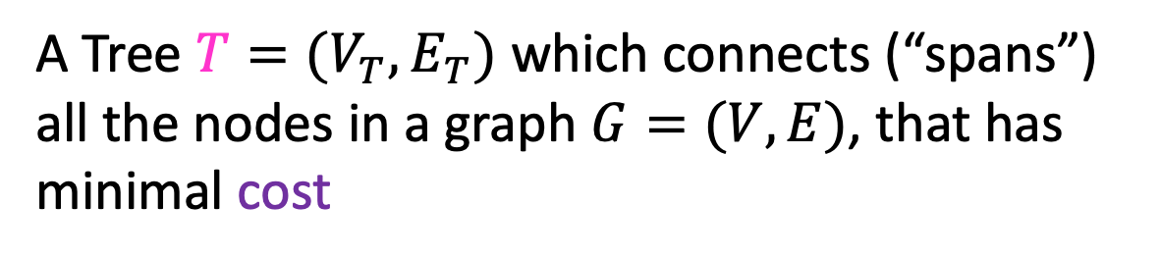
Definition: Minimum Spanning Tree
A Tree $T=(V_{T},E_{T})$ which connects (“spans”) all the nodes in a graph $G=(V,E)$, that has minimal cost
$$Cost\left(T\right)=\sum_{e∈E_{T}}{w(e)}$$
B
8
10
E
8
7
H
A
9
2
How many edges does $T$ have?
D
5
9
$$V−1$$
I
12
3
C
3
11
G
1
F
6

Slide 16
Greedy Algorithms
Require Optimal Substructure
Solution to larger problem contains the solution to a smaller one
Only one subproblem to consider!
Idea:
Identify a greedy choice property
How to make a choice guaranteed to be included in some optimal solution
Repeatedly apply the choice property until no subproblems remain

Slide 17
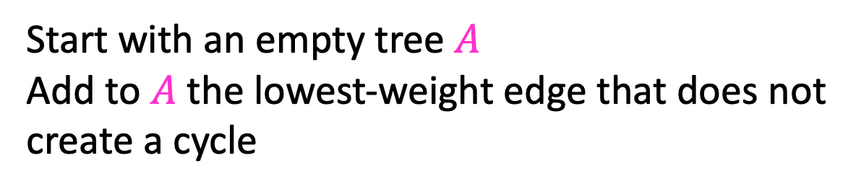
Kruskal’s Algorithm
Start with an empty tree $A$
Add to $A$ the lowest-weight edge that does not create a cycle
B
8
10
E
8
7
H
A
9
2
D
5
9
I
12
3
C
3
11
G
1
F
6

Slide 18
Kruskal’s Algorithm
Start with an empty tree $A$
Add to $A$ the lowest-weight edge that does not create a cycle
B
8
10
E
8
7
H
A
9
2
D
5
9
I
12
3
C
3
11
G
1
F
6

Slide 19
Kruskal’s Algorithm
Start with an empty tree $A$
Add to $A$ the lowest-weight edge that does not create a cycle
B
8
10
E
8
7
H
A
9
2
D
5
9
I
12
3
C
3
11
G
1
F
6

Slide 20
Kruskal’s Algorithm
Start with an empty tree $A$
Add to $A$ the lowest-weight edge that does not create a cycle
B
8
10
E
8
7
H
A
9
2
D
5
9
I
12
3
C
3
11
G
1
F
6

Slide 21
Kruskal’s Algorithm
Start with an empty tree $A$
Add to $A$ the lowest-weight edge that does not create a cycle
B
8
10
E
8
7
H
A
9
2
D
5
9
I
12
3
C
3
11
G
1
F
6

Slide 22

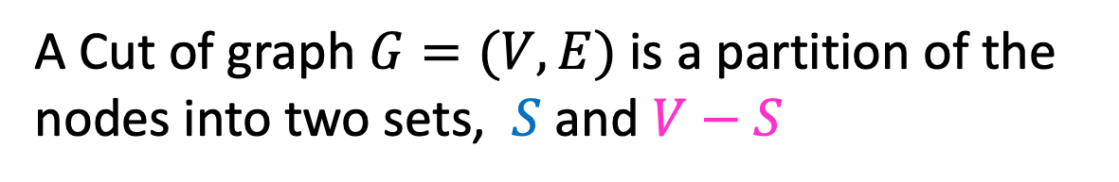
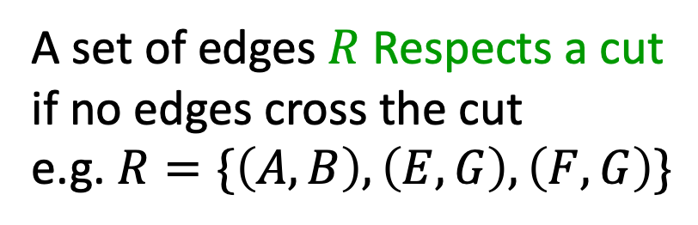
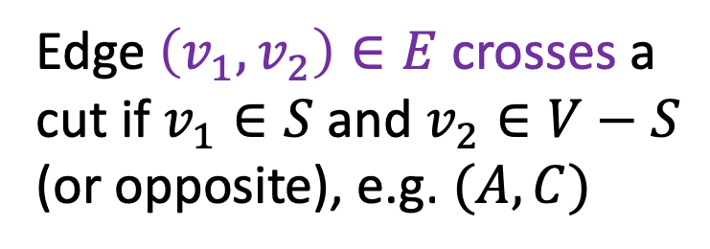
Definition: Cut
A Cut of graph $G=(V,E)$ is a partition of the nodes into two sets, $S$ and $V−S$
B
8
10
E
8
7
H
A
9
2
D
5
9
$$S$$
I
12
3
C
3
11
G
1
F
6
Edge $\left(v_{1},v_{2}\right)∈E$ crosses a cut if $v_{1}∈S$ and $v_{2}∈V−S$ (or opposite), e.g. $(A,C)$
A set of edges $R$ Respects a cut if no edges cross the cut
e.g. $R=\{\left(A,B\right),\left(E,G\right),\left(F,G\right)\}$

Slide 23
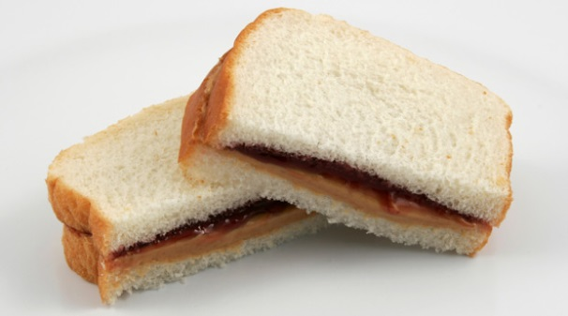
Exchange argument
Shows correctness of a greedy algorithm
Idea:
Show exchanging an item from an arbitrary optimal solution with your greedy choice makes the new solution no worse
How to show my sandwich is at least as good as yours:
Show: “I can remove any item from your sandwich, and it would be no worse by replacing it with the same item from my sandwich”

Slide 24
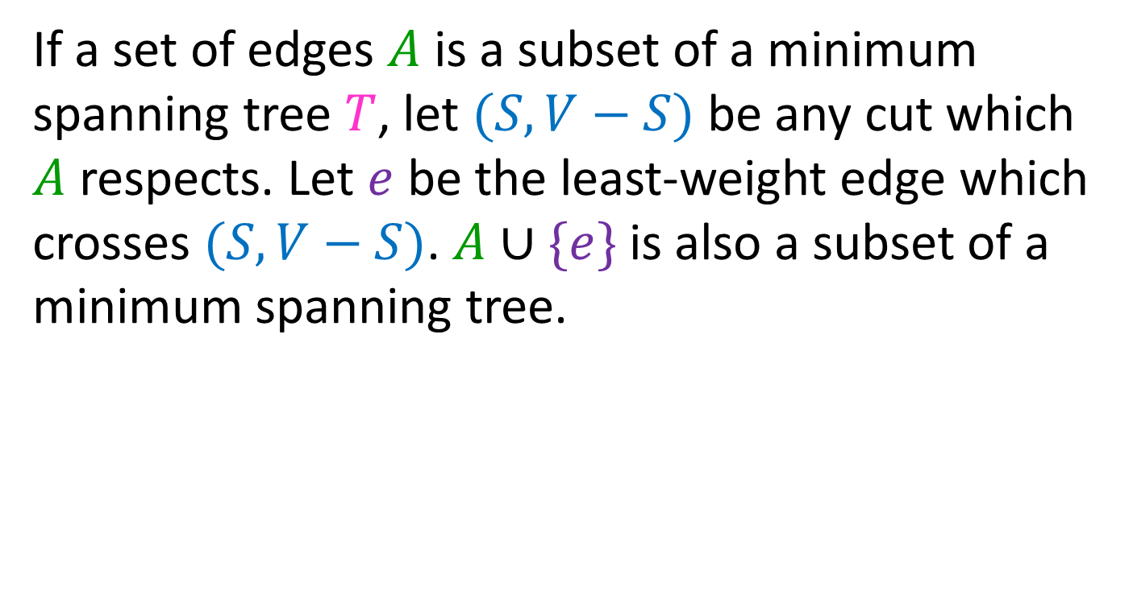
Cut Theorem
If a set of edges $A$ is a subset of a minimum spanning tree $T$, let $(S, V−S)$ be any cut which $A$ respects. Let $e$ be the least-weight edge which crosses $(S, V−S)$. $A∪\{e\}$ is also a subset of a minimum spanning tree.
B
8
10
E
8
7
H
A
9
2
D
5
9
I
12
3
C
3
11
G
1
F
6

Slide 25
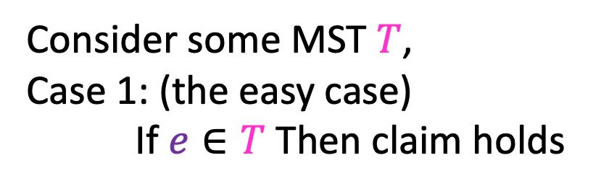


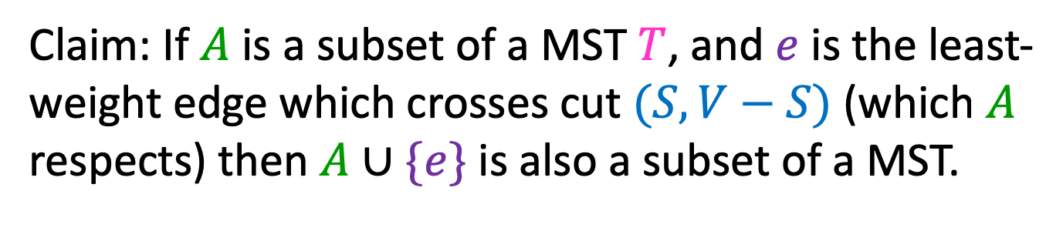


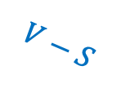
Proof of Cut Theorem
Claim: If $A$ is a subset of a MST $T$, and $e$ is the least-weight edge which crosses cut $(S, V−S)$ (which $A$ respects) then $A∪\{e\}$ is also a subset of a MST.
$$T$$
Consider some MST $T$,
Case 1: (the easy case)
If $e∈T$ Then claim holds
$$A⊆T$$
$$S$$
$$e$$
$$V−S$$

Slide 26



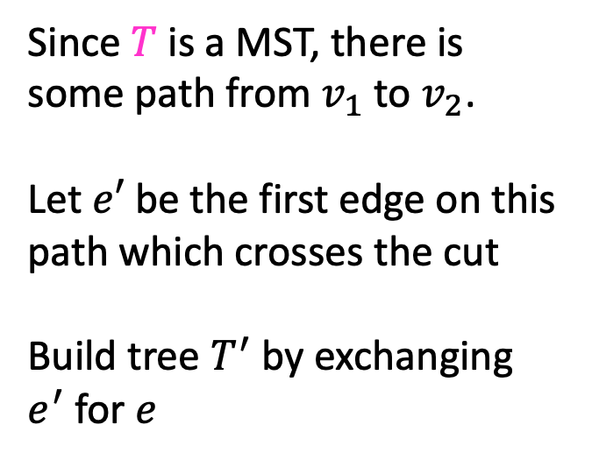
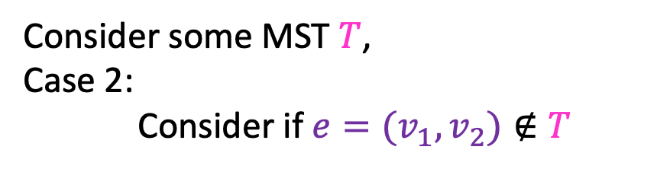


Proof of Cut Theorem
Claim: If $A$ is a subset of a MST $T$, and $e$ is the least-weight edge which crosses cut $(S, V−S)$ (which $A$ respects) then $A∪\{e\}$ is also a subset of a MST.
$$T$$
Consider some MST $T$,
Case 2:
Consider if $e=(v_{1},v_{2})∉T$
$$A⊆T$$
$$S$$
Since $T$ is a MST, there is some path from $v_{1}$ to $v_{2}$.
Let $e′$ be the first edge on this path which crosses the cut
Build tree $T^{′}$ by exchanging $e^{′}$ for $e$
$$v_{1}$$
$$e$$
$$e′$$
$$v_{2}$$
$$V−S$$

Slide 27
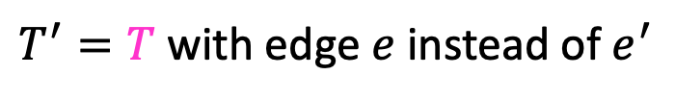
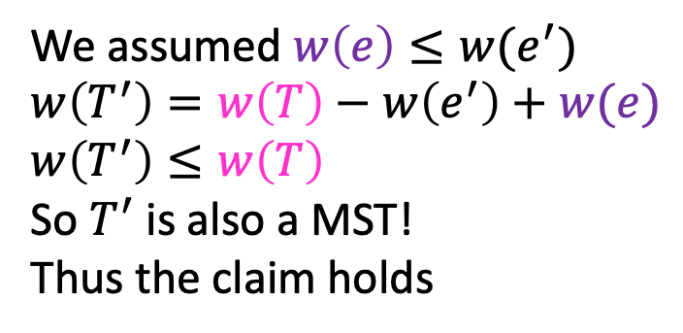
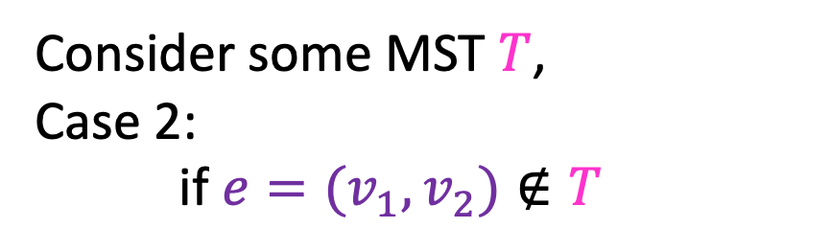
Proof of Cut Theorem
Claim: If $A$ is a subset of a MST $T$, and $e$ is the least-weight edge which crosses cut $(S, V−S)$ (which $A$ respects) then $A∪\{e\}$ is also a subset of a MST.
Consider some MST $T$,
Case 2:
if $e=(v_{1},v_{2})∉T$
$$T$$
$$A⊆T$$
$$S$$
$T^{′}=T$ with edge $e$ instead of $e^{′}$
$$v_{1}$$
We assumed $w\left(e\right)≤w(e^{′})$
$w\left(T^{′}\right)=w\left(T\right)−w\left(e^{′}\right)+w(e)$
$w\left(T^{′}\right)≤w\left(T\right)$
So $T^{′}$ is also a MST!
Thus the claim holds
$$e$$
$$e′$$
$$v_{2}$$
$$V−S$$

Slide 28

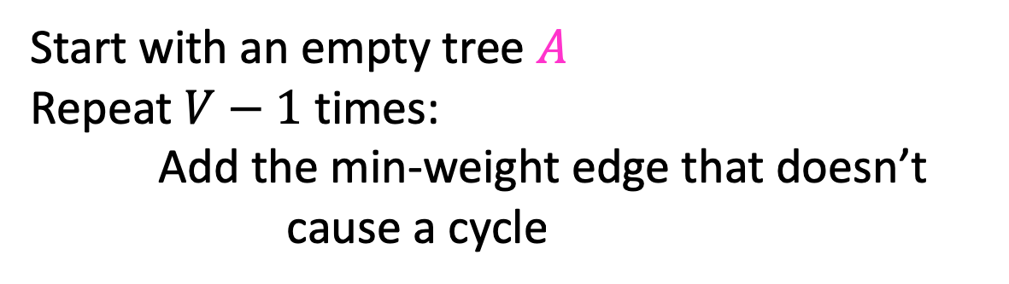
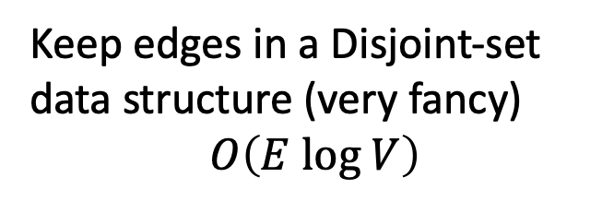

Kruskal’s Algorithm
Start with an empty tree $A$
Repeat $V−1$ times:
Add the min-weight edge that doesn’t cause a cycle
Keep edges in a Disjoint-set data structure (very fancy)
$$O\left(E log V\right)$$
B
8
10
E
8
7
H
A
9
2
D
5
9
I
12
3
C
3
$$e$$
11
G
1
F
6
$$S$$

Slide 29
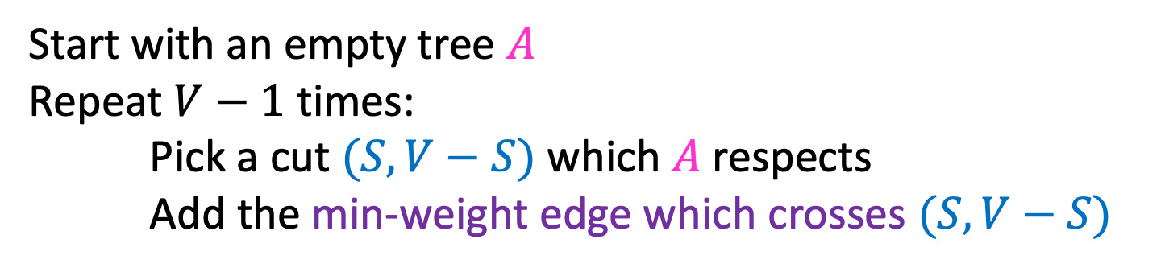
General MST Algorithm
Start with an empty tree $A$
Repeat $V−1$ times:
Pick a cut $(S,V−S)$ which $A$ respects
Add the min-weight edge which crosses $(S,V−S)$
B
8
10
E
8
7
H
A
9
2
D
5
9
I
12
3
C
3
11
G
1
F
6

Slide 30
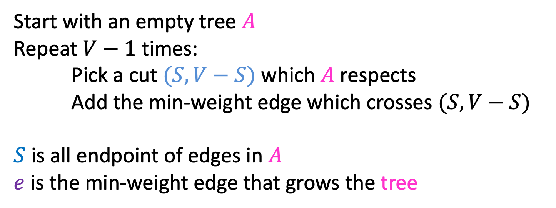
Prim’s Algorithm
Start with an empty tree $A$
Repeat $V−1$ times:
Pick a cut $(S,V−S)$ which $A$ respects
Add the min-weight edge which crosses $(S,V−S)$
$S$ is all endpoint of edges in $A$
$e$ is the min-weight edge that grows the tree
B
8
10
E
6
7
H
A
9
2
D
5
9
I
12
3
C
3
11
G
1
F
7

Slide 31
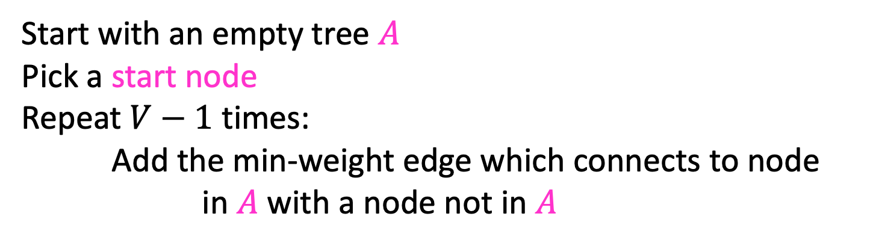
Prim’s Algorithm
Start with an empty tree $A$
Pick a start node
Repeat $V−1$ times:
Add the min-weight edge which connects to node in $A$ with a node not in $A$
B
8
10
E
6
7
H
A
9
2
D
5
9
I
12
3
C
3
11
G
1
F
7

Slide 32
Prim’s Algorithm
Start with an empty tree $A$
Pick a start node
Repeat $V−1$ times:
Add the min-weight edge which connects to node in $A$ with a node not in $A$
B
8
10
E
6
7
H
A
9
2
D
5
9
I
12
3
C
3
11
G
1
F
7

Slide 33
Prim’s Algorithm
Start with an empty tree $A$
Pick a start node
Repeat $V−1$ times:
Add the min-weight edge which connects to node in $A$ with a node not in $A$
B
8
10
E
6
7
H
A
9
2
D
5
9
I
12
3
C
3
11
G
1
F
7

Slide 34
Prim’s Algorithm
Start with an empty tree $A$
Pick a start node
Repeat $V−1$ times:
Add the min-weight edge which connects to node in $A$ with a node not in $A$
B
8
10
E
6
7
H
A
9
2
D
5
9
I
12
3
C
3
11
G
1
F
7

Slide 35
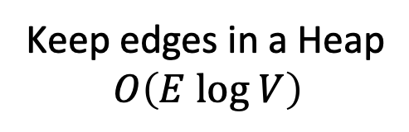
Prim’s Algorithm
Start with an empty tree $A$
Pick a start node
Repeat $V−1$ times:
Add the min-weight edge which connects to node in $A$ with a node not in $A$
Keep edges in a Heap
$$O\left(E log V\right)$$
B
8
10
E
6
7
H
A
9
2
D
5
9
I
12
3
C
3
11
G
1
F
7

Slide 36
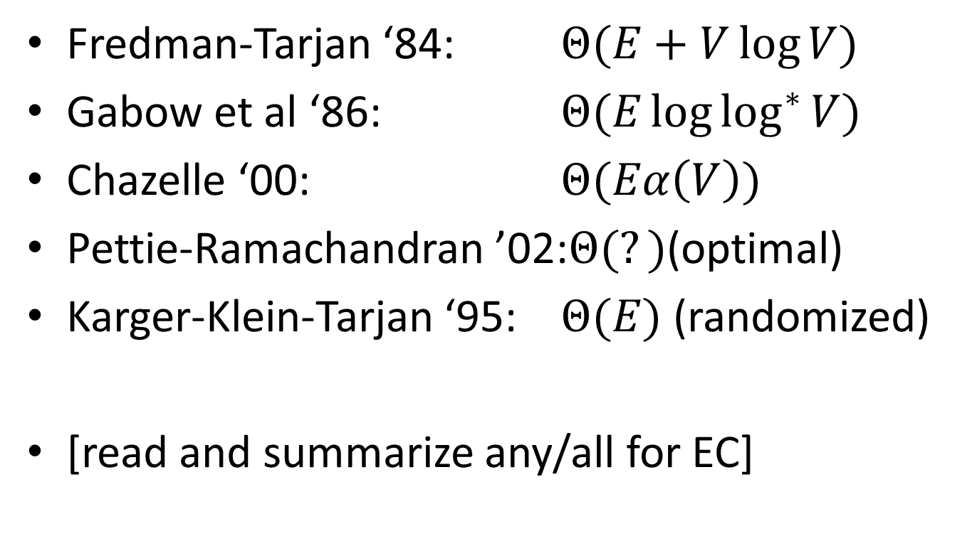
Summary of MST results
Fredman-Tarjan ‘84: $Θ(E+V\log{V})$
Gabow et al ‘86: $Θ(E\log{\log^{∗}{V}})$
Chazelle ‘00: $Θ(Eα\left(V\right))$
Pettie-Ramachandran ’02:$Θ(?)$(optimal)
Karger-Klein-Tarjan ‘95: $Θ(E)$ (randomized)
[read and summarize any/all for EC]

Slide 37
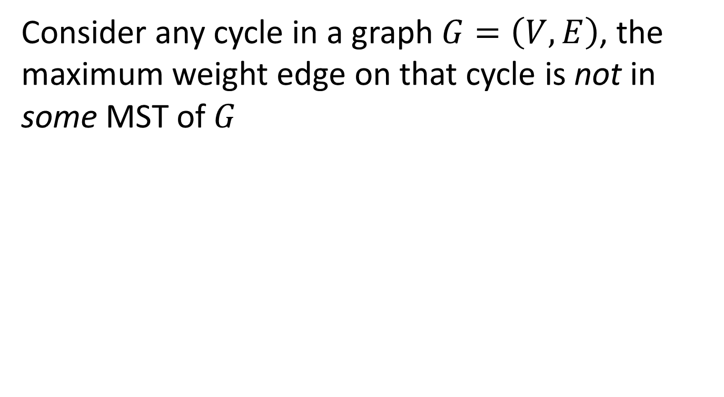


Cycle Property
Consider any cycle in a graph $G=\left(V,E\right)$, the maximum weight edge on that cycle is not in some MST of $G$
$$S$$
$$v_{1}$$
$$e$$
$$e′$$
$$v_{2}$$
$$v_{4}$$
$$V−S$$
$$v_{3}$$

Slide 38
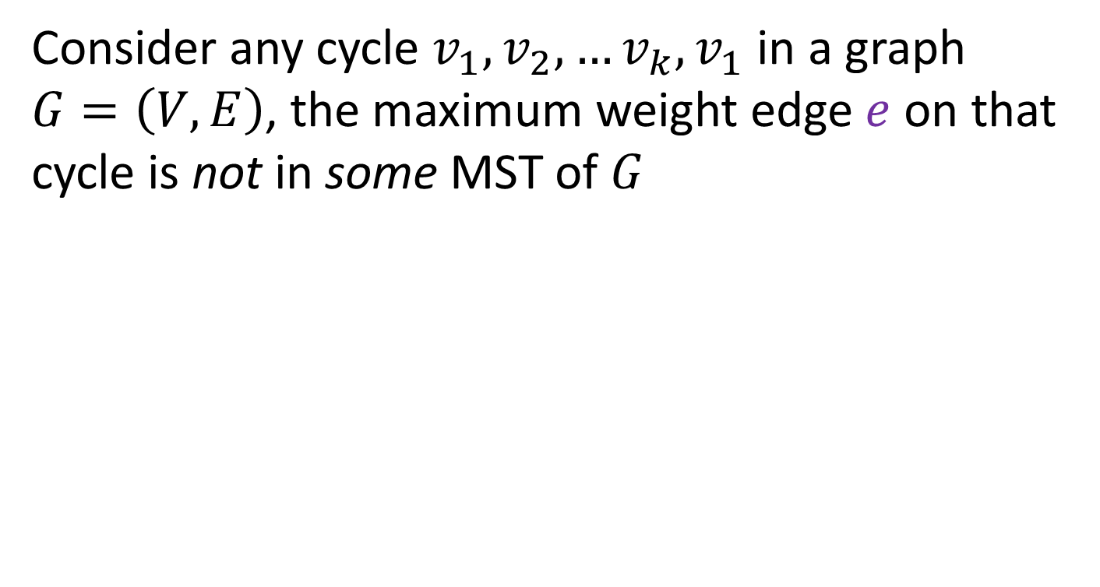
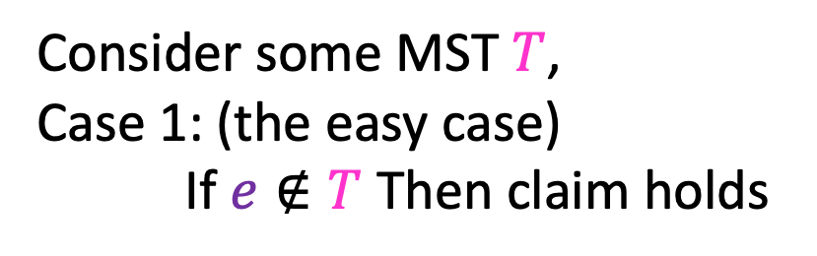
Cycle Property
Consider any cycle $v_{1},v_{2},…v_{k},v_{1}$ in a graph $G=\left(V,E\right)$, the maximum weight edge $e$ on that cycle is not in some MST of $G$
Consider some MST $T$,
Case 1: (the easy case)
If $e∉T$ Then claim holds
$$v_{1}$$
$$e′$$
$$v_{2}$$
$$e$$
$$v_{4}$$
$$v_{3}$$

Slide 39
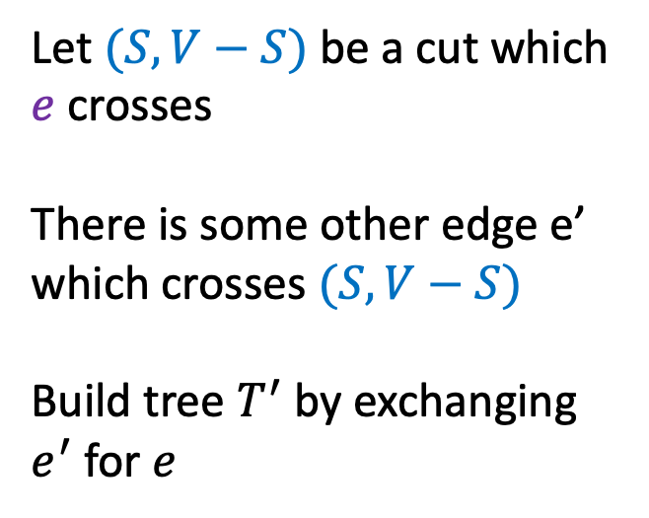
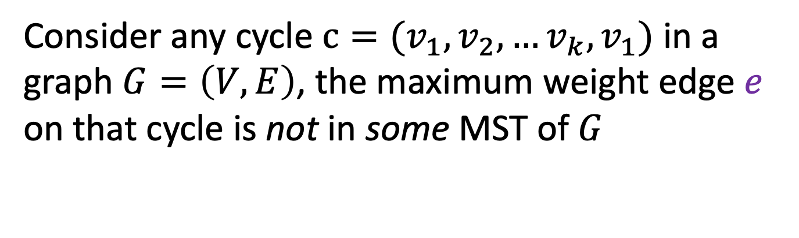
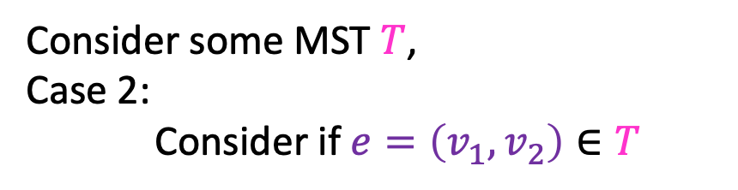

Cycle Property
Consider any cycle $c=(v_{1},v_{2},…v_{k},v_{1})$ in a graph $G=\left(V,E\right)$, the maximum weight edge $e$ on that cycle is not in some MST of $G$
Consider some MST $T$,
Case 2:
Consider if $e=\left(v_{1},v_{2}\right)∈T$
$$S$$
Let $(S, V−S)$ be a cut which $e$ crosses
There is some other edge e’ which crosses $(S, V−S)$
Build tree $T^{′}$ by exchanging $e^{′}$ for $e$
$$v_{1}$$
$$e$$
$$v_{2}$$
$$e′$$
$$v_{4}$$
$$V−S$$
$$v_{3}$$

Slide 40
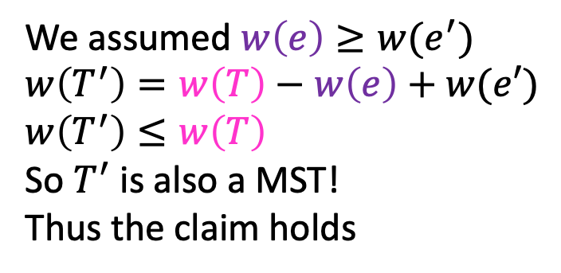
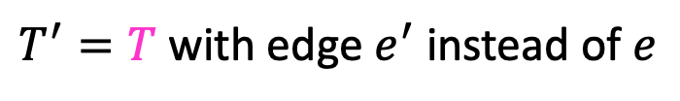
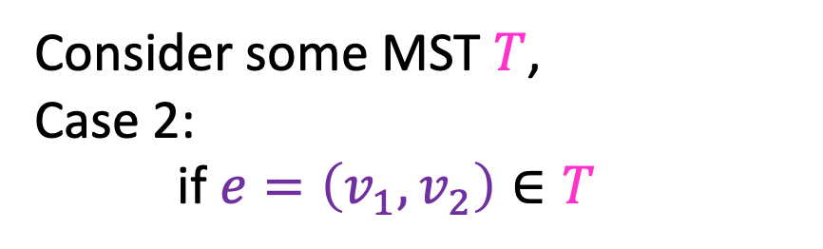
Cycle Property
Consider any cycle $c=(v_{1},v_{2},…v_{k},v_{1})$ in a graph $G=\left(V,E\right)$, the maximum weight edge $e$ on that cycle is not in some MST of $G$
Consider some MST $T$,
Case 2:
if $e=\left(v_{1},v_{2}\right)∈T$
$$S$$
$T^{′}=T$ with edge $e^{′}$ instead of $e$
$$v_{1}$$
We assumed $w\left(e\right)≥w(e^{′})$
$w\left(T^{′}\right)=w\left(T\right)−w\left(e\right)+w(e′)$
$w\left(T^{′}\right)≤w\left(T\right)$
So $T^{′}$ is also a MST!
Thus the claim holds
$$e$$
$$v_{2}$$
$$e′$$
$$v_{4}$$
$$V−S$$
$$v_{3}$$

Slide 41

Cycle Property
Consider any cycle in a graph $G=\left(V,E\right)$, the maximum weight edge on that cycle is not in some MST of $G$
Let $e$ be the heaviest edge on cycle $v_{1},v_{2},v_{3},v_{4},v_{1}$
Assume $T$ is a MST which includes $e$
Let $(S, V−S)$ be a cut which $e$ crosses
There must be some other edge $e^{′}$ in the cycle which also crosses $(S, V−S)$
Create Tree $T^{′}$ by removing edge $e$ in favor of $e^{′}$
$$w\left(T^{′}\right)=w\left(T\right)−w\left(e\right)+w\left(e^{′}\right)$$
$$w\left(e^{′}\right)≤w(e)$$
$$w\left(T^{′}\right)≤w(T)$$
$$S$$
$$v_{1}$$
$$e$$
$$e′$$
$$v_{2}$$
$$v_{4}$$
$$V−S$$
$$v_{3}$$

