Slide 1
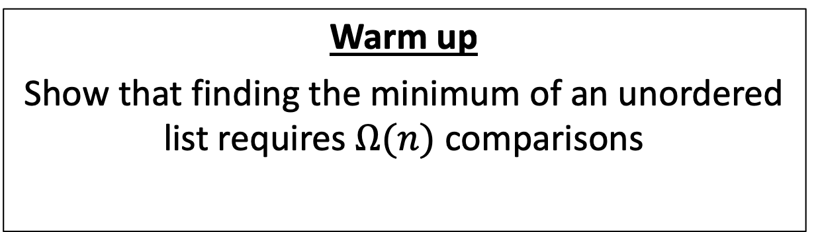
CS4102 Algorithms
Fall 2018
Warm up
Show that finding the minimum of an unordered list requires $Ω(n)$ comparisons

Slide 2
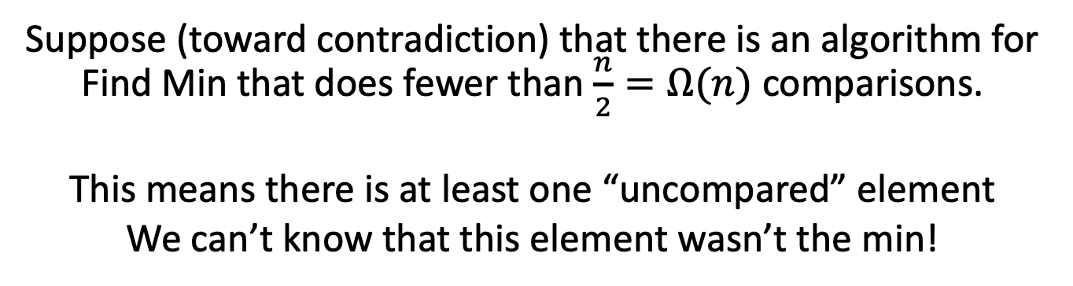
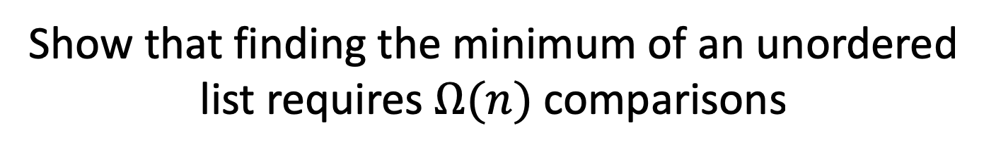

Find Min, Lower Bound Proof
Show that finding the minimum of an unordered list requires $Ω(n)$ comparisons
Suppose (toward contradiction) that there is an algorithm for Find Min that does fewer than $\frac{n}{2}=Ω(n)$ comparisons.
This means there is at least one “uncompared” element
We can’t know that this element wasn’t the min!
2
8
19
20
$$−{10}^{100}$$
3
9
-4
0
1
2
3
4
5
6
7

Slide 3
Homeworks
Regrade office hours TODAY 4-5pm
Check for new HW2 scores this afternoon
Hw3 Due 11pm Wednesday Oct 3
Divide and conquer
Written (use LaTeX!)
Hw4 is out
Sorting
Written

Slide 4
Today’s Keywords
Sorting
Linear time Sorting
Counting Sort
Radix Sort

Slide 5
CLRS Readings
Chapter 8

Slide 6
Sorting in Linear Time
Cannot be comparison-based
Need to make some sort of assumption about the contents of the list
Small number of unique values
Small range of values
Etc.

Slide 7
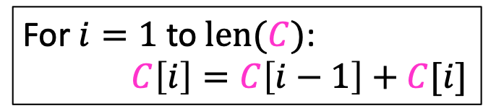


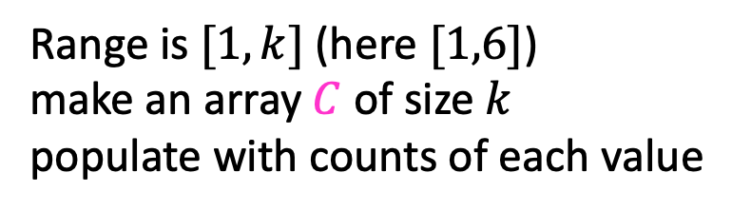
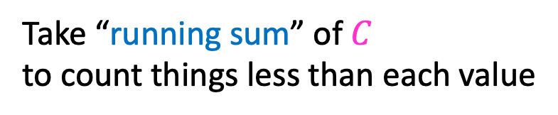

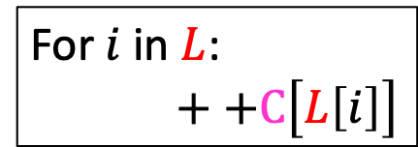
Counting Sort
Idea: Count how many things are less than each element
$$L=$$
3
6
6
1
3
4
1
6
1
2
3
4
5
6
7
8
1.
Range is $[1,k]$ (here $[1,6]$)
make an array $C$ of size $k$
populate with counts of each value
$$C=$$
2
0
2
1
0
3
1
2
3
4
5
6
For $i$ in $L$:
$++C\left[L\left[i\right]\right]$
running sum
2.
Take “running sum” of $C$
to count things less than each value
$$C=$$
2
2
4
5
5
8
1
2
3
4
5
6
For $i=1$ to $len(C)$:
$C\left[i\right]=C\left[i−1\right]+C[i]$
To sort: last item of value 3 goes at index 4

Slide 8
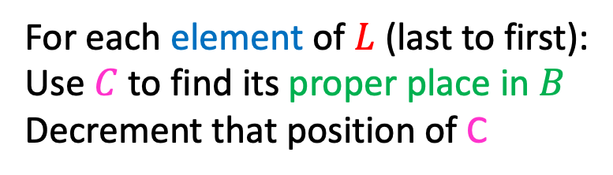

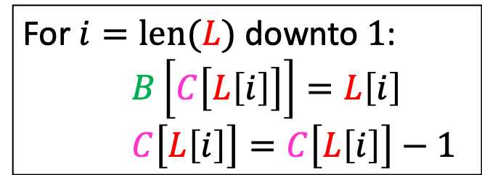


Counting Sort
Idea: Count how many things are less than each element
$$L=$$
3
6
6
1
3
4
1
6
$$C=$$
2
2
4
5
5
8
7
1
2
3
4
5
6
7
8
1
2
3
4
5
6
Last item of value 6 goes at index 8
For each element of $L$ (last to first):
Use $C$ to find its proper place in $B$
Decrement that position of C
For $i=len(L)$ downto $1$:
$B\left[C\left[L\left[i\right]\right]\right]=L\left[i\right]$
$C\left[L\left[i\right]\right]=C\left[L\left[i\right]\right]−1$
$$B=$$
6
1
2
3
4
5
6
7
8

Slide 9
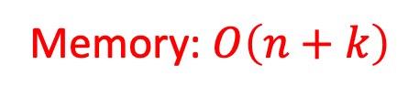
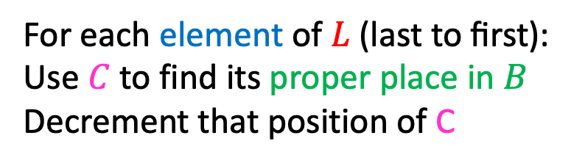
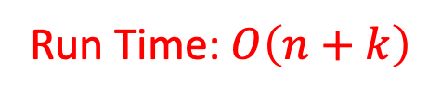
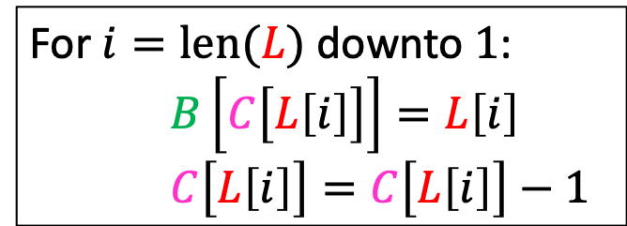
Counting Sort
Idea: Count how many things are less than each element
$$L=$$
3
6
6
1
3
4
1
6
$$C=$$
2
2
4
5
5
7
1
1
2
3
4
5
6
7
8
1
2
3
4
5
6
Last item of value 1 goes at index 2
For each element of $L \text{(}\text{last} \text{to} \text{first}\text{)}$:
Use $C$ to find its proper place in $B$
Decrement that position of C
For $i=len(L)$ downto $1$:
$B\left[C\left[L\left[i\right]\right]\right]=L\left[i\right]$
$C\left[L\left[i\right]\right]=C\left[L\left[i\right]\right]−1$
Run Time: $O\left(n+k\right)$
$$B=$$
1
6
1
2
3
4
5
6
7
8
Memory: $O\left(n+k\right)$

Slide 10
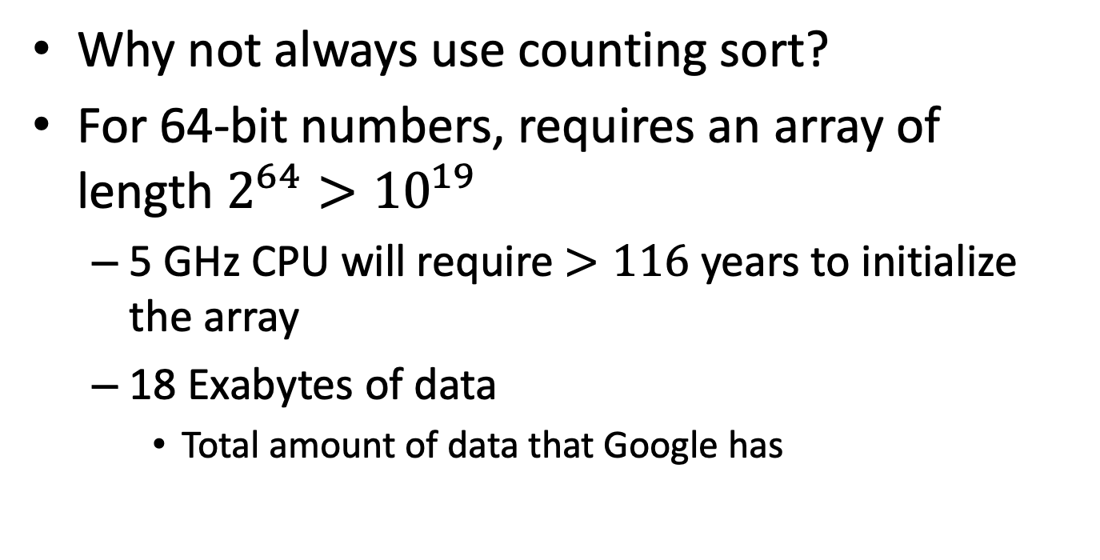
Counting Sort
Why not always use counting sort?
For 64-bit numbers, requires an array of length $2^{64}>{10}^{19}$
5 GHz CPU will require $>116$ years to initialize the array
18 Exabytes of data
Total amount of data that Google has
10

Slide 11
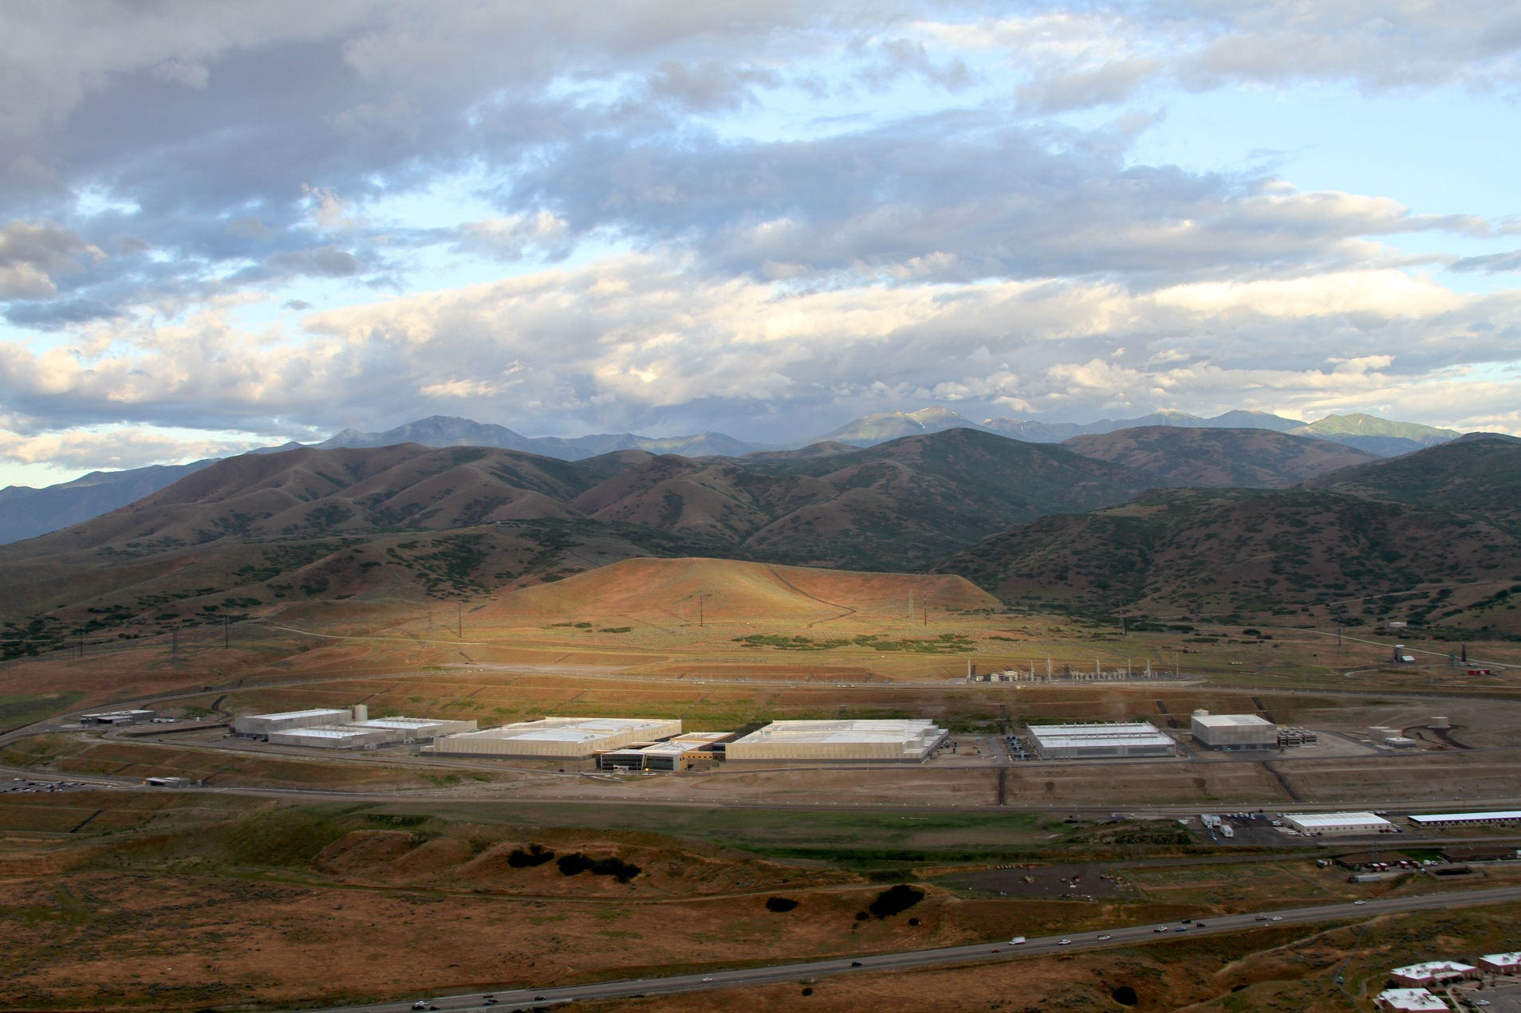
12 Exabytes

Slide 12
Radix Sort
Idea: Stable sort on each digit, from least significant to most significant
103
801
401
323
255
823
999
101
113
901
555
512
245
800
018
121
0
1
2
3
4
5
6
7
8
9
10
11
12
13
14
15
Place each element into a “bucket” according to its 1’s place
800
801
401
101
901
121
512
103
323
823
113
255
555
245
018
999
0
1
2
3
4
5
6
7
8
9

Slide 13
Radix Sort
Idea: Stable sort on each digit, from least significant to most significant
800
801
401
101
901
121
512
103
323
823
113
255
555
245
018
999
Place each element into a “bucket” according to its 10’s place
0
1
2
3
4
5
6
7
8
9
800
801
401
101
901
103
512
113
018
121
323
823
245
255
555
999
0
1
2
3
4
5
6
7
8
9

Slide 14
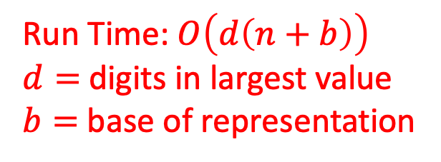
Radix Sort
Idea: Stable sort on each digit, from least significant to most significant
800
801
401
101
901
103
512
113
018
121
323
823
245
255
555
999
Place each element into a “bucket” according to its 100’s place
0
1
2
3
4
5
6
7
8
9
018
101
103
113
121
245
255
323
401
512
555
800
801
823
901
999
Run Time: $O\left(d\left(n+b\right)\right)$
$d=$digits in largest value
$b=$ base of representation
0
1
2
3
4
5
6
7
8
9

Slide 15
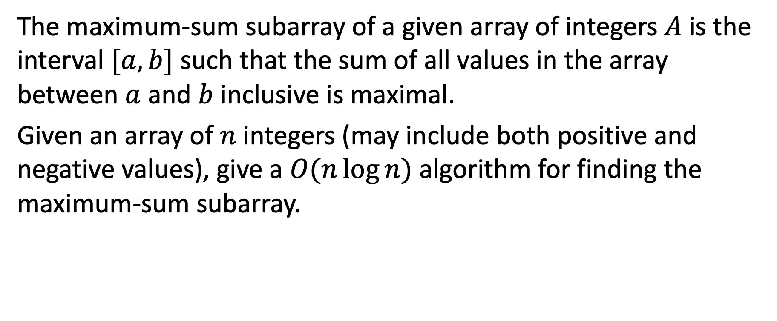
Maximum Sum Continuous Subarray Problem
The maximum-sum subarray of a given array of integers $A$ is the interval $[a,b]$ such that the sum of all values in the array between $a$ and $b$ inclusive is maximal.
Given an array of $n$ integers (may include both positive and negative values), give a $O(n\log{n})$ algorithm for finding the maximum-sum subarray.

Slide 16
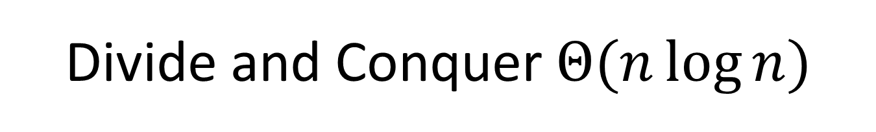
Divide and Conquer $Θ(n\log{n})$
5
8
-4
3
7
-15
2
8
-20
17
8
-50
-5
22
0
1
2
3
4
5
6
7
8
9
10
11
12
13
Recursively Solve on Left
Recursively Solve on Right
Divide in half

Slide 17
Divide and Conquer $Θ(n\log{n})$
Largest sum that ends here
Largest sum that starts here
+
6
1
-7
-3
-6
-13
2
8
-12
5
13
-37
-42
-20
5
8
-4
3
7
-15
2
8
-20
17
8
-50
-5
22
0
1
2
3
4
5
6
7
8
9
10
11
12
13
Recursively Solve on Left
19
Recursively Solve on Right
25
Divide in half
Find Largest sum that spans the cut

Slide 18
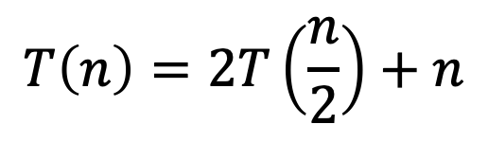
Divide and Conquer $Θ(n\log{n})$
Return the Max of Left, Right, Center
6
1
-7
-3
-6
-13
2
8
-12
5
13
-37
-42
-20
5
8
-4
3
7
-15
2
8
-20
17
8
-50
-5
22
0
1
2
3
4
5
6
7
8
9
10
11
12
13
Recursively Solve on Left
19
Recursively Solve on Right
25
Divide in half
Find Largest sum that spans the cut
19
$$T\left(n\right)=2T\left(\frac{n}{2}\right)+n$$

Slide 19
Divide and Conquer Summary
Typically multiple subproblems.
Typically all roughly the same size.
Divide
Break the list in half
Conquer
Find the best subarrays on the left and right
Combine
Find the best subarray that “spans the divide”
I.e. the best subarray that ends at the divide concatenated with the best that starts at the divide

Slide 20
Types of “Divide and Conquer”
Divide and Conquer
Break the problem up into several subproblems of roughly equal size, recursively solve
E.g. Karatsuba, Closest Pair of Points, Mergesort…
Decrease and Conquer
Break the problem into a single smaller subproblem, recursively solve
E.g. Gotham City Police, Quickselect, Binary Search

Slide 21
Pattern So Far
Typically looking to divide the problem by some fraction (½, ¼ the size)
Not necessarily always the best!
Sometimes, we can write faster algorithms by finding unbalanced divides.

Slide 22
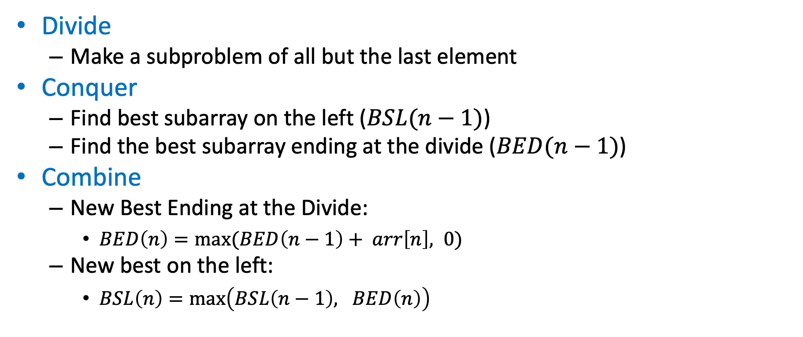
Unbalanced Divide and Conquer
Divide
Make a subproblem of all but the last element
Conquer
Find best subarray on the left ($BSL(n−1)$)
Find the best subarray ending at the divide ($BED(n−1)$)
Combine
New Best Ending at the Divide:
$BED\left(n\right)=max⁡(BED\left(n−1\right)+ arr\left[n\right], 0)$
New best on the left:
$BSL\left(n\right)=\max\left(BSL\left(n−1\right), BED\left(n\right)\right)$

Slide 23
5
8
-4
3
7
-15
2
8
-20
17
8
-50
-5
22
0
1
2
3
4
5
6
7
8
9
10
11
12
13
Recursively Solve on Left
25
Divide
Find Largest sum ending at the cut
22

Slide 24
5
8
-4
3
7
-15
2
8
-20
17
8
-50
-5
22
0
1
2
3
4
5
6
7
8
9
10
11
12
13
Recursively Solve on Left
25
Divide
Find Largest sum ending at the cut
0

Slide 25
5
8
-4
3
7
-15
2
8
-20
17
8
-50
-5
22
0
1
2
3
4
5
6
7
8
9
10
11
12
13
Recursively Solve on Left
25
Divide
Find Largest sum ending at the cut
0

Slide 26
5
8
-4
3
7
-15
2
8
-20
17
8
-50
-5
22
0
1
2
3
4
5
6
7
8
9
10
11
12
13
Recursively Solve on Left
25
Divide
Find Largest sum ending at the cut
25

Slide 27
5
8
-4
3
7
-15
2
8
-20
17
8
-50
-5
22
0
1
2
3
4
5
6
7
8
9
10
11
12
13
Recursively Solve on Left
19
Divide
Find Largest sum ending at the cut
17

Slide 28
5
8
-4
3
7
-15
2
8
-20
17
8
-50
-5
22
0
1
2
3
4
5
6
7
8
9
10
11
12
13
Recursively Solve on Left
19
Divide
Find Largest sum ending at the cut
0

Slide 29
5
8
-4
3
7
-15
2
8
-20
17
8
-50
-5
22
0
1
2
3
4
5
6
7
8
9
10
11
12
13
Recursively Solve on Left
13
Divide
Find Largest sum ending at the cut
12

Slide 30
Unbalanced Divide and Conquer
Divide
Make a subproblem of all but the last element
Conquer
Find best subarray on the left ($BSL(n−1)$)
Find the best subarray ending at the divide ($BED(n−1)$)
Combine
New Best Ending at the Divide:
$BED\left(n\right)=max⁡(BED\left(n−1\right)+ arr\left[n\right], 0)$
New best on the left:
$BSL\left(n\right)=\max\left(BSL\left(n−1\right), BED\left(n\right)\right)$

Slide 31
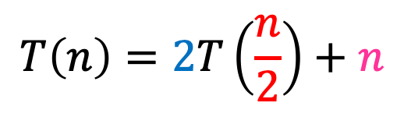
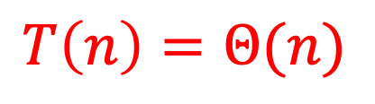
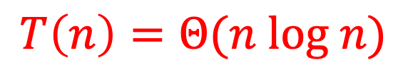

Why was unbalanced better?
$$T\left(n\right)=2T\left(\frac{n}{2}\right)+n$$
Old:
We divided in Half
We solved 2 different problems:
Find the best overall on BOTH the left/right
Find the best which end/start on BOTH the left/right respectively
Linear time combine
New:
We divide by 1, n-1
We solve 2 different problems:
Find the best overall on the left ONLY
Find the best which ends on the left ONLY
Constant time combine
$$T\left(n\right)=Θ(n log n)$$
$$T\left(n\right)=1T\left(n−1\right)+1$$
$$T\left(n\right)=Θ(n)$$

Slide 32
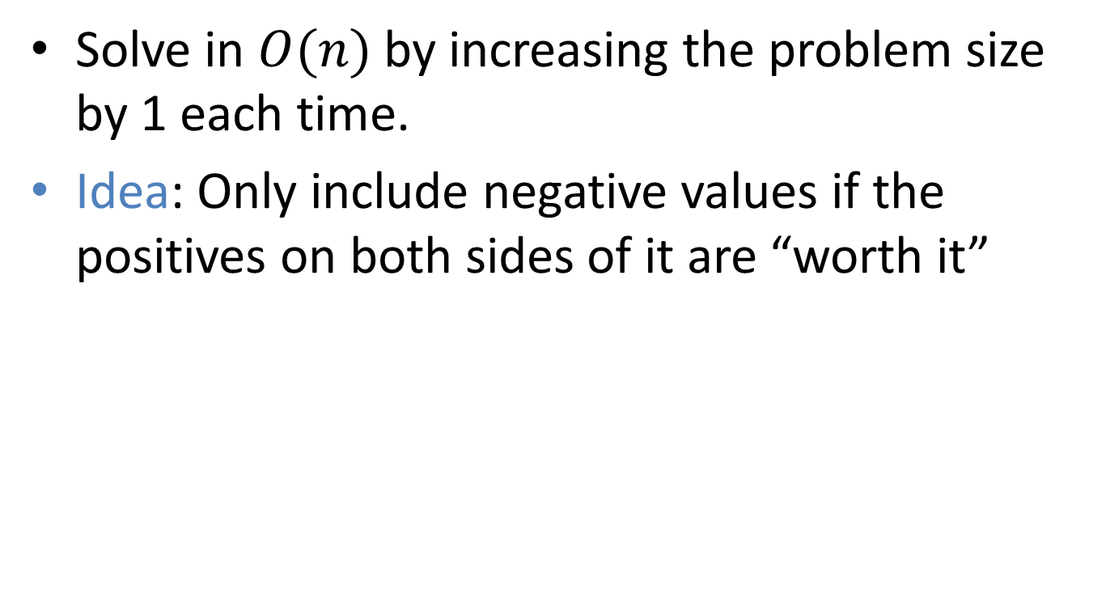
Maximum Sum Continuous Subarray Problem Redux
Solve in $O(n)$ by increasing the problem size by 1 each time.
Idea: Only include negative values if the positives on both sides of it are “worth it”

Slide 33

$Θ(n)$ Solution
5
8
-4
3
7
-15
2
8
-20
17
8
-50
-5
22
0
1
2
3
4
5
6
7
8
9
10
11
12
13
Begin here
Remember two values:
Best So Far
Best ending here
5
5

Slide 34
$Θ(n)$ Solution
5
8
-4
3
7
-15
2
8
-20
17
8
-50
-5
22
0
1
2
3
4
5
6
7
8
9
10
11
12
13
Remember two values:
Best So Far
Best ending here
13
13

Slide 35
$Θ(n)$ Solution
5
8
-4
3
7
-15
2
8
-20
17
8
-50
-5
22
0
1
2
3
4
5
6
7
8
9
10
11
12
13
Remember two values:
Best So Far
Best ending here
13
9

Slide 36
$Θ(n)$ Solution
5
8
-4
3
7
-15
2
8
-20
17
8
-50
-5
22
0
1
2
3
4
5
6
7
8
9
10
11
12
13
Remember two values:
Best So Far
Best ending here
13
12

Slide 37
$Θ(n)$ Solution
5
8
-4
3
7
-15
2
8
-20
17
8
-50
-5
22
0
1
2
3
4
5
6
7
8
9
10
11
12
13
Remember two values:
Best So Far
Best ending here
19
19

Slide 38
$Θ(n)$ Solution
5
8
-4
3
7
-15
2
8
-20
17
8
-50
-5
22
0
1
2
3
4
5
6
7
8
9
10
11
12
13
Remember two values:
Best So Far
Best ending here
19
4

Slide 39
$Θ(n)$ Solution
5
8
-4
3
7
-15
2
8
-20
17
8
-50
-5
22
0
1
2
3
4
5
6
7
8
9
10
11
12
13
Remember two values:
Best So Far
Best ending here
19
14

Slide 40
$Θ(n)$ Solution
5
8
-4
3
7
-15
2
8
-20
17
8
-50
-5
22
0
1
2
3
4
5
6
7
8
9
10
11
12
13
Remember two values:
Best So Far
Best ending here
19
0

Slide 41
$Θ(n)$ Solution
5
8
-4
3
7
-15
2
8
-20
17
8
-50
-5
22
0
1
2
3
4
5
6
7
8
9
10
11
12
13
Remember two values:
Best So Far
Best ending here
19
17

Slide 42
$Θ(n)$ Solution
5
8
-4
3
7
-15
2
8
-20
17
8
-50
-5
22
0
1
2
3
4
5
6
7
8
9
10
11
12
13
Remember two values:
Best So Far
Best ending here
25
25

Slide 43
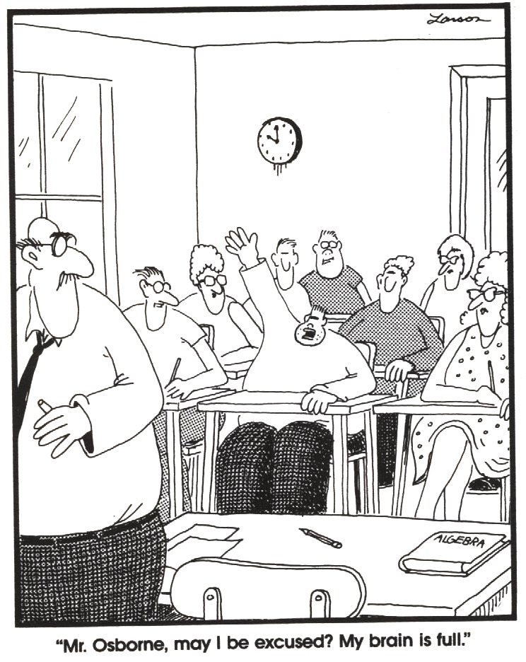
End of Midterm Exam Materials!

