Slide 1
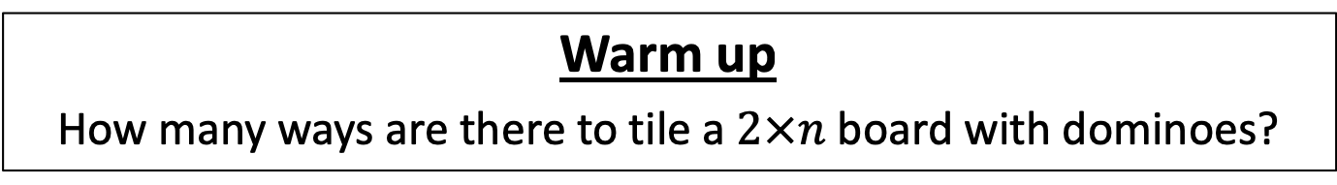
CS4102 Algorithms
Fall 2018
Warm up
How many ways are there to tile a $2×n$ board with dominoes?
How many ways to tile this:
With these?

Slide 2
Announcements
SDAC is looking for a notetaker for our class. Please consider doing this as a great service for one of your classmates. http://yukon.accessiblelearning.com/virginia/ApplicationNotetaker.aspx SDAC has some great prizes to raffle off to successful notetakers at the end of the semester. Prizes include gift certificates to local restaurants, shops, and entertainment such as Bodo's, Boylan Heights, and The Escape Room.

Slide 3
Today’s Keywords
Dynamic Programming
Log Cutting

Slide 4
CLRS Readings
Chapter 15

Slide 5
Homework
Hw4 Due 11pm Oct 12
Sorting
Written

Slide 6
Midterm
Tuesday October 16 in class
Covers all content through last class
We will have a review session (more details to come!)

Slide 7


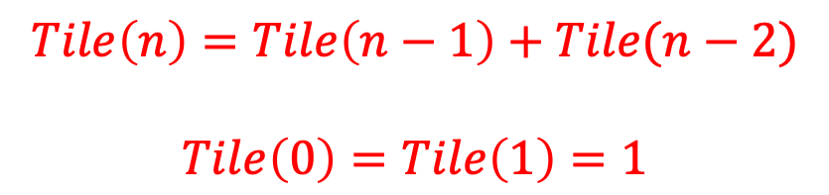

How many ways are there to tile a $2×n$ board with dominoes?
Two ways to fill the final column:
$$Tile\left(n\right)=Tile\left(n−1\right)+Tile(n−2)$$
$$Tile\left(0\right)=Tile\left(1\right)=1$$
$$n−1$$
$$n−2$$

Slide 8

How to compute $Tile(n)$?
Tile(n):
if n < 2:
return 1
return Tile(n-1)+Tile(n-2)
Problem?

Slide 9
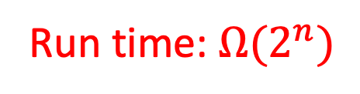
Recursion Tree
Tile(5)
Tile(4)
Tile(3)
Tile(3)
Tile(2)
Tile(2)
Tile(1)
Tile(2)
Tile(1)
Tile(1)
Tile(0)
Tile(1)
Tile(0)
Tile(1)
Tile(0)
Many redundant calls!
Run time: $Ω(2^{n})$
Better way: Use Memory!

Slide 10

Computing $Tile(n)$ with Memory
Initialize Memory M
Tile(n):
if n < 2:
return 1
if M[n] is filled:
return M[n]
M[n] = Tile(n-1)+Tile(n-2)
return M[n]
M
0
1
2
3
4
5
6

Slide 11
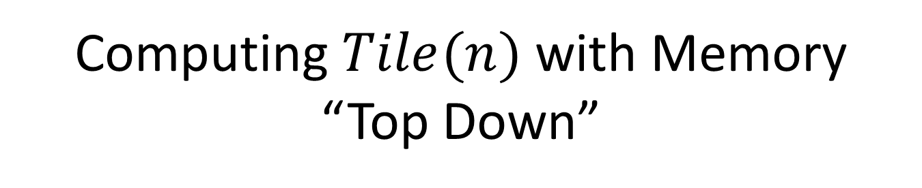
Computing $Tile(n)$ with Memory “Top Down”
Initialize Memory M
Tile(n):
if n < 2:
return 1
if M[n] is filled:
return M[n]
M[n] = Tile(n-1)+Tile(n-2)
return M[n]
M
1
0
1
1
2
2
3
3
5
4
8
5
13
6
Recursive calls happen in a predictable order

Slide 12

Better $Tile(n)$ with Memory “Bottom Up”
Tile(n):
Initialize Memory M
M[0] = 1
M[1] = 1
for i = 2 to n:
M[i] = M[i-1] + M[i-2]
return M[n]
M
0
1
2
3
4
5
6

Slide 13
Dynamic Programming
Requires Optimal Substructure
Solution to larger problem contains the solutions to smaller ones
Idea:
Identify recursive structure of the problem
What is the “last thing” done?
Select a good order for solving subproblems
Usually smallest problem first
“Bottom up”

Slide 14
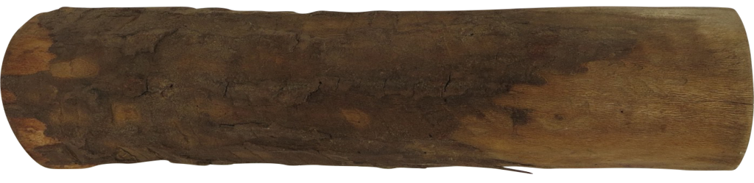
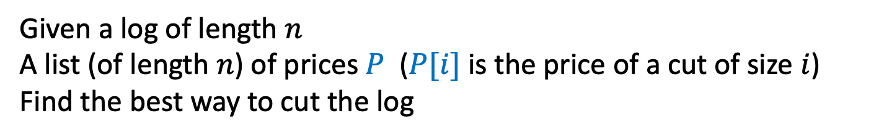
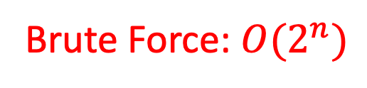
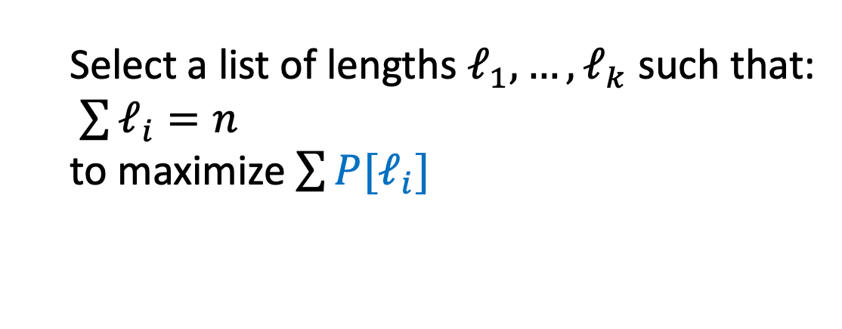
Log Cutting
Given a log of length $n$
A list (of length $n$) of prices $P$ ($P[i]$ is the price of a cut of size $i$)
Find the best way to cut the log
Price:
1
5
8
9
10
17
17
20
24
30
Length:
1
2
3
4
5
6
7
8
9
10
Select a list of lengths $ℓ_{1}, …, ℓ_{k}$ such that:
$\sum{ℓ_{i}=n}$
to maximize $\sum{{P[ℓ}_{i}]}$
Brute Force: $O(2^{n})$

Slide 15
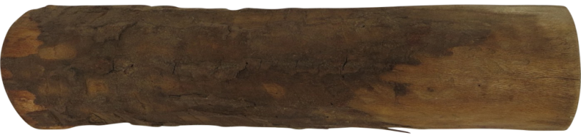
Greedy won’t work
Greedy algorithms (next unit) build a solution by picking the best option “right now”
Select the most profitable cut first
1
18
24
36
50
50
Greedy: Lengths: 5, 1
Profit: 51
Price:
Length:
1
2
3
4
5
6
Better: Lengths: 2, 4
Profit: 54

Slide 16
Greedy won’t work
Greedy algorithms (next unit) build a solution by picking the best option “right now”
Select the “most bang for your buck”
(best price / length ratio)
1
18
24
36
50
50
Greedy: Lengths: 5, 1
Profit: 51
Price:
Length:
1
2
3
4
5
6
Better: Lengths: 2, 4
Profit: 54

Slide 17
Dynamic Programming
Idea:
Identify recursive structure of the problem
What is the “last thing” done?
Select a good order for solving subproblems
Usually smallest problem first
“Bottom up”

Slide 18

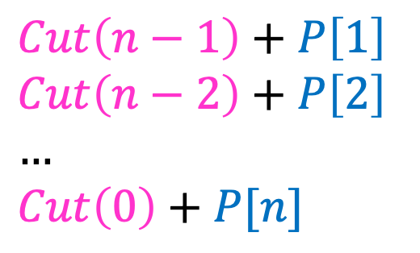



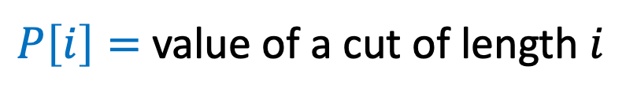
1. Identify Recursive Structure
$P\left[i\right]=$ value of a cut of length $i$
$Cut(n)=$ value of best way to cut a log of length $n$
$Cut\left(n−1\right)+P\left[1\right]$
$Cut\left(n−2\right)+P\left[2\right]$
$…$
$Cut\left(0\right)+P[n]$
$Cut\left(n\right)=max⁡$
$$Cut(n−ℓ_{n})$$
$$ℓ_{n}$$
best way to cut a log of length $n−ℓ_{n}$
Last Cut

Slide 19
Dynamic Programming
Idea:
Identify recursive structure of the problem
What is the “last thing” done?
Select a good order for solving subproblems
Usually smallest problem first
“Bottom up”

Slide 20

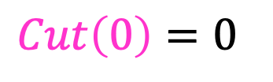
2. Select a Good Order for Solving Subproblems
Solve Smallest subproblem first
$Cut\left(0\right)=0⁡$
$Cut(i)$:
0
Length:
0
1
2
3
4
5
6
7
8
9
10
0

Slide 21

2. Select a Good Order for Solving Subproblems
Solve Smallest subproblem first
$Cut\left(1\right)=Cut\left(0\right)+P[1]⁡$
$Cut(i)$:
0
Length:
0
1
2
3
4
5
6
7
8
9
10
1

Slide 22


2. Select a Good Order for Solving Subproblems
Solve Smallest subproblem first
$Cut\left(1\right)+P\left[1\right]$
$Cut\left(0\right)+P\left[2\right]$
$Cut\left(2\right)=max⁡$
$Cut(i)$:
0
Length:
0
1
2
3
4
5
6
7
8
9
10
2

Slide 23
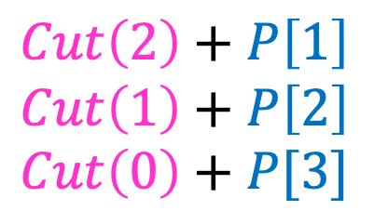

2. Select a Good Order for Solving Subproblems
Solve Smallest subproblem first
$Cut\left(2\right)+P\left[1\right]$
$Cut\left(1\right)+P\left[2\right]$
$Cut\left(0\right)+P[3]$
$Cut\left(3\right)=max⁡$
$Cut(i)$:
0
Length:
0
1
2
3
4
5
6
7
8
9
10
3

Slide 24
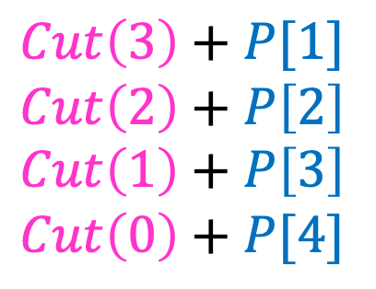

2. Select a Good Order for Solving Subproblems
Solve Smallest subproblem first
$Cut\left(3\right)+P[1]$
$Cut\left(2\right)+P\left[2\right]$
$Cut\left(1\right)+P\left[3\right]$
$Cut\left(0\right)+P[4]$
$Cut\left(4\right)=max⁡$
$Cut(i)$:
0
Length:
0
1
2
3
4
5
6
7
8
9
10
4

Slide 25
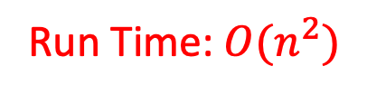
Log Cutting Pseudocode
Initialize Memory C
Cut(n):
C[0] = 0
for i=1 to n:
best = 0
for j = 1 to i:
best = max(best, C[i-j] + P[j])
C[i] = best
return C[n]
Run Time: $O(n^{2})$

Slide 26
How to find the cuts?
This procedure told us the profit, but not the cuts themselves
Idea: remember the choice that you made, then backtrack

Slide 27
Remember the choice made
Initialize Memory C, Choices
Cut(n):
C[0] = 0
for i=1 to n:
best = 0
for j = 1 to i:
if best < C[i-j] + P[j]:
best = C[i-j] + P[j]
Choices[i]=j
C[i] = best
return C[n]
Gives the size of the last cut

Slide 28
Reconstruct the Cuts
Backtrack through the choices
Choices:
0
1
1
2
4
3
4
1
2
4
3
Length:
0
1
2
3
4
5
6
7
8
9
10
1
2
6
7

Slide 29
Backtracking Pseudocode
i = n
while i>0:
print Choices[i]
i = i – Choices[i]

