Slide 1


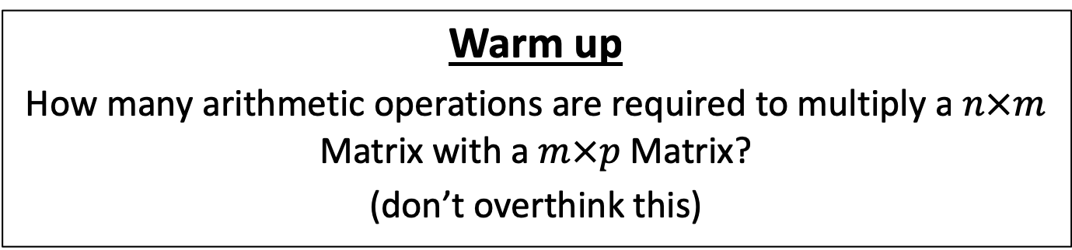



CS4102 Algorithms
Fall 2018
Warm up
How many arithmetic operations are required to multiply a $n×m$ Matrix with a $m×p$ Matrix?
(don’t overthink this)
$$p$$
$$m$$
$$n$$
$$×$$
$$m$$

Slide 2

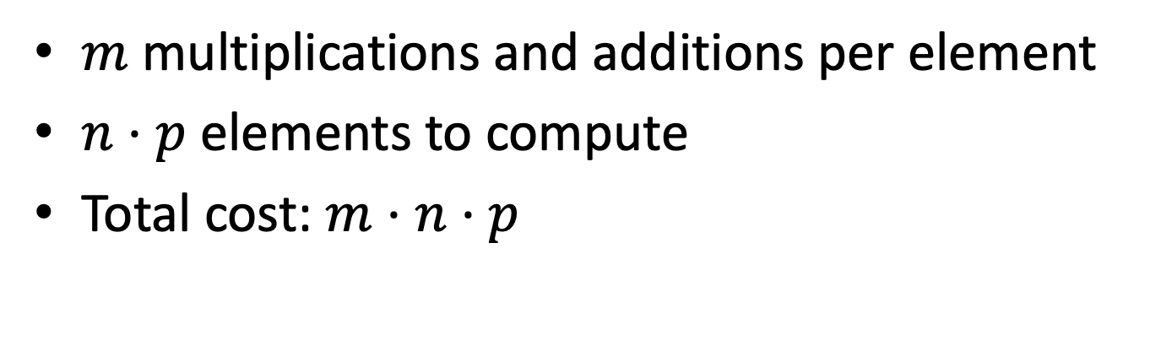

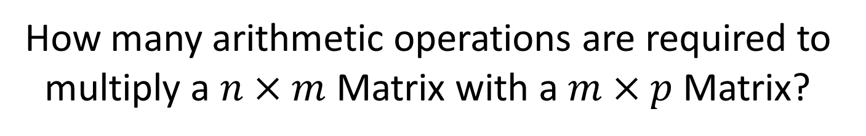





How many arithmetic operations are required to multiply a $n×m$ Matrix with a $m×p$ Matrix?
$$p$$
$$m$$
$$p$$
$$n$$
$$×$$
$$m$$
$$=$$
$$n$$
$m$ multiplications and additions per element
$n⋅p$ elements to compute
Total cost: $m⋅n⋅p$

Slide 3
Today’s Keywords
Dynamic Programming
Matrix Chaining
Longest Common Subsequence

Slide 4
CLRS Readings
Chapter 15

Slide 5
Homeworks
Hw4 due 11pm Friday Oct 12
Sorting
Written

Slide 6
Midterm
Tuesday Oct 16 in class
Covers all content through sorting
We will have a review session the weekend before

Slide 7
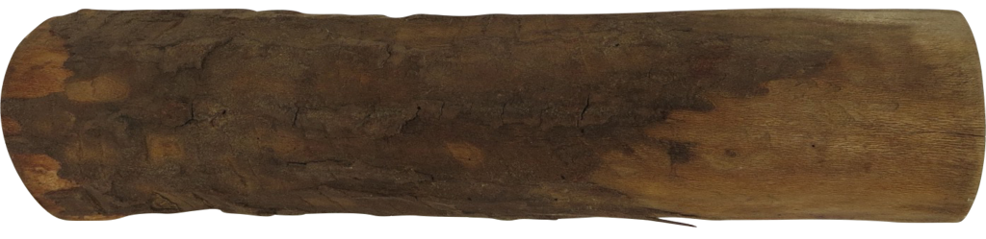
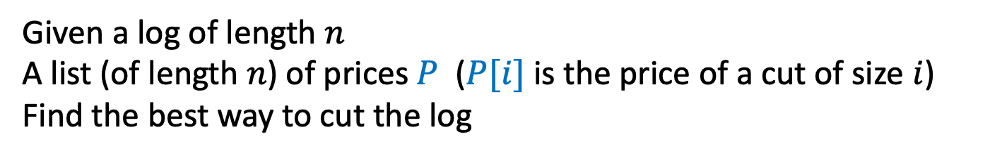
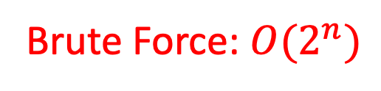
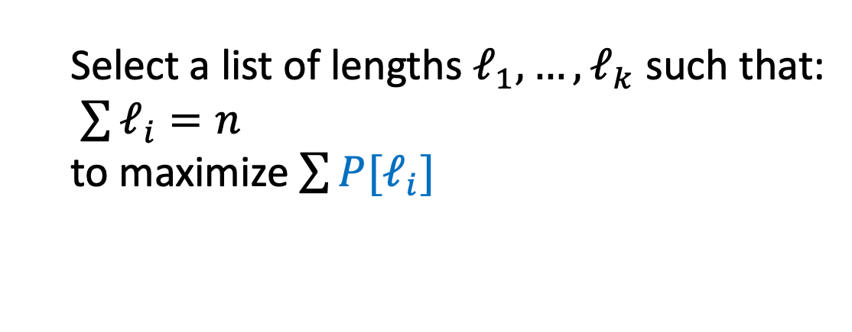
Log Cutting
Given a log of length $n$
A list (of length $n$) of prices $P$ ($P[i]$ is the price of a cut of size $i$)
Find the best way to cut the log
Price:
1
5
8
9
10
17
17
20
24
30
Length:
1
2
3
4
5
6
7
8
9
10
Select a list of lengths $ℓ_{1}, …, ℓ_{k}$ such that:
$\sum{ℓ_{i}=n}$
to maximize $\sum{{P[ℓ}_{i}]}$
Brute Force: $O(2^{n})$

Slide 8
Dynamic Programming
Idea:
Identify recursive structure of the problem
What is the “last thing” done?
Select a good order for solving subproblems
Usually smallest problem first
“Bottom up”

Slide 9
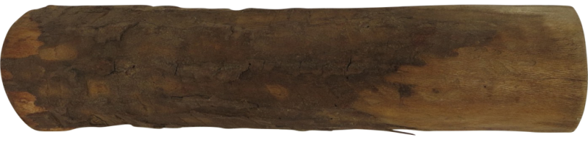
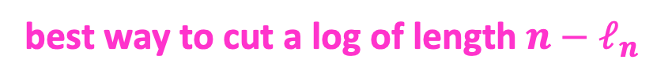
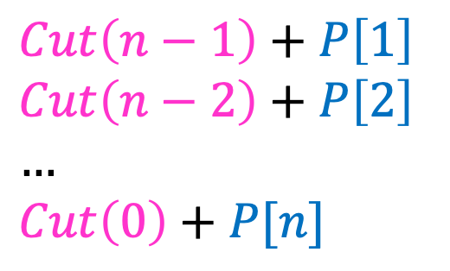



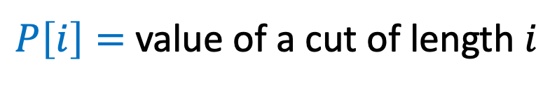
1. Identify Recursive Structure
$P\left[i\right]=$ value of a cut of length $i$
$Cut(n)=$ value of best way to cut a log of length $n$
$Cut\left(n−1\right)+P\left[1\right]$
$Cut\left(n−2\right)+P\left[2\right]$
$…$
$Cut\left(0\right)+P[n]$
$Cut\left(n\right)=max⁡$
$$Cut(n−ℓ_{n})$$
$$ℓ_{n}$$
best way to cut a log of length $n−ℓ_{n}$
Last Cut

Slide 10
Dynamic Programming
Idea:
Identify recursive structure of the problem
What is the “last thing” done?
Select a good order for solving subproblems
Usually smallest problem first
“Bottom up”

Slide 11

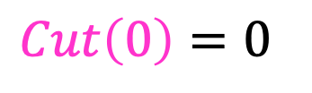
2. Select a Good Order for Solving Subproblems
Solve Smallest subproblem first
$Cut\left(0\right)=0⁡$
$Cut(i)$:
0
Length:
0
1
2
3
4
5
6
7
8
9
10
0

Slide 12

2. Select a Good Order for Solving Subproblems
Solve Smallest subproblem first
$Cut\left(1\right)=Cut\left(0\right)+P[1]⁡$
$Cut(i)$:
0
Length:
0
1
2
3
4
5
6
7
8
9
10
1

Slide 13


2. Select a Good Order for Solving Subproblems
Solve Smallest subproblem first
$Cut\left(1\right)+P\left[1\right]$
$Cut\left(0\right)+P\left[2\right]$
$Cut\left(2\right)=max⁡$
$Cut(i)$:
0
Length:
0
1
2
3
4
5
6
7
8
9
10
2

Slide 14
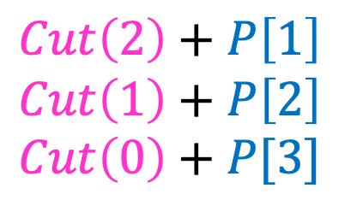

2. Select a Good Order for Solving Subproblems
Solve Smallest subproblem first
$Cut\left(2\right)+P\left[1\right]$
$Cut\left(1\right)+P\left[2\right]$
$Cut\left(0\right)+P[3]$
$Cut\left(3\right)=max⁡$
$Cut(i)$:
0
Length:
0
1
2
3
4
5
6
7
8
9
10
3

Slide 15
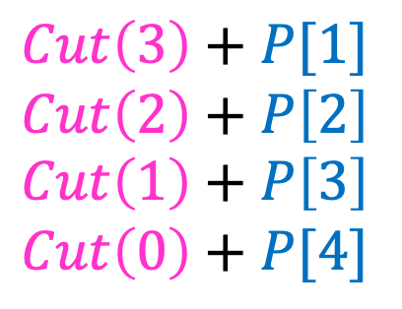

2. Select a Good Order for Solving Subproblems
Solve Smallest subproblem first
$Cut\left(3\right)+P[1]$
$Cut\left(2\right)+P\left[2\right]$
$Cut\left(1\right)+P\left[3\right]$
$Cut\left(0\right)+P[4]$
$Cut\left(4\right)=max⁡$
$Cut(i)$:
0
Length:
0
1
2
3
4
5
6
7
8
9
10
4

Slide 16
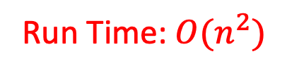
Log Cutting Pseudocode
Initialize Memory C
Cut(n):
C[0] = 0
for i=1 to n:
best = 0
for j = 1 to i:
best = max(best, C[i-j] + P[j])
C[i] = best
return C[n]
Run Time: $O(n^{2})$

Slide 17
How to find the cuts?
This procedure told us the profit, but not the cuts themselves
Idea: remember the choice that you made, then backtrack

Slide 18
Remember the choice made
Initialize Memory C, Choices
Cut(n):
C[0] = 0
for i=1 to n:
best = 0
for j = 1 to i:
if best < C[i-j] + P[j]:
best = C[i-j] + P[j]
Choices[i]=j
C[i] = best
return C[n]
Gives the size of the last cut

Slide 19
Reconstruct the Cuts
Backtrack through the choices
Choices:
0
1
1
2
4
3
4
1
2
4
3
Length:
0
1
2
3
4
5
6
7
8
9
10
1
2
6
7

Slide 20
Backtracking Pseudocode
i = n
while i>0:
print Choices[i]
i = i – Choices[i]

Slide 21
Dynamic Programming
Requires Optimal Substructure
Solution to larger problem contains the solutions to smaller ones
Idea:
Identify recursive structure of the problem
What is the “last thing” done?
Select a good order for solving subproblems
“Top Down”: Solve each recursively
“Bottom Up”: Iteratively solve smallest to largest
Save solution to each subproblem in memory

Slide 22















Matrix Chaining
Given a sequence of Matrices $(M_{1}, …, M_{n})$, what is the most efficient way to multiply them?
$$c_{4}$$
$$c_{2}$$
$$M_{4}$$
$$c_{1}$$
$$M_{2}$$
$$c_{3}$$
$$M_{1}$$
$$M_{3}$$
$$r_{1}$$
$$×$$
$$r_{2}$$
$$×$$
$$r_{3}$$
$$×$$
$$r_{4}$$

Slide 23


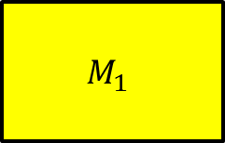


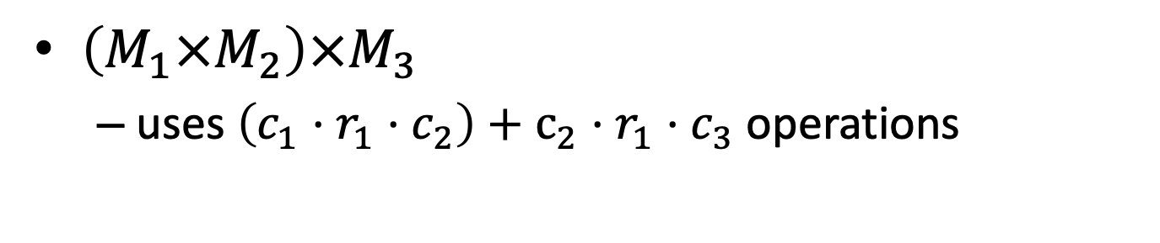









Order Matters!
$$c_{1}=r_{2}$$
$$c_{2}=r_{3}$$
$$c_{2}$$
$$c_{1}$$
$$M_{2}$$
$$c_{3}$$
$$M_{1}$$
$$M_{3}$$
$$r_{1}$$
$$×$$
$$r_{2}$$
$$×$$
$$r_{3}$$
$$c_{2}$$
$$r_{1}$$
$\left(M_{1}×M_{2}\right)×M_{3}$
uses $\left(c_{1}⋅r_{1}⋅c_{2}\right)+c_{2}⋅r_{1}⋅c_{3}$ operations

Slide 24
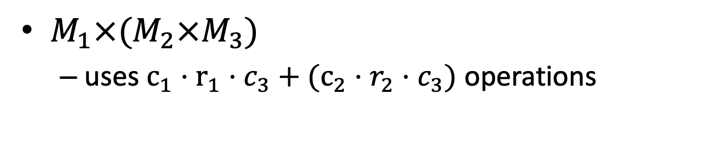



Order Matters!
$$c_{1}=r_{2}$$
$$c_{2}=r_{3}$$
$$c_{2}$$
$$c_{1}$$
$$M_{2}$$
$$c_{3}$$
$$M_{1}$$
$$M_{3}$$
$$r_{1}$$
$$×$$
$$r_{2}$$
$$×$$
$$r_{3}$$
$$c_{3}$$
$$r_{2}$$
$M_{1}×(M_{2}×M_{3})$
uses $c_{1}⋅r_{1}⋅c_{3}+(c_{2}⋅r_{2}⋅c_{3})$ operations

Slide 25

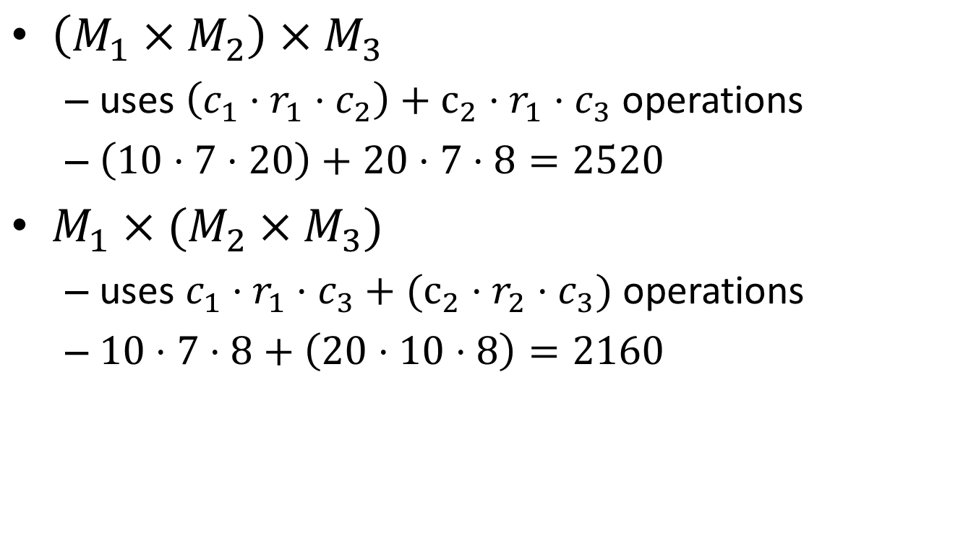

Order Matters!
$$c_{1}=r_{2}$$
$$c_{2}=r_{3}$$
$\left(M_{1}×M_{2}\right)×M_{3}$
uses $\left(c_{1}⋅r_{1}⋅c_{2}\right)+c_{2}⋅r_{1}⋅c_{3}$ operations
$\left(10⋅7⋅20\right)+20⋅7⋅8=2520$
$M_{1}×(M_{2}×M_{3})$
uses $c_{1}⋅r_{1}⋅c_{3}+(c_{2}⋅r_{2}⋅c_{3})$ operations
$10⋅7⋅8+\left(20⋅10⋅8\right)=2160$
$$c_{1}=10$$
$$c_{2}=20$$
$$c_{3}=8$$
$$r_{1}=7$$
$$r_{2}=10$$
$$r_{3}=20$$

Slide 26
Dynamic Programming
Requires Optimal Substructure
Solution to larger problem contains the solutions to smaller ones
Idea:
Identify recursive structure of the problem
What is the “last thing” done?
Select a good order for solving subproblems
“Top Down”: Solve each recursively
“Bottom Up”: Iteratively solve smallest to largest
Save solution to each subproblem in memory

Slide 27



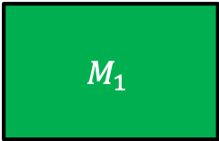
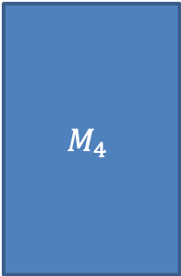








1. Identify the Recursive Structure of the Problem
$Best\left(1,n\right)=$ cheapest way to multiply together $M_{1}$ through $M_{n}$
$$Best\left(2,4\right)+r_{1}r_{2}c_{4}$$
$$Best\left(1,4\right)=min$$
$$c_{4}$$
$$r_{2}$$
$$c_{4}$$
$$c_{2}$$
$$M_{4}$$
$$c_{1}$$
$$M_{2}$$
$$c_{3}$$
$$M_{1}$$
$$M_{3}$$
$$r_{1}$$
$$×$$
$$r_{2}$$
$$×$$
$$r_{3}$$
$$×$$
$$r_{4}$$

Slide 28





1. Identify the Recursive Structure of the Problem
$Best\left(1,n\right)=$ cheapest way to multiply together $M_{1}$ through $M_{n}$
$$Best\left(2,4\right)+r_{1}r_{2}c_{4}$$
$$Best\left(1,4\right)=min$$
$$Best\left(1,2\right)+Best\left(3, 4\right)+r_{1}r_{3}c_{4}$$
$$c_{2}$$
$$c_{4}$$
$$r_{3}$$
$$r_{1}$$
$$c_{4}$$
$$c_{2}$$
$$M_{4}$$
$$c_{1}$$
$$M_{2}$$
$$c_{3}$$
$$M_{1}$$
$$M_{3}$$
$$r_{1}$$
$$×$$
$$r_{2}$$
$$×$$
$$r_{3}$$
$$×$$
$$r_{4}$$

Slide 29




1. Identify the Recursive Structure of the Problem
$Best\left(1,n\right)=$ cheapest way to multiply together $M_{1}$ through $M_{n}$
$$Best\left(2,4\right)+r_{1}r_{2}c_{4}$$
$$Best\left(1,4\right)=min$$
$$Best\left(1,2\right)+Best\left(3, 4\right)+r_{1}r_{3}c_{4}$$
$$Best\left(1,3\right)+r_{1}r_{4}c_{4}$$
$$c_{3}$$
$$r_{1}$$
$$c_{4}$$
$$c_{2}$$
$$M_{4}$$
$$c_{1}$$
$$M_{2}$$
$$c_{3}$$
$$M_{1}$$
$$M_{3}$$
$$r_{1}$$
$$×$$
$$r_{2}$$
$$×$$
$$r_{3}$$
$$×$$
$$r_{4}$$

Slide 30






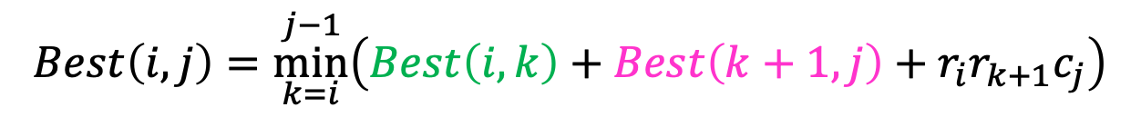


1. Identify the Recursive Structure of the Problem
In general:
$Best\left(i,j\right)=$ cheapest way to multiply together $M_{i}$ through $M_{j}$
$$Best\left(i,j\right)=\underset{k=i}{\overset{j−1}{min}}\left(Best\left(i,k\right)+Best\left(k+1, j\right)+r_{i}r_{k+1}c_{j}\right)$$
$$Best\left(i,i\right)=0$$
$$Best\left(2,n\right)+r_{1}r_{2}c_{n}$$
$$Best\left(1,2\right)+Best\left(3, n\right)+r_{1}r_{3}c_{n}$$
$$Best\left(1,3\right)+Best\left(4, n\right)+r_{1}r_{4}c_{n}$$
$$Best\left(1,n\right)=min$$
$$Best\left(1,4\right)+Best\left(5, n\right)+r_{1}r_{5}c_{n}$$
$$…$$
$$Best\left(1,n−1\right)+r_{1}r_{n}c_{n}$$

Slide 31
Dynamic Programming
Requires Optimal Substructure
Solution to larger problem contains the solutions to smaller ones
Idea:
Identify recursive structure of the problem
What is the “last thing” done?
Select a good order for solving subproblems
“Top Down”: Solve each recursively
“Bottom Up”: Iteratively solve smallest to largest
Save solution to each subproblem in memory

Slide 32







1. Identify the Recursive Structure of the Problem
In general:
$Best\left(i,j\right)=$ cheapest way to multiply together $M_{i}$ through $M_{j}$
$$Best\left(i,j\right)=\underset{k=i}{\overset{j−1}{min}}\left(Best\left(i,k\right)+Best\left(k+1, j\right)+r_{i}r_{k+1}c_{j}\right)$$
$$Best\left(i,i\right)=0$$
Read from M[n]
if present
Save to M[n]
$$Best\left(2,n\right)+r_{1}r_{2}c_{n}$$
$$Best\left(1,2\right)+Best\left(3, n\right)+r_{1}r_{3}c_{n}$$
$$Best\left(1,3\right)+Best\left(4, n\right)+r_{1}r_{4}c_{n}$$
$$Best\left(1,n\right)=min$$
$$Best\left(1,4\right)+Best\left(5, n\right)+r_{1}r_{5}c_{n}$$
$$…$$
$$Best\left(1,n−1\right)+r_{1}r_{n}c_{n}$$

Slide 33
Dynamic Programming
Requires Optimal Substructure
Solution to larger problem contains the solutions to smaller ones
Idea:
Identify recursive structure of the problem
What is the “last thing” done?
Select a good order for solving subproblems
“Top Down”: Solve each recursively
“Bottom Up”: Iteratively solve smallest to largest
Save solution to each subproblem in memory

Slide 34



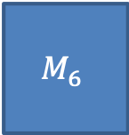























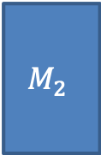

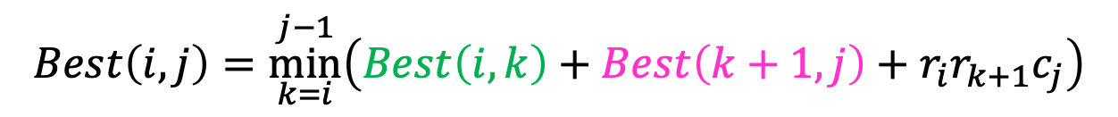




2. Select a good order for solving subproblems
$$35$$
$$15$$
$$5$$
$$10$$
$$20$$
$$25$$
$$M_{1}$$
$$M_{2}$$
$$M_{3}$$
$$M_{4}$$
$$M_{5}$$
$$M_{6}$$
$$30$$
$$×$$
$$35$$
$$×$$
$$15$$
$$×$$
$$5$$
$$×$$
$$10$$
$$×$$
$$20$$
$$Best\left(i,j\right)=\underset{k=i}{\overset{j−1}{min}}\left(Best\left(i,k\right)+Best\left(k+1, j\right)+r_{i}r_{k+1}c_{j}\right)$$
$$j=$$
$$1$$
$$2$$
$$3$$
$$4$$
$$5$$
$$6$$
$$=i$$
$$Best\left(i,i\right)=0$$
0
$$1$$
0
$$2$$
0
$$3$$
0
$$4$$
0
$$5$$
0
$$6$$

Slide 35









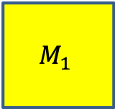



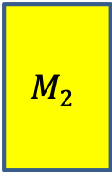



2. Select a good order for solving subproblems
$$35$$
$$15$$
$$5$$
$$10$$
$$20$$
$$25$$
$$M_{1}$$
$$M_{2}$$
$$M_{3}$$
$$M_{4}$$
$$M_{5}$$
$$M_{6}$$
$$30$$
$$×$$
$$35$$
$$×$$
$$15$$
$$×$$
$$5$$
$$×$$
$$10$$
$$×$$
$$20$$
$$Best\left(i,j\right)=\underset{k=i}{\overset{j−1}{min}}\left(Best\left(i,k\right)+Best\left(k+1, j\right)+r_{i}r_{k+1}c_{j}\right)$$
$$j=$$
$$1$$
$$2$$
$$3$$
$$4$$
$$5$$
$$6$$
$$=i$$
$$Best\left(i,i\right)=0$$
0
15750
$$1$$
0
$$2$$
0
$$3$$
0
$$4$$
$$Best\left(1,1\right)+Best\left(2, 2\right)+r_{1}r_{2}c_{2}$$
0
$$5$$
$$Best\left(1,2\right)=min$$
0
$$6$$

Slide 36




2. Select a good order for solving subproblems
$$35$$
$$15$$
$$5$$
$$10$$
$$20$$
$$25$$
$$M_{1}$$
$$M_{2}$$
$$M_{3}$$
$$M_{4}$$
$$M_{5}$$
$$M_{6}$$
$$30$$
$$×$$
$$35$$
$$×$$
$$15$$
$$×$$
$$5$$
$$×$$
$$10$$
$$×$$
$$20$$
$$Best\left(i,j\right)=\underset{k=i}{\overset{j−1}{min}}\left(Best\left(i,k\right)+Best\left(k+1, j\right)+r_{i}r_{k+1}c_{j}\right)$$
$$j=$$
$$1$$
$$2$$
$$3$$
$$4$$
$$5$$
$$6$$
$$=i$$
$$Best\left(i,i\right)=0$$
0
15750
$$1$$
0
2625
$$2$$
0
$$3$$
0
$$4$$
$$Best\left(2,2\right)+Best\left(3, 3\right)+r_{2}r_{3}c_{3}$$
0
$$5$$
$$Best\left(2,3\right)=min$$
0
$$6$$

Slide 37


2. Select a good order for solving subproblems
$$35$$
$$15$$
$$5$$
$$10$$
$$20$$
$$25$$
$$M_{1}$$
$$M_{2}$$
$$M_{3}$$
$$M_{4}$$
$$M_{5}$$
$$M_{6}$$
$$30$$
$$×$$
$$35$$
$$×$$
$$15$$
$$×$$
$$5$$
$$×$$
$$10$$
$$×$$
$$20$$
$$Best\left(i,j\right)=\underset{k=i}{\overset{j−1}{min}}\left(Best\left(i,k\right)+Best\left(k+1, j\right)+r_{i}r_{k+1}c_{j}\right)$$
$$j=$$
$$1$$
$$2$$
$$3$$
$$4$$
$$5$$
$$6$$
$$=i$$
$$Best\left(i,i\right)=0$$
0
15750
$$1$$
0
2625
$$2$$
0
750
$$3$$
0
1000
$$4$$
0
5000
$$5$$
0
$$6$$

Slide 38









2. Select a good order for solving subproblems
$$35$$
$$15$$
$$5$$
$$10$$
$$20$$
$$25$$
$$M_{1}$$
$$M_{2}$$
$$M_{3}$$
$$M_{4}$$
$$M_{5}$$
$$M_{6}$$
$$30$$
$$×$$
$$35$$
$$×$$
$$15$$
$$×$$
$$5$$
$$×$$
$$10$$
$$×$$
$$20$$
$$Best\left(i,j\right)=\underset{k=i}{\overset{j−1}{min}}\left(Best\left(i,k\right)+Best\left(k+1, j\right)+r_{i}r_{k+1}c_{j}\right)$$
$$j=$$
$$1$$
$$2$$
$$3$$
$$4$$
$$5$$
$$6$$
$$=i$$
$$Best\left(i,i\right)=0$$
0
15750
7875
$$1$$
$$r_{1}r_{2}c_{3}=30⋅35⋅5=5250$$
0
2625
$$2$$
$$r_{1}r_{3}c_{3}=30⋅15⋅5=2250$$
0
750
$$3$$
0
1000
$$4$$
$$0$$
$$2625$$
$$Best\left(1,1\right)+Best\left(2, 3\right)+r_{1}r_{2}c_{3}$$
0
5000
$$5$$
$$Best\left(1,3\right)=min$$
$$Best\left(1,2\right)+Best\left(3, 3\right)+r_{1}r_{3}c_{3}$$
0
$$6$$
$$15750$$
$$0$$

Slide 39

2. Select a good order for solving subproblems
$$35$$
$$15$$
$$5$$
$$10$$
$$20$$
$$25$$
$$M_{1}$$
$$M_{2}$$
$$M_{3}$$
$$M_{4}$$
$$M_{5}$$
$$M_{6}$$
$$30$$
$$×$$
$$35$$
$$×$$
$$15$$
$$×$$
$$5$$
$$×$$
$$10$$
$$×$$
$$20$$
$$Best\left(i,j\right)=\underset{k=i}{\overset{j−1}{min}}\left(Best\left(i,k\right)+Best\left(k+1, j\right)+r_{i}r_{k+1}c_{j}\right)$$
$$j=$$
$$1$$
$$2$$
$$3$$
$$4$$
$$5$$
$$6$$
$$=i$$
$$Best\left(i,i\right)=0$$
0
15750
7875
$$1$$
0
2625
$$2$$
To find $Best(i,j)$: Need all preceding terms of row $i$ and column $j$
0
750
$$3$$
0
1000
$$4$$
Conclusion: solve in order of diagonal
0
5000
$$5$$
0
$$6$$

Slide 40






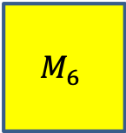



Longest Common Subsequence
$$35$$
$$15$$
$$5$$
$$10$$
$$20$$
$$25$$
$$M_{1}$$
$$M_{2}$$
$$M_{3}$$
$$M_{4}$$
$$M_{5}$$
$$M_{6}$$
$$30$$
$$×$$
$$35$$
$$×$$
$$15$$
$$×$$
$$5$$
$$×$$
$$10$$
$$×$$
$$20$$
$$Best\left(i,j\right)=\underset{k=i}{\overset{j−1}{min}}\left(Best\left(i,k\right)+Best\left(k+1, j\right)+r_{i}r_{k+1}c_{j}\right)$$
$$j=$$
$$1$$
$$2$$
$$3$$
$$4$$
$$5$$
$$6$$
$$=i$$
$$Best\left(i,i\right)=0$$
0
15750
7875
9375
11875
$$15125$$
$$1$$
0
2625
4375
7125
10500
$$2$$
0
750
2500
5375
$$3$$
$$Best\left(1,1\right)+Best\left(2, 6\right)+r_{1}r_{2}c_{6}$$
0
1000
3500
$$4$$
$$Best\left(1,2\right)+Best\left(3, 6\right)+r_{1}r_{3}c_{6}$$
$$Best\left(1,6\right)=min$$
$$Best\left(1,3\right)+Best\left(4, 6\right)+r_{1}r_{4}c_{6}$$
0
5000
$$5$$
$$Best\left(1,4\right)+Best\left(5, 6\right)+r_{1}r_{5}c_{6}$$
0
$$Best\left(1,5\right)+Best\left(6, 6\right)+r_{1}r_{6}c_{6}$$
$$6$$

Slide 41
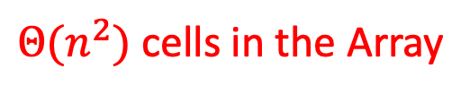
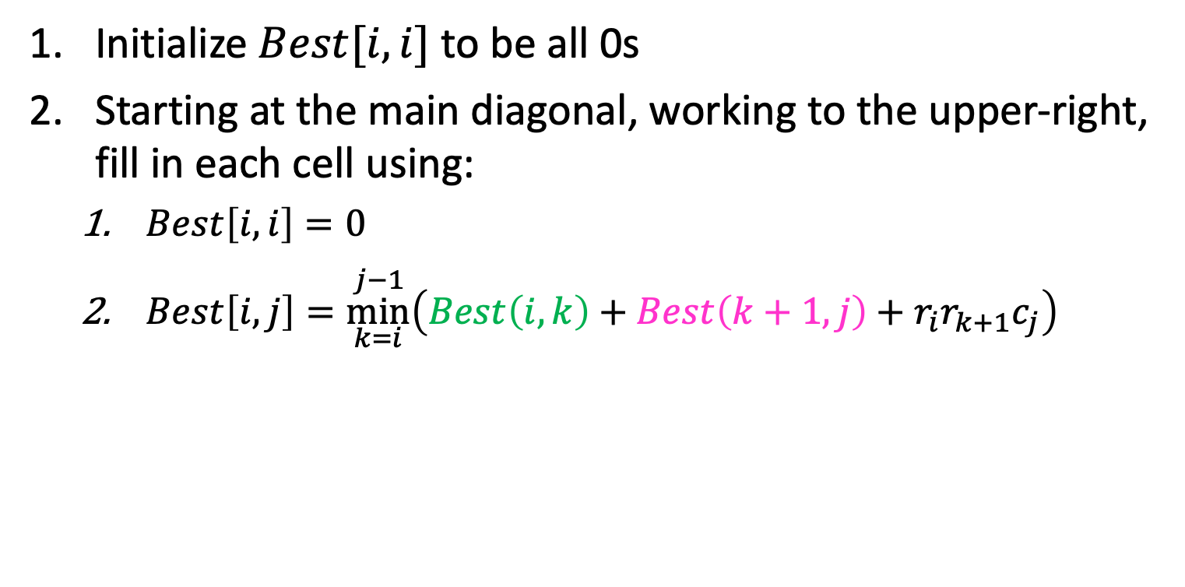
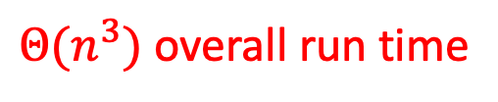
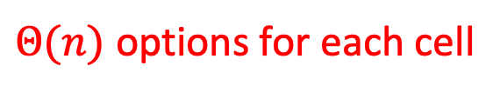
Run Time
Initialize $Best[i,i]$ to be all 0s
Starting at the main diagonal, working to the upper-right, fill in each cell using:
$Best\left[i,i\right]=0$
$Best\left[i,j\right]=\underset{k=i}{\overset{j−1}{min}}\left(Best\left(i,k\right)+Best\left(k+1, j\right)+r_{i}r_{k+1}c_{j}\right)$
$Θ(n^{2})$ cells in the Array
$Θ(n)$ options for each cell
$Θ(n^{3})$ overall run time

Slide 42




Backtrack to find the best order
“remember” which choice of $k$ was the minimum at each cell
$$Best\left(i,j\right)=\underset{k=i}{\overset{j−1}{min}}\left(Best\left(i,k\right)+Best\left(k+1, j\right)+r_{i}r_{k+1}c_{j}\right)$$
$$j=$$
$$1$$
$$2$$
$$3$$
$$4$$
$$5$$
$$6$$
$$=i$$
$$Best\left(i,i\right)=0$$
0
15750
7875
9375
11875
$$15125$$
$$1$$
$$1$$
$$3$$
0
2625
4375
7125
10500
$$2$$
0
750
2500
5375
$$3$$
$$Best\left(1,1\right)+Best\left(2, 6\right)+r_{1}r_{2}c_{6}$$
0
1000
3500
$$4$$
$$Best\left(1,2\right)+Best\left(3, 6\right)+r_{1}r_{3}c_{6}$$
$$5$$
$$Best\left(1,6\right)=min$$
$$Best\left(1,3\right)+Best\left(4, 6\right)+r_{1}r_{4}c_{6}$$
0
5000
$$5$$
$$Best\left(1,4\right)+Best\left(5, 6\right)+r_{1}r_{5}c_{6}$$
0
$$Best\left(1,5\right)+Best\left(6, 6\right)+r_{1}r_{6}c_{6}$$
$$6$$
42

Slide 43
Dynamic Programming
Requires Optimal Substructure
Solution to larger problem contains the solutions to smaller ones
Idea:
Identify recursive structure of the problem
What is the “last thing” done?
Select a good order for solving subproblems
“Top Down”: Solve each recursively
“Bottom Up”: Iteratively solve smallest to largest
Save solution to each subproblem in memory

Slide 44
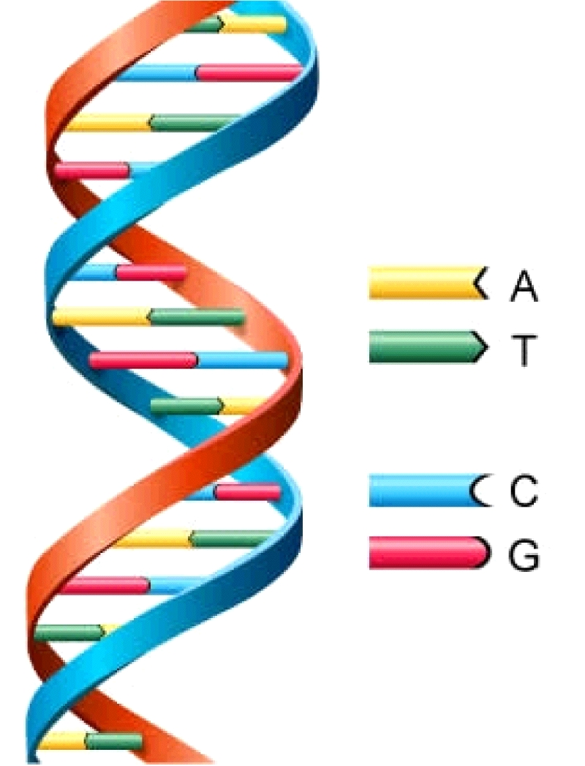
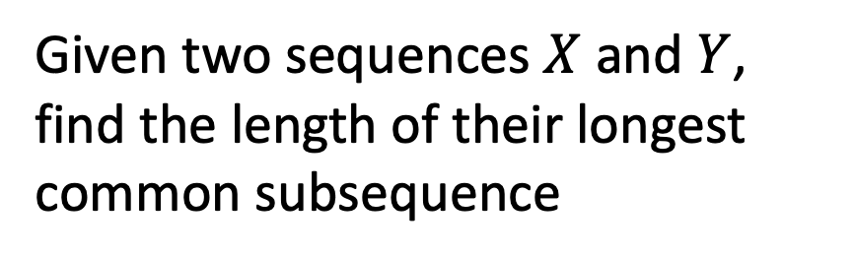
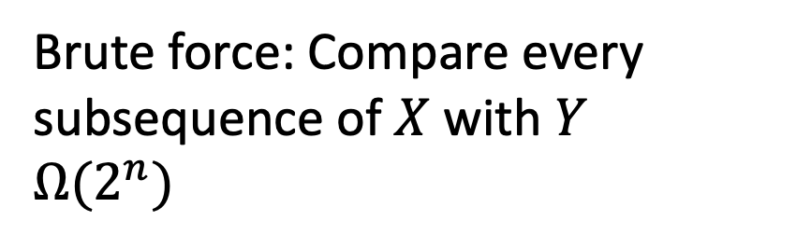

Longest Common Subsequence
Given two sequences $X$ and $Y$, find the length of their longest common subsequence
Example:
$X=ATCTGAT$
$Y=TGCATA$
$LCS=TCTA$
Brute force: Compare every subsequence of $X$ with $Y$
$Ω(2^{n})$

Slide 45
Dynamic Programming
Requires Optimal Substructure
Solution to larger problem contains the solutions to smaller ones
Idea:
Identify recursive structure of the problem
What is the “last thing” done?
Select a good order for solving subproblems
“Top Down”: Solve each recursively
“Bottom Up”: Iteratively solve smallest to largest
Save solution to each subproblem in memory

Slide 46
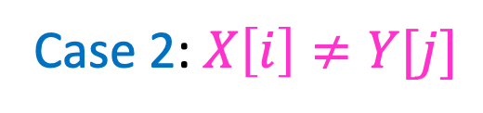
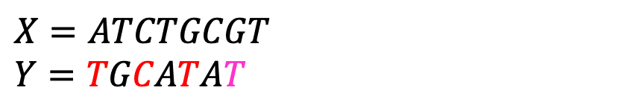
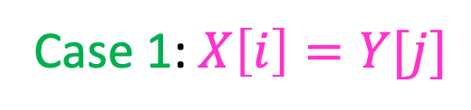
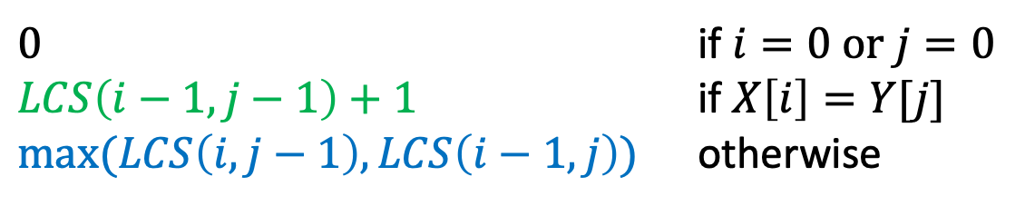
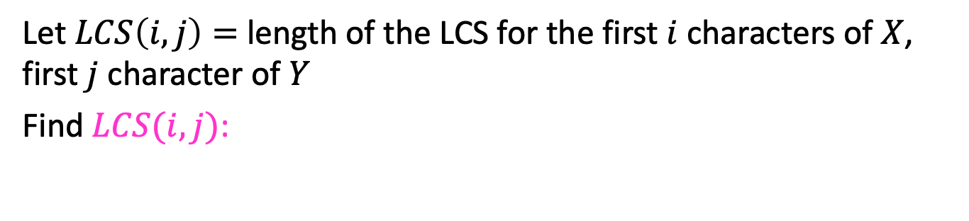






1. Identify Recursive Structure
Let $LCS\left(i,j\right)=$ length of the LCS for the first $i$ characters of $X$, first $j$ character of $Y$
Find $LCS(i,j)$:
Case 1: $X\left[i\right]=Y[j]$
$X=ATCTGCGT$
$Y=TGCATAT$
$$LCS\left(i,j\right)=LCS\left(i−1, j−1\right)+1$$
Case 2: $X\left[i\right]≠Y[j]$
$X=ATCTGCGA$
$Y=TGCATAT$
$X=ATCTGCGT$
$Y=TGCATAC$
$LCS\left(i,j\right)=LCS\left(i,j−1\right)$
$LCS\left(i,j\right)=LCS\left(i−1,j\right)$
$0$ if $i=0$ or $j=0$
$LCS\left(i−1,j−1\right)+1$ if $X\left[i\right]=Y[j]$
$\max{(LCS\left(i,j−1\right),LCS\left(i−1,j\right))}$ otherwise
$$LCS\left(i,j\right)=$$

Slide 47
Dynamic Programming
Requires Optimal Substructure
Solution to larger problem contains the solutions to smaller ones
Idea:
Identify recursive structure of the problem
What is the “last thing” done?
Select a good order for solving subproblems
“Top Down”: Solve each recursively
“Bottom Up”: Iteratively solve smallest to largest
Save solution to each subproblem in memory

Slide 48


1. Identify Recursive Structure
Let $LCS\left(i,j\right)=$ length of the LCS for the first $i$ characters of $X$, first $j$ character of $Y$
Find $LCS(i,j)$:
Case 1: $X\left[i\right]=Y[j]$
$X=ATCTGCGT$
$Y=TGCATAT$
$$LCS\left(i,j\right)=LCS\left(i−1, j−1\right)+1$$
Case 2: $X\left[i\right]≠Y[j]$
$X=ATCTGCGA$
$Y=TGCATAT$
$X=ATCTGCGT$
$Y=TGCATAC$
$LCS\left(i,j\right)=LCS\left(i,j−1\right)$
$LCS\left(i,j\right)=LCS\left(i−1,j\right)$
Read from M[I,j]
if present
$0$ if $i=0$ or $j=0$
$LCS\left(i−1,j−1\right)+1$ if $X\left[i\right]=Y[j]$
$\max{(LCS\left(i,j−1\right),LCS\left(i−1,j\right))}$ otherwise
$$LCS\left(i,j\right)=$$
Save to M[I,j]

Slide 49
Dynamic Programming
Requires Optimal Substructure
Solution to larger problem contains the solutions to smaller ones
Idea:
Identify recursive structure of the problem
What is the “last thing” done?
Select a good order for solving subproblems
“Top Down”: Solve each recursively
“Bottom Up”: Iteratively solve smallest to largest
Save solution to each subproblem in memory

Slide 50

























2. Solve in a Good Order
$0$ if $i=0$ or $j=0$
$LCS\left(i−1,j−1\right)+1$ if $X\left[i\right]=Y[j]$
$\max{(LCS\left(i,j−1\right),LCS\left(i−1,j\right))}$ otherwise
$$LCS\left(i,j\right)=$$
$$X=$$
$$A$$
$$T$$
$$C$$
$$T$$
$$G$$
$$A$$
$$T$$
$$Y=$$
$$0$$
$$1$$
$$2$$
$$3$$
$$4$$
$$5$$
$$6$$
$$7$$
$$0$$
0 | 0 | 0 | 0 | 0 | 0 | 0 | 0
0 | 0 | 1 | 1 | 1 | 1 | 1 | 1
0 | 0 | 1 | 1 | 1 | 2 | 2 | 2
0 | 0 | 1 | 2 | 2 | 2 | 2 | 2
0 | 1 | 1 | 2 | 2 | 2 | 3 | 3
0 | 1 | 2 | 2 | 3 | 3 | 3 | 4
0 | 1 | 2 | 2 | 3 | 3 | 4 | 4
$$T$$
$$1$$
$$G$$
$$2$$
$$C$$
$$3$$
$$A$$
$$4$$
$$T$$
$$5$$
$$A$$
$$6$$
To fill in cell $(i,j)$ we need cells $\left(i−1,j−1\right),\left(i−1,j\right),(i,j−1)$
Fill from Top->Bottom, Left->Right (with any preference)

Slide 51

Run Time?
$0$ if $i=0$ or $j=0$
$LCS\left(i−1,j−1\right)+1$ if $X\left[i\right]=Y[j]$
$\max{(LCS\left(i,j−1\right),LCS\left(i−1,j\right))}$ otherwise
$$LCS\left(i,j\right)=$$
$$X=$$
$$A$$
$$T$$
$$C$$
$$T$$
$$G$$
$$A$$
$$T$$
$$Y=$$
$$0$$
$$1$$
$$2$$
$$3$$
$$4$$
$$5$$
$$6$$
$$7$$
$$0$$
0 | 0 | 0 | 0 | 0 | 0 | 0 | 0
0 | 0 | 1 | 1 | 1 | 1 | 1 | 1
0 | 0 | 1 | 1 | 1 | 2 | 2 | 2
0 | 0 | 1 | 2 | 2 | 2 | 2 | 2
0 | 1 | 1 | 2 | 2 | 2 | 3 | 3
0 | 1 | 2 | 2 | 3 | 3 | 3 | 4
0 | 1 | 2 | 2 | 3 | 3 | 4 | 4
$$T$$
$$1$$
$$G$$
$$2$$
$$C$$
$$3$$
$$A$$
$$4$$
$$T$$
$$5$$
$$A$$
$$6$$
Run Time: $Θ(n⋅m)$ (for $\left|X\right|=n$, $\left|Y\right|=m$)

Slide 52
Reconstructing the LCS
$0$ if $i=0$ or $j=0$
$LCS\left(i−1,j−1\right)+1$ if $X\left[i\right]=Y[j]$
$\max{(LCS\left(i,j−1\right),LCS\left(i−1,j\right))}$ otherwise
$$LCS\left(i,j\right)=$$
$$X=$$
$$A$$
$$T$$
$$C$$
$$T$$
$$G$$
$$A$$
$$T$$
$$Y=$$
$$0$$
$$1$$
$$2$$
$$3$$
$$4$$
$$5$$
$$6$$
$$7$$
$$0$$
0 | 0 | 0 | 0 | 0 | 0 | 0 | 0
0 | 0 | 1 | 1 | 1 | 1 | 1 | 1
0 | 0 | 1 | 1 | 1 | 2 | 2 | 2
0 | 0 | 1 | 2 | 2 | 2 | 2 | 2
0 | 1 | 1 | 2 | 2 | 2 | 3 | 3
0 | 1 | 2 | 2 | 3 | 3 | 3 | 4
0 | 1 | 2 | 2 | 3 | 3 | 4 | 4
$$T$$
$$1$$
$$G$$
$$2$$
$$C$$
$$3$$
$$A$$
$$4$$
$$T$$
$$5$$
$$A$$
$$6$$
Start from bottom right,
if symbols matched, print that symbol then go diagonally
else go to largest adjacent

Slide 53
Reconstructing the LCS
$0$ if $i=0$ or $j=0$
$LCS\left(i−1,j−1\right)+1$ if $X\left[i\right]=Y[j]$
$\max{(LCS\left(i,j−1\right),LCS\left(i−1,j\right))}$ otherwise
$$LCS\left(i,j\right)=$$
$$X=$$
$$A$$
$$T$$
$$C$$
$$T$$
$$G$$
$$A$$
$$T$$
$$Y=$$
$$0$$
$$1$$
$$2$$
$$3$$
$$4$$
$$5$$
$$6$$
$$7$$
$$0$$
0 | 0 | 0 | 0 | 0 | 0 | 0 | 0
0 | 0 | 1 | 1 | 1 | 1 | 1 | 1
0 | 0 | 1 | 1 | 1 | 2 | 2 | 2
0 | 0 | 1 | 2 | 2 | 2 | 2 | 2
0 | 1 | 1 | 2 | 2 | 2 | 3 | 3
0 | 1 | 2 | 2 | 3 | 3 | 3 | 4
0 | 1 | 2 | 2 | 3 | 3 | 4 | 4
$$T$$
$$1$$
$$G$$
$$2$$
$$C$$
$$3$$
$$A$$
$$4$$
$$T$$
$$5$$
$$A$$
$$6$$
Start from bottom right,
if symbols matched, print that symbol then go diagonally
else go to largest adjacent

Slide 54
Reconstructing the LCS
$0$ if $i=0$ or $j=0$
$LCS\left(i−1,j−1\right)+1$ if $X\left[i\right]=Y[j]$
$\max{(LCS\left(i,j−1\right),LCS\left(i−1,j\right))}$ otherwise
$$LCS\left(i,j\right)=$$
$$X=$$
$$A$$
$$T$$
$$C$$
$$T$$
$$G$$
$$A$$
$$T$$
$$Y=$$
$$0$$
$$1$$
$$2$$
$$3$$
$$4$$
$$5$$
$$6$$
$$7$$
$$0$$
0 | 0 | 0 | 0 | 0 | 0 | 0 | 0
0 | 0 | 1 | 1 | 1 | 1 | 1 | 1
0 | 0 | 1 | 1 | 1 | 2 | 2 | 2
0 | 0 | 1 | 2 | 2 | 2 | 2 | 2
0 | 1 | 1 | 2 | 2 | 2 | 3 | 3
0 | 1 | 2 | 2 | 3 | 3 | 3 | 4
0 | 1 | 2 | 2 | 3 | 3 | 4 | 4
$$T$$
$$1$$
$$G$$
$$2$$
$$C$$
$$3$$
$$A$$
$$4$$
$$T$$
$$5$$
$$A$$
$$6$$
Start from bottom right,
if symbols matched, print that symbol then go diagonally
else go to largest adjacent

