Slide 1

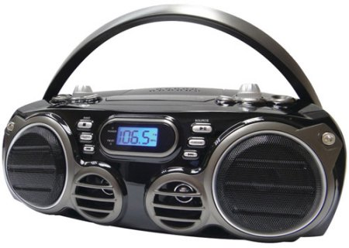
CS4102 Algorithms
Fall 2018
Warm up
In Season 9 Episode 7 “The Slicer” of the hit 90s TV show Seinfeld, George discovers that, years prior, he had a heated argument with his new boss, Mr. Kruger. This argument ended in George throwing Mr. Kruger’s boombox into the ocean. How did George make this discovery?

Slide 2
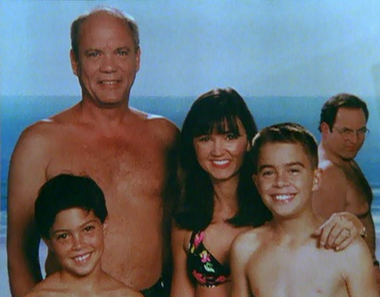
https://www.youtube.com/watch?v=pSB3HdmLcY4

Slide 3
Today’s Keywords
Dynamic Programming
Longest Common Subsequence
Seam Carving
Seinfeld

Slide 4
CLRS Readings
Chapter 15

Slide 5
Homeworks
Hw5 Released on Friday
Programming
Dynamic Programming

Slide 6
Dynamic Programming
Requires Optimal Substructure
Solution to larger problem contains the solutions to smaller ones
Idea:
Identify recursive structure of the problem
What is the “last thing” done?
Select a good order for solving subproblems
“Top Down”: Solve each recursively
“Bottom Up”: Iteratively solve smallest to largest
Save solution to each subproblem in memory

Slide 7

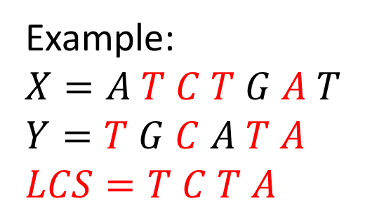
Longest Common Subsequence
Given two sequences $X$ and $Y$, find the length of their longest common subsequence
Example:
$X=A T C T G A T$
$Y=T G C A T A$
$LCS=T C T A$
Brute force: Compare every subsequence of $X$ with $Y$
$Ω(2^{n})$

Slide 8
Dynamic Programming
Requires Optimal Substructure
Solution to larger problem contains the solutions to smaller ones
Idea:
Identify recursive structure of the problem
What is the “last thing” done?
Select a good order for solving subproblems
“Top Down”: Solve each recursively
“Bottom Up”: Iteratively solve smallest to largest
Save solution to each subproblem in memory

Slide 9
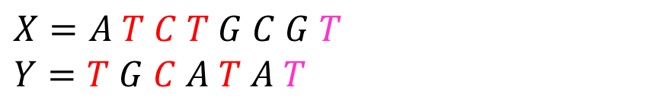
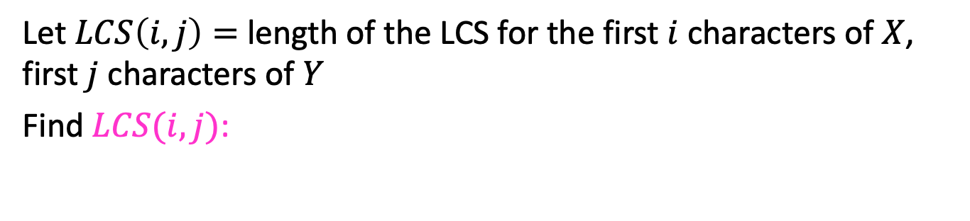
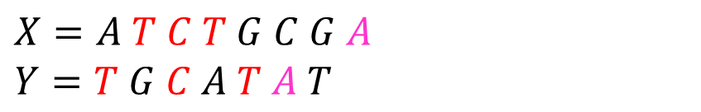
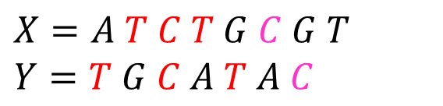
1. Identify Recursive Structure
Let $LCS\left(i,j\right)=$ length of the LCS for the first $i$ characters of $X$, first $j$ characters of $Y$
Find $LCS(i,j)$:
Case 1: $X\left[i\right]=Y[j]$
$X=A T C T G C G T$
$Y=T G C A T A T$
$$LCS\left(i,j\right)=LCS\left(i−1, j−1\right)+1$$
Case 2: $X\left[i\right]≠Y[j]$
$X=A T C T G C G A$
$Y=T G C A T A T$
$X=A T C T G C G T$
$Y=T G C A T A C$
$LCS\left(i,j\right)=LCS\left(i,j−1\right)$
$LCS\left(i,j\right)=LCS\left(i−1,j\right)$
$0$ if $i=0$ or $j=0$
$LCS\left(i−1,j−1\right)+1$ if $X\left[i\right]=Y[j]$
$\max{(LCS\left(i,j−1\right),LCS\left(i−1,j\right))}$ otherwise
$$LCS\left(i,j\right)=$$

Slide 10
Dynamic Programming
Requires Optimal Substructure
Solution to larger problem contains the solutions to smaller ones
Idea:
Identify recursive structure of the problem
What is the “last thing” done?
Select a good order for solving subproblems
“Top Down”: Solve each recursively
“Bottom Up”: Iteratively solve smallest to largest
Save solution to each subproblem in memory

Slide 11
1. Identify Recursive Structure
Let $LCS\left(i,j\right)=$ length of the LCS for the first $i$ characters of $X$, first $j$ character of $Y$
Find $LCS(i,j)$:
Case 1: $X\left[i\right]=Y[j]$
$X=A T C T G C G T$
$Y=T G C A T A T$
$$LCS\left(i,j\right)=LCS\left(i−1, j−1\right)+1$$
Case 2: $X\left[i\right]≠Y[j]$
$X=A T C T G C G A$
$Y=T G C A T A T$
$X=A T C T G C G T$
$Y=T G C A T A C$
$LCS\left(i,j\right)=LCS\left(i,j−1\right)$
$LCS\left(i,j\right)=LCS\left(i−1,j\right)$
Read from M[i,j]
if present
$0$ if $i=0$ or $j=0$
$LCS\left(i−1,j−1\right)+1$ if $X\left[i\right]=Y[j]$
$\max{(LCS\left(i,j−1\right),LCS\left(i−1,j\right))}$ otherwise
$$LCS\left(i,j\right)=$$
Save to M[i,j]

Slide 12
Dynamic Programming
Requires Optimal Substructure
Solution to larger problem contains the solutions to smaller ones
Idea:
Identify recursive structure of the problem
What is the “last thing” done?
Select a good order for solving subproblems
“Top Down”: Solve each recursively
“Bottom Up”: Iteratively solve smallest to largest
Save solution to each subproblem in memory

Slide 13
2. Solve in a Good Order
$0$ if $i=0$ or $j=0$
$LCS\left(i−1,j−1\right)+1$ if $X\left[i\right]=Y[j]$
$\max{(LCS\left(i,j−1\right),LCS\left(i−1,j\right))}$ otherwise
$$LCS\left(i,j\right)=$$
$$X=$$
$$A$$
$$T$$
$$C$$
$$T$$
$$G$$
$$A$$
$$T$$
$$Y=$$
$$0$$
$$1$$
$$2$$
$$3$$
$$4$$
$$5$$
$$6$$
$$7$$
$$0$$
0 | 0 | 0 | 0 | 0 | 0 | 0 | 0
0 | 0 | 1 | 1 | 1 | 1 | 1 | 1
0 | 0 | 1 | 1 | 1 | 2 | 2 | 2
0 | 0 | 1 | 2 | 2 | 2 | 2 | 2
0 | 1 | 1 | 2 | 2 | 2 | 3 | 3
0 | 1 | 2 | 2 | 3 | 3 | 3 | 4
0 | 1 | 2 | 2 | 3 | 3 | 4 | 4
$$T$$
$$1$$
$$G$$
$$2$$
$$C$$
$$3$$
$$A$$
$$4$$
$$T$$
$$5$$
$$A$$
$$6$$
To fill in cell $(i,j)$ we need cells $\left(i−1,j−1\right),\left(i−1,j\right),(i,j−1)$
Fill from Top->Bottom, Left->Right (with any preference)

Slide 14
Run Time?
$0$ if $i=0$ or $j=0$
$LCS\left(i−1,j−1\right)+1$ if $X\left[i\right]=Y[j]$
$\max{(LCS\left(i,j−1\right),LCS\left(i−1,j\right))}$ otherwise
$$LCS\left(i,j\right)=$$
$$X=$$
$$A$$
$$T$$
$$C$$
$$T$$
$$G$$
$$A$$
$$T$$
$$Y=$$
$$0$$
$$1$$
$$2$$
$$3$$
$$4$$
$$5$$
$$6$$
$$7$$
$$0$$
0 | 0 | 0 | 0 | 0 | 0 | 0 | 0
0 | 0 | 1 | 1 | 1 | 1 | 1 | 1
0 | 0 | 1 | 1 | 1 | 2 | 2 | 2
0 | 0 | 1 | 2 | 2 | 2 | 2 | 2
0 | 1 | 1 | 2 | 2 | 2 | 3 | 3
0 | 1 | 2 | 2 | 3 | 3 | 3 | 4
0 | 1 | 2 | 2 | 3 | 3 | 4 | 4
$$T$$
$$1$$
$$G$$
$$2$$
$$C$$
$$3$$
$$A$$
$$4$$
$$T$$
$$5$$
$$A$$
$$6$$
Run Time: $Θ(n⋅m)$ (for $\left|X\right|=n$, $\left|Y\right|=m$)

Slide 15
Reconstructing the LCS
$0$ if $i=0$ or $j=0$
$LCS\left(i−1,j−1\right)+1$ if $X\left[i\right]=Y[j]$
$\max{(LCS\left(i,j−1\right),LCS\left(i−1,j\right))}$ otherwise
$$LCS\left(i,j\right)=$$
$$X=$$
$$A$$
$$T$$
$$C$$
$$T$$
$$G$$
$$A$$
$$T$$
$$Y=$$
$$0$$
$$1$$
$$2$$
$$3$$
$$4$$
$$5$$
$$6$$
$$7$$
$$0$$
0 | 0 | 0 | 0 | 0 | 0 | 0 | 0
0 | 0 | 1 | 1 | 1 | 1 | 1 | 1
0 | 0 | 1 | 1 | 1 | 2 | 2 | 2
0 | 0 | 1 | 2 | 2 | 2 | 2 | 2
0 | 1 | 1 | 2 | 2 | 2 | 3 | 3
0 | 1 | 2 | 2 | 3 | 3 | 3 | 4
0 | 1 | 2 | 2 | 3 | 3 | 4 | 4
$$T$$
$$1$$
$$G$$
$$2$$
$$C$$
$$3$$
$$A$$
$$4$$
$$T$$
$$5$$
$$A$$
$$6$$
Start from bottom right,
if symbols matched, print that symbol then go diagonally
else go to largest adjacent

Slide 16
Reconstructing the LCS
$0$ if $i=0$ or $j=0$
$LCS\left(i−1,j−1\right)+1$ if $X\left[i\right]=Y[j]$
$\max{(LCS\left(i,j−1\right),LCS\left(i−1,j\right))}$ otherwise
$$LCS\left(i,j\right)=$$
$$X=$$
$$A$$
$$T$$
$$C$$
$$T$$
$$G$$
$$A$$
$$T$$
$$Y=$$
$$0$$
$$1$$
$$2$$
$$3$$
$$4$$
$$5$$
$$6$$
$$7$$
$$0$$
0 | 0 | 0 | 0 | 0 | 0 | 0 | 0
0 | 0 | 1 | 1 | 1 | 1 | 1 | 1
0 | 0 | 1 | 1 | 1 | 2 | 2 | 2
0 | 0 | 1 | 2 | 2 | 2 | 2 | 2
0 | 1 | 1 | 2 | 2 | 2 | 3 | 3
0 | 1 | 2 | 2 | 3 | 3 | 3 | 4
0 | 1 | 2 | 2 | 3 | 3 | 4 | 4
$$T$$
$$1$$
$$G$$
$$2$$
$$C$$
$$3$$
$$A$$
$$4$$
$$T$$
$$5$$
$$A$$
$$6$$
Start from bottom right,
if symbols matched, print that symbol then go diagonally
else go to largest adjacent

Slide 17
Reconstructing the LCS
$0$ if $i=0$ or $j=0$
$LCS\left(i−1,j−1\right)+1$ if $X\left[i\right]=Y[j]$
$\max{(LCS\left(i,j−1\right),LCS\left(i−1,j\right))}$ otherwise
$$LCS\left(i,j\right)=$$
$$X=$$
$$A$$
$$T$$
$$C$$
$$T$$
$$G$$
$$A$$
$$T$$
$$Y=$$
$$0$$
$$1$$
$$2$$
$$3$$
$$4$$
$$5$$
$$6$$
$$7$$
$$0$$
0 | 0 | 0 | 0 | 0 | 0 | 0 | 0
0 | 0 | 1 | 1 | 1 | 1 | 1 | 1
0 | 0 | 1 | 1 | 1 | 2 | 2 | 2
0 | 0 | 1 | 2 | 2 | 2 | 2 | 2
0 | 1 | 1 | 2 | 2 | 2 | 3 | 3
0 | 1 | 2 | 2 | 3 | 3 | 3 | 4
0 | 1 | 2 | 2 | 3 | 3 | 4 | 4
$$T$$
$$1$$
$$G$$
$$2$$
$$C$$
$$3$$
$$A$$
$$4$$
$$T$$
$$5$$
$$A$$
$$6$$
Start from bottom right,
if symbols matched, print that symbol then go diagonally
else go to largest adjacent

Slide 18
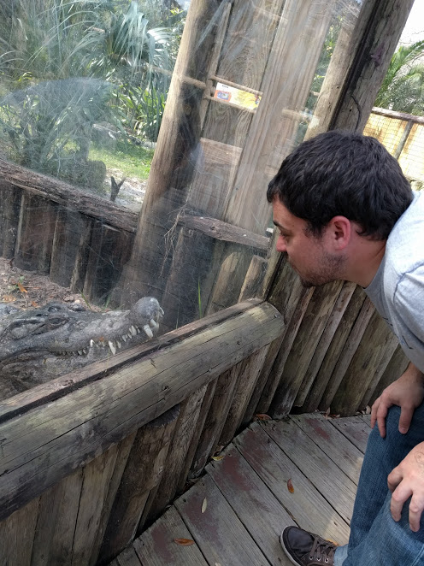
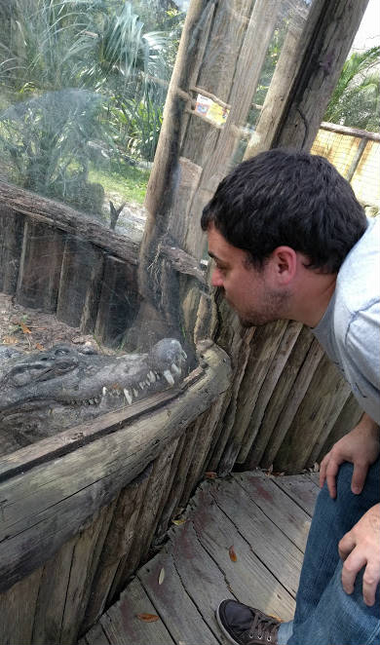
Seam Carving
Method for image resizing that doesn’t scale/crop the image
Cropped
Scaled
Carved

Slide 19
Cropping
Removes a “block” of pixels
Cropped

Slide 20
Scaling
Removes “stripes” of pixels
Scaled

Slide 21
Seam Carving
Removes “least energy seam” of pixels
http://rsizr.com/
Carved

Slide 22
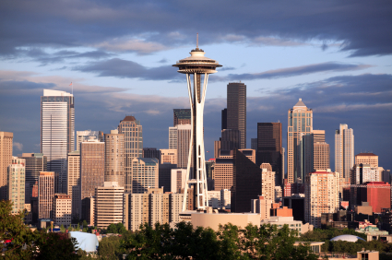
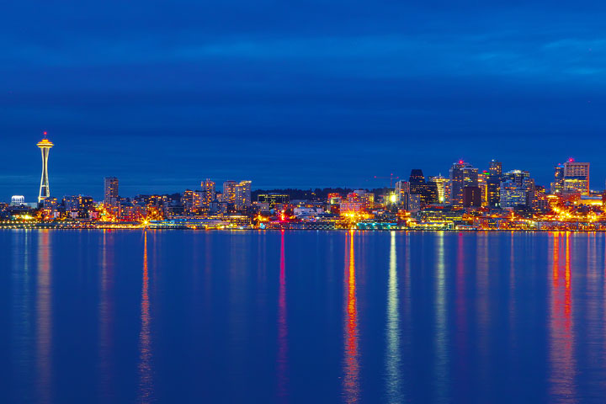
Seattle Skyline

Slide 23
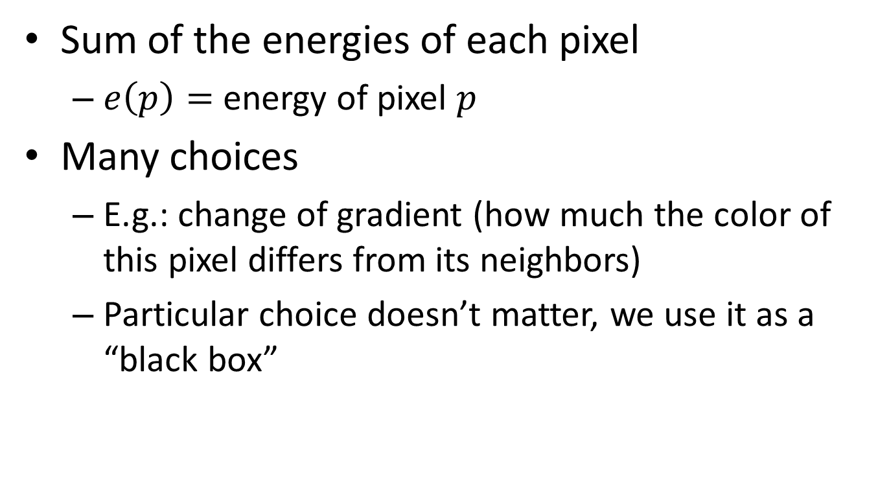
Energy of a Seam
Sum of the energies of each pixel
$e\left(p\right)=$ energy of pixel $p$
Many choices
E.g.: change of gradient (how much the color of this pixel differs from its neighbors)
Particular choice doesn’t matter, we use it as a “black box”

Slide 24


Identify Recursive Structure
Let $S\left(i,j\right)=$least energy seam from the bottom of the image up to pixel $p_{i,j}$
$$p_{i,j}$$

Slide 25




Finding the Least Energy Seam
Want the least energy seam going from bottom to top, so delete:
$$\underset{k=1}{\overset{m}{min}}\left(S(n,k)\right)$$
$$p_{n,k}$$
$$n$$
$$m$$

Slide 26
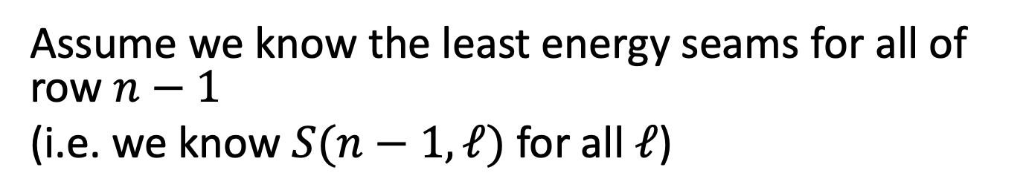

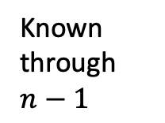
Computing $S(n,k)$
Assume we know the least energy seams for all of row $n−1$
(i.e. we know $S(n−1,ℓ)$ for all $ℓ$)
$$p_{n,k}$$
Known through $n−1$
$$m$$

Slide 27






Computing $S(n,k)$
Assume we know the least energy seams for all of row $n−1$ (i.e. we know $S(n−1,ℓ)$ for all $ℓ$)
$$S\left(n−1,k−1\right)+e(p_{n,k})$$
$$S\left(n,k\right)=min$$
$$p_{n,k}$$
$$S\left(n−1,k\right)+e(p_{n,k})$$
S(n,k)
$$S\left(n−1,k+1\right)+e(p_{n,k})$$
S(n-1,k-1)
S(n-1,k)
S(n-1,k+1)

Slide 28

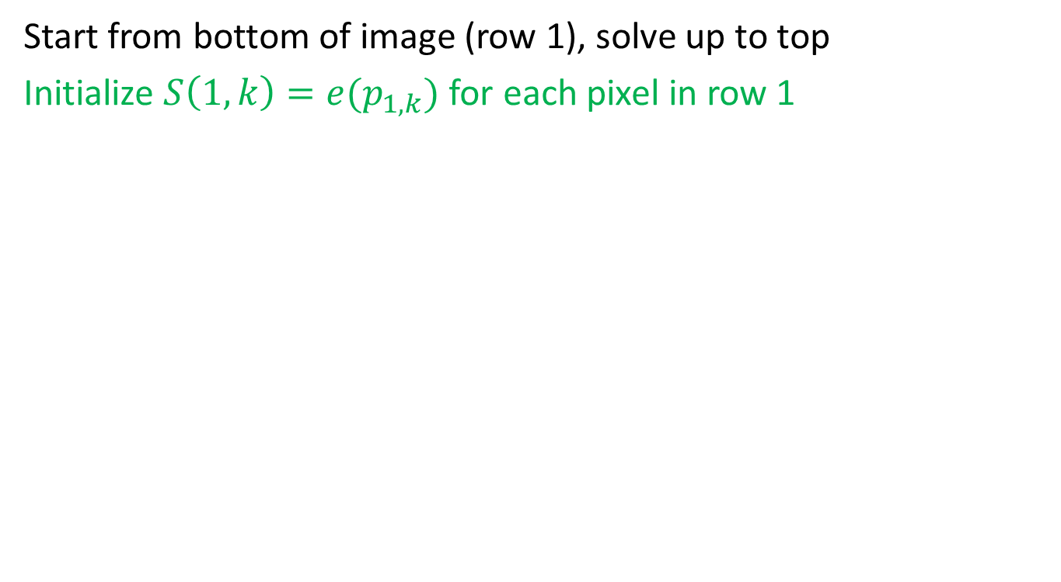

Bring It All Together
Start from bottom of image (row 1), solve up to top
Initialize $S\left(1,k\right)=e(p_{1,k})$ for each pixel in row 1
$$n$$
Energy of the seam initialized to the energy of that pixel
$$m$$

Slide 29




Bring It All Together
Start from bottom of image (row 1), solve up to top
Initialize $S\left(1,k\right)=e(p_{1,k})$ for each pixel $p_{1,k}$
For $i≥2$ find $S\left(i,k\right)=min$
$$S\left(n−1,k−1\right)+e(p_{n,k})$$
$$S\left(n−1,k\right)+e(p_{n,k})$$
$$S\left(n−1,k+1\right)+e(p_{n,k})$$
$$n$$
Energy of the seam initialized to the energy of that pixel
$$m$$

Slide 30

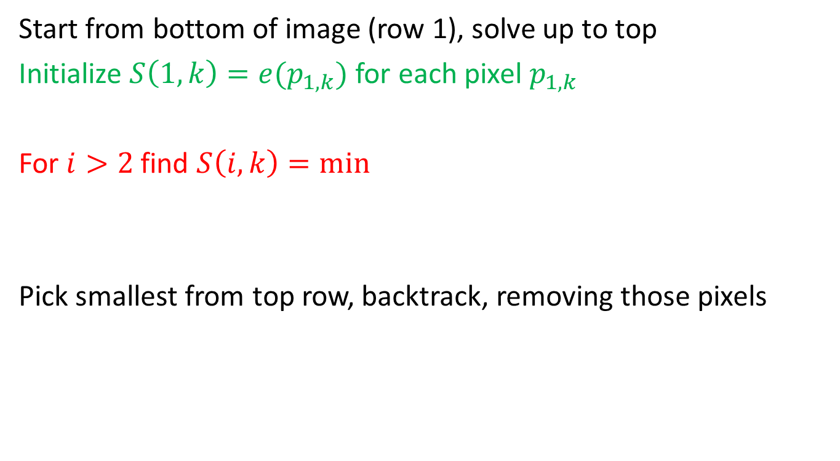


Bring It All Together
Start from bottom of image (row 1), solve up to top
Initialize $S\left(1,k\right)=e(p_{1,k})$ for each pixel $p_{1,k}$
For $i>2$ find $S\left(i,k\right)=min$
Pick smallest from top row, backtrack, removing those pixels
$$S\left(n−1,k−1\right)+e(p_{n,k})$$
$$S\left(n−1,k\right)+e(p_{n,k})$$
$$S\left(n−1,k+1\right)+e(p_{n,k})$$
$$n$$
Energy of the seam initialized to the energy of that pixel
$$m$$

Slide 31
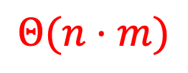




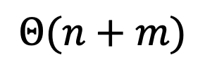
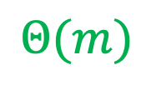
Run Time?
Start from bottom of image (row 1), solve up to top
Initialize $S\left(1,k\right)=e(p_{1,k})$ for each pixel $p_{1,k}$
For $i≥2$ find $S\left(i,k\right)=min$
Pick smallest from top row, backtrack, removing those pixels
$$Θ(m)$$
$$S\left(n−1,k−1\right)+e(p_{i,k})$$
$$Θ(n⋅m)$$
$$S\left(n−1,k\right)+e(p_{i,k})$$
$$S\left(n−1,k+1\right)+e(p_{i,k})$$
$$Θ(n+m)$$
$$n$$
Energy of the seam initialized to the energy of that pixel
$$m$$

Slide 32



Repeated Seam Removal
Only need to update pixels dependent on the removed seam
$2n$ pixels change
$Θ(2n)$ time to update pixels
$Θ(n+m)$ time to find min+backtrack
$$n$$
$$m$$

