Slide 1
CS4102 Algorithms
Fall 2018
Can you fill a $8×8$ board with the corners missing using dominoes?
Can you tile this?
With these?

Slide 2
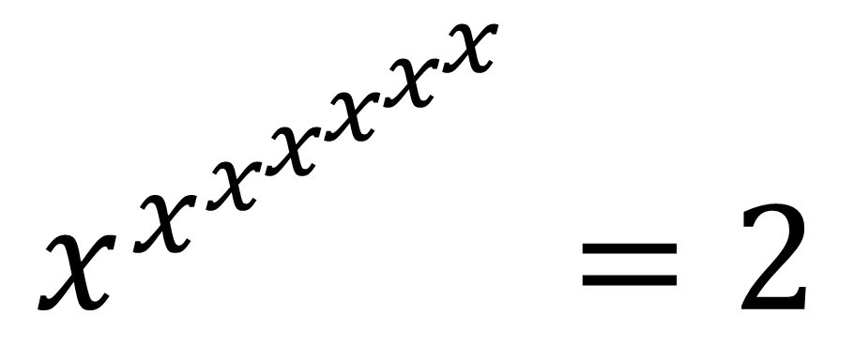


Power Tower
Solve for $x$:
$$…$$
$$x^{x^{x^{x^{x^{x^{x}}}}}}=2$$

Slide 3
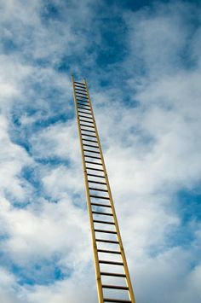
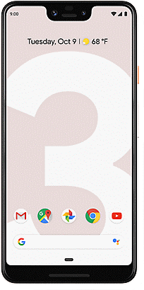
Phone Drop
You have 2 identical phones and a 100-step ladder.
Find the highest step of the ladder from which the phones can fall without breaking using the minimum number of trials.

