Slide 1
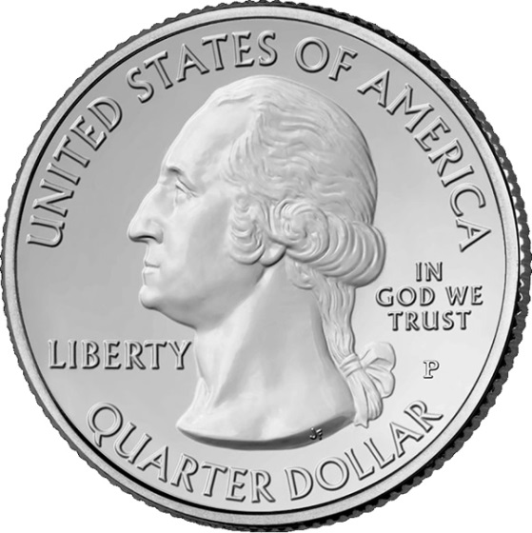
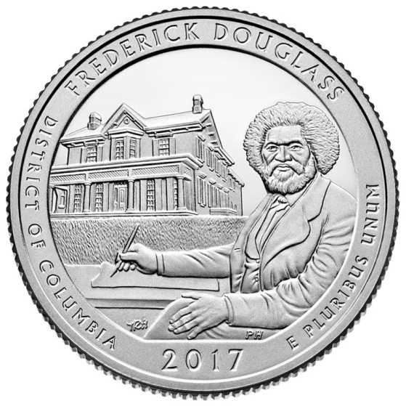
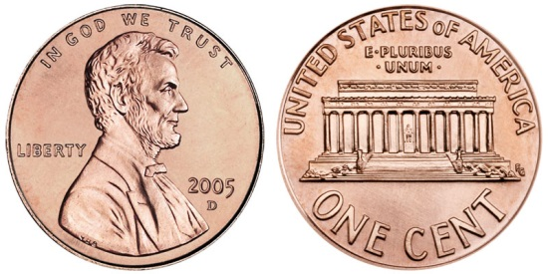
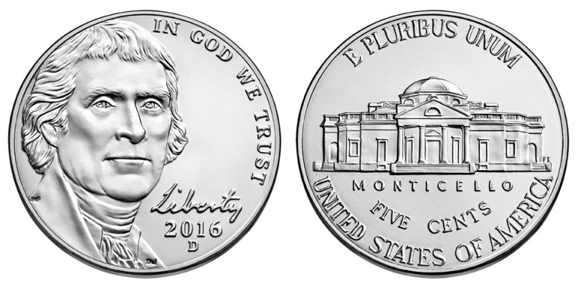
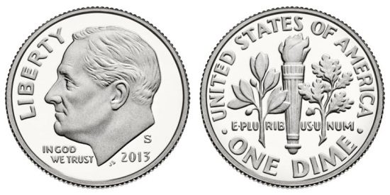
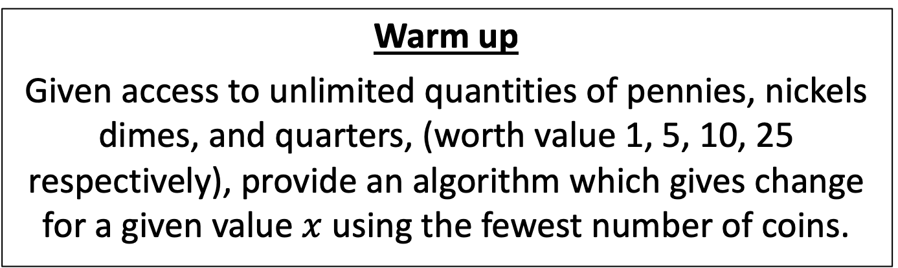
CS4102 Algorithms
Fall 2018
Warm up
Given access to unlimited quantities of pennies, nickels dimes, and quarters, (worth value 1, 5, 10, 25 respectively), provide an algorithm which gives change for a given value $x$ using the fewest number of coins.

Slide 2

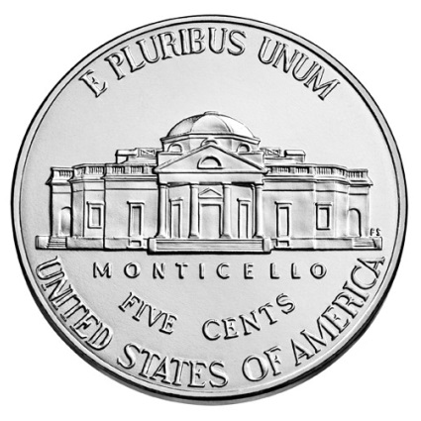
Change Making
43 cents

Slide 3
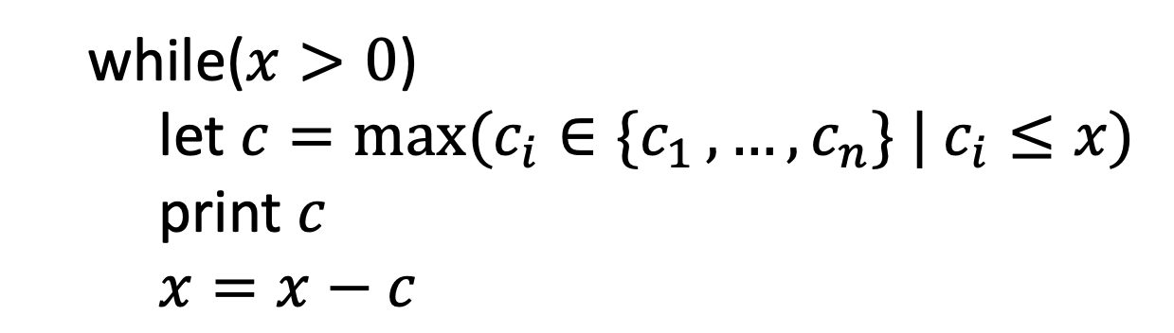

Change Making Algorithm
Given: target value $x$, list of coins $C=[c_{1}, …,c_{n}]$ (in this case $C=[1,5,10,25]$)
Repeatedly select the largest coin less than the remaining target value:
while($x>0$)
let $c=\max{{(c_{i}∈\{c}_{1}}, …,c_{n}\} | c_{i}≤x)$
print $c$
$x=x−c$

Slide 4
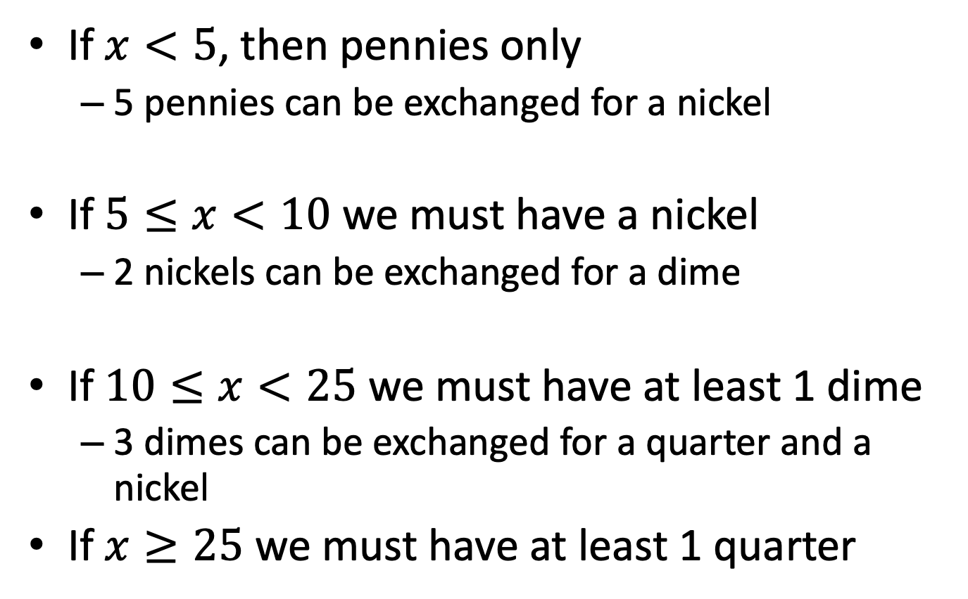
Why does this always work?
If $x<5$, then pennies only
5 pennies can be exchanged for a nickel
If $5≤x<10$ we must have a nickel
2 nickels can be exchanged for a dime
If $10≤x<25$ we must have at least 1 dime
3 dimes can be exchanged for a quarter and a nickel
If $x≥25$ we must have at least 1 quarter
Only case Greedy uses pennies!
Only case Greedy uses nickels!
Only case Greedy uses dimes!
Only case Greedy uses quarters!

Slide 5

Warm up 2
Given access to unlimited quantities of pennies, nickels dimes, kims, and quarters, (worth value 1, 5, 10, 11, 25 respectively), give 90 cents change using the fewest number of coins.

Slide 6
Greedy solution
90 cents

Slide 7
Greedy solution
90 cents

Slide 8
Today’s Keywords
Greedy Algorithms
Choice Function
Change Making
Interval Scheduling
Exchange Argument

Slide 9
CLRS Readings
Chapter 16

Slide 10
Homework
Hw6 Due Friday November 9, 11pm
Dynamic Programming and Greedy
Written assignment

Slide 11
Greedy vs DP
Dynamic Programming:
Require Optimal Substructure
Several choices for which small subproblem
Greedy:
Require Optimal Substructure
Must only consider one choice for small subproblem

Slide 12
Greedy Algorithms
Require Optimal Substructure
Solution to larger problem contains the solution to a smaller one
Only one subproblem to consider!
Idea:
Identify a greedy choice property
How to make a choice guaranteed to be included in some optimal solution
Repeatedly apply the choice property until no subproblems remain

Slide 13
Change Making Choice Property
Largest coin less than or equal to target value must be part of some optimal solution (for standard U.S. coins)

Slide 14
Interval Scheduling
Input: List of events with their start and end times (sorted by end time)
Output: largest set of non-conflicting events (start time of each event is after the end time of all preceding events)
[2, 3.25] CS4102
[1, 4] Corn Maze Run
[3, 4] CHS Prom
[3.5, 4.75] DMB concert
[4, 5.25] Bingo
[4.5, 6] SCUBA lessons
[5, 6.5] Roller Derby
[7, 8] Pumpkin Carving

Slide 15







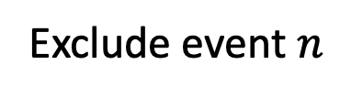



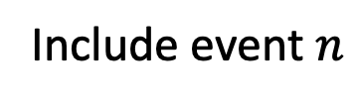
Interval Scheduling DP
$Best(t)=$ max # events that can be scheduled before time $t$
$$Best\left(s_{n}\right)+1$$
Include event $n$
$$Best\left(e_{n}\right)=max$$
$$Best\left(e_{n−1}\right)$$
Exclude event $n$
$$s_{1}$$
$$s_{2}$$
$$s_{3}$$
$$e_{2}$$
$$s_{n}$$
$$e_{n−1}$$
$$e_{n}$$

Slide 16

Greedy Interval Scheduling
Step 1: Identify a greedy choice property
Options:
Shortest interval
Fewest conflicts
Earliest start
Earliest end
Prove using Exchange Argument

Slide 17
Interval Scheduling Algorithm
Find event ending earliest, add to solution,
Remove it and all conflicting events,
Repeat until all events removed, return solution

Slide 18
Interval Scheduling Algorithm
Find event ending earliest, add to solution,
Remove it and all conflicting events,
Repeat until all events removed, return solution

Slide 19
Interval Scheduling Algorithm
Find event ending earliest, add to solution,
Remove it and all conflicting events,
Repeat until all events removed, return solution

Slide 20
Interval Scheduling Algorithm
Find event ending earliest, add to solution,
Remove it and all conflicting events,
Repeat until all events removed, return solution

Slide 21



Interval Scheduling Run Time
Find event ending earliest, add to solution,
Remove it and all conflicting events,
Repeat until all events removed, return solution
Equivalent way
StartTime = 0
For each interval (in order of finish time):
if end of interval < Start Time:
do nothing
else:
add interval to solution
StartTime = end of interval
$$O(n)$$
$$O(1)$$
$$O(1)$$

Slide 22
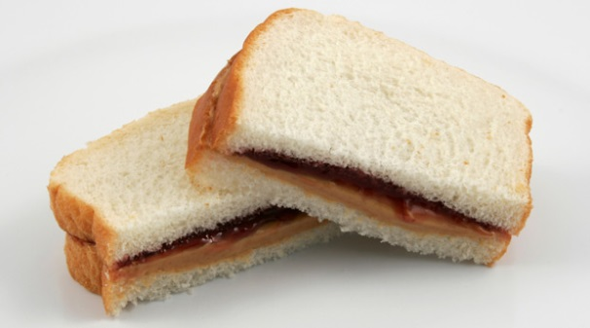
Exchange argument
Shows correctness of a greedy algorithm
Idea:
Show exchanging an item from an arbitrary optimal solution with your greedy choice makes the new solution no worse
How to show my sandwich is at least as good as yours:
Show: “I can remove any item from your sandwich, and it would be no worse by replacing it with the same item from my sandwich”

Slide 23
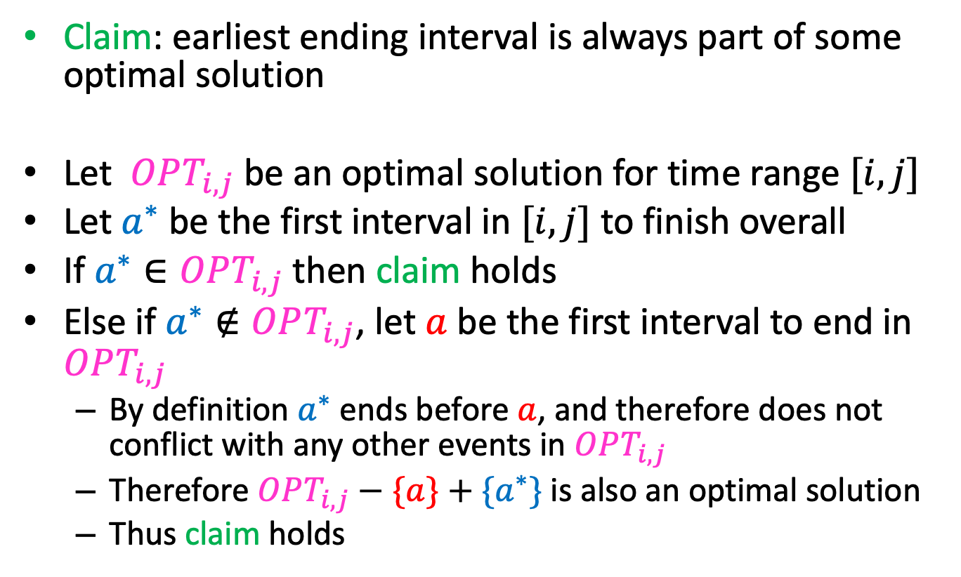
Exchange Argument for Earliest End Time
Claim: earliest ending interval is always part of some optimal solution
Let $OPT_{i,j}$ be an optimal solution for time range $[i,j]$
Let $a^{∗}$ be the first interval in $[i,j]$ to finish overall
If $a^{∗}∈OPT_{i,j}$ then claim holds
Else if $a^{∗}∉OPT_{i,j}$, let $a$ be the first interval to end in $OPT_{i,j}$
By definition $a^{∗}$ ends before $a$, and therefore does not conflict with any other events in $OPT_{i,j}$
Therefore $OPT_{i,j}−\{a\}+\{a^{∗}\}$ is also an optimal solution
Thus claim holds

Slide 24
Next Time: Caching Problem
Why is using too much memory a bad thing?

Slide 25
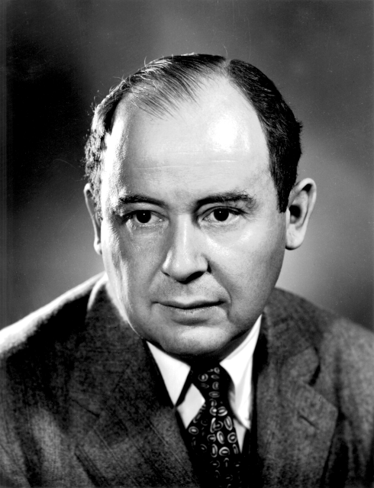
Von Neumann Bottleneck
Named for John von Neumann
Inventor of modern computer architecture
Other notable influences include:
Mathematics
Physics
Economics
Computer Science

Slide 26
Von Neumann Bottleneck
Reading from memory is VERY slow
Big memory = slow memory
Solution: hierarchical memory
Takeaway for Algorithms: Memory is time, more memory is a lot more time
Disc
Hope it’s not here
Hopefully your data in here
If not look here
Cache
CPU, registers
Access time:
1 cycle
Access time:
1,000,000 cycles
Access time:
10 cycles

Slide 27
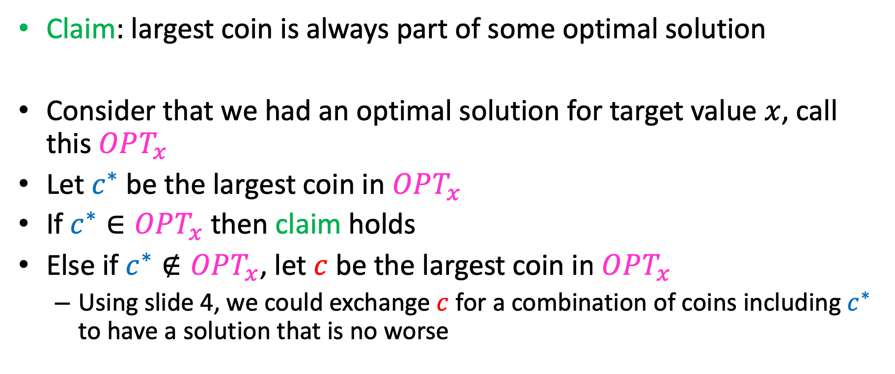
Exchange Argument for (U.S. coin) Change Making
Claim: largest coin is always part of some optimal solution
Consider that we had an optimal solution for target value $x$, call this $OPT_{x}$
Let $c^{∗}$ be the largest coin in $OPT_{x}$
If $c^{∗}∈OPT_{x}$ then claim holds
Else if $c^{∗}∉OPT_{x}$, let $c$ be the largest coin in $OPT_{x}$
Using slide 4, we could exchange $c$ for a combination of coins including $c^{∗}$ to have a solution that is no worse

