Slide 1
CS4102 Algorithms
Fall 2018
Warm up
Decode the line below into English
(hint: use Google or Wolfram Alpha)
·· ·-·· ·· -·- · ·- ·-·· --· --- ·-· ·· - ···· -- ···

Slide 2
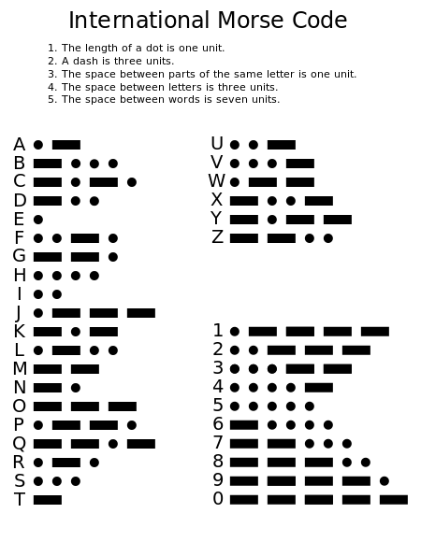
CS4102 Algorithms
Fall 2018
Warm up
Decode the line below into English
(hint: use Google or Wolfram Alpha)
·· ·-·· ·· -·- · ·- ·-·· --· --- ·-· ·· - ···· -- ···

Slide 3



Interval Scheduling Run Time
Find event ending earliest, add to solution,
Remove it and all conflicting events,
Repeat until all events removed, return solution
Equivalent way
StartTime = 0
For each interval (in order of finish time):
if end of interval < Start Time:
do nothing
else:
add interval to solution
StartTime = end of interval
$$O(n)$$
$$O(1)$$
$$O(1)$$

Slide 4
Interval Scheduling Algorithm
Find event ending earliest, add to solution,
Remove it and all conflicting events,
Repeat until all events removed, return solution

Slide 5
Today’s Keywords
Greedy Algorithms
Choice Function
Prefix-free code
Compression
Huffman Code

Slide 6
CLRS Readings
Chapter 16

Slide 7
Homeworks
HW6 Due Friday Nov 9 @11pm
Written (use latex)
DP and Greedy

Slide 8
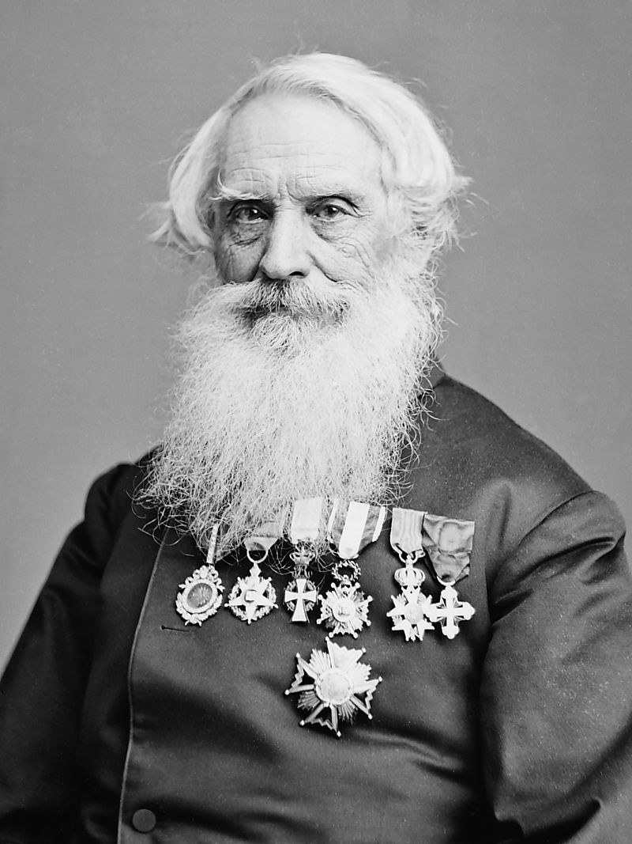
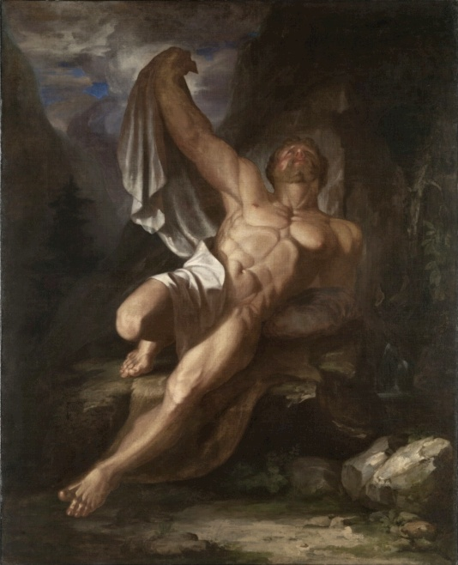
Sam Morse
Engineer and artist

Slide 9
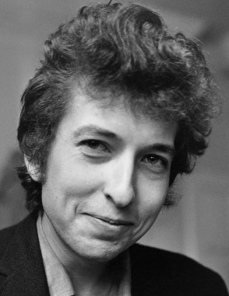


Message Encoding
Problem: need to electronically send a message to two people at a distance.
Channel for message is binary (either on or off)
$$m$$

Slide 10
How can we do it?
Character Frequency
Encoding
a: 2
d: 2
e: 13
g: 14
i: 8
k: 1
l: 9
n: 3
p: 1
q: 1
r: 2
s: 3
u: 1
w: 6
y: 2
0000
0001
0010
0011
0100
0101
0110
0111
1000
1001
1010
1011
1100
1101
1110
wiggle, wiggle, wiggle like a gypsy queen wiggle, wiggle, wiggle all dressed in green
Take the message, send it over character-by-character with an encoding

Slide 11
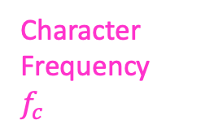
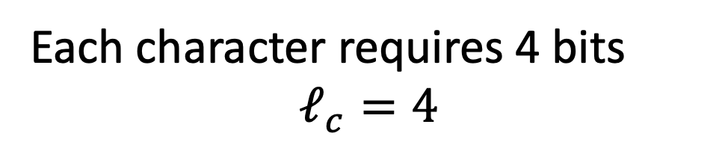
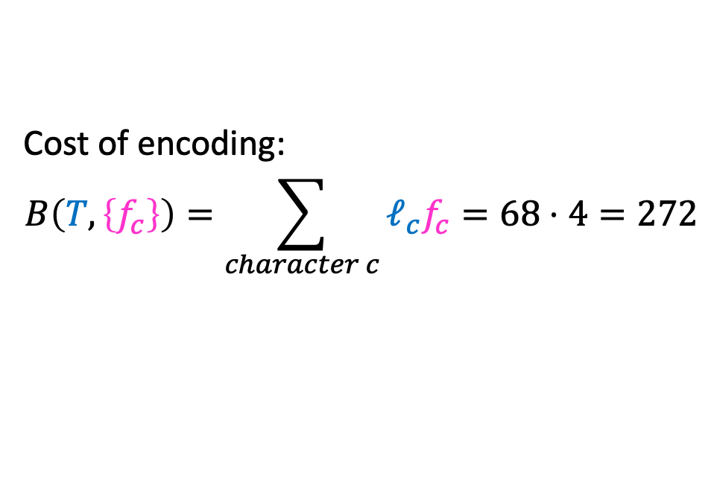
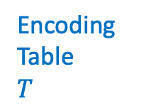
How efficient is this?
Character Frequency
$f_{c}$
Encoding
Table
$T$
a: 2
d: 2
e: 13
g: 14
i: 8
k: 1
l: 9
n: 3
p: 1
q: 1
r: 2
s: 3
u: 1
w: 6
y: 2
0001
0010
0011
0100
0101
0110
0111
1000
1001
1010
1011
1100
1101
1110
1111
wiggle wiggle wiggle like a gypsy queen wiggle wiggle wiggle all dressed in green
Each character requires 4 bits
$$ℓ_{c}=4$$
Cost of encoding:
$$B\left(T,\left\{f_{c}\right\}\right)=\sum_{character c}{ℓ_{c}f_{c}}=68⋅4=272$$
Better Solution: Allow for different characters to have different-size encodings
(high frequency → short code)

Slide 12
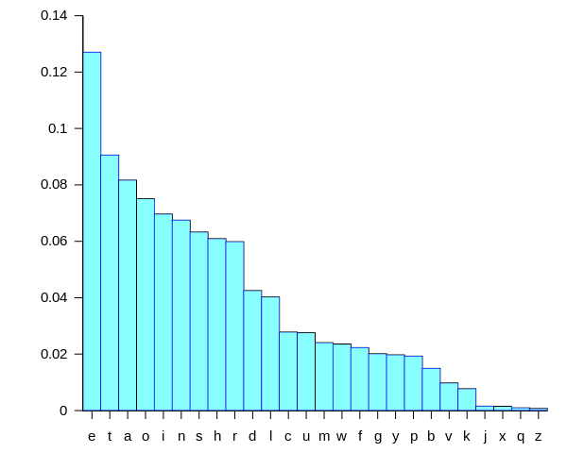
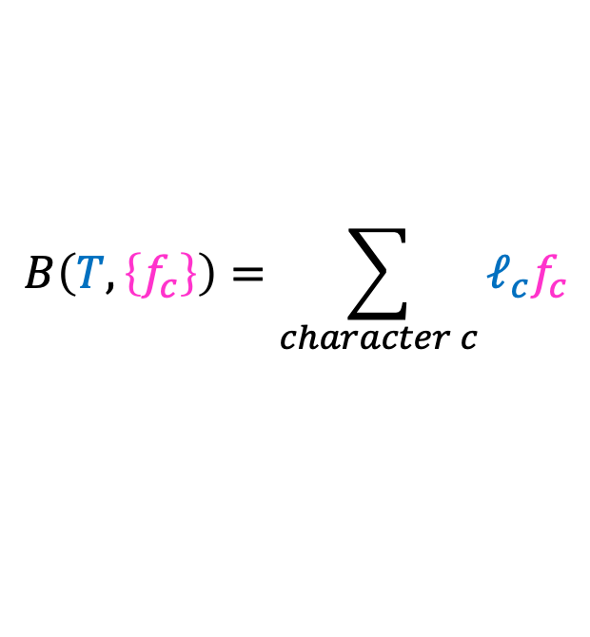
More efficient coding
When this is big
$$B\left(T,\left\{f_{c}\right\}\right)=\sum_{character c}{ℓ_{c}f_{c}}$$
Make this small
Character Frequency
Codeword Size

Slide 13
Morse Code
Character Frequency
Codeword Size

Slide 14
Problem with Morse Code
A
A
Decode:
ET
ET
R
T
EN
T
Ambiguous Decoding

Slide 15
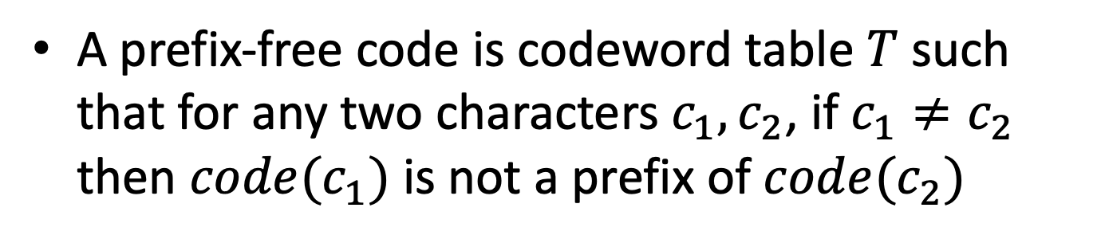
Prefix-Free Code
A prefix-free code is codeword table $T$ such that for any two characters $c_{1},c_{2}$, if $c_{1}≠c_{2}$ then $code(c_{1})$ is not a prefix of $code(c_{2})$
g
e
l
i
w
…
0
10
110
1110
11110
…
1111011100011010
w i gg l e

Slide 16
Binary Trees = Prefix-free Codes
I can represent any prefix-free code as a binary tree
I can create a prefix-free code from any binary tree
g
e
l
i
w
…
0
10
110
1110
11110
…
1
0
g
1
0
g
e
l
i
w
…
00
01
10
110
111
…
1
e
0
0
1
1
l
0
1
0
i
0
1
0
w
0
1
g
e
l
i
w

Slide 17
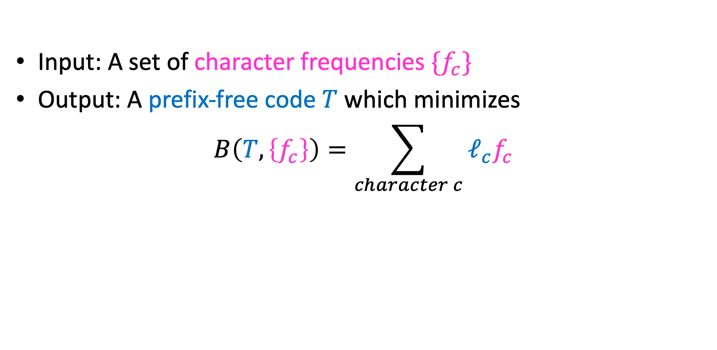
Goal: Shortest Prefix-Free Encoding
Input: A set of character frequencies $\{f_{c}\}$
Output: A prefix-free code $T$ which minimizes
$$B\left(T,\left\{f_{c}\right\}\right)=\sum_{character c}{ℓ_{c}f_{c}}$$
Huffman Coding!!

Slide 18
Greedy Algorithms
Require Optimal Substructure
Solution to larger problem contains the solution to a smaller one
Only one subproblem to consider!
Idea:
Identify a greedy choice property
How to make a choice guaranteed to be included in some optimal solution
Repeatedly apply the choice property until no subproblems remain

Slide 19
Huffman Algorithm
Choose the least frequent pair, combine into a subtree
G:14
E:13
L:9
I:8
W:6
N:3
S:3
A:2
D:2
R:2
Y:2
K:1
P:1
Q:1
U:1

Slide 20
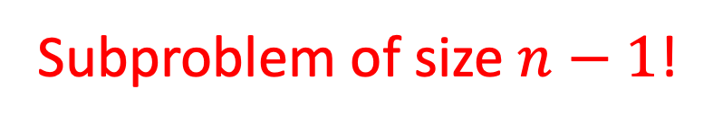
Huffman Algorithm
Choose the least frequent pair, combine into a subtree
G:14
E:13
L:9
I:8
W:6
N:3
S:3
A:2
D:2
R:2
Y:2
2
K:1
P:1
0
1
Q:1
U:1
Subproblem of size $n−1$!

Slide 21
Huffman Algorithm
Choose the least frequent pair, combine into a subtree
G:14
E:13
L:9
I:8
W:6
N:3
S:3
A:2
D:2
R:2
Y:2
2
2
0
1
0
1
Q:1
U:1
K:1
P:1

Slide 22
Huffman Algorithm
Choose the least frequent pair, combine into a subtree
G:14
E:13
L:9
I:8
W:6
4
N:3
S:3
A:2
D:2
R:2
Y:2
0
1
2
2
0
1
0
1
Q:1
U:1
K:1
P:1

Slide 23
Huffman Algorithm
Choose the least frequent pair, combine into a subtree
G:14
E:13
L:9
I:8
W:6
4
4
N:3
S:3
A:2
D:2
0
1
0
1
R:2
Y:2
2
2
0
1
0
1
Q:1
U:1
K:1
P:1

Slide 24
Huffman Algorithm
Choose the least frequent pair, combine into a subtree
G:14
E:13
L:9
I:8
W:6
4
4
4
N:3
S:3
0
1
0
1
0
1
R:2
Y:2
A:2
D:2
2
2
0
1
0
1
Q:1
U:1
K:1
P:1

Slide 25
Huffman Algorithm
Choose the least frequent pair, combine into a subtree
G:14
E:13
L:9
I:8
W:6
6
4
4
4
0
1
0
1
0
1
0
1
N:3
S:3
R:2
Y:2
A:2
D:2
2
2
0
1
0
1
Q:1
U:1
K:1
P:1

Slide 26
Huffman Algorithm
Choose the least frequent pair, combine into a subtree
68
0
1
41
27
0
1
0
1
24
17
G:14
E:13
0
1
0
1
14
10
L:9
I:8
0
1
0
1
8
W:6
6
4
0
1
0
1
0
1
N:3
S:3
4
4
2
2
0
1
0
1
0
1
0
1
R:2
Y:2
A:2
D:2
Q:1
U:1
K:1
P:1

Slide 27
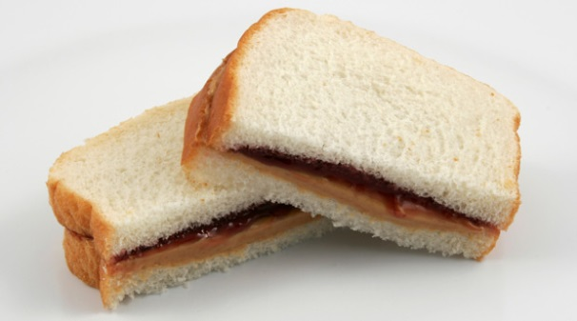
Exchange argument
Shows correctness of a greedy algorithm
Idea:
Show exchanging an item from an arbitrary optimal solution with your greedy choice makes the new solution no worse
How to show my sandwich is at least as good as yours:
Show: “I can remove any item from your sandwich, and it would be no worse by replacing it with the same item from my sandwich”

Slide 28
Showing Huffman is Optimal
Overview:
Show that there is an optimal tree in which the least frequent characters are siblings
Exchange argument
Show that making them siblings and solving the new smaller sub-problem results in an optimal solution
Proof by contradiction

Slide 29
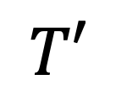

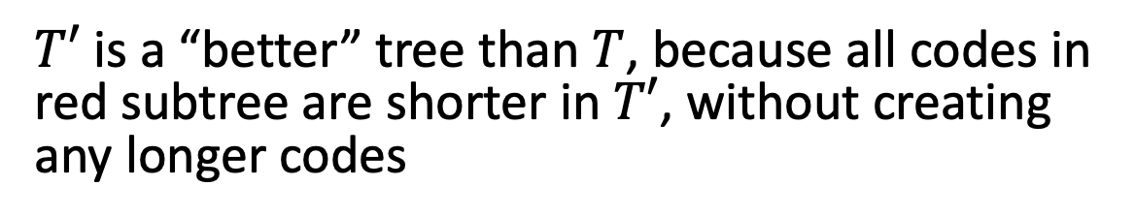
Showing Huffman is Optimal
First Step: Show any optimal tree is “full” (each node has either 0 or 2 children)
$$T$$
$$T′$$
0
1
0
1
W
W
0
0
1
R
Y
0
1
$T′$ is a “better” tree than $T$, because all codes in red subtree are shorter in $T′$, without creating any longer codes
R
Y

Slide 30

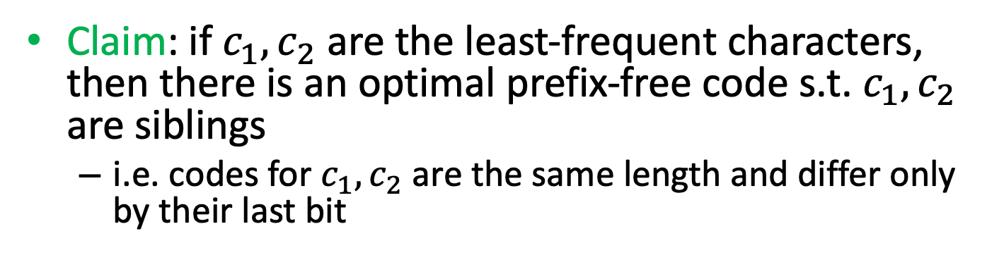
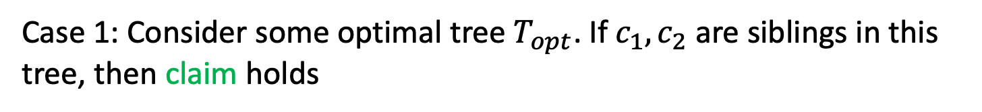


Huffman Exchange Argument
Claim: if $c_{1},c_{2}$ are the least-frequent characters, then there is an optimal prefix-free code s.t. $c_{1},c_{2}$ are siblings
i.e. codes for $c_{1},c_{2}$ are the same length and differ only by their last bit
Case 1: Consider some optimal tree $T_{opt}$. If $c_{1},c_{2}$ are siblings in this tree, then claim holds
$$T_{opt}$$
$$c_{1}$$
$$c_{2}$$

Slide 31



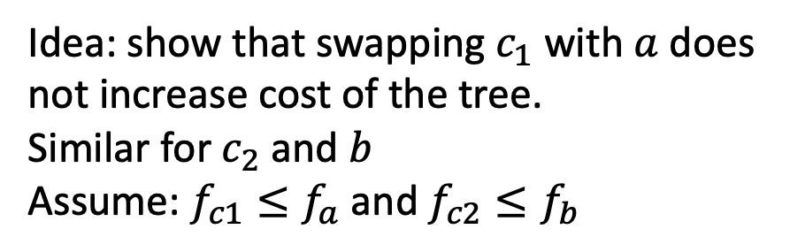

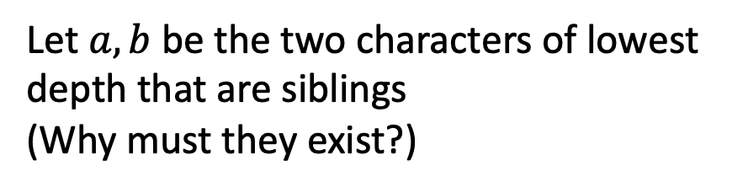
Huffman Exchange Argument
Claim: if $c_{1},c_{2}$ are the least-frequent characters, then there is an optimal prefix-free code s.t. $c_{1},c_{2}$ are siblings
i.e. codes for $c_{1},c_{2}$ are the same length and differ only by their last bit
Case 2: Consider some optimal tree $T_{opt}$, in which $c_{1},c_{2}$ are not siblings
Let $a,b$ be the two characters of lowest depth that are siblings
(Why must they exist?)
$$T_{opt}$$
$$c_{2}$$
Idea: show that swapping $c_{1}$ with $a$ does not increase cost of the tree.
Similar for $c_{2}$ and $b$
Assume: $f_{c1}≤f_{a}$ and $f_{c2}≤f_{b}$
$$c_{1}$$
$$a$$
$$b$$

Slide 32
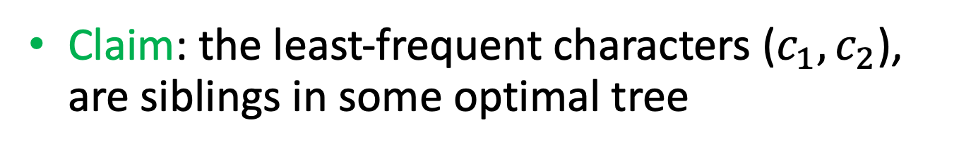







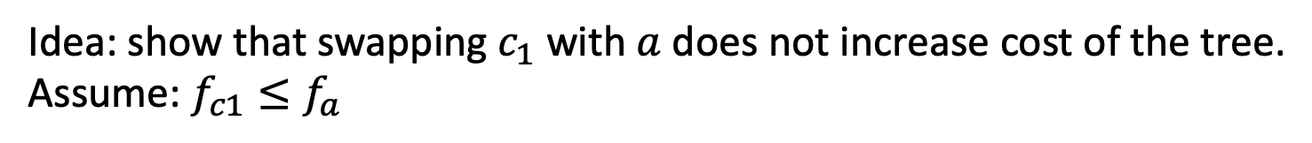
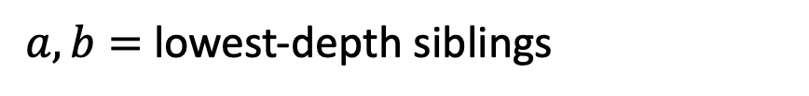

Case 2: $c_{1},c_{2}$ are not siblings in $T_{opt}$
Claim: the least-frequent characters ($c_{1},c_{2}$), are siblings in some optimal tree
$a,b=$lowest-depth siblings
Idea: show that swapping $c_{1}$ with $a$ does not increase cost of the tree.
Assume: $f_{c1}≤f_{a}$
$$B\left(T_{opt}\right)=C+f_{c1}ℓ_{c1}+f_{a}ℓ_{a}$$
$$B\left(T′\right)=C+f_{c1}ℓ_{a}+f_{a}ℓ_{c1}$$
$$T_{opt}$$
$$T′$$
$$c_{2}$$
$$c_{2}$$
$$c_{1}$$
$$a$$
$$a$$
$$b$$
$$c_{1}$$
$$b$$

Slide 33




Case 2: $c_{1},c_{2}$ are not siblings in $T_{opt}$
Claim: the least-frequent characters ($c_{1},c_{2}$), are siblings in some optimal tree
$a,b=$lowest-depth siblings
Idea: show that swapping $c_{1}$ with $a$ does not increase cost of the tree.
Assume: $f_{c1}≤f_{a}$
$$B\left(T_{opt}\right)=C+f_{c1}ℓ_{c1}+f_{a}ℓ_{a}$$
$$B\left(T′\right)=C+f_{c1}ℓ_{a}+f_{a}ℓ_{c1}$$
$≥0⇒T′$ optimal
$$B\left(T_{opt}\right)−B\left(T^{′}\right)=C+f_{c1}ℓ_{c1}+f_{a}ℓ_{a}−(C+f_{c1}ℓ_{a}+f_{a}ℓ_{c1})$$
$$=f_{c1}ℓ_{c1}+f_{a}ℓ_{a}−f_{c1}ℓ_{a}−f_{a}ℓ_{c1}$$
$$=f_{c1}(ℓ_{c1}−ℓ_{a})+f_{a}(ℓ_{a}−ℓ_{c1})$$
$$={(f}_{a}−f_{c1})(ℓ_{a}−ℓ_{c1})$$

Slide 34









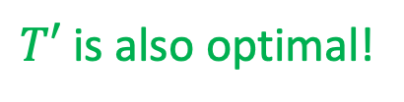
Case 2: $c_{1},c_{2}$ are not siblings in $T_{opt}$
Claim: the least-frequent characters ($c_{1},c_{2}$), are siblings in some optimal tree
$a,b=$lowest-depth siblings
Idea: show that swapping $c_{1}$ with $a$ does not increase cost of the tree.
Assume: $f_{c1}≤f_{a}$
$$B\left(T_{opt}\right)=C+f_{c1}ℓ_{c1}+f_{a}ℓ_{a}$$
$$B\left(T′\right)=C+f_{c1}ℓ_{a}+f_{a}ℓ_{c1}$$
$$T_{opt}$$
$$T′$$
$$c_{2}$$
$$c_{2}$$
$$B\left(T_{opt}\right)−B\left(T^{′}\right)={(f}_{a}−f_{c1})(ℓ_{a}−ℓ_{c1})$$
$$≥0$$
$$≥0$$
$$a$$
$$c_{1}$$
$$B\left(T_{opt}\right)−B\left(T^{′}\right)≥0$$
$$a$$
$$b$$
$T′$ is also optimal!
$$c_{1}$$
$$b$$

Slide 35



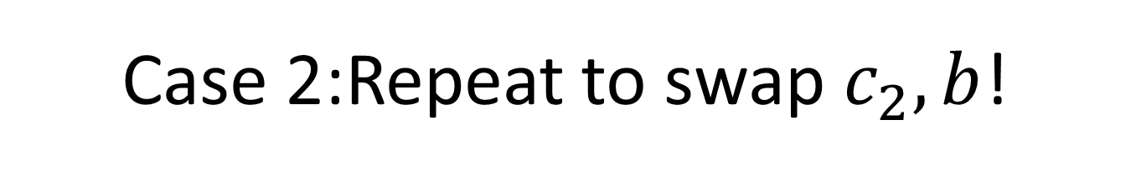





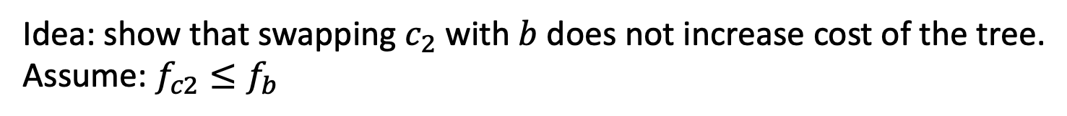

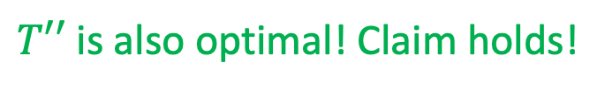
Case 2:Repeat to swap $c_{2},b$!
Claim: the least-frequent characters ($c_{1},c_{2}$), are siblings in some optimal tree
$a,b=$lowest-depth siblings
Idea: show that swapping $c_{2}$ with $b$ does not increase cost of the tree.
Assume: $f_{c2}≤f_{b}$
$$B\left(T′\right)=C+f_{c2}ℓ_{c2}+f_{b}ℓ_{b}$$
$$B\left(T′′\right)=C+f_{c2}ℓ_{b}+f_{b}ℓ_{c2}$$
$$T′$$
$$T′′$$
$$c_{2}$$
$$b$$
$$B\left(T′\right)−B\left(T^{′′}\right)={(f}_{b}−f_{c2})(ℓ_{b}−ℓ_{c2})$$
$$≥0$$
$$≥0$$
$$a$$
$$a$$
$$B\left(T′\right)−B\left(T^{′′}\right)≥0$$
$$c_{1}$$
$$b$$
$T′′$ is also optimal! Claim holds!
$$c_{1}$$
$$c_{2}$$

Slide 36
Showing Huffman is Optimal
Overview:
Show that there is an optimal tree in which the least frequent characters are siblings
Exchange argument
Show that making them siblings and solving the new smaller sub-problem results in an optimal solution
Proof by contradiction

Slide 37


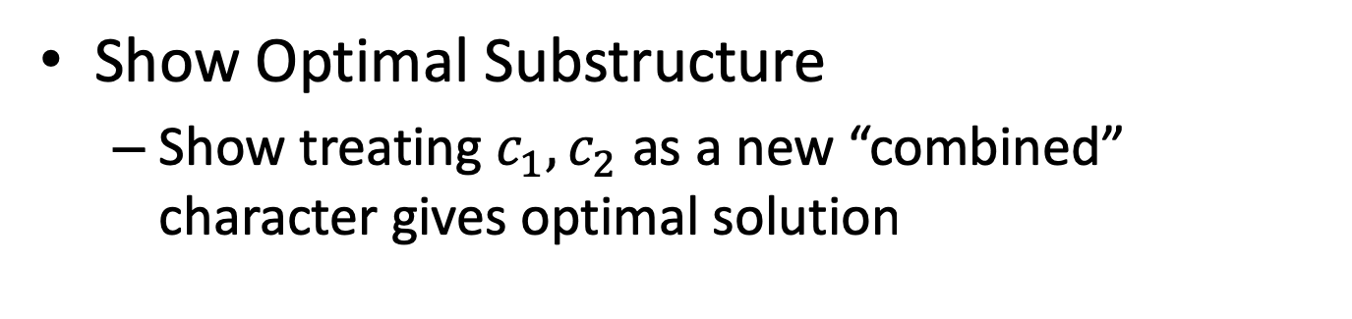



Finishing the Proof
Show Optimal Substructure
Show treating $c_{1},c_{2}$ as a new “combined” character gives optimal solution
Why does solving this:
$$σ$$
$$c_{1}$$
$$c_{2}$$
Give an optimal solution to this?:
$$c_{1}$$
$$c_{2}$$

Slide 38

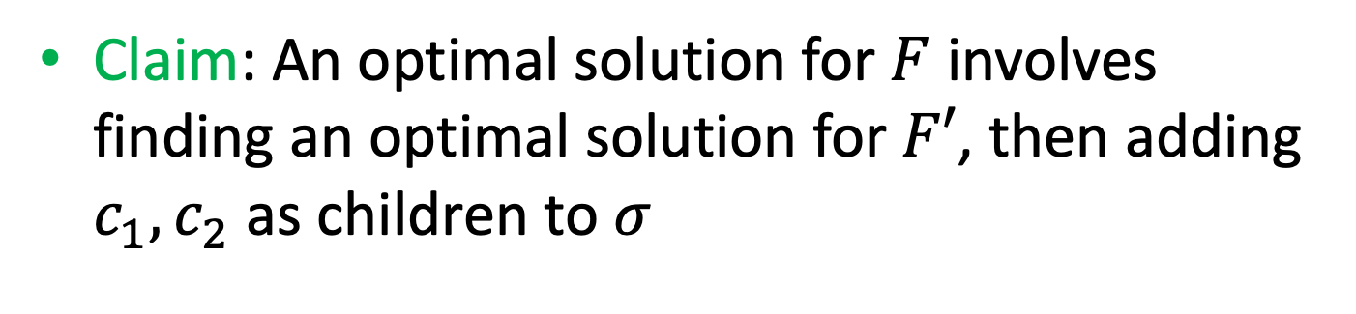

Optimal Substructure
Claim: An optimal solution for $F$ involves finding an optimal solution for $F′$, then adding $c_{1},c_{2}$ as children to $σ$
$$F′$$
$$σ$$
$$c_{1}$$
$$c_{2}$$
$$F$$
$$c_{1}$$
$$c_{2}$$

Slide 39


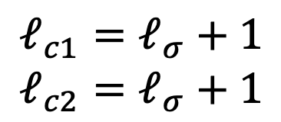

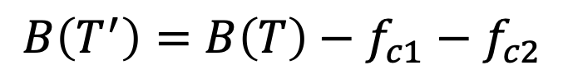

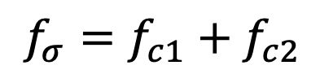


Optimal Substructure
Claim: An optimal solution for $F$ involves finding an optimal solution for $F′$, then adding $c_{1},c_{2}$ as children to $σ$
If this is optimal
Then this is optimal
$$T′$$
$$T$$
$$σ$$
$$σ$$
$$f_{σ}=f_{c1}+f_{c2}$$
$$c_{1}$$
$$c_{2}$$
$$ℓ_{c1}=ℓ_{σ}+1$$
$$ℓ_{c2}=ℓ_{σ}+1$$
$$B\left(T^{′}\right)=B\left(T\right)−f_{c1}−f_{c2}$$
Notes:
B(T’) = C + (fc1 + fc2)(L)
B(T) = C + fc1(L+1) + fc2(L+1) = fc1 + fc1L + fc2 + fc2L

Slide 40


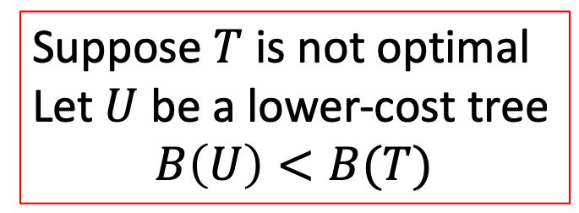





Optimal Substructure
Claim: An optimal solution for $F$ involves finding an optimal solution for $F′$, then adding $c_{1},c_{2}$ as children to $σ$
Toward contradiction
Suppose $T$ is not optimal
Let $U$ be a lower-cost tree
$$B\left(U\right)<B(T)$$
$$U$$
$$T$$
$$σ$$
$$c_{1}$$
$$c_{2}$$
$$c_{1}$$
$$c_{2}$$

Slide 41

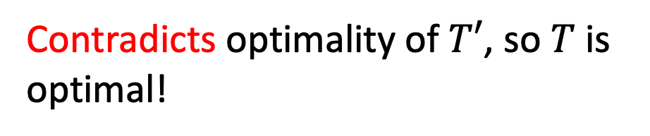

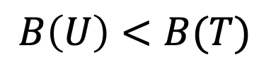
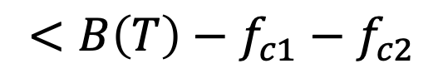

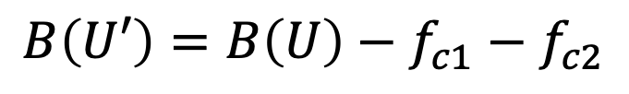
Optimal Substructure
Claim: An optimal solution for $F$ involves finding an optimal solution for $F′$, then adding $c_{1},c_{2}$ as children to $σ$
$$B\left(U\right)<B(T)$$
$$B\left(U′\right)=B\left(U\right)−f_{c1}−f_{c2}$$
$$U$$
$$<B\left(T\right)−f_{c1}−f_{c2}$$
$$U′$$
$$=B\left(T′\right)$$
$$σ$$
Contradicts optimality of $T′$, so $T$ is optimal!
$$c_{1}$$
$$c_{2}$$

Slide 43
Entire Huffman Derivation Follows
Not covered in class, just for your review

Slide 44
Huffman Algorithm
Choose the least frequent pair, combine into a subtree
G:14
E:13
L:9
I:8
W:6
N:3
S:3
A:2
D:2
R:2
Y:2
K:1
P:1
Q:1
U:1

Slide 45
Huffman Algorithm
Choose the least frequent pair, combine into a subtree
G:14
E:13
L:9
I:8
W:6
N:3
S:3
A:2
D:2
R:2
Y:2
2
K:1
P:1
0
1
Q:1
U:1

Slide 46
Huffman Algorithm
Choose the least frequent pair, combine into a subtree
G:14
E:13
L:9
I:8
W:6
N:3
S:3
A:2
D:2
R:2
Y:2
2
2
0
1
0
1
Q:1
U:1
K:1
P:1

Slide 47
Huffman Algorithm
Choose the least frequent pair, combine into a subtree
G:14
E:13
L:9
I:8
W:6
4
N:3
S:3
A:2
D:2
R:2
Y:2
0
1
2
2
0
1
0
1
Q:1
U:1
K:1
P:1

Slide 48
Huffman Algorithm
Choose the least frequent pair, combine into a subtree
G:14
E:13
L:9
I:8
W:6
4
4
N:3
S:3
A:2
D:2
0
1
0
1
R:2
Y:2
2
2
0
1
0
1
Q:1
U:1
K:1
P:1

Slide 49
Huffman Algorithm
Choose the least frequent pair, combine into a subtree
G:14
E:13
L:9
I:8
W:6
4
4
4
N:3
S:3
0
1
0
1
0
1
R:2
Y:2
A:2
D:2
2
2
0
1
0
1
Q:1
U:1
K:1
P:1

Slide 50
Huffman Algorithm
Choose the least frequent pair, combine into a subtree
G:14
E:13
L:9
I:8
W:6
6
4
4
4
0
1
0
1
0
1
0
1
N:3
S:3
R:2
Y:2
A:2
D:2
2
2
0
1
0
1
Q:1
U:1
K:1
P:1

Slide 51
Huffman Algorithm
Choose the least frequent pair, combine into a subtree
G:14
E:13
L:9
I:8
8
W:6
6
4
0
1
0
1
0
1
N:3
S:3
4
4
2
2
0
1
0
1
0
1
0
1
R:2
Y:2
A:2
D:2
Q:1
U:1
K:1
P:1

Slide 52
Huffman Algorithm
Choose the least frequent pair, combine into a subtree
G:14
E:13
10
L:9
I:8
8
W:6
0
1
0
1
4
4
6
4
0
1
0
1
0
1
0
1
R:2
Y:2
A:2
D:2
N:3
S:3
2
2
0
1
0
1
Q:1
U:1
K:1
P:1

Slide 53
Huffman Algorithm
Choose the least frequent pair, combine into a subtree
G:14
E:13
14
10
L:9
I:8
0
1
0
1
8
W:6
6
4
0
1
0
1
0
1
N:3
S:3
4
4
2
2
0
1
0
1
0
1
0
1
R:2
Y:2
A:2
D:2
Q:1
U:1
K:1
P:1

Slide 54
Huffman Algorithm
Choose the least frequent pair, combine into a subtree
17
G:14
E:13
14
10
0
1
0
1
0
1
L:9
I:8
8
W:6
6
4
0
1
0
1
0
1
N:3
S:3
4
4
2
2
0
1
0
1
0
1
0
1
R:2
Y:2
A:2
D:2
Q:1
U:1
K:1
P:1

Slide 55
Huffman Algorithm
Choose the least frequent pair, combine into a subtree
24
17
G:14
E:13
0
1
0
1
14
10
L:9
I:8
0
1
0
1
8
W:6
6
4
0
1
0
1
0
1
N:3
S:3
4
4
2
2
0
1
0
1
0
1
0
1
R:2
Y:2
A:2
D:2
Q:1
U:1
K:1
P:1

Slide 56
Huffman Algorithm
Choose the least frequent pair, combine into a subtree
27
24
17
0
1
0
1
0
1
G:14
E:13
14
10
L:9
I:8
0
1
0
1
8
W:6
6
4
0
1
0
1
0
1
N:3
S:3
4
4
2
2
0
1
0
1
0
1
0
1
R:2
Y:2
A:2
D:2
Q:1
U:1
K:1
P:1

Slide 57
Huffman Algorithm
Choose the least frequent pair, combine into a subtree
41
27
0
1
0
1
24
17
G:14
E:13
0
1
0
1
14
10
L:9
I:8
0
1
0
1
8
W:6
6
4
0
1
0
1
0
1
N:3
S:3
4
4
2
2
0
1
0
1
0
1
0
1
R:2
Y:2
A:2
D:2
Q:1
U:1
K:1
P:1

Slide 58
Huffman Algorithm
Choose the least frequent pair, combine into a subtree
68
0
1
41
27
0
1
0
1
24
17
G:14
E:13
0
1
0
1
14
10
L:9
I:8
0
1
0
1
8
W:6
6
4
0
1
0
1
0
1
N:3
S:3
4
4
2
2
0
1
0
1
0
1
0
1
R:2
Y:2
A:2
D:2
Q:1
U:1
K:1
P:1

