Slide 1
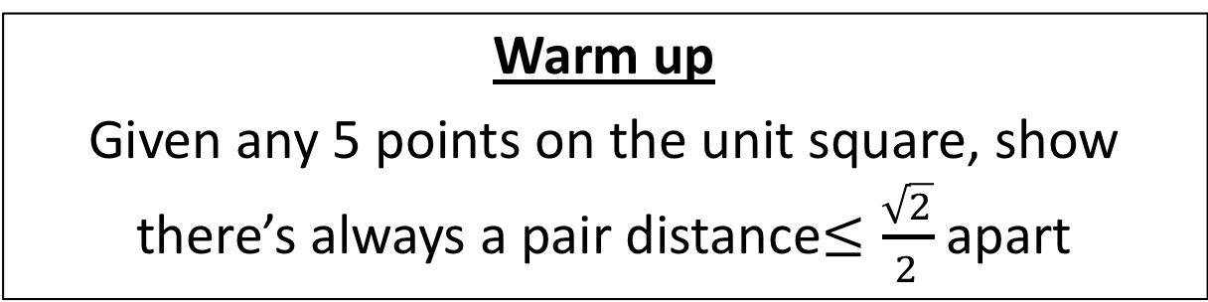
CS4102 Algorithms
Fall 2018
Warm up
Given any 5 points on the unit square, show there’s always a pair distance$≤\frac{\sqrt{2}}{2}$ apart
1
1

Slide 2


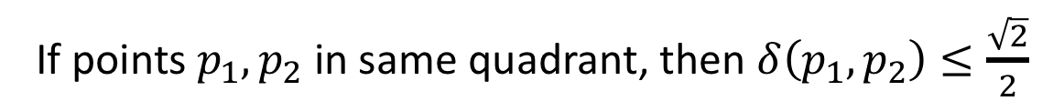

If points $p_{1},p_{2}$ in same quadrant, then $δ\left(p_{1},p_{2}\right)≤\frac{\sqrt{2}}{2}$
Given 5 points, two must share the same quadrant
Pigeonhole Principle!
$$\frac{\sqrt{2}}{2}$$
$$\frac{1}{2}$$
1
$$\frac{1}{2}$$
1

Slide 3
Today’s Keywords
Solving recurrences
Cookbook Method
Master Theorem
Substitution Method

Slide 4
CLRS Readings
Chapter 4

Slide 5
Homework
Hw1 due 11pm Wednesday, Sept 12
Written (use Latex!)
Asymptotic notation
Recurrences
Divide and conquer
Hw2 released Thursday, Sept 13
Programming assignment (Python or Java)
Divide and conquer

Slide 6
Homework
Hw1 due 11pm Wednesday, Sept 12 Friday, Sept 14
Written (use Latex!)
Asymptotic notation
Recurrences
Divide and conquer
Hw2 released Thursday, Sept 13
Programming assignment (Python or Java)
Divide and conquer

Slide 7



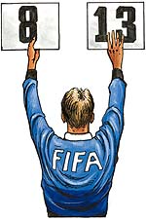
Recurrence Solving Techniques
Tree
Guess/Check
“Cookbook”
Substitution
?
(induction)

Slide 8
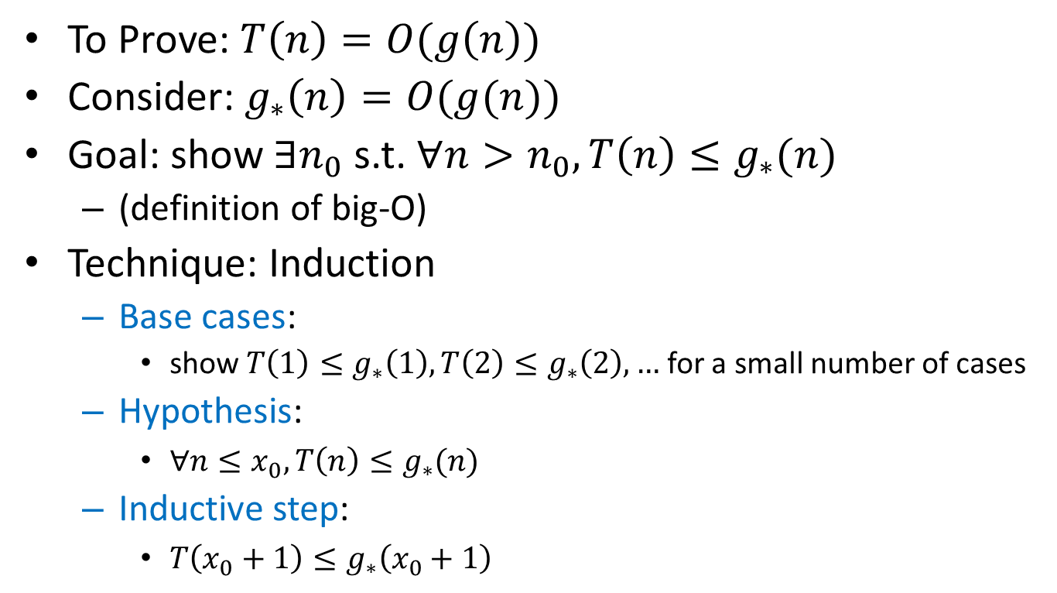
Guess and Check Intuition
To Prove: $T\left(n\right)=O(g\left(n\right))$
Consider: $g_{∗}\left(n\right)=O(g(n))$
Goal: show $∃n_{0}$s.t. $∀n>n_{0},T\left(n\right)≤g_{∗}(n)$
(definition of big-O)
Technique: Induction
Base cases:
show $T\left(1\right)≤g_{∗}\left(1\right), T\left(2\right)≤g_{∗}\left(2\right),…$ for a small number of cases
Hypothesis:
$∀n≤x_{0}, T\left(n\right)≤g_{∗}(n)$
Inductive step:
$T\left(x_{0}+1\right)≤g_{∗}\left(x_{0}+1\right)$

Slide 9
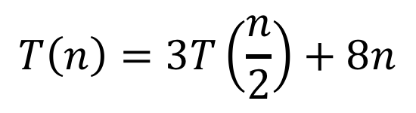
Karatsuba Guess and Check
$$T\left(n\right)=3T\left(\frac{n}{2}\right)+8n$$
Goal: $T\left(n\right)≤{24n}^{\log_{2}{3}}−16n=O(n^{\log_{2}{3}})$
Base cases: by inspection, holds for small $n$ (at home)
Hypothesis: $∀n≤x_{0}, T\left(n\right)≤24n^{\log_{2}{3}}−16n$
Inductive step: $T\left(x_{0}+1\right)≤{24(x_{0}+1)}^{\log_{2}{3}}−16(x_{0}+1)$

Slide 10

What if we leave out the $−16n$?
$$T\left(n\right)=3T\left(\frac{n}{2}\right)+8n$$
Goal: $T\left(n\right)≤{24n}^{\log_{2}{3}}−16n=O(n^{\log_{2}{3}})$
Base cases: by inspection, holds for small $n$ (at home)
Hypothesis: $∀n≤x_{0}, T\left(n\right)≤{24n}^{\log_{2}{3}}−16n$
Inductive step: $T\left(x_{0}+1\right)≤{24(x_{0}+1)}^{\log_{2}{3}}−16(x_{0}+1)$
What we wanted: $T\left(x_{0}+1\right)≤{24(x_{0}+1)}^{\log_{2}{3}}$
Induction failed!
What we got: $T\left(x_{0}+1\right)≤{24(x_{0}+1)}^{\log_{2}{3}}+8(x_{0}+1)$

Slide 11
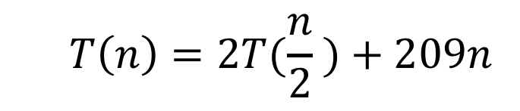
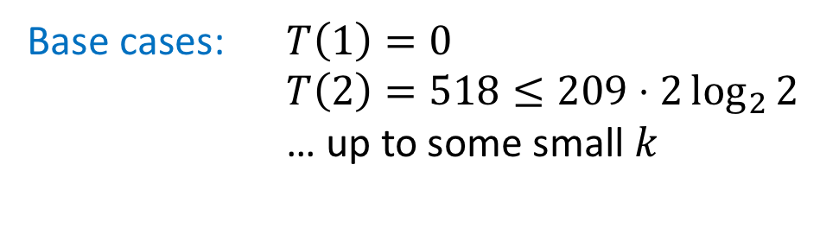
“Bad Mergesort” Guess and Check
$$T\left(n\right)=2T(\frac{n}{2} )+209n$$
Goal: $T\left(n\right)≤209n\log_{2}{n} =O(n\log_{2}{n})$
Base cases: $T\left(1\right)=0$
$T\left(2\right)=518≤209⋅2\log_{2}{2}$
… up to some small $k$
Hypothesis: $∀n≤x_{0}, T\left(n\right)≤209n\log_{2}{n}$
Inductive step: $T\left(x_{0}+1\right)≤209\left(x_{0}+1\right)\log_{2}{(x_{0}+1)}$

Slide 12
Recurrence Solving Techniques
Tree
Guess/Check
“Cookbook”
Substitution
?

Slide 13
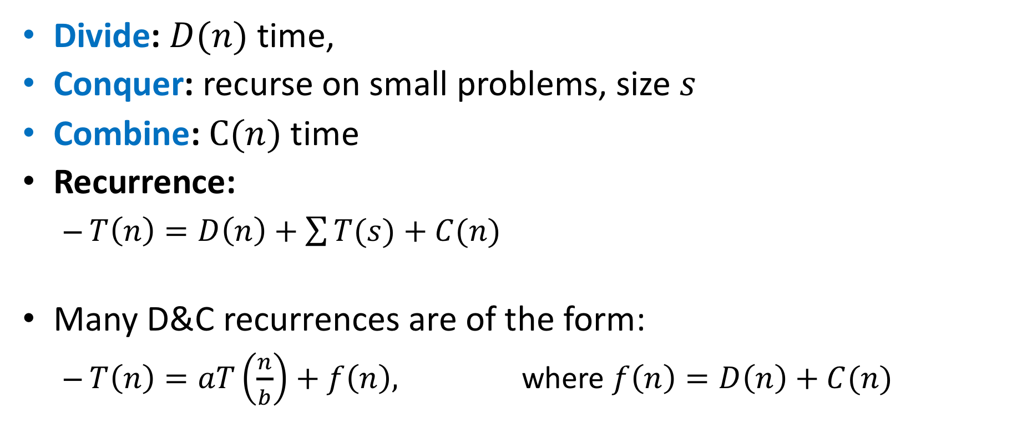
Observation
Divide: $D(n)$ time,
Conquer: recurse on small problems, size $s$
Combine: $C(n)$ time
Recurrence:
$T\left(n\right)=D\left(n\right)+\sum{T(s)}+C(n)$
Many D&C recurrences are of the form:
$T\left(n\right)=aT\left(\frac{n}{b}\right)+f\left(n\right),$ where $f\left(n\right)=D\left(n\right)+C(n)$

Slide 14
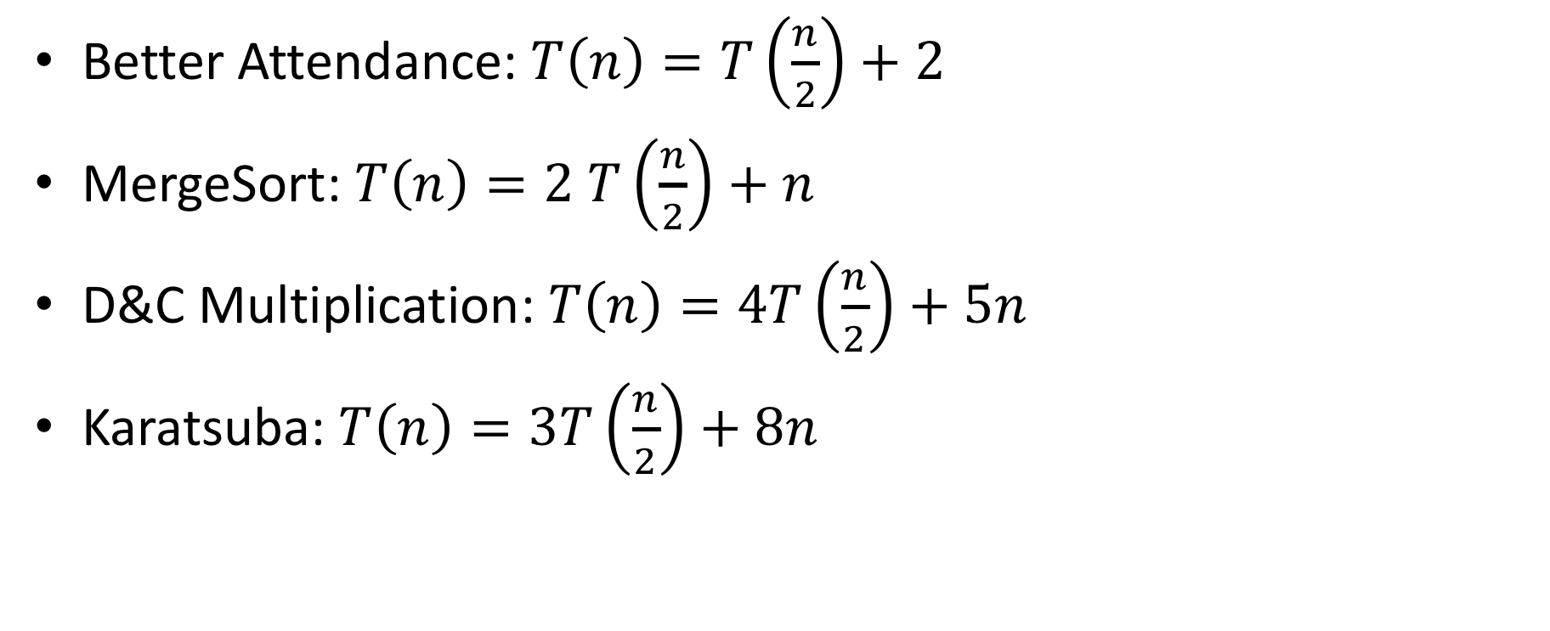
Remember…
Better Attendance: $T\left(n\right)=T\left(\frac{n}{2}\right)+2$
MergeSort: $T\left(n\right)=2 T\left(\frac{n}{2}\right)+n$
D&C Multiplication: $T\left(n\right)=4T\left(\frac{n}{2}\right)+5n$
Karatsuba: $T\left(n\right)=3T\left(\frac{n}{2}\right)+8n$

Slide 15

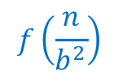




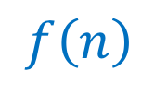
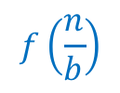



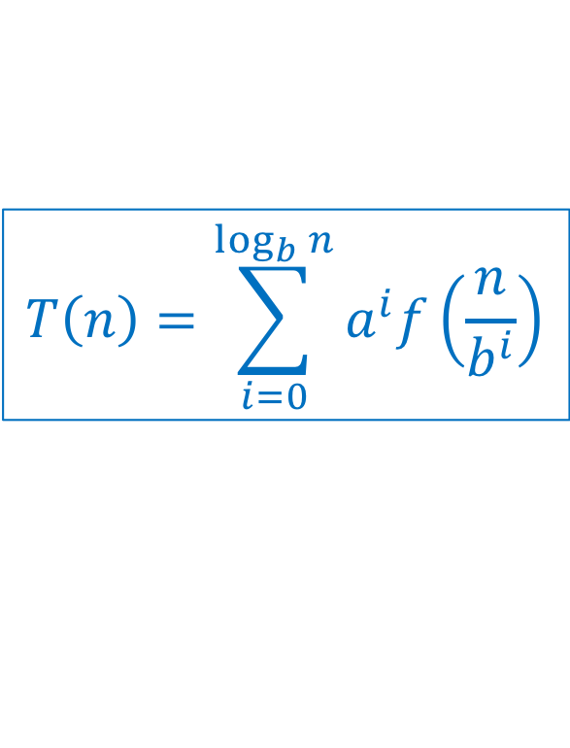
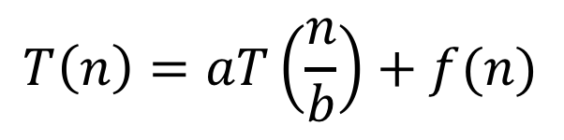



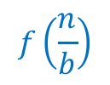


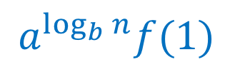
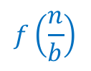



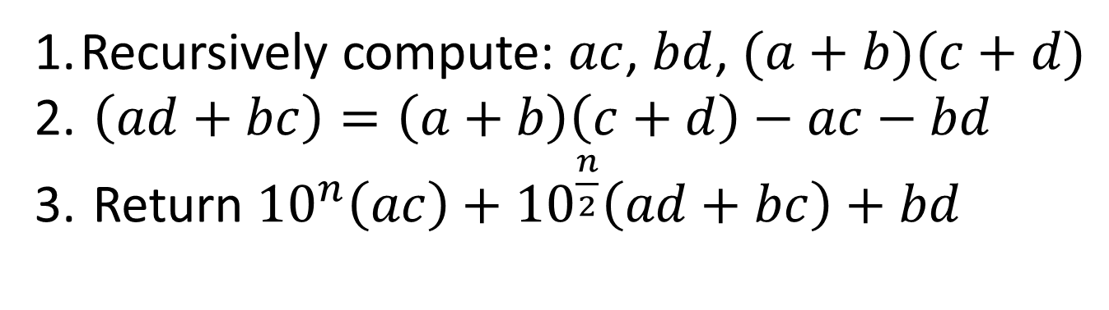

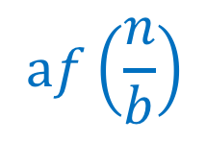


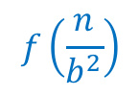



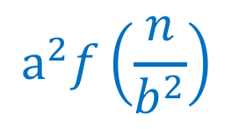
General
$$T\left(n\right)=\sum_{i=0}^{\log_{b}{n}}{a^{i}f\left(\frac{n}{b^{i}}\right)}$$
$$T\left(n\right)=aT\left(\frac{n}{b}\right)+f(n)$$
$$n$$
$$f(n)$$
$$f\left(n\right)$$
$$af\left(\frac{n}{b}\right)$$
$$\frac{n}{b}$$
$$f\left(\frac{n}{b}\right)$$
$$\frac{n}{b}$$
$$f\left(\frac{n}{b}\right)$$
…
$$\frac{n}{b}$$
$$f\left(\frac{n}{b}\right)$$
$$\frac{n}{b^{2}}$$
$$\frac{n}{b^{2}}$$
…
$$\frac{n}{b^{2}}$$
…
$$\frac{n}{b^{2}}$$
$$a^{2}f\left(\frac{n}{b^{2}}\right)$$
$$f\left(\frac{n}{b^{2}}\right)$$
…
$$f\left(\frac{n}{b^{2}}\right)$$
$$f\left(\frac{n}{b^{2}}\right)$$
$$f\left(\frac{n}{b^{2}}\right)$$
…
…
…
…
…
…
…
…
$$f(1)$$
$$f(1)$$
$$f(1)$$
$$f(1)$$
$$f(1)$$
$$f(1)$$
$$f(1)$$
$$1$$
$$1$$
$$1$$
$$1$$
$$a^{\log_{b}{n}}f(1)$$
$$1$$
$$1$$
$$1$$

Slide 16
3 Cases
$$T\left(n\right)=f\left(n\right)+af\left(\frac{n}{b}\right)+a^{2}f\left(\frac{n}{b^{2}}\right)+a^{3}f\left(\frac{n}{b^{3}}\right)+…+a^{L}f(\frac{n}{b^{L}})$$
Case 1:
Most work happens at the leaves
Case 2:
Work happens consistently throughout
Case 3:
Most work happens at top of tree

Slide 17
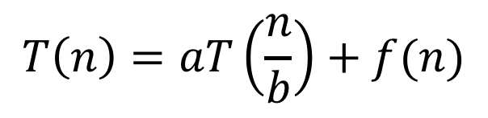
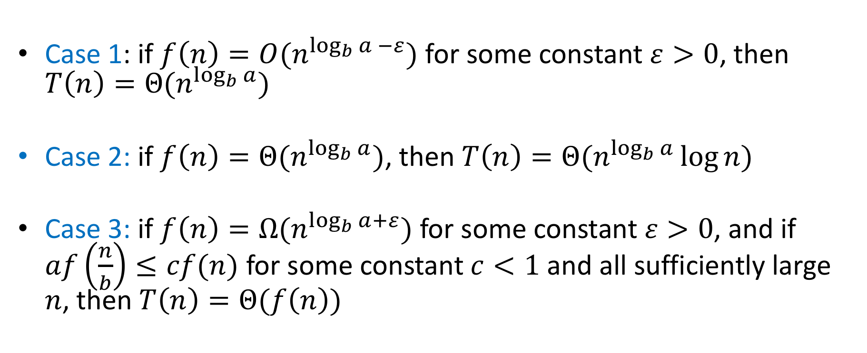
Master Theorem
$$T\left(n\right)=aT\left(\frac{n}{b}\right)+f(n)$$
Case 1: if $f\left(n\right)=O(n^{\log_{b}{a} −ε})$ for some constant $ε>0$, then $T\left(n\right)=Θ(n^{\log_{b}{a}})$
Case 2: if $f\left(n\right)=Θ(n^{\log_{b}{a}})$, then $T\left(n\right)=Θ(n^{\log_{b}{a}}\log{n})$
Case 3: if $f\left(n\right)=Ω(n^{\log_{b}{a+ε}})$ for some constant $ε>0$, and if $af\left(\frac{n}{b}\right)≤cf(n)$ for some constant $c<1$ and all sufficiently large $n$, then $T\left(n\right)=Θ(f\left(n\right))$

Slide 18
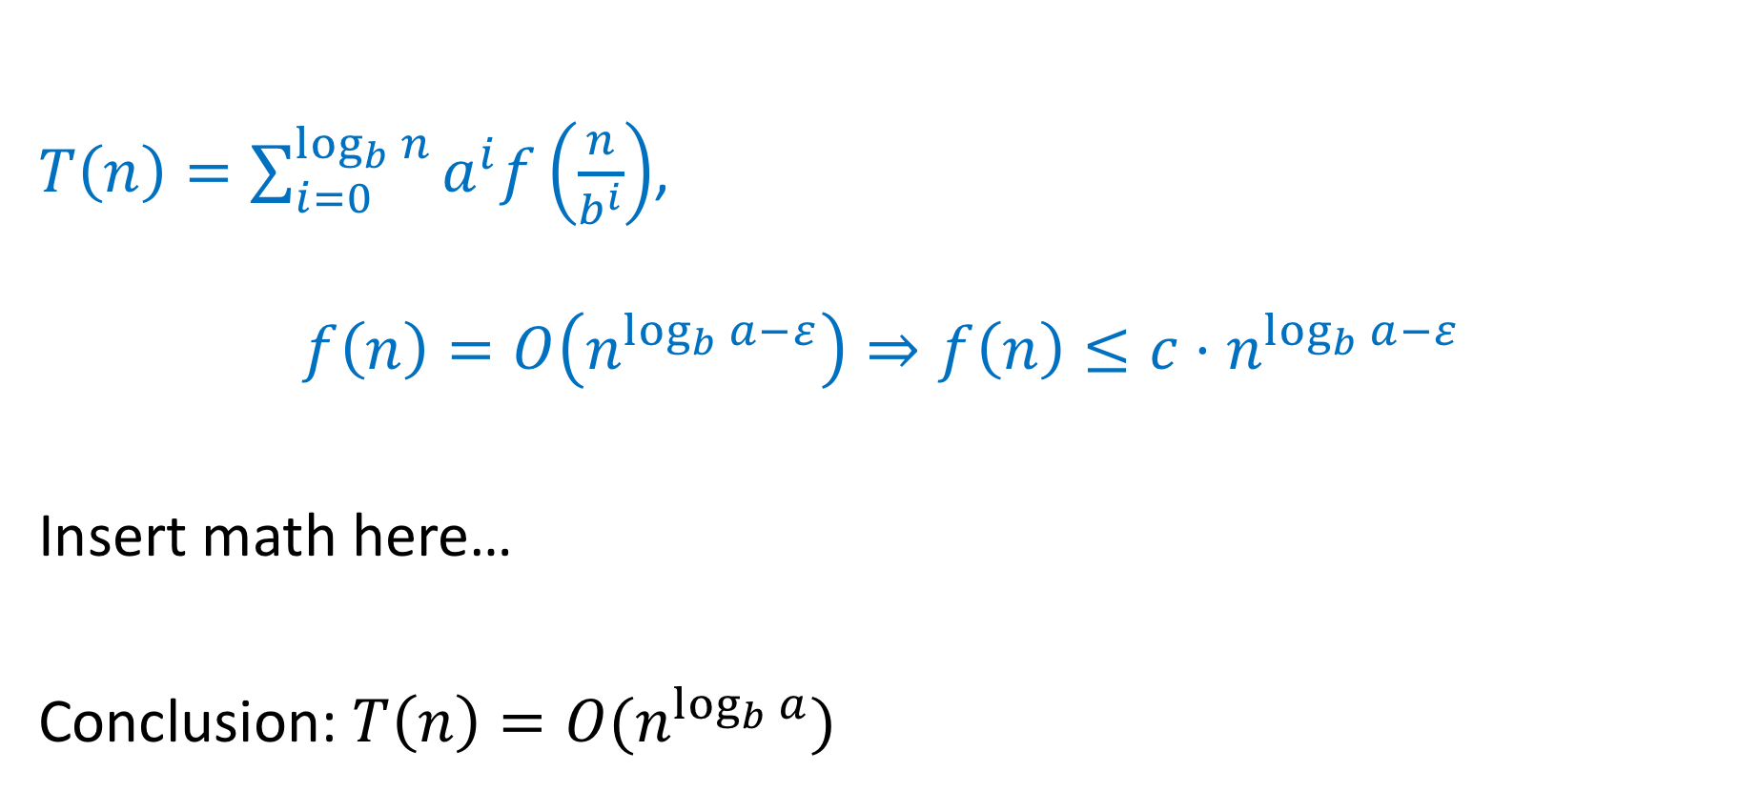
Proof of Case 1
$T\left(n\right)=\sum_{i=0}^{\log_{b}{n}}{a^{i}f\left(\frac{n}{b^{i}}\right)}$,
$$f\left(n\right)=O\left(n^{\log_{b}{a}−ε}\right)⇒f\left(n\right)≤c⋅n^{\log_{b}{a}−ε}$$
Insert math here…
Conclusion: $T\left(n\right)=O(n^{\log_{b}{a}})$

Slide 19
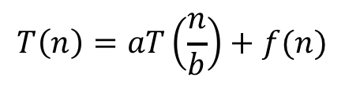
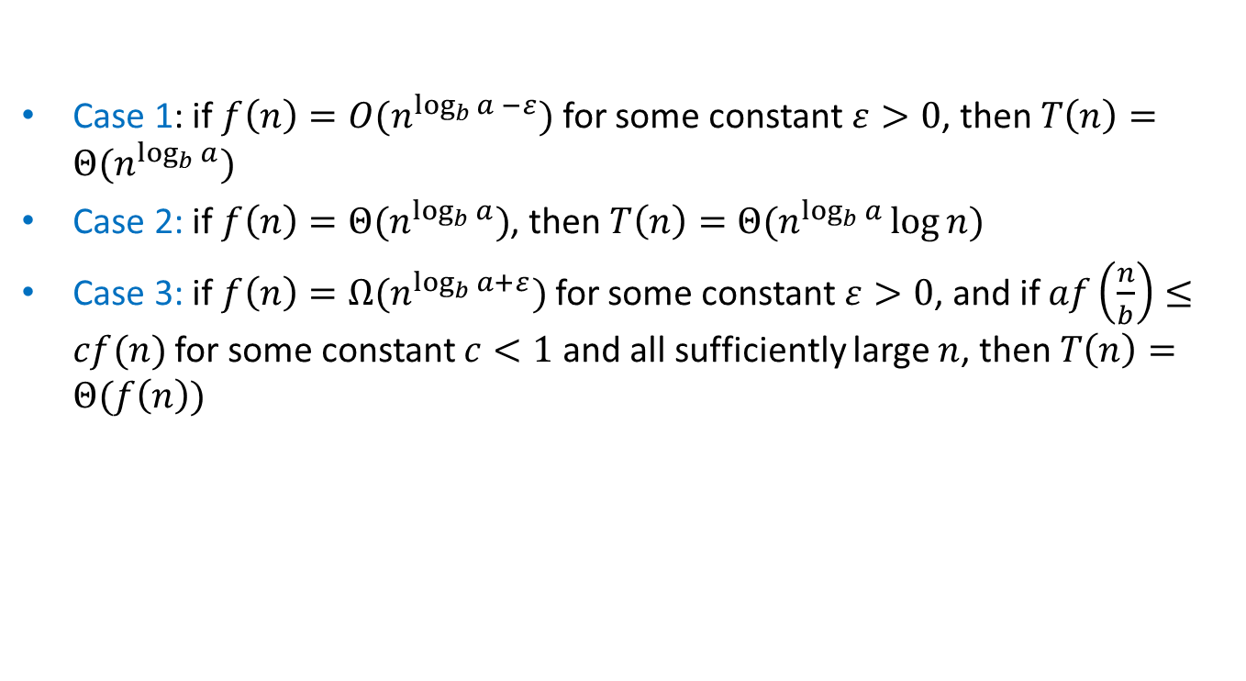
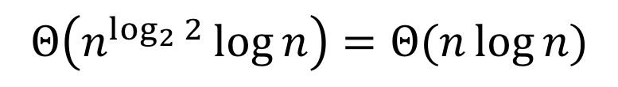
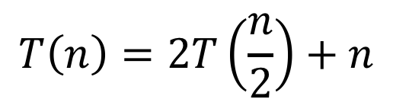
Master Theorem Example 1
$$T\left(n\right)=aT\left(\frac{n}{b}\right)+f(n)$$
Case 1: if $f\left(n\right)=O(n^{\log_{b}{a} −ε})$ for some constant $ε>0$, then $T\left(n\right)=Θ(n^{\log_{b}{a}})$
Case 2: if $f\left(n\right)=Θ(n^{\log_{b}{a}})$, then $T\left(n\right)=Θ(n^{\log_{b}{a}}\log{n})$
Case 3: if $f\left(n\right)=Ω(n^{\log_{b}{a+ε}})$ for some constant $ε>0$, and if $af\left(\frac{n}{b}\right)≤cf(n)$ for some constant $c<1$ and all sufficiently large $n$, then $T\left(n\right)=Θ(f\left(n\right))$
$$T\left(n\right)=2T\left(\frac{n}{2}\right)+n$$
Case 2
$$Θ\left(n^{\log_{2}{2}}\log{n}\right)=Θ(n\log{n})$$

Slide 20
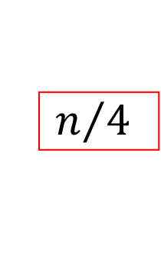



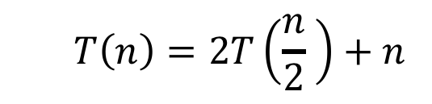

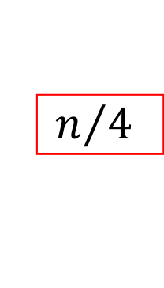







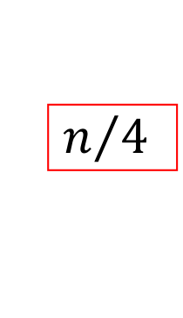


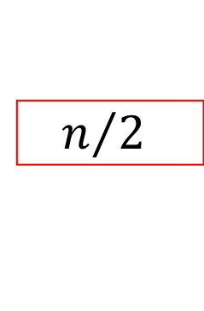











Tree method
$$T\left(n\right)=2T\left(\frac{n}{2} \right)+n$$
$$n$$
$$n$$
$$n$$
$$n/2$$
$$n/2$$
$$n$$
$$n/2$$
$$+$$
$$n/2$$
$$\log_{2}⁡n$$
$$n/4$$
$$n/4$$
$$n/4$$
$$n/4$$
$$+$$
$$n/4$$
$$n/4$$
$$+$$
$$n/4$$
$$n/4$$
$$n$$
$$+$$
…
…
…
…
$$1$$
…
$$1$$
$$1$$
$$1$$
$$1$$
$$1$$
$$n$$
$$1$$
$$+$$
$$1$$
$$+$$
$$1$$
$$+$$
$$1$$
$$+$$
$$1$$
$$+$$
$$1$$

Slide 21
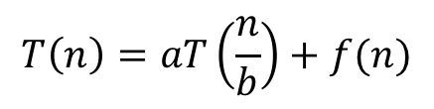
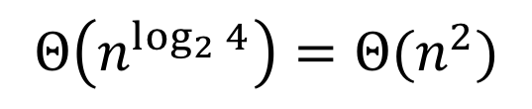
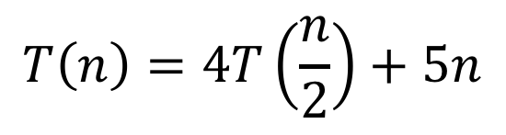
Master Theorem Example 2
$$T\left(n\right)=aT\left(\frac{n}{b}\right)+f(n)$$
Case 1: if $f\left(n\right)=O(n^{\log_{b}{a} −ε})$ for some constant $ε>0$, then $T\left(n\right)=Θ(n^{\log_{b}{a}})$
Case 2: if $f\left(n\right)=Θ(n^{\log_{b}{a}})$, then $T\left(n\right)=Θ(n^{\log_{b}{a}}\log{n})$
Case 3: if $f\left(n\right)=Ω(n^{\log_{b}{a+ε}})$ for some constant $ε>0$, and if $af\left(\frac{n}{b}\right)≤cf(n)$ for some constant $c<1$ and all sufficiently large $n$, then $T\left(n\right)=Θ(f\left(n\right))$
$$T\left(n\right)=4T\left(\frac{n}{2}\right)+5n$$
Case 1
$$Θ\left(n^{\log_{2}{4}}\right)=Θ(n^{2})$$

Slide 22







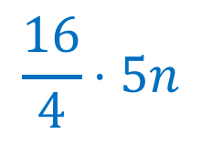





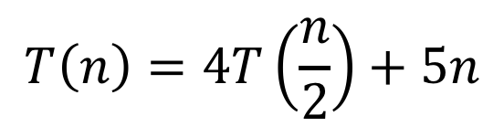




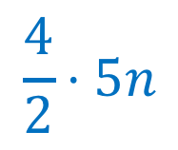



























Tree method
$$T\left(n\right)=4T\left(\frac{n}{2}\right)+5n$$
$$n$$
$$5n$$
$$5n$$
$$\frac{n}{2}$$
$$\frac{5n}{2}$$
$$\frac{n}{2}$$
$$\frac{5n}{2}$$
$$\frac{n}{2}$$
$$\frac{5n}{2}$$
$$\frac{n}{2}$$
$$\frac{5n}{2}$$
$$\frac{4}{2}⋅5n$$
$$\frac{n}{4}$$
$$\frac{n}{4}$$
$$\frac{n}{4}$$
$$\frac{n}{4}$$
…
$$\frac{n}{4}$$
$$\frac{n}{4}$$
$$\frac{n}{4}$$
$$\frac{n}{4}$$
$$\frac{16}{4}⋅5n$$
$$\frac{5n}{4}$$
$$\frac{5n}{4}$$
$$\frac{5n}{4}$$
$$\frac{5n}{4}$$
$$\frac{5n}{4}$$
$$\frac{5n}{4}$$
$$\frac{5n}{4}$$
$$\frac{5n}{4}$$
…
…
…
…
…
…
…
…
…
…
$$5$$
$$5$$
$$5$$
$$5$$
$$5$$
$$5$$
$$5$$
$$2^{\log_{2}{n}}⋅5n$$
$$5$$
$$5$$
$$5$$
$$5$$
$$5$$
$$5$$
$$5$$
$$1$$
$$1$$
$$1$$
$$1$$
$$1$$
$$1$$
$$1$$
$$1$$
$$1$$
$$1$$
$$1$$
$$1$$
$$1$$
$$1$$

Slide 23
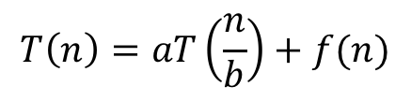
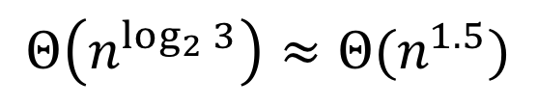
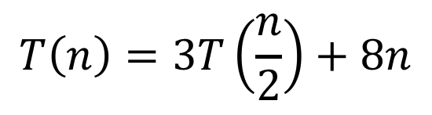
Master Theorem Example 3
$$T\left(n\right)=aT\left(\frac{n}{b}\right)+f(n)$$
Case 1: if $f\left(n\right)=O(n^{\log_{b}{a} −ε})$ for some constant $ε>0$, then $T\left(n\right)=Θ(n^{\log_{b}{a}})$
Case 2: if $f\left(n\right)=Θ(n^{\log_{b}{a}})$, then $T\left(n\right)=Θ(n^{\log_{b}{a}}\log{n})$
Case 3: if $f\left(n\right)=Ω(n^{\log_{b}{a+ε}})$ for some constant $ε>0$, and if $af\left(\frac{n}{b}\right)≤cf(n)$ for some constant $c<1$ and all sufficiently large $n$, then $T\left(n\right)=Θ(f\left(n\right))$
$$T\left(n\right)=3T\left(\frac{n}{2}\right)+8n$$
Case 1
$$Θ\left(n^{\log_{2}{3}}\right)≈Θ(n^{1.5})$$

Slide 24



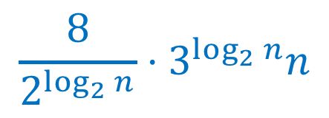


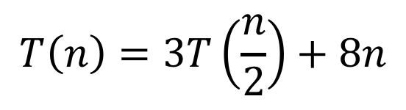

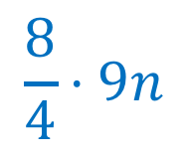


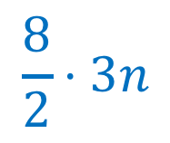






Karatsuba
$$T\left(n\right)=3T\left(\frac{n}{2}\right)+8n$$
$$n$$
$$8n$$
$$8⋅1n$$
$$\frac{n}{2}$$
$$\frac{8n}{2}$$
$$\frac{n}{2}$$
$$\frac{8n}{2}$$
$$\frac{n}{2}$$
$$\frac{8n}{2}$$
$$\frac{8}{2}⋅3n$$
$$\frac{n}{4}$$
$$\frac{n}{4}$$
$$\frac{n}{4}$$
…
$$\frac{n}{4}$$
$$\frac{n}{4}$$
$$\frac{n}{4}$$
$$\frac{8}{4}⋅9n$$
$$\frac{8n}{4}$$
$$\frac{8n}{4}$$
$$\frac{8n}{4}$$
$$\frac{8n}{4}$$
$$\frac{8n}{4}$$
$$\frac{8n}{4}$$
…
…
…
…
…
…
…
$$\frac{8}{2^{\log_{2}{n}}}⋅3^{\log_{2}{n}}n$$
…
$$8$$
$$8$$
$$8$$
$$8$$
$$8$$
$$8$$
$$8$$
$$8$$
$$8$$
$$8$$
$$1$$
$$1$$
$$1$$
$$1$$
$$1$$
$$1$$
$$1$$
$$1$$
$$1$$
$$1$$

Slide 25

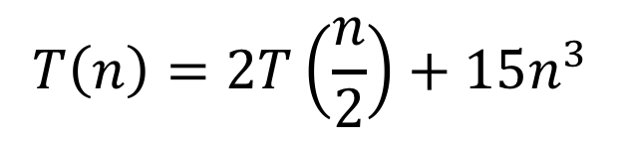
Master Theorem Example 4
$$T\left(n\right)=aT\left(\frac{n}{b}\right)+f(n)$$
Case 1: if $f\left(n\right)=O(n^{\log_{b}{a} −ε})$ for some constant $ε>0$, then $T\left(n\right)=Θ(n^{\log_{b}{a}})$
Case 2: if $f\left(n\right)=Θ(n^{\log_{b}{a}})$, then $T\left(n\right)=Θ(n^{\log_{b}{a}}\log{n})$
Case 3: if $f\left(n\right)=Ω(n^{\log_{b}{a+ε}})$ for some constant $ε>0$, and if $af\left(\frac{n}{b}\right)≤cf(n)$ for some constant $c<1$ and all sufficiently large $n$, then $T\left(n\right)=Θ(f\left(n\right))$
$$T\left(n\right)=2T\left(\frac{n}{2}\right)+15n^{3}$$
Case 3
$$Θ\left(n^{3}\right)$$

Slide 26
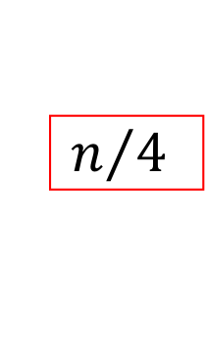


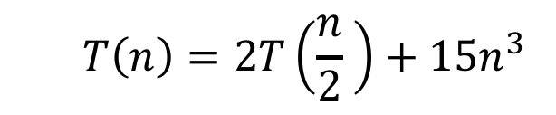















Tree method
$$T\left(n\right)=2T\left(\frac{n}{2} \right)+15n^{3}$$
$$15n^{3}$$
$$15n^{3}$$
$$n$$
$$\frac{15n^{3}}{4}$$
$$15{\left(\frac{n}{2}\right)}^{3}$$
$$15{\left(\frac{n}{2}\right)}^{3}$$
$$n/2$$
$$+$$
$$n/2$$
$$15{\left(\frac{n}{4}\right)}^{3}$$
$$15{\left(\frac{n}{4}\right)}^{3}$$
$$15{\left(\frac{n}{4}\right)}^{3}$$
$$15{\left(\frac{n}{4}\right)}^{3}$$
$$\log_{2}⁡n$$
$$\frac{15n^{3}}{16}$$
$$n/4$$
$$+$$
$$n/4$$
$$+$$
$$n/4$$
$$+$$
$$n/4$$
…
…
…
…
$$15$$
…
$$15$$
$$15$$
$$15$$
$$15$$
$$15$$
$$1$$
$$+$$
$$1$$
$$+$$
$$1$$
$$+$$
$$1$$
$$+$$
$$1$$
$$+$$
$$1$$
$$15\log_{2}{n}$$

Slide 27
Recurrence Solving Techniques
Tree
Guess/Check
“Cookbook”
Substitution
?

Slide 28

Substitution Method
Idea: take a “difficult” recurrence, re-express it such that one of our other methods applies.
Example:
$$T\left(n\right)=2T\left(\sqrt{n}\right)+\log_{2}{n}$$

Slide 29






















Tree method
$$T\left(n\right)=2T(\sqrt{n})+\log_{2}{n}$$
$$\log_{2}{n}$$
$$\log_{2}{n}$$
$$n$$
$$\frac{1}{2}\log_{2}{n}$$
$$\frac{1}{2}\log_{2}{n}$$
$$\log_{2}{n}$$
$$\sqrt{n}$$
$$+$$
$$\sqrt{n}$$
$$\frac{1}{4}\log_{2}{n}$$
$$\frac{1}{4}\log_{2}{n}$$
$$\frac{1}{4}\log_{2}{n}$$
$$\frac{1}{4}\log_{2}{n}$$
$$\log_{2}⁡\log_{2}{n}$$
$$\sqrt{\sqrt{n}}$$
$$+$$
$$\sqrt{\sqrt{n}}$$
$$+$$
$$\sqrt{\sqrt{n}}$$
$$+$$
$$\sqrt{\sqrt{n}}$$
$$\log_{2}{n}$$
…
…
…
…
$$1$$
…
$$1$$
$$1$$
$$1$$
$$1$$
$$1$$
$$\log_{2}{n}$$
$$2$$
$$+$$
$$2$$
$$+$$
$$2$$
$$+$$
$$2$$
$$+$$
$$2$$
$$+$$
$$2$$
$$T\left(n\right)=O(\log_{2}{n}⋅\log_{2}{\log_{2}{n}})$$

Slide 30





Substitution Method
Idea: take a “difficult” recurrence, re-express it such that one of our other methods applies.
Example:
$$T\left(n\right)=2T\left(\sqrt{n}\right)+\log_{2}{n}$$
Let $n=2^{m}$, i.e. $m=\log_{2}{n}$
$$T\left(2^{m}\right)=2T\left(2^{\frac{m}{2}}\right)+m$$
Rewrite in terms of exponent!
Let $S\left(m\right)=2S\left(\frac{m}{2}\right)+m$
Case 2!
Let $S\left(m\right)=Θ(m\log{m})$
Substitute Back
Let T$\left(n\right)=Θ(\log{n}\log{\log{n}})$

Slide 31











Tree method
$$T\left(2^{m}\right)=2T\left(2^{\frac{m}{2}}\right)+m$$
$$n=2^{m}$$
$$T\left(n\right)=2T(\sqrt{n})+\log_{2}{n}$$
$$\log_{2}{n}$$
$$\log_{2}{n}$$
$$n$$
$$2^{m}$$
$$\frac{1}{2}\log_{2}{n}$$
$$\frac{1}{2}\log_{2}{n}$$
$$\log_{2}{n}$$
$$\sqrt{n}$$
$$+$$
$$\sqrt{n}$$
$$2^{m/2}$$
$$2^{m/2}$$
$$\frac{1}{4}\log_{2}{n}$$
$$\frac{1}{4}\log_{2}{n}$$
$$\frac{1}{4}\log_{2}{n}$$
$$\frac{1}{4}\log_{2}{n}$$
$$\log_{2}⁡\log_{2}{n}$$
$$\sqrt{\sqrt{n}}$$
$$+$$
$$\sqrt{\sqrt{n}}$$
$$+$$
$$\sqrt{\sqrt{n}}$$
$$+$$
$$\sqrt{\sqrt{n}}$$
$$\log_{2}{n}$$
$$2^{m/4}$$
$$2^{m/4}$$
$$2^{m/4}$$
$$2^{m/4}$$
…
…
…
…
$$1$$
…
$$1$$
$$1$$
$$1$$
$$1$$
$$1$$
$$\log_{2}{n}$$
$$2$$
$$+$$
$$2$$
$$+$$
$$2$$
$$+$$
$$2$$
$$+$$
$$2$$
$$+$$
$$2$$

Slide 32





















Tree method
$$n=2^{m}$$
$$T\left(2^{m}\right)=2T(2^{m})+\log_{2}{n}$$
$$m$$
$$m$$
$$2^{m}$$
$$\frac{m}{2}$$
$$\frac{m}{2}$$
$$m$$
$$2^{m/2}$$
$$+$$
$$2^{m/2}$$
$$\frac{m}{4}$$
$$\frac{m}{4}$$
$$\frac{m}{4}$$
$$\frac{m}{4}$$
$$\log_{2}m$$
$$2^{m/4}$$
$$+$$
$$2^{m/4}$$
$$+$$
$$2^{m/4}$$
$$+$$
$$2^{m/4}$$
$$m$$
…
…
…
…
$$1$$
…
$$1$$
$$1$$
$$1$$
$$1$$
$$1$$
$$m$$
$$2^{1}$$
$$+$$
$$2^{1}$$
$$+$$
$$2^{1}$$
$$+$$
$$2^{1}$$
$$+$$
$$2^{1}$$
$$+$$
$$2^{1}$$

Slide 33










Tree method
$$n=2^{m}$$
$$T\left(2^{m}\right)=S(m)$$
$$S\left(m\right)=2S\left(\frac{m}{2}\right)+m$$
$$m$$
$$m$$
$$m$$
$$\frac{m}{2}$$
$$\frac{m}{2}$$
$$m$$
$$m/2$$
$$+$$
$$m/2$$
$$\frac{m}{4}$$
$$\frac{m}{4}$$
$$\frac{m}{4}$$
$$\frac{m}{4}$$
$$\log_{2}m$$
$$m/4$$
$$+$$
$$m/4$$
$$+$$
$$m/4$$
$$+$$
$$m/4$$
$$m$$
…
…
…
…
$$1$$
…
$$1$$
$$1$$
$$1$$
$$1$$
$$1$$
$$m$$
$$1$$
$$+$$
$$1$$
$$+$$
$$1$$
$$+$$
$$1$$
$$+$$
$$1$$
$$+$$
$$1$$
$$T\left(n\right)=O(m⋅\log_{2}{m})$$
$$=O(\log_{2}{n}⋅\log_{2}{\log_{2}{n}})$$

