Slide 1
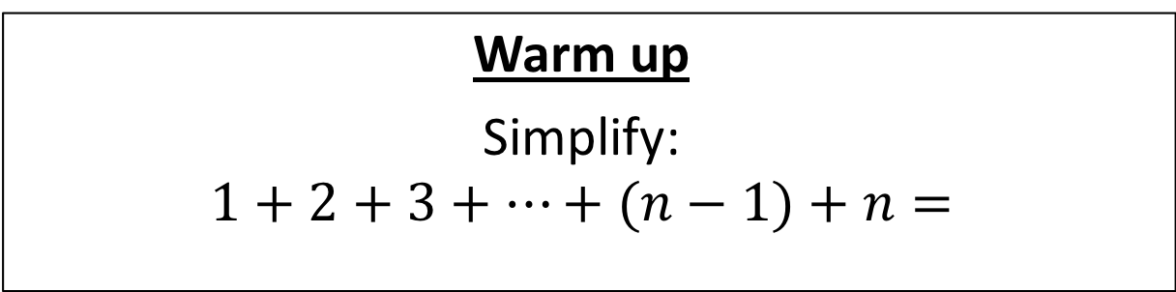
CS4102 Algorithms
Fall 2018
Warm up
Simplify:
$$1+2+3+…+(n−1)+n=$$

Slide 2



$$1+2+3+…+(n−1)+n=$$
$$\frac{n\left(n+1\right)}{2}$$
$$n$$
$$n+1$$

Slide 3
Today’s Keywords
Divide and Conquer
Matrix Multiplication
Strassen’s Algorithm
Sorting
Quicksort

Slide 4
CLRS Readings
Chapter 4
Chapter 7

Slide 5
Homeworks
Hw2 due 11pm Friday!
Programming (use Python or Java!)
Divide and conquer
Closest pair of points

Slide 6
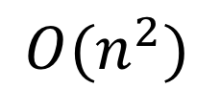
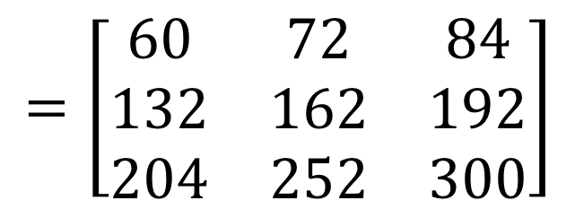

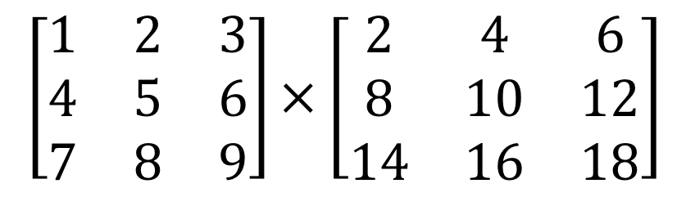

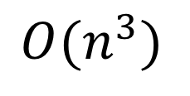
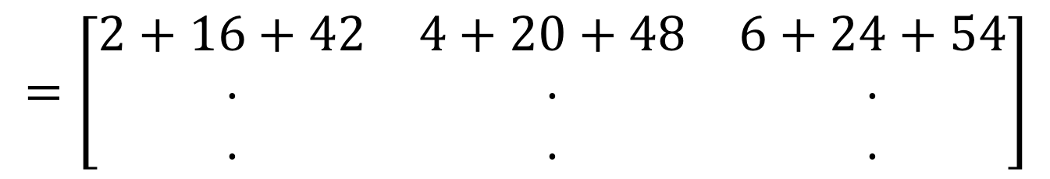
Matrix Multiplication
$$n$$
$$\left[\begin{matrix}1 & 2 & 3 \\ 4 & 5 & 6 \\ 7 & 8 & 9\end{matrix}\right]×\left[\begin{matrix}2 & 4 & 6 \\ 8 & 10 & 12 \\ 14 & 16 & 18\end{matrix}\right]$$
$$n$$
$$=\left[\begin{matrix}2+16+42 & 4+20+48 & 6+24+54 \\ ⋅ & ⋅ & ⋅ \\ ⋅ & ⋅ & ⋅\end{matrix}\right]$$
$$=\left[\begin{matrix}60 & 72 & 84 \\ 132 & 162 & 192 \\ 204 & 252 & 300\end{matrix}\right]$$
Run time?
$$O(n^{3})$$
Lower Bound?
$$O(n^{2})$$

Slide 7
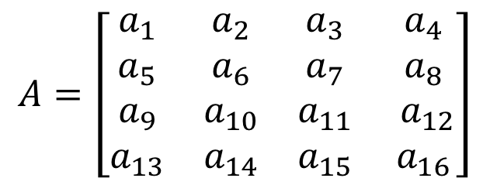
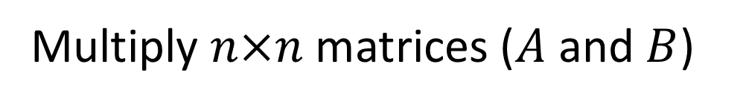
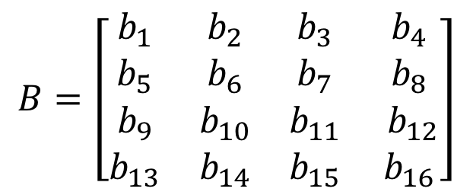
Matrix Multiplication D&C
Multiply $n×n$ matrices ($A$ and $B$)
Divide:
$$A=\left[\begin{matrix}a_{1} & a_{2} & a_{3} & a_{4} \\ a_{5} & a_{6} & a_{7} & a_{8} \\ a_{9} & a_{10} & a_{11} & a_{12} \\ a_{13} & a_{14} & a_{15} & a_{16}\end{matrix}\right]$$
$$B=\left[\begin{matrix}b_{1} & b_{2} & b_{3} & b_{4} \\ b_{5} & b_{6} & b_{7} & b_{8} \\ b_{9} & b_{10} & b_{11} & b_{12} \\ b_{13} & b_{14} & b_{15} & b_{16}\end{matrix}\right]$$

Slide 8
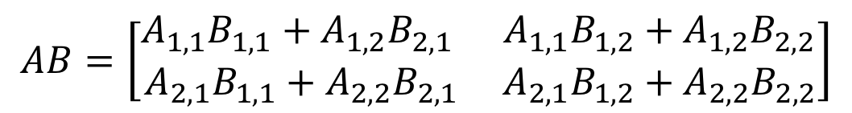








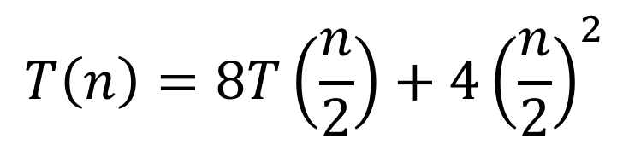
Matrix Multiplication D&C
Multiply $n×n$ matrices ($A$ and $B$)
$$A=\left[\begin{matrix}a_{1} & a_{2} & a_{3} & a_{4} \\ a_{5} & a_{6} & a_{7} & a_{8} \\ a_{9} & a_{10} & a_{11} & a_{12} \\ a_{13} & a_{14} & a_{15} & a_{16}\end{matrix}\right]$$
$$A_{1,1}$$
$$A_{1,2}$$
$$B=\left[\begin{matrix}b_{1} & b_{2} & b_{3} & b_{4} \\ b_{5} & b_{6} & b_{7} & b_{8} \\ b_{9} & b_{10} & b_{11} & b_{12} \\ b_{13} & b_{14} & b_{15} & b_{16}\end{matrix}\right]$$
$$B_{1,1}$$
$$B_{1,2}$$
$$A_{2,1}$$
$$A_{2,2}$$
$$B_{2,1}$$
$$B_{2,2}$$
Combine:
$$AB=\left[\begin{matrix}A_{1,1}B_{1,1}+A_{1,2}B_{2,1} & A_{1,1}B_{1,2}+A_{1,2}B_{2,2} \\ A_{2,1}B_{1,1}+A_{2,2}B_{2,1} & A_{2,1}B_{1,2}+A_{2,2}B_{2,2}\end{matrix}\right]$$
$$T\left(n\right)=8T\left(\frac{n}{2}\right)+4{\left(\frac{n}{2}\right)}^{2}$$
Cost of additions
Run time?

Slide 9
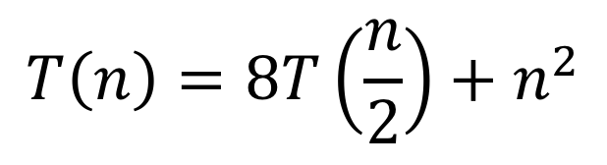
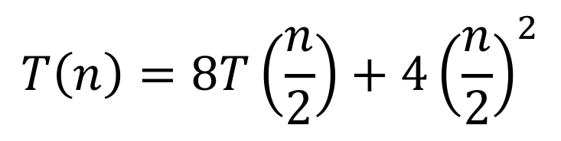
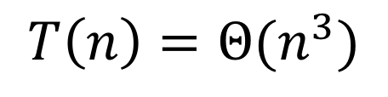
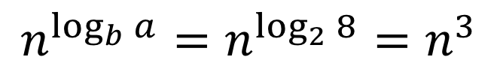
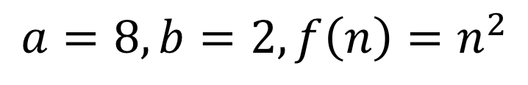
Matrix Multiplication D&C
$$T\left(n\right)=8T\left(\frac{n}{2}\right)+4{\left(\frac{n}{2}\right)}^{2}$$
$$T\left(n\right)=8T\left(\frac{n}{2}\right)+n^{2}$$
$$a=8, b=2, f\left(n\right)=n^{2}$$
Case 1!
$$n^{\log_{b}{a}}=n^{\log_{2}{8}}=n^{3}$$
$$T\left(n\right)=Θ(n^{3})$$
We can do better…

Slide 10
Matrix Multiplication D&C
Multiply $n×n$ matrices ($A$ and $B$)
$$A=\left[\begin{matrix}a_{1} & a_{2} & a_{3} & a_{4} \\ a_{5} & a_{6} & a_{7} & a_{8} \\ a_{9} & a_{10} & a_{11} & a_{12} \\ a_{13} & a_{14} & a_{15} & a_{16}\end{matrix}\right]$$
$$A_{1,1}$$
$$A_{1,2}$$
$$B=\left[\begin{matrix}b_{1} & b_{2} & b_{3} & b_{4} \\ b_{5} & b_{6} & b_{7} & b_{8} \\ b_{9} & b_{10} & b_{11} & b_{12} \\ b_{13} & b_{14} & b_{15} & b_{16}\end{matrix}\right]$$
$$B_{1,1}$$
$$B_{1,2}$$
$$A_{2,1}$$
$$A_{2,2}$$
$$B_{2,1}$$
$$B_{2,2}$$
$$AB=\left[\begin{matrix}A_{1,1}B_{1,1}+A_{1,2}B_{2,1} & A_{1,1}B_{1,2}+A_{1,2}B_{2,2} \\ A_{2,1}B_{1,1}+A_{2,2}B_{2,1} & A_{2,1}B_{1,2}+A_{2,2}B_{2,2}\end{matrix}\right]$$
Idea: Use a Karatsuba-like technique on this

Slide 11
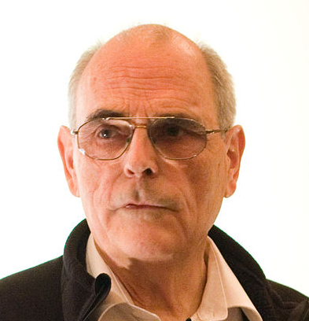




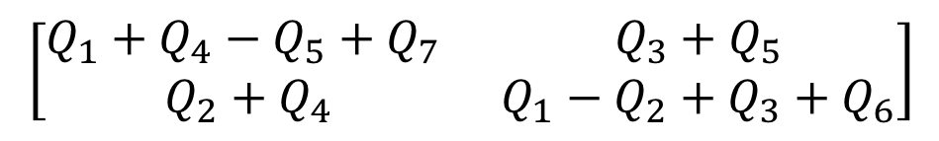


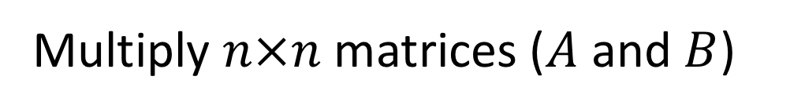

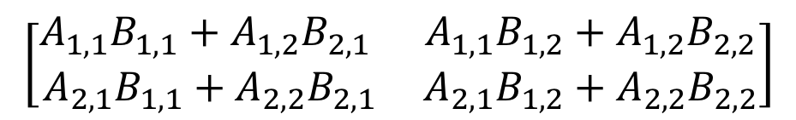


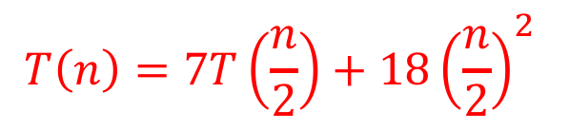






Strassen’s Algorithm
Multiply $n×n$ matrices ($A$ and $B$)
$$A=\left[\begin{matrix}a_{1} & a_{2} & a_{3} & a_{4} \\ a_{5} & a_{6} & a_{7} & a_{8} \\ a_{9} & a_{10} & a_{11} & a_{12} \\ a_{13} & a_{14} & a_{15} & a_{16}\end{matrix}\right]$$
$$A_{1,1}$$
$$A_{1,2}$$
$$B=\left[\begin{matrix}b_{1} & b_{2} & b_{3} & b_{4} \\ b_{5} & b_{6} & b_{7} & b_{8} \\ b_{9} & b_{10} & b_{11} & b_{12} \\ b_{13} & b_{14} & b_{15} & b_{16}\end{matrix}\right]$$
$$B_{1,1}$$
$$B_{1,2}$$
$$A_{2,1}$$
$$A_{2,2}$$
$$B_{2,1}$$
$$B_{2,2}$$
Calculate:
Find $AB$:
$$Q_{1}=\left(A_{1,1}+A_{2,2}\right)(B_{1,1}+B_{2,2})$$
$$\left[\begin{matrix}A_{1,1}B_{1,1}+A_{1,2}B_{2,1} & A_{1,1}B_{1,2}+A_{1,2}B_{2,2} \\ A_{2,1}B_{1,1}+A_{2,2}B_{2,1} & A_{2,1}B_{1,2}+A_{2,2}B_{2,2}\end{matrix}\right]$$
$$Q_{2}=\left(A_{2,1}+A_{2,2}\right)B_{1,1}$$
$$Q_{3}=A_{1,1}(B_{1,2} −B_{2,2})$$
$$=$$
$$Q_{4}=A_{2,2}(B_{2,1}−B_{1,1})$$
$$\left[\begin{matrix}Q_{1}+Q_{4}−Q_{5}+Q_{7} & Q_{3}+Q_{5} \\ Q_{2}+Q_{4} & Q_{1}−Q_{2}+Q_{3}+Q_{6}\end{matrix}\right]$$
$$Q_{5}=\left(A_{1,1}+A_{1,2}\right)B_{2,2}$$
$$Q_{6}=\left(A_{2,1}−A_{1,1}\right)(B_{1,1}+B_{1,2})$$
Number Mults.: 7
Number Adds.: 18
$$Q_{7}=\left(A_{1,2}−A_{2,2}\right)(B_{2,1}+B_{2,2})$$
$$T\left(n\right)=7T\left(\frac{n}{2}\right)+18{\left(\frac{n}{2}\right)}^{2}$$

Slide 12
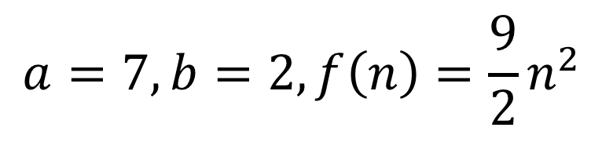
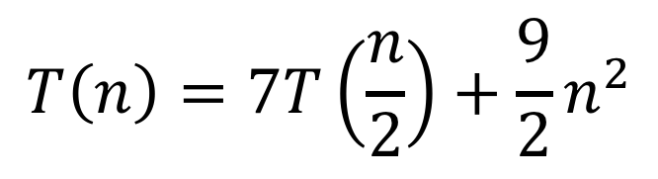
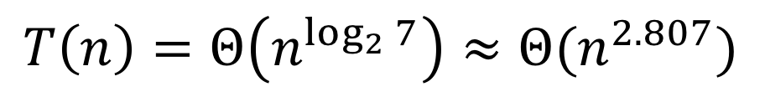
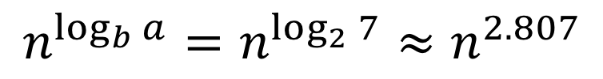
Strassen’s Algorithm
$$T\left(n\right)=7T\left(\frac{n}{2}\right)+\frac{9}{2}n^{2}$$
$$a=7, b=2, f\left(n\right)={\frac{9}{2}n}^{2}$$
Case 1!
$$n^{\log_{b}{a}}=n^{\log_{2}{7}}≈n^{2.807}$$
$$T\left(n\right)=Θ\left(n^{\log_{2}{7}}\right)≈Θ(n^{2.807})$$

Slide 13
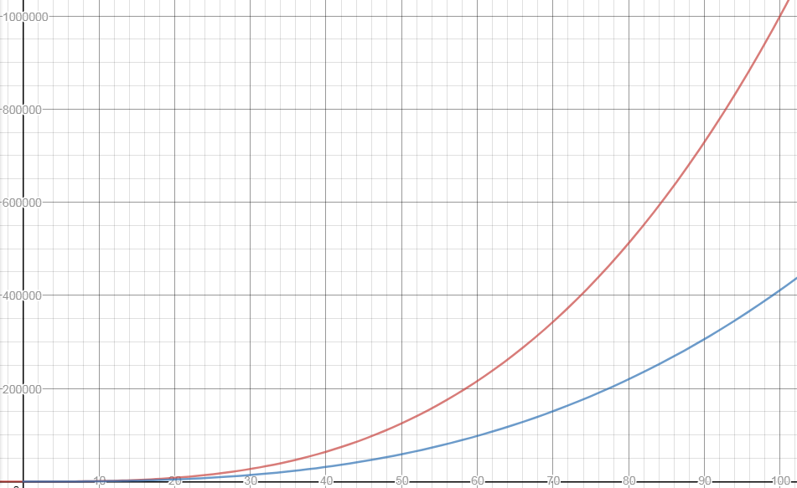


$$n^{3}$$
$$n^{\log_{2}{7}}$$

Slide 14
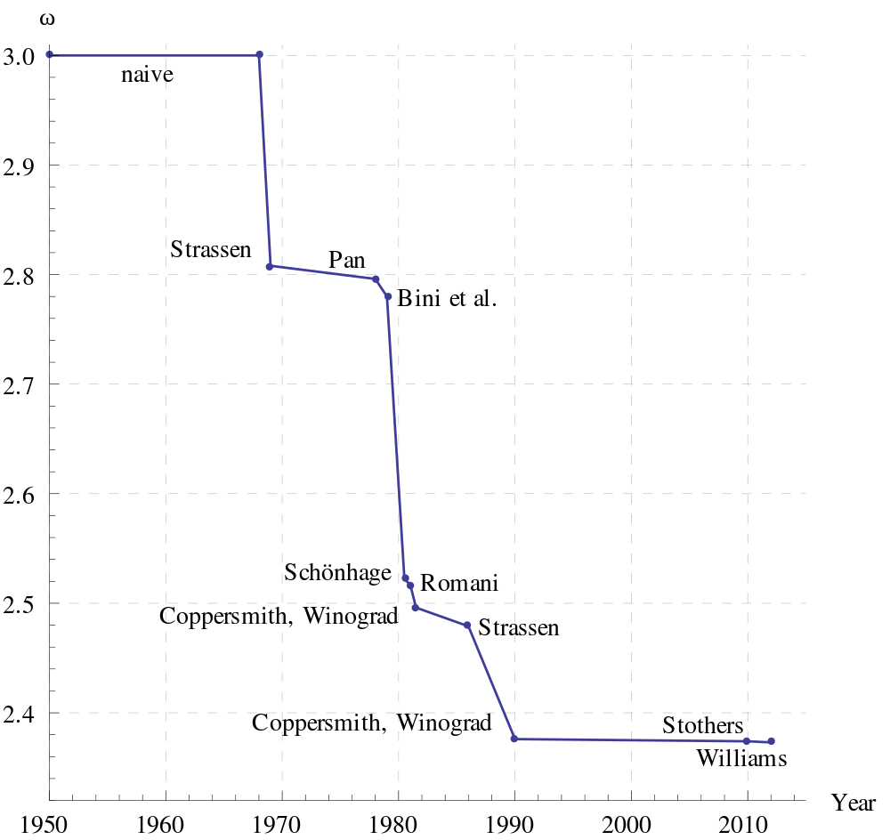
Is this the fastest?
Best possible is unknown
May not even exist!

Slide 15
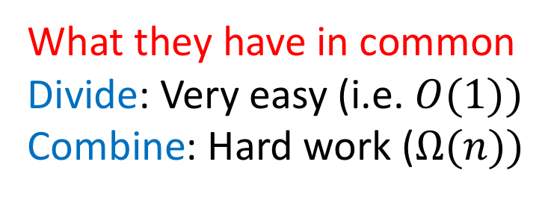
Divide and Conquer, so far
What they have in common
Divide: Very easy (i.e. $O(1))$
Combine: Hard work ($Ω(n))$
Mergesort
Naïve Multiplication
Karatsuba
Closest Pair of Points
Strassen’s

Slide 16
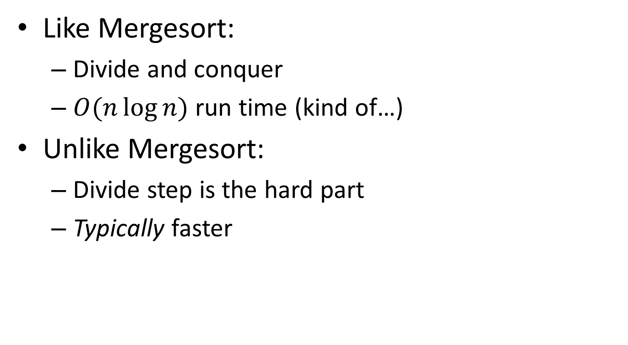
Quicksort
Like Mergesort:
Divide and conquer
$O(n\log{n})$ run time (kind of…)
Unlike Mergesort:
Divide step is the hard part
Typically faster

Slide 17
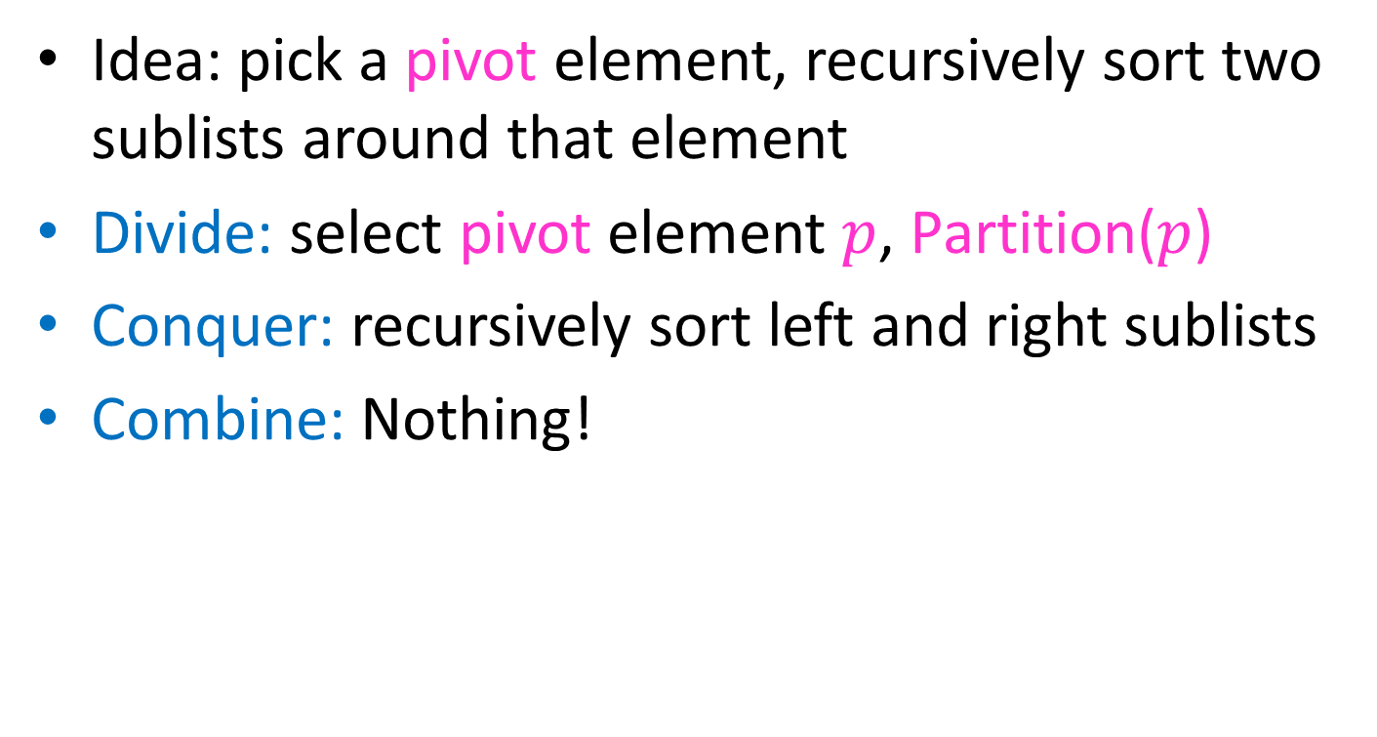
Quicksort
Idea: pick a pivot element, recursively sort two sublists around that element
Divide: select pivot element $p$, Partition($p$)
Conquer: recursively sort left and right sublists
Combine: Nothing!

Slide 18


Partition (Divide step)
Given: a list, a pivot $p$
Start: unordered list
8
5
7
3
12
10
1
2
4
9
6
11
Goal: All elements $<p$ on left, all $>p$ on right
5
7
3
1
2
4
6
8
12
10
9
11

Slide 19
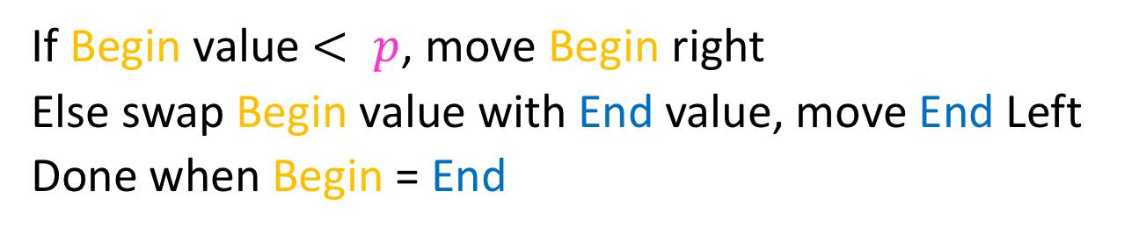
Partition, Procedure
If Begin value $< p$, move Begin right
Else swap Begin value with End value, move End Left
Done when Begin = End
8
5
7
3
12
10
1
2
4
9
6
11
8
5
7
3
12
10
1
2
4
9
6
11
8
5
7
3
12
10
1
2
4
9
6
11
8
5
7
3
11
10
1
2
4
9
6
12

Slide 20
Partition, Procedure
If Begin value $< p$, move Begin right
Else swap Begin value with End value, move End Left
Done when Begin = End
8
5
7
3
11
10
1
2
4
9
6
12
8
5
7
3
6
10
1
2
4
9
11
12
8
5
7
3
6
10
1
2
4
9
11
12
8
5
7
3
6
10
1
2
4
9
11
12

Slide 21
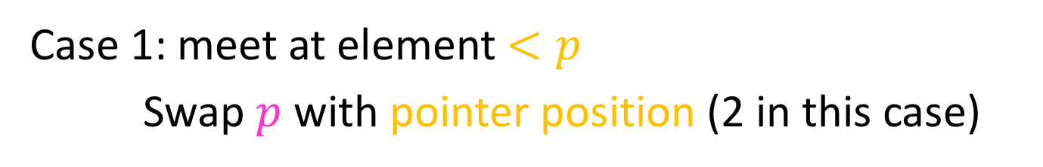
Partition, Procedure
If Begin value $< p$, move Begin right
Else swap Begin value with End value, move End Left
Done when Begin = End
8
5
7
3
6
4
1
2
10
9
11
12
Case 1: meet at element $<p$
Swap $p$ with pointer position (2 in this case)
2
5
7
3
6
4
1
8
10
9
11
12

Slide 22
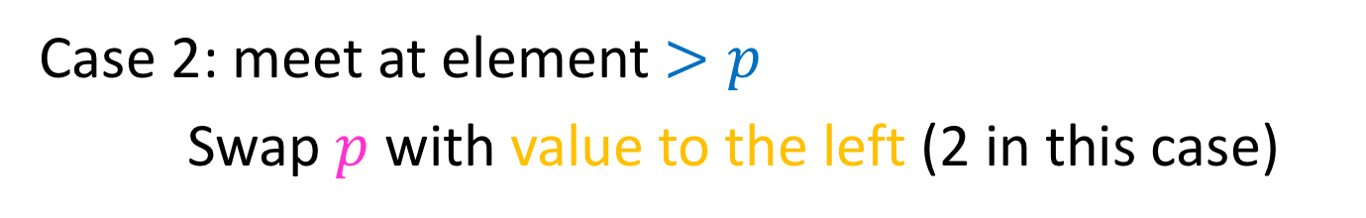
Partition, Procedure
If Begin value $< p$, move Begin right
Else swap Begin value with End value, move End Left
Done when Begin = End
8
5
7
3
6
4
1
2
10
9
11
12
Case 2: meet at element $>p$
Swap $p$ with value to the left (2 in this case)
2
5
7
3
6
4
1
8
10
9
11
12

Slide 23
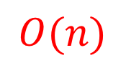
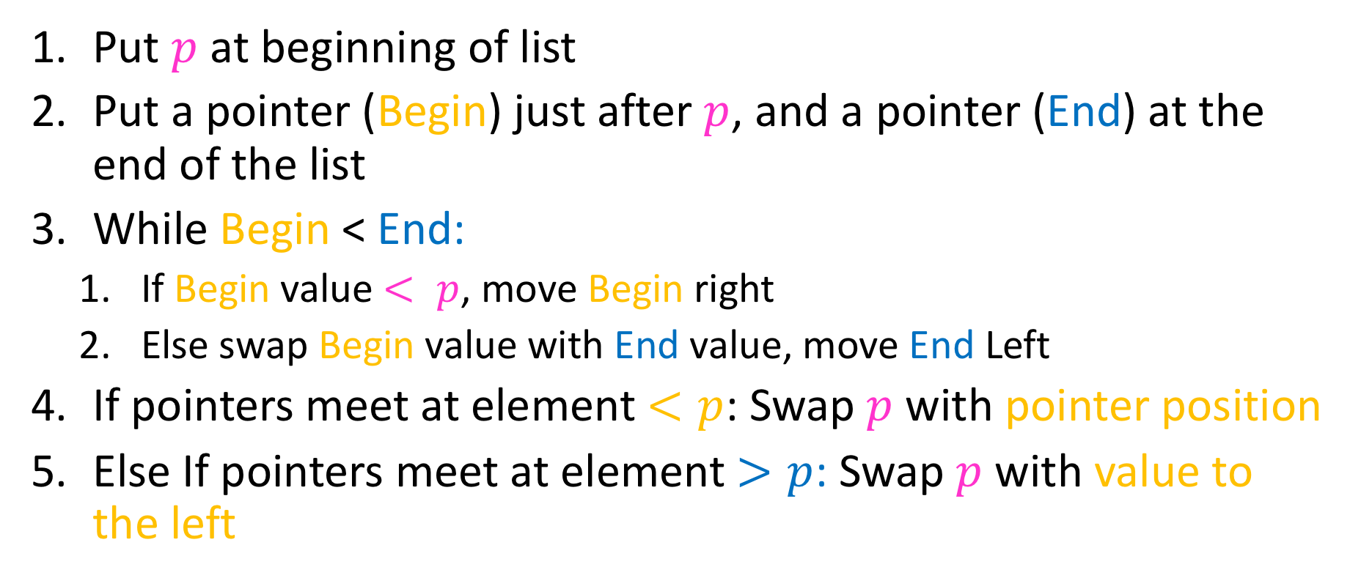
Partition Summary
Put $p$ at beginning of list
Put a pointer (Begin) just after $p$, and a pointer (End) at the end of the list
While Begin < End:
If Begin value $< p$, move Begin right
Else swap Begin value with End value, move End Left
If pointers meet at element $<p$: Swap $p$ with pointer position
Else If pointers meet at element $>p$: Swap $p$ with value to the left
Run time?
$$O(n)$$

Slide 24
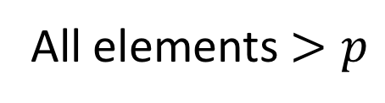
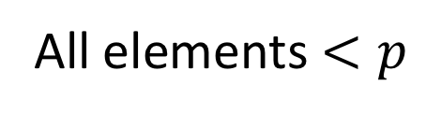
Conquer
2
5
7
3
6
4
1
8
10
9
11
12
All elements $<p$
All elements $>p$
Exactly where it belongs!
Recursively sort Left and Right sublists

Slide 25

Quicksort Run Time (Best)
If the pivot is always the median:
2
5
1
3
6
4
7
8
10
9
11
12
2
1
3
5
6
4
7
8
9
10
11
12
Then we divide in half each time
$$T\left(n\right)=2T\left(\frac{n}{2}\right)+n$$
$$T\left(n\right)=O(n\log{n})$$

Slide 26
Quicksort Run Time (Worst)
If the pivot is always at the extreme:
1
5
2
3
6
4
7
8
10
9
11
12
1
2
3
5
6
4
7
8
10
9
11
12
Then we shorten by 1 each time
$$T\left(n\right)=T\left(n−1\right)+n$$
$$T\left(n\right)=O(n^{2})$$

Slide 27











Quicksort Run Time (Worst)
$$T\left(n\right)=T\left(n−1\right)+n$$
$$n$$
$$n$$
$$n−1$$
$$n−1$$
$$T\left(n\right)=1+2+3+…+n$$
$$n−2$$
$$n−2$$
$$T\left(n\right)=\frac{n\left(n+1\right)}{2}$$
…
$$1$$
$$1$$
$$T\left(n\right)=O(n^{2})$$

Slide 28
Quicksort on a (nearly) Sorted List
First element always yields unbalanced pivot
1
2
3
4
5
6
7
8
9
10
11
12
1
2
3
4
5
6
7
8
9
10
11
12
So we shorten by 1 each time
$$T\left(n\right)=T\left(n−1\right)+n$$
$$T\left(n\right)=O(n^{2})$$

Slide 29
Takeaway Question
How to pick the pivot?

