Slide 1
Greedy Algorithms Greedy Algorithms
Weighted Knapsack
CS 3100 – DSA2
Ethan Blaser (Grad TA)
Slides adopted from Prof. Brunelle and Prof. Floryan

Slide 2
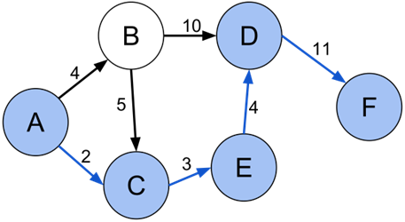
Optimization Problems
Greedy algorithms can (sometimes) solve optimization problems:
Find the best solution among all feasible solutions
An example you know: Find the shortest path in a weighted graph G from s to v
Form of the solution: a path (and sum of its edge-weights)
Feasible solutions must meet problem constraints
Example: All edges in solution are in graph G and form a simple path from s to v
We can get a score for each feasible solution on some criteria: We call this the objective function
Example: the sum of the edge weights in path
One (or more) feasible solutions that scores highest (by the objective function) is the optimal solution(s)

Slide 3
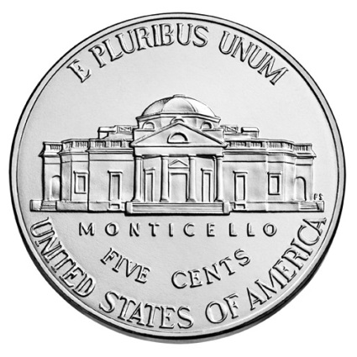
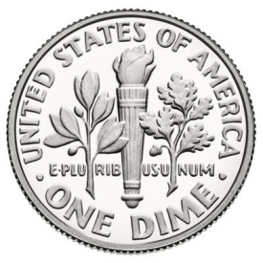
Optimization Problem Solving Tree
Q: Does our optimization problem have optimal substructure? Can we prove it?
Optimal Substructure: If given an optimal solution to the larger problem, it can be seen to be made up of optimal solutions to smaller versions of the same problem
If 𝐴 is an optimal solution to a problem, then the components of 𝐴 are optimal solutions to subproblems (pg. 379 of CLRS)
Ex. Coin Change from prev. lecture
Optimal Substructure?
=
10 cents subproblem
5 cents subproblem
15 cents

Slide 4
Optimization Problem Solving Tree
Divide and Conquer does NOT require optimal substructure!
Optimal Substructure?
Divide and Conquer (We saw this already)
Linear Programming
Quadratic Programming
Non-linear Programming
Machine Learning (We will see this later!)
Others!
No
Use Other Optimization Techniques

Slide 5
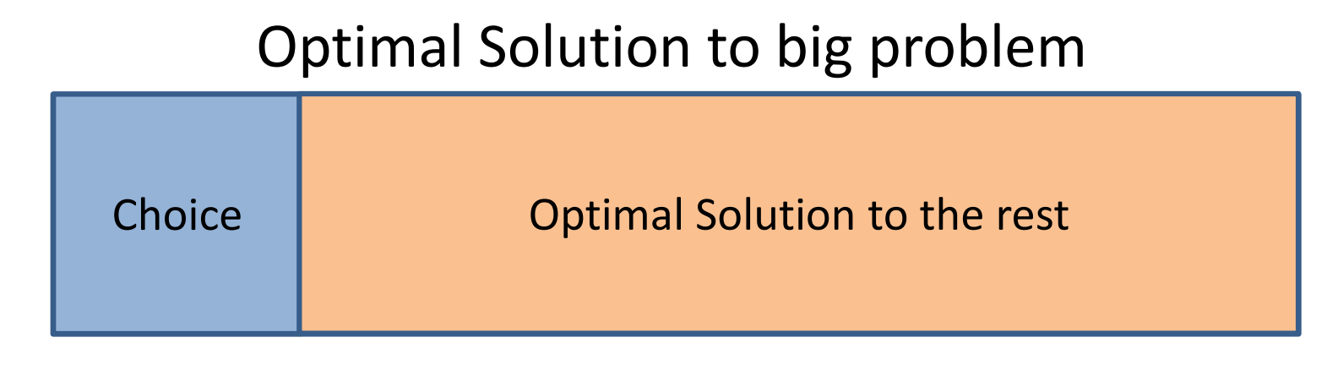
Optimization Problem Solving Tree
Q: Does this problem exhibit the greedy choice property? If so, what is the greedy choice function?
Greedy Choice Property: We can achieve the globally optimal solution by repeatedly making locally optimal choices
Greedy Choice Function: The rule for how to choose an item guaranteed to be in the optimal solution
Locally optimal: best choice given what info available now
Irrevocable: a choice can’t be un-done
Must prove optimality for a given problem and greedy choice function!
Greedy Choice Property?
Yes
Optimal Substructure?
No
Use Other Optimization Techniques

Slide 6
Optimization Problem Solving Tree
Greedy Algorithm
Yes
Greedy Choice Property?
Yes
Optimal Substructure?
Greedy Algorithm:
Apply the greedy choice function to make a decision
Identify your subproblem, then solve it
(repeat)
No
Use Other Optimization Techniques

Slide 7
Optimization Problem Solving Tree
Greedy Algorithm
Yes
Greedy Choice Property?
Yes
No
Dynamic Programming Algorithm
Optimal Substructure?
No
Use Other Optimization Techniques
If a problem has optimal structure, then there ALWAYS exists a Dynamic Programming solution to the problem. We will cover this next unit!

Slide 8
Optimization Problem Solving Tree
Greedy Algorithms
Our focus this unit!
Yes
Greedy Choice Property?
Yes
No
Dynamic Programming
Optimal Substructure?
No
Use Other Optimization Techniques

Slide 9
Optimization Problem Solving Tree (Reality)
Greedy Algorithm
Yes
Greedy Choice Property?
Greedy Algorithm **
Yes
No
Is an approximation algorithm good enough?
Yes
Optimal Substructure?
No
Dynamic Programming
No
Use Other Optimization Techniques
** In practice, Greedy Algorithms can be good approximators for optimal solutions, but it is often hard to prove how good

Slide 10
Weighted Knapsack

Slide 11

Knapsack Problems
Description: Thief robbing a store finds n items, each with a profit amount p_{i} and a weight w_{i}
Wants to steal as valuable a load as possible
But can only carry total weight C in their knapsack
Which items should they take to maximize profit?
Form of the solution: an x_{i} value for each item, showing if (or how much) of that item is taken
Inputs: C, n, the p_{i} and w_{i} values
Notes:
Make a table

Slide 12
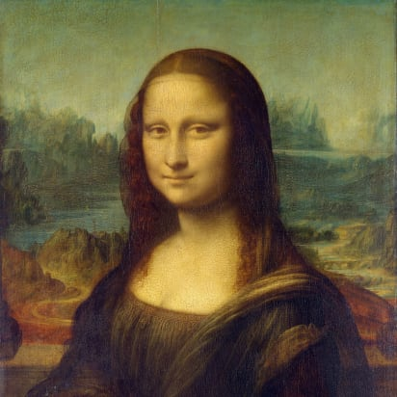
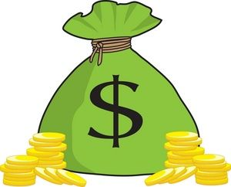
Two Types of Knapsack Problem
0/1 knapsack problem
Each item is discrete: must choose all of it or none of it
Each x_{i} is 0 or 1
Greedy approach does not produce optimal solutions
But dynamic programming does
Fractional knapsack problem (AKA weighted knapsack)
Can pick up fractions of each item So each x_{i} is a value between 0 or 1
A greedy algorithm finds the optimal solution

Slide 13
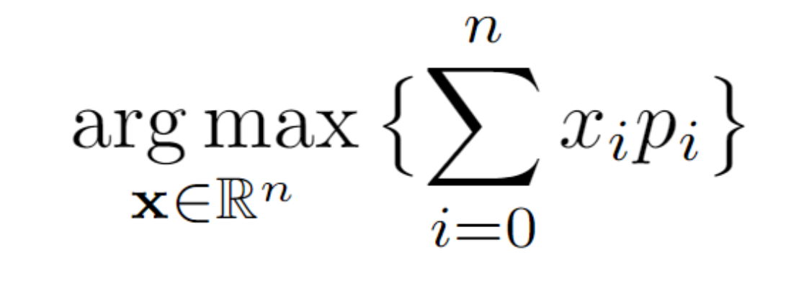




Fractional Knapsack Problem Statement
Given n objects and a knapsack of capacity C, where object i has total weight w_{i} and earns profit p_{i}, find values x_{i} that maximize the total profit (objective function):
subject to the constraints:
x
Objective function
$$x_{1}$$
$$x_{2}$$
$$x_{3}$$
$$x_{n}$$

Slide 14
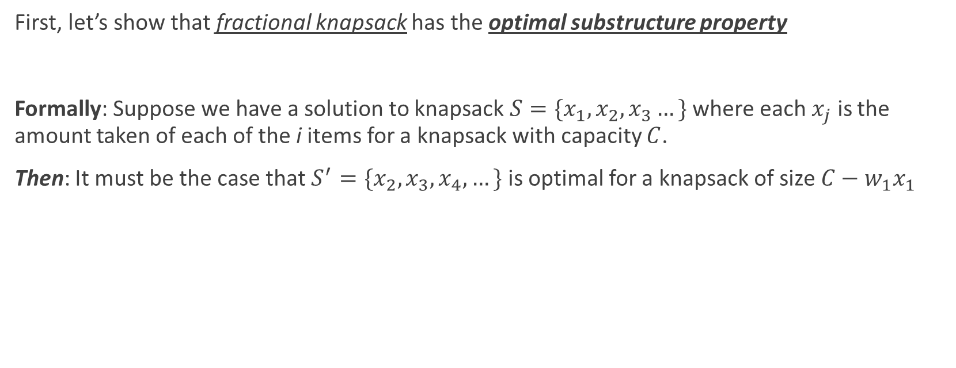
Optimal Substructure Proof
First, let’s show that fractional knapsack has the optimal substructure property
Formally: Suppose we have a solution to knapsack $S=\{x_{1},x_{2},x_{3}…\}$ where each $x_{j}$ is the amount taken of each of the i items for a knapsack with capacity $C$.
Then: It must be the case that $S^{′}=\{x_{2},x_{3},x_{4},…\}$ is optimal for a knapsack of size $C−{w_{1}x}_{1}$

Slide 15
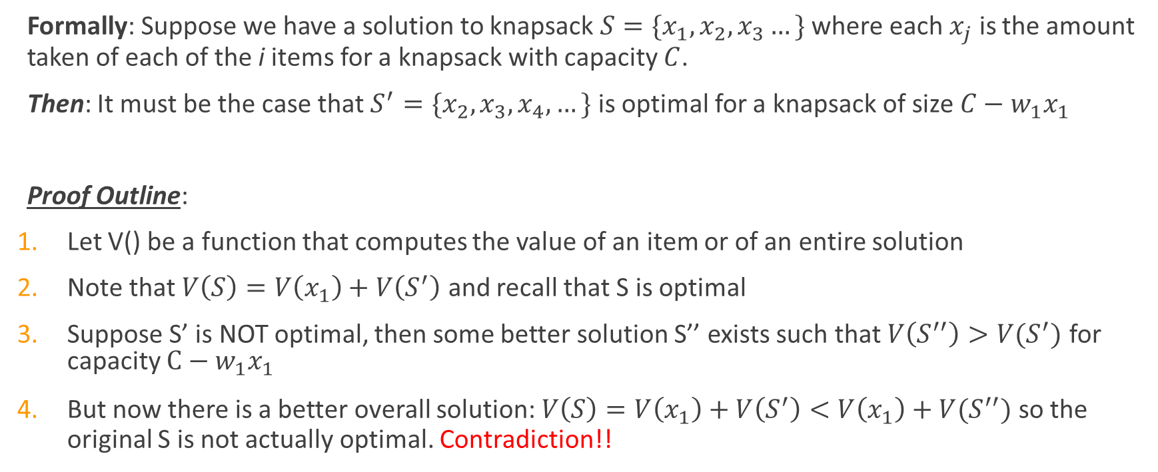
Optimal Substructure Proof
Formally: Suppose we have a solution to knapsack $S=\{x_{1},x_{2},x_{3}…\}$ where each $x_{j}$ is the amount taken of each of the i items for a knapsack with capacity $C$.
Then: It must be the case that $S^{′}=\{x_{2},x_{3},x_{4},…\}$ is optimal for a knapsack of size $C−{w_{1}x}_{1}$
Proof Outline:
Let V() be a function that computes the value of an item or of an entire solution
Note that $V\left(S\right)=V\left(x_{1}\right)+V\left(S^{′}\right)$ and recall that S is optimal
Suppose S’ is NOT optimal, then some better solution S’’ exists such that $V\left(S^{′′}\right)>V(S^{′})$ for capacity $C−{w_{1}x}_{1}$
But now there is a better overall solution: $V\left(S\right)=V\left(x_{1}\right)+V\left(S^{′}\right)<V\left(x_{1}\right)+V(S^{′′})$ so the original S is not actually optimal. Contradiction!!

Slide 16
Greedy Approach for Fractional Knapsack
Build up a partial solutions:
Determine which of the remaining items to add
How much can you add (its x_{i})
Repeat until knapsack is full (or no more items)
What’s a good greedy choice?
Let’s try several options on this example:
Item | Value | Weight
1 | 25 | 18
2 | 24 | 15
3 | 15 | 10
n = 3, C = 20

Slide 17
Possible Greedy Choices for Knapsack
Greedy choice #1: by highest profit value
n = 3, C = 20
Item 1 first. Can take all of it, so x₁ is 1. Capacity used is 18 of 20. Profit so far is 25.
Item 2 next. Room for only 2 units, so x₂ is 2/15 = 0.133. Capacity used is 20 of 20. Profit so far is 25 + (24 x 0.133) = 28.2.
Item 3 would be next, but knapsack full! x₃ is 0. Total profit is 28.2. x = [1, .133, 0]
Item | Value | Weight
1 | 25 | 18
2 | 24 | 15
3 | 15 | 10
Select item 1 first, then item 2, then item 3. Take as much of each as fits!

Slide 18
Possible Greedy Choices for Knapsack
Greedy choice #2: by lowest weight
n = 3, C = 20
Item 3 first. Can take all of it, so x₃ is 1. Capacity used is 10 of 20. Profit so far is 15.
Item 2 next. Room for only 10 units, so x₂ is 10/15 = 0.667. Capacity used is 20 of 20. Profit so far is 15 + (24 x 0.667) = 31.
Item 1 would be next, but knapsack full! x₁ is 0. Total profit is 31.0. x_{i} = (0, .667, 1)
Note it’s better than previous greedy choice.
Best possible?
Item | Value | Weight
1 | 25 | 18
2 | 24 | 15
3 | 15 | 10
Select item 3 first, then item 2, then item 1. Take as much of each as fits!

Slide 19
Possible Greedy Choices for Knapsack
Greedy choice #3: highest value-to-weight ratio
n = 3, C = 20
Item 2 first. Can take all of it, so x₂ is 1. Capacity used is 15 of 20. Profit so far is 24.
Item 3 next. Room for only 5 units, so x₁ is 5/10 = 0.5. Capacity used is 20 of 20. Profit so far is 24 + (15 x 0.5) = 31.5.
Item 1 would be next, but knapsack full! x₁ is 0. Total profit is 31.5. x_{i} = (0, 1, 0.5)
This greedy choice produces optimal solution!
Must prove this.
Item | Value | Weight | Ratio
1 | 25 | 18 | 1.4
2 | 24 | 15 | 1.6
3 | 15 | 10 | 1.5
Select item 2 first, then item 3, then item 1. Take as much of each as fits!

Slide 20
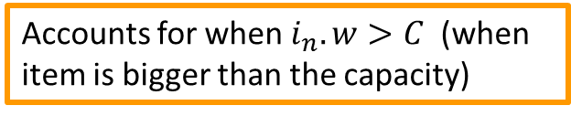
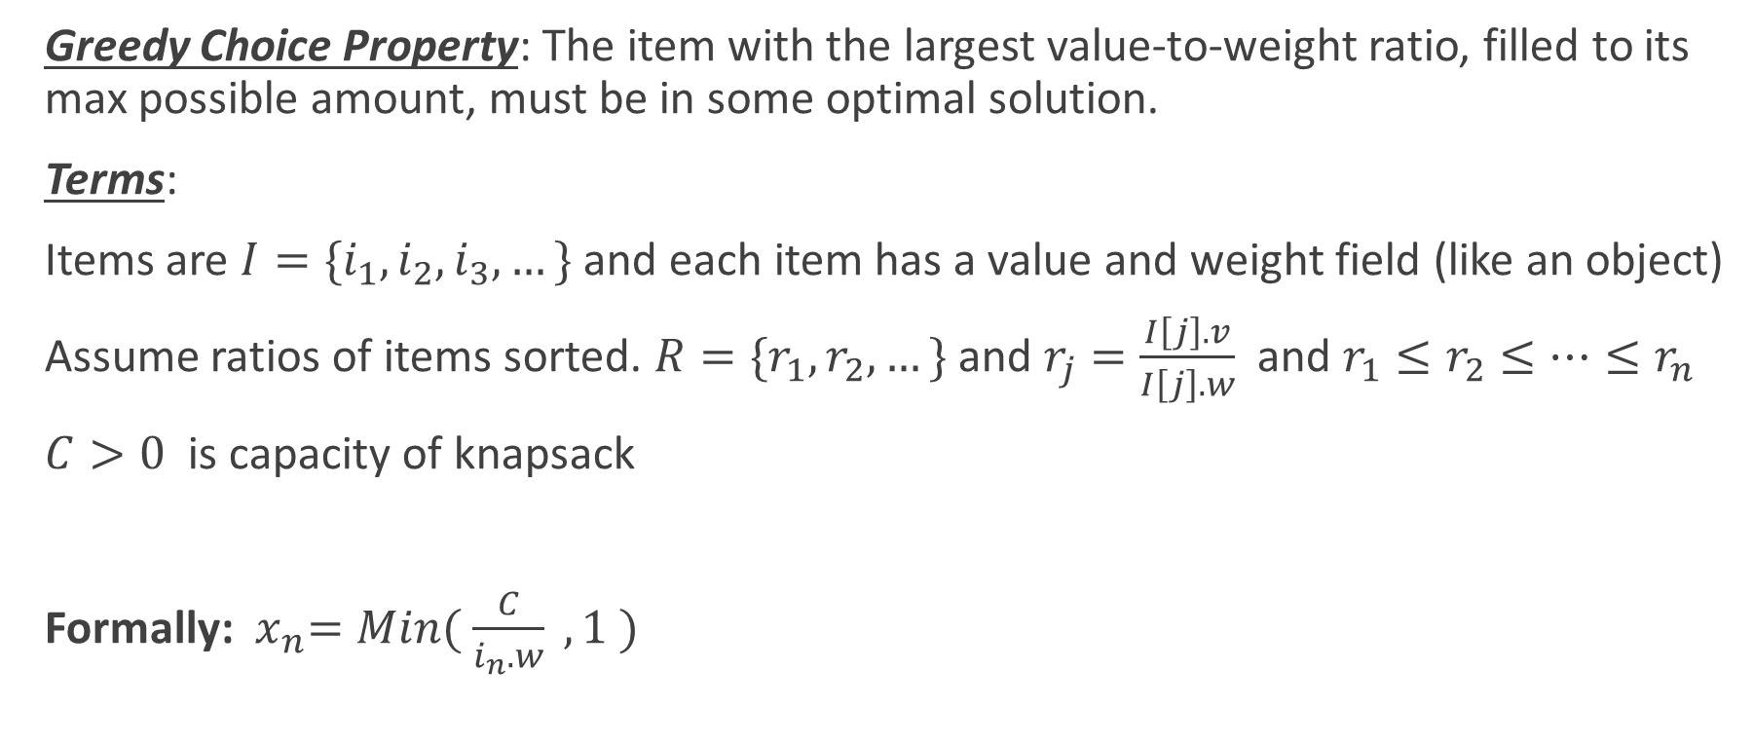
Greedy Choice Property
Greedy Choice Property: The item with the largest value-to-weight ratio, filled to its max possible amount, must be in some optimal solution.
Terms:
Items are $I=\{i_{1}, i_{2},i_{3},…\}$ and each item has a value and weight field (like an object)
Assume ratios of items sorted. $R=\{r_{1},r_{2},…\}$ and $r_{j}=\frac{I\left[j\right].v}{I\left[j\right].w}$ and $r_{1}≤r_{2}≤…≤r_{n}$
$C>0$ is capacity of knapsack
Formally: ${ x}_{n}=Min( \frac{C}{i_{n}.w} ,1 )$
Accounts for when $i_{n}.w>C$(when item is bigger than the capacity)
Otherwise, take the whole item

Slide 21
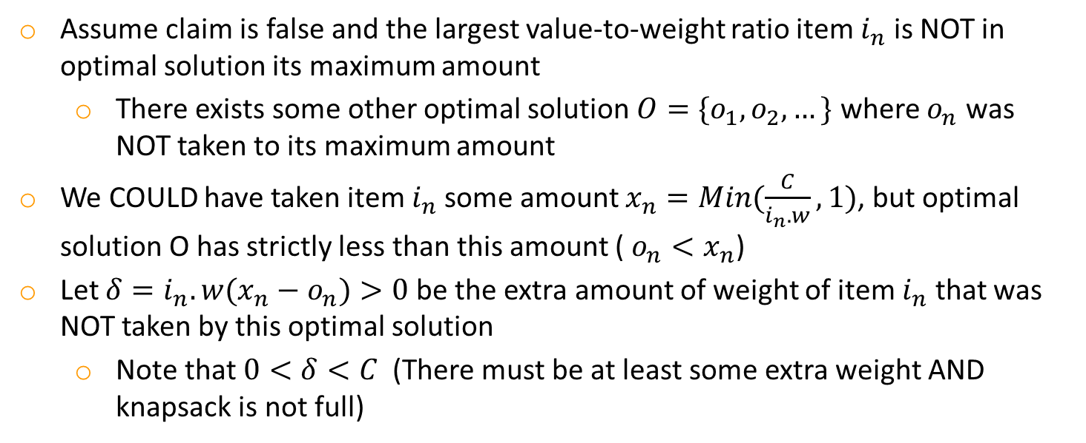



Greedy Choice Property Proof
Greedy Choice Property: The item with the largest value-to-weight ratio, filled to its max possible amount w.r.t. knapsack capacity, must be in some optimal solution.
Proof (Exchange Argument):
Assume claim is false and the largest value-to-weight ratio item $i_{n}$ is NOT in optimal solution its maximum amount
There exists some other optimal solution $O=\{o_{1},o_{2},…\}$ where $o_{n}$ was NOT taken to its maximum amount
We COULD have taken item $i_{n}$some amount $x_{n}=Min(\frac{C}{i_{n}.w},1)$, but optimal solution O has strictly less than this amount ( $o_{n}<x_{n}$)
Let $δ={i_{n}.w(x}_{n}−o_{n})>0$ be the extra amount of weight of item $i_{n}$ that was NOT taken by this optimal solution
Note that $0<δ<C$ (There must be at least some extra weight AND knapsack is not full)
Optimal Solution O
$$δ$$
$${i_{n}.w∗x}_{n}$$
$${i_{n}.w∗o}_{n}$$
Optimally Filled

Slide 22


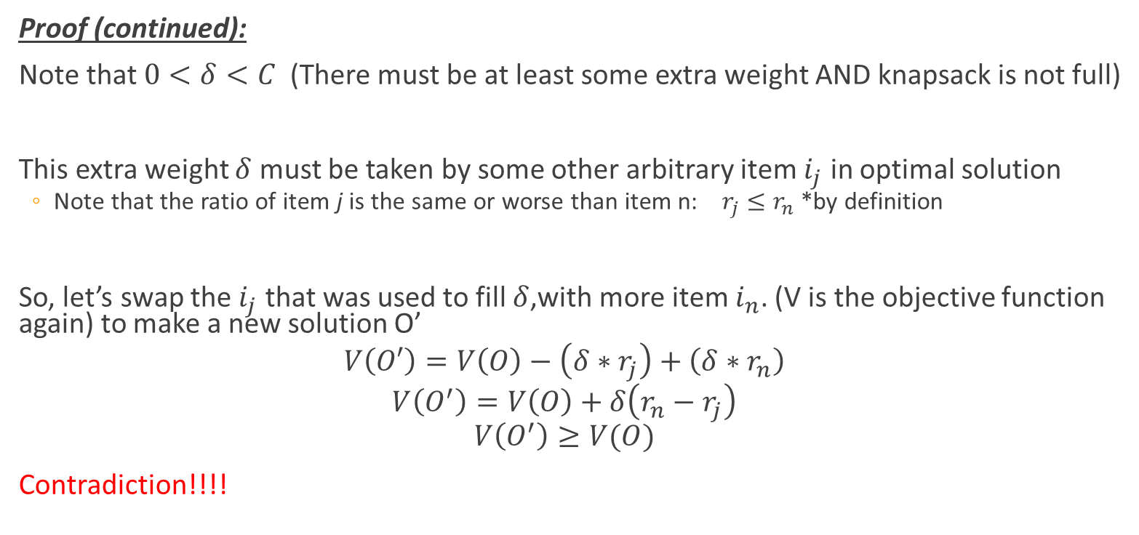



Greedy Choice Property Proof
Proof (continued):
Note that $0<δ<C$ (There must be at least some extra weight AND knapsack is not full)
This extra weight $δ$ must be taken by some other arbitrary item $i_{j}$ in optimal solution
Note that the ratio of item j is the same or worse than item n: $r_{j}≤r_{n}$ *by definition
So, let’s swap the $i_{j}$ that was used to fill $δ$,with more item $i_{n}$. (V is the objective function again) to make a new solution O’
$$V\left(O′\right)=V\left(O\right)−\left(δ∗r_{j}\right)+\left(δ∗r_{n}\right)$$
$$V\left(O^{′}\right)=V\left(O\right)+δ\left(r_{n}−r_{j}\right)$$
$$V\left(O^{′}\right)≥V(O)$$
Contradiction!!!!
Optimal Solution O’
Optimal Solution O
$$δ$$
$$i_{j}$$
$$δ$$
$$i_{n}$$
$$i_{n}$$
Optimally Filled

Slide 23
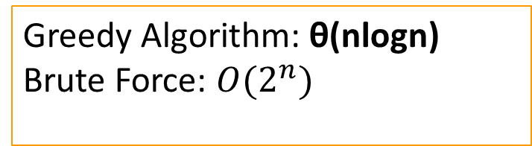
Fractional Knapsack Algorithm
FRACTIONAL_KNAPSACK(a, C)
1 n = a.last
2 for i = 1 to n
3 ratio[i] = a[i].p / a[i].w
4 sort(a, ratio)
5 weight = 0
6 i = n
7 while (i >= 0 and weight < C)
8 if (weight + a[i].w ≤ C)
9 println “select all of object “ + a[i].id
10 weight = weight + a[i].w
11 else
12 r = (C – weight) / a[i].w
13 println “select “ + r + “ of object “ + a[i].id
14 weight = C
15 i = i-1
Sorting is θ(nlogn)
For loop and while loop take θ(n) time
Greedy Algorithm: θ(nlogn) Brute Force: $O(2^{n})$

Slide 24
Another Knapsack Example to Try
Assume for this problem that:
Ratios of profit to weight:
What order do we examine items?
What are the x_{i} values that result?
What’s the total profit?
p₁/w₁ = 5/120 = .0417
p₂/w₂ = 5/150 = .0333
p₃/w₃ = 4/200 = .0200
p₄/w₄ = 8/150 = .0533
p₅/w₅ = 3/140 = .0214

Slide 25
0/1 Knapsack
n = 3, C = 4
Let’s try this same greedy solution with the 0/1 version
New example inputs →
Item 1 first. So x₁ is 1. Capacity used is 1 of 4. Profit so far is 3.
Item 2 next. There’s room for it! So x₂ is 1. Capacity used is 3 of 4. Profit so far is 3 + 5 = 8.
Item 3 would be next, but its weight is 3 and knapsack only has 1 unit left! So x₃ is 0. Total profit is 8. x_{i} = (1, 1, 0)
But picking items 1 and 3 will fit in knapsack, with total value of 9
Thus, the greedy solution does not produce an optimal solution to the 0/1 knapsack algorithm
Greedy choice left unused room, but we can’t take a fraction of an item
The 0/1 knapsack problem doesn’t have the greedy choice property
Item | Value | Weight | Ratio
1 | 3 | 1 | 3
2 | 5 | 2 | 2.5
3 | 6 | 3 | 2

Slide 26
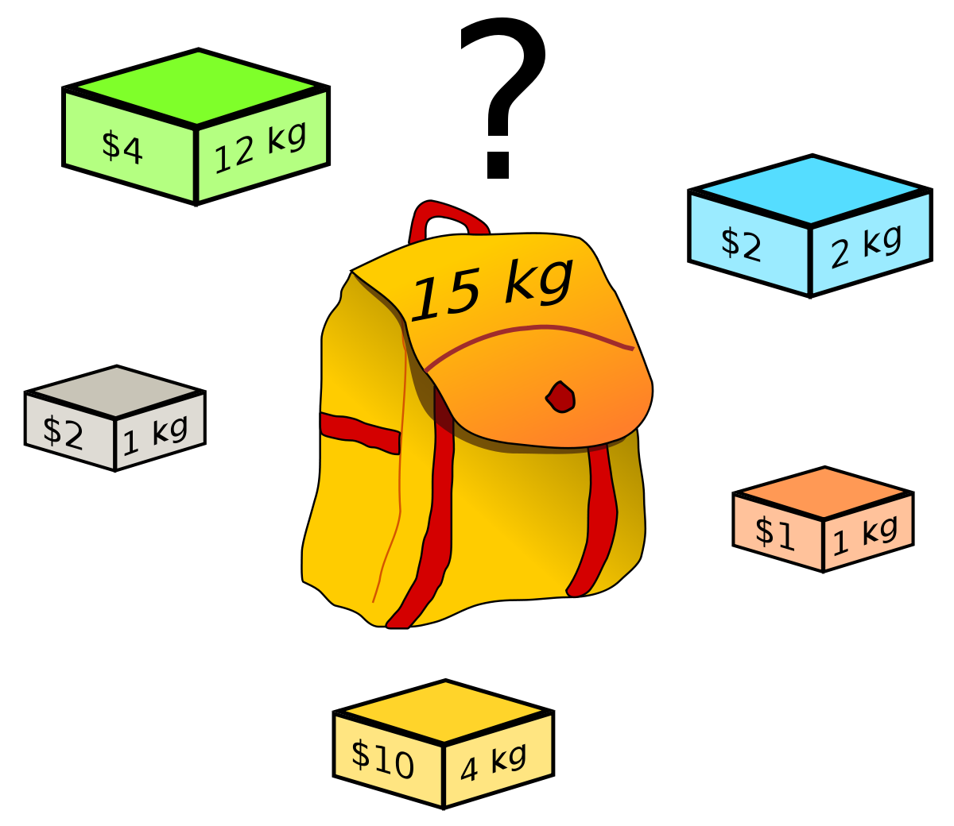
Recap
Optimization problems can sometimes be solved by Greedy Algorithms
Discussed “Optimization Problem Solving Tree” to determine which algorithmic approach best suits your problem
Greedy Algorithms require the problem to have:
Optimal Substructure
Greedy Choice Property
Weighted Knapsack Problem
Proved optimal substructure
Formulated the Greedy Choice function
Proved the greedy choice function is optimal
Exchange argument

