Slide 1
CSE 332 Winter 2026
Lecture 7: Recurrences, Dictionaries, BSTs
Nathan Brunelle
http://www.cs.uw.edu/332

Slide 2
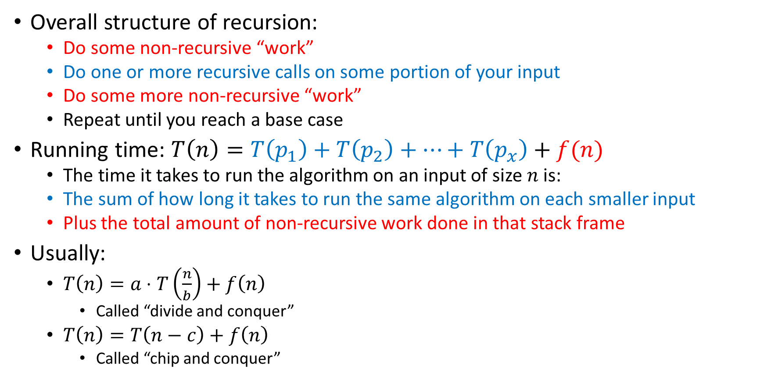
Analysis of Recursive Algorithms
Overall structure of recursion:
  Do some non-recursive “work”
  Do one or more recursive calls on some portion of your input
  Do some more non-recursive “work”
  Repeat until you reach a base case
Running time: $T\left(n\right)=T\left(p_{1}\right)+T\left(p_{2}\right)+…+T\left(p_{x}\right)+f(n)$
  The time it takes to run the algorithm on an input of size $n$ is:
  The sum of how long it takes to run the same algorithm on each smaller input
  Plus the total amount of non-recursive work done in that stack frame
Usually:
  $T\left(n\right)=a⋅T\left(\frac{n}{b}\right)+f\left(n\right)$
    Called “divide and conquer”
  $T\left(n\right)=T\left(n−c\right)+f\left(n\right)$
    Called “chip and conquer”

Slide 3
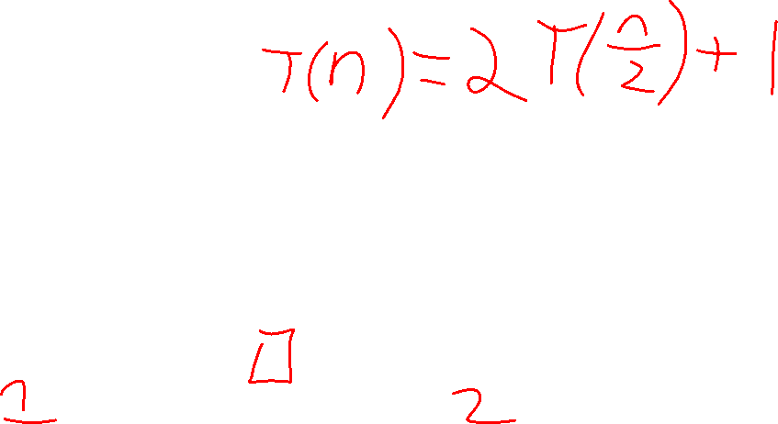
Recursive List Summation
public int sum(int[] list){
return sum_helper(list, 0, list.size);
}
private int sum_helper(int[] list, int low, int high){
if (low == high){ return 0; }
if (low == high-1){ return list[low]; }
int middle = (high+low)/2;
return sum_helper(list, low, middle) + sum_helper(list, middle, high);
}

Slide 4








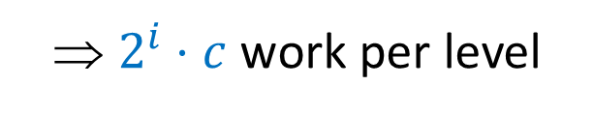


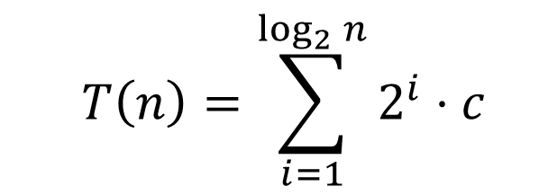


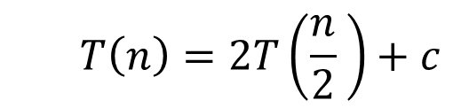


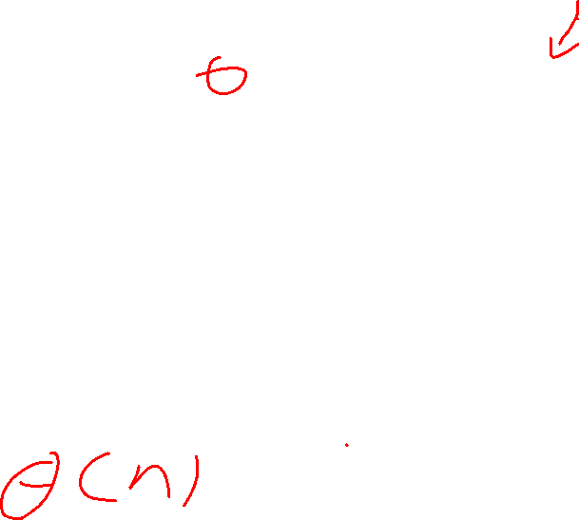






Tree Method
  $$T\left(n\right)=2T\left(\frac{n}{2} \right)+c$$
Red box represents a problem instance
Blue value represents time spent at that level of recursion
$$c$$
⇒ $2^{i}⋅c$ work per level
$$n$$
$$n/2$$
$$c$$
$$n/2$$
$$c$$
$$c$$
$$c$$
$$c$$
$$c$$
$\log_{2}⁡n$ levels
of recursion
$$n/4$$
$$n/4$$
$$n/4$$
$$n/4$$
…
…
…
…
…
$$1$$
$$1$$
$$1$$
$$1$$
$$1$$
$$1$$
$$1$$
$$1$$
$$1$$
$$1$$
$$1$$
$$1$$
  $$T\left(n\right)=\sum_{i=1}^{\log_{2}{n}}{2^{i}⋅c}$$

Slide 5
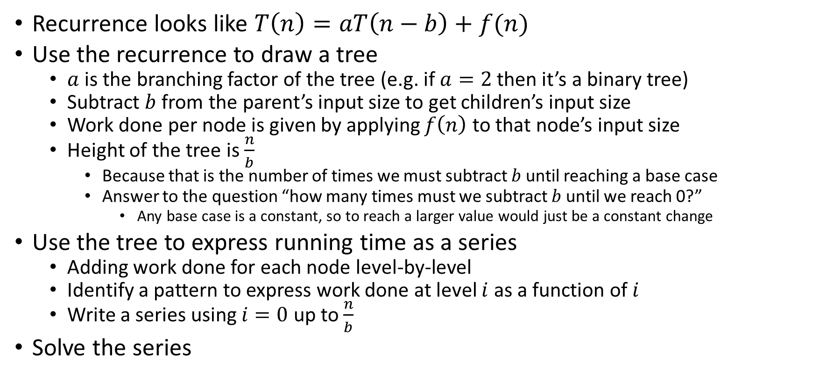
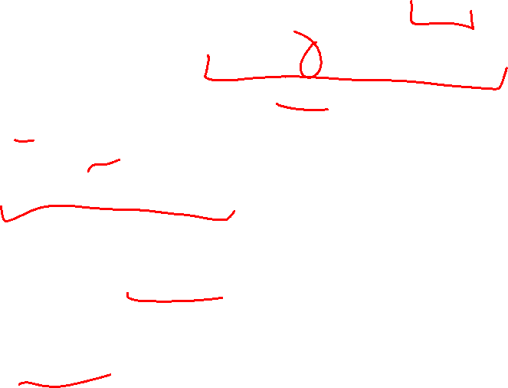
Tree Method Summary: Chip and Conquer
Recurrence looks like $T\left(n\right)=aT\left(n−b\right)+f(n)$
Use the recurrence to draw a tree
  $a$ is the branching factor of the tree (e.g. if $a=2$ then it’s a binary tree)
  Subtract $b$ from the parent’s input size to get children’s input size
  Work done per node is given by applying $f\left(n\right)$ to that node’s input size
  Height of the tree is $\frac{n}{b}$
    Because that is the number of times we must subtract $b$ until reaching a base case
    Answer to the question “how many times must we subtract $b$ until we reach 0?”
      Any base case is a constant, so to reach a larger value would just be a constant change
Use the tree to express running time as a series
  Adding work done for each node level-by-level
  Identify a pattern to express work done at level $i$ as a function of $i$
  Write a series using $i=0$ up to $\frac{n}{b}$
Solve the series

Slide 6
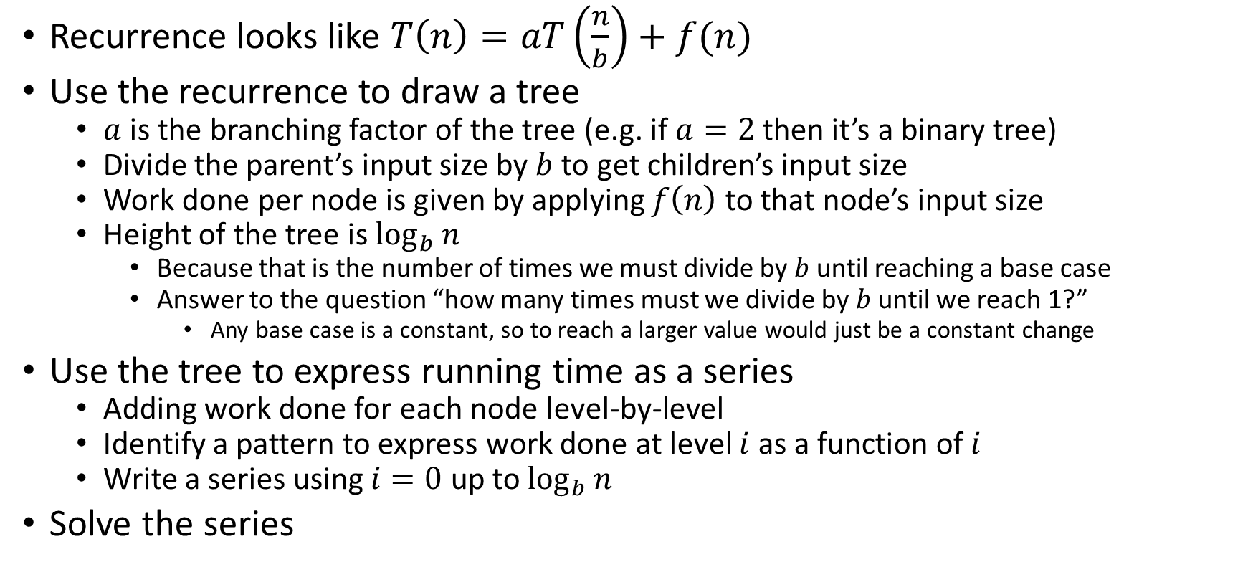
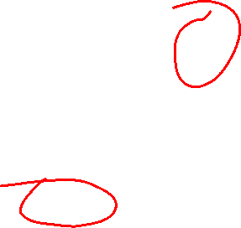
Tree Method Summary: Divide and Conquer
Recurrence looks like $T\left(n\right)=aT\left(\frac{n}{b}\right)+f(n)$
Use the recurrence to draw a tree
  $a$ is the branching factor of the tree (e.g. if $a=2$ then it’s a binary tree)
  Divide the parent’s input size by $b$ to get children’s input size
  Work done per node is given by applying $f\left(n\right)$ to that node’s input size
  Height of the tree is $\log_{b}{n}$
    Because that is the number of times we must divide by $b$ until reaching a base case
    Answer to the question “how many times must we divide by $b$ until we reach 1?”
      Any base case is a constant, so to reach a larger value would just be a constant change
Use the tree to express running time as a series
  Adding work done for each node level-by-level
  Identify a pattern to express work done at level $i$ as a function of $i$
  Write a series using $i=0$ up to $\log_{b}{n}$
Solve the series

Slide 7


Let’s do some more!
For each, assume the base case is $n=1$ and $T\left(1\right)=1$
$T\left(n\right)=2T\left(\frac{n}{2}\right)+n$
$T\left(n\right)=2T\left(\frac{n}{2}\right)+n^{2}$
$T\left(n\right)=2T\left(\frac{n}{8}\right)+1$

Slide 8




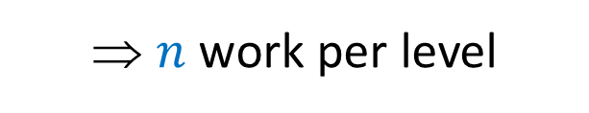


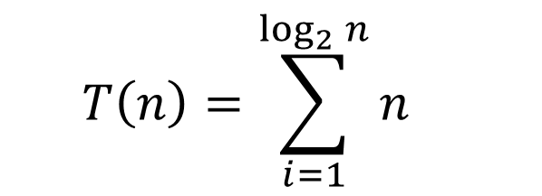
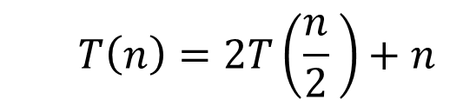


Tree Method
  $$T\left(n\right)=2T\left(\frac{n}{2} \right)+n$$
Red box represents a problem instance
Blue value represents time spent at that level of recursion
$$n$$
⇒ $n$ work per level
$$n$$
$$n/2$$
$$\frac{n}{2}$$
$$n/2$$
$$\frac{n}{2}$$
$$\frac{n}{4}$$
$$\frac{n}{4}$$
$$\frac{n}{4}$$
$$\frac{n}{4}$$
$\log_{2}⁡n$ levels
of recursion
$$n/4$$
$$n/4$$
$$n/4$$
$$n/4$$
…
…
…
…
…
$$1$$
$$1$$
$$1$$
$$1$$
$$1$$
$$1$$
$$1$$
$$1$$
$$1$$
$$1$$
$$1$$
$$1$$
  $$T\left(n\right)=\sum_{i=1}^{\log_{2}{n}}{n}$$

Slide 9





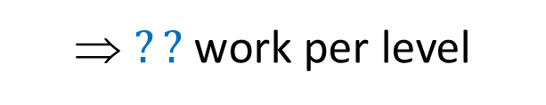


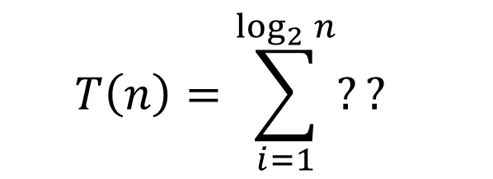
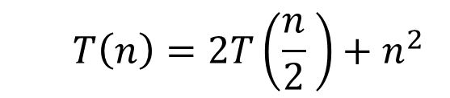


Tree Method
  $$T\left(n\right)=2T\left(\frac{n}{2} \right)+n^{2}$$
Red box represents a problem instance
Blue value represents time spent at that level of recursion
$$n^{2}$$
⇒ $??$ work per level
$$n$$
$$n/2$$
$$\frac{n^{2}}{4}$$
$$n/2$$
$$\frac{n^{2}}{4}$$
$$\frac{n^{2}}{16}$$
$$\frac{n^{2}}{16}$$
$$\frac{n^{2}}{16}$$
$$\frac{n^{2}}{16}$$
$\log_{2}⁡n$ levels
of recursion
$$n/4$$
$$n/4$$
$$n/4$$
$$n/4$$
…
…
…
…
…
$$1$$
$$1$$
$$1$$
$$1$$
$$1$$
$$1$$
$$1$$
$$1$$
$$1$$
$$1$$
$$1$$
$$1$$
  $$T\left(n\right)=\sum_{i=1}^{\log_{2}{n}}{??}$$

Slide 10


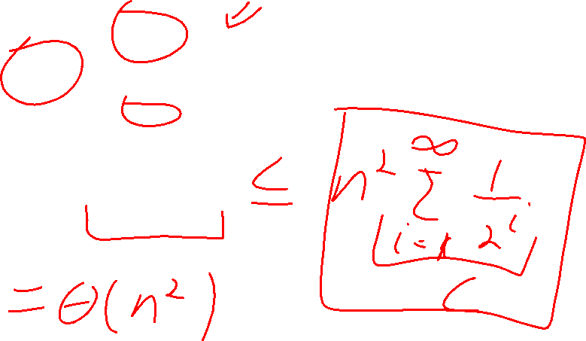
Solving $T\left(n\right)=2T\left(\frac{n}{2}\right)+n^{2}$
  $$T\left(n\right)=\sum_{i=1}^{\log_{2}{n}}{\frac{n^{2}}{2^{i}}}$$
  $$=n^{2}⋅\sum_{i=1}^{\log_{2}{n}}{{\left(\frac{1}{2}\right)}^{i}}$$

Slide 11


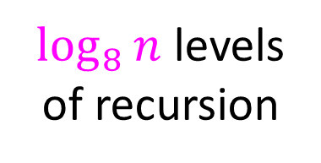




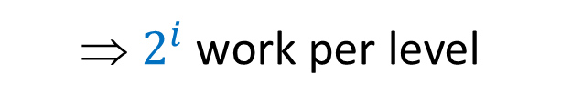

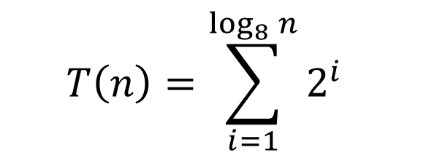

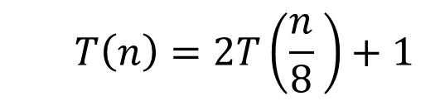






Tree Method
  $$T\left(n\right)=2T\left(\frac{n}{8} \right)+1$$
Red box represents a problem instance
Blue value represents time spent at that level of recursion
$$1$$
⇒ $2^{i}$ work per level
$$n$$
$$n/8$$
$$1$$
$$n/8$$
$$1$$
$$1$$
$$1$$
$$1$$
$$1$$
$\log_{8}⁡n$ levels
of recursion
$$n/{64}$$
$$n/{64}$$
$$n/{64}$$
$$n/{64}$$
…
…
…
…
…
$$1$$
$$1$$
$$1$$
$$1$$
$$1$$
$$1$$
$$1$$
$$1$$
$$1$$
$$1$$
$$1$$
$$1$$
  $$T\left(n\right)=\sum_{i=1}^{\log_{8}{n}}{2^{i}}$$

Slide 12


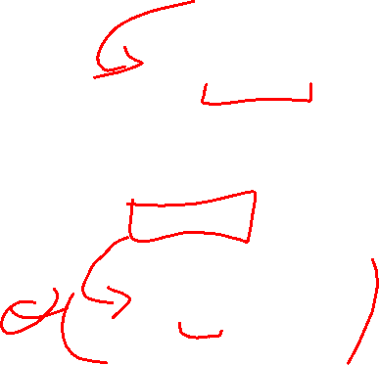
Solving $T\left(n\right)=2T\left(\frac{n}{8}\right)+1$
  $$T\left(n\right)=\sum_{i=1}^{\log_{8}{n}}{2^{i}}$$
  $$=\left(\frac{1−2^{\log_{8}{n}}}{1−2}\right)$$
  $$=2^{\log_{8}{n}}−1$$
  $$=n^{\log_{8}{2}}=n^{\frac{1}{3}}$$

Slide 13

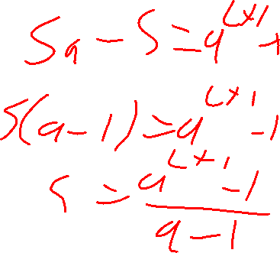


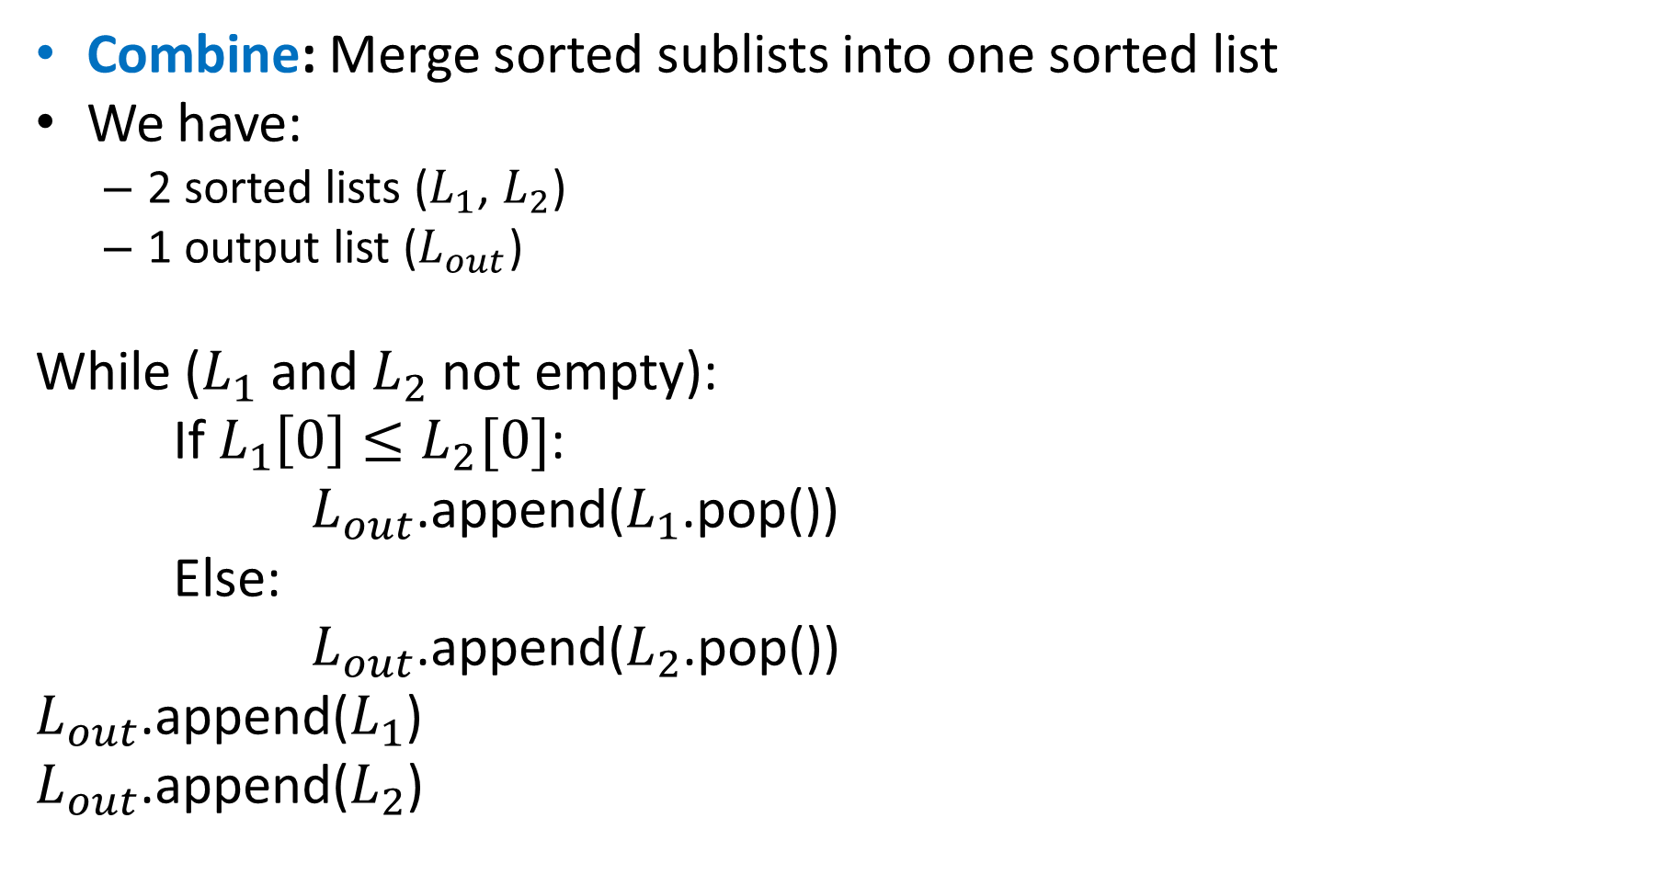
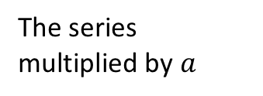

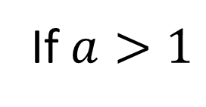



Finite Geometric Series
$$\sum_{i=0}^{L}{a^{i}}$$
If $a>1$
$$−$$
$$−$$
$$=$$
The series multiplied by $a$
The next term in the series
The series
The first term
$$\left(1+a+a^{2}+…+a^{L}\right)a$$
$$\left(1+a+a^{2}+…+a^{L}\right)1$$
$$a^{L+1}$$
$$1$$

Slide 14
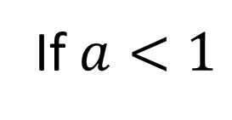
Finite Geometric Series
$$\sum_{i=0}^{L}{a^{i}}$$
If $a<1$
$$−$$
$$−$$
$$=$$
The series multiplied by $a$
The next term in the series
The series
The first term
$$\left(1+a+a^{2}+…+a^{L}\right)a$$
$$\left(1+a+a^{2}+…+a^{L}\right)1$$
$$a^{L+1}$$
$$1$$
Solve for the series

Slide 15
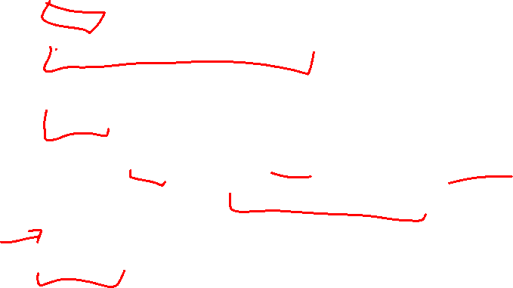
Dictionary (Map) ADT
Contents:
  Sets of key+value pairs
  Keys must be comparable
Operations:
  insert(key, value)
    Adds the (key,value) pair into the dictionary
    If the key already has a value, overwrite the old value
      Consequence: Keys cannot be repeated
  find(key)
    Returns the value associated with the given key
  delete(key)
    Remove the key (and its associated value)

Slide 16
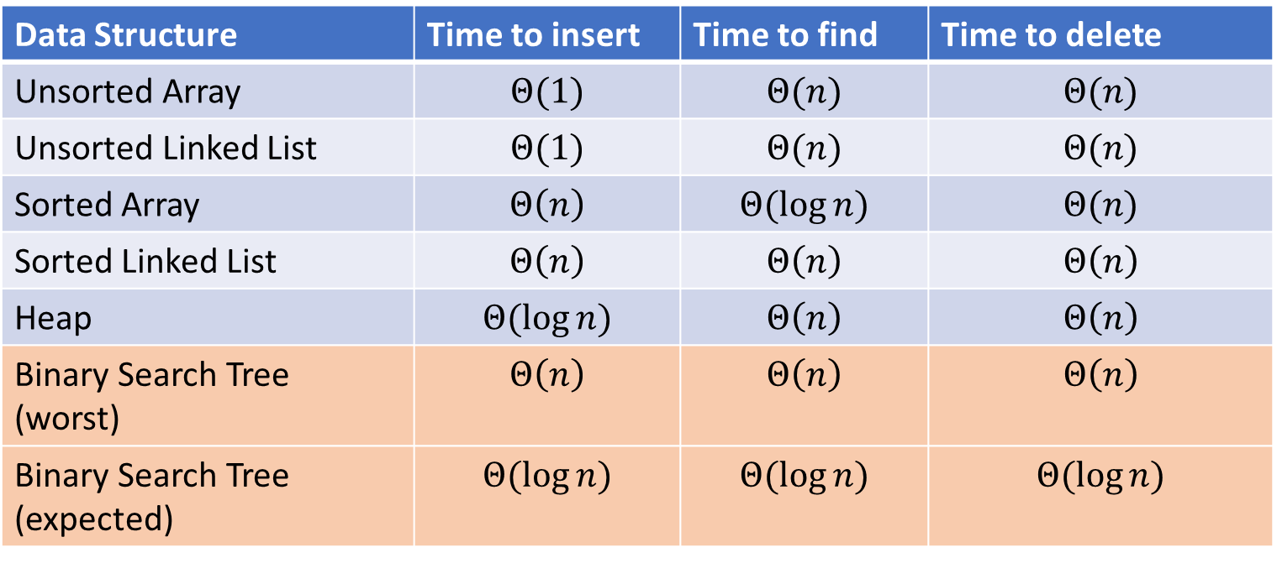
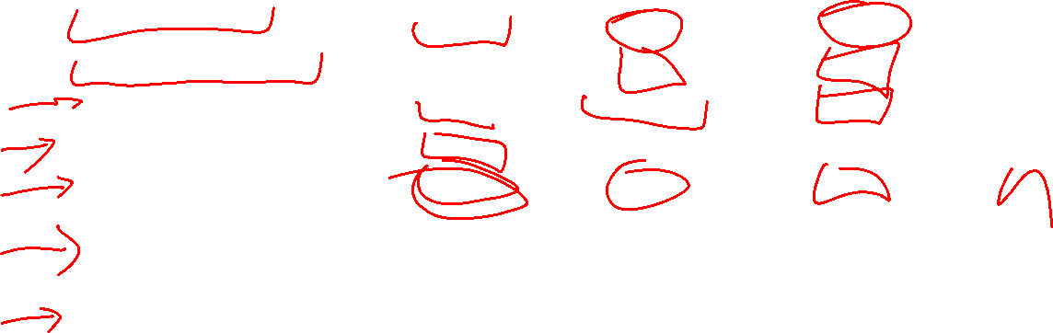
Naïve attempts
Data Structure | Time to insert | Time to find | Time to delete
Unsorted Array | $$Θ(1)$$ | $$Θ(n)$$ | $$Θ(n)$$
Unsorted Linked List | $$Θ(1)$$ | $$Θ(n)$$ | $$Θ(n)$$
Sorted Array | $$Θ\left(n\right)$$ | $$Θ(\log{n})$$ | $$Θ(n)$$
Sorted Linked List | $$Θ\left(n\right)$$ | $$Θ\left(n\right)$$ | $$Θ\left(n\right)$$
Heap | $$Θ(\log{n})$$ | $$Θ\left(n\right)$$ | $$Θ\left(n\right)$$
Binary Search Tree (worst) | $$Θ\left(n\right)$$ | $$Θ\left(n\right)$$ | $$Θ\left(n\right)$$
Binary Search Tree (expected) | $$Θ(\log{n})$$ | $$Θ(\log{n})$$ | $$Θ(\log{n})$$

Slide 17
More Tree “Vocab”
D
U
B
Traversal:
  An algorithm for “visiting/processing” every node in a tree
Pre-Order Traversal:
  Root, Left Subtree, Right Subtree
  D U S 2 B
In-Order Traversal:
  Left Subtree, Root, Right Subtree
  S U 2 D B
Post-Order Traversal
  Left Subtree, Right Subtree, Root
  S 2 U B D
S
2

Slide 18
Name that Traversal!
AorderTraversal(root){
if (root.left != Null){
process(root.left);
}
if (root.right != Null){
process(root.right);
}
process(root);
}
BorderTraversal(root){
process(root);
if (root.left != Null){
process(root.left);
}
if (root.right != Null){
process(root.right);
}
}
CorderTraversal(root){
if (root.left != Null){
process(root.left);
}
process(root)
if (root.right != Null){
process(root.right);
}
}

Slide 19
Binary Search Tree
7
3
10
1
6
8
16
Binary Tree
  Definition:
    Tree where each node has at most 2 children
Order Property
  All keys in the left subtree are smaller than the root
  All keys in the right subtree are larger than the root
  Consequence: cannot have repeated values
0
2

Slide 20
Are these BSTs?
7
3
10
7
7
16
1
3
10
0
1
16
16
10
0
7
7
3
10
3
1
8
16
1
0
0

Slide 21
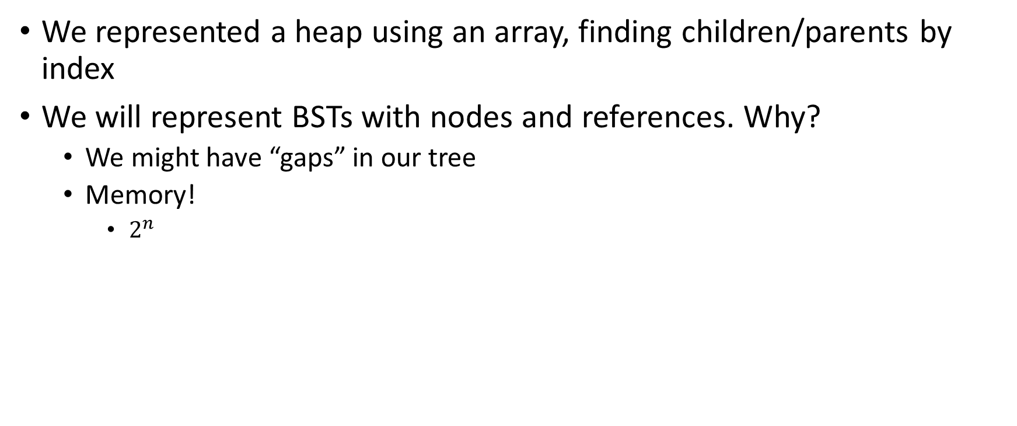
Aside: Why not use an array?
We represented a heap using an array, finding children/parents by index
We will represent BSTs with nodes and references. Why?
  We might have “gaps” in our tree
  Memory!
    $2^{n}$

Slide 22
Find Operation (recursive)
7
3
10
find(key, root){
if (root == Null){
return Null;
{
if (key == root.key){
return root.value;
}
if (key < root.key){
return find(key, root.left);
}
if (key > root.key){
return find(key, root.right);
}
return Null;
}
1
6
16
0

Slide 23
Find Operation (iterative)
7
3
10
find(key, root){
while (root != Null && key != root.key){
if (key < root.key){
root = root.left;
}
else if (key > root.key){
root = root.right;
}
}
if (root == Null){
return Null;
}
return root.value;
}
1
6
16
0

Slide 24
Insert Operation (recursive)
7
3
10
insert(key, value, root){
root = insertHelper(key, value, root);
}
insertHelper(key, value, root){
if(root == null)
return new Node(key, value);
if (root.key < key)
root.right = insertHelper(key, value, root.right);
else
root.left = insertHelper(key, value, root.left);
return root;
}
1
6
16
0
Note: Insert happens only at the leaves!

Slide 25
Insert Operation (iterative)
7
3
10
insert(key, value, root){
if (root == Null){ this.root = new Node(key, value); }
parent = Null;
while (root != Null && key != root.key){
parent = root;
if (key < root.key){ root = root.left; }
else if (key > root.key){ root = root.right; }
}
if (root != Null){ root.value = value; }
else if (key < parent.key){ parent.left = new Node(key, value); }
else{ parent.right = new Node (key, value); }
}
1
6
16
0
Note: Insert happens only at the leaves!

Slide 26
Delete Operation (iterative)
9
3
10
delete(key, root){
while (root != Null && key != root.key){
if (key < root.key){ root = root.left; }
else if (key > root.key){ root = root.right; }
}
if (root == Null){ return; }
// Now root is the node to delete, what happens next?
}
1
6
16
0
5
7

Slide 27
Delete – 3 Cases
9
3
10
1
6
16
0 Children (i.e. it’s a leaf)
1 Child
  Replace the deleted node with its child
2 Children
  Replace the deleted with the largest node to its left or else the smallest node to its right
0
5
7

Slide 28
Finding the Max and Min
9
3
10
maxNode(root){
if (root == Null){ return Null; }
while (root.right != Null){
root = root.right;
}
return root;
}
1
6
16
Max of a BST:
  Right-most Thing
Min of a BST:
  Left-most Thing
0
5
7
minNode(root){
if (root == Null){ return Null; }
while (root.left != Null){
root = root.left;
}
return root;
}

Slide 29
Delete Operation (iterative)
9
3
10
delete(key, root){
while (root != Null && key != root.key){
if (key < root.key){ root = root.left; }
else if (key > root.key){ root = root.right; }
}
if (root == Null){ return; }
if (root has no children){
make parent point to Null Instead;
}
if (root has one child){
make parent point to that child instead;
}
if (root has two children){
make parent point to either the max from the left or min from the right
}
}
1
6
16
0
5
7

Slide 30
Delete Operation (recursive)
9
3
10
delete(key, root){
if (root == Null){ return; } // key not present
if (root.key == key){
if (root has no children) { return Null; }
if (root has one child) { return that child; }
if (root has two children) {return removeMax(root.left);}
}
if (root.key < key) { root.right = delete(key, root.right); }
else { root.left = delete(key, root.left); }
}
1
6
16
0
5
7

