Slide 1
CSE 332 Winter 2024
Lecture 6: Priority Queues and recurrences
Nathan Brunelle
http://www.cs.uw.edu/332

Slide 2
ADT: Priority Queue
What is it?
  A collection of items and their “priorities”
  Allows quick access/removal to the “top priority” thing
What Operations do we need?
  insert(item, priority)
    Add a new item to the PQ with indicated priority
    Usually, smaller priority value means more important
  deleteMin
    Remove and return the “top priority” item from the queue
  Is_empty
    Indicate whether or not there are items still on the queue
Note: the “priority” value can be any type/class so long as it’s comparable (i.e. you can use “<“ or “compareTo” with it)

Slide 3
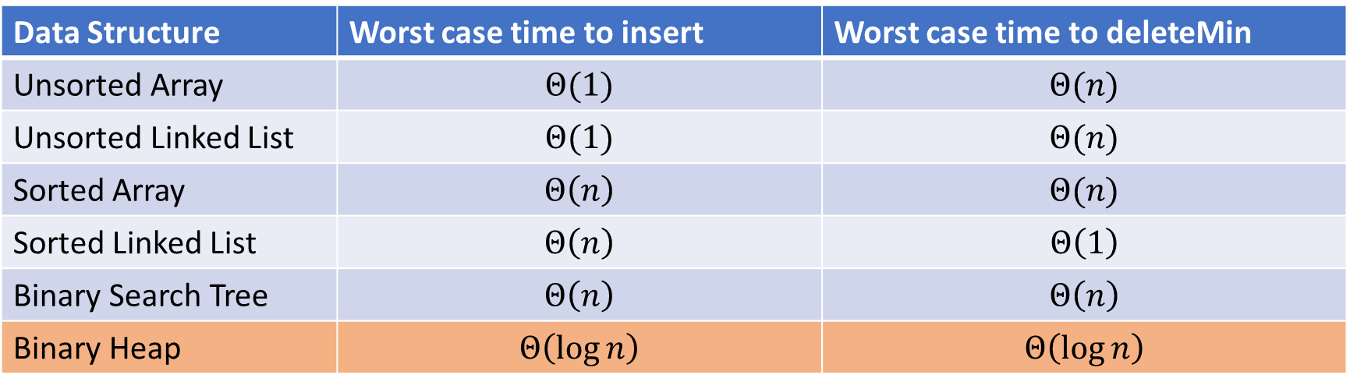
Thinking through implementations
Data Structure | Worst case time to insert | Worst case time to deleteMin
Unsorted Array | $$Θ(1)$$ | $$Θ(n)$$
Unsorted Linked List | $$Θ(1)$$ | $$Θ(n)$$
Sorted Array | $$Θ\left(n\right)$$ | $$Θ(n)$$
Sorted Linked List | $$Θ\left(n\right)$$ | $$Θ\left(1\right)$$
Binary Search Tree | $$Θ\left(n\right)$$ | $$Θ\left(n\right)$$
Binary Heap | $$Θ\left(\log{n}\right)$$ | $$Θ\left(\log{n}\right)$$
Note: Assume we know the maximum size of the PQ in advance

Slide 4

(Min) Heap Data Structure
Keep items in a complete binary tree
Maintain the “(Min) Heap Property” of the tree
  Every node’s priority is $≤$ its children’s priority
  Max Heap Property: every node’s priority is $≥$ its children
1
3
2
4
7
5
6
5
9

Slide 5
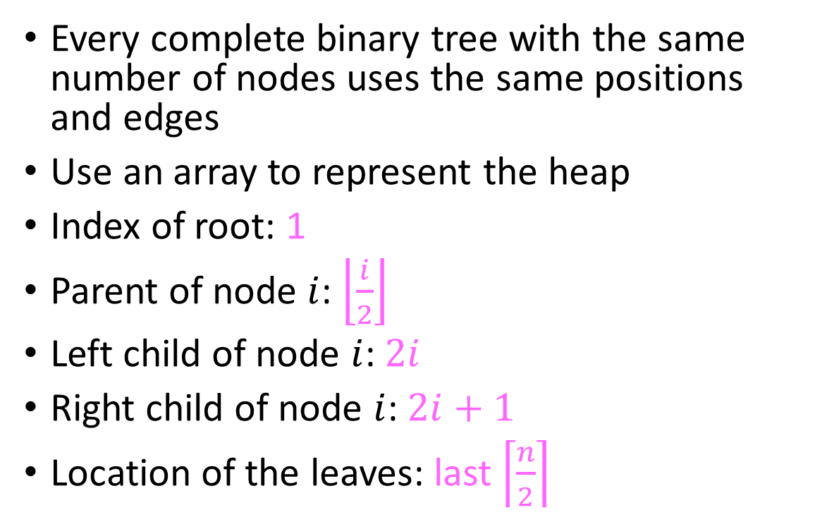
Representing a Heap
1
3
2
4
7
5
6
5
9
0
1
2
3
4
5
6
7
8
9
Every complete binary tree with the same number of nodes uses the same positions and edges
Use an array to represent the heap
Index of root: 1
Parent of node $i$: $\left\lfloor \frac{i}{2}\right\rfloor$
Left child of node $i$: $2i$
Right child of node $i$: $2i+1$
Location of the leaves: last $\left\lceil \frac{n}{2}\right\rceil$
1
1
3
2
4
2
7
5
3
6
4
5
6
7
5
9
8
9

Slide 6
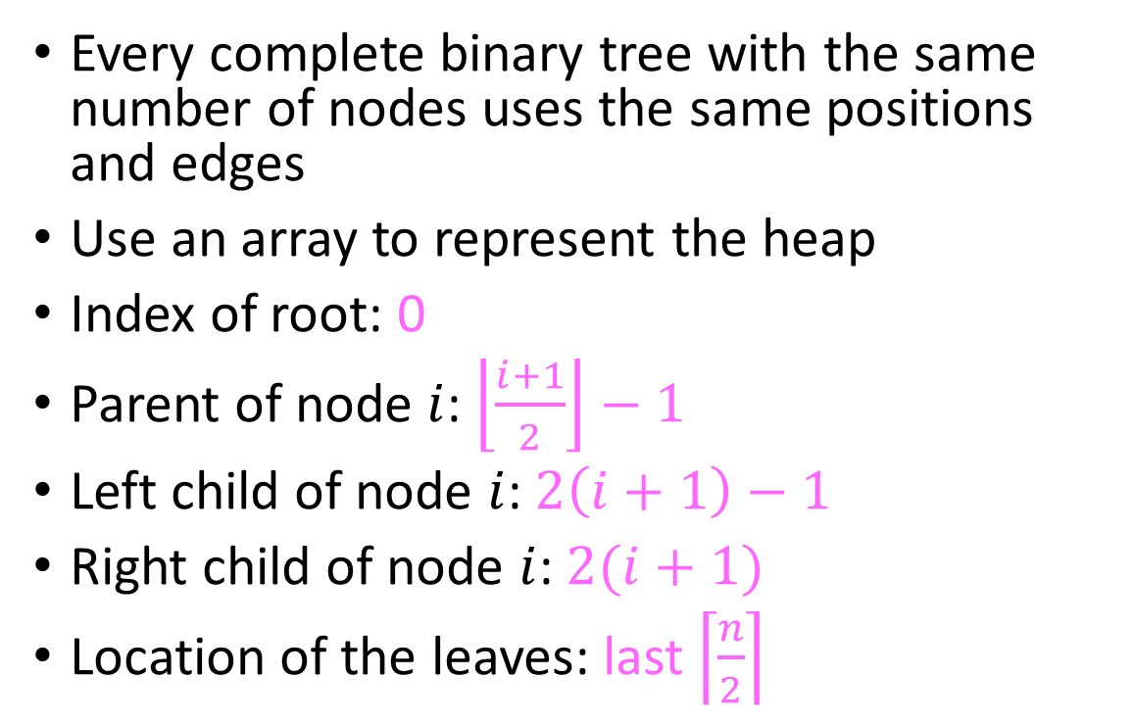
Representing a Heap
1
3
2
4
7
5
6
5
9
0
1
2
3
4
5
6
7
8
Every complete binary tree with the same number of nodes uses the same positions and edges
Use an array to represent the heap
Index of root: 0
Parent of node $i$: $\left\lfloor \frac{i+1}{2}\right\rfloor −1$
Left child of node $i$: $2\left(i+1\right)−1$
Right child of node $i$: $2(i+1)$
Location of the leaves: last $\left\lceil \frac{n}{2}\right\rceil$
1
0
3
2
4
1
7
5
2
6
3
4
5
6
5
9
7
8

Slide 7
Insert Psuedocode
1
3
2
4
7
5
6
5
9
0
1
2
3
4
5
6
7
8
9
10
insert(item){
if(size == arr.length – 1){resize();}
size++;
arr[i] = item;
percolateUp(i);
}
1
1
3
2
4
2
7
5
3
6
4
5
6
7
5
9
8
9

Slide 8
Heap extract
1
1.5
2
4
3
5
6
extract(){
min = arr[1];
last = arr[size--];
arr[1] = last;
percolateDown(1);
return min
}
5
9
7

Slide 9
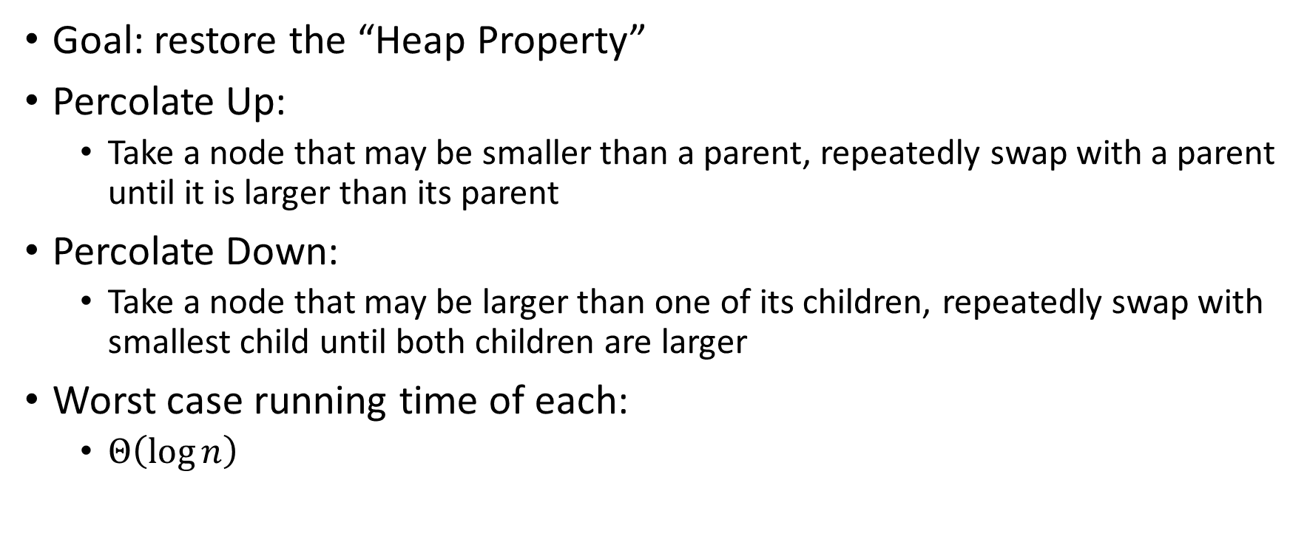
Percolate Up and Down (for a Min Heap)
Goal: restore the “Heap Property”
Percolate Up:
  Take a node that may be smaller than a parent, repeatedly swap with a parent until it is larger than its parent
Percolate Down:
  Take a node that may be larger than one of its children, repeatedly swap with smallest child until both children are larger
Worst case running time of each:
  $Θ\left(\log{n}\right)$

Slide 10
Percolate Up
percolateUp(int i){
int parent = i/2; \\ index of parent
Item val = arr[i]; \\ value at current location
while(i > 1 && arr[i].priority < arr[parent].priority){ \\ until location is root or heap property holds
arr[i] = arr[parent]; \\ move parent value to this location
arr[parent] = val; \\ put current value into parent’s location
i = parent; \\ make current location the parent
parent = i/2; \\ update new parent
}
}

Slide 11
Percolate Down
percolateDown(int i){
int left = i*2; \\ index of left child
int right = i*2+1; \\ index of right child
Item val = arr[i]; \\ value at location
while(left <= size){ \\ until location is leaf
int toSwap = right;
if(right > size || arr[left].priority < arr[right] .priority){ \\ if there is no right child or if left child is smaller
toSwap = left; \\ swap with left
} \\ now toSwap has the smaller of left/right, or left if right does not exist
if (arr[toSwap] .priority < val.priority){ \\ if the smaller child is less than the current value
arr[i] = arr[toSwap];
arr[toSwap] = val; \\ swap parent with smaller child
i = toSwap; \\ update current node to be smaller child
left = i*2;
right = i*2+1;
}
else{ return;} \\ if we don’t swap, then heap property holds
}
}

Slide 12
Other Operations
Increase Key
  Given the index of an item in the PQ, make its priority value larger
    Min Heap: Then percolate down
    Max Heap: Then percolate up
Decrease Key
  Given the index of an item in the PQ, make its priority value smaller
    Min Heap: Then percolate up
    Max Heap: Then percolate down
Remove
  Given the item at the given index from the PQ

Slide 13

Building a Heap From “Scratch”
Suppose we had $n$ items and wanted to “heapify” them
5
5
6
10
3
15
8
7
14
2
1
Violate Heap Property!
1
0
1
2
3
4
5
6
7
8
9
10
6
10
3
2
15
8
3
7
Two ways for “fix” the heap:
Percolate Up
Percolate Down
4
5
6
7
14
2
1
8
9
10

Slide 14
Floyd’s buildHeap method
Working towards the root, one row at a time, percolate down
buildHeap(){
for(int i = size; i>0; i--){
percolateDown(i);
}
}

Slide 15
Floyd’s buildHeap method
Suppose we had $n$ items and wanted to “heapify” them
Violate Heap Property!
Nodes bigger than a child
5
5
6
10
3
15
8
7
14
2
1
1
0
1
2
3
4
5
6
7
8
9
10
6
10
3
2
8
3
7
buildHeap(){
for(int i = size; i>0; i--){
percolateDown(i);
}
}
15
4
5
6
7
14
2
1
8
9
10

Slide 16
Floyd’s buildHeap method
Suppose we had $n$ items and wanted to “heapify” them
Violate Heap Property!
Nodes bigger than a child
5
5
6
10
3
15
8
7
14
2
1
1
0
1
2
3
4
5
6
7
8
9
10
6
10
3
2
8
3
7
buildHeap(){
for(int i = size; i>0; i--){
percolateDown(i);
}
}
1
4
5
6
7
14
2
15
8
9
10

Slide 17
Floyd’s buildHeap method
Suppose we had $n$ items and wanted to “heapify” them
5
5
6
10
3
15
8
7
14
2
1
Violate Heap Property!
1
0
1
2
3
4
5
6
7
8
9
10
6
10
2
2
8
3
7
buildHeap(){
for(int i = size; i>0; i--){
percolateDown(i);
}
}
1
4
5
6
7
14
3
15
8
9
10

Slide 18
Floyd’s buildHeap method
Suppose we had $n$ items and wanted to “heapify” them
5
5
6
10
3
15
8
7
14
2
1
Violate Heap Property!
1
0
1
2
3
4
5
6
7
8
9
10
6
7
2
2
8
3
10
buildHeap(){
for(int i = size; i>0; i--){
percolateDown(i);
}
}
1
4
5
6
7
14
3
15
8
9
10

Slide 19
Floyd’s buildHeap method
Suppose we had $n$ items and wanted to “heapify” them
5
5
6
10
3
15
8
7
14
2
1
Violate Heap Property!
1
0
1
2
3
4
5
6
7
8
9
10
1
7
2
2
8
3
10
buildHeap(){
for(int i = size; i>0; i--){
percolateDown(i);
}
}
6
4
5
6
7
14
3
15
8
9
10

Slide 20
Floyd’s buildHeap method
Suppose we had $n$ items and wanted to “heapify” them
1
5
6
10
3
15
8
7
14
2
1
Violate Heap Property!
1
0
1
2
3
4
5
6
7
8
9
10
2
7
3
2
8
3
10
buildHeap(){
for(int i = size; i>0; i--){
percolateDown(i);
}
}
6
4
5
6
7
14
5
15
8
9
10

Slide 21
How long did this take?
buildHeap(){
for(int i = size; i>0; i--){
percolateDown(i);
}
}
Worst case running time of buildHeap:
No node can percolate down more than the height of its subtree
  When i is a leaf:
  When i is second-from-last level:
  When i is third-from-last level:
Overall Running time:

Slide 22
Binary Search
search(value, sortedArr){
return helper(value, sortedArr, 0, sortedArr.length);
}
helper(value, arr, low, high){
if (low == high){ return false; }
mid = (high + low) / 2;
if (arr[mid] == value){ return true; }
if (arr[mid] < value){ return helper(value, arr, mid+1, high); }
else { return helper(value, arr, low, mid); }
}

Slide 23
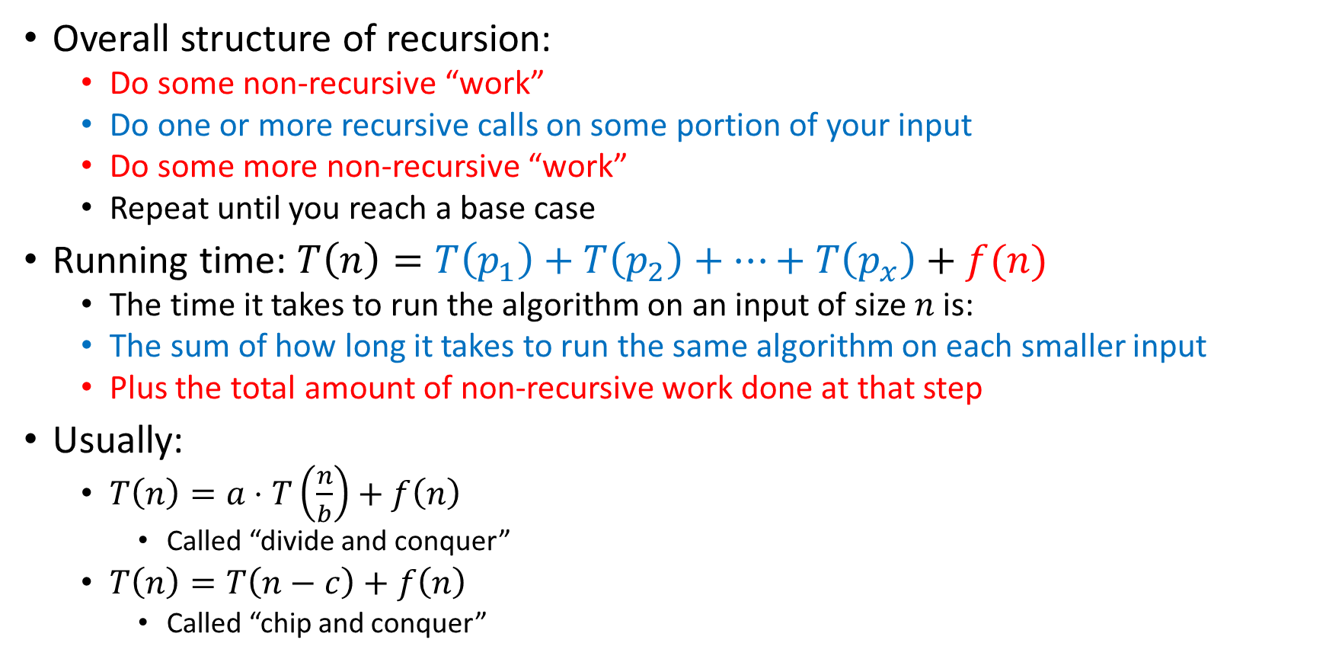
Analysis of Recursive Algorithms
Overall structure of recursion:
  Do some non-recursive “work”
  Do one or more recursive calls on some portion of your input
  Do some more non-recursive “work”
  Repeat until you reach a base case
Running time: $T\left(n\right)=T\left(p_{1}\right)+T\left(p_{2}\right)+…+T\left(p_{x}\right)+f(n)$
  The time it takes to run the algorithm on an input of size $n$ is:
  The sum of how long it takes to run the same algorithm on each smaller input
  Plus the total amount of non-recursive work done at that step
Usually:
  $T\left(n\right)=a⋅T\left(\frac{n}{b}\right)+f\left(n\right)$
    Called “divide and conquer”
  $T\left(n\right)=T\left(n−c\right)+f\left(n\right)$
    Called “chip and conquer”

Slide 24
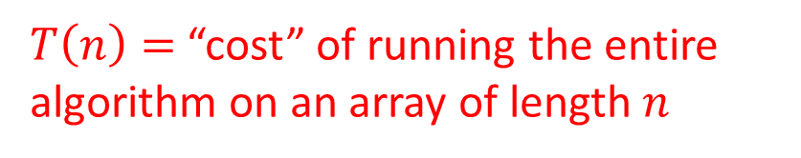

How Efficient Is It?
$T\left(n\right)=$ “cost” of running the entire algorithm on an array of length $n$
$T\left(n\right)=1+T\left(\left\lceil \frac{n}{2}\right\rceil \right)$
Base case: $T\left(1\right)=1$

Slide 25
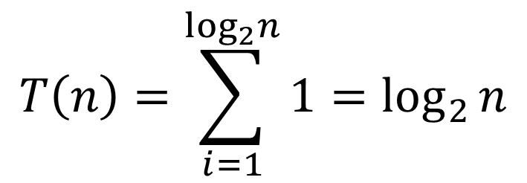

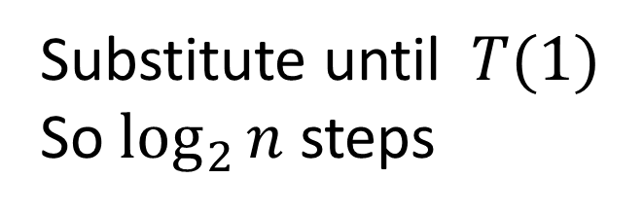





Let’s Solve the Recurrence!
$$T\left(1\right)=1$$
$$T\left(n\right)=1+T(n/2)$$
$$1+T(n/4)$$
Substitute until $T(1)$
So $\log_{2}{n}$ steps
$$1+T(n/8)$$
…
$$1$$
$$T\left(n\right)=\sum_{i=1}^{\log_{2}n}{1}=\log_{2}{n}$$
$$T\left(n\right)∈Θ\left(\log{n}\right)$$

Slide 26
Recursive Linear Search
search(value, list){
if(list.isEmpty()){
return false;
{
if (value == list[0]){
return true;
}
list.remove(0);
return search(value, list);
}

Slide 27
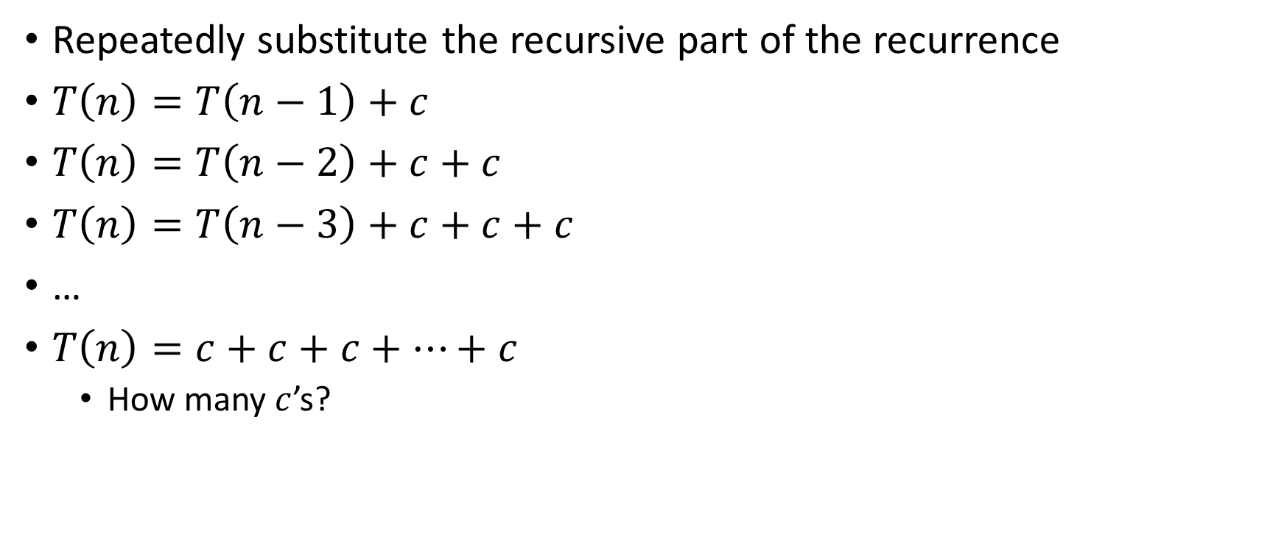
Unrolling Method
Repeatedly substitute the recursive part of the recurrence
$T\left(n\right)=T\left(n−1\right)+c$
$T\left(n\right)=T\left(n−2\right)+c+c$
$T\left(n\right)=T\left(n−3\right)+c+c+c$
…
$T\left(n\right)=c+c+c+…+c$
  How many $c$’s?

Slide 28
Recursive List Summation
sum(list){
return sum_helper(list, 0, list.size);
}
sum_helper(list, low, high){
if (low == high){ return 0; }
if (low == high-1){ return list[low]; }
middle = (high+low)/2;
return sum_helper(list, low, middle) + sum_helper(list, middle, high);
}

Slide 29

Loop Unrolling Method
$T\left(n\right)=2T\left(\frac{n}{2}\right)+c$

Slide 30
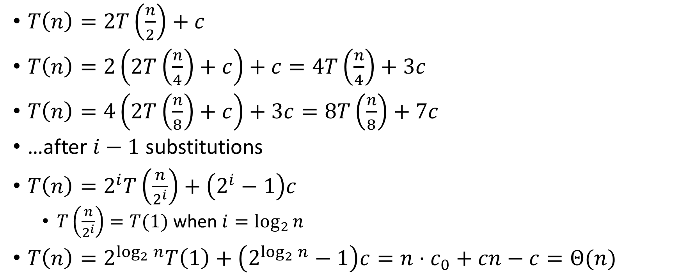
Loop Unrolling Method
$T\left(n\right)=2T\left(\frac{n}{2}\right)+c$
$T\left(n\right)=2\left(2T\left(\frac{n}{4}\right)+c\right)+c=4T\left(\frac{n}{4}\right)+3c$
$T\left(n\right)=4\left(2T\left(\frac{n}{8}\right)+c\right)+3c=8T\left(\frac{n}{8}\right)+7c$
…after $i−1$ substitutions
$T\left(n\right)=2^{i}T\left(\frac{n}{2^{i}}\right)+\left(2^{i}−1\right)c$
  $T\left(\frac{n}{2^{i}}\right)=T(1)$ when $i=\log_{2}{n}$
$T\left(n\right)=2^{\log_{2}{n}}T\left(1\right)+\left(2^{\log_{2}{n}}−1\right)c=n⋅c_{0}+cn−c=Θ(n)$

Slide 31








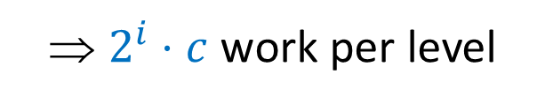


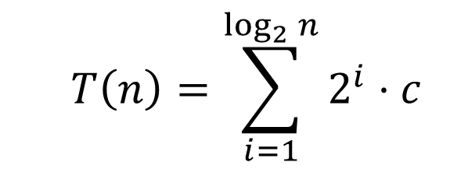


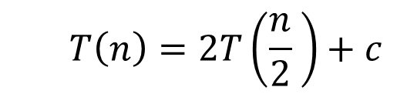








Tree Method
  $$T\left(n\right)=2T\left(\frac{n}{2} \right)+c$$
Red box represents a problem instance
Blue value represents time spent at that level of recursion
$$c$$
⇒ $2^{i}⋅c$ work per level
$$n$$
$$n/2$$
$$c$$
$$n/2$$
$$c$$
$$c$$
$$c$$
$$c$$
$$c$$
$\log_{2}⁡n$ levels
of recursion
$$n/4$$
$$n/4$$
$$n/4$$
$$n/4$$
…
…
…
…
…
$$1$$
$$1$$
$$1$$
$$1$$
$$1$$
$$1$$
$$1$$
$$1$$
$$1$$
$$1$$
$$1$$
$$1$$
  $$T\left(n\right)=\sum_{i=1}^{\log_{2}{n}}{2^{i}⋅c}$$

Slide 32
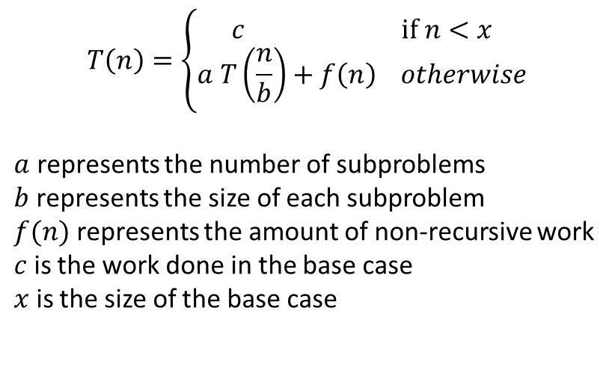
Recurrence Relation idea
$$T\left(n\right)=\left\{\begin{aligned}c if n<x \\ a T\left(\frac{n}{b}\right)+f\left(n\right) otherwise\end{aligned}\right.$$
$a$ represents the number of subproblems
$b$ represents the size of each subproblem
$f(n)$ represents the amount of non-recursive work
$c$ is the work done in the base case
$x$ is the size of the base case

Slide 33



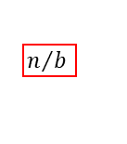
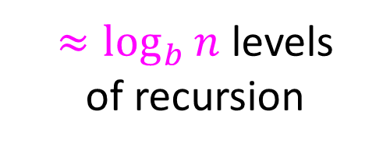





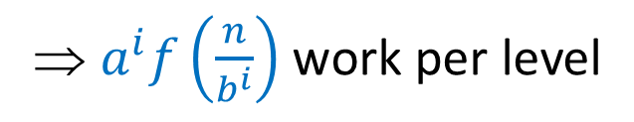







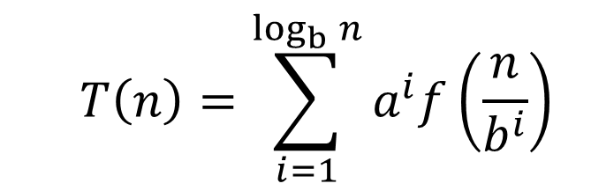












Tree Method Idea
Asymptotically, these never matter!
$$T\left(n\right)=\left\{\begin{aligned}c if n≤x \\ a T\left(\frac{n}{b}\right)+f\left(n\right) otherwise\end{aligned}\right.$$
Red box represents a problem instance
$$f(n)$$
$$n$$
Blue value represents time spent at that level of recursion
⇒ $a^{i}f\left(\frac{n}{b^{i}}\right)$ work per level
…
$a$ children
$$n/b$$
$$n/b$$
$$f\left(\frac{n}{b}\right)$$
$$n/b$$
$$f\left(\frac{n}{b}\right)$$
$$n/b$$
…
$$f\left(\frac{n}{b^{2}}\right)$$
…
$$f\left(\frac{n}{b^{2}}\right)$$
$$f\left(\frac{n}{b^{2}}\right)$$
$$f\left(\frac{n}{b^{2}}\right)$$
$≈\log_{b}⁡n$ levels
of recursion
$$n/{b^{2}}$$
$$n/{b^{2}}$$
$$n/{b^{2}}$$
$$n/{b^{2}}$$
…
…
…
…
…
$$x$$
$$c$$
$$x$$
$$c$$
$$x$$
c
$$x$$
$$c$$
$$x$$
$$c$$
$$x$$
$$c$$
  $$T\left(n\right)=\sum_{i=1}^{\log_{b}{n}}{a^{i}f\left(\frac{n}{b^{i}}\right)}$$

Slide 34

Recursive List Summation
  $$T\left(n\right)=\sum_{i=1}^{\log_{2}{n}}{2^{i}⋅c}$$
  $$=c⋅\sum_{i=1}^{\log_{2}{n}}{2^{i}}$$
  $$=c\left(\frac{1−2^{\log_{2}{n}}}{1−2}\right)$$

