Slide 1
CSE 332 Winter 2026 Lecture 22: Amdahl’s Law and Wisdom
Nathan Brunelle
http://www.cs.uw.edu/332

Slide 2
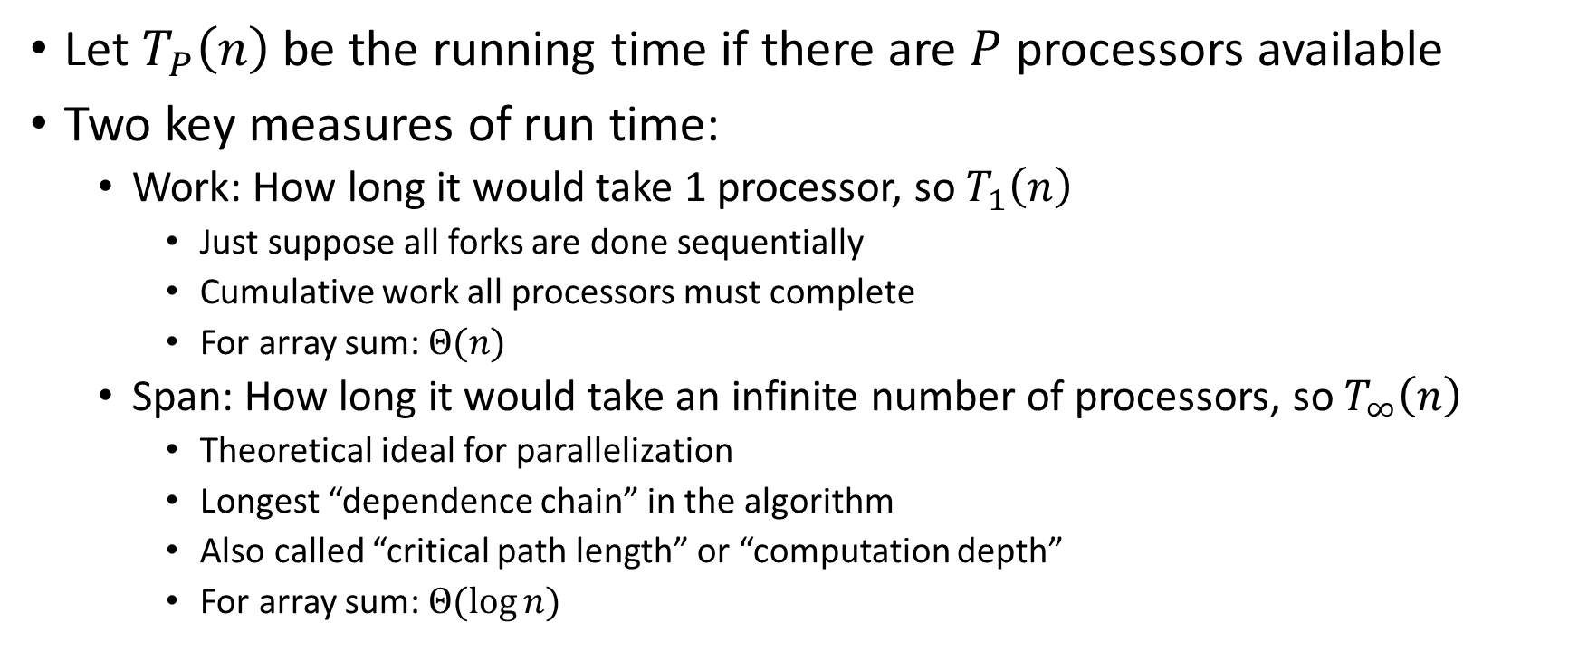

Work and Span
Let $T_{P}\left(n\right)$ be the running time if there are $P$ processors available
Two key measures of run time:
Work: How long it would take 1 processor, so $T_{1}\left(n\right)$
Just suppose all forks are done sequentially
Cumulative work all processors must complete
For array sum: $Θ(n)$
Span: How long it would take an infinite number of processors, so $T_{∞}\left(n\right)$
Theoretical ideal for parallelization
Longest “dependence chain” in the algorithm
Also called “critical path length” or “computation depth”
For array sum: $Θ(log{n})$

Slide 3
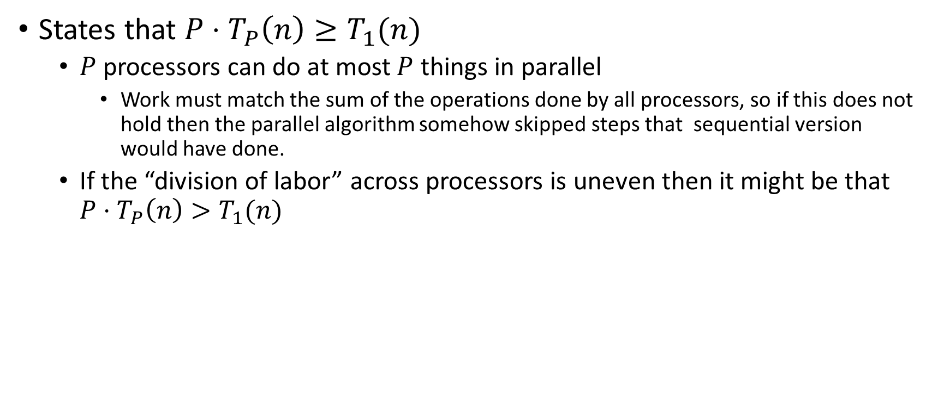

Work Law
States that $P⋅T_{P}\left(n\right)≥T_{1}(n)$
$P$ processors can do at most $P$ things in parallel
Work must match the sum of the operations done by all processors, so if this does not hold then the parallel algorithm somehow skipped steps that sequential version would have done.
If the “division of labor” across processors is uneven then it might be that $P⋅T_{P}\left(n\right)>T_{1}(n)$

Slide 4
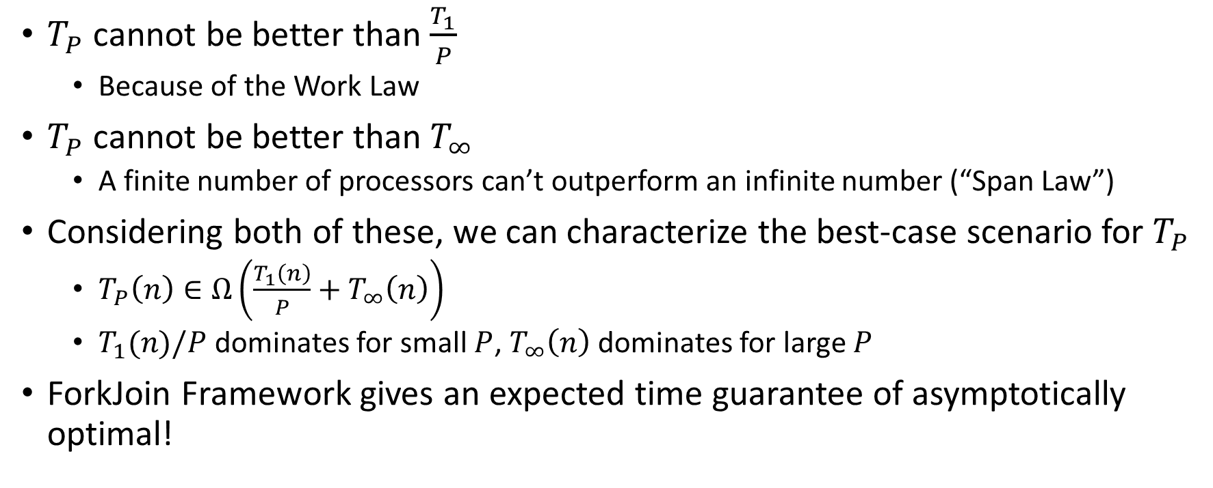


Asymptotically Optimal $T_{P}$
$T_{P}$ cannot be better than $\frac{T_{1}}{P}$
Because of the Work Law
$T_{P}$ cannot be better than $T_{∞}$
A finite number of processors can’t outperform an infinite number (“Span Law”)
Considering both of these, we can characterize the best-case scenario for $T_{P}$
$T_{P}\left(n\right)∈Ω\left(\frac{T_{1}\left(n\right)}{P}+T_{∞}\left(n\right)\right)$
$T_{1}(n)/P$ dominates for small $P$, $T_{∞}\left(n\right)$ dominates for large $P$
ForkJoin Framework gives an expected time guarantee of asymptotically optimal!

Slide 5
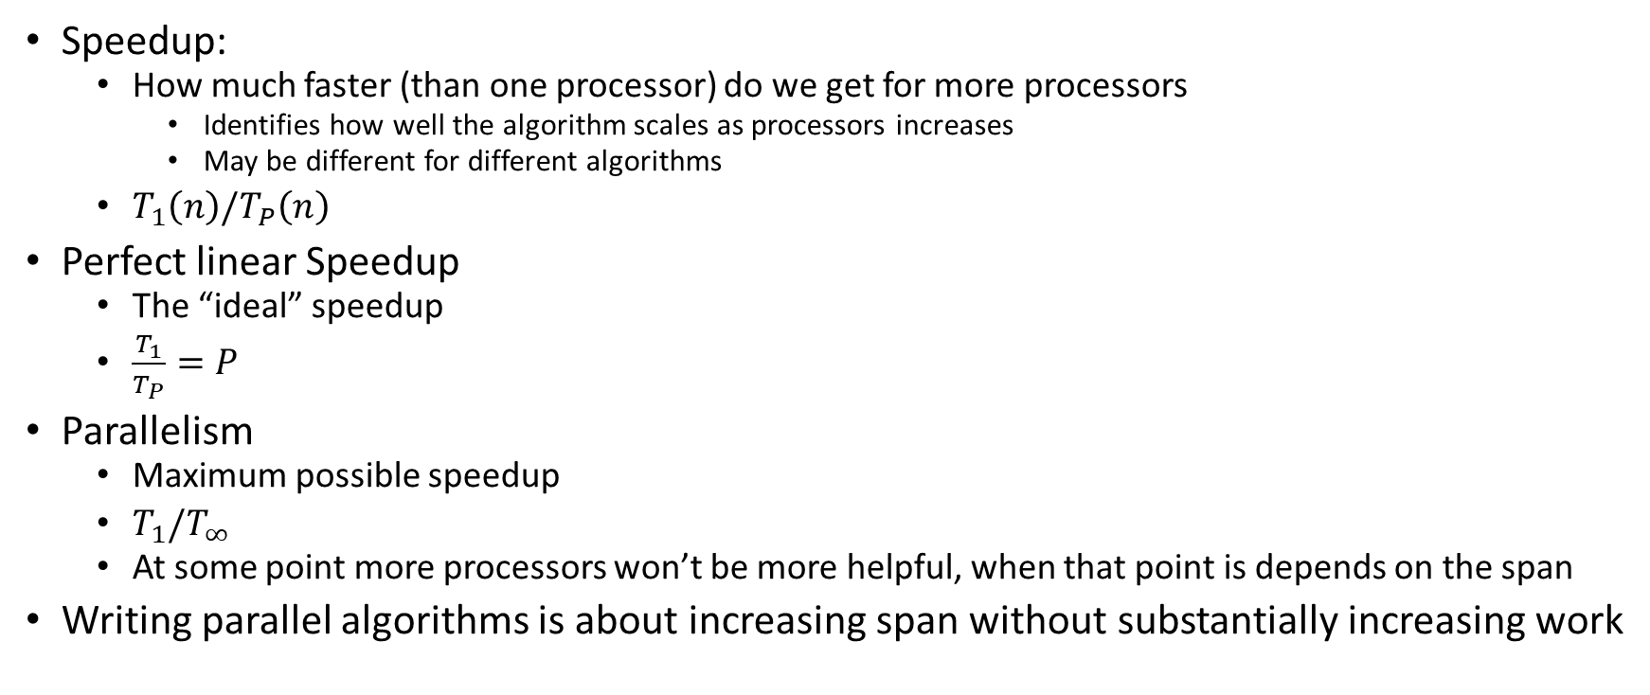

More Vocab
Speedup:
How much faster (than one processor) do we get for more processors
Identifies how well the algorithm scales as processors increases
May be different for different algorithms
$T_{1}\left(n\right)/T_{P}\left(n\right)$
Perfect linear Speedup
The “ideal” speedup
$\frac{T_{1}}{T_{P}}=P$
Parallelism
Maximum possible speedup
$T_{1}/T_{∞}$
At some point more processors won’t be more helpful, when that point is depends on the span
Writing parallel algorithms is about increasing span without substantially increasing work

Slide 6

And now for some bad news…
In practice it’s common for your program to have:
Parts that parallelize well
Maps/reduces/filters over arrays and other data structures
Anything ForkJoin!
Tasks that don’t need to access a shared data structure
Parts that don’t parallelize at all
Reading a linked list, getting input, computations where each step needs the results of previous step, concurrency concerns forcing mutual exclusion
These unparallelizable parts can turn out to be a big bottleneck

Slide 7
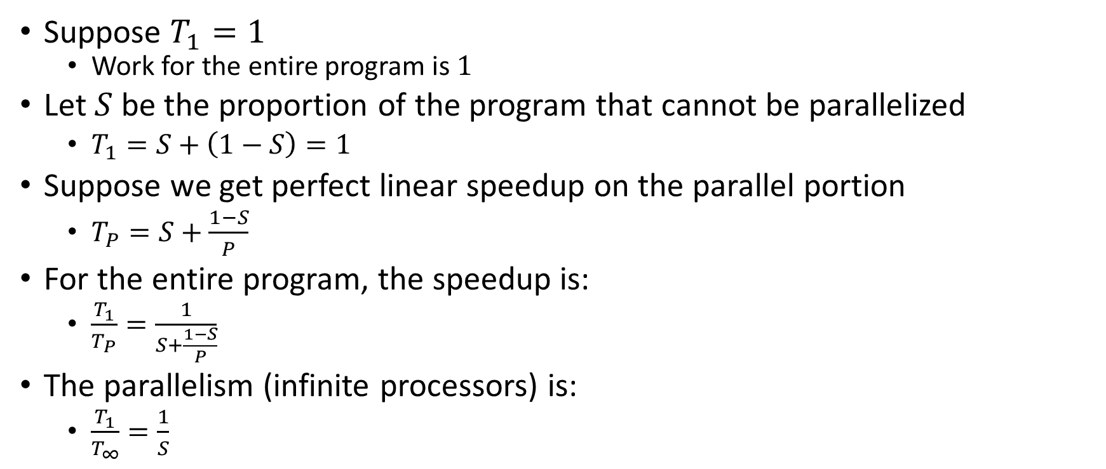

Amdahl’s Law (mostly bad news)
Suppose $T_{1}=1$
Work for the entire program is $1$
Let $S$ be the proportion of the program that cannot be parallelized
$T_{1}=S+\left(1−S\right)=1$
Suppose we get perfect linear speedup on the parallel portion
$T_{P}=S+\frac{1−S}{P}$
For the entire program, the speedup is:
$\frac{T_{1}}{T_{P}}=\frac{1}{S+\frac{1−S}{P}}$
The parallelism (infinite processors) is:
$\frac{T_{1}}{T_{∞}}=\frac{1}{S}$

Slide 8

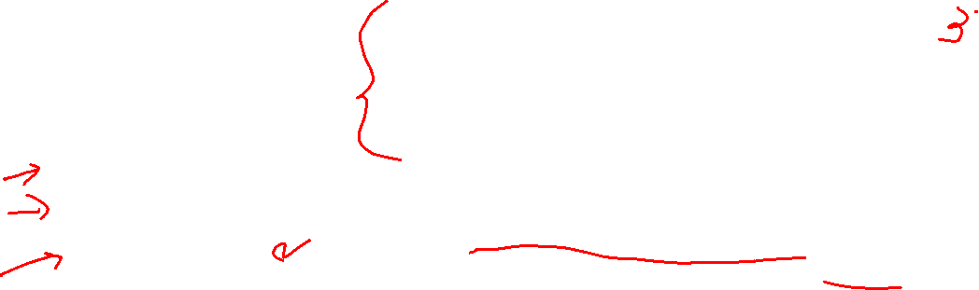
Amdahl’s Law Example
Suppose 2/3 of your program is parallelizable, but 1/3 is not.
$S=\frac{1}{3}$
$T_{1}=\frac{2}{3}+\frac{1}{3}=1$
$T_{P}=S+\frac{1−S}{P}=\frac{1}{3}+\frac{2/3}{P}$
If $T_{1}$ is 100 seconds:
$T_{P}=33+\frac{67}{P}$
$T_{2}=33+\frac{67}{2}≈67$
$T_{3}=33+\frac{67}{3}≈55$
$T_{6}=33+\frac{67}{6}≈44$
$T_{12}=33+\frac{67}{12}≈39$
Notice:
We got a lot of speedup with the second processor (23%)
Adding a third processor only gave half as much speedup (12%)
After going up to 6 processors, we still only got 11% speedup
No matter how many processors we add, we will never get more 11% additional improvement
Conclusion:
When a portion of our code is sequential, the improvement gained from more and more processors diminishes very quickly.
Notes:
Suppose 2/3 of your program is parallelizable, but 1/3 is not.
$$S=\frac{1}{3}$$
$$T_{1}=\frac{2}{3}+\frac{1}{3}=1$$
$$T_{P}=S+\frac{1−S}{P}=\frac{1}{3}+\frac{2/3}{P}$$
If $T_{1}$ is 100 seconds:
$$T_{P}=33+\frac{67}{P}$$
$$T_{3}=33+\frac{67}{3}=33+22=55$$
$$T_{6}=33+\frac{67}{6}=33+11=44$$
$$T_{12}=33+\frac{67}{12}=33+5.5=38.5$$

Slide 9

Conclusion
Even with many many processors the sequential part of your program becomes a bottleneck
Parallelizable code requires skill and insight from the developer to recognize where parallelism is possible, and how to do it well.

Slide 10
Parallel Code Conventional Wisdom

Slide 11
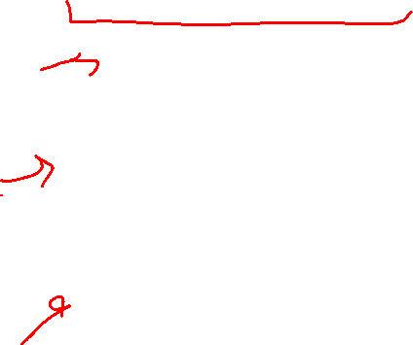
Reasons to Use Parallelism
Code Responsiveness:
While doing an expensive computation, you don’t what your interface to freeze
Processor Utilization:
If one thread is waiting on a deep-hierarchy memory access you can still use that processor time
Failure Isolation:
If one portion of your code fails, it will only crash that one portion.

Slide 12
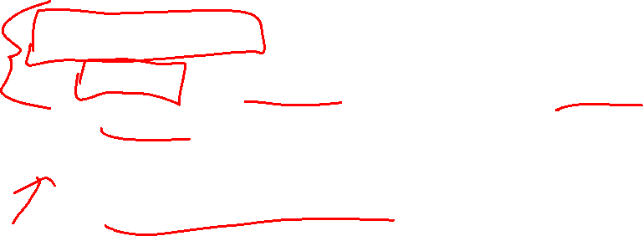
Memory Categories
All memory must fit one of three categories:
Thread Local: Each thread has its own copy
Shared and Immutable: There is just one copy, but nothing will ever write to it
Shared and Mutable: There is just one copy, it may change
Requires Synchronization!

Slide 13

Thread Local Memory
Whenever possible, avoid sharing resources
Dodges all race conditions, since no other threads can touch it!
No synchronization necessary!
Use whenever threads do not need to communicate using the resource
E.g., each thread should have its own Random object
In most cases, most objects should be in this category

Slide 14

Immutable Objects
Whenever possible, avoid changing objects
Make new objects instead
Parallel reads are not data races
If an object is never written to, no synchronization necessary!
Many programmers over-use mutation, minimize it

Slide 15
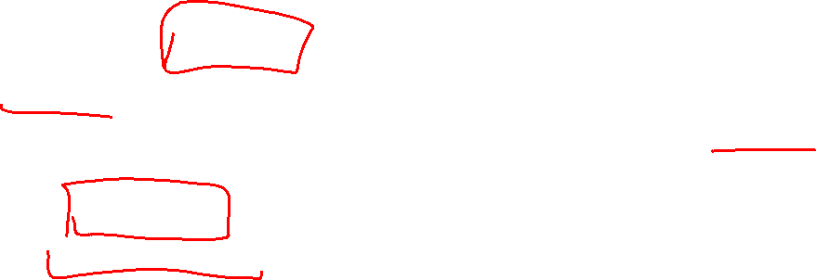
Shared and Mutable Objects
For everything else, use locks
Avoid all data races
Every read and write should be projected with a lock, even if it “seems safe”
Almost every Java/C program with a data race is wrong
Even without data races, it still may be incorrect
Watch for bad interleavings as well!

Slide 16


Consistent Locking
For each location needing synchronization, have a lock that is always held when reading or writing the location
The same lock can (and often should) “guard” multiple fields/objects
Clearly document what each lock guards!
In Java, the lock should usually be the object itself (i.e. “this”)
Have a mapping between memory locations and lock objects and stick to it!

Slide 17
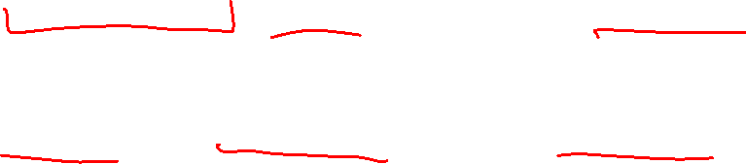
Lock Granularity
Coarse Grained: Fewer locks guarding more things each
One lock for an entire data structure
One lock shared by multiple objects (e.g. one lock for all bank accounts)
Fine Grained: More locks guarding fewer things each
One lock per data structure location (e.g. array index)
One lock per object or per field in one object (e.g. one lock for each account)
Note: there’s really a continuum between them…

Slide 18

Example: Separate Chaining Hashtable
Maximally Coarse-grained: One lock for the entire hashtable
Maximally Fine-grained: One lock for each bucket
Which supports more parallelism in insert and find?
Which makes rehashing easier?
What happens if you want to have a size field?

Slide 19
Example: Separate Chaining Hashtable
Maximally Coarse-grained: One lock for the entire hashtable
Maximally Fine-grained: One lock for each bucket
Which supports more parallelism in insert and find?
Fine-grained, since inserts and finds can happen in parallel when there is no collision
Which makes rehashing easier?
Course-grained, as with fine-grained you would need to acquire ALL of the locks
What happens if you want to have a size field?
For fine-grained, every insert would need to update the size, so there’s risk of a data race

Slide 20

Tradeoffs
Coarse-Grained Locking:
Simpler to implement and avoid race conditions
Faster/easier to implement operations that access multiple locations (because all guarded by the same lock)
Much easier for operations that modify data-structure shape
Fine-Grained Locking:
More simultaneous access (performance when coarse grained would lead to unnecessary blocking)
Can make multi-location operations more difficult: say, rotations in an AVL tree
Guideline:
Start with coarse-grained, make finer only as necessary to improve performance

Slide 21

Similar But Separate Issue: Critical Section Granularity
Coarse-grained
For every method that needs a lock, put the entire method body in a lock
Fine-grained
Keep the lock only for the sections of code where it’s necessary
Guideline:
Try to structure code so that expensive operations (like I/O) can be done outside of your critical section
E.g., if you’re trying to print all the values in a tree, maybe copy items into an array inside your critical section, then print the array’s contents outside.

Slide 22

Atomicity
Atomic: indivisible
Atomic operation: one that should be thought of as a single step
Some sequences of operations should behave as if they are one unit
Between two operations you may need to avoid exposing an intermediate state
Usually ADT operations should be atomic
You don’t want another thread trying to do an insert while another thread is rotating the AVL tree
Think first in terms of what operations need to be atomic
Design critical sections and locking granularity based on these decisions

Slide 23

Use Pre-Tested Code
Whenever possible, use built-in libraries!
Other people have already invested tons of effort into making things both efficient and correct, use their work when you can!
Especially true for concurrent data structures
Use thread-safe data structures when available
E.g. Java as ConcurrentHashMap

