Slide 1
CSE 332 Winter 2026 Lecture 27: Five Worlds
Nathan Brunelle
http://www.cs.uw.edu/332

Slide 2
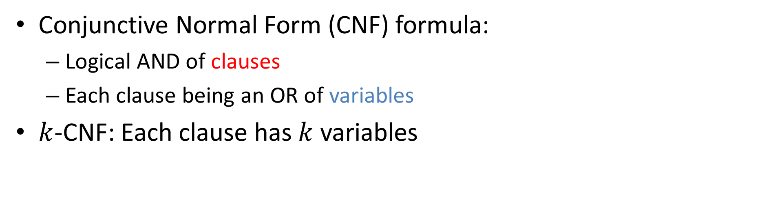

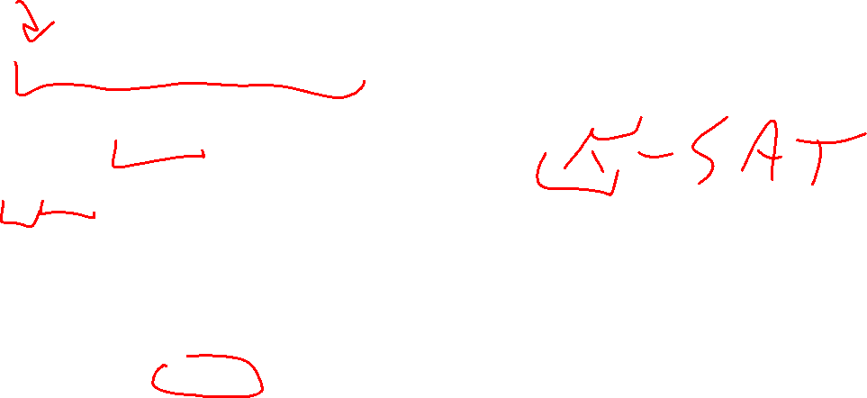
($k$-)CNF
Conjunctive Normal Form (CNF) formula:
Logical AND of clauses
Each clause being an OR of variables
$k$-CNF: Each clause has $k$ variables
$$\left(x∨y∨z\right)∧\left(x∨\overline{y}∨y\right)∧\left(u∨y∨\overline{z}\right)∧\left(z∨\overline{x}∨u\right)∧(\overline{x}∨\overline{y}∨\overline{z})$$
Clause
Variables

Slide 3


1-SAT
Given a 1-CNF formula (logical AND of clauses, each an OR of 1 variables), Is there an assignment of true/false to each variable to make the formula true?
$$\left(x\right)∧\left(y\right)∧\left(\overline{z}\right)∧\left(\overline{x}\right)$$

Slide 4
1-SAT algorithm
Running Time:

Slide 5
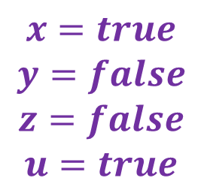
2-SAT
Given a 2-CNF formula (logical AND of clauses, each an OR of 2 variables), Is there an assignment of true/false to each variable to make the formula true?
$$\left(x∨y\right)∧\left(x∨\overline{y}\right)∧\left(y∨\overline{z}\right)∧\left(z∨u\right)∧(\overline{y}∨\overline{z})$$
$$x=true$$
$$y=false$$
$$z=false$$
$$u=true$$
Clause
Variables

Slide 6
















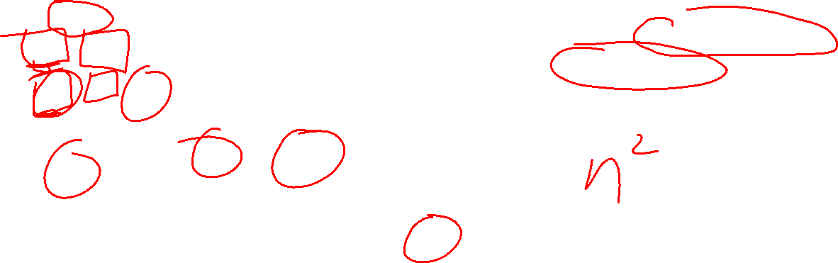












2-SAT in Polynomial Time
Convert formula to an “implication graph”
$$\left(x∨y\right) ∧ \left(x∨\overline{y}\right) ∧ \left(y∨\overline{z}\right) ∧ \left(z∨u\right) ∧ (\overline{y}∨\overline{z})$$
Are there any cycles with a variable and its negation?
$$\overline{x}$$
$$y$$
$$\overline{x}$$
$$\overline{y}$$
$$\overline{y}$$
$$\overline{z}$$
$$\overline{z}$$
$$u$$
$$y$$
$$\overline{z}$$
$$x$$
$$\overline{y}$$
$$x$$
$$y$$
$$y$$
$$z$$
$$z$$
$$\overline{u}$$
$$\overline{y}$$
$$z$$
$$x$$
$$y$$
$$z$$
$$u$$
$$\overline{x}$$
$$\overline{y}$$
$$\overline{z}$$
$$\overline{u}$$

Slide 7





2-SAT in Polynomial Time
Convert formula to an “implication graph”
$$\left(x∨y\right) ∧ \left(\overline{x}∨y\right) ∧ \left(x∨\overline{y}\right)∧(\overline{x}∨\overline{y})$$
Are there any cycles with a variable and its negation?
$$x$$
$$y$$
$$\overline{x}$$
$$\overline{y}$$

Slide 8

3-SAT
Given a 3-CNF formula (logical AND of clauses, each an OR of 3 variables), Is there an assignment of true/false to each variable to make the formula true?
$$\left(x∨y∨z\right)∧\left(x∨\overline{y}∨y\right)∧\left(u∨y∨\overline{z}\right)∧\left(z∨\overline{x}∨u\right)∧(\overline{x}∨\overline{y}∨\overline{z})$$
Clause
$$x=true$$
$$y=false$$
$$z=false$$
$$u=true$$
Variables

Slide 9
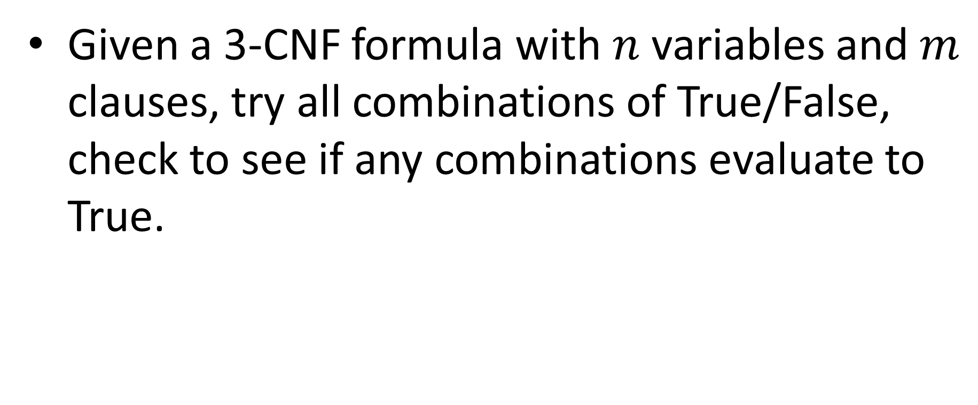
3-SAT algorithm
Given a 3-CNF formula with $n$ variables and $m$ clauses, try all combinations of True/False, check to see if any combinations evaluate to True.

Slide 10
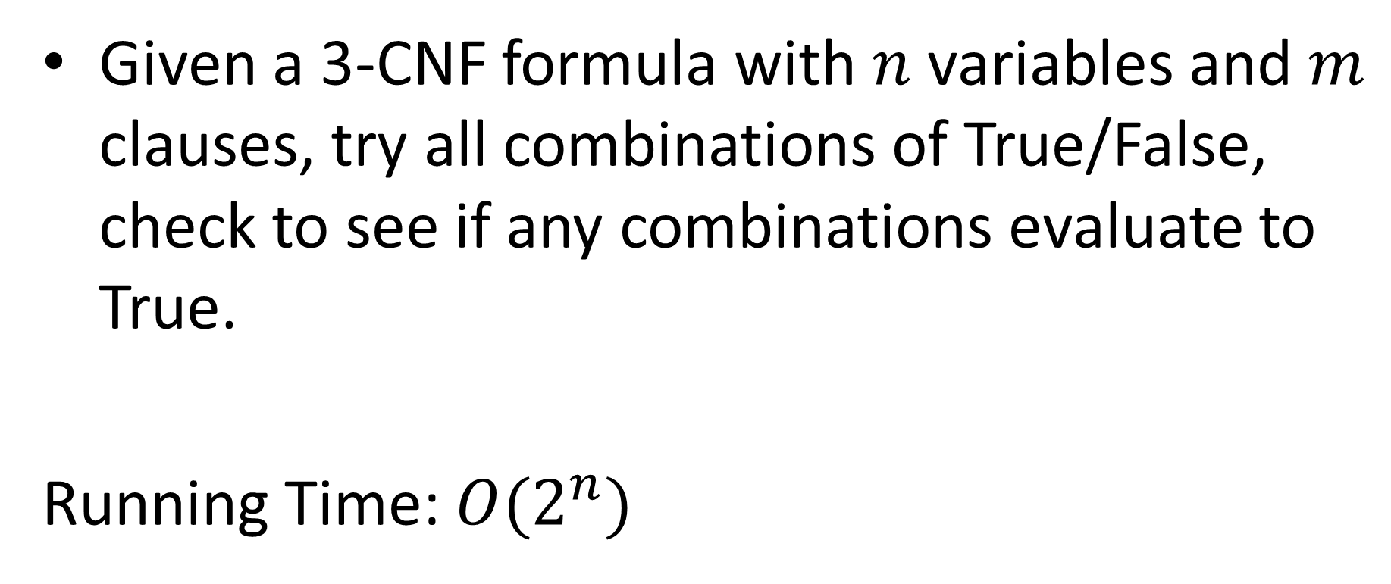
3-SAT algorithm
Given a 3-CNF formula with $n$ variables and $m$ clauses, try all combinations of True/False, check to see if any combinations evaluate to True.
Running Time: ${O(2}^{n})$

Slide 11
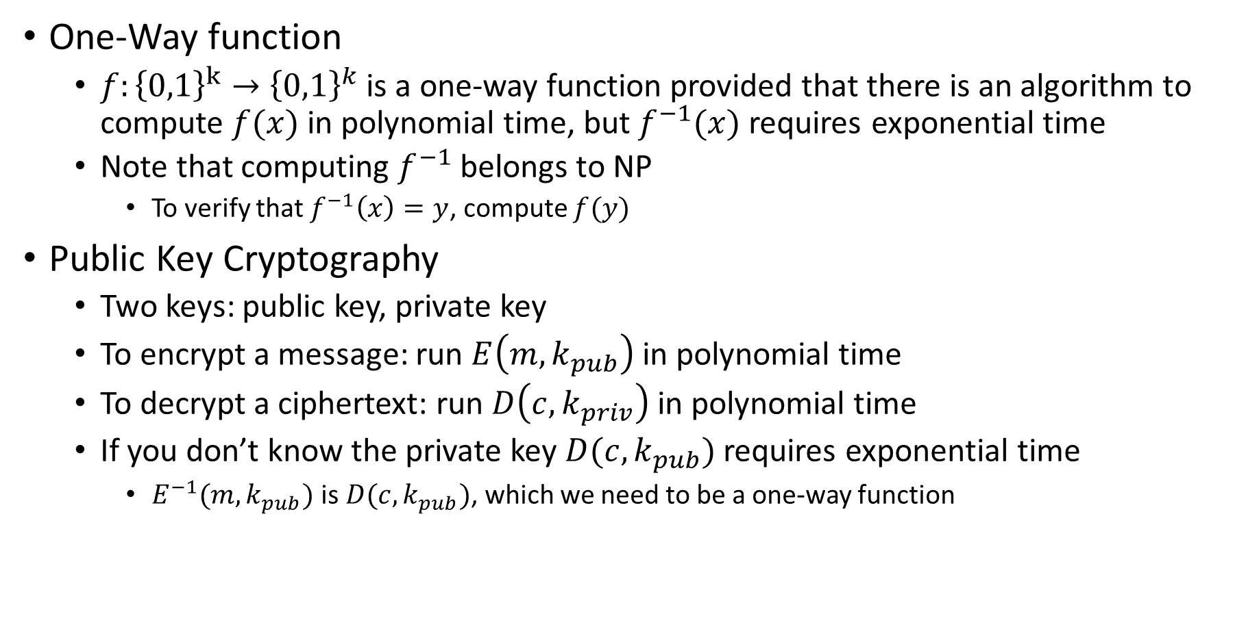
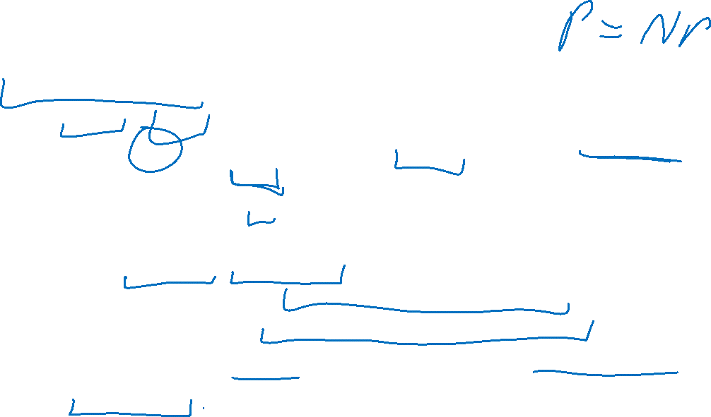
Other ideas related to P and NP
One-Way function
$f:{\left\{0,1\right\}}^{k}→{\left\{0,1\right\}}^{k}$ is a one-way function provided that there is an algorithm to compute $f(x)$ in polynomial time, but $f^{−1}(x)$ requires exponential time
Note that computing $f^{−1}$ belongs to NP
To verify that $f^{−1}\left(x\right)=y$, compute $f(y)$
Public Key Cryptography
Two keys: public key, private key
To encrypt a message: run $E\left(m, k_{pub}\right)$ in polynomial time
To decrypt a ciphertext: run $D\left(c,k_{priv}\right)$ in polynomial time
If you don’t know the private key $D(c, k_{pub})$ requires exponential time
$E^{−1}(m,k_{pub})$ is $D(c, k_{pub})$, which we need to be a one-way function

Slide 12

Impagliazzo’s 5 Worlds
Describes what computer science might look like depending on how certain open questions are answered.
Algorithmica
Heuristica
Pessiland
Minicrypt
Cryptomania

Slide 13
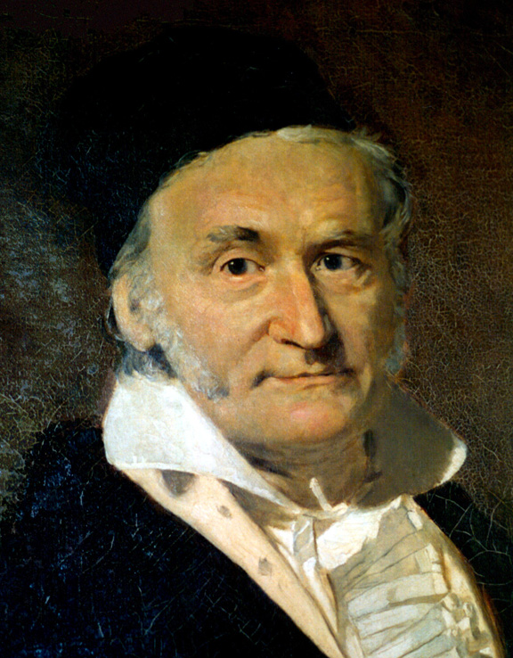
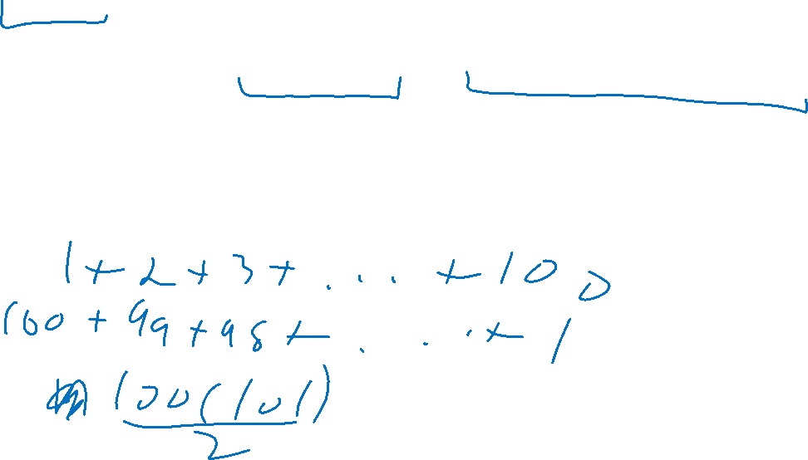
Gauss vs. Büttner
Büttner’s goal: embarrass Gauss
Come up with a problem which Gauss finds difficult but Büttner can solve quickly
Come up with a 3-CNF formula and a satisfying assignment together
Give the formula to Gauss
When Gauss is stumped show the satisfying assignment

Slide 14

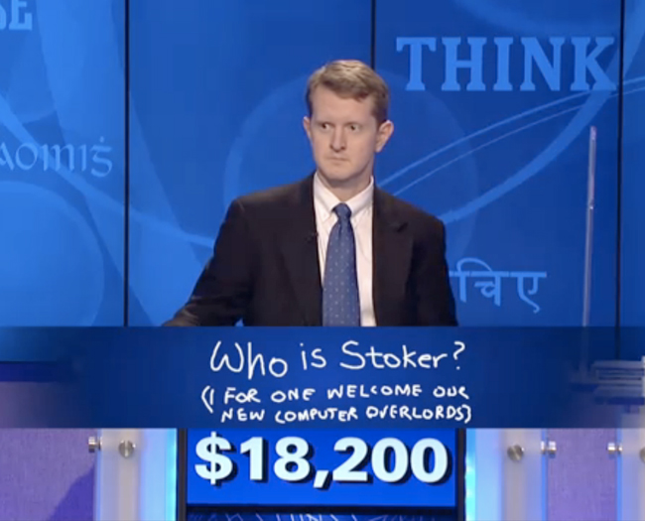

Algorithmica
P=NP
NP problems solvable efficiently
Gauss can quickly find the solution to Buttner’s problem
Gauss is not embarrassed – he can solve any problem Buttner gives
Advantages:
VLSI Design
Strong AI
Cure for cancer?
Disadvantages:
No privacy
Computers take over

Slide 15
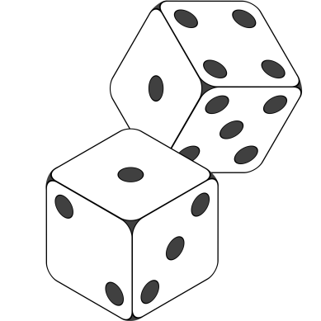

Heuristica
P≠NP in worst case, P=NP on average
Time to come up with a problem ≈ time to solve it
Büttner can give hard problems, but it’s hard to find them
Gauss is not embarrassed – Most formulas Buttner gives are easy
Advantages:
Maybe similar to Algorithmica
Depends on real-world distributions
Disadvantages:
Bad real world distributions could make things hard to solve

Slide 16
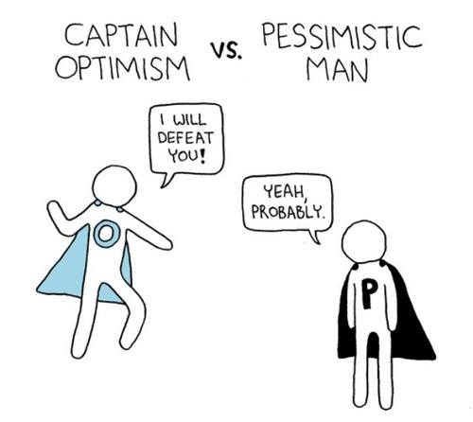
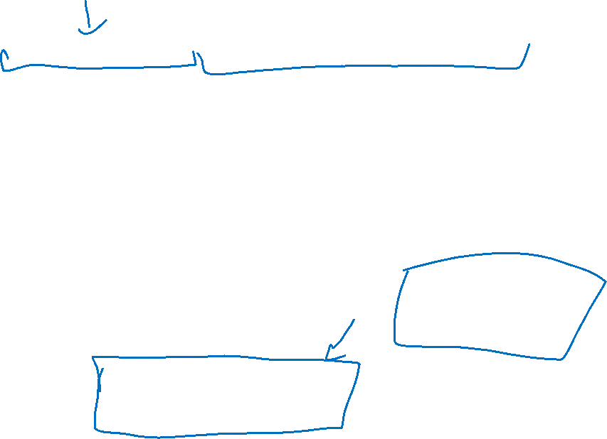
Pessiland
P≠NP on average, one-way functions don’t exist
Hard problems easy to find, but solved hard problems difficult to find
Gauss can be stumped, but Büttner does no better – The only way Buttner wins is to first find a hard problem, then solve it on his own.
Advantages:
Universal Compression
Derandomization
Quantum computing doesn’t matter
Disadvantages:
No crypto
No algorithmic advantages
Progress is slow

Slide 17
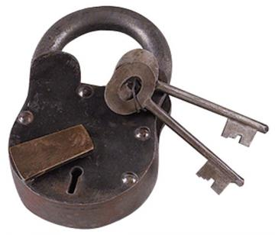


Minicrypt
One-way functions exist, no public key cryptography
Büttner can give hard problems to Gauss and also know their solutions
Gauss is embarrassed – Using a one-way function, Buttner can give $f(x)$ and ask Gauss to identify $x$
Advantages:
Private key crypto
Can prove identity (digital signatures)
Disadvantages:
No electronic currencies

Slide 18
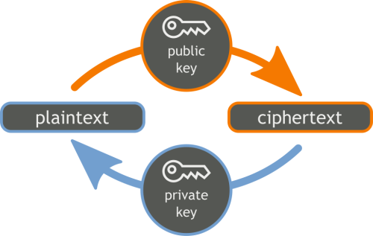
Cryptomania
Public Key Crypto Exists
Büttner can come up with problems and solutions, then share the solution with all other students
Gauss is very embarrassed – Buttner can share the private key with all students, then ask Gauss to decrypt ciphertexts. Gauss is the only one in the room who won’t be able to do it.
Advantages:
Secure computation
Signatures
Bitcoin, etc.
Disadvantages:
Algorithmic progress will be slow

Slide 19
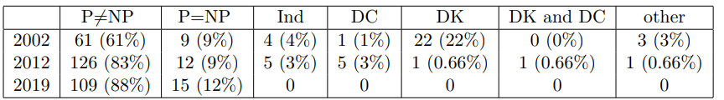

Does P=NP?
https://www.cs.umd.edu/users/gasarch/BLOGPAPERS/pollpaper3.pdf

Slide 20
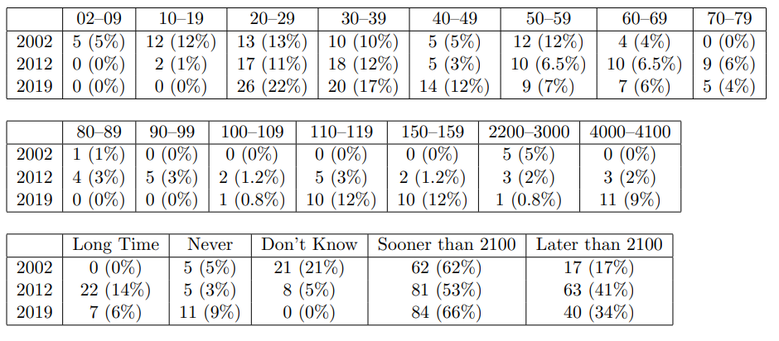

When Will P=NP be resolved?

Slide 21
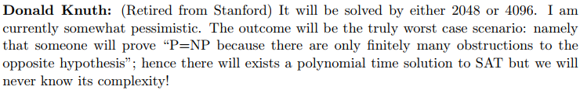

Notable Statements on P vs NP
Suggested rephrased question:

Slide 22
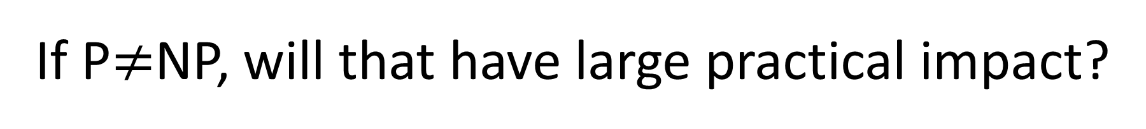
If P$≠$NP, will that have large practical impact?

Slide 23
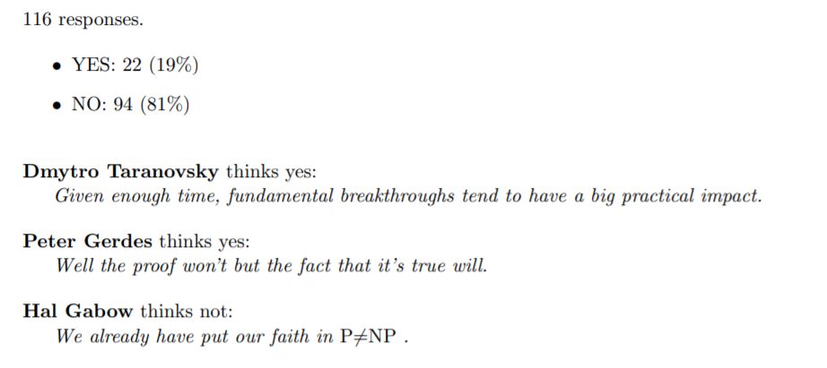
If P$≠$NP, will that have large practical impact?

Slide 24
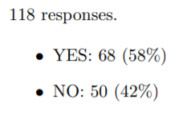
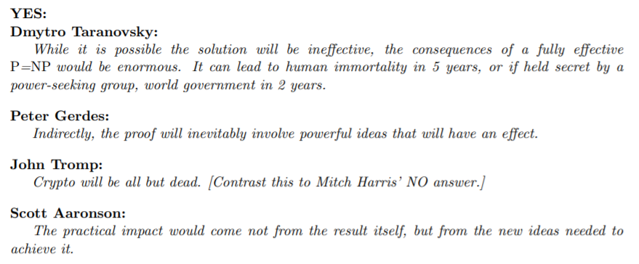
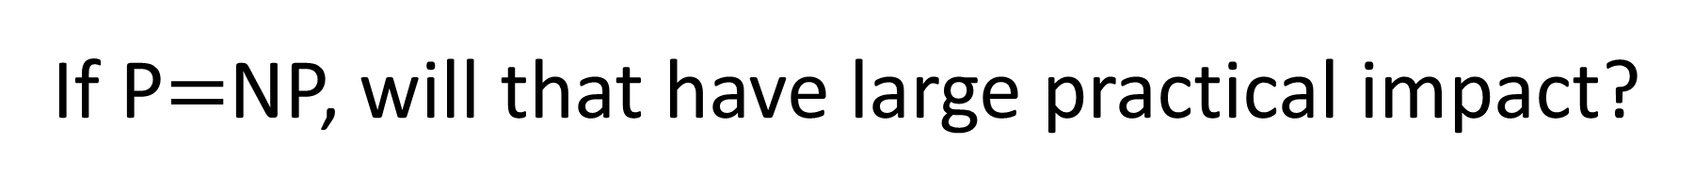
If P$=$NP, will that have large practical impact?

Slide 25
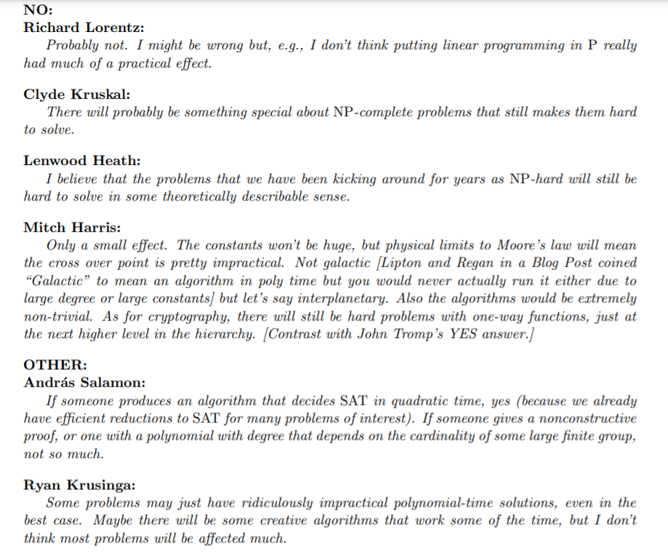
If P$=$NP, will that have large practical impact?

