Slide 1
CSE 332 Spring 2026 Lecture 14: Sorting 3
Nathan Brunelle
http://www.cs.uw.edu/332

Slide 2
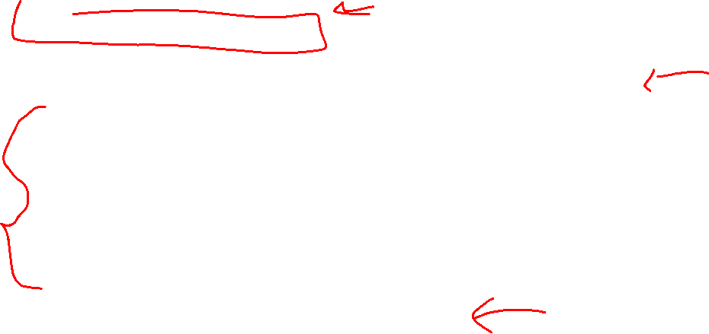
Properties To Consider
Worst case running time
In place:
We only need to use the pre-existing array to do sorting
Constant extra space (only some additional variables needed)
Adaptive
The running improves as the given list is closer to being sorted
It should be linear time for a pre-sorted list, and nearly linear time if the list is nearly sorted
Online
We can start sorting before we have the entire list.
Stable
“Tied” elements keep their original order

Slide 3
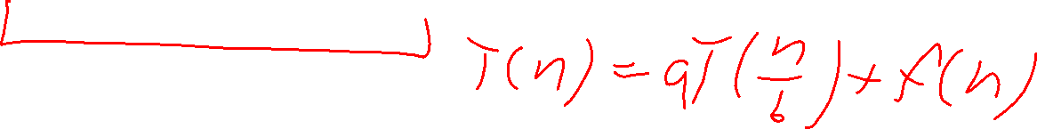
Divide And Conquer Sorting
Divide and Conquer:
Recursive algorithm design technique
Solve a large problem by breaking it up into smaller versions of the same problem

Slide 4

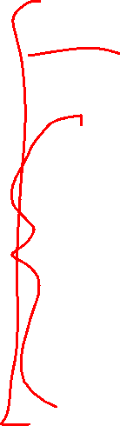
Divide and Conquer
Base Case:
If the problem is “small” then solve directly and return
Divide:
Break the problem into subproblem(s), each smaller instances
Conquer:
Solve subproblem(s) recursively
Combine:
Use solutions to subproblems to solve original problem
A
B

Slide 5
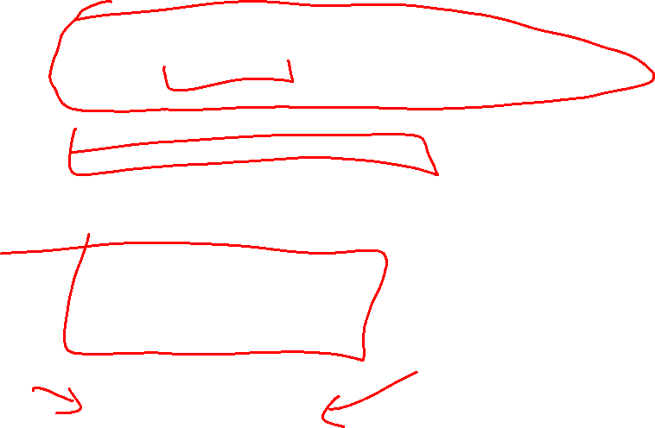
Divide and Conquer Template Pseudocode
def my_DandC(problem){ // Base Case
if (problem.size() <= small_value){
return solve(problem); // directly solve (e.g., brute force)
}
// Divide
List subproblems = divide(problem);
// Conquer
solutions = new List();
for (sub : subproblems){
subsolution = my_DandC(sub);
solutions.add(subsolution);
}
// Combine
return combine(solutions);
}

Slide 6
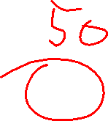
Merge Sort
5
8
2
9
4
1
Base Case:
If the list is of length 1 or 0, it’s already sorted, so just return it
Divide:
Split the list into two “sublists” of (roughly) equal length
Conquer:
Sort both lists recursively
Combine:
Merge sorted sublists into one sorted list
5
5
8
2
9
4
1
2
5
8
1
4
9
2
5
8
1
4
9
1
2
4
5
8
9

Slide 7








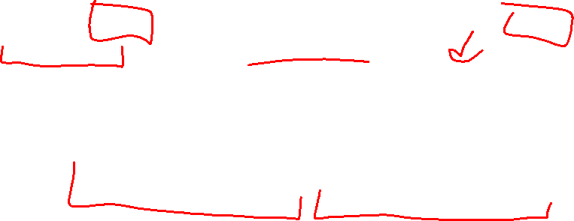
Merge Sort In Action!
Sort between indices $low$ and $high$
5
8
2
9
4
1
3
7
$$low$$
$$high$$
Base Case: if $low$ == $high$ then that range is already sorted!
Divide and Conquer: Otherwise call mergesort on ranges $\left(low,\frac{low+high}{2}\right)$ and $\left(\frac{low+high}{2}+1, high\right)$
5
8
2
9
4
1
3
7
$$low$$
$$\frac{low+high}{2}$$
$$\frac{low+high}{2}+1$$
$$high$$
2
5
8
9
1
3
4
7
After Recursion:
$$low$$
$$high$$

Slide 8

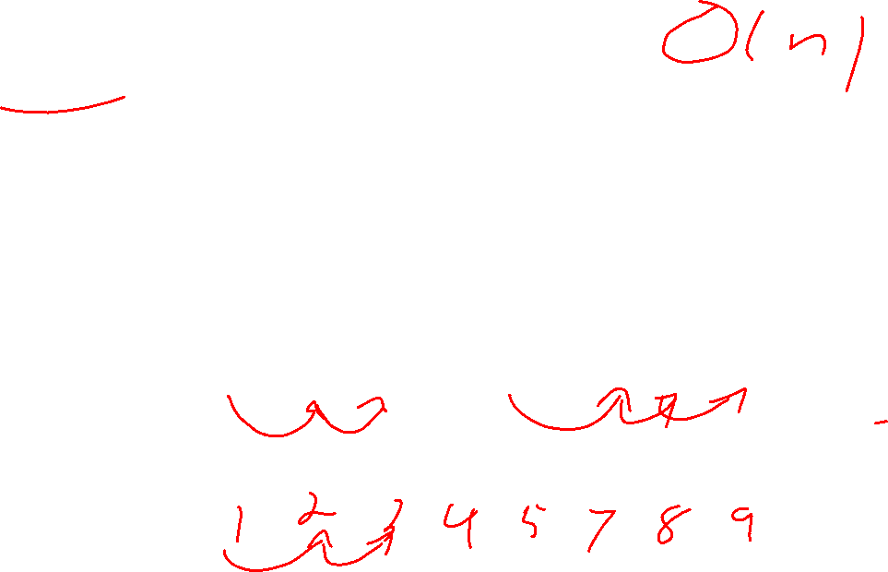


Merge (the combine part)
Create a new array to merge into, and 3 pointers/indices:
L_next: the smallest “unmerged” thing on the left
R_next: the smallest “unmerged” thing on the right
M_next: where the next smallest thing goes in the merged array
One-by-one: put the smallest of L_next and R_next into M_next, then advance both M_next and whichever of L/R was used.
2
5
8
9
1
3
4
7
L next
R next
$$\frac{low+high}{2}+1$$
$$low$$
$$\frac{low+high}{2}$$
$$high$$
M next

Slide 9
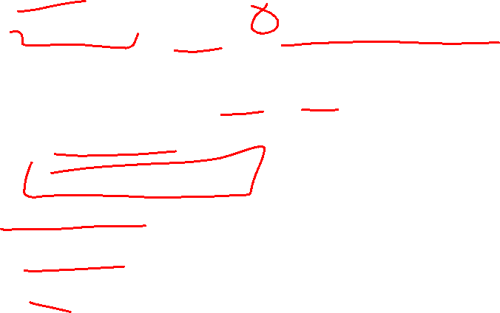
Merge Sort Pseudocode
void mergesort(myArray){
ms_helper(myArray, 0, myArray.length()); }
void mshelper(myArray, low, high){
if (low == high){return;} // Base Case
mid = (low+high)/2;
ms_helper(low, mid);
ms_helper(mid+1, high);
merge(myArray, low, mid, high);
}

Slide 10
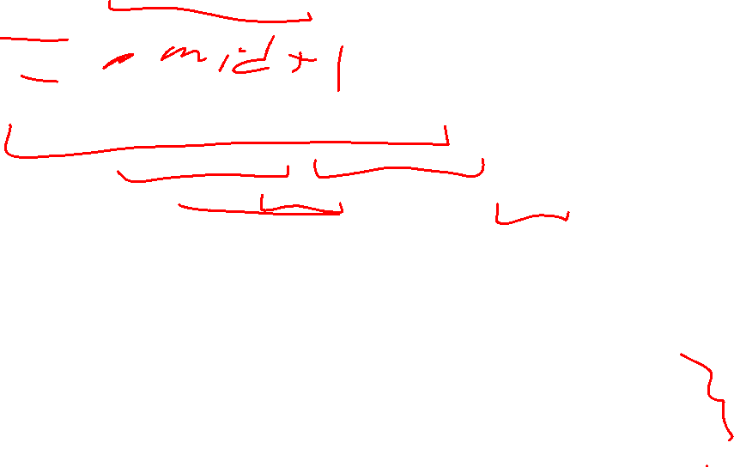
Merge Pseudocode
void merge(myArray, low, mid, high){
merged = new int[high-low+1]; // or whatever type is in myArray
l_next = low;
r_next = high;
m_next = 0;
while (l_next <= mid && r_next <= high){
if (myArray[l_next] <= myArray[r_next]){
merged[m_next++] = myArray[l_next++];
}
else{
merged[m_next++] = myArray[r_next++];
}
}
while (l_next <= mid){ merged[m_next++] = myArray[l_next++]; }
while (r_next <= high){ merged[m_next++] = myArray[r_next++]; }
for(i=0; i<=merged.length; i++){ myArray[i+low] = merged[i];}
}

Slide 11
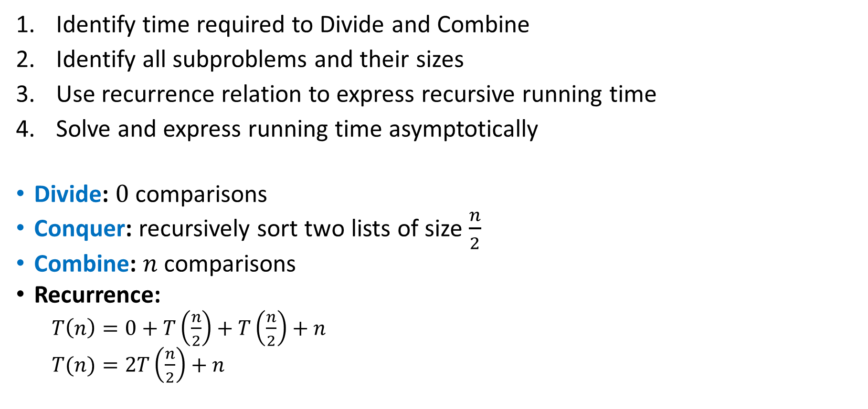
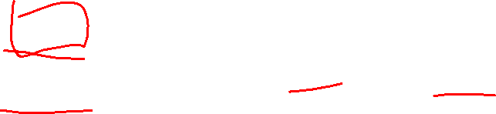
Analyzing Merge Sort
Identify time required to Divide and Combine
Identify all subproblems and their sizes
Use recurrence relation to express recursive running time
Solve and express running time asymptotically
Divide: $0$ comparisons
Conquer: recursively sort two lists of size $\frac{n}{2}$
Combine: $n$ comparisons
Recurrence:
$T\left(n\right)=0+T\left(\frac{n}{2}\right)+T\left(\frac{n}{2}\right)+n$
$T(n)=2T\left(\frac{n}{2}\right)+n$

Slide 12










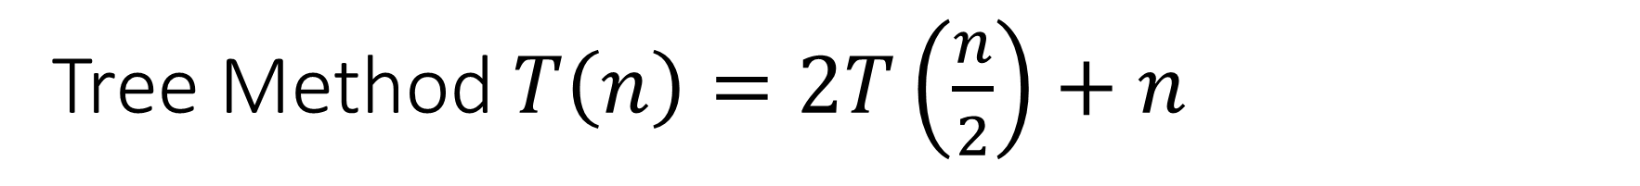


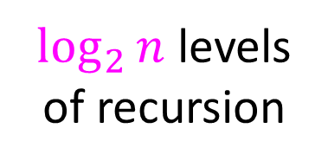







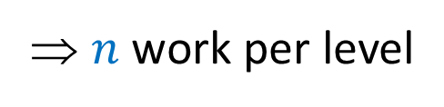







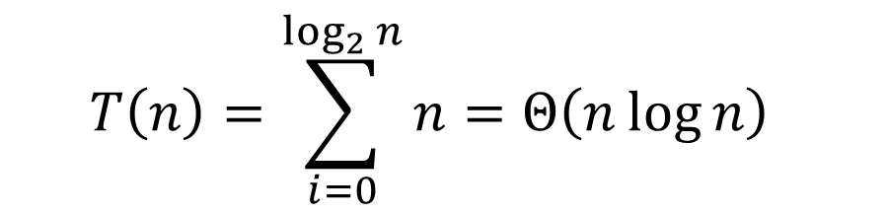
Tree Method $T\left(n\right)=2T\left(\frac{n}{2}\right)+n$
Red box represents a problem instance
$$n$$
⇒ $n$ work per level
$$n$$
Blue value next to each box represents time spent at that level of recursion
$$n/2$$
$$\frac{n}{2}$$
$$n/2$$
$$\frac{n}{2}$$
$\log_{2}⁡n$ levels
of recursion
$$n/4$$
$$\frac{n}{4}$$
$$n/4$$
$$\frac{n}{4}$$
$$n/4$$
$$\frac{n}{4}$$
$$n/4$$
$$\frac{n}{4}$$
…
…
…
…
…
$$1$$
$$1$$
$$1$$
$$1$$
$$1$$
$$1$$
$$1$$
$$1$$
$$1$$
$$1$$
$$1$$
$$1$$
$$T\left(n\right)=\sum_{i=0}^{\log_{2}{n}}{n}=Θ\left(n\log{n}\right)$$

Slide 13
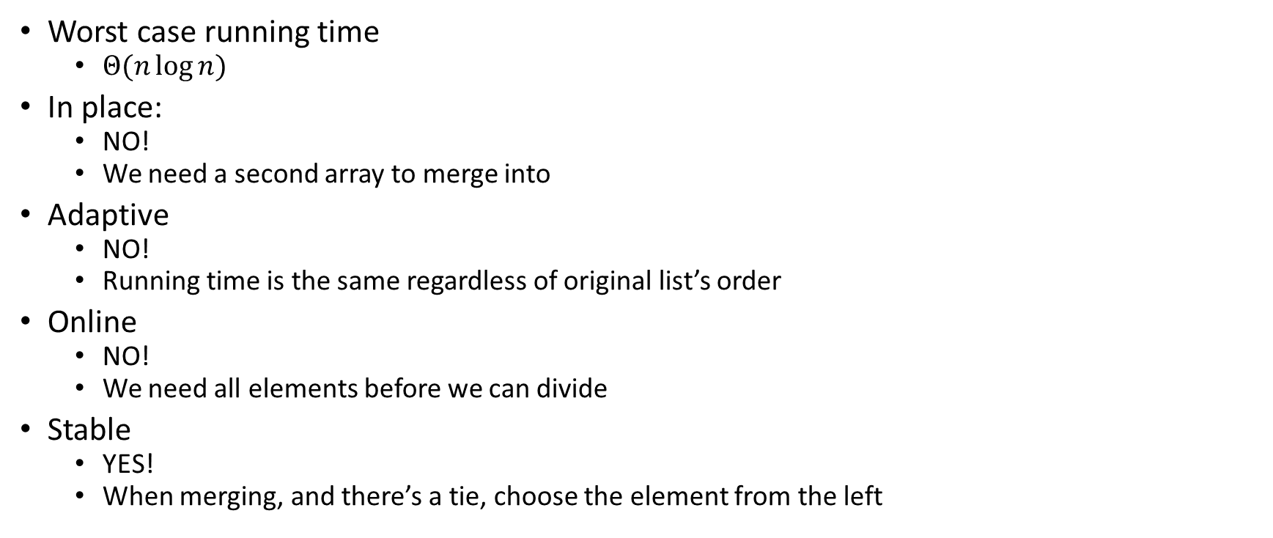
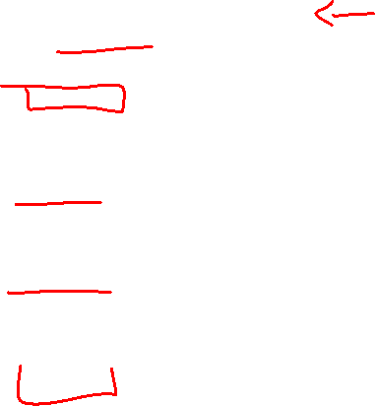
Merge Sort Properties
Worst case running time
$Θ(n\log{n})$
In place:
NO!
We need a second array to merge into
Adaptive
NO!
Running time is the same regardless of original list’s order
Online
NO!
We need all elements before we can divide
Stable
YES!
When merging, and there’s a tie, choose the element from the left

Slide 14

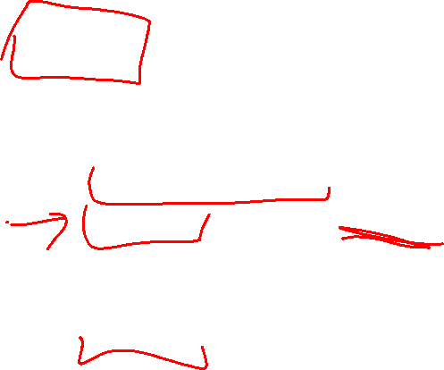
Quicksort Vs. Mergesort
Like Mergesort:
Divide and conquer
$O(n\log{n})$ run time (kind of…)
Unlike Mergesort:
Divide step is the “hard” part
Typically faster than Mergesort

Slide 15
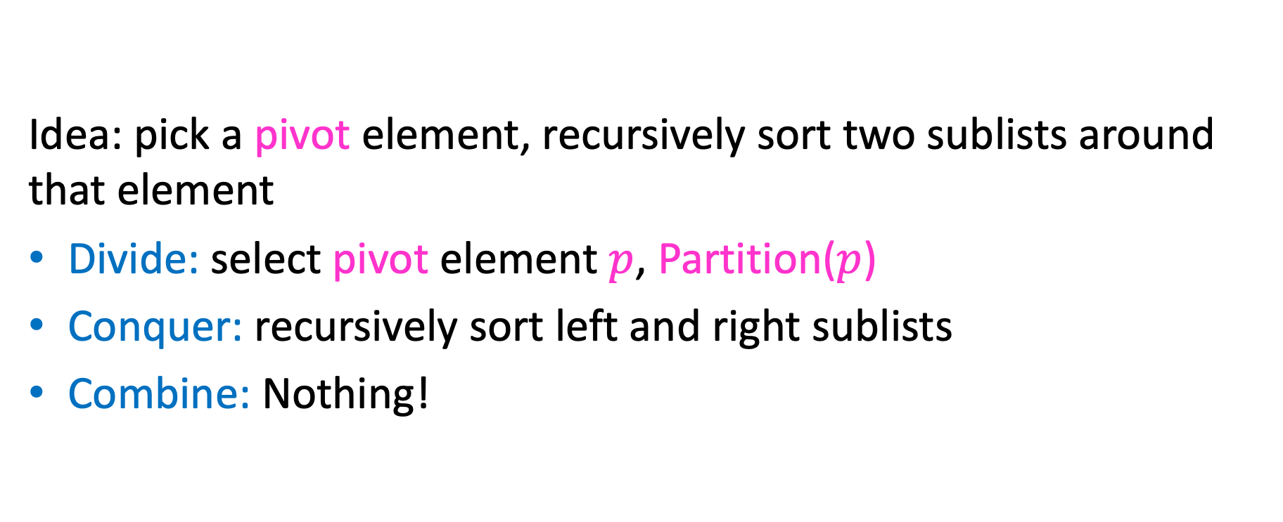

Quicksort Overview
Idea: pick a pivot element, recursively sort two sublists around that element
Divide: select pivot element $p$, Partition($p$)
Conquer: recursively sort left and right sublists
Combine: Nothing!

Slide 16



Partition (Divide step)
Given: a list, a pivot $p$
Start: unordered list
8
5
7
3
12
10
1
2
4
9
6
11
Goal: All elements $<p$ on left, all $>p$ on right
5
7
3
1
2
4
6
8
12
10
9
11

Slide 17
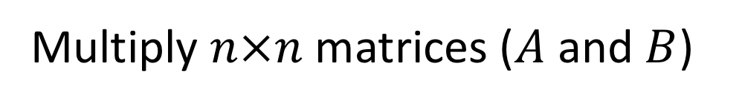
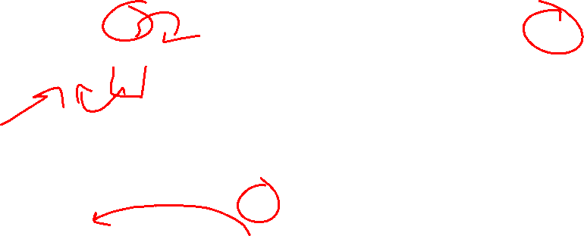
Partition Procedure (Slide 1 of 2)
If Begin value $< p$, move Begin right
Else swap Begin value with End value, move End Left
Done when Begin = End
8
5
7
3
12
10
1
2
4
9
6
11
8
5
7
3
12
10
1
2
4
9
6
11
8
5
7
3
12
10
1
2
4
9
6
11
8
5
7
3
11
10
1
2
4
9
6
12

Slide 18
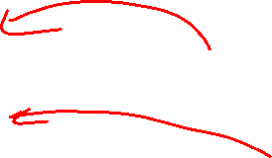
Partition Procedure (Slide 2 of 2)
If Begin value $< p$, move Begin right
Else swap Begin value with End value, move End Left
Done when Begin = End
8
5
7
3
11
10
1
2
4
9
6
12
8
5
7
3
6
10
1
2
4
9
11
12
8
5
7
3
6
10
1
2
4
9
11
12
8
5
7
3
6
9
1
2
4
10
11
12

Slide 19
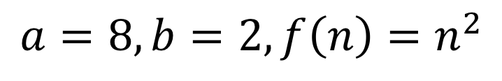
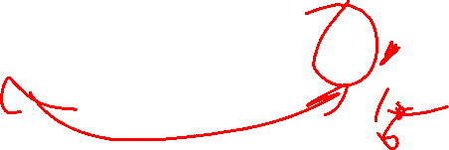
Partition – Begin Meets End (Case 1)
If Begin value $< p$, move Begin right
Else swap Begin value with End value, move End Left
Done when Begin = End
8
5
7
3
6
4
1
2
10
9
11
12
Case 1: meet at element $<p$
Swap $p$ with pointer position (2 in this case)
2
5
7
3
6
4
1
8
10
9
11
12

Slide 20
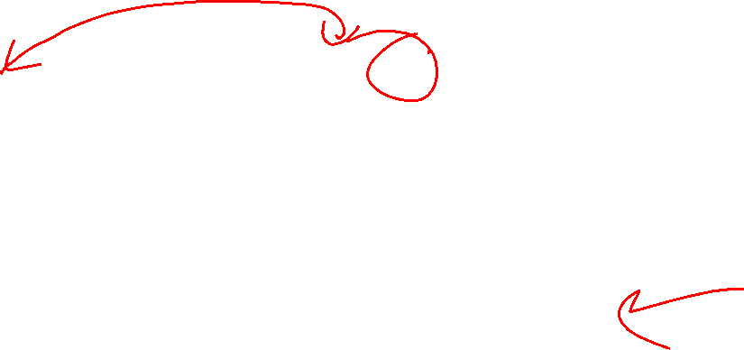
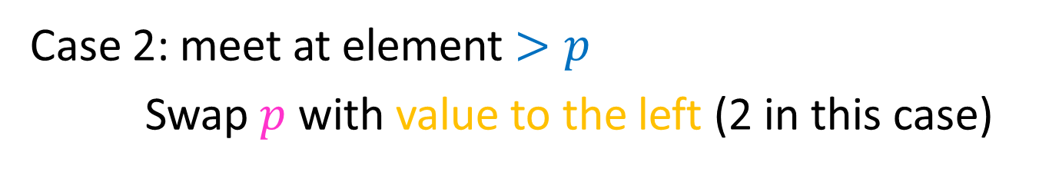
Partition – Begin Meets End (Case 2)
If Begin value $< p$, move Begin right
Else swap Begin value with End value, move End Left
Done when Begin = End
8
5
7
3
6
4
1
2
10
9
11
12
Case 2: meet at element $>p$
Swap $p$ with value to the left (2 in this case)
2
5
7
3
6
4
1
8
10
9
11
12

Slide 21
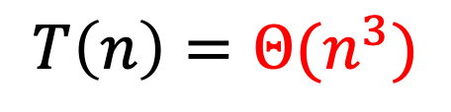
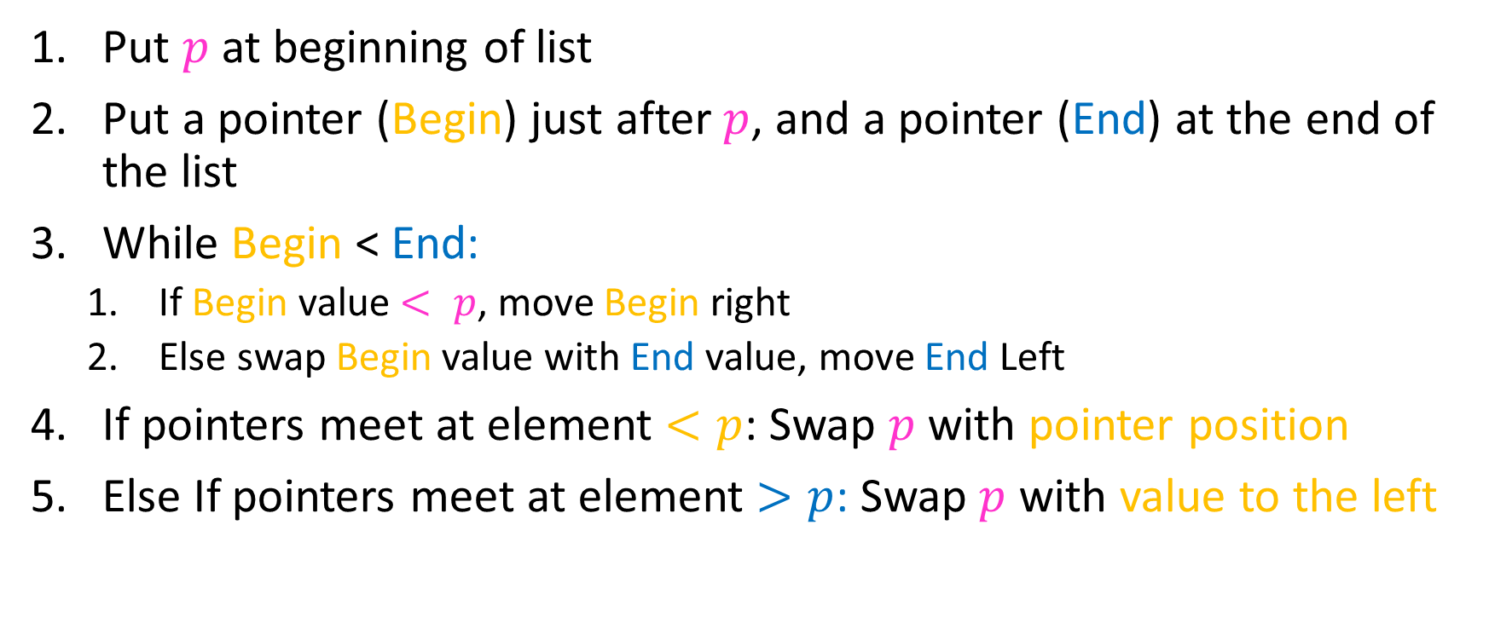

Partition Summary
Put $p$ at beginning of list
Put a pointer (Begin) just after $p$, and a pointer (End) at the end of the list
While Begin < End:
If Begin value $< p$, move Begin right
Else swap Begin value with End value, move End Left
If pointers meet at element $<p$: Swap $p$ with pointer position
Else If pointers meet at element $>p$: Swap $p$ with value to the left
Run time?
$$O(n)$$

Slide 22
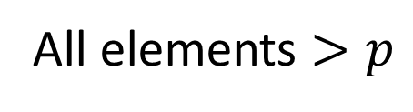
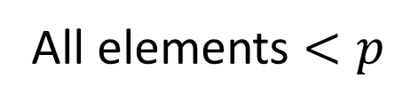
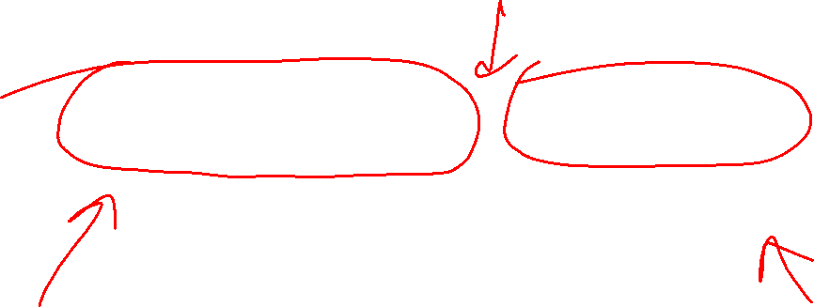
Conquer
2
5
7
3
6
4
1
8
10
9
11
12
All elements $<p$
All elements $>p$
Exactly where it belongs!
Recursively sort Left and Right sublists

Slide 23


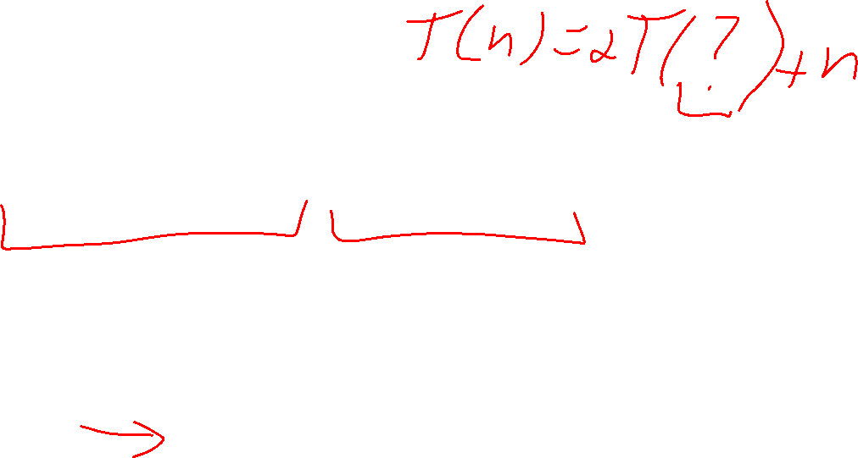
Quicksort Run Time (Best)
If the pivot is always the median:
2
5
1
3
6
4
7
8
10
9
11
12
2
1
3
5
6
4
7
8
9
10
11
12
Then we divide in half each time
$$T\left(n\right)=2T\left(\frac{n}{2}\right)+n$$
$$T\left(n\right)=O(n\log{n})$$

Slide 24


Quicksort Run Time (Worst)
If the pivot is always at the extreme:
1
5
2
3
6
4
7
8
10
9
11
12
1
2
3
5
6
4
7
8
10
9
11
12
Then we shorten by 1 each time
$$T\left(n\right)=T\left(n−1\right)+n$$
$$T\left(n\right)=O(n^{2})$$

Slide 25


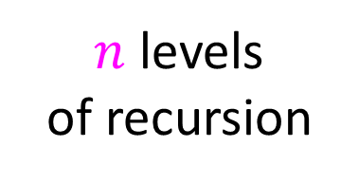


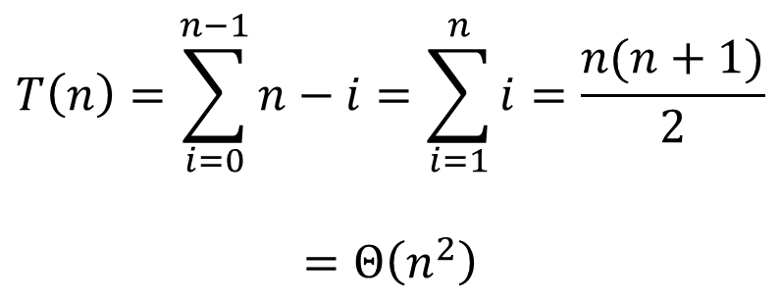





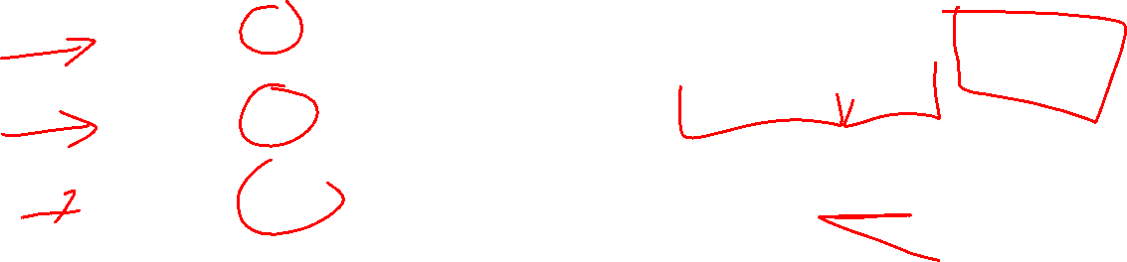


Quicksort Worst Case Tree Method
$$T\left(n\right)=T\left(n−1\right)+n$$
$$n$$
$$T\left(n\right)=\sum_{i=0}^{n−1}{n−i}=\sum_{i=1}^{n}{i}=\frac{n(n+1)}{2}$$
$$=Θ\left(n^{2}\right)$$
$$n$$
$$n−1$$
$$n−1$$
$$n−2$$
$$n−2$$
$n$ levels
of recursion
$$n−3$$
$$n−3$$
…
$$1$$
$$1$$

Slide 26
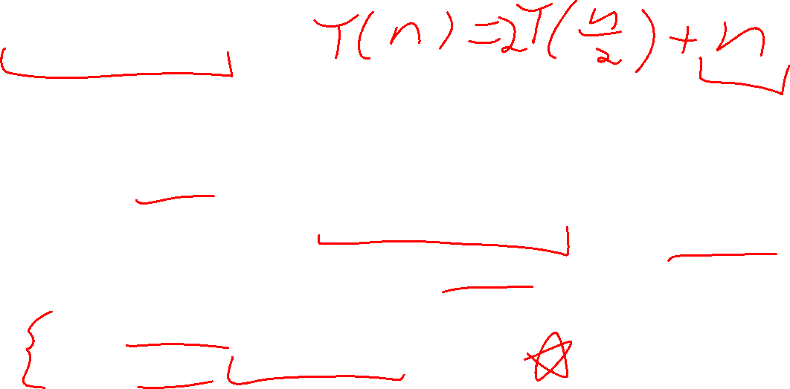
Good Pivot
What makes a good Pivot?
Roughly even split between left and right
Ideally: median
There are ways to find the median in linear time, but it’s complicated and slow and you’re better off using mergesort
In Practice:
Pick a random value as a pivot
Pick the middle of 3 random values as the pivot

Slide 27
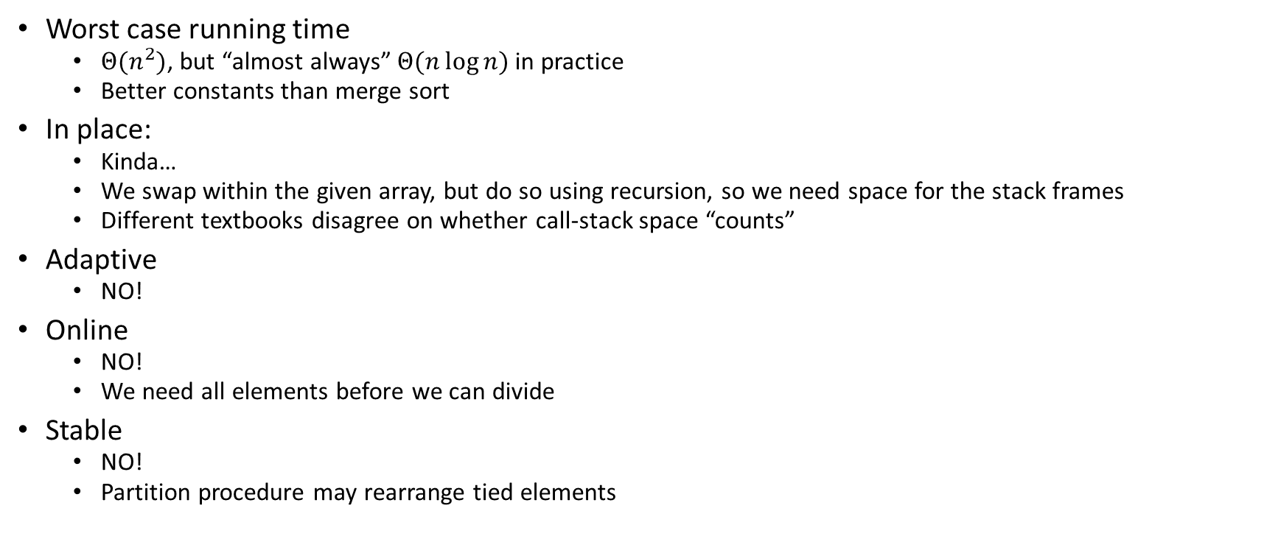
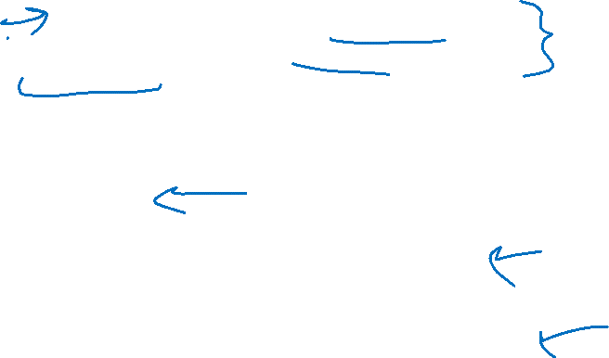
Quick Sort Properties
Worst case running time
$Θ(n^{2})$, but “almost always” $Θ(n\log{n})$ in practice
Better constants than merge sort
In place:
Kinda…
We swap within the given array, but do so using recursion, so we need space for the stack frames
Different textbooks disagree on whether call-stack space “counts”
Adaptive
NO!
Online
NO!
We need all elements before we can divide
Stable
NO!
Partition procedure may rearrange tied elements

Slide 28
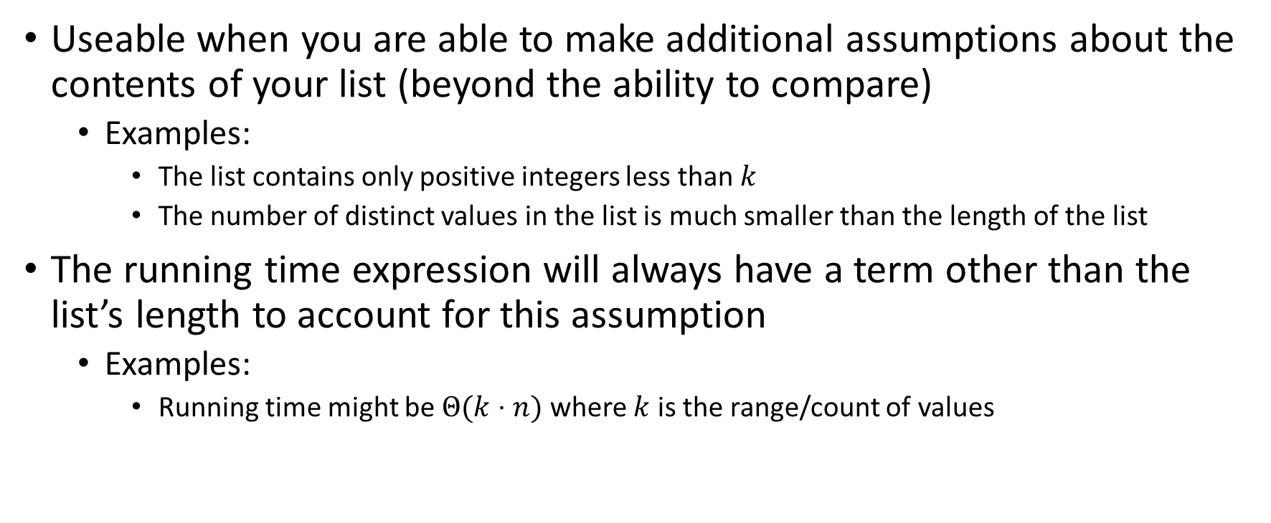
“Linear Time” Sorting Algorithms
Useable when you are able to make additional assumptions about the contents of your list (beyond the ability to compare)
Examples:
The list contains only positive integers less than $k$
The number of distinct values in the list is much smaller than the length of the list
The running time expression will always have a term other than the list’s length to account for this assumption
Examples:
Running time might be $Θ(k⋅n)$ where $k$ is the range/count of values

Slide 29
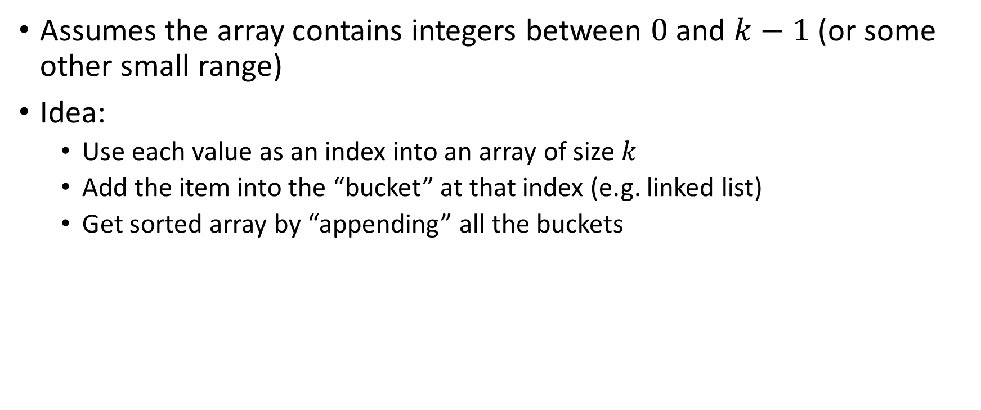
BucketSort
Assumes the array contains integers between $0$ and $k−1$ (or some other small range)
Idea:
Use each value as an index into an array of size $k$
Add the item into the “bucket” at that index (e.g. linked list)
Get sorted array by “appending” all the buckets
0
0
0
0
0
1
1
2
2
2
3
3
0
2
3
0
0
1
2
1
3
0
2
0
0
0
0
0
0
1
1
2
2
2
3
3
0
1
2
3

Slide 30
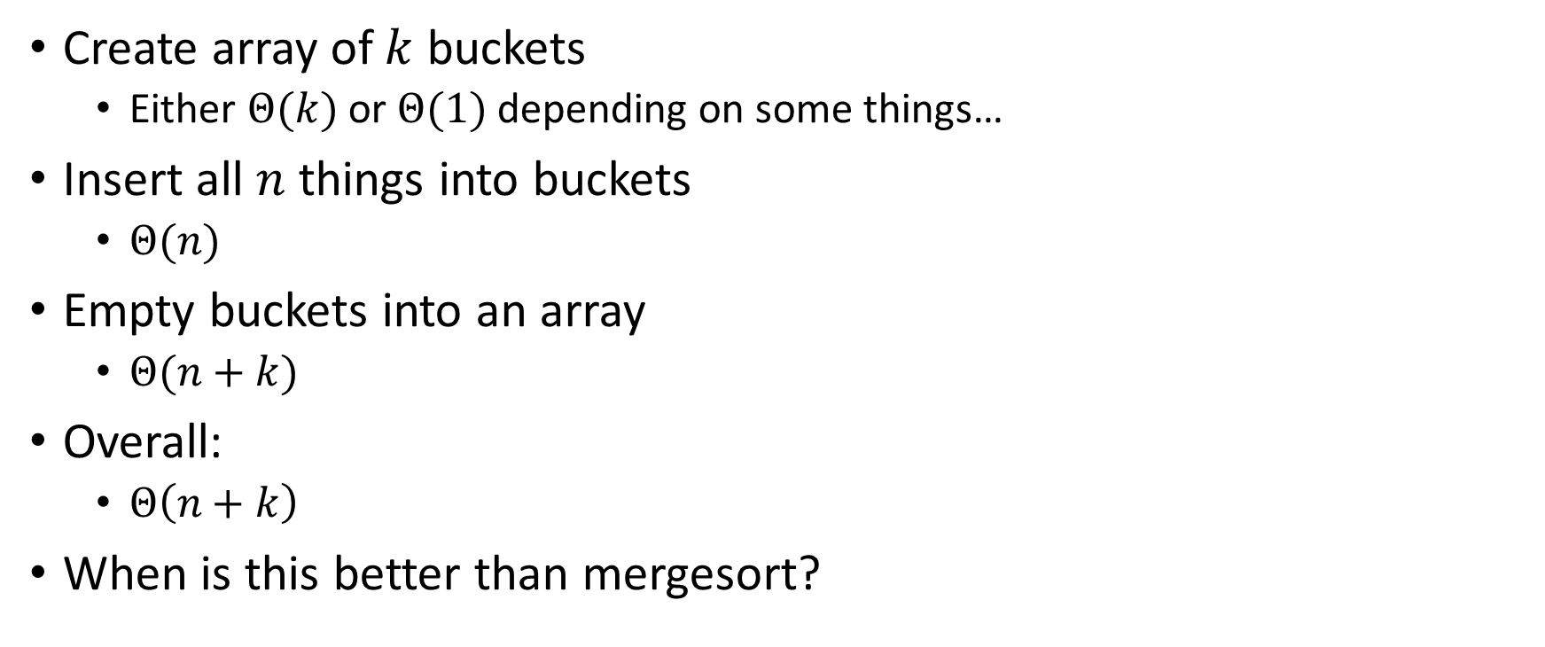
BucketSort Running Time
Create array of $k$ buckets
Either $Θ(k)$ or $Θ(1)$ depending on some things…
Insert all $n$ things into buckets
$Θ(n)$
Empty buckets into an array
$Θ(n+k)$
Overall:
$Θ\left(n+k\right)$
When is this better than mergesort?

Slide 31
Properties of BucketSort
In-Place?
No
Adaptive?
No
Stable?
Yes!

Slide 32
RadixSort
Radix: The base of a number system
We’ll use base 10, most implementations will use larger bases
Idea:
BucketSort by each digit, one at a time, from least significant to most significant
103
801
401
323
255
823
999
101
113
901
555
512
245
800
018
121
0
1
2
3
4
5
6
7
8
9
10
11
12
13
14
15
800
801
401
101
901
121
512
103
323
823
113
255
555
245
018
999
Place each element into a “bucket” according to its 1’s place
0
1
2
3
4
5
6
7
8
9

Slide 33
RadixSort – Re-Bucket by 10s
Radix: The base of a number system
We’ll use base 10, most implementations will use larger bases
Idea:
BucketSort by each digit, one at a time, from least significant to most significant
800
801
401
101
901
121
512
103
323
823
113
255
555
245
018
999
800
801
401
101
901
103
512
113
018
121
323
823
245
255
555
999
0
1
2
3
4
5
6
7
8
9
Place each element into a “bucket” according to its 10’s place
0
1
2
3
4
5
6
7
8
9

Slide 34
RadixSort – Re-Bucket by 100s
Radix: The base of a number system
We’ll use base 10, most implementations will use larger bases
Idea:
BucketSort by each digit, one at a time, from least significant to most significant
800
801
401
101
901
103
512
113
018
121
323
823
245
255
555
999
018
101
103
113
121
245
255
323
401
512
555
800
801
823
901
999
0
1
2
3
4
5
6
7
8
9
Place each element into a “bucket” according to its 100’s place
0
1
2
3
4
5
6
7
8
9

Slide 35
RadixSort – Empty Buckets into Output Array
Radix: The base of a number system
We’ll use base 10, most implementations will use larger bases
Idea:
BucketSort by each digit, one at a time, from least significant to most significant
018
101
103
113
121
245
255
323
401
512
555
800
801
823
901
999
Convert back into an array
0
1
2
3
4
5
6
7
8
9
018
101
103
113
121
245
255
323
401
512
555
800
801
823
901
999
0
1
2
3
4
5
6
7
8
9
10
11
12
13
14
15

Slide 36
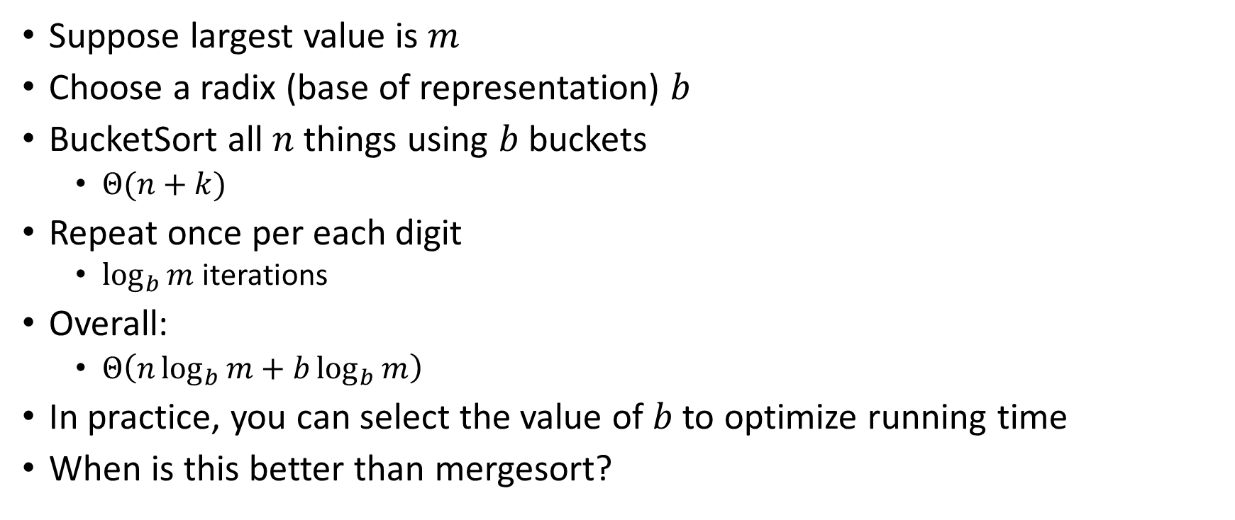
RadixSort Running Time
Suppose largest value is $m$
Choose a radix (base of representation) $b$
BucketSort all $n$ things using $b$ buckets
$Θ(n+k)$
Repeat once per each digit
$\log_{b}{m}$ iterations
Overall:
$Θ\left(n\log_{b}{m}+b\log_{b}{m}\right)$
In practice, you can select the value of $b$ to optimize running time
When is this better than mergesort?

