Slide 1


CSE 332 Winter 2026 Lecture 24: Complexity and Tractability
Nathan Brunelle
http://www.cs.uw.edu/332

Slide 2
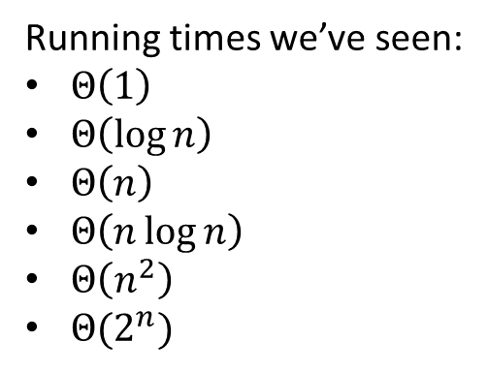

Running Times
Running times we’ve seen:
$Θ\left(1\right)$
$Θ\left(\log{n}\right)$
$Θ\left(n\right)$
$Θ\left(n\log{n}\right)$
$Θ\left(n^{2}\right)$
$Θ(2^{n})$
Operations
Input Size

Slide 3
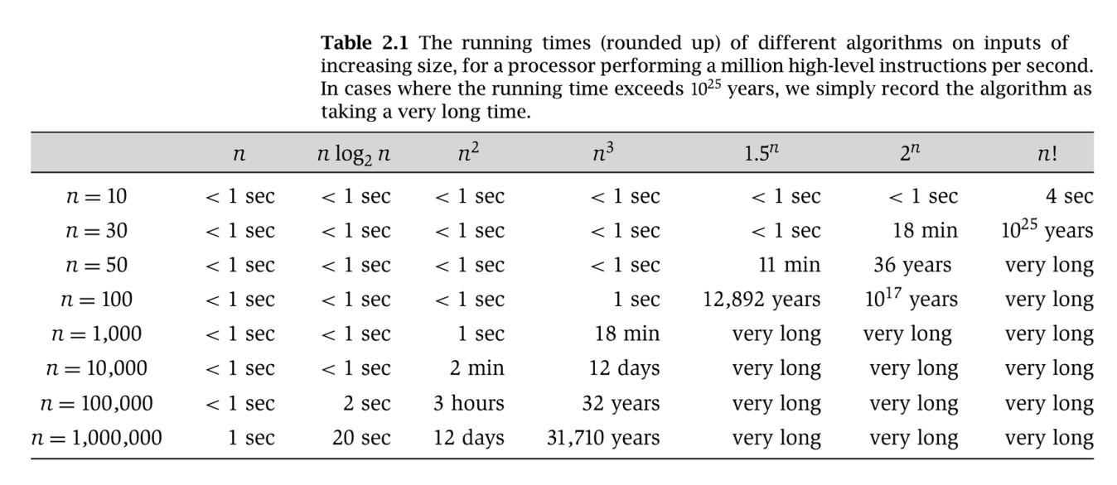
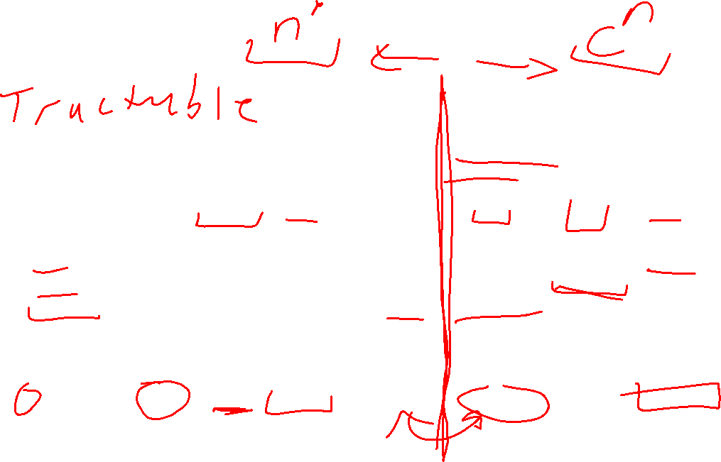
Running Times

Slide 4
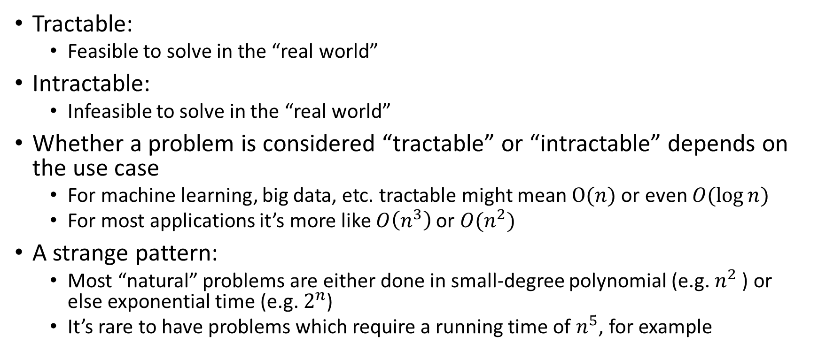
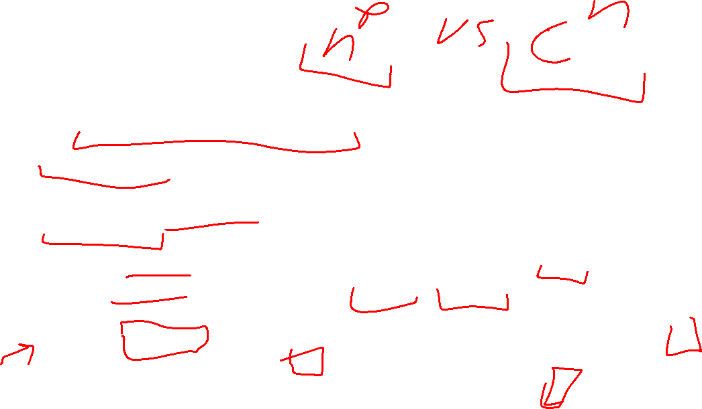
Tractability
Tractable:
Feasible to solve in the “real world”
Intractable:
Infeasible to solve in the “real world”
Whether a problem is considered “tractable” or “intractable” depends on the use case
For machine learning, big data, etc. tractable might mean $O(n)$ or even $O(\log{n})$
For most applications it’s more like $O\left(n^{3}\right)$ or $O(n^{2})$
A strange pattern:
Most “natural” problems are either done in small-degree polynomial (e.g. $n^{2}$ ) or else exponential time (e.g. $2^{n}$)
It’s rare to have problems which require a running time of $n^{5}$, for example

Slide 5
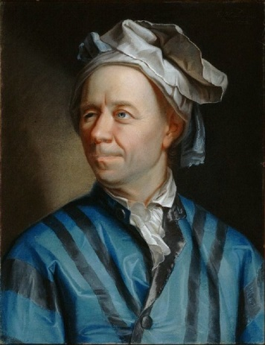
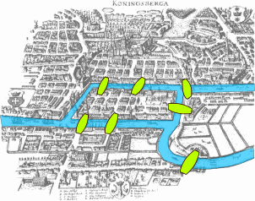
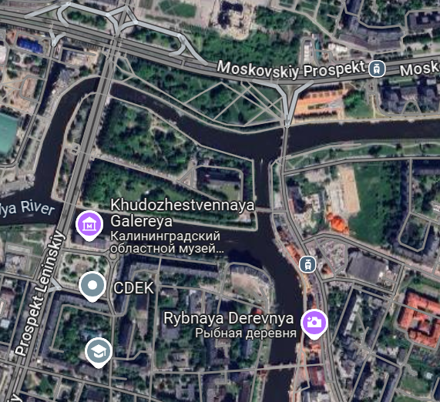
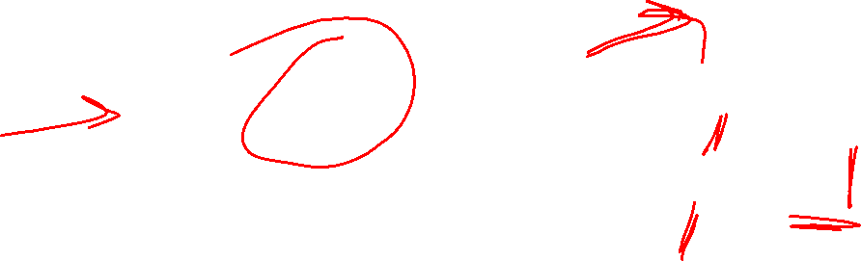
7 Bridges of Königsberg
B
A
D
C
The Pregel River runs through the city of Koenigsberg, creating 2 islands. Among these 2 islands and the 2 sides of the river, there are 7 bridges. Is there any path starting at one landmass which crosses each bridge exactly once?

Slide 6
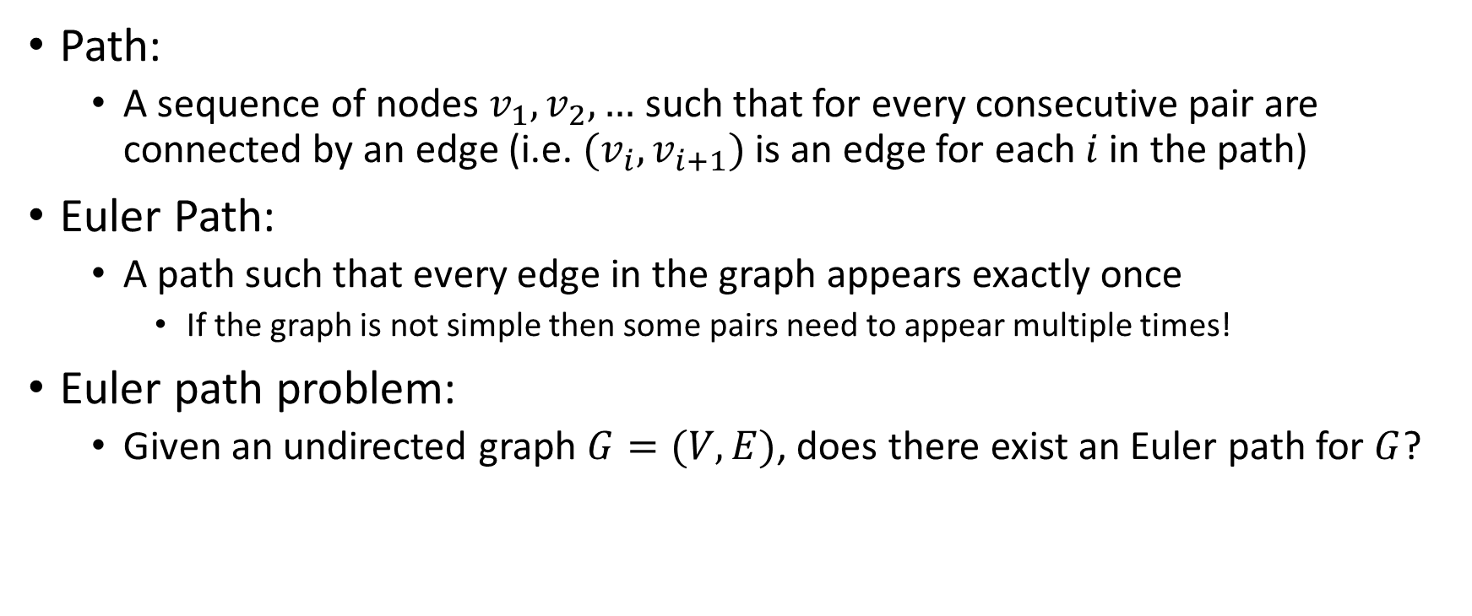


Euler Path Problem
B
B
A
A
D
D
C
Path:
A sequence of nodes $v_{1},v_{2},…$ such that for every consecutive pair are connected by an edge (i.e. $(v_{i},v_{i+1})$ is an edge for each $i$ in the path)
Euler Path:
A path such that every edge in the graph appears exactly once
If the graph is not simple then some pairs need to appear multiple times!
Euler path problem:
Given an undirected graph $G=(V,E)$, does there exist an Euler path for $G$?
C

Slide 7


Examples
Which of the graphs below have an Euler path?
B
B
D
B
A
A
D
D
A
C
C
C
Euler path exists!
$$A,B,D,A,C,D$$
No Euler path exists!
Euler path exists!
$$A,B,C,D,A,C,B,D$$

Slide 8
Euler’s Theorem
A graph has an Euler Path if and only if it is connected and has exactly 0 or 2 nodes with odd degree.
B
B
D
B
A
A
D
D
A
C
C
C

Slide 9
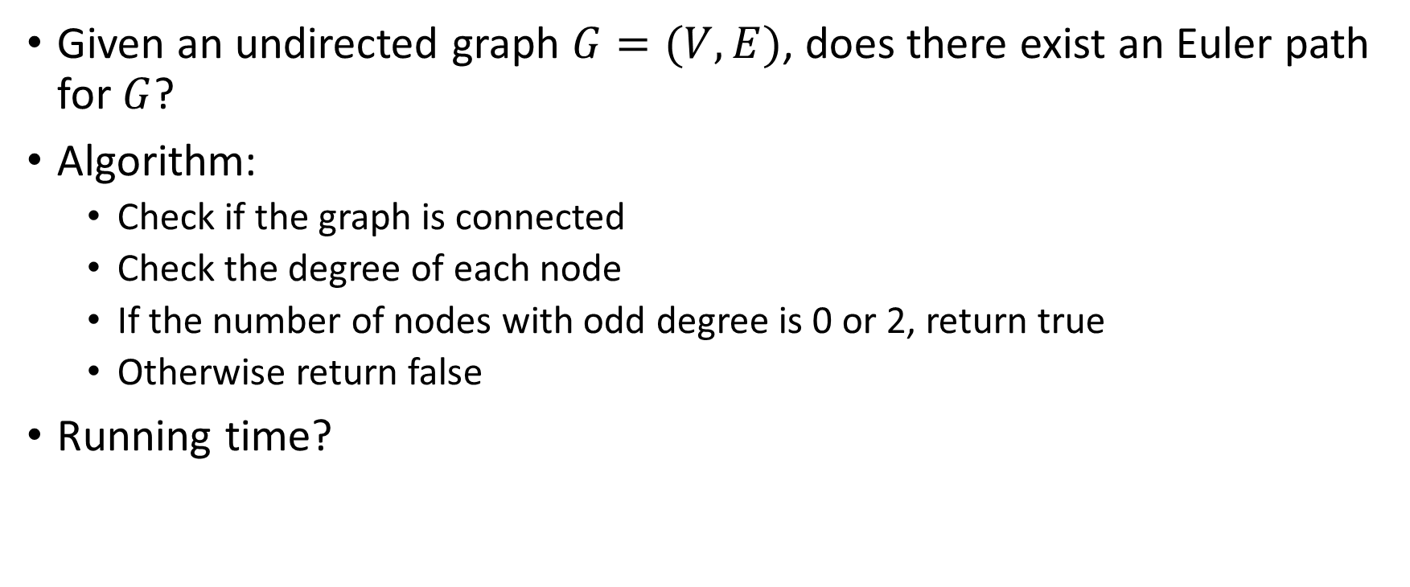
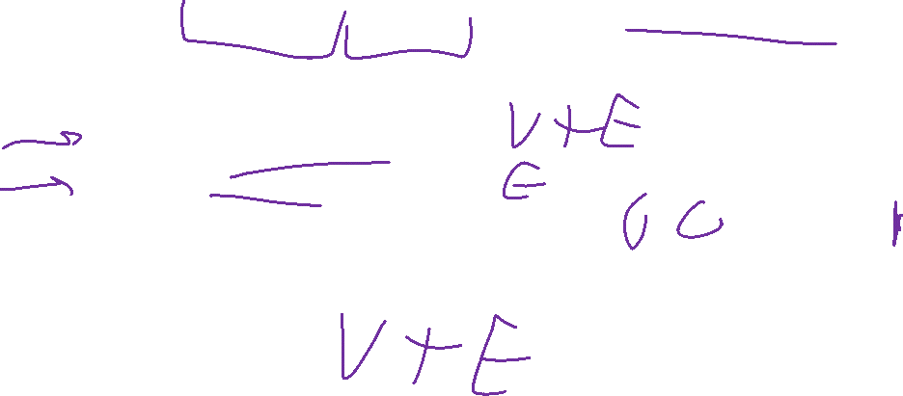
Algorithm for the Euler Path Problem
Given an undirected graph $G=(V,E)$, does there exist an Euler path for $G$?
Algorithm:
Check if the graph is connected
Check the degree of each node
If the number of nodes with odd degree is 0 or 2, return true
Otherwise return false
Running time?

Slide 10
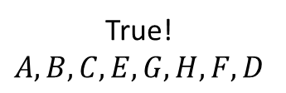


A Seemingly Similar Problem
Hamiltonian Path:
A path that includes every node in the graph exactly once
Hamiltonian Path Problem:
Given a graph $G=(V,E)$, does that graph have a Hamiltonian Path?
B
G
A
C
E
True!
$$A, B, C, E, G, H, F, D$$
H
F
D

Slide 11
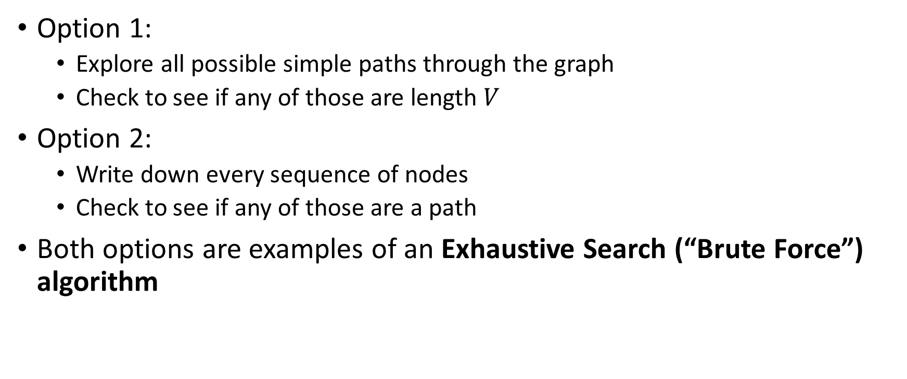
Algorithms for the Hamiltonian Path Problem
Option 1:
Explore all possible simple paths through the graph
Check to see if any of those are length $V$
Option 2:
Write down every sequence of nodes
Check to see if any of those are a path
Both options are examples of an Exhaustive Search (“Brute Force”) algorithm

Slide 12


Option 2: List all sequences, look for a path
Running time:
$G=(V,E)$
Number of permutations of $V$ is $\left|V\right|!$
$n!=n⋅\left(n−1\right)⋅\left(n−2\right)⋅…⋅2⋅1$
How does $n!$ compare with $2^{n}$?
$n!∈Ω(2^{n})$
Exponential running time!

Slide 13
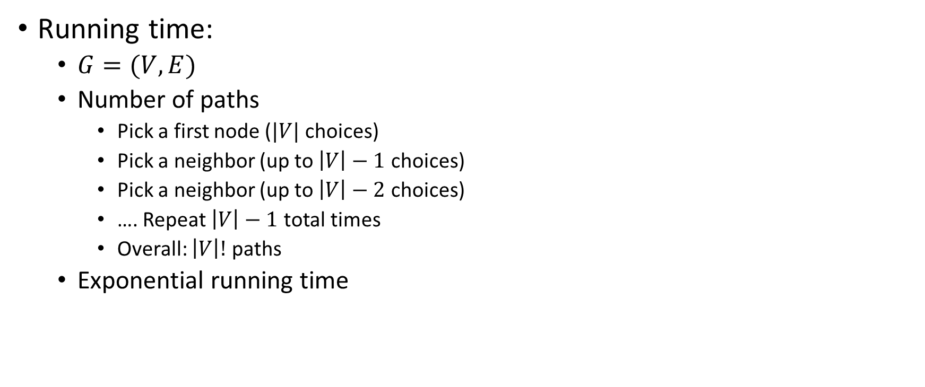


Option 1: Explore all simple paths, check for one of length $V$
Running time:
$G=(V,E)$
Number of paths
Pick a first node ($|V|$ choices)
Pick a neighbor (up to $\left|V\right|−1$ choices)
Pick a neighbor (up to $\left|V\right|−2$ choices)
…. Repeat $\left|V\right|−1$ total times
Overall: $\left|V\right|!$ paths
Exponential running time
B
D
E
A
C

Slide 14
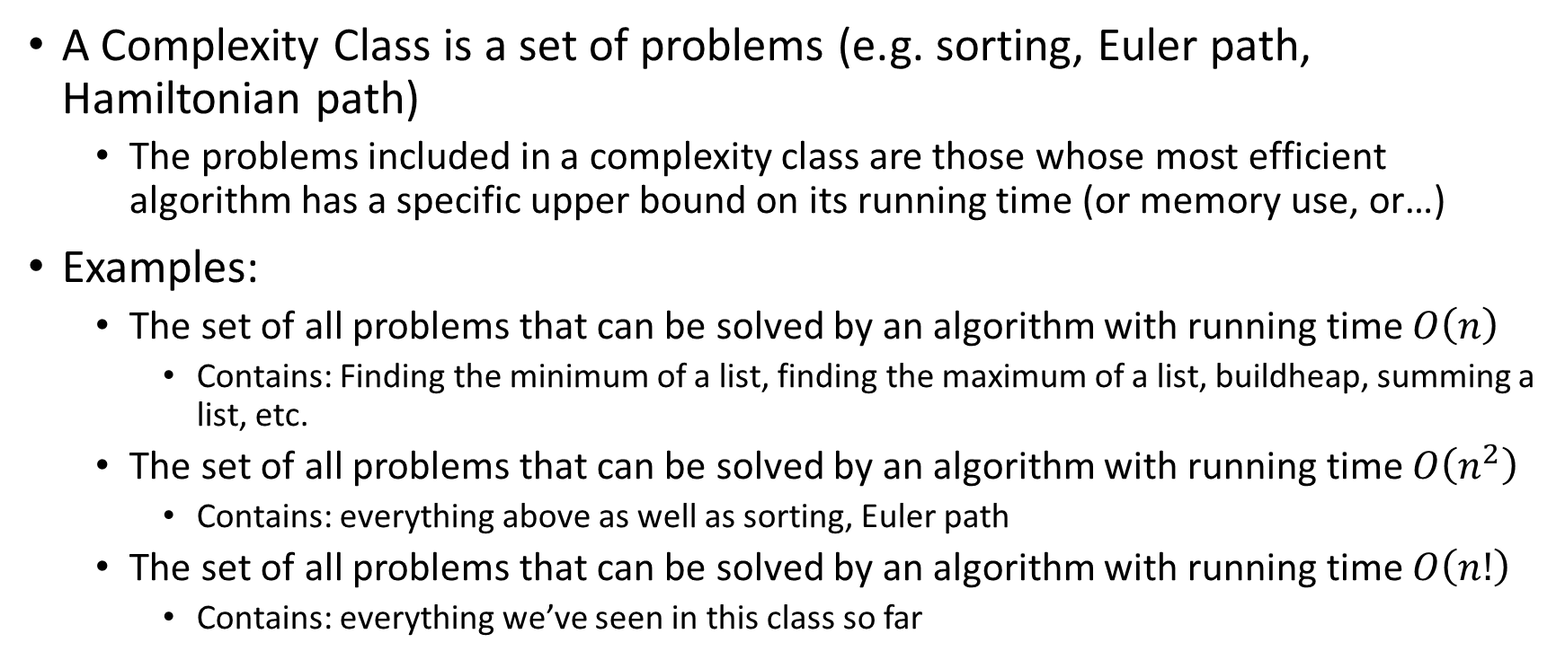

Complexity Classes
A Complexity Class is a set of problems (e.g. sorting, Euler path, Hamiltonian path)
The problems included in a complexity class are those whose most efficient algorithm has a specific upper bound on its running time (or memory use, or…)
Examples:
The set of all problems that can be solved by an algorithm with running time $O\left(n\right)$
Contains: Finding the minimum of a list, finding the maximum of a list, buildheap, summing a list, etc.
The set of all problems that can be solved by an algorithm with running time $O\left(n^{2}\right)$
Contains: everything above as well as sorting, Euler path
The set of all problems that can be solved by an algorithm with running time $O\left(n!\right)$
Contains: everything we’ve seen in this class so far

Slide 15
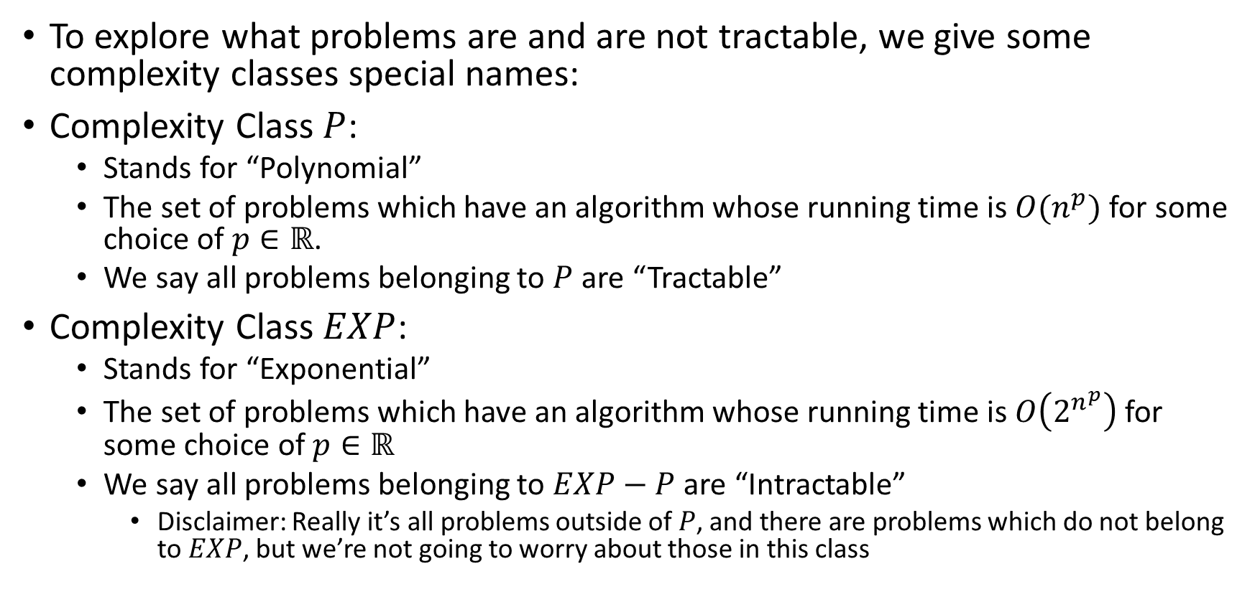
Complexity Classes and Tractability
To explore what problems are and are not tractable, we give some complexity classes special names:
Complexity Class $P$:
Stands for “Polynomial”
The set of problems which have an algorithm whose running time is $O(n^{p})$ for some choice of $p∈ℝ$.
We say all problems belonging to $P$ are “Tractable”
Complexity Class $EXP$:
Stands for “Exponential”
The set of problems which have an algorithm whose running time is $O\left(2^{n^{p}}\right)$ for some choice of $p∈ℝ$
We say all problems belonging to $EXP−P$ are “Intractable”
Disclaimer: Really it’s all problems outside of $P$, and there are problems which do not belong to $EXP$, but we’re not going to worry about those in this class

Slide 16

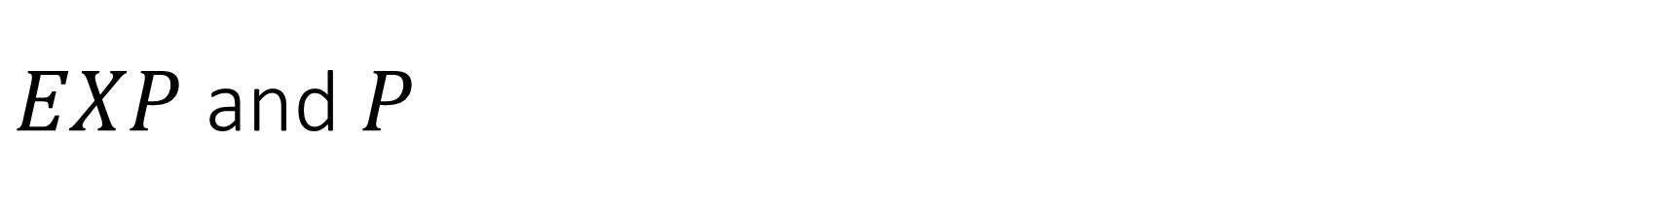
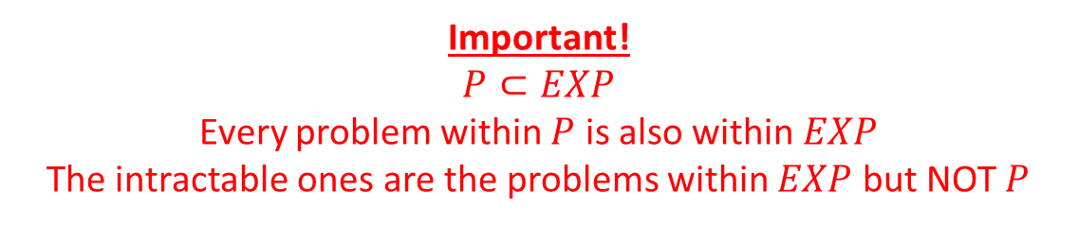
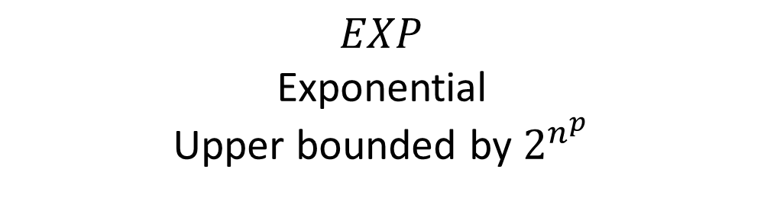
$EXP$ and $P$
Important!
$$P⊂EXP$$
Every problem within $P$ is also within $EXP$
The intractable ones are the problems within $EXP$ but NOT $P$
$$EXP$$
Exponential
Upper bounded by $2^{n^{p}}$
$$P$$
Polynomial
Upper bounded by $n^{p}$
Intractable
Tractable

Slide 17
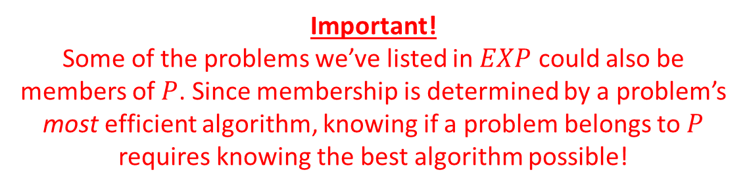

Members
Important!
Some of the problems we’ve listed in $EXP$ could also be members of $P$. Since membership is determined by a problem’s most efficient algorithm, knowing if a problem belongs to $P$ requires knowing the best algorithm possible!
$$EXP$$
Sorting
Shortest Path
Euler Path
Hamiltonian Path
Longest Path
Vertex Cover
Independent Set
Satisfiability
Most Board Game Strategies
$$P$$
Tractable
Intractable

Slide 18
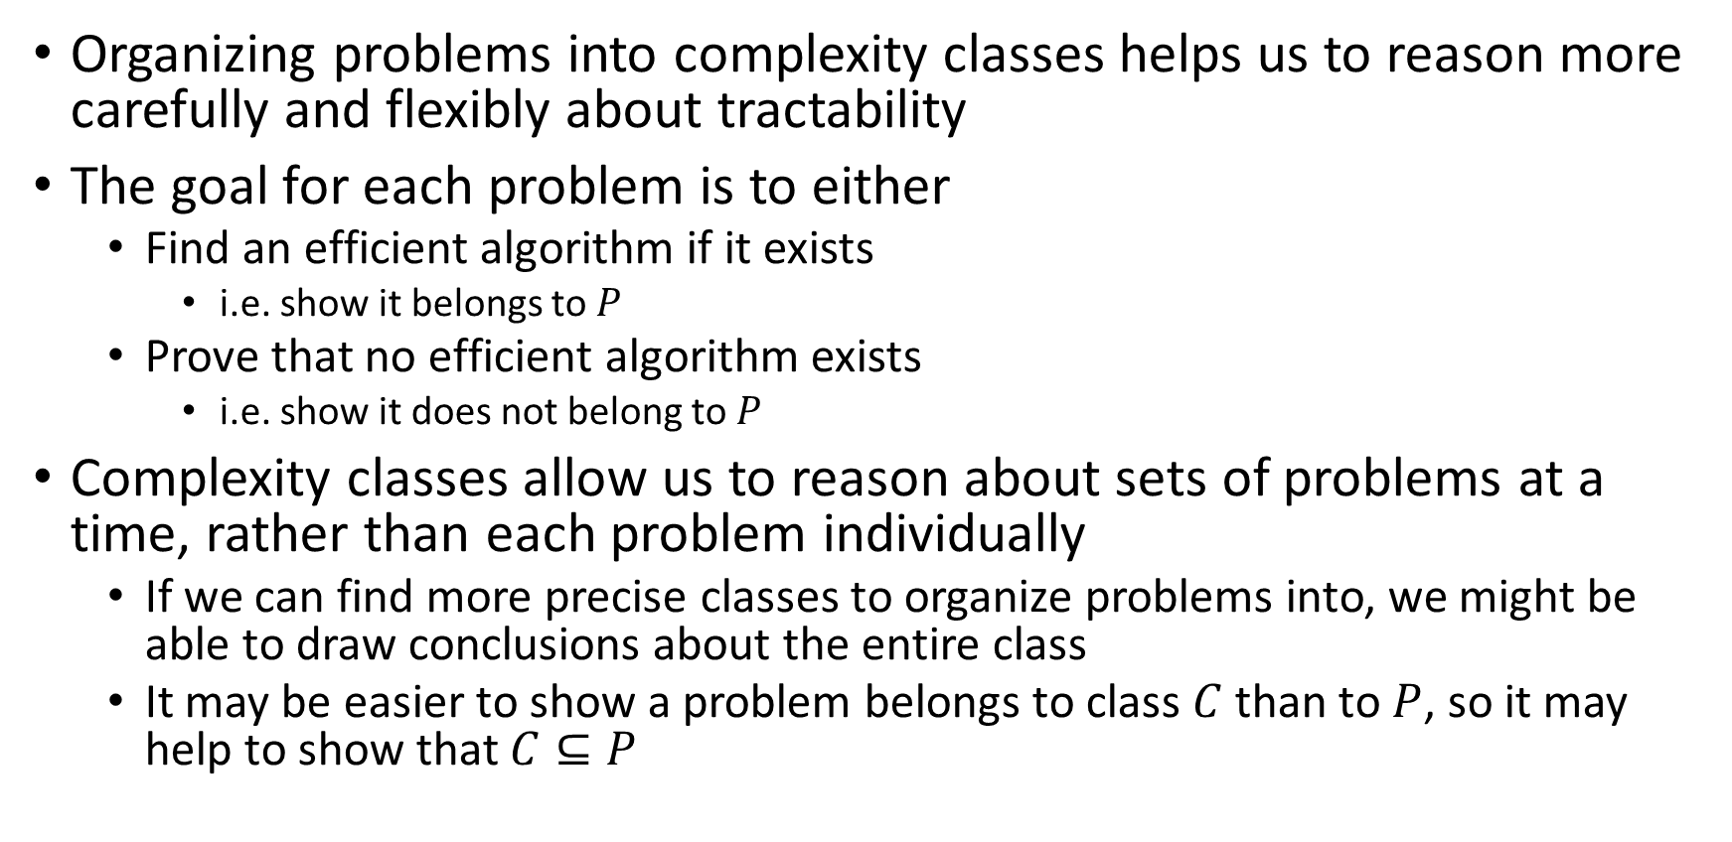
Studying Complexity and Tractability
Organizing problems into complexity classes helps us to reason more carefully and flexibly about tractability
The goal for each problem is to either
Find an efficient algorithm if it exists
i.e. show it belongs to $P$
Prove that no efficient algorithm exists
i.e. show it does not belong to $P$
Complexity classes allow us to reason about sets of problems at a time, rather than each problem individually
If we can find more precise classes to organize problems into, we might be able to draw conclusions about the entire class
It may be easier to show a problem belongs to class $C$ than to $P$, so it may help to show that $C⊆P$

Slide 19

Some problems in $EXP$ seem “easier”
There are some problems that we do not have polynomial time algorithms to solve, but provided answers are easy to check
Hamiltonian Path:
It’s “hard” to look at a graph and determine whether it has a Hamiltonian Path
It’s “easy” to look at a graph and a candidate path together and determine whether THAT path is a Hamiltonian Path
It’s easy to verify whether a given path is a Hamiltonian path

Slide 20
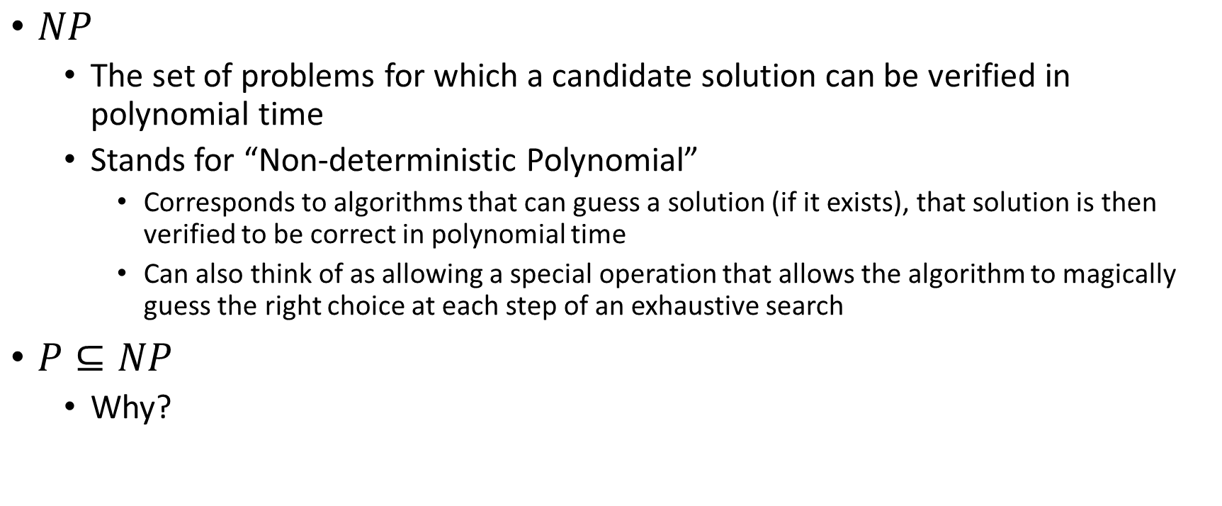

Class $NP$
$NP$
The set of problems for which a candidate solution can be verified in polynomial time
Stands for “Non-deterministic Polynomial”
Corresponds to algorithms that can guess a solution (if it exists), that solution is then verified to be correct in polynomial time
Can also think of as allowing a special operation that allows the algorithm to magically guess the right choice at each step of an exhaustive search
$P⊆NP$
Why?

Slide 21
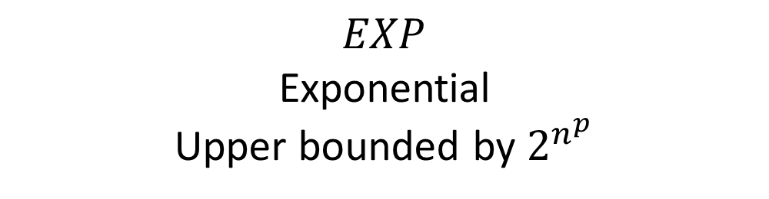



$EXP⊃NP⊇P$
$$EXP$$
Exponential
Upper bounded by $2^{n^{p}}$
$$NP$$
Nondeterministic Polynomial
Verified in $n^{p}$ time
$$P$$
Polynomial
Upper bounded by $n^{p}$
Gap?
Unknown!

Slide 22
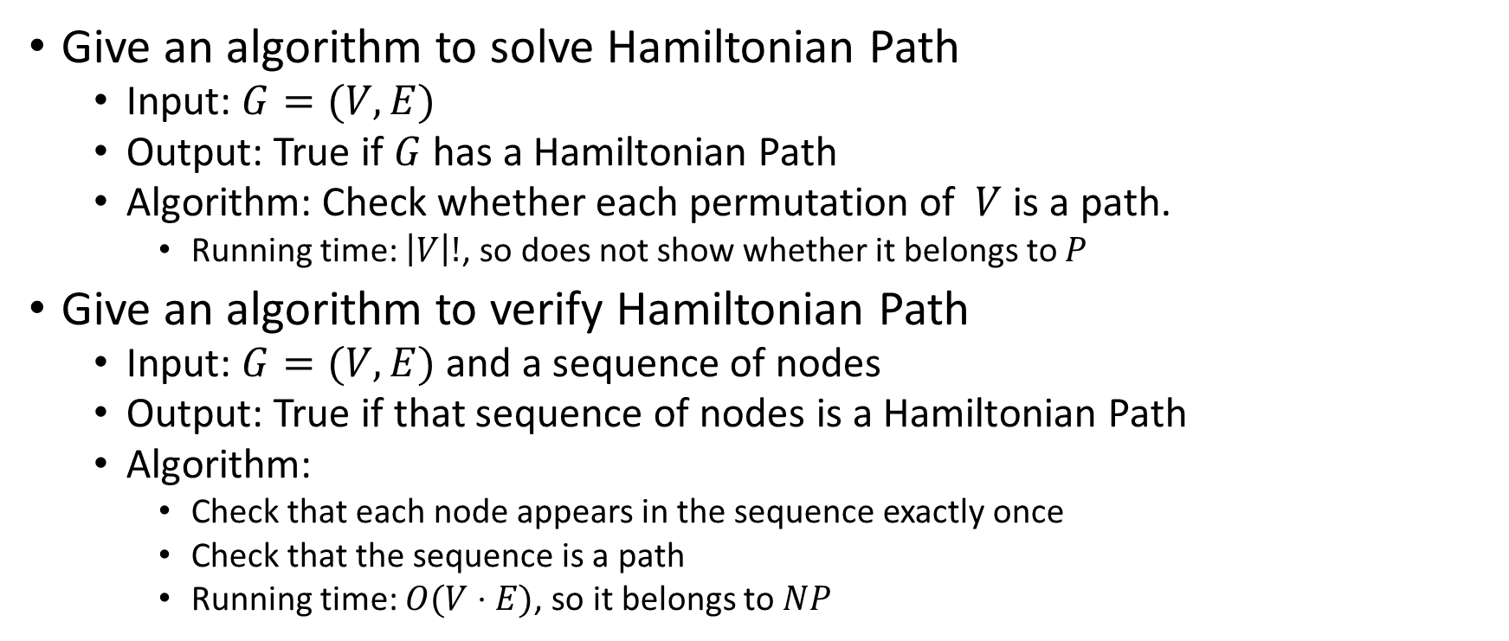
Solving and Verifying Hamiltonian Path
Give an algorithm to solve Hamiltonian Path
Input: $G=(V,E)$
Output: True if $G$ has a Hamiltonian Path
Algorithm: Check whether each permutation of $V$ is a path.
Running time: $\left|V\right|!$, so does not show whether it belongs to $P$
Give an algorithm to verify Hamiltonian Path
Input: $G=(V,E)$ and a sequence of nodes
Output: True if that sequence of nodes is a Hamiltonian Path
Algorithm:
Check that each node appears in the sequence exactly once
Check that the sequence is a path
Running time: $O(V⋅E)$, so it belongs to $NP$

Slide 23












Party Problem
Draw Edges between people who don’t get along
How many people can I invite to a party if everyone must get along?

Slide 24

Independent Set
Independent set:
$S⊆V$ is an independent set if no two nodes in $S$ share an edge
Independent Set Problem:
Given a graph $G=(V,E)$ and a number $k$, determine whether there is an independent set $S$ of size $k$

Slide 25
Example
Independent set of size 6

Slide 26
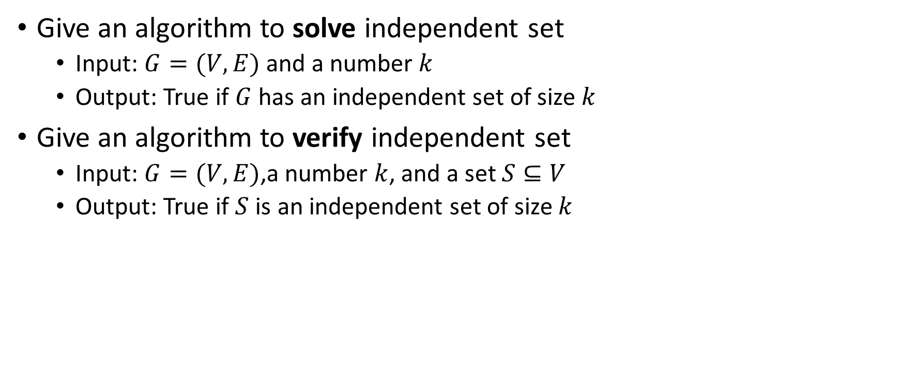
Solving and Verifying Independent Set
Give an algorithm to solve independent set
Input: $G=(V,E)$ and a number $k$
Output: True if $G$ has an independent set of size $k$
Give an algorithm to verify independent set
Input: $G=(V,E)$,a number $k$, and a set $S⊆V$
Output: True if $S$ is an independent set of size $k$

Slide 27
Generalized Baseball

Slide 28
Generalized Baseball
Need to place defenders on bases such that every edge is defended
How many defenders would suffice?

Slide 29

Vertex Cover
Vertex Cover:
$C⊆V$ is a vertex cover if every edge in $E$ has one of its endpoints in $C$
Vertex Cover Problem:
Given a graph $G=(V,E)$ and a number $k$, determine if there is a vertex cover $C$ of size $k$

Slide 30
Example
Vertex cover of size 5

Slide 31
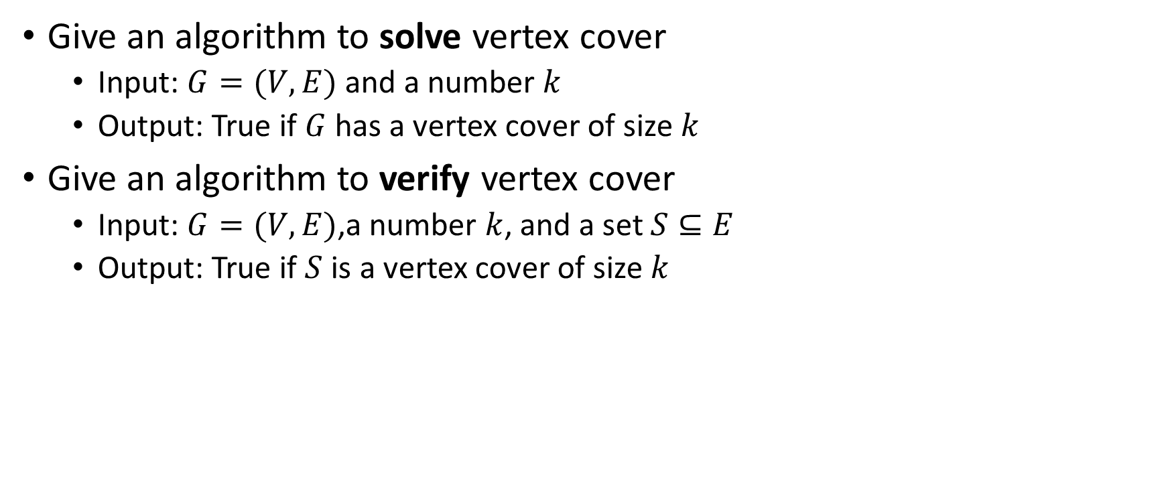
Solving and Verifying Vertex Cover
Give an algorithm to solve vertex cover
Input: $G=(V,E)$ and a number $k$
Output: True if $G$ has a vertex cover of size $k$
Give an algorithm to verify vertex cover
Input: $G=(V,E)$,a number $k$, and a set $S⊆E$
Output: True if $S$ is a vertex cover of size $k$

Slide 32


$EXP⊃NP⊇P$
$P=NP$ or $P⊂NP$
$$EXP$$
Exponential
Upper bounded by $2^{n^{p}}$
Checkers
Go
Chess
Vertex Cover
Independent Set
Hamiltonian Path
Cryptography
Prime factorization
$$NP$$
Nondeterministic Polynomial
Verified in $n^{p}$ time
$$P$$
Polynomial
Upper bounded by $n^{p}$
Sorting
Shortest Path
Euler Path
Gap?
Unknown!

Slide 33
Way Cool!
$S$ is an independent set of $G$ iff $V−S$ is a vertex cover of $G$
Independent Set
Vertex Cover

Slide 34
Way Cool!
$S$ is an independent set of $G$ iff $V−S$ is a vertex cover of $G$
Vertex Cover
Independent Set

Slide 35
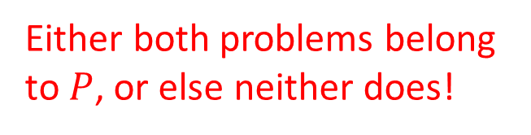
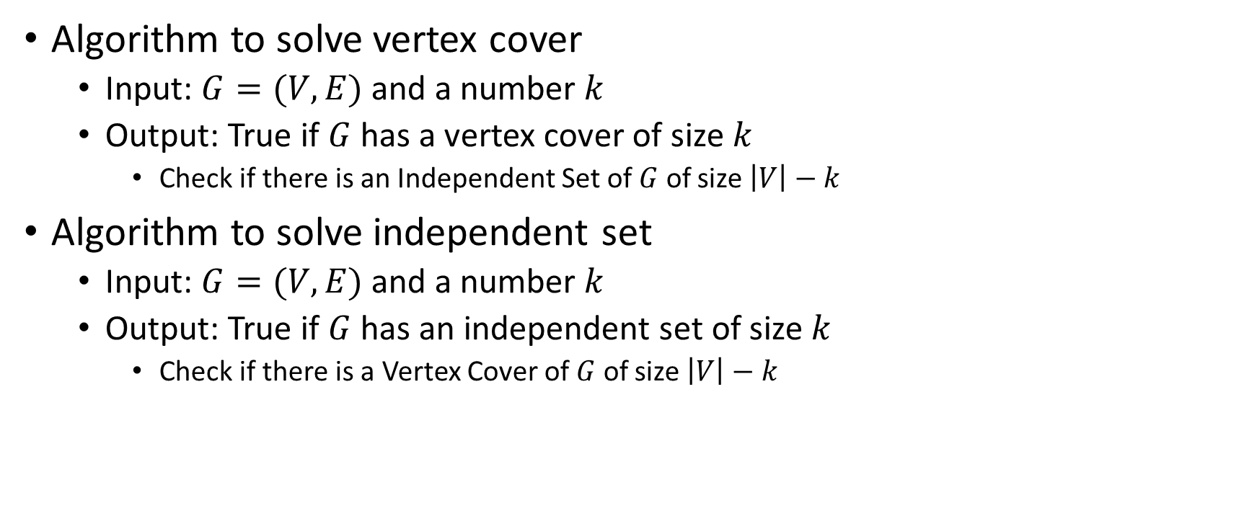
Solving Vertex Cover and Independent Set
Algorithm to solve vertex cover
Input: $G=(V,E)$ and a number $k$
Output: True if $G$ has a vertex cover of size $k$
Check if there is an Independent Set of $G$ of size $\left|V\right|−k$
Algorithm to solve independent set
Input: $G=(V,E)$ and a number $k$
Output: True if $G$ has an independent set of size $k$
Check if there is a Vertex Cover of $G$ of size $\left|V\right|−k$
Either both problems belong to $P$, or else neither does!

Slide 36
Reduction
A strategy for creating algorithms
Solve one problem by converting it into a different problem, then using an algorithm for that other problem.

Slide 37

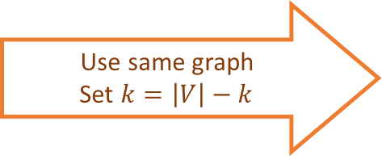

Independent Set Reduces To Vertex Cover
Independent Set Input
O(V) Time
Vertex Cover Input
Relate Independent Set input to Vertex Cover output
Use same graph
Set $k=\left|V\right|−k$
$$k$$
$$k$$
Any Algorithm for Vertex Cover
Relate Independent Set output to Vertex Cover output
Independent Set Output
Vertex Cover Ouput
Give same output
Reduction

Slide 38


Reductions
Shows how two different problems relate to each other
MOVIE TIME!

Slide 39











MacGyver’s Reduction
Problem we don’t know how to solve
Problem we do know how to solve
$$A$$
Opening a door
Aim duct at door, insert keg
Lighting a fire
$$B$$
How?
Solution for $A$
Solution for $B$
Keg cannon battering ram
Alcohol, wood, matches
Put fire under the Keg
Reduction

Slide 40
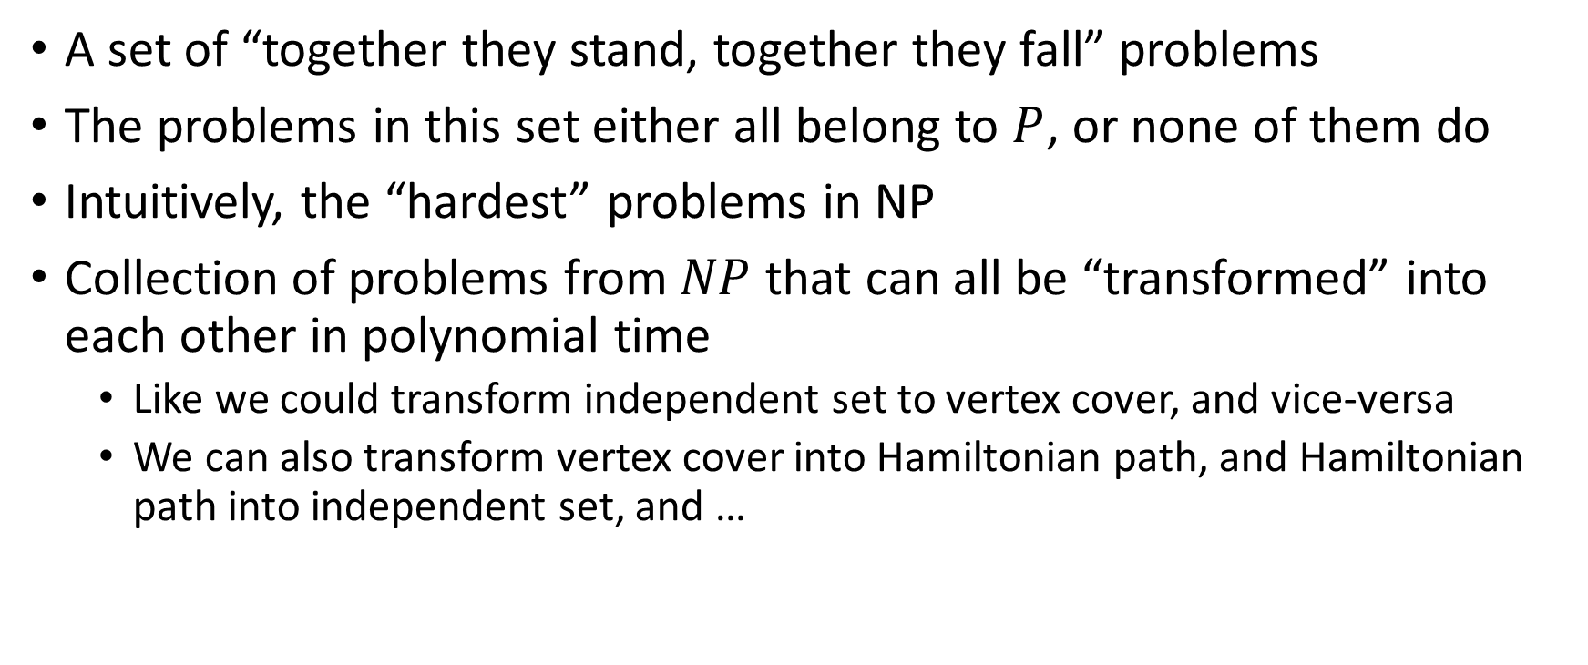
NP-Complete
A set of “together they stand, together they fall” problems
The problems in this set either all belong to $P$, or none of them do
Intuitively, the “hardest” problems in NP
Collection of problems from $NP$ that can all be “transformed” into each other in polynomial time
Like we could transform independent set to vertex cover, and vice-versa
We can also transform vertex cover into Hamiltonian path, and Hamiltonian path into independent set, and …

Slide 41
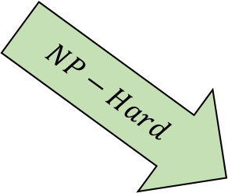
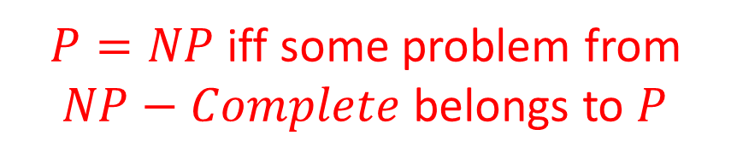
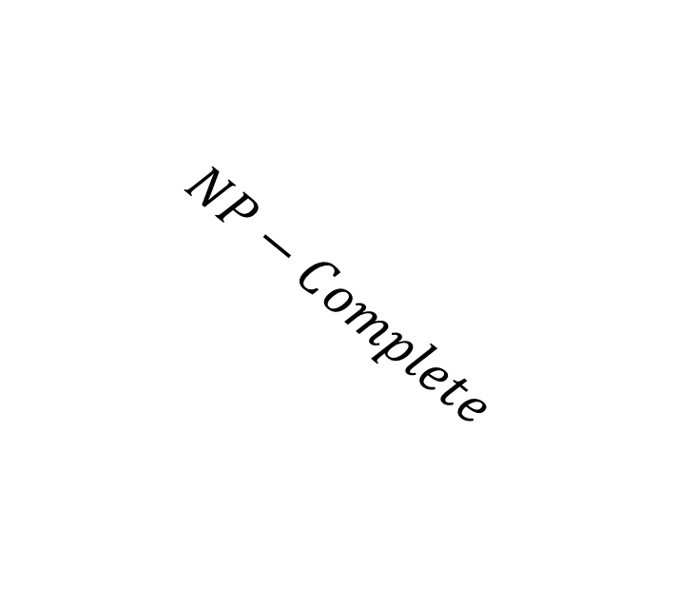


$EXP⊃NP−Complete⊇NP⊇P$
$P=NP$ iff some problem from $NP−Complete$ belongs to $P$
$$EXP$$
Checkers
Go
Chess
Vertex Cover
Independent Set
Hamiltonian Path
$$NP$$
$$NP−Complete$$
$$P$$
Cryptography
Prime factorization
Sorting
Shortest Path
Euler Path
$$NP−Hard$$
Gap?
Unknown!

Slide 42


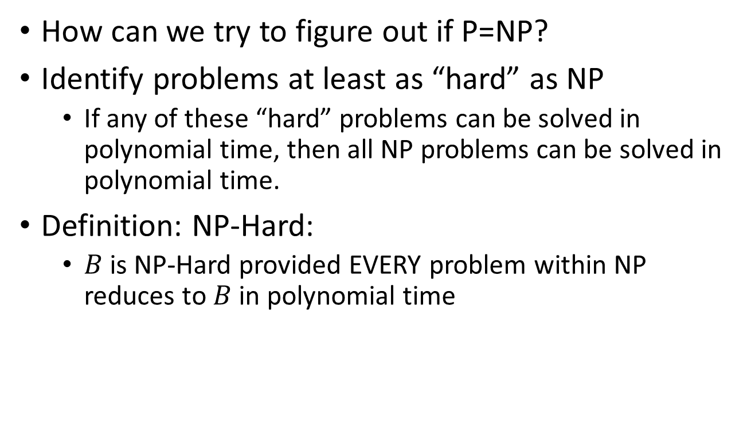
NP-Hard
$$EXP$$
$$NP$$
$$P$$
How can we try to figure out if P=NP?
Identify problems at least as “hard” as NP
If any of these “hard” problems can be solved in polynomial time, then all NP problems can be solved in polynomial time.
Definition: NP-Hard:
$B$ is NP-Hard provided EVERY problem within NP reduces to $B$ in polynomial time
$$NP−Hard$$

Slide 43



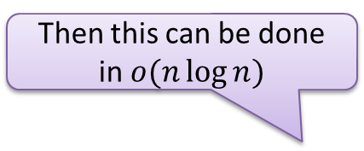


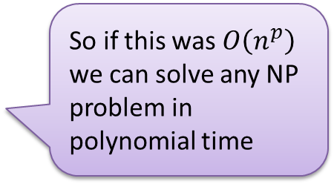
NP-Hard Idea
For every NP problem
Any NP Problem
$$O(n^{p})$$
An NP-Hard Problem
$$A$$
$$B$$
So if this was $O\left(n^{p}\right)$ we can solve any NP problem in polynomial time
There exists a polynomial-time reduction to each NP-Hard Problem
Solution for $A$
Solution for $B$
$$X$$
$$Y$$
Reduction

Slide 44






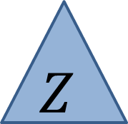

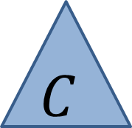


Showing NP-Hardness
Any NP Problem
$$O(n^{p})$$
A First NP-Hard
Problem
$$O(n^{p})$$
A new NP-Hard Problem
$$C$$
$$A$$
$$B$$
Solution for $C$
Solution for $A$
Solution for $B$
$$Z$$
$$X$$
$$Y$$
Reduction
Reduction

Slide 45
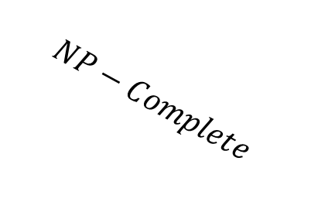
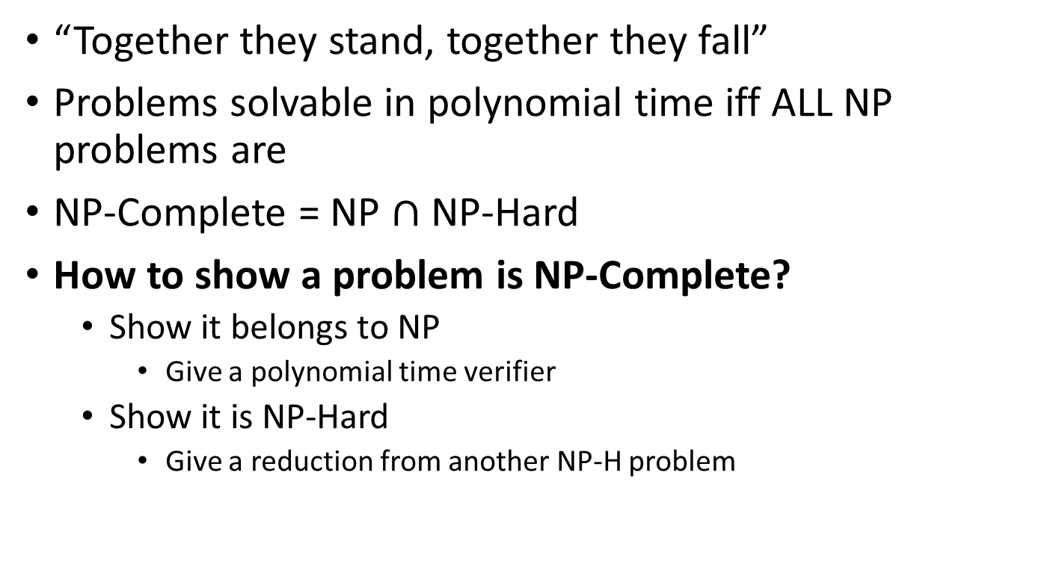

NP-Complete
$$EXP$$
$$NP$$
$$NP−Complete$$
$$P$$
“Together they stand, together they fall”
Problems solvable in polynomial time iff ALL NP problems are
NP-Complete = NP $∩$ NP-Hard
How to show a problem is NP-Complete?
Show it belongs to NP
Give a polynomial time verifier
Show it is NP-Hard
Give a reduction from another NP-H problem
$$NP−Hard$$

Slide 46
NP-Completeness
Any NP-Complete Problem
$$O(n^{p})$$
Any other NP-Complete Problem
$$A$$
$$B$$
If this could be done in polynomial time
Then this could be done in polynomial time
Solution for $A$
Solution for $B$
$$X$$
$$Y$$
Reduction

Slide 47
NP-Completeness
Any NP-Complete Problem
$$O(n^{p})$$
Any other NP-Complete Problem
$$A$$
$$B$$
Then this cannot be done in polynomial time
If this cannot be done in polynomial time
Solution for $A$
Solution for $B$
$$X$$
$$Y$$
Reduction

Slide 48
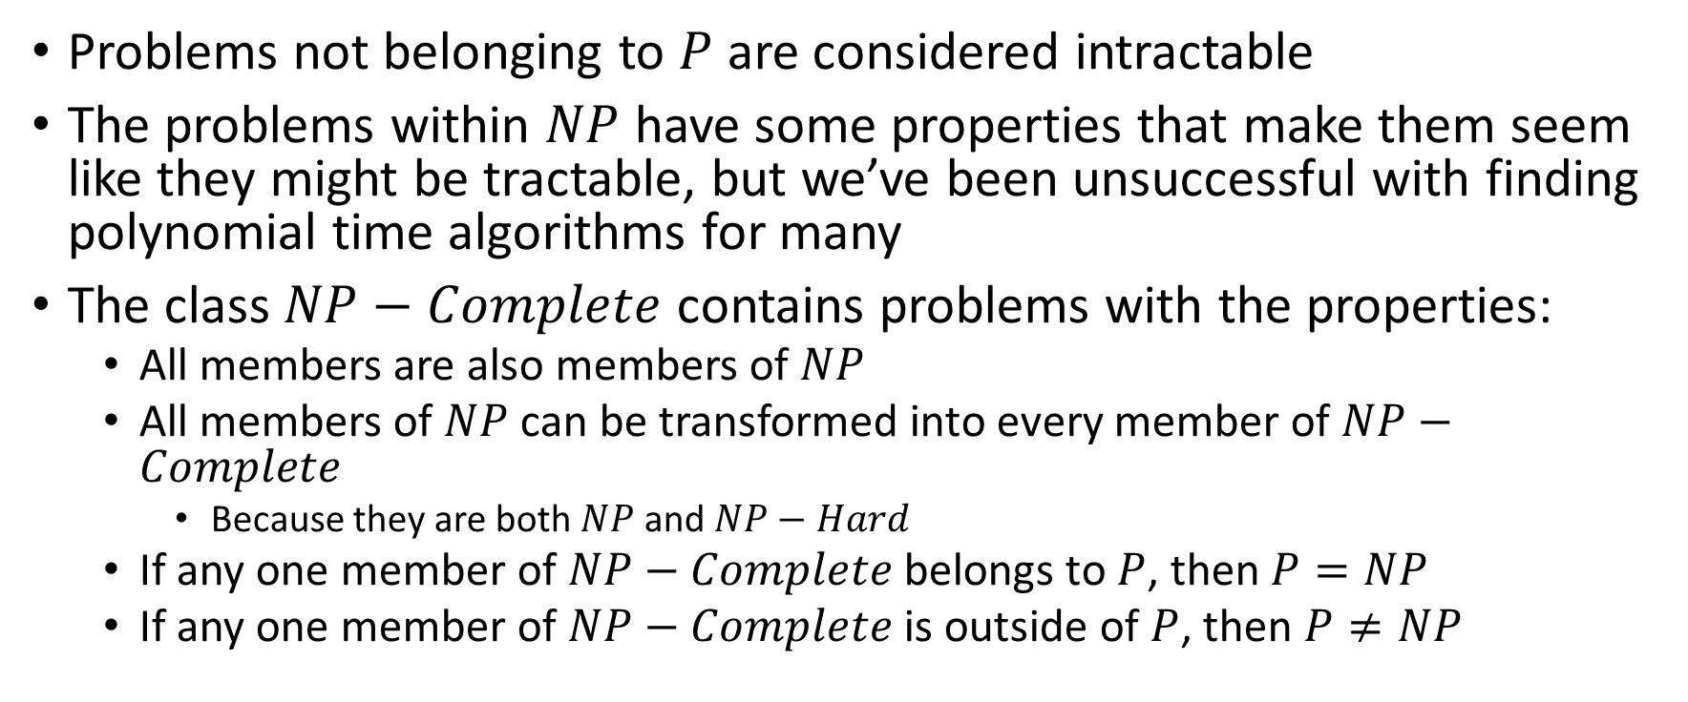
Overview
Problems not belonging to $P$ are considered intractable
The problems within $NP$ have some properties that make them seem like they might be tractable, but we’ve been unsuccessful with finding polynomial time algorithms for many
The class $NP−Complete$ contains problems with the properties:
All members are also members of $NP$
All members of $NP$ can be transformed into every member of $NP−Complete$
Because they are both $NP$ and $NP−Hard$
If any one member of $NP−Complete$ belongs to $P$, then $P=NP$
If any one member of $NP−Complete$ is outside of $P$, then $P≠NP$

Slide 49
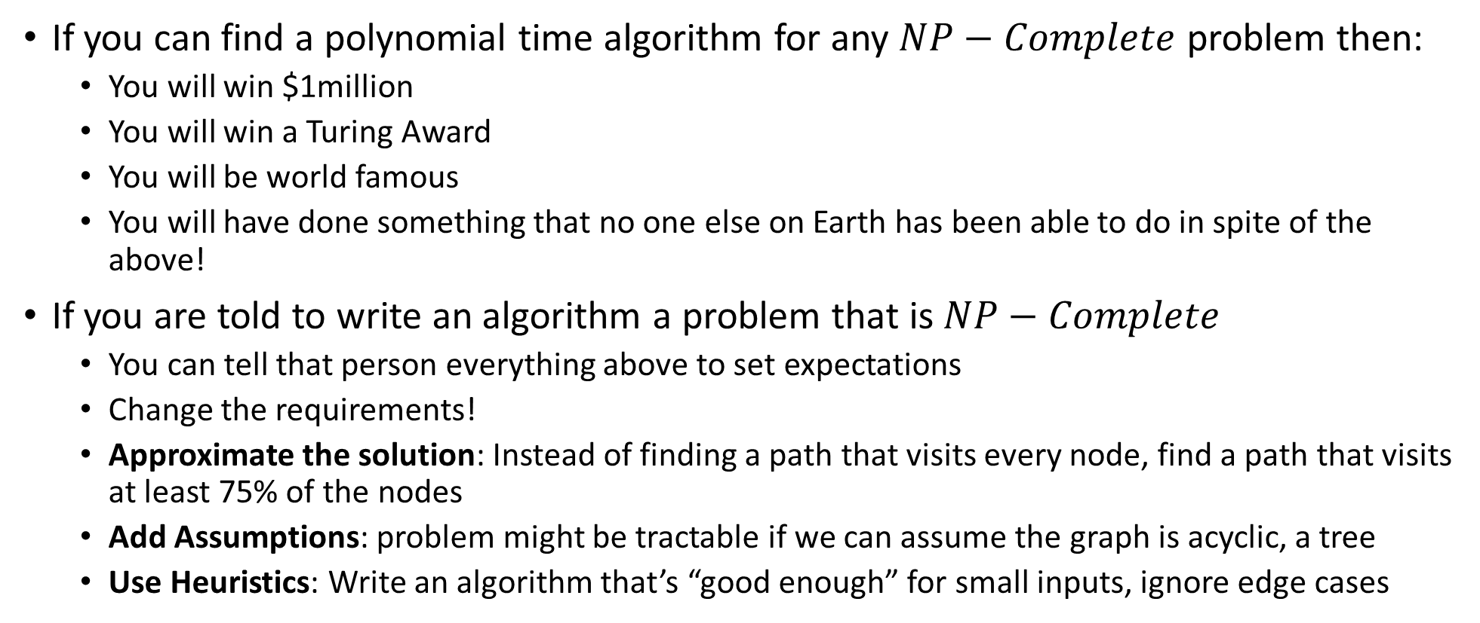
Why should YOU care?
If you can find a polynomial time algorithm for any $NP−Complete$ problem then:
You will win $1million
You will win a Turing Award
You will be world famous
You will have done something that no one else on Earth has been able to do in spite of the above!
If you are told to write an algorithm a problem that is $NP−Complete$
You can tell that person everything above to set expectations
Change the requirements!
Approximate the solution: Instead of finding a path that visits every node, find a path that visits at least 75% of the nodes
Add Assumptions: problem might be tractable if we can assume the graph is acyclic, a tree
Use Heuristics: Write an algorithm that’s “good enough” for small inputs, ignore edge cases

Slide 50
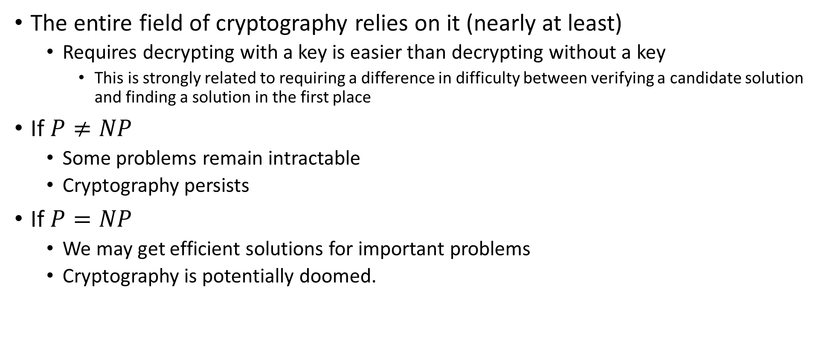
Why should YOU care?
The entire field of cryptography relies on it (nearly at least)
Requires decrypting with a key is easier than decrypting without a key
This is strongly related to requiring a difference in difficulty between verifying a candidate solution and finding a solution in the first place
If $P≠NP$
Some problems remain intractable
Cryptography persists
If $P=NP$
We may get efficient solutions for important problems
Cryptography is potentially doomed.

Slide 51

Does P=NP?
https://www.cs.umd.edu/users/gasarch/BLOGPAPERS/pollpaper3.pdf

Slide 52

When Will P=NP be resolved?

Slide 53

Notable Statements on P vs NP
Suggested rephrased question:

Slide 54
NP-Complete
A set of “together they stand, together they fall” problems
The problems in this set either all belong to $P$, or none of them do
Intuitively, the “hardest” problems in NP
Collection of problems from $NP$ that can all be “transformed” into each other in polynomial time
Like we could transform independent set to vertex cover, and vice-versa
We can also transform vertex cover into Hamiltonian path, and Hamiltonian path into independent set, and …

Slide 55
$EXP⊃NP−Complete⊇NP⊇P$
$P=NP$ iff some problem from $NP−Complete$ belongs to $P$
$$EXP$$
Checkers
Go
Chess
Vertex Cover
Independent Set
Hamiltonian Path
$$NP$$
$$NP−Complete$$
$$P$$
Cryptography
Prime factorization
Sorting
Shortest Path
Euler Path
$$NP−Hard$$
Gap?
Unknown!

Slide 56

Overview
Problems not belonging to $P$ are considered intractable
The problems within $NP$ have some properties that make them seem like they might be tractable, but we’ve been unsuccessful with finding polynomial time algorithms for many
The class $NP−Complete$ contains problems with the properties:
All members are also members of $NP$
All members of $NP$ can be transformed into every member of $NP−Complete$
Therefore if any one member of $NP−Complete$ belongs to $P$, then $P=NP$

Slide 57
Why should YOU care?
If you can find a polynomial time algorithm for any $NP−Complete$ problem then:
You will win $1million
You will win a Turing Award
You will be world famous
You will have done something that no one else on Earth has been able to do in spite of the above!
If you are told to write an algorithm a problem that is $NP−Complete$
You can tell that person everything above to set expectations
Change the requirements!
Approximate the solution: Instead of finding a path that visits every node, find a path that visits at least 75% of the nodes
Add Assumptions: problem might be tractable if we can assume the graph is acyclic, a tree
Use Heuristics: Write an algorithm that’s “good enough” for small inputs, ignore edge cases

