Slide 1
CSE 332 Winter 2026 Lecture 23: Minimum Spanning Trees
Nathan Brunelle
http://www.cs.uw.edu/332

Slide 2
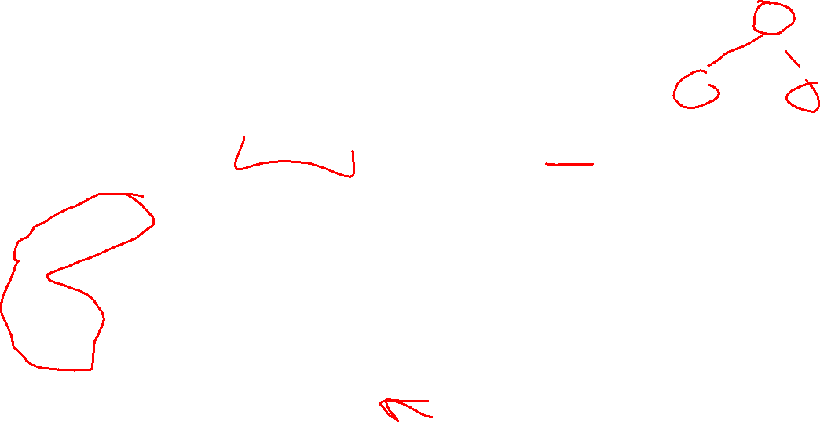
Definition: Tree
A connected graph with no cycles
10
B
E
7
H
A
Note: A tree does not need a root, but they often do!
D
5
9
I
12
3
C
3
11
G
F

Slide 3
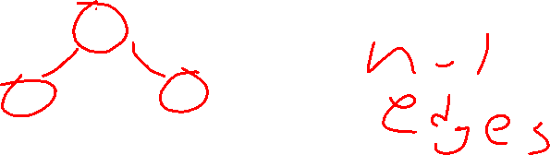
Definition: Tree
A connected graph with no cycles
D
3
7
10
B
E
3
7
H
C
F
E
A
12
D
5
9
5
I
12
3
Pick some arbitrary root node and rearrange tree
3
A
G
C
11
11
G
10
9
F
B
H
I

Slide 4
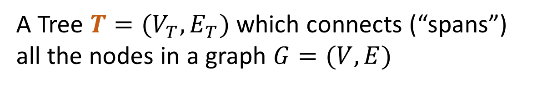


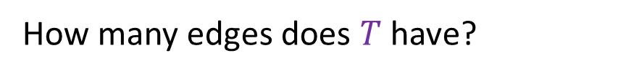
Definition: Spanning Tree
A Tree $T=(V_{T},E_{T})$ which connects (“spans”) all the nodes in a graph $G=(V,E)$
How many edges does $T$ have?
B
8
10
E
8
$$V−1$$
8
7
H
E
8
A
9
2
10
B
H
D
5
9
5
2
I
12
A
G
I
3
Pick some arbitrary root node and rearrange tree
C
3
6
11
1
F
G
3
1
F
6
C
D
Any set of V-1 edges in the graph that doesn’t have any cycles is guaranteed to be a spanning tree!
Any set of V-1 edges that connects all the nodes in the graph is guaranteed to be a spanning tree!
Notes:
Some set of edges from the graph, which forms a tree with all of the nodes in a graph. Subset of the edges, which has no cycles, and connects all the nodes.

Slide 5
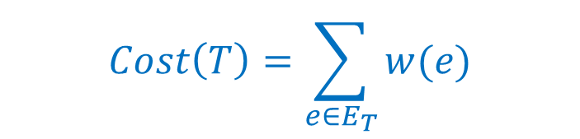
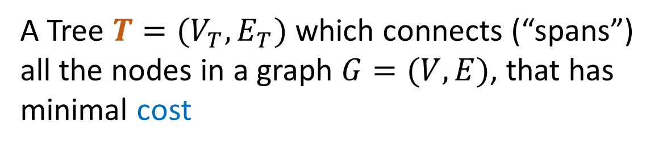
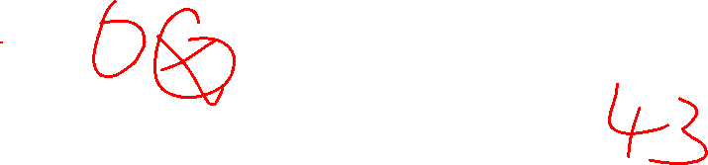
Definition: Minimum Spanning Tree
A Tree $T=(V_{T},E_{T})$ which connects (“spans”) all the nodes in a graph $G=(V,E)$, that has minimal cost
B
8
10
E
8
$$Cost\left(T\right)=\sum_{e∈E_{T}}{w(e)}$$
7
H
A
9
2
D
5
9
I
12
3
C
3
11
G
1
F
6

Slide 6
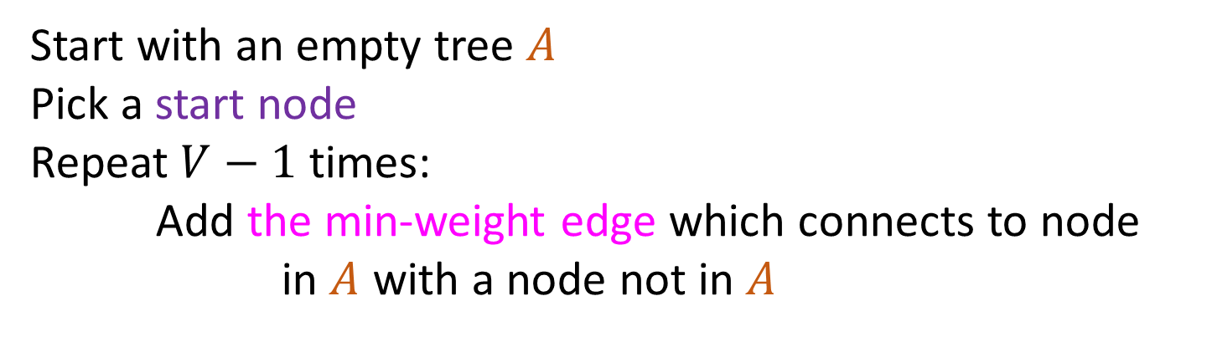
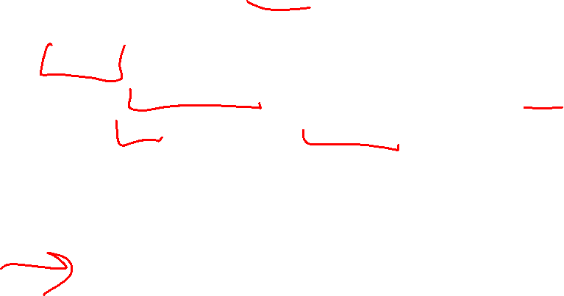
Prim’s Algorithm
Start with an empty tree $A$
Pick a start node
Repeat $V−1$ times:
Add the min-weight edge which connects to node in $A$ with a node not in $A$
B
8
10
E
6
7
H
A
9
2
D
5
9
I
12
3
C
3
11
G
1
F
7

Slide 7

Prim’s Algorithm
Start with an empty tree $A$
Pick a start node
Repeat $V−1$ times:
Add the min-weight edge which connects to node in $A$ with a node not in $A$
B
8
10
E
6
7
H
A
9
2
D
5
9
I
12
3
C
3
11
G
1
F
7

Slide 8
Prim’s Algorithm
Start with an empty tree $A$
Pick a start node
Repeat $V−1$ times:
Add the min-weight edge which connects to node in $A$ with a node not in $A$
B
8
10
E
6
7
H
A
9
2
D
5
9
I
12
3
C
3
11
G
1
F
7

Slide 9
Prim’s Algorithm
Start with an empty tree $A$
Pick a start node
Repeat $V−1$ times:
Add the min-weight edge which connects to node in $A$ with a node not in $A$
B
8
10
E
6
7
H
A
9
2
D
5
9
I
12
3
C
3
11
G
1
F
7

Slide 10
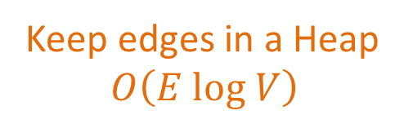
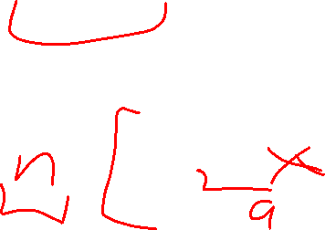
Prim’s Algorithm
Start with an empty tree $A$
Pick a start node
Repeat $V−1$ times:
Add the min-weight edge which connects to node in $A$ with a node not in $A$
Keep edges in a Heap
$$O\left(E log V\right)$$
B
8
10
E
6
7
H
A
9
2
D
5
9
I
12
3
C
3
11
G
1
F
7

Slide 11
Dijkstra’s Algorithm
1
8
10
4
Distance to start = 0
Add the start node to PQ with priority 0
Mark start as “seen”
While the PQ is not empty:
curr = PQ.extract()
mark curr as “done”
add the edge (previous of curr, curr) to the spanning tree
for each neighbor v of curr:
d = distance to curr + weight of (curr,v)
if v is not “seen”:
mark v as “seen”
distance to v = d
previous of v = curr
PQ.add(v, d);
if v is not “done” && d < distance to v:
distance to v = d
previous of v = curr
PQ.decreaseKey(v, d)
Return the spanning tree
6
7
7
0
9
2
3
5
9
8
12
3
2
3
11
6
1
5
7

Slide 12
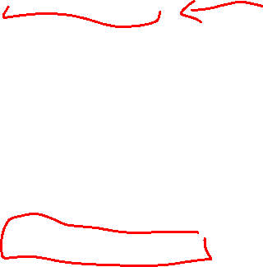
Prim’s Algorithm
1
8
10
4
Distance to start = 0
Add the start node to PQ with priority 0
Mark start as “seen”
While the PQ is not empty:
curr = PQ.extract()
mark curr as “done”
add the edge (previous of curr, curr) to the spanning tree
for each neighbor v of curr:
d = weight of (curr,v)
if v is not “seen”:
mark v as “seen”
distance to v = d
previous of v = curr
PQ.add(v, d);
if v is not “done” && d < distance to v:
distance to v = d
previous of v = curr
PQ.decreaseKey(v, d)
Return the spanning tree
6
7
7
0
9
2
3
5
9
8
12
3
2
3
11
6
1
5
7

Slide 13
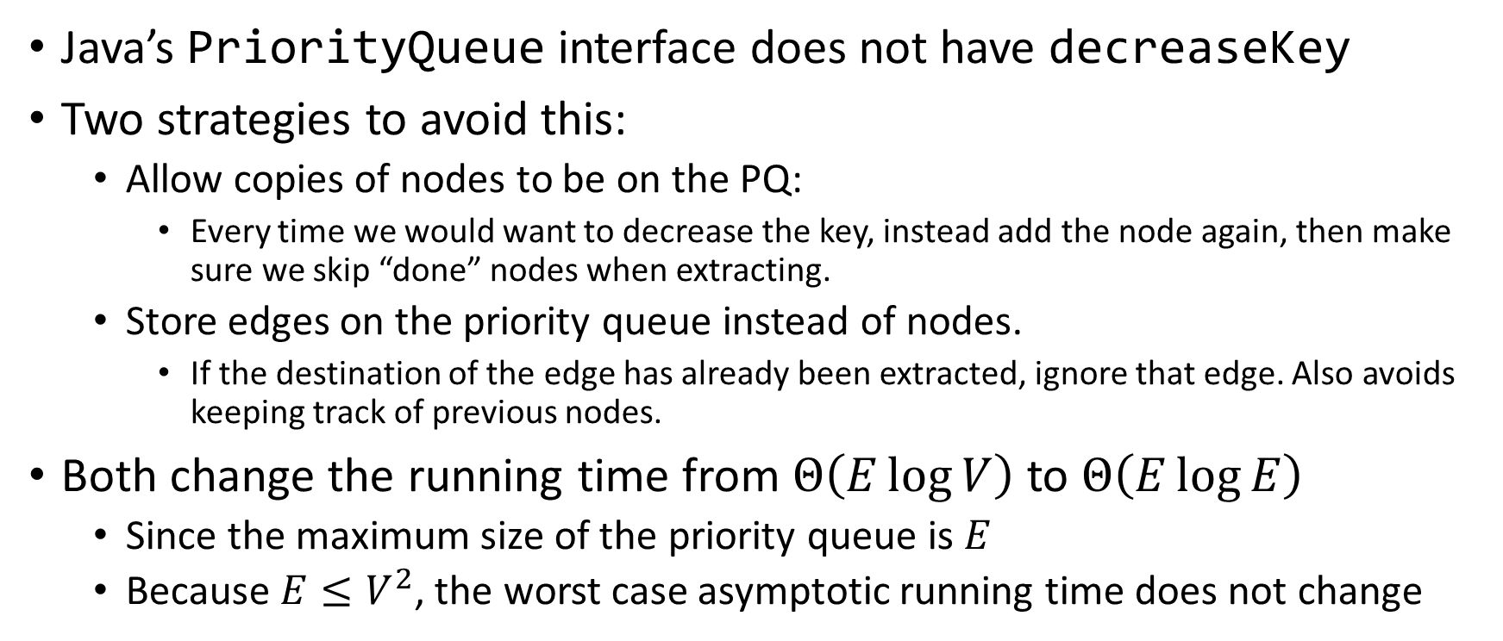
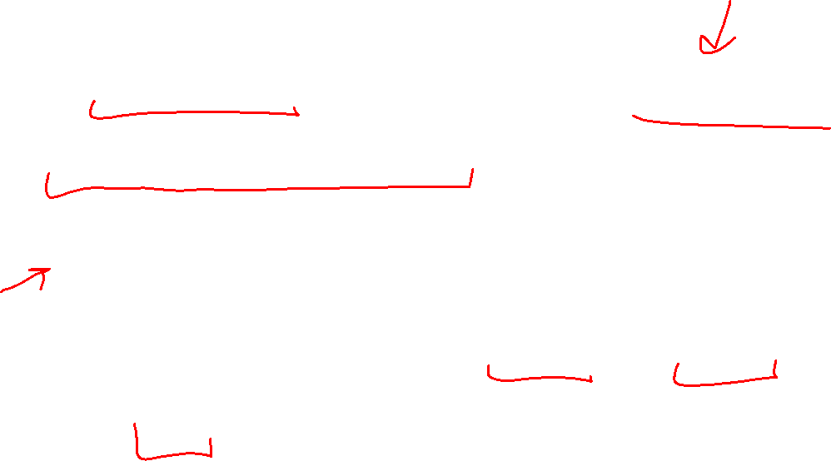
Avoiding Decrease Key
Java’s PriorityQueue interface does not have decreaseKey
Two strategies to avoid this:
Allow copies of nodes to be on the PQ:
Every time we would want to decrease the key, instead add the node again, then make sure we skip “done” nodes when extracting.
Store edges on the priority queue instead of nodes.
If the destination of the edge has already been extracted, ignore that edge. Also avoids keeping track of previous nodes.
Both change the running time from $Θ\left(E\log{V}\right)$ to $Θ\left(E\log{E}\right)$
Since the maximum size of the priority queue is $E$
Because $E≤V^{2}$, the worst case asymptotic running time does not change

Slide 14
Prim’s Algorithm – Original Recipe
Distance to start = 0
Add the start node to PQ with priority 0
Mark start as “seen”
While the PQ is not empty:
curr = PQ.extract()
mark curr as “done”
add the edge (previous of curr, curr) to the spanning tree
for each neighbor v of curr:
d = weight of (curr,v)
if v is not “seen”:
mark v as “seen”
distance to v = d
previous of v = curr
PQ.add(v, d);
if v is not “done” && d < distance to v:
distance to v = d
previous of v = curr
PQ.decreaseKey(v, d)
Return the spanning tree

Slide 15
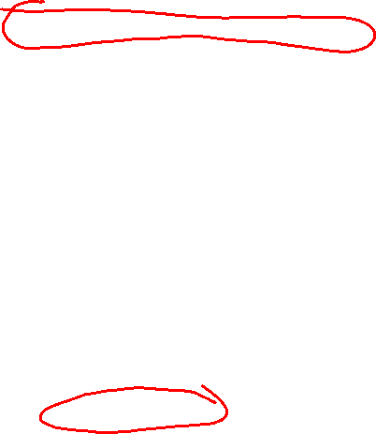
Prim’s Algorithm – Duplicate Nodes on the PQ
Distance to start = 0
Add the start node to PQ with priority 0
Mark start as “seen”
While the PQ is not empty:
curr = PQ.extract()
if(curr is “done”) then continue
mark curr as “done”
add the edge (previous of curr, curr) to the spanning tree
for each neighbor v of curr:
d = weight of (curr,v)
if v is not “seen”:
mark v as “seen”
distance to v = d
previous of v = curr
PQ.add(v, d);
if v is not “done” && d < distance to v:
distance to v = d
previous of v = curr
PQ.add(v, d)
Return the spanning tree

Slide 16
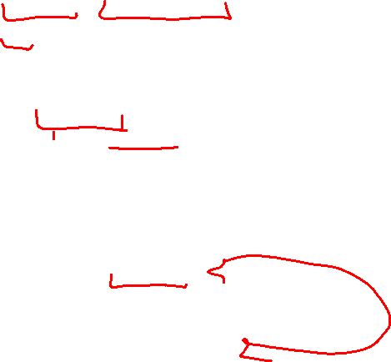
Prim’s Algorithm – Edges on the PQ
Distance to start = 0
Add the start node to PQ with priority 0
Mark start as “seen”
While the PQ is not empty:
currEdge = PQ.extract()
curr = currEdge.destination
if(curr is “done”) then continue
mark curr as “done”
add currEdge to the spanning tree
for each neighbor v of curr:
d = weight of (curr,v)
if v is not “seen”:
mark v as “seen”
distance to v = d
PQ.add((curr,v),d);
if v is not “done” && d < distance to v:
distance to v = d
PQ.add((curr,v), d)
Return the spanning tree

Slide 17
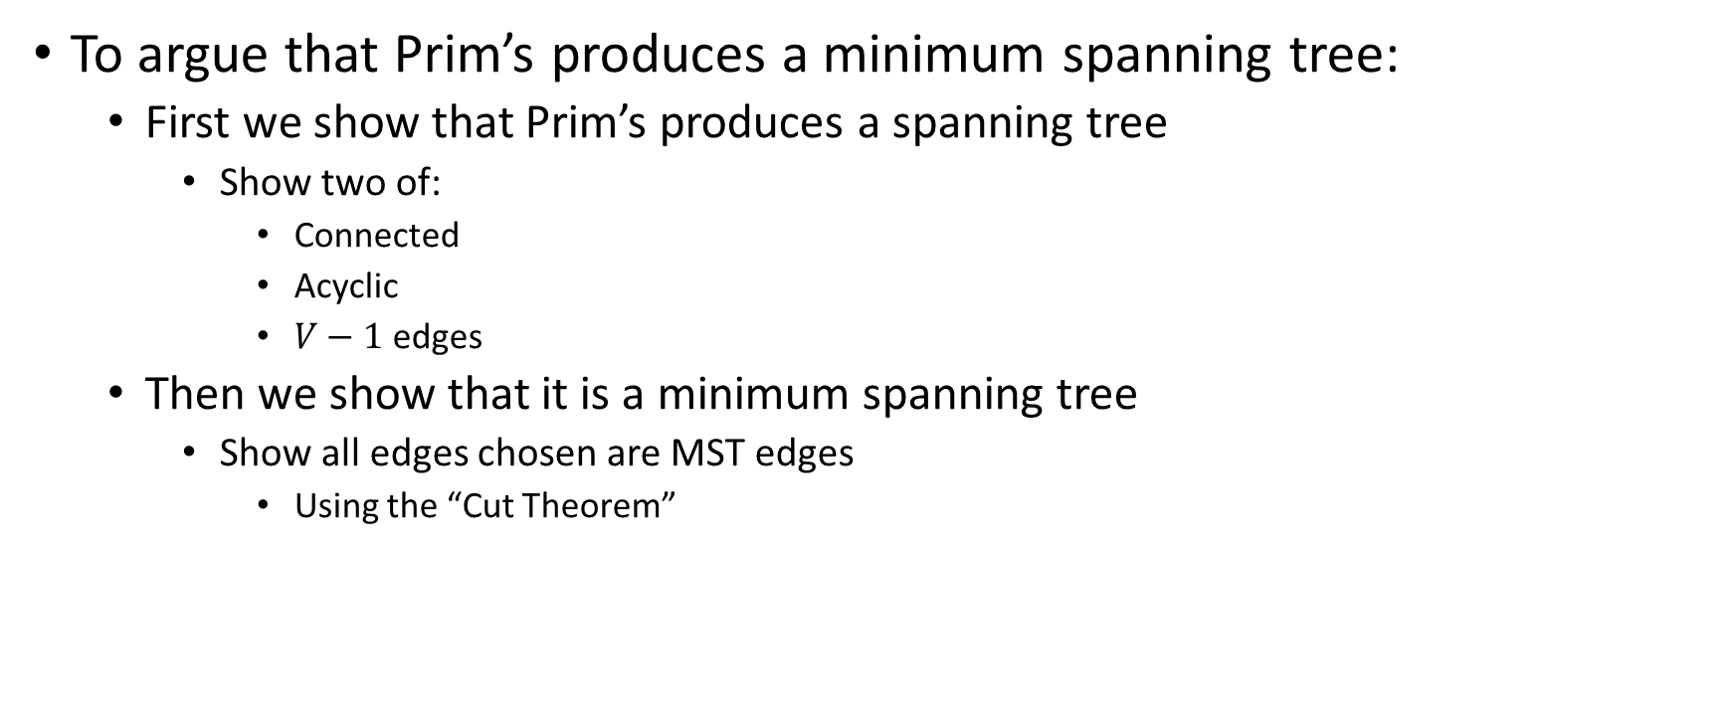
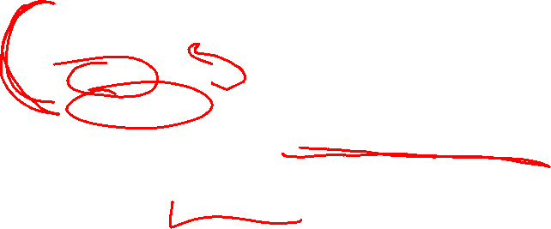
Why does this work?
To argue that Prim’s produces a minimum spanning tree:
First we show that Prim’s produces a spanning tree
Show two of:
Connected
Acyclic
$V−1$ edges
Then we show that it is a minimum spanning tree
Show all edges chosen are MST edges
Using the “Cut Theorem”

Slide 18
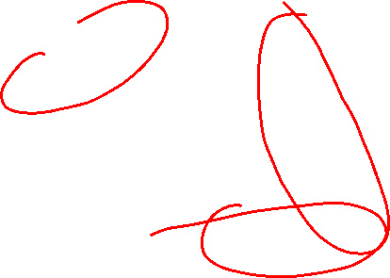
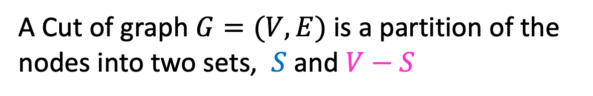
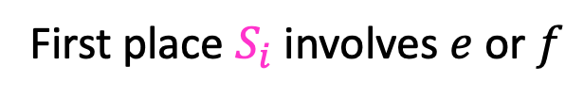


Definition: Cut
A Cut of graph $G=(V,E)$ is a partition of the nodes into two sets, $S$ and $V−S$
B
8
10
E
8
7
H
A
9
2
D
5
9
$$S$$
I
12
3
C
3
11
G
1
F
6
Edge $\left(v_{1},v_{2}\right)∈E$ crosses a cut if $v_{1}∈S$ and $v_{2}∈V−S$ (or opposite), e.g. $(A,C)$
A set of edges $R$ Respects a cut if no edges cross the cut
e.g. $R=\{\left(A,B\right),\left(E,G\right),\left(F,G\right)\}$
Notes:
Go over some examples of edges that cross the cut and edges that do not

Slide 19

Cut Theorem
If a set of edges $A$ is a subset of a minimum spanning tree $T$, let $(S, V−S)$ be any cut which $A$ respects. Let $e$ be the least-weight edge which crosses $(S, V−S)$. $A∪\{e\}$ is also a subset of a minimum spanning tree.
Notes:
If I take any cut at all in the graph, then the least weight edge across that cut is guaranteed to be part of some minimum spanning tree. The least weight edge that crosses any cut in .
We need a bit more mechanics to make this work for kruskals.
Suppose A is a subset of a minimum spanning tree, meaning, we are on our way to building. There is a minimum spanning tree T, where every edge in A is part of this minimum spanning tree T
Define some cut (S,V-S), which A respects. It is safe to add e to A and we will have made more progress
Repeat v-1 times. If we know we can start with some arbitrary subset, then we can add this edge e . There is some minimum spanning tree that has this edge f,g. If I used some other edge instead, an

Slide 20

Cut Theorem
If a set of edges $A$ is a subset of a minimum spanning tree $T$, let $(S, V−S)$ be any cut which $A$ respects. Let $e$ be the least-weight edge which crosses $(S, V−S)$. $A∪\{e\}$ is also a subset of a minimum spanning tree.
B
8
10
E
8
7
H
A
9
2
D
5
9
I
12
3
C
3
11
G
1
F
6
Notes:
If I take any cut at all in the graph, then the least weight edge across that cut is guaranteed to be part of some minimum spanning tree. The least weight edge that crosses any cut in .
We need a bit more mechanics to make this work for kruskals.
Suppose A is a subset of a minimum spanning tree, meaning, we are on our way to building. There is a minimum spanning tree T, where every edge in A is part of this minimum spanning tree T
Define some cut (S,V-S), which A respects. It is safe to add e to A and we will have made more progress
Repeat v-1 times. If we know we can start with some arbitrary subset, then we can add this edge e . There is some minimum spanning tree that has this edge f,g. If I used some other edge instead, an

Slide 21

Cut Theorem
If a set of edges $A$ is a subset of a minimum spanning tree $T$, let $(S, V−S)$ be any cut which $A$ respects. Let $e$ be the least-weight edge which crosses $(S, V−S)$. $A∪\{e\}$ is also a subset of a minimum spanning tree.
B
8
10
E
8
7
H
A
9
2
D
5
9
I
12
3
C
3
11
G
1
F
6
Notes:
If I take any cut at all in the graph, then the least weight edge across that cut is guaranteed to be part of some minimum spanning tree. The least weight edge that crosses any cut in .
We need a bit more mechanics to make this work for kruskals.
Suppose A is a subset of a minimum spanning tree, meaning, we are on our way to building. There is a minimum spanning tree T, where every edge in A is part of this minimum spanning tree T
Define some cut (S,V-S), which A respects. It is safe to add e to A and we will have made more progress
Repeat v-1 times. If we know we can start with some arbitrary subset, then we can add this edge e . There is some minimum spanning tree that has this edge f,g. If I used some other edge instead, an

Slide 22

Cut Theorem
If a set of edges $A$ is a subset of a minimum spanning tree $T$, let $(S, V−S)$ be any cut which $A$ respects. Let $e$ be the least-weight edge which crosses $(S, V−S)$. $A∪\{e\}$ is also a subset of a minimum spanning tree.
B
8
10
E
8
7
H
A
9
2
D
5
9
I
12
3
C
3
11
G
1
F
6
Notes:
If I take any cut at all in the graph, then the least weight edge across that cut is guaranteed to be part of some minimum spanning tree. The least weight edge that crosses any cut in .
We need a bit more mechanics to make this work for kruskals.
Suppose A is a subset of a minimum spanning tree, meaning, we are on our way to building. There is a minimum spanning tree T, where every edge in A is part of this minimum spanning tree T
Define some cut (S,V-S), which A respects. It is safe to add e to A and we will have made more progress
Repeat v-1 times. If we know we can start with some arbitrary subset, then we can add this edge e . There is some minimum spanning tree that has this edge f,g. If I used some other edge instead, an

Slide 23


Cut Theorem
If a set of edges $A$ is a subset of a minimum spanning tree $T$, let $(S, V−S)$ be any cut which $A$ respects. Let $e$ be the least-weight edge which crosses $(S, V−S)$. $A∪\{e\}$ is also a subset of a minimum spanning tree.
B
8
10
E
8
7
H
A
9
2
D
5
9
I
12
3
C
3
11
G
1
F
6
Notes:
If I take any cut at all in the graph, then the least weight edge across that cut is guaranteed to be part of some minimum spanning tree. The least weight edge that crosses any cut in .
We need a bit more mechanics to make this work for kruskals.
Suppose A is a subset of a minimum spanning tree, meaning, we are on our way to building. There is a minimum spanning tree T, where every edge in A is part of this minimum spanning tree T
Define some cut (S,V-S), which A respects. It is safe to add e to A and we will have made more progress
Repeat v-1 times. If we know we can start with some arbitrary subset, then we can add this edge e . There is some minimum spanning tree that has this edge f,g. If I used some other edge instead, an

Slide 24

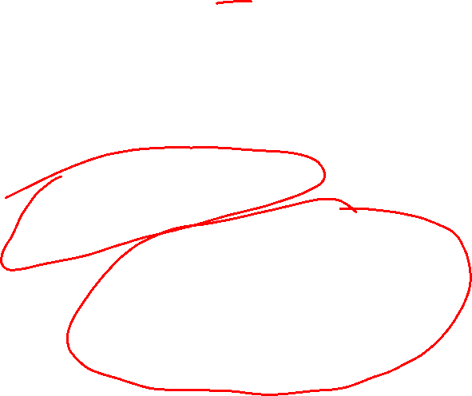
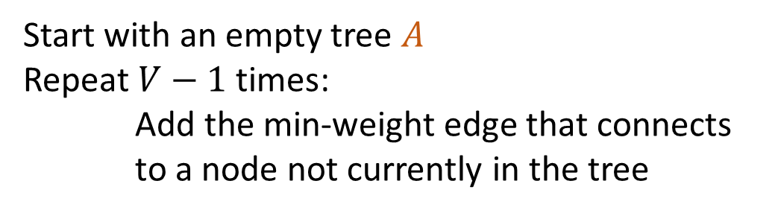

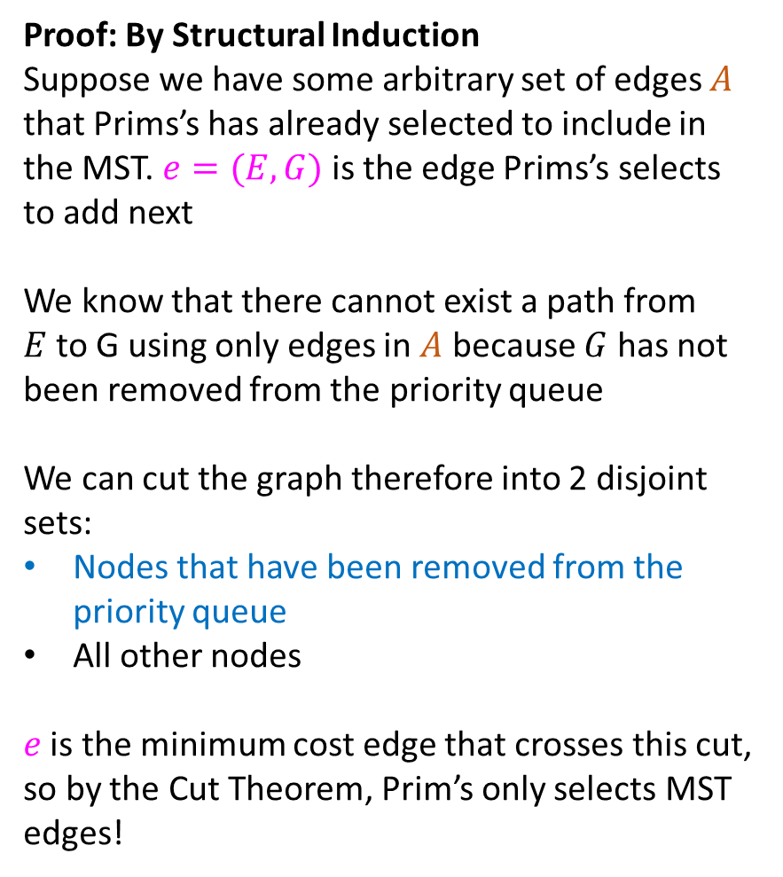
Proof of Prim’s Algorithm
Proof: By Structural Induction
Suppose we have some arbitrary set of edges $A$ that Prims’s has already selected to include in the MST. $e=(E,G)$is the edge Prims’s selects to add next
We know that there cannot exist a path from $E$to G using only edges in $A$ because $G$ has not been removed from the priority queue
We can cut the graph therefore into 2 disjoint sets:
Nodes that have been removed from the priority queue
All other nodes
$e$ is the minimum cost edge that crosses this cut, so by the Cut Theorem, Prim’s only selects MST edges!
Start with an empty tree $A$
Repeat $V−1$ times:
Add the min-weight edge that connects
to a node not currently in the tree
$$S$$
B
8
10
E
6
7
H
A
9
$$e$$
2
D
5
9
I
12
3
C
3
11
G
1
F
7

Slide 25
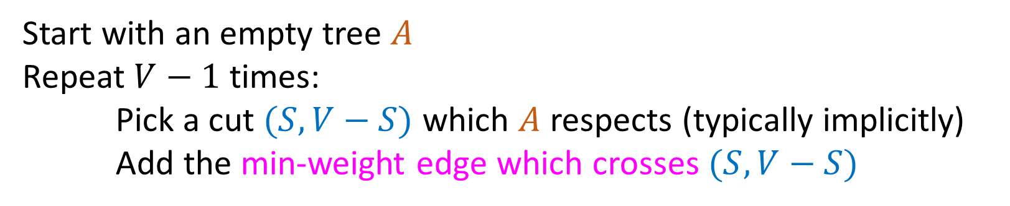
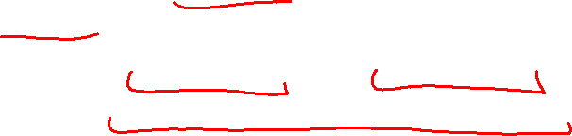
General MST Algorithm
Start with an empty tree $A$
Repeat $V−1$ times:
Pick a cut $(S,V−S)$ which $A$ respects (typically implicitly)
Add the min-weight edge which crosses $(S,V−S)$
B
8
10
E
8
7
H
A
9
2
D
5
9
I
12
3
C
3
11
G
1
F
6

Slide 26
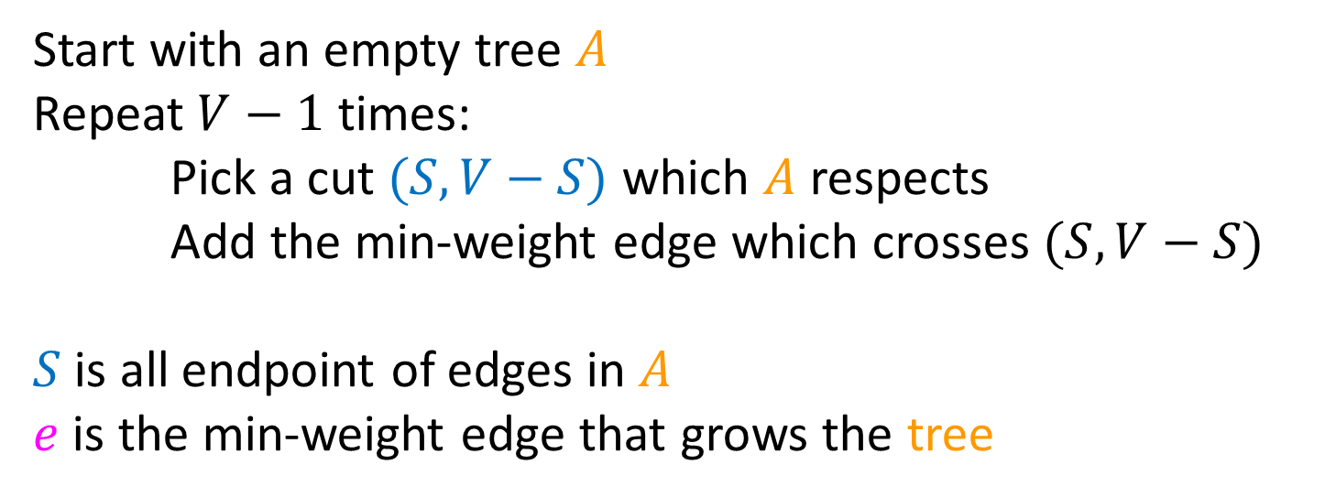
Prim’s Algorithm
Start with an empty tree $A$
Repeat $V−1$ times:
Pick a cut $(S,V−S)$ which $A$ respects
Add the min-weight edge which crosses $(S,V−S)$
$S$ is all endpoint of edges in $A$
$e$ is the min-weight edge that grows the tree
B
8
10
E
6
7
H
A
9
2
D
5
9
I
12
3
C
3
11
G
1
F
7

Slide 27

Kruskal’s Algorithm
Start with an empty tree $A$
Add to $A$ the lowest-weight edge that does not create a cycle
B
8
10
E
8
7
H
A
9
2
D
5
9
I
12
3
C
3
11
G
1
F
6

Slide 28
Kruskal’s Algorithm
Start with an empty tree $A$
Add to $A$ the lowest-weight edge that does not create a cycle
B
8
10
E
8
7
H
A
9
2
D
5
9
I
12
3
C
3
11
G
1
F
6

Slide 29
Kruskal’s Algorithm
Start with an empty tree $A$
Add to $A$ the lowest-weight edge that does not create a cycle
B
8
10
E
8
7
H
A
9
2
D
5
9
I
12
3
C
3
11
G
1
F
6

Slide 30
Kruskal’s Algorithm
Start with an empty tree $A$
Add to $A$ the lowest-weight edge that does not create a cycle
B
8
10
E
8
7
H
A
9
2
D
5
9
I
12
3
C
3
11
G
1
F
6

Slide 31
Kruskal’s Algorithm
Start with an empty tree $A$
Add to $A$ the lowest-weight edge that does not create a cycle
B
8
10
E
8
7
H
A
9
2
D
5
9
I
12
3
C
3
11
G
1
F
6

Slide 32
Kruskal’s Algorithm
Start with an empty tree $A$
Add to $A$ the lowest-weight edge that does not create a cycle
B
8
10
E
8
7
H
A
9
2
D
5
9
I
12
3
C
3
11
G
1
F
6

Slide 33
Correctness of Kruskal’s Algorithm
It’s sufficient to just show that it follows the template of our “General MST Algorithm”
Show that for every edge chosen, it is the least-weight edge which crosses some cut that respects all already-chosen edges.

Slide 34

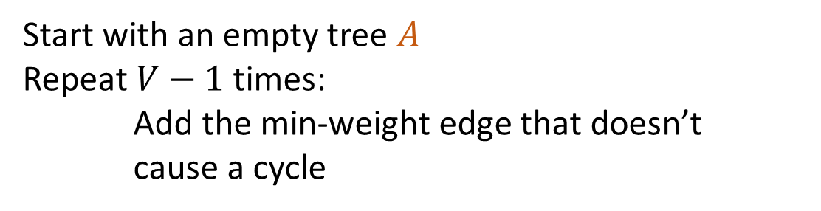
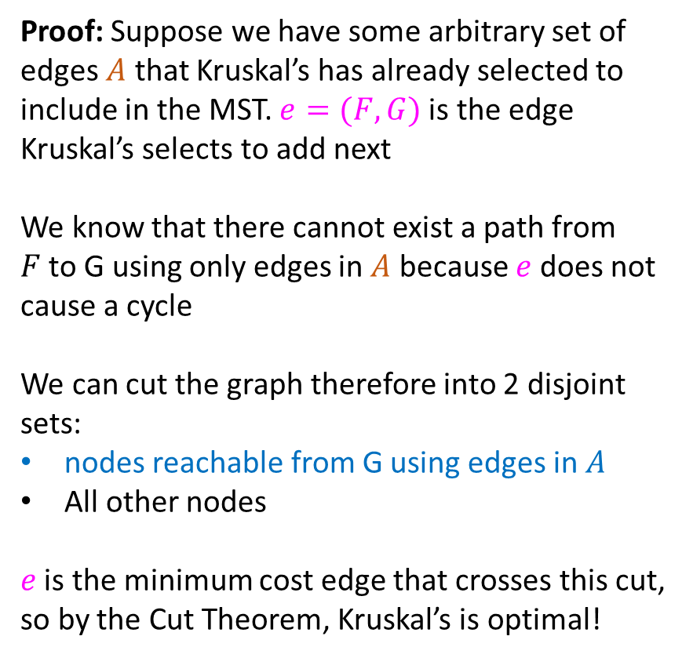

Proof of Kruskal’s Algorithm
Start with an empty tree $A$
Repeat $V−1$ times:
Add the min-weight edge that doesn’t cause a cycle
Proof: Suppose we have some arbitrary set of edges $A$ that Kruskal’s has already selected to include in the MST. $e=(F,G)$is the edge Kruskal’s selects to add next
We know that there cannot exist a path from $F$to G using only edges in $A$ because $e$ does not cause a cycle
We can cut the graph therefore into 2 disjoint sets:
nodes reachable from G using edges in $A$
All other nodes
$e$ is the minimum cost edge that crosses this cut, so by the Cut Theorem, Kruskal’s is optimal!
B
8
10
E
8
7
H
A
9
2
D
5
9
I
12
3
C
3
$$e$$
11
G
1
F
6
$$S$$

Slide 35

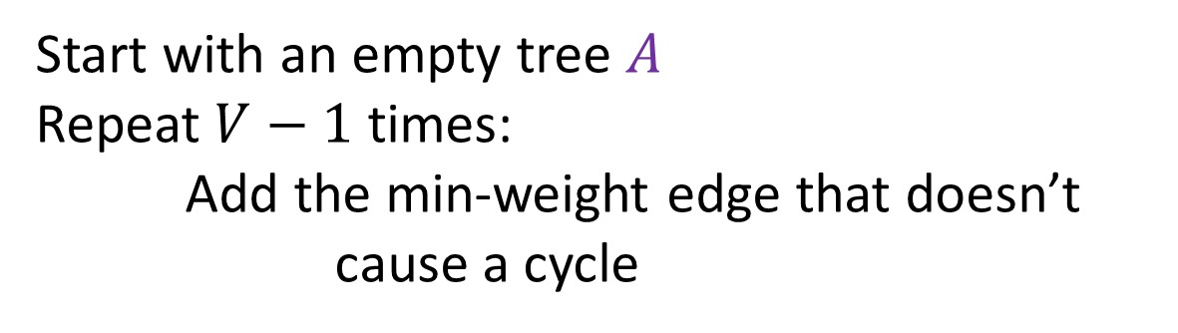
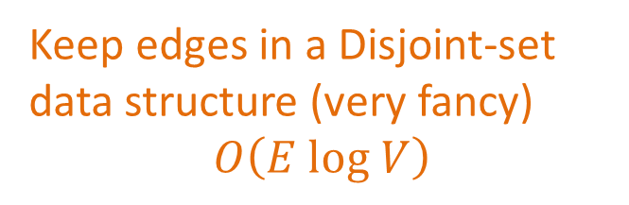


Kruskal’s Algorithm Runtime
Start with an empty tree $A$
Repeat $V−1$ times:
Add the min-weight edge that doesn’t cause a cycle
Keep edges in a Disjoint-set data structure (very fancy)
$$O\left(E log V\right)$$
B
8
10
E
8
7
H
A
9
2
D
5
9
I
12
3
C
3
$$e$$
11
G
1
F
6
$$S$$

