Slide 1
CSE 332 Spring 2026 Lecture 9: AVL Trees pt. 2
Nathan Brunelle
http://www.cs.uw.edu/332

Slide 2
Dictionary (Map) ADT
Contents:
Sets of key+value pairs
Keys must be comparable
Operations:
insert(key, value)
Adds the (key,value) pair into the dictionary
If the key already has a value, overwrite the old value
Consequence: Keys cannot be repeated
find(key)
Returns the value associated with the given key
delete(key)
Remove the key (and its associated value)

Slide 3
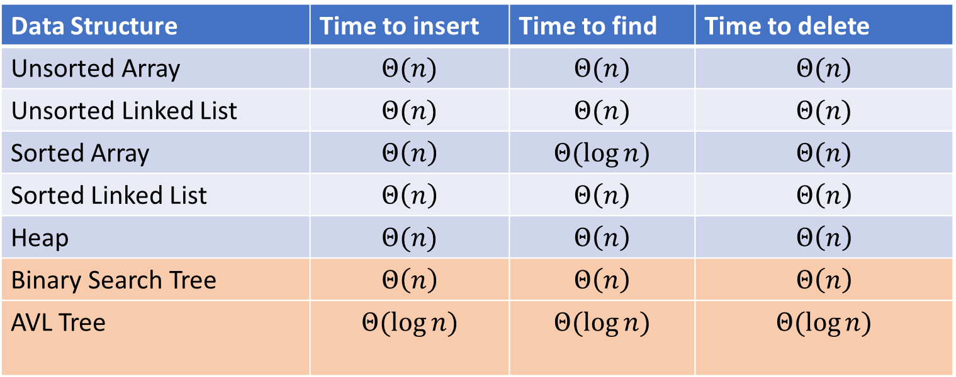
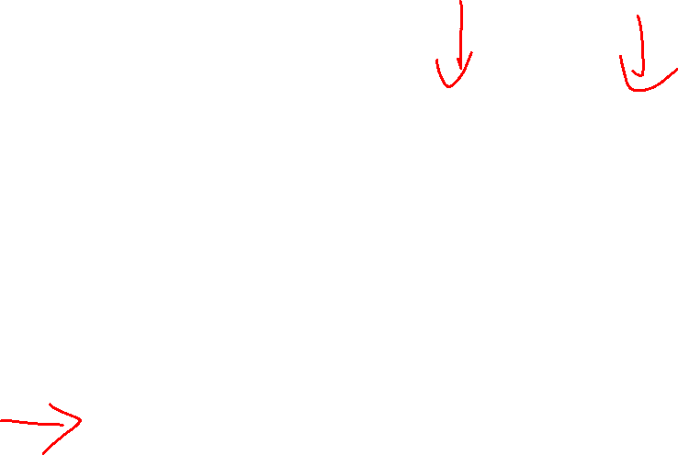
Naïve attempts
Data Structure | Time to insert | Time to find | Time to delete
Unsorted Array | $$Θ(n)$$ | $$Θ(n)$$ | $$Θ(n)$$
Unsorted Linked List | $$Θ(n)$$ | $$Θ(n)$$ | $$Θ(n)$$
Sorted Array | $$Θ\left(n\right)$$ | $$Θ(\log{n})$$ | $$Θ(n)$$
Sorted Linked List | $$Θ\left(n\right)$$ | $$Θ\left(n\right)$$ | $$Θ\left(n\right)$$
Heap | $$Θ(n)$$ | $$Θ\left(n\right)$$ | $$Θ\left(n\right)$$
Binary Search Tree | $$Θ\left(n\right)$$ | $$Θ\left(n\right)$$ | $$Θ\left(n\right)$$
AVL Tree | $$Θ(\log{n})$$ | $$Θ(\log{n})$$ | $$Θ(\log{n})$$

Slide 4
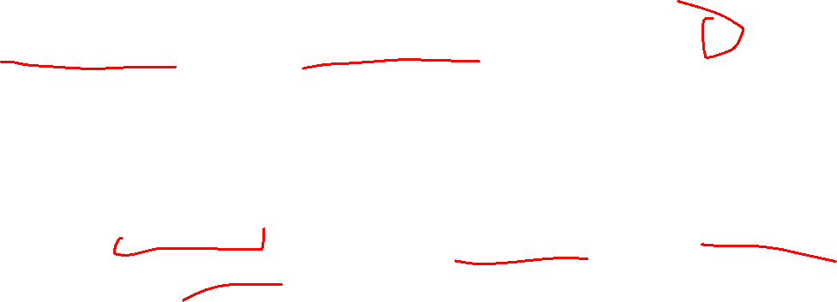
AVL Tree
A Binary Search tree that maintains that the left and right subtrees of every node have heights that differ by at most one.
height of left subtree and height of right subtree off by at most 1
Not too weak (ensures trees are short)
Not too strong (works for any number of nodes)
Idea of AVL Tree:
When you insert/delete nodes, if tree is “out of balance” then modify the tree
Modification = “rotation”

Slide 5

Representing AVL Trees
Key = 9
Value = “hello”
Height = 3
Left = Node 3
Right = Node 10
Each node has:
Key
Value
Height
Left child
Right child
9
3
10
1
6
16
0
5
7

Slide 6
Find Operation (Same as BST)
7
3
10
find(key, root){
if (root == Null){
return Null;
{
else if (key == root.key){
return root.value;
}
else if (key < root.key){
return find(key, root.left);
}
else{
return find(key, root.right);
}
}
1
6
16
0

Slide 7

Inserting into an AVL Tree
Starts out the same way as BST:
“Find” where the new node should go
Put it in the right place (it will be a leaf)
Next check the balance
If the tree is still balanced, you’re done!
Otherwise we need to do rotations

Slide 8
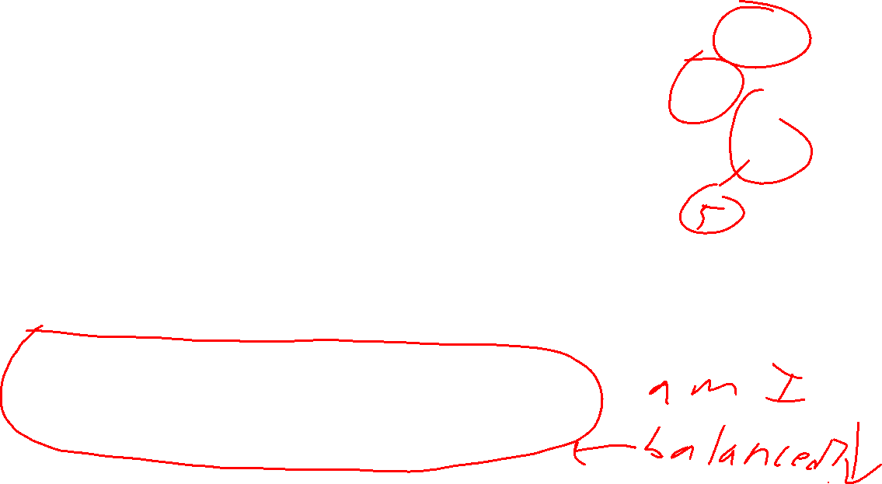
Insert Operation (for BST)
7
3
10
insert(key, value, root){
root = insertHelper(key, value, root);
}
insertHelper(key, value, root){
if(root == null)
return new Node(key, value);
if (root.key == key)
root.value = value;
else if (root.key < key)
root.right = insertHelper(key, value, root.right);
else
root.left = insertHelper(key, value, root.left);
return root;
}
1
6
16
0
Note: Insert happens only at the leaves!

Slide 9
Insert Example (Insert 10)
10
9
3
11
1
6
16
0
2
7

Slide 10

Insert 10 (After)
Is the tree still balanced?
To confirm we only need to check nodes in the path from root to the new node
Why? We assume the tree was balanced before the insert, so unchanged subtrees cannot be unbalanced.
Height=3
9
Height=2
Height=1
3
11
Height=0
Height=0
1
6
10
16
0
2
7

Slide 11
Insert Example (Insert -1)
-1
9
3
11
1
6
16
0
2
7

Slide 12
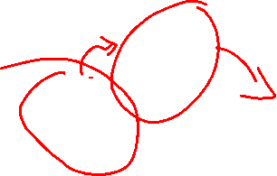
Insert -1, BST Insert Step
Not Balanced!
Node 9 is the “problem node” Left and right children of node 9 are different by 2.
Idea: “shorten” the left subtree, “lengthen” the right
Height=4
9
Height=3
Height=1
3
11
Height=2
Height=1
1
6
16
Height=1
Height=0
0
2
7
Height=0
-1
Height=-1

Slide 13
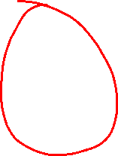
Right Rotation
Solution:
Take the subtree starting with the problem node,
“Rotate” that tree to the right
9
Height=3
Height=1
3
11
1
6
16
0
2
7
-1

Slide 14
After the Right Rotation, Balanced!
3
Height=2
Height=2
1
9
0
2
6
11
-1
7
16

Slide 15


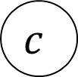
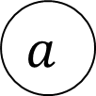















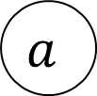



Right Rotation - Definition
We just inserted $c$, node $a$ is the deepest “problem” node
Make the left child the new root
Make the old root the right child of the new
Make the new root’s right subtree the old root’s left subtree
$$h+3$$
$$h+2$$
$$b$$
$$a$$
$$h+2$$
$$h$$
$$h+1$$
$$b$$
$$z$$
$$x$$
$$h+1$$
$$a$$
Right Rotation
$$h+1$$
$$h$$
$$h$$
$$h$$
$$x$$
$$y$$
$$y$$
$$z$$
$$c$$
$$c$$

Slide 16


Right Rotation - Implementation
b=a.left
a.left=b.right
b.right=a
return b
Running time: $Θ(1)$
$$h+3$$
$$h+2$$
$$b$$
$$a$$
$$h+2$$
$$h$$
$$h+1$$
$$b$$
$$z$$
$$x$$
$$h+1$$
$$a$$
Right Rotation
$$h+1$$
$$h$$
$$h$$
$$h$$
$$x$$
$$y$$
$$y$$
$$z$$
$$c$$
$$c$$

Slide 17
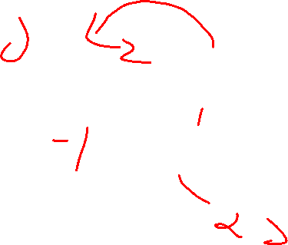
Insert Example (Insert 20)
9
20
3
11
1
6
10
16
0
2
18

Slide 18

Not Balanced! Multiple Problem Nodes
Here, nodes 11 and 16 are problem nodes.
There may be multiple places where we can do a rotation to rebalance the tree, but the deepest problem node always works!
9
Height=2
Height=3
3
11
Height=0
Height=2
1
6
10
16
Height=1
0
2
Height=-1
18
Height=0
20
Height=-1

Slide 19
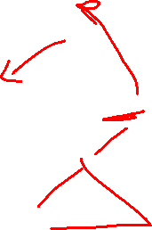
Left Rotation
Solution:
Take the subtree starting with the problem node,
“Rotate” that tree to the left
9
3
11
1
6
10
16
Height=1
0
2
Height=-1
18
20

Slide 20
After the Left Rotation, Balanced!
9
3
11
1
6
10
18
Height=0
Height=0
0
2
16
20

Slide 21



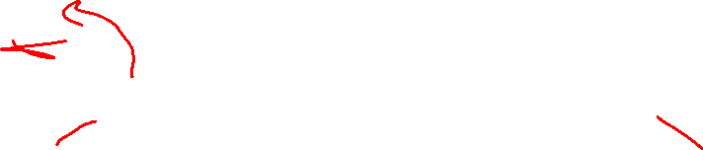




















Left Rotation - Definition
We just inserted $c$, node $a$ is the deepest “problem” node
Make the right child the new root
Make the old root the left child of the new
Make the new root’s left subtree the old root’s right subtree
$$h+3$$
$$a$$
$$h+2$$
$$b$$
$$h$$
$$h+1$$
$$h+1$$
$$x$$
$$h+2$$
$$b$$
$$a$$
$$z$$
Left Rotation
$$h$$
$$h+1$$
$$h$$
$$h$$
$$y$$
$$z$$
$$x$$
$$y$$
$$c$$
$$c$$

Slide 22
Left Rotation (Implementation)
b=a.right
a.right=b.left
b.left=a
return b
$$h+3$$
$$a$$
$$h+2$$
$$b$$
$$h$$
$$h+1$$
$$h+1$$
$$x$$
$$h+2$$
$$b$$
$$a$$
$$z$$
Left Rotation
$$h$$
$$h+1$$
$$h$$
$$h$$
$$y$$
$$z$$
$$x$$
$$y$$
$$c$$
$$c$$

Slide 23
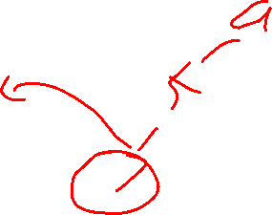
Insertion Story So Far
After insertion, update the heights of the node’s ancestors
Check for unbalance
If unbalanced then at the deepest unbalanced root:
If the left subtree was deeper then rotate right
If the right subtree was deeper then rotate left
This is incomplete!
There are some cases where this doesn’t work!
9
9
5
Insert 7
Right Rotation
5
5
9
7
7

Slide 24
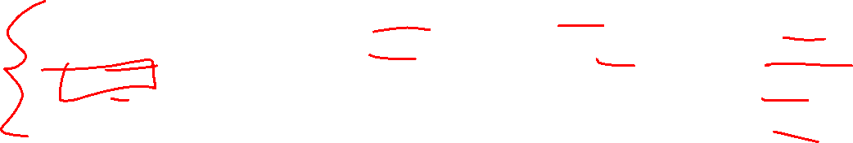
Insertion Cases
After insertion, update the heights of the node’s ancestors
Check for unbalance
If unbalanced then at the deepest unbalanced root:
Case LL: If we inserted in the left subtree of the left child then rotate right
Case RR: If we inserted in the right subtree of the right child then rotate left
Case LR: If we inserted into the right subtree of the left child then ???
Case RL: If we inserted into the left subtree of the right child then ???
Cases LR and RL require 2 rotations!

Slide 25
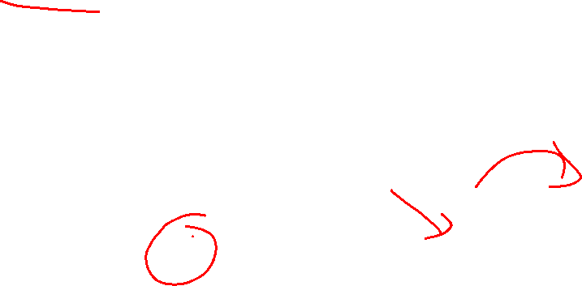
Case LR
From deepest problem node:
Rotate left at the left child
Rotate right at the problem node
9
9
9
Insert 7
Rotate Left at 5
5
Rotate Right at 9
7
5
7
7
5
9
5

Slide 26





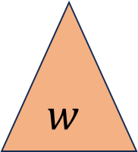





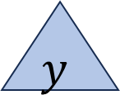








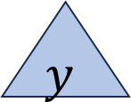



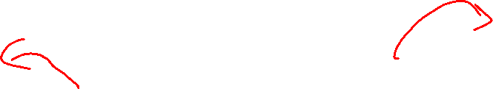







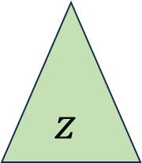













Case LR - Definition
We just inserted $d$, node $a$ is the deepest “problem” node
Imbalance caused by inserting in the left child’s right subtree
Rotate left at the left child
Rotate right at the unbalanced node
$$h+3$$
$$h+3$$
$$a$$
$$h+2$$
$$a$$
$$c$$
Rotate
Left at $b$
Rotate Right at $a$
$$h+2$$
$$h+2$$
$$h$$
$$h+1$$
$$h$$
$$c$$
$$z$$
$$a$$
$$b$$
$$z$$
$$b$$
$$h+1$$
$$h+1$$
$$h$$
$$h+1$$
$$c$$
$$b$$
$$y$$
$$h$$
$$h$$
$$w$$
$$w$$
$$x$$
$$y$$
$$z$$
$$h$$
$$x$$
$$y$$
$$w$$
$$x$$
$$d$$
$$d$$
$$d$$
$$d$$
$$d$$
$$d$$

Slide 27
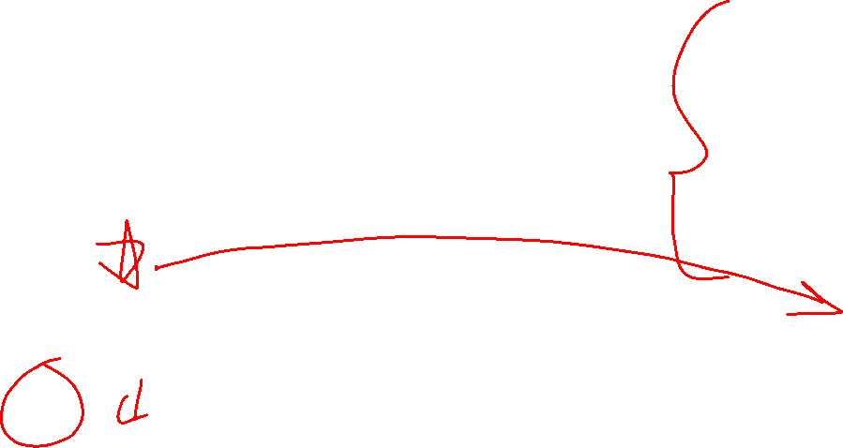
Case LR Implementation
b=a.left
c=b.right
b.right=c.left
a.left=c.right
c.right=a
c.left=b
return c
$$h+3$$
$$h+3$$
$$a$$
$$h+2$$
$$a$$
$$c$$
Rotate
Left at $b$
Rotate Right at $a$
$$h+2$$
$$h+2$$
$$h$$
$$h+1$$
$$h$$
$$c$$
$$z$$
$$a$$
$$b$$
$$z$$
$$b$$
$$h+1$$
$$h+1$$
$$h$$
$$h+1$$
$$c$$
$$b$$
$$y$$
$$h$$
$$h$$
$$w$$
$$w$$
$$x$$
$$y$$
$$z$$
$$h$$
$$x$$
$$y$$
$$w$$
$$x$$
$$d$$
$$d$$
$$d$$
$$d$$
$$d$$
$$d$$

Slide 28
















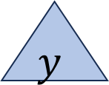








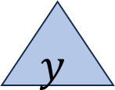

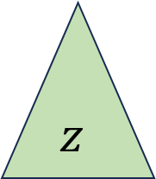






Case RL - Definition
We just inserted $d$, node $a$ is the deepest “problem” node
Imbalance caused by inserting in the right child’s left subtree
Rotate right at the right child
Rotate left at the unbalanced node
$$a$$
$$h+2$$
$$c$$
$$h+3$$
$$h+3$$
$$a$$
Rotate Right at $b$
Rotate Left at $a$
$$h+2$$
$$b$$
$$h$$
$$c$$
$$h+1$$
$$b$$
$$h$$
$$w$$
$$h+2$$
$$a$$
$$h+1$$
$$w$$
$$h+1$$
$$c$$
$$h$$
$$h+1$$
$$b$$
$$h$$
$$h$$
$$z$$
$$x$$
$$w$$
$$x$$
$$y$$
$$z$$
$$h$$
$$x$$
$$y$$
$$y$$
$$z$$
$$d$$
$$d$$
$$d$$
$$d$$
$$d$$
$$d$$

Slide 29
Case RL Implementation
b=a.right
c=b.left
b.left=c.right
a.right=c.left
c.left=a
c.right=b
return c
$$a$$
$$h+2$$
$$c$$
$$h+3$$
$$h+3$$
$$a$$
Rotate Right at $b$
Rotate Left at $a$
$$h+2$$
$$b$$
$$h$$
$$c$$
$$h+1$$
$$b$$
$$h$$
$$w$$
$$h+2$$
$$a$$
$$h+1$$
$$w$$
$$h+1$$
$$c$$
$$h$$
$$h+1$$
$$b$$
$$h$$
$$h$$
$$z$$
$$x$$
$$w$$
$$x$$
$$y$$
$$z$$
$$h$$
$$x$$
$$y$$
$$y$$
$$z$$
$$d$$
$$d$$
$$d$$
$$d$$
$$d$$
$$d$$

Slide 30
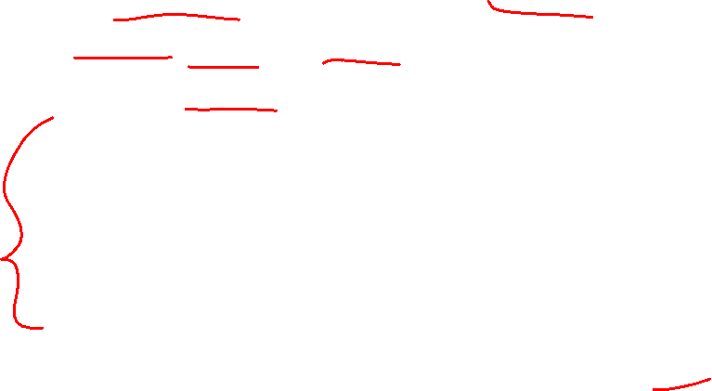
Insert Summary
After a BST insertion, update the heights of the node’s ancestors
From leaf to root, check if each node is balanced
If a node is unbalanced then at the deepest unbalanced node:
Case LL: If we inserted in the left subtree of the left child then: rotate right
Case RR: If we inserted in the right subtree of the right child then: rotate left
Case LR: If we inserted into the right subtree of the left child then: rotate left at the left child and then rotate right at the root
Case RL: If we inserted into the left subtree of the right child then: rotate right at the right child and then rotate left at the root
Done after either reaching the root or applying one of the above cases

Slide 31
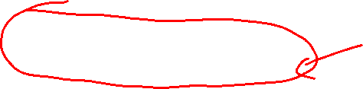
Insert Operation (for AVL)
insert(key, value, root){
root = insertHelper(key, value, root);
}
insertHelper(key, value, root){
if(root == null)
return new Node(key, value);
if (root.key < key)
root.right = insertHelper(key, value, root.right);
else
root.left = insertHelper(key, value, root.left);
if(isUnbalanced(root))
root=rotate(root);
return root;
}

Slide 32
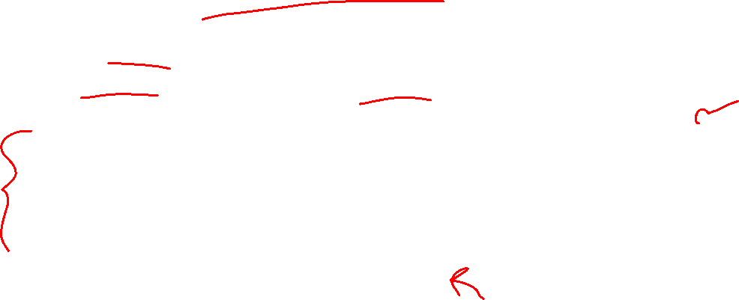
Delete Summary
Tldr: same cases, reverse direction of rotation, may need to repeat with ancestors
After a BST deletion, update the heights of the node’s ancestors
From leaf to root, check if each node is unbalanced
If a node is unbalanced then at the deepest unbalanced node:
Case LL: If we deleted in the left subtree of the left child then: rotate left
Case RR: If we deleted in the right subtree of the right child then: rotate right
Case LR: If we deleted into the right subtree of the left child then: rotate right at the left child and then rotate left at the root
Case RL: If we deleted into the left subtree of the right child then: rotate left at the right child and then rotate right at the root
Continue checking until reach the root

Slide 33
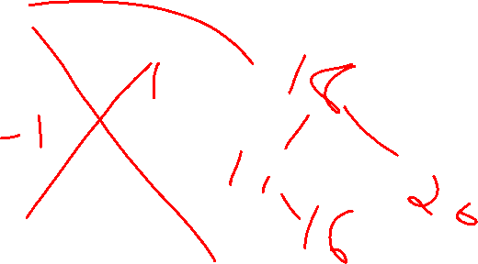
After the Left Rotation, Balanced!
9
3
11
1
6
18
0
2
16
20

Slide 34
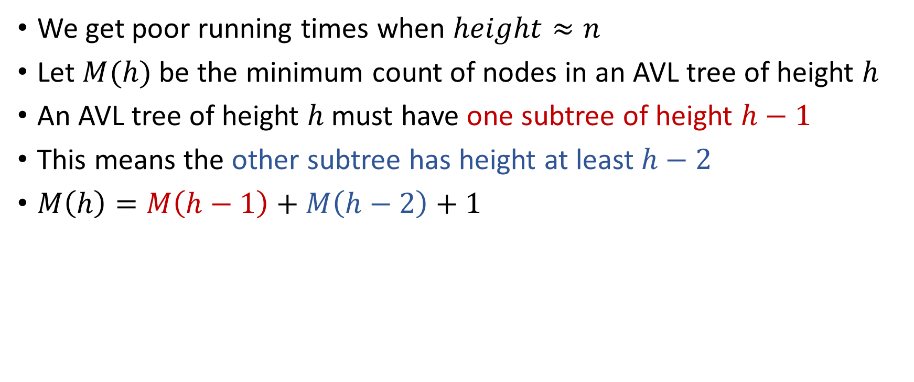

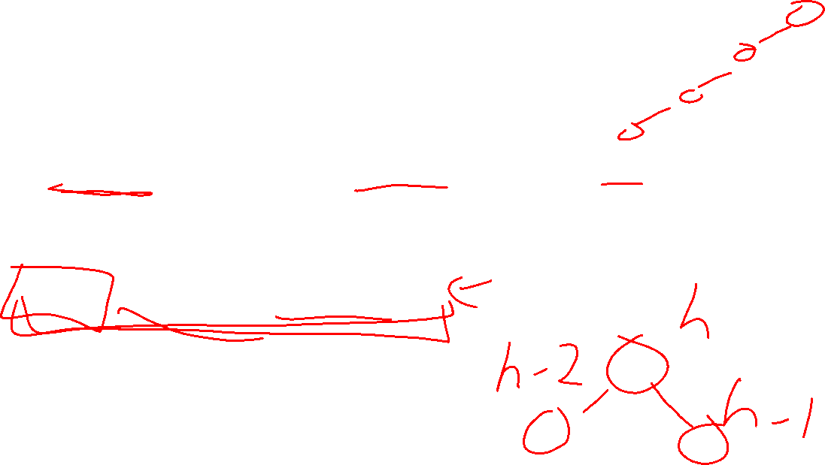
Why is this $Θ(\log{n})$ time?
We get poor running times when $height≈n$
Let $M(h)$ be the minimum count of nodes in an AVL tree of height $h$
An AVL tree of height $h$ must have one subtree of height $h−1$
This means the other subtree has height at least $h−2$
$M\left(h\right)=M\left(h−1\right)+M\left(h−2\right)+1$

Slide 35
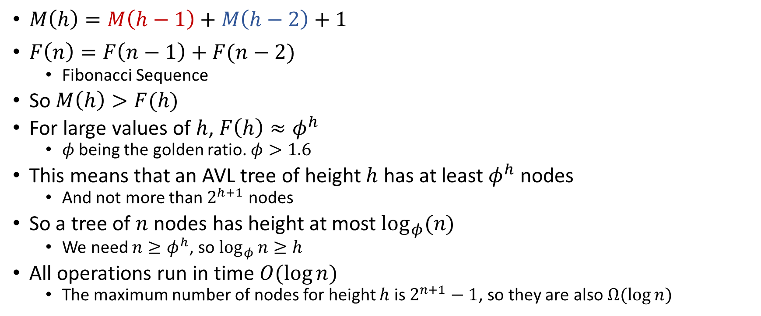
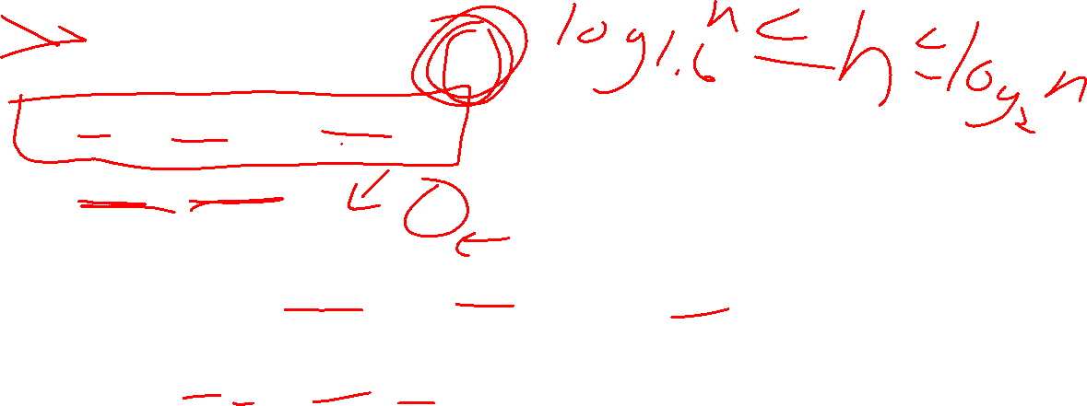
Comparing to Fibonacci Sequence
$M\left(h\right)=M\left(h−1\right)+M\left(h−2\right)+1$
$F\left(n\right)=F\left(n−1\right)+F(n−2)$
Fibonacci Sequence
So $M\left(h\right)>F(h)$
For large values of $h$, $F\left(h\right)≈φ^{h}$
$φ$ being the golden ratio. $φ>1.6$
This means that an AVL tree of height $h$ has at least $φ^{h}$ nodes
And not more than $2^{h+1}$ nodes
So a tree of $n$ nodes has height at most $\log_{φ}(n)$
We need $n≥φ^{h}$, so $\log_{φ}{n}≥h$
All operations run in time $O(\log{n})$
The maximum number of nodes for height $h$ is $2^{n+1}−1$, so they are also $Ω(\log{n})$

