Slide 1
CSE 332 Spring 2026 Lecture 4: Algorithm Analysis and Priority Queues
Nathan Brunelle
http://www.cs.uw.edu/332

Slide 2
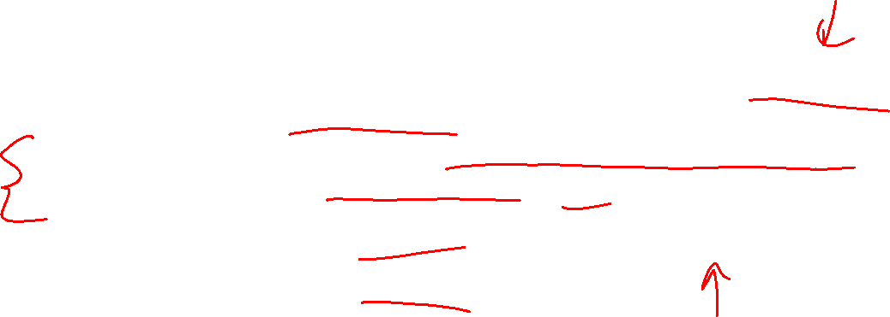
Motivation for Algorithm Analysis
We want to define algorithm running times in a way that’s predictive:
We’re not required to implement+run the algorithms to determine the time
Our conclusions do not depend on how the algorithm is implemented/run
E.g. variation in choice of programming language, machine, or other tasks the computer is doing in parallel
We can use it to compare running times of different algorithms
We do not need to select an input size in advance

Slide 3
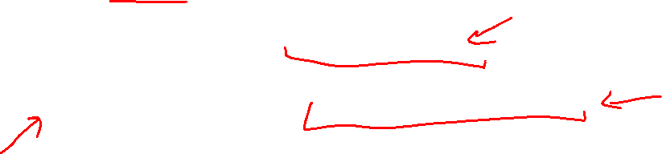
Process for Algorithm Analysis
Identify a function which maps the algorithm’s input size to a measure of resources used
Domain of the function: sizes of the input
Number of characters in a string, number of items in a list, number of pixels in an image
Codomain of the function: counts of resources used
Number of times the algorithm adds two numbers together, number times the algorithm does a > or < comparison, maximum number of bytes of memory the algorithm uses at any time
Important note: Make sure you know the “units” of your domain and codomain!
Domain = inputs to the function
Codomain = outputs to the function

Slide 4
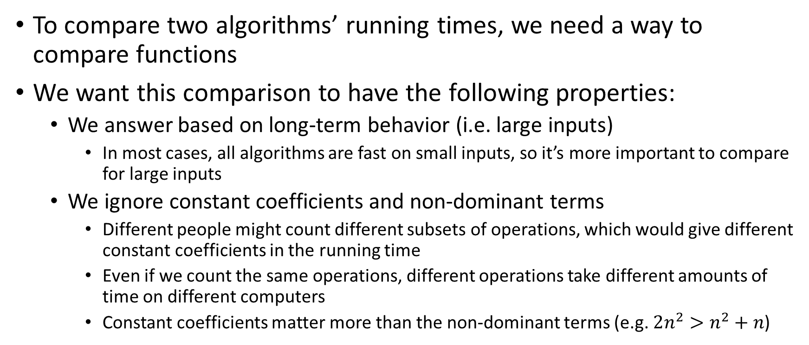
Comparing Running Times
To compare two algorithms’ running times, we need a way to compare functions
We want this comparison to have the following properties:
We answer based on long-term behavior (i.e. large inputs)
In most cases, all algorithms are fast on small inputs, so it’s more important to compare for large inputs
We ignore constant coefficients and non-dominant terms
Different people might count different subsets of operations, which would give different constant coefficients in the running time
Even if we count the same operations, different operations take different amounts of time on different computers
Constant coefficients matter more than the non-dominant terms (e.g. $2n^{2}>n^{2}+n$)

Slide 5
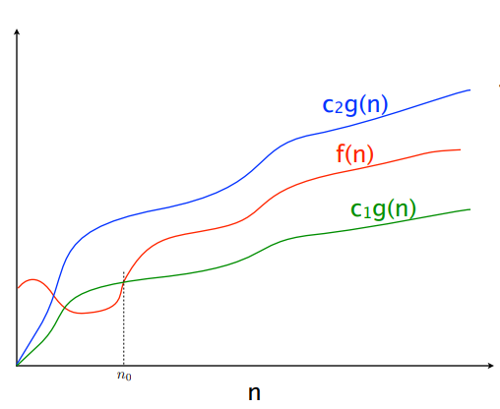
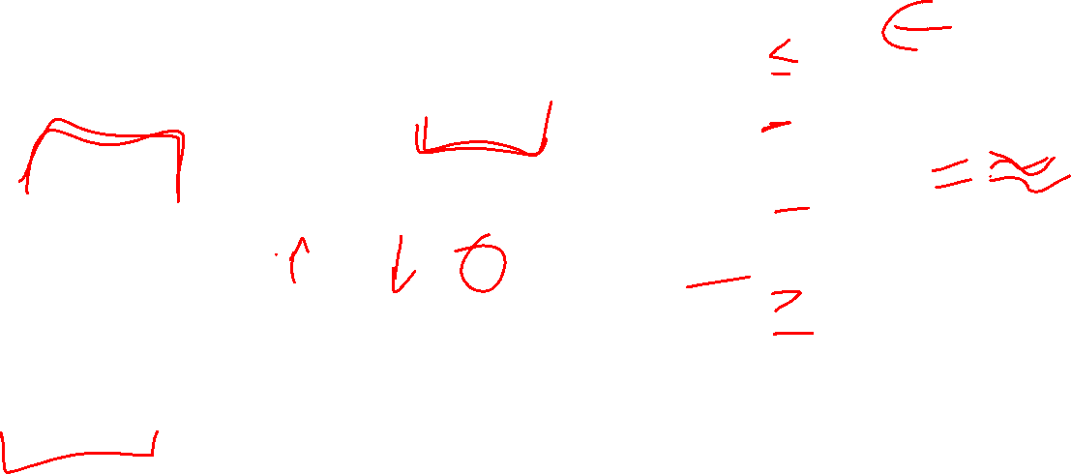

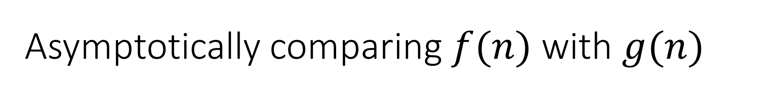


Asymptotically comparing $f(n)$ with $g(n)$
$$f(n)=O(g\left(n\right))$$
$$f(n)=Θ(g\left(n\right))$$
$$f(n)=Ω(g\left(n\right))$$

Slide 6



Idea of $Θ$
$x=y$
$x≤y∧x≥y$

Slide 7
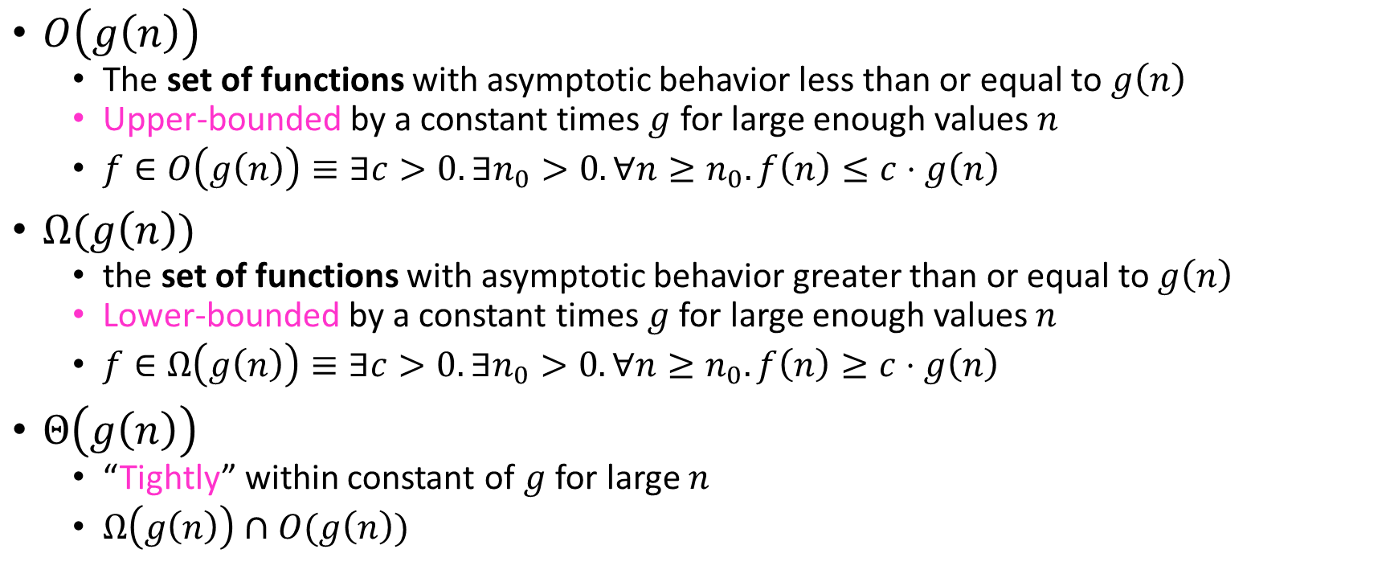
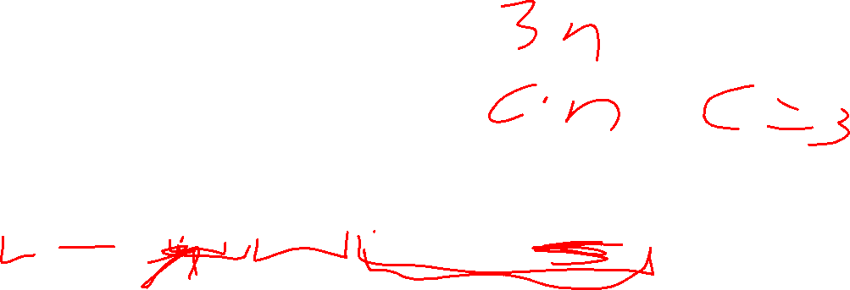
Asymptotic Notation
$O\left(g\left(n\right)\right)$
The set of functions with asymptotic behavior less than or equal to $g\left(n\right)$
Upper-bounded by a constant times $g$ for large enough values $n$
$f∈O\left(g\left(n\right)\right)≡∃c>0. ∃n_{0}>0. ∀n≥n_{0}. f\left(n\right)≤c⋅g\left(n\right)$
$Ω(g\left(n\right))$
the set of functions with asymptotic behavior greater than or equal to $g\left(n\right)$
Lower-bounded by a constant times $g$ for large enough values $n$
$f∈Ω\left(g\left(n\right)\right)≡∃c>0. ∃n_{0}>0. ∀n≥n_{0}. f\left(n\right)≥c⋅g\left(n\right)$
$Θ\left(g\left(n\right)\right)$
“Tightly” within constant of $g$ for large $n$
$Ω\left(g\left(n\right)\right)∩O(g\left(n\right))$

Slide 8
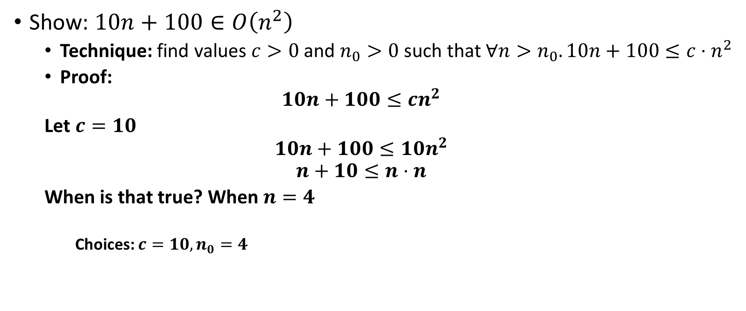
Asymptotic Notation Example 1
Show: $10n+100∈O\left(n^{2}\right)$
Technique: find values $c>0$ and $n_{0}>0$ such that $∀n>n_{0}. 10n+100≤c⋅n^{2}$
Proof:
$$10n+100≤cn^{2}$$
Let $c=10$
$$10n+100≤10n^{2}$$
$$n+10≤n⋅n$$
When is that true? When $n=4$
Choices: $c=10, n_{0}=4$

Slide 9
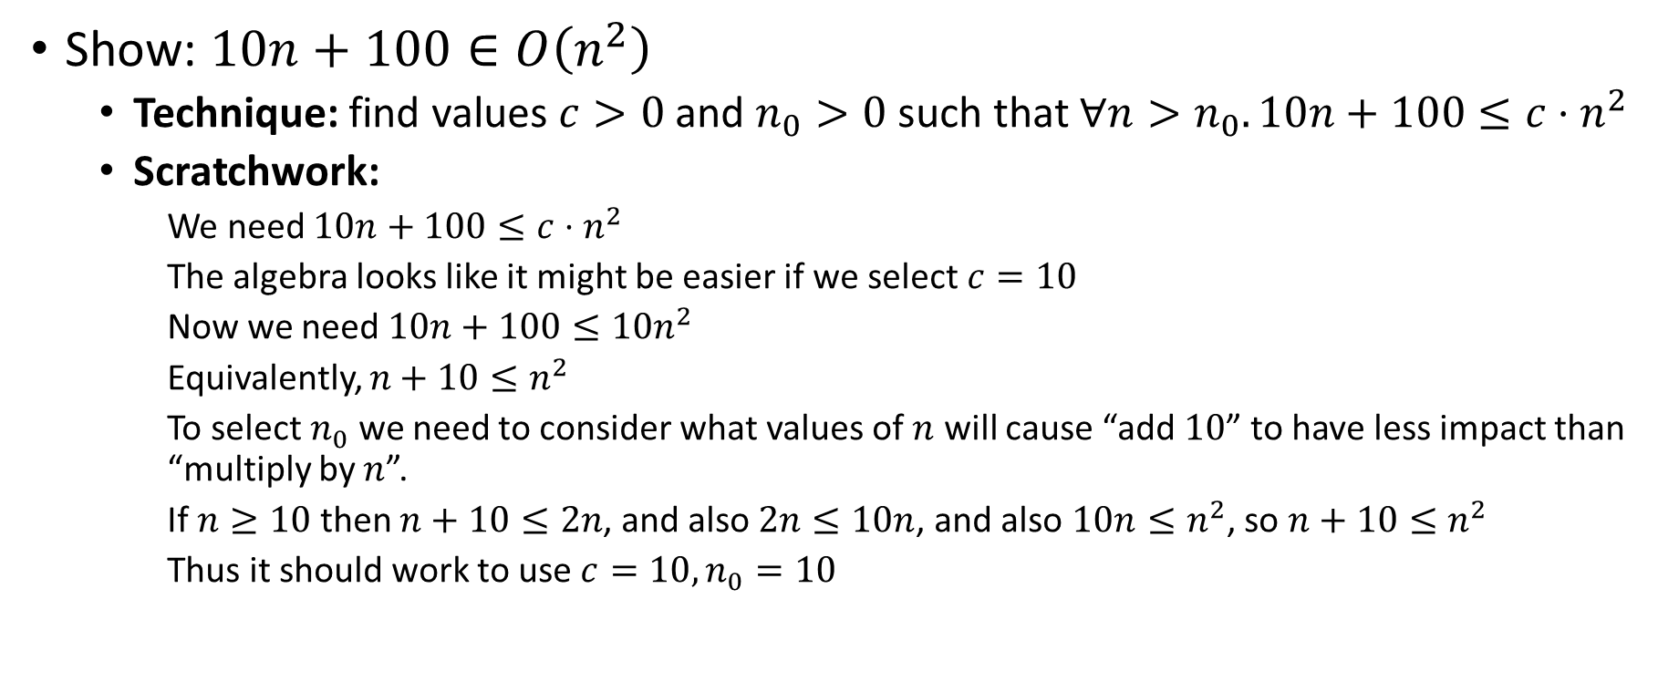
Asymptotic Notation Example 1 (Scratchwork)
Show: $10n+100∈O\left(n^{2}\right)$
Technique: find values $c>0$ and $n_{0}>0$ such that $∀n>n_{0}. 10n+100≤c⋅n^{2}$
Scratchwork:
We need $10n+100≤c⋅n^{2}$
The algebra looks like it might be easier if we select $c=10$
Now we need $10n+100≤10n^{2}$
Equivalently, $n+10≤n^{2}$
To select $n_{0}$ we need to consider what values of $n$ will cause “add $10$” to have less impact than “multiply by $n$”.
If $n≥10$ then $n+10≤2n$, and also $2n≤10n$, and also $10n≤n^{2}$, so $n+10≤n^{2}$
Thus it should work to use $c=10, n_{0}=10$

Slide 10
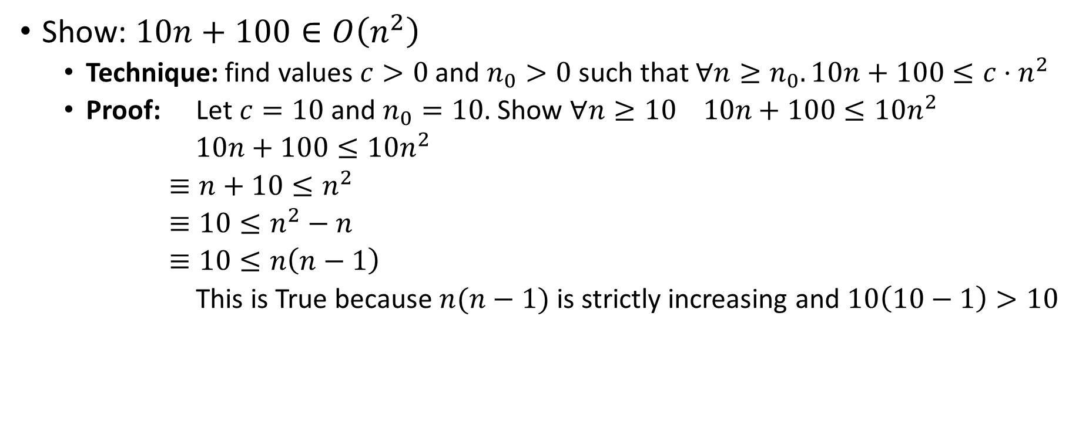
Asymptotic Notation Example 1 (Proof)
Show: $10n+100∈O\left(n^{2}\right)$
Technique: find values $c>0$ and $n_{0}>0$ such that $∀n≥n_{0}. 10n+100≤c⋅n^{2}$
Proof: Let $c=10$ and $n_{0}=10$. Show $∀n≥10 10n+100≤10n^{2}$
$10n+100≤10n^{2}$
$≡n+10≤n^{2}$
$≡10≤n^{2}−n$
$≡10≤n\left(n−1\right)$
This is True because $n(n−1)$ is strictly increasing and $10\left(10−1\right)>10$

Slide 11

Asymptotic Notation Example 2
Show: $13n^{2}−50n∈Ω\left(n^{2}\right)$
Technique: find values $c>0$ and $n_{0}>0$ such that $∀n≥n_{0}. 13n^{2}−50n≥c⋅n^{2}$
$$13n^{2}−50n≥cn^{2}$$
$$c=12$$
$$13n^{2}−50n≥12n^{2}$$
$$n^{2}−50n≥0$$
$$n^{2}≥50n$$
Let $n_{0}>0$
$$n≥50$$
Use $n_{0}=50$

Slide 12
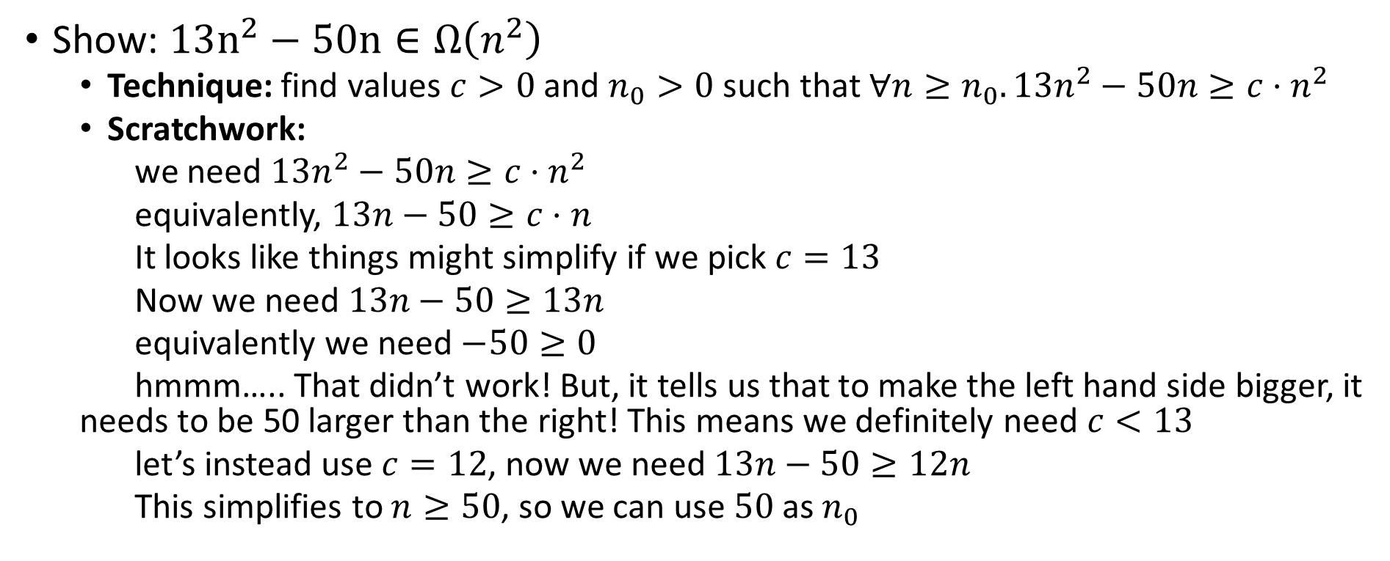
Asymptotic Notation Example 2 (Scratchwork)
Show: $13n^{2}−50n∈Ω\left(n^{2}\right)$
Technique: find values $c>0$ and $n_{0}>0$ such that $∀n≥n_{0}. 13n^{2}−50n≥c⋅n^{2}$
Scratchwork:
we need $13n^{2}−50n≥c⋅n^{2}$
equivalently, $13n−50≥c⋅n$
It looks like things might simplify if we pick $c=13$
Now we need $13n−50≥13n$
equivalently we need $−50≥0$
hmmm….. That didn’t work! But, it tells us that to make the left hand side bigger, it needs to be 50 larger than the right! This means we definitely need $c<13$
let’s instead use $c=12$, now we need $13n−50≥12n$
This simplifies to $n≥50$, so we can use $50$ as $n_{0}$

Slide 13
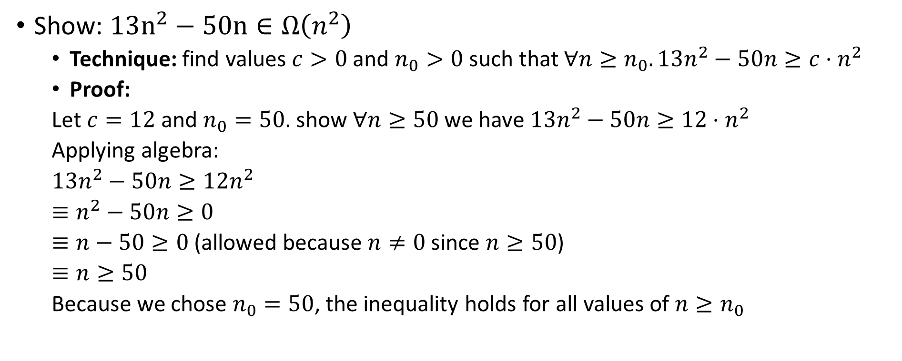
Asymptotic Notation Example 2 (Proof)
Show: $13n^{2}−50n∈Ω\left(n^{2}\right)$
Technique: find values $c>0$ and $n_{0}>0$ such that $∀n≥n_{0}. 13n^{2}−50n≥c⋅n^{2}$
Proof:
Let $c=12$ and $n_{0}=50$. show $∀n≥50$ we have $13n^{2}−50n≥12⋅n^{2}$
Applying algebra:
$13n^{2}−50n≥12n^{2}$
$≡n^{2}−50n≥0$
$≡n−50≥0$ (allowed because $n≠0$ since $n≥50$)
$≡n≥50$
Because we chose $n_{0}=50$, the inequality holds for all values of $n≥n_{0}$

Slide 14
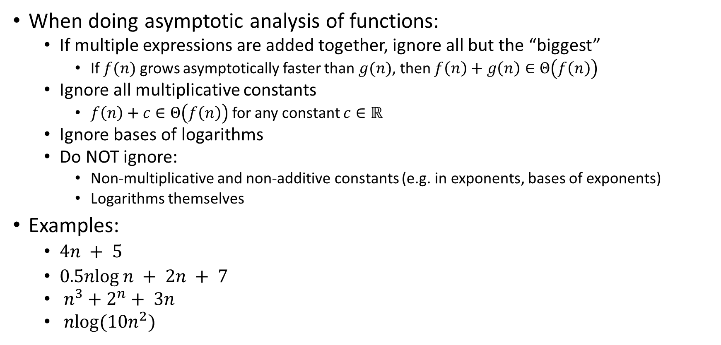
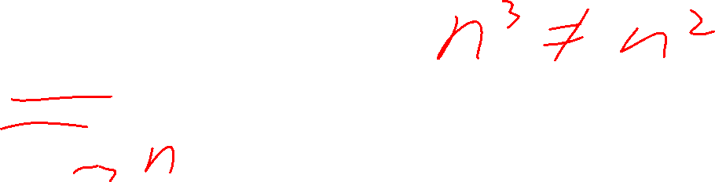

Gaining Intuition
When doing asymptotic analysis of functions:
If multiple expressions are added together, ignore all but the “biggest”
If $f(n)$ grows asymptotically faster than $g(n)$, then $f\left(n\right)+g\left(n\right)∈Θ\left(f\left(n\right)\right)$
Ignore all multiplicative constants
$f\left(n\right)+c∈Θ\left(f\left(n\right)\right)$ for any constant $c∈ℝ$
Ignore bases of logarithms
Do NOT ignore:
Non-multiplicative and non-additive constants (e.g. in exponents, bases of exponents)
Logarithms themselves
Examples:
$4n + 5$
$0.5nlog⁡n + 2n + 7$
$n^{3}+2^{n}+ 3n$
$nlog(10n^{2})$

Slide 15

More Examples
Is each of the following True or False?
$4+3n∈ O(n)$
$n+2\log{n}∈ O(\log{n})$
$\log{n}+2∈ O(1)$
$n^{50}∈ O({1.1}^{n})$
$3^{n}∈Θ(2^{n})$

Slide 16
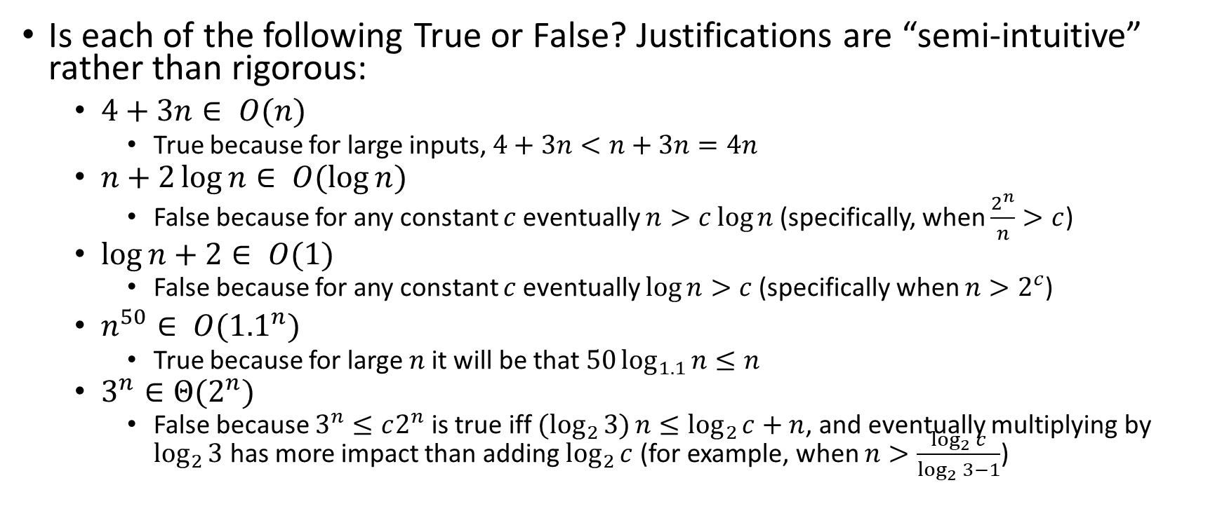
Solutions
Is each of the following True or False? Justifications are “semi-intuitive” rather than rigorous:
$4+3n∈ O(n)$
True because for large inputs, $4+3n<n+3n=4n$
$n+2\log{n}∈ O(\log{n})$
False because for any constant $c$ eventually $n>c\log{n}$ (specifically, when $\frac{2^{n}}{n}>c$)
$\log{n}+2∈ O(1)$
False because for any constant $c$ eventually $\log{n}>c$ (specifically when $n>2^{c}$)
$n^{50}∈ O({1.1}^{n})$
True because for large $n$ it will be that $50\log_{1.1}{n}≤n$
$3^{n}∈Θ(2^{n})$
False because $3^{n}≤c2^{n}$ is true iff ${(log}_{2}{3)}n≤\log_{2}{c}+n$, and eventually multiplying by $\log_{2}{3}$ has more impact than adding $\log_{2}{c}$ (for example, when $n>\frac{\log_{2}{c}}{\log_{2}{3}−1}$)

Slide 17


Common Categories
$O(1)$ “constant”
$O\left(\log{n}\right)$ “logarithmic”
$O\left(n\right)$ “linear”
$O\left(n\log{n}\right)$ “log-linear”
$O\left(n^{2}\right)$ “quadratic”
$O\left(n^{3}\right)$ “cubic”
$O\left(n^{k}\right)$ “polynomial”
$O\left(k^{n}\right)$ “exponential”

Slide 18
ADT: Queue
What is it?
A “First In First Out” (FIFO) collection of items
What Operations do we need?
Enqueue
Add a new item to the queue
Dequeue
Remove the “oldest” item from the queue
Is_empty
Indicate whether or not there are items still on the queue

Slide 19
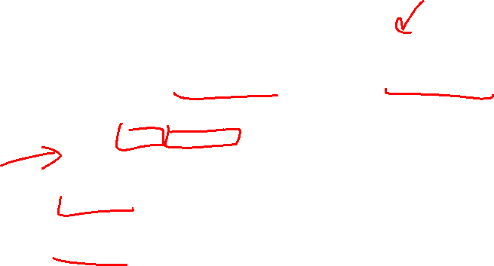
ADT: Priority Queue
What is it?
A collection of items and their “priorities”
Allows quick access/removal to the “top priority” thing
What Operations do we need?
insert(item, priority)
Add a new item to the PQ with indicated priority
Usually, smaller priority value means more important
extract
Remove and return the “top priority” item from the queue
Is_empty
Indicate whether or not there are items still on the queue
Note: the “priority” value can be any type/class so long as it’s comparable (i.e. you can use “<“ or “compareTo” with it)

Slide 20
Priority Queue Example 1
PriorityQueue PQ = new PriorityQueue();
PQ.insert(5,5)
PQ.insert(6,6)
PQ.insert(1,1)
PQ.insert(3,3)
PQ.insert(8,8)
Print(PQ.extract)
Print(PQ.extract)
Print(PQ.extract)
Print(PQ.extract)
Print(PQ.extract)
Prints:
1
3
5
6
8

Slide 21

Priority Queue Example 2
PriorityQueue PQ = new PriorityQueue();
PQ.insert(5,5)
PQ.insert(6,6)
PQ.insert(3,3)
Print(PQ.extract)
PQ.insert(1,1)
Print(PQ.extract)
Print(PQ.extract)
PQ.insert(8,8)
Print(PQ.extract)
Print(PQ.extract)
Prints:
3
1
5
6
8

Slide 22
Applications?

Slide 23
Thinking through implementations
Data Structure | Worst case time to insert | Worst case time to extract
Unsorted Array
Unsorted Linked List
Sorted Array
Sorted Linked List
Binary Search Tree
For simplicity, Assume we know the maximum size of the PQ in advance (otherwise we’d do an amortized analysis, but get the same answers…)

Slide 24
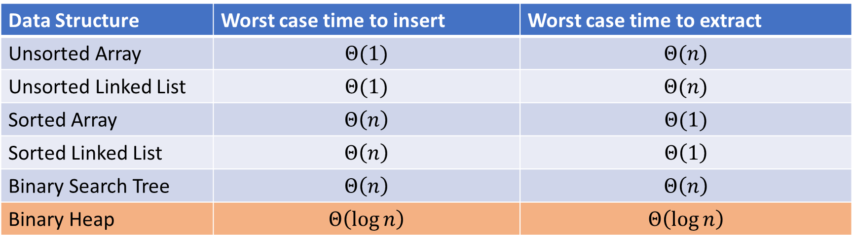
Thinking through implementations (solutions)
Data Structure | Worst case time to insert | Worst case time to extract
Unsorted Array | $$Θ(1)$$ | $$Θ(n)$$
Unsorted Linked List | $$Θ(1)$$ | $$Θ(n)$$
Sorted Array | $$Θ\left(n\right)$$ | $$Θ(1)$$
Sorted Linked List | $$Θ\left(n\right)$$ | $$Θ\left(1\right)$$
Binary Search Tree | $$Θ\left(n\right)$$ | $$Θ\left(n\right)$$
Binary Heap | $$Θ\left(\log{n}\right)$$ | $$Θ\left(\log{n}\right)$$
For simplicity, Assume we know the maximum size of the PQ in advance (otherwise we’d do an amortized analysis, but get the same answers…)

Slide 25

Trees for Heaps
Binary Trees:
The branching factor is 2
Every node has $≤$ 2 children
Complete Tree:
All “layers” are full, except the bottom
Bottom layer filled left-to-right
1
3
2
4
7
5
6
5
9

Slide 26

Heap – Priority Queue Data Structure
Idea: We need to keep some ordering, but it doesn’t need to be entirely sorted
$Θ(\log{n})$ worst case for extract and insert
1
1
3
2
4
2
7
5
3
6
4
5
6
7
5
9
8
9

Slide 27
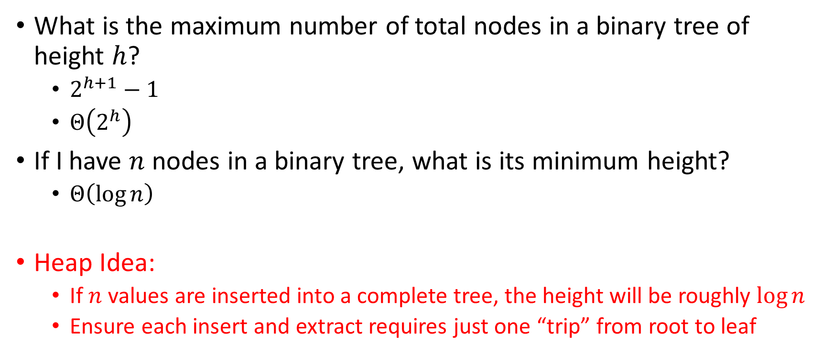
Tree Measurements Challenge!
What is the maximum number of total nodes in a binary tree of height $h$?
$2^{h+1}−1$
$Θ\left(2^{h}\right)$
If I have $n$ nodes in a binary tree, what is its minimum height?
$Θ\left(\log{n}\right)$
Heap Idea:
If $n$ values are inserted into a complete tree, the height will be roughly $\log{n}$
Ensure each insert and extract requires just one “trip” from root to leaf

Slide 28
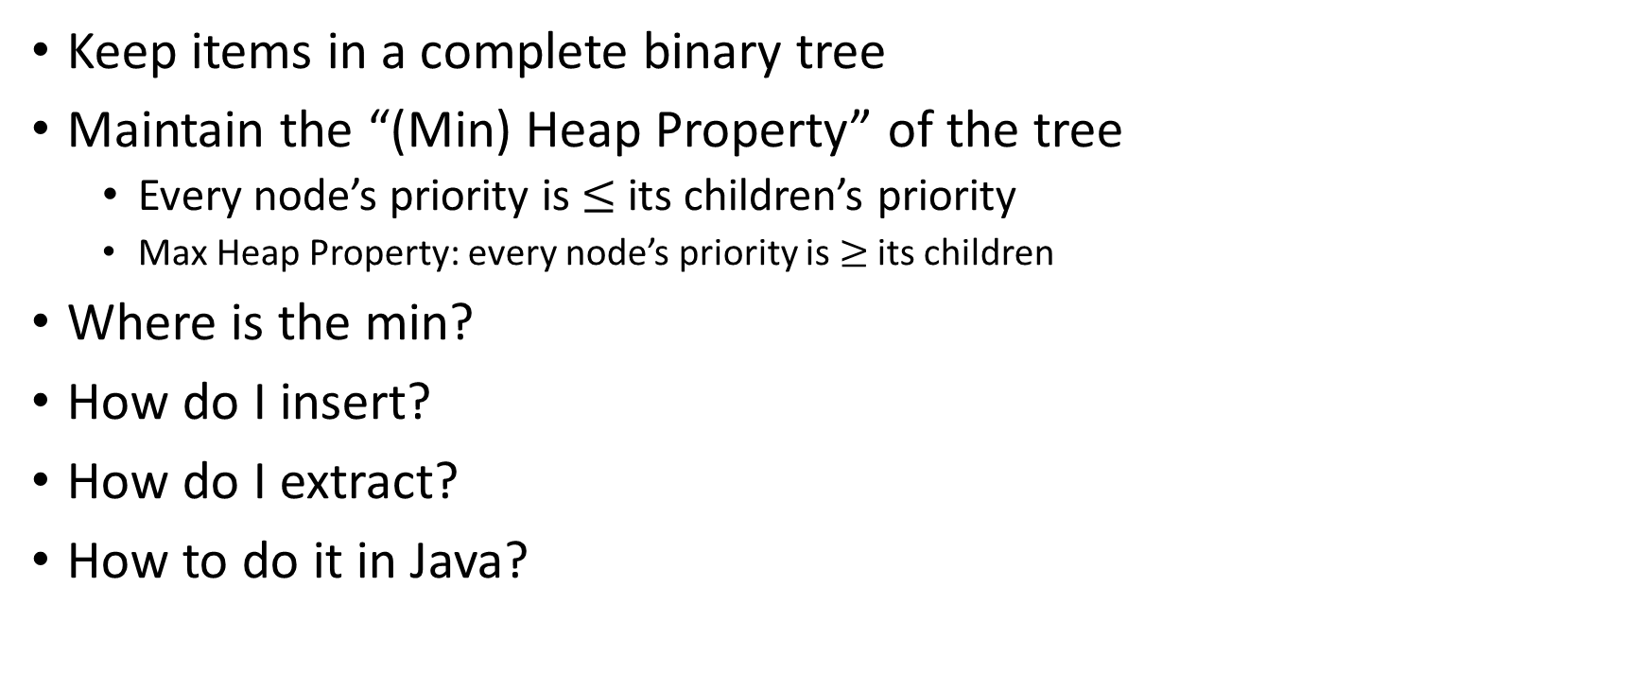
(Min) Heap Data Structure
Keep items in a complete binary tree
Maintain the “(Min) Heap Property” of the tree
Every node’s priority is $≤$ its children’s priority
Max Heap Property: every node’s priority is $≥$ its children
Where is the min?
How do I insert?
How do I extract?
How to do it in Java?
1
1
3
2
4
2
7
5
3
6
4
5
6
7
5
9
8
9

