Slide 1
CSE 332 Winter 2026
Lecture 3: Algorithm Analysis pt.2
Nathan Brunelle
http://www.cs.uw.edu/332

Slide 2
Running Time Analysis
Units of “time”
  Operations
    Whichever operations we pick
How do we express running time?
  Function
    Domain (input): size of the input
    Range: count of operations

Slide 3
Defining your running time function
Worst-case complexity:
  max number of steps algorithm takes on “most challenging” input
Best-case complexity:
  min number of steps algorithm takes on “easiest” input
Average/expected complexity:
  avg number of steps algorithm takes on random inputs (context-dependent)
Amortized complexity:
  max total number of steps algorithm takes on M “most challenging” consecutive inputs, divided by M (i.e., divide the max total sum by M).

Slide 4

Worst Case Running Time Analysis
If an algorithm has a worst case running time of $f(n)$
  Among all possible size-$n$ inputs, the “worst” one will do $f(n)$ “operations”
  $f(n)$ gives the maximum count of operations needed from among all inputs of size $n$

Slide 5
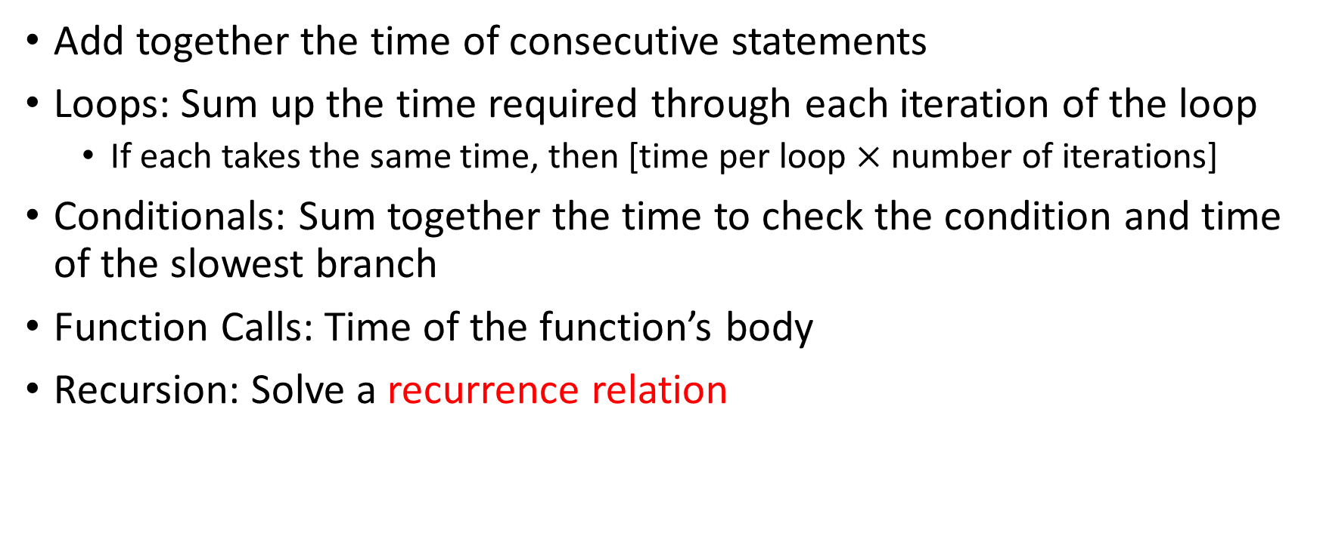
Worst Case Running Time – General Guide
Add together the time of consecutive statements
Loops: Sum up the time required through each iteration of the loop
  If each takes the same time, then [time per loop $×$ number of iterations]
Conditionals: Sum together the time to check the condition and time of the slowest branch
Function Calls: Time of the function’s body
Recursion: Solve a recurrence relation

Slide 6

Worst Case Running Time - Example
myFunction(List n){
b = 55 + 5; // 1
c = b / 3; // 1
b = c + 100; // 1
for (i = 0; i < n.size(); i++) { //0
b++; // 1 each iteration across n iterations
}
if (b % 2 == 0) { //1
c++;
}
else {
for (i = 0; i < n.size(); i++) { //0
c++; // 1 each iteration across n iterations
}
}
return c;
}
Questions to ask:
What are the units of the input size?
  Number of things in the list
What are the operations we’re counting?
  arithmetic (+-*%) except for i++
For each line:
  How many times will it run?
  How long does it take to run?
  Does this change with different inputs?
Answer:
  1+1+1+n+1+n=4+2n
  $O(n)$

Slide 7

Worst Case Running Time - Example
myFunction(List n){
b = 55 + 5; // 1
c = b / 3; // 1
b = c + 100; // 1
for (i = 0; i < n.size(); i++) { // 1, n times
b++; // 1
}
if (b % 2 == 0) { // 1
c++; // 1
}
else {
for (i = 0; i < n.size(); i++) { // 1, n times
c++; // 1
}
}
return c;
}
Questions to ask:
What are the units of the input size?
  # of items in the list
What are the operations we’re counting?
  Arithmetic ops (+-*/)
For each line:
  How many times will it run?
  How long does it take to run?
  Does this change with different inputs?
Answer:
  $3+2n+1+2n=4n+4$
  $O(n)$

Slide 8

Worst Case Running Time – Example 2
beAnnoying(List n){
List m = [];
for (i=0; i < n.size(); i++){ // iterates n times
m.add(n[i]); // 0
for (j=0; j< n.size(); j++){ // iterates n times per outer loop
print (“Hi, I’m annoying”); // once per inner loop
}
}
}
Questions to ask:
What are the units of the input size?
  Size of the list
What are the operations we’re counting?
  Count prints
For each line:
  How many times will it run?
  How long does it take to run?
  Does this change with the input size?
Answer:
  $n^{2}$

Slide 9

Worst Case Running Time – Example 2
beAnnoying(List n){
List m = [];
for (i=0; i < n.size(); i++){ // n
m.add(n[i]);
for (j=0; j< n.size(); j++){ // n iterations per outer
print (“Hi, I’m annoying”); // 1 time
}
}
}
Questions to ask:
What are the units of the input size?
  Size of the list
What are the operations we’re counting?
  printing
For each line:
  How many times will it run?
  How long does it take to run?
  Does this change with the input size?
$O(n^{2})$

Slide 10
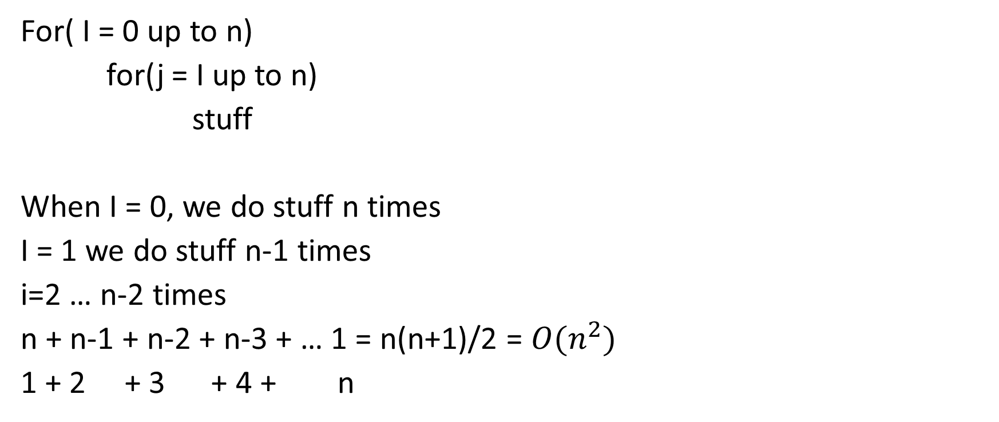
For( I = 0 up to n)
for(j = I up to n)
stuff
When I = 0, we do stuff n times
I = 1 we do stuff n-1 times
i=2 … n-2 times
n + n-1 + n-2 + n-3 + … 1 = n(n+1)/2 = $O(n^{2})$
1 + 2 + 3 + 4 + n

Slide 11
Amortized Analysis Analogy
Suppose I’d like to park in a lot where they charge $10 per day to park
If you are caught in the lot without paying you are given a warning
If you get 3 warnings, you are charged a $25 fine, and your warnings reset.
Should you actually pay to park?
  If you pay every day then you pay an average of $10 per day
  If you do not pay then for every three days parking costs $0+$0+$25, for an average of $8.33 per day
    Worst case analysis: parking costs $25
    Amortized analysis: parking costs $8.33

Slide 12

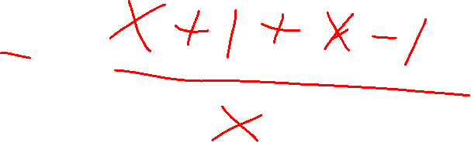
Amortized Complexity Example - ArrayList
public void add(T value){
if(data.length == size)
resize();
data[size] = value;
size++;
}
private void resize(){
T[] oldData = data;
data = (T[]) new Object[data.length*2];
for(int i = 0; i < oldData.length; i++)
data[i] = oldData[i];
}
What is the worst case running time of add?
  Input size: size of “this”
  Operations counted: indexing
  $O\left(n\right)$

Slide 13
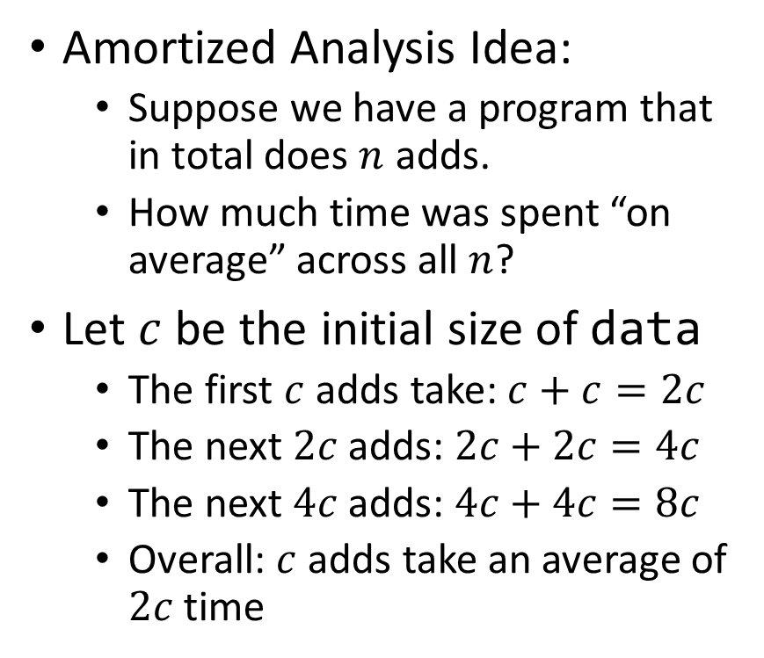
Amortized Complexity Example - ArrayList
public void add(T value){
if(data.length == size)
resize();
data[size] = value;
size++;
}
private void resize(){
T[] oldData = data;
data = (T[]) new Object[data.length*2];
for(int i = 0; i < oldData.length; i++)
data[i] = oldData[i];
}
Amortized Analysis Idea:
  Suppose we have a program that in total does $n$ adds.
  How much time was spent “on average” across all $n$?
Let $c$ be the initial size of data
  The first $c$ adds take: $c+c=2c$
  The next $2c$ adds: $2c+2c=4c$
  The next $4c$ adds: $4c+4c=8c$
  Overall: $c$ adds take an average of $2c$ time
Every time we resize, we earn data.length more adds guaranteed to not resize!
Notes:
Amortized: “running average”

Slide 14
Searching in a Sorted List
5
8
13
42
75
79
88
90
95
99
0
1
2
3
4
5
6
7
8
9
public static boolean contains(List<Integer> a, int k){
for(int i=0; i< a.size(); i++){
if (a.get(i) == k)
return true;
}
return false;
}

Slide 15
Faster way?
5
8
13
42
75
79
88
90
95
99
0
1
2
3
4
5
6
7
8
9
Can you think of a faster algorithm to solve this problem?

Slide 16
Binary Search
5
8
13
42
75
79
88
90
95
99
0
1
2
3
4
5
6
7
8
9
public static boolean contains(List<Integer> a, int k){
int start = 0;
int end = a.size();
while(start < end){
int mid = start + (end-start)/2;
if(a.get(mid) == k)
return true;
else if(a.get(mid) < k)
start = mid+1;
else
end = mid;
}
return false;
}

Slide 17
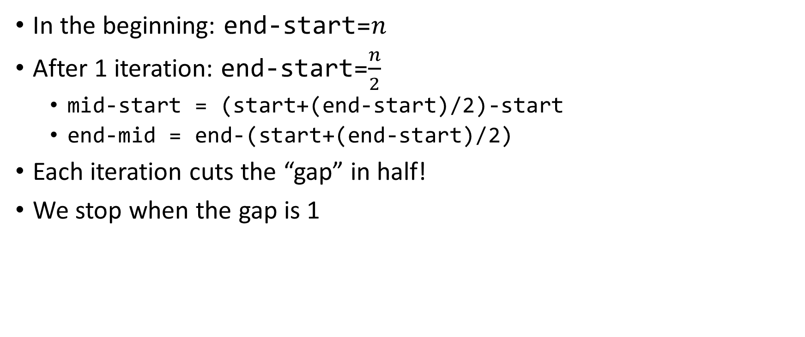

Why is this $\log_{2}{n}$?
In the beginning: end-start=$n$
After 1 iteration: end-start=$\frac{n}{2}$
  mid-start = (start+(end-start)/2)-start
  end-mid = end-(start+(end-start)/2)
Each iteration cuts the “gap” in half!
We stop when the gap is 1

Slide 18
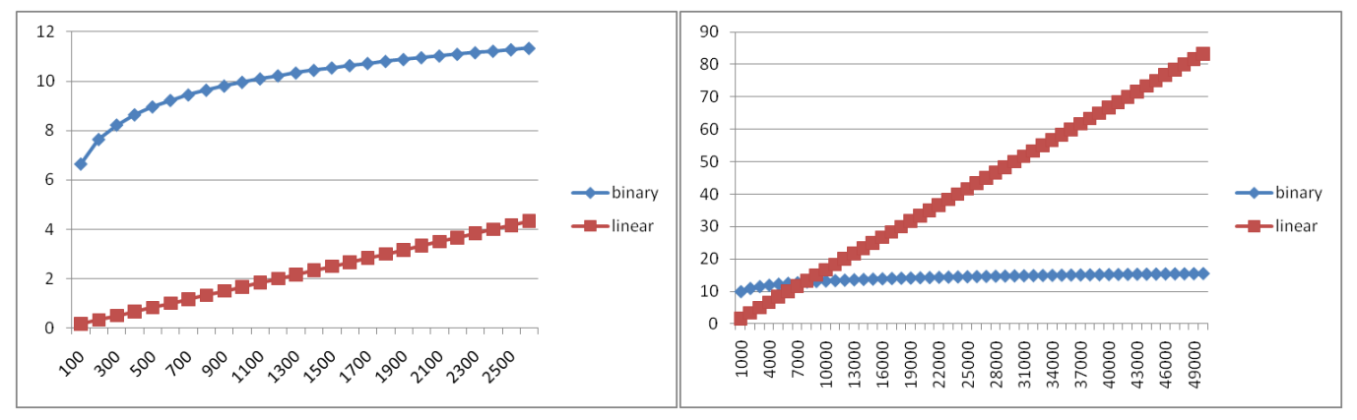
Comparing

Slide 19
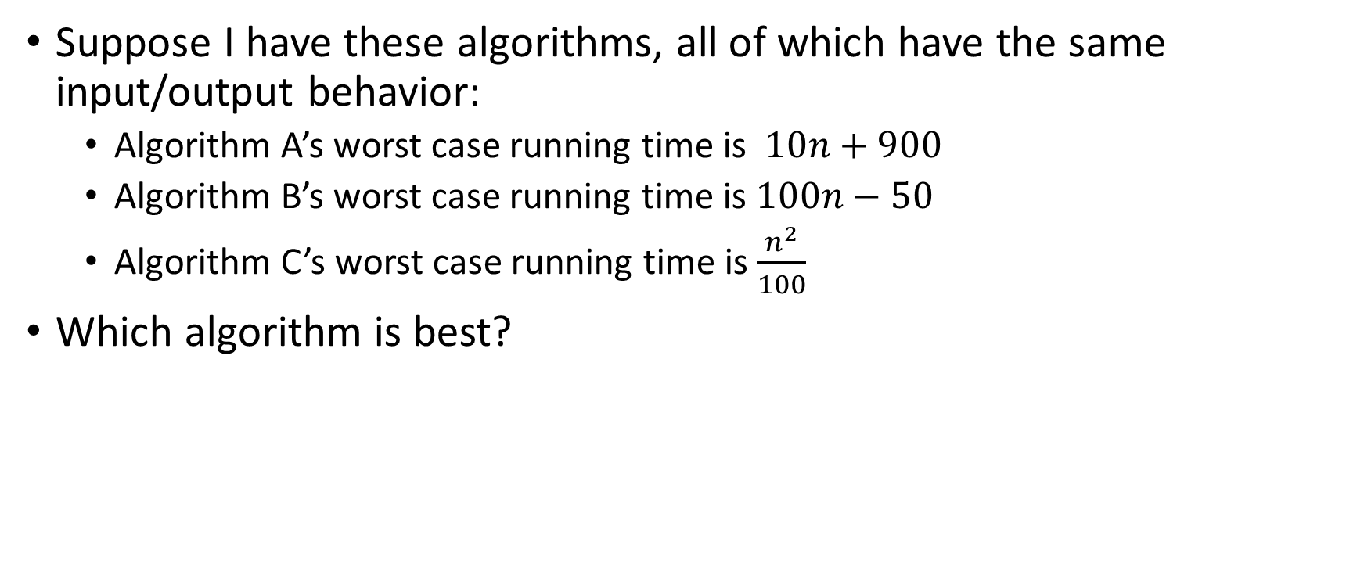
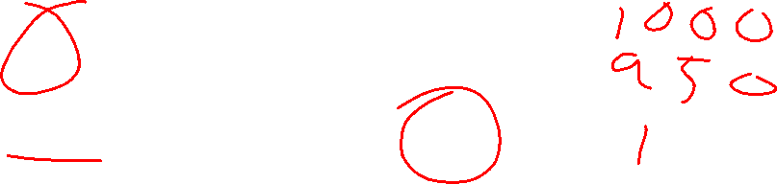
Comparing Running Times
Suppose I have these algorithms, all of which have the same input/output behavior:
  Algorithm A’s worst case running time is $10n+900$
  Algorithm B’s worst case running time is $100n−50$
  Algorithm C’s worst case running time is $\frac{n^{2}}{100}$
Which algorithm is best?

Slide 20
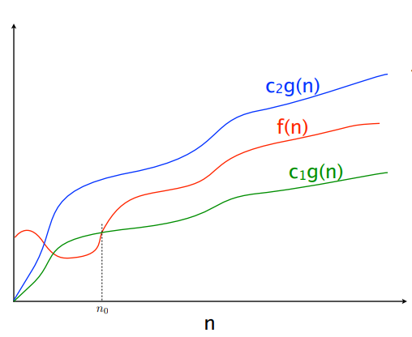

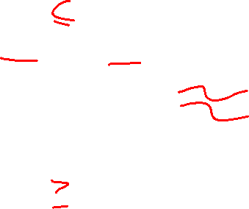


$$f(n)=O(g\left(n\right))$$
$$f(n)=Θ(g\left(n\right))$$
$$f(n)=Ω(g\left(n\right))$$

Slide 21
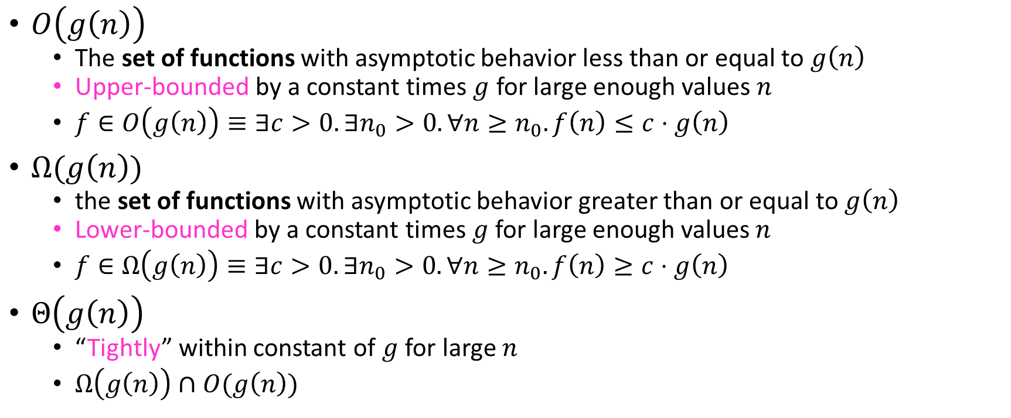

Asymptotic Notation
$O\left(g\left(n\right)\right)$
  The set of functions with asymptotic behavior less than or equal to $g\left(n\right)$
  Upper-bounded by a constant times $g$ for large enough values $n$
  $f∈O\left(g\left(n\right)\right)≡∃c>0. ∃n_{0}>0. ∀n≥n_{0}. f\left(n\right)≤c⋅g\left(n\right)$
$Ω(g\left(n\right))$
  the set of functions with asymptotic behavior greater than or equal to $g\left(n\right)$
  Lower-bounded by a constant times $g$ for large enough values $n$
  $f∈Ω\left(g\left(n\right)\right)≡∃c>0. ∃n_{0}>0. ∀n≥n_{0}. f\left(n\right)≥c⋅g\left(n\right)$
$Θ\left(g\left(n\right)\right)$
  “Tightly” within constant of $g$ for large $n$
  $Ω\left(g\left(n\right)\right)∩O(g\left(n\right))$

Slide 22


Idea of $Θ$
$x=y$
  $x≤y∧x≥y$

Slide 23

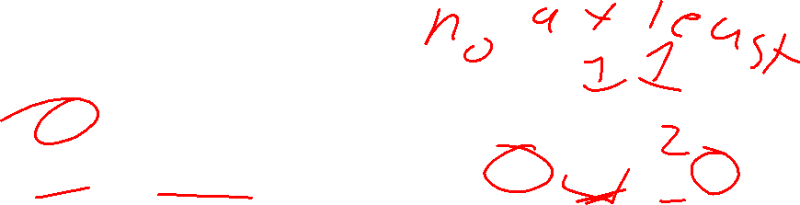
Asymptotic Notation Example
Show: $10n+100∈O\left(n^{2}\right)$
  Technique: find values $c>0$ and $n_{0}>0$ such that $∀n>n_{0}. 10n+100≤c⋅n^{2}$
  Proof:

Slide 24
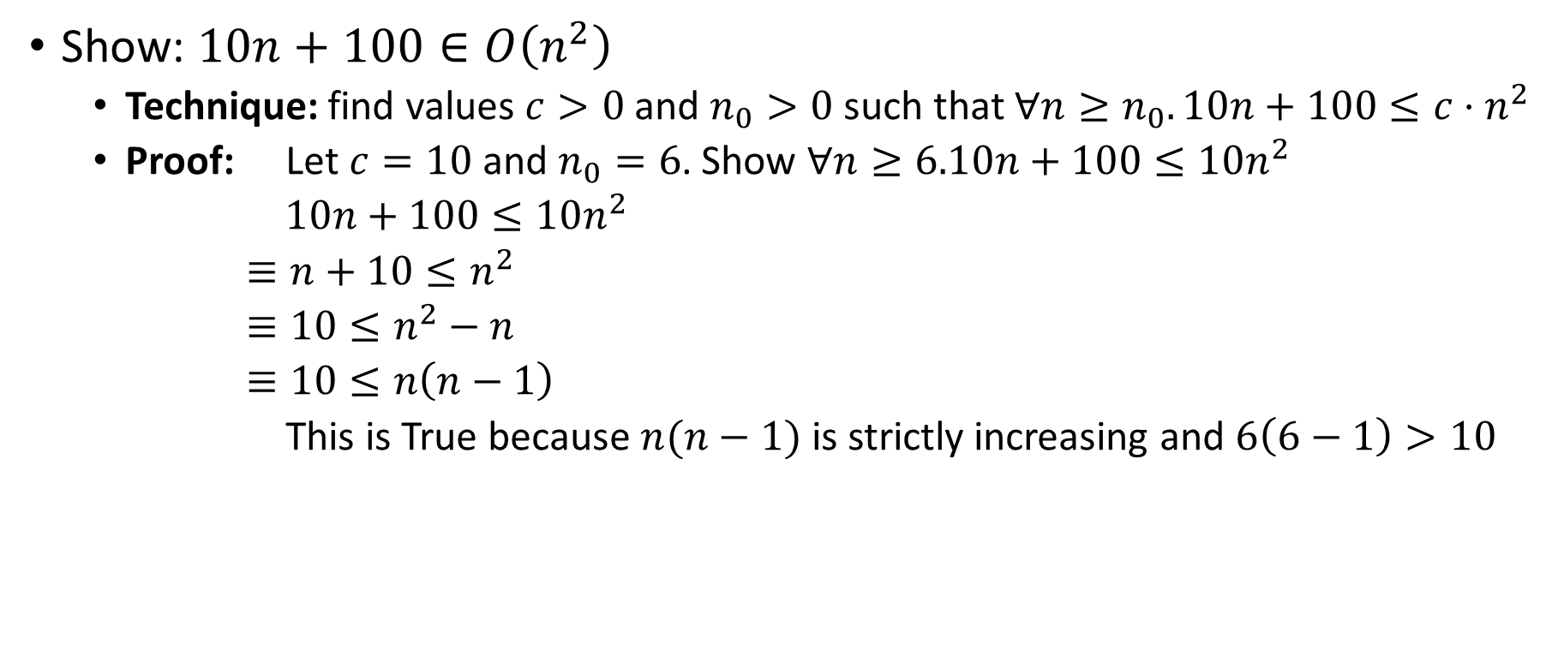
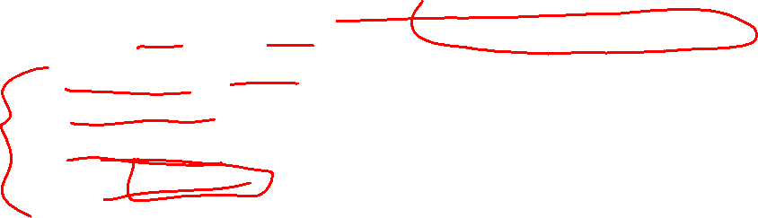
Asymptotic Notation Example
Show: $10n+100∈O\left(n^{2}\right)$
  Technique: find values $c>0$ and $n_{0}>0$ such that $∀n≥n_{0}. 10n+100≤c⋅n^{2}$
  Proof: Let $c=10$ and $n_{0}=6$. Show $∀n≥6.10n+100≤10n^{2}$
  $10n+100≤10n^{2}$
  $≡n+10≤n^{2}$
  $≡10≤n^{2}−n$
  $≡10≤n\left(n−1\right)$
  This is True because $n(n−1)$ is strictly increasing and $6\left(6−1\right)>10$

Slide 25

Asymptotic Notation Example
Show: $13n^{2}−50n∈Ω\left(n^{2}\right)$
  Technique: find values $c>0$ and $n_{0}>0$ such that $∀n≥n_{0}. 13n^{2}−50n≥c⋅n^{2}$
  Proof:
  $c=$
  $n_{0}=$

Slide 26
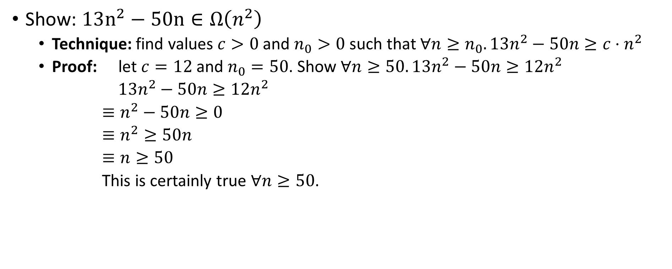
Asymptotic Notation Example
Show: $13n^{2}−50n∈Ω\left(n^{2}\right)$
  Technique: find values $c>0$ and $n_{0}>0$ such that $∀n≥n_{0}. 13n^{2}−50n≥c⋅n^{2}$
  Proof: let $c=12$ and $n_{0}=50$. Show $∀n≥50. 13n^{2}−50n≥12n^{2}$
  $13n^{2}−50n≥12n^{2}$
  $≡n^{2}−50n≥0$
  $≡n^{2}≥50n$
  $≡n≥50$
  This is certainly true $∀n≥50$.

Slide 27

Asymptotic Notation Example
Show: $n^{2}∉O\left(n\right)$
Want to show that there does not exist a pair of $c$ and $n_{0}$ such that $∀n_{0}>n. n^{2}≤c⋅n$

Slide 28
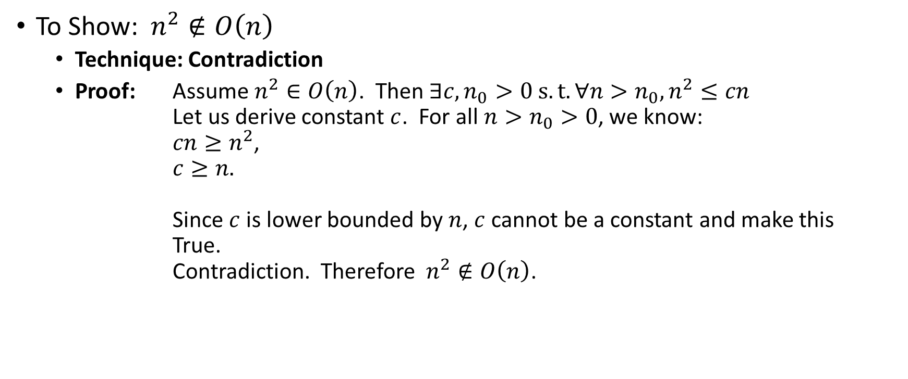
Asymptotic Notation Example
Proof by Contradiction!
To Show:$n^{2}∉O\left(n\right)$
  Technique: Contradiction
  Proof: Assume $n^{2}∈O\left(n\right)$. Then $∃c,n_{0}>0 s.t. ∀n>n_{0},n^{2}≤cn$
  Let us derive constant $c$. For all $n>n_{0}>0$, we know:
  $cn≥n^{2}$,
  $c≥n.$
  Since $c$ is lower bounded by $n$, $c$ cannot be a constant and make this True.
  Contradiction. Therefore$n^{2}∉O\left(n\right)$.

Slide 29
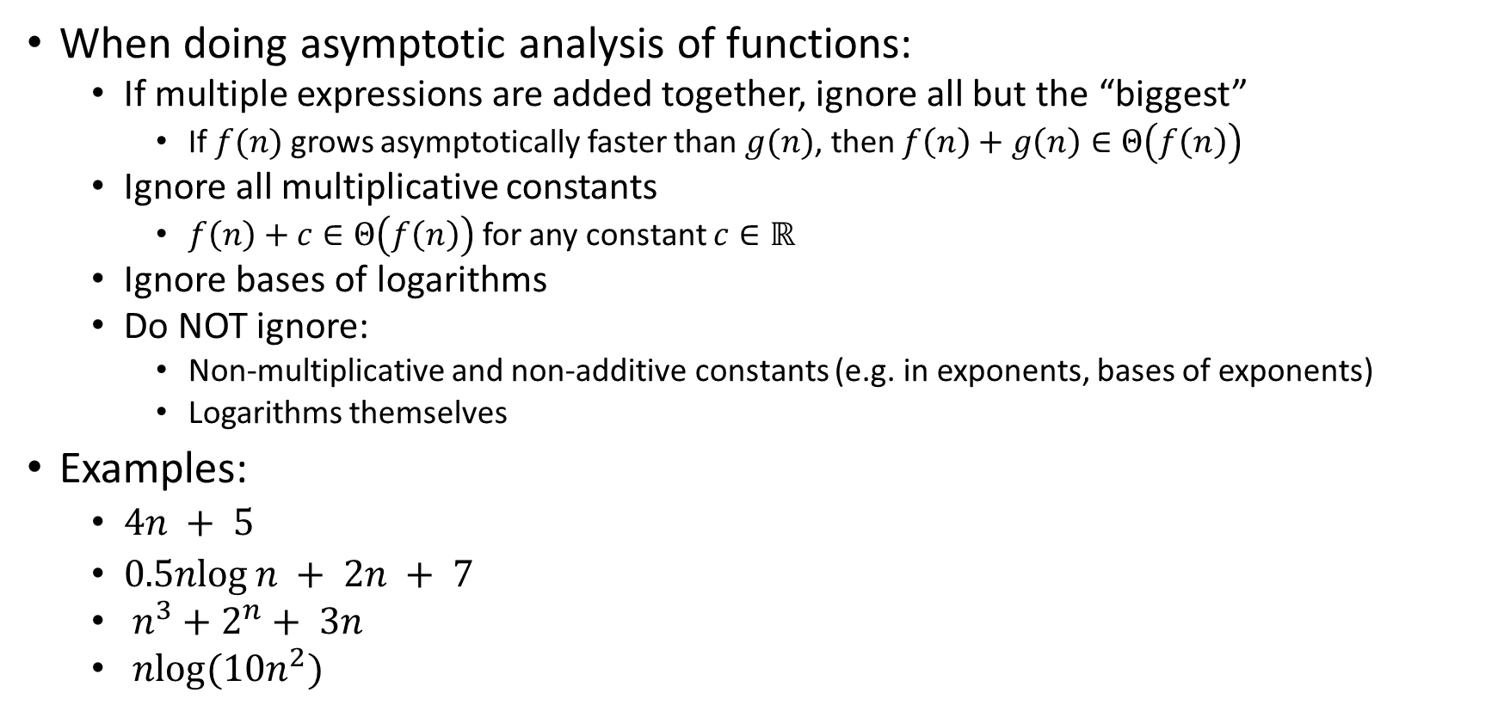
Gaining Intuition
When doing asymptotic analysis of functions:
  If multiple expressions are added together, ignore all but the “biggest”
    If $f(n)$ grows asymptotically faster than $g(n)$, then $f\left(n\right)+g\left(n\right)∈Θ\left(f\left(n\right)\right)$
  Ignore all multiplicative constants
    $f\left(n\right)+c∈Θ\left(f\left(n\right)\right)$ for any constant $c∈ℝ$
  Ignore bases of logarithms
  Do NOT ignore:
    Non-multiplicative and non-additive constants (e.g. in exponents, bases of exponents)
    Logarithms themselves
Examples:
  $4n + 5$
  $0.5nlog⁡n + 2n + 7$
  $n^{3}+2^{n}+ 3n$
  $nlog(10n^{2})$

Slide 30

More Examples
Is each of the following True or False?
  $4+3n∈ O(n)$
  $n+2\log{n}∈ O(\log{n})$
  $\log{n}+2∈ O(1)$
  $n^{50}∈ O({1.1}^{n})$
  $3^{n}∈Θ(2^{n})$

Slide 31

Common Categories
$O(1)$ “constant”
$O\left(\log{n}\right)$ “logarithmic”
$O\left(n\right)$ “linear”
$O\left(n\log{n}\right)$ “log-linear”
$O\left(n^{2}\right)$ “quadratic”
$O\left(n^{3}\right)$ “cubic”
$O\left(n^{k}\right)$ “polynomial”
$O\left(k^{n}\right)$ “exponential”

Slide 32
Defining your running time function
Worst-case complexity:
  max number of steps algorithm takes on “most challenging” input
Best-case complexity:
  min number of steps algorithm takes on “easiest” input
Average/expected complexity:
  avg number of steps algorithm takes on random inputs (context-dependent)
Amortized complexity:
  max total number of steps algorithm takes on M “most challenging” consecutive inputs, divided by M (i.e., divide the max total sum by M).

Slide 33
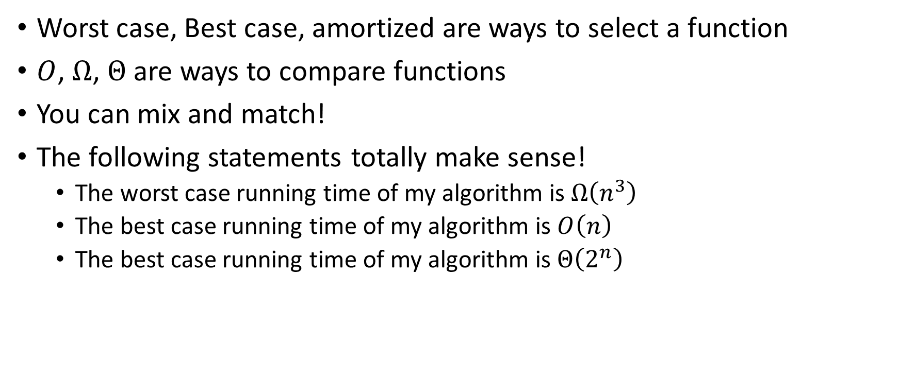
Beware!
Worst case, Best case, amortized are ways to select a function
$O$, $Ω$, $Θ$ are ways to compare functions
You can mix and match!
The following statements totally make sense!
  The worst case running time of my algorithm is $Ω\left(n^{3}\right)$
  The best case running time of my algorithm is $O\left(n\right)$
  The best case running time of my algorithm is $Θ\left(2^{n}\right)$

