Slide 1
CSE 332 Winter 2026 Lecture 11: hashing 2
Nathan Brunelle
http://www.cs.uw.edu/332

Slide 2

Dictionary (Map) ADT - Unordered
Contents:
Sets of key+value pairs
Keys must be comparable Keys have a hash function
Operations:
insert(key, value)
Adds the (key,value) pair into the dictionary
If the key already has a value, overwrite the old value
Consequence: Keys cannot be repeated
find(key)
Returns the value associated with the given key
delete(key)
Remove the key (and its associated value)

Slide 3
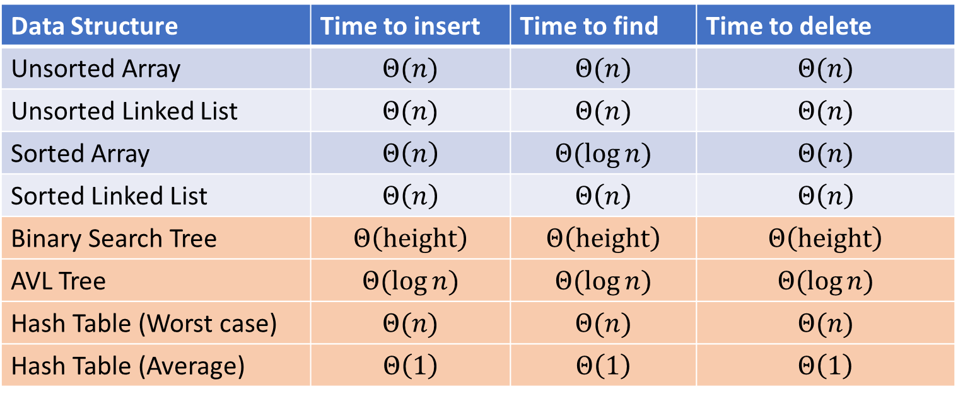

Next topic: Hash Tables
Data Structure | Time to insert | Time to find | Time to delete
Unsorted Array | $$Θ(n)$$ | $$Θ(n)$$ | $$Θ(n)$$
Unsorted Linked List | $$Θ(n)$$ | $$Θ(n)$$ | $$Θ(n)$$
Sorted Array | $$Θ\left(n\right)$$ | $$Θ(\log{n})$$ | $$Θ(n)$$
Sorted Linked List | $$Θ\left(n\right)$$ | $$Θ\left(n\right)$$ | $$Θ\left(n\right)$$
Binary Search Tree | $$Θ\left(height\right)$$ | $$Θ\left(height\right)$$ | $$Θ\left(height\right)$$
AVL Tree | $$Θ(\log{n})$$ | $$Θ(\log{n})$$ | $$Θ(\log{n})$$
Hash Table (Worst case) | $$Θ(n)$$ | $$Θ(n)$$ | $$Θ(n)$$
Hash Table (Average) | $$Θ\left(1\right)$$ | $$Θ\left(1\right)$$ | $$Θ\left(1\right)$$

Slide 4

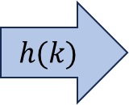
Hash Tables
Idea:
Have a small array to store information
Use a hash function to convert the key into an index
Hash function should “scatter” the keys, behave as if it randomly assigned keys to indices
Store key at the index given by the hash function
Do something if two keys map to the same place (should be very rare)
Collision resolution
Insert / find /
delete
$$h(k)$$
Some Integer
& value
Key Object

Slide 5
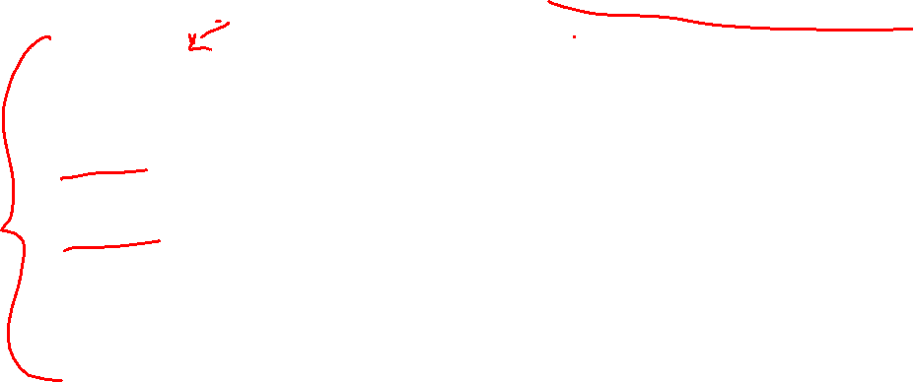
Properties of a “Good” Hash
Definition: A hash function maps objects to integers
Goal: A hash function should behave as if every key is assigned to a random index
Consistent
Objects considered “equal” should hash to the same value
Deterministic: running the hash function on the same object twice should yield the same result
Uniform
Should be able to use every index in a fixed-size array
Should use every index at roughly equal rates
Effective
It should be difficult to find two objects which hash to the same value
Given on object, it should be hard to find a different object which hashes to the same value
“Avalanche effect”: making a small change to the object yields big changes in the value it hashes to
Efficient
Time to calculate the hash should be very small

Slide 6
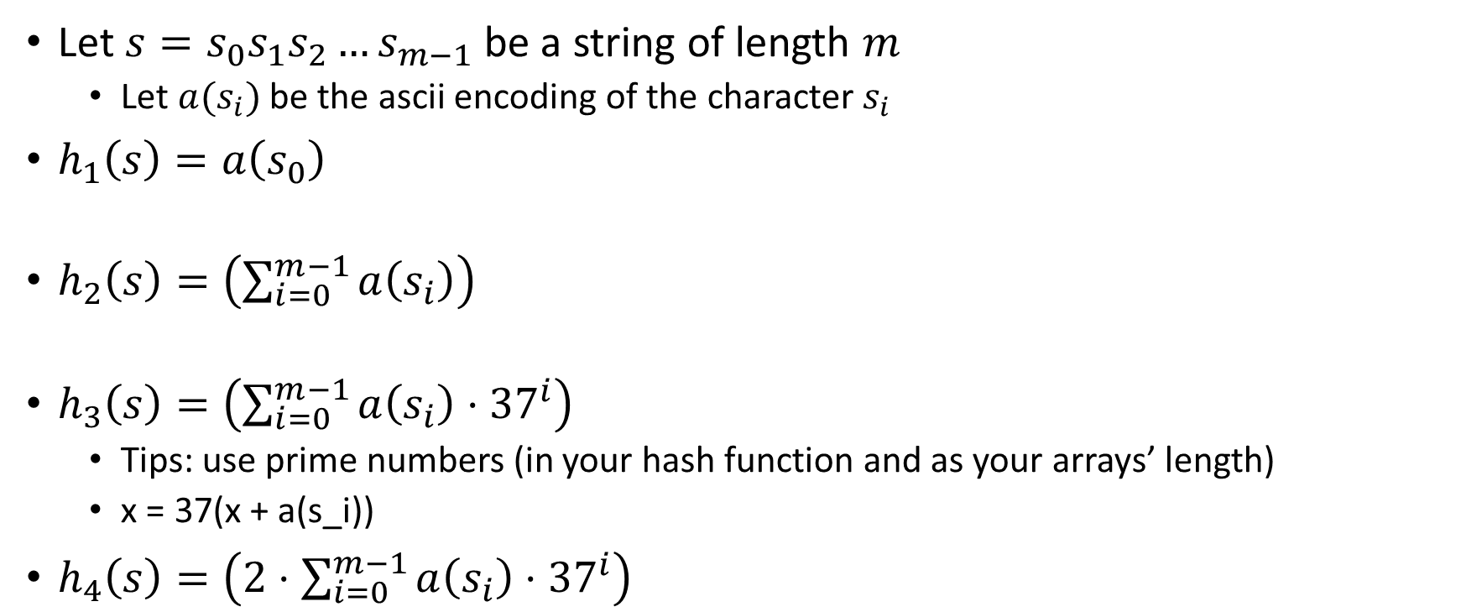
Compare These Hash Functions (for strings)
Let $s=s_{0}s_{1}s_{2}…s_{m−1}$ be a string of length $m$
Let $a(s_{i})$ be the ascii encoding of the character $s_{i}$
$h_{1}\left(s\right)=a\left(s_{0}\right)$
$h_{2}\left(s\right)=\left(\sum_{i=0}^{m−1}{a\left(s_{i}\right)}\right)$
$h_{3}\left(s\right)=\left(\sum_{i=0}^{m−1}{a\left(s_{i}\right)⋅{37}^{i}}\right)$
Tips: use prime numbers (in your hash function and as your arrays’ length)
x = 37(x + a(s_i))
$h_{4}\left(s\right)=\left(2⋅\sum_{i=0}^{m−1}{a\left(s_{i}\right)⋅{37}^{i}}\right)$

Slide 7
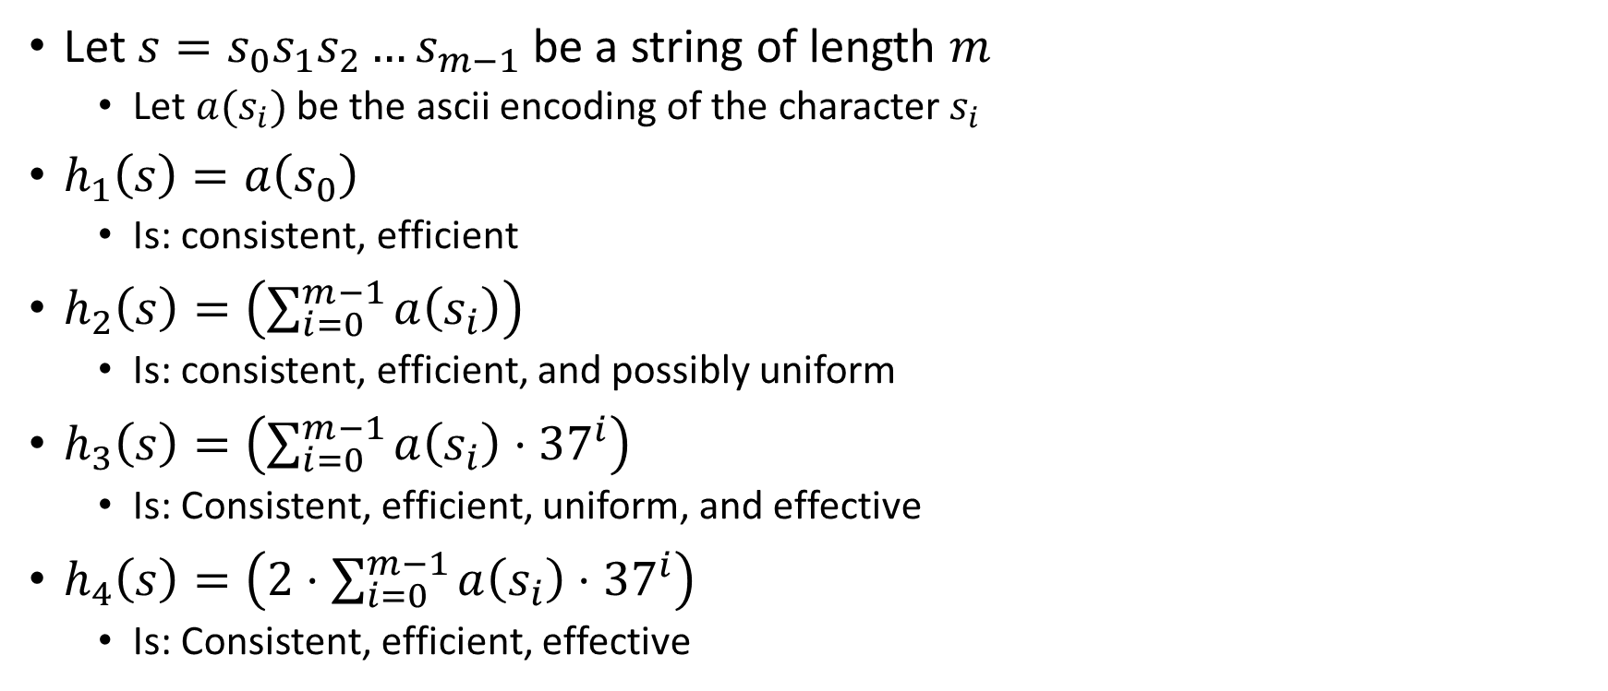
Properties of Those Example Hash Functions
Let $s=s_{0}s_{1}s_{2}…s_{m−1}$ be a string of length $m$
Let $a(s_{i})$ be the ascii encoding of the character $s_{i}$
$h_{1}\left(s\right)=a\left(s_{0}\right)$
Is: consistent, efficient
$h_{2}\left(s\right)=\left(\sum_{i=0}^{m−1}{a\left(s_{i}\right)}\right)$
Is: consistent, efficient, and possibly uniform
$h_{3}\left(s\right)=\left(\sum_{i=0}^{m−1}{a\left(s_{i}\right)⋅{37}^{i}}\right)$
Is: Consistent, efficient, uniform, and effective
$h_{4}\left(s\right)=\left(2⋅\sum_{i=0}^{m−1}{a\left(s_{i}\right)⋅{37}^{i}}\right)$
Is: Consistent, efficient, effective

Slide 8

Ideal Insert procedure
Supposing we have a “good” hash function:
insert(key, value){
h = key.hash();
table[h % table.length] = value;
}
Problem: It’s possible that two different keys map to the same index!
This is called a “collision”

Slide 9
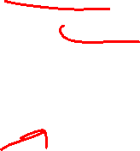
Collision Resolution
A Collision occurs when we want to insert something into an already-occupied position in the hash table
2 main strategies:
Separate Chaining
Use a secondary data structure to contain the items
E.g. each index in the hash table is itself a linked list
Open Addressing
Use a different spot in the table instead
Linear Probing
Quadratic Probing
Double Hashing
0
1
2
3
4
5
6
7
8
9

Slide 10
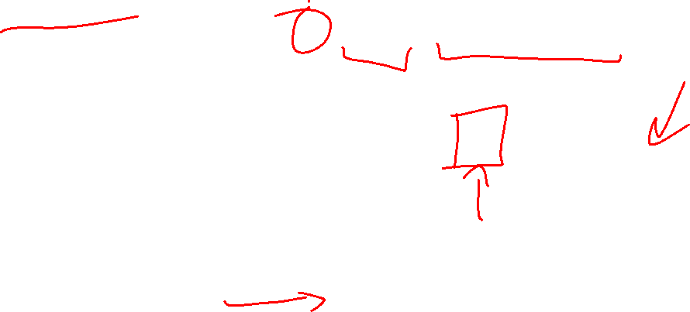
Separate Chaining Insert
To insert k, v:
Compute the index using i = h(k) % table.length
Add the key-value pair to the data structure at table[i]
k,v
k,v
k,v
0
1
2
3
4
5
6
7
8
9

Slide 11
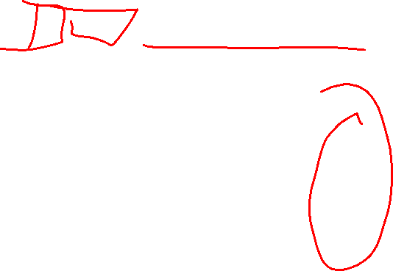
Separate Chaining Find
To find k:
Compute the index using i = h(k) % table.length
Call find with the key on the data structure at table[i]
k,v
k,v
k,v
0
1
2
3
4
5
6
7
8
9

Slide 12
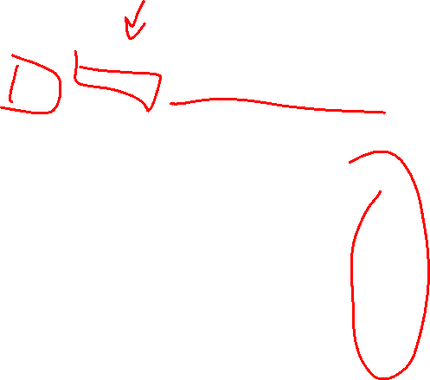
Separate Chaining Delete
To delete k:
Compute the index using i = h(k) % table.length
Call delete with the key on the data structure at table[i]
k,v
k,v
k,v
0
1
2
3
4
5
6
7
8
9

Slide 13
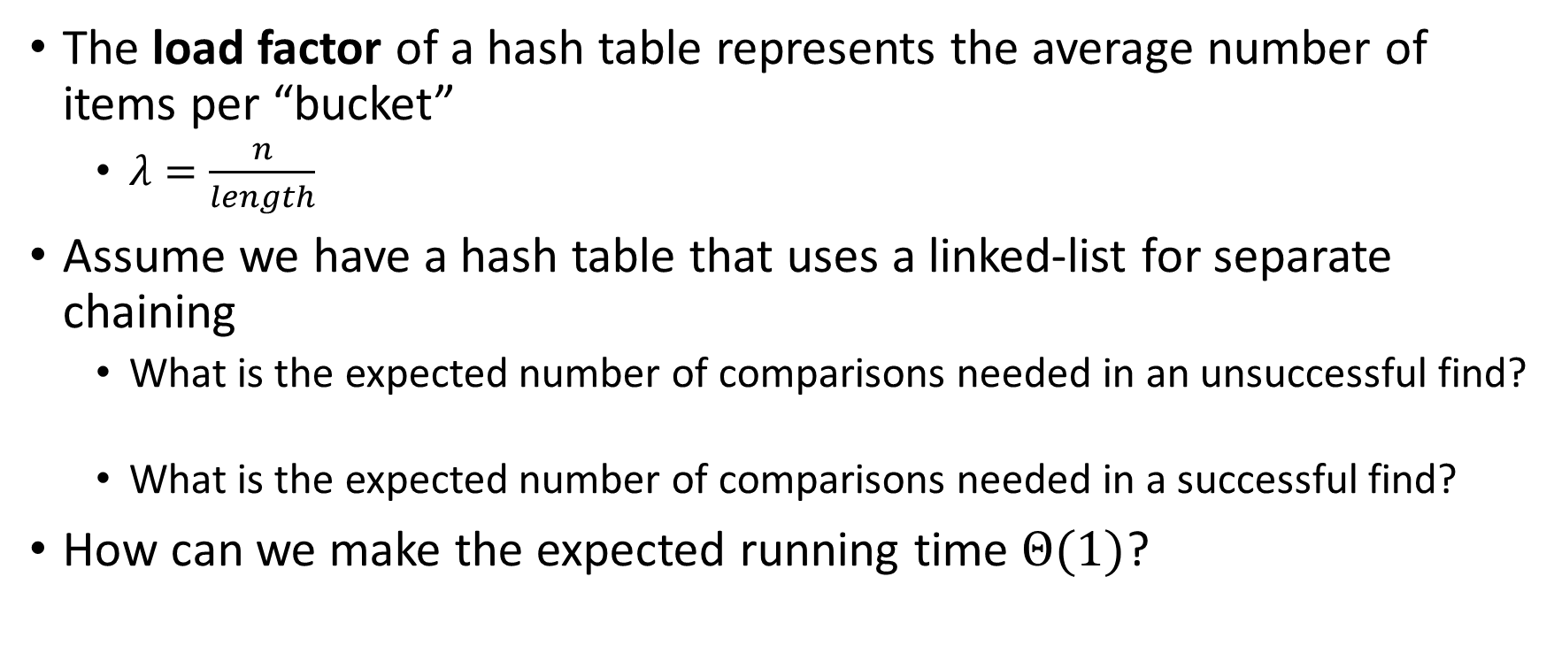
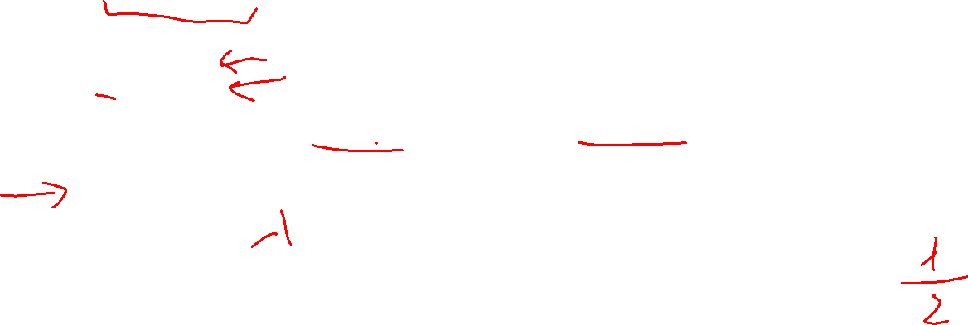
Formal Running Time Analysis
The load factor of a hash table represents the average number of items per “bucket”
$λ=\frac{n}{length}$
Assume we have a hash table that uses a linked-list for separate chaining
What is the expected number of comparisons needed in an unsuccessful find?
What is the expected number of comparisons needed in a successful find?
How can we make the expected running time $Θ(1)$?

Slide 14
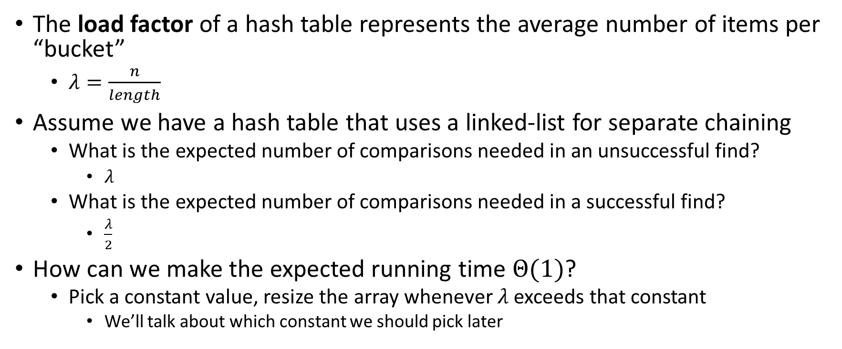

Formal Running Time Analysis (Answers)
The load factor of a hash table represents the average number of items per “bucket”
$λ=\frac{n}{length}$
Assume we have a hash table that uses a linked-list for separate chaining
What is the expected number of comparisons needed in an unsuccessful find?
$λ$
What is the expected number of comparisons needed in a successful find?
$\frac{λ}{2}$
How can we make the expected running time $Θ(1)$?
Pick a constant value, resize the array whenever $λ$ exceeds that constant
We’ll talk about which constant we should pick later

Slide 15


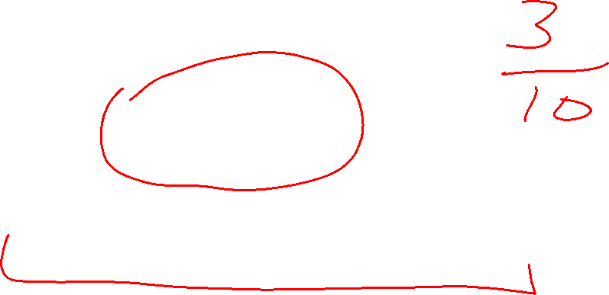

Load Factor Example 1
$$k,v$$
$$k,v$$
$$k,v$$
0
1
2
3
4
5
6
7
8
9

Slide 16



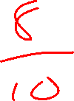


Load Factor Example 2
$$k,v$$
$$k,v$$
$$k,v$$
$$k,v$$
$$k,v$$
$$k,v$$
$$k,v$$
$$k,v$$
0
1
2
3
4
5
6
7
8
9

Slide 17

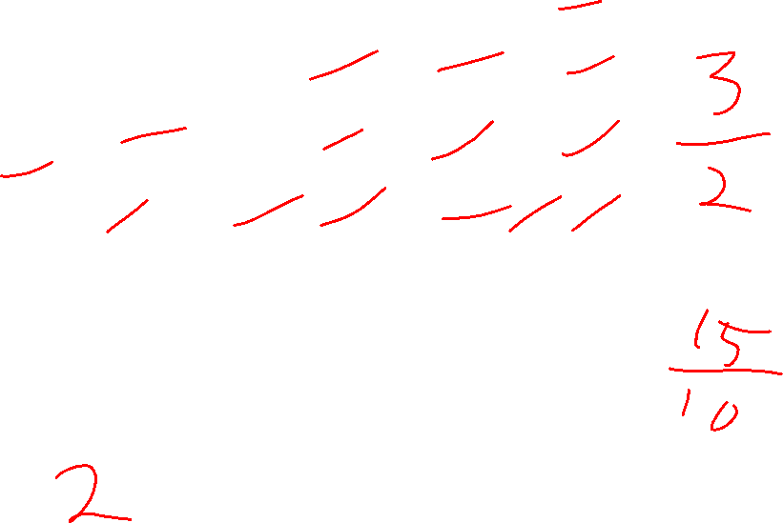






Load Factor Example 3
$$k,v$$
$$k,v$$
$$k,v$$
$$k,v$$
$$k,v$$
$$k,v$$
$$k,v$$
$$k,v$$
$$k,v$$
$$k,v$$
$$k,v$$
$$k,v$$
$$k,v$$
$$k,v$$
$$k,v$$
0
1
2
3
4
5
6
7
8
9

Slide 18
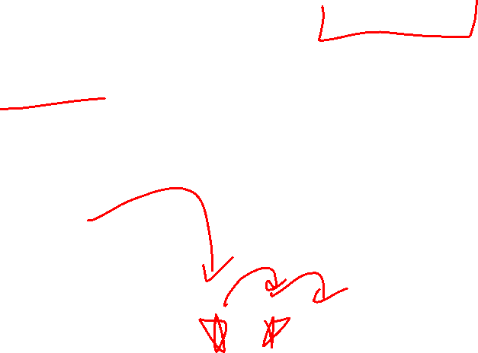
Collision Resolution: Linear Probing
When there’s a collision, use the next open space in the table
0
1
2
3
4
5
6
7
8
9

Slide 19
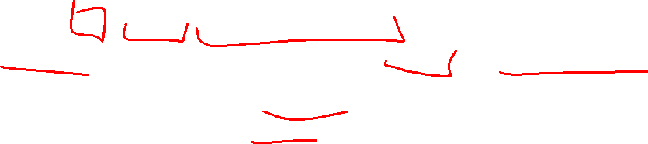
Linear Probing: Insert Procedure
To insert k,v
Calculate i = h(k) % table.length
If table[i] is occupied then try index (i+1) % table.length
If that is occupied try index (i+2) % table.length
If that is occupied try index (i+3) % table.length
…
0
1
2
3
4
5
6
7
8
9

Slide 20
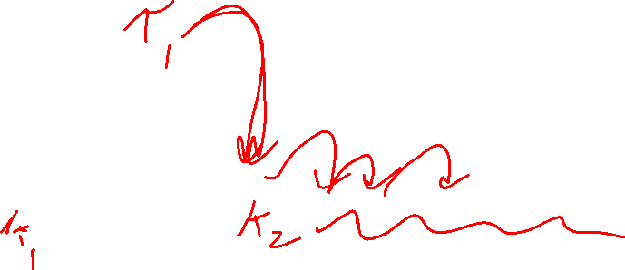
Linear Probing: How to find?
What do you think?
0
1
2
3
4
5
6
7
8
9

Slide 21
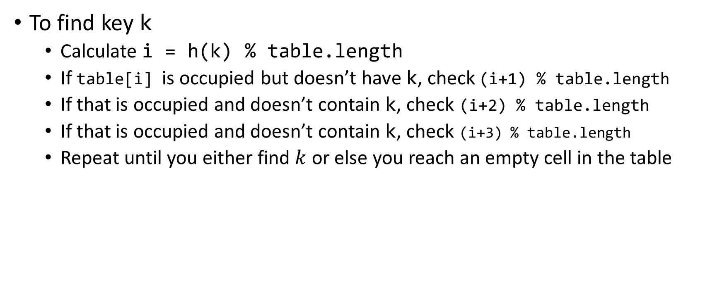
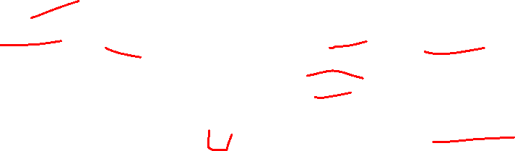
Linear Probing: Find
To find key k
Calculate i = h(k) % table.length
If table[i] is occupied but doesn’t have k, check (i+1) % table.length
If that is occupied and doesn’t contain k, check (i+2) % table.length
If that is occupied and doesn’t contain k, check (i+3) % table.length
Repeat until you either find $k$ or else you reach an empty cell in the table
0
1
2
3
4
5
6
7
8
9

Slide 22
Linear Probing: Delete is Hard (Example 1)
Suppose we insert A, B, C, D, and E in that order, where all map to 3
How should we delete B?
Before:
A
B
C
D
E
0
1
2
3
4
5
6
7
8
9
We need future probing to work correctly, so we must fill in the hole.
After:
A
C
D
E
0
1
2
3
4
5
6
7
8
9

Slide 23
Linear Probing: Delete is Hard (Example 2)
Suppose we insert A, B, C, D, and E in that order, where A,B,E all map to 3 and C,D map to 5.
How should we delete B?
Before:
A
B
C
D
E
0
1
2
3
4
5
6
7
8
9
We need future probing to work correctly, so we must fill in the hole.
We cannot move C or D over because they map to an index later in the probe path
After:
A
E
C
D
0
1
2
3
4
5
6
7
8
9

Slide 24
Linear Probing: Delete is Hard (Example 3)
Suppose we insert A, B, C, D, and E in that order, where A,B,E map to 8 and C,D map to 0.
How should we delete B?
Before:
C
D
E
A
B
0
1
2
3
4
5
6
7
8
9
We cannot move C or D over because they map to an index later in the probe path, even though the index number happens to be smaller. E moves to a larger index because it’s earlier in its probe path
After:
C
D
A
E
0
1
2
3
4
5
6
7
8
9

Slide 25


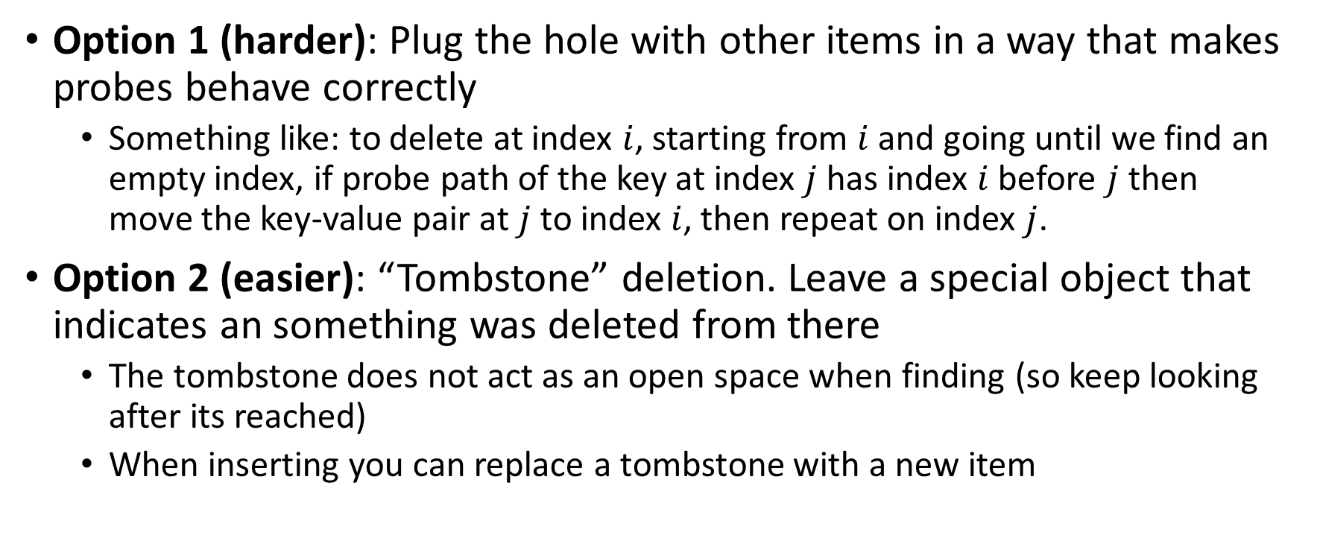
Linear Probing: Delete
Option 1 (harder): Plug the hole with other items in a way that makes probes behave correctly
Something like: to delete at index $i$, starting from $i$ and going until we find an empty index, if probe path of the key at index $j$ has index $i$ before $j$ then move the key-value pair at $j$ to index $i$, then repeat on index $j$.
Option 2 (easier): “Tombstone” deletion. Leave a special object that indicates an something was deleted from there
The tombstone does not act as an open space when finding (so keep looking after its reached)
When inserting you can replace a tombstone with a new item
$$k,v$$
$$k,v$$
$$k,v$$
$$k,v$$
0
1
2
3
4
5
6
7
8
9

Slide 26
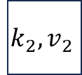
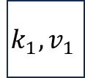
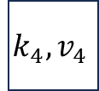

Linear Probing + Tombstone: Find
To find key k
Calculate i = h(k) % table.length
While table[i] has a key other than k, set i = (i+1) % table.length
If you come across k return table[i]
If you come across an empty index, the find was unsuccessful
Tombstones do not count as empty!
$$k_{1},v_{1}$$
$$k_{2},v_{2}$$
$$k_{3},v_{3}$$
$$k_{4},v_{4}$$
0
1
2
3
4
5
6
7
8
9

Slide 27
Linear Probing + Tombstone: Insert
To insert k,v
Calculate i = h(k) % table.length
While table[i] has a key other than k, set i = (i+1) % table.length
If table[i] has a tombstone, set dest = i
That is where we will insert if the find is unsuccessful
If you come across k, set table[i] = k,v
If you come across an empty index, the find was unsuccessful
Set table[x] = k,v if we saw a tombstone
Set table[x] = k,v otherwise
$$k_{1},v_{1}$$
$$k_{2},v_{2}$$
$$k_{3},v_{3}$$
$$k_{4},v_{4}$$
0
1
2
3
4
5
6
7
8
9

Slide 28
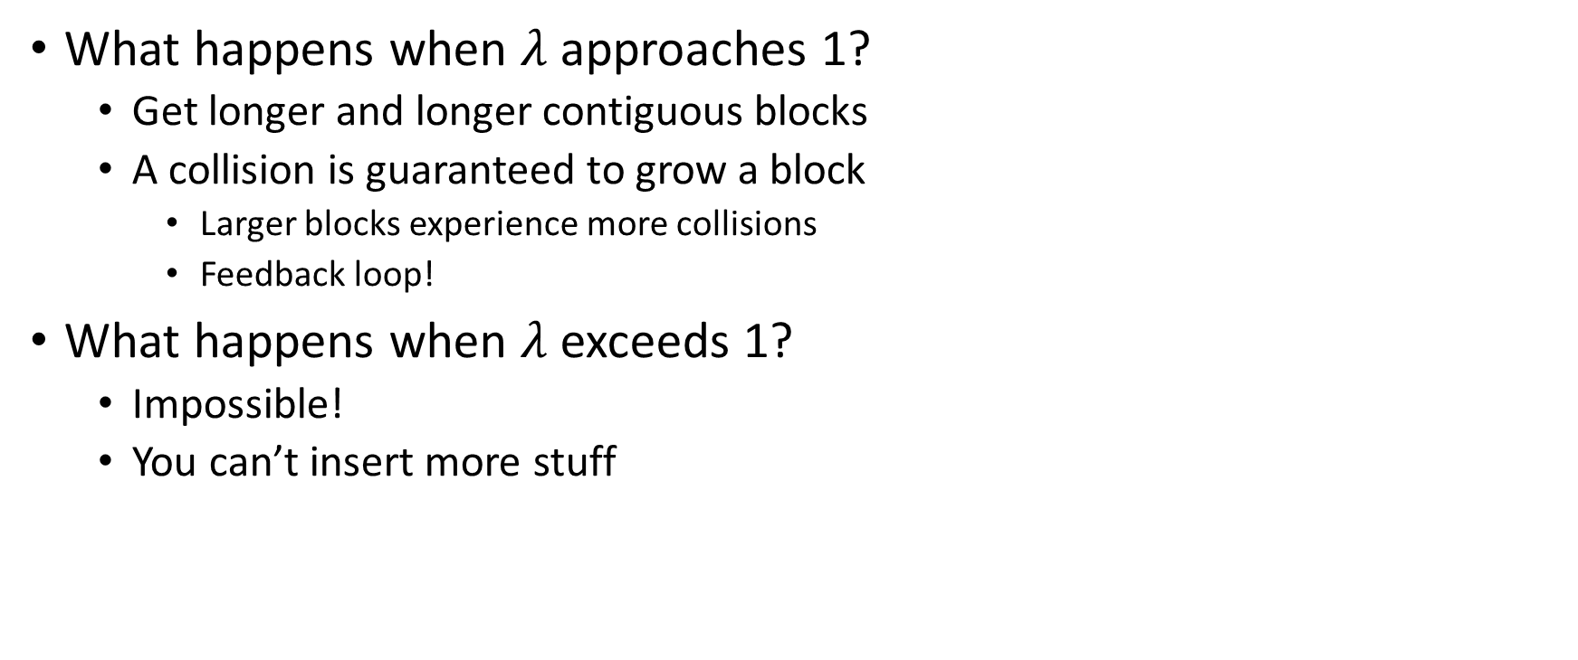
Downsides of Linear Probing
What happens when $λ$ approaches 1?
Get longer and longer contiguous blocks
A collision is guaranteed to grow a block
Larger blocks experience more collisions
Feedback loop!
What happens when $λ$ exceeds 1?
Impossible!
You can’t insert more stuff

Slide 29
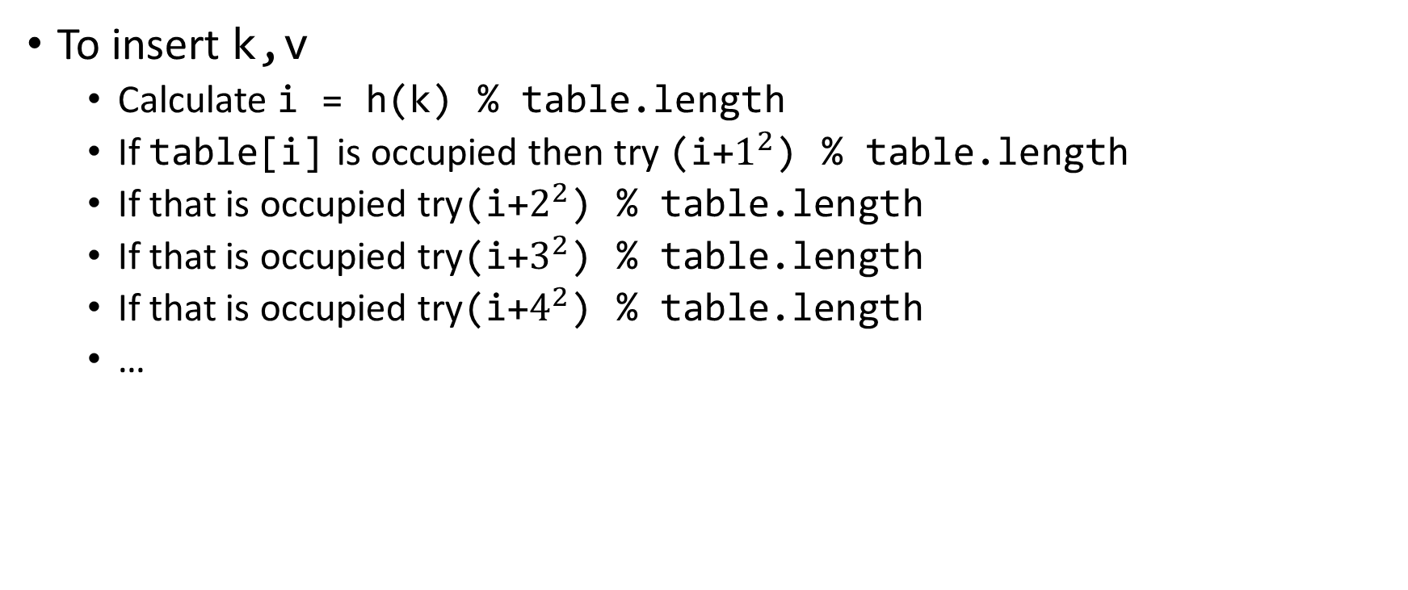
Quadratic Probing: Insert Procedure
To insert k,v
Calculate i = h(k) % table.length
If table[i] is occupied then try (i+$1^{2}$) % table.length
If that is occupied try(i+$2^{2}$) % table.length
If that is occupied try(i+$3^{2}$) % table.length
If that is occupied try(i+$4^{2}$) % table.length
…
0
1
2
3
4
5
6
7
8
9

Slide 30
Quadratic Probing: Example
Insert:
76
40
48
5
55
47
0
1
2
3
4
5
6

Slide 31
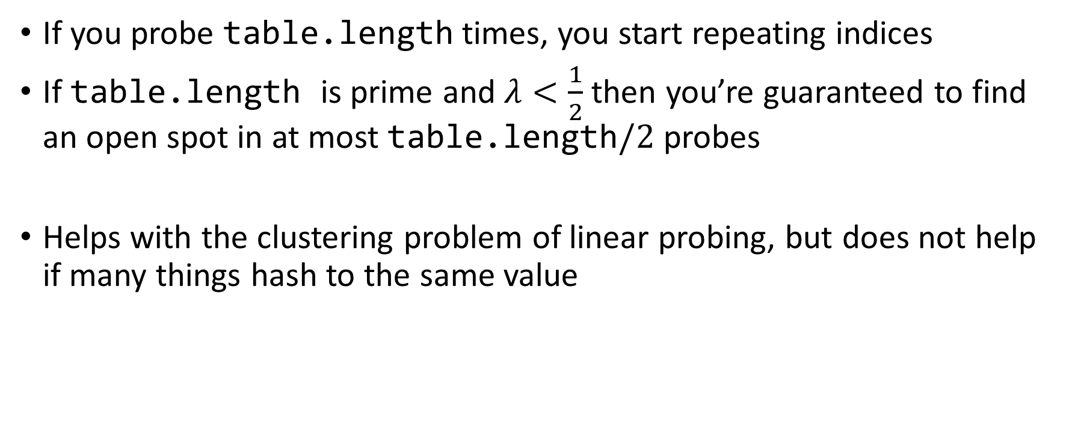
Using Quadratic Probing
If you probe table.length times, you start repeating indices
If table.length is prime and $λ<\frac{1}{2}$ then you’re guaranteed to find an open spot in at most table.length$/2$ probes
Helps with the clustering problem of linear probing, but does not help if many things hash to the same value

Slide 32
Double Hashing: Insert Procedure
Given h and g are both good hash functions
To insert k,v
Calculate i = h(k) % table.length
If table[i] is occupied then try (i+g(k)) % table.length
If that is occupied try (i+2*g(k)) % table.length
If that is occupied try (i+3*g(k)) % table.length
If that is occupied try (i+4*g(k)) % table.length
…
0
1
2
3
4
5
6
7
8
9

