Slide 1
CSE 332 Winter 2026
Lecture 12: Sorting
Nathan Brunelle
http://www.cs.uw.edu/332

Slide 2
Collision Resolution
A Collision occurs when we want to insert something into an already-occupied position in the hash table
2 main strategies:
  Separate Chaining
    Use a secondary data structure to contain the items
      E.g. each index in the hash table is itself a linked list
  Open Addressing
    Use a different spot in the table instead
      Linear Probing
      Quadratic Probing
      Double Hashing
0
1
2
3
4
5
6
7
8
9

Slide 3
Collision Resolution: Linear Probing
When there’s a collision, use the next open space in the table
0
1
2
3
4
5
6
7
8
9

Slide 4
Linear Probing: Insert Procedure
To insert k,v
  Calculate i = h(k) % table.length
  If table[i] is occupied then try index (i+1) % table.length
  If that is occupied try index (i+2) % table.length
  If that is occupied try index (i+3) % table.length
  …
0
1
2
3
4
5
6
7
8
9

Slide 5
Linear Probing: How to find?
What do you think?
0
1
2
3
4
5
6
7
8
9

Slide 6
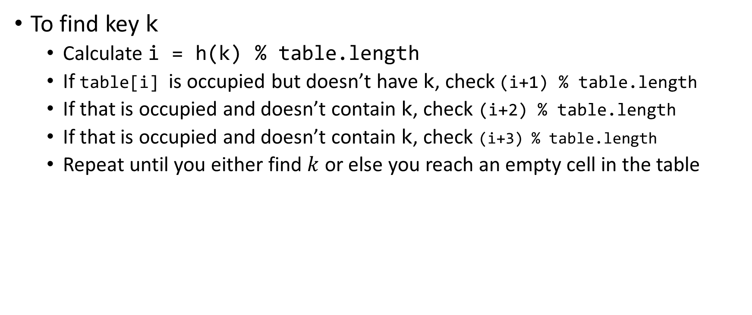
Linear Probing: Find
To find key k
  Calculate i = h(k) % table.length
  If table[i] is occupied but doesn’t have k, check (i+1) % table.length
  If that is occupied and doesn’t contain k, check (i+2) % table.length
  If that is occupied and doesn’t contain k, check (i+3) % table.length
  Repeat until you either find $k$ or else you reach an empty cell in the table
0
1
2
3
4
5
6
7
8
9

Slide 7
Linear Probing: Delete is Hard (Example 1)
Suppose we insert A, B, C, D, and E in that order, where all map to 3
How should we delete B?
Before:
A
B
C
D
E
0
1
2
3
4
5
6
7
8
9
We need future probing to work correctly, so we must fill in the hole.
After:
A
C
D
E
0
1
2
3
4
5
6
7
8
9

Slide 8
Linear Probing: Delete is Hard (Example 2)
Suppose we insert A, B, C, D, and E in that order, where A,B,E all map to 3 and C,D map to 5.
How should we delete B?
Before:
A
B
C
D
E
0
1
2
3
4
5
6
7
8
9
We need future probing to work correctly, so we must fill in the hole.
We cannot move C or D over because they map to an index later in the probe path
After:
A
E
C
D
0
1
2
3
4
5
6
7
8
9

Slide 9
Linear Probing: Delete is Hard (Example 3)
Suppose we insert A, B, C, D, and E in that order, where A,B,E map to 8 and C,D map to 0.
How should we delete B?
Before:
C
D
E
A
B
0
1
2
3
4
5
6
7
8
9
We cannot move C or D over because they map to an index later in the probe path, even though the index number happens to be smaller.
E moves to a larger index because it’s earlier in its probe path
After:
C
D
A
E
0
1
2
3
4
5
6
7
8
9

Slide 10


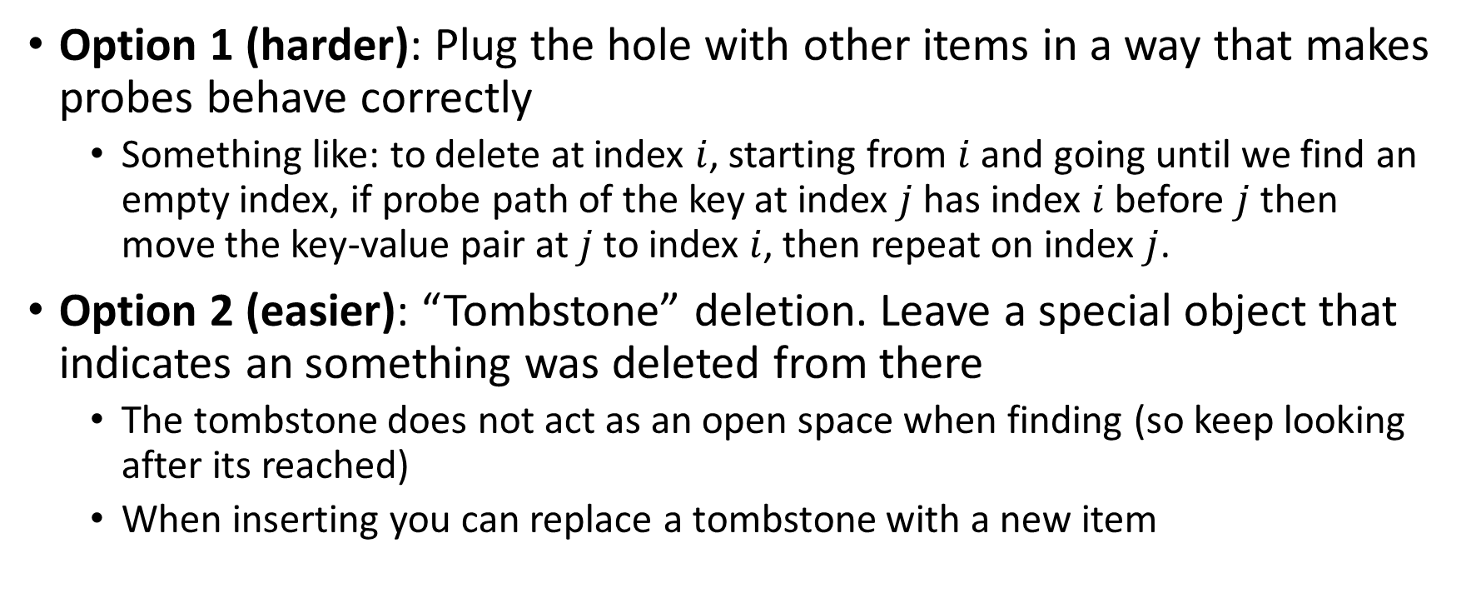
Linear Probing: Delete
Option 1 (harder): Plug the hole with other items in a way that makes probes behave correctly
  Something like: to delete at index $i$, starting from $i$ and going until we find an empty index, if probe path of the key at index $j$ has index $i$ before $j$ then move the key-value pair at $j$ to index $i$, then repeat on index $j$.
Option 2 (easier): “Tombstone” deletion. Leave a special object that indicates an something was deleted from there
  The tombstone does not act as an open space when finding (so keep looking after its reached)
  When inserting you can replace a tombstone with a new item
$$k,v$$
$$k,v$$
$$k,v$$
$$k,v$$
0
1
2
3
4
5
6
7
8
9

Slide 11
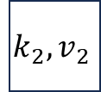
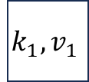
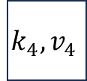

Linear Probing + Tombstone: Find
To find key k
  Calculate i = h(k) % table.length
  While table[i] has a key other than k, set i = (i+1) % table.length
  If you come across k return table[i]
  If you come across an empty index, the find was unsuccessful
    Tombstones do not count as empty!
$$k_{1},v_{1}$$
$$k_{2},v_{2}$$
$$k_{3},v_{3}$$
$$k_{4},v_{4}$$
0
1
2
3
4
5
6
7
8
9

Slide 12
Linear Probing + Tombstone: Insert
To insert k,v
  Calculate i = h(k) % table.length
  While table[i] has a key other than k, set i = (i+1) % table.length
    If table[i] has a tombstone, set dest = i
      That is where we will insert if the find is unsuccessful
    If you come across k, set table[i] = k,v
    If you come across an empty index, the find was unsuccessful
      Set table[x] = k,v if we saw a tombstone
    Set table[x] = k,v otherwise
$$k_{1},v_{1}$$
$$k_{2},v_{2}$$
$$k_{3},v_{3}$$
$$k_{4},v_{4}$$
0
1
2
3
4
5
6
7
8
9

Slide 13
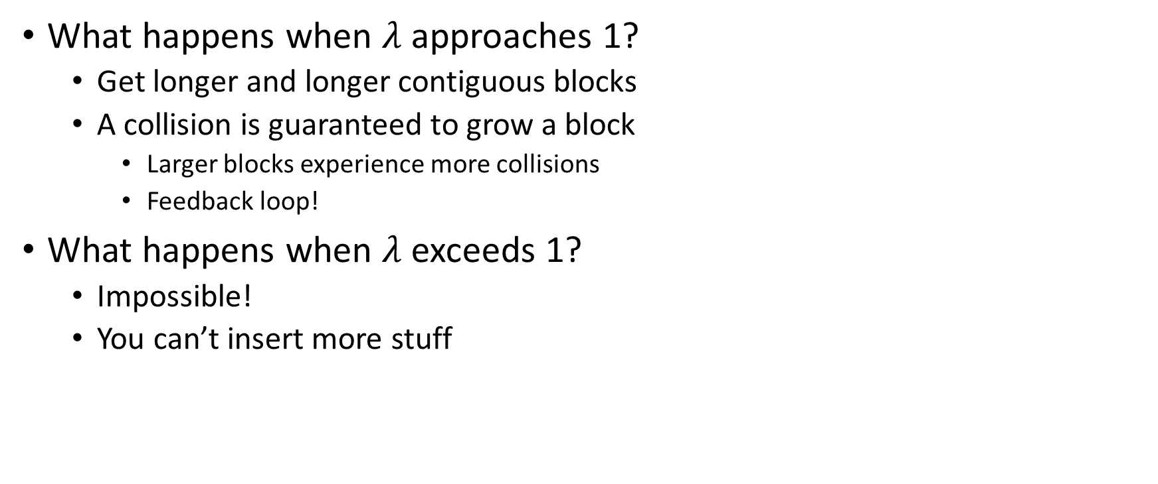
Downsides of Linear Probing
What happens when $λ$ approaches 1?
  Get longer and longer contiguous blocks
  A collision is guaranteed to grow a block
    Larger blocks experience more collisions
    Feedback loop!
What happens when $λ$ exceeds 1?
  Impossible!
  You can’t insert more stuff

Slide 14
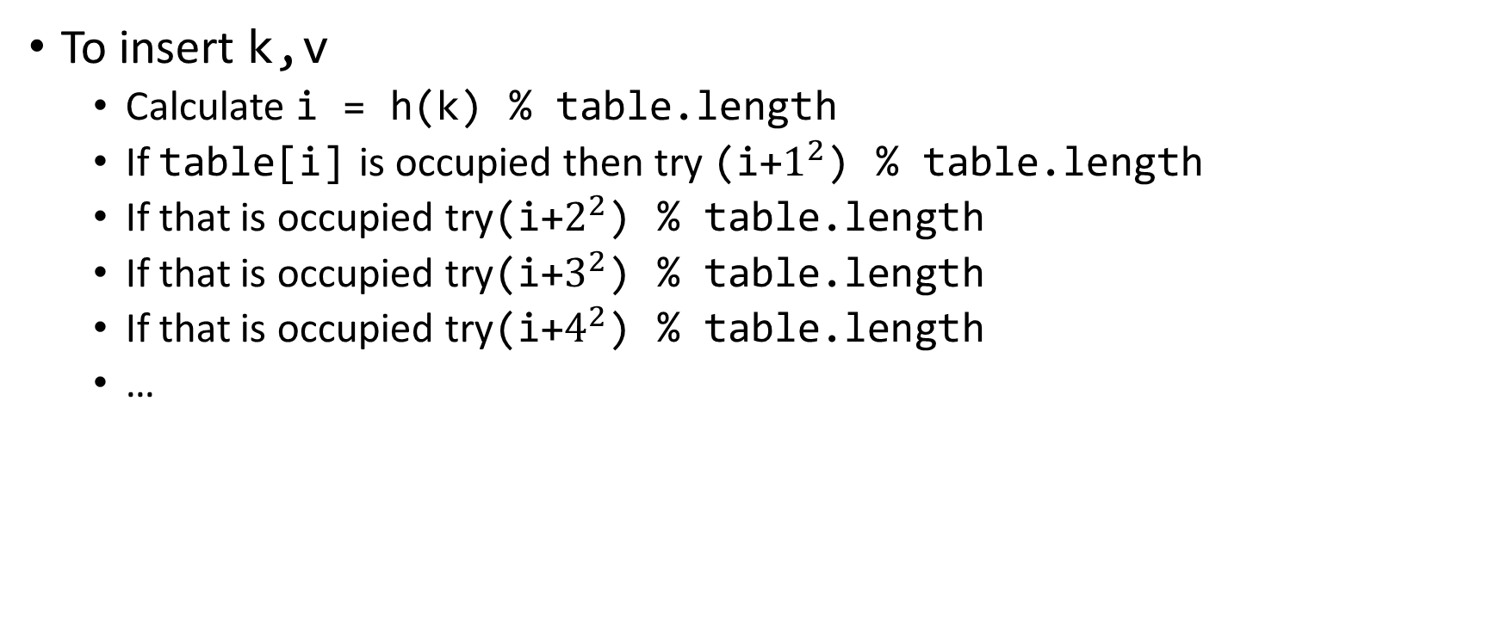
Quadratic Probing: Insert Procedure
To insert k,v
  Calculate i = h(k) % table.length
  If table[i] is occupied then try (i+$1^{2}$) % table.length
  If that is occupied try(i+$2^{2}$) % table.length
  If that is occupied try(i+$3^{2}$) % table.length
  If that is occupied try(i+$4^{2}$) % table.length
  …
0
1
2
3
4
5
6
7
8
9

Slide 15
Quadratic Probing: Example
Insert:
  76
  40
  48
  5
  55
  47
0
1
2
3
4
5
6

Slide 16
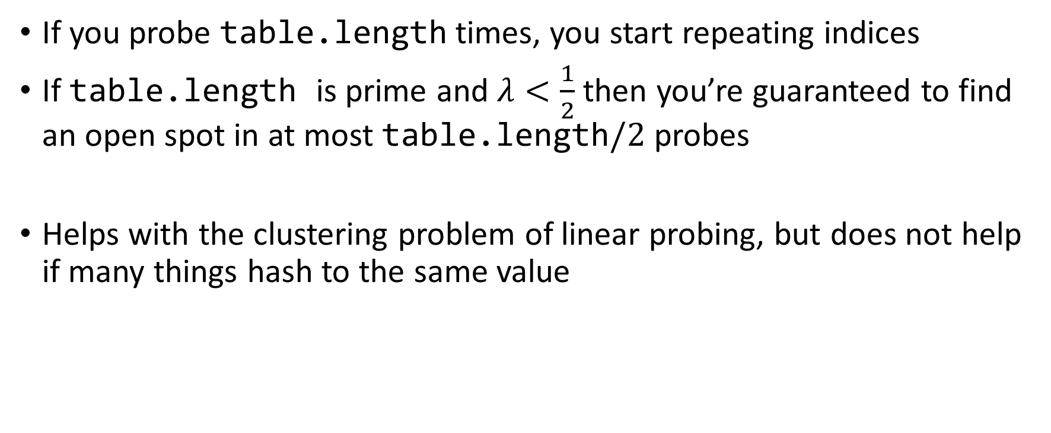
Using Quadratic Probing
If you probe table.length times, you start repeating indices
If table.length is prime and $λ<\frac{1}{2}$ then you’re guaranteed to find an open spot in at most table.length$/2$ probes
Helps with the clustering problem of linear probing, but does not help if many things hash to the same value

Slide 17
Double Hashing: Insert Procedure
Given h and g are both good hash functions
To insert k,v
  Calculate i = h(k) % table.length
  If table[i] is occupied then try (i+g(k)) % table.length
  If that is occupied try (i+2*g(k)) % table.length
  If that is occupied try (i+3*g(k)) % table.length
  If that is occupied try (i+4*g(k)) % table.length
  …
0
1
2
3
4
5
6
7
8
9

Slide 18
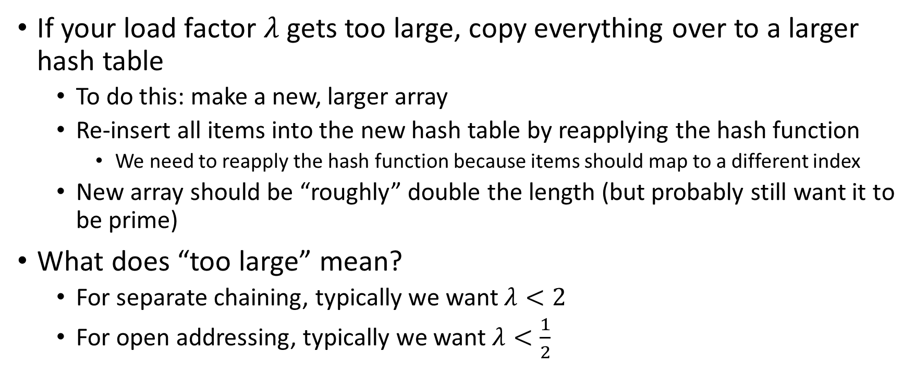
Rehashing
If your load factor $λ$ gets too large, copy everything over to a larger hash table
  To do this: make a new, larger array
  Re-insert all items into the new hash table by reapplying the hash function
    We need to reapply the hash function because items should map to a different index
  New array should be “roughly” double the length (but probably still want it to be prime)
What does “too large” mean?
  For separate chaining, typically we want $λ<2$
  For open addressing, typically we want $λ<\frac{1}{2}$

Slide 19
Sorting
Rearrangement of items into some defined sequence
  Usually: reordering a list from smallest to largest according to some metric
Why sort things?
  Enable things like binary search
    It makes some algorithms faster
  Nicer for human algorithms too
  Data organization

Slide 20
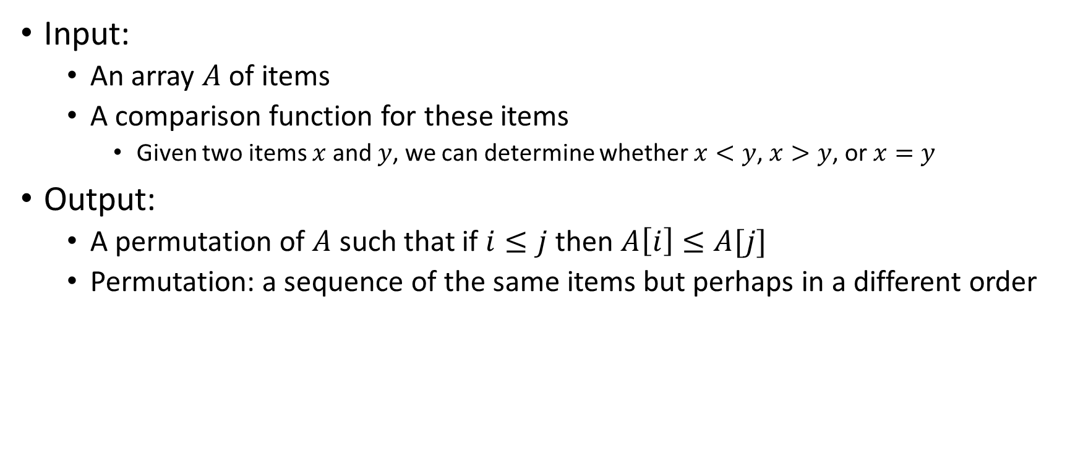
More Formal Definition
Input:
  An array $A$ of items
  A comparison function for these items
    Given two items $x$ and $y$, we can determine whether $x<y$, $x>y$, or $x=y$
Output:
  A permutation of $A$ such that if $i≤j$ then $A\left[i\right]≤A[j]$
  Permutation: a sequence of the same items but perhaps in a different order

Slide 21
Sorting “Landscape”
There is no singular best algorithm for sorting
Some are faster, some are slower
Some use more memory, some use less
Some are super extra fast if your data matches particular assumptions
Some have other special properties that make them valuable
No sorting algorithm can have only all the “best” attributes

Slide 22
Insertion Sort
Idea: Maintain a sorted list prefix, extend that prefix by “inserting” the next element
Sorted Prefix
3
5
7
8
10
12
9
2
4
6
1
11
3
5
7
8
10
9
12
2
4
6
1
11
3
5
7
8
9
10
12
2
4
6
1
11
Sorted Prefix
3
5
7
8
9
10
12
2
4
6
1
11

Slide 23
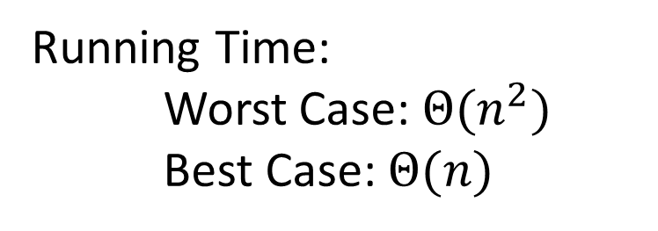
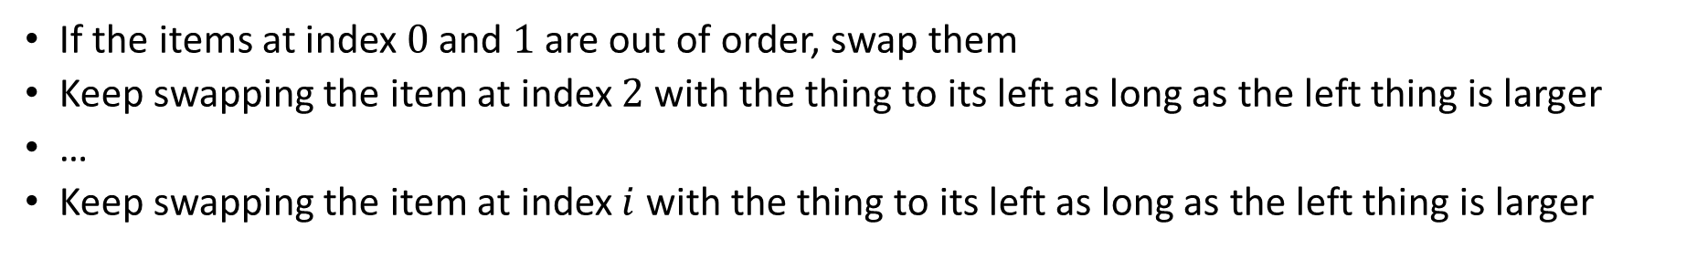
Insertion Sort
If the items at index $0$ and $1$ are out of order, swap them
Keep swapping the item at index $2$ with the thing to its left as long as the left thing is larger
…
Keep swapping the item at index $i$ with the thing to its left as long as the left thing is larger
for (i=1; i<a.length; i++){
prev = i-1;
while(a[i] < a[prev] && prev > -1){
temp = a[i];
a[i] = a[prev];
a[prev] = a[i];
i--;
prev--;
}
}
Running Time:
Worst Case: $Θ(n^{2})$
Best Case: $Θ(n)$
10
77
5
15
2
22
64
41
18
19
30
21
3
24
23
33
0
1
2
3
4
5
6
7
8
9
10
11
12
13
14
15

Slide 24
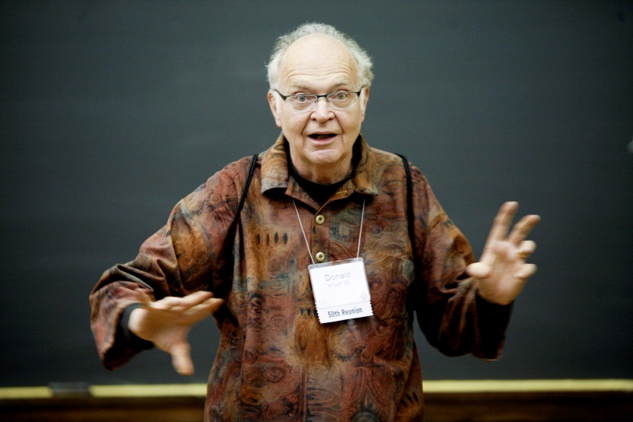
Aside: Bubble Sort – we won’t cover it
"the bubble sort seems to have nothing to recommend it, except a catchy name and the fact that it leads to some interesting theoretical problems” –Donald Knuth, The Art of Computer Programming

Slide 25
Heap Sort
Idea: Build a maxHeap, repeatedly extract the max element from the heap to build sorted list Right-to-Left
10
9
0
6
Max Heap Property: Each node is larger than its children
8
1
7
5
2
2
3
4
5
6
4
1
3
7
8
9
10
9
6
8
7
5
2
4
1
3
0
1
2
3
4
5
6
7
8
9

Slide 26

Building a Heap From “Scratch”
Suppose we had $n$ items and wanted to “heapify” them
5
6
10
3
15
8
7
14
2
1
5
1
2
3
4
5
6
7
8
9
10
Violate Heap Property!
0
6
10
3
1
15
8
2
7
Two ways for “fix” the heap:
Percolate Up
Percolate Down
3
4
5
6
14
2
1
7
8
9

Slide 27
Floyd’s buildHeap method
Working towards the root, one row at a time, percolate down
buildHeap(){
for(int i = size; i>0; i--){
percolateDown(i);
}
}

Slide 28
Floyd’s buildHeap method (Percolate 15)
Suppose we had $n$ items and wanted to “heapify” them
5
6
10
3
15
8
7
14
2
1
Violate Heap Property!
Nodes bigger than a child
5
1
2
3
4
5
6
7
8
9
10
0
6
10
buildHeap(){
for(int i = size; i>0; i--){
percolateDown(i);
}
}
3
1
15
8
2
7
3
4
5
6
14
2
1
7
8
9

Slide 29
Floyd’s buildHeap method (Percolate 3)
Suppose we had $n$ items and wanted to “heapify” them
Violate Heap Property!
Nodes bigger than a child
5
5
6
10
3
1
8
7
14
2
15
0
1
2
3
4
5
6
7
8
9
10
6
10
3
1
8
2
7
buildHeap(){
for(int i = size; i>0; i--){
percolateDown(i);
}
}
1
3
4
5
6
14
2
15
7
8
9

Slide 30
Floyd’s buildHeap method (Percolate 10)
Suppose we had $n$ items and wanted to “heapify” them
5
5
6
10
2
1
8
7
14
3
15
Violate Heap Property!
0
1
2
3
4
5
6
7
8
9
10
6
10
2
1
8
2
7
buildHeap(){
for(int i = size; i>0; i--){
percolateDown(i);
}
}
1
3
4
5
6
14
3
15
7
8
9

Slide 31
Floyd’s buildHeap method (Percolate 6)
Suppose we had $n$ items and wanted to “heapify” them
5
5
6
7
2
1
8
10
14
3
15
Violate Heap Property!
0
1
2
3
4
5
6
7
8
9
10
6
7
2
1
8
2
10
buildHeap(){
for(int i = size; i>0; i--){
percolateDown(i);
}
}
1
3
4
5
6
14
3
15
7
8
9

Slide 32
Floyd’s buildHeap method (Percolate 5)
Suppose we had $n$ items and wanted to “heapify” them
5
5
1
7
2
6
8
10
14
3
15
Violate Heap Property!
0
1
2
3
4
5
6
7
8
9
10
1
7
2
1
8
2
10
buildHeap(){
for(int i = size; i>0; i--){
percolateDown(i);
}
}
6
3
4
5
6
14
3
15
7
8
9

Slide 33
Floyd’s buildHeap method (Done)
Suppose we had $n$ items and wanted to “heapify” them
1
1
2
7
3
6
8
10
14
5
15
Violate Heap Property!
0
1
2
3
4
5
6
7
8
9
10
2
7
3
1
8
2
10
buildHeap(){
for(int i = size; i>0; i--){
percolateDown(i);
}
}
6
3
4
5
6
14
5
15
7
8
9

Slide 34
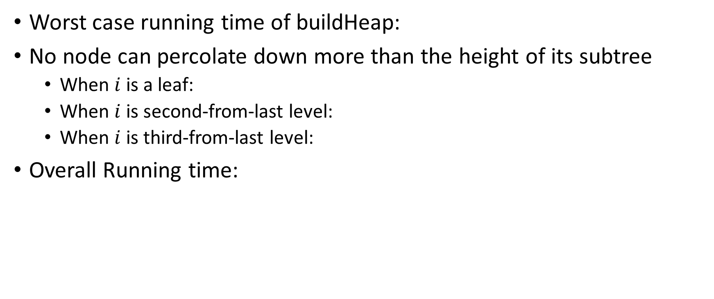
How long did this take?
Worst case running time of buildHeap:
No node can percolate down more than the height of its subtree
  When $i$ is a leaf:
  When $i$ is second-from-last level:
  When $i$ is third-from-last level:
Overall Running time:
buildHeap(){
for(int i = size; i>0; i--){
percolateDown(i);
}
}

Slide 35
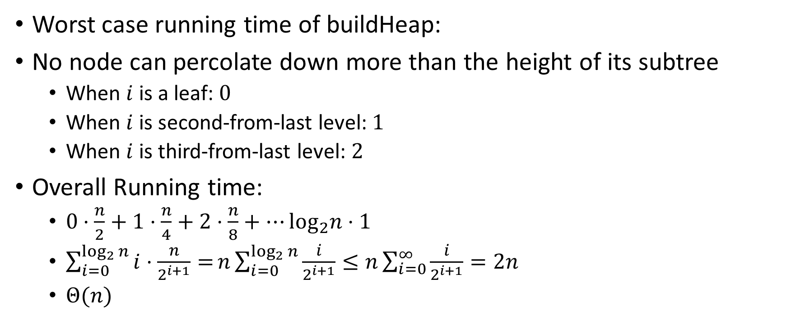
How long did this take? (Answers)
Worst case running time of buildHeap:
No node can percolate down more than the height of its subtree
  When $i$ is a leaf: $0$
  When $i$ is second-from-last level: $1$
  When $i$ is third-from-last level: $2$
Overall Running time:
  $0⋅\frac{n}{2}+1⋅\frac{n}{4}+2⋅\frac{n}{8}+…\log_{2}n⋅1$
  $\sum_{i=0}^{\log_{2}{n}}{i⋅\frac{n}{2^{i+1}}=}n\sum_{i=0}^{\log_{2}{n}}{\frac{i}{2^{i+1}}}≤n\sum_{i=0}^{∞}{\frac{i}{2^{i+1}}}=2n$
  $Θ(n)$
buildHeap(){
for(int i = size; i>0; i--){
percolateDown(i);
}
}

Slide 36
Heap Sort (Example)
Idea: Build a maxHeap, repeatedly extract the max element from the heap to build sorted list Right-to-Left
10
9
0
6
Max Heap Property: Each node is larger than its children
8
1
7
5
2
2
3
4
5
6
4
1
3
7
8
9
10
9
6
8
7
5
2
4
1
3
0
1
2
3
4
5
6
7
8
9

Slide 37
Heap Sort (First Extract)
Remove the Max element (i.e. the root) from the Heap: replace with last element, call percolateDown(root)
3
9
6
8
7
5
2
4
1
0
1
2
3
4
5
6
7
8
9
3
9
0
6
8
1
7
5
2
2
3
4
5
6
4
1
Percolate Down(node): if node satisfies heap property, done. Else swap with largest child and repeat on that subtree
7
8

Slide 38
Heap Sort (Percolate Down, Swap 1)
Remove the Max element (i.e. the root) from the Heap: replace with last element, call percolateDown(root)
9
3
6
8
7
5
2
4
1
0
1
2
3
4
5
6
7
8
9
9
3
0
6
8
1
7
5
2
2
3
4
5
6
4
1
Percolate Down(node): if node satisfies heap property, done. Else swap with largest child and repeat on that subtree
7
8

Slide 39
Heap Sort (Percolate Down, Swap 2)
Remove the Max element (i.e. the root) from the Heap: replace with last element, call percolateDown(root)
9
8
6
3
7
5
2
4
1
0
1
2
3
4
5
6
7
8
9
9
8
0
6
3
1
7
5
2
2
3
4
5
6
4
1
Percolate Down(node): if node satisfies heap property, done. Else swap with largest child and repeat on that subtree
7
8

Slide 40
Heap Sort (Percolate Down, Swap 2)
Remove the Max element (i.e. the root) from the Heap: replace with last element, call percolateDown(root)
9
8
6
4
7
5
2
3
1
0
1
2
3
4
5
6
7
8
9
9
8
0
6
4
1
7
5
2
2
3
4
5
6
3
1
Percolate Down(node): if node satisfies heap property, done. Else swap with largest child and repeat on that subtree
7
8

Slide 41
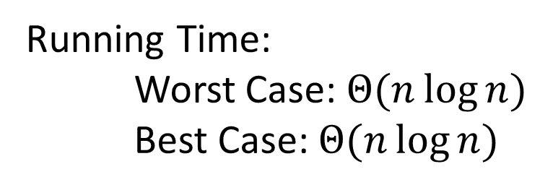
Heap Sort - Summary
Build a max heap
Call extract
Put that at the end of the array
myHeap = buildMaxHeap(a);
for (int i = a.length-1; i>=0; i--){
item = myHeap.extract();
a[i] = item;
}
Running Time:
Worst Case: $Θ(n\log{n})$
Best Case: $Θ(n\log{n})$

Slide 42
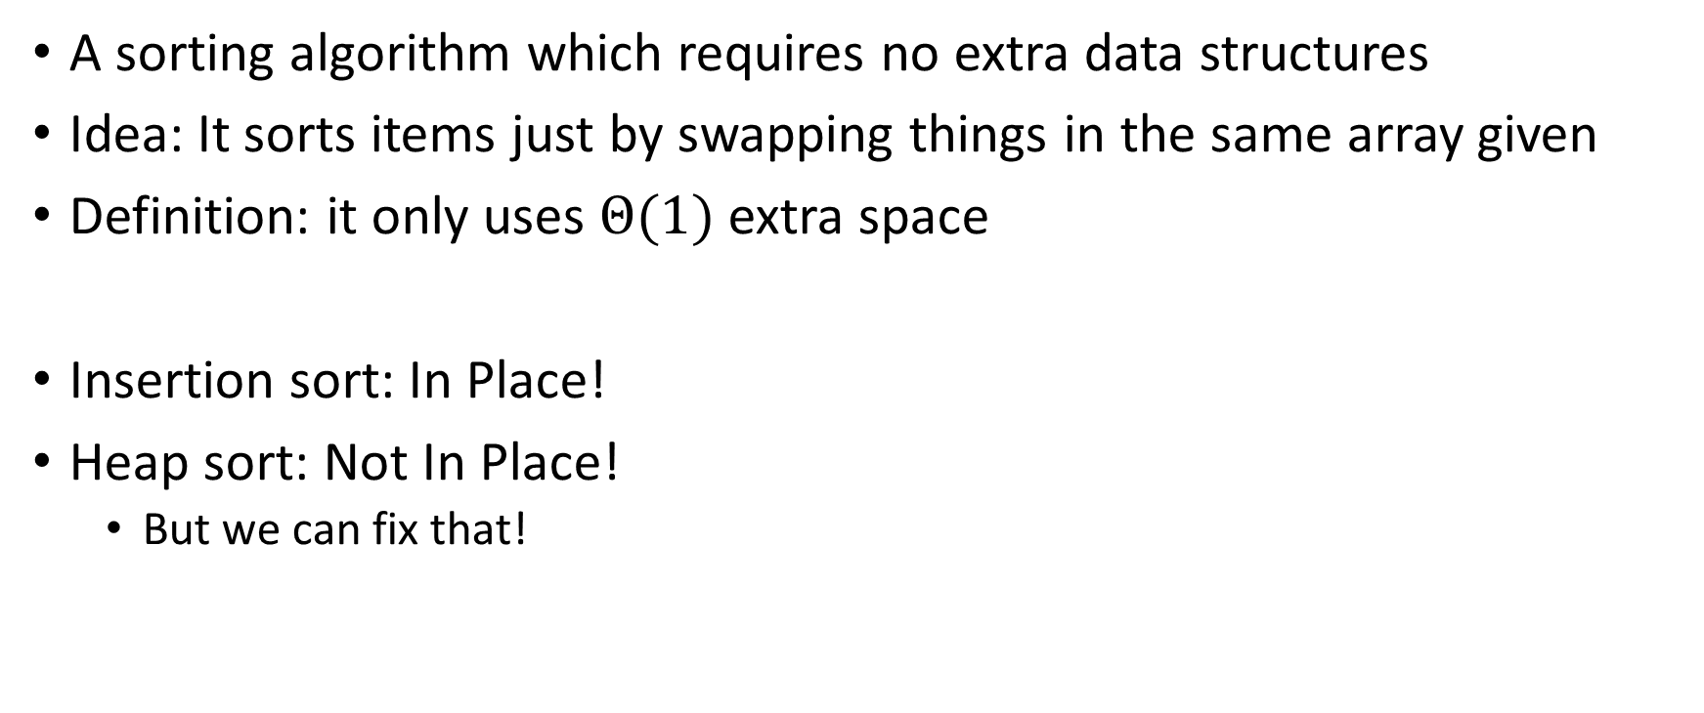
“In Place” Sorting Algorithm
A sorting algorithm which requires no extra data structures
Idea: It sorts items just by swapping things in the same array given
Definition: it only uses $Θ(1)$ extra space
Insertion sort: In Place!
Heap sort: Not In Place!
  But we can fix that!

Slide 43
In Place Heap Sort
Idea: When extracting an element from the heap, swap it with the last item of the heap then “pretend” the heap is one item shorter
10
9
6
8
7
5
2
4
1
3
0
1
2
3
4
5
6
7
8
9
10
9
0
6
8
1
7
5
2
2
3
4
5
6
4
1
3
7
8
9

Slide 44
Heap Sort (First Extract)
Idea: When extracting an element from the heap, swap it with the last item of the heap then “pretend” the heap is one item shorter
3
9
6
8
7
5
2
4
1
10
0
1
2
3
4
5
6
7
8
9
3
9
0
6
8
1
7
5
2
2
3
4
5
6
4
1
7
8

Slide 45
Heap Sort (First Percolate Down)
Idea: When extracting an element from the heap, swap it with the last item of the heap then “pretend” the heap is one item shorter
9
8
6
4
7
5
2
3
1
10
0
1
2
3
4
5
6
7
8
9
9
8
0
6
4
1
7
5
2
2
3
4
5
6
3
1
7
8

Slide 46
Heap Sort
Idea: When extracting an element from the heap, swap it with the last item of the heap then “pretend” the heap is one item shorter
1
8
6
4
7
5
2
3
9
10
0
1
2
3
4
5
6
7
8
9
1
8
0
6
4
1
7
5
2
2
3
4
5
6
3
7

Slide 47
Heap Sort
Idea: When extracting an element from the heap, swap it with the last item of the heap then “pretend” the heap is one item shorter
1
8
6
4
7
5
2
3
9
10
0
1
2
3
4
5
6
7
8
9
8
7
0
6
4
1
1
5
2
2
3
4
5
6
3
7

Slide 48
Heap Sort
Idea: When extracting an element from the heap, swap it with the last item of the heap then “pretend” the heap is one item shorter
3
8
6
4
7
5
2
8
9
10
0
1
2
3
4
5
6
7
8
9
3
7
0
6
4
1
1
5
2
2
3
4
5
6

Slide 49
Heap Sort
Idea: When extracting an element from the heap, swap it with the last item of the heap then “pretend” the heap is one item shorter
3
8
6
4
7
5
2
8
9
10
0
1
2
3
4
5
6
7
8
9
7
4
0
6
3
1
1
5
2
2
3
4
5
6

Slide 50
In Place Heap Sort - Summary
Build a heap using the same array (Floyd’s build heap algorithm works)
Call extract
Put that at the end of the array
buildHeap(a);
for (int i = a.length-1; i>=0; i--){
temp=a[i]
a[i] = a[0];
a[0] = temp;
percolateDown(0);
}
Running Time:
Worst Case: $Θ(n\log{n})$
Best Case: $Θ(n\log{n})$

Slide 51
Divide And Conquer Sorting
Divide and Conquer:
  Recursive algorithm design technique
  Solve a large problem by breaking it up into smaller versions of the same problem

Slide 52

Divide and Conquer
Base Case:
  If the problem is “small” then solve directly and return
Divide:
  Break the problem into subproblem(s), each smaller instances
Conquer:
  Solve subproblem(s) recursively
Combine:
  Use solutions to subproblems to solve original problem
A
B

Slide 53
Divide and Conquer Template Pseudocode
def my_DandC(problem){
// Base Case
if (problem.size() <= small_value){
return solve(problem); // directly solve (e.g., brute force)
}
// Divide
List subproblems = divide(problem);
// Conquer
solutions = new List();
for (sub : subproblems){
subsolution = my_DandC(sub);
solutions.add(subsolution);
}
// Combine
return combine(solutions);
}

Slide 54
Merge Sort
5
8
2
9
4
1
Base Case:
  If the list is of length 1 or 0, it’s already sorted, so just return it
Divide:
  Split the list into two “sublists” of (roughly) equal length
Conquer:
  Sort both lists recursively
Combine:
  Merge sorted sublists into one sorted list
5
5
8
2
9
4
1
2
5
8
1
4
9
2
5
8
1
4
9
1
2
4
5
8
9

Slide 55








Merge Sort In Action!
Sort between indices $low$ and $high$
5
8
2
9
4
1
3
7
$$low$$
$$high$$
Base Case: if $low$ == $high$ then that range is already sorted!
Divide and Conquer: Otherwise call mergesort on ranges $\left(low,\frac{low+high}{2}\right)$ and $\left(\frac{low+high}{2}+1, high\right)$
5
8
2
9
4
1
3
7
$$low$$
$$\frac{low+high}{2}$$
$$\frac{low+high}{2}+1$$
$$high$$
2
5
8
9
1
3
4
7
After Recursion:
$$low$$
$$high$$

Slide 56



Merge (the combine part)
2
5
8
9
1
3
4
7
L next
R next
$$\frac{low+high}{2}+1$$
$$low$$
$$\frac{low+high}{2}$$
$$high$$
M next
Create a new array to merge into, and 3 pointers/indices:
L_next: the smallest “unmerged” thing on the left
R_next: the smallest “unmerged” thing on the right
M_next: where the next smallest thing goes in the merged array
One-by-one: put the smallest of L_next and R_next into M_next, then advance both M_next and whichever of L/R was used.

Slide 57
Merge Sort Pseudocode
void mergesort(myArray){
ms_helper(myArray, 0, myArray.length());
}
void mshelper(myArray, low, high){
if (low == high){return;} // Base Case
mid = (low+high)/2;
ms_helper(low, mid);
ms_helper(mid+1, high);
merge(myArray, low, mid, high);
}

Slide 58
Merge Pseudocode
void merge(myArray, low, mid, high){
merged = new int[high-low+1]; // or whatever type is in myArray
l_next = low;
r_next = high;
m_next = 0;
while (l_next <= mid && r_next <= high){
if (myArray[l_next] <= myArray[r_next]){
merged[m_next++] = myArray[l_next++];
}
else{
merged[m_next++] = myArray[r_next++];
}
}
while (l_next <= mid){ merged[m_next++] = myArray[l_next++]; }
while (r_next <= high){ merged[m_next++] = myArray[r_next++]; }
for(i=0; i<=merged.length; i++){ myArray[i+low] = merged[i];}
}

Slide 59

Analyzing Merge Sort
Identify time required to Divide and Combine
Identify all subproblems and their sizes
Use recurrence relation to express recursive running time
Solve and express running time asymptotically
Divide: $0$ comparisons
Conquer: recursively sort two lists of size $\frac{n}{2}$
Combine: $n$ comparisons
Recurrence:
  $T\left(n\right)=0+T\left(\frac{n}{2}\right)+T\left(\frac{n}{2}\right)+n$
  $T(n)=2T\left(\frac{n}{2}\right)+n$

Slide 60








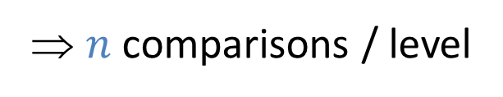


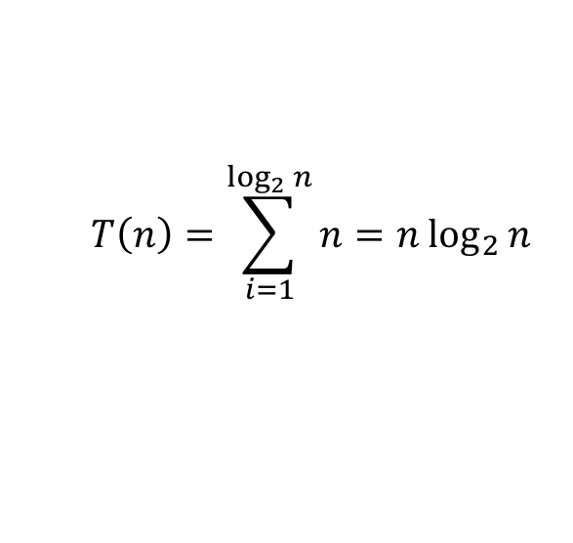

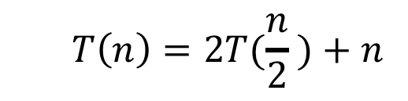








Red box represents a problem instance
Blue value represents time spent at that level of recursion
  $$T\left(n\right)=2T(\frac{n}{2} )+n$$
$$n$$
⇒ $n$ comparisons / level
$$n$$
$$n/2$$
$$\frac{n}{2}$$
$$n/2$$
$$\frac{n}{2}$$
$$\frac{n}{4}$$
$$\frac{n}{4}$$
$$\frac{n}{4}$$
$$\frac{n}{4}$$
$\log_{2}⁡n$ levels
of recursion
$$n/4$$
$$n/4$$
$$n/4$$
$$n/4$$
…
…
…
…
…
$$1$$
$$1$$
$$1$$
$$1$$
$$1$$
$$1$$
$$1$$
$$1$$
$$1$$
$$1$$
$$1$$
$$1$$
  $$T\left(n\right)=\sum_{i=1}^{\log_{2}{n}}{n}=n\log_{2}{n}$$

Slide 61

Properties of Merge Sort
Worst Case Running time:
  $Θ(n\log{n})$
In-Place?
  No!
Adaptive?
  No!
Stable?
  Yes!
  As long as in a tie you always pick l_next

Slide 62

Quicksort
Like Mergesort:
  Divide and conquer
  $O(n\log{n})$ run time (kind of…)
Unlike Mergesort:
  Divide step is the “hard” part
  Typically faster than Mergesort

Slide 63

Quicksort
Idea: pick a pivot element, recursively sort two sublists around that element
Divide: select pivot element $p$, Partition($p$)
Conquer: recursively sort left and right sublists
Combine: Nothing!

Slide 64


Partition (Divide step)
Given: a list, a pivot $p$
Start: unordered list
8
5
7
3
12
10
1
2
4
9
6
11
Goal: All elements $<p$ on left, all $>p$ on right
5
7
3
1
2
4
6
8
12
10
9
11

Slide 65
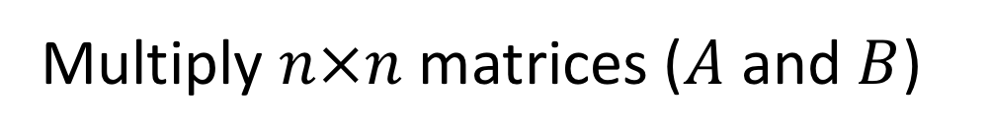
Partition, Procedure
If Begin value $< p$, move Begin right
Else swap Begin value with End value, move End Left
Done when Begin = End
8
5
7
3
12
10
1
2
4
9
6
11
8
5
7
3
12
10
1
2
4
9
6
11
8
5
7
3
12
10
1
2
4
9
6
11
8
5
7
3
11
10
1
2
4
9
6
12

Slide 66
Partition, Procedure
If Begin value $< p$, move Begin right
Else swap Begin value with End value, move End Left
Done when Begin = End
8
5
7
3
11
10
1
2
4
9
6
12
8
5
7
3
6
10
1
2
4
9
11
12
8
5
7
3
6
10
1
2
4
9
11
12
8
5
7
3
6
10
1
2
4
9
11
12

Slide 67
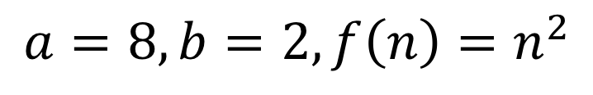
Partition, Procedure
If Begin value $< p$, move Begin right
Else swap Begin value with End value, move End Left
Done when Begin = End
8
5
7
3
6
4
1
2
10
9
11
12
Case 1: meet at element $<p$
Swap $p$ with pointer position (2 in this case)
2
5
7
3
6
4
1
8
10
9
11
12

Slide 68
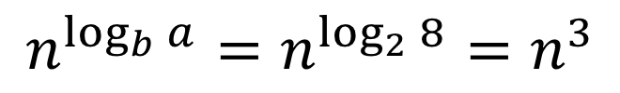
Partition, Procedure
If Begin value $< p$, move Begin right
Else swap Begin value with End value, move End Left
Done when Begin = End
8
5
7
3
6
4
1
2
10
9
11
12
Case 2: meet at element $>p$
Swap $p$ with value to the left (2 in this case)
2
5
7
3
6
4
1
8
10
9
11
12

Slide 69


Partition Summary
Put $p$ at beginning of list
Put a pointer (Begin) just after $p$, and a pointer (End) at the end of the list
While Begin < End:
  If Begin value $< p$, move Begin right
  Else swap Begin value with End value, move End Left
If pointers meet at element $<p$: Swap $p$ with pointer position
Else If pointers meet at element $>p$: Swap $p$ with value to the left
Run time?
$$O(n)$$

Slide 70
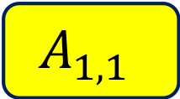
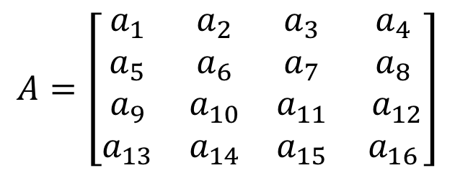
Conquer
2
5
7
3
6
4
1
8
10
9
11
12
All elements $<p$
All elements $>p$
Exactly where it belongs!
Recursively sort Left and Right sublists

Slide 71


Quicksort Run Time (Best)
If the pivot is always the median:
2
5
1
3
6
4
7
8
10
9
11
12
2
1
3
5
6
4
7
8
9
10
11
12
Then we divide in half each time
$$T\left(n\right)=2T\left(\frac{n}{2}\right)+n$$
$$T\left(n\right)=O(n\log{n})$$

Slide 72

Quicksort Run Time (Worst)
If the pivot is always at the extreme:
1
5
2
3
6
4
7
8
10
9
11
12
1
2
3
5
6
4
7
8
10
9
11
12
Then we shorten by 1 each time
$$T\left(n\right)=T\left(n−1\right)+n$$
$$T\left(n\right)=O(n^{2})$$

Slide 73
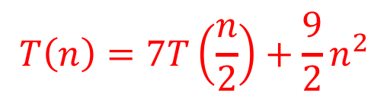



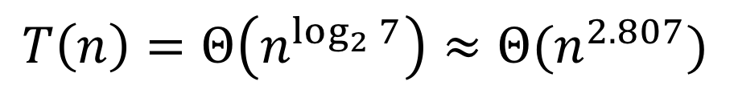

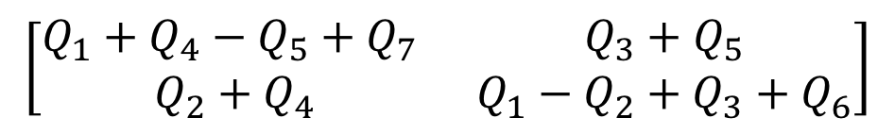

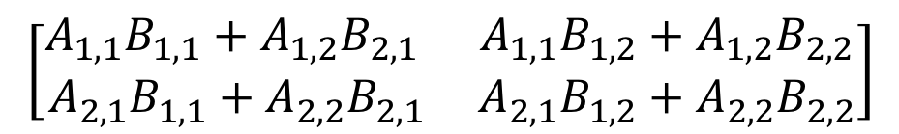
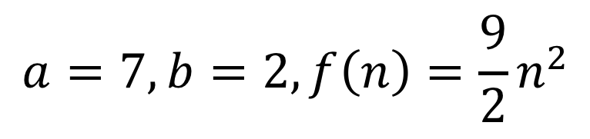

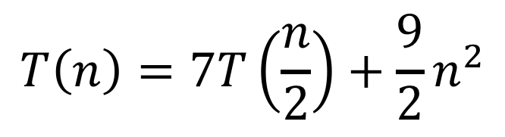
Quicksort Run Time (Worst)
$$T\left(n\right)=T\left(n−1\right)+n$$
$$n$$
$$n$$
$$n−1$$
$$n−1$$
$$T\left(n\right)=1+2+3+…+n$$
$$n−2$$
$$n−2$$
$$T\left(n\right)=\frac{n\left(n+1\right)}{2}$$
…
$$1$$
$$1$$
$$T\left(n\right)=O(n^{2})$$

Slide 74
Quicksort on a (nearly) Sorted List
First element always yields unbalanced pivot
1
2
3
4
5
6
7
8
9
10
11
12
1
2
3
4
5
6
7
8
9
10
11
12
So we shorten by 1 each time
$$T\left(n\right)=T\left(n−1\right)+n$$
$$T\left(n\right)=O(n^{2})$$

Slide 75
Good Pivot
What makes a good Pivot?
  Roughly even split between left and right
  Ideally: median
There are ways to find the median in linear time, but it’s complicated and slow and you’re better off using mergesort
In Practice:
  Pick a random value as a pivot
  Pick the middle of 3 random values as the pivot

Slide 76

Properties of Quick Sort
Worst Case Running time:
  $Θ(n^{2})$
  But $Θ(n\log{n})$ average! And typically faster than mergesort!
In-Place?
  ….Debatable
Adaptive?
  No!
Stable?
  No!

Slide 77
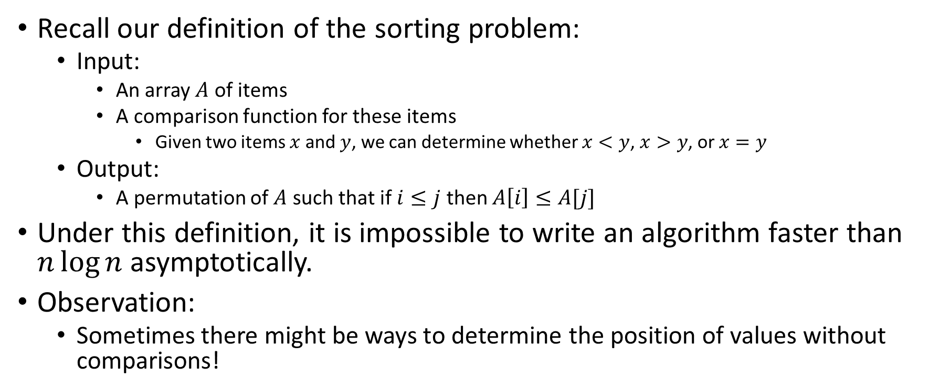
Improving Running time
Recall our definition of the sorting problem:
  Input:
    An array $A$ of items
    A comparison function for these items
      Given two items $x$ and $y$, we can determine whether $x<y$, $x>y$, or $x=y$
  Output:
    A permutation of $A$ such that if $i≤j$ then $A\left[i\right]≤A[j]$
Under this definition, it is impossible to write an algorithm faster than $n\log{n}$ asymptotically.
Observation:
  Sometimes there might be ways to determine the position of values without comparisons!

