Slide 1
CSE 332 Spring 2026 Lecture 3: Algorithm Analysis pt.2
Nathan Brunelle
http://www.cs.uw.edu/332

Slide 2
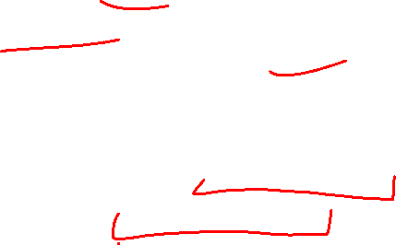
Running Time Analysis
Units of “time”
Operations
Whichever operations we pick
How do we express running time?
Function
Domain (input): size of the input
Range: count of operations

Slide 3
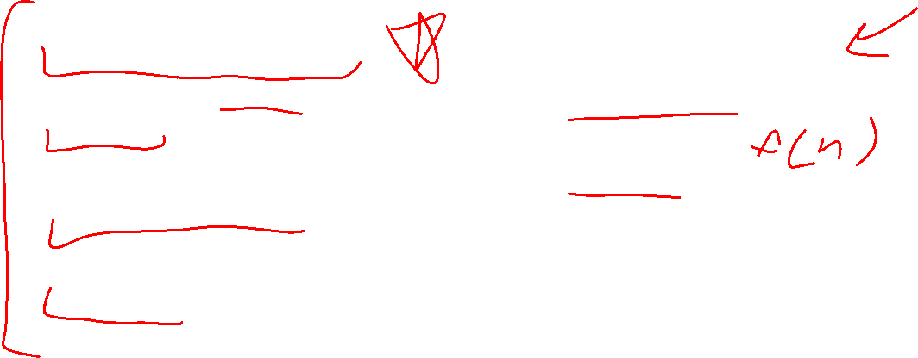
Options for your running time function
Worst-case complexity:
max number of steps algorithm takes on “most challenging” input
Best-case complexity:
min number of steps algorithm takes on “easiest” input
Average/expected complexity:
avg number of steps algorithm takes on random inputs (context-dependent)
Amortized complexity:
max total number of steps algorithm takes on M “most challenging” consecutive inputs, divided by M (i.e., divide the max total sum by M).

Slide 4

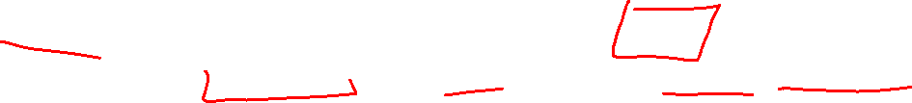
Worst Case Running Time Analysis
If an algorithm has a worst case running time of $f(n)$
Among all possible size-$n$ inputs, the “worst” one will do $f(n)$ “operations”
$f(n)$ gives the maximum count of operations needed from among all inputs of size $n$

Slide 5
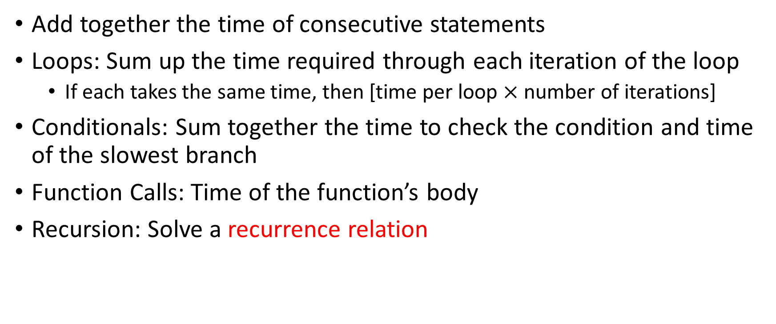

Worst Case Running Time – General Guide
Add together the time of consecutive statements
Loops: Sum up the time required through each iteration of the loop
If each takes the same time, then [time per loop $×$ number of iterations]
Conditionals: Sum together the time to check the condition and time of the slowest branch
Function Calls: Time of the function’s body
Recursion: Solve a recurrence relation

Slide 6
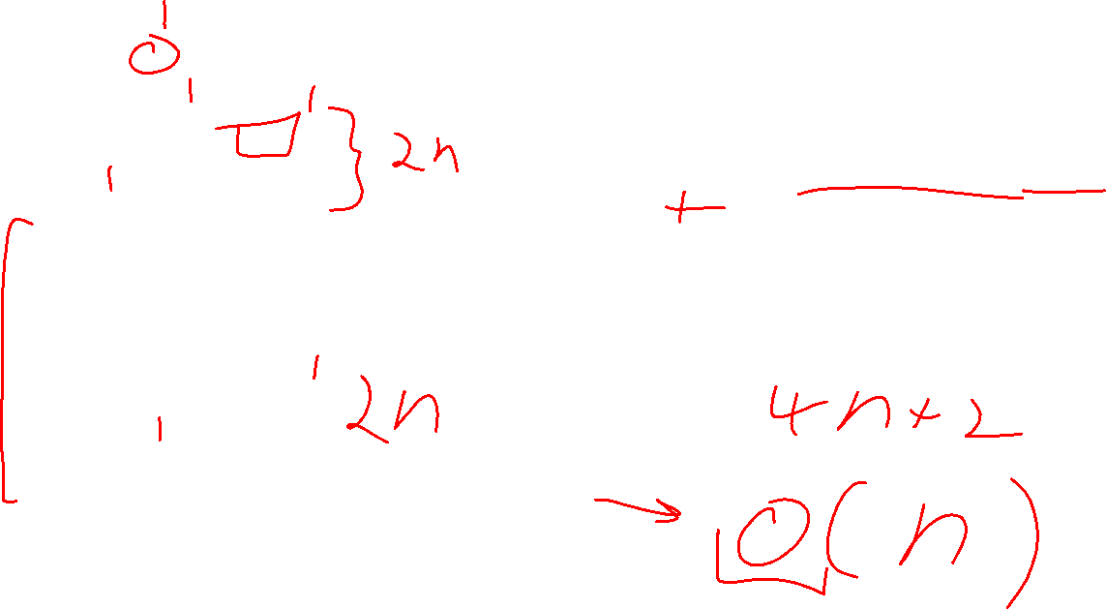
Worst Case – Example 1 (Questions)
myFunction(List n){
b = 55 + 5;
c = b / 3;
b = c + 100;
for (i = 0; i < n.size(); i++) {
b++;
}
if (b % 2 == 0) {
c++;
}
else {
for (i = 0; i < n.size(); i++) {
c++;
}
}
return c;
}
Questions to ask:
What are the units of the input size?
What are the operations we’re counting?
For each line:
How many times will it run?
How long does it take to run?
Does this change with different inputs?
Answer:

Slide 7

Worst Case – Example 1 (Answers)
myFunction(List n){
b = 55 + 5; // 1
c = b / 3; // 1
b = c + 100; // 1
for (i = 0; i < n.size(); i++) { // 1, n times
b++; // 1
}
if (b % 2 == 0) { // 1
c++; // 1
}
else {
for (i = 0; i < n.size(); i++) { // 1, n times
c++; // 1
}
}
return c;
}
Questions to ask:
What are the units of the input size?
# of items in the list
What are the operations we’re counting?
Arithmetic ops (+-*/)
For each line:
How many times will it run?
How long does it take to run?
Does this change with different inputs?
Answer:
$3+2n+1+2n=4n+4$
$O(n)$

Slide 8
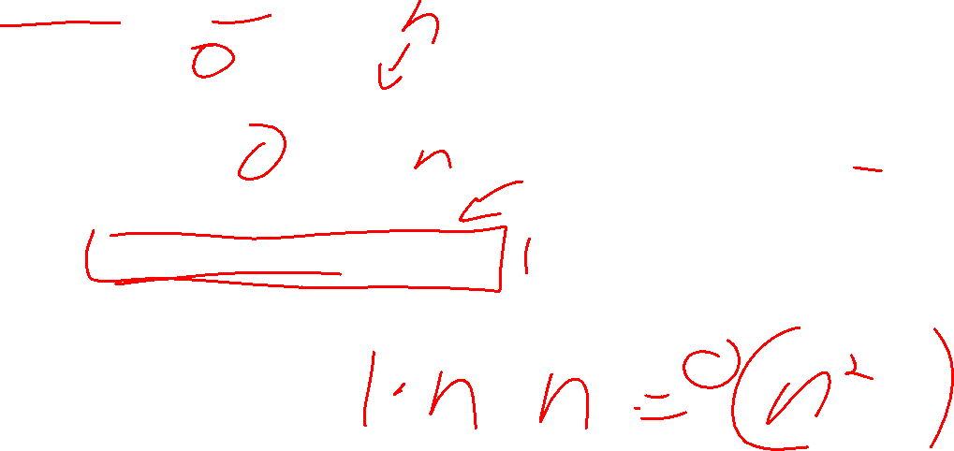
Worst Case – Example 2 (Questions)
beAnnoying(List n){
List m = [];
for (i=0; i < n.size(); i++){
m.add(n[i]);
for (j=0; j< n.size(); j++){
print (“Hi, I’m annoying”);
}
}
}
Questions to ask:
What are the units of the input size?
What are the operations we’re counting?
For each line:
How many times will it run?
How long does it take to run?
Does this change with the input size?

Slide 9

Worst Case – Example 2 (Answers)
beAnnoying(List n){
List m = [];
for (i=0; i < n.size(); i++){ // n times
m.add(n[i]);
for (j=0; j< n.size(); j++){ // n times
print (“Hi, I’m annoying”); // 1
}
}
}
Questions to ask:
What are the units of the input size?
# items
What are the operations we’re counting?
Adding or printing
Printing: $O\left(n^{2}\right)$
For each line:
How many times will it run?
How long does it take to run?
Does this change with the input size?

Slide 10
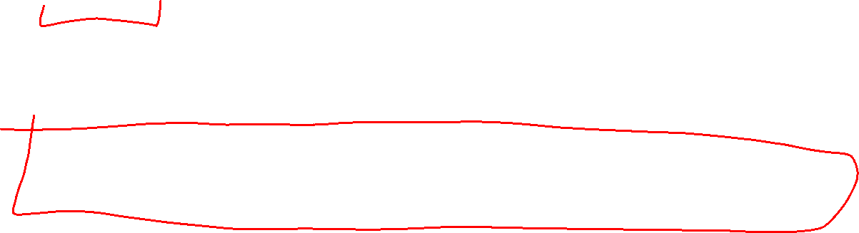
Reminder: Options for your running time function
Worst-case complexity:
max number of steps algorithm takes on “most challenging” input
Best-case complexity:
min number of steps algorithm takes on “easiest” input
Average/expected complexity:
avg number of steps algorithm takes on random inputs (distribution-dependent)
Amortized complexity:
max total number of steps algorithm takes on M “most challenging” consecutive inputs, divided by M (i.e., divide the max total sum by M).

Slide 11

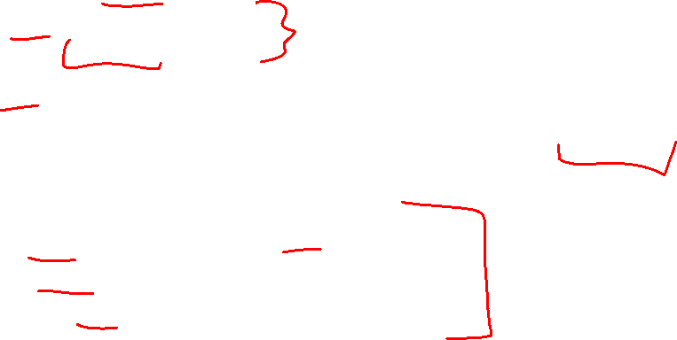
ArrayList - Worst Case Time of Add
public void add(int value){
if(data.length == size)
resize();
data[size] = value;
size++;
}
private void resize(){
int[] oldData = data;
data = new int[data.length*2];
for(int i = 0; i < oldData.length; i++)
data[i] = oldData[i];
}
What is the worst case running time of add?
Input size: size of “this”
Operations counted: indexing
$O\left(n\right)$

Slide 12
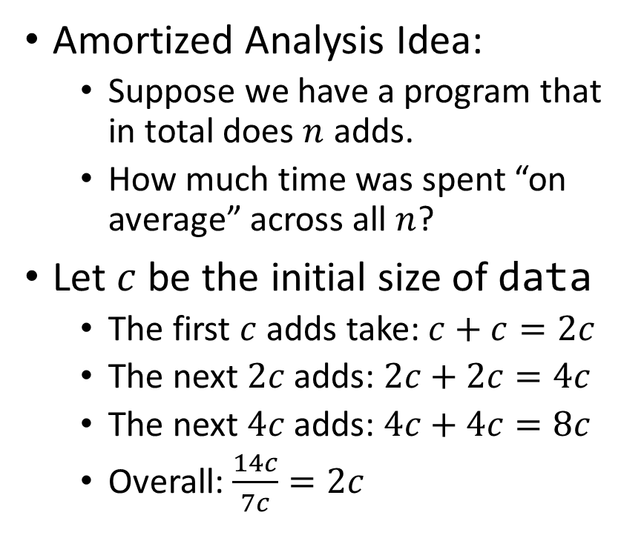
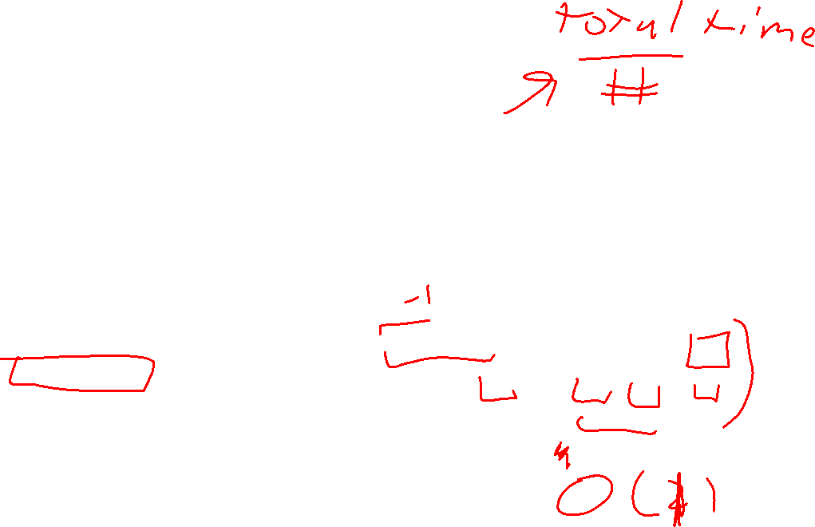
ArrayList – Amortized Time of Add
public void add(int value){
if(data.length == size)
resize();
data[size] = value;
size++;
}
private void resize(){
int[] oldData = data;
data = new int[data.length*2];
for(int i = 0; i < oldData.length; i++)
data[i] = oldData[i];
}
Amortized Analysis Idea:
Suppose we have a program that in total does $n$ adds.
How much time was spent “on average” across all $n$?
Let $c$ be the initial size of data
The first $c$ adds take: $c+c=2c$
The next $2c$ adds: $2c+2c=4c$
The next $4c$ adds: $4c+4c=8c$
Overall: $\frac{14c}{7c}=2c$
Every time we resize, we earn data.length more adds before the next resize!
Notes:
Amortized: “running average”

Slide 13
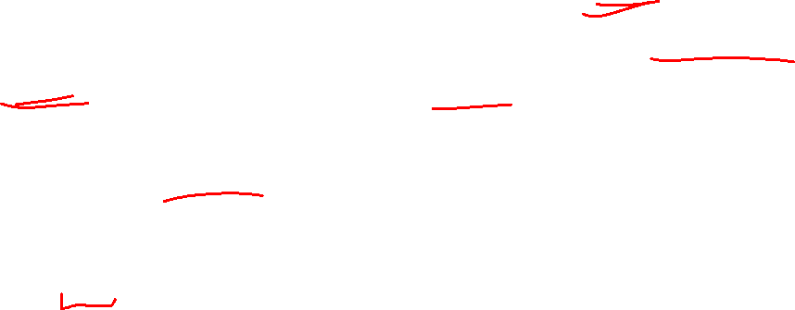
Amortized Analysis Analogy
Suppose I’d like to park in a lot where they charge $10 per day to park
If you are caught in the lot without paying you are given a warning
If you get 3 warnings, you are charged a $25 fine, and your warnings reset.
Should you actually pay to park?
If you pay every day then you pay an average of $10 per day
If you do not pay then for every three days parking costs $0+$0+$25, for an average of $8.33 per day
This is an amortized analysis

Slide 14
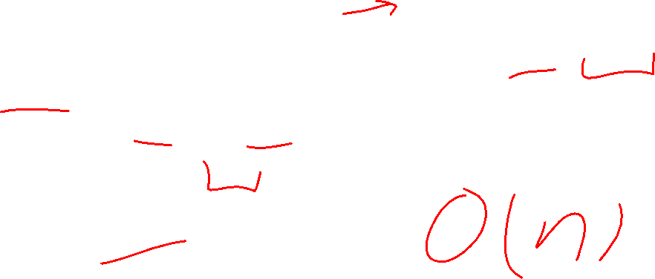
Searching in a Sorted List
5
8
13
42
75
79
88
90
95
99
0
1
2
3
4
5
6
7
8
9
public static boolean contains(List<Integer> a, int k){
for(int i=0; i< a.size(); i++){
if (a.get(i) == k)
return true;
}
return false;
}

Slide 15
Faster way?
5
8
13
42
75
79
88
90
95
99
0
1
2
3
4
5
6
7
8
9
Can you think of a faster algorithm to solve this problem?

Slide 16
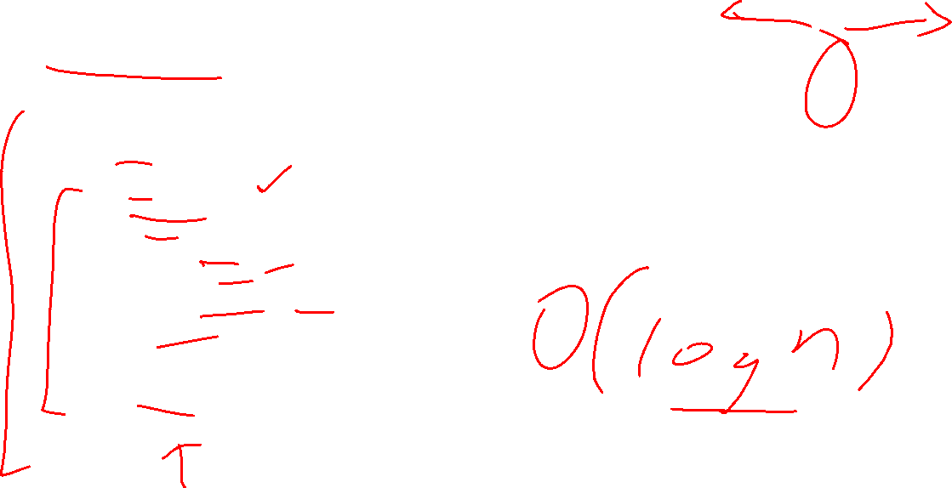
Binary Search
5
8
13
42
75
79
88
90
95
99
0
1
2
3
4
5
6
7
8
9
public static boolean contains(List<Integer> a, int k){
int start = 0;
int end = a.size();
while(start < end){
int mid = start + (end-start)/2;
if(a.get(mid) == k)
return true;
else if(a.get(mid) < k)
start = mid+1;
else
end = mid;
}
return false;
}

Slide 17
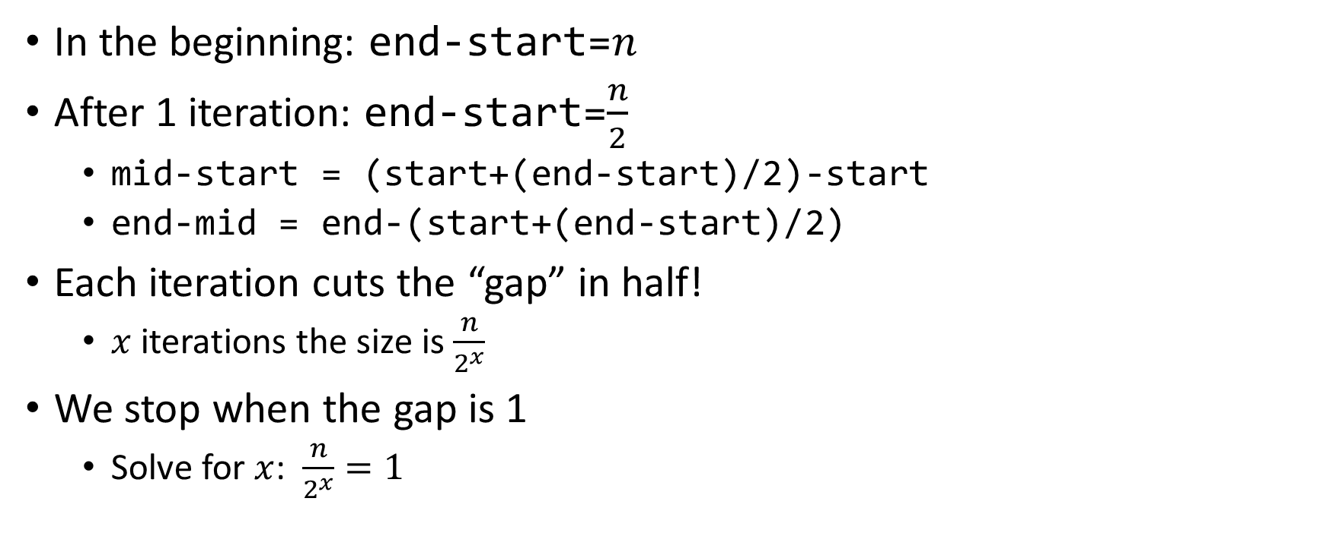

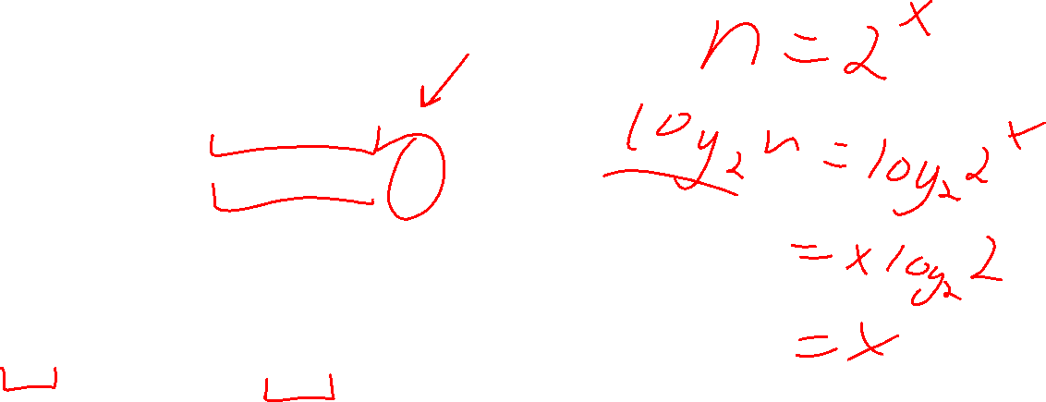
Why is this $\log_{2}{n}$?
In the beginning: end-start=$n$
After 1 iteration: end-start=$\frac{n}{2}$
mid-start = (start+(end-start)/2)-start
end-mid = end-(start+(end-start)/2)
Each iteration cuts the “gap” in half!
$x$ iterations the size is $\frac{n}{2^{x}}$
We stop when the gap is 1
Solve for $x$: $\frac{n}{2^{x}}=1$

Slide 18
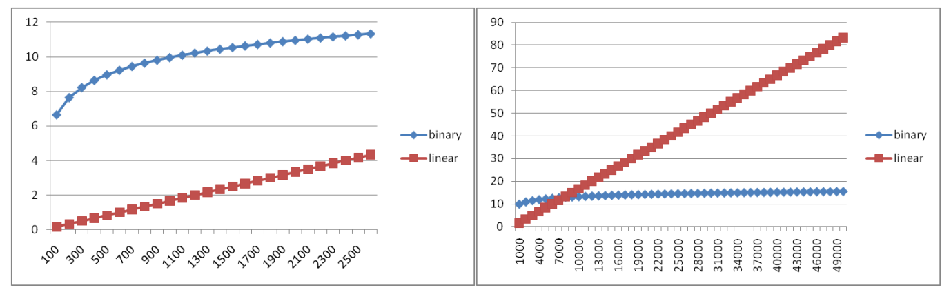
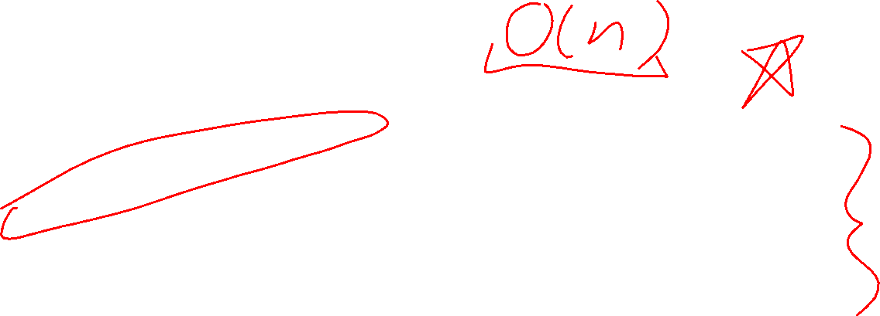
Running Time Graphed

Slide 19
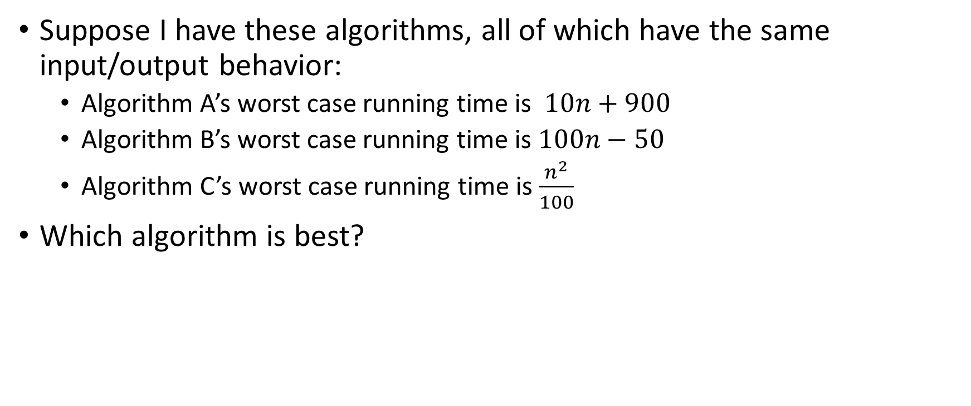
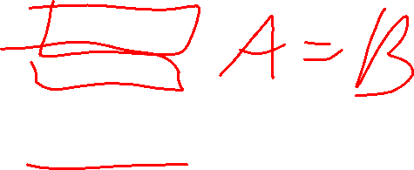
Comparing Running Times
Suppose I have these algorithms, all of which have the same input/output behavior:
Algorithm A’s worst case running time is $10n+900$
Algorithm B’s worst case running time is $100n−50$
Algorithm C’s worst case running time is $\frac{n^{2}}{100}$
Which algorithm is best?

Slide 20
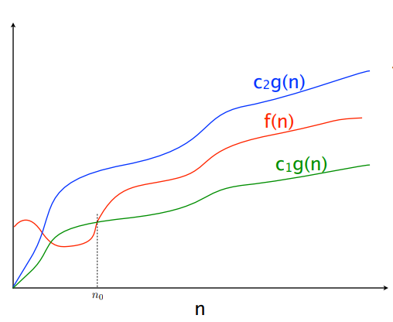
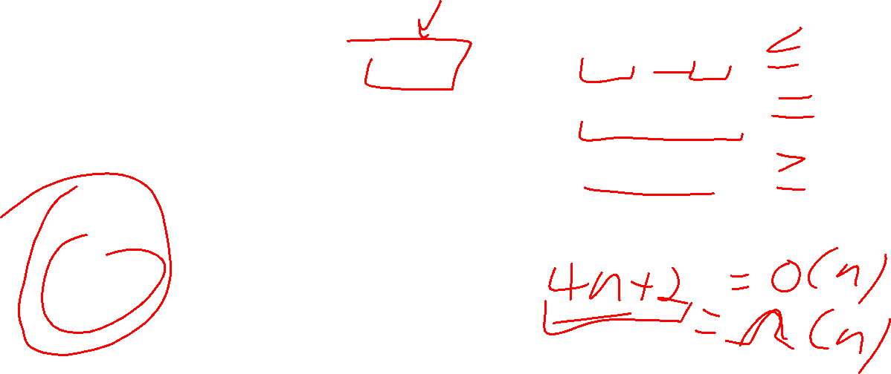

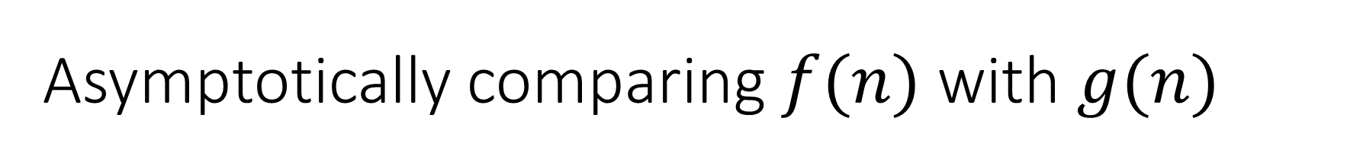


Asymptotically comparing $f(n)$ with $g(n)$
$$f(n)=O(g\left(n\right))$$
$$f(n)=Θ(g\left(n\right))$$
$$f(n)=Ω(g\left(n\right))$$

Slide 21
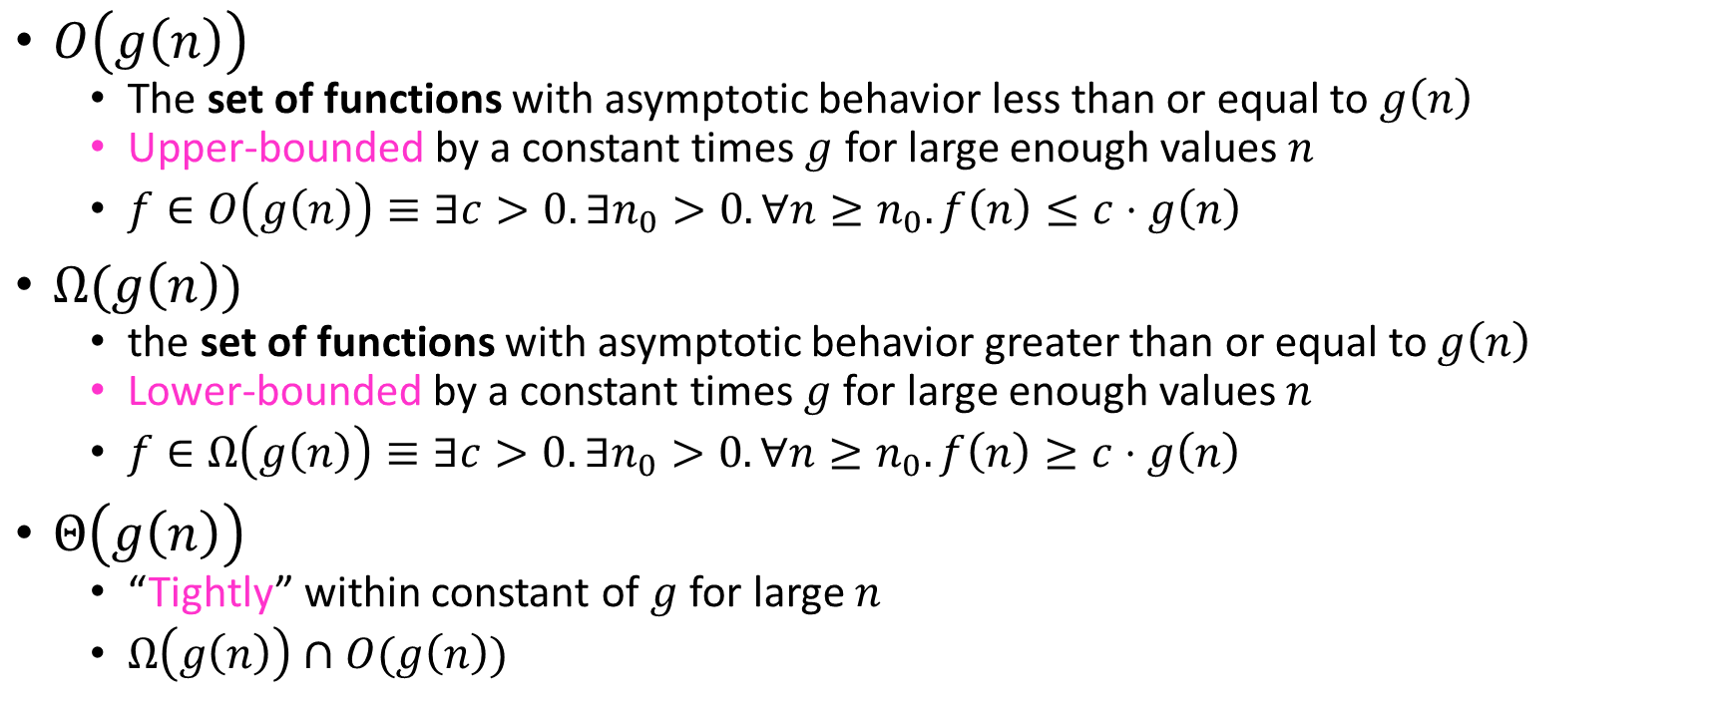
Asymptotic Notation
$O\left(g\left(n\right)\right)$
The set of functions with asymptotic behavior less than or equal to $g\left(n\right)$
Upper-bounded by a constant times $g$ for large enough values $n$
$f∈O\left(g\left(n\right)\right)≡∃c>0. ∃n_{0}>0. ∀n≥n_{0}. f\left(n\right)≤c⋅g\left(n\right)$
$Ω(g\left(n\right))$
the set of functions with asymptotic behavior greater than or equal to $g\left(n\right)$
Lower-bounded by a constant times $g$ for large enough values $n$
$f∈Ω\left(g\left(n\right)\right)≡∃c>0. ∃n_{0}>0. ∀n≥n_{0}. f\left(n\right)≥c⋅g\left(n\right)$
$Θ\left(g\left(n\right)\right)$
“Tightly” within constant of $g$ for large $n$
$Ω\left(g\left(n\right)\right)∩O(g\left(n\right))$

Slide 22


Idea of $Θ$
$x=y$
$x≤y∧x≥y$

Slide 23

Asymptotic Notation Example 1
Show: $10n+100∈O\left(n^{2}\right)$
Technique: find values $c>0$ and $n_{0}>0$ such that $∀n>n_{0}. 10n+100≤c⋅n^{2}$
Proof:

Slide 24
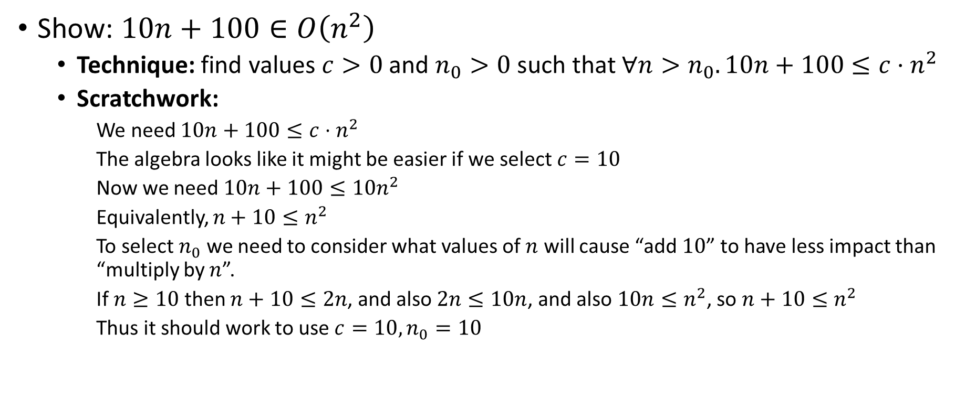
Asymptotic Notation Example 1 (Scratchwork)
Show: $10n+100∈O\left(n^{2}\right)$
Technique: find values $c>0$ and $n_{0}>0$ such that $∀n>n_{0}. 10n+100≤c⋅n^{2}$
Scratchwork:
We need $10n+100≤c⋅n^{2}$
The algebra looks like it might be easier if we select $c=10$
Now we need $10n+100≤10n^{2}$
Equivalently, $n+10≤n^{2}$
To select $n_{0}$ we need to consider what values of $n$ will cause “add $10$” to have less impact than “multiply by $n$”.
If $n≥10$ then $n+10≤2n$, and also $2n≤10n$, and also $10n≤n^{2}$, so $n+10≤n^{2}$
Thus it should work to use $c=10, n_{0}=10$

Slide 25
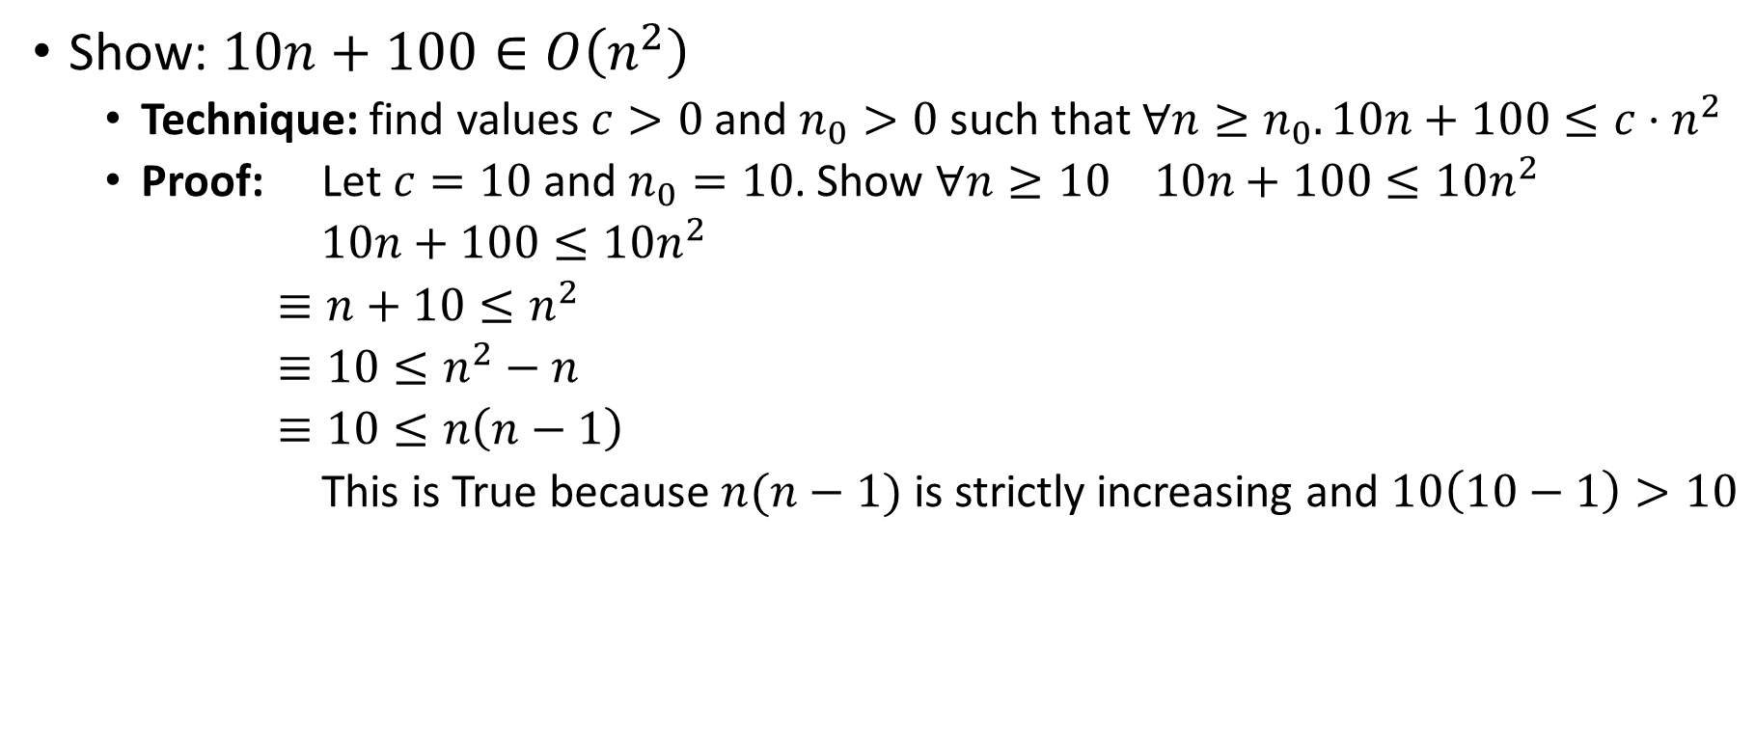
Asymptotic Notation Example 1 (Proof)
Show: $10n+100∈O\left(n^{2}\right)$
Technique: find values $c>0$ and $n_{0}>0$ such that $∀n≥n_{0}. 10n+100≤c⋅n^{2}$
Proof: Let $c=10$ and $n_{0}=10$. Show $∀n≥10 10n+100≤10n^{2}$
$10n+100≤10n^{2}$
$≡n+10≤n^{2}$
$≡10≤n^{2}−n$
$≡10≤n\left(n−1\right)$
This is True because $n(n−1)$ is strictly increasing and $10\left(10−1\right)>10$

Slide 26

Asymptotic Notation Example 2
Show: $13n^{2}−50n∈Ω\left(n^{2}\right)$
Technique: find values $c>0$ and $n_{0}>0$ such that $∀n≥n_{0}. 13n^{2}−50n≥c⋅n^{2}$

Slide 27
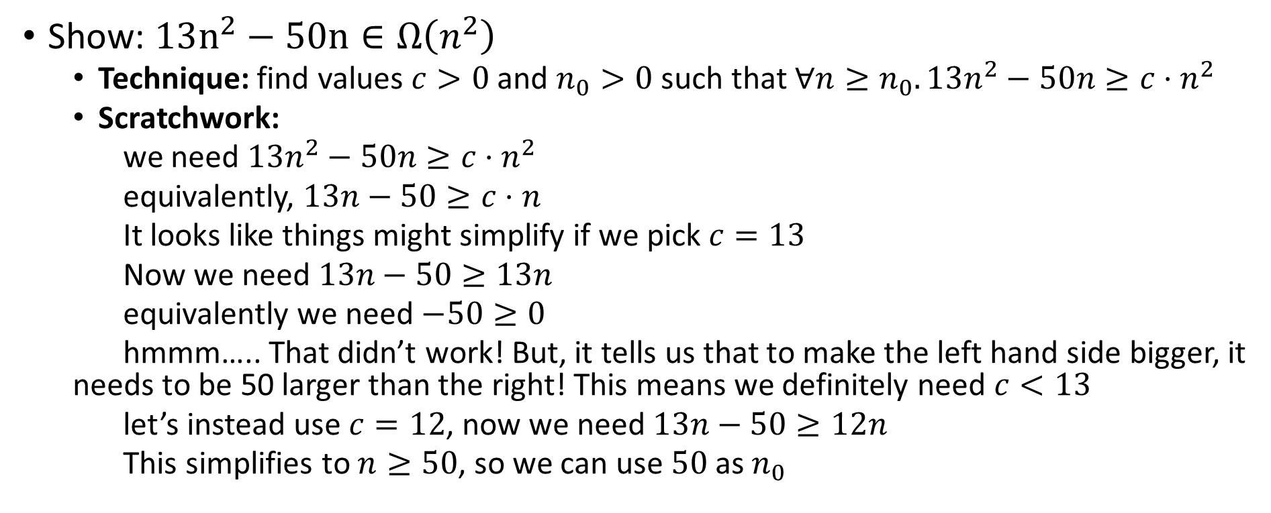
Asymptotic Notation Example 2 (Scratchwork)
Show: $13n^{2}−50n∈Ω\left(n^{2}\right)$
Technique: find values $c>0$ and $n_{0}>0$ such that $∀n≥n_{0}. 13n^{2}−50n≥c⋅n^{2}$
Scratchwork:
we need $13n^{2}−50n≥c⋅n^{2}$
equivalently, $13n−50≥c⋅n$
It looks like things might simplify if we pick $c=13$
Now we need $13n−50≥13n$
equivalently we need $−50≥0$
hmmm….. That didn’t work! But, it tells us that to make the left hand side bigger, it needs to be 50 larger than the right! This means we definitely need $c<13$
let’s instead use $c=12$, now we need $13n−50≥12n$
This simplifies to $n≥50$, so we can use $50$ as $n_{0}$

Slide 28
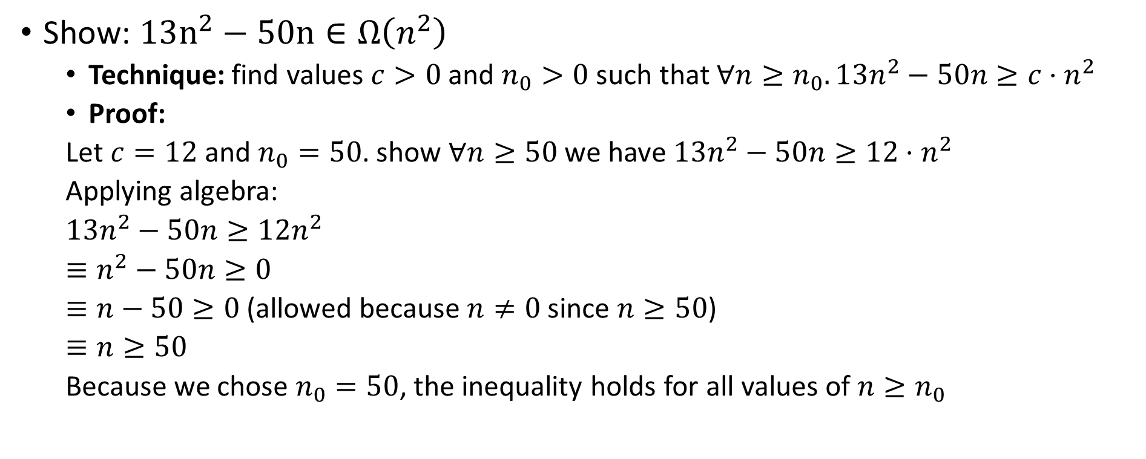
Asymptotic Notation Example 2 (Proof)
Show: $13n^{2}−50n∈Ω\left(n^{2}\right)$
Technique: find values $c>0$ and $n_{0}>0$ such that $∀n≥n_{0}. 13n^{2}−50n≥c⋅n^{2}$
Proof:
Let $c=12$ and $n_{0}=50$. show $∀n≥50$ we have $13n^{2}−50n≥12⋅n^{2}$
Applying algebra:
$13n^{2}−50n≥12n^{2}$
$≡n^{2}−50n≥0$
$≡n−50≥0$ (allowed because $n≠0$ since $n≥50$)
$≡n≥50$
Because we chose $n_{0}=50$, the inequality holds for all values of $n≥n_{0}$

Slide 29

Asymptotic Notation Example 3
Show: $n^{2}∉O\left(n\right)$
Want to show that there does not exist a pair of $c$ and $n_{0}$ such that $∀n_{0}>n. n^{2}≤c⋅n$

Slide 30
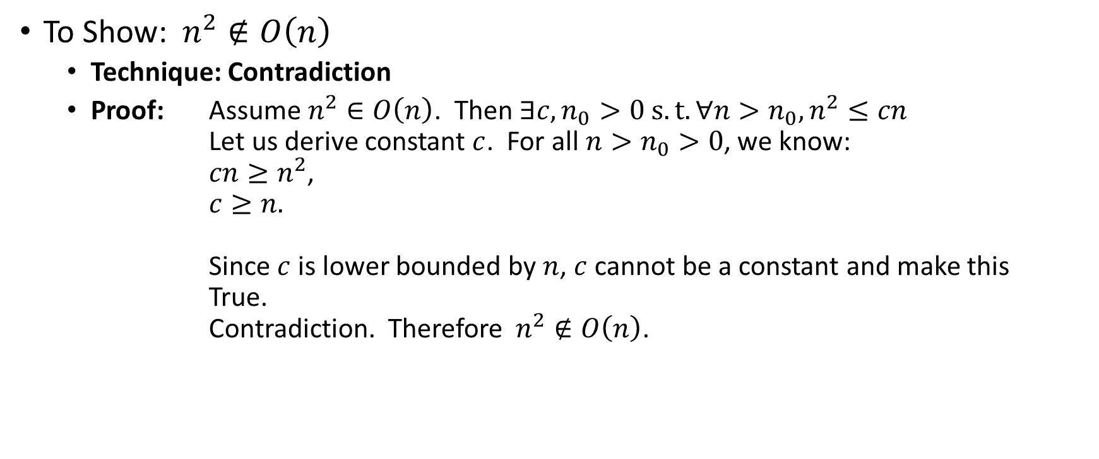
Asymptotic Notation Example 3 (Proof)
Proof by Contradiction!
To Show:$n^{2}∉O\left(n\right)$
Technique: Contradiction
Proof: Assume $n^{2}∈O\left(n\right)$. Then $∃c,n_{0}>0 s.t. ∀n>n_{0},n^{2}≤cn$ Let us derive constant $c$. For all $n>n_{0}>0$, we know: $cn≥n^{2}$, $c≥n.$ Since $c$ is lower bounded by $n$, $c$ cannot be a constant and make this True. Contradiction. Therefore$n^{2}∉O\left(n\right)$.

Slide 31
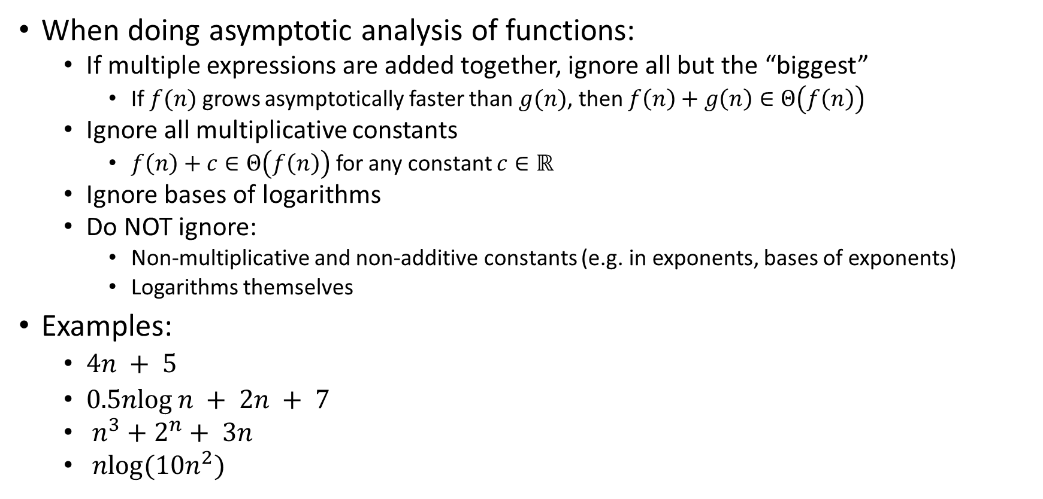
Gaining Intuition
When doing asymptotic analysis of functions:
If multiple expressions are added together, ignore all but the “biggest”
If $f(n)$ grows asymptotically faster than $g(n)$, then $f\left(n\right)+g\left(n\right)∈Θ\left(f\left(n\right)\right)$
Ignore all multiplicative constants
$f\left(n\right)+c∈Θ\left(f\left(n\right)\right)$ for any constant $c∈ℝ$
Ignore bases of logarithms
Do NOT ignore:
Non-multiplicative and non-additive constants (e.g. in exponents, bases of exponents)
Logarithms themselves
Examples:
$4n + 5$
$0.5nlog⁡n + 2n + 7$
$n^{3}+2^{n}+ 3n$
$nlog(10n^{2})$

Slide 32

More Examples
Is each of the following True or False?
$4+3n∈ O(n)$
$n+2\log{n}∈ O(\log{n})$
$\log{n}+2∈ O(1)$
$n^{50}∈ O({1.1}^{n})$
$3^{n}∈Θ(2^{n})$

Slide 33

Common Categories
$O(1)$ “constant”
$O\left(\log{n}\right)$ “logarithmic”
$O\left(n\right)$ “linear”
$O\left(n\log{n}\right)$ “log-linear”
$O\left(n^{2}\right)$ “quadratic”
$O\left(n^{3}\right)$ “cubic”
$O\left(n^{k}\right)$ “polynomial”
$O\left(k^{n}\right)$ “exponential”

Slide 34
Defining your running time function
Worst-case complexity:
max number of steps algorithm takes on “most challenging” input
Best-case complexity:
min number of steps algorithm takes on “easiest” input
Average/expected complexity:
avg number of steps algorithm takes on random inputs (context-dependent)
Amortized complexity:
max total number of steps algorithm takes on M “most challenging” consecutive inputs, divided by M (i.e., divide the max total sum by M).

Slide 35
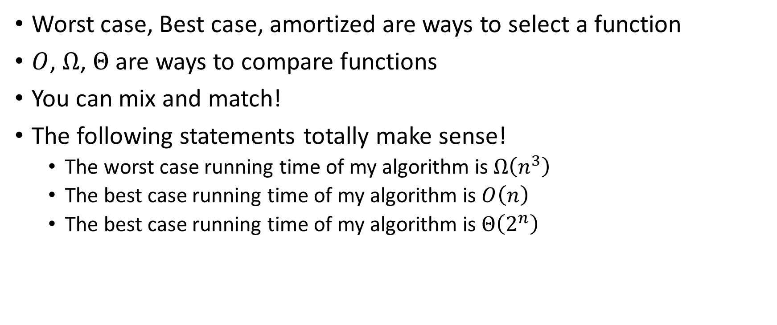
Beware!
Worst case, Best case, amortized are ways to select a function
$O$, $Ω$, $Θ$ are ways to compare functions
You can mix and match!
The following statements totally make sense!
The worst case running time of my algorithm is $Ω\left(n^{3}\right)$
The best case running time of my algorithm is $O\left(n\right)$
The best case running time of my algorithm is $Θ\left(2^{n}\right)$

