Slide 1
CSE 332 Spring 2026 Lecture 18: Graphs 4, MSTs
Nathan Brunelle
http://www.cs.uw.edu/332

Slide 2
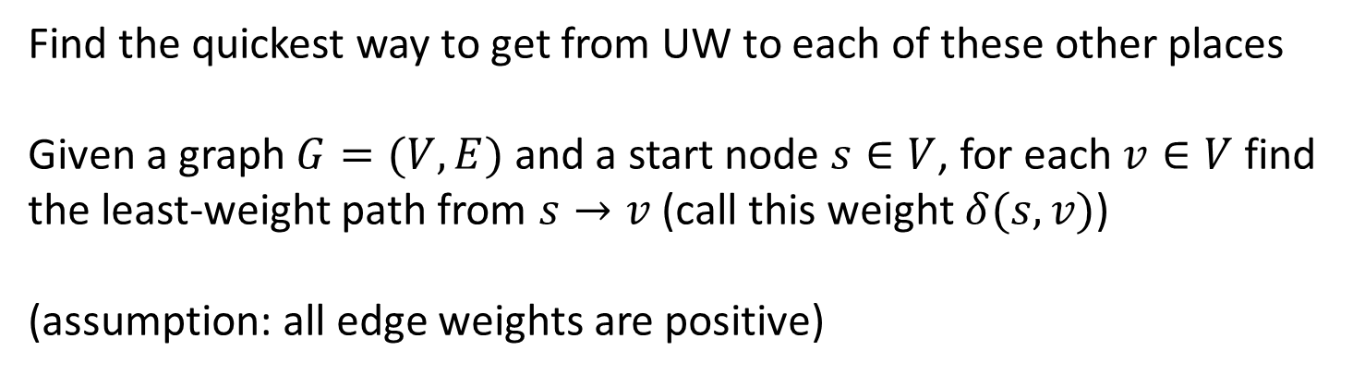
Single-Source Shortest Path
2
8
5
10
8
7
8
1
2
9
4
5
9
9
12
3
3
3
11
7
1
6
6
Find the quickest way to get from UW to each of these other places
Given a graph $G=(V,E)$ and a start node $s∈V$, for each $v∈V$ find the least-weight path from $s→v$ (call this weight $δ(s,v)$)
(assumption: all edge weights are positive)

Slide 3




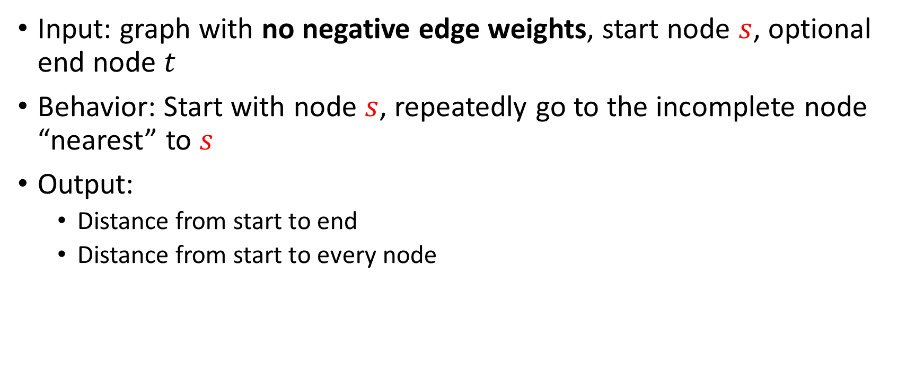





Dijkstra’s Algorithm
Input: graph with no negative edge weights, start node $s$, optional end node $t$
Behavior: Start with node $s$, repeatedly go to the incomplete node “nearest” to $s$
Output:
Distance from start to end
Distance from start to every node
$$10$$
$$18$$
1
8
10
4
$$∞$$
6
0
7
7
0
9
$$15$$
2
3
5
$$∞$$
9
8
12
3
$$12$$
2
1
$$13$$
$$∞$$
11
6
1
5
7

Slide 4
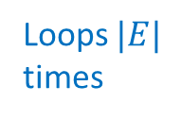

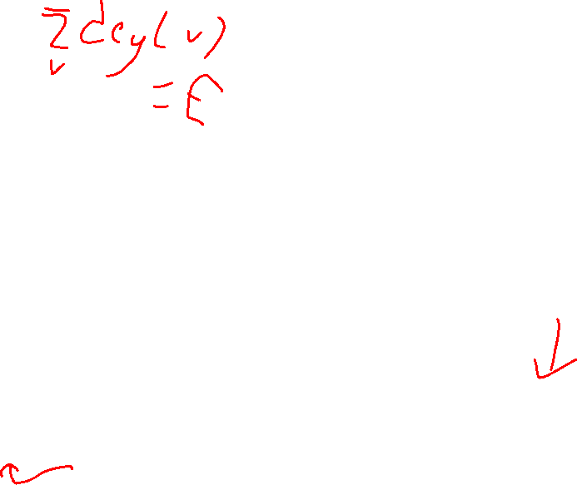
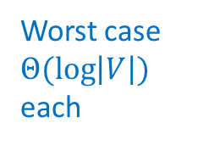
Dijkstra’s
Idea: When a node is the closest not-done thing to the start, we have found its shortest path
Distance to start = 0
Add the start node to PQ with priority 0
Mark start as “seen”
While the PQ is not empty:
curr = PQ.extract();
mark curr as “done”
for each neighbor v of curr:
d = distance to curr + weight of (curr,v)
if v is not “seen”:
mark v as “seen”
distance to v = d
PQ.add(v, d);
if v is not “done” && d < distance to v:
distance to v = d
PQ.decreaseKey(v, d)
Extract a node from priority queue (making it “done”)
Mark extracted node as seen
for each not-done neighbor:
Update its distance if we found a better path
Seen = added to the priority queue
Done = removed from the priority queue
When it’s done we’ve found the shortest path to that node
Loops $|E|$ times
Worst case $Θ(\log\left|V\right|)$ each
Running time: $Θ\left(\left|E\right|\log\left|V\right|\right)$

Slide 5



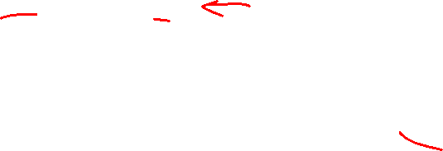



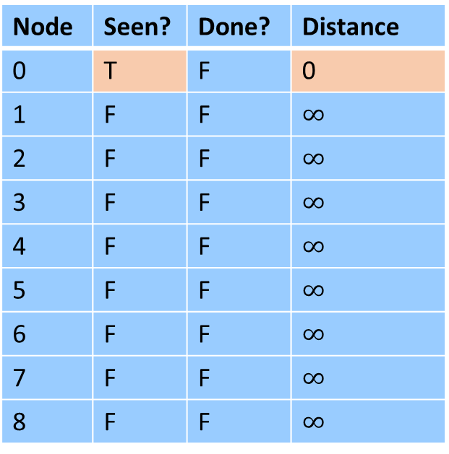


Dijkstra’s Algorithm (1/8)
Idea: When a node is the closest not-done thing to the start, we have found its shortest path
Extract a node from priority queue (making it “done”)
Mark extracted node as seen
for each not-done neighbor:
Update its distance if we found a better path
Node | Seen? | Done? | Distance
0 | T | F | 0
1 | F | F | $∞$
2 | F | F | $∞$
3 | F | F | $∞$
4 | F | F | $∞$
5 | F | F | $∞$
6 | F | F | $∞$
7 | F | F | $∞$
8 | F | F | $∞$
$$∞$$
$$∞$$
1
8
10
4
$$∞$$
6
0
7
7
0
9
$$∞$$
2
3
5
$$∞$$
9
8
12
3
$$∞$$
2
1
$$∞$$
$$∞$$
11
6
1
5
7

Slide 6

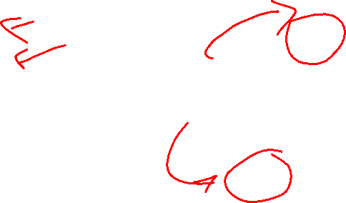

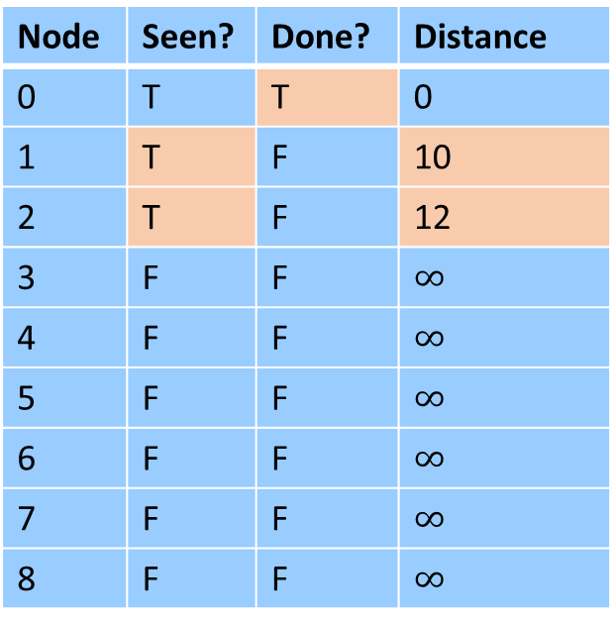
Dijkstra’s Algorithm (2/8)
Idea: When a node is the closest not-done thing to the start, we have found its shortest path
Extract a node from priority queue (making it “done”)
Mark extracted node as seen
for each not-done neighbor:
Update its distance if we found a better path
Node | Seen? | Done? | Distance
0 | T | T | 0
1 | T | F | 10
2 | T | F | 12
3 | F | F | $∞$
4 | F | F | $∞$
5 | F | F | $∞$
6 | F | F | $∞$
7 | F | F | $∞$
8 | F | F | $∞$
$$10$$
$$∞$$
1
8
10
4
$$∞$$
6
0
7
7
0
9
$$∞$$
2
3
5
$$∞$$
9
8
12
3
$$12$$
2
1
$$∞$$
$$∞$$
11
6
1
5
7

Slide 7
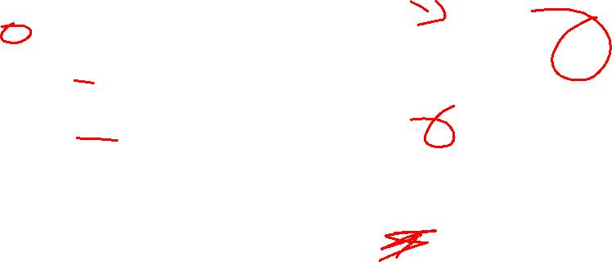

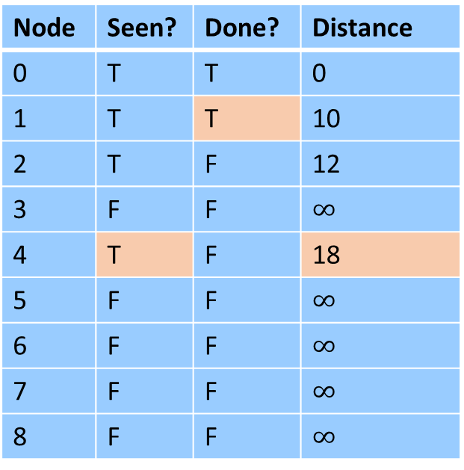
Dijkstra’s Algorithm (3/8)
Idea: When a node is the closest not-done thing to the start, we have found its shortest path
Extract a node from priority queue (making it “done”)
Mark extracted node as seen
for each not-done neighbor:
Update its distance if we found a better path
Node | Seen? | Done? | Distance
0 | T | T | 0
1 | T | T | 10
2 | T | F | 12
3 | F | F | $∞$
4 | T | F | 18
5 | F | F | $∞$
6 | F | F | $∞$
7 | F | F | $∞$
8 | F | F | $∞$
$$10$$
$$18$$
1
8
10
4
$$∞$$
6
0
7
7
0
9
$$∞$$
2
3
5
$$∞$$
9
8
12
3
$$12$$
2
1
$$∞$$
$$∞$$
11
6
1
5
7

Slide 8
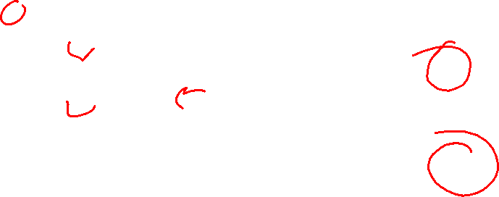

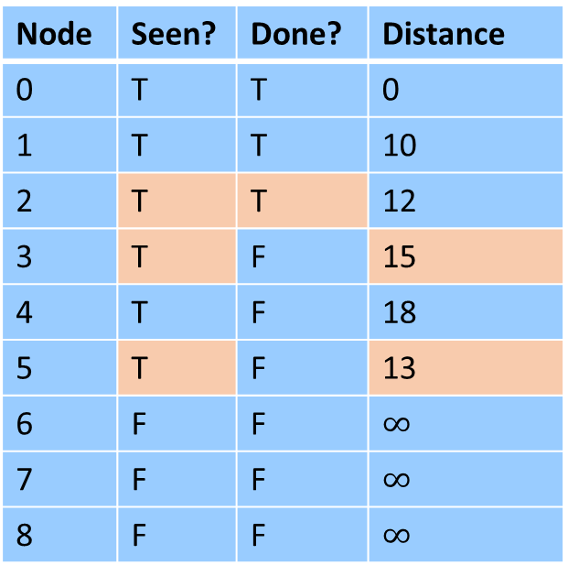

Dijkstra’s Algorithm (4/8)
Idea: When a node is the closest not-done thing to the start, we have found its shortest path
Extract a node from priority queue (making it “done”)
Mark extracted node as seen
for each not-done neighbor:
Update its distance if we found a better path
Node | Seen? | Done? | Distance
0 | T | T | 0
1 | T | T | 10
2 | T | T | 12
3 | T | F | 15
4 | T | F | 18
5 | T | F | 13
6 | F | F | $∞$
7 | F | F | $∞$
8 | F | F | $∞$
$$10$$
$$18$$
1
8
10
4
$$∞$$
6
0
7
7
0
9
$$15$$
2
3
5
$$∞$$
9
8
12
3
$$12$$
2
1
$$13$$
$$∞$$
11
6
1
5
7

Slide 9


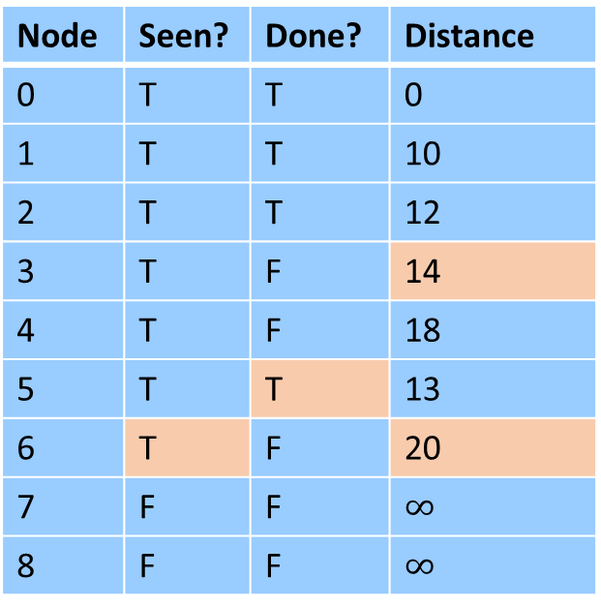

Dijkstra’s Algorithm (5/8)
Idea: When a node is the closest not-done thing to the start, we have found its shortest path
Extract a node from priority queue (making it “done”)
Mark extracted node as seen
for each not-done neighbor:
Update its distance if we found a better path
Node | Seen? | Done? | Distance
0 | T | T | 0
1 | T | T | 10
2 | T | T | 12
3 | T | F | 14
4 | T | F | 18
5 | T | T | 13
6 | T | F | 20
7 | F | F | $∞$
8 | F | F | $∞$
$$10$$
$$18$$
1
8
10
4
$$∞$$
6
0
7
7
0
9
$$14$$
2
3
5
$$∞$$
9
8
12
3
$$12$$
2
1
$$13$$
$$20$$
11
6
1
5
7

Slide 10
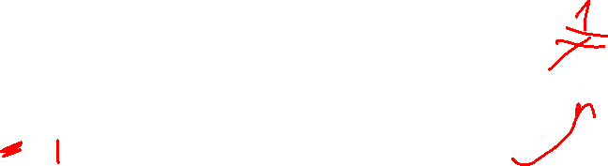

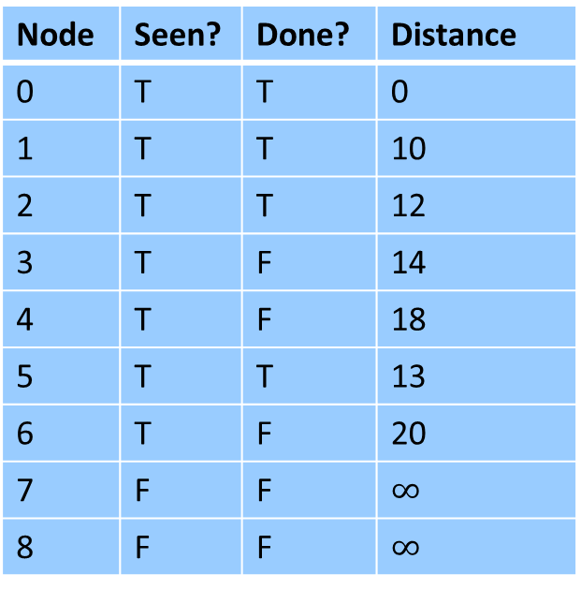
Dijkstra’s Algorithm (6/8)
What if we had a negative-weight edge?
Extract a node from priority queue (making it “done”)
Mark extracted node as seen
for each not-done neighbor:
Update its distance if we found a better path
Node | Seen? | Done? | Distance
0 | T | T | 0
1 | T | T | 10
2 | T | T | 12
3 | T | F | 14
4 | T | F | 18
5 | T | T | 13
6 | T | F | 20
7 | F | F | $∞$
8 | F | F | $∞$
$$10$$
$$18$$
1
8
10
4
$$∞$$
6
0
$$−13$$
7
0
9
$$14$$
2
3
5
$$∞$$
9
8
12
3
$$12$$
2
1
$$13$$
$$20$$
11
6
1
5
7

Slide 11




Dijkstra’s Algorithm (7/8)
What if we had a negative-weight edge?
Extract a node from priority queue (making it “done”)
Mark extracted node as seen
for each not-done neighbor:
Update its distance if we found a better path
Node | Seen? | Done? | Distance
0 | T | T | 0
1 | T | T | 10
2 | T | T | 12
3 | T | T | 14
4 | T | F | 1
5 | T | T | 13
6 | T | F | 20
7 | F | F | $∞$
8 | F | F | $∞$
$$10$$
$$1$$
1
8
10
4
$$∞$$
6
0
$$−13$$
7
0
9
$$14$$
2
3
5
$$∞$$
9
8
12
3
$$12$$
2
1
$$13$$
$$20$$
11
6
1
5
7

Slide 12
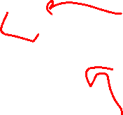

Dijkstra’s Algorithm (8/8)
What if we had a negative-weight edge?
Extract a node from priority queue (making it “done”)
Mark extracted node as seen
for each not-done neighbor:
Update its distance if we found a better path
Node | Seen? | Done? | Distance
0 | T | T | 0
1 | T | T | 10
2 | T | T | 12
3 | T | T | 14
4 | T | T | 1
5 | T | T | 13
6 | T | F | 20
7 | F | F | $∞$
8 | F | F | $∞$
There’s a better path!
$$10$$
$$1$$
1
8
10
4
$$∞$$
6
0
$$−13$$
7
0
9
$$14$$
2
3
5
$$∞$$
9
8
12
3
$$12$$
2
1
$$13$$
$$20$$
11
6
1
5
7

Slide 13
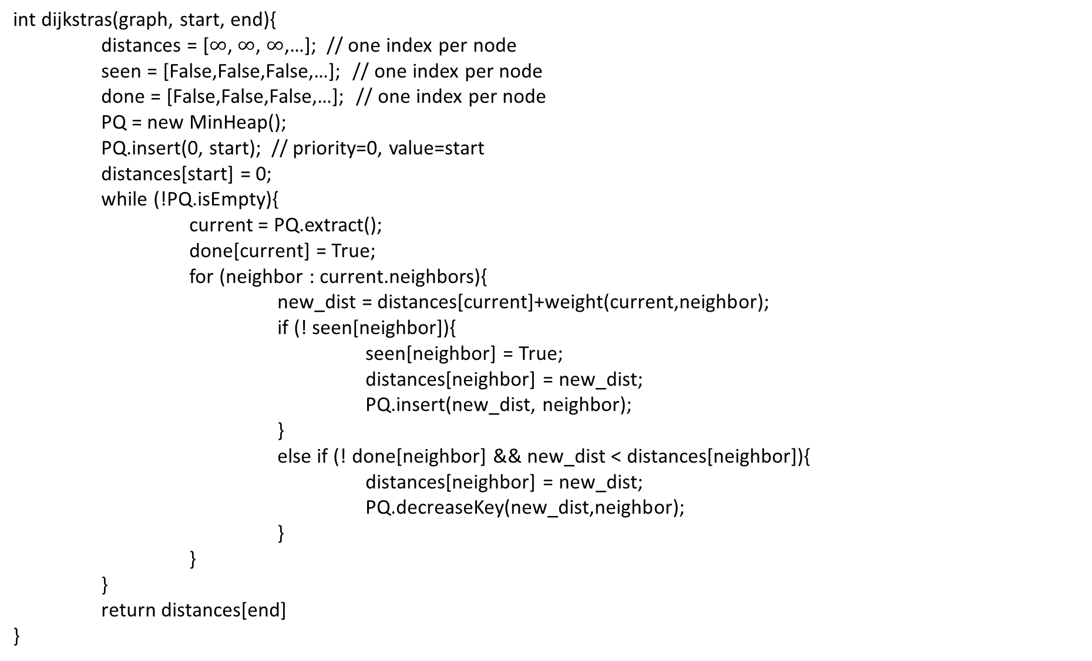

Dijkstra’s Algorithm - Pseudocode
int dijkstras(graph, start, end){
distances = [$∞$, $∞$, $∞$,…]; // one index per node
seen = [False,False,False,…]; // one index per node
done = [False,False,False,…]; // one index per node
PQ = new MinHeap();
PQ.insert(0, start); // priority=0, value=start
distances[start] = 0;
while (!PQ.isEmpty){
current = PQ.extract();
done[current] = True;
for (neighbor : current.neighbors){
new_dist = distances[current]+weight(current,neighbor);
if (! seen[neighbor]){
seen[neighbor] = True;
distances[neighbor] = new_dist;
PQ.insert(new_dist, neighbor);
}
else if (! done[neighbor] && new_dist < distances[neighbor]){
distances[neighbor] = new_dist;
PQ.decreaseKey(new_dist,neighbor);
}
}
}
return distances[end]
}

Slide 14
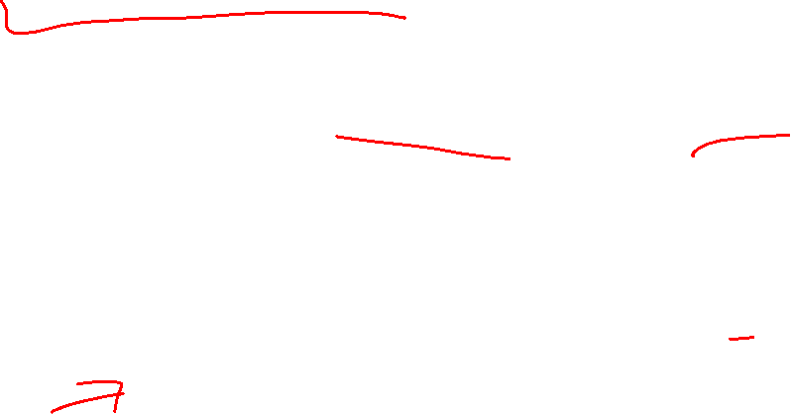
Definition: Tree
A connected graph with no cycles
2
5
8
1
Note: A tree does not need a root, but they often do!
4
9
3
7
6
A Tree

Slide 15
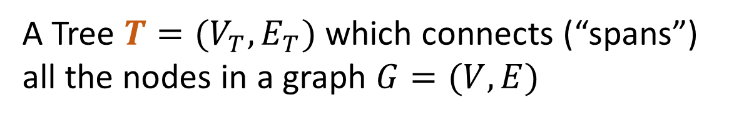
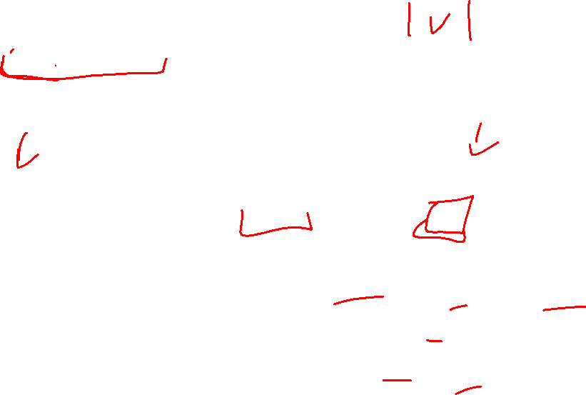

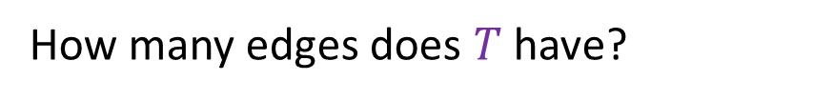
Definition: Spanning Tree
A Tree $T=(V_{T},E_{T})$ which connects (“spans”) all the nodes in a graph $G=(V,E)$
How many edges does $T$ have?
B
8
10
E
8
$$V−1$$
8
7
H
E
8
A
9
2
10
B
H
D
5
9
5
2
I
12
A
G
I
3
Pick some arbitrary root node and rearrange tree
C
3
6
11
1
F
G
3
1
F
6
C
D
Any set of V-1 edges in the graph that doesn’t have any cycles is guaranteed to be a spanning tree!
Any set of V-1 edges that connects all the nodes in the graph is guaranteed to be a spanning tree!
Notes:
Some set of edges from the graph, which forms a tree with all of the nodes in a graph. Subset of the edges, which has no cycles, and connects all the nodes.

Slide 16
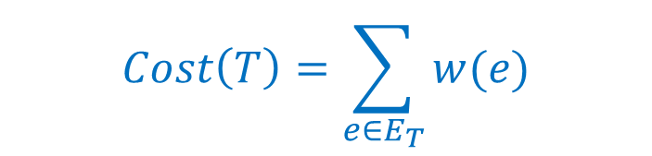
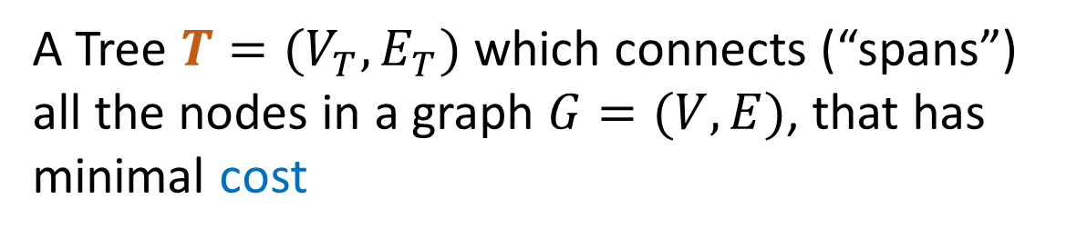

Definition: Minimum Spanning Tree
A Tree $T=(V_{T},E_{T})$ which connects (“spans”) all the nodes in a graph $G=(V,E)$, that has minimal cost
B
8
10
E
8
$$Cost\left(T\right)=\sum_{e∈E_{T}}{w(e)}$$
7
H
A
9
2
D
5
9
I
12
3
C
3
11
G
1
F
6

Slide 17
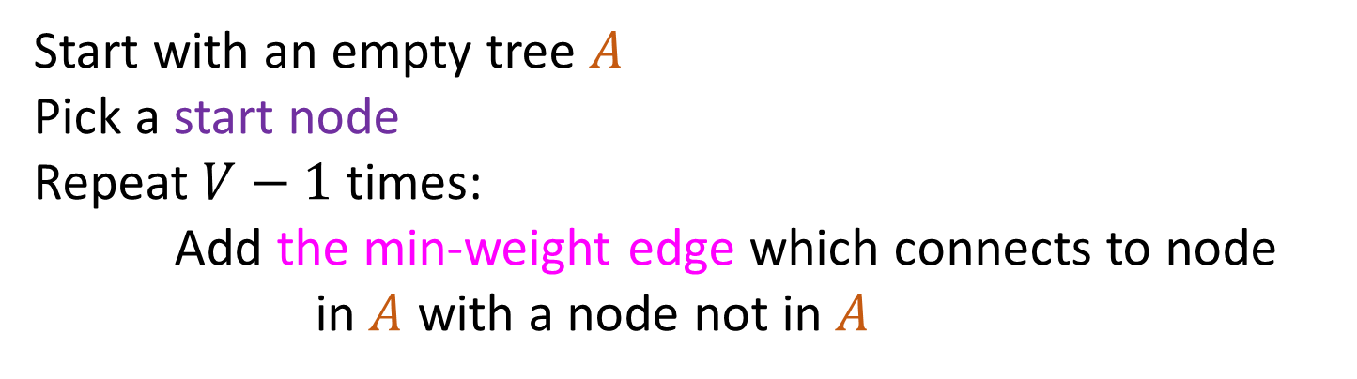
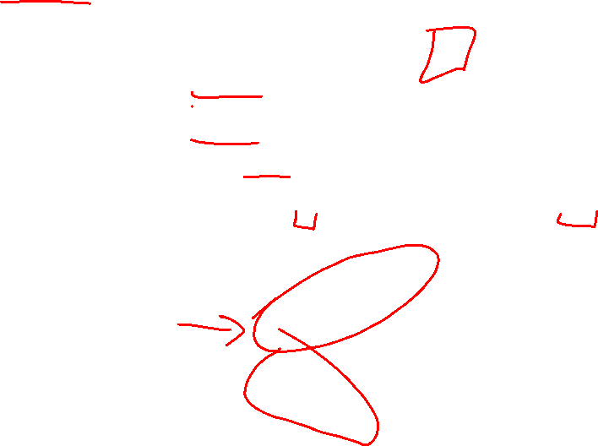
Prim’s Algorithm (1/4)
Start with an empty tree $A$
Pick a start node
Repeat $V−1$ times:
Add the min-weight edge which connects to node in $A$ with a node not in $A$
B
8
10
E
6
7
H
A
9
2
D
5
9
I
12
3
C
3
11
G
1
F
7

Slide 18

Prim’s Algorithm (2/4)
Start with an empty tree $A$
Pick a start node
Repeat $V−1$ times:
Add the min-weight edge which connects to node in $A$ with a node not in $A$
B
8
10
E
6
7
H
A
9
2
D
5
9
I
12
3
C
3
11
G
1
F
7

Slide 19
Prim’s Algorithm (3/4)
Start with an empty tree $A$
Pick a start node
Repeat $V−1$ times:
Add the min-weight edge which connects to node in $A$ with a node not in $A$
B
8
10
E
6
7
H
A
9
2
D
5
9
I
12
3
C
3
11
G
1
F
7

Slide 20

Prim’s Algorithm (4/4)
Start with an empty tree $A$
Pick a start node
Repeat $V−1$ times:
Add the min-weight edge which connects to node in $A$ with a node not in $A$
B
8
10
E
6
7
H
A
9
2
D
5
9
I
12
3
C
3
11
G
1
F
7

Slide 21
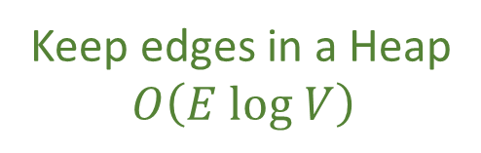
Prim’s Algorithm Running Time
Keep edges in a Heap
$$O\left(E log V\right)$$
Start with an empty tree $A$
Pick a start node
Repeat $V−1$ times:
Add the min-weight edge which connects to node in $A$ with a node not in $A$
B
8
10
E
6
7
H
A
9
2
D
5
9
I
12
3
C
3
11
G
1
F
7

Slide 22

Recall Dijkstra’s Algorithm
1
8
10
4
Distance to start = 0
Add the start node to PQ with priority 0
Mark start as “seen”
While the PQ is not empty:
curr = PQ.extract()
mark curr as “done”
add the edge (previous of curr, curr) to the spanning tree
for each neighbor v of curr:
d = distance to curr + weight of (curr,v)
if v is not “seen”:
mark v as “seen”
distance to v = d
previous of v = curr
PQ.add(v, d);
if v is not “done” && d < distance to v:
distance to v = d
previous of v = curr
PQ.decreaseKey(v, d)
Return the spanning tree
6
7
7
0
9
2
3
5
9
8
12
3
2
3
11
6
1
5
7

Slide 23

Prim’s Algorithm
1
8
10
4
Distance to start = 0
Add the start node to PQ with priority 0
Mark start as “seen”
While the PQ is not empty:
curr = PQ.extract()
mark curr as “done”
add the edge (previous of curr, curr) to the spanning tree
for each neighbor v of curr:
d = weight of (curr,v)
if v is not “seen”:
mark v as “seen”
distance to v = d
previous of v = curr
PQ.add(v, d);
if v is not “done” && d < distance to v:
distance to v = d
previous of v = curr
PQ.decreaseKey(v, d)
Return the spanning tree
6
7
7
0
9
2
3
5
9
8
12
3
2
3
11
6
1
5
7

Slide 24
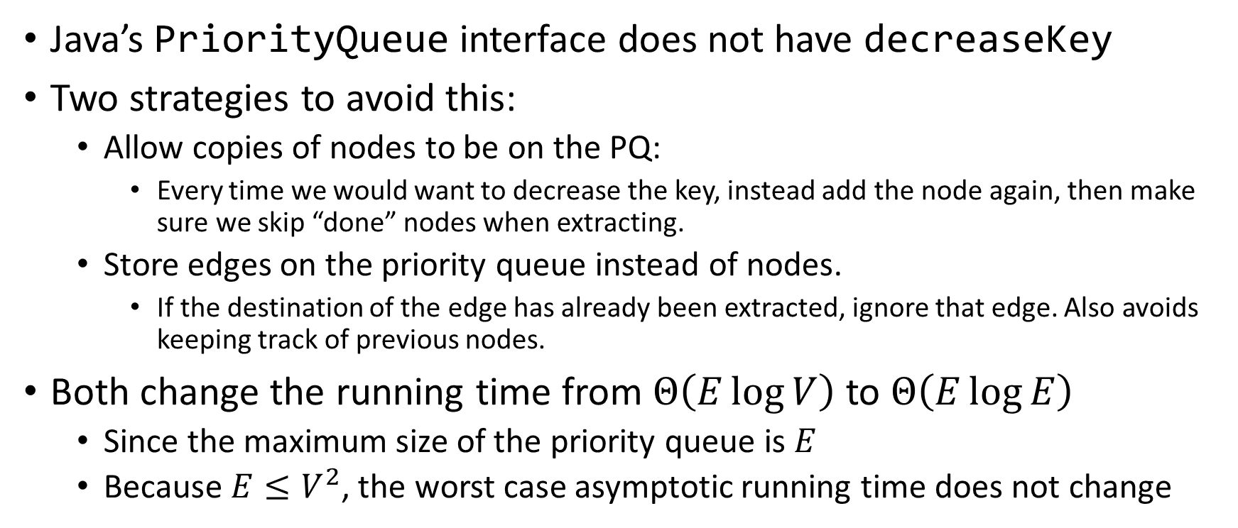
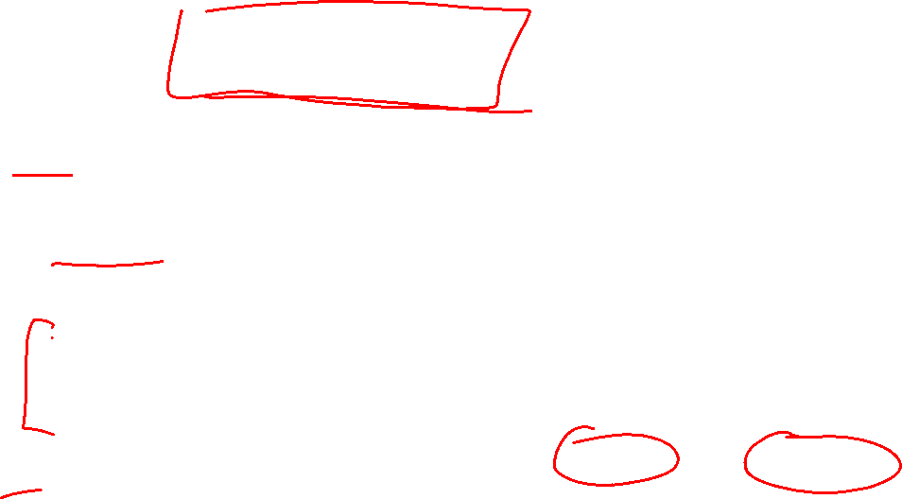
Avoiding Decrease Key
Java’s PriorityQueue interface does not have decreaseKey
Two strategies to avoid this:
Allow copies of nodes to be on the PQ:
Every time we would want to decrease the key, instead add the node again, then make sure we skip “done” nodes when extracting.
Store edges on the priority queue instead of nodes.
If the destination of the edge has already been extracted, ignore that edge. Also avoids keeping track of previous nodes.
Both change the running time from $Θ\left(E\log{V}\right)$ to $Θ\left(E\log{E}\right)$
Since the maximum size of the priority queue is $E$
Because $E≤V^{2}$, the worst case asymptotic running time does not change

Slide 25
Prim’s Algorithm – Original Recipe
Distance to start = 0
Add the start node to PQ with priority 0
Mark start as “seen”
While the PQ is not empty:
curr = PQ.extract()
mark curr as “done”
add the edge (previous of curr, curr) to the spanning tree
for each neighbor v of curr:
d = weight of (curr,v)
if v is not “seen”:
mark v as “seen”
distance to v = d
previous of v = curr
PQ.add(v, d);
if v is not “done” && d < distance to v:
distance to v = d
previous of v = curr
PQ.decreaseKey(v, d)
Return the spanning tree

Slide 26
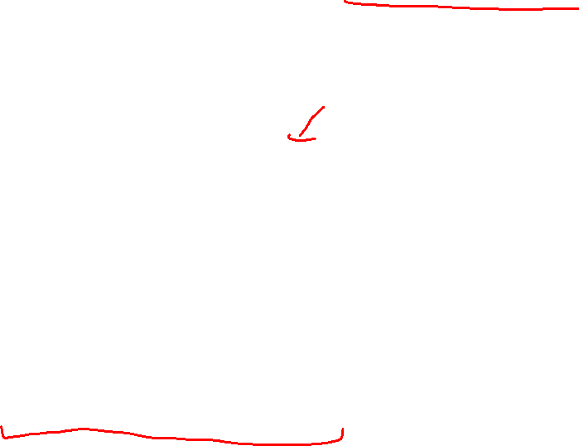
Prim’s Algorithm – Duplicate Nodes on the PQ
Distance to start = 0
Add the start node to PQ with priority 0
Mark start as “seen”
While the PQ is not empty:
curr = PQ.extract()
if(curr is “done”) then continue
mark curr as “done”
add the edge (previous of curr, curr) to the spanning tree
for each neighbor v of curr:
d = weight of (curr,v)
if v is not “seen”:
mark v as “seen”
distance to v = d
previous of v = curr
PQ.add(v, d);
if v is not “done” && d < distance to v:
distance to v = d
previous of v = curr
PQ.add(v, d)
Return the spanning tree

Slide 27
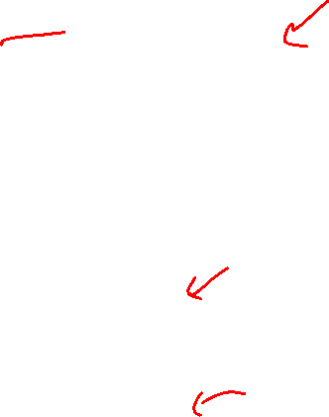
Prim’s Algorithm – Edges on the PQ
Distance to start = 0
Add the start node to PQ with priority 0
Mark start as “seen”
While the PQ is not empty:
currEdge = PQ.extract()
curr = currEdge.destination
if(curr is “done”) then continue
mark curr as “done”
add currEdge to the spanning tree
for each neighbor v of curr:
d = weight of (curr,v)
if v is not “seen”:
mark v as “seen”
distance to v = d
PQ.add((curr,v),d);
if v is not “done” && d < distance to v:
distance to v = d
PQ.add((curr,v), d)
Return the spanning tree

Slide 28
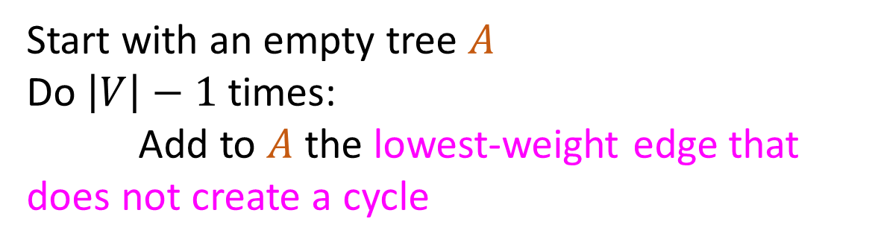
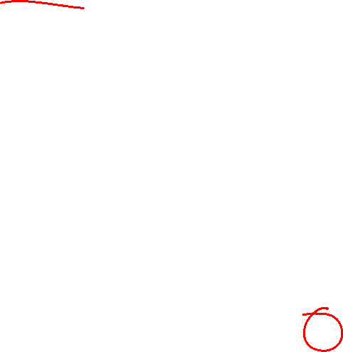
Kruskal’s Algorithm (1/6)
Start with an empty tree $A$
Do $\left|V\right|−1$ times:
Add to $A$ the lowest-weight edge that does not create a cycle
B
8
10
E
8
7
H
A
9
2
D
5
9
I
12
3
C
3
11
G
1
F
6

Slide 29

Kruskal’s Algorithm (2/6)
Start with an empty tree $A$
Do $\left|V\right|−1$ times:
Add to $A$ the lowest-weight edge that does not create a cycle
B
8
10
E
8
7
H
A
9
2
D
5
9
I
12
3
C
3
11
G
1
F
6

Slide 30
Kruskal’s Algorithm (3/6)
Start with an empty tree $A$
Do $\left|V\right|−1$ times:
Add to $A$ the lowest-weight edge that does not create a cycle
B
8
10
E
8
7
H
A
9
2
D
5
9
I
12
3
C
3
11
G
1
F
6

Slide 31

Kruskal’s Algorithm (4/6)
Start with an empty tree $A$
Do $\left|V\right|−1$ times:
Add to $A$ the lowest-weight edge that does not create a cycle
B
8
10
E
8
7
H
A
9
2
D
5
9
I
12
3
C
3
11
G
1
F
6

Slide 32

Kruskal’s Algorithm (5/6)
Start with an empty tree $A$
Do $\left|V\right|−1$ times:
Add to $A$ the lowest-weight edge that does not create a cycle
B
8
10
E
8
7
H
A
9
2
D
5
9
I
12
3
C
3
11
G
1
F
6

Slide 33
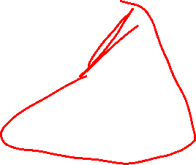
Kruskal’s Algorithm (6/6)
Start with an empty tree $A$
Do $\left|V\right|−1$ times:
Add to $A$ the lowest-weight edge that does not create a cycle
B
8
10
E
8
7
H
A
9
2
D
5
9
I
12
3
C
3
11
G
1
F
6

Slide 34
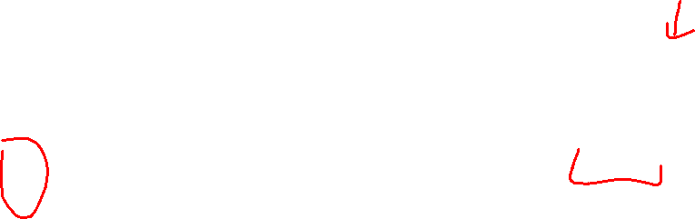
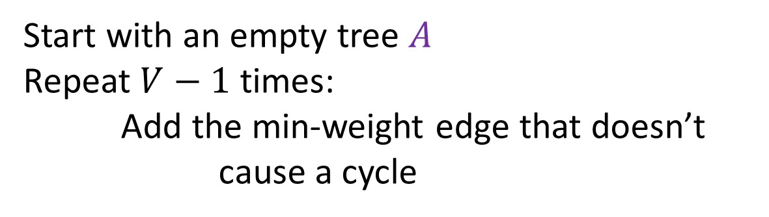
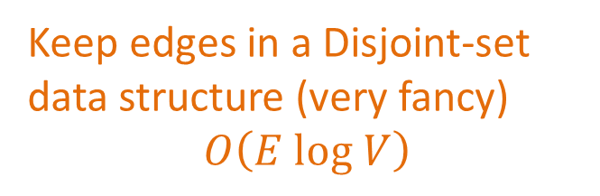
Kruskal’s Algorithm Runtime
Start with an empty tree $A$
Repeat $V−1$ times:
Add the min-weight edge that doesn’t cause a cycle
Keep edges in a Disjoint-set data structure (very fancy)
$$O\left(E log V\right)$$
B
8
10
E
8
7
H
A
9
2
D
5
9
I
12
3
C
3
11
G
1
F
6

Slide 35
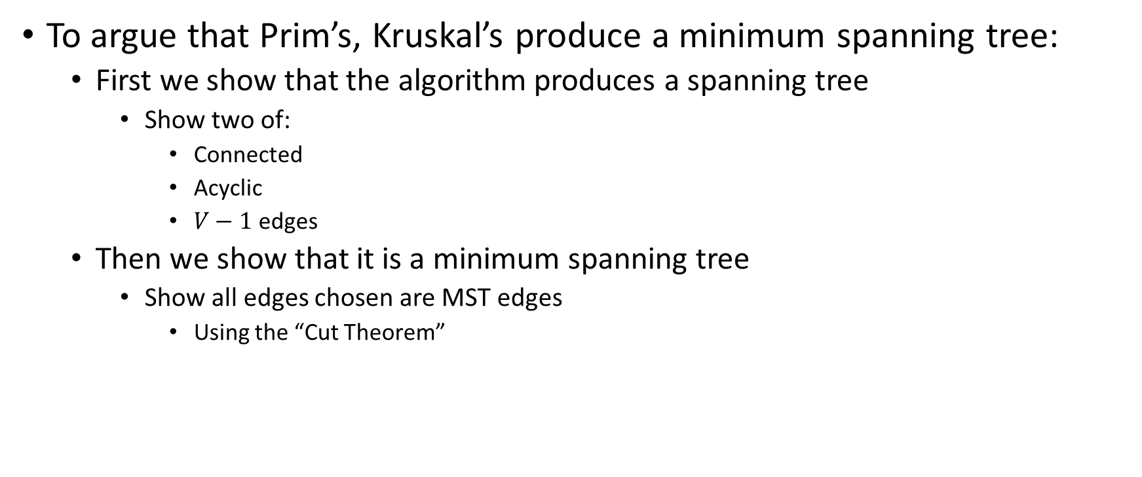
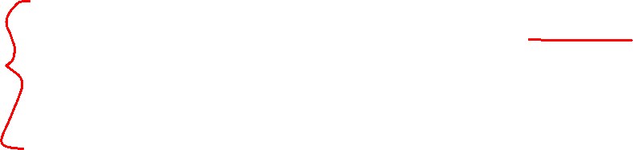
Why do these work?
To argue that Prim’s, Kruskal’s produce a minimum spanning tree:
First we show that the algorithm produces a spanning tree
Show two of:
Connected
Acyclic
$V−1$ edges
Then we show that it is a minimum spanning tree
Show all edges chosen are MST edges
Using the “Cut Theorem”

Slide 36
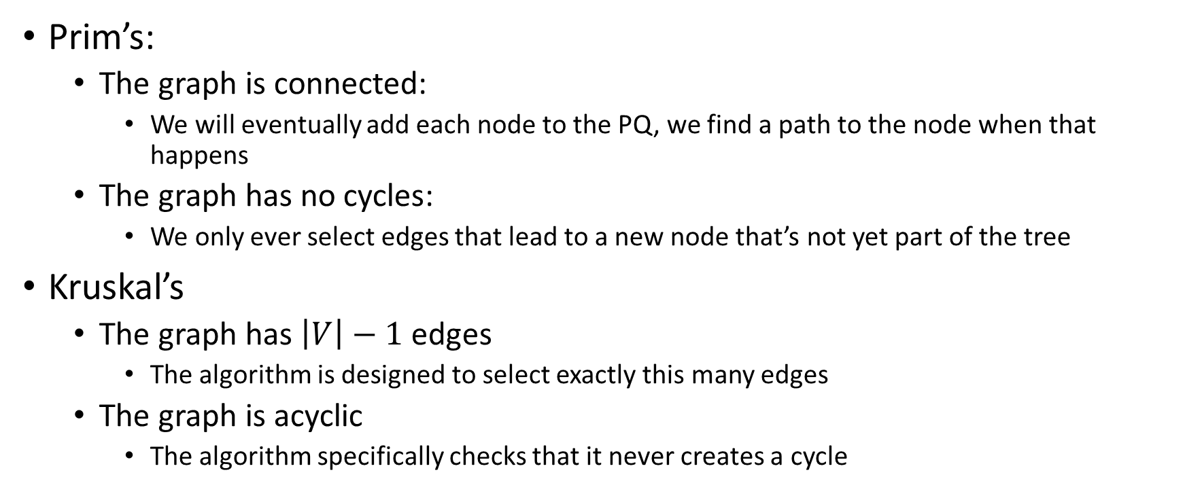
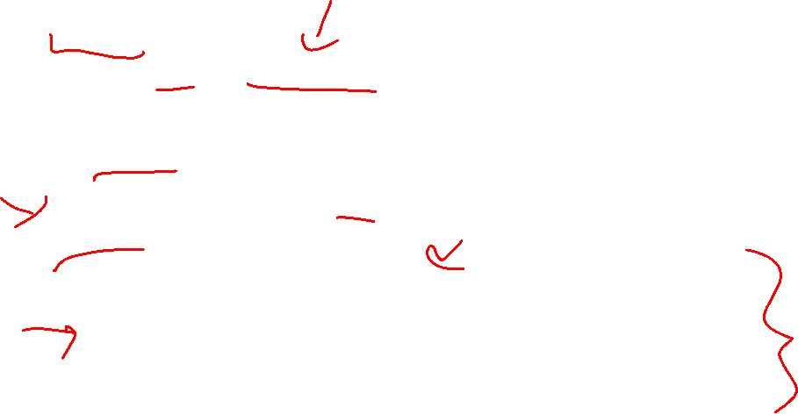
Prim’s, Kruskal’s Produce a Spanning Tree
Prim’s:
The graph is connected:
We will eventually add each node to the PQ, we find a path to the node when that happens
The graph has no cycles:
We only ever select edges that lead to a new node that’s not yet part of the tree
Kruskal’s
The graph has $\left|V\right|−1$ edges
The algorithm is designed to select exactly this many edges
The graph is acyclic
The algorithm specifically checks that it never creates a cycle

Slide 37
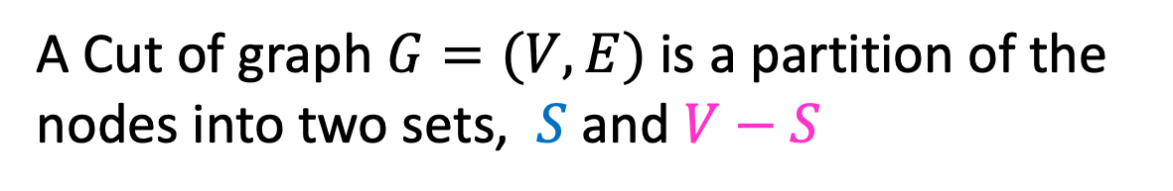
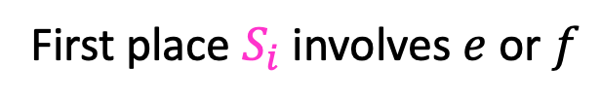


Definition: Cut
A Cut of graph $G=(V,E)$ is a partition of the nodes into two sets, $S$ and $V−S$
B
8
10
E
8
7
H
A
9
2
D
5
9
$$S$$
I
12
3
C
3
11
G
1
F
6
Edge $\left(v_{1},v_{2}\right)∈E$ crosses a cut if $v_{1}∈S$ and $v_{2}∈V−S$ (or opposite), e.g. $(A,C)$
A set of edges $R$ Respects a cut if no edges cross the cut
e.g. $R=\{\left(A,B\right),\left(E,G\right),\left(F,G\right)\}$
Notes:
Go over some examples of edges that cross the cut and edges that do not

Slide 38

Cut Theorem
If a set of edges $A$ is a subset of a minimum spanning tree $T$, let $(S, V−S)$ be any cut which $A$ respects. Let $e$ be the least-weight edge which crosses $(S, V−S)$. $A∪\{e\}$ is also a subset of a minimum spanning tree.
Notes:
If I take any cut at all in the graph, then the least weight edge across that cut is guaranteed to be part of some minimum spanning tree. The least weight edge that crosses any cut in .
We need a bit more mechanics to make this work for kruskals.
Suppose A is a subset of a minimum spanning tree, meaning, we are on our way to building. There is a minimum spanning tree T, where every edge in A is part of this minimum spanning tree T
Define some cut (S,V-S), which A respects. It is safe to add e to A and we will have made more progress
Repeat v-1 times. If we know we can start with some arbitrary subset, then we can add this edge e . There is some minimum spanning tree that has this edge f,g. If I used some other edge instead, an

Slide 39

Cut Theorem (1/4)
If a set of edges $A$ is a subset of a minimum spanning tree $T$, let $(S, V−S)$ be any cut which $A$ respects. Let $e$ be the least-weight edge which crosses $(S, V−S)$. $A∪\{e\}$ is also a subset of a minimum spanning tree.
B
8
10
E
8
7
H
A
9
2
D
5
9
I
12
3
C
3
11
G
1
F
6
Notes:
If I take any cut at all in the graph, then the least weight edge across that cut is guaranteed to be part of some minimum spanning tree. The least weight edge that crosses any cut in .
We need a bit more mechanics to make this work for kruskals.
Suppose A is a subset of a minimum spanning tree, meaning, we are on our way to building. There is a minimum spanning tree T, where every edge in A is part of this minimum spanning tree T
Define some cut (S,V-S), which A respects. It is safe to add e to A and we will have made more progress
Repeat v-1 times. If we know we can start with some arbitrary subset, then we can add this edge e . There is some minimum spanning tree that has this edge f,g. If I used some other edge instead, an

Slide 40

Cut Theorem (2/4)
If a set of edges $A$ is a subset of a minimum spanning tree $T$, let $(S, V−S)$ be any cut which $A$ respects. Let $e$ be the least-weight edge which crosses $(S, V−S)$. $A∪\{e\}$ is also a subset of a minimum spanning tree.
B
8
10
E
8
7
H
A
9
2
D
5
9
I
12
3
C
3
11
G
1
F
6
Notes:
If I take any cut at all in the graph, then the least weight edge across that cut is guaranteed to be part of some minimum spanning tree. The least weight edge that crosses any cut in .
We need a bit more mechanics to make this work for kruskals.
Suppose A is a subset of a minimum spanning tree, meaning, we are on our way to building. There is a minimum spanning tree T, where every edge in A is part of this minimum spanning tree T
Define some cut (S,V-S), which A respects. It is safe to add e to A and we will have made more progress
Repeat v-1 times. If we know we can start with some arbitrary subset, then we can add this edge e . There is some minimum spanning tree that has this edge f,g. If I used some other edge instead, an

Slide 41

Cut Theorem (3/4)
If a set of edges $A$ is a subset of a minimum spanning tree $T$, let $(S, V−S)$ be any cut which $A$ respects. Let $e$ be the least-weight edge which crosses $(S, V−S)$. $A∪\{e\}$ is also a subset of a minimum spanning tree.
B
8
10
E
8
7
H
A
9
2
D
5
9
I
12
3
C
3
11
G
1
F
6
Notes:
If I take any cut at all in the graph, then the least weight edge across that cut is guaranteed to be part of some minimum spanning tree. The least weight edge that crosses any cut in .
We need a bit more mechanics to make this work for kruskals.
Suppose A is a subset of a minimum spanning tree, meaning, we are on our way to building. There is a minimum spanning tree T, where every edge in A is part of this minimum spanning tree T
Define some cut (S,V-S), which A respects. It is safe to add e to A and we will have made more progress
Repeat v-1 times. If we know we can start with some arbitrary subset, then we can add this edge e . There is some minimum spanning tree that has this edge f,g. If I used some other edge instead, an

Slide 42

Cut Theorem (4/4)
If a set of edges $A$ is a subset of a minimum spanning tree $T$, let $(S, V−S)$ be any cut which $A$ respects. Let $e$ be the least-weight edge which crosses $(S, V−S)$. $A∪\{e\}$ is also a subset of a minimum spanning tree.
B
8
10
E
8
7
H
A
9
2
D
5
9
I
12
3
C
3
11
G
1
F
6
Notes:
If I take any cut at all in the graph, then the least weight edge across that cut is guaranteed to be part of some minimum spanning tree. The least weight edge that crosses any cut in .
We need a bit more mechanics to make this work for kruskals.
Suppose A is a subset of a minimum spanning tree, meaning, we are on our way to building. There is a minimum spanning tree T, where every edge in A is part of this minimum spanning tree T
Define some cut (S,V-S), which A respects. It is safe to add e to A and we will have made more progress
Repeat v-1 times. If we know we can start with some arbitrary subset, then we can add this edge e . There is some minimum spanning tree that has this edge f,g. If I used some other edge instead, an

Slide 43




Proof of Prim’s Algorithm
Proof: By Structural Induction
Suppose we have some arbitrary set of edges $A$ that Prims’s has already selected to include in the MST. $e=(E,G)$is the edge Prims’s selects to add next
We know that there cannot exist a path from $E$to G using only edges in $A$ because $G$ has not been removed from the priority queue
We can cut the graph therefore into 2 disjoint sets:
Nodes that have been removed from the priority queue
All other nodes
$e$ is the minimum cost edge that crosses this cut, so by the Cut Theorem, Prim’s only selects MST edges!
Start with an empty tree $A$
Repeat $V−1$ times:
Add the min-weight edge that connects
to a node not currently in the tree
$$S$$
B
8
10
E
6
7
H
A
9
$$e$$
2
D
5
9
I
12
3
C
3
11
G
1
F
7

Slide 44




Proof of Kruskal’s Algorithm
Start with an empty tree $A$
Repeat $V−1$ times:
Add the min-weight edge that doesn’t cause a cycle
Proof: Suppose we have some arbitrary set of edges $A$ that Kruskal’s has already selected to include in the MST. $e=(F,G)$is the edge Kruskal’s selects to add next
We know that there cannot exist a path from $F$to G using only edges in $A$ because $e$ does not cause a cycle
We can cut the graph therefore into 2 disjoint sets:
nodes reachable from G using edges in $A$
All other nodes
$e$ is the minimum cost edge that crosses this cut, so by the Cut Theorem, Kruskal’s is optimal!
B
8
10
E
8
7
H
A
9
2
D
5
9
I
12
3
C
3
$$e$$
11
G
1
F
6
$$S$$

Slide 45

General MST Algorithm
Start with an empty tree $A$
Repeat $V−1$ times:
Pick a cut $(S,V−S)$ which $A$ respects (typically implicitly)
Add the min-weight edge which crosses $(S,V−S)$
B
8
10
E
8
7
H
A
9
2
D
5
9
I
12
3
C
3
11
G
1
F
6

Slide 46

Generic MST Algorithm as Prim’s
Start with an empty tree $A$
Repeat $V−1$ times:
Pick a cut $(S,V−S)$ which $A$ respects
Add the min-weight edge which crosses $(S,V−S)$
$S$ is all endpoints of edges in $A$
$e$ is the min-weight edge that grows the tree
B
8
10
E
6
7
H
A
9
2
D
5
9
I
12
3
C
3
11
G
1
F
7

Slide 47

Generic MST Algorithm as Kruskal’s
Start with an empty tree $A$
Repeat $V−1$ times:
Pick a cut $(S,V−S)$ which $A$ respects
Add the min-weight edge which crosses $(S,V−S)$
$S$ is all nodes reaching from 1 endpoint of $e$
$e$ is the least-weight edge that does not create a cycle
B
8
10
E
6
7
H
A
9
2
D
5
9
I
12
3
C
3
11
G
1
F
7

