Slide 1
CSE 332 Spring 2026 Lecture 10: hashing
Nathan Brunelle
http://www.cs.uw.edu/332

Slide 2

Dictionary (Map) ADT - Ordered
Contents:
Sets of key+value pairs
Keys must be comparable
Operations:
insert(key, value)
Adds the (key,value) pair into the dictionary
If the key already has a value, overwrite the old value
Consequence: Keys cannot be repeated
find(key)
Returns the value associated with the given key
delete(key)
Remove the key (and its associated value)

Slide 3
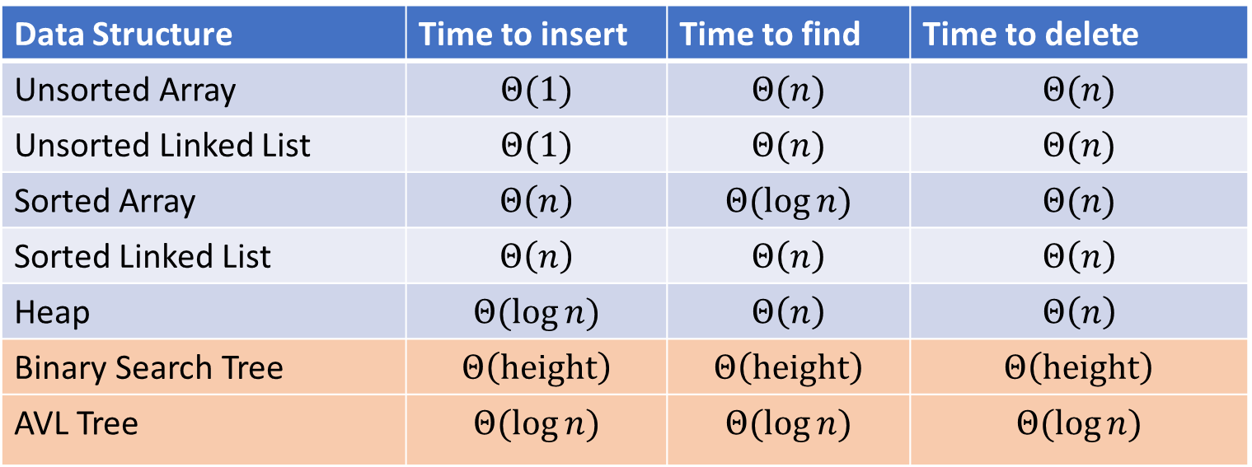

Dictionary Data Structures
Data Structure | Time to insert | Time to find | Time to delete
Unsorted Array | $$Θ(1)$$ | $$Θ(n)$$ | $$Θ(n)$$
Unsorted Linked List | $$Θ(1)$$ | $$Θ(n)$$ | $$Θ(n)$$
Sorted Array | $$Θ\left(n\right)$$ | $$Θ(\log{n})$$ | $$Θ(n)$$
Sorted Linked List | $$Θ\left(n\right)$$ | $$Θ\left(n\right)$$ | $$Θ\left(n\right)$$
Heap | $$Θ(\log{n})$$ | $$Θ\left(n\right)$$ | $$Θ\left(n\right)$$
Binary Search Tree | $$Θ\left(height\right)$$ | $$Θ\left(height\right)$$ | $$Θ\left(height\right)$$
AVL Tree | $$Θ(\log{n})$$ | $$Θ(\log{n})$$ | $$Θ(\log{n})$$

Slide 4
BSTs and AVL Trees
Binary Search Tree:
A binary tree where for each node, all keys in its left subtree are smaller and all keys in its right subtree are larger
Find:
If it matches, return the value.
If the search key is less than the current node, look left. If it’s greater, look right.
If we reach an empty spot, find was unsuccessful
Insert:
Do a find, if it was successful then update the value
If it was unsuccessful, add a new node to the empty spot we found.
Delete:
If the deleted node is a leaf, just remove it
If the deleted node had one child, replace it with that one child
If the deleted node had 2 children, replace it with the largest key to the left
AVL Tree:
A binary search tree where for each node, the height of its left subtree and the height of its right subtree are off by at most 1.
Find:
Same as BST
Insert:
Do a BST insert, then rotate if tree is unbalanced (apply one LL, RR, LR, RL case)
Delete:
Do a BST delete, then rotate if the tree is unbalanced (apply LL, RR, LR, RL cases as needed from leaf to root)

Slide 5
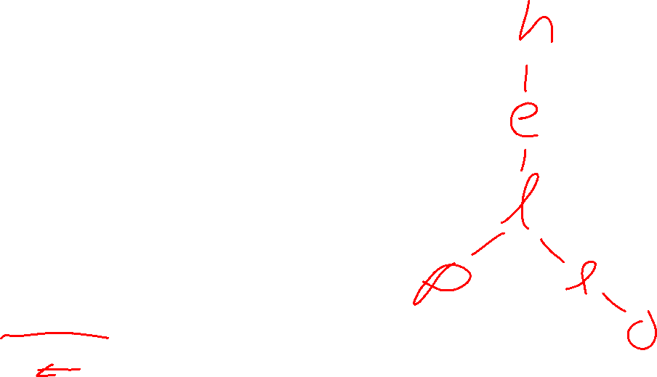
Other Tree-based Dictionaries
Red-Black Trees
Similar to AVL Trees in that we add shape rules to BSTs
More “relaxed” shape than an AVL Tree
Trees can be taller (though not asymptotically so)
Needs to move nodes less frequently
This is what Java’s TreeMap uses!
Tries
Similar to a Huffman Tree
Requires keys to be sequences (e.g. Strings)
Combines shared prefixes among keys to save space
Often used for text-based searches
Web search
Genomes

Slide 6
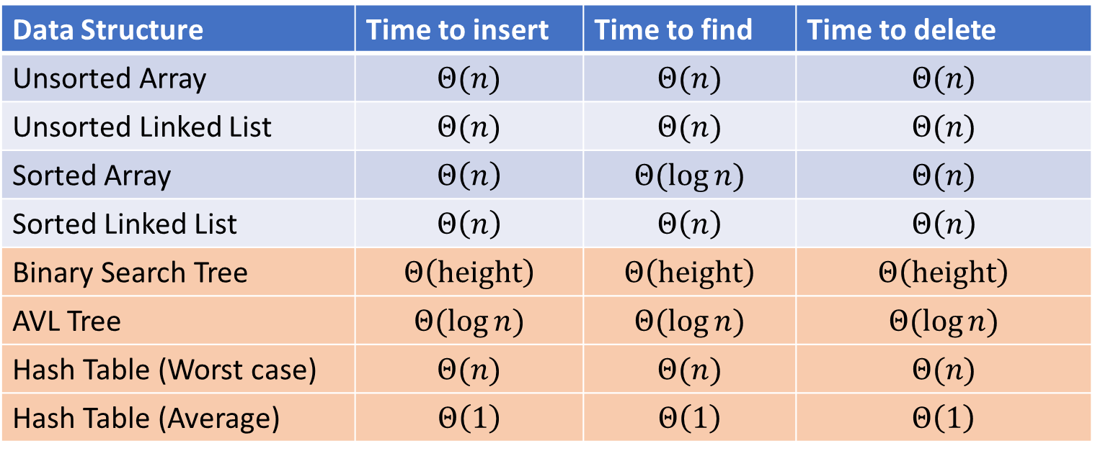

Next topic: Hash Tables
Data Structure | Time to insert | Time to find | Time to delete
Unsorted Array | $$Θ(n)$$ | $$Θ(n)$$ | $$Θ(n)$$
Unsorted Linked List | $$Θ(n)$$ | $$Θ(n)$$ | $$Θ(n)$$
Sorted Array | $$Θ\left(n\right)$$ | $$Θ(\log{n})$$ | $$Θ(n)$$
Sorted Linked List | $$Θ\left(n\right)$$ | $$Θ\left(n\right)$$ | $$Θ\left(n\right)$$
Binary Search Tree | $$Θ\left(height\right)$$ | $$Θ\left(height\right)$$ | $$Θ\left(height\right)$$
AVL Tree | $$Θ(\log{n})$$ | $$Θ(\log{n})$$ | $$Θ(\log{n})$$
Hash Table (Worst case) | $$Θ(n)$$ | $$Θ(n)$$ | $$Θ(n)$$
Hash Table (Average) | $$Θ\left(1\right)$$ | $$Θ\left(1\right)$$ | $$Θ\left(1\right)$$

Slide 7

Dictionary (Map) ADT - Unordered
Contents:
Sets of key+value pairs
Keys must be comparable Keys have a hash function
Operations:
insert(key, value)
Adds the (key,value) pair into the dictionary
If the key already has a value, overwrite the old value
Consequence: Keys cannot be repeated
find(key)
Returns the value associated with the given key
delete(key)
Remove the key (and its associated value)

Slide 8
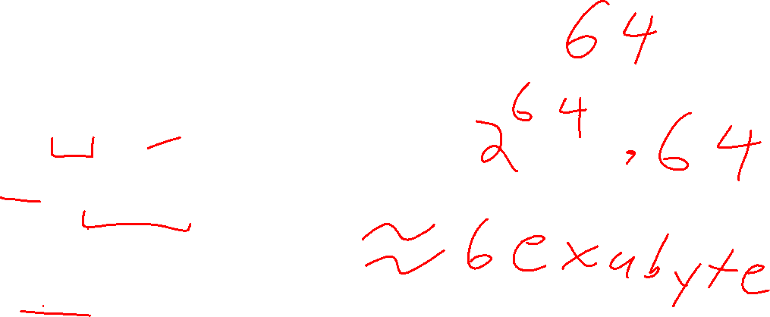
The Best Dictionary Data Structure!
Think of every key as a number
Give each key its own index in an array
insert(key, value){
arr[key]=value; }
find(key){
return arr[key];
}
delete(key){
arr[key] = null;
}

Slide 9
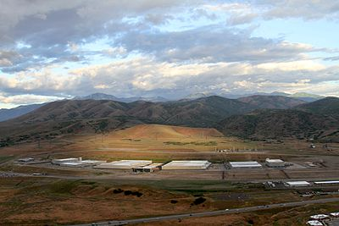
Problem?

Slide 10

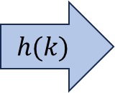
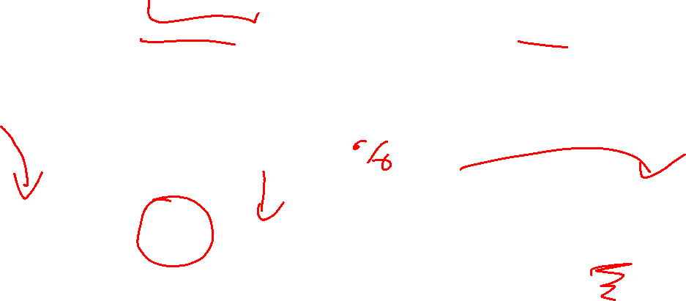
Hash Tables
Idea:
Have a small array to store information
Use a hash function to convert the key into an index
Hash function should “scatter” the keys, behave as if it randomly assigned keys to indices
Store key at the index given by the hash function
Do something if two keys map to the same place (should be very rare)
Collision resolution
Insert / find /
delete
$$h(k)$$
Some Integer
& value
Key Object

Slide 11


Example
0
1
2
3
4
5
6
7
8
9
Key: Phone Number
Value: People
Table size: 10
$h\left(phone\right)=$ number as an integer
$h\left(8675309\right)\%10=9$

Slide 12
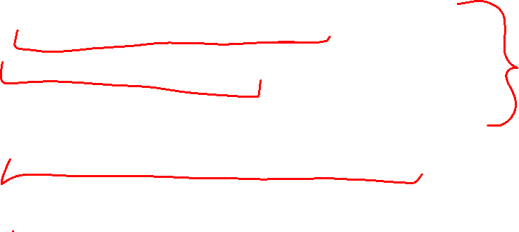
What Influences Running time?
How long hashing itself takes
Likelihood of collisions
Size of the array vs number of values in the array
“quality” of our hash function
What we do when we have a collision

Slide 13
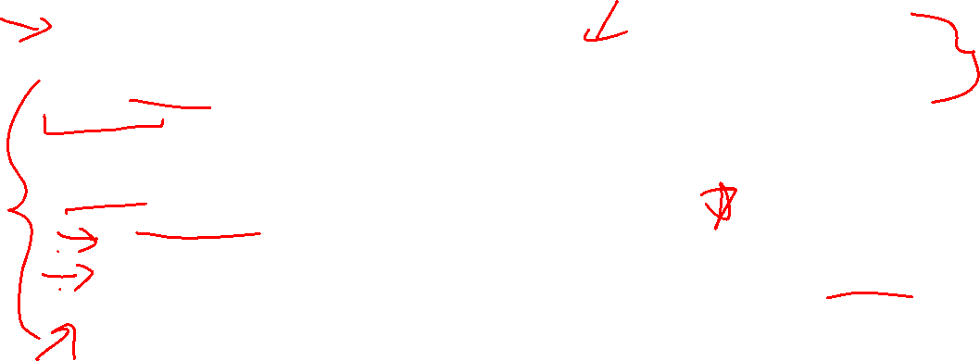
Properties of a “Good” Hash
Definition: A hash function maps objects to integers
Consistent
Objects considered “equal” should hash to the same value
Deterministic: running the hash function on the same object twice should yield the same result
Uniform
Should be able to use every index in a fixed-size array
Should use every index at roughly equal rates
Effective
It should be difficult to find two objects which hash to the same value
Given on object, it should be hard to find a different object which hashes to the same value
“Avalanche effect”: making a small change to the object yields big changes in the value it hashes to
Efficient
Time to calculate the hash should be very small

Slide 14
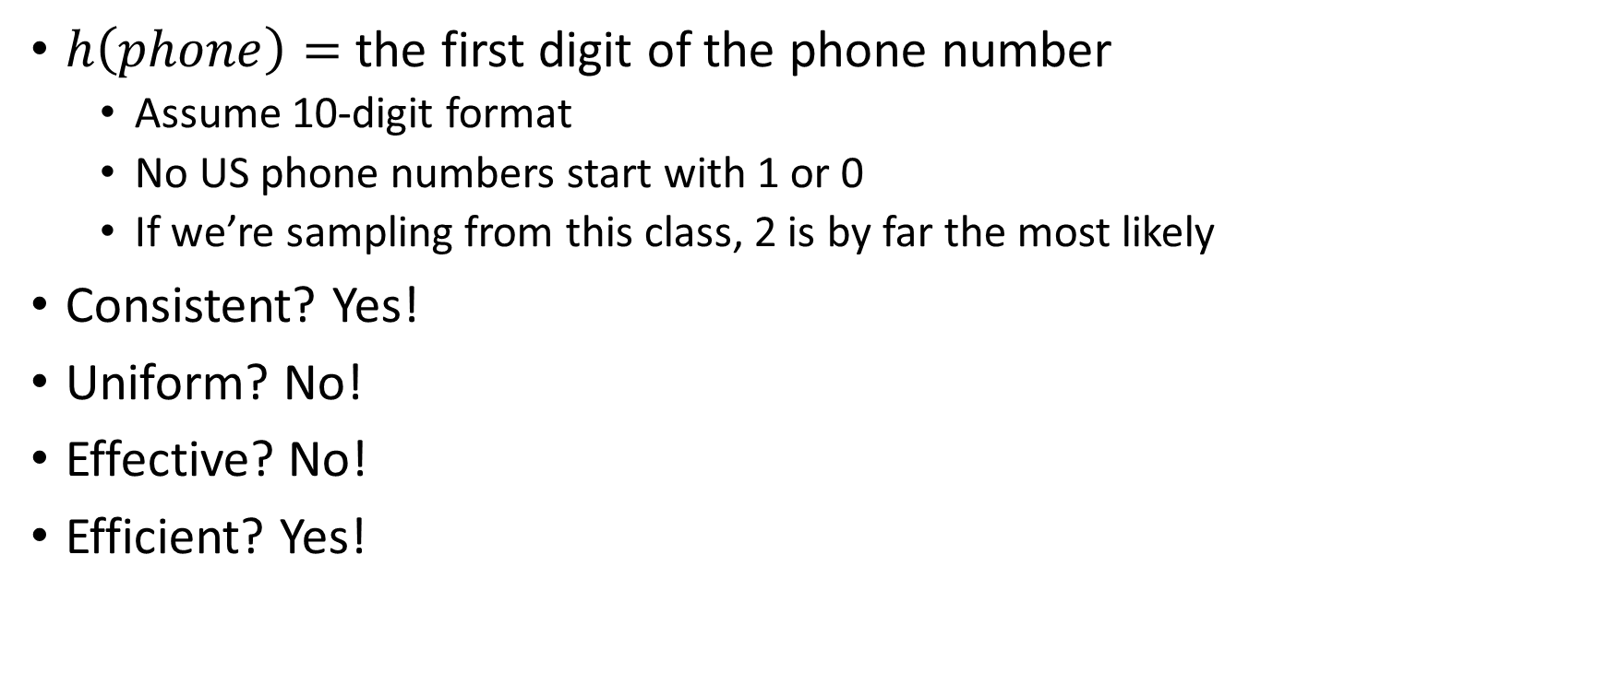
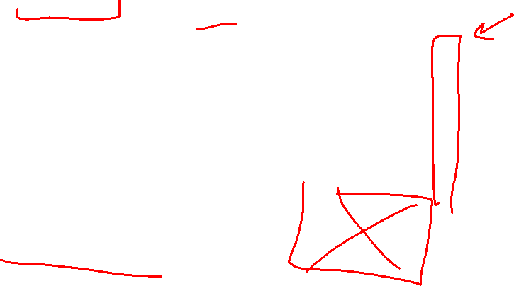
A Bad Hash (and phone number trivia)
$h\left(phone\right)=$ the first digit of the phone number
Assume 10-digit format
No US phone numbers start with 1 or 0
If we’re sampling from this class, 2 is by far the most likely
Consistent? Yes!
Uniform? No!
Effective? No!
Efficient? Yes!
0
1
2
3
4
5
6
7
8
9

Slide 15
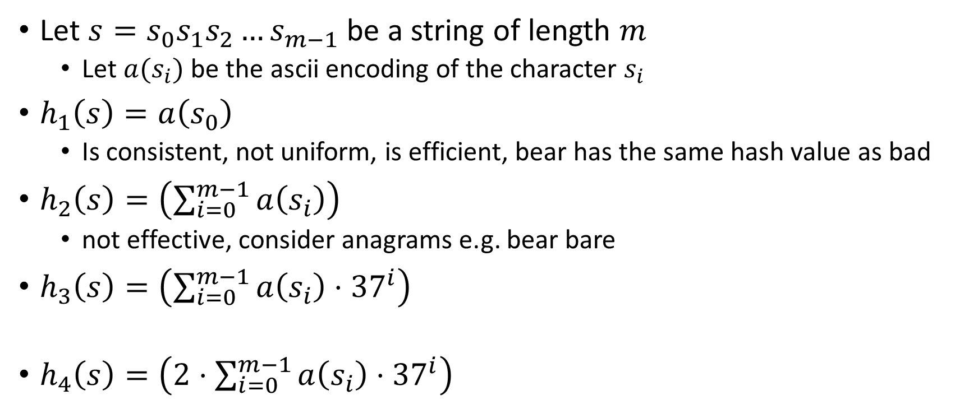
Compare These Hash Functions (for strings)
Let $s=s_{0}s_{1}s_{2}…s_{m−1}$ be a string of length $m$
Let $a(s_{i})$ be the ascii encoding of the character $s_{i}$
$h_{1}\left(s\right)=a\left(s_{0}\right)$
Is consistent, not uniform, is efficient, bear has the same hash value as bad
$h_{2}\left(s\right)=\left(\sum_{i=0}^{m−1}{a\left(s_{i}\right)}\right)$
not effective, consider anagrams e.g. bear bare
$h_{3}\left(s\right)=\left(\sum_{i=0}^{m−1}{a\left(s_{i}\right)⋅{37}^{i}}\right)$
$h_{4}\left(s\right)=\left(2⋅\sum_{i=0}^{m−1}{a\left(s_{i}\right)⋅{37}^{i}}\right)$

Slide 16
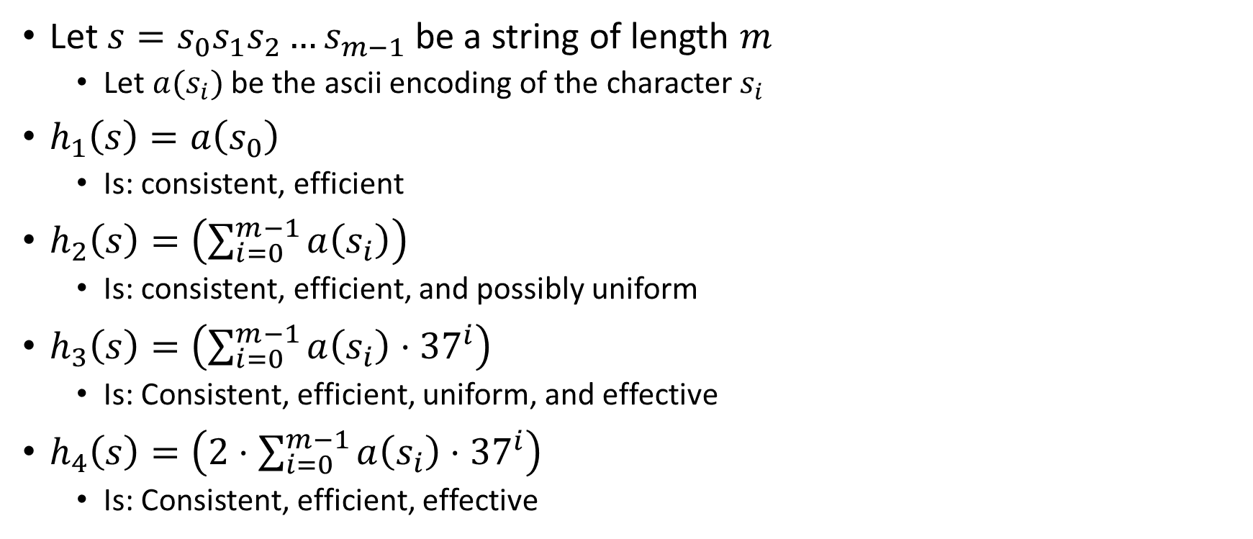
Properties of Those Example Hash Functions
Let $s=s_{0}s_{1}s_{2}…s_{m−1}$ be a string of length $m$
Let $a(s_{i})$ be the ascii encoding of the character $s_{i}$
$h_{1}\left(s\right)=a\left(s_{0}\right)$
Is: consistent, efficient
$h_{2}\left(s\right)=\left(\sum_{i=0}^{m−1}{a\left(s_{i}\right)}\right)$
Is: consistent, efficient, and possibly uniform
$h_{3}\left(s\right)=\left(\sum_{i=0}^{m−1}{a\left(s_{i}\right)⋅{37}^{i}}\right)$
Is: Consistent, efficient, uniform, and effective
$h_{4}\left(s\right)=\left(2⋅\sum_{i=0}^{m−1}{a\left(s_{i}\right)⋅{37}^{i}}\right)$
Is: Consistent, efficient, effective

Slide 17
Ideal Insert procedure
Supposing we have a “good” hash function:
insert(key, value){
h = key.hash();
arr[h % table.length] = value;
}
Problem: It’s possible that two different keys map to the same index!
This is called a “collision”

Slide 18
Collision Resolution
A Collision occurs when we want to insert something into an already-occupied position in the hash table
2 main strategies:
Separate Chaining
Use a secondary data structure to contain the items
E.g. each index in the hash table is itself a linked list
Open Addressing
Use a different spot in the table instead
Linear Probing
Quadratic Probing
Double Hashing
0
1
2
3
4
5
6
7
8
9

Slide 19
Separate Chaining Insert
To insert k, v:
Compute the index using i = h(k) % table.length
Add the key-value pair to the data structure at table[i]
k,v
k,v
k,v
0
1
2
3
4
5
6
7
8
9

Slide 20
Separate Chaining Find
To find k:
Compute the index using i = h(k) % table.length
Call find with the key on the data structure at table[i]
k,v
k,v
k,v
0
1
2
3
4
5
6
7
8
9

Slide 21
Separate Chaining Delete
To delete k:
Compute the index using i = h(k) % table.length
Call delete with the key on the data structure at table[i]
k,v
k,v
k,v
0
1
2
3
4
5
6
7
8
9

Slide 22
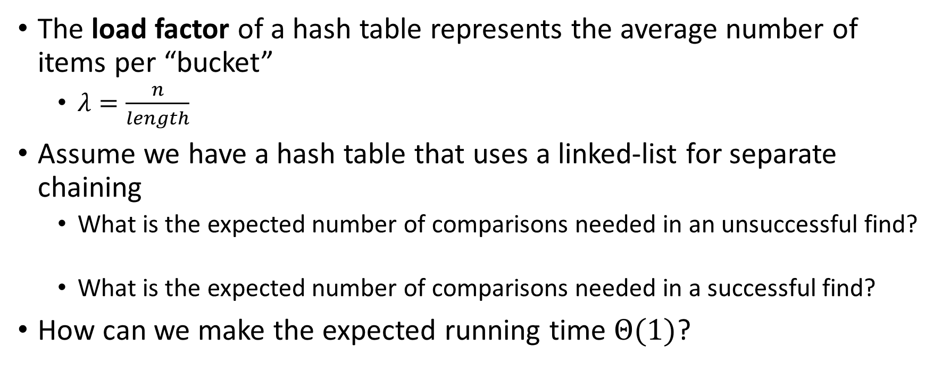
Formal Running Time Analysis
The load factor of a hash table represents the average number of items per “bucket”
$λ=\frac{n}{length}$
Assume we have a hash table that uses a linked-list for separate chaining
What is the expected number of comparisons needed in an unsuccessful find?
What is the expected number of comparisons needed in a successful find?
How can we make the expected running time $Θ(1)$?

Slide 23
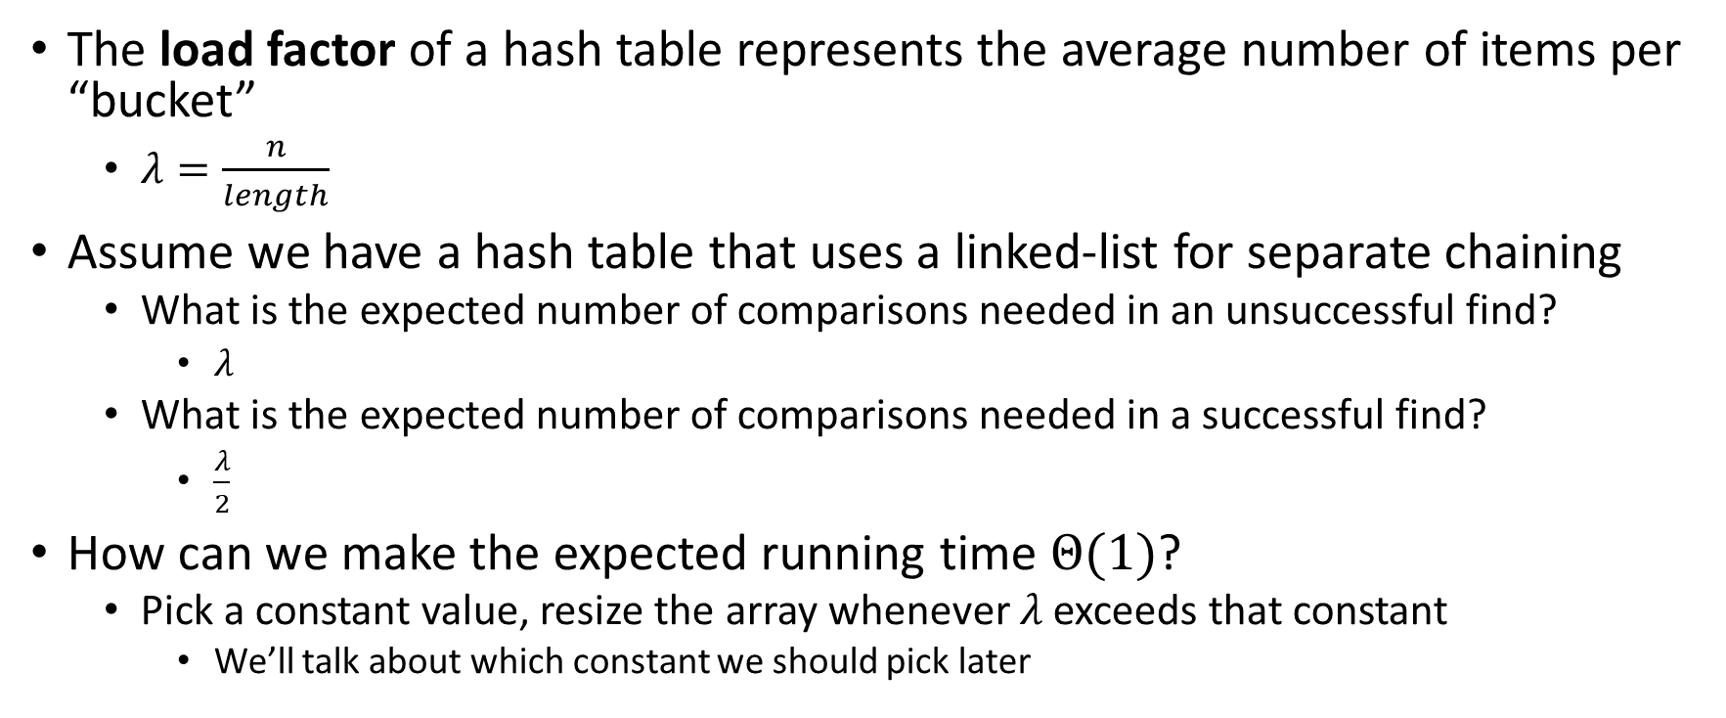
Formal Running Time Analysis (Answers)
The load factor of a hash table represents the average number of items per “bucket”
$λ=\frac{n}{length}$
Assume we have a hash table that uses a linked-list for separate chaining
What is the expected number of comparisons needed in an unsuccessful find?
$λ$
What is the expected number of comparisons needed in a successful find?
$\frac{λ}{2}$
How can we make the expected running time $Θ(1)$?
Pick a constant value, resize the array whenever $λ$ exceeds that constant
We’ll talk about which constant we should pick later

Slide 24



Load Factor Example 1
$$k,v$$
$$k,v$$
$$k,v$$
0
1
2
3
4
5
6
7
8
9

Slide 25





Load Factor Example 2
$$k,v$$
$$k,v$$
$$k,v$$
$$k,v$$
$$k,v$$
$$k,v$$
$$k,v$$
$$k,v$$
0
1
2
3
4
5
6
7
8
9

Slide 26







Load Factor Example 3
$$k,v$$
$$k,v$$
$$k,v$$
$$k,v$$
$$k,v$$
$$k,v$$
$$k,v$$
$$k,v$$
$$k,v$$
$$k,v$$
$$k,v$$
$$k,v$$
$$k,v$$
$$k,v$$
$$k,v$$
0
1
2
3
4
5
6
7
8
9

Slide 27
Collision Resolution: Linear Probing
When there’s a collision, use the next open space in the table
0
1
2
3
4
5
6
7
8
9

Slide 28
Linear Probing: Insert Procedure
To insert k,v
Calculate i = h(k) % table.length
If table[i] is occupied then try index (i+1) % table.length
If that is occupied try index (i+2) % table.length
If that is occupied try index (i+3) % table.length
…
0
1
2
3
4
5
6
7
8
9

Slide 29
Linear Probing: How to find?
What do you think?
0
1
2
3
4
5
6
7
8
9

Slide 30
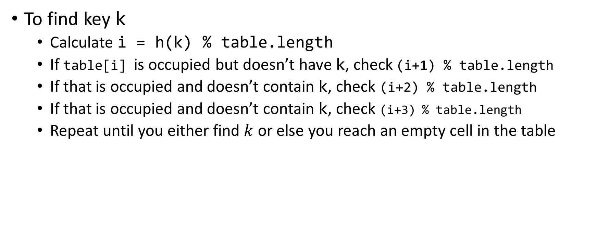
Linear Probing: Find
To find key k
Calculate i = h(k) % table.length
If table[i] is occupied but doesn’t have k, check (i+1) % table.length
If that is occupied and doesn’t contain k, check (i+2) % table.length
If that is occupied and doesn’t contain k, check (i+3) % table.length
Repeat until you either find $k$ or else you reach an empty cell in the table
0
1
2
3
4
5
6
7
8
9

