Slide 1
CSE 332 Spring 2026 Lecture 1: Intro to ADTs, Stacks, Queues
Nathan Brunelle
http://www.cs.uw.edu/332

Slide 2
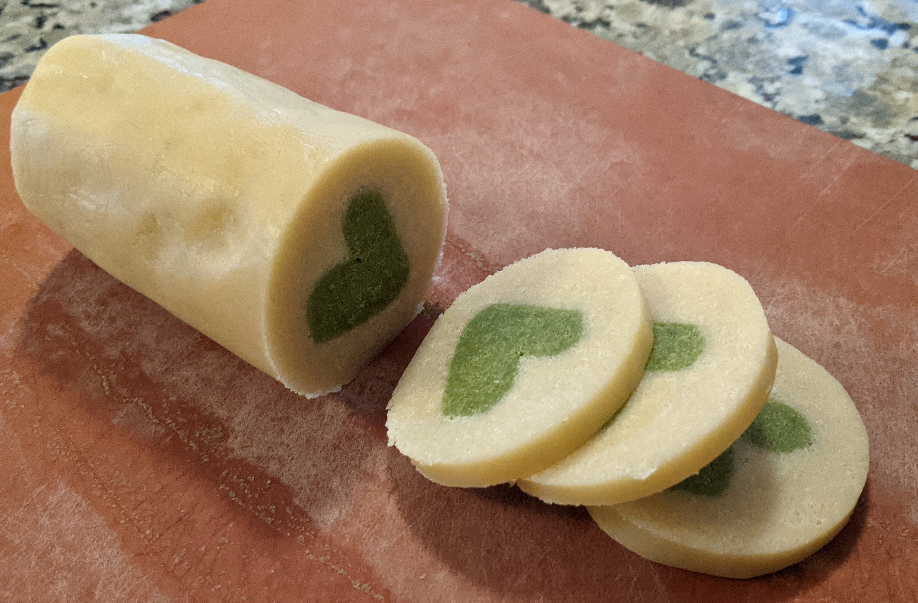


Nathan Brunelle
Born: Virginia Beach, VA
Ugrad: Math and CS at University of Virginia
Grad: CS at University of Virginia
Taught at UVA for 6 years
Intro to programming (e.g. 121)
Discrete Math (e.g. 311)
Algorithms (e.g. 421)
Theory of Computation (e.g. 431)
Year 3 at UW
CSE123
CSE332
CSE373
CSE417
CSE421

Slide 3
About this course
Topics covered:
Data Structures
Specific “classic” data structures
Introduction to Algorithms and Analysis
Parallelism and Concurrency
Parallelism: Use multiple processors to finish sooner
Concurrency: Correct access to shared resources

Slide 4
Warm Up!
Put up one hand (you can switch if it gets tired)!
Set your counter to 1
While (you and at least one other person have a hand up){
Make a partnership with someone whose hand is still raised
Share your name with your partner
Add together your counter and your partner’s counter
Identify which of you woke up earliest this morning
Release partnership
If you woke up later, then put your hand down and return to your seat
}

Slide 5
Course Staff
Instructor:
Nathan Brunelle
TAs:
http://www.cs.uw.edu/332/staff.html#tas

Slide 6
Course Info
Text (optional):
Data Structures & Algorithm Analysis in Java, (Mark Allen Weiss), 3rd edition, 2012 (2nd edition also o.k.)
Course Page:
http://www.cs.uw.edu/332

Slide 7
Communication
Ed STEM Discussion board
Your first stop for questions about course content & assignments

Slide 8
Course Meetings
Lecture
Materials posted (slides before class, inked slides after)
Recorded using Panopto
Ask questions, focus on key ideas (rarely coding details)
Section
Practice problems!
Answer Java/homework questions, etc.
Occasionally may introduce new material
An important part of the course (not optional)
Office hours
Use them: please visit us!

Slide 9
Grading
13 Weekly homework exercises (4.67% each, 56% total)
The lowest 1 will be dropped
Except for EX12, which cannot be dropped
Midterm and final exam (40% total)
Midterm weighted 15%
Final weighted 25%
In-person
Midterm in class on Monday 05/04
Final at 12:30pm on Thursday 06/11
17 Concept Checks (0.25% each, 4% total)
The lowest 1 will be dropped
One per “concept” in the course
We instantly tell you whether you got each question correct
Unlimited submissions, so keep at it!

Slide 10
Collaboration
Try it yourself first
Collaborate with classmates (no external interactive help on assignments permitted)
Collaboration is “whiteboard only”
Looking for a collaborator?
Post on the Ed Discussion board
Go to the CSE study room (Allen Center 006, there’s a table specifically for 332!)
Cite your sources!

Slide 11
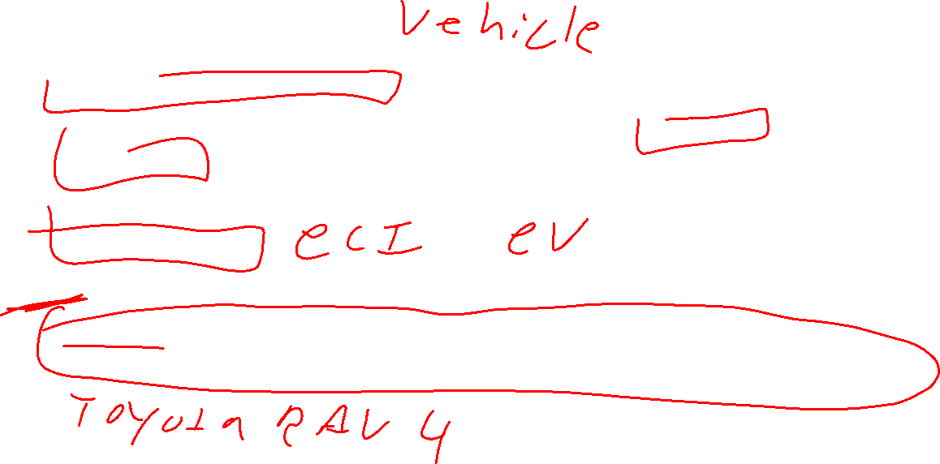
Terminology
Abstract Data Type (ADT)
Mathematical description of a “thing” with set of operations on that “thing”
Algorithm
A high level, language-independent description of a step-by-step process
Data structure
An organization of data and family of algorithms for implementing an ADT
Implementation of a data structure
The data organization and algorithms written in a programming language

Slide 12
ADT: Queue (Activity)
What is it?
ONLY be accessing in a FIFO way
What operations do we need?
Add/Enqueue
Remove/Dequeue
Get/peek
Set/ DNE
isEmpty/isEmpty
Suggested data structures?

Slide 13
ADT: Queue
What is it?
A collection of items that we interact with in a “First In First Out” (FIFO) way
What operations do we need?
Enqueue
Add a new item to the queue
Dequeue
Remove the “oldest” item from the queue
IsEmpty
Indicate whether or not there are items still on the queue

Slide 14
Linked Queue Data Structure (Idea)
front
5
8
3
4
7
Queue represented as a “chain” of items
A “front” reference to the oldest item
A “back” reference to the most recent item
Each Node references the item enqueued after it
enqueue Procedure:
dequeue Procedure:
isEmpty Procedure:
back

Slide 15
Linked Queue Data Structure (Algorithms)
front
5
8
3
4
7
Queue represented as a “chain” of items
A “front” reference to the oldest item
A “back” reference to the most recent item
Each Node references the item enqueued after it
enqueue Procedure:
dequeue Procedure:
isEmpty Procedure:
back
enqueue(x){
last = new ListNode(x);
back.next = last;
back = last;
}
dequeue(){
first = front.value;
front = front.next;
if (front == null) {back = null;}
return first
}
isEmpty(){
return front == null;
}

Slide 16
“Circular” Array Queue (Idea)
front=0
5
8
3
4
7
0
1
2
3
4
5
6
7
8
9
back=5
Queue represented as an array of items
A “front” index to indicate the oldest item in the queue
A “back” index to indicate the most recent item in the queue
Actually, the first “open” slot in the array
enqueue Procedure:
dequeue Procedure:
isEmpty Procedure:

Slide 17
“Circular” Array
Intuitively, An array of values arranged in a “circle” rather than a line
If you go beyond the last index, to wrap back around to 0
5
8
3
4
7
…
5
0
1
2
3
4
5
6
7
8
9
…
9
0
8
8
1
front=0
…
7
2
3
back=5
6
3
…
5
4
4
…
7

Slide 18
“Circular” Array Queue (Algorithms)
front=0
5
8
3
4
7
0
1
2
3
4
5
6
7
8
9
back=5
Queue represented as an array of items
A “front” index to indicate the oldest item in the queue
A “back” index to indicate the most recent item in the queue
enqueue Procedure:
dequeue Procedure:
isEmpty Procedure:
enqueue(x){
queue[back] = x;
back = (back + 1) % queue.length;
size++;
}
What if we run out of space?!
dequeue(){
// Assumes queue is not empty
first = queue[front];
front = (front + 1) % queue.length;
size--;
return first;
}
isEmpty(){
return size == 0;
}

Slide 19
Resizing “Circular” Array Queue
front=0
5
8
3
4
7
0
1
2
3
4
5
6
7
8
9
back=5
Queue represented as an array of items
A “front” index to indicate the oldest item in the queue
A “back” index to indicate the most recent item in the queue
enqueue Procedure:
dequeue Procedure:
isEmpty Procedure:
How do you resize? That’s for Exercise 0!
enqueue(x){
if (size == queue.length-1) {resize();}
queue[back] = x;
back = (back + 1) % queue.length;
size++;
}
dequeue(){
// Assumes queue is not empty
first = queue[front];
front = (front + 1) % queue.length;
size--;
return first;
}
isEmpty(){
return size == 0;
}

Slide 20
Linked List vs. Circular Array
Let’s Summarize the benefits and drawbacks of each

Slide 21
ADT: Stack
What is it?
A “Last In First Out” (LIFO) collection of items (sometimes called FILO)
What operations do we need?
push
Add a new item onto the stack
peek
Return the value of the most recently pushed item
pop
Return the value of the most recently pushed item and remove it from the stack
isEmpty
Indicate whether or not there are items still on the stack

