Slide 1
CSE 332 Spring 2026 Lecture 13: Sorting 2
Nathan Brunelle
http://www.cs.uw.edu/332

Slide 2

Sorting
Rearrangement of items into some defined sequence
Usually: reordering a list from smallest to largest according to some metric
Why sort things?
Enable things like binary search
It makes some algorithms faster
Nicer for human algorithms too
Data organization

Slide 3
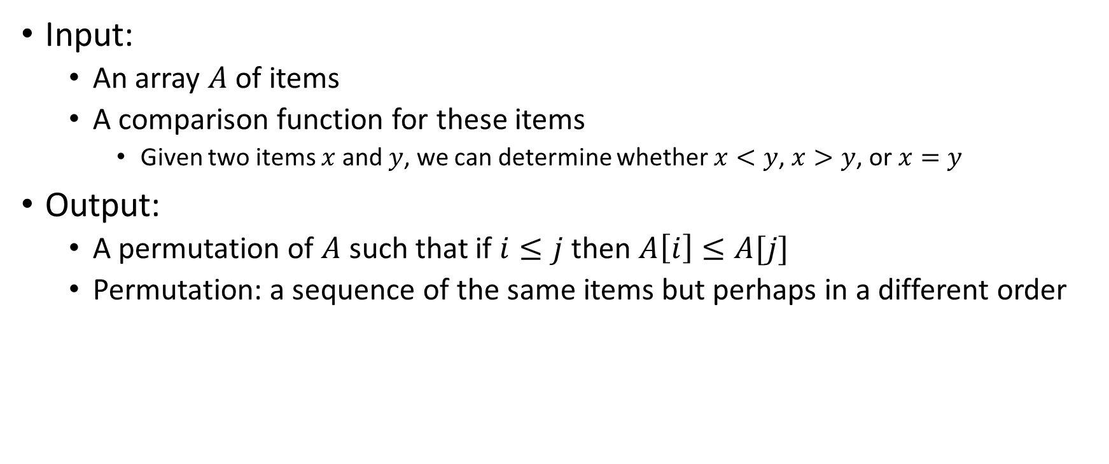
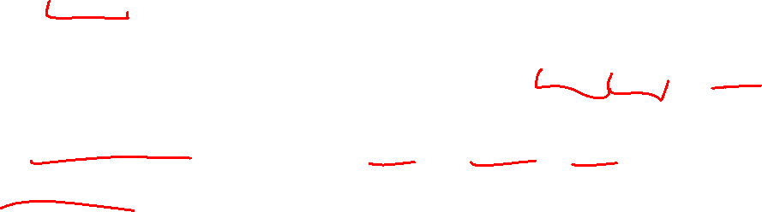
More Formal Definition
Input:
An array $A$ of items
A comparison function for these items
Given two items $x$ and $y$, we can determine whether $x<y$, $x>y$, or $x=y$
Output:
A permutation of $A$ such that if $i≤j$ then $A\left[i\right]≤A[j]$
Permutation: a sequence of the same items but perhaps in a different order

Slide 4

Sorting “Landscape”
There is no singular best algorithm for sorting
Some are faster, some are slower
Some use more memory, some use less
Some are super extra fast if your data matches particular assumptions
Some have other special properties that make them valuable
No sorting algorithm can have only all the “best” attributes

Slide 5
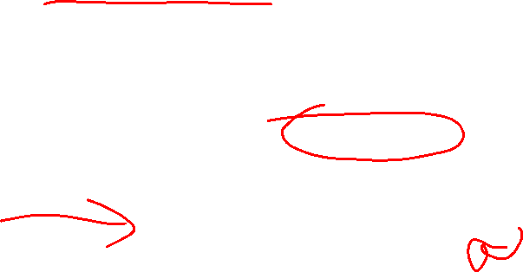
Insertion Sort
Idea: Maintain a sorted list prefix, extend that prefix by “inserting” the next element
Sorted Prefix
3
5
7
8
10
12
9
2
4
6
1
11
3
5
7
8
10
9
12
2
4
6
1
11
3
5
7
8
9
10
12
2
4
6
1
11
Sorted Prefix
3
5
7
8
9
10
12
2
4
6
1
11

Slide 6
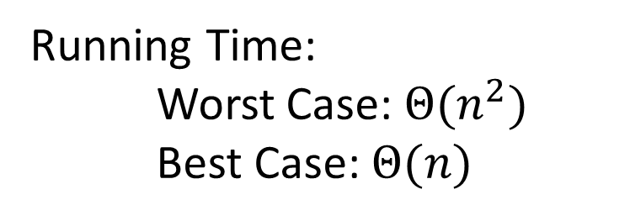
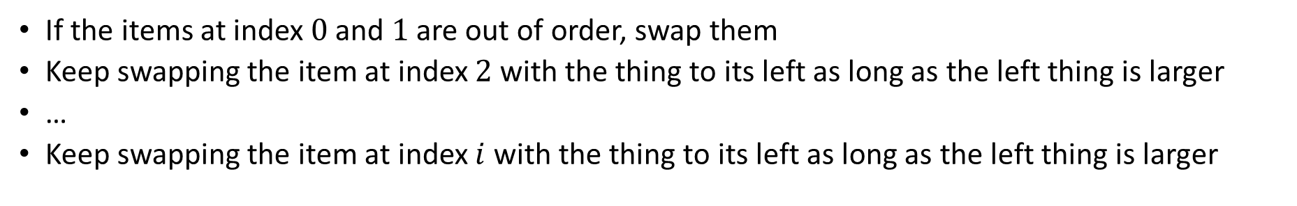
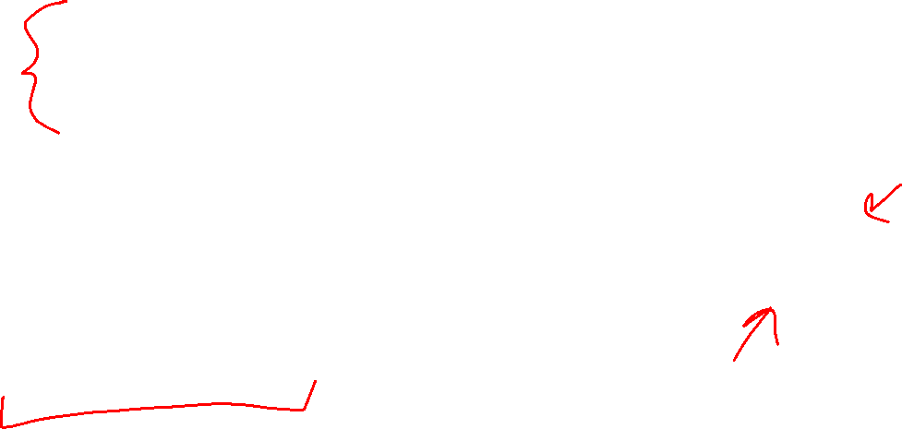
Insertion Sort - Summary
If the items at index $0$ and $1$ are out of order, swap them
Keep swapping the item at index $2$ with the thing to its left as long as the left thing is larger
…
Keep swapping the item at index $i$ with the thing to its left as long as the left thing is larger
for (i=1; i<a.length; i++){
prev = i-1;
while(a[i] < a[prev] && prev > -1){
temp = a[i];
a[i] = a[prev];
a[prev] = a[i];
i--;
prev--;
}
}
Running Time:
Worst Case: $Θ(n^{2})$
Best Case: $Θ(n)$
10
77
5
15
2
22
64
41
18
19
30
21
3
24
23
33
0
1
2
3
4
5
6
7
8
9
10
11
12
13
14
15

Slide 7
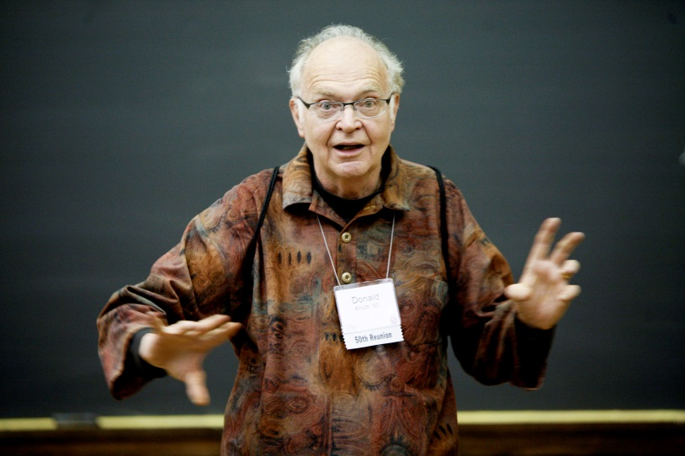
Aside: Bubble Sort – we won’t cover it
"the bubble sort seems to have nothing to recommend it, except a catchy name and the fact that it leads to some interesting theoretical problems” –Donald Knuth, The Art of Computer Programming

Slide 8
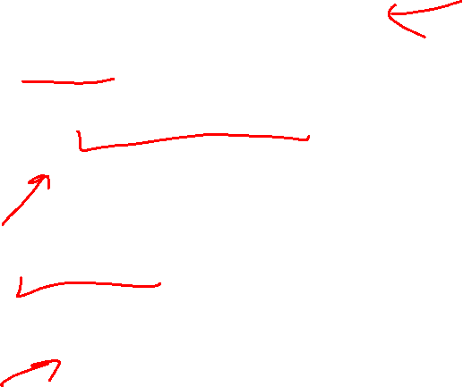
Properties To Consider
Worst case running time
In place:
We only need to use the pre-existing array to do sorting
Constant extra space (only some additional variables needed)
Adaptive
The running improves as the given list is closer to being sorted
It should be linear time for a pre-sorted list, and nearly linear time if the list is nearly sorted
Online
We can start sorting before we have the entire list.
Stable
“Tied” elements keep their original order

Slide 9
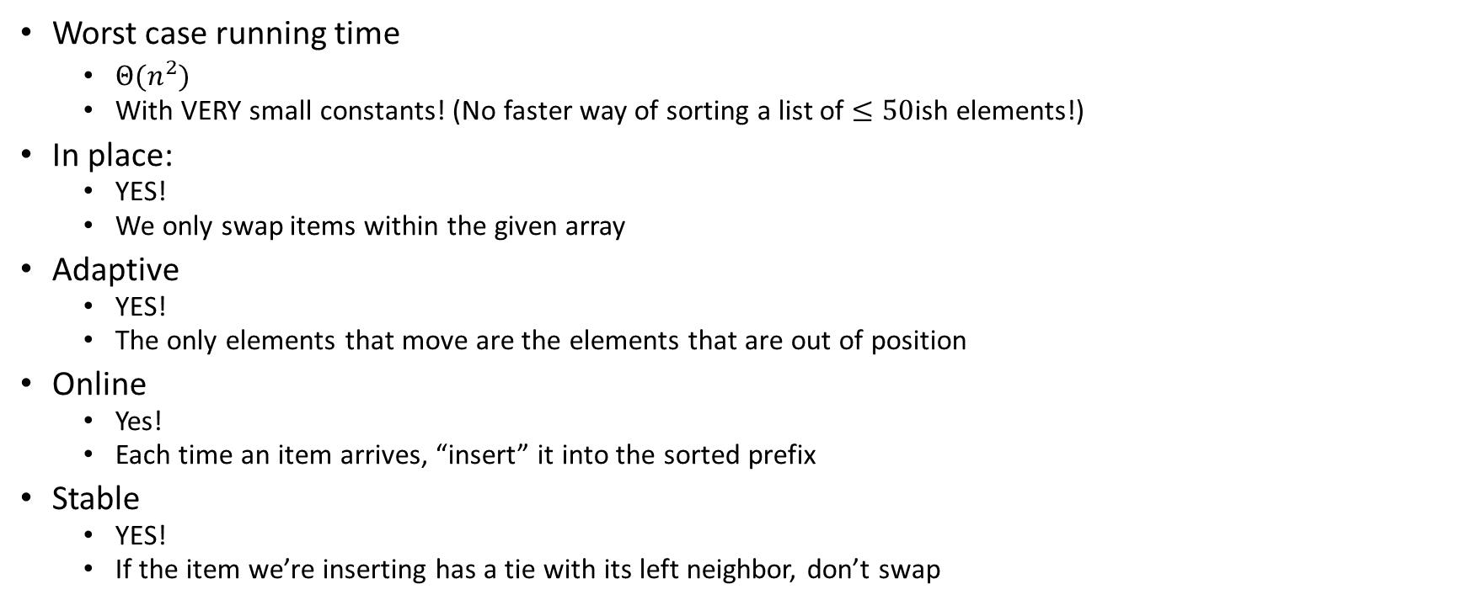
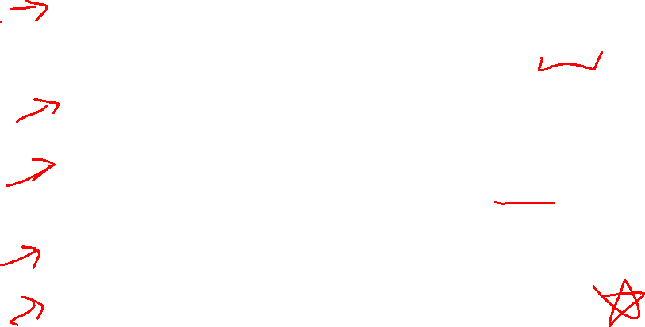
Insertion Sort Properties
Summary: except for its asymptotic running time, it has everything you might want!
Worst case running time
$Θ(n^{2})$
With VERY small constants! (No faster way of sorting a list of $≤50$ish elements!)
In place:
YES!
We only swap items within the given array
Adaptive
YES!
The only elements that move are the elements that are out of position
Online
Yes!
Each time an item arrives, “insert” it into the sorted prefix
Stable
YES!
If the item we’re inserting has a tie with its left neighbor, don’t swap

Slide 10
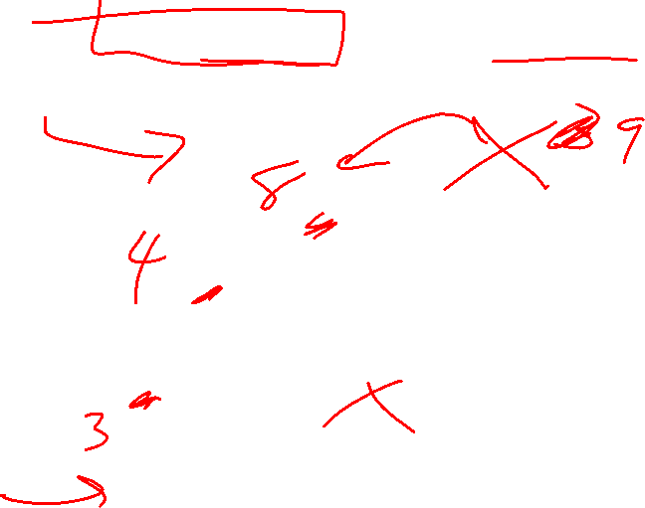
Heap Sort
Idea: Build a maxHeap, repeatedly extract the max element from the heap to build sorted list Right-to-Left
10
9
0
6
Max Heap Property: Each node is larger than its children
8
1
7
5
2
2
3
4
5
6
4
1
3
7
8
9
10
9
6
8
7
5
2
4
1
3
0
1
2
3
4
5
6
7
8
9

Slide 11

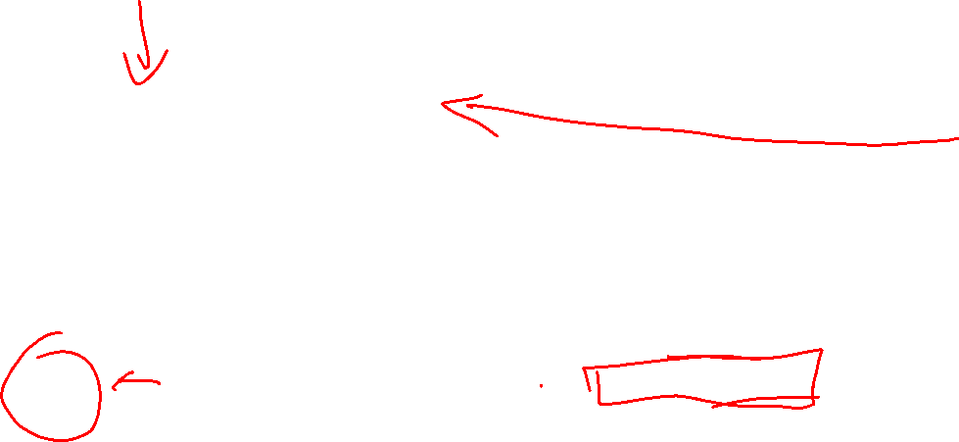
Building a Heap From “Scratch”
Suppose we had $n$ items and wanted to “heapify” them
5
6
10
3
15
8
7
14
2
1
5
1
2
3
4
5
6
7
8
9
10
Violate Heap Property!
0
6
10
3
1
15
8
2
7
Two ways for “fix” the heap:
Percolate Up
Percolate Down
3
4
5
6
14
2
1
7
8
9

Slide 12

Floyd’s buildHeap method
Working towards the root, one row at a time, percolate down
buildHeap(){
for(int i = size; i>0; i--){
percolateDown(i);
}
}

Slide 13

Floyd’s buildHeap method (Percolate 15)
Suppose we had $n$ items and wanted to “heapify” them
5
6
10
3
15
8
7
14
2
1
Violate Heap Property!
Nodes bigger than a child
5
1
2
3
4
5
6
7
8
9
10
0
6
10
buildHeap(){
for(int i = size; i>0; i--){
percolateDown(i);
}
}
3
1
15
8
2
7
3
4
5
6
14
2
1
7
8
9

Slide 14
Floyd’s buildHeap method (Percolate 3)
Suppose we had $n$ items and wanted to “heapify” them
Violate Heap Property!
Nodes bigger than a child
5
5
6
10
3
1
8
7
14
2
15
0
1
2
3
4
5
6
7
8
9
10
6
10
3
1
8
2
7
buildHeap(){
for(int i = size; i>0; i--){
percolateDown(i);
}
}
1
3
4
5
6
14
2
15
7
8
9

Slide 15
Floyd’s buildHeap method (Percolate 10)
Suppose we had $n$ items and wanted to “heapify” them
5
5
6
10
2
1
8
7
14
3
15
Violate Heap Property!
0
1
2
3
4
5
6
7
8
9
10
6
10
2
1
8
2
7
buildHeap(){
for(int i = size; i>0; i--){
percolateDown(i);
}
}
1
3
4
5
6
14
3
15
7
8
9

Slide 16
Floyd’s buildHeap method (Percolate 6)
Suppose we had $n$ items and wanted to “heapify” them
5
5
6
7
2
1
8
10
14
3
15
Violate Heap Property!
0
1
2
3
4
5
6
7
8
9
10
6
7
2
1
8
2
10
buildHeap(){
for(int i = size; i>0; i--){
percolateDown(i);
}
}
1
3
4
5
6
14
3
15
7
8
9

Slide 17

Floyd’s buildHeap method (Percolate 5)
Suppose we had $n$ items and wanted to “heapify” them
5
5
1
7
2
6
8
10
14
3
15
Violate Heap Property!
0
1
2
3
4
5
6
7
8
9
10
1
7
2
1
8
2
10
buildHeap(){
for(int i = size; i>0; i--){
percolateDown(i);
}
}
6
3
4
5
6
14
3
15
7
8
9

Slide 18
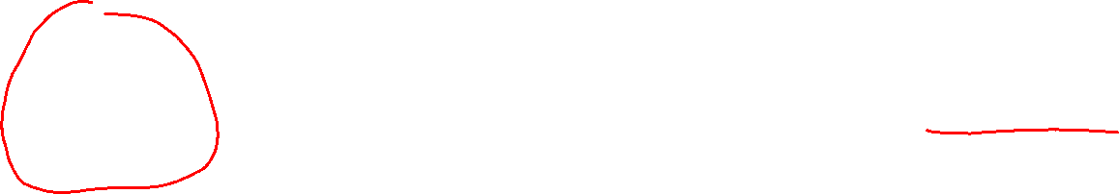
Floyd’s buildHeap method (Done)
Suppose we had $n$ items and wanted to “heapify” them
1
1
2
7
3
6
8
10
14
5
15
Violate Heap Property!
0
1
2
3
4
5
6
7
8
9
10
2
7
3
1
8
2
10
buildHeap(){
for(int i = size; i>0; i--){
percolateDown(i);
}
}
6
3
4
5
6
14
5
15
7
8
9

Slide 19
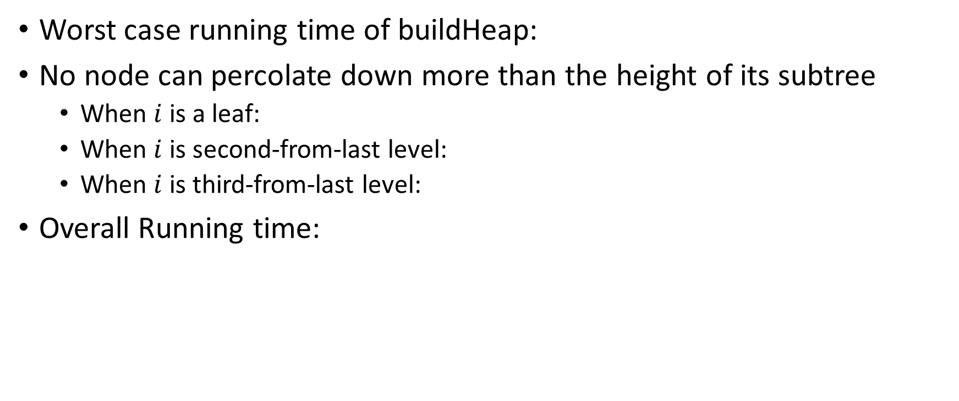

How long did this take?
Worst case running time of buildHeap:
No node can percolate down more than the height of its subtree
When $i$ is a leaf:
When $i$ is second-from-last level:
When $i$ is third-from-last level:
Overall Running time:
buildHeap(){
for(int i = size; i>0; i--){
percolateDown(i);
}
}

Slide 20
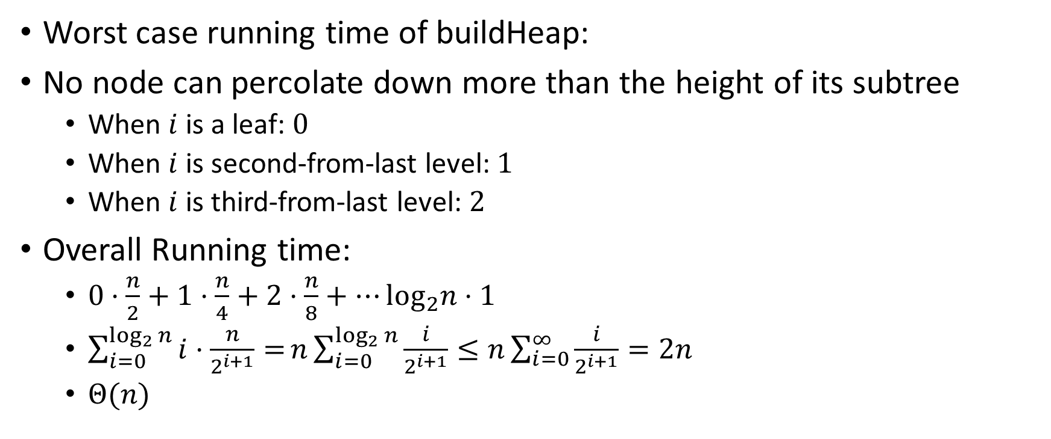
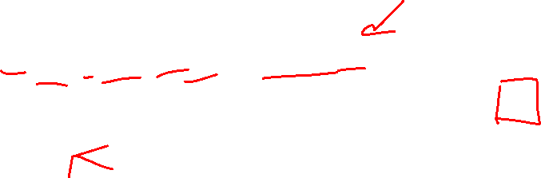
How long did this take? (Answers)
Worst case running time of buildHeap:
No node can percolate down more than the height of its subtree
When $i$ is a leaf: $0$
When $i$ is second-from-last level: $1$
When $i$ is third-from-last level: $2$
Overall Running time:
$0⋅\frac{n}{2}+1⋅\frac{n}{4}+2⋅\frac{n}{8}+…\log_{2}n⋅1$
$\sum_{i=0}^{\log_{2}{n}}{i⋅\frac{n}{2^{i+1}}=}n\sum_{i=0}^{\log_{2}{n}}{\frac{i}{2^{i+1}}}≤n\sum_{i=0}^{∞}{\frac{i}{2^{i+1}}}=2n$
$Θ(n)$
buildHeap(){
for(int i = size; i>0; i--){
percolateDown(i);
}
}

Slide 21
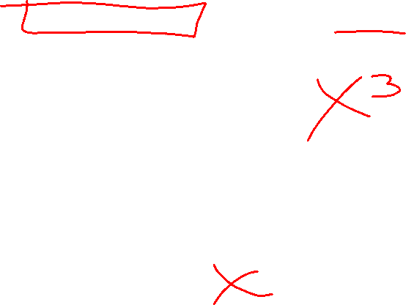
Heap Sort (Example)
Idea: Build a maxHeap, repeatedly extract the max element from the heap to build sorted list Right-to-Left
10
9
0
6
Max Heap Property: Each node is larger than its children
8
1
7
5
2
2
3
4
5
6
4
1
3
7
8
9
10
9
6
8
7
5
2
4
1
3
0
1
2
3
4
5
6
7
8
9

Slide 22
Heap Sort (First Extract)
Remove the Max element (i.e. the root) from the Heap: replace with last element, call percolateDown(root)
3
9
6
8
7
5
2
4
1
0
1
2
3
4
5
6
7
8
9
3
9
0
6
8
1
7
5
2
2
3
4
5
6
4
1
Percolate Down(node): if node satisfies heap property, done. Else swap with largest child and repeat on that subtree
7
8

Slide 23
Heap Sort (Percolate Down, Swap 1)
Remove the Max element (i.e. the root) from the Heap: replace with last element, call percolateDown(root)
9
3
6
8
7
5
2
4
1
0
1
2
3
4
5
6
7
8
9
9
3
0
6
8
1
7
5
2
2
3
4
5
6
4
1
Percolate Down(node): if node satisfies heap property, done. Else swap with largest child and repeat on that subtree
7
8

Slide 24
Heap Sort (Percolate Down, Swap 2)
Remove the Max element (i.e. the root) from the Heap: replace with last element, call percolateDown(root)
9
8
6
3
7
5
2
4
1
0
1
2
3
4
5
6
7
8
9
9
8
0
6
3
1
7
5
2
2
3
4
5
6
4
1
Percolate Down(node): if node satisfies heap property, done. Else swap with largest child and repeat on that subtree
7
8

Slide 25
Heap Sort (Percolate Down, Swap 3)
Remove the Max element (i.e. the root) from the Heap: replace with last element, call percolateDown(root)
9
8
6
4
7
5
2
3
1
0
1
2
3
4
5
6
7
8
9
9
8
0
6
4
1
7
5
2
2
3
4
5
6
3
1
Percolate Down(node): if node satisfies heap property, done. Else swap with largest child and repeat on that subtree
7
8

Slide 26
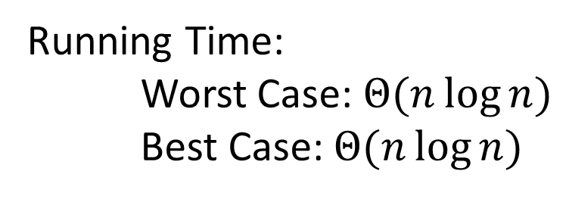
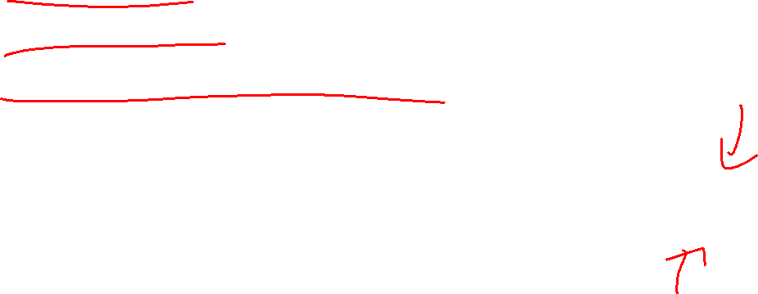
Heap Sort - Summary
Build a max heap
Call extract
Put that at the end of the array
myHeap = buildMaxHeap(a);
for (int i = a.length-1; i>=0; i--){
item = myHeap.extract();
a[i] = item;
}
Running Time:
Worst Case: $Θ(n\log{n})$
Best Case: $Θ(n\log{n})$

Slide 27
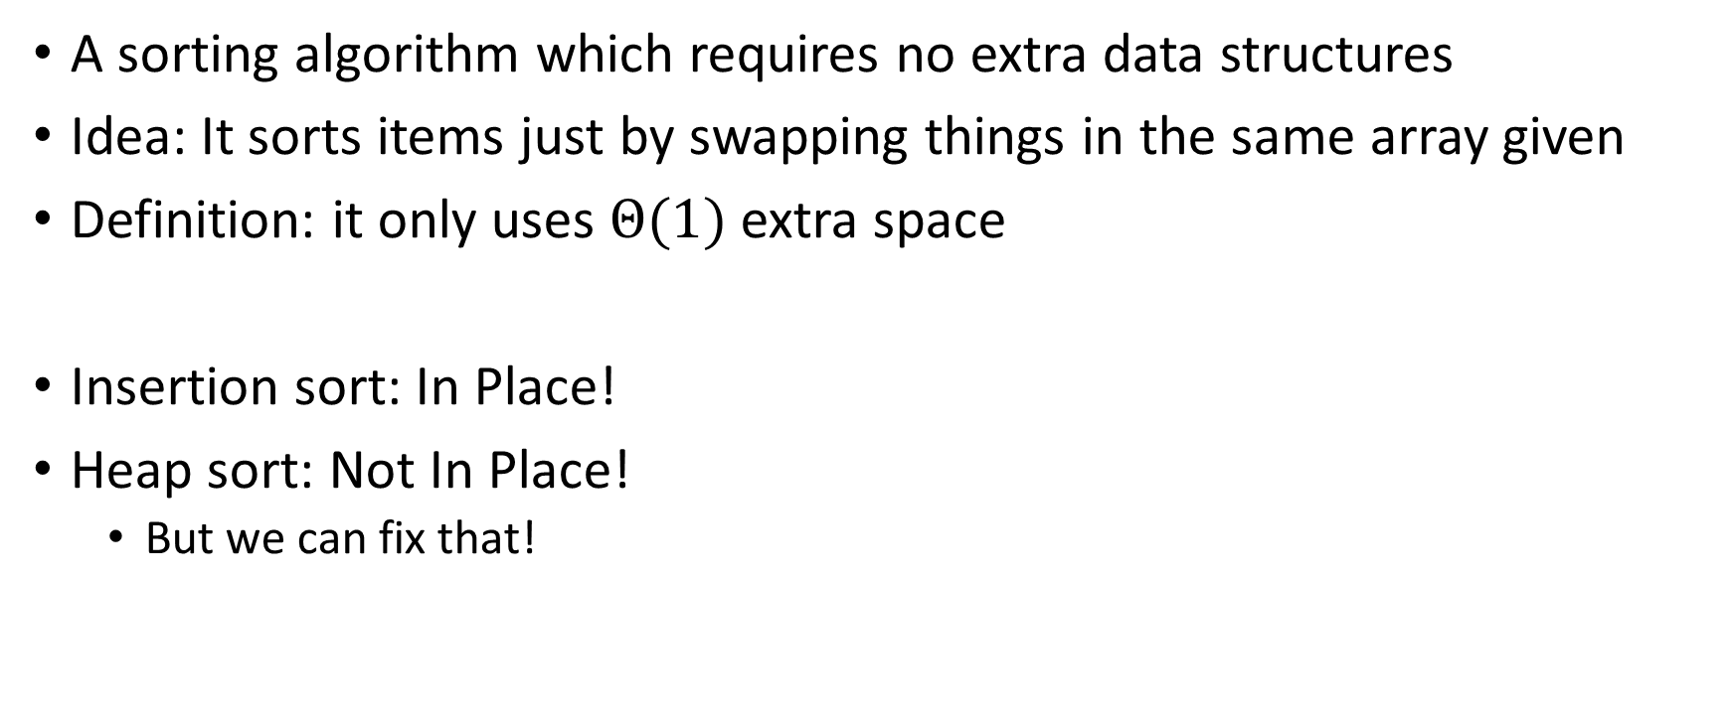
“In Place” Sorting Algorithm
A sorting algorithm which requires no extra data structures
Idea: It sorts items just by swapping things in the same array given
Definition: it only uses $Θ(1)$ extra space
Insertion sort: In Place!
Heap sort: Not In Place!
But we can fix that!

Slide 28

In Place Heap Sort
Idea: Insert all items into a max heap, extract the largest one-by-one to fill sorted list from end to beginning, all the while the heap and sorted list share the same array
Heap
Heap
List
10
9
6
8
7
5
2
4
1
3
9
8
6
4
7
5
2
3
1
10
0
1
2
3
4
5
6
7
8
9
0
1
2
3
4
5
6
7
8
9
10
9
9
0
6
8
0
6
8
1
7
5
2
2
4
1
7
5
2
2
3
4
5
6
3
4
5
6
4
1
3
3
1
7
8
9
7
8

Slide 29

In Place Heap Sort (First Extract)
Idea: When extracting an element from the heap, swap it with the last item of the heap then “pretend” the heap is one item shorter
3
9
6
8
7
5
2
4
1
10
0
1
2
3
4
5
6
7
8
9
3
9
0
6
8
1
7
5
2
2
3
4
5
6
4
1
7
8

Slide 30

In Place Heap Sort (First Percolate Down)
Idea: When extracting an element from the heap, swap it with the last item of the heap then “pretend” the heap is one item shorter
9
8
6
4
7
5
2
3
1
10
0
1
2
3
4
5
6
7
8
9
9
8
0
6
4
1
7
5
2
2
3
4
5
6
3
1
7
8

Slide 31
In Place Heap Sort (Second Extract)
Idea: When extracting an element from the heap, swap it with the last item of the heap then “pretend” the heap is one item shorter
1
8
6
4
7
5
2
3
9
10
0
1
2
3
4
5
6
7
8
9
1
8
0
6
4
1
7
5
2
2
3
4
5
6
3
7

Slide 32

In Place Heap Sort (Second Percolate Down)
Idea: When extracting an element from the heap, swap it with the last item of the heap then “pretend” the heap is one item shorter
1
8
6
4
7
5
2
3
9
10
0
1
2
3
4
5
6
7
8
9
8
7
0
6
4
1
1
5
2
2
3
4
5
6
3
7

Slide 33
In Place Heap Sort (Third Extract)
Idea: When extracting an element from the heap, swap it with the last item of the heap then “pretend” the heap is one item shorter
3
8
6
4
7
5
2
8
9
10
0
1
2
3
4
5
6
7
8
9
3
7
0
6
4
1
1
5
2
2
3
4
5
6

Slide 34
In Place Heap Sort (Third Percolate Down)
Idea: When extracting an element from the heap, swap it with the last item of the heap then “pretend” the heap is one item shorter
3
8
6
4
7
5
2
8
9
10
0
1
2
3
4
5
6
7
8
9
7
4
0
6
3
1
1
5
2
2
3
4
5
6

Slide 35
In Place Heap Sort - Summary
Build a heap using the same array (Floyd’s build heap algorithm works)
Call extract
Put that at the end of the array
buildHeap(a);
for (int i = a.length-1; i>=0; i--){
temp=a[i]
a[i] = a[0];
a[0] = temp;
percolateDown(0);
}
Running Time:
Worst Case: $Θ(n\log{n})$
Best Case: $Θ(n\log{n})$

Slide 36
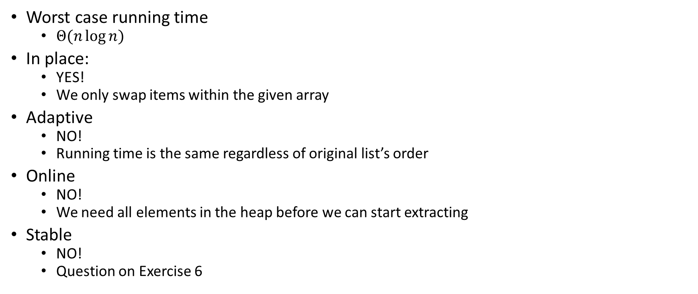
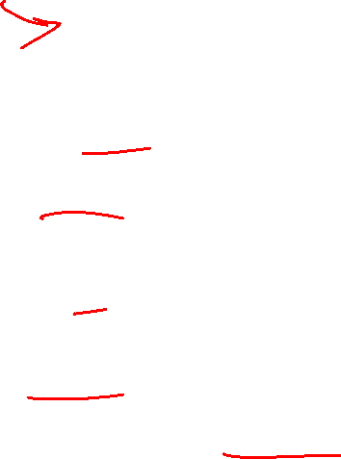
Heap Sort Properties
Worst case running time
$Θ(n\log{n})$
In place:
YES!
We only swap items within the given array
Adaptive
NO!
Running time is the same regardless of original list’s order
Online
NO!
We need all elements in the heap before we can start extracting
Stable
NO!
Question on Exercise 6

Slide 37
Divide And Conquer Sorting
Divide and Conquer:
Recursive algorithm design technique
Solve a large problem by breaking it up into smaller versions of the same problem

Slide 38

Divide and Conquer
Base Case:
If the problem is “small” then solve directly and return
Divide:
Break the problem into subproblem(s), each smaller instances
Conquer:
Solve subproblem(s) recursively
Combine:
Use solutions to subproblems to solve original problem
A
B

Slide 39
Divide and Conquer Template Pseudocode
def my_DandC(problem){ // Base Case
if (problem.size() <= small_value){
return solve(problem); // directly solve (e.g., brute force)
}
// Divide
List subproblems = divide(problem);
// Conquer
solutions = new List();
for (sub : subproblems){
subsolution = my_DandC(sub);
solutions.add(subsolution);
}
// Combine
return combine(solutions);
}

Slide 40
Merge Sort
5
8
2
9
4
1
Base Case:
If the list is of length 1 or 0, it’s already sorted, so just return it
Divide:
Split the list into two “sublists” of (roughly) equal length
Conquer:
Sort both lists recursively
Combine:
Merge sorted sublists into one sorted list
5
5
8
2
9
4
1
2
5
8
1
4
9
2
5
8
1
4
9
1
2
4
5
8
9

Slide 41








Merge Sort In Action!
Sort between indices $low$ and $high$
5
8
2
9
4
1
3
7
$$low$$
$$high$$
Base Case: if $low$ == $high$ then that range is already sorted!
Divide and Conquer: Otherwise call mergesort on ranges $\left(low,\frac{low+high}{2}\right)$ and $\left(\frac{low+high}{2}+1, high\right)$
5
8
2
9
4
1
3
7
$$low$$
$$\frac{low+high}{2}$$
$$\frac{low+high}{2}+1$$
$$high$$
2
5
8
9
1
3
4
7
After Recursion:
$$low$$
$$high$$

Slide 42



Merge (the combine part)
Create a new array to merge into, and 3 pointers/indices:
L_next: the smallest “unmerged” thing on the left
R_next: the smallest “unmerged” thing on the right
M_next: where the next smallest thing goes in the merged array
One-by-one: put the smallest of L_next and R_next into M_next, then advance both M_next and whichever of L/R was used.
2
5
8
9
1
3
4
7
L next
R next
$$\frac{low+high}{2}+1$$
$$low$$
$$\frac{low+high}{2}$$
$$high$$
M next

Slide 43
Merge Sort Pseudocode
void mergesort(myArray){
ms_helper(myArray, 0, myArray.length()); }
void mshelper(myArray, low, high){
if (low == high){return;} // Base Case
mid = (low+high)/2;
ms_helper(low, mid);
ms_helper(mid+1, high);
merge(myArray, low, mid, high);
}

Slide 44
Merge Pseudocode
void merge(myArray, low, mid, high){
merged = new int[high-low+1]; // or whatever type is in myArray
l_next = low;
r_next = high;
m_next = 0;
while (l_next <= mid && r_next <= high){
if (myArray[l_next] <= myArray[r_next]){
merged[m_next++] = myArray[l_next++];
}
else{
merged[m_next++] = myArray[r_next++];
}
}
while (l_next <= mid){ merged[m_next++] = myArray[l_next++]; }
while (r_next <= high){ merged[m_next++] = myArray[r_next++]; }
for(i=0; i<=merged.length; i++){ myArray[i+low] = merged[i];}
}

Slide 45
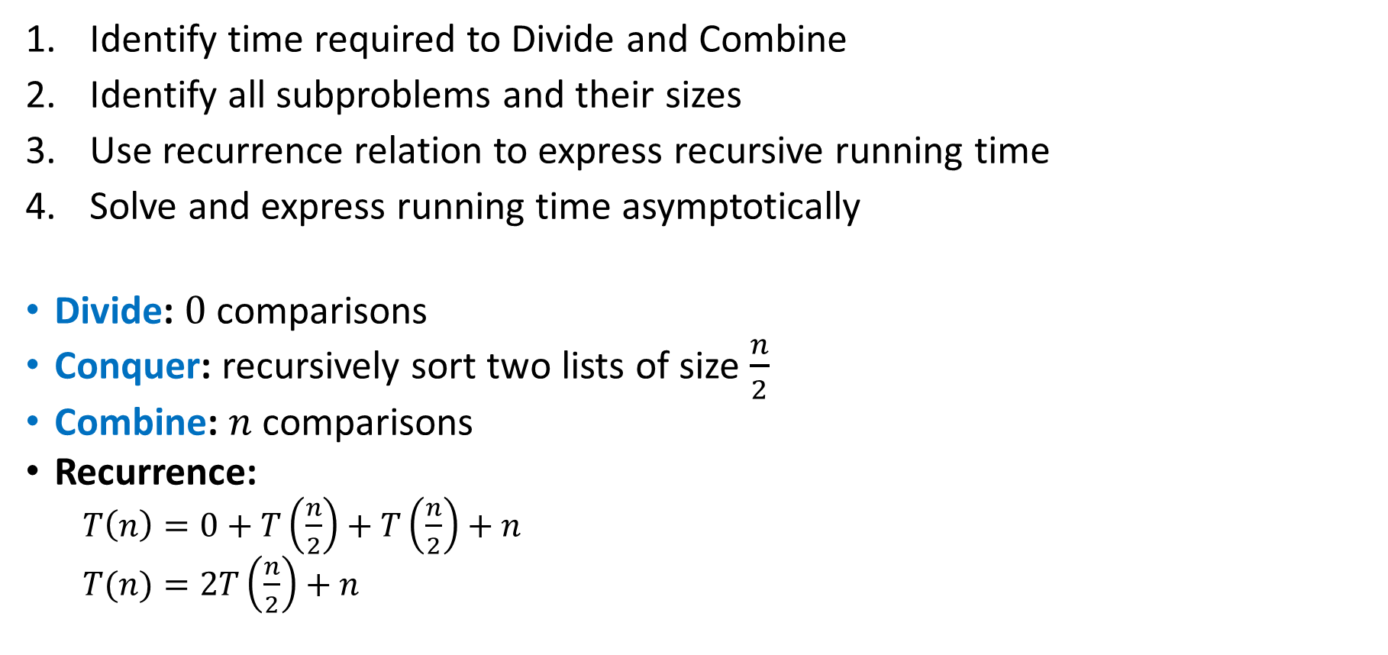
Analyzing Merge Sort
Identify time required to Divide and Combine
Identify all subproblems and their sizes
Use recurrence relation to express recursive running time
Solve and express running time asymptotically
Divide: $0$ comparisons
Conquer: recursively sort two lists of size $\frac{n}{2}$
Combine: $n$ comparisons
Recurrence:
$T\left(n\right)=0+T\left(\frac{n}{2}\right)+T\left(\frac{n}{2}\right)+n$
$T(n)=2T\left(\frac{n}{2}\right)+n$

Slide 46













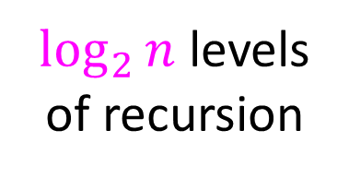






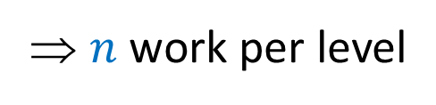







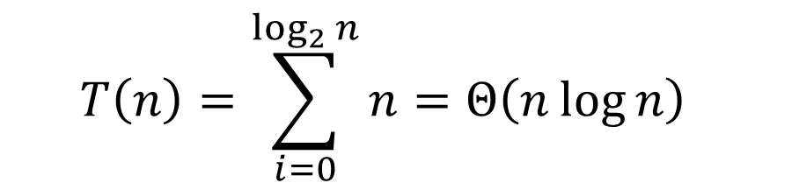
Tree Method $T\left(n\right)=2T\left(\frac{n}{2}\right)+n$
Red box represents a problem instance
$$n$$
⇒ $n$ work per level
$$n$$
Blue value next to each box represents time spent at that level of recursion
$$n/2$$
$$\frac{n}{2}$$
$$n/2$$
$$\frac{n}{2}$$
$\log_{2}⁡n$ levels
of recursion
$$n/4$$
$$\frac{n}{4}$$
$$n/4$$
$$\frac{n}{4}$$
$$n/4$$
$$\frac{n}{4}$$
$$n/4$$
$$\frac{n}{4}$$
…
…
…
…
…
$$1$$
$$1$$
$$1$$
$$1$$
$$1$$
$$1$$
$$1$$
$$1$$
$$1$$
$$1$$
$$1$$
$$1$$
$$T\left(n\right)=\sum_{i=0}^{\log_{2}{n}}{n}=Θ\left(n\log{n}\right)$$

Slide 47
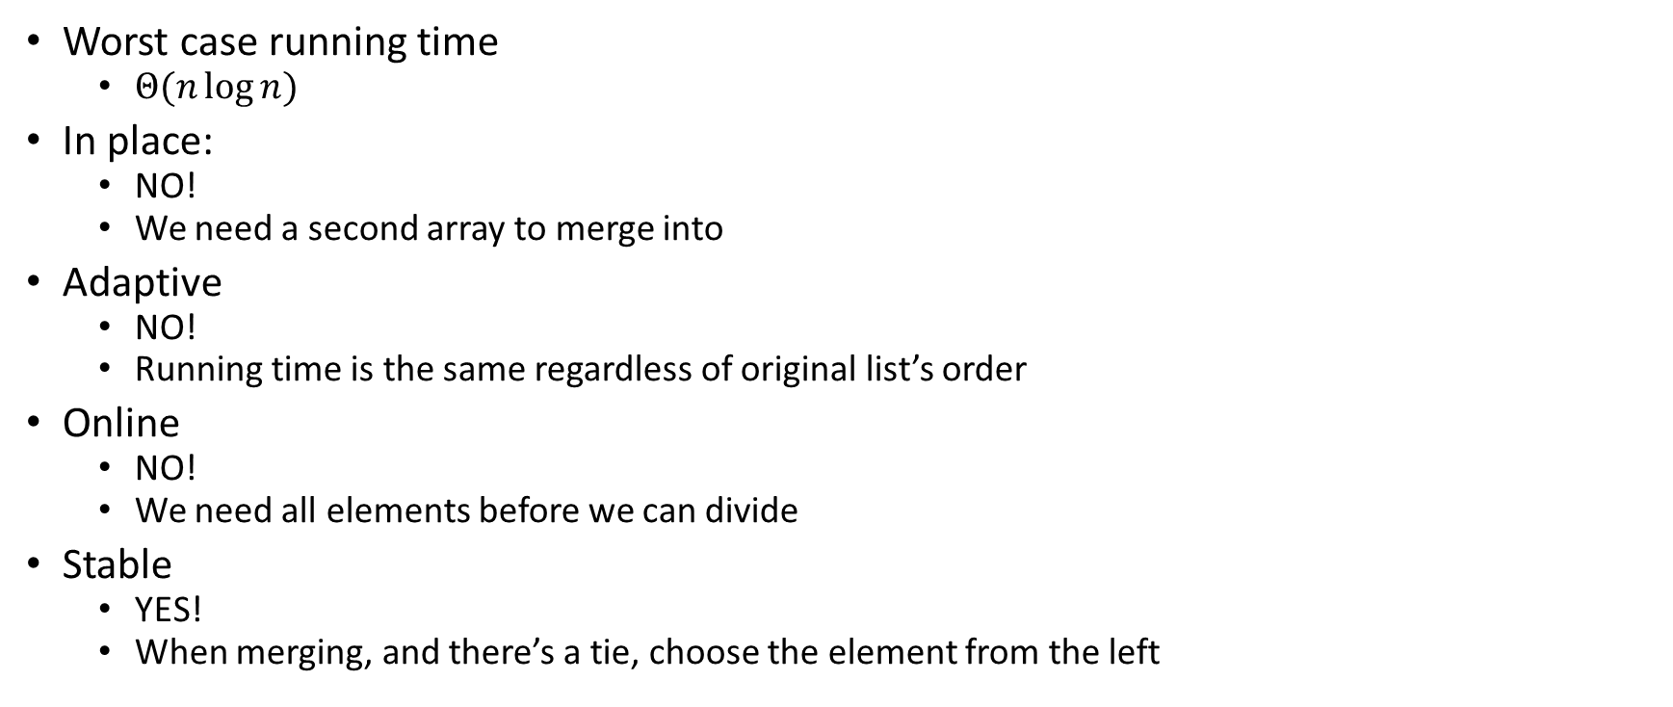
Merge Sort Properties
Worst case running time
$Θ(n\log{n})$
In place:
NO!
We need a second array to merge into
Adaptive
NO!
Running time is the same regardless of original list’s order
Online
NO!
We need all elements before we can divide
Stable
YES!
When merging, and there’s a tie, choose the element from the left

Slide 48

Quicksort Vs. Mergesort
Like Mergesort:
Divide and conquer
$O(n\log{n})$ run time (kind of…)
Unlike Mergesort:
Divide step is the “hard” part
Typically faster than Mergesort

Slide 49
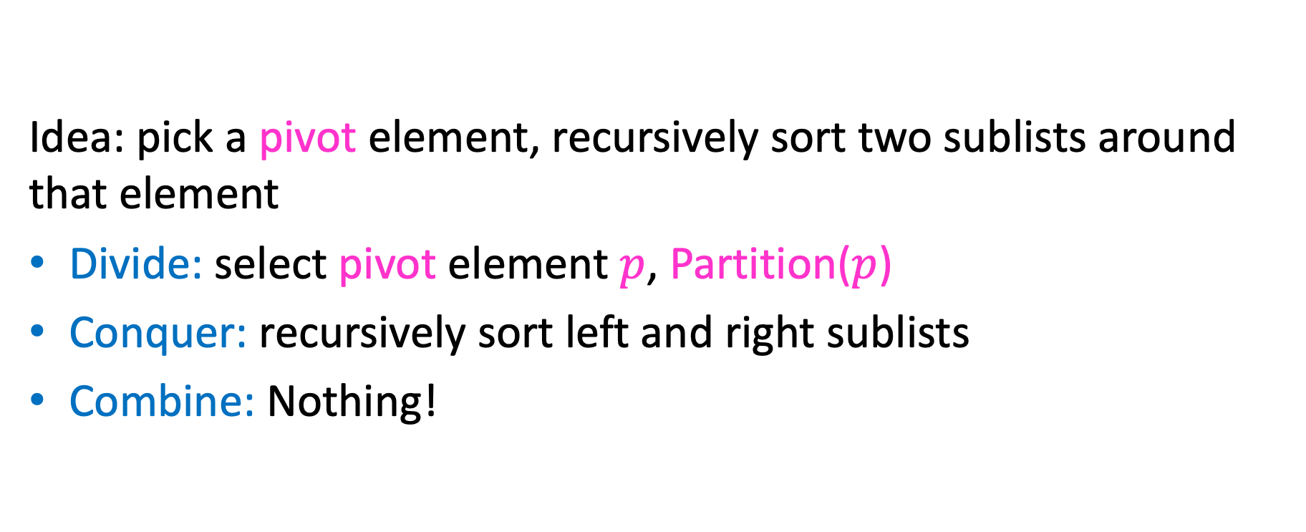
Quicksort Overview
Idea: pick a pivot element, recursively sort two sublists around that element
Divide: select pivot element $p$, Partition($p$)
Conquer: recursively sort left and right sublists
Combine: Nothing!

Slide 50


Partition (Divide step)
Given: a list, a pivot $p$
Start: unordered list
8
5
7
3
12
10
1
2
4
9
6
11
Goal: All elements $<p$ on left, all $>p$ on right
5
7
3
1
2
4
6
8
12
10
9
11

Slide 51
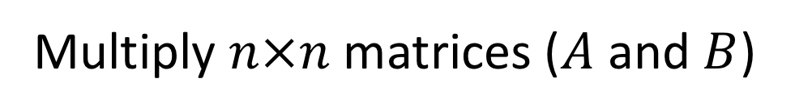
Partition Procedure (Slide 1 of 2)
If Begin value $< p$, move Begin right
Else swap Begin value with End value, move End Left
Done when Begin = End
8
5
7
3
12
10
1
2
4
9
6
11
8
5
7
3
12
10
1
2
4
9
6
11
8
5
7
3
12
10
1
2
4
9
6
11
8
5
7
3
11
10
1
2
4
9
6
12

Slide 52
Partition Procedure (Slide 2 of 2)
If Begin value $< p$, move Begin right
Else swap Begin value with End value, move End Left
Done when Begin = End
8
5
7
3
11
10
1
2
4
9
6
12
8
5
7
3
6
10
1
2
4
9
11
12
8
5
7
3
6
10
1
2
4
9
11
12
8
5
7
3
6
9
1
2
4
10
11
12

Slide 53
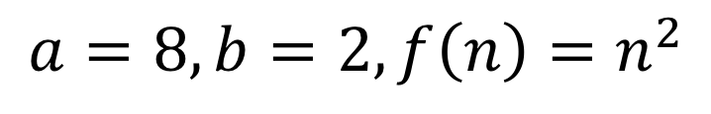
Partition – Begin Meets End (Case 1)
If Begin value $< p$, move Begin right
Else swap Begin value with End value, move End Left
Done when Begin = End
8
5
7
3
6
4
1
2
10
9
11
12
Case 1: meet at element $<p$
Swap $p$ with pointer position (2 in this case)
2
5
7
3
6
4
1
8
10
9
11
12

Slide 54
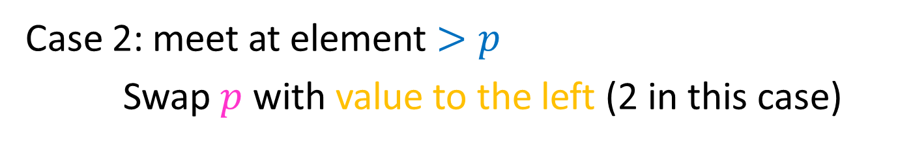
Partition – Begin Meets End (Case 2)
If Begin value $< p$, move Begin right
Else swap Begin value with End value, move End Left
Done when Begin = End
8
5
7
3
6
4
1
2
10
9
11
12
Case 2: meet at element $>p$
Swap $p$ with value to the left (2 in this case)
2
5
7
3
6
4
1
8
10
9
11
12

Slide 55
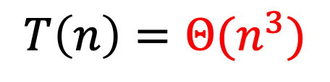
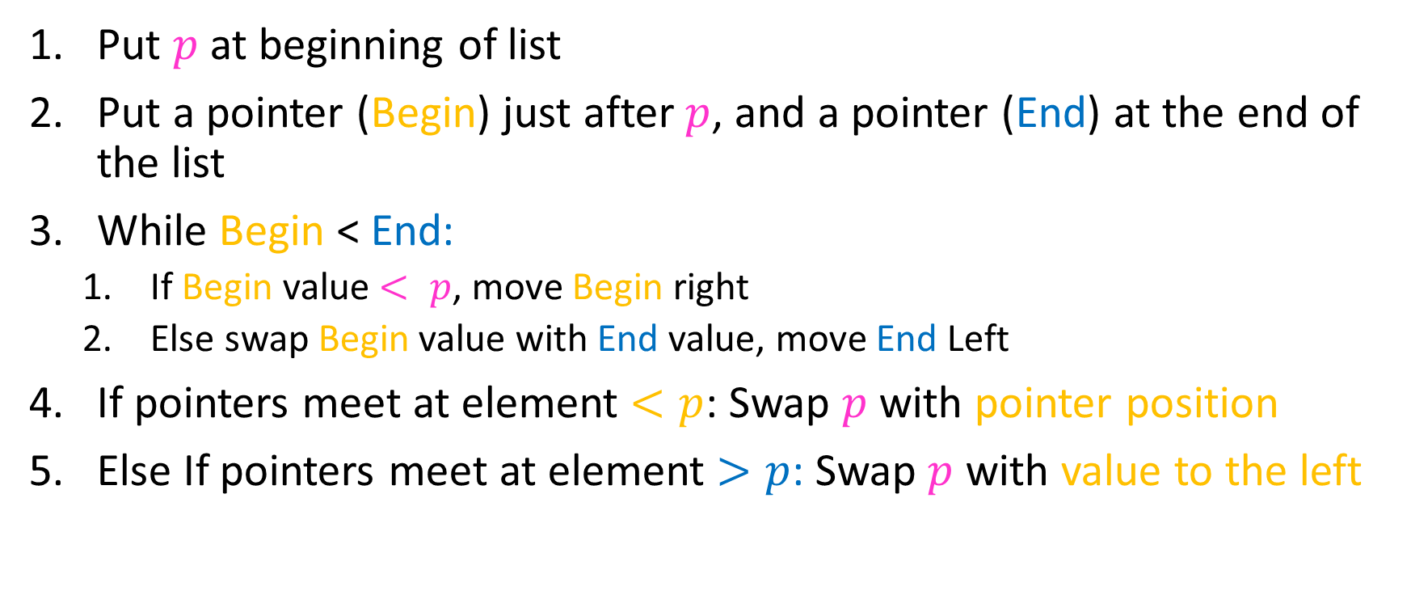
Partition Summary
Put $p$ at beginning of list
Put a pointer (Begin) just after $p$, and a pointer (End) at the end of the list
While Begin < End:
If Begin value $< p$, move Begin right
Else swap Begin value with End value, move End Left
If pointers meet at element $<p$: Swap $p$ with pointer position
Else If pointers meet at element $>p$: Swap $p$ with value to the left
Run time?
$$O(n)$$

Slide 56
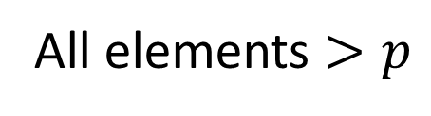
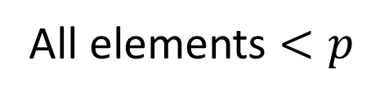
Conquer
2
5
7
3
6
4
1
8
10
9
11
12
All elements $<p$
All elements $>p$
Exactly where it belongs!
Recursively sort Left and Right sublists

Slide 57


Quicksort Run Time (Best)
If the pivot is always the median:
2
5
1
3
6
4
7
8
10
9
11
12
2
1
3
5
6
4
7
8
9
10
11
12
Then we divide in half each time
$$T\left(n\right)=2T\left(\frac{n}{2}\right)+n$$
$$T\left(n\right)=O(n\log{n})$$

Slide 58

Quicksort Run Time (Worst)
If the pivot is always at the extreme:
1
5
2
3
6
4
7
8
10
9
11
12
1
2
3
5
6
4
7
8
10
9
11
12
Then we shorten by 1 each time
$$T\left(n\right)=T\left(n−1\right)+n$$
$$T\left(n\right)=O(n^{2})$$

Slide 59


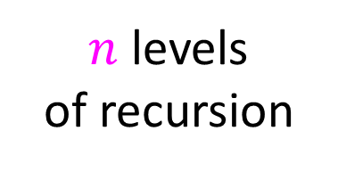


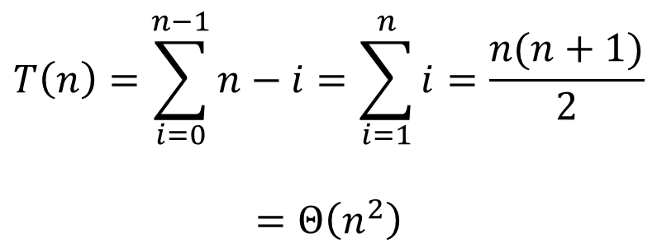







Quicksort Worst Case Tree Method
$$T\left(n\right)=T\left(n−1\right)+n$$
$$n$$
$$T\left(n\right)=\sum_{i=0}^{n−1}{n−i}=\sum_{i=1}^{n}{i}=\frac{n(n+1)}{2}$$
$$=Θ\left(n^{2}\right)$$
$$n$$
$$n−1$$
$$n−1$$
$$n−2$$
$$n−2$$
$n$ levels
of recursion
$$n−3$$
$$n−3$$
…
$$1$$
$$1$$

Slide 60
Good Pivot
What makes a good Pivot?
Roughly even split between left and right
Ideally: median
There are ways to find the median in linear time, but it’s complicated and slow and you’re better off using mergesort
In Practice:
Pick a random value as a pivot
Pick the middle of 3 random values as the pivot

Slide 61
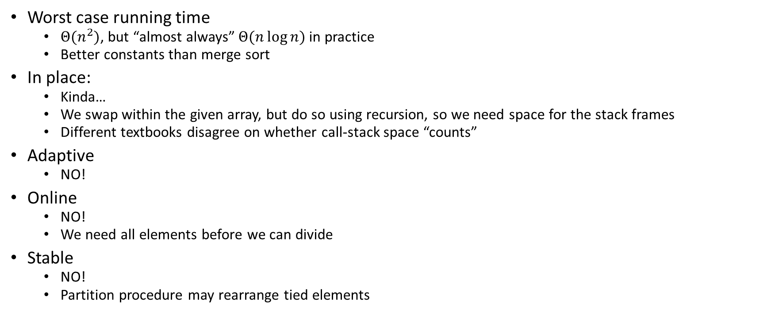
Quick Sort Properties
Worst case running time
$Θ(n^{2})$, but “almost always” $Θ(n\log{n})$ in practice
Better constants than merge sort
In place:
Kinda…
We swap within the given array, but do so using recursion, so we need space for the stack frames
Different textbooks disagree on whether call-stack space “counts”
Adaptive
NO!
Online
NO!
We need all elements before we can divide
Stable
NO!
Partition procedure may rearrange tied elements

