Slide 1
CSE 332 Winter 2026
Lecture 9: AVL Trees pt. 2
Nathan Brunelle
http://www.cs.uw.edu/332

Slide 2
Dictionary (Map) ADT
Contents:
  Sets of key+value pairs
  Keys must be comparable
Operations:
  insert(key, value)
    Adds the (key,value) pair into the dictionary
    If the key already has a value, overwrite the old value
      Consequence: Keys cannot be repeated
  find(key)
    Returns the value associated with the given key
  delete(key)
    Remove the key (and its associated value)

Slide 3
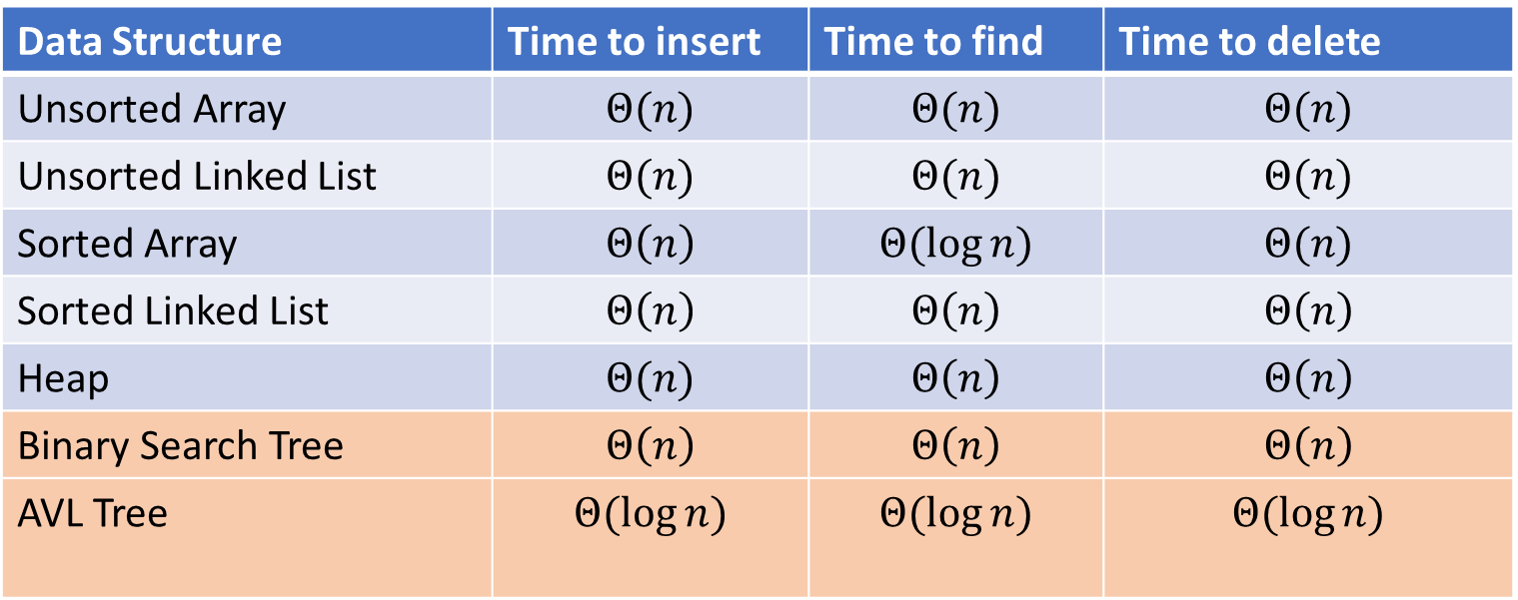
Naïve attempts
Data Structure | Time to insert | Time to find | Time to delete
Unsorted Array | $$Θ(n)$$ | $$Θ(n)$$ | $$Θ(n)$$
Unsorted Linked List | $$Θ(n)$$ | $$Θ(n)$$ | $$Θ(n)$$
Sorted Array | $$Θ\left(n\right)$$ | $$Θ(\log{n})$$ | $$Θ(n)$$
Sorted Linked List | $$Θ\left(n\right)$$ | $$Θ\left(n\right)$$ | $$Θ\left(n\right)$$
Heap | $$Θ(n)$$ | $$Θ\left(n\right)$$ | $$Θ\left(n\right)$$
Binary Search Tree | $$Θ\left(n\right)$$ | $$Θ\left(n\right)$$ | $$Θ\left(n\right)$$
AVL Tree | $$Θ(\log{n})$$ | $$Θ(\log{n})$$ | $$Θ(\log{n})$$

Slide 4
Binary Search Tree
7
3
10
1
6
8
16
Binary Tree
  Definition:
    Tree where each node has at most 2 children
Order Property
  All keys in the left subtree are smaller than the root
  All keys in the right subtree are larger than the root
  Consequence: cannot have repeated values
0
2

Slide 5
Improving the worst case
How can we get a better worst case running time?
  Add rules about the shape of our BST
AVL Tree
  A BST with some shape rules
    Algorithms need to change to accommodate those

Slide 6

AVL Tree
A Binary Search tree that maintains that the left and right subtrees of every node have heights that differ by at most one.
  height of left subtree and height of right subtree off by at most 1
  Not too weak (ensures trees are short)
  Not too strong (works for any number of nodes)
Idea of AVL Tree:
  When you insert/delete nodes, if tree is “out of balance” then modify the tree
  Modification = “rotation”

Slide 7
Find Operation (Same as BST)
7
3
10
find(key, root){
if (root == Null){
return Null;
{
if (key == root.key){
return root.value;
}
if (key < root.key){
return find(key, root.left);
}
if (key > root.key){
return find(key, root.right);
}
return Null;
}
1
6
16
0

Slide 8
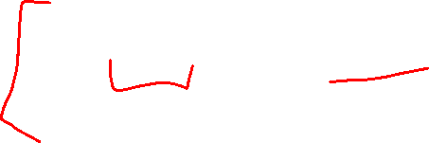
Inserting into an AVL Tree
Starts out the same way as BST:
  “Find” where the new node should go
  Put it in the right place (it will be a leaf)
Next check the balance
  If the tree is still balanced, you’re done!
  Otherwise we need to do rotations

Slide 9

Insert Operation (for BST)
7
3
10
insert(key, value, root){
root = insertHelper(key, value, root);
}
insertHelper(key, value, root){
if(root == null)
return new Node(key, value);
if (root.key < key)
root.right = insertHelper(key, value, root.right);
else
root.left = insertHelper(key, value, root.left);
return root;
}
1
6
16
0
Note: Insert happens only at the leaves!

Slide 10
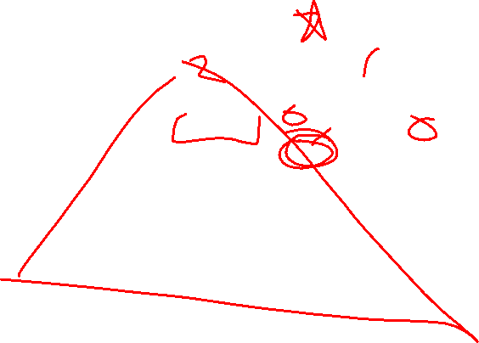
Insert Example
10
9
3
11
1
6
16
0
2
7

Slide 11

Insert Example
Is the tree still balanced?
To confirm we only need to check nodes in the path from root to the new node
Why? We assume the tree was balanced before the insert, so unchanged subtrees cannot be unbalanced.
Height=3
9
Height=2
Height=1
3
11
Height=0
Height=0
1
6
10
16
0
2
7

Slide 12
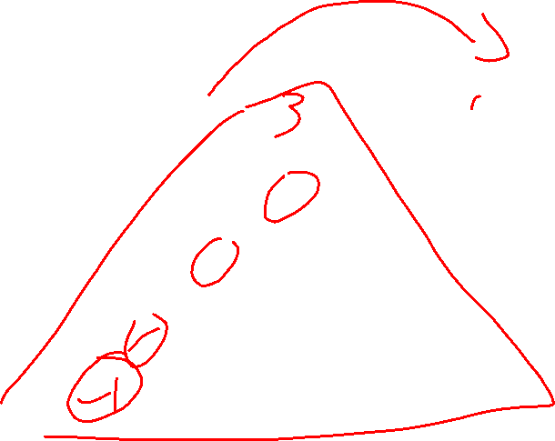
Insert Example
-1
9
3
11
1
6
16
0
2
7

Slide 13
Insert Example
Not Balanced!
Node 9 is the “problem node” Left and right children of node 9 are different by 2.
Idea: “shorten” the left subtree, “lengthen” the right
Height=4
9
Height=3
Height=1
3
11
Height=2
Height=1
1
6
16
Height=1
Height=0
0
2
7
Height=0
-1
Height=-1

Slide 14
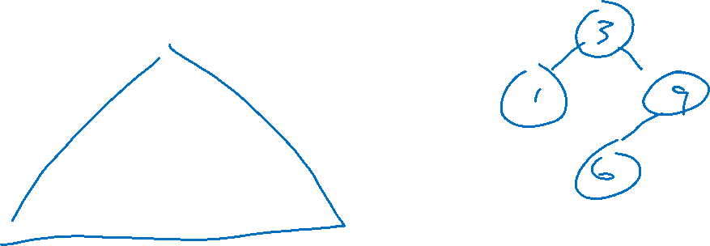
Right Rotation
Solution:
Take the subtree starting with the problem node,
“Rotate” that tree to the right
9
Height=3
Height=1
3
11
1
6
16
0
2
7
-1

Slide 15
Balanced!
3
Height=2
Height=2
1
9
0
2
6
11
-1
7
16

Slide 16



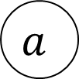
















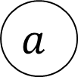


Right Rotation
We just inserted $c$, node $a$ is the deepest “problem” node
Make the left child the new root
Make the old root the right child of the new
Make the new root’s right subtree the old root’s left subtree
$$h+3$$
$$h+2$$
$$b$$
$$a$$
$$h+2$$
$$h$$
$$h+1$$
$$b$$
$$z$$
$$x$$
$$h+1$$
$$a$$
Right Rotation
$$h+1$$
$$h$$
$$h$$
$$h$$
$$x$$
$$y$$
$$y$$
$$z$$
$$c$$
$$c$$

Slide 17

Right Rotation - Implementation
b=a.left
a.left=b.right
b.right=a
return b
Running time: $Θ(1)$
$$h+3$$
$$h+2$$
$$b$$
$$a$$
$$h+2$$
$$h$$
$$h+1$$
$$b$$
$$z$$
$$x$$
$$h+1$$
$$a$$
Right Rotation
$$h+1$$
$$h$$
$$h$$
$$h$$
$$x$$
$$y$$
$$y$$
$$z$$
$$c$$
$$c$$

Slide 18

Insert Example
20
9
3
11
1
6
10
16
0
2
18

Slide 19
Not Balanced! Multiple Problem Nodes
Here, nodes 11 and 16 are problem nodes.
There may be multiple places where we can do a rotation to rebalance the tree, but the deepest problem node always works!
9
Height=2
Height=3
3
11
Height=0
Height=2
1
6
10
16
Height=1
0
2
Height=-1
18
Height=0
20
Height=-1

Slide 20

Left Rotation
Solution:
Take the subtree starting with the problem node,
“Rotate” that tree to the left
9
3
11
1
6
10
16
Height=1
0
2
Height=-1
18
20

Slide 21
Balanced!
9
3
11
1
6
10
18
Height=0
Height=0
0
2
16
20

Slide 22























Left Rotation
We just inserted $c$, node $a$ is the deepest “problem” node
Make the right child the new root
Make the old root the left child of the new
Make the new root’s left subtree the old root’s right subtree
$$h+3$$
$$a$$
$$h+2$$
$$b$$
$$h$$
$$h+1$$
$$h+1$$
$$x$$
$$h+2$$
$$b$$
$$a$$
$$z$$
Left Rotation
$$h$$
$$h+1$$
$$h$$
$$h$$
$$y$$
$$z$$
$$x$$
$$y$$
$$c$$
$$c$$

Slide 23

Left Rotation (Implementation)
b=a.right
a.right=b.left
b.left=a
return b
$$h+3$$
$$a$$
$$h+2$$
$$b$$
$$h$$
$$h+1$$
$$h+1$$
$$x$$
$$h+2$$
$$b$$
$$a$$
$$z$$
Left Rotation
$$h$$
$$h+1$$
$$h$$
$$h$$
$$y$$
$$z$$
$$x$$
$$y$$
$$c$$
$$c$$

Slide 24
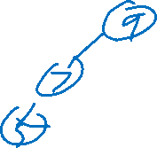
Insertion Story So Far
After insertion, update the heights of the node’s ancestors
Check for unbalance
If unbalanced then at the deepest unbalanced root:
  If the left subtree was deeper then rotate right
  If the right subtree was deeper then rotate left
This is incomplete!
There are some cases where this doesn’t work!
9
9
5
Insert 7
Right Rotation
5
5
9
7
7

Slide 25

Insertion Story So Far
After insertion, update the heights of the node’s ancestors
Check for unbalance
If unbalanced then at the deepest unbalanced root:
  Case LL: If we inserted in the left subtree of the left child then rotate right
  Case RR: If we inserted in the right subtree of the right child then rotate left
  Case LR: If we inserted into the right subtree of the left child then ???
  Case RL: If we inserted into the left subtree of the right child then ???
Cases LR and RL require 2 rotations!

Slide 26
Case LR
From deepest problem node:
  Rotate left at the left child
  Rotate right at the problem node
9
9
9
Insert 7
Rotate Left at 5
5
Rotate Right at 9
7
5
7
7
5
9
5

Slide 27



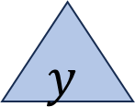
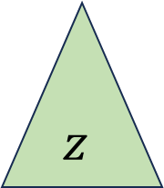









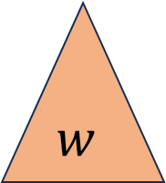




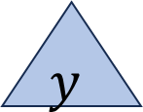

























Case LR in General
We just inserted $d$, node $a$ is the deepest “problem” node
Imbalance caused by inserting in the left child’s right subtree
Rotate left at the left child
Rotate right at the unbalanced node
$$h+3$$
$$h+3$$
$$a$$
$$h+2$$
$$a$$
$$c$$
Rotate
Left at $b$
Rotate Right at $a$
$$h+2$$
$$h+2$$
$$h$$
$$h+1$$
$$h$$
$$c$$
$$z$$
$$a$$
$$b$$
$$z$$
$$b$$
$$h+1$$
$$h+1$$
$$h$$
$$h+1$$
$$c$$
$$b$$
$$y$$
$$h$$
$$h$$
$$w$$
$$w$$
$$x$$
$$y$$
$$z$$
$$h$$
$$x$$
$$y$$
$$w$$
$$x$$
$$d$$
$$d$$
$$d$$
$$d$$
$$d$$
$$d$$

Slide 28
Case LR Implementation
b=a.left
c=b.right
b.right=c.left
a.left=c.right
c.right=a
c.left=b
return c
$$h+3$$
$$h+3$$
$$a$$
$$h+2$$
$$a$$
$$c$$
Rotate
Left at $b$
Rotate Right at $a$
$$h+2$$
$$h+2$$
$$h$$
$$h+1$$
$$h$$
$$c$$
$$z$$
$$a$$
$$b$$
$$z$$
$$b$$
$$h+1$$
$$h+1$$
$$h$$
$$h+1$$
$$c$$
$$b$$
$$y$$
$$h$$
$$h$$
$$w$$
$$w$$
$$x$$
$$y$$
$$z$$
$$h$$
$$x$$
$$y$$
$$w$$
$$x$$
$$d$$
$$d$$
$$d$$
$$d$$
$$d$$
$$d$$

Slide 29















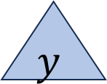









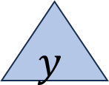
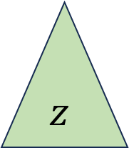







Case RL in General
We just inserted $d$, node $a$ is the deepest “problem” node
Imbalance caused by inserting in the right child’s left subtree
Rotate right at the right child
Rotate left at the unbalanced node
$$a$$
$$h+2$$
$$c$$
$$h+3$$
$$h+3$$
$$a$$
Rotate Right at $b$
Rotate Left at $a$
$$h+2$$
$$b$$
$$h$$
$$c$$
$$h+1$$
$$b$$
$$h$$
$$w$$
$$h+2$$
$$a$$
$$h+1$$
$$w$$
$$h+1$$
$$c$$
$$h$$
$$h+1$$
$$b$$
$$h$$
$$h$$
$$z$$
$$x$$
$$w$$
$$x$$
$$y$$
$$z$$
$$h$$
$$x$$
$$y$$
$$y$$
$$z$$
$$d$$
$$d$$
$$d$$
$$d$$
$$d$$
$$d$$

Slide 30
Case RL Implementation
b=a.right
c=b.left
b.left=c.right
a.right=c.left
c.left=a
c.right=b
return c
$$a$$
$$h+2$$
$$c$$
$$h+3$$
$$h+3$$
$$a$$
Rotate Right at $b$
Rotate Left at $a$
$$h+2$$
$$b$$
$$h$$
$$c$$
$$h+1$$
$$b$$
$$h$$
$$w$$
$$h+2$$
$$a$$
$$h+1$$
$$w$$
$$h+1$$
$$c$$
$$h$$
$$h+1$$
$$b$$
$$h$$
$$h$$
$$z$$
$$x$$
$$w$$
$$x$$
$$y$$
$$z$$
$$h$$
$$x$$
$$y$$
$$y$$
$$z$$
$$d$$
$$d$$
$$d$$
$$d$$
$$d$$
$$d$$

Slide 31
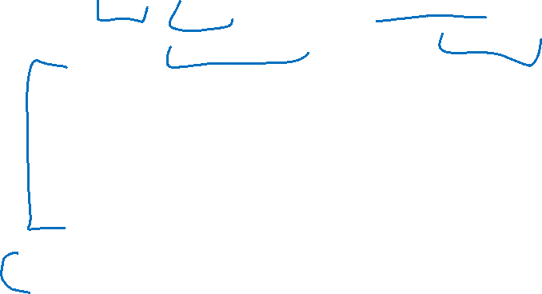
Insert Summary
After a BST insertion, update the heights of the node’s ancestors
From leaf to root, check if each node is balanced
If a node is unbalanced then at the deepest unbalanced node:
  Case LL: If we inserted in the left subtree of the left child then: rotate right
  Case RR: If we inserted in the right subtree of the right child then: rotate left
  Case LR: If we inserted into the right subtree of the left child then: rotate left at the left child and then rotate right at the root
  Case RL: If we inserted into the left subtree of the right child then: rotate right at the right child and then rotate left at the root
Done after either reaching the root or applying one of the above cases

Slide 32
Insert Operation (for AVL)
insert(key, value, root){
root = insertHelper(key, value, root);
}
insertHelper(key, value, root){
if(root == null)
return new Node(key, value);
if (root.key < key)
root.right = insertHelper(key, value, root.right);
else
root.left = insertHelper(key, value, root.left);
if(isUnbalanced(root))
root=rotate(root);
return root;
}

Slide 33
Delete Summary
Tldr: same cases, reverse direction of rotation, may need to repeat with ancestors
After a BST deletion, update the heights of the node’s ancestors
From leaf to root, check if each node is unbalanced
If a node is unbalanced then at the deepest unbalanced node:
  Case LL: If we deleted in the left subtree of the left child then: rotate left
  Case RR: If we deleted in the right subtree of the right child then: rotate right
  Case LR: If we deleted into the right subtree of the left child then: rotate right at the left child and then rotate left at the root
  Case RL: If we deleted into the left subtree of the right child then: rotate left at the right child and then rotate right at the root
Continue checking until reach the root

Slide 34
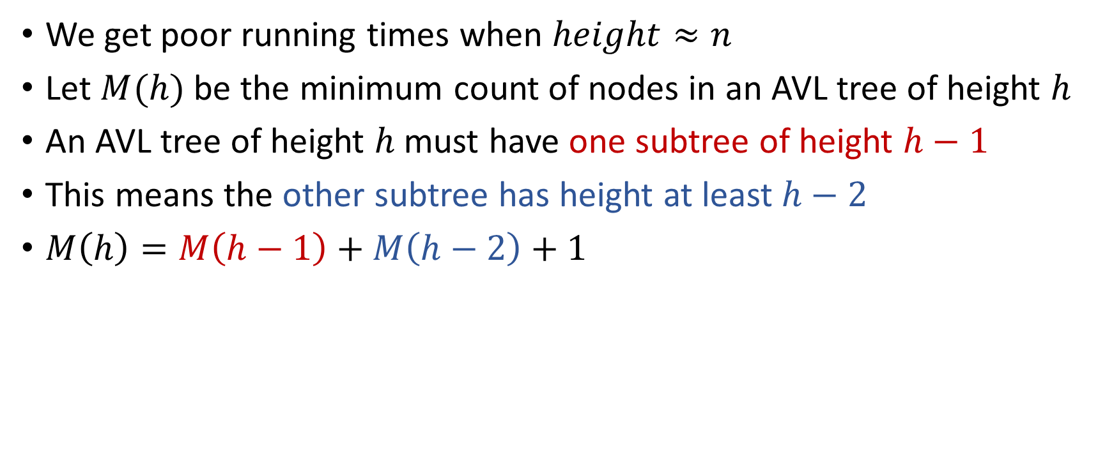

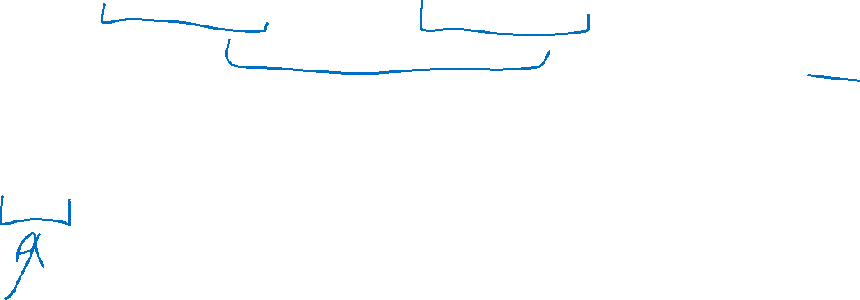
Why is this $Θ(\log{n})$ time?
We get poor running times when $height≈n$
Let $M(h)$ be the minimum count of nodes in an AVL tree of height $h$
An AVL tree of height $h$ must have one subtree of height $h−1$
This means the other subtree has height at least $h−2$
$M\left(h\right)=M\left(h−1\right)+M\left(h−2\right)+1$

Slide 35
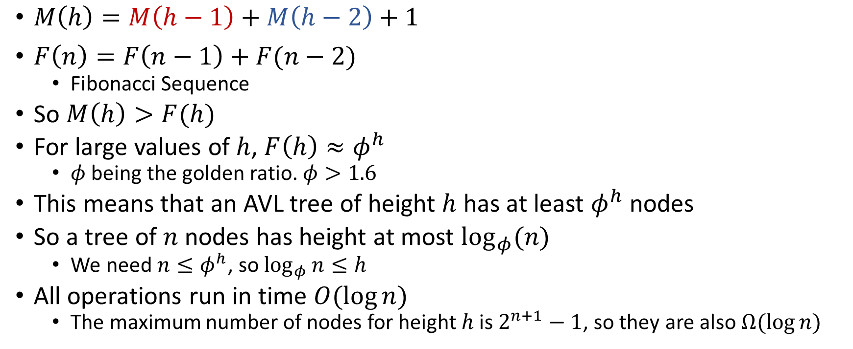
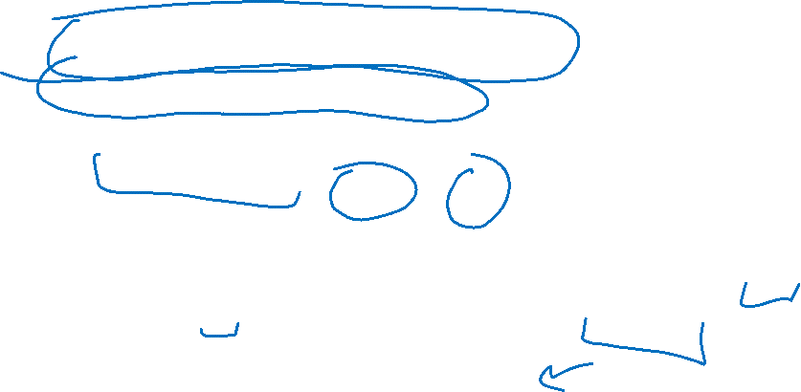
Comparing to Fibonacci Sequence
$M\left(h\right)=M\left(h−1\right)+M\left(h−2\right)+1$
$F\left(n\right)=F\left(n−1\right)+F(n−2)$
  Fibonacci Sequence
So $M\left(h\right)>F(h)$
For large values of $h$, $F\left(h\right)≈φ^{h}$
  $φ$ being the golden ratio. $φ>1.6$
This means that an AVL tree of height $h$ has at least $φ^{h}$ nodes
So a tree of $n$ nodes has height at most $\log_{φ}(n)$
  We need $n≤φ^{h}$, so $\log_{φ}{n}≤h$
All operations run in time $O(\log{n})$
  The maximum number of nodes for height $h$ is $2^{n+1}−1$, so they are also $Ω(\log{n})$

