Slide 1
CSE 332 Spring 2026 Lecture 6: Recurrences
Nathan Brunelle
http://www.cs.uw.edu/332

Slide 2
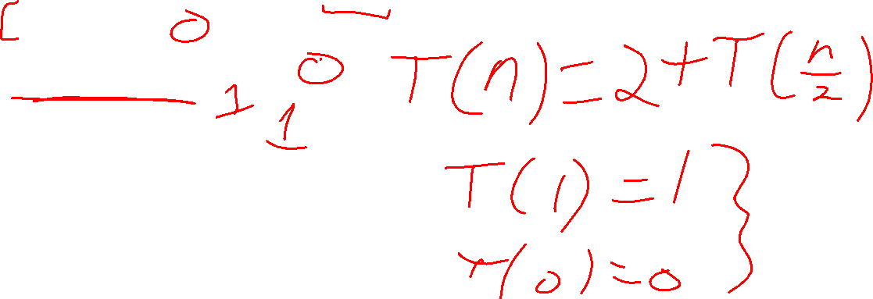
Recursive Binary Search
5
8
13
42
75
79
88
90
95
99
0
1
2
3
4
5
6
7
8
9
public static boolean binarySearch(List<Integer> lst, int k){
return binarySearch(lst, k, 0, lst.size());
}
private static boolean binarySearch(List<Integer> lst, int k, int start, int end){
if(start == end)
return false;
int mid = start + (end-start)/2;
if(lst.get(mid) == k){
return true;
} else if(lst.get(mid) > k){
return binarySearch(lst, k, start, mid);
} else{
return binarySearch(lst, k, mid+1, end);
}
}

Slide 3
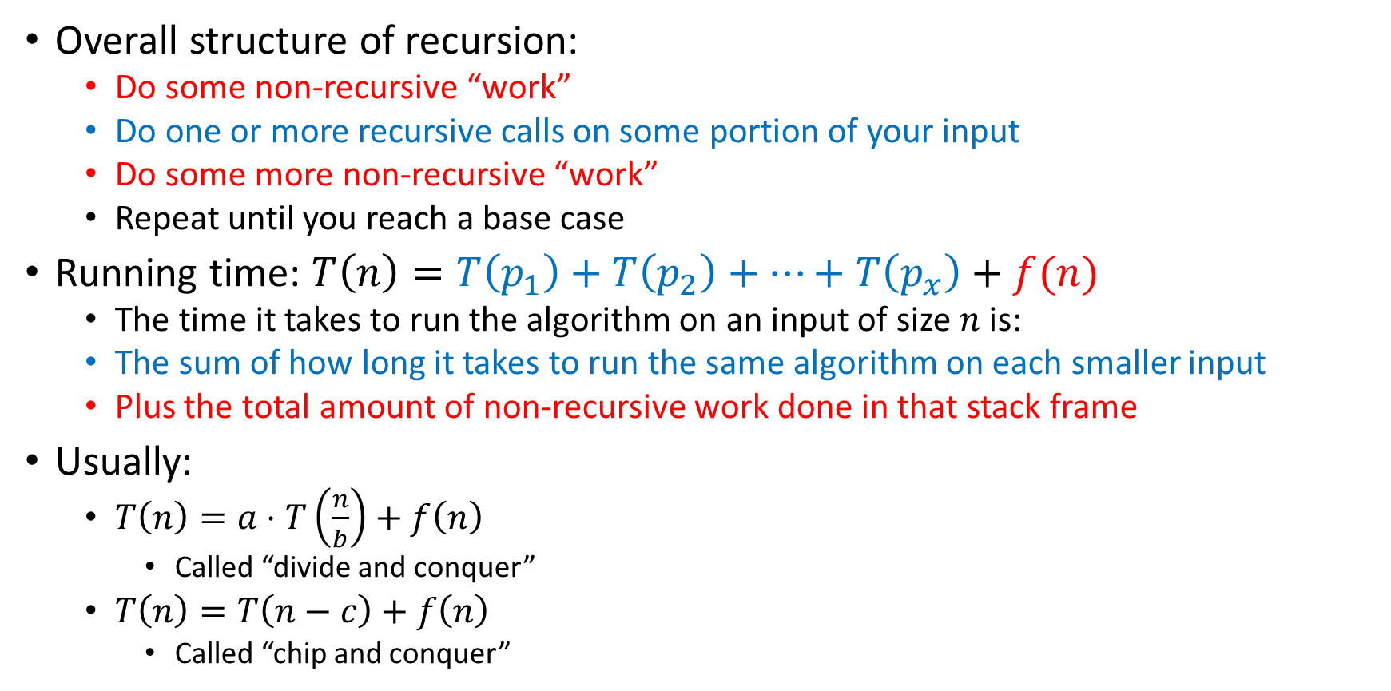
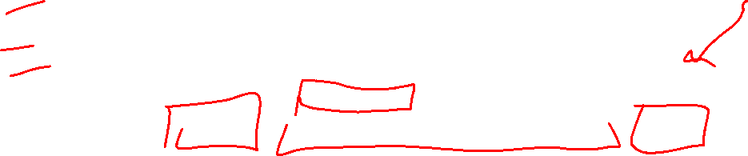
Analysis of Recursive Algorithms
Overall structure of recursion:
Do some non-recursive “work”
Do one or more recursive calls on some portion of your input
Do some more non-recursive “work”
Repeat until you reach a base case
Running time: $T\left(n\right)=T\left(p_{1}\right)+T\left(p_{2}\right)+…+T\left(p_{x}\right)+f(n)$
The time it takes to run the algorithm on an input of size $n$ is:
The sum of how long it takes to run the same algorithm on each smaller input
Plus the total amount of non-recursive work done in that stack frame
Usually:
$T\left(n\right)=a⋅T\left(\frac{n}{b}\right)+f\left(n\right)$
Called “divide and conquer”
$T\left(n\right)=T\left(n−c\right)+f\left(n\right)$
Called “chip and conquer”

Slide 4
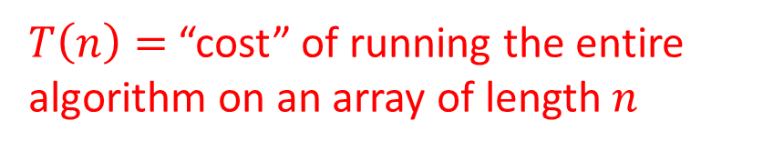

How Efficient Is It?
$T\left(n\right)=$ “cost” of running the entire algorithm on an array of length $n$
$T\left(n\right)=1+T\left(\left\lceil \frac{n}{2}\right\rceil \right)$
Base case: $T\left(1\right)=1$

Slide 5
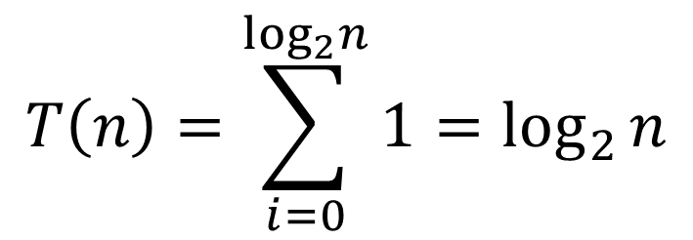

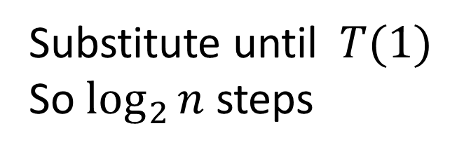


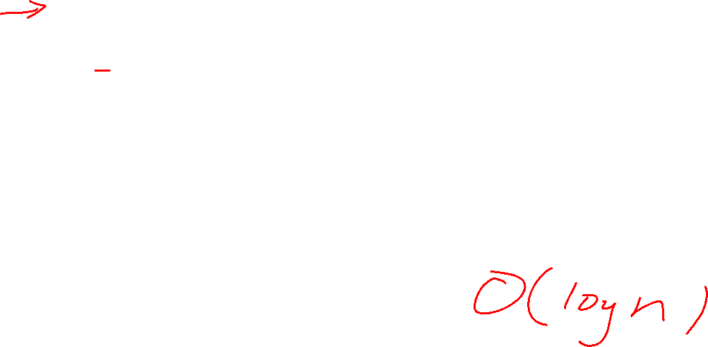



Let’s Solve the Recurrence!
$$T\left(1\right)=1$$
$$T\left(n\right)=1+T(n/2)$$
$$1+T(n/4)$$
Substitute until $T(1)$
So $\log_{2}{n}$ steps
$$1+T(n/8)$$
…
$$1$$
$$T\left(n\right)=\sum_{i=0}^{\log_{2}n}{1}=\log_{2}{n}$$
$$T\left(n\right)∈Θ\left(\log{n}\right)$$

Slide 6

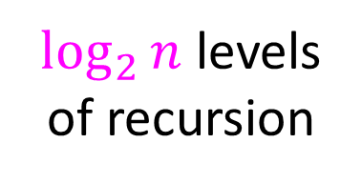











Make our process “prettier”
$$T\left(n\right)=T\left(\frac{n}{2}\right)+1$$
Draw a picture of the recursion
Identify the work done per stack frame
Add up all the work!
Sum is the answer!
In this case $Θ(\log_{2}{n})$
$$1$$
$$n$$
$$n/2$$
$$1$$
$$n/4$$
$$1$$
$\log_{2}⁡n$ levels
of recursion
$$n/8$$
$$1$$
The “Tree Method”
…
$$1$$
$$1$$

Slide 7
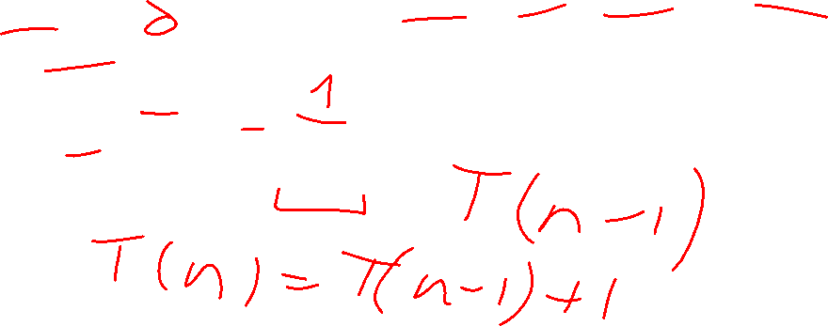
Recursive Linear Search
5
8
13
42
75
79
88
90
95
99
0
1
2
3
4
5
6
7
8
9
public static boolean linearSearch(List<Integer> lst, int k){
return linearSearch(lst, k, 0, lst.size());
}
private static boolean linearSearch(List<Integer> lst, int k, int start, int end){
if(start == end){
return false;
} else if(lst.get(start) == k){
return true;
} else{
return linearSearch(lst, k, start+1, end);
}
}

Slide 8

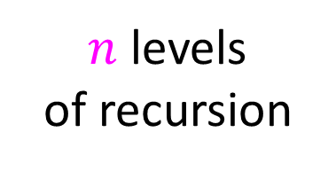



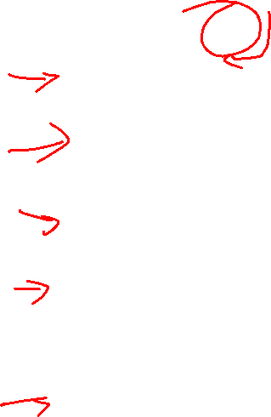




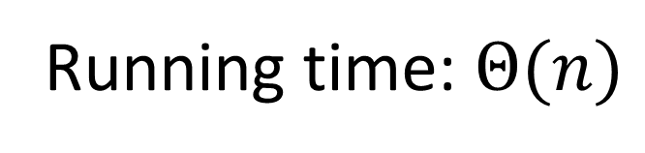

Prettier List Sum Substitution
Draw a picture of the recursion
Identify the work done per stack frame
Add up all the work!
$$T\left(n\right)=T\left(n−1\right)+1$$
$$1$$
$$n$$
$$n−1$$
$$1$$
$$n−2$$
$$1$$
$n$ levels
of recursion
Running time: $Θ(n)$
$$n−3$$
$$1$$
…
$$1$$
$$1$$

Slide 9
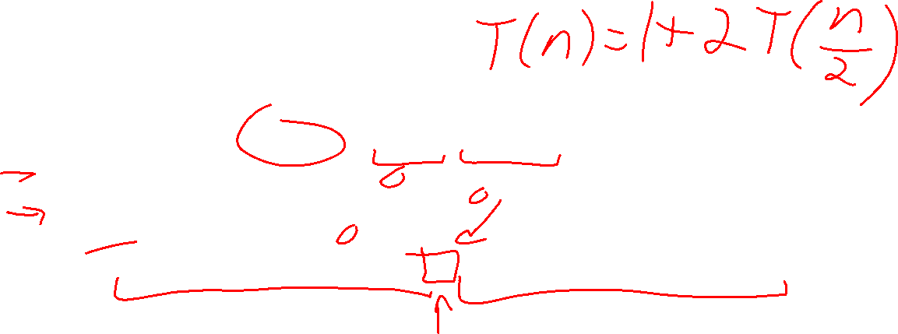
Recursive List Summation Code
public int sum(int[] list){
return sum_helper(list, 0, list.size);
}
private int sum_helper(int[] list, int low, int high){
if (low == high){ return 0; }
if (low == high-1){ return list[low]; }
int middle = (high+low)/2;
return sum_helper(list, low, middle) + sum_helper(list, middle, high);
}

Slide 10










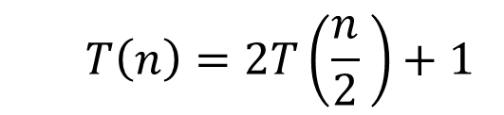


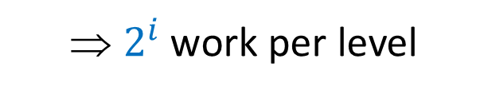



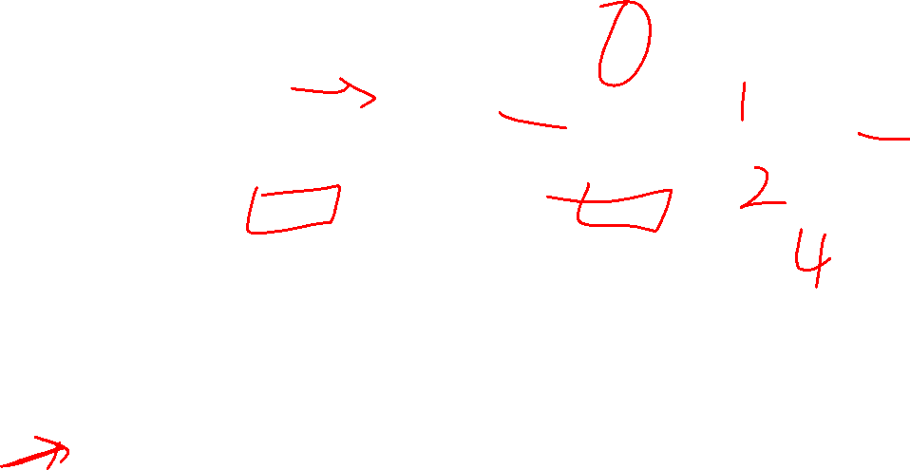











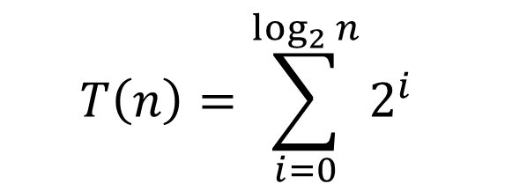
Tree Method for Recursive Summation
Red box represents a problem instance
$$T\left(n\right)=2T\left(\frac{n}{2} \right)+1$$
Blue value next to each box represents time spent at that level of recursion
$$1$$
⇒ $2^{i}$ work per level
$$n$$
$$n/2$$
$$1$$
$$n/2$$
$$1$$
$$1$$
$$1$$
$$1$$
$$1$$
$\log_{2}⁡n$ levels
of recursion
$$n/4$$
$$n/4$$
$$n/4$$
$$n/4$$
…
…
…
…
…
$$1$$
$$1$$
$$1$$
$$1$$
$$1$$
$$1$$
$$1$$
$$1$$
$$1$$
$$1$$
$$1$$
$$1$$
$$T\left(n\right)=\sum_{i=0}^{\log_{2}{n}}{2^{i}}$$

Slide 11

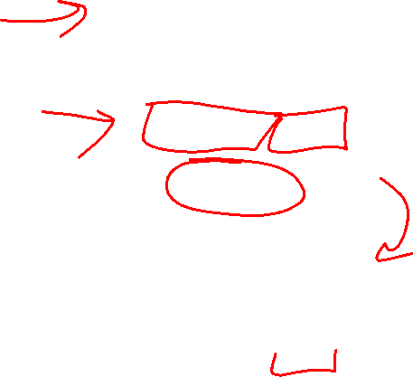
Recursive List Summation – Solving the Series
$$T\left(n\right)=\sum_{i=0}^{\log_{2}{n}}{2^{i}}$$
$$=\left(\frac{2^{{1+log}_{2}{n}}−1}{2−1}\right)$$
$$=2⋅2^{\log_{2}{n}}−1$$
$$=2n−1=Θ(n)$$

Slide 12
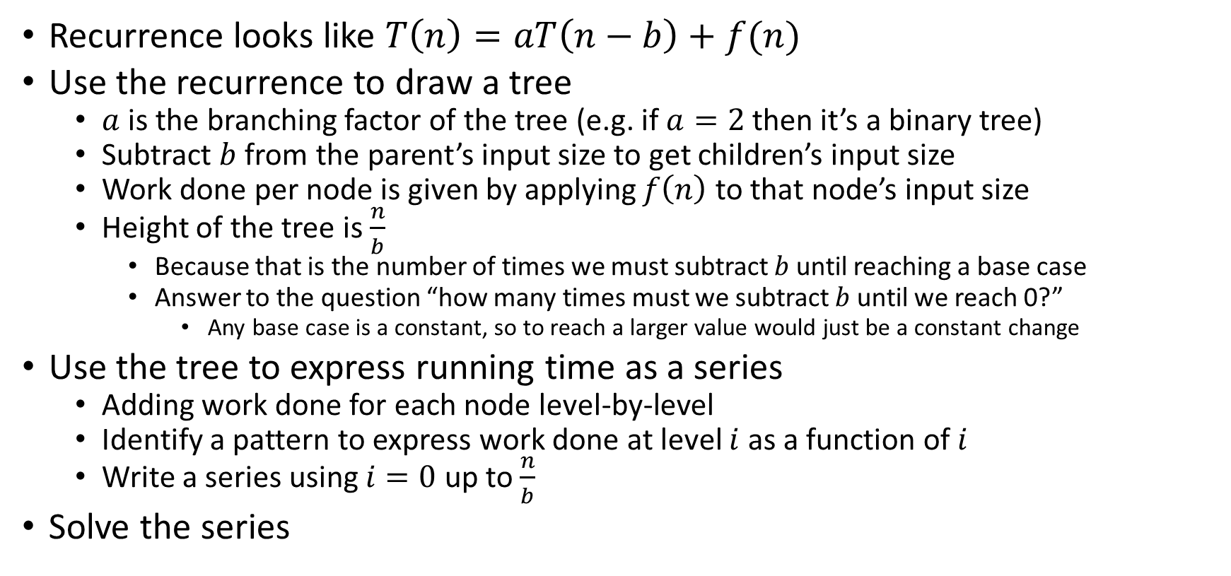
Tree Method Summary: Chip and Conquer
Recurrence looks like $T\left(n\right)=aT\left(n−b\right)+f(n)$
Use the recurrence to draw a tree
$a$ is the branching factor of the tree (e.g. if $a=2$ then it’s a binary tree)
Subtract $b$ from the parent’s input size to get children’s input size
Work done per node is given by applying $f\left(n\right)$ to that node’s input size
Height of the tree is $\frac{n}{b}$
Because that is the number of times we must subtract $b$ until reaching a base case
Answer to the question “how many times must we subtract $b$ until we reach 0?”
Any base case is a constant, so to reach a larger value would just be a constant change
Use the tree to express running time as a series
Adding work done for each node level-by-level
Identify a pattern to express work done at level $i$ as a function of $i$
Write a series using $i=0$ up to $\frac{n}{b}$
Solve the series

Slide 13
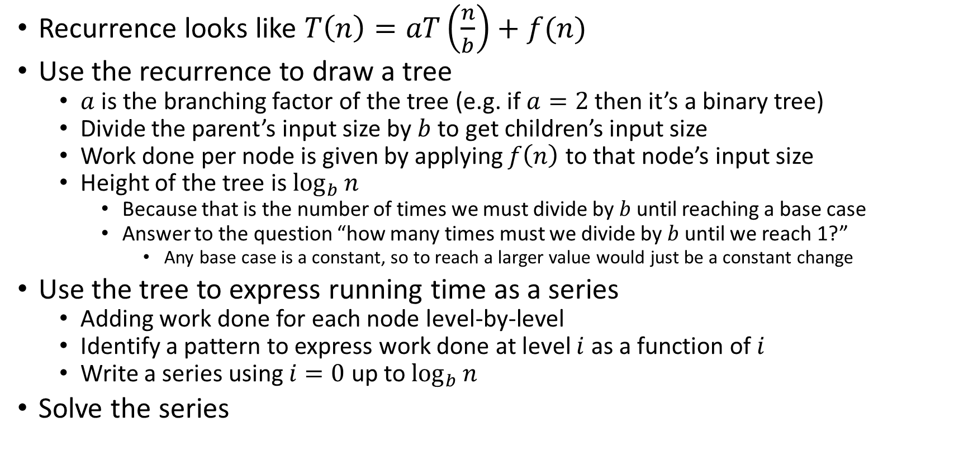
Tree Method Summary: Divide and Conquer
Recurrence looks like $T\left(n\right)=aT\left(\frac{n}{b}\right)+f(n)$
Use the recurrence to draw a tree
$a$ is the branching factor of the tree (e.g. if $a=2$ then it’s a binary tree)
Divide the parent’s input size by $b$ to get children’s input size
Work done per node is given by applying $f\left(n\right)$ to that node’s input size
Height of the tree is $\log_{b}{n}$
Because that is the number of times we must divide by $b$ until reaching a base case
Answer to the question “how many times must we divide by $b$ until we reach 1?”
Any base case is a constant, so to reach a larger value would just be a constant change
Use the tree to express running time as a series
Adding work done for each node level-by-level
Identify a pattern to express work done at level $i$ as a function of $i$
Write a series using $i=0$ up to $\log_{b}{n}$
Solve the series

Slide 14

Let’s do some more!
For each, assume the base case is $n=1$ and $T\left(1\right)=1$
$T\left(n\right)=2T\left(\frac{n}{2}\right)+n$
$T\left(n\right)=2T\left(\frac{n}{2}\right)+n^{2}$
$T\left(n\right)=2T\left(\frac{n}{8}\right)+1$

Slide 15

















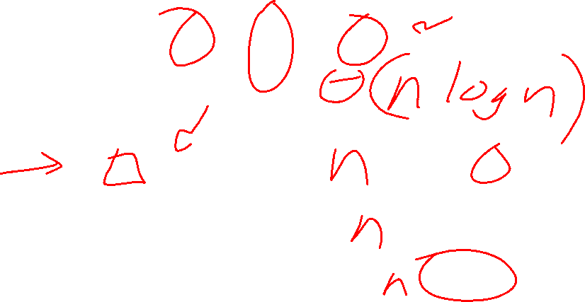



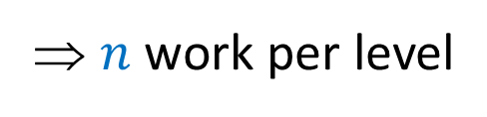







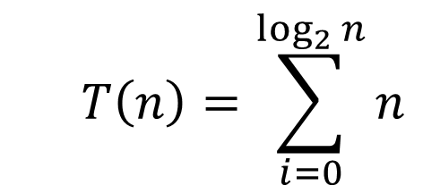
Tree Method $T\left(n\right)=2T\left(\frac{n}{2}\right)+n$
Red box represents a problem instance
Blue value next to each box represents time spent at that level of recursion
$$n$$
⇒ $n$ work per level
$$n$$
$$n/2$$
$$\frac{n}{2}$$
$$n/2$$
$$\frac{n}{2}$$
$\log_{2}⁡n$ levels
of recursion
$$n/4$$
$$\frac{n}{4}$$
$$n/4$$
$$\frac{n}{4}$$
$$n/4$$
$$\frac{n}{4}$$
$$n/4$$
$$\frac{n}{4}$$
…
…
…
…
…
$$1$$
$$1$$
$$1$$
$$1$$
$$1$$
$$1$$
$$1$$
$$1$$
$$1$$
$$1$$
$$1$$
$$1$$
$$T\left(n\right)=\sum_{i=0}^{\log_{2}{n}}{n}$$

Slide 16

















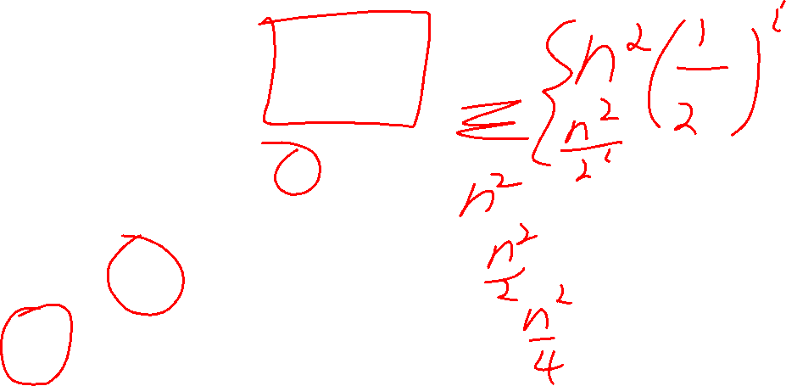



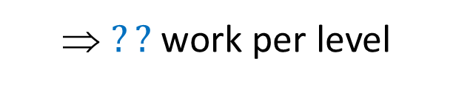







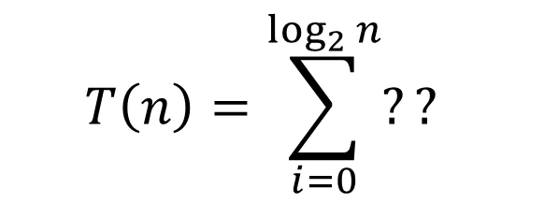
Tree Method $T\left(n\right)=2T\left(\frac{n}{2}\right)+n^{2}$
Red box represents a problem instance
Blue value next to each box represents time spent at that level of recursion
$$n^{2}$$
⇒ $??$ work per level
$$n$$
$$n/2$$
$$\frac{n^{2}}{4}$$
$$n/2$$
$$\frac{n^{2}}{4}$$
$\log_{2}⁡n$ levels
of recursion
$$n/4$$
$$\frac{n^{2}}{16}$$
$$n/4$$
$$\frac{n^{2}}{16}$$
$$n/4$$
$$\frac{n^{2}}{16}$$
$$n/4$$
$$\frac{n^{2}}{16}$$
…
…
…
…
…
$$1$$
$$1$$
$$1$$
$$1$$
$$1$$
$$1$$
$$1$$
$$1$$
$$1$$
$$1$$
$$1$$
$$1$$
$$T\left(n\right)=\sum_{i=0}^{\log_{2}{n}}{??}$$

Slide 17


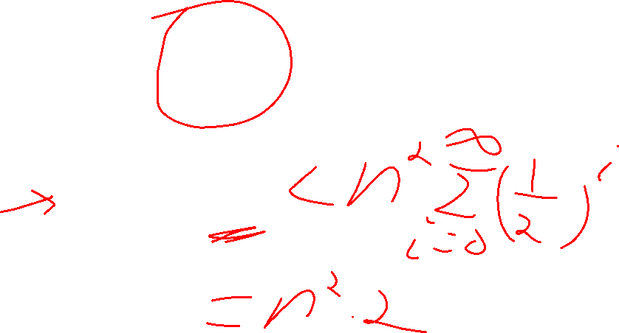
Solving $T\left(n\right)=2T\left(\frac{n}{2}\right)+n^{2}$
$$T\left(n\right)=\sum_{i=0}^{\log_{2}{n}}{\frac{n^{2}}{2^{i}}}$$
$$=n^{2}⋅\sum_{i=0}^{\log_{2}{n}}{{\left(\frac{1}{2}\right)}^{i}}$$

Slide 18













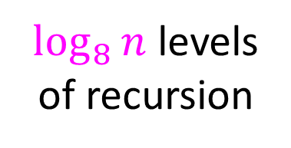



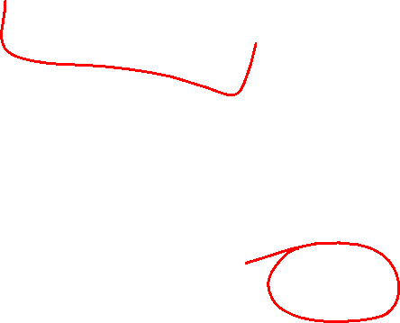



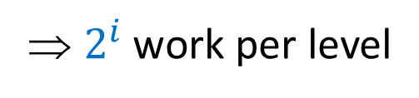







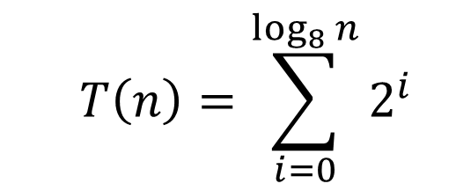
Tree Method $T\left(n\right)=2T\left(\frac{n}{8}\right)+1$
Red box represents a problem instance
Blue value next to each box represents time spent at that level of recursion
$$1$$
$$n$$
⇒ $2^{i}$ work per level
$$n/8$$
$$1$$
$$n/8$$
$$1$$
$\log_{8}⁡n$ levels
of recursion
$$n/{64}$$
$$1$$
$$n/{64}$$
$$1$$
$$n/{64}$$
$$1$$
$$n/{64}$$
$$1$$
…
…
…
…
…
$$T\left(n\right)=\sum_{i=0}^{\log_{8}{n}}{2^{i}}$$
$$1$$
$$1$$
$$1$$
$$1$$
$$1$$
$$1$$
$$1$$
$$1$$
$$1$$
$$1$$
$$1$$
$$1$$

Slide 19


Solving $T\left(n\right)=2T\left(\frac{n}{8}\right)+1$
$$T\left(n\right)=\sum_{i=0}^{\log_{8}{n}}{2^{i}}$$
$$=\left(\frac{2^{{1+log}_{8}{n}}−1}{2−1}\right)$$
$$=2⋅2^{\log_{8}{n}}−1$$
$$=2n^{\log_{8}{2}}−1=Θ\left(n^{\frac{1}{3}}\right)$$

Slide 20

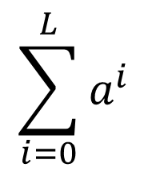
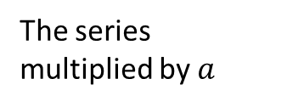







Finite Geometric Series ($a>1$)
$$\sum_{i=0}^{L}{a^{i}}$$
$$−$$
$$−$$
$$=$$
The series multiplied by $a$
The next term in the series
The series
The first term
$$\left(1+a+a^{2}+…+a^{L}\right)a$$
$$\left(1+a+a^{2}+…+a^{L}\right)1$$
$$a^{L+1}$$
$$1$$

Slide 21

Finite Geometric Series ($a<1$)
$$\sum_{i=0}^{L}{a^{i}}$$
$$−$$
$$−$$
$$=$$
The series multiplied by $a$
The next term in the series
The series
The first term
$$\left(1+a+a^{2}+…+a^{L}\right)a$$
$$\left(1+a+a^{2}+…+a^{L}\right)1$$
$$a^{L+1}$$
$$1$$
Solve for the series

