Slide 1
CSE 332 Spring 2026 Lecture 7: Dictionaries, BSTs
Nathan Brunelle
http://www.cs.uw.edu/332

Slide 2
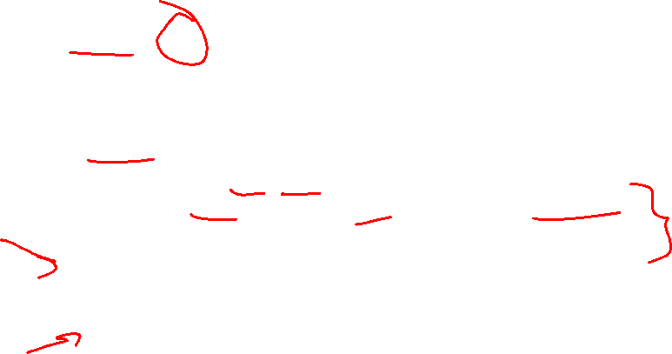
Dictionary (Map) ADT
Contents:
Sets of key+value pairs
Keys must be comparable
Operations:
insert(key, value)
Adds the (key,value) pair into the dictionary
If the key already has a value, overwrite the old value
Consequence: Keys cannot be repeated
find(key)
Returns the value associated with the given key
delete(key)
Remove the key (and its associated value)

Slide 3
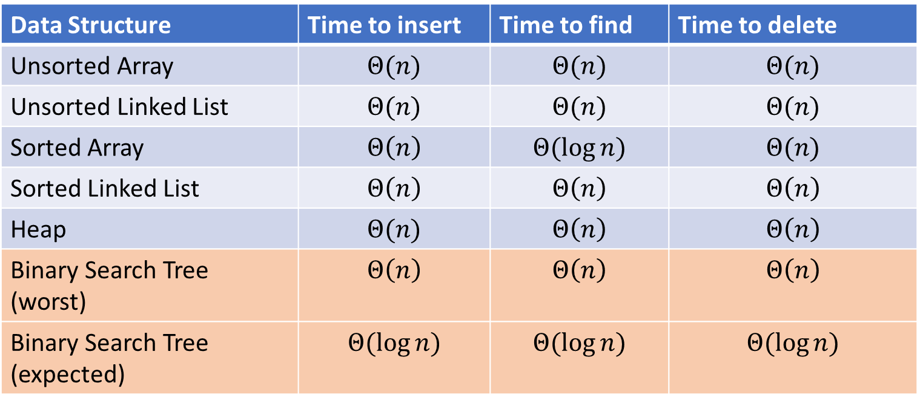
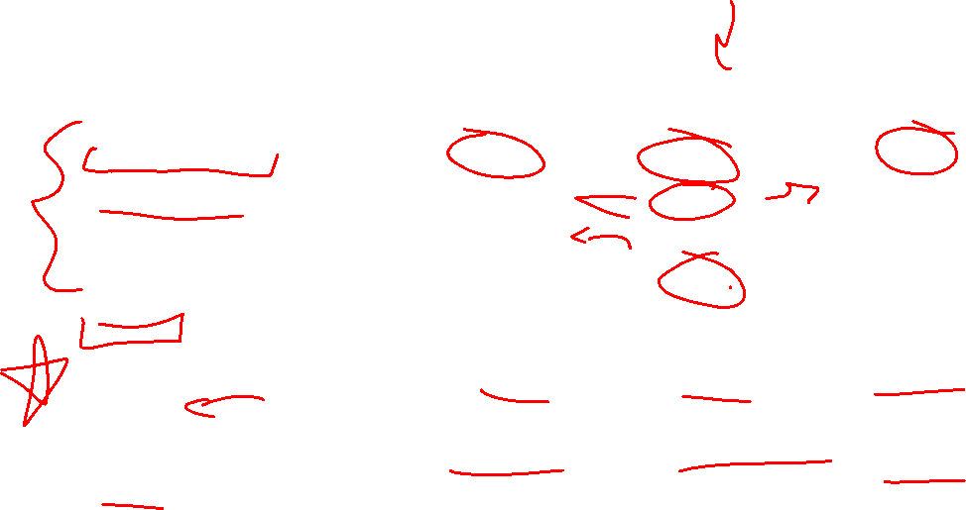
Naïve attempts
Data Structure | Time to insert | Time to find | Time to delete
Unsorted Array | $$Θ(n)$$ | $$Θ(n)$$ | $$Θ(n)$$
Unsorted Linked List | $$Θ(n)$$ | $$Θ(n)$$ | $$Θ(n)$$
Sorted Array | $$Θ\left(n\right)$$ | $$Θ(\log{n})$$ | $$Θ(n)$$
Sorted Linked List | $$Θ\left(n\right)$$ | $$Θ\left(n\right)$$ | $$Θ\left(n\right)$$
Heap | $$Θ(n)$$ | $$Θ\left(n\right)$$ | $$Θ\left(n\right)$$
Binary Search Tree (worst) | $$Θ\left(n\right)$$ | $$Θ\left(n\right)$$ | $$Θ\left(n\right)$$
Binary Search Tree (expected) | $$Θ(\log{n})$$ | $$Θ(\log{n})$$ | $$Θ(\log{n})$$

Slide 4

More Tree “Vocab”
D
U
B
Traversal:
An algorithm for “visiting/processing” every node in a tree
Pre-Order Traversal:
Root, Left Subtree, Right Subtree
D U S 2 B
In-Order Traversal:
Left Subtree, Root, Right Subtree
S U 2 D B
Post-Order Traversal
Left Subtree, Right Subtree, Root
S 2 U B D
S
2

Slide 5

Name that Traversal!
aOrder(root){
if (root.left != Null){
aOrder(root.left);
}
if (root.right != Null){
aOrder(root.right);
}
process(root);
}
bOrder(root){
process(root);
if (root.left != Null){
bOrder(root.left);
}
if (root.right != Null){
bOrder(root.right);
}
}
cOrder(root){
if (root.left != Null){
cOrder(root.left);
}
process(root)
if (root.right != Null){
cOrder(root.right);
}
}

Slide 6
Name that Traversal! (Answers)
postOrder(root){
if (root.left != Null){
postOrder(root.left);
}
if (root.right != Null){
postOrder(root.right);
}
process(root);
}
preOrder(root){
process(root);
if (root.left != Null){
preOrder(root.left);
}
if (root.right != Null){
preOrder(root.right);
}
}
inOrder(root){
if (root.left != Null){
inOrder(root.left);
}
process(root)
if (root.right != Null){
inOrder(root.right);
}
}

Slide 7
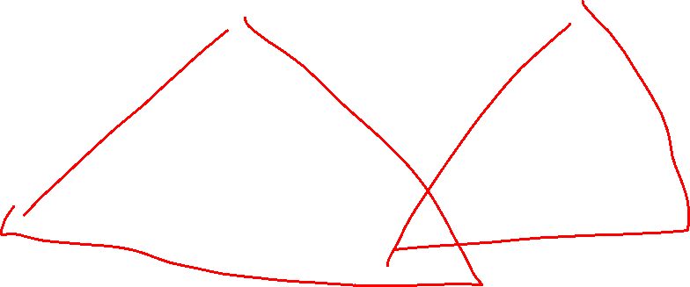
Binary Search Tree
7
3
10
1
6
8
16
Binary Tree
Definition:
Tree where each node has at most 2 children
Order Property
All keys in the left subtree are smaller than the root
All keys in the right subtree are larger than the root
Consequence: cannot have repeated values
0
2

Slide 8
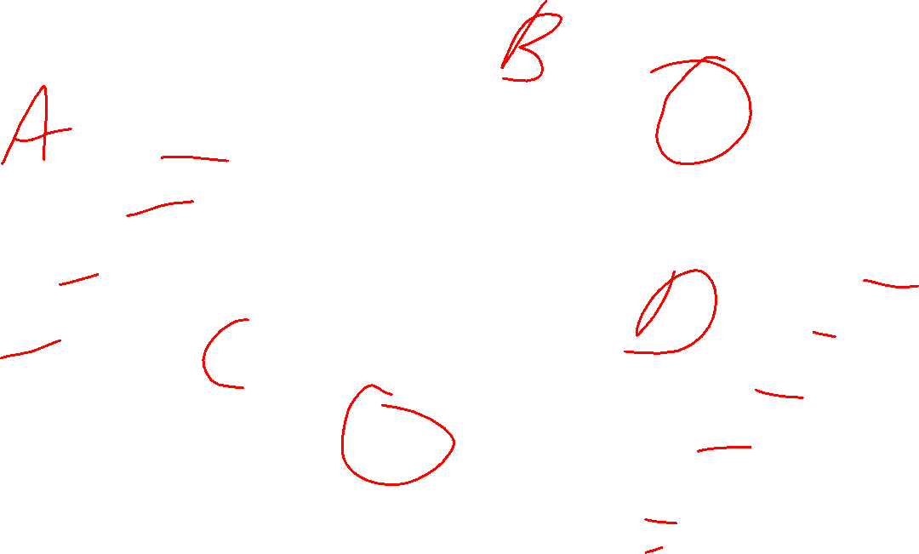
Are these BSTs?
7
3
10
7
7
16
1
3
10
0
1
16
16
10
0
7
7
3
10
3
1
8
16
1
0
0

Slide 9
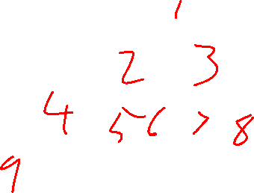
Are these BSTs? (Answers)
7
3
10
7
7
16
1
3
10
0
NO!
1
16
16
YES!
10
0
7
7
3
10
3
YES!
1
8
16
1
NO!
0
0

Slide 10
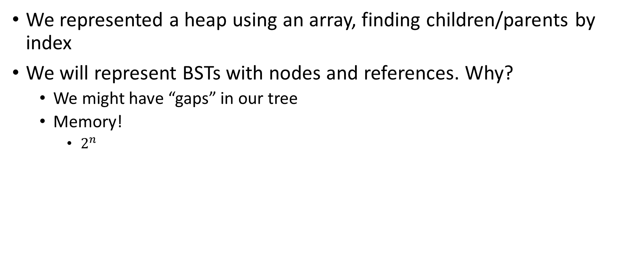
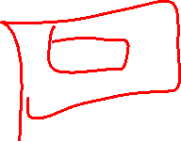
Aside: Why not use an array?
We represented a heap using an array, finding children/parents by index
We will represent BSTs with nodes and references. Why?
We might have “gaps” in our tree
Memory!
$2^{n}$

Slide 11
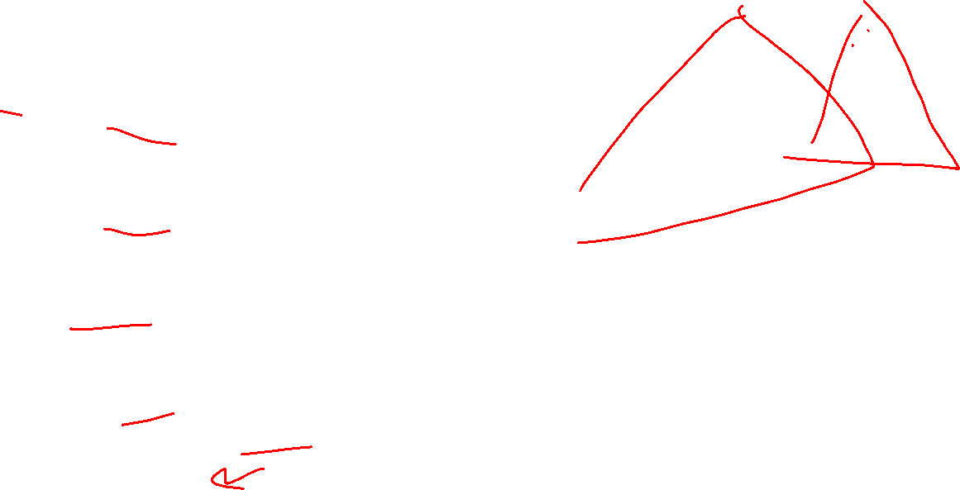
Find Operation (recursive)
7
3
10
find(key, root){
if (root == Null){
return Null;
{
if (key == root.key){
return root.value;
}
if (key < root.key){
return find(key, root.left);
}
if (key > root.key){
return find(key, root.right);
}
return Null;
}
1
6
16
0

Slide 12
Find Operation (iterative)
7
3
10
find(key, root){
while (root != Null && key != root.key){
if (key < root.key){
root = root.left;
}
else if (key > root.key){
root = root.right;
}
}
if (root == Null){
return Null;
}
return root.value;
}
1
6
16
0

Slide 13
Insert Operation (recursive)
7
3
10
insert(key, value, root){
root = insertHelper(key, value, root);
}
insertHelper(key, value, root){
if(root == null)
return new Node(key, value);
if(root.key == key)
root.value = value
return root
if (root.key < key)
root.right = insertHelper(key, value, root.right);
else
root.left = insertHelper(key, value, root.left);
return root;
}
1
6
16
0
Note: Insert happens only at the leaves!

Slide 14
Insert Operation (iterative)
7
3
10
insert(key, value, root){
if (root == Null){ this.root = new Node(key, value); }
parent = Null;
while (root != Null && key != root.key){
parent = root;
if (key < root.key){ root = root.left; }
else if (key > root.key){ root = root.right; }
}
if (root != Null){ root.value = value; }
else if (key < parent.key){ parent.left = new Node(key, value); }
else{ parent.right = new Node (key, value); }
}
1
6
16
0
Note: Insert happens only at the leaves!

Slide 15
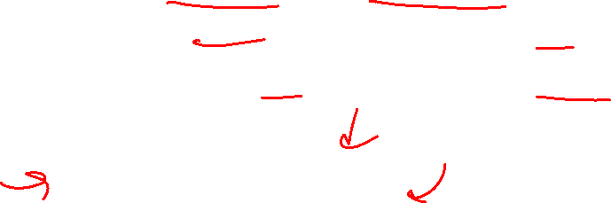
Delete Operation (iterative, incomplete)
9
3
10
delete(key, root){
while (root != Null && key != root.key){
if (key < root.key){ root = root.left; }
else if (key > root.key){ root = root.right; }
}
if (root == Null){ return; }
// Now root is the node to delete, what happens next?
}
1
6
16
0
5
7

Slide 16
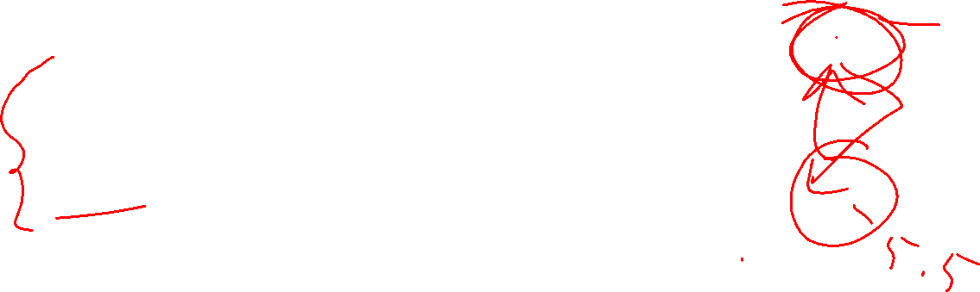
Delete – 3 Cases
9
3
10
1
6
16
0 Children (i.e. it’s a leaf)
1 Child
Replace the deleted node with its child
2 Children
Replace the deleted with the largest node to its left or else the smallest node to its right
0
5
7

Slide 17
Finding the Max and Min
9
3
10
maxNode(root){
if (root == Null){ return Null; }
while (root.right != Null){
root = root.right;
}
return root;
}
1
6
16
Max of a BST:
Right-most Thing
Min of a BST:
Left-most Thing
0
5
7
minNode(root){
if (root == Null){ return Null; }
while (root.left != Null){
root = root.left;
}
return root;
}

Slide 18
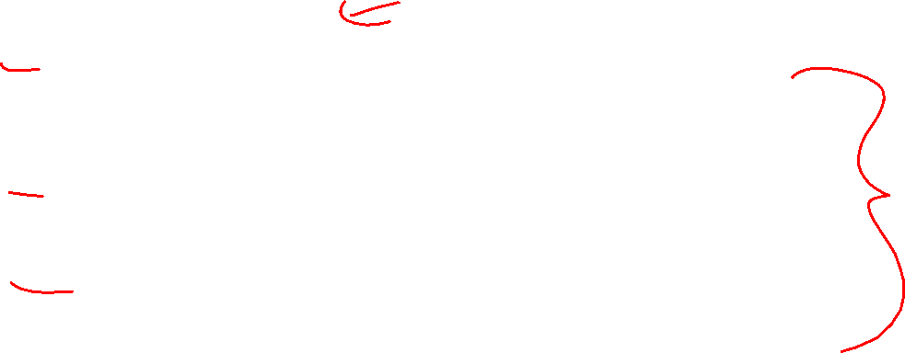
Delete Operation (iterative)
9
3
10
delete(key, root){
while (root != Null && key != root.key){
if (key < root.key){ root = root.left; }
else if (key > root.key){ root = root.right; }
}
if (root == Null){ return; }
if (root has no children){
make parent point to Null Instead;
}
if (root has one child){
make parent point to that child instead;
}
if (root has two children){
make parent point to either the max from the left or min from the right
}
}
1
6
16
0
5
7

Slide 19
Delete Operation (recursive)
9
3
10
delete(key, root){
if (root == Null){ return; } // key not present
if (root.key == key){
if (root has no children) { return Null; }
if (root has one child) { return that child; }
if (root has two children) {return removeMax(root.left);}
}
if (root.key < key) { root.right = delete(key, root.right); }
else { root.left = delete(key, root.left); }
}
1
6
16
0
5
7

Slide 20

Worst Case Analysis
For each of Find, insert, Delete:
Worst case running time matches height of the tree
What is the maximum height of a BST with $n$ nodes?
$Θ(n)$

Slide 21
Improving the worst case
How can we get a better worst case running time?
Add rules about the shape of our BST
AVL Tree
A BST with some shape rules
Algorithms need to change to accommodate those

Slide 22
“Balanced” Binary Search Trees
We get better running times by having “shorter” trees
Trees get tall due to them being “sparse” (many one-child nodes)
Idea: modify how we insert/delete to keep the tree more “full”
Encourage Branches!

Slide 23
Idea 1: Both Subtrees of Root have same # Nodes

Slide 24
Idea 1: Both Subtrees of Root have same # Nodes - Issue
16
10
17
7
18
3
19
1
20
0
21

Slide 25
Idea 2: Both Subtrees of Root have same height

Slide 26
Idea 2: Both Subtrees of Root have same height - Issue
16
10
17
7
18
3
19
1
20
0
21

Slide 27
Idea 3: Both Subtrees of every Node have same # Nodes

Slide 28
Idea 3: Both Subtrees of every Node have same # Nodes - Issue
Not all tree sizes are possible!
For example, cannot have a tree of size 3.

Slide 29
Idea 4: Both Subtrees of every Node have same height

Slide 30
Idea 4: Both Subtrees of every Node have same height - Issue
Not all tree sizes are possible!
For example, cannot have a tree of size 3.

Slide 31
AVL Tree
A Binary Search tree that maintains that the left and right subtrees of every node have heights that differ by at most one.
height of left subtree and height of right subtree off by at most 1
Not too weak (ensures trees are short)
Not too strong (works for any number of nodes)
Idea of AVL Tree:
When you insert/delete nodes, if tree is “out of balance” then modify the tree
Modification = “rotation”

Slide 32
Is it an AVL Tree?
9
9
3
10
3
10
6
16
1
1
6
0
5
0
5
9
9
3
10
3
10
6
16
1
6
16
5
0
5
7

Slide 33
Is it an AVL Tree? (Answers)
9
Not Balanced!
9
3
10
“Problem” Node
Its children’s heights differ by more than 1
3
10
1
6
16
1
6
0
5
Balanced!
0
5
9
9
3
10
3
10
6
16
1
6
16
5
Not Balanced!
0
5
7
Balanced!

