Slide 1
CSE 332 Winter 2026
Lecture 16: Graphs 3
Nathan Brunelle
http://www.cs.uw.edu/332

Slide 2
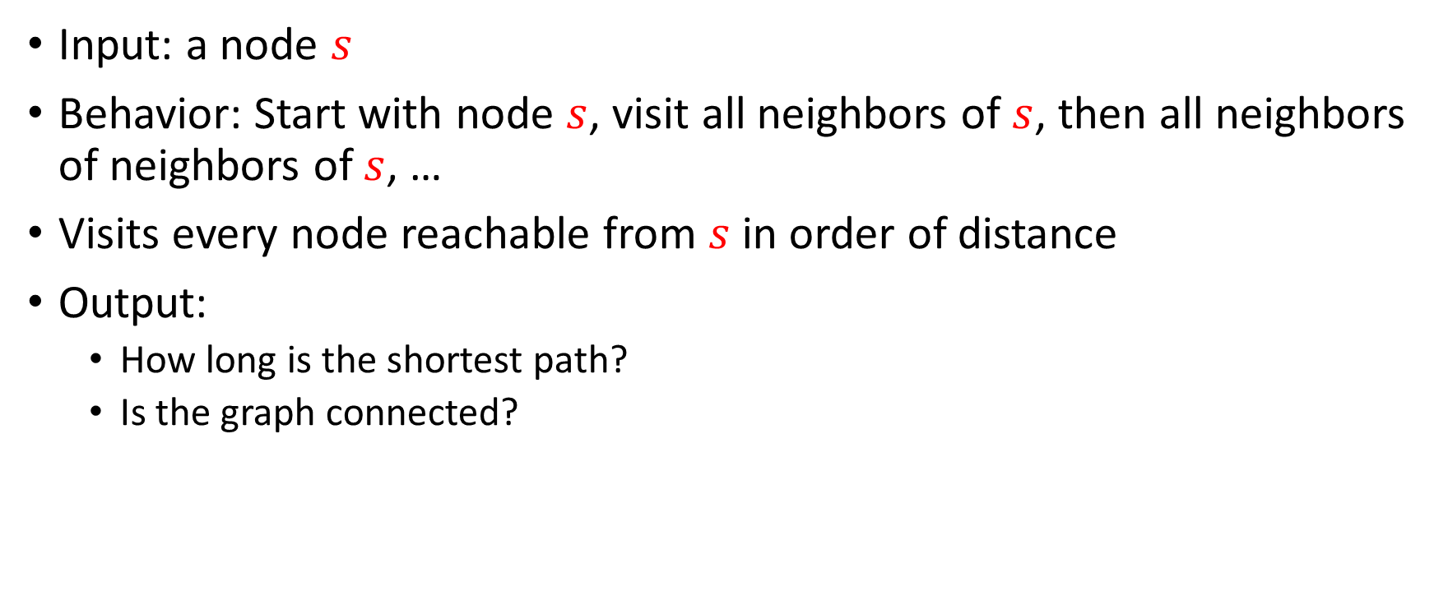
Breadth-First Search
Input: a node $s$
Behavior: Start with node $s$, visit all neighbors of $s$, then all neighbors of neighbors of $s$, …
Visits every node reachable from $s$ in order of distance
Output:
  How long is the shortest path?
  Is the graph connected?
2
5
8
1
4
9
3
7
6

Slide 3

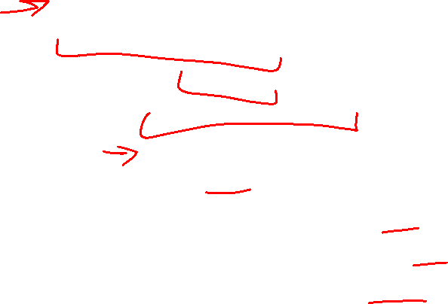
BFS
void bfs(graph, s){
found = new Queue();
found.enqueue(s);
mark s as “visited”;
While (!found.isEmpty()){
current = found.dequeue();
for (v : neighbors(current)){
if (! v marked “visited”){
mark v as “visited”;
found.enqueue(v);
}
}
}
}
2
5
8
1
4
9
3
7
6
Running time: $Θ\left(\left|V\right|+\left|E\right|\right)$

Slide 4
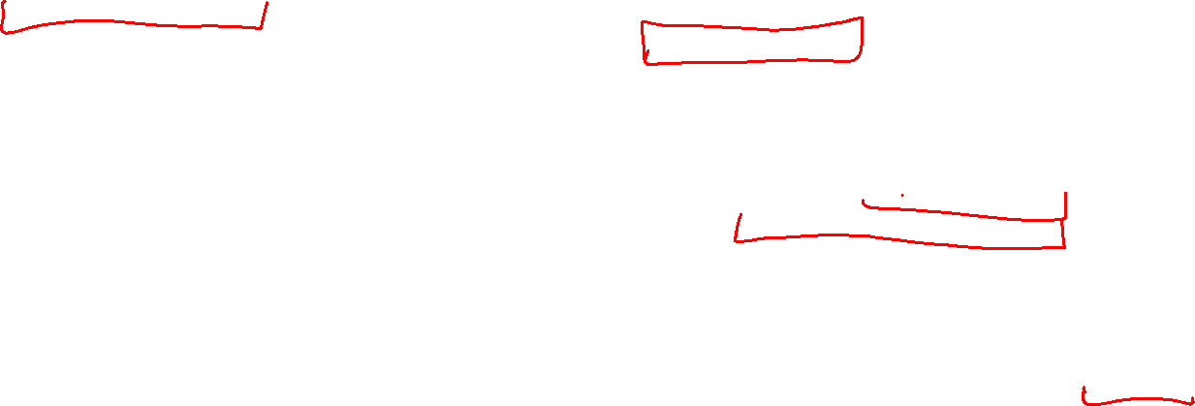
Find Distance (unweighted)
int findDistance(graph, s, t){
found = new Queue();
layer = 0;
depth of s = 0;
found.enqueue(s);
mark s as “visited”;
While (!found.isEmpty()){
current = found.dequeue();
layer = depth of current;
for (v : neighbors(current)){
if (! v marked “visited”){
mark v as “visited”;
depth of v = layer + 1;
found.enqueue(v);
}
}
}
return depth of t;
}
2
5
8
1
4
9
3
7
6
Idea: when it’s seen, remember its “layer” depth!

Slide 5
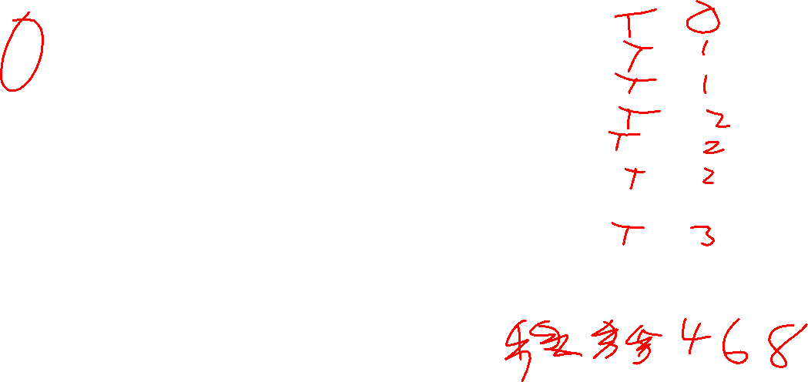
Find Distance – Worked Example
2
Node | Visited? | Depth
1
2
3
4
5
6
7
8
9
5
8
1
4
9
3
7
6
For each node:
update current layer
For each unvisited neighbor:
add that neighbor to a queue
mark that neighbor as visited
set neighbor’s layer to be current layer + 1
Queue:

Slide 6
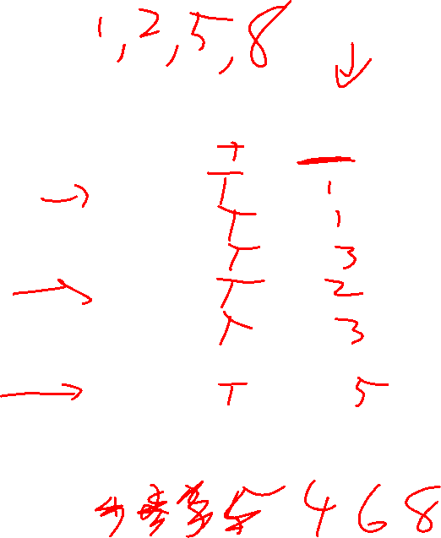
Shortest Path - Idea
2
Node | Visited? | Previous
1
2
3
4
5
6
7
8
9
5
8
1
4
9
3
7
6
For each node:
For each unvisited neighbor:
add that neighbor to a queue
mark that neighbor as visited
set neighbor’s previous to be the current node
Queue:

Slide 7
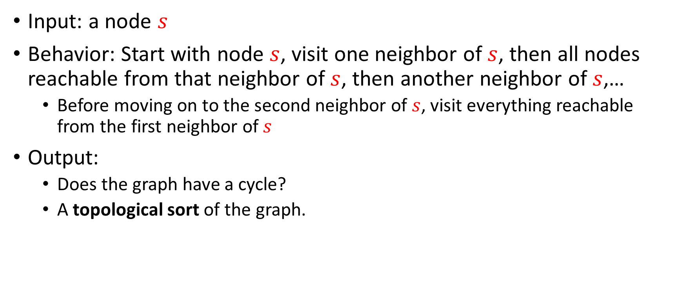
Depth-First Search
Input: a node $s$
Behavior: Start with node $s$, visit one neighbor of $s$, then all nodes reachable from that neighbor of $s$, then another neighbor of $s$,…
  Before moving on to the second neighbor of $s$, visit everything reachable from the first neighbor of $s$
Output:
  Does the graph have a cycle?
  A topological sort of the graph.
1
2
2
5
3
0
8
1
6
4
9
5
3
7
6
4
7

Slide 8
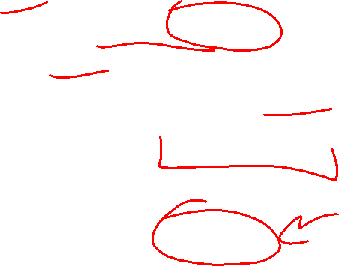
DFS Recursively (more common)
void dfs(graph, curr){
mark curr as “visited”;
for (v : neighbors(current)){
if (! v marked “visited”){
dfs(graph, v);
}
}
mark curr as “done”;
}
2
5
8
1
4
9
3
7
6

Slide 9
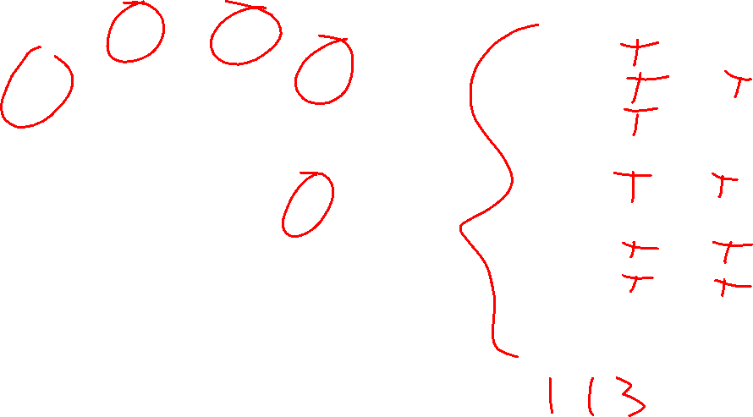
DFS – Worked Example
Node | Visited? | Done? | Other Info
1
2
3
4
5
6
7
8
9
2
5
8
1
4
9
3
7
6
Starting from the current node:
for each unvisited neighbor:
mark the neighbor as visited
do a DFS from the neighbor
mark the current node as done
(Call)
Stack:

Slide 10
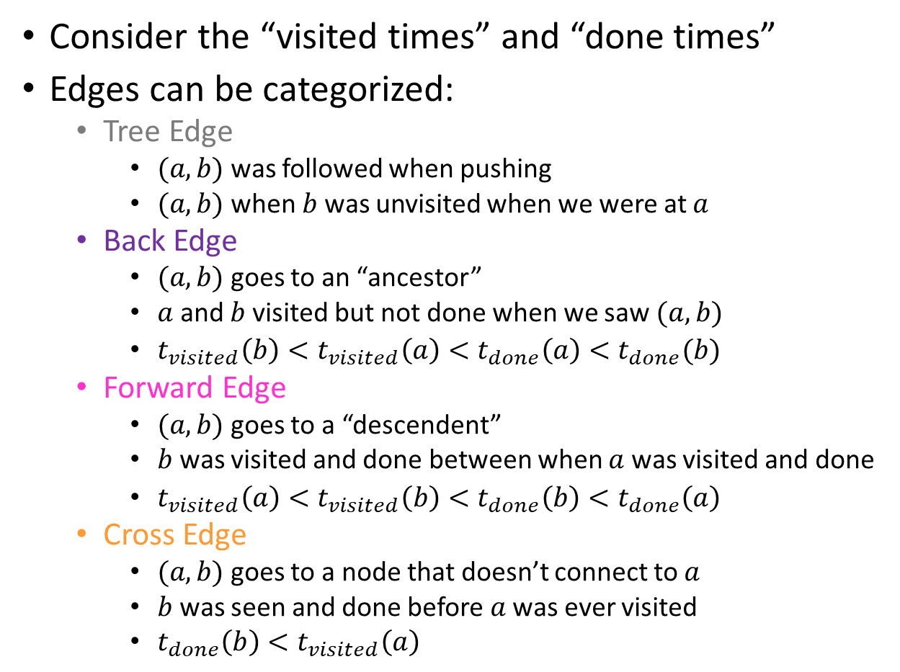

Using DFS
Consider the “visited times” and “done times”
Edges can be categorized:
  Tree Edge
    $(a,b)$ was followed when pushing
    $(a,b)$ when $b$ was unvisited when we were at $a$
  Back Edge
    $(a,b)$ goes to an “ancestor”
    $a$ and $b$ visited but not done when we saw $(a,b)$
    $t_{visited}\left(b\right)<t_{visited}\left(a\right)<t_{done}\left(a\right)<t_{done}(b)$
  Forward Edge
    $(a,b)$ goes to a “descendent”
    $b$ was visited and done between when $a$ was visited and done
    $t_{visited}\left(a\right)<t_{visited}\left(b\right)<t_{done}\left(b\right)<t_{done}\left(a\right)$
  Cross Edge
    $(a,b)$ goes to a node that doesn’t connect to $a$
    $b$ was seen and done before $a$ was ever visited
    $t_{done}\left(b\right)<t_{visited}\left(a\right)$
Visited : 1
Done: 8
Visited : 2
Done: 7
Visited : 3
Done: 6
Visited: 0
Done: 15
2
5
8
1
Visited : 10
Done: 13
4
9
Visited : 9
Done: 14
3
7
6
Visited : 11
Done: 12
Visited : 4
Done: 5

Slide 11
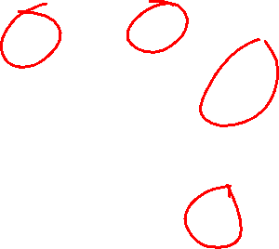
Back Edges
Behavior of DFS:
  “Visit everything reachable from the current node before going back”
Back Edge:
  The current node’s neighbor is an “in progress” node
  Since that other node is “in progress”, the current node is reachable from it
  The back edge is a path to that other node
  Cycle!
2
5
8
1
4
9
3
7
6

Slide 12
Cycle Detection
Idea: Look for a back edge!
boolean hasCycle(graph, curr){
mark curr as “visited”;
cycleFound = false;
for (v : neighbors(current)){
if (v marked “visited” && ! v marked “done”){
cycleFound=true;
}
if (! v marked “visited” && !cycleFound){
cycleFound = hasCycle(graph, v);
}
}
mark curr as “done”;
return cycleFound;
}
2
5
8
1
4
9
3
7
6

Slide 13
Cycle Detection – Worked Example
2
5
Node | Visited? | Done? | Other Info
1
2
3
4
5
6
7
8
9
8
1
4
9
3
7
6
Starting from the current node:
for each non-done neighbor:
if the neighbor is visited:
we found a cycle!
else:
mark the neighbor as visited
do a DFS from the neighbor
mark the current node as done
(Call)
Stack:

Slide 14









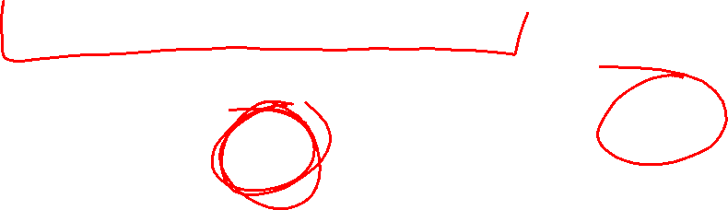
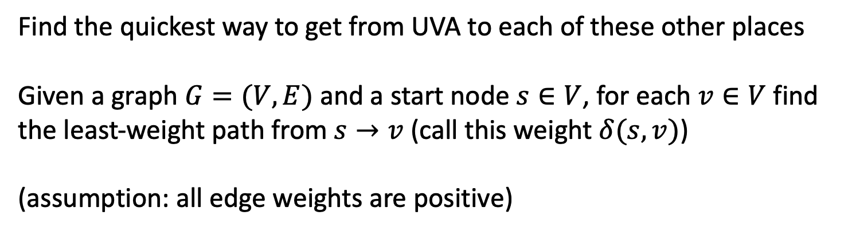
Single-Source Shortest Path
10
1
6
2
12
13
10
8
6
5
15
3
20
Find the quickest way to get from UVA to each of these other places
Given a graph $G=(V,E)$ and a start node $s∈V$, for each $v∈V$ find the least-weight path from $s→v$ (call this weight $δ(s,v)$)
(assumption: all edge weights are positive)

Slide 15




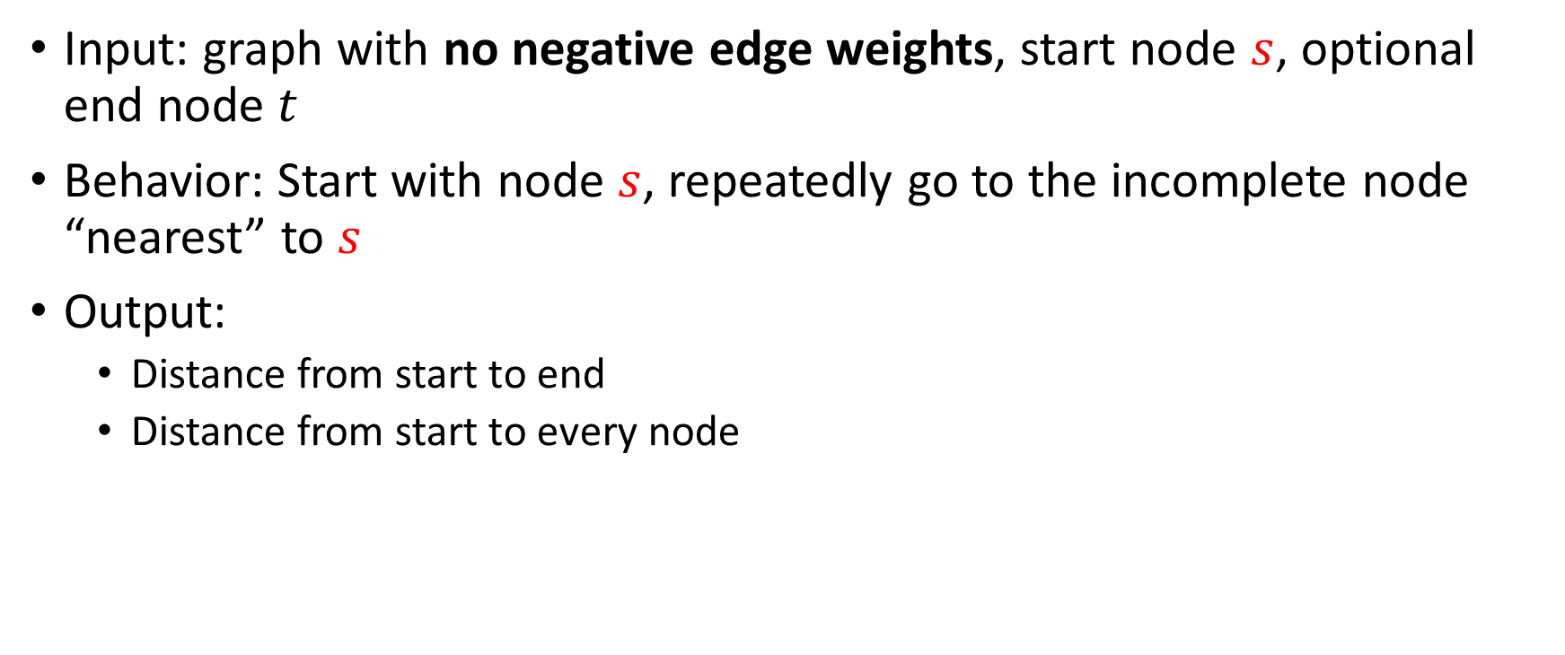





Dijkstra’s Algorithm
Input: graph with no negative edge weights, start node $s$, optional end node $t$
Behavior: Start with node $s$, repeatedly go to the incomplete node “nearest” to $s$
Output:
  Distance from start to end
  Distance from start to every node
$$10$$
$$18$$
1
8
10
4
$$∞$$
6
0
7
7
0
9
$$15$$
2
3
5
$$∞$$
9
8
12
3
$$12$$
2
1
$$13$$
$$∞$$
11
6
1
5
7

Slide 16
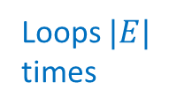

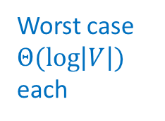
Dijkstra’s
Idea: When a node is the closest not-done thing to the start, we have found its shortest path
Distance to start = 0
Add the start node to PQ with priority 0
Mark start as “seen”
While the PQ is not empty:
curr = PQ.extract();
mark curr as “done”
for each neighbor v of curr:
d = distance to curr + weight of (curr,v)
if v is not “seen”:
mark v as “seen”
distance to v = d
PQ.add(v, d);
if v is not “done” && d < distance to v:
distance to v = d
PQ.decreaseKey(v, d)
Extract a node from priority queue (making it “done”)
Mark extracted node as seen
for each not-done neighbor:
Update its distance if we found a better path
Seen = added to the priority queue
Done = removed from the priority queue
When it’s done we’ve found the shortest path to that node
Loops $|E|$ times
Worst case $Θ(\log\left|V\right|)$ each
Running time: $Θ\left(\left|E\right|\log\left|V\right|\right)$

Slide 17






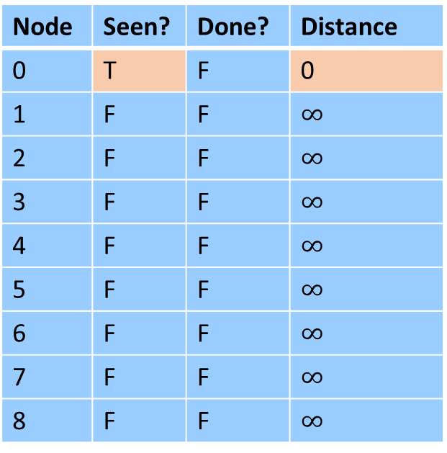


Dijkstra’s Algorithm
Idea: When a node is the closest not-done thing to the start, we have found its shortest path
Start: 0
End: 8
Extract a node from priority queue (making it “done”)
Mark extracted node as seen
for each not-done neighbor:
Update its distance if we found a better path
Node | Seen? | Done? | Distance
0 | T | F | 0
1 | F | F | $∞$
2 | F | F | $∞$
3 | F | F | $∞$
4 | F | F | $∞$
5 | F | F | $∞$
6 | F | F | $∞$
7 | F | F | $∞$
8 | F | F | $∞$
$$∞$$
$$∞$$
1
8
10
4
$$∞$$
6
0
7
7
0
9
$$∞$$
2
3
5
$$∞$$
9
8
12
3
$$∞$$
2
1
$$∞$$
$$∞$$
11
6
1
5
7

Slide 18

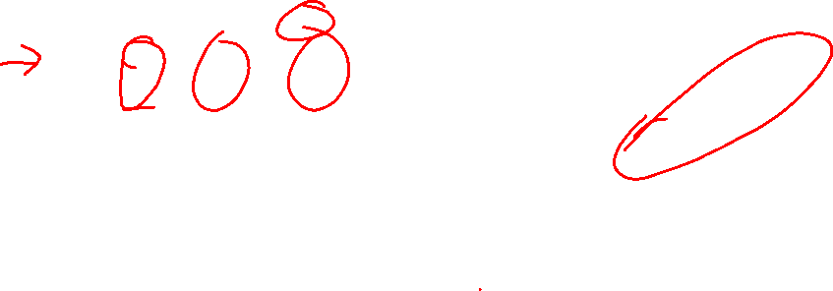

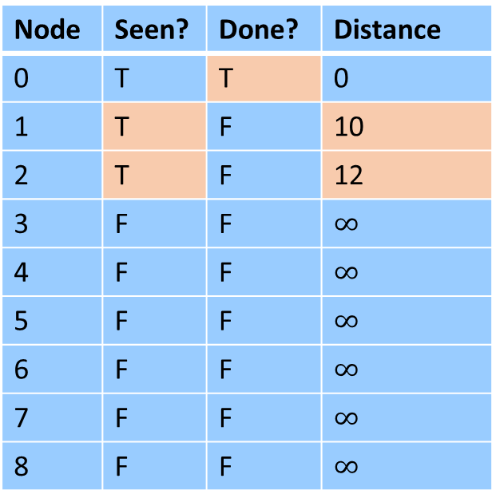
Dijkstra’s Algorithm
Idea: When a node is the closest not-done thing to the start, we have found its shortest path
Start: 0
End: 8
Extract a node from priority queue (making it “done”)
Mark extracted node as seen
for each not-done neighbor:
Update its distance if we found a better path
Node | Seen? | Done? | Distance
0 | T | T | 0
1 | T | F | 10
2 | T | F | 12
3 | F | F | $∞$
4 | F | F | $∞$
5 | F | F | $∞$
6 | F | F | $∞$
7 | F | F | $∞$
8 | F | F | $∞$
$$10$$
$$∞$$
1
8
10
4
$$∞$$
6
0
7
7
0
9
$$∞$$
2
3
5
$$∞$$
9
8
12
3
$$12$$
2
1
$$∞$$
$$∞$$
11
6
1
5
7

Slide 19
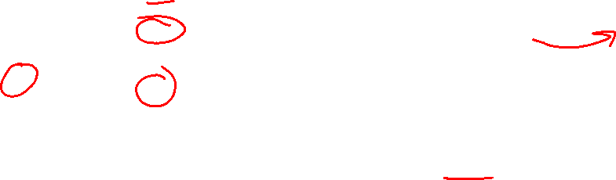

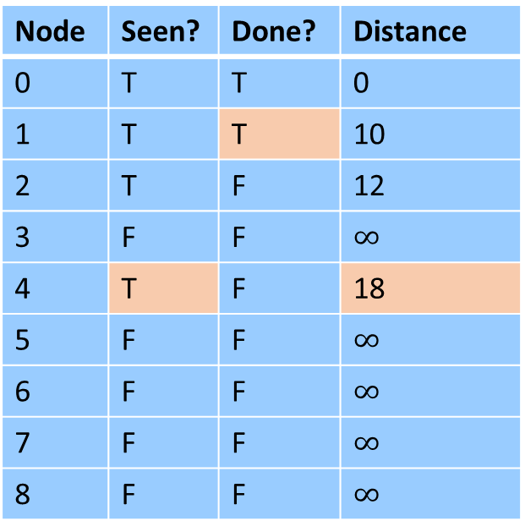
Dijkstra’s Algorithm
Idea: When a node is the closest not-done thing to the start, we have found its shortest path
Start: 0
End: 8
Extract a node from priority queue (making it “done”)
Mark extracted node as seen
for each not-done neighbor:
Update its distance if we found a better path
Node | Seen? | Done? | Distance
0 | T | T | 0
1 | T | T | 10
2 | T | F | 12
3 | F | F | $∞$
4 | T | F | 18
5 | F | F | $∞$
6 | F | F | $∞$
7 | F | F | $∞$
8 | F | F | $∞$
$$10$$
$$18$$
1
8
10
4
$$∞$$
6
0
7
7
0
9
$$∞$$
2
3
5
$$∞$$
9
8
12
3
$$12$$
2
1
$$∞$$
$$∞$$
11
6
1
5
7

Slide 20
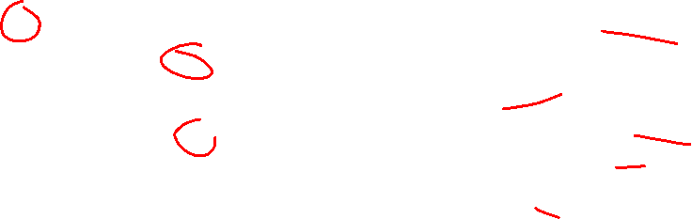

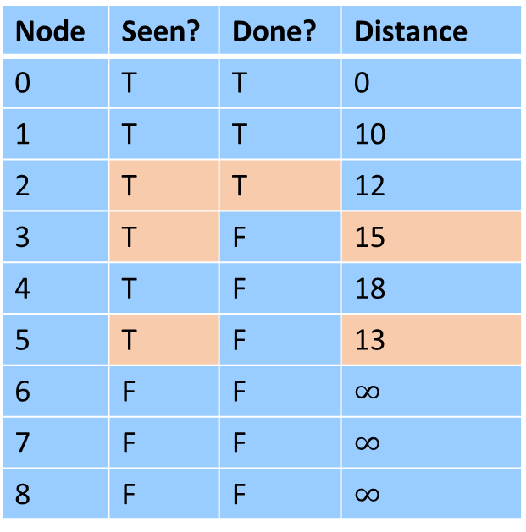

Dijkstra’s Algorithm
Idea: When a node is the closest not-done thing to the start, we have found its shortest path
Start: 0
End: 8
Extract a node from priority queue (making it “done”)
Mark extracted node as seen
for each not-done neighbor:
Update its distance if we found a better path
Node | Seen? | Done? | Distance
0 | T | T | 0
1 | T | T | 10
2 | T | T | 12
3 | T | F | 15
4 | T | F | 18
5 | T | F | 13
6 | F | F | $∞$
7 | F | F | $∞$
8 | F | F | $∞$
$$10$$
$$18$$
1
8
10
4
$$∞$$
6
0
7
7
0
9
$$15$$
2
3
5
$$∞$$
9
8
12
3
$$12$$
2
1
$$13$$
$$∞$$
11
6
1
5
7

Slide 21

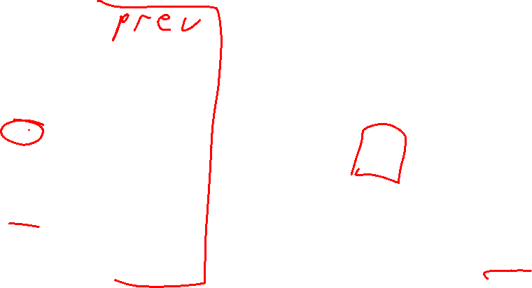
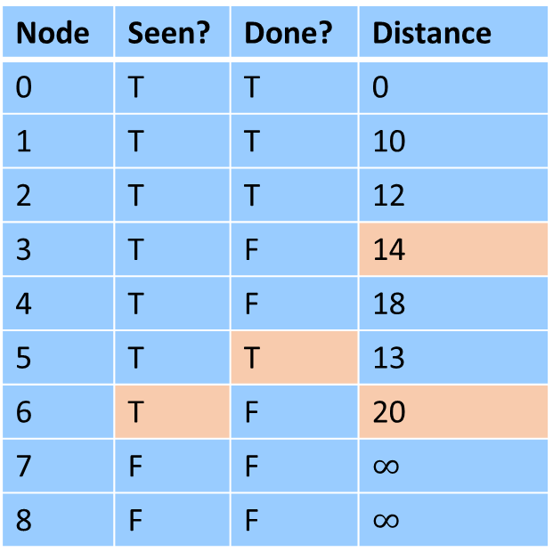

Dijkstra’s Algorithm
Idea: When a node is the closest not-done thing to the start, we have found its shortest path
Start: 0
End: 8
Extract a node from priority queue (making it “done”)
Mark extracted node as seen
for each not-done neighbor:
Update its distance if we found a better path
Node | Seen? | Done? | Distance
0 | T | T | 0
1 | T | T | 10
2 | T | T | 12
3 | T | F | 14
4 | T | F | 18
5 | T | T | 13
6 | T | F | 20
7 | F | F | $∞$
8 | F | F | $∞$
$$10$$
$$18$$
1
8
10
4
$$∞$$
6
0
7
7
0
9
$$14$$
2
3
5
$$∞$$
9
8
12
3
$$12$$
2
1
$$13$$
$$20$$
11
6
1
5
7

Slide 22
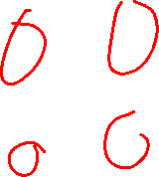

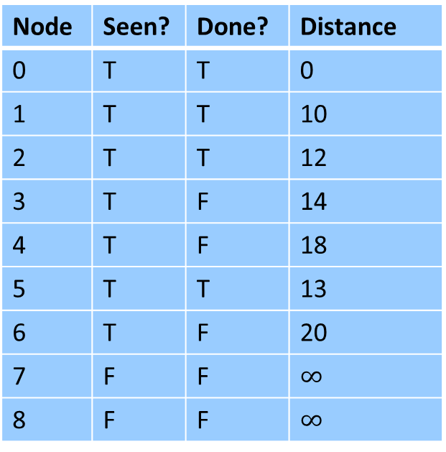
Dijkstra’s Algorithm
What if we had a negative-weight edge?
Start: 0
End: 8
Extract a node from priority queue (making it “done”)
Mark extracted node as seen
for each not-done neighbor:
Update its distance if we found a better path
Node | Seen? | Done? | Distance
0 | T | T | 0
1 | T | T | 10
2 | T | T | 12
3 | T | F | 14
4 | T | F | 18
5 | T | T | 13
6 | T | F | 20
7 | F | F | $∞$
8 | F | F | $∞$
$$10$$
$$18$$
1
8
10
4
$$∞$$
6
0
$$−13$$
7
0
9
$$14$$
2
3
5
$$∞$$
9
8
12
3
$$12$$
2
1
$$13$$
$$20$$
11
6
1
5
7

Slide 23
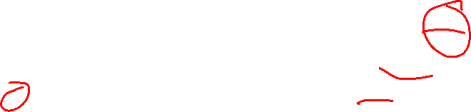



Dijkstra’s Algorithm
What if we had a negative-weight edge?
Start: 0
End: 8
Extract a node from priority queue (making it “done”)
Mark extracted node as seen
for each not-done neighbor:
Update its distance if we found a better path
Node | Seen? | Done? | Distance
0 | T | T | 0
1 | T | T | 10
2 | T | T | 12
3 | T | T | 14
4 | T | F | 1
5 | T | T | 13
6 | T | F | 20
7 | F | F | $∞$
8 | F | F | $∞$
$$10$$
$$1$$
1
8
10
4
$$∞$$
6
0
$$−13$$
7
0
9
$$14$$
2
3
5
$$∞$$
9
8
12
3
$$12$$
2
1
$$13$$
$$20$$
11
6
1
5
7

Slide 24
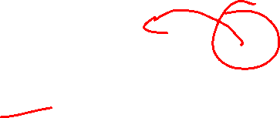

Dijkstra’s Algorithm
What if we had a negative-weight edge?
Start: 0
End: 8
Extract a node from priority queue (making it “done”)
Mark extracted node as seen
for each not-done neighbor:
Update its distance if we found a better path
Node | Seen? | Done? | Distance
0 | T | T | 0
1 | T | T | 10
2 | T | T | 12
3 | T | T | 14
4 | T | T | 1
5 | T | T | 13
6 | T | F | 20
7 | F | F | $∞$
8 | F | F | $∞$
There’s a better path!
$$10$$
$$1$$
1
8
10
4
$$∞$$
6
0
$$−13$$
7
0
9
$$14$$
2
3
5
$$∞$$
9
8
12
3
$$12$$
2
1
$$13$$
$$20$$
11
6
1
5
7

Slide 25
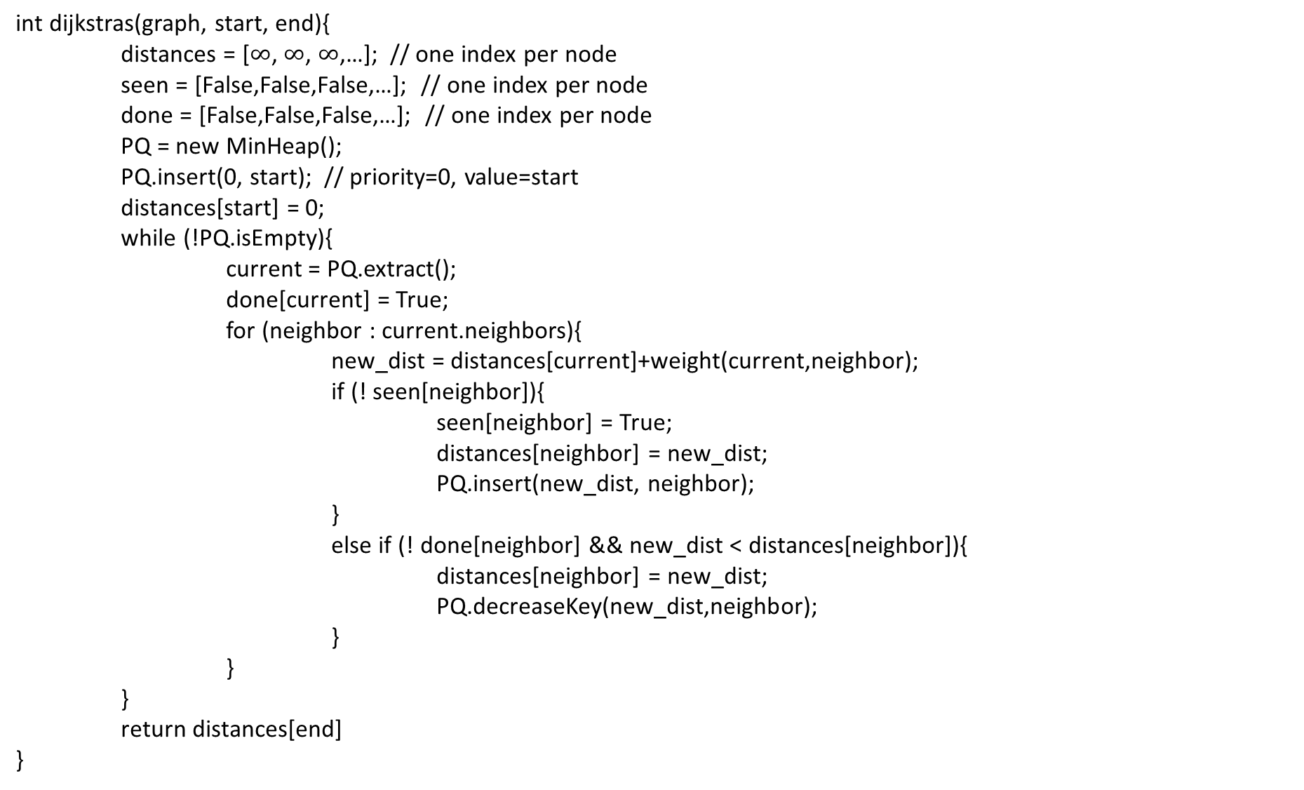

Dijkstra’s Algorithm
int dijkstras(graph, start, end){
distances = [$∞$, $∞$, $∞$,…]; // one index per node
seen = [False,False,False,…]; // one index per node
done = [False,False,False,…]; // one index per node
PQ = new MinHeap();
PQ.insert(0, start); // priority=0, value=start
distances[start] = 0;
while (!PQ.isEmpty){
current = PQ.extract();
done[current] = True;
for (neighbor : current.neighbors){
new_dist = distances[current]+weight(current,neighbor);
if (! seen[neighbor]){
seen[neighbor] = True;
distances[neighbor] = new_dist;
PQ.insert(new_dist, neighbor);
}
else if (! done[neighbor] && new_dist < distances[neighbor]){
distances[neighbor] = new_dist;
PQ.decreaseKey(new_dist,neighbor);
}
}
}
return distances[end]
}

Slide 26
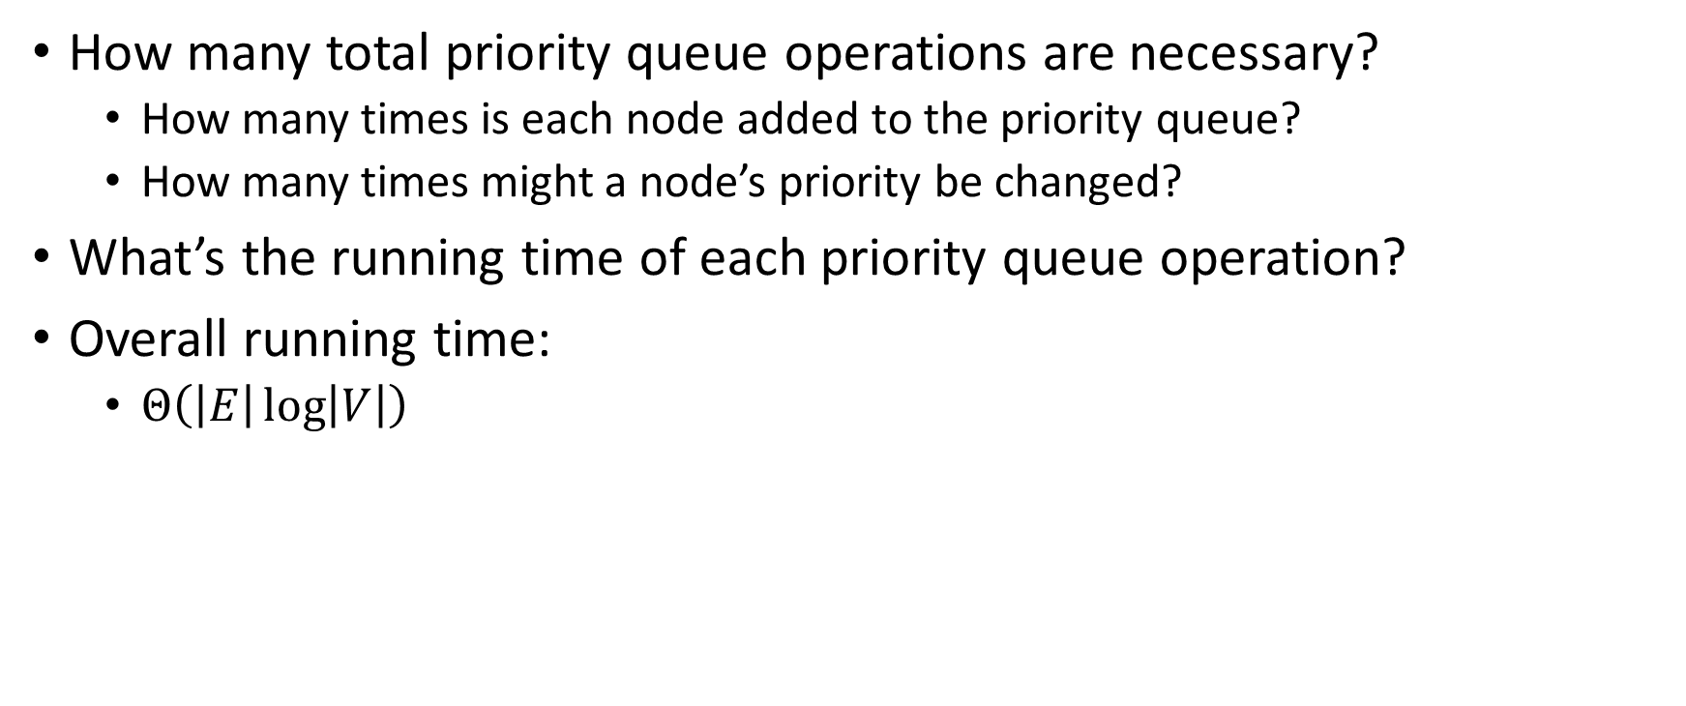
Dijkstra’s Algorithm: Running Time
How many total priority queue operations are necessary?
  How many times is each node added to the priority queue?
  How many times might a node’s priority be changed?
What’s the running time of each priority queue operation?
Overall running time:
  $Θ\left(\left|E\right|\log\left|V\right|\right)$

Slide 27
Dijkstra’s Algorithm: Correctness
Claim: when a node is removed from the priority queue, we have found its shortest path
Induction over number of completed nodes
Base Case:
Inductive Step:
1
8
10
4
6
7
7
0
9
2
3
5
9
8
12
3
2
3
11
6
1
5
7

Slide 28



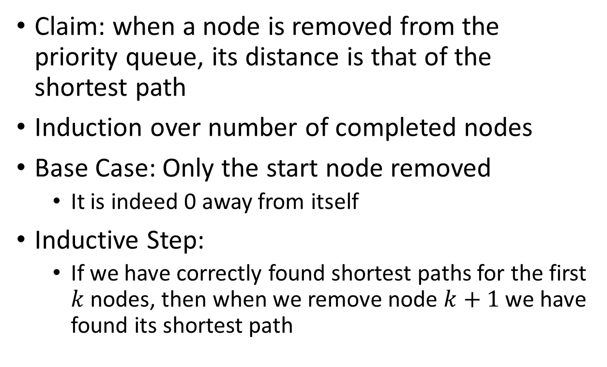



Dijkstra’s Algorithm: Correctness
Claim: when a node is removed from the priority queue, its distance is that of the shortest path
Induction over number of completed nodes
Base Case: Only the start node removed
  It is indeed 0 away from itself
Inductive Step:
  If we have correctly found shortest paths for the first $k$ nodes, then when we remove node $k+1$ we have found its shortest path
$$b$$
$$x$$
$$s$$
$k$ nodes
$$a$$
$$y$$

Slide 29

Dijkstra’s Algorithm: Correctness
Suppose $a$ is the next node removed from the queue. What do we know bout $a$?
$$b$$
$$x$$
$$s$$
$k$ nodes
$$a$$
$$y$$

Slide 30
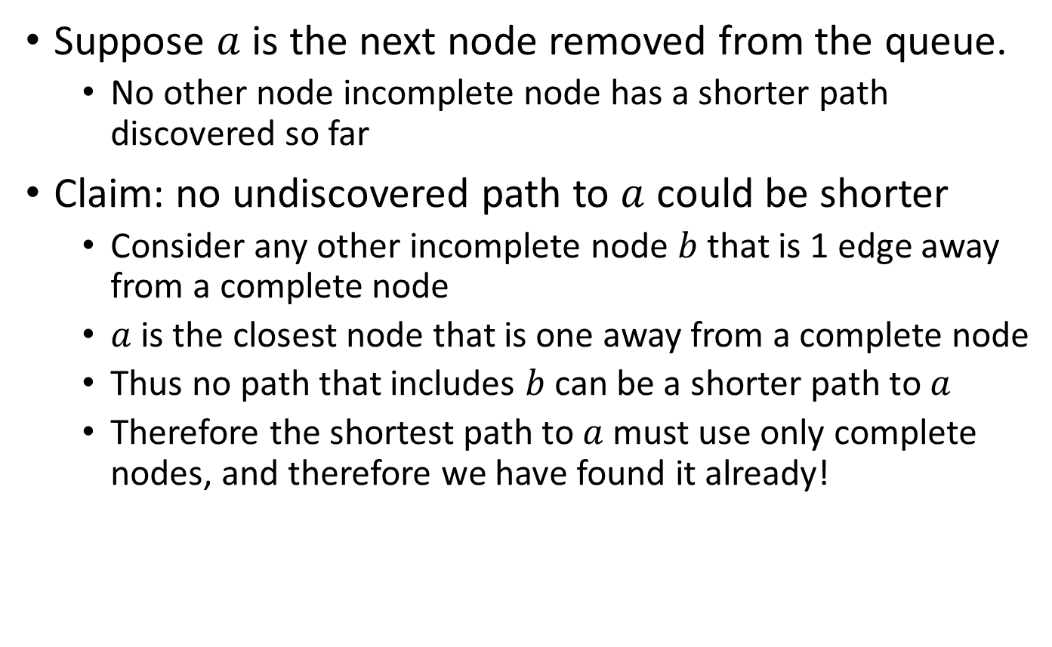
Dijkstra’s Algorithm: Correctness
Suppose $a$ is the next node removed from the queue.
  No other node incomplete node has a shorter path discovered so far
Claim: no undiscovered path to $a$ could be shorter
  Consider any other incomplete node $b$ that is 1 edge away from a complete node
  $a$ is the closest node that is one away from a complete node
  Thus no path that includes $b$ can be a shorter path to $a$
  Therefore the shortest path to $a$ must use only complete nodes, and therefore we have found it already!
$$b$$
$$x$$
$$s$$
$k$ nodes
$$a$$
$$y$$

Slide 31
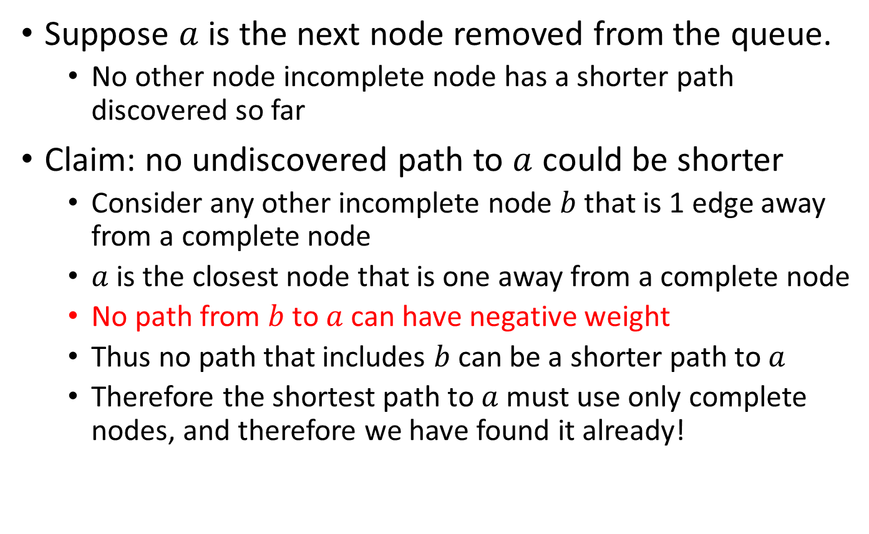
Dijkstra’s Algorithm: Correctness
Suppose $a$ is the next node removed from the queue.
  No other node incomplete node has a shorter path discovered so far
Claim: no undiscovered path to $a$ could be shorter
  Consider any other incomplete node $b$ that is 1 edge away from a complete node
  $a$ is the closest node that is one away from a complete node
  No path from $b$ to $a$ can have negative weight
  Thus no path that includes $b$ can be a shorter path to $a$
  Therefore the shortest path to $a$ must use only complete nodes, and therefore we have found it already!
$$b$$
$$x$$
$$s$$
$k$ nodes
$$a$$
$$y$$

