Slide 1
CSE 332 Spring 2026 Lecture 2: Algorithm Analysis pt.1
Nathan Brunelle
http://www.cs.uw.edu/332

Slide 2
Announcements
Exercise 0 released
Due Wednesday 4/8
There are 2 separate gradescope submissions
Concept check 0 released
Helps us to get more familiar with each other!
Gradescope submission due 4/10
Meet the staff activity due by 5/1
Come to any office hours, chat with us, ask us to mark you off for this

Slide 3
ADT: Queue
What is it?
A collection of items that we interact with in a “First In First Out” (FIFO) way
What operations do we need?
Enqueue
Add a new item to the queue
Dequeue
Remove the “oldest” item from the queue
IsEmpty
Indicate whether or not there are items still on the queue

Slide 4
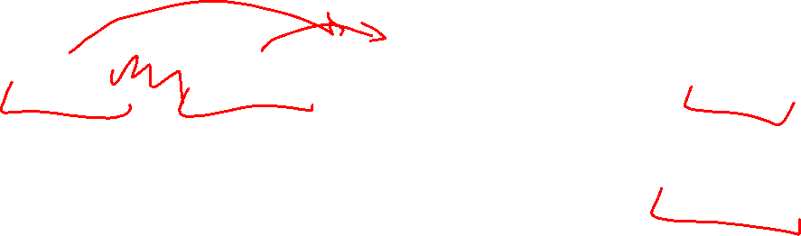
Linked Queue Data Structure (Idea)
front
5
8
3
4
7
Queue represented as a “chain” of items
A “front” reference to the oldest item
A “back” reference to the most recent item
Each Node references the item enqueued after it
enqueue Procedure:
dequeue Procedure:
isEmpty Procedure:
back

Slide 5
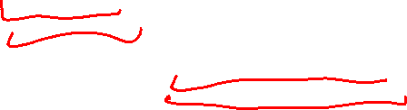
Linked Queue Data Structure (Algorithms)
front
5
8
3
4
7
Queue represented as a “chain” of items
A “front” reference to the oldest item
A “back” reference to the most recent item
Each Node references the item enqueued after it
enqueue Procedure:
dequeue Procedure:
isEmpty Procedure:
back
enqueue(x){
last = new ListNode(x);
back.next = last;
back = last;
}
dequeue(){
first = front.value;
front = front.next;
if (front == null) {back = null;}
return first
}
isEmpty(){
return front == null;
}

Slide 6
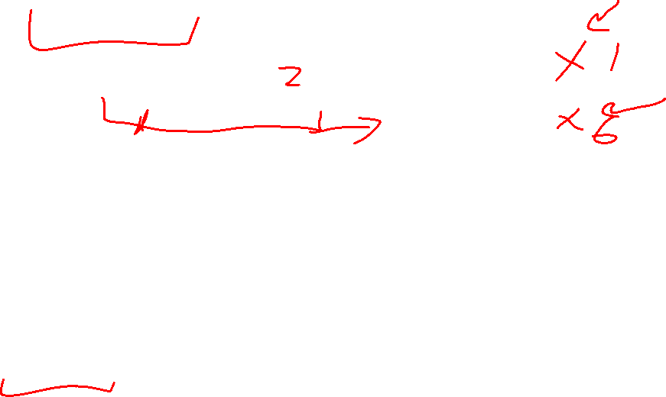
“Circular” Array Queue (Idea)
front=0
5
8
3
4
7
0
1
2
3
4
5
6
7
8
9
back=5
Queue represented as an array of items
A “front” index to indicate the oldest item in the queue
A “back” index to indicate the most recent item in the queue
Actually, the first “open” slot in the array
enqueue Procedure:
dequeue Procedure:
isEmpty Procedure:

Slide 7
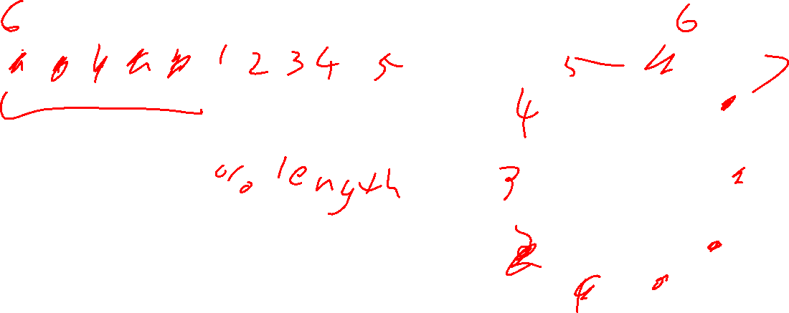
“Circular” Array
Intuitively, An array of values arranged in a “circle” rather than a line
If you go beyond the last index, to wrap back around to 0
5
8
3
4
7
…
5
0
1
2
3
4
5
6
7
8
9
…
9
0
8
8
1
front=0
…
7
2
3
back=5
6
3
…
5
4
4
…
7

Slide 8
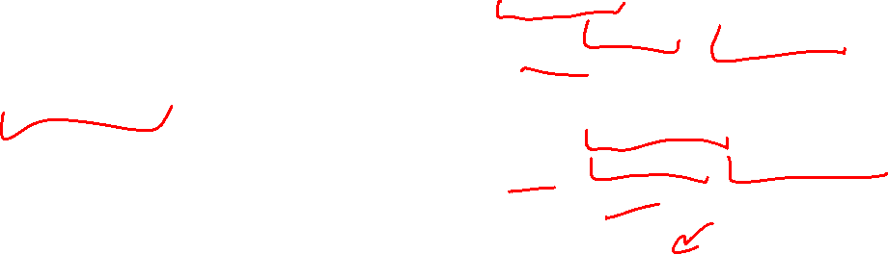
“Circular” Array Queue (Algorithms)
front=0
5
8
3
4
7
0
1
2
3
4
5
6
7
8
9
back=5
Queue represented as an array of items
A “front” index to indicate the oldest item in the queue
A “back” index to indicate the most recent item in the queue
enqueue Procedure:
dequeue Procedure:
isEmpty Procedure:
enqueue(x){
queue[back] = x;
back = (back + 1) % queue.length;
size++;
}
What if we run out of space?!
dequeue(){
// Assumes queue is not empty
first = queue[front];
front = (front + 1) % queue.length;
size--;
return first;
}
isEmpty(){
return size == 0;
}

Slide 9
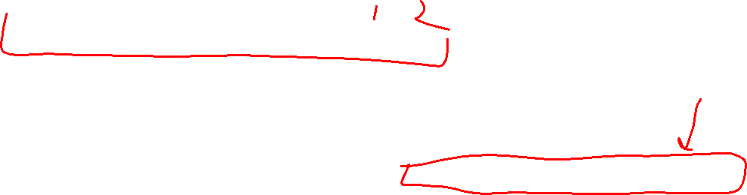
Resizing “Circular” Array Queue
front=0
5
8
3
4
7
0
1
2
3
4
5
6
7
8
9
back=5
Queue represented as an array of items
A “front” index to indicate the oldest item in the queue
A “back” index to indicate the most recent item in the queue
enqueue Procedure:
dequeue Procedure:
isEmpty Procedure:
How do you resize? That’s for Exercise 0!
enqueue(x){
if (size == queue.length-1) {resize();}
queue[back] = x;
back = (back + 1) % queue.length;
size++;
}
dequeue(){
// Assumes queue is not empty
first = queue[front];
front = (front + 1) % queue.length;
size--;
return first;
}
isEmpty(){
return size == 0;
}

Slide 10
Linked Nodes vs. Circular Array
Let’s Summarize some benefits and drawbacks of each
Arrays provide random access, which the queue ADT doesn’t need
Arrays have a resizing cost, Linked nodes don’t
Linked nodes maybe use more storage
Maybe if we knew that the approximate of our array, we wouldn’t need to do resizing, which saves object creation time
Memory allocation is very slow
Less frequently need to allocate memory for the array
Constant time for all operations (both)
Cache locality

Slide 11
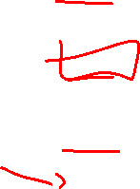
ADT: Stack
What is it?
A “Last In First Out” (LIFO) collection of items (sometimes called FILO)
What operations do we need?
push
Add a new item onto the stack
peek
Return the value of the most recently pushed item
pop
Return the value of the most recently pushed item and remove it from the stack
isEmpty
Indicate whether or not there are items still on the stack

Slide 12
Motivating Example

Slide 13

Let’s design an algorithm
I have a pile of string
I have one end of the string in-hand
I need to find the other end in the pile
How can I do this efficiently?

Slide 14
Algorithm Ideas
Whatcha got?

Slide 15
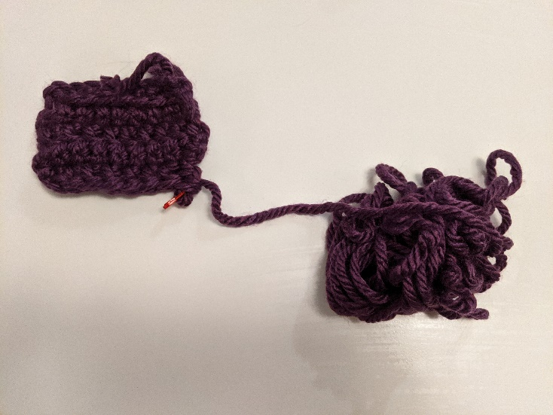
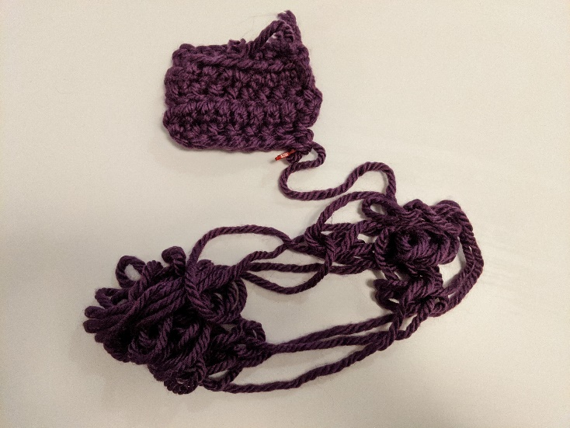
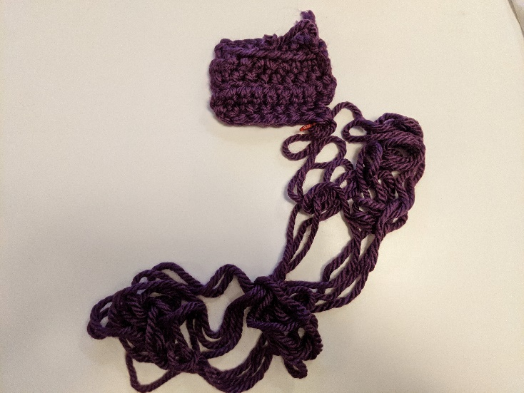
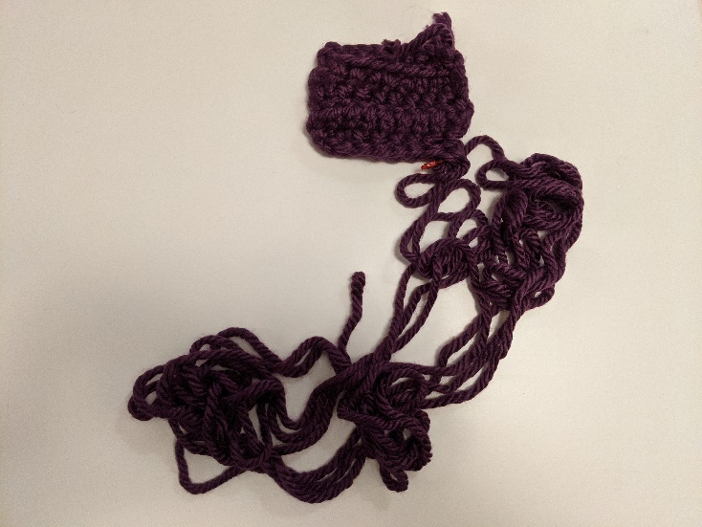
My Approach

Slide 16
End-of-Yarn Finding Algorithm
Set aside the already-obtained beginning Do the following until you find the end: Separate the pile of yarn into 2 piles Label A to be the pile that the beginning enters Label B to be the other pile Count the number of strands crossing the piles If count is even, set the pile to be A Otherwise set the pile to be B.
A
B

Slide 17
Resource Analysis

Slide 18
Why do resource analysis?
Allows us to compare algorithms, not implementations
Using observations necessarily couples the algorithm with its implementation
If my implementation on my computer takes more time than your implementation on your computer, we cannot conclude your algorithm is better
We can predict an algorithm’s running time before implementing
Understand where the bottlenecks are in our algorithm

Slide 19
Process for resource Analysis
End Result: A function which maps the algorithm’s input size to count of resources used
Input of the function: sizes of the input
Number of characters in a string, number of items in a list, number of pixels in an image
Output of the function: counts of resources used
Number of times the algorithm adds two numbers together, number times the algorithm does a > or < comparison, maximum number of bytes of memory the algorithm uses at any time
Important note: Make sure you know the “units” of your input and output!

Slide 20
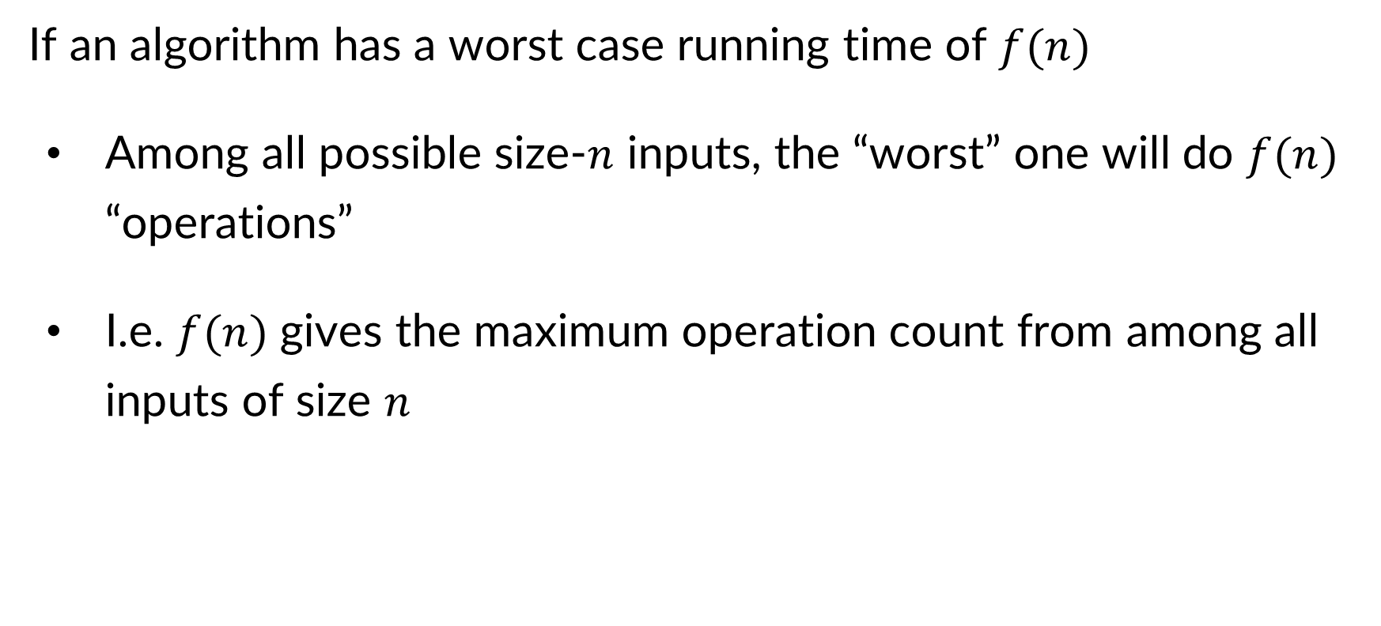
Resource Analysis – Worst Case Running Time
If an algorithm has a worst case running time of $f(n)$
Among all possible size-$n$ inputs, the “worst” one will do $f(n)$ “operations”
I.e. $f(n)$ gives the maximum operation count from among all inputs of size $n$

Slide 21
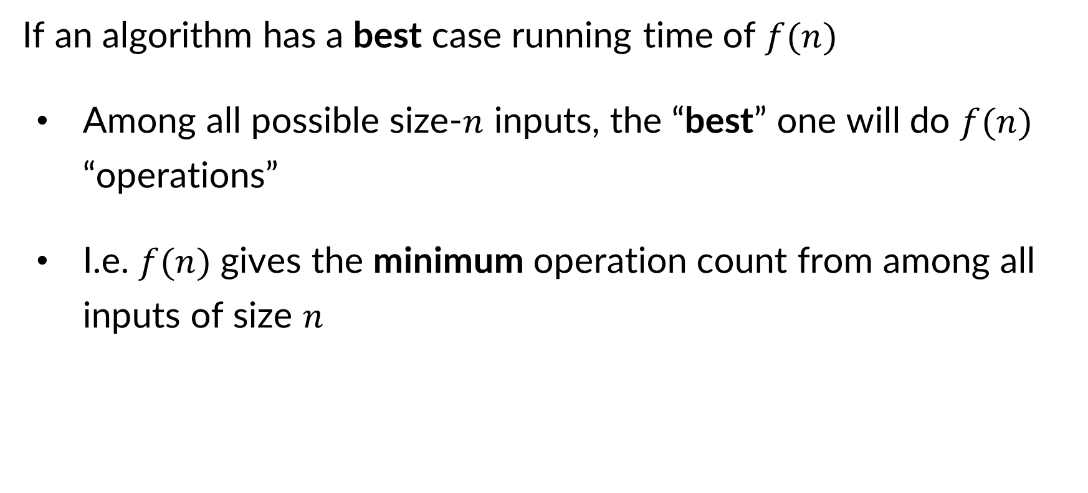
Resource Analysis – Best Case Running Time
If an algorithm has a best case running time of $f(n)$
Among all possible size-$n$ inputs, the “best” one will do $f(n)$ “operations”
I.e. $f(n)$ gives the minimum operation count from among all inputs of size $n$

Slide 22
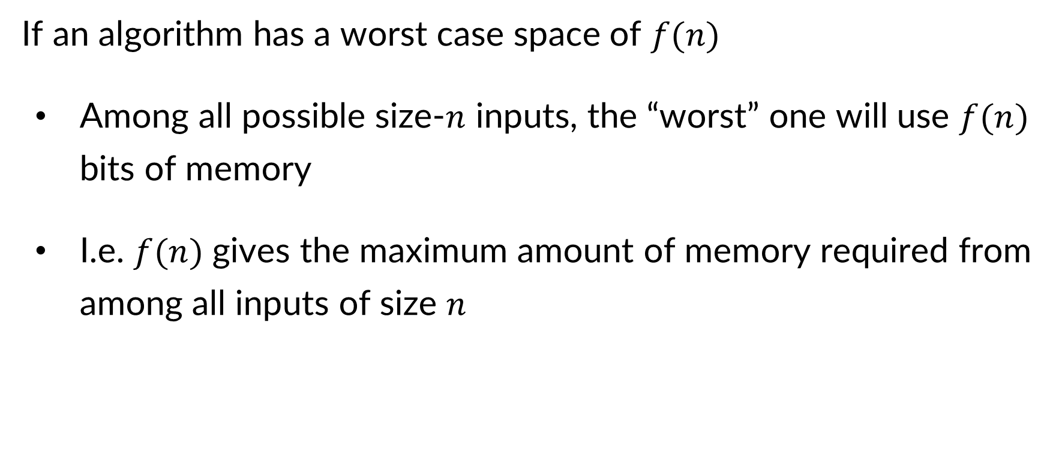
Resource Analysis – Worst Case Space
If an algorithm has a worst case space of $f(n)$
Among all possible size-$n$ inputs, the “worst” one will use $f(n)$ bits of memory
I.e. $f(n)$ gives the maximum amount of memory required from among all inputs of size $n$

Slide 23
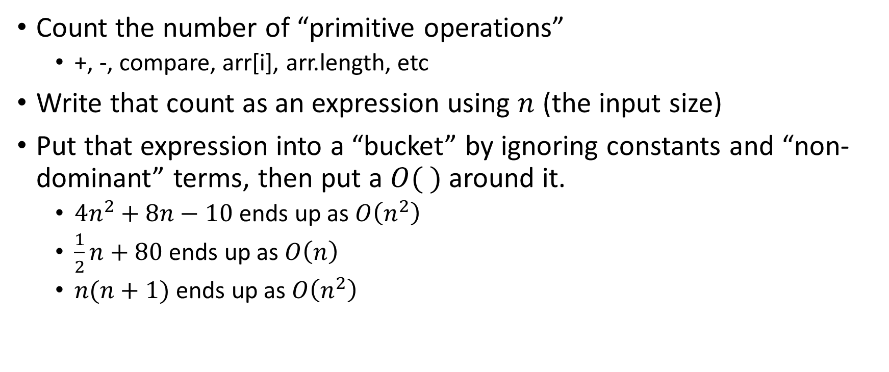
Analysis Process From 123/143
Count the number of “primitive operations”
+, -, compare, arr[i], arr.length, etc
Write that count as an expression using $n$ (the input size)
Put that expression into a “bucket” by ignoring constants and “non-dominant” terms, then put a $O( )$ around it.
$4n^{2}+8n−10$ ends up as $O\left(n^{2}\right)$
$\frac{1}{2}n+80$ ends up as $O\left(n\right)$
$n(n+1)$ ends up as $O\left(n^{2}\right)$

Slide 24
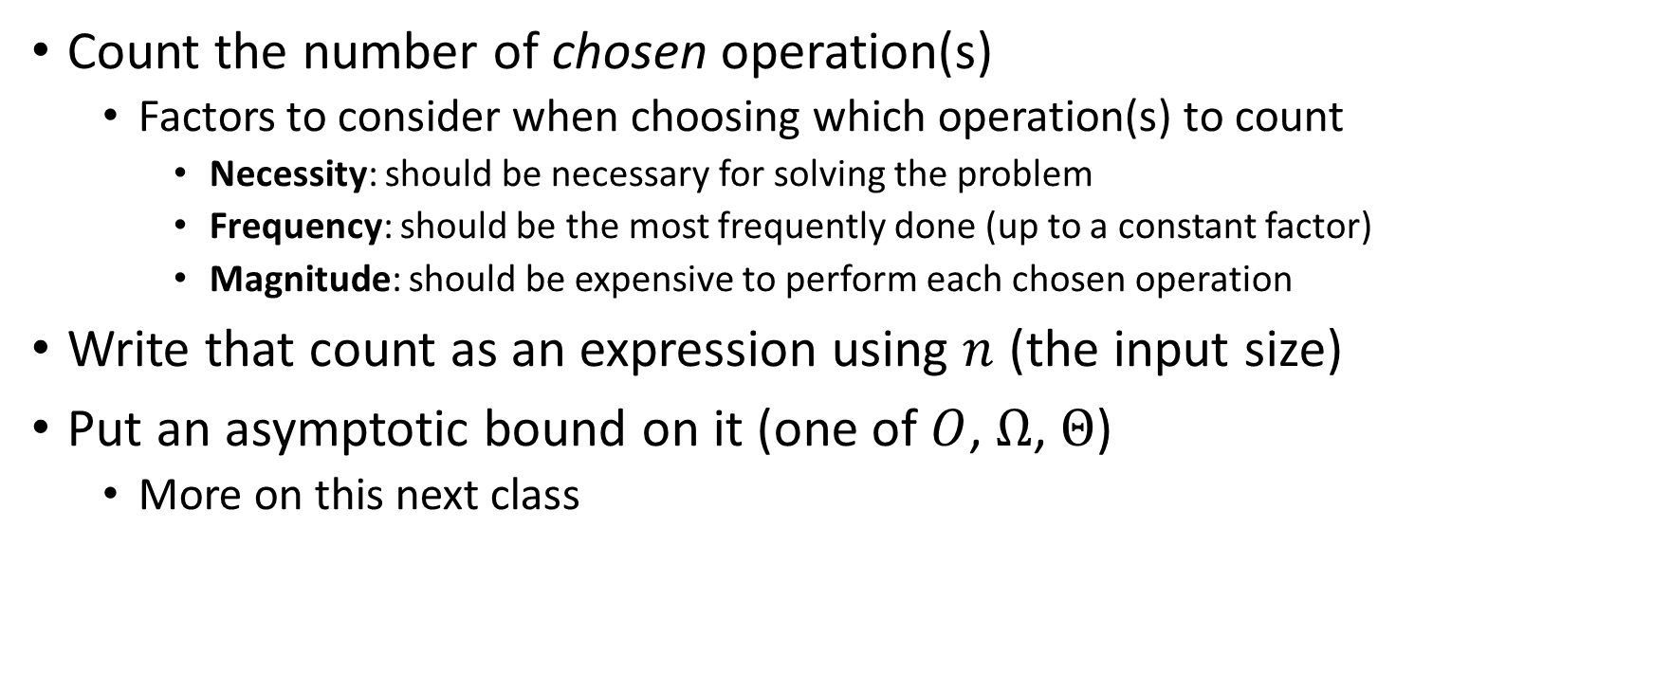
Analysis Process For Us
Count the number of chosen operation(s)
Factors to consider when choosing which operation(s) to count
Necessity: should be necessary for solving the problem
Frequency: should be the most frequently done (up to a constant factor)
Magnitude: should be expensive to perform each chosen operation
Write that count as an expression using $n$ (the input size)
Put an asymptotic bound on it (one of $O$, $Ω$, $Θ$)
More on this next class

Slide 25
Worst Case – Example 1 (Questions)
myFunction(List n){
b = 55 + 5;
c = b / 3;
b = c + 100;
for (i = 0; i < n.size(); i++) {
b++;
}
if (b % 2 == 0) {
c++;
}
else {
for (i = 0; i < n.size(); i++) {
c++;
}
}
return c;
}
Questions to ask:
What are the units of the input size?
What are the operations we’re counting?
For each line:
How many times will it run?
How long does it take to run?
Does this change with different inputs?
Answer:

Slide 26

Worst Case – Example 1 (Answers)
myFunction(List n){
b = 55 + 5; // 1
c = b / 3; // 1
b = c + 100; // 1
for (i = 0; i < n.size(); i++) { // 1, n times
b++; // 1
}
if (b % 2 == 0) { // 1
c++; // 1
}
else {
for (i = 0; i < n.size(); i++) { // 1, n times
c++; // 1
}
}
return c;
}
Questions to ask:
What are the units of the input size?
# of items in the list
What are the operations we’re counting?
Arithmetic ops (+-*/)
For each line:
How many times will it run?
How long does it take to run?
Does this change with different inputs?
Answer:
$3+2n+1+2n=4n+4$
$O(n)$

Slide 27
Worst Case – Example 2 (Questions)
beAnnoying(List n){
List m = [];
for (i=0; i < n.size(); i++){
m.add(n[i]);
for (j=0; j< n.size(); j++){
print (“Hi, I’m annoying”);
}
}
}
Questions to ask:
What are the units of the input size?
What are the operations we’re counting?
For each line:
How many times will it run?
How long does it take to run?
Does this change with the input size?

Slide 28

Worst Case – Example 2 (Answers)
beAnnoying(List n){
List m = [];
for (i=0; i < n.size(); i++){ // n times
m.add(n[i]);
for (j=0; j< n.size(); j++){ // n times
print (“Hi, I’m annoying”); // 1
}
}
}
Questions to ask:
What are the units of the input size?
# items
What are the operations we’re counting?
Adding or printing
Printing: $O\left(n^{2}\right)$
For each line:
How many times will it run?
How long does it take to run?
Does this change with the input size?

Slide 29
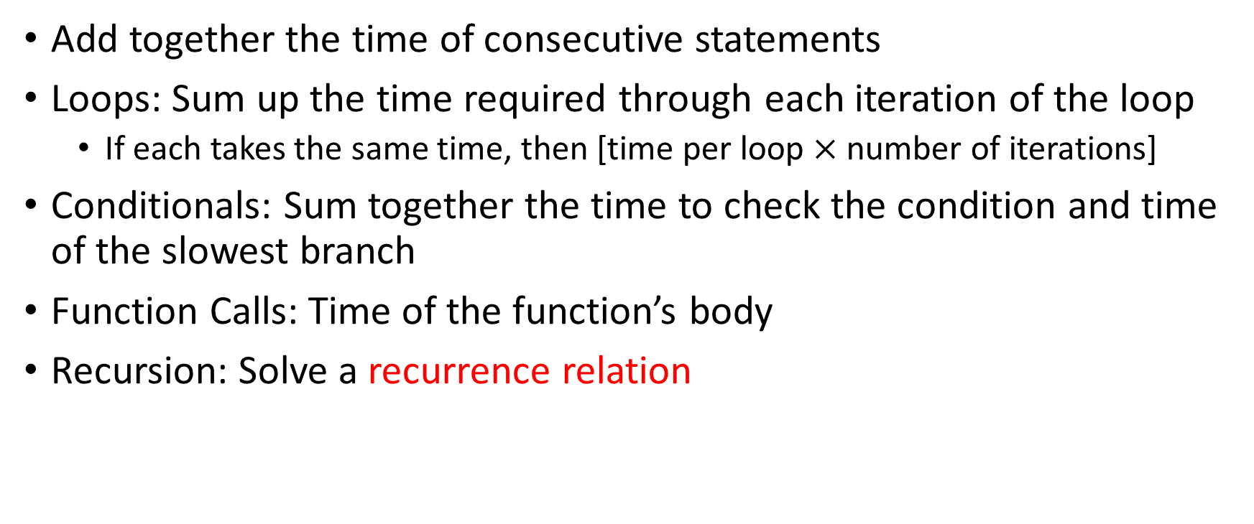
Worst Case Running Time – General Guide
Add together the time of consecutive statements
Loops: Sum up the time required through each iteration of the loop
If each takes the same time, then [time per loop $×$ number of iterations]
Conditionals: Sum together the time to check the condition and time of the slowest branch
Function Calls: Time of the function’s body
Recursion: Solve a recurrence relation

Slide 30
Defining your running time function
Worst-case complexity:
max number of steps algorithm takes on “most challenging” input
Best-case complexity:
min number of steps algorithm takes on “easiest” input
Average/expected complexity:
avg number of steps algorithm takes on random inputs (distribution-dependent)
Amortized complexity:
max total number of steps algorithm takes on M “most challenging” consecutive inputs, divided by M (i.e., divide the max total sum by M).

Slide 31

ArrayList - Worst Case Time of Add
public void add(int value){
if(data.length == size)
resize();
data[size] = value;
size++;
}
private void resize(){
int[] oldData = data;
data = new int[data.length*2];
for(int i = 0; i < oldData.length; i++)
data[i] = oldData[i];
}
What is the worst case running time of add?
Input size: size of “this”
Operations counted: indexing
$O\left(n\right)$

Slide 32
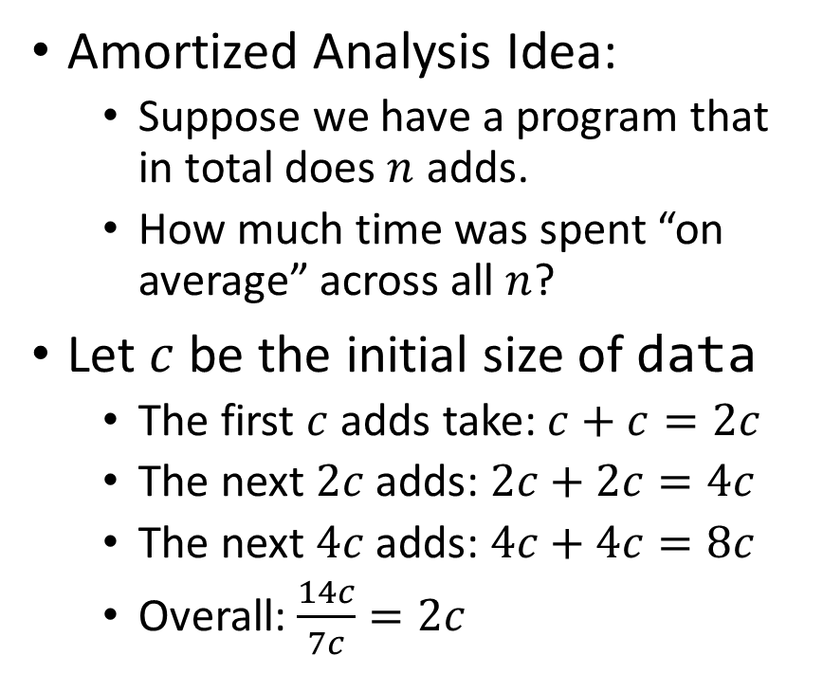
ArrayList – Amortized Time of Add
public void add(int value){
if(data.length == size)
resize();
data[size] = value;
size++;
}
private void resize(){
int[] oldData = data;
data = new int[data.length*2];
for(int i = 0; i < oldData.length; i++)
data[i] = oldData[i];
}
Amortized Analysis Idea:
Suppose we have a program that in total does $n$ adds.
How much time was spent “on average” across all $n$?
Let $c$ be the initial size of data
The first $c$ adds take: $c+c=2c$
The next $2c$ adds: $2c+2c=4c$
The next $4c$ adds: $4c+4c=8c$
Overall: $\frac{14c}{7c}=2c$
Every time we resize, we earn data.length more adds before the next resize!
Notes:
Amortized: “running average”

Slide 33
Amortized Analysis Analogy
Suppose I’d like to park in a lot where they charge $10 per day to park
If you are caught in the lot without paying you are given a warning
If you get 3 warnings, you are charged a $25 fine, and your warnings reset.
Should you actually pay to park?
If you pay every day then you pay an average of $10 per day
If you do not pay then for every three days parking costs $0+$0+$25, for an average of $8.33 per day
This is an amortized analysis

