Slide 1
CSE 332 Spring 2026 Lecture 20: Parallel Prefix
Nathan Brunelle
http://www.cs.uw.edu/332

Slide 2
Which Data Structures are “Suitable” for Parallelism?
For each data structure, can we write a parallel algorithm to sum all of its values that’s more efficient than a sequential one?
Array
Linked List
Binary Tree

Slide 3
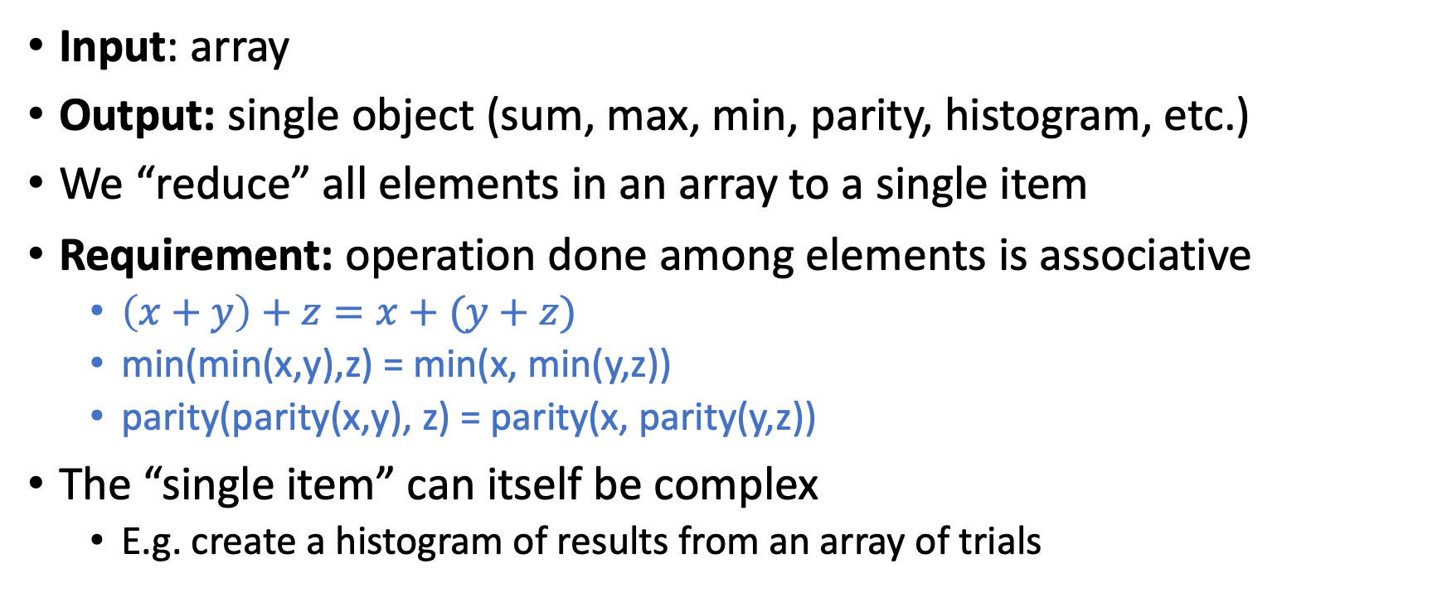
Reduction/Fold
Input: array
Output: single object (sum, max, min, parity, histogram, etc.)
We “reduce” all elements in an array to a single item
Requirement: operation done among elements is associative
$\left(x+y\right)+z=x+(y+z)$
min(min(x,y),z) = min(x, min(y,z))
parity(parity(x,y), z) = parity(x, parity(y,z))
The “single item” can itself be complex
E.g. create a histogram of results from an array of trials

Slide 4
Find Max with ForkJoin
class MaxTask extends RecursiveTask<Integer> {
int lo; int hi; int[] arr; // fields to know what to do
SumTask(int[] a, int l, int h) { … }
protected Integer compute(){// return answer
if(hi – lo < SEQUENTIAL_CUTOFF) { // base case
int ans = Integer.MIN_VALUE; // local var, not a field
for(int i=lo; i < hi; i++) {
ans = Math.max(ans, arr[i]);}
return ans;
else {
MaxTask left = new MaxTask(arr,lo,(hi+lo)/2); // divide
MaxTask right= new MaxTask(arr,(hi+lo)/2,hi); // divide
left.fork(); // fork a thread and calls compute (conquer)
int rightAns = right.compute(); //call compute directly (conquer)
int leftAns = left.join(); // get result from left
return Math.max(rightAns, leftAns); // combine
}
}
}

Slide 5
Map
Input: array(s)
Output: array (of same size)
Requirement: apply some function to individual array elements.
Examples:
Vector addition:
sum[i] = arr1[i] + arr2[i]
Function application:
out[i] = f(arr[i]);

Slide 6
Vector Addition with ForkJoin
class AddTask extends RecursiveAction {
int lo; int hi; int[] a; int[] b; int[] sum;
AddTask(int[] a, int[] b, int[] sum, int l, int h) { … }
protected void compute(){// return answer
if(hi – lo < SEQUENTIAL_CUTOFF) { // base case
for(int i=lo; i < hi; i++) {
sum[i] = a[i] + b[i];}
else {
AddTask left = new AddTask(a,b,sum,lo,(hi+lo)/2); // divide
AddTask right= new AddTask(a,b,sum,(hi+lo)/2,hi); // divide
left.fork(); // fork a thread and calls compute (conquer)
right.compute(); //call compute directly (conquer)
left.join(); // get result from left
return; // combine
}
}
}

Slide 7
Function Application with ForkJoin
public String mapFunction(int x){…}
class MapTask extends RecursiveAction {
int lo; int hi; int[] arr; String[] out
MapTask(int[] arr, String[] out, int l, int h) { … }
protected void compute(){// return answer
if(hi – lo < SEQUENTIAL_CUTOFF) { // base case
for(int i=lo; i < hi; i++) {
out[i] = mapFunction(arr[i]);}
else {
MapTask left = new MapTask(arr,out,lo,(hi+lo)/2); // divide
MapTask right= new MapTask(arr,out,(hi+lo)/2,hi); // divide
left.fork(); // fork a thread and calls compute (conquer)
right.compute(); //call compute directly (conquer)
left.join(); // get result from left
return; // combine
}
}
}

Slide 8
ForkJoin Picture
.fork()
range: [0,8)
Thread: 1
.compute()
range: [4,8)
Thread: 1
.fork()
range: [0,4)
Thread: 2
.fork()
.compute()
.compute()
range: [0,2)
Thread: 3
range: [2,4)
Thread: 2
range: [4,6)
Thread: 4
range: [6,8)
Thread: 1

Slide 9
Map/Reduction Example
Task: Multiply together the lengths of all the odd-length strings in array
Apply map to convert the array of strings into an array of their lengths
Then do a map on that array so each value maps to 1 if it’s even and itself if it’s odd
Then do a reduction to multiply together that final result
Note: You could do this in a single ForkJoin RecursiveTask
but “deconstructing” useful since some languages designed specifically for parallelism have Map/Reduce built in.
Map and Reduce are two from a trio, with Pack/Filter being the third

Slide 10

Pack/Filter
Given an array of values and a Boolean function, return a new array which contains only elements that were “true”
10
16
4
18
8
2
10
16
18
$$f\left(x\right)=x>9$$
Question: Can we Pack/Filter in parallel?
Answer: yes, with help of parallel Prefix Sum

Slide 11

Prefix Sum
Given an array, compute a new array where each index $i$ is the sum of all values up to $i$
10
16
4
18
8
2
10
26
30
48
56
58
Later: will be useful for parallel packing/filtering!

Slide 12

Parallel Prefix Sum
Algorithm will have two major parallel steps
Called a “two pass” parallel algorithm
First step:
Create a tree data structure
Second Step:
Use the tree to fill in the output array
Richard Ladner
Allen School Faculty
The “subproblem” this node represents
lower bound is inclusive, upper is exclusive
range: [lo,hi)
sum:
leftSum:
Tree Node:
The sum of all values in the range
The sum of all values to the left of the range
i.e. in the range [0, lo)

Slide 13
Step 1: Using D&C Create a Tree, Fill in sum
14
9
Input:
10
16
4
18
8
2
Output:
For this pass we will only fill in sum
In the next pass we will find leftSum
range: [0,8)
sum:
leftSum:
0
1
2
3
4
5
6
7
range: [0,4)
sum:
leftSum:
range: [4,8)
sum:
leftSum:
range: [0,2)
sum:
leftSum:
range: [2,4)
sum:
leftSum:
range: [4,6)
sum:
leftSum:
range: [6,8)
sum:
leftSum:
range: [0,1)
sum:
leftSum:
range: [1,2)
sum:
leftSum:
range: [2,3)
sum:
leftSum:
range: [3,4)
sum:
leftSum:
range: [4,5)
sum:
leftSum:
range: [5,6)
sum:
leftSum:
range: [6,7)
sum:
leftSum:
range: [7,8)
sum:
leftSum:

Slide 14
Step 1: Create a Tree, Fill in sum
10
16
4
18
8
2
14
9
range: [2,3)
sum: 4
leftSum:
Base Case:
If the rand is smaller than the Sequential Cutoff, create a node for that range and find the sum sequentially
Divide:
Split the list into two “sublists” of (roughly) equal length, create a thread for each sublist.
Conquer:
Call start() for each thread to compute the left and right subtrees
Combine:
Create parent node, connect to children, fill in sum
4
8
2
14
9
10
16
4
18
range: [0,4)
sum: 48
leftSum:
range: [4,8)
sum: 33
leftSum:
range: [0,8)
sum: 81
leftSum:
range: [0,4)
sum: 48
leftSum:
range: [4,8)
sum: 33
leftSum:

Slide 15
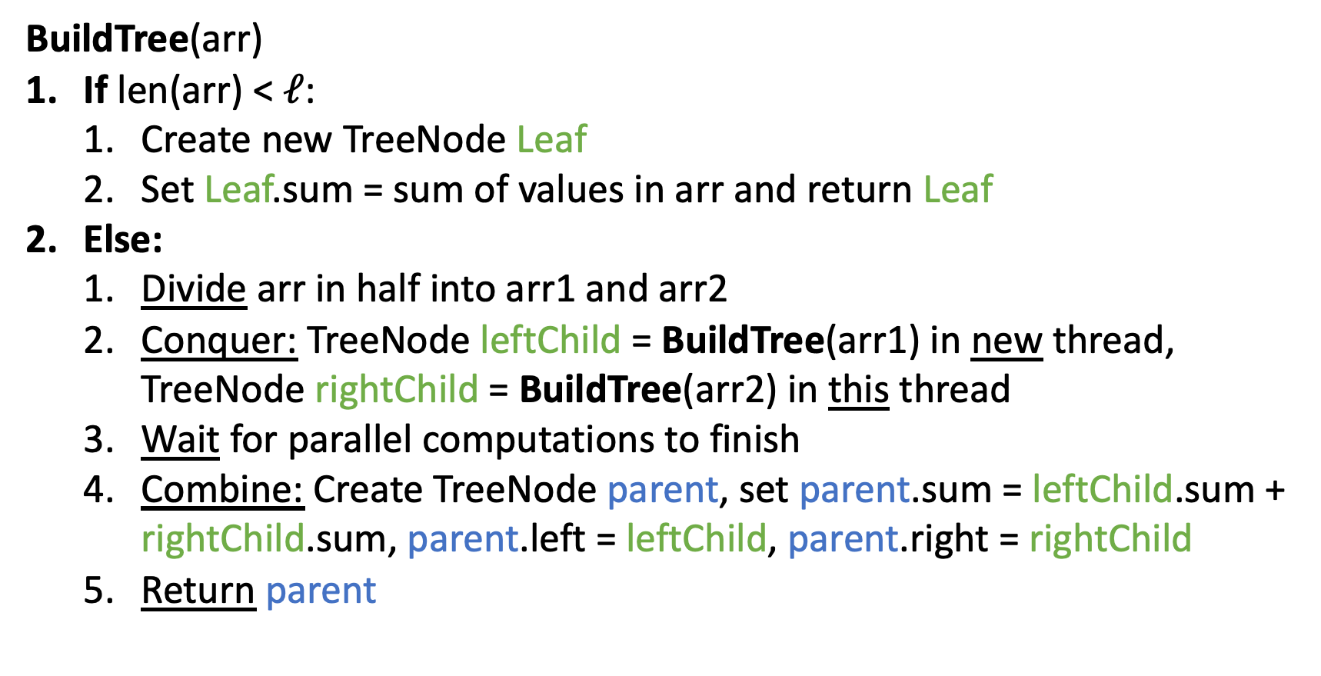
Step 1 pseudocode (create tree, compute sum)
BuildTree(arr)
If len(arr) < $ℓ$:
Create new TreeNode Leaf
Set Leaf.sum = sum of values in arr and return Leaf
Else:
Divide arr in half into arr1 and arr2
Conquer: TreeNode leftChild = BuildTree(arr1) in new thread, TreeNode rightChild = BuildTree(arr2) in this thread
Wait for parallel computations to finish
Combine: Create TreeNode parent, set parent.sum = leftChild.sum + rightChild.sum, parent.left = leftChild, parent.right = rightChild
Return parent

Slide 16
Step 1 Java Code
class BuildTreeTask extends RecursiveTask<PrefixSumNode> {
int lo; int hi; int[] arr;
public BuildTreeTask(int lo, int hi, int[] arr) {…}
protected PrefixSumNode compute(){
if(hi – lo < SEQUENTIAL_CUTOFF) { // base case
int ans = 0; // local var, not a field
for(int i=lo; i < hi; i++)
ans += arr[i];
return new PrefixSumNode(lo, hi, ans); }
else {
BuildTreeTask left = new BuildTreeTask(arr,lo,(hi+lo)/2);
BuildTreeTask right= new BuildTreeTask(arr,(hi+lo)/2,hi);
left.fork();
PrefixSumNode rightChild = right.compute();
PrefixSumNode leftChild = left.join();
int ans = rightChild.sum + leftChild.sum;
parent = new PrefixSumNode(lo, hi, ans);
parent.left = leftChild;
parent.right = rightChild;
return parent; }
}
}

Slide 17
After Step 1
Input:
10
16
4
18
8
2
14
9
All sums filled in per node
In the next pass we will find leftSum
leftSum is the sum of all elements strictly to the left of the current range
Output:
range: [0,8)
sum: 81
leftSum:
0
1
2
3
4
5
6
7
range: [0,4)
sum: 48
leftSum:
range: [4,8)
sum: 33
leftSum:
range: [0,2)
sum: 26
leftSum:
range: [2,4)
sum: 22
leftSum:
range: [4,6)
sum: 10
leftSum:
range: [6,8)
sum: 23
leftSum:
range: [0,1)
sum: 10
leftSum:
range: [1,2)
sum: 16
leftSum:
range: [2,3)
sum: 4
leftSum:
range: [3,4)
sum: 18
leftSum:
range: [4,5)
sum: 8
leftSum:
range: [5,6)
sum: 2
leftSum:
range: [6,7)
sum: 14
leftSum:
range: [7,8)
sum: 9
leftSum:

Slide 18
Step 2: fill in leftSum and Output (1/4)
Input:
10
16
4
18
8
2
14
9
Output:
leftSum is the sum of all elements strictly to the left of the current range
We’re going to go root-down, so we can use: any node’s sum, parent’s leftSum
range: [0,8)
sum: 81
leftSum:
0
1
2
3
4
5
6
7
range: [0,4)
sum: 48
leftSum:
range: [4,8)
sum: 33
leftSum:
range: [0,2)
sum: 26
leftSum:
range: [2,4)
sum: 22
leftSum:
range: [4,6)
sum: 10
leftSum:
range: [6,8)
sum: 23
leftSum:
range: [0,1)
sum: 10
leftSum:
range: [1,2)
sum: 16
leftSum:
range: [2,3)
sum: 4
leftSum:
range: [3,4)
sum: 18
leftSum:
range: [4,5)
sum: 8
leftSum:
range: [5,6)
sum: 2
leftSum:
range: [6,7)
sum: 14
leftSum:
range: [7,8)
sum: 9
leftSum:

Slide 19
Step 2: fill in leftSum and Output (2/4)
Input:
10
16
4
18
8
2
14
9
Output:
If this is a left child:
leftSum = parent.leftSum
If this is a right child:
leftSum = parent.leftSum + sibling.sum
range: [0,8)
sum: 81
leftSum:
0
1
2
3
4
5
6
7
range: [0,4)
sum: 48
leftSum:
range: [4,8)
sum: 33
leftSum:
range: [0,2)
sum: 26
leftSum:
range: [2,4)
sum: 22
leftSum:
range: [4,6)
sum: 10
leftSum:
range: [6,8)
sum: 23
leftSum:
range: [0,1)
sum: 10
leftSum:
range: [1,2)
sum: 16
leftSum:
range: [2,3)
sum: 4
leftSum:
range: [3,4)
sum: 18
leftSum:
range: [4,5)
sum: 8
leftSum:
range: [5,6)
sum: 2
leftSum:
range: [6,7)
sum: 14
leftSum:
range: [7,8)
sum: 9
leftSum:

Slide 20
Step 2: fill in leftSum and Output (3/4)
Input:
10
16
4
18
8
2
14
9
If this is a left child:
leftSum = parent.leftSum
If this is a right child:
leftSum = parent.leftSum + sibling.sum
For the leaves:
use leftSum+sum
to complete output
Output:
range: [0,8)
sum: 81
leftSum: 0
0
1
2
3
4
5
6
7
range: [0,4)
sum: 48
leftSum: 0
range: [4,8)
sum: 33
leftSum: 48
range: [0,2)
sum: 26
leftSum: 0
range: [2,4)
sum: 22
leftSum: 26
range: [4,6)
sum: 10
leftSum: 48
range: [6,8)
sum: 23
leftSum: 58
range: [0,1)
sum: 10
leftSum: 0
range: [1,2)
sum: 16
leftSum: 10
range: [2,3)
sum: 4
leftSum: 26
range: [3,4)
sum: 18
leftSum: 30
range: [4,5)
sum: 8
leftSum: 48
range: [5,6)
sum: 2
leftSum: 56
range: [6,7)
sum: 14
leftSum: 58
range: [7,8)
sum: 9
leftSum: 72

Slide 21
Step 2: fill in leftSum and Output (4/4)
Input:
10
16
4
18
8
2
14
9
If this is a left child:
leftSum = parent.leftSum
If this is a right child:
leftSum = parent.leftSum + sibling.sum
For the leaves:
use leftSum+sum
to complete output
Output:
10
26
30
48
56
58
72
81
range: [0,8)
sum: 81
leftSum: 0
0
1
2
3
4
5
6
7
range: [0,4)
sum: 48
leftSum: 0
range: [4,8)
sum: 33
leftSum: 48
range: [0,2)
sum: 26
leftSum: 0
range: [2,4)
sum: 22
leftSum: 26
range: [4,6)
sum: 10
leftSum: 48
range: [6,8)
sum: 23
leftSum: 58
range: [0,1)
sum: 10
leftSum: 0
range: [1,2)
sum: 16
leftSum: 10
range: [2,3)
sum: 4
leftSum: 26
range: [3,4)
sum: 18
leftSum: 30
range: [4,5)
sum: 8
leftSum: 48
range: [5,6)
sum: 2
leftSum: 56
range: [6,7)
sum: 14
leftSum: 58
range: [7,8)
sum: 9
leftSum: 72

Slide 22
Step 2 pseudocode (Compute Leftsum)
CompleteTree(Node curr)
If curr is a left child of curr.parent:
Set curr.LeftSum = curr.parent.LeftSum
Else:
Set curr.LeftSum = curr.parent.LeftSum + curr.sibling.Sum
If curr is not a leaf:
Divide and conquer: call CompleteTree(curr.left) and CompleteTree(curr.right) in parallel threads
Wait for parallel computations to finish
Else (curr is a leaf):
Set output[curr.lo] = curr.LeftSum + input[curr.lo]
for i = curr.lo + 1 to curr.hi:
Set output[i] = output[i-1] + input[i]
Base Case

Slide 23
Step 2 Java Code
class CompleteTree extends RecursiveAction {
public CompleteTree(PrefixSumNode curr, PrefixSumNode parent, PrefixSumNode sibling, boolean isLeftChild, int[] output, int[] input){…}
protected void compute(){
if(parent == null) {curr.sumLeft = 0;} // if curr is the root
else if(isLeftChild) {curr.sumLeft = parent.sumLeft;} // if curr is a left child
else {curr.sumLeft = parent.sumLeft + sibling.sum;} // if curr is a right child
if (curr.leftChild != null && curr.rightChild != null){ // if this isn’t a leaf
CompleteTree left = new CompleteTree(curr.leftChild, curr, curr.rightChild, true, output, input);
left.fork();
CompleteTree right = new CompleteTree(curr.rightChild, curr, curr.leftChild, false, output, input);
right.compute();
left.join();
}
else{ // if it is a leaf
output[curr.lo] = curr.sumLeft + input[curr.lo];
for(int i = curr.lo+1; i < curr.hi; i++){
output[i] = output[i-1] + input[i]
}
}}}

Slide 24
Whew! Back to Pack/Filter
Given an array of values and a Boolean function, return a new array which contains only elements that were “true”
10
16
4
18
8
2
14
9
10
16
18
14
$$f\left(x\right)=x>9$$

Slide 25
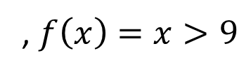
Parallel Pack
Input:
10
16
4
18
8
2
14
9
, $f\left(x\right)=x>9$
Output:
10
16
18
14
0
1
2
3
4
5
6
7
Do a map to identify the true elements
Do prefix sum on the result → count of true elements seen to the left of each position
Populate in the output in parallel:
1
1
0
1
0
0
1
0
1
2
2
3
3
3
4
4
10
16
18
14

Slide 26
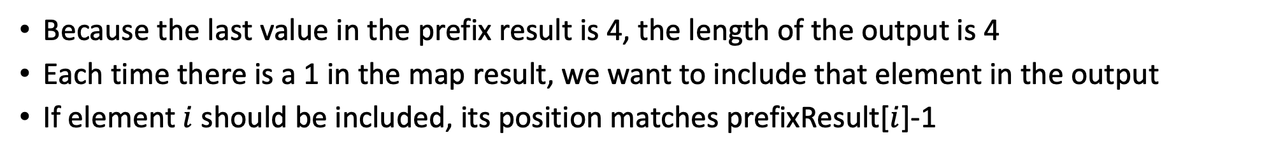
3. Populate in the output in parallel:
Input:
10
16
4
18
8
2
14
9
Map Result:
1
1
0
1
0
0
1
0
Prefix Result:
1
2
2
3
3
3
4
4
Output:
Because the last value in the prefix result is 4, the length of the output is 4
Each time there is a 1 in the map result, we want to include that element in the output
If element $i$ should be included, its position matches prefixResult[$i$]-1
In parallel: if mapResult[i] == 1:
output[prefixResult[i]-1] = input[i]

Slide 27
Step 3 Java Code
class PopulateTask extends RecursiveAction {
int lo; int hi; int[] arr; int[] map; int[] prefix; int[] out;
PopulateTask(int[] arr, int[] map, int[] prefix, int[] out, int l, int h) { … }
protected void compute(){// return answer
if(hi – lo < SEQUENTIAL_CUTOFF) { // base case
for(int i=lo; i < hi; i++) {
if(map[i] == 1){
out[prefix[i]-1]=arr[i];
}
}
else {
PopulateTask left = new PopulateTask(arr, map, prefix, out, lo,(hi+lo)/2); // divide
PopulateTask right= new PopulateTask(arr, map, prefix, out, (hi+lo)/2,hi); // divide
left.fork(); // fork a thread and calls compute (conquer)
right.compute(); //call compute directly (conquer)
left.join(); // get result from left
return; // combine
}
}
}

Slide 28
Parallel Pack Java Code
public Boolean mapFunction(int x){…}
static final ForkJoinPool POOL = new ForkJoinPool();
public int[] parallelPrefixSum(int[] arr){
int[] out = new int[arr.length];
PrefixSumNode root = POOL.invoke(new BuildTreeTask(0, arr.length, arr));
POOL.invoke(new CompleteTree(root, null, null, false, out, arr));
return out;
}
public int[] parallelPack(int[] arr){
int[] map = new int[arr.length];
POOL.invoke(new MapTask(arr, map, 0, arr.length));
int[] prefix = parallelPrefixSum(map);
int[] pack = new int[prefix[prefix.length-1]];
POOL.invoke(new PopulateTask(arr, map, prefix, pack, 0, arr.length));
return pack;
}

Slide 29
Map/Reduction/Pack Example
Multiply together the lengths of all of the odd-length strings in a given array
First, do a map to covert the array of strings into an array of their lengths
Then do a map on that array so each value maps to 1 if it’s even and itself if it’s odd
Alternatively, do a pack on the array to remove all even values
Then do a reduction to multiply together that final result

