Slide 1
CSE 332 Spring 2026 Lecture 19: ForkJoin
Nathan Brunelle
http://www.cs.uw.edu/332

Slide 2

Parallelism Vs. Concurrency (with Potatoes)
Sequential:
The task is completed by just one processor doing one thing at a time
There is one cook who peels all the potatoes
Parallelism:
One task being completed by many threads/processors
Recruit several cooks to peel a lot of potatoes faster
Concurrency:
Parallel tasks using a shared resource
Several cooks are making their own recipes, but there is only 1 oven

Slide 3
New Story of Code Execution
Old Story:
One program counter (current line of code)
One call stack (with each stack frame holding local variables)
Objects in the heap created by memory allocation (i.e., new ___)
(nothing to do with data structure called a heap)
Operating System time slicing where programs may be paused by the OS at any time, with their execution being resumed later
New Story:
Collection of threads each with its own:
Program Counter
Call Stack
Local Variables
References to objects in the heap
One shared heap
Time slicing

Slide 4
Old Stroy
Heap Containing Objects and Static Fields
Call Stack
Program Counter
Local Variables (primitives and references to Heap objects)

Slide 5

New Story
Threads, each with its own unshared:
Call Stack
Program Counter
Local Variables (primitives and references to Heap objects)
Heap Containing Objects and Static Fields

Slide 6
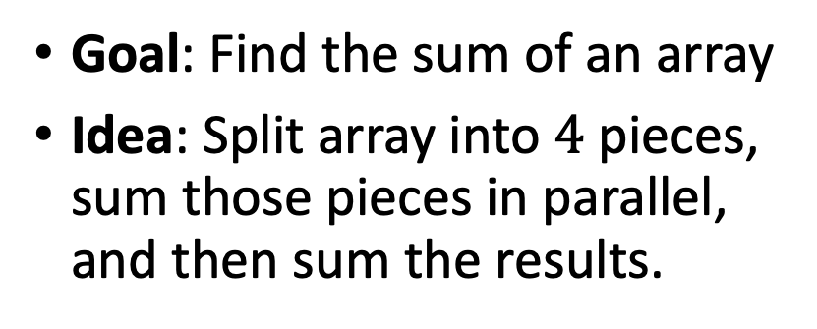

Running Example: Summing an Array
Goal: Find the sum of an array
Idea: Split array into $4$ pieces, sum those pieces in parallel, and then sum the results.
Input: array (arr) of integers
In parallel: split array into 4 equal pieces, sum up those four pieces.
res[i] = sum arr[i*len/4, (i+1)*len/4]
Return res[0] + res[1] + res[2] + res[3]
Needs from Programming language
Way to create threads, and run them in parallel
Way to access shared memory (refs to common objects)
Way to synchronize threads (wait until finished)
Cannot sum res[0] + … + res[3] until each thread has finished!

Slide 7

Accomplishing this in Java (Java.lang.Thread)
Create class C extending java.lang.Thread
C must have a run method (acts as main)
Call C’s start method to
create a new thread (i.e. parallel task, not Thread object in java)
execute run in that separate, parallel thread
Calling “run” directly causes the program to execute “run” sequentially

Slide 8
Back to Summing an Array
Goal: Find the sum of an array
Idea: 4 threads each find the sum of one quarter of the array
Process:
Create 4 thread objects, each given a portion of the work
Call start() on each thread object to run it in parallel
Wait for threads to finish using join()
Add together their 4 answers for the final result
+
+
+
+
+

Slide 9

First Attempt (part 1, Defining Thread Object)
class SumThread extends java.lang.Thread {
int lo; int hi; int[] arr; int ans = 0;
SumThread(int[] a, int l, int h) {
lo=l; hi=h; arr=a;
}
public void run() { //override, must have this signature
// no arguments and no return allowed
// must use the object’s fields for input/output
for(int i=lo; i < hi; i++)
ans += arr[i];
}

Slide 10

First Attempt (part 2, Creating Thread Objects)
static int parallelSum(int[] arr){ // this method could be anywhere
int len = arr.length;
int ans = 0;
SumThread[] threads = new SumThread[4];
for(int i=0; i < 4; i++) // create threads
threads[i] = new SumThread(arr, i*len/4, (i+1)*len/4);
// more stuff to follow
}
class SumThread extends java.lang.Thread {
int lo, int hi, int[] arr; int ans = 0;
SumThread(int[] a, int l, int h) { … }
public void run(){ … } // override
}

Slide 11

First Attempt (part 3, Running Thread Objects)
static int parallelSum(int[] arr){ // this method could be anywhere
int len = arr.length;
int ans = 0;
SumThread[] threads = new SumThread[4];
for(int i=0; i < 4; i++){ // create threads, do parallel computations
threads[i] = new SumThread(arr,i*len/4,(i+1)*len/4);
threads[i].start(); // start not run
}
for(int i=0; i < 4; i++) // combine results
ans += threads[i].ans;
return ans;
}
class SumThread extends java.lang.Thread {
int lo, int hi, int[] arr; int ans = 0;
SumThread(int[] a, int l, int h) { … }
public void run(){ … } // override
}

Slide 12
First Attempt (part 4, Synchronizing)
static int parallelSum(int[] arr){ // this method could be anywhere
int len = arr.length;
int ans = 0;
SumThread[] threads = new SumThread[4];
for(int i=0; i < 4; i++){ // do parallel computations
threads[i] = new SumThread(arr,i*len/4,(i+1)*len/4);
threads[i].start(); // start not run
}
for(int i=0; i < 4; i++){ // combine results
threads[i].join(); // wait for thread to finish!
ans += threads[i].ans;
}
return ans;
}
class SumThread extends java.lang.Thread {
int lo, int hi, int[] arr; int ans = 0;
SumThread(int[] a, int l, int h) { … }
public void run(){ … } // override
}

Slide 13

Join
Causes program to pause until the other thread completes its run method
Avoids a race condition
Without join the other thread’s ans field may not have its final answer yet

Slide 14
Recap so far
Way to create threads, and run them in parallel
C extends java.lang.Thread
C.start()
Way to wait for threads to finish
C.join()

Slide 15
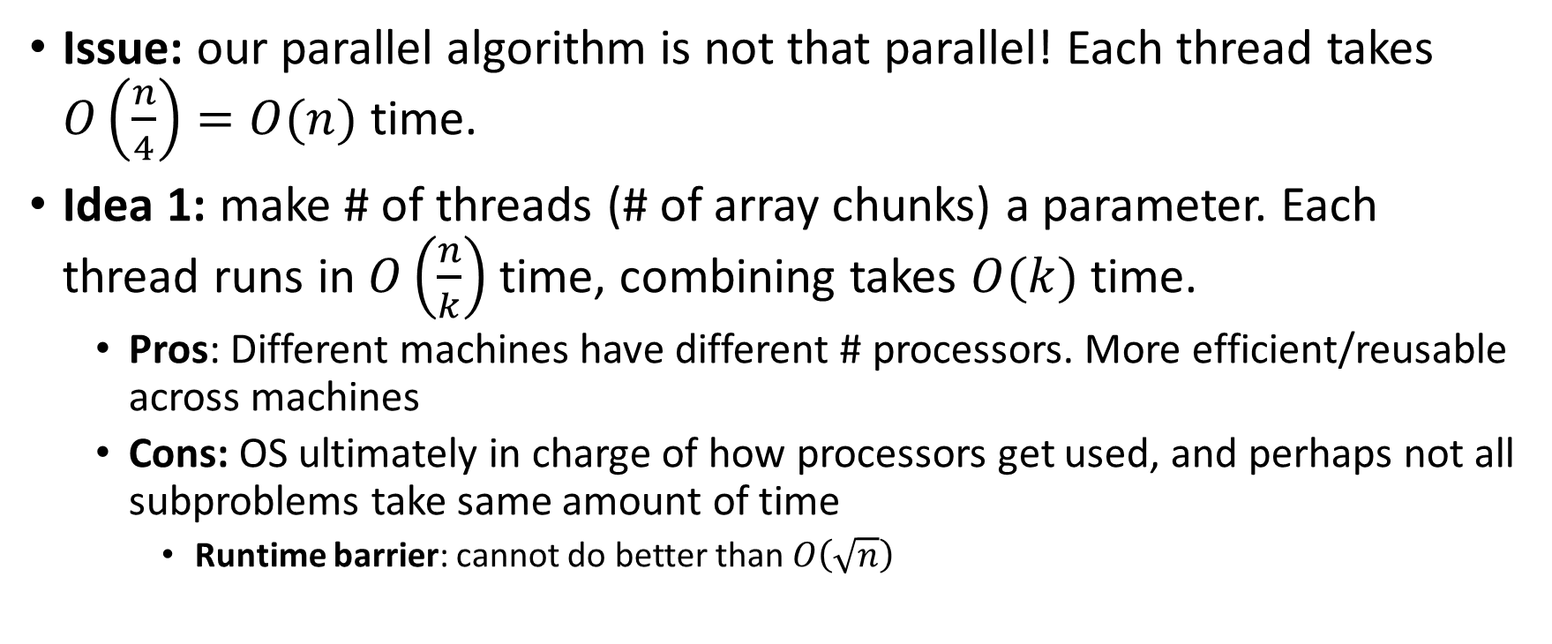

More Threads?
Issue: our parallel algorithm is not that parallel! Each thread takes $O\left(\frac{n}{4}\right)=O(n)$ time.
Idea 1: make # of threads (# of array chunks) a parameter. Each thread runs in $O\left(\frac{n}{k}\right)$ time, combining takes $O(k)$ time.
Pros: Different machines have different # processors. More efficient/reusable across machines
Cons: OS ultimately in charge of how processors get used, and perhaps not all subproblems take same amount of time
Runtime barrier: cannot do better than $O\left(\sqrt{n}\right)$

Slide 16
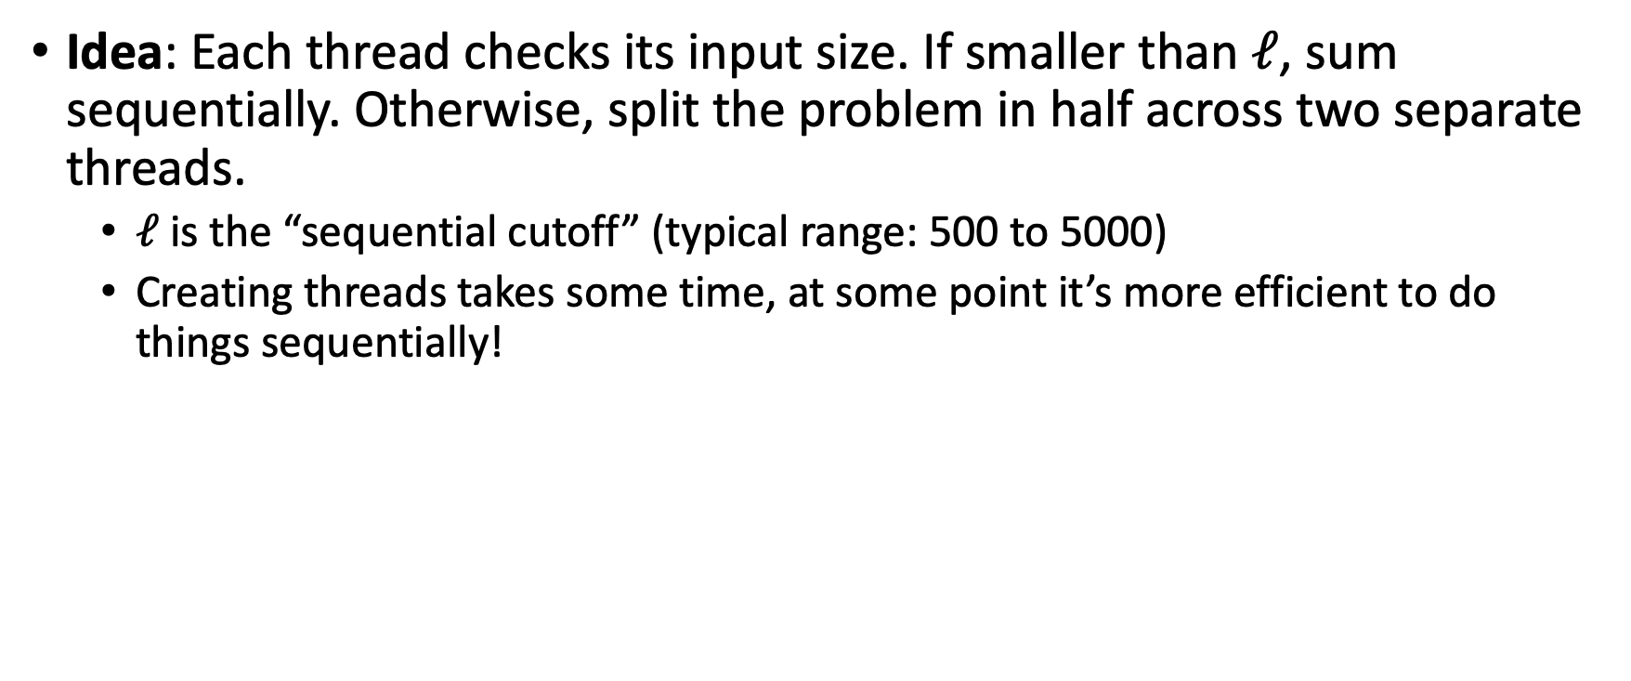

A Better Solution: Divide and Conquer!
Idea: Each thread checks its input size. If smaller than $ℓ$, sum sequentially. Otherwise, split the problem in half across two separate threads.
$ℓ$ is the “sequential cutoff” (typical range: 500 to 5000)
Creating threads takes some time, at some point it’s more efficient to do things sequentially!

Slide 17

Merge Sort
5
8
2
9
4
1
Base Case:
If the list is of length 1 or 0, it’s already sorted, so just return it
Divide:
Split the list into two “sublists” of (roughly) equal length
Conquer:
Sort both lists recursively
Combine:
Merge sorted sublists into one sorted list
5
5
8
2
9
4
1
2
5
8
1
4
9
2
5
8
1
4
9
1
2
4
5
8
9

Slide 18

Parallel Sum
5
8
2
9
4
1
5
Base Case:
If the list’s length is smaller than the Sequential Cutoff, find the sum sequentially
Divide:
Split the list into two “sublists” of (roughly) equal length, create a Thread to sum each sublist.
Conquer:
Call start() for each thread
Combine:
Sum together the answers from each thread
5
8
2
9
4
1
ans=15
ans=14
ans=29

Slide 19
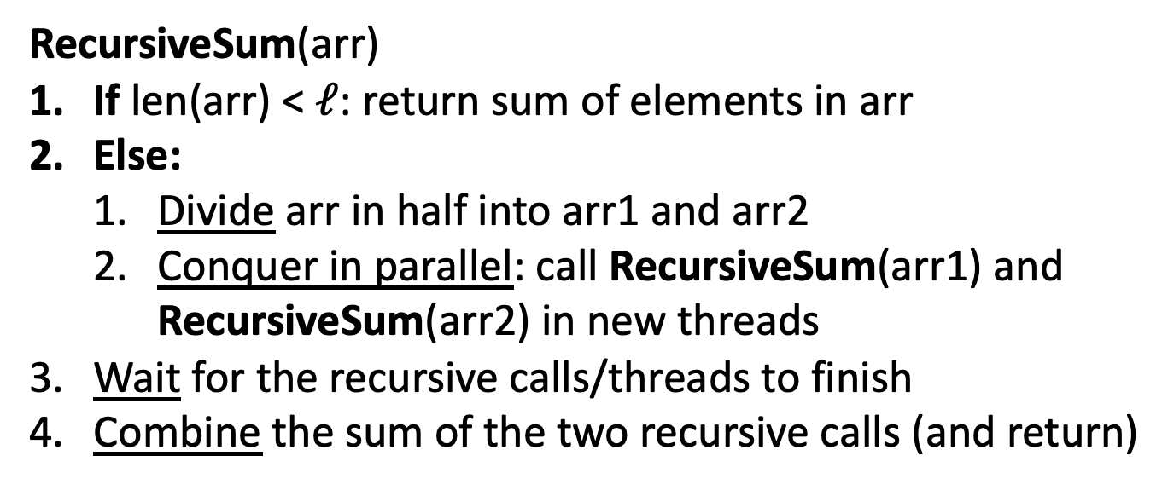

Parallel Divide and Conquer Pseudocode
RecursiveSum(arr)
If len(arr) < $ℓ$: return sum of elements in arr
Else:
Divide arr in half into arr1 and arr2
Conquer in parallel: call RecursiveSum(arr1) and RecursiveSum(arr2) in new threads
Wait for the recursive calls/threads to finish
Combine the sum of the two recursive calls (and return)

Slide 20

Divide and Conquer with Java Threads
class SumThread extends java.lang.Thread {
public void run(){ // override
if(hi – lo < SEQUENTIAL_CUTOFF) // “base case”
for(int i=lo; i < hi; i++) ans += arr[i];
else {
SumThread left = new SumThread(arr,lo,(hi+lo)/2); // divide
SumThread right= new SumThread(arr,(hi+lo)/2,hi); // divide
left.start(); right.start(); // conquer
left.join(); right.join(); // wait
ans = left.ans + right.ans; // combine
}
}
}
int sum(int[] arr){ // just make one thread!
SumThread t = new SumThread(arr,0,arr.length);
t.run();
return t.ans; }

Slide 21
Small optimization
Instead of calling two separate threads for the two subproblems, create one parallel thread (using start) and one sequential thread (using run)

Slide 22

Divide and Conquer with Threads (optimized)
class SumThread extends java.lang.Thread {
public void run(){ // override
if(hi – lo < SEQUENTIAL_CUTOFF) // “base case”
for(int i=lo; i < hi; i++) ans += arr[i];
else {
SumThread left = new SumThread(arr,lo,(hi+lo)/2); // divide
SumThread right= new SumThread(arr,(hi+lo)/2,hi); // divide
left.start(); // conquer in parallel in new thread
right.run(); // conquer in this thread
left.join(); // don’t move this up a line – why?
//right.join();
ans = left.ans + right.ans; // combine
}
}
}
int sum(int[] arr){ // just make one thread!
SumThread t = new SumThread(arr,0,arr.length);
t.run();
return t.ans; }

Slide 23

ForkJoin Framework
This strategy is common enough that Java (and C++, and C#, and…) provides a library to do it for you!
What you would do in Threads | What to instead in ForkJoin
Subclass Thread | Subclass RecursiveTask<V> (to return a value of type V) or RecursiveAction (for void return)
Override run | Override compute
Store the answer in a field | Return a V from compute
Call start | Call fork
join synchronizes only | join synchronizes and returns the answer
Call run to execute sequentially | Call compute to execute sequentially
Have a topmost thread and call run | Create a pool and call invoke

Slide 24

Divide and Conquer with ForkJoin
class SumTask extends RecursiveTask<Integer> {
int lo; int hi; int[] arr; // fields to know what to do
SumTask(int[] a, int l, int h) { … } // constructor
protected Integer compute(){ // return answer
if(hi – lo < SEQUENTIAL_CUTOFF) { // base case
int ans = 0; // local var, not a field
for(int i=lo; i < hi; i++) {
ans += arr[i]; return ans; }
else {
SumTask left = new SumTask(arr,lo,(hi+lo)/2); // divide
SumTask right= new SumTask(arr,(hi+lo)/2,hi); // divide
left.fork(); // conquer in parallel
int rightAns = right.compute(); // conquer in this thread
int leftAns = left.join(); // wait
return leftAns + rightAns; // combine
}
}
}

Slide 25

Divide and Conquer with ForkJoin (continued)
static final ForkJoinPool POOL = new ForkJoinPool();
static int parallelSum(int[] arr){
SumTask task = new SumTask(arr,0,arr.length)
return POOL.invoke(task); // invoke returns the value compute returns
}

Slide 26
Find Max with ForkJoin
class MaxTask extends RecursiveTask<Integer> {
int lo; int hi; int[] arr; // fields to know what to do
SumTask(int[] a, int l, int h) { … }
protected Integer compute(){// return answer
if(hi – lo < SEQUENTIAL_CUTOFF) { // base case
int ans = Integer.MIN_VALUE; // local var, not a field
for(int i=lo; i < hi; i++) {
ans = Math.max(ans, arr[i]);}
return ans;
else {
MaxTask left = new MaxTask(arr,lo,(hi+lo)/2); // divide
MaxTask right= new MaxTask(arr,(hi+lo)/2,hi); // divide
left.fork(); // fork a thread and calls compute (conquer)
int rightAns = right.compute(); //call compute directly (conquer)
int leftAns = left.join(); // get result from left
return Math.max(rightAns, leftAns); // combine
}
}
}

Slide 27
Other Problems that can be solved similarly
Element Search
Is the value 17 in the array?
Counting items with a certain property
How many elements of the array are divisible by 5?
Checking if the array is sorted
Find the smallest rectangle that covers all points in the array
Find the first thing that satisfies a property
What is the leftmost item that is divisible by 20?

Slide 28
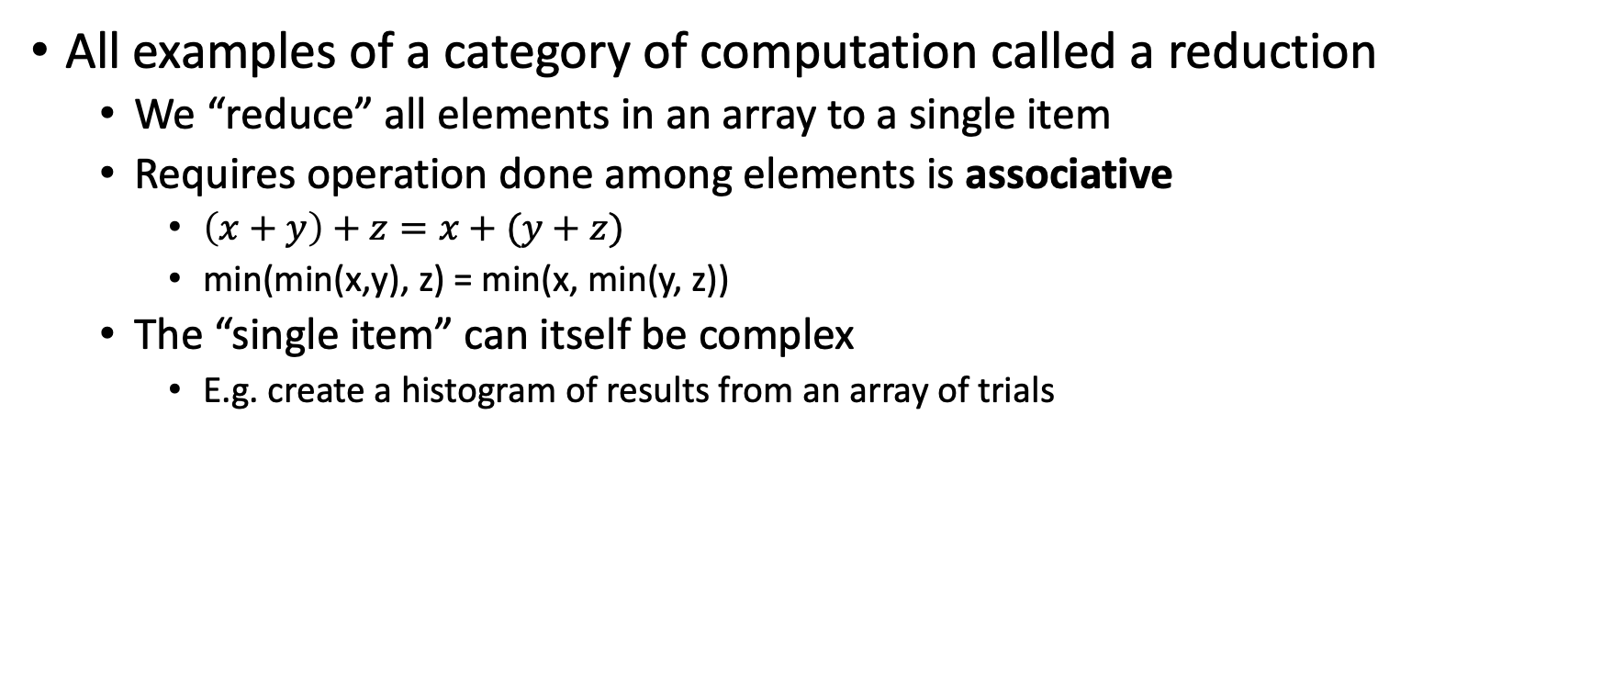
Reductions/Folds
All examples of a category of computation called a reduction
We “reduce” all elements in an array to a single item
Requires operation done among elements is associative
$\left(x+y\right)+z=x+(y+z)$
min(min(x,y), z) = min(x, min(y, z))
The “single item” can itself be complex
E.g. create a histogram of results from an array of trials

Slide 29
Map
New task: Apply a function (map) to each element of an array
Examples:
Vector addition:
sum[i] = arr1[i] + arr2[i]
Function application:
out[i] = f(arr[i]);
Observation: maps also parallelizable in the same way!
No need for combination step

Slide 30
Map with ForkJoin
class AddVecs extends RecursiveAction {
int lo; int hi; int[] arr; // fields to know what to do
AddVecs(int[] a, int[] b, int[] sum, int l, int h) { … }
protected void compute(){// return answer
if(hi – lo < SEQUENTIAL_CUTOFF) { // base case
for(int i=lo; i < hi; i++) {
sum[i] = a[i] + b[i];}
else {
AddTask left = new AddVecs(a,b,sum,lo,(hi+lo)/2); // divide
AddTask right= new AddVecs(a,b,sum,(hi+lo)/2,hi); // divide
left.fork(); // fork a thread and calls compute (conquer)
right.compute(); //call compute directly (conquer)
left.join(); // wait for thread to finish
return; // combine
}
}
}

Slide 31
Map with ForkJoin (continued)
static final ForkJoinPool POOL = new ForkJoinPool();
int[] add(int[] a, int[] b){
int[] ans = new int[a.length];
AddVecs task = new AddVecs(a, b, ans, 0, a.length)
POOL.invoke(task);
return ans;
}

Slide 32
Maps and Reductions
“Workhorse” constructs in parallel programming
Many problems can be written in terms of maps and reductions
With practice, writing them will become second nature
Like how over time for loops and if statements have gotten easier

Slide 33
Section
Working with examples of ForkJoin
Make sure to bring your laptops!
And charge it!

