Slide 1
CSE 332 Winter 2026
Lecture 5: Priority Queues
Nathan Brunelle
http://www.cs.uw.edu/332

Slide 2
ADT: Priority Queue
What is it?
  A collection of items and their “priorities”
  Allows quick access/removal to the “top priority” thing
    Usually a smaller priority value means the item is “more important”
What Operations do we need?
  insert(item, priority)
    Add a new item to the PQ with indicated priority
  extract
    Remove and return the “top priority” item from the queue
      Usually the item with the smallest priority value
  IsEmpty
    Indicate whether or not there are items still on the queue
Note: the “priority” value can be any type/class so long as it’s comparable (i.e. you can use “<“ or “compareTo” with it)

Slide 3
Applications?
ER
Operating systems allocating resources
Allocation of power to devices on a vehicle
Homework
Airplane boarding

Slide 4
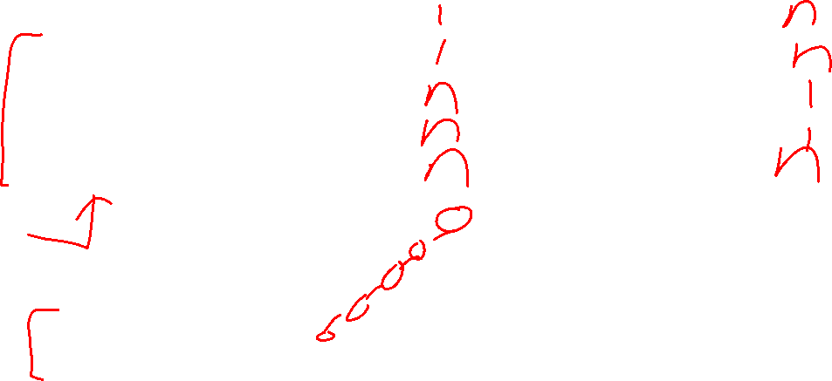
Thinking through implementations
Data Structure | Worst case time to insert | Worst case time to extract
Unsorted Array
Unsorted Linked List
Sorted Array
Sorted Linked List
Binary Search Tree
For simplicity, Assume we know the maximum size of the PQ in advance (otherwise we’d do an amortized analysis, but get the same answers…)

Slide 5
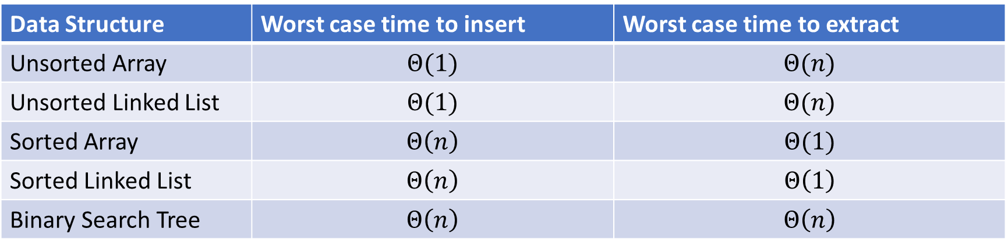
Thinking through implementations
Data Structure | Worst case time to insert | Worst case time to extract
Unsorted Array | $$Θ(1)$$ | $$Θ(n)$$
Unsorted Linked List | $$Θ(1)$$ | $$Θ(n)$$
Sorted Array | $$Θ\left(n\right)$$ | $$Θ(1)$$
Sorted Linked List | $$Θ\left(n\right)$$ | $$Θ\left(1\right)$$
Binary Search Tree | $$Θ\left(n\right)$$ | $$Θ\left(n\right)$$
For simplicity, Assume we know the maximum size of the PQ in advance (otherwise we’d do an amortized analysis, but get the same answers…)

Slide 6
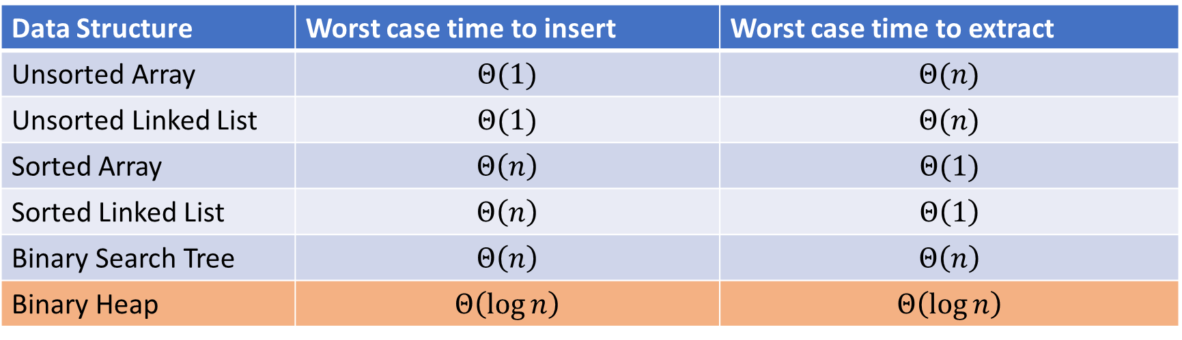
Thinking through implementations
Data Structure | Worst case time to insert | Worst case time to extract
Unsorted Array | $$Θ(1)$$ | $$Θ(n)$$
Unsorted Linked List | $$Θ(1)$$ | $$Θ(n)$$
Sorted Array | $$Θ\left(n\right)$$ | $$Θ(1)$$
Sorted Linked List | $$Θ\left(n\right)$$ | $$Θ\left(1\right)$$
Binary Search Tree | $$Θ\left(n\right)$$ | $$Θ\left(n\right)$$
Binary Heap | $$Θ\left(\log{n}\right)$$ | $$Θ\left(\log{n}\right)$$
For simplicity, Assume we know the maximum size of the PQ in advance (otherwise we’d do an amortized analysis, but get the same answers…)

Slide 7

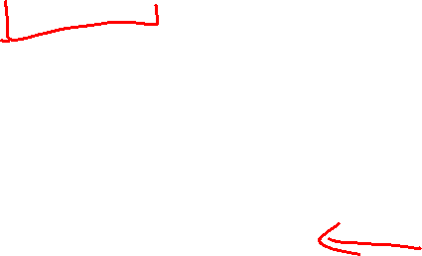
Trees for Heaps
Binary Trees:
  The branching factor is 2
  Every node has $≤$ 2 children
Complete Tree:
  All “layers” are full, except the bottom
  Bottom layer filled left-to-right
1
3
2
4
7
5
6
5
9

Slide 8

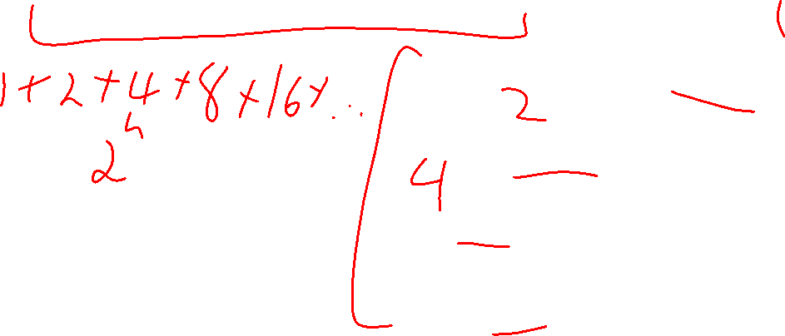
Priority Queue Data Structure – Heap Idea
Idea: Maintain a limited amount of order
$Θ(\log{n})$ worst case for extract and insert
1
3
2
4
7
5
6
5
9

Slide 9
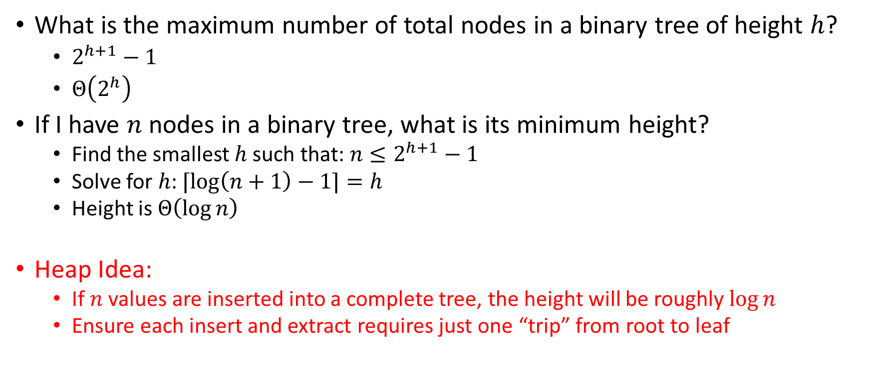

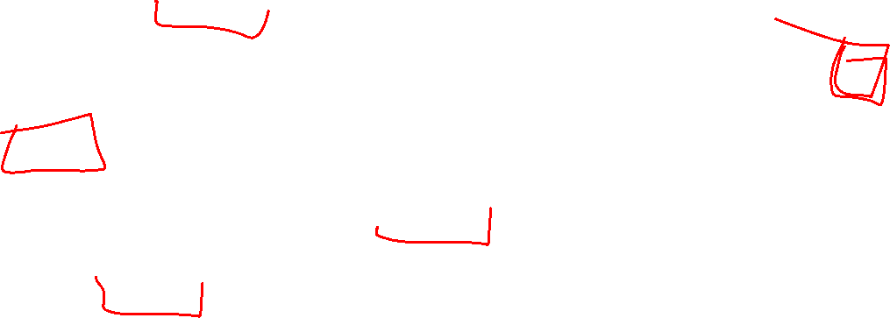
Achieving $\log{n}$ Running Time
What is the maximum number of total nodes in a binary tree of height $h$?
  $2^{h+1}−1$
  $Θ\left(2^{h}\right)$
If I have $n$ nodes in a binary tree, what is its minimum height?
  Find the smallest $h$ such that: $n≤2^{h+1}−1$
  Solve for $h$: $⌈\log\left(n+1\right)−1⌉=h$
  Height is $Θ\left(\log{n}\right)$
Heap Idea:
  If $n$ values are inserted into a complete tree, the height will be roughly $\log{n}$
  Ensure each insert and extract requires just one “trip” from root to leaf

Slide 10
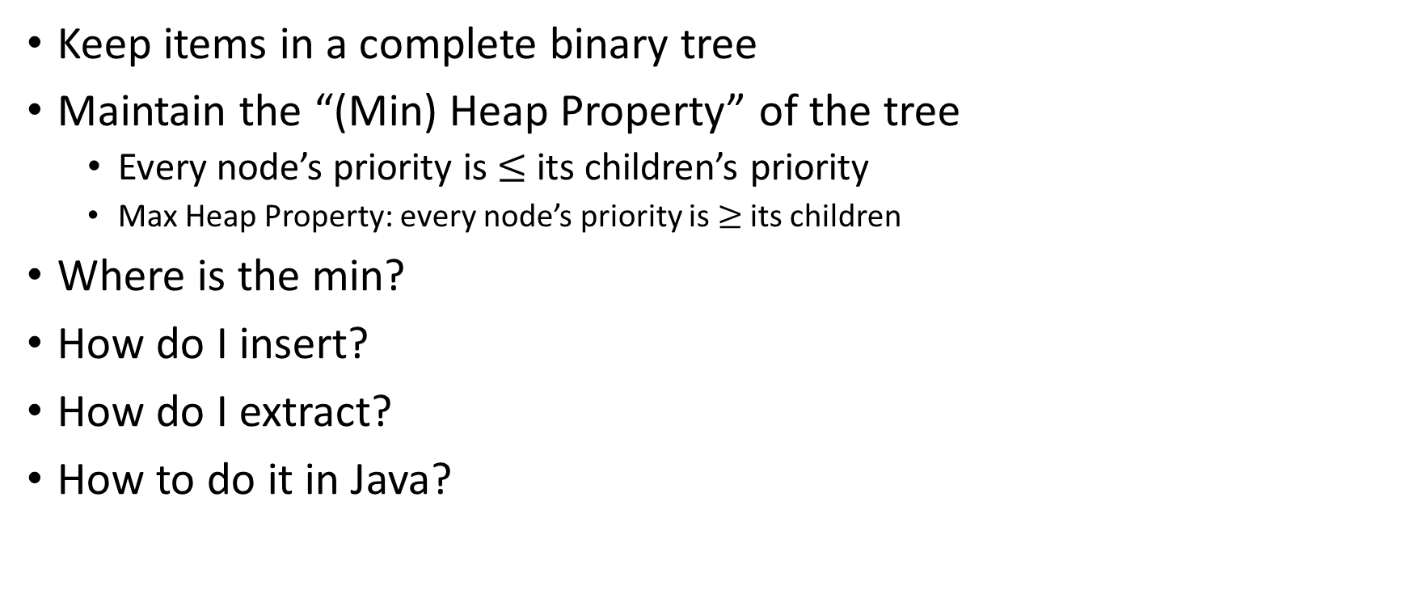
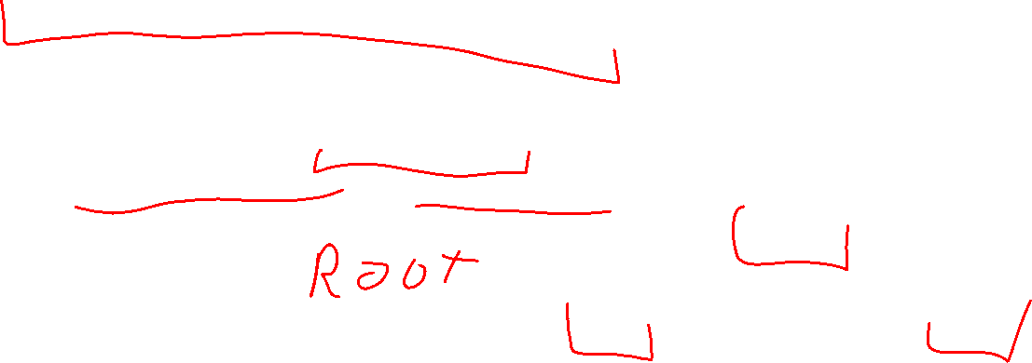
(Min) Heap Data Structure
Keep items in a complete binary tree
Maintain the “(Min) Heap Property” of the tree
  Every node’s priority is $≤$ its children’s priority
  Max Heap Property: every node’s priority is $≥$ its children
Where is the min?
How do I insert?
How do I extract?
How to do it in Java?
1
3
2
4
7
5
6
5
9

Slide 11

Heap Insert
1
1.5
3
2
4
7
5
6
5
9
insert(item, priority){
put item in the “next open” spot (keep tree complete)
while (priority < parent’s priority){
swap item with parent
}
}

Slide 12
Heap Insert
1
3
2
4
7
5
6
5
9
1.5
insert(item, priority){
put item in the “next open” spot (keep tree complete)
while (priority < parent’s priority){
swap item with parent
}
}

Slide 13
Heap Insert
1
3
2
4
1.5
5
6
5
9
7
insert(item, priority){
put item in the “next open” spot (keep tree complete)
while (priority < parent’s priority){
swap item with parent
}
}
Percolate Up

Slide 14

Heap Insert
1
1.5
2
4
3
5
6
5
9
7
insert(item, priority){
put item in the “next open” spot (keep tree complete)
while (priority < parent’s priority){
swap item with parent
}
}
Percolate Up

Slide 15
Heap Insert
1
1.5
2
4
3
5
6
5
9
7
insert(item, priority){
put item in the “next open” spot (keep tree complete)
while (priority < parent’s priority){
swap item with parent
}
}

Slide 16
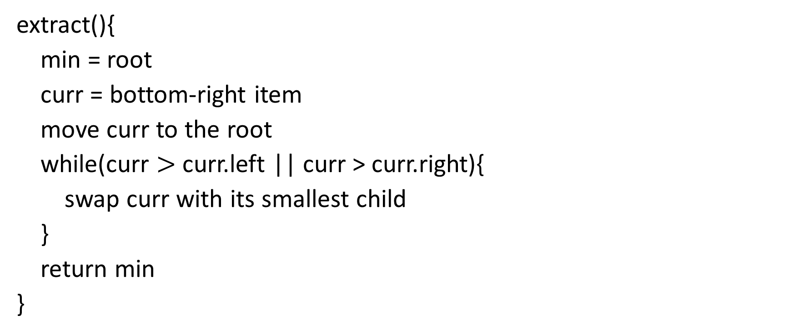
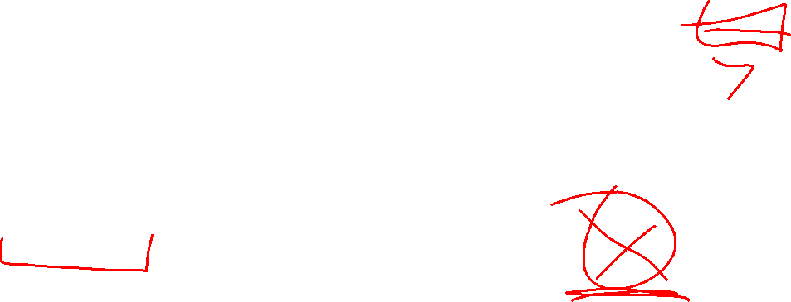
Heap extract
1
1.5
2
4
3
5
6
extract(){
min = root
curr = bottom-right item
move curr to the root
while(curr $>$ curr.left || curr > curr.right){
swap curr with its smallest child
}
return min
}
5
9
7

Slide 17
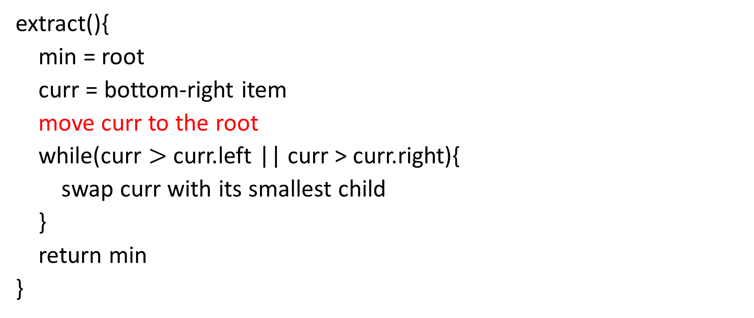

Heap extract
7
1.5
2
4
3
5
6
extract(){
min = root
curr = bottom-right item
move curr to the root
while(curr $>$ curr.left || curr > curr.right){
swap curr with its smallest child
}
return min
}
5
9
7

Slide 18
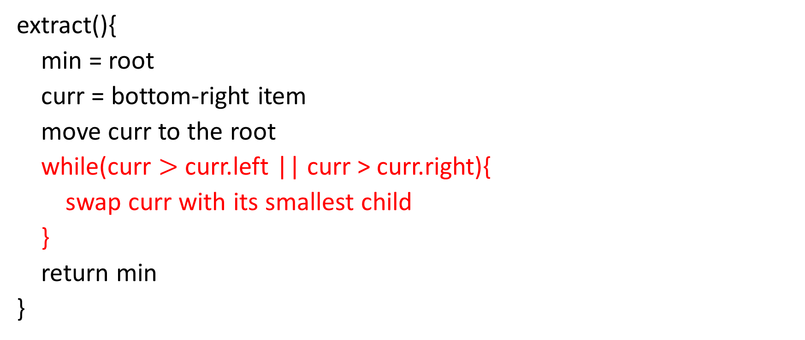
Heap extract
1.5
7
2
4
3
5
6
extract(){
min = root
curr = bottom-right item
move curr to the root
while(curr $>$ curr.left || curr > curr.right){
swap curr with its smallest child
}
return min
}
5
9
Percolate Down

Slide 19
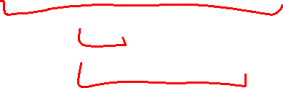
Heap extract
1.5
3
2
4
7
5
6
extract(){
min = root
curr = bottom-right item
move curr to the root
while(curr $>$ curr.left || curr > curr.right){
swap curr with its smallest child
}
return min
}
5
9
Percolate Down

Slide 20
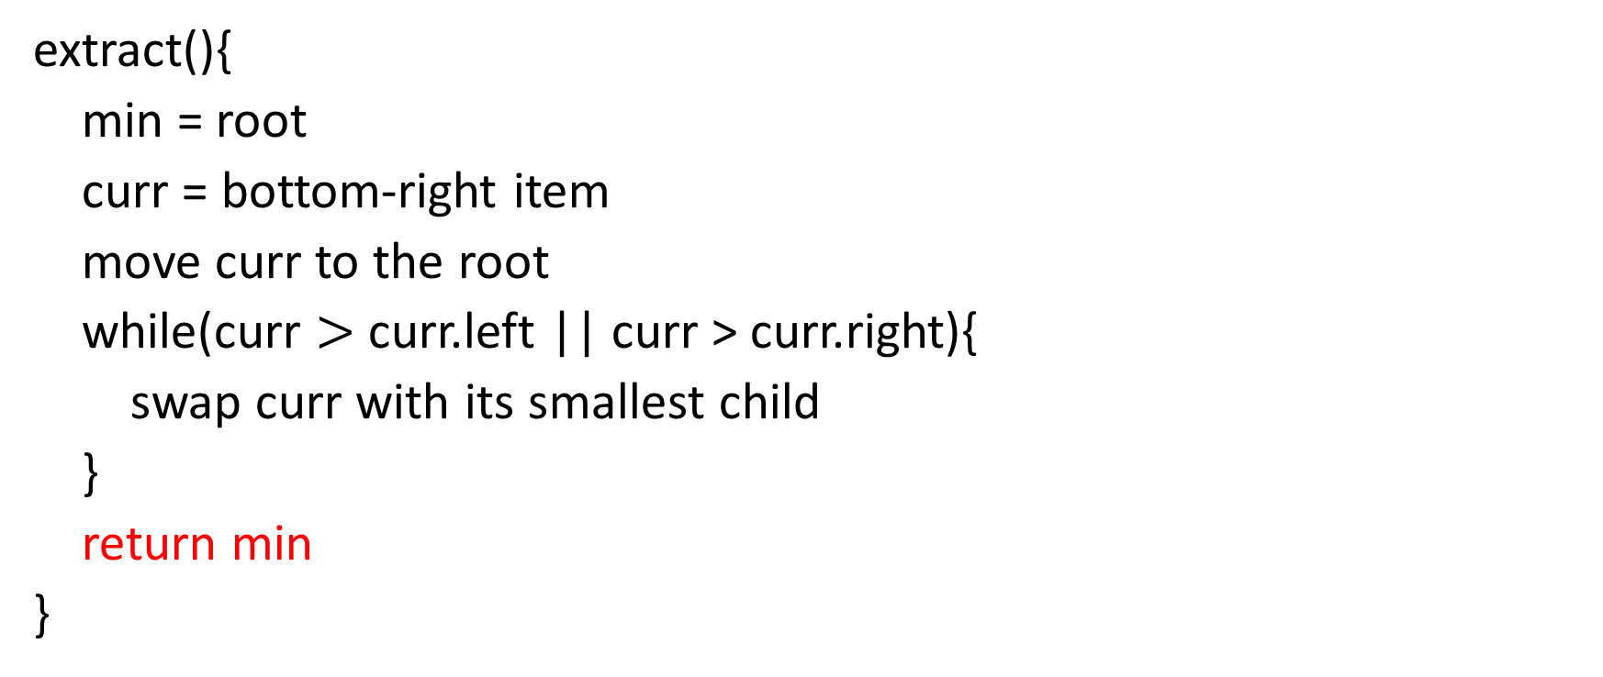
Heap extract
1.5
3
2
4
7
5
6
extract(){
min = root
curr = bottom-right item
move curr to the root
while(curr $>$ curr.left || curr > curr.right){
swap curr with its smallest child
}
return min
}
5
9

Slide 21
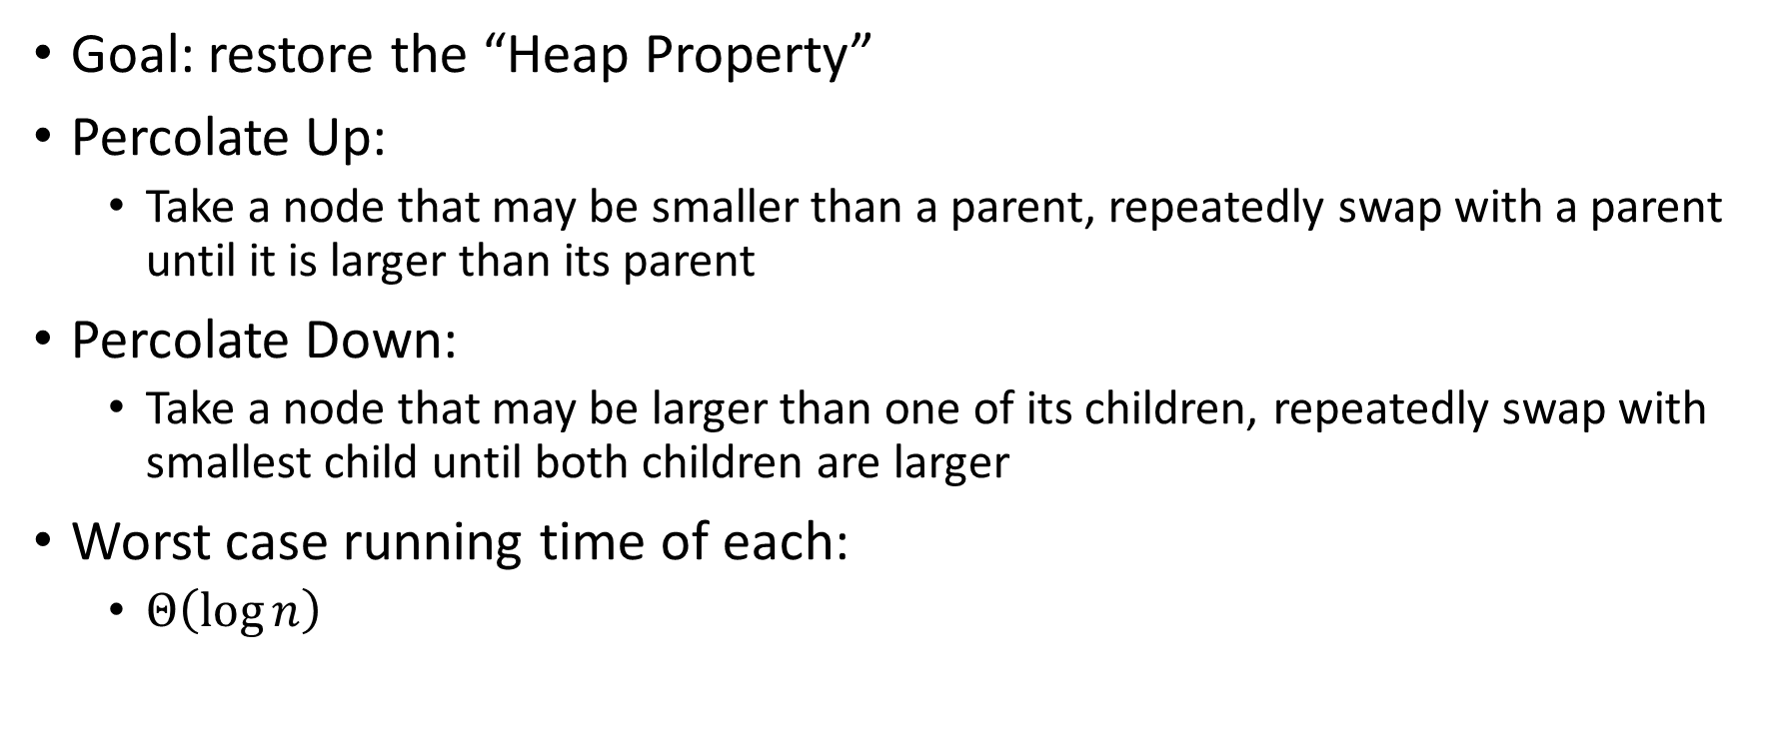
Percolate Up and Down (for a Min Heap)
Goal: restore the “Heap Property”
Percolate Up:
  Take a node that may be smaller than a parent, repeatedly swap with a parent until it is larger than its parent
Percolate Down:
  Take a node that may be larger than one of its children, repeatedly swap with smallest child until both children are larger
Worst case running time of each:
  $Θ\left(\log{n}\right)$

Slide 22
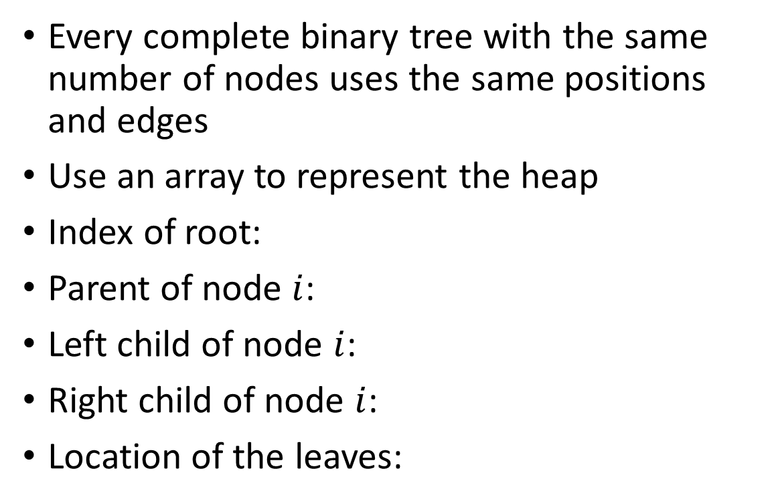
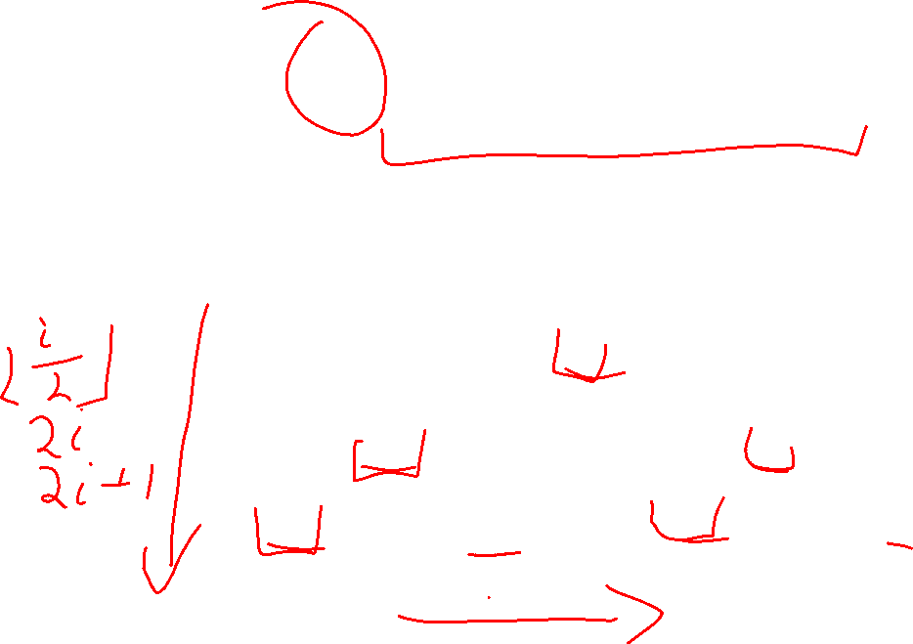
Representing a Heap
1
3
2
4
7
5
6
5
9
0
1
2
3
4
5
6
7
8
9
Every complete binary tree with the same number of nodes uses the same positions and edges
Use an array to represent the heap
Index of root:
Parent of node $i$:
Left child of node $i$:
Right child of node $i$:
Location of the leaves:
1
1
3
2
4
2
7
5
3
6
4
5
6
7
5
9
8
9

Slide 23
Insert Pseudocode
1
3
2
4
7
5
6
5
9
For simplicity, assume is the same as priority
0
1
2
3
4
5
6
7
8
9
10
insert(item){
if(size == arr.length – 1){resize();}
size++;
arr[size] = item;
percolateUp(size)
}
1
1
3
2
4
2
7
5
3
6
4
5
6
7
5
9
8
9

Slide 24
Percolate Up
percolateUp(int i){
int parent = i/2; \\ index of parent
Item val = arr[i]; \\ value at current location
while(i > 1 && arr[i] < arr[parent]){ \\ until location is root or heap property holds
arr[i] = arr[parent]; \\ move parent value to this location
arr[parent] = val; \\ put current value into parent’s location
i = parent; \\ make current location the parent
parent = i/2; \\ update new parent
}
}

Slide 25
extract Pseudocode
extract(){
theMin = arr[1];
arr[1] = arr[size];
size--;
percolateDown(1);
return theMin;
}

Slide 26
Percolate Down
percolateDown(int i){
int left = i*2; \\ index of left child
int right = i*2+1; \\ index of right child
Item val = arr[i]; \\ value at location
while(left <= size){ \\ until location is leaf
int toSwap = right;
if(right > size || arr[left] < arr[right]){ \\ if there is no right child or if left child is smaller
toSwap = left; \\ swap with left
} \\ now toSwap has the smaller of left/right, or left if right does not exist
if (arr[toSwap] < val){ \\ if the smaller child is less than the current value
arr[i] = arr[toSwap];
arr[toSwap] = val; \\ swap parent with smaller child
i = toSwap; \\ update current node to be smaller child
left = i*2;
right = i*2+1;
}
else{ return;} \\ if we don’t swap, then heap property holds
}
}

Slide 27
Other Operations
Increase Key
  Given the index of an item in the PQ, make its priority value larger
    Min Heap: Then percolate down
    Max Heap: Then percolate up
Decrease Key
  Given the index of an item in the PQ, make its priority value smaller
    Min Heap: Then percolate up
    Max Heap: Then percolate down
Remove
  Given the item at the given index from the PQ

Slide 28

Building a Heap From “Scratch”
Suppose we had $n$ items and wanted to “heapify” them
5
5
6
10
3
15
8
7
14
2
1
Violate Heap Property!
1
0
1
2
3
4
5
6
7
8
9
10
6
10
3
2
15
8
3
7
Two ways for “fix” the heap:
Percolate Up
Percolate Down
4
5
6
7
14
2
1
8
9
10

Slide 29
Floyd’s buildHeap method
Working towards the root, one row at a time, percolate down
buildHeap(){
for(int i = size; i>0; i--){
percolateDown(i);
}
}

Slide 30
Floyd’s buildHeap method
Suppose we had $n$ items and wanted to “heapify” them
Violate Heap Property!
Nodes bigger than a child
5
5
6
10
3
15
8
7
14
2
1
1
0
1
2
3
4
5
6
7
8
9
10
6
10
3
2
8
3
7
buildHeap(){
for(int i = size; i>0; i--){
percolateDown(i);
}
}
15
4
5
6
7
14
2
1
8
9
10

Slide 31
Floyd’s buildHeap method
Suppose we had $n$ items and wanted to “heapify” them
Violate Heap Property!
Nodes bigger than a child
5
5
6
10
3
15
8
7
14
2
1
1
0
1
2
3
4
5
6
7
8
9
10
6
10
3
2
8
3
7
buildHeap(){
for(int i = size; i>0; i--){
percolateDown(i);
}
}
1
4
5
6
7
14
2
15
8
9
10

Slide 32
Floyd’s buildHeap method
Suppose we had $n$ items and wanted to “heapify” them
5
5
6
10
3
15
8
7
14
2
1
Violate Heap Property!
1
0
1
2
3
4
5
6
7
8
9
10
6
10
2
2
8
3
7
buildHeap(){
for(int i = size; i>0; i--){
percolateDown(i);
}
}
1
4
5
6
7
14
3
15
8
9
10

Slide 33
Floyd’s buildHeap method
Suppose we had $n$ items and wanted to “heapify” them
5
5
6
10
3
15
8
7
14
2
1
Violate Heap Property!
1
0
1
2
3
4
5
6
7
8
9
10
6
7
2
2
8
3
10
buildHeap(){
for(int i = size; i>0; i--){
percolateDown(i);
}
}
1
4
5
6
7
14
3
15
8
9
10

Slide 34
Floyd’s buildHeap method
Suppose we had $n$ items and wanted to “heapify” them
5
5
6
10
3
15
8
7
14
2
1
Violate Heap Property!
1
0
1
2
3
4
5
6
7
8
9
10
1
7
2
2
8
3
10
buildHeap(){
for(int i = size; i>0; i--){
percolateDown(i);
}
}
6
4
5
6
7
14
3
15
8
9
10

Slide 35
Floyd’s buildHeap method
Suppose we had $n$ items and wanted to “heapify” them
1
5
6
10
3
15
8
7
14
2
1
Violate Heap Property!
1
0
1
2
3
4
5
6
7
8
9
10
2
7
3
2
8
3
10
buildHeap(){
for(int i = size; i>0; i--){
percolateDown(i);
}
}
6
4
5
6
7
14
5
15
8
9
10

Slide 36
How long did this take?
buildHeap(){
for(int i = size; i>0; i--){
percolateDown(i);
}
}
Worst case running time of buildHeap:
No node can percolate down more than the height of its subtree
  When i is a leaf:
  When i is second-from-last level:
  When i is third-from-last level:
Overall Running time:

