Slide 1
CSE 332 Summer 2024
Lecture 5: Priority Queues
Nathan Brunelle
http://www.cs.uw.edu/332

Slide 2

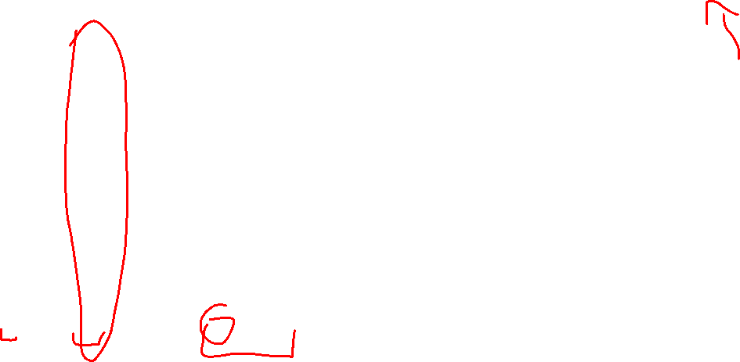


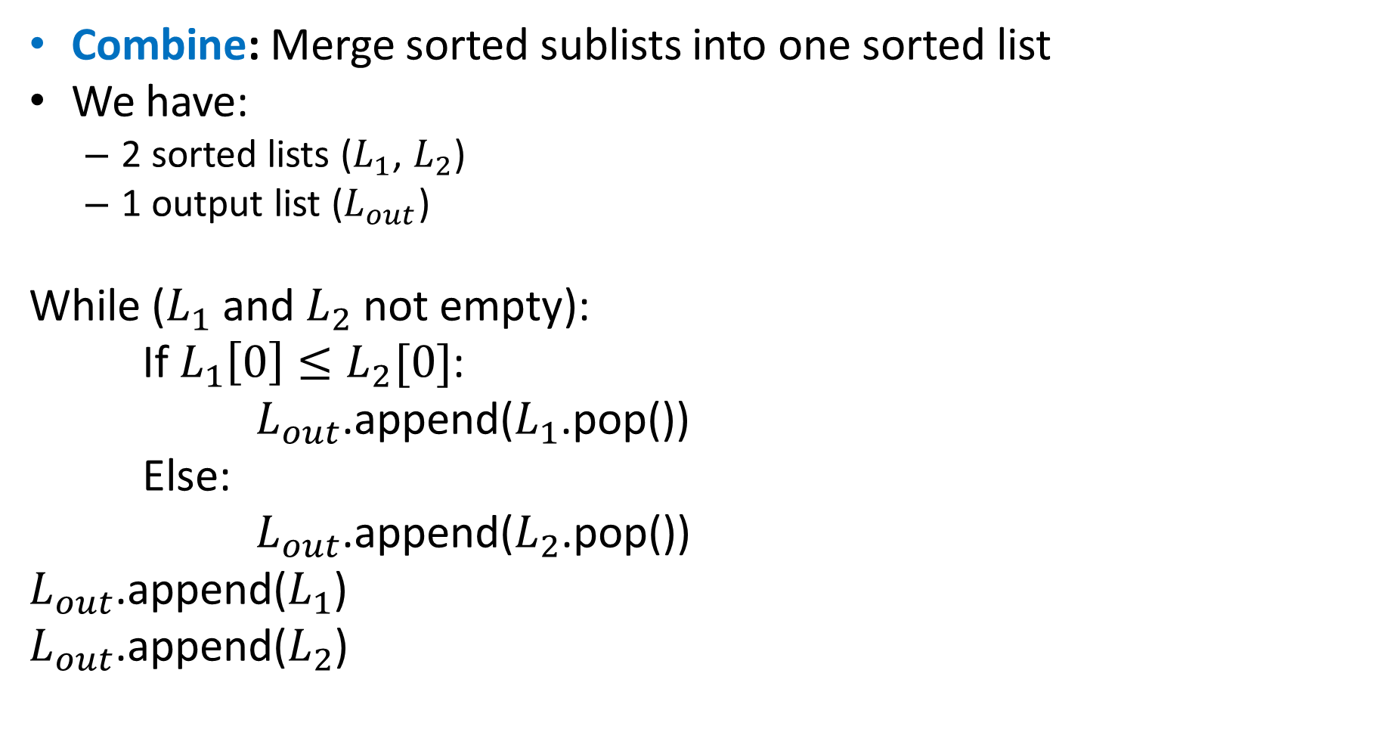
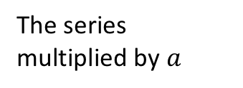

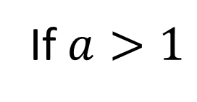



Finite Geometric Series
$$\sum_{i=0}^{L}{a^{i}}$$
If $a>1$
$$−$$
$$−$$
$$=$$
The series multiplied by $a$
The next term in the series
The series
The first term
$$\left(1+a+a^{2}+…+a^{L}\right)a$$
$$\left(1+a+a^{2}+…+a^{L}\right)1$$
$$a^{L+1}$$
$$1$$

Slide 3
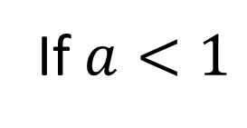
Finite Geometric Series
$$\sum_{i=0}^{L}{a^{i}}$$
If $a<1$
$$−$$
$$−$$
$$=$$
The series multiplied by $a$
The next term in the series
The series
The first term
$$\left(1+a+a^{2}+…+a^{L}\right)a$$
$$\left(1+a+a^{2}+…+a^{L}\right)1$$
$$a^{L+1}$$
$$1$$
Solve for the series

Slide 4
ADT: Queue
What is it?
  A “First In First Out” (FIFO) collection of items
What Operations do we need?
  Enqueue
    Add a new item to the queue
  Dequeue
    Remove the “oldest” item from the queue
  IsEmpty
    Indicate whether or not there are items still on the queue

Slide 5
ADT: Priority Queue
What is it?
  A collection of items and their “priorities”
  Allows quick access/removal to the “top priority” thing
    Usually a smaller priority value means the item is “more important”
What Operations do we need?
  insert(item, priority)
    Add a new item to the PQ with indicated priority
  extract
    Remove and return the “top priority” item from the queue
      Usually the item with the smallest priority value
  IsEmpty
    Indicate whether or not there are items still on the queue
Note: the “priority” value can be any type/class so long as it’s comparable (i.e. you can use “<“ or “compareTo” with it)

Slide 6
Priority Queue, example
PriorityQueue PQ = new PriorityQueue();
PQ.insert(5,5)
PQ.insert(6,6)
PQ.insert(1,1)
PQ.insert(3,3)
PQ.insert(8,8) // PQ has 5, 6, 3, and 8
Print(PQ.extract()) // 1
Print(PQ.extract()) // 3
Print(PQ.extract()) // 5
Print(PQ.extract()) // 6
Print(PQ.extract()) // 8

Slide 7
Priority Queue, example
PriorityQueue PQ = new PriorityQueue();
PQ.insert(5,5)
PQ.insert(6,6)
PQ.insert(1,1) // 5, 6, 1
Print(PQ.extract()) // 1
PQ.insert(3,3) // 5, 6, 3
Print(PQ.extract()) // 3
Print(PQ.extract()) // 5
PQ.insert(8,8) // 6, 8
Print(PQ.extract()) // 6
Print(PQ.extract()) // 8

Slide 8
Applications?
ER
Sorting
Corrupt restaurant
Restaurants with reservations
Presales – priority registration
Operating systems – managing tasks
Airline boarding
Distributing tasks
Huffman

Slide 9
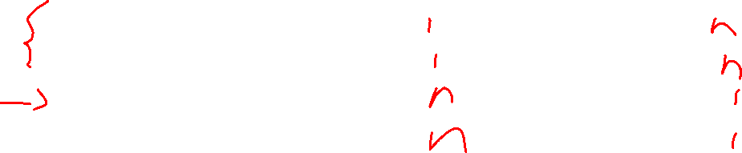
Thinking through implementations
Data Structure | Worst case time to insert | Worst case time to extract
Unsorted Array
Unsorted Linked List
Sorted Array
Sorted Linked List
Binary Search Tree
For simplicity, Assume we know the maximum size of the PQ in advance (otherwise we’d do an amortized analysis, but get the same answers…)

Slide 10
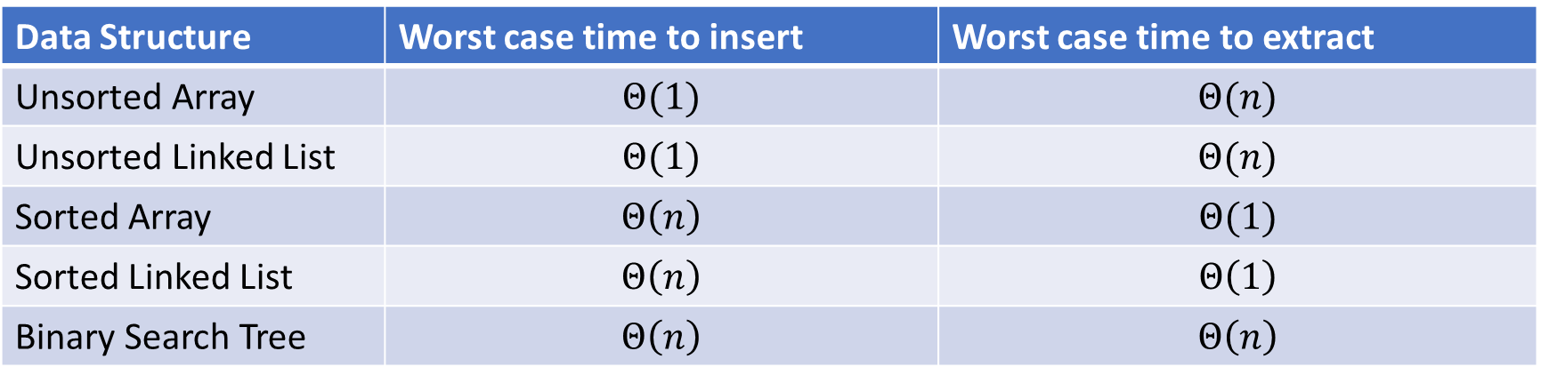
Thinking through implementations
Data Structure | Worst case time to insert | Worst case time to extract
Unsorted Array | $$Θ(1)$$ | $$Θ(n)$$
Unsorted Linked List | $$Θ(1)$$ | $$Θ(n)$$
Sorted Array | $$Θ\left(n\right)$$ | $$Θ(1)$$
Sorted Linked List | $$Θ\left(n\right)$$ | $$Θ\left(1\right)$$
Binary Search Tree | $$Θ\left(n\right)$$ | $$Θ\left(n\right)$$
For simplicity, Assume we know the maximum size of the PQ in advance (otherwise we’d do an amortized analysis, but get the same answers…)

Slide 11
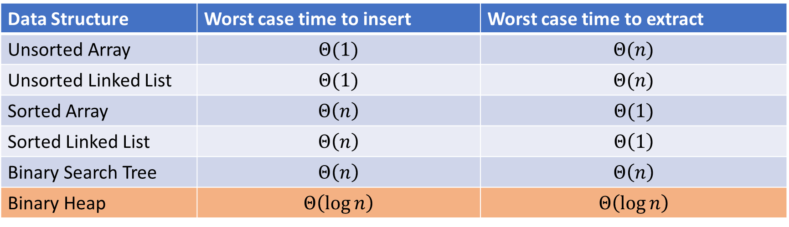
Thinking through implementations
Data Structure | Worst case time to insert | Worst case time to extract
Unsorted Array | $$Θ(1)$$ | $$Θ(n)$$
Unsorted Linked List | $$Θ(1)$$ | $$Θ(n)$$
Sorted Array | $$Θ\left(n\right)$$ | $$Θ(1)$$
Sorted Linked List | $$Θ\left(n\right)$$ | $$Θ\left(1\right)$$
Binary Search Tree | $$Θ\left(n\right)$$ | $$Θ\left(n\right)$$
Binary Heap | $$Θ\left(\log{n}\right)$$ | $$Θ\left(\log{n}\right)$$
For simplicity, Assume we know the maximum size of the PQ in advance (otherwise we’d do an amortized analysis, but get the same answers…)

Slide 12


Trees for Heaps
Binary Trees:
  The branching factor is 2
  Every node has $≤$ 2 children
Complete Tree:
  All “layers” are full, except the bottom
  Bottom layer filled left-to-right
1
3
2
4
7
5
6
5
9

Slide 13

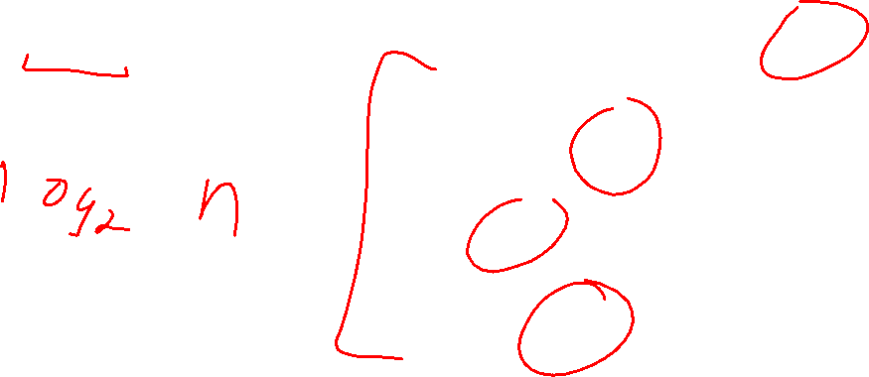
Heap – Priority Queue Data Structure
Idea: We need to keep some ordering, but it doesn’t need to be entirely sorted
$Θ(\log{n})$ worst case for extract and insert
1
3
2
4
7
5
6
5
9

Slide 14

Heap – Priority Queue Data Structure
Idea: We need to keep some ordering, but it doesn’t need to be entirely sorted
$Θ(\log{n})$ worst case for extract and insert
1
1
3
2
4
2
7
5
3
6
4
5
6
7
5
9
8
9

Slide 15
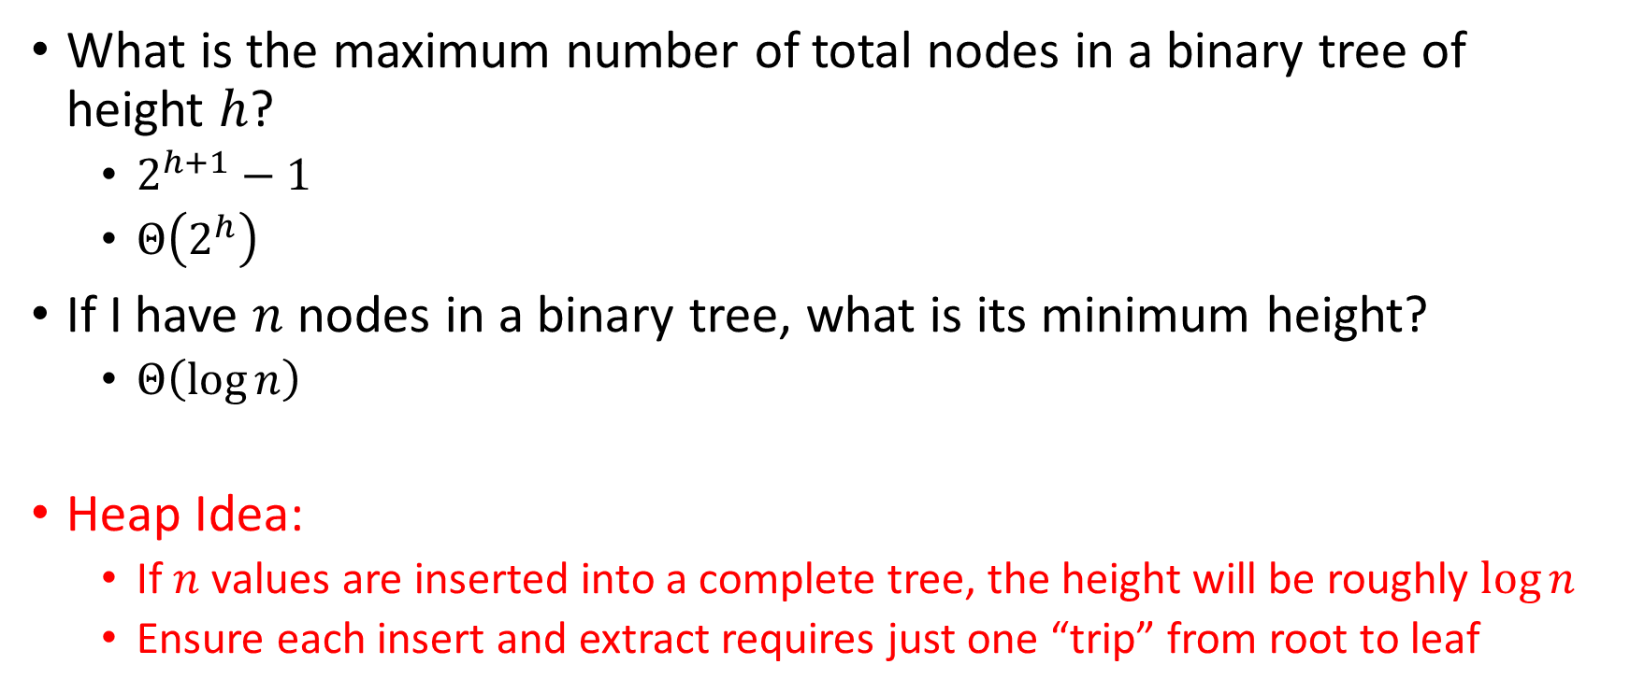
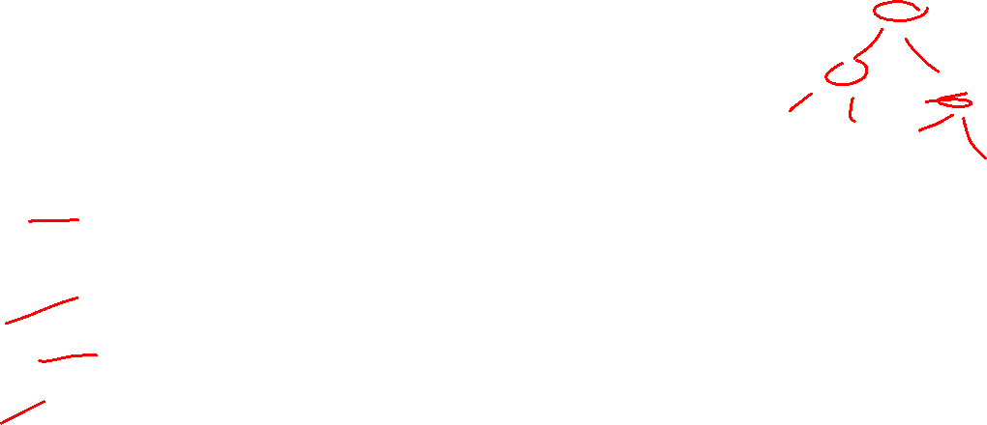
Challenge!
What is the maximum number of total nodes in a binary tree of height $h$?
  $2^{h+1}−1$
  $Θ\left(2^{h}\right)$
If I have $n$ nodes in a binary tree, what is its minimum height?
  $Θ\left(\log{n}\right)$
Heap Idea:
  If $n$ values are inserted into a complete tree, the height will be roughly $\log{n}$
  Ensure each insert and extract requires just one “trip” from root to leaf

Slide 16
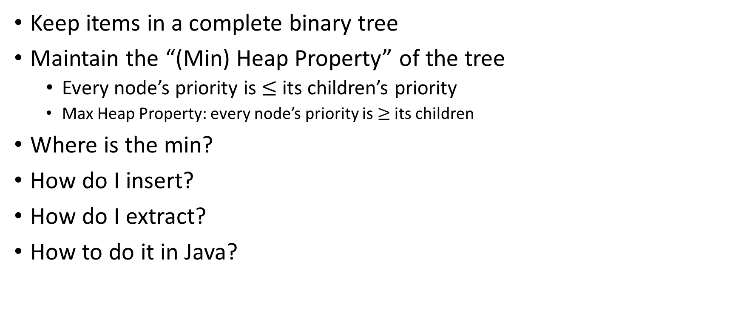
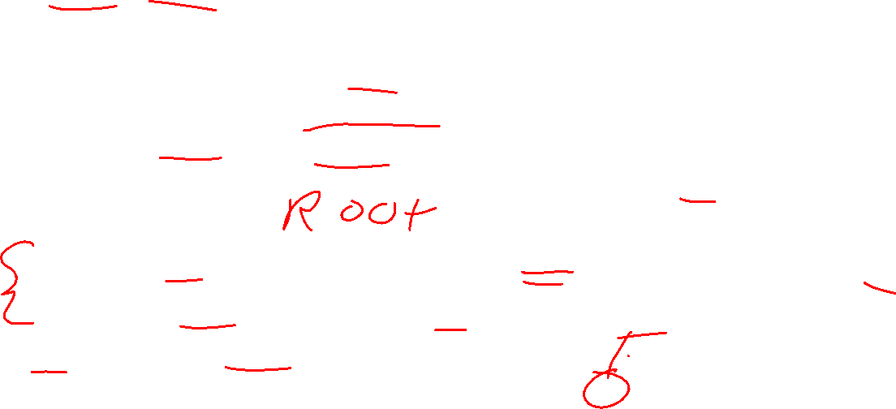
(Min) Heap Data Structure
Keep items in a complete binary tree
Maintain the “(Min) Heap Property” of the tree
  Every node’s priority is $≤$ its children’s priority
  Max Heap Property: every node’s priority is $≥$ its children
Where is the min?
How do I insert?
How do I extract?
How to do it in Java?
1
3
2
4
7
5
6
5
9

Slide 17

Heap Insert
1
1.5
3
2
4
7
5
6
5
9
insert(item, priority){
put item in the “next open” spot (keep tree complete)
while (priority < parent’s priority){
swap item with parent
}
}

Slide 18
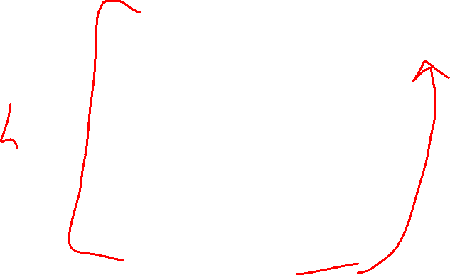
Heap Insert
1
3
2
4
7
5
6
5
9
1.5
insert(item, priority){
put item in the “next open” spot (keep tree complete)
while (priority < parent’s priority){
swap item with parent
}
}

Slide 19

Heap Insert
1
3
2
4
1.5
5
6
5
9
7
insert(item, priority){
put item in the “next open” spot (keep tree complete)
while (priority < parent’s priority){
swap item with parent
}
}
Percolate Up

Slide 20

Heap Insert
1
1.5
2
4
3
5
6
5
9
7
insert(item, priority){
put item in the “next open” spot (keep tree complete)
while (priority < parent’s priority){
swap item with parent
}
}
Percolate Up

Slide 21
Heap Insert
1
1.5
2
4
3
5
6
5
9
7
insert(item, priority){
put item in the “next open” spot (keep tree complete)
while (priority < parent’s priority){
swap item with parent
}
}

Slide 22
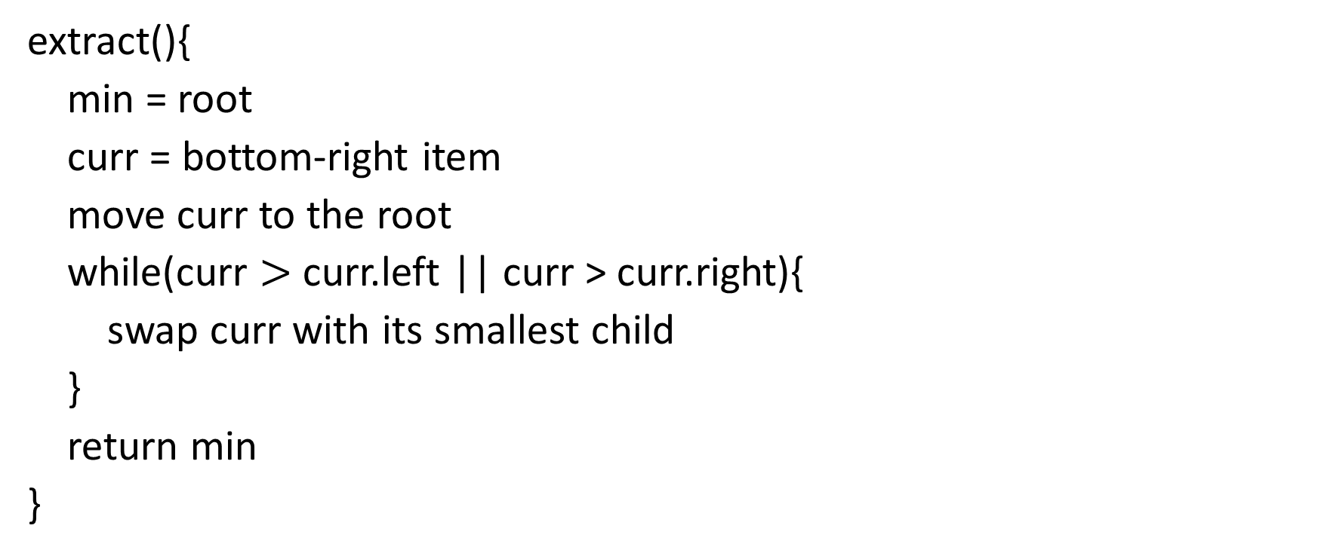

Heap extract
1
1.5
2
4
3
5
6
extract(){
min = root
curr = bottom-right item
move curr to the root
while(curr $>$ curr.left || curr > curr.right){
swap curr with its smallest child
}
return min
}
5
9
7

Slide 23
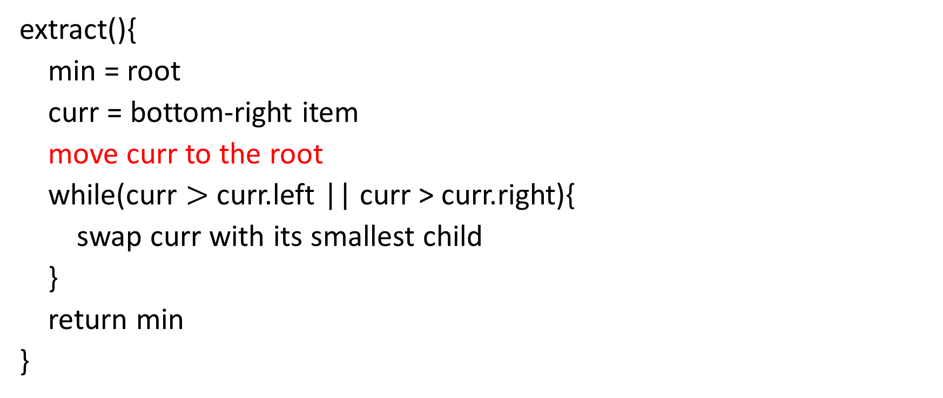

Heap extract
7
1.5
2
4
3
5
6
extract(){
min = root
curr = bottom-right item
move curr to the root
while(curr $>$ curr.left || curr > curr.right){
swap curr with its smallest child
}
return min
}
5
9
7

Slide 24
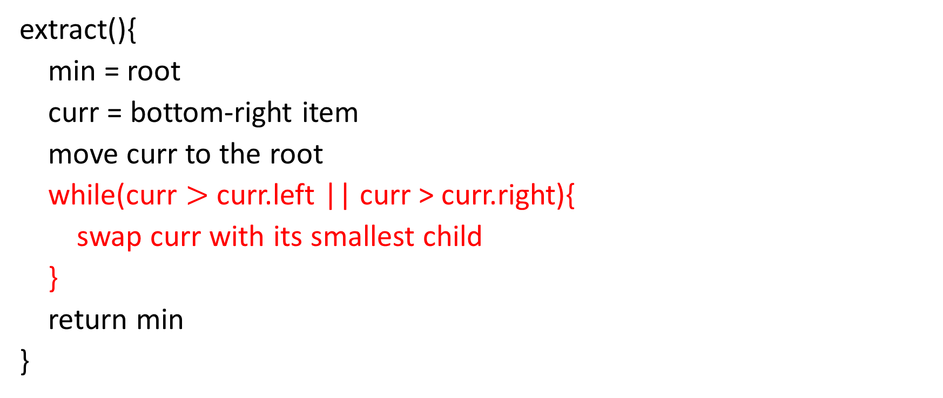

Heap extract
1.5
7
2
4
3
5
6
extract(){
min = root
curr = bottom-right item
move curr to the root
while(curr $>$ curr.left || curr > curr.right){
swap curr with its smallest child
}
return min
}
5
9
Percolate Down

Slide 25

Heap extract
1.5
3
2
4
7
5
6
extract(){
min = root
curr = bottom-right item
move curr to the root
while(curr $>$ curr.left || curr > curr.right){
swap curr with its smallest child
}
return min
}
5
9
Percolate Down

Slide 26
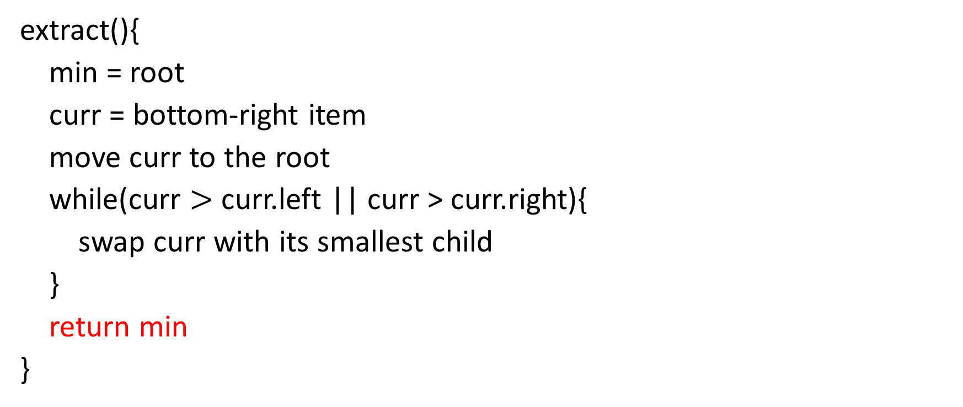
Heap extract
1.5
3
2
4
7
5
6
extract(){
min = root
curr = bottom-right item
move curr to the root
while(curr $>$ curr.left || curr > curr.right){
swap curr with its smallest child
}
return min
}
5
9

Slide 27
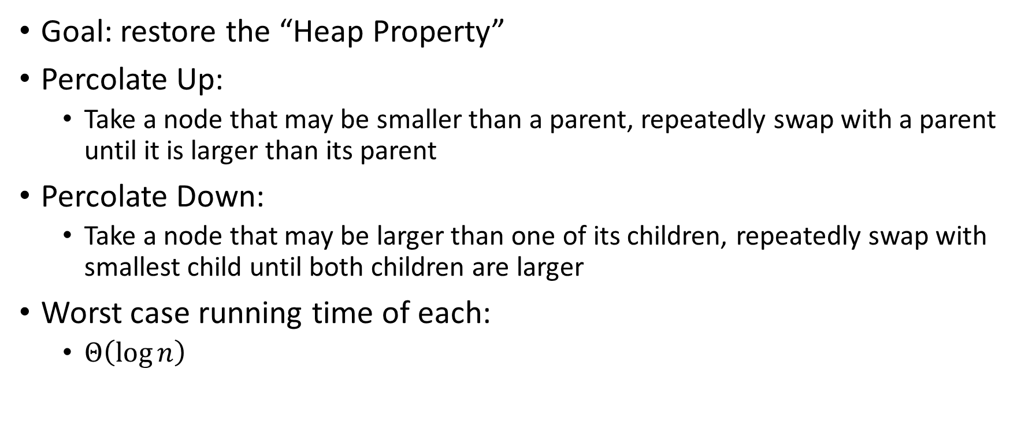

Percolate Up and Down (for a Min Heap)
Goal: restore the “Heap Property”
Percolate Up:
  Take a node that may be smaller than a parent, repeatedly swap with a parent until it is larger than its parent
Percolate Down:
  Take a node that may be larger than one of its children, repeatedly swap with smallest child until both children are larger
Worst case running time of each:
  $Θ\left(\log{n}\right)$

Slide 28
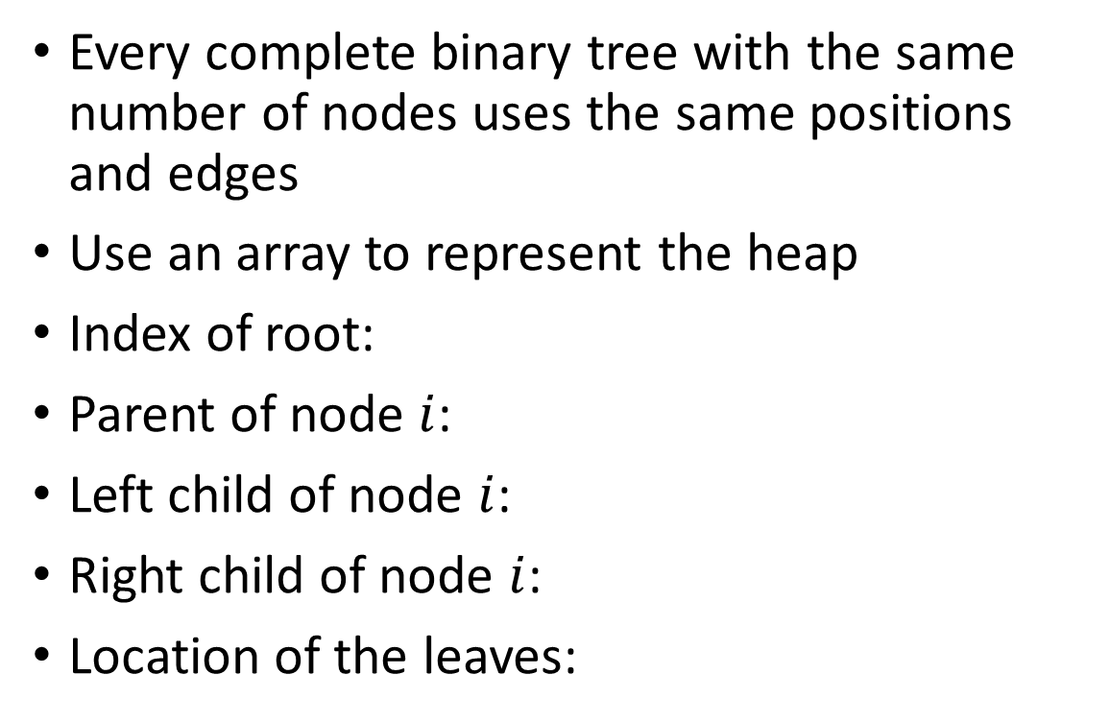
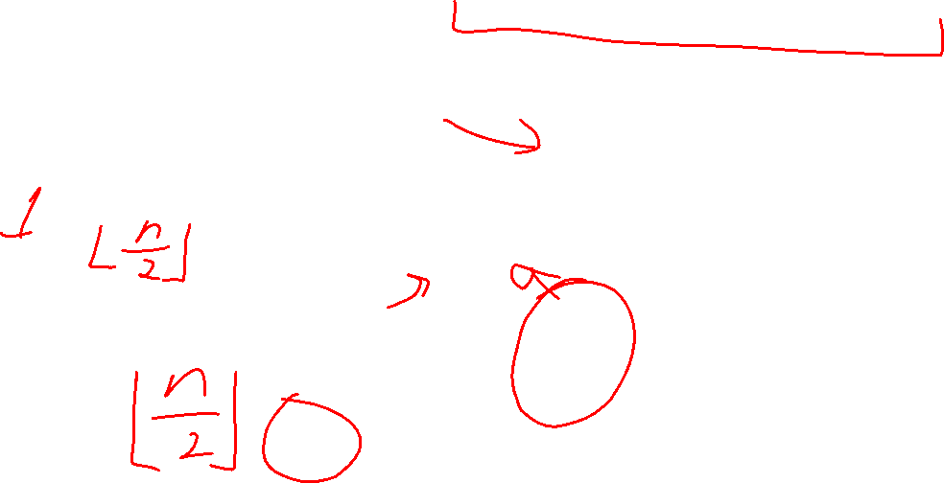
Representing a Heap
1
3
2
4
7
5
6
5
9
0
1
2
3
4
5
6
7
8
9
Every complete binary tree with the same number of nodes uses the same positions and edges
Use an array to represent the heap
Index of root:
Parent of node $i$:
Left child of node $i$:
Right child of node $i$:
Location of the leaves:
1
1
3
2
4
2
7
5
3
6
4
5
6
7
5
9
8
9

Slide 29
Insert Psuedocode
1
3
2
4
7
5
6
5
9
For simplicity, assume is the same as priority
0
1
2
3
4
5
6
7
8
9
10
insert(item){
if(size == arr.length – 1){resize();}
size++;
arr[size] = item;
percolateUp(size)
}
1
1
3
2
4
2
7
5
3
6
4
5
6
7
5
9
8
9

Slide 30
Percolate Up
percolateUp(int i){
int parent = i/2; \\ index of parent
Item val = arr[i]; \\ value at current location
while(i > 1 && arr[i] < arr[parent]){ \\ until location is root or heap property holds
arr[i] = arr[parent]; \\ move parent value to this location
arr[parent] = val; \\ put current value into parent’s location
i = parent; \\ make current location the parent
parent = i/2; \\ update new parent
}
}

Slide 31
extract Psuedocode
extract(){
theMin = arr[1];
arr[1] = arr[size];
size--;
percolateDown(1);
return theMin;
}

Slide 32
Percolate Down
percolateDown(int i){
int left = i*2; \\ index of left child
int right = i*2+1; \\ index of right child
Item val = arr[i]; \\ value at location
while(left <= size){ \\ until location is leaf
int toSwap = right;
if(right > size || arr[left] < arr[right]){ \\ if there is no right child or if left child is smaller
toSwap = left; \\ swap with left
} \\ now toSwap has the smaller of left/right, or left if right does not exist
if (arr[toSwap] < val){ \\ if the smaller child is less than the current value
arr[i] = arr[toSwap];
arr[toSwap] = val; \\ swap parent with smaller child
i = toSwap; \\ update current node to be smaller child
left = i*2;
right = i*2+1;
}
else{ return;} \\ if we don’t swap, then heap property holds
}
}

Slide 33
Other Operations
Increase Key
  Given the index of an item in the PQ, make its priority value larger
    Min Heap: Then percolate Down
    Max Heap: Then percolate Up
Decrease Key
  Given the index of an item in the PQ, make its priority value smaller
    Min Heap: Then percolate Up
    Max Heap: Then percolate Down
Remove
  Given the item at the given index from the PQ

Slide 34
Aside: Expected Running time of Insert

Slide 35

Building a Heap From “Scratch”
Suppose we had $n$ items and wanted to “heapify” them
5
5
6
10
3
15
8
7
14
2
1
Violate Heap Property!
1
0
1
2
3
4
5
6
7
8
9
10
6
10
3
2
15
8
3
7
Two ways for “fix” the heap:
Percolate Up
Percolate Down
4
5
6
7
14
2
1
8
9
10

Slide 36
Floyd’s buildHeap method
Working towards the root, one row at a time, percolate down
buildHeap(){
for(int i = size; i>0; i--){
percolateDown(i);
}
}

Slide 37
Floyd’s buildHeap method
Suppose we had $n$ items and wanted to “heapify” them
Violate Heap Property!
Nodes bigger than a child
5
5
6
10
3
15
8
7
14
2
1
1
0
1
2
3
4
5
6
7
8
9
10
6
10
3
2
8
3
7
buildHeap(){
for(int i = size; i>0; i--){
percolateDown(i);
}
}
15
4
5
6
7
14
2
1
8
9
10

Slide 38
Floyd’s buildHeap method
Suppose we had $n$ items and wanted to “heapify” them
Violate Heap Property!
Nodes bigger than a child
5
5
6
10
3
15
8
7
14
2
1
1
0
1
2
3
4
5
6
7
8
9
10
6
10
3
2
8
3
7
buildHeap(){
for(int i = size; i>0; i--){
percolateDown(i);
}
}
1
4
5
6
7
14
2
15
8
9
10

Slide 39
Floyd’s buildHeap method
Suppose we had $n$ items and wanted to “heapify” them
5
5
6
10
3
15
8
7
14
2
1
Violate Heap Property!
1
0
1
2
3
4
5
6
7
8
9
10
6
10
2
2
8
3
7
buildHeap(){
for(int i = size; i>0; i--){
percolateDown(i);
}
}
1
4
5
6
7
14
3
15
8
9
10

Slide 40
Floyd’s buildHeap method
Suppose we had $n$ items and wanted to “heapify” them
5
5
6
10
3
15
8
7
14
2
1
Violate Heap Property!
1
0
1
2
3
4
5
6
7
8
9
10
6
7
2
2
8
3
10
buildHeap(){
for(int i = size; i>0; i--){
percolateDown(i);
}
}
1
4
5
6
7
14
3
15
8
9
10

Slide 41
Floyd’s buildHeap method
Suppose we had $n$ items and wanted to “heapify” them
5
5
6
10
3
15
8
7
14
2
1
Violate Heap Property!
1
0
1
2
3
4
5
6
7
8
9
10
1
7
2
2
8
3
10
buildHeap(){
for(int i = size; i>0; i--){
percolateDown(i);
}
}
6
4
5
6
7
14
3
15
8
9
10

Slide 42
Floyd’s buildHeap method
Suppose we had $n$ items and wanted to “heapify” them
1
5
6
10
3
15
8
7
14
2
1
Violate Heap Property!
1
0
1
2
3
4
5
6
7
8
9
10
2
7
3
2
8
3
10
buildHeap(){
for(int i = size; i>0; i--){
percolateDown(i);
}
}
6
4
5
6
7
14
5
15
8
9
10

Slide 43
How long did this take?
buildHeap(){
for(int i = size; i>0; i--){
percolateDown(i);
}
}
Worst case running time of buildHeap:
No node can percolate down more than the height of its subtree
  When i is a leaf:
  When i is second-from-last level:
  When i is third-from-last level:
Overall Running time:

