Slide 1
CSE 332 Spring 2026 Lecture 22: Amdahl’s Law and Mutual Exclusion
Nathan Brunelle
http://www.cs.uw.edu/332

Slide 2
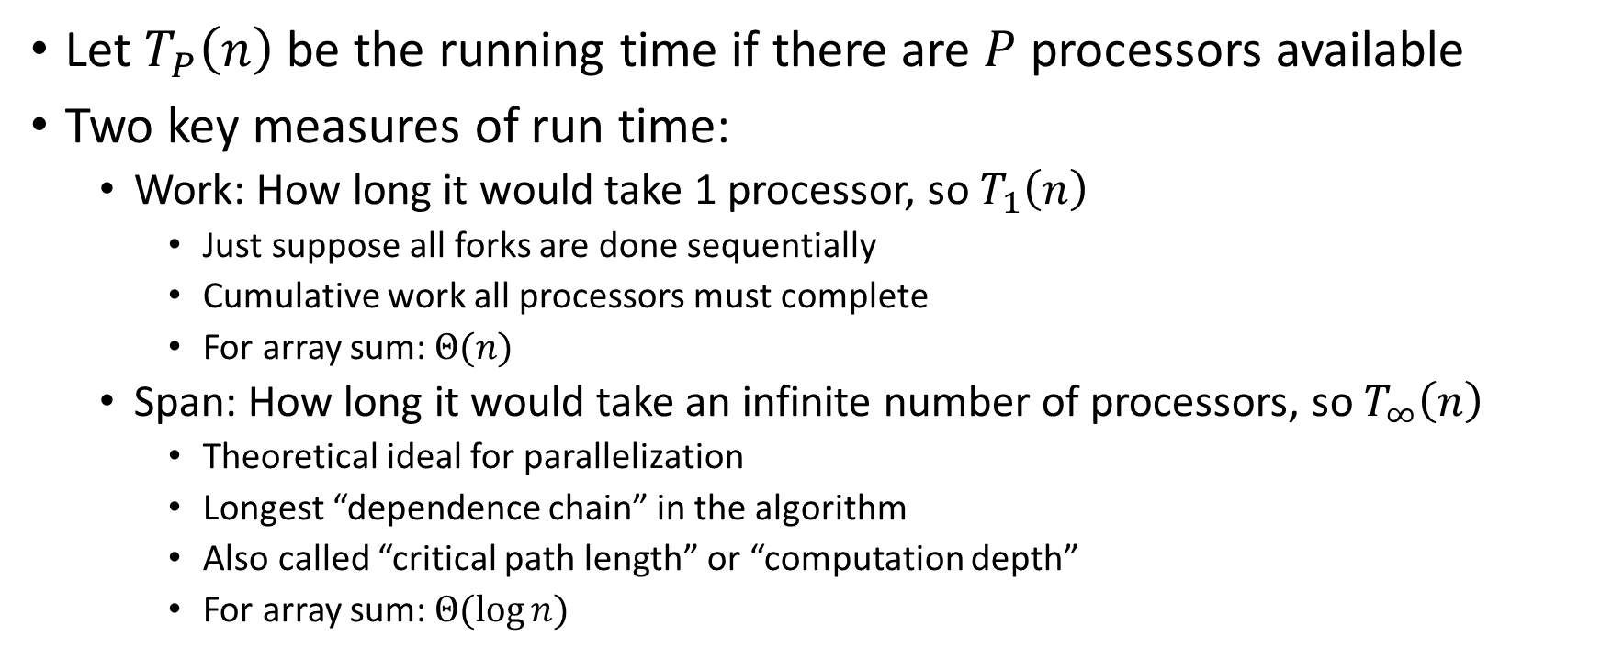
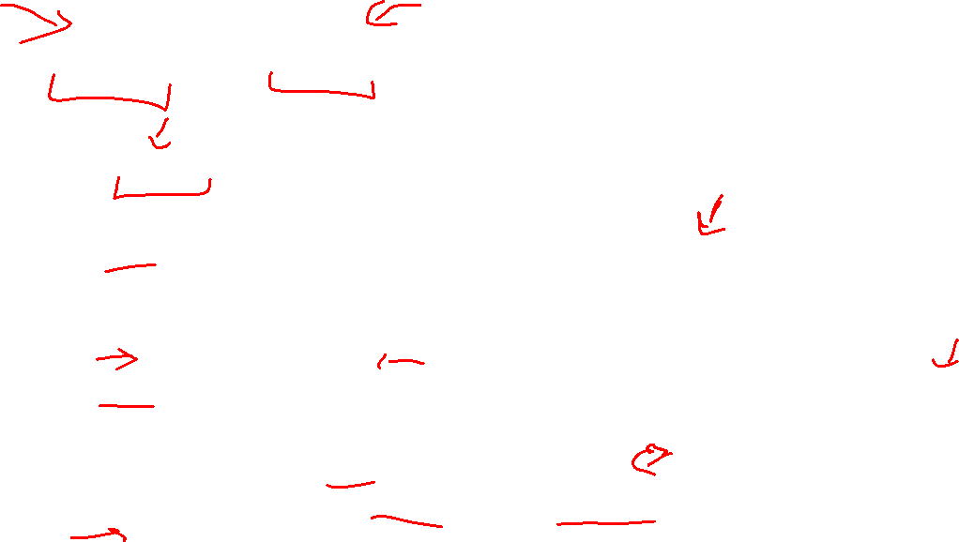
Work and Span
Let $T_{P}\left(n\right)$ be the running time if there are $P$ processors available
Two key measures of run time:
Work: How long it would take 1 processor, so $T_{1}\left(n\right)$
Just suppose all forks are done sequentially
Cumulative work all processors must complete
For array sum: $Θ(n)$
Span: How long it would take an infinite number of processors, so $T_{∞}\left(n\right)$
Theoretical ideal for parallelization
Longest “dependence chain” in the algorithm
Also called “critical path length” or “computation depth”
For array sum: $Θ(log{n})$

Slide 3
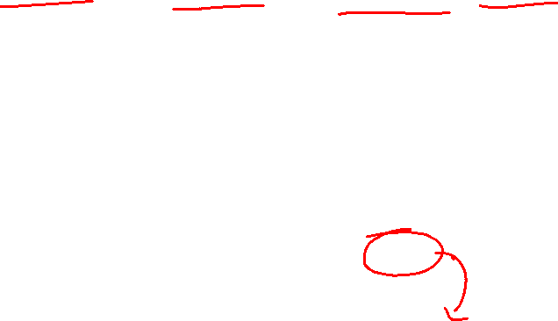
Directed Acyclic Graph (DAG)
A directed graph that has no cycles
Often used to depict dependencies
E.g. software dependencies, Java inheritance, dependencies among sequential tasks!
1
3
2

Slide 4



Task Dependency Graph
“Sketches” what parts of the algorithm may be done in parallel vs. must be done in-order
Each node is a step of the algorithm that may depend on other steps (draw an edge)
This graph depicts a forkjoin algorithm. Each step takes constant time.
Fork and Join each create a new node
When calling fork/compute
Algorithm creates two new threads, there is a dependency from the creating code to the code done by these threads
When calling join
There is a dependency from the code done by the other thread to the code after join
Divide
$Σ$ gives work
$max$ path gives span
Base Cases
Work = sum of the running times of all nodes
Span = longest path from start node to end node.
Combine

Slide 5
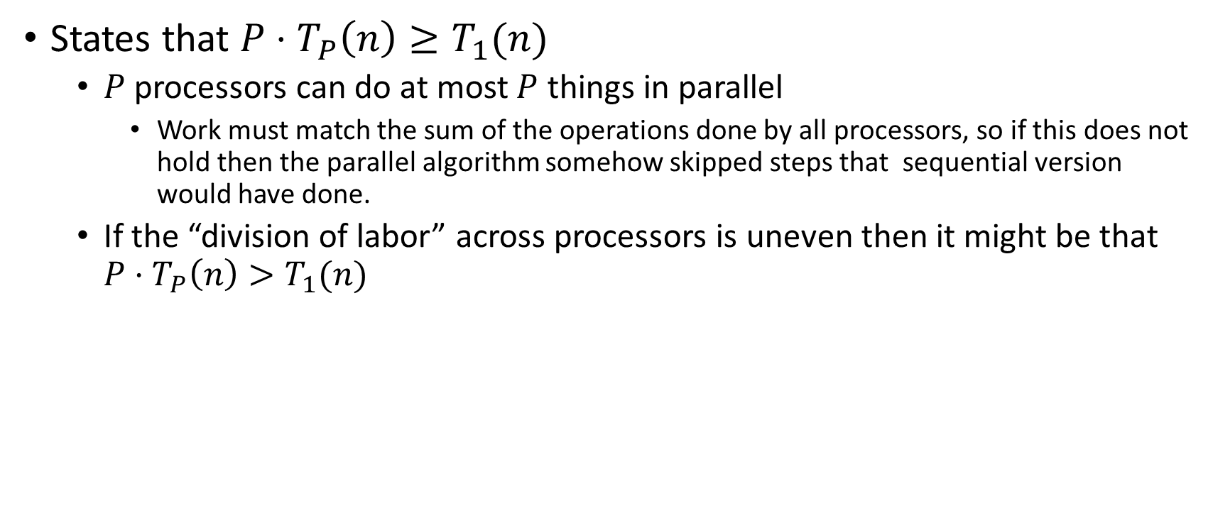
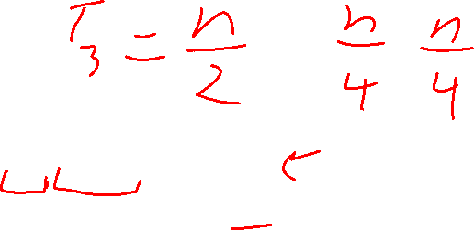
Work Law
States that $P⋅T_{P}\left(n\right)≥T_{1}(n)$
$P$ processors can do at most $P$ things in parallel
Work must match the sum of the operations done by all processors, so if this does not hold then the parallel algorithm somehow skipped steps that sequential version would have done.
If the “division of labor” across processors is uneven then it might be that $P⋅T_{P}\left(n\right)>T_{1}(n)$

Slide 6
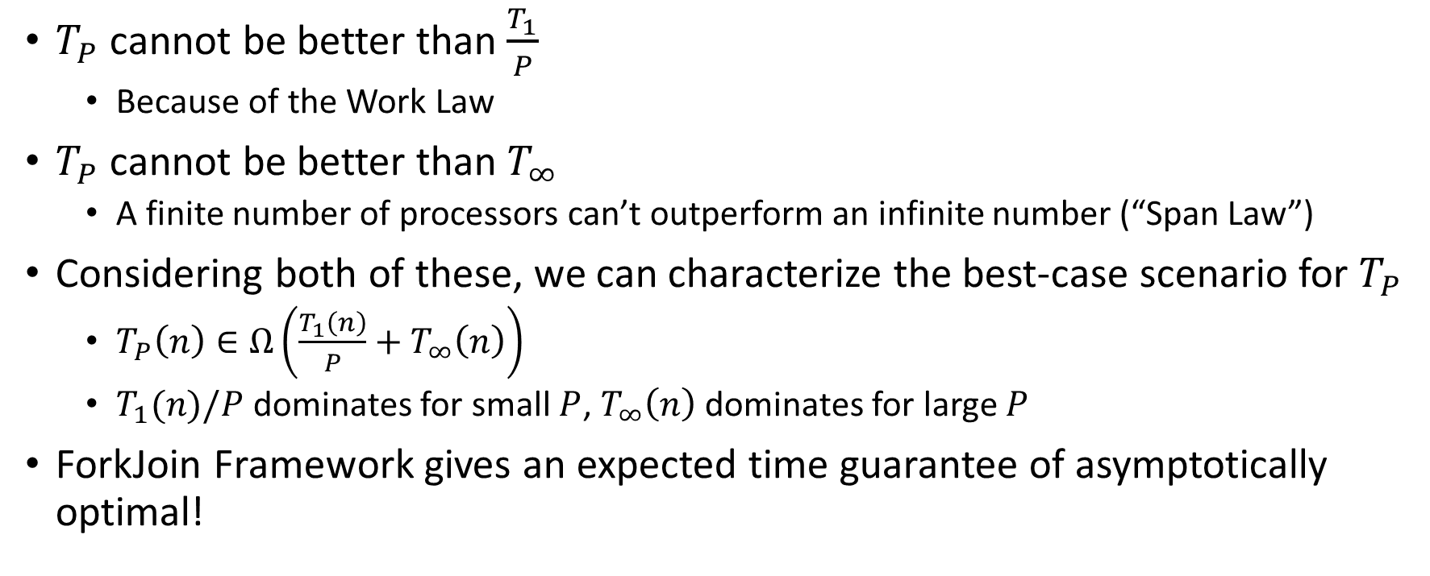
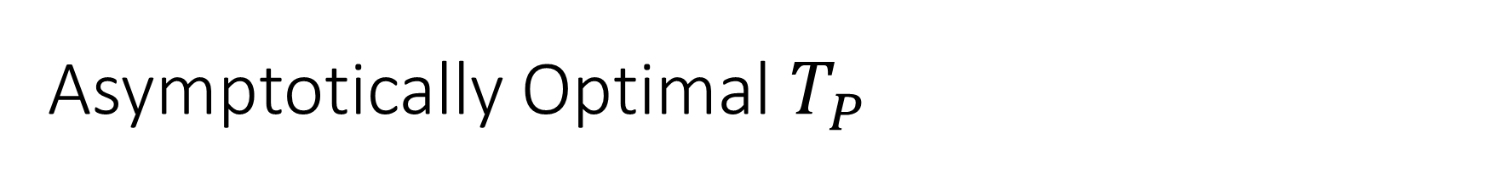
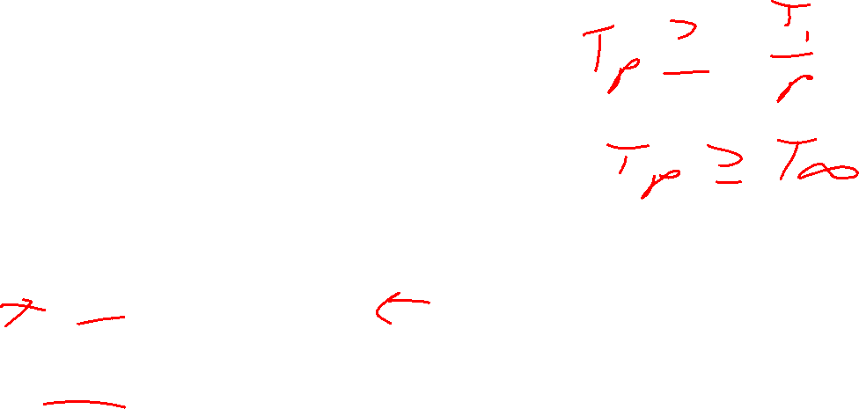
Asymptotically Optimal $T_{P}$
$T_{P}$ cannot be better than $\frac{T_{1}}{P}$
Because of the Work Law
$T_{P}$ cannot be better than $T_{∞}$
A finite number of processors can’t outperform an infinite number (“Span Law”)
Considering both of these, we can characterize the best-case scenario for $T_{P}$
$T_{P}\left(n\right)∈Ω\left(\frac{T_{1}\left(n\right)}{P}+T_{∞}\left(n\right)\right)$
$T_{1}(n)/P$ dominates for small $P$, $T_{∞}\left(n\right)$ dominates for large $P$
ForkJoin Framework gives an expected time guarantee of asymptotically optimal!

Slide 7
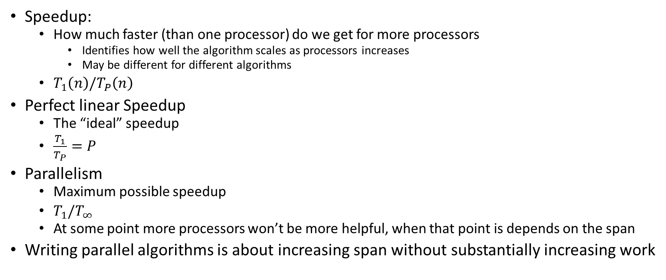
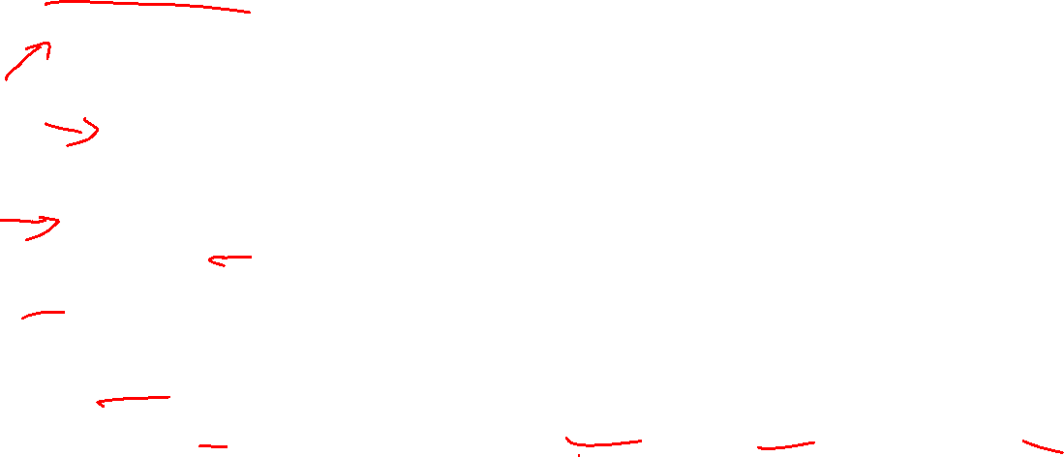
More Vocab
Speedup:
How much faster (than one processor) do we get for more processors
Identifies how well the algorithm scales as processors increases
May be different for different algorithms
$T_{1}\left(n\right)/T_{P}\left(n\right)$
Perfect linear Speedup
The “ideal” speedup
$\frac{T_{1}}{T_{P}}=P$
Parallelism
Maximum possible speedup
$T_{1}/T_{∞}$
At some point more processors won’t be more helpful, when that point is depends on the span
Writing parallel algorithms is about increasing span without substantially increasing work

Slide 8

And now for some bad news…
In practice it’s common for your program to have:
Parts that parallelize well
Maps/reduces/filters over arrays and other data structures
Anything ForkJoin!
Tasks that don’t need to access a shared data structure
Parts that don’t parallelize at all
Reading a linked list, getting input, computations where each step needs the results of previous step, concurrency concerns forcing mutual exclusion
These unparallelizable parts can turn out to be a big bottleneck

Slide 9
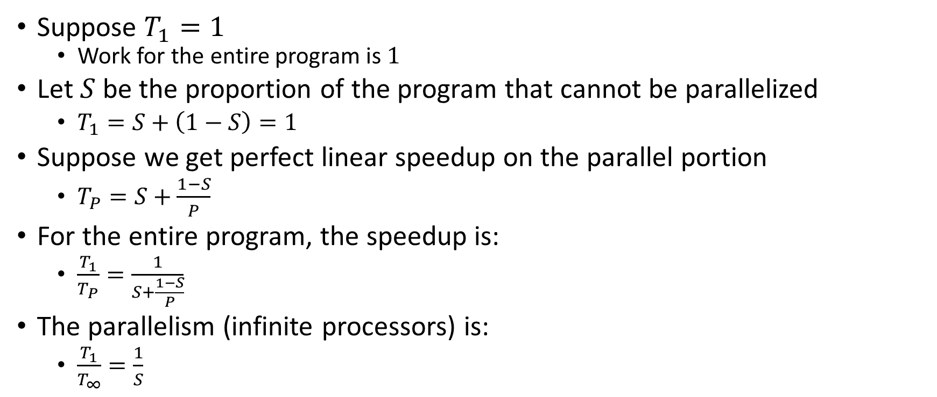
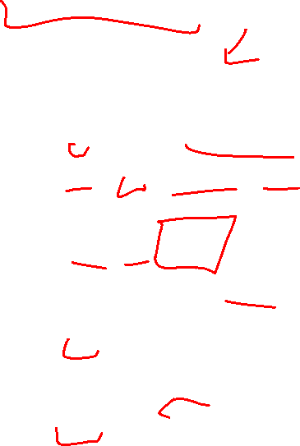
Amdahl’s Law (mostly bad news)
Suppose $T_{1}=1$
Work for the entire program is $1$
Let $S$ be the proportion of the program that cannot be parallelized
$T_{1}=S+\left(1−S\right)=1$
Suppose we get perfect linear speedup on the parallel portion
$T_{P}=S+\frac{1−S}{P}$
For the entire program, the speedup is:
$\frac{T_{1}}{T_{P}}=\frac{1}{S+\frac{1−S}{P}}$
The parallelism (infinite processors) is:
$\frac{T_{1}}{T_{∞}}=\frac{1}{S}$

Slide 10


Amdahl’s Law Example
Suppose 2/3 of your program is parallelizable, but 1/3 is not.
$S=\frac{1}{3}$
$T_{1}=\frac{2}{3}+\frac{1}{3}=1$
$T_{P}=S+\frac{1−S}{P}=\frac{1}{3}+\frac{2/3}{P}$
If $T_{1}$ is 100 seconds:
$T_{P}=33+\frac{67}{P}$
$T_{2}=33+\frac{67}{2}≈67$
$T_{3}=33+\frac{67}{3}≈55$
$T_{6}=33+\frac{67}{6}≈44$
$T_{12}=33+\frac{67}{12}≈39$
Notice:
We got a lot of speedup with the second processor (23%)
Adding a third processor only gave half as much speedup (12%)
After going up to 6 processors, we still only got 11% speedup
No matter how many processors we add, we will never get more 11% additional improvement
Conclusion:
When a portion of our code is sequential, the improvement gained from more and more processors diminishes very quickly.
Notes:
Suppose 2/3 of your program is parallelizable, but 1/3 is not.
$$S=\frac{1}{3}$$
$$T_{1}=\frac{2}{3}+\frac{1}{3}=1$$
$$T_{P}=S+\frac{1−S}{P}=\frac{1}{3}+\frac{2/3}{P}$$
If $T_{1}$ is 100 seconds:
$$T_{P}=33+\frac{67}{P}$$
$$T_{3}=33+\frac{67}{3}=33+22=55$$
$$T_{6}=33+\frac{67}{6}=33+11=44$$
$$T_{12}=33+\frac{67}{12}=33+5.5=38.5$$

Slide 11
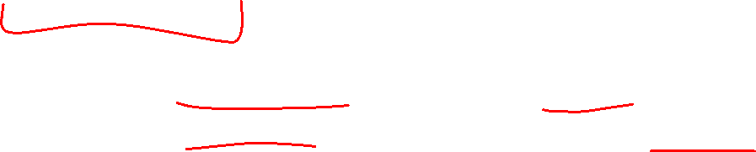
Conclusion
Even with many many processors the sequential part of your program becomes a bottleneck
Parallelizable code requires skill and insight from the developer to recognize where parallelism is possible, and how to do it well.

Slide 12
Memory Sharing With ForkJoin
Structure of ForkJoin:
All threads are executing the same algorithm
Each task is responsible for its own portion of the input/output
If one task needs another’s result, use join() to ensure it uses the final answer
This does not help when:
Memory accessed by threads is overlapping or unpredictable
Threads are doing independent tasks using same resources (rather than implementing the same algorithm)

Slide 13

Example: Shared Queue
Imagine two threads are both using the same linked list based queue.
What could go wrong?
enqueue(x){
if ( back == null ){
back = new Node(x);
front = back;
}
else {
back.next = new Node(x);
back = back.next;
}
}

Slide 14
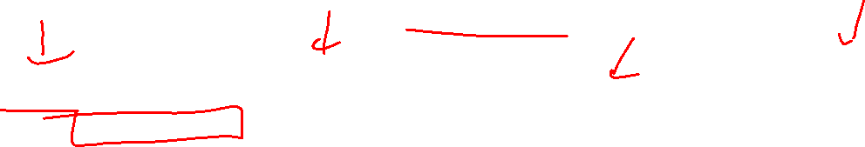
Shared Queue Interleaving
Thread 1
Thread 2
enqueue(x){
if ( back == null ){
back = new Node(x);
front = back;
}
else {
back.next = new Node(x);
back = back.next;
}
}
enqueue(x){
if ( back == null ){
back = new Node(x);
front = back;
}
else {
back.next = new Node(x);
back = back.next;
}
}
back
front
5
8
3
4
7

Slide 15

Empty Shared Queue
Suppose the Queue is empty, and the threads execute in this order.
Assume Thread 1 enqueues 1, and Thread 2 enqueues 2.
Thread 1
Thread 2
enqueue(x){
if ( back == null ){
back = new Node(x);
front = back;
}
else {
back.next = new Node(x);
back = back.next;
}
}
enqueue(x){
if ( back == null ){
back = new Node(x);
front = back;
}
else {
back.next = new Node(x);
back = back.next;
}
}
front
back

Slide 16
Thread 1 – first two lines
Thread 1 has decided the queue is empty
Thread 1
Thread 2
enqueue(x){
if ( back == null ){
back = new Node(x);
front = back;
}
else {
back.next = new Node(x);
back = back.next;
}
}
enqueue(x){
if ( back == null ){
back = new Node(x);
front = back;
}
else {
back.next = new Node(x);
back = back.next;
}
}
front
back

Slide 17
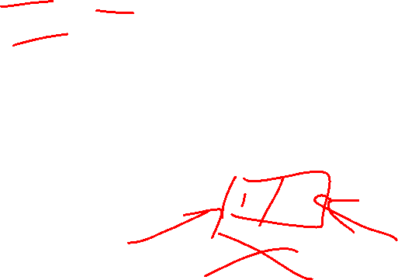
Thread 2 – all lines
Thread 1 has decided the queue is empty
Meanwhile, thread 2 enqueues 2
Thread 1
Thread 2
enqueue(x){
if ( back == null ){
back = new Node(x);
front = back;
}
else {
back.next = new Node(x);
back = back.next;
}
}
enqueue(x){
if ( back == null ){
back = new Node(x);
front = back;
}
else {
back.next = new Node(x);
back = back.next;
}
}
front
2
back

Slide 18
Thread 1 – remaining lines
Thread 1 has decided the queue is empty
Meanwhile, thread 2 enqueues 2
Thread 1 continues as if the queue is still empty, overwriting Thread 2’s work
Thread 1
Thread 2
enqueue(x){
if ( back == null ){
back = new Node(x);
front = back;
}
else {
back.next = new Node(x);
back = back.next;
}
}
enqueue(x){
if ( back == null ){
back = new Node(x);
front = back;
}
else {
back.next = new Node(x);
back = back.next;
}
}
front
1
back

Slide 19
Interleaving
Due to time slicing, a thread can be interrupted at any time
Between any two lines of code
Within a single line of code
The sequence that operations occur across two threads is called an interleaving
Without doing anything else, we have no control over how different threads might be interleaved

Slide 20
Concurrent Programming
Concurrency:
Correctly and efficiently managing access to shared resources across multiple possibly-simultaneous tasks
Requires synchronization to avoid incorrect simultaneous access
Use some way of “blocking” other tasks from using a resource when another modifies it or makes decisions based on its state
That blocking task will free up the resource when it’s done
Warning:
Because we have no control over when threads are scheduled by the OS, even correct implementations are highly non-deterministic
Errors are hard to reproduce, which complicates debugging

Slide 21
Analogue Example – Data Race
Count to 10 aloud
Clap three times
Erase the contents of the box
Write your name in the box,
pausing 2 seconds between letters
Wave your arms in the air

Slide 22
Analogue Example – With “Mutual Exclusion”
There is only one trident, so no two threads (both executing this same code) can execute lines 4 and 5 at the same time.
All threads after the first must wait at line 3 for the trident to become available.
The trident causes any one thread to “lock out” (exclude) all other threads.
Any thread being between lines 3 and 6 excludes all other threads, so this is called “mutual exclusion”.
The trident itself we call a “lock”
Count to 10 aloud
Clap three times
Pick up the trident
Erase the contents of the box
Write your name in the box,
pausing 2 seconds between letters
Put down the trident
Wave your arms in the air

Slide 23
Bank Account Example
The following code implements a bank account object correctly for a synchronized situation
Assume the initial balance is 150
class BankAccount {
private int balance = 0;
int getBalance() { return balance; }
void setBalance(int x) { balance = x; }
void withdraw(int amount) {
int b = getBalance();
if (amount > b)
throw new WithdrawTooLargeException();
setBalance(b – amount); }
// other operations like deposit, etc.
}
What Happens here?
withdraw(100);
withdraw(75)

Slide 24
Bank Account Example - Parallel
Assume the initial balance is 150
class BankAccount {
private int balance = 0;
int getBalance() { return balance; }
void setBalance(int x) { balance = x; }
void withdraw(int amount) {
int b = getBalance();
if (amount > b)
throw new WithdrawTooLargeException();
setBalance(b – amount); }
// other operations like deposit, etc.
}
Thread 1:
withdraw(100);
Thread 2:
withdraw(75);

Slide 25
An “OK” Interleaving
Assume the initial balance is 150
Thread 1:
Thread 2:
withdraw(100);
withdraw(75);
int b = getBalance();
if (amount > b)
throw new Exception();
setBalance(b – amount);
int b = getBalance();
if (amount > b)
throw new Exception();
setBalance(b – amount);

Slide 26
A “Bad” Interleaving
Assume the initial balance is 150
Thread 1:
Thread 2:
withdraw(100);
withdraw(75);
int b = getBalance();
if (amount > b)
throw new Exception();
setBalance(b – amount);
int b = getBalance();
if (amount > b)
throw new Exception();
setBalance(b – amount);

Slide 27
A Bad Fix
Assume the initial balance is 150
class BankAccount {
private int balance = 0;
int getBalance() { return balance; }
void setBalance(int x) { balance = x; }
void withdraw(int amount) {
if (amount > getBalance())
throw new WithdrawTooLargeException();
setBalance(getBalance() – amount); }
// other operations like deposit, etc.
}

Slide 28
Avoiding Variables doesn’t work
Assume the initial balance is 150
Thread 1:
Thread 2:
withdraw(100);
withdraw(75);
if (amount > getBalance())
throw new Exception();
setBalance(getBalance() – amount);
setBalance(getBalance() – amount);
if (amount > getBalance())
throw new Exception();
setBalance(getBalance() – amount);

Slide 29
What we want – Mutual Exclusion
While one thread is withdrawing from the account, we want to exclude all other threads from also withdrawing
Called mutual exclusion:
One thread using a resource (here: a bank account) means another thread must wait
We call the area of code that we want to have mutual exclusion (only one thread can be there at a time) a critical section.
The programmer must implement critical sections!
It requires programming language primitives to do correctly

Slide 30
A Bad attempt at Mutual Exclusion
class BankAccount {
private int balance = 0;
private Boolean busy = false;
int getBalance() { return balance; }
void setBalance(int x) { balance = x; }
void withdraw(int amount) {
while (busy) { /* wait until not busy */ }
busy = true;
int b = getBalance();
if (amount > b)
throw new WithdrawTooLargeException();
setBalance(b – amount);
busy = false;}
// other operations like deposit, etc.
}

Slide 31
The “Busy Signal” Doesn’t Work
Assume the initial balance is 150
Thread 1:
Thread 2:
withdraw(100);
withdraw(75);
while (busy) { /* wait until not busy */ }
busy = true;
int b = getBalance();
if (amount > b)
throw new Exception();
setBalance(b – amount);
busy = false;
while (busy) { /* wait until not busy */ }
busy = true;
int b = getBalance();
if (amount > b)
throw new Exception();
setBalance(b – amount);
busy = false;

Slide 32
Solution
We need a construct from Java to do this
One Solution – A Mutual Exclusion Lock (called a Mutex or Lock)
We define a Lock to be an ADT with operations:
New:
make a new lock, initially “not held”
Acquire:
If lock is not held, mark it as “held”
These two steps always done together in a way that cannot be interrupted!
If lock is held, pause until it is marked as “not held”
Release:
Mark the lock as “not held”

Slide 33
Almost Correct Bank Account Example
class BankAccount {
private int balance = 0;
private Lock lck = new Lock();
int getBalance() { return balance; }
void setBalance(int x) { balance = x; }
void withdraw(int amount) {
lk.acquire();
int b = getBalance();
if (amount > b)
throw new WithdrawTooLargeException();
setBalance(b – amount);
lk.release();}
// other operations like deposit, etc.
}
Questions:
What is the critical section?
What is the Error?

Slide 34
Exceptions End the Method!
class BankAccount {
private int balance = 0;
private Lock lck = new Lock();
int getBalance() { return balance; }
void setBalance(int x) { balance = x; }
void withdraw(int amount) {
lk.acquire();
int b = getBalance();
if (amount > b)
throw new WithdrawTooLargeException();
setBalance(b – amount);
lk.release();}
// other operations like deposit, etc.
}
If we throw an exception, we never finish the method!
The lock would never get released!

Slide 35
Try…Finally
Try Block:
Body of code that will be run
Finally Block:
Always runs once the program exits try block (whether due to a return, exception, anything!)

Slide 36
Correct (but not Java) Bank Account Example
class BankAccount {
private int balance = 0;
private Lock lck = new Lock();
int getBalance() { return balance; }
void setBalance(int x) { balance = x; }
void withdraw(int amount) {
try{
lk.acquire();
int b = getBalance();
if (amount > b)
throw new WithdrawTooLargeException();
setBalance(b – amount); }
finally { lk.release(); } }
// other operations like deposit, etc.
}
Questions:
Should deposit have its own lock object?
What about getBalance?
What about setBalance?
Should they share one?

