Slide 1
CSE 332 Winter 2026
Lecture 25: P and NP
Nathan Brunelle
http://www.cs.uw.edu/332

Slide 2
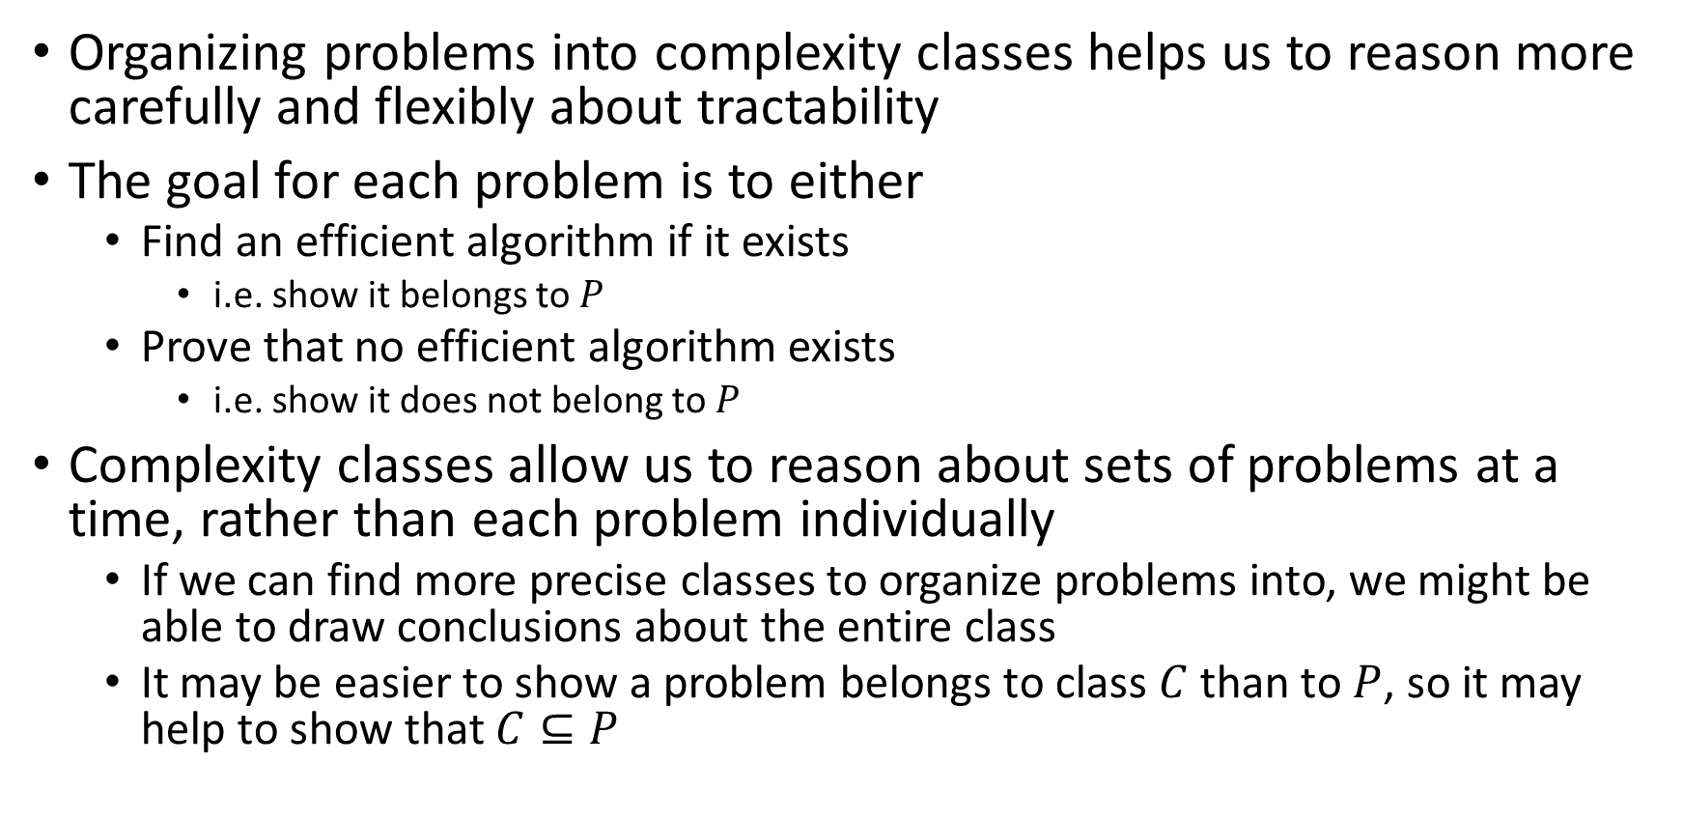
Studying Complexity and Tractability
Organizing problems into complexity classes helps us to reason more carefully and flexibly about tractability
The goal for each problem is to either
  Find an efficient algorithm if it exists
    i.e. show it belongs to $P$
  Prove that no efficient algorithm exists
    i.e. show it does not belong to $P$
Complexity classes allow us to reason about sets of problems at a time, rather than each problem individually
  If we can find more precise classes to organize problems into, we might be able to draw conclusions about the entire class
  It may be easier to show a problem belongs to class $C$ than to $P$, so it may help to show that $C⊆P$

Slide 3

Some problems in $EXP$ seem “easier”
There are some problems that we do not have polynomial time algorithms to solve, but provided answers are easy to check
Hamiltonian Path:
  It’s “hard” to look at a graph and determine whether it has a Hamiltonian Path
  It’s “easy” to look at a graph and a candidate path together and determine whether THAT path is a Hamiltonian Path
    It’s easy to verify whether a given path is a Hamiltonian path

Slide 4
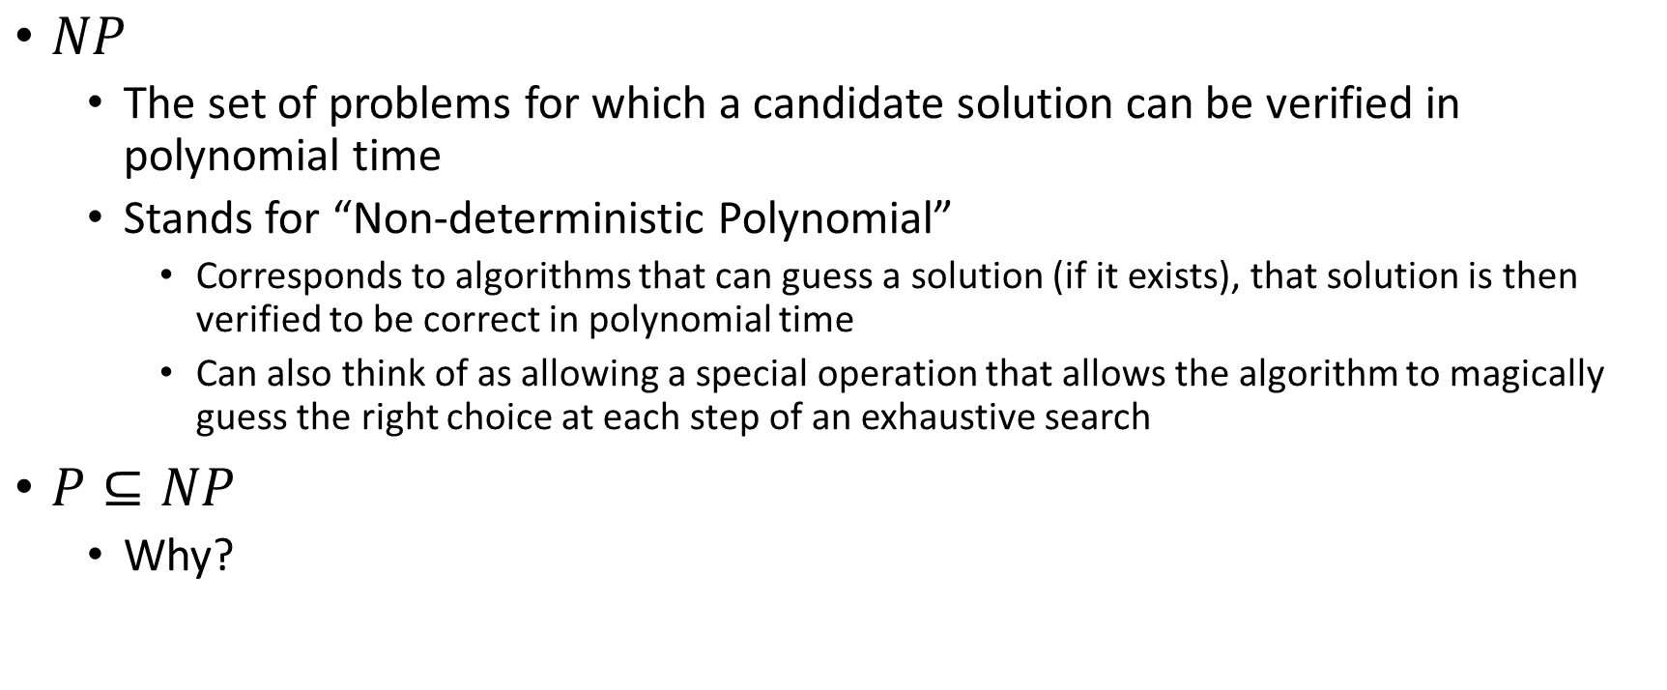

Class $NP$
$NP$
  The set of problems for which a candidate solution can be verified in polynomial time
  Stands for “Non-deterministic Polynomial”
    Corresponds to algorithms that can guess a solution (if it exists), that solution is then verified to be correct in polynomial time
    Can also think of as allowing a special operation that allows the algorithm to magically guess the right choice at each step of an exhaustive search
$P⊆NP$
  Why?

Slide 5

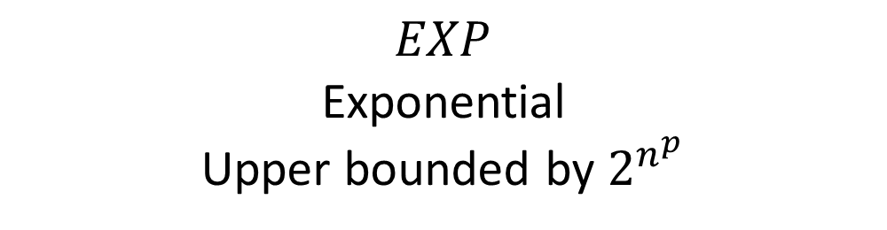



$EXP⊃NP⊇P$
$P=NP$ or $P⊂NP$
$$EXP$$
Exponential
Upper bounded by $2^{n^{p}}$
Checkers
Go
Chess
Vertex Cover
Independent Set
Hamiltonian Path
Cryptography
Prime factorization
$$NP$$
Nondeterministic Polynomial
Verified in $n^{p}$ time
$$P$$
Polynomial
Upper bounded by $n^{p}$
Sorting
Shortest Path
Euler Path
Gap?
Unknown!

Slide 6

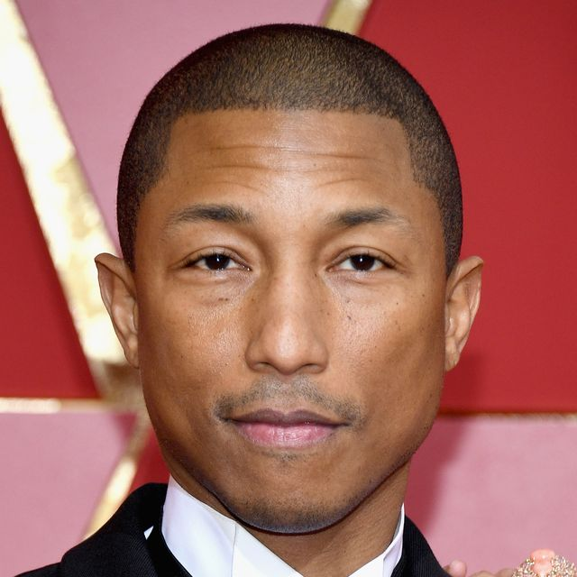










Party Problem
Draw Edges between people who don’t get along
How many people can I invite to a party if everyone must get along?

Slide 7

Independent Set
Independent set:
  $S⊆V$ is an independent set if no two nodes in $S$ share an edge
Independent Set Problem:
  Given a graph $G=(V,E)$ and a number $k$, determine whether there is an independent set $S$ of size $k$

Slide 8
Generalized Baseball
Need to place defenders on bases such that every edge is defended
How many defenders would suffice?

Slide 9

Vertex Cover
Vertex Cover:
  $C⊆V$ is a vertex cover if every edge in $E$ has one of its endpoints in $C$
Vertex Cover Problem:
  Given a graph $G=(V,E)$ and a number $k$, determine if there is a vertex cover $C$ of size $k$

Slide 10
Transforming an IS into a VC
$S$ is an independent set of $G$ iff $V−S$ is a vertex cover of $G$
Independent Set
Vertex Cover

Slide 11
Transforming a VC into an IS
$S$ is an independent set of $G$ iff $V−S$ is a vertex cover of $G$
Vertex Cover
Independent Set

Slide 12
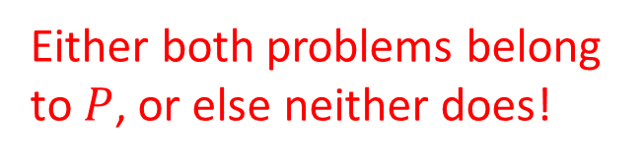
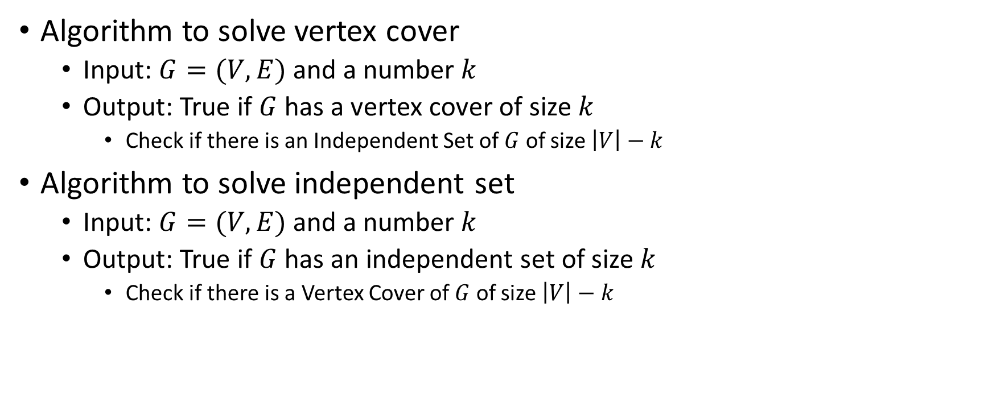
Solving Vertex Cover and Independent Set
Algorithm to solve vertex cover
  Input: $G=(V,E)$ and a number $k$
  Output: True if $G$ has a vertex cover of size $k$
    Check if there is an Independent Set of $G$ of size $\left|V\right|−k$
Algorithm to solve independent set
  Input: $G=(V,E)$ and a number $k$
  Output: True if $G$ has an independent set of size $k$
    Check if there is a Vertex Cover of $G$ of size $\left|V\right|−k$
Either both problems belong to $P$, or else neither does!

Slide 13
Reduction
A strategy for creating algorithms
Solve one problem by converting it into a different problem, then using an algorithm for that other problem.

Slide 14

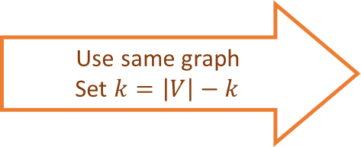

Independent Set Reduces To Vertex Cover
Independent Set Input
O(V) Time
Vertex Cover Input
Relate Independent Set input to Vertex Cover output
Use same graph
Set $k=\left|V\right|−k$
$$k$$
$$k$$
Any Algorithm for Vertex Cover
Relate Independent Set output to Vertex Cover output
Independent Set Output
Vertex Cover Ouput
Give same output
Reduction

Slide 15


Reductions
Shows how two different problems relate to each other
MOVIE TIME!

Slide 16











MacGyver’s Reduction
Problem we don’t know how to solve
Problem we do know how to solve
$$A$$
Opening a door
Aim duct at door, insert keg
Lighting a fire
$$B$$
How?
Solution for $A$
Solution for $B$
Keg cannon battering ram
Alcohol, wood, matches
Put fire under the Keg
Reduction

Slide 17
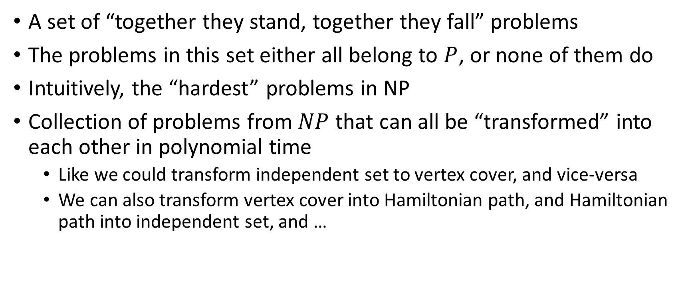
NP-Complete
A set of “together they stand, together they fall” problems
The problems in this set either all belong to $P$, or none of them do
Intuitively, the “hardest” problems in NP
Collection of problems from $NP$ that can all be “transformed” into each other in polynomial time
  Like we could transform independent set to vertex cover, and vice-versa
  We can also transform vertex cover into Hamiltonian path, and Hamiltonian path into independent set, and …

Slide 18
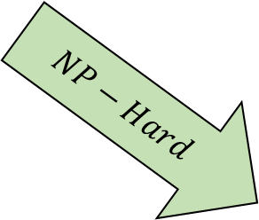
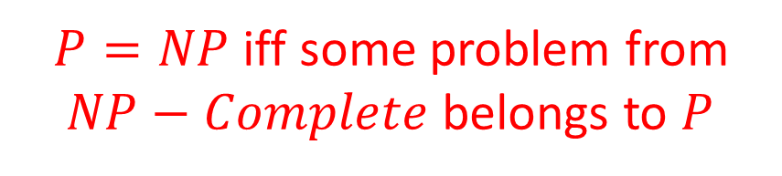
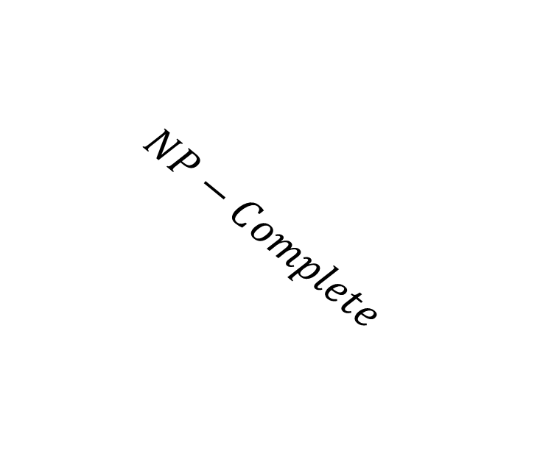


$EXP⊃NP−Complete⊇NP⊇P$
$P=NP$ iff some problem from $NP−Complete$ belongs to $P$
$$EXP$$
Checkers
Go
Chess
Vertex Cover
Independent Set
Hamiltonian Path
$$NP$$
$$NP−Complete$$
$$P$$
Cryptography
Prime factorization
Sorting
Shortest Path
Euler Path
$$NP−Hard$$
Gap?
Unknown!

Slide 19

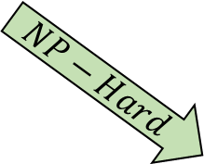
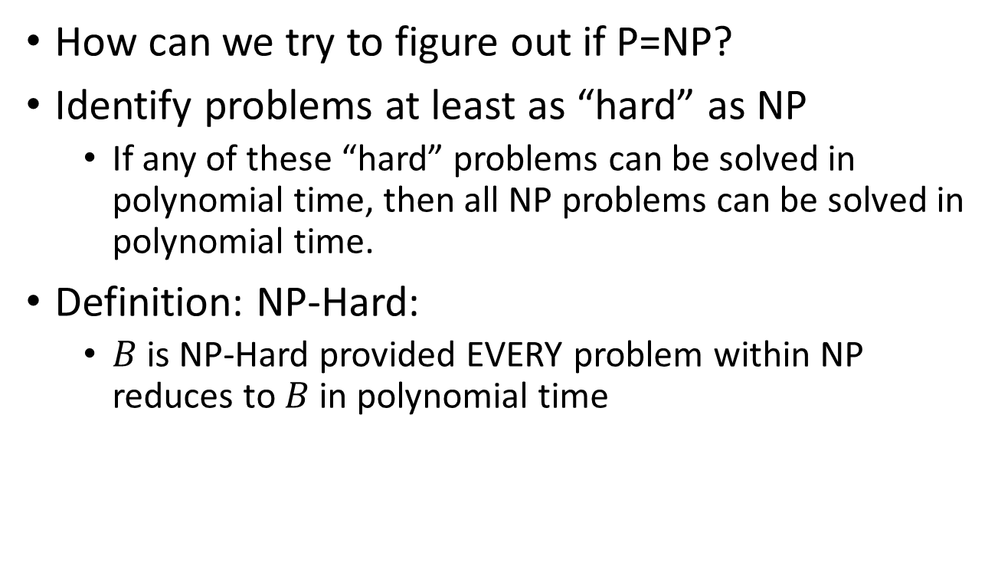
NP-Hard
$$EXP$$
$$NP$$
$$P$$
How can we try to figure out if P=NP?
Identify problems at least as “hard” as NP
  If any of these “hard” problems can be solved in polynomial time, then all NP problems can be solved in polynomial time.
Definition: NP-Hard:
  $B$ is NP-Hard provided EVERY problem within NP reduces to $B$ in polynomial time
$$NP−Hard$$

Slide 20



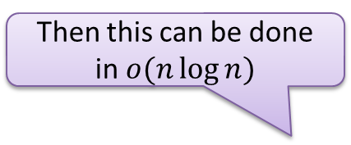


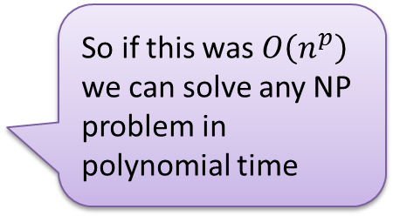
NP-Hard Idea
For every NP problem
Any NP Problem
$$O(n^{p})$$
An NP-Hard Problem
$$A$$
$$B$$
So if this was $O\left(n^{p}\right)$ we can solve any NP problem in polynomial time
There exists a polynomial-time reduction to each NP-Hard Problem
Solution for $A$
Solution for $B$
$$X$$
$$Y$$
Reduction

Slide 21






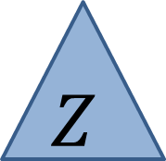

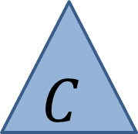


Showing NP-Hardness
Any NP Problem
$$O(n^{p})$$
A First NP-Hard
Problem
$$O(n^{p})$$
A new NP-Hard Problem
$$C$$
$$A$$
$$B$$
Solution for $C$
Solution for $A$
Solution for $B$
$$Z$$
$$X$$
$$Y$$
Reduction
Reduction

Slide 22
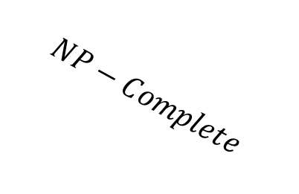
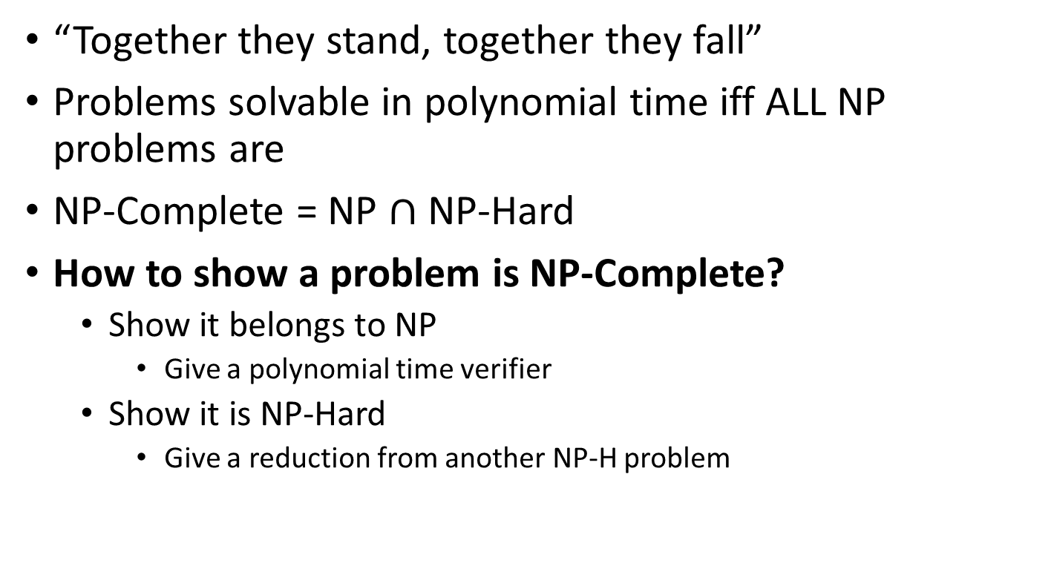

NP-Complete
$$EXP$$
$$NP$$
$$NP−Complete$$
$$P$$
“Together they stand, together they fall”
Problems solvable in polynomial time iff ALL NP problems are
NP-Complete = NP $∩$ NP-Hard
How to show a problem is NP-Complete?
  Show it belongs to NP
    Give a polynomial time verifier
  Show it is NP-Hard
    Give a reduction from another NP-H problem
$$NP−Hard$$

Slide 23
NP-Completeness
Any NP-Complete Problem
$$O(n^{p})$$
Any other NP-Complete Problem
$$A$$
$$B$$
If this could be done in polynomial time
Then this could be done in polynomial time
Solution for $A$
Solution for $B$
$$X$$
$$Y$$
Reduction

Slide 24
NP-Completeness
Any NP-Complete Problem
$$O(n^{p})$$
Any other NP-Complete Problem
$$A$$
$$B$$
Then this cannot be done in polynomial time
If this cannot be done in polynomial time
Solution for $A$
Solution for $B$
$$X$$
$$Y$$
Reduction

Slide 25
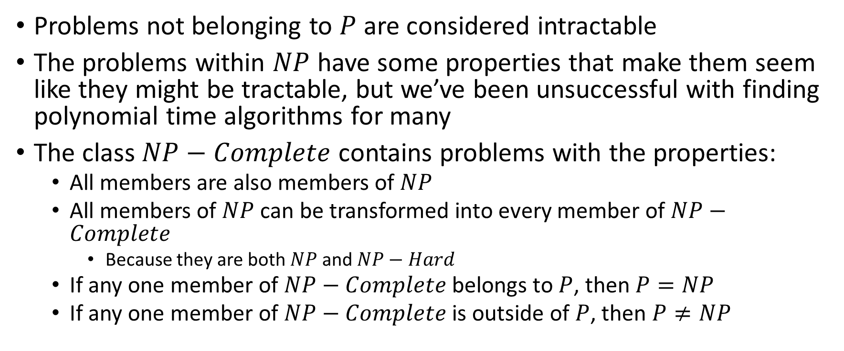
Overview
Problems not belonging to $P$ are considered intractable
The problems within $NP$ have some properties that make them seem like they might be tractable, but we’ve been unsuccessful with finding polynomial time algorithms for many
The class $NP−Complete$ contains problems with the properties:
  All members are also members of $NP$
  All members of $NP$ can be transformed into every member of $NP−Complete$
    Because they are both $NP$ and $NP−Hard$
  If any one member of $NP−Complete$ belongs to $P$, then $P=NP$
  If any one member of $NP−Complete$ is outside of $P$, then $P≠NP$

Slide 26
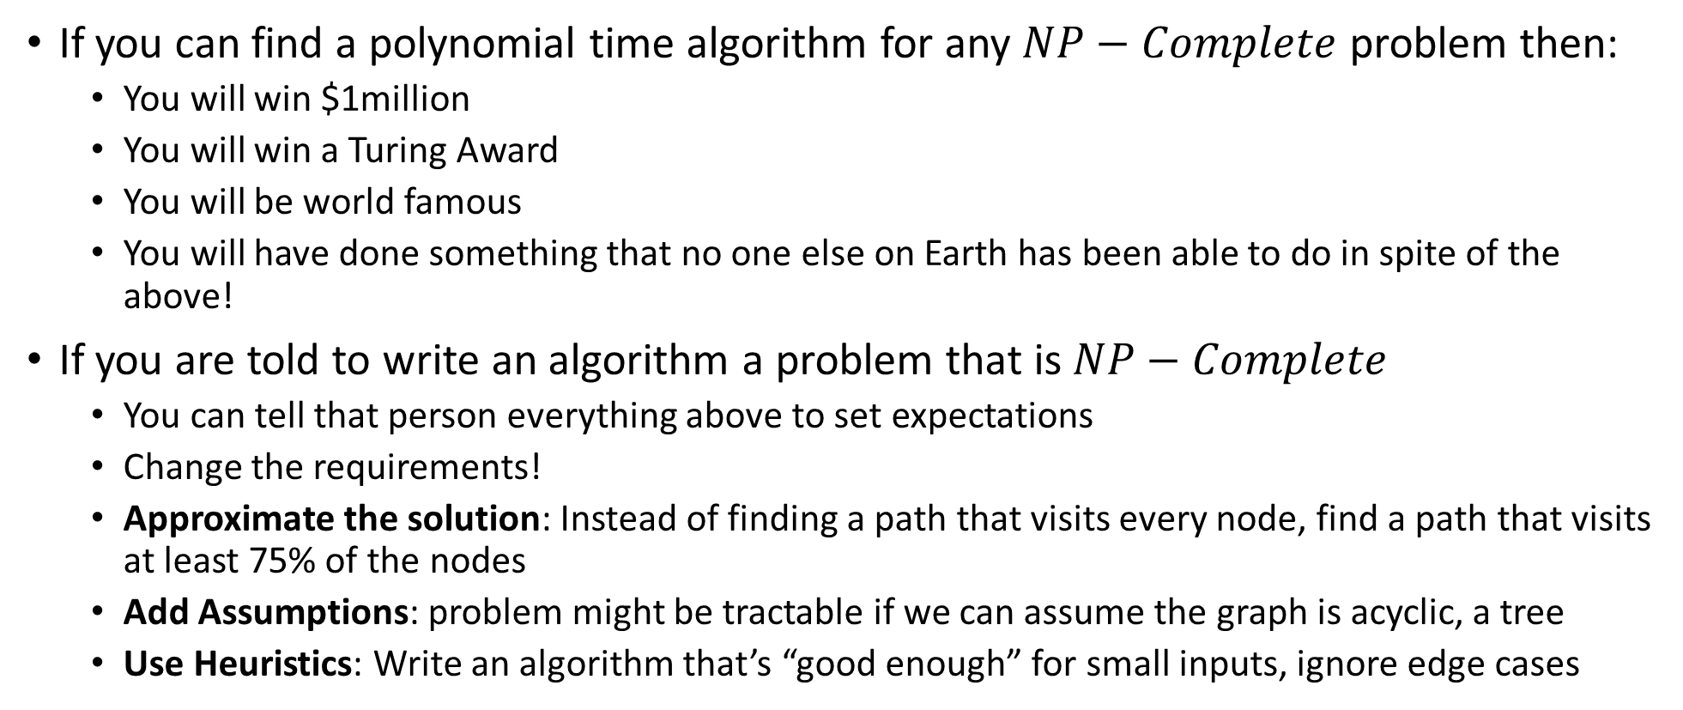
Why should YOU care?
If you can find a polynomial time algorithm for any $NP−Complete$ problem then:
  You will win $1million
  You will win a Turing Award
  You will be world famous
  You will have done something that no one else on Earth has been able to do in spite of the above!
If you are told to write an algorithm a problem that is $NP−Complete$
  You can tell that person everything above to set expectations
  Change the requirements!
  Approximate the solution: Instead of finding a path that visits every node, find a path that visits at least 75% of the nodes
  Add Assumptions: problem might be tractable if we can assume the graph is acyclic, a tree
  Use Heuristics: Write an algorithm that’s “good enough” for small inputs, ignore edge cases

Slide 27
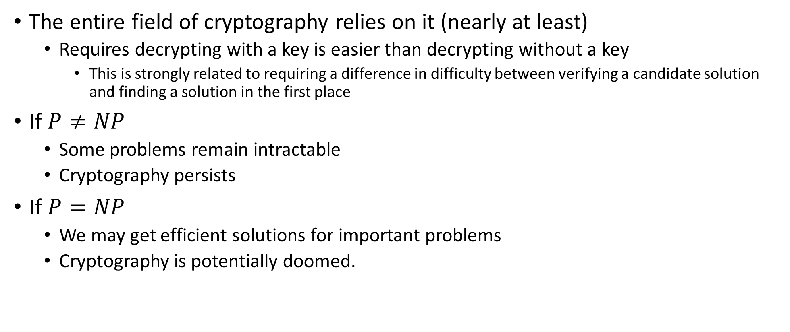
Why should YOU care?
The entire field of cryptography relies on it (nearly at least)
  Requires decrypting with a key is easier than decrypting without a key
    This is strongly related to requiring a difference in difficulty between verifying a candidate solution and finding a solution in the first place
If $P≠NP$
  Some problems remain intractable
  Cryptography persists
If $P=NP$
  We may get efficient solutions for important problems
  Cryptography is potentially doomed.

Slide 28
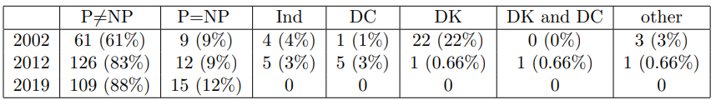
Does P=NP?
https://www.cs.umd.edu/users/gasarch/BLOGPAPERS/pollpaper3.pdf

Slide 29
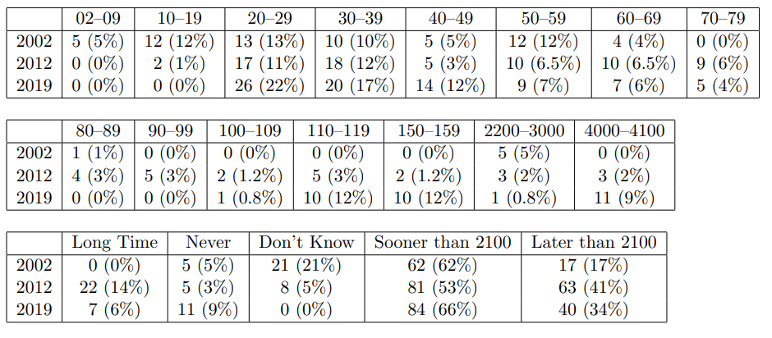
When Will P=NP be resolved?

Slide 30
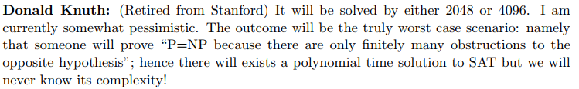
Notable Statements on P vs NP
Suggested rephrased question:

