Slide 1

CSE 332 Spring 2026 Lecture 25: Complexity and Tractability
Nathan Brunelle
http://www.cs.uw.edu/332

Slide 2
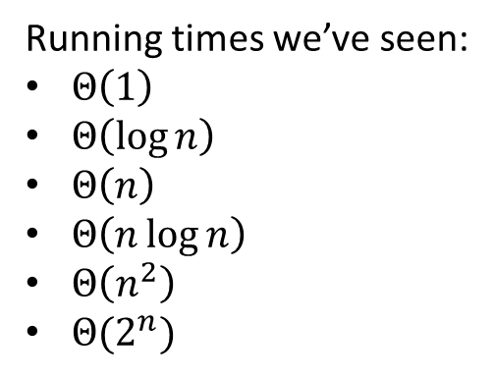
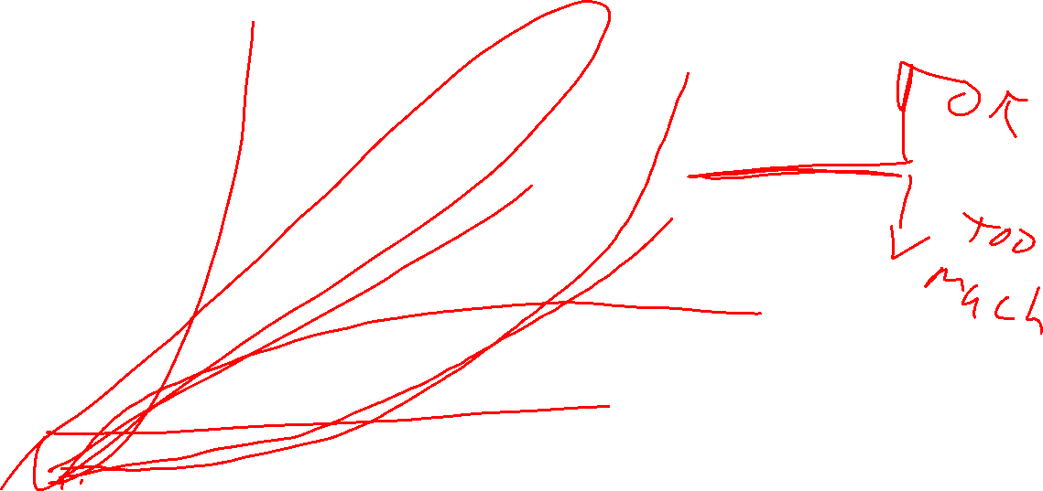
Running Times - Graph
Running times we’ve seen:
$Θ\left(1\right)$
$Θ\left(\log{n}\right)$
$Θ\left(n\right)$
$Θ\left(n\log{n}\right)$
$Θ\left(n^{2}\right)$
$Θ(2^{n})$
Operations
Input Size

Slide 3
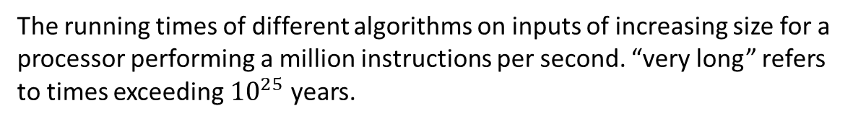
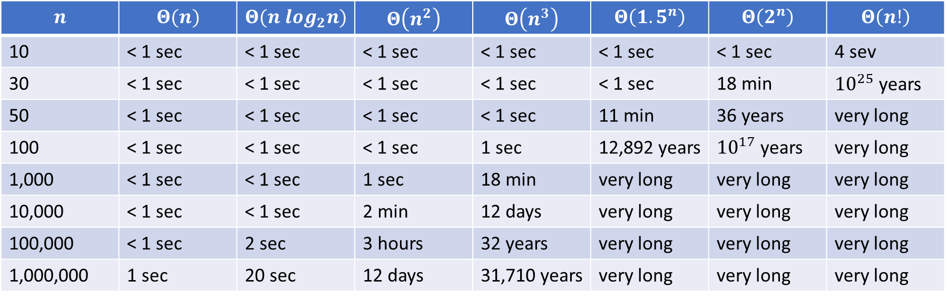
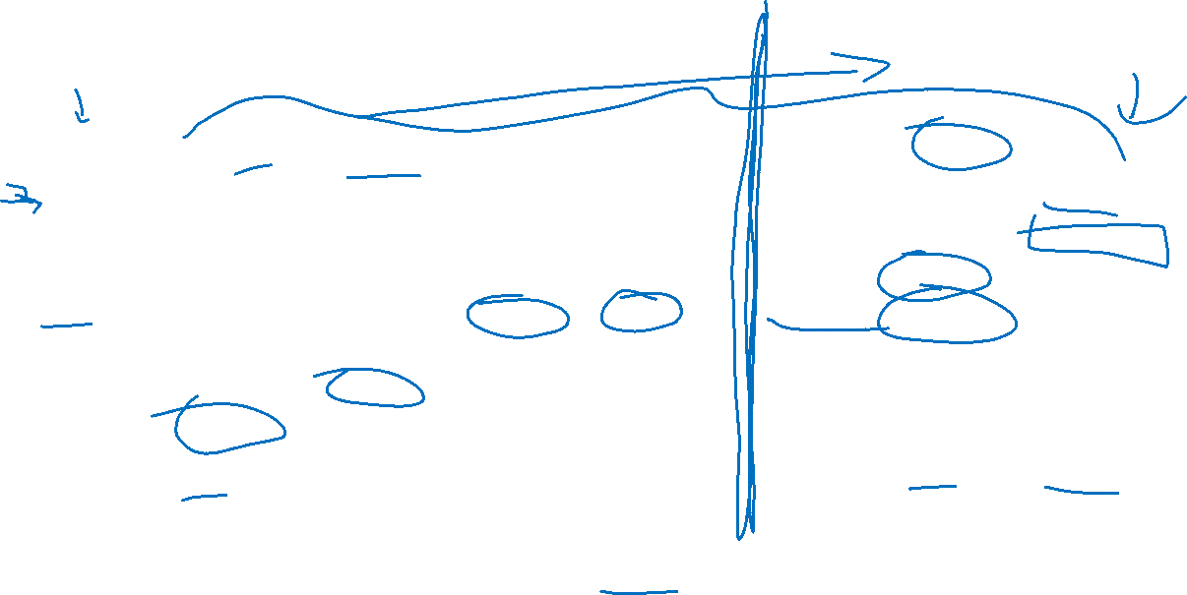
Running Times - Table
$$n$$ | $$Θ(n)$$ | $$Θ(n log_{2}n)$$ | $$Θ\left(n^{2}\right)$$ | $$Θ\left(n^{3}\right)$$ | $$Θ\left(1.5^{n}\right)$$ | $$Θ\left(2^{n}\right)$$ | $$Θ\left(n!\right)$$
10 | < 1 sec | < 1 sec | < 1 sec | < 1 sec | < 1 sec | < 1 sec | 4 sev
30 | < 1 sec | < 1 sec | < 1 sec | < 1 sec | < 1 sec | 18 min | ${10}^{25}$ years
50 | < 1 sec | < 1 sec | < 1 sec | < 1 sec | 11 min | 36 years | very long
100 | < 1 sec | < 1 sec | < 1 sec | 1 sec | 12,892 years | ${10}^{17}$ years | very long
1,000 | < 1 sec | < 1 sec | 1 sec | 18 min | very long | very long | very long
10,000 | < 1 sec | < 1 sec | 2 min | 12 days | very long | very long | very long
100,000 | < 1 sec | 2 sec | 3 hours | 32 years | very long | very long | very long
1,000,000 | 1 sec | 20 sec | 12 days | 31,710 years | very long | very long | very long
The running times of different algorithms on inputs of increasing size for a processor performing a million instructions per second. “very long” refers to times exceeding ${10}^{25}$ years.

Slide 4
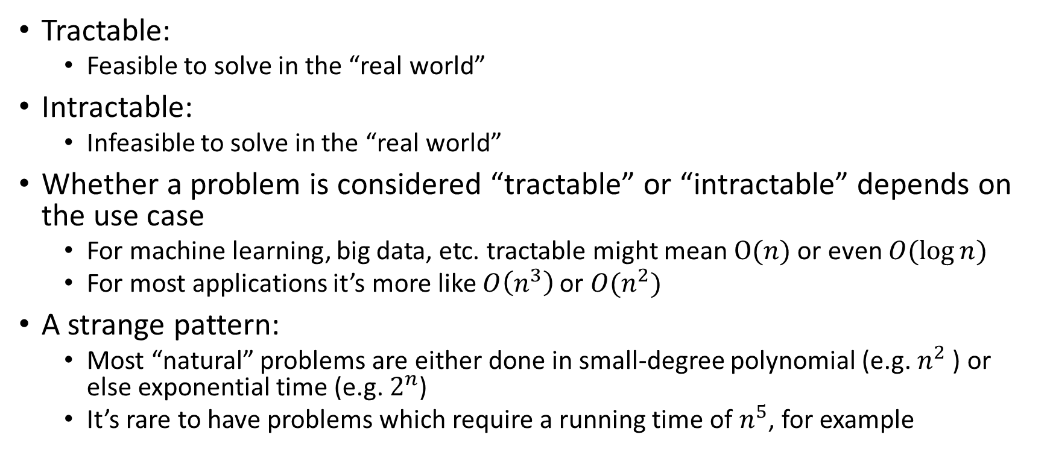
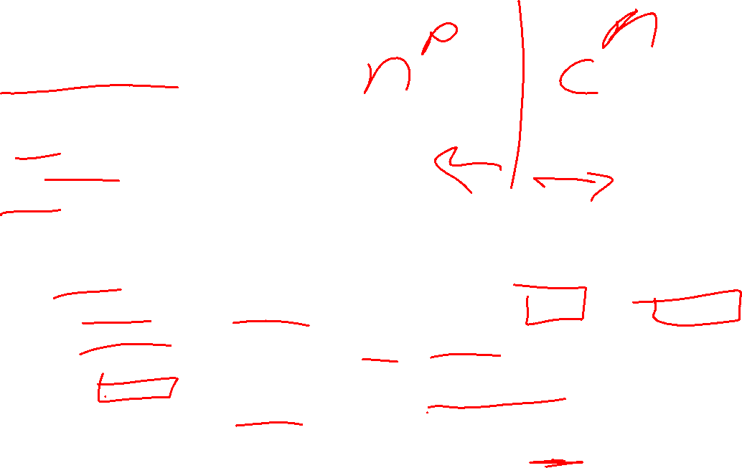
Tractability
Tractable:
Feasible to solve in the “real world”
Intractable:
Infeasible to solve in the “real world”
Whether a problem is considered “tractable” or “intractable” depends on the use case
For machine learning, big data, etc. tractable might mean $O(n)$ or even $O(\log{n})$
For most applications it’s more like $O\left(n^{3}\right)$ or $O(n^{2})$
A strange pattern:
Most “natural” problems are either done in small-degree polynomial (e.g. $n^{2}$ ) or else exponential time (e.g. $2^{n}$)
It’s rare to have problems which require a running time of $n^{5}$, for example

Slide 5
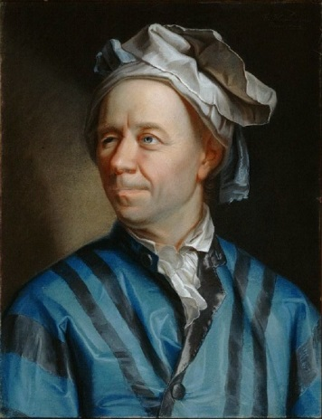
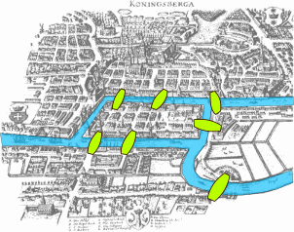
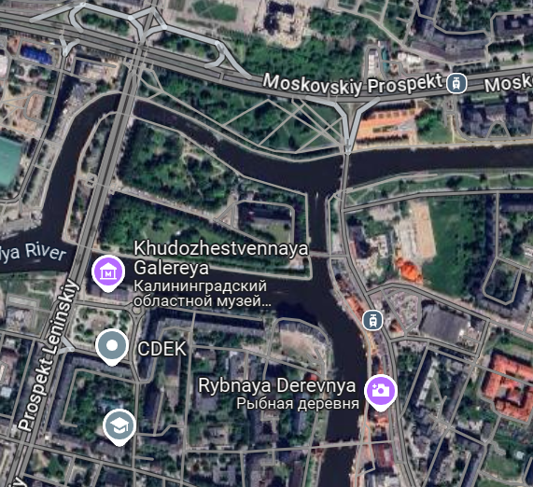
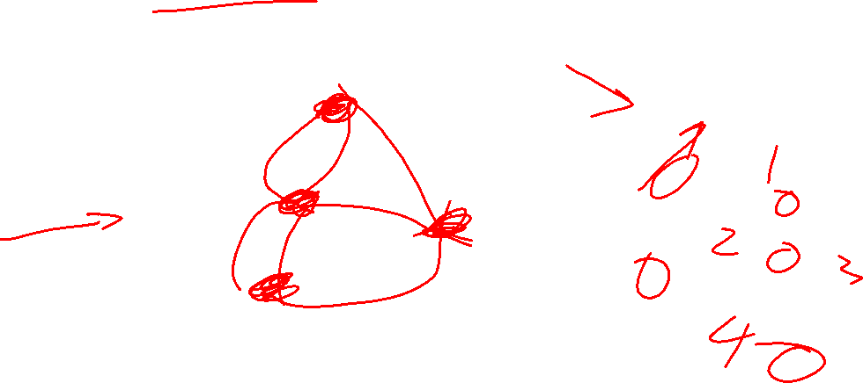
7 Bridges of Königsberg
B
A
D
C
The Pregel River runs through the city of Koenigsberg, creating 2 islands. Among these 2 islands and the 2 sides of the river, there are 7 bridges. Is there any path starting at one landmass which crosses each bridge exactly once?

Slide 6
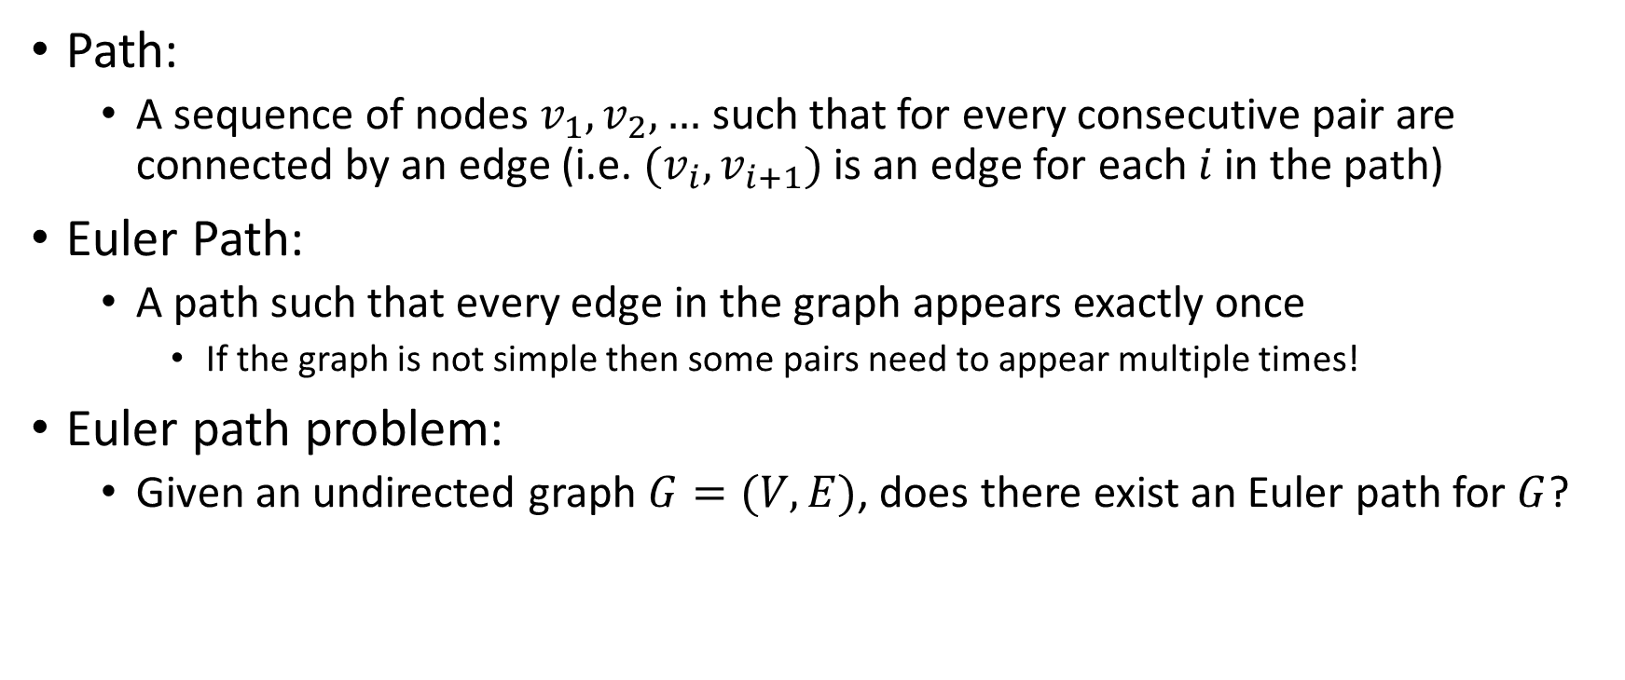

Euler Path Problem
B
B
A
A
D
D
C
Path:
A sequence of nodes $v_{1},v_{2},…$ such that for every consecutive pair are connected by an edge (i.e. $(v_{i},v_{i+1})$ is an edge for each $i$ in the path)
Euler Path:
A path such that every edge in the graph appears exactly once
If the graph is not simple then some pairs need to appear multiple times!
Euler path problem:
Given an undirected graph $G=(V,E)$, does there exist an Euler path for $G$?
C

Slide 7


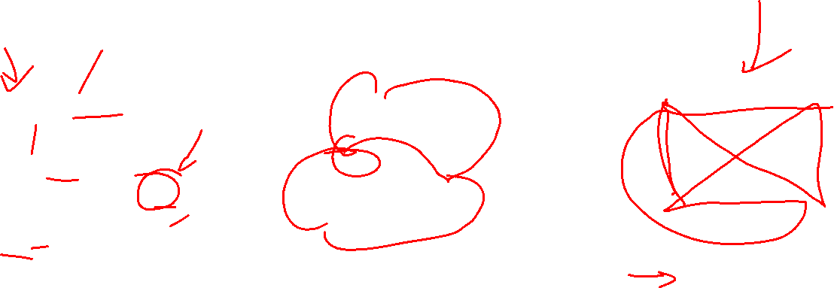
Euler Path Examples
Which of the graphs below have an Euler path?
B
B
D
B
A
A
D
D
A
C
C
C
Euler path exists!
$$A,B,D,A,C,D$$
No Euler path exists!
Euler path exists!
$$A,B,C,D,A,C,B,D$$

Slide 8
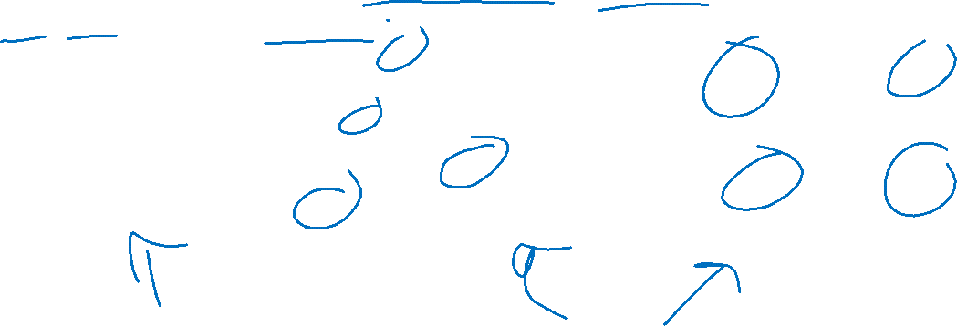
Euler’s Theorem
A graph has an Euler Path if and only if it is connected and has exactly 0 or 2 nodes with odd degree.
B
B
D
B
A
A
D
D
A
C
C
C
Euler path exists!
$$A,B,D,A,C,D$$
No Euler path exists!
Euler path exists!
$$A,B,C,D,A,C,B,D$$

Slide 9
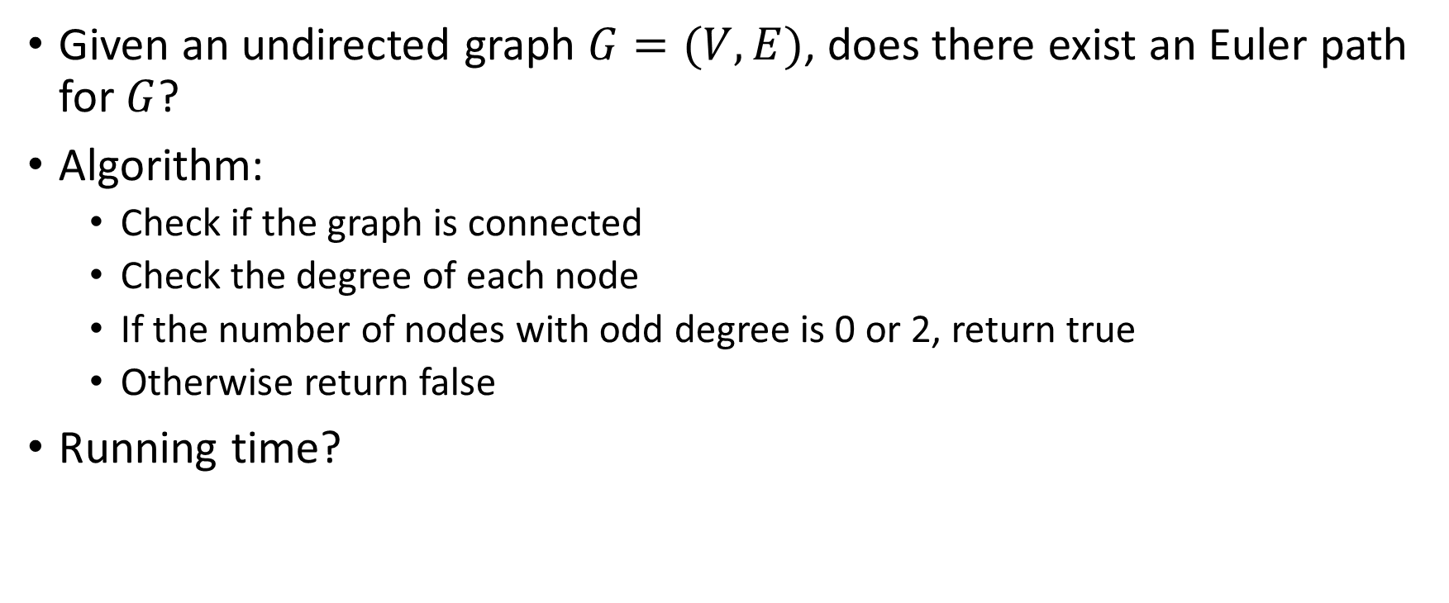
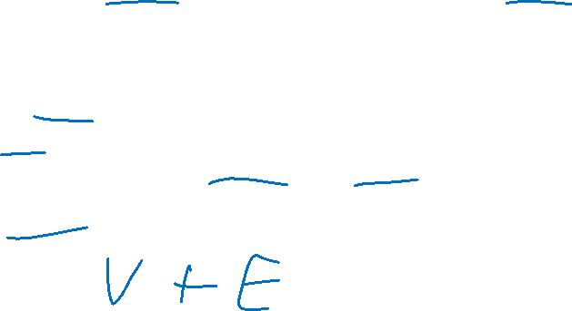
Algorithm for the Euler Path Problem
Given an undirected graph $G=(V,E)$, does there exist an Euler path for $G$?
Algorithm:
Check if the graph is connected
Check the degree of each node
If the number of nodes with odd degree is 0 or 2, return true
Otherwise return false
Running time?

Slide 10
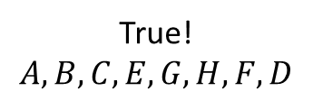


A Seemingly Similar Problem
Hamiltonian Path:
A path that includes every node in the graph exactly once
Hamiltonian Path Problem:
Given a graph $G=(V,E)$, does that graph have a Hamiltonian Path?
B
G
A
C
E
True!
$$A, B, C, E, G, H, F, D$$
H
F
D

Slide 11
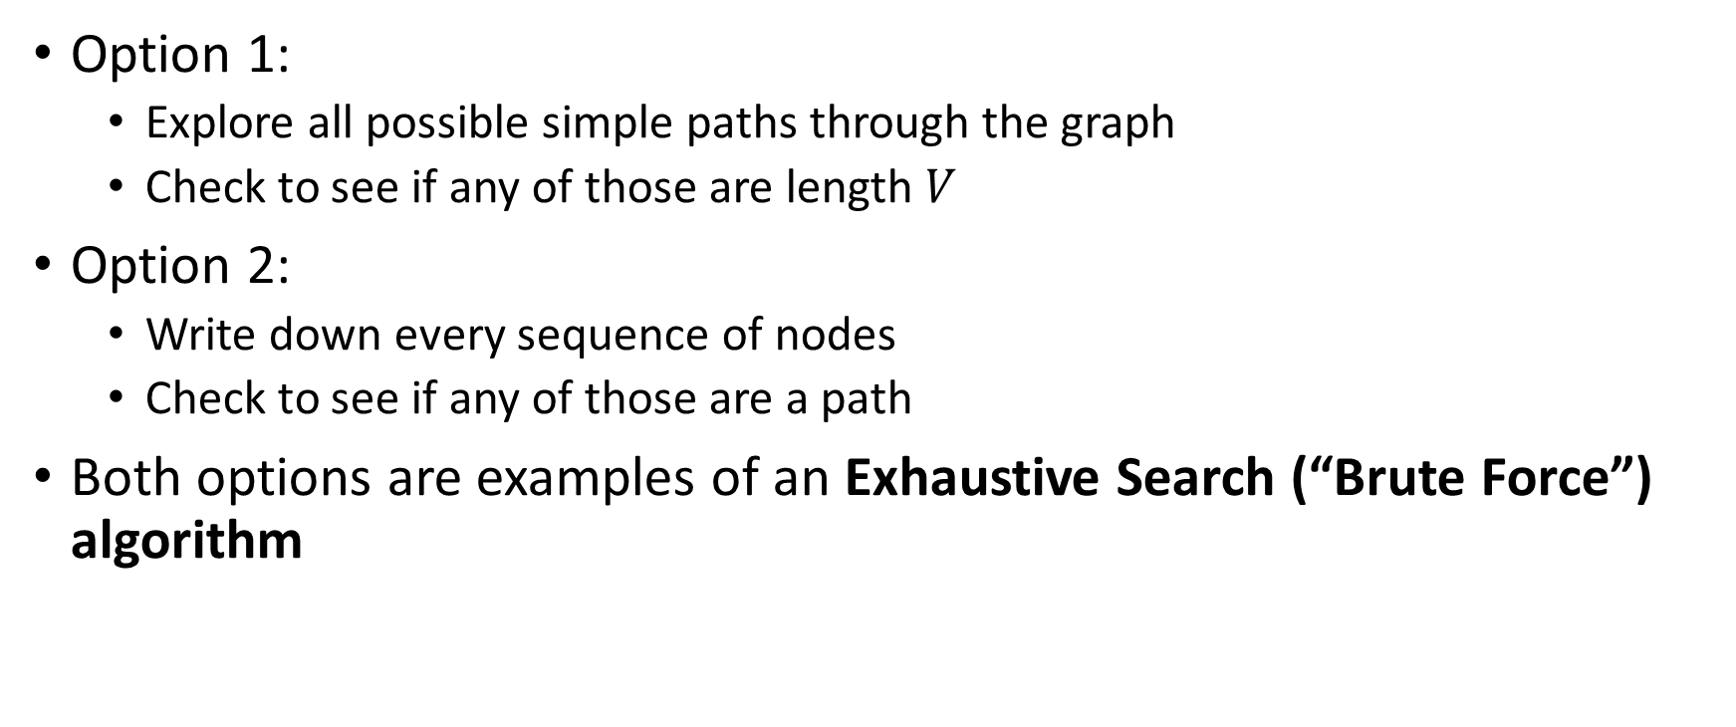

Algorithms for the Hamiltonian Path Problem
Option 1:
Explore all possible simple paths through the graph
Check to see if any of those are length $V$
Option 2:
Write down every sequence of nodes
Check to see if any of those are a path
Both options are examples of an Exhaustive Search (“Brute Force”) algorithm

Slide 12

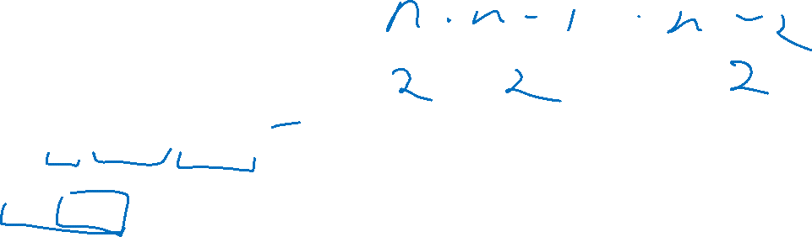
Option 2: List all sequences, look for a path
Running time:
$G=(V,E)$
Number of permutations of $V$ is $\left|V\right|!$
$n!=n⋅\left(n−1\right)⋅\left(n−2\right)⋅…⋅2⋅1$
How does $n!$ compare with $2^{n}$?
$n!∈Ω(2^{n})$
Exponential running time!

Slide 13
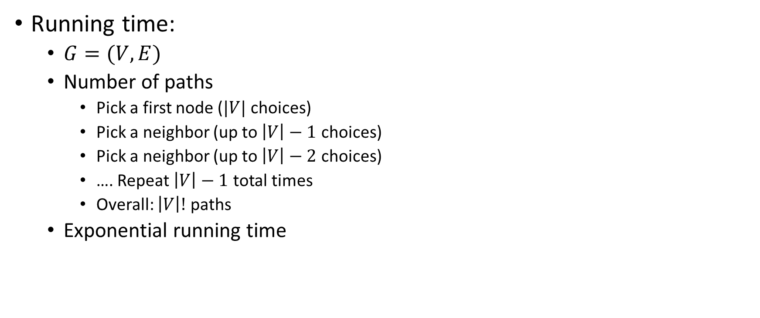


Option 1: Explore all simple paths, check for one of length $V$
Running time:
$G=(V,E)$
Number of paths
Pick a first node ($|V|$ choices)
Pick a neighbor (up to $\left|V\right|−1$ choices)
Pick a neighbor (up to $\left|V\right|−2$ choices)
…. Repeat $\left|V\right|−1$ total times
Overall: $\left|V\right|!$ paths
Exponential running time
B
D
E
A
C

Slide 14
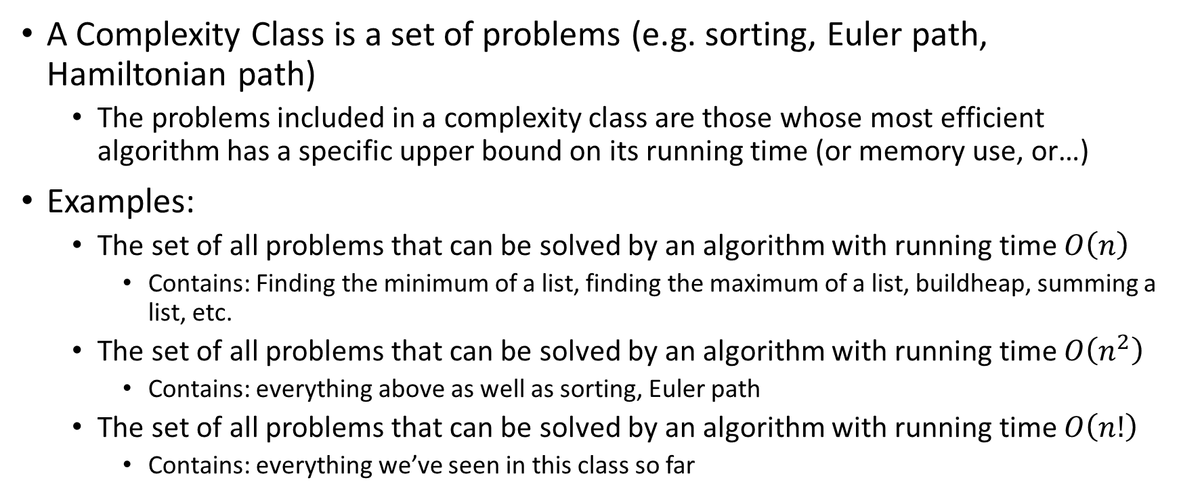
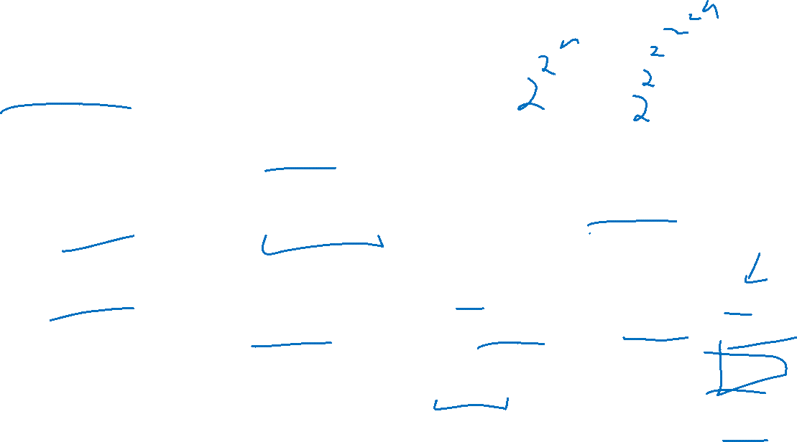
Complexity Classes
A Complexity Class is a set of problems (e.g. sorting, Euler path, Hamiltonian path)
The problems included in a complexity class are those whose most efficient algorithm has a specific upper bound on its running time (or memory use, or…)
Examples:
The set of all problems that can be solved by an algorithm with running time $O\left(n\right)$
Contains: Finding the minimum of a list, finding the maximum of a list, buildheap, summing a list, etc.
The set of all problems that can be solved by an algorithm with running time $O\left(n^{2}\right)$
Contains: everything above as well as sorting, Euler path
The set of all problems that can be solved by an algorithm with running time $O\left(n!\right)$
Contains: everything we’ve seen in this class so far

Slide 15
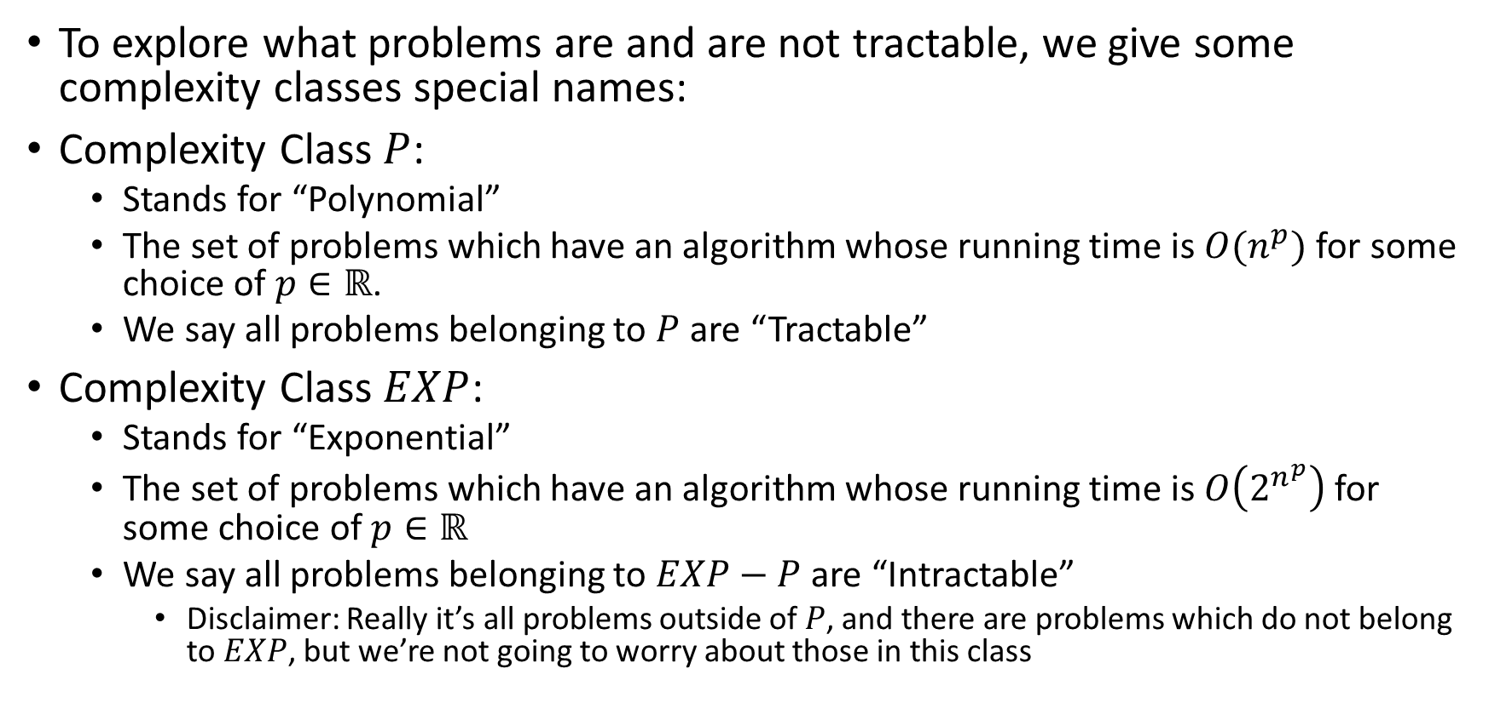

Complexity Classes and Tractability
To explore what problems are and are not tractable, we give some complexity classes special names:
Complexity Class $P$:
Stands for “Polynomial”
The set of problems which have an algorithm whose running time is $O(n^{p})$ for some choice of $p∈ℝ$.
We say all problems belonging to $P$ are “Tractable”
Complexity Class $EXP$:
Stands for “Exponential”
The set of problems which have an algorithm whose running time is $O\left(2^{n^{p}}\right)$ for some choice of $p∈ℝ$
We say all problems belonging to $EXP−P$ are “Intractable”
Disclaimer: Really it’s all problems outside of $P$, and there are problems which do not belong to $EXP$, but we’re not going to worry about those in this class

Slide 16



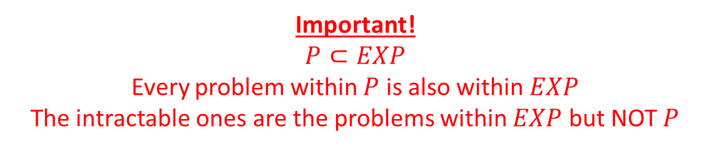
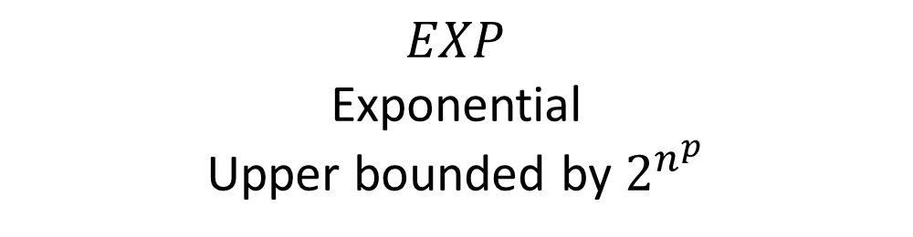
$EXP$ and $P$
Important!
$$P⊂EXP$$
Every problem within $P$ is also within $EXP$
The intractable ones are the problems within $EXP$ but NOT $P$
$$EXP$$
Exponential
Upper bounded by $2^{n^{p}}$
$$P$$
Polynomial
Upper bounded by $n^{p}$
Intractable
Tractable

Slide 17
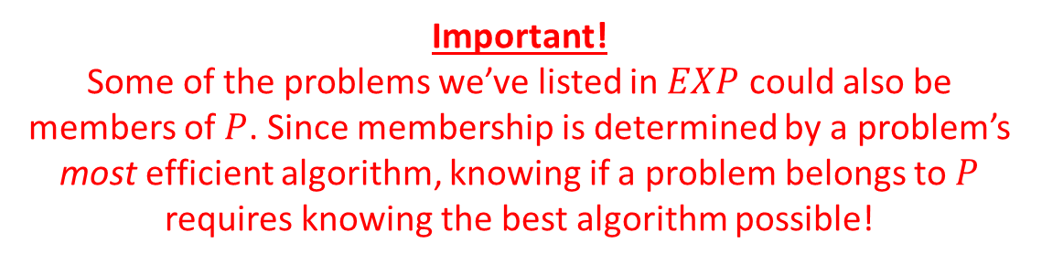
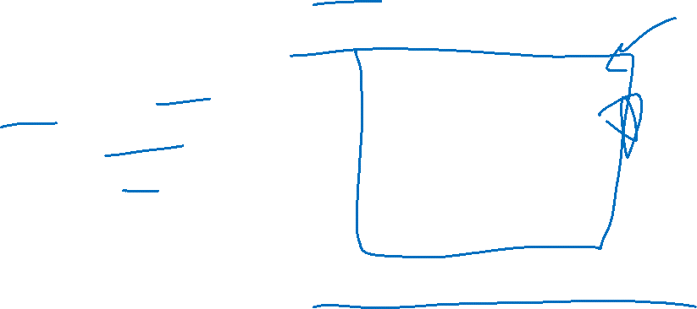


Members of $EXP$ and $P$
Important!
Some of the problems we’ve listed in $EXP$ could also be members of $P$. Since membership is determined by a problem’s most efficient algorithm, knowing if a problem belongs to $P$ requires knowing the best algorithm possible!
$$EXP$$
Sorting
Shortest Path
Euler Path
Hamiltonian Path
Longest Path
Vertex Cover
Independent Set
Satisfiability
Most Board Game Strategies
$$P$$
Tractable
Intractable

Slide 18
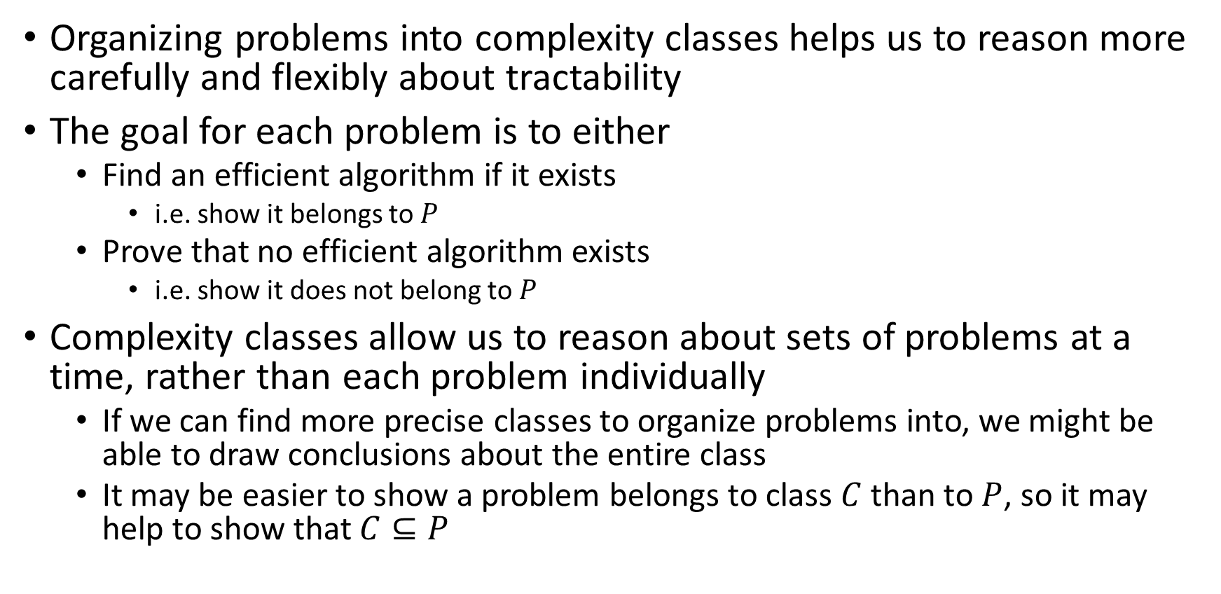
Studying Complexity and Tractability
Organizing problems into complexity classes helps us to reason more carefully and flexibly about tractability
The goal for each problem is to either
Find an efficient algorithm if it exists
i.e. show it belongs to $P$
Prove that no efficient algorithm exists
i.e. show it does not belong to $P$
Complexity classes allow us to reason about sets of problems at a time, rather than each problem individually
If we can find more precise classes to organize problems into, we might be able to draw conclusions about the entire class
It may be easier to show a problem belongs to class $C$ than to $P$, so it may help to show that $C⊆P$

Slide 19

Some problems in $EXP$ seem “easier”
There are some problems that we do not have polynomial time algorithms to solve, but provided answers are easy to check
Hamiltonian Path:
It’s “hard” to look at a graph and determine whether it has a Hamiltonian Path
It’s “easy” to look at a graph and a candidate path together and determine whether THAT path is a Hamiltonian Path
It’s easy to verify whether a given path is a Hamiltonian path

Slide 20
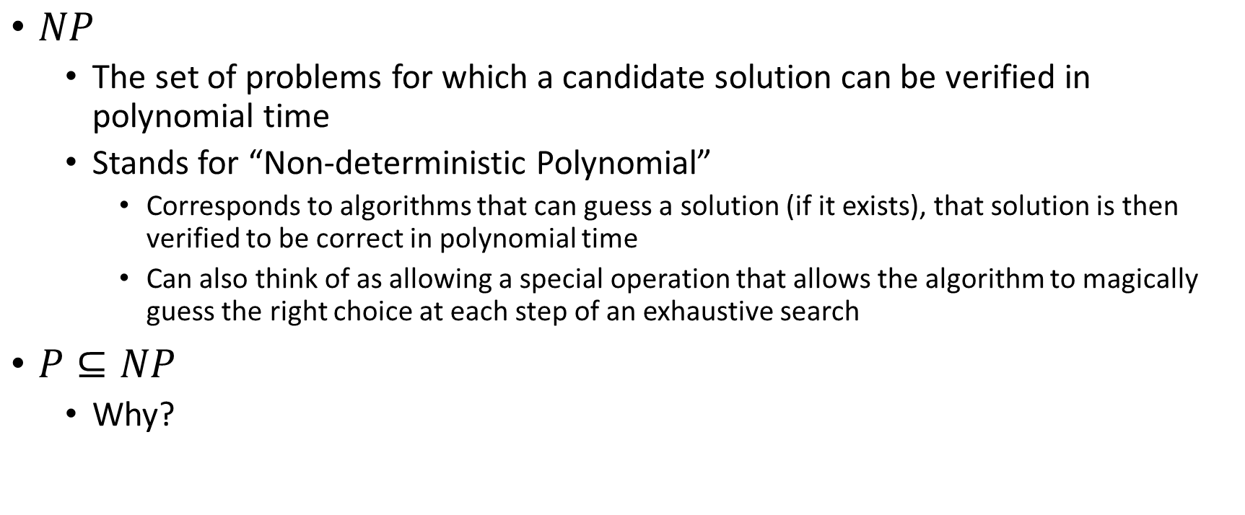

Class $NP$
$NP$
The set of problems for which a candidate solution can be verified in polynomial time
Stands for “Non-deterministic Polynomial”
Corresponds to algorithms that can guess a solution (if it exists), that solution is then verified to be correct in polynomial time
Can also think of as allowing a special operation that allows the algorithm to magically guess the right choice at each step of an exhaustive search
$P⊆NP$
Why?

Slide 21
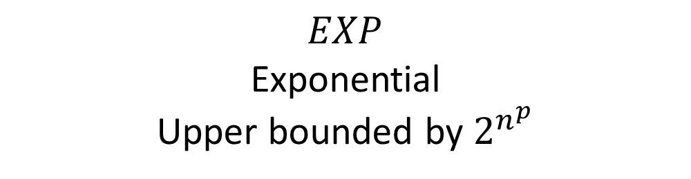



$EXP⊃NP⊇P$
$$EXP$$
Exponential
Upper bounded by $2^{n^{p}}$
$$NP$$
Nondeterministic Polynomial
Verified in $n^{p}$ time
$$P$$
Polynomial
Upper bounded by $n^{p}$
Gap?
Unknown!

Slide 22
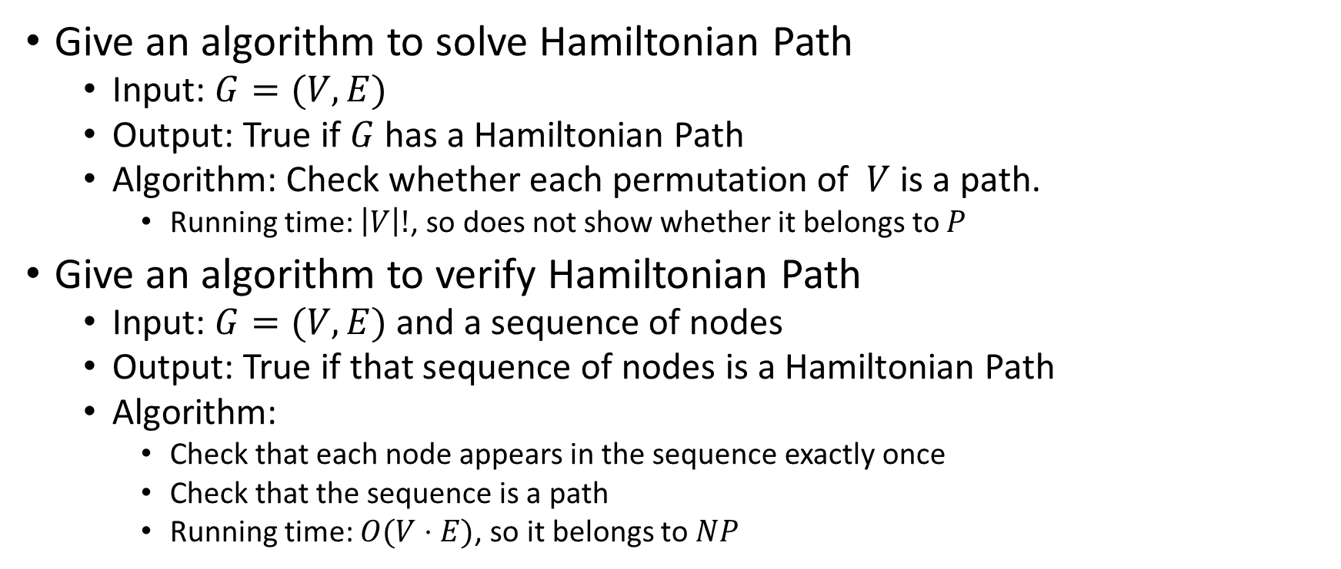
Solving and Verifying Hamiltonian Path
Give an algorithm to solve Hamiltonian Path
Input: $G=(V,E)$
Output: True if $G$ has a Hamiltonian Path
Algorithm: Check whether each permutation of $V$ is a path.
Running time: $\left|V\right|!$, so does not show whether it belongs to $P$
Give an algorithm to verify Hamiltonian Path
Input: $G=(V,E)$ and a sequence of nodes
Output: True if that sequence of nodes is a Hamiltonian Path
Algorithm:
Check that each node appears in the sequence exactly once
Check that the sequence is a path
Running time: $O(V⋅E)$, so it belongs to $NP$

Slide 23

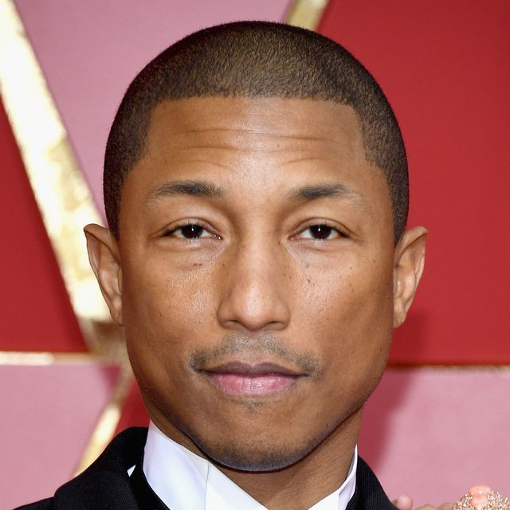










Party Problem
Draw Edges between people who don’t get along
How many people can I invite to a party if everyone must get along?

Slide 24

Independent Set
Independent set:
$S⊆V$ is an independent set if no two nodes in $S$ share an edge
Independent Set Problem:
Given a graph $G=(V,E)$ and a number $k$, determine whether there is an independent set $S$ of size $k$

Slide 25
Independent Set Example
Independent set of size 6

Slide 26
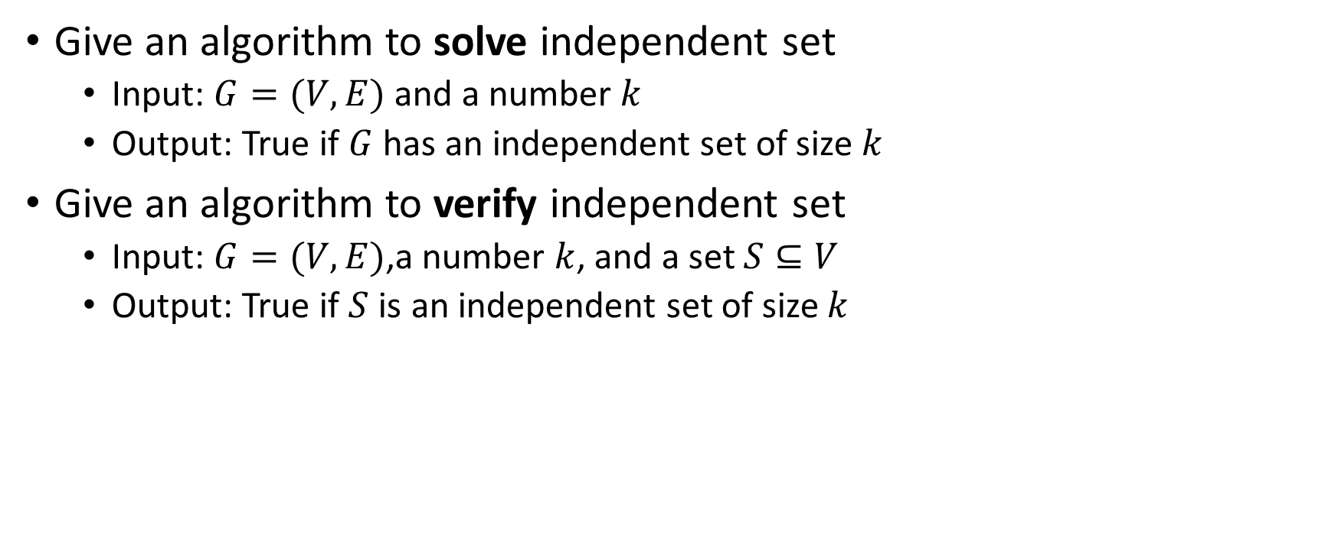
Solving and Verifying Independent Set
Give an algorithm to solve independent set
Input: $G=(V,E)$ and a number $k$
Output: True if $G$ has an independent set of size $k$
Give an algorithm to verify independent set
Input: $G=(V,E)$,a number $k$, and a set $S⊆V$
Output: True if $S$ is an independent set of size $k$

Slide 27
Baseball

Slide 28
Generalized Baseball
Need to place defenders on bases such that every edge is defended
How many defenders would suffice?

Slide 29

Vertex Cover
Vertex Cover:
$C⊆V$ is a vertex cover if every edge in $E$ has one of its endpoints in $C$
Vertex Cover Problem:
Given a graph $G=(V,E)$ and a number $k$, determine if there is a vertex cover $C$ of size $k$

Slide 30
Vertex Cover Example
Vertex cover of size 5

Slide 31
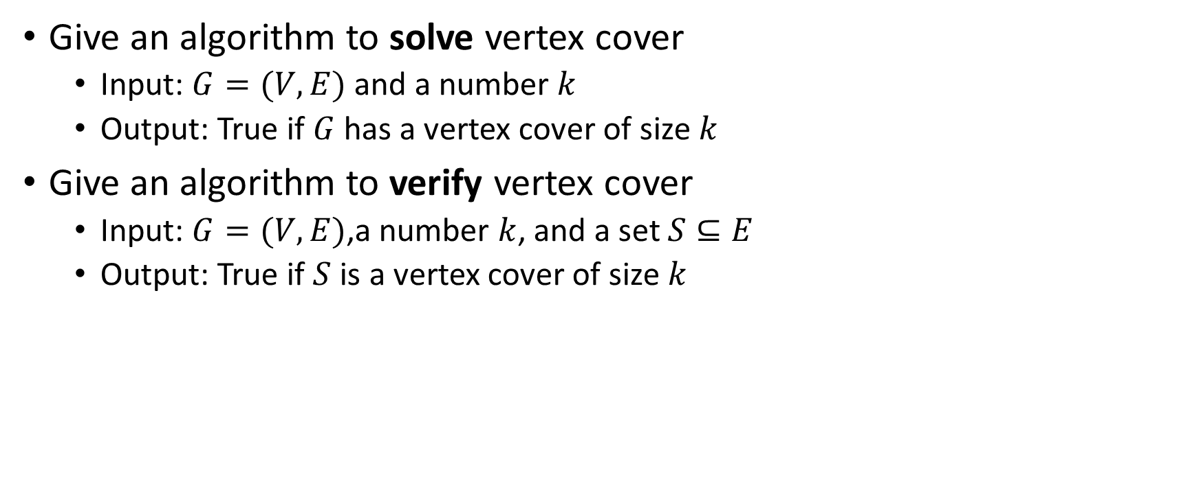
Solving and Verifying Vertex Cover
Give an algorithm to solve vertex cover
Input: $G=(V,E)$ and a number $k$
Output: True if $G$ has a vertex cover of size $k$
Give an algorithm to verify vertex cover
Input: $G=(V,E)$,a number $k$, and a set $S⊆E$
Output: True if $S$ is a vertex cover of size $k$

