Slide 1
CSE 332 Winter 2026
Lecture 13: Sorting 2
Nathan Brunelle
http://www.cs.uw.edu/332

Slide 2
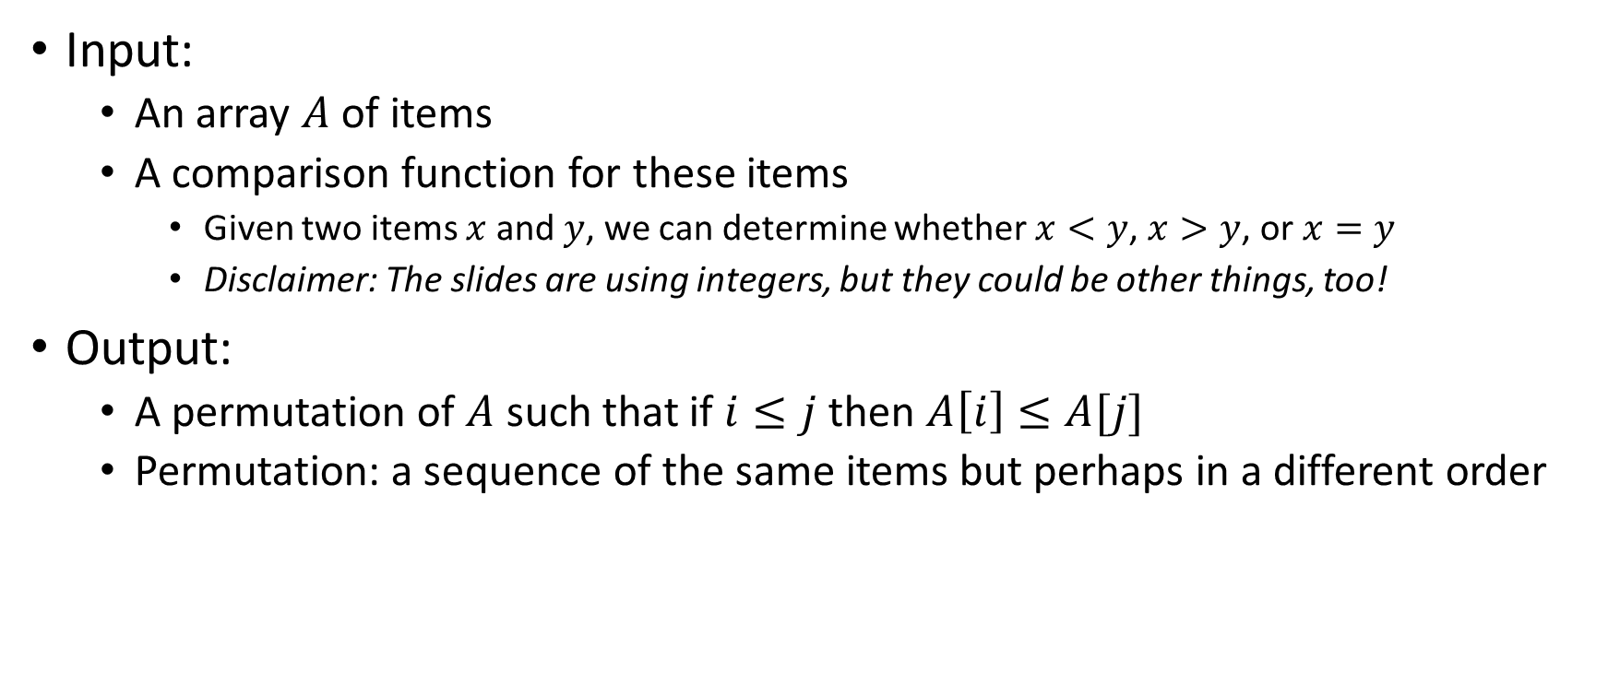
Sorting Definition
Input:
  An array $A$ of items
  A comparison function for these items
    Given two items $x$ and $y$, we can determine whether $x<y$, $x>y$, or $x=y$
    Disclaimer: The slides are using integers, but they could be other things, too!
Output:
  A permutation of $A$ such that if $i≤j$ then $A\left[i\right]≤A[j]$
  Permutation: a sequence of the same items but perhaps in a different order

Slide 3

Properties To Consider
Worst case running time
In place:
  We only need to use the pre-existing array to do sorting
  Constant extra space (only some additional variables needed)
  Insertion Sort, Heap Sort
Adaptive
  The running improves as the given list is closer to being sorted
  It should be linear time for a pre-sorted list, and nearly linear time if the list is nearly sorted
  Insertion Sort
Online
  We can start sorting before we have the entire list.
  Insertion Sort
Stable
  “Tied” elements keep their original order
  Insertion Sort

Slide 4
Insertion Sort
Idea: Maintain a sorted list prefix, extend that prefix by “inserting” the next element
Sorted Prefix
3
5
7
8
10
12
9
2
4
6
1
11
3
5
7
8
10
9
12
2
4
6
1
11
3
5
7
8
9
10
12
2
4
6
1
11
Sorted Prefix
3
5
7
8
9
10
12
2
4
6
1
11

Slide 5
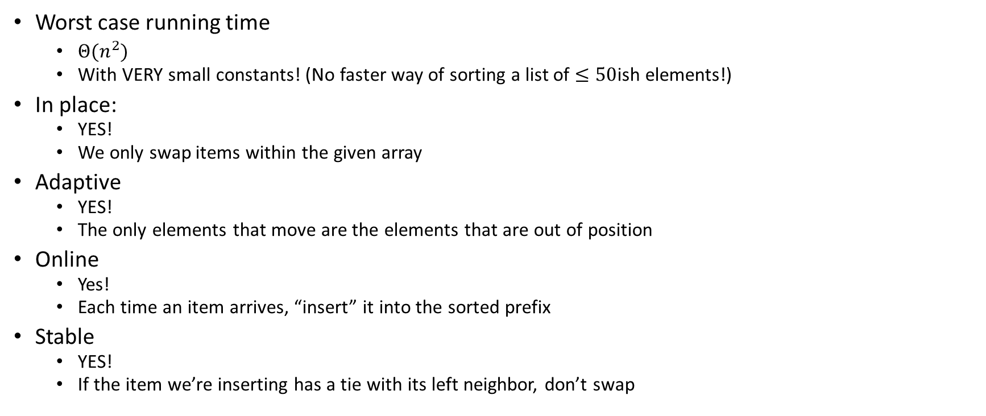

Insertion Sort Properties
Summary: except for its asymptotic running time, it has everything you might want!
Worst case running time
  $Θ(n^{2})$
  With VERY small constants! (No faster way of sorting a list of $≤50$ish elements!)
In place:
  YES!
  We only swap items within the given array
Adaptive
  YES!
  The only elements that move are the elements that are out of position
Online
  Yes!
  Each time an item arrives, “insert” it into the sorted prefix
Stable
  YES!
  If the item we’re inserting has a tie with its left neighbor, don’t swap

Slide 6
Heap Sort
Idea: Insert all items into a max heap, extract the largest one-by-one to fill sorted list from end to beginning, all the while the heap and sorted list share the same array
Heap
Heap
List
10
9
6
8
7
5
2
4
1
3
9
8
6
4
7
5
2
3
1
10
0
1
2
3
4
5
6
7
8
9
0
1
2
3
4
5
6
7
8
9
10
9
9
0
6
8
0
6
8
1
7
5
2
2
4
1
7
5
2
2
3
4
5
6
3
4
5
6
4
1
3
3
1
7
8
9
7
8

Slide 7
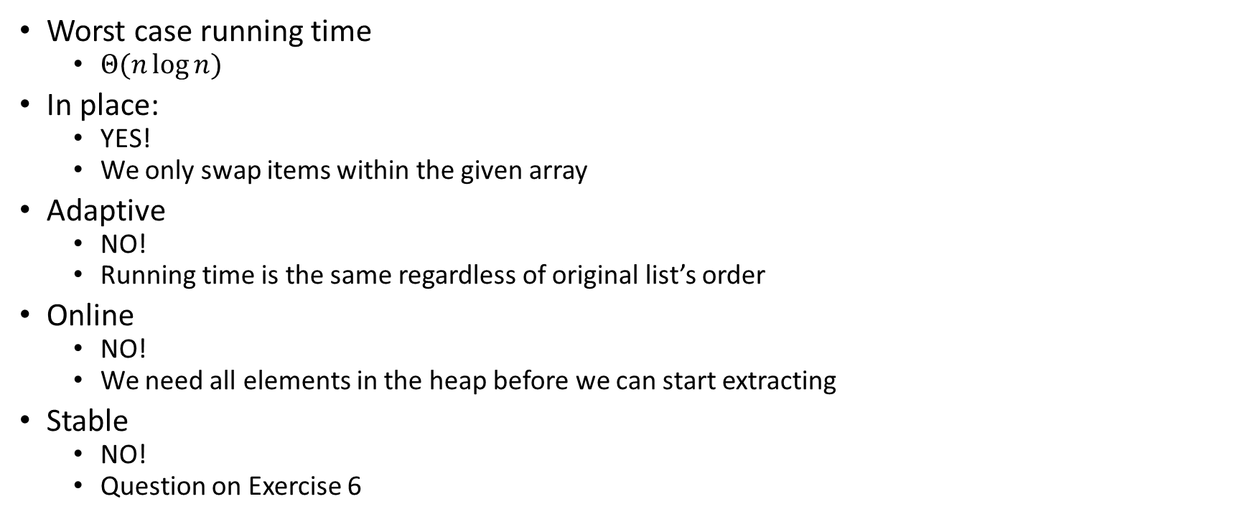
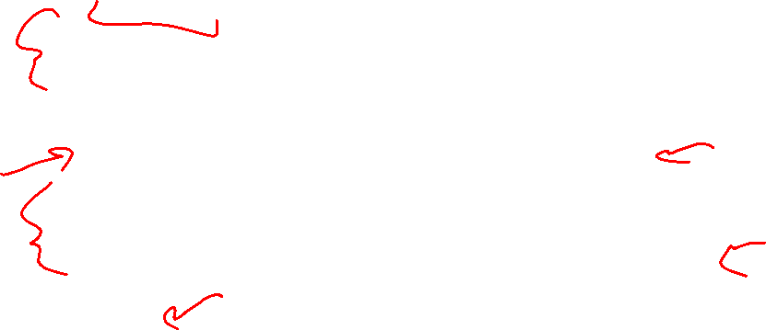
Heap Sort Properties
Worst case running time
  $Θ(n\log{n})$
In place:
  YES!
  We only swap items within the given array
Adaptive
  NO!
  Running time is the same regardless of original list’s order
Online
  NO!
  We need all elements in the heap before we can start extracting
Stable
  NO!
  Question on Exercise 6

Slide 8
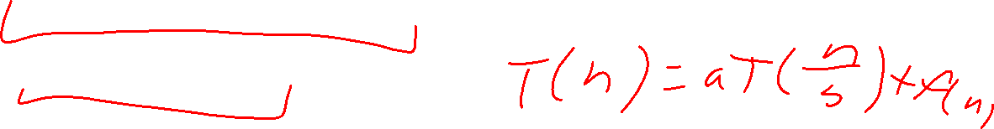
Divide And Conquer Sorting
Divide and Conquer:
  Recursive algorithm design technique
  Solve a large problem by breaking it up into smaller versions of the same problem

Slide 9

Divide and Conquer
Base Case:
  If the problem is “small” then solve directly and return
Divide:
  Break the problem into subproblem(s), each smaller instances
Conquer:
  Solve subproblem(s) recursively
Combine:
  Use solutions to subproblems to solve original problem
A
B

Slide 10
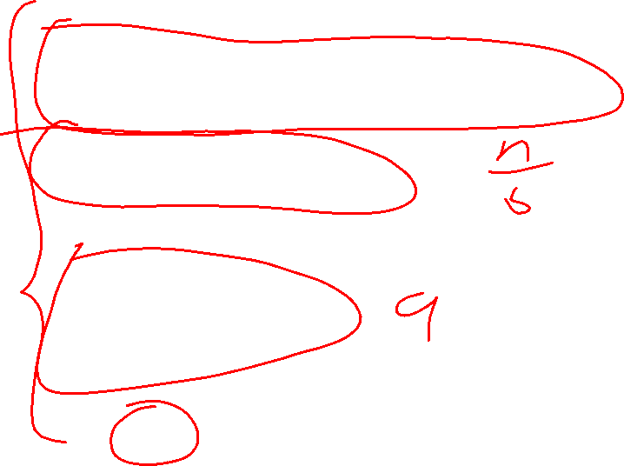
Divide and Conquer Template Pseudocode
def my_DandC(problem){
// Base Case
if (problem.size() <= small_value){
return solve(problem); // directly solve (e.g., brute force)
}
// Divide
List subproblems = divide(problem);
// Conquer
solutions = new List();
for (sub : subproblems){
subsolution = my_DandC(sub);
solutions.add(subsolution);
}
// Combine
return combine(solutions);
}

Slide 11
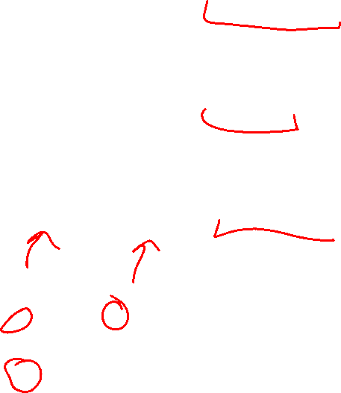
Merge Sort
5
8
2
9
4
1
Base Case:
  If the list is of length 1 or 0, it’s already sorted, so just return it
Divide:
  Split the list into two “sublists” of (roughly) equal length
Conquer:
  Sort both lists recursively
Combine:
  Merge sorted sublists into one sorted list
5
5
8
2
9
4
1
2
5
8
1
4
9
2
5
8
1
4
9
1
2
4
5
8
9

Slide 12








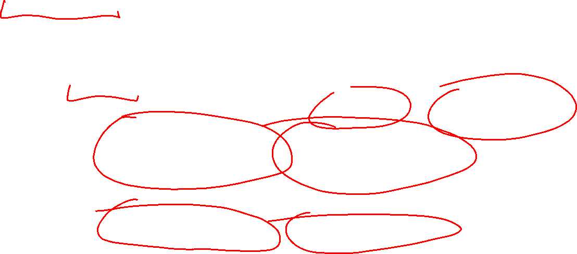
Merge Sort In Action!
Sort between indices $low$ and $high$
5
8
2
9
4
1
3
7
$$low$$
$$high$$
Base Case: if $low$ == $high$ then that range is already sorted!
Divide and Conquer: Otherwise call mergesort on ranges $\left(low,\frac{low+high}{2}\right)$ and $\left(\frac{low+high}{2}+1, high\right)$
5
8
2
9
4
1
3
7
$$low$$
$$\frac{low+high}{2}$$
$$\frac{low+high}{2}+1$$
$$high$$
2
5
8
9
1
3
4
7
After Recursion:
$$low$$
$$high$$

Slide 13

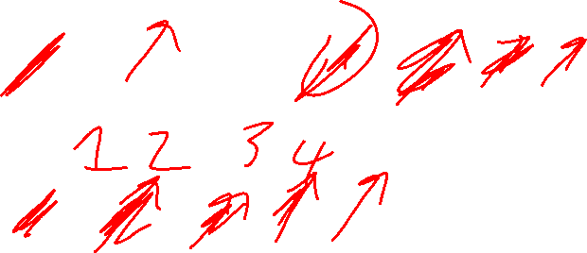


Merge (the combine part)
2
5
8
9
1
3
4
7
L next
R next
$$\frac{low+high}{2}+1$$
$$low$$
$$\frac{low+high}{2}$$
$$high$$
M next
Create a new array to merge into, and 3 pointers/indices:
L_next: the smallest “unmerged” thing on the left
R_next: the smallest “unmerged” thing on the right
M_next: where the next smallest thing goes in the merged array
One-by-one: put the smallest of L_next and R_next into M_next, then advance both M_next and whichever of L/R was used.

Slide 14
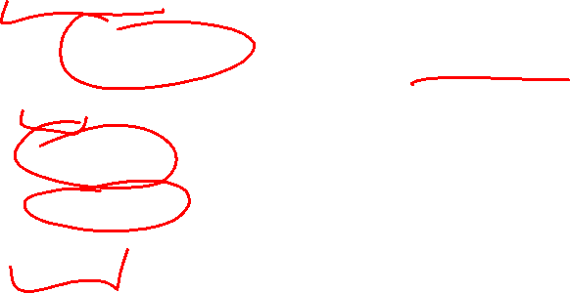
Merge Sort Pseudocode
void mergesort(myArray){
ms_helper(myArray, 0, myArray.length());
}
void mshelper(myArray, low, high){
if (low == high){return;} // Base Case
mid = (low+high)/2;
ms_helper(low, mid);
ms_helper(mid+1, high);
merge(myArray, low, mid, high);
}

Slide 15
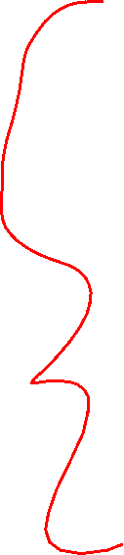
Merge Pseudocode
void merge(myArray, low, mid, high){
merged = new int[high-low+1]; // or whatever type is in myArray
l_next = low;
r_next = high;
m_next = 0;
while (l_next <= mid && r_next <= high){
if (myArray[l_next] <= myArray[r_next]){
merged[m_next++] = myArray[l_next++];
}
else{
merged[m_next++] = myArray[r_next++];
}
}
while (l_next <= mid){ merged[m_next++] = myArray[l_next++]; }
while (r_next <= high){ merged[m_next++] = myArray[r_next++]; }
for(i=0; i<=merged.length; i++){ myArray[i+low] = merged[i];}
}

Slide 16


Analyzing Merge Sort
Identify time required to Divide and Combine
Identify all subproblems and their sizes
Use recurrence relation to express recursive running time
Solve and express running time asymptotically
Divide: $0$ comparisons
Conquer: recursively sort two lists of size $\frac{n}{2}$
Combine: $n$ comparisons
Recurrence:
  $T\left(n\right)=0+T\left(\frac{n}{2}\right)+T\left(\frac{n}{2}\right)+n$
  $T(n)=2T\left(\frac{n}{2}\right)+n$

Slide 17








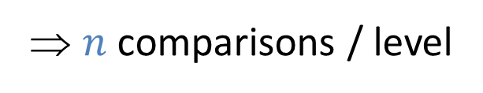


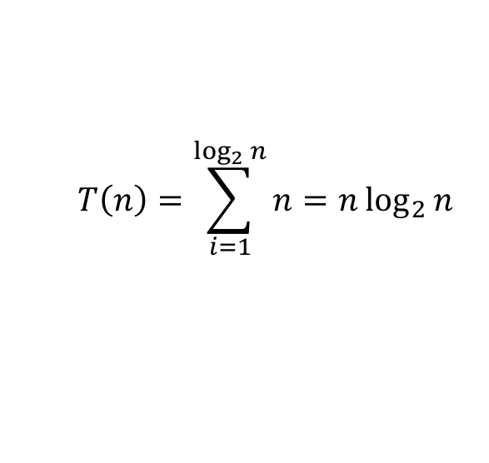

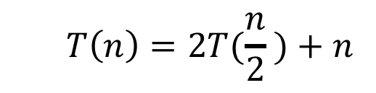








Red box represents a problem instance
Blue value represents time spent at that level of recursion
  $$T\left(n\right)=2T(\frac{n}{2} )+n$$
$$n$$
⇒ $n$ comparisons / level
$$n$$
$$n/2$$
$$\frac{n}{2}$$
$$n/2$$
$$\frac{n}{2}$$
$$\frac{n}{4}$$
$$\frac{n}{4}$$
$$\frac{n}{4}$$
$$\frac{n}{4}$$
$\log_{2}⁡n$ levels
of recursion
$$n/4$$
$$n/4$$
$$n/4$$
$$n/4$$
…
…
…
…
…
$$1$$
$$1$$
$$1$$
$$1$$
$$1$$
$$1$$
$$1$$
$$1$$
$$1$$
$$1$$
$$1$$
$$1$$
  $$T\left(n\right)=\sum_{i=1}^{\log_{2}{n}}{n}=n\log_{2}{n}$$

Slide 18
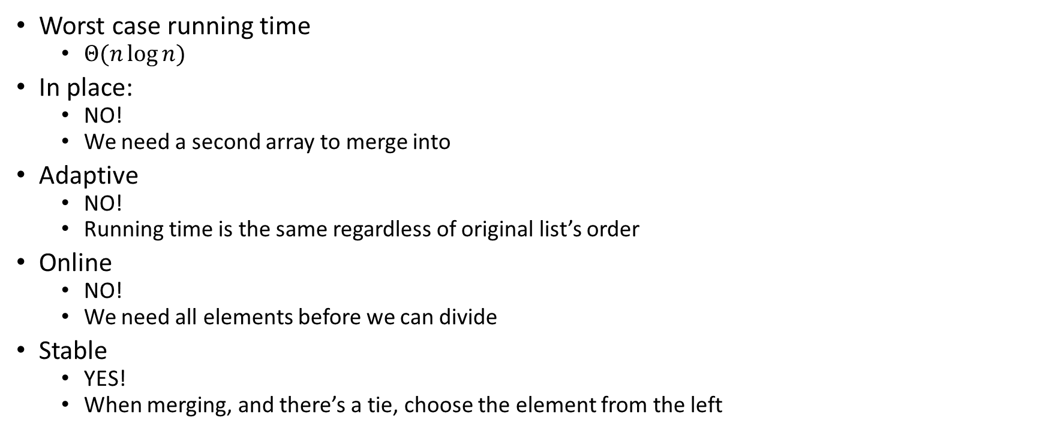
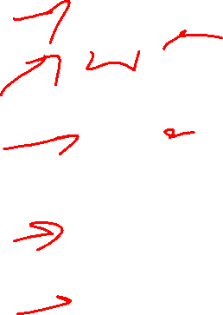
Merge Sort Properties
Worst case running time
  $Θ(n\log{n})$
In place:
  NO!
  We need a second array to merge into
Adaptive
  NO!
  Running time is the same regardless of original list’s order
Online
  NO!
  We need all elements before we can divide
Stable
  YES!
  When merging, and there’s a tie, choose the element from the left

Slide 19


Quicksort
Like Mergesort:
  Divide and conquer
  $O(n\log{n})$ run time (kind of…)
Unlike Mergesort:
  Divide step is the “hard” part
  Typically faster than Mergesort

Slide 20

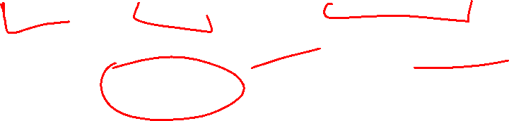
Quicksort
Idea: pick a pivot element, recursively sort two sublists around that element
Divide: select pivot element $p$, Partition($p$)
Conquer: recursively sort left and right sublists
Combine: Nothing!

Slide 21
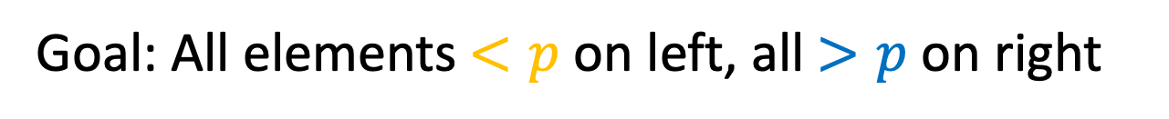

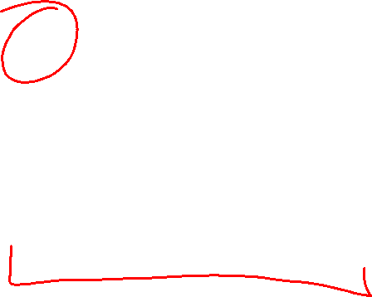
Partition (Divide step)
Given: a list, a pivot $p$
Start: unordered list
8
5
7
3
12
10
1
2
4
9
6
11
Goal: All elements $<p$ on left, all $>p$ on right
5
7
3
1
2
4
6
8
12
10
9
11

Slide 22
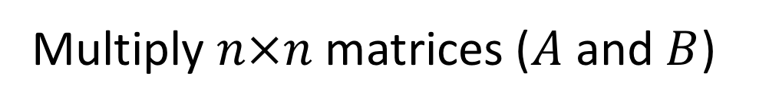

Partition, Procedure
If Begin value $< p$, move Begin right
Else swap Begin value with End value, move End Left
Done when Begin = End
8
5
7
3
12
10
1
2
4
9
6
11
8
5
7
3
12
10
1
2
4
9
6
11
8
5
7
3
12
10
1
2
4
9
6
11
8
5
7
3
11
10
1
2
4
9
6
12

Slide 23
Partition, Procedure
If Begin value $< p$, move Begin right
Else swap Begin value with End value, move End Left
Done when Begin = End
8
5
7
3
11
10
1
2
4
9
6
12
8
5
7
3
6
10
1
2
4
9
11
12
8
5
7
3
6
10
1
2
4
9
11
12
8
5
7
3
6
10
1
2
4
9
11
12

Slide 24
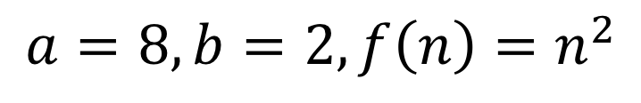
Partition, Procedure
If Begin value $< p$, move Begin right
Else swap Begin value with End value, move End Left
Done when Begin = End
8
5
7
3
6
4
1
2
10
9
11
12
Case 1: meet at element $<p$
Swap $p$ with pointer position (2 in this case)
2
5
7
3
6
4
1
8
10
9
11
12

Slide 25
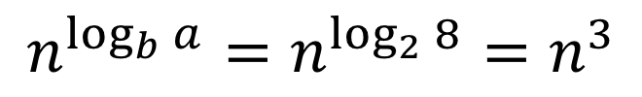
Partition, Procedure
If Begin value $< p$, move Begin right
Else swap Begin value with End value, move End Left
Done when Begin = End
8
5
7
3
6
4
1
2
10
9
11
12
Case 2: meet at element $>p$
Swap $p$ with value to the left (2 in this case)
2
5
7
3
6
4
1
8
10
9
11
12

Slide 26



Partition Summary
Put $p$ at beginning of list
Put a pointer (Begin) just after $p$, and a pointer (End) at the end of the list
While Begin < End:
  If Begin value $< p$, move Begin right
  Else swap Begin value with End value, move End Left
If pointers meet at element $<p$: Swap $p$ with pointer position
Else If pointers meet at element $>p$: Swap $p$ with value to the left
Run time?
$$O(n)$$

Slide 27
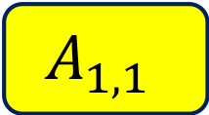
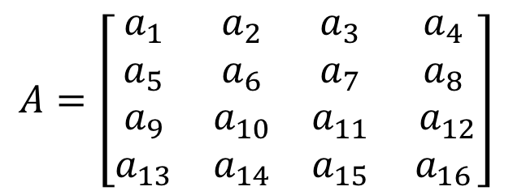
Conquer
2
5
7
3
6
4
1
8
10
9
11
12
All elements $<p$
All elements $>p$
Exactly where it belongs!
Recursively sort Left and Right sublists

Slide 28


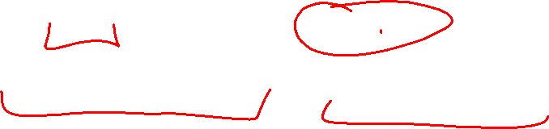
Quicksort Run Time (Best)
If the pivot is always the median:
2
5
1
3
6
4
7
8
10
9
11
12
2
1
3
5
6
4
7
8
9
10
11
12
Then we divide in half each time
$$T\left(n\right)=2T\left(\frac{n}{2}\right)+n$$
$$T\left(n\right)=O(n\log{n})$$

Slide 29

Quicksort Run Time (Worst)
If the pivot is always at the extreme:
1
5
2
3
6
4
7
8
10
9
11
12
1
2
3
5
6
4
7
8
10
9
11
12
Then we shorten by 1 each time
$$T\left(n\right)=T\left(n−1\right)+n$$
$$T\left(n\right)=O(n^{2})$$

Slide 30
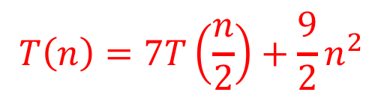



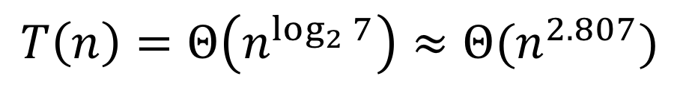

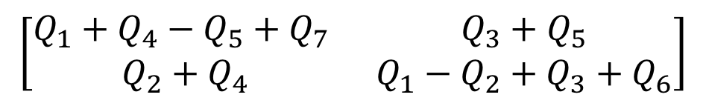

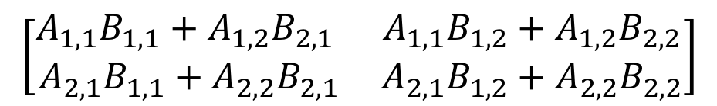
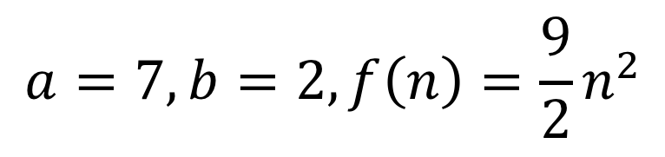

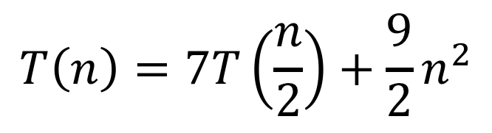
Quicksort Run Time (Worst)
$$T\left(n\right)=T\left(n−1\right)+n$$
$$n$$
$$n$$
$$n−1$$
$$n−1$$
$$T\left(n\right)=1+2+3+…+n$$
$$n−2$$
$$n−2$$
$$T\left(n\right)=\frac{n\left(n+1\right)}{2}$$
…
$$1$$
$$1$$
$$T\left(n\right)=O(n^{2})$$

Slide 31
Quicksort on a (nearly) Sorted List
First element always yields unbalanced pivot
1
2
3
4
5
6
7
8
9
10
11
12
1
2
3
4
5
6
7
8
9
10
11
12
So we shorten by 1 each time
$$T\left(n\right)=T\left(n−1\right)+n$$
$$T\left(n\right)=O(n^{2})$$

Slide 32

Good Pivot
What makes a good Pivot?
  Roughly even split between left and right
  Ideally: median
There are ways to find the median in linear time, but it’s complicated and slow and you’re better off using mergesort
In Practice:
  Pick a random value as a pivot
  Pick the middle of 3 random values as the pivot

Slide 33
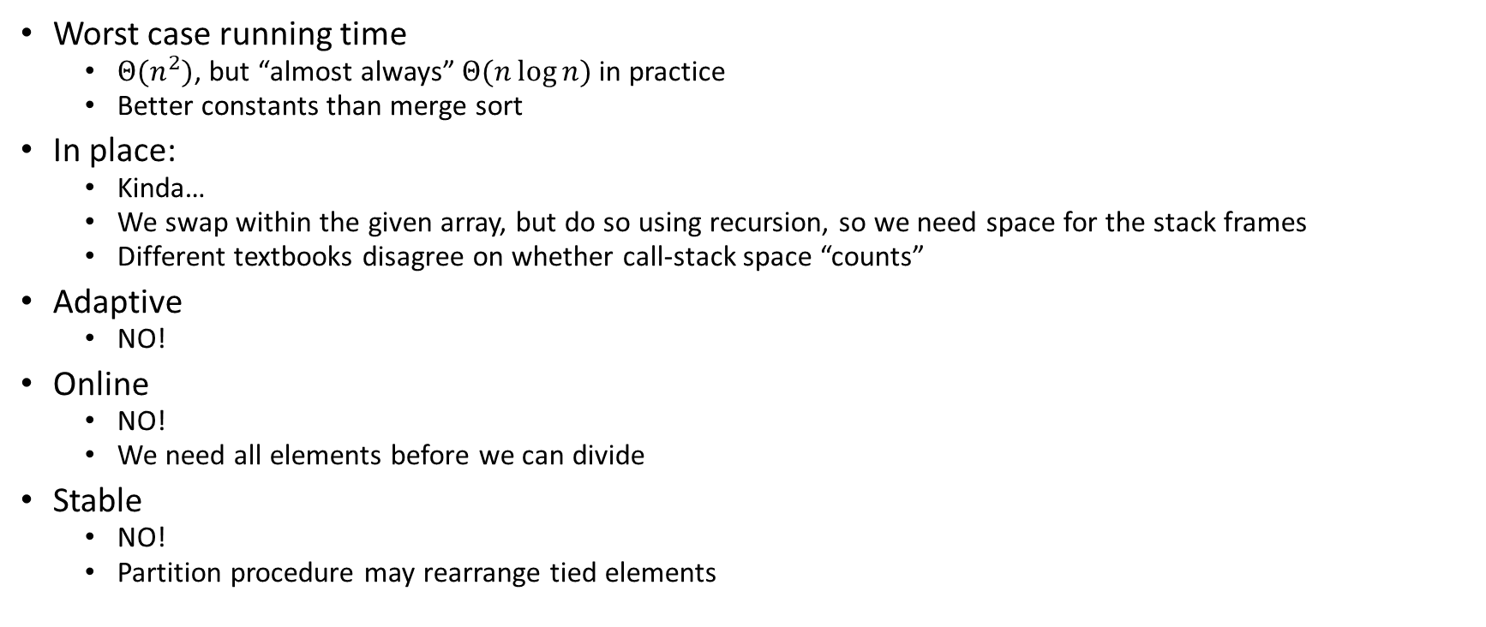
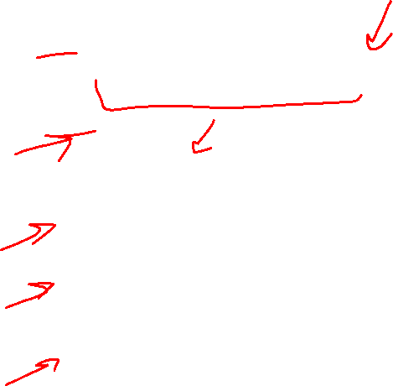
Quick Sort Properties
Worst case running time
  $Θ(n^{2})$, but “almost always” $Θ(n\log{n})$ in practice
  Better constants than merge sort
In place:
  Kinda…
  We swap within the given array, but do so using recursion, so we need space for the stack frames
  Different textbooks disagree on whether call-stack space “counts”
Adaptive
  NO!
Online
  NO!
  We need all elements before we can divide
Stable
  NO!
  Partition procedure may rearrange tied elements

Slide 34
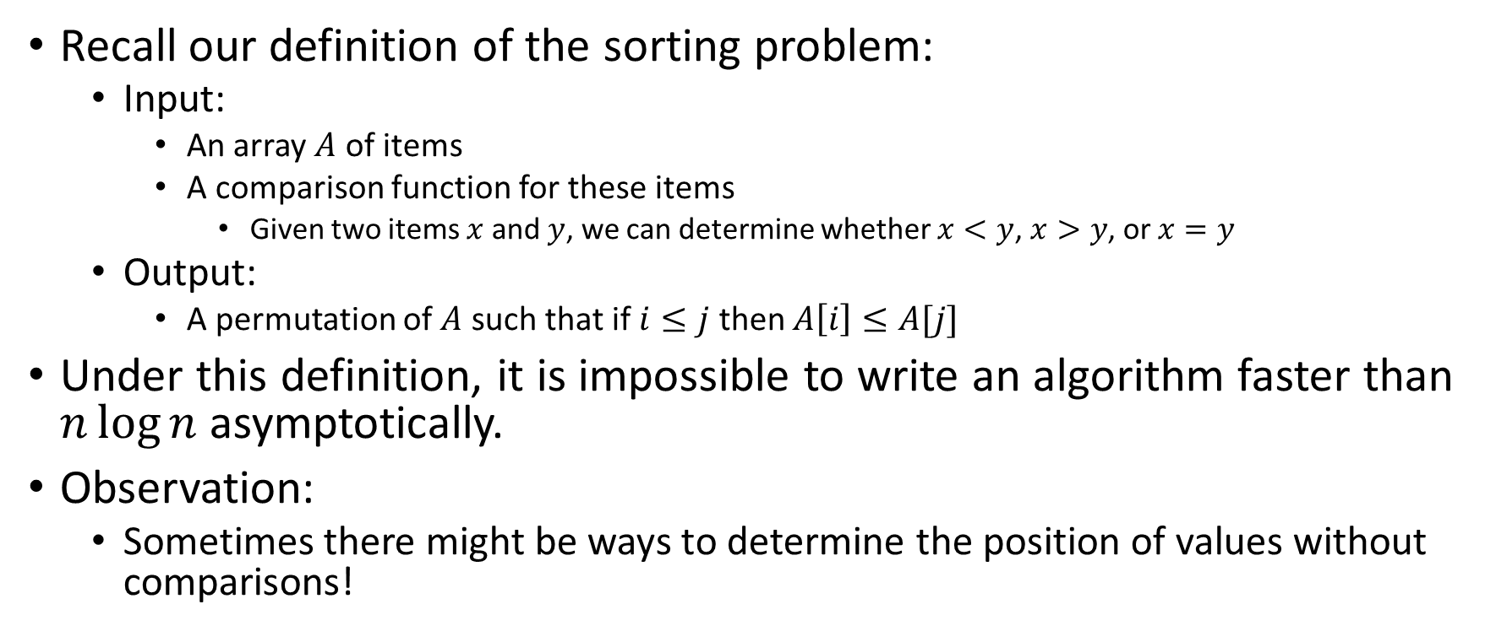
Improving Running time
Recall our definition of the sorting problem:
  Input:
    An array $A$ of items
    A comparison function for these items
      Given two items $x$ and $y$, we can determine whether $x<y$, $x>y$, or $x=y$
  Output:
    A permutation of $A$ such that if $i≤j$ then $A\left[i\right]≤A[j]$
Under this definition, it is impossible to write an algorithm faster than $n\log{n}$ asymptotically.
Observation:
  Sometimes there might be ways to determine the position of values without comparisons!

Slide 35
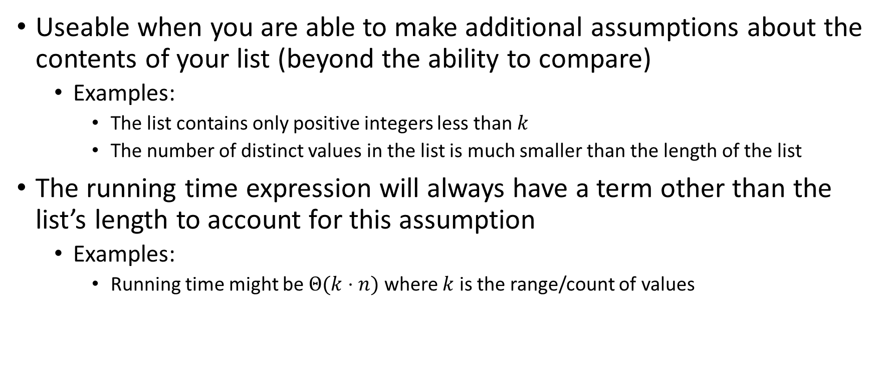

“Linear Time” Sorting Algorithms
Useable when you are able to make additional assumptions about the contents of your list (beyond the ability to compare)
  Examples:
    The list contains only positive integers less than $k$
    The number of distinct values in the list is much smaller than the length of the list
The running time expression will always have a term other than the list’s length to account for this assumption
  Examples:
    Running time might be $Θ(k⋅n)$ where $k$ is the range/count of values

Slide 36
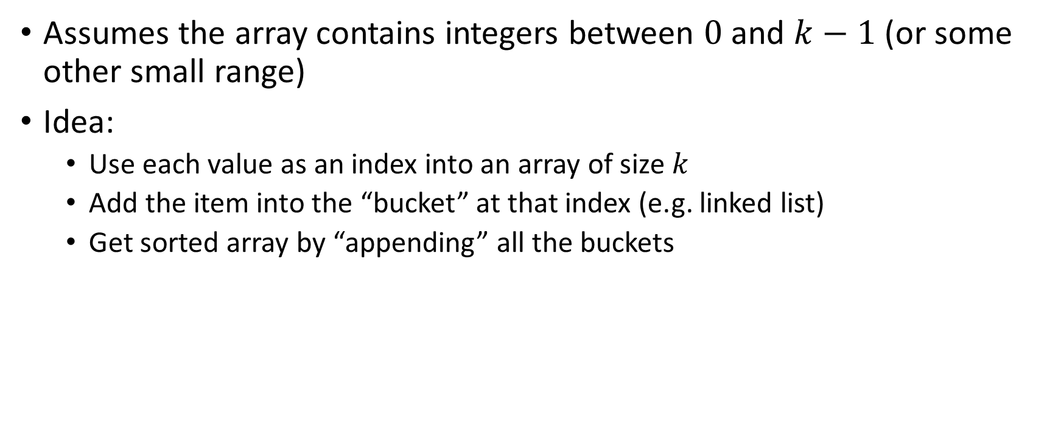
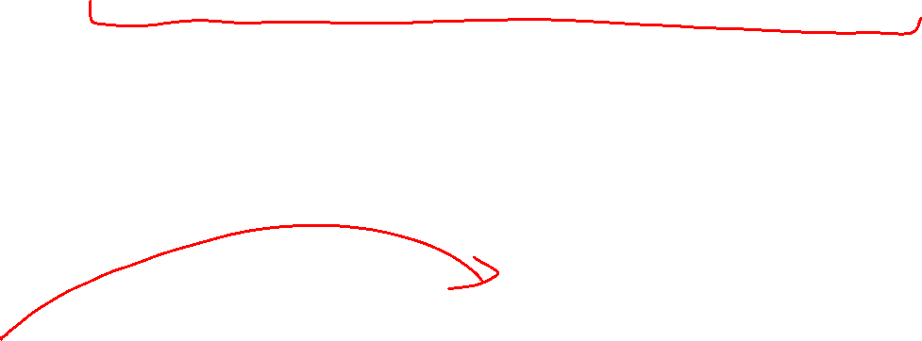
BucketSort
Assumes the array contains integers between $0$ and $k−1$ (or some other small range)
Idea:
  Use each value as an index into an array of size $k$
  Add the item into the “bucket” at that index (e.g. linked list)
  Get sorted array by “appending” all the buckets
0
0
0
0
0
1
1
2
2
2
3
3
0
2
3
0
0
1
2
1
3
0
2
0
0
0
0
0
0
1
1
2
2
2
3
3
0
1
2
3

Slide 37
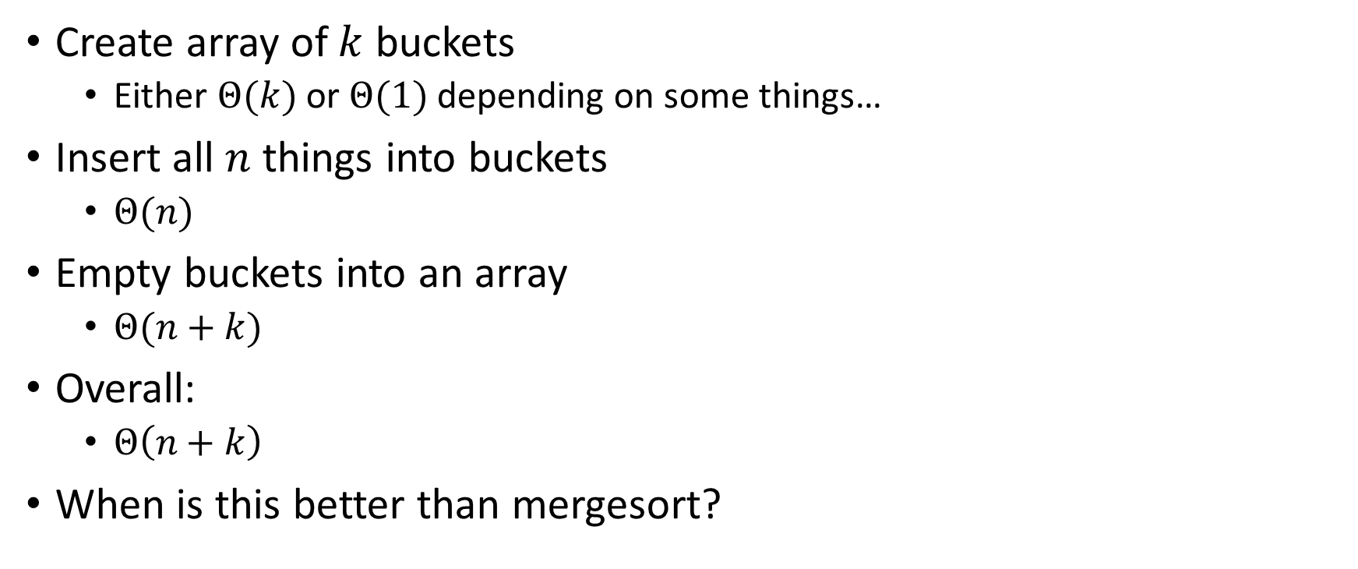
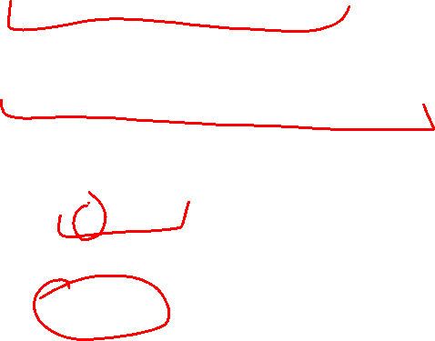
BucketSort Running Time
Create array of $k$ buckets
  Either $Θ(k)$ or $Θ(1)$ depending on some things…
Insert all $n$ things into buckets
  $Θ(n)$
Empty buckets into an array
  $Θ(n+k)$
Overall:
  $Θ\left(n+k\right)$
When is this better than mergesort?

Slide 38
Properties of BucketSort
In-Place?
  No
Adaptive?
  No
Stable?
  Yes!

Slide 39
RadixSort
Radix: The base of a number system
  We’ll use base 10, most implementations will use larger bases
Idea:
  BucketSort by each digit, one at a time, from least significant to most significant
103
801
401
323
255
823
999
101
113
901
555
512
245
800
018
121
0
1
2
3
4
5
6
7
8
9
10
11
12
13
14
15
800
801
401
101
901
121
512
103
323
823
113
255
555
245
018
999
Place each element into a “bucket” according to its 1’s place
0
1
2
3
4
5
6
7
8
9

Slide 40
RadixSort
Radix: The base of a number system
  We’ll use base 10, most implementations will use larger bases
Idea:
  BucketSort by each digit, one at a time, from least significant to most significant
800
801
401
101
901
121
512
103
323
823
113
255
555
245
018
999
800
801
401
101
901
103
512
113
018
121
323
823
245
255
555
999
0
1
2
3
4
5
6
7
8
9
Place each element into a “bucket” according to its 10’s place
0
1
2
3
4
5
6
7
8
9

Slide 41
RadixSort
Radix: The base of a number system
  We’ll use base 10, most implementations will use larger bases
Idea:
  BucketSort by each digit, one at a time, from least significant to most significant
800
801
401
101
901
103
512
113
018
121
323
823
245
255
555
999
018
101
103
113
121
245
255
323
401
512
555
800
801
823
901
999
0
1
2
3
4
5
6
7
8
9
Place each element into a “bucket” according to its 100’s place
0
1
2
3
4
5
6
7
8
9

Slide 42
RadixSort
Radix: The base of a number system
  We’ll use base 10, most implementations will use larger bases
Idea:
  BucketSort by each digit, one at a time, from least significant to most significant
018
101
103
113
121
245
255
323
401
512
555
800
801
823
901
999
Convert back into an array
0
1
2
3
4
5
6
7
8
9
018
811
103
113
121
245
255
323
401
512
555
800
801
823
901
999
0
1
2
3
4
5
6
7
8
9
10
11
12
13
14
15

Slide 43
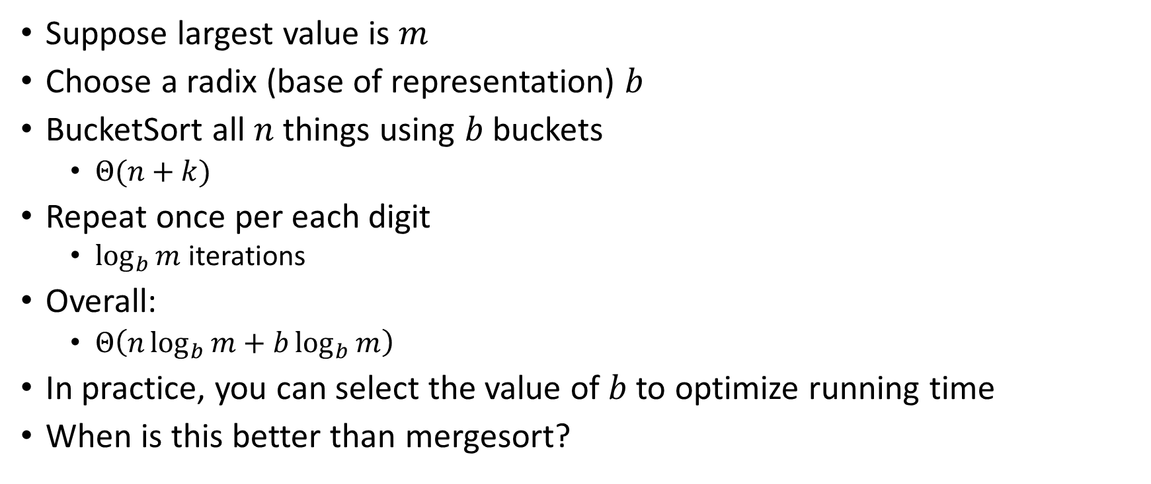
RadixSort Running Time
Suppose largest value is $m$
Choose a radix (base of representation) $b$
BucketSort all $n$ things using $b$ buckets
  $Θ(n+k)$
Repeat once per each digit
  $\log_{b}{m}$ iterations
Overall:
  $Θ\left(n\log_{b}{m}+b\log_{b}{m}\right)$
In practice, you can select the value of $b$ to optimize running time
When is this better than mergesort?

