Slide 1
CSE 332 Winter 2026 Lecture 12: Sorting
Nathan Brunelle
http://www.cs.uw.edu/332

Slide 2

Collision Resolution
A Collision occurs when we want to insert something into an already-occupied position in the hash table
2 main strategies:
Separate Chaining
Use a secondary data structure to contain the items
E.g. each index in the hash table is itself a linked list
Open Addressing
Use a different spot in the table instead
Linear Probing
Quadratic Probing
Double Hashing
0
1
2
3
4
5
6
7
8
9

Slide 3
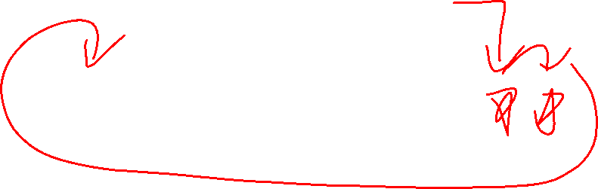
Collision Resolution: Linear Probing
When there’s a collision, use the next open space in the table
0
1
2
3
4
5
6
7
8
9

Slide 4
Linear Probing: Insert Procedure
To insert k,v
Calculate i = h(k) % table.length
If table[i] is occupied then try index (i+1) % table.length
If that is occupied try index (i+2) % table.length
If that is occupied try index (i+3) % table.length
…
0
1
2
3
4
5
6
7
8
9

Slide 5
Linear Probing: How to find?
What do you think?
0
1
2
3
4
5
6
7
8
9

Slide 6
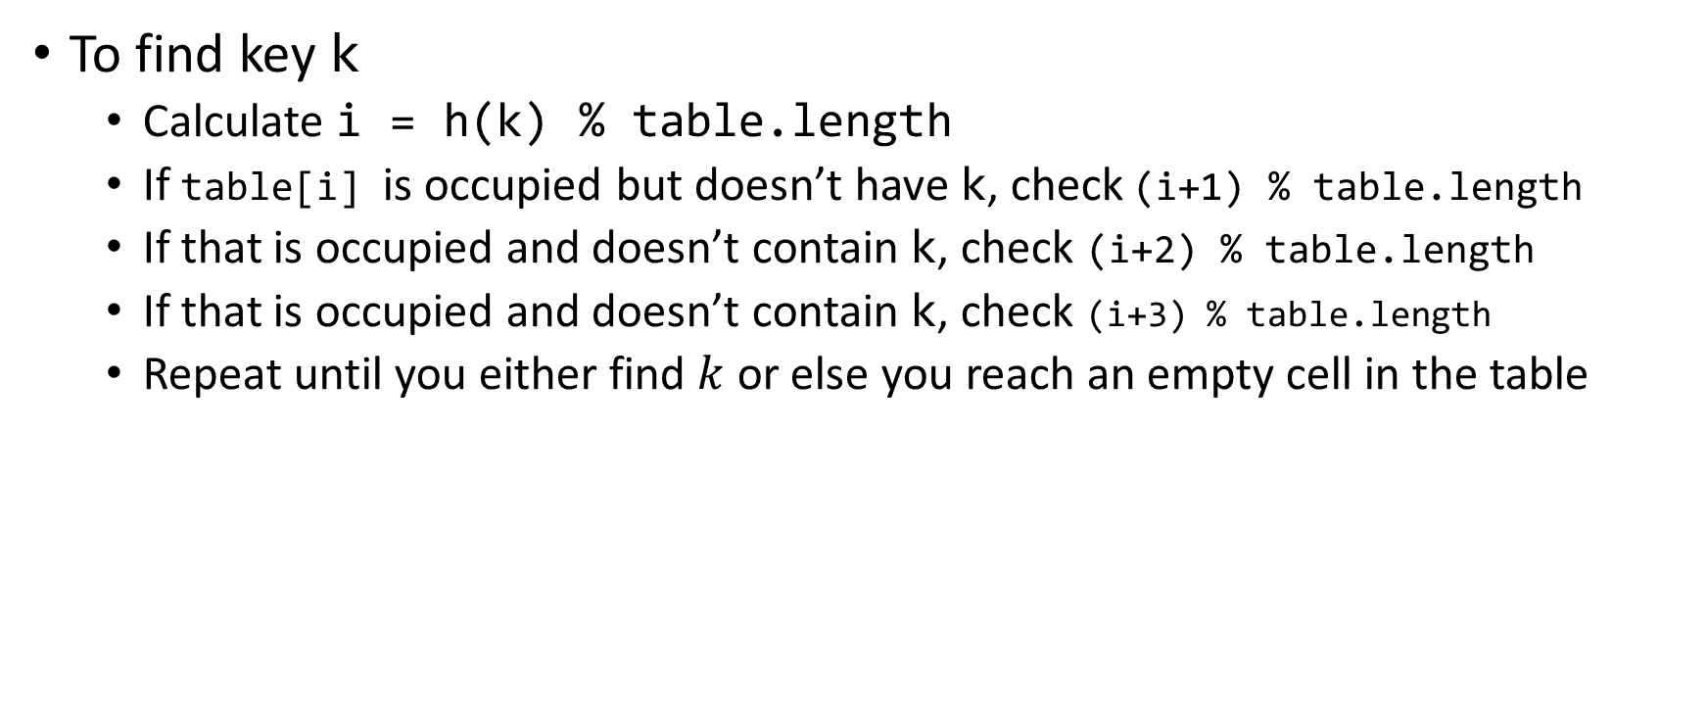
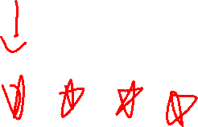
Linear Probing: Find
To find key k
Calculate i = h(k) % table.length
If table[i] is occupied but doesn’t have k, check (i+1) % table.length
If that is occupied and doesn’t contain k, check (i+2) % table.length
If that is occupied and doesn’t contain k, check (i+3) % table.length
Repeat until you either find $k$ or else you reach an empty cell in the table
0
1
2
3
4
5
6
7
8
9

Slide 7
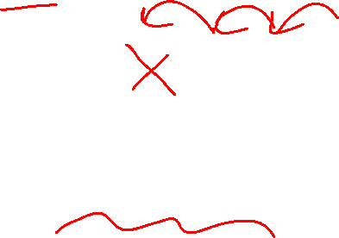
Linear Probing: Delete is Hard (Example 1)
Suppose we insert A, B, C, D, and E in that order, where all map to 3
How should we delete B?
Before:
A
B
C
D
E
0
1
2
3
4
5
6
7
8
9
We need future probing to work correctly, so we must fill in the hole.
After:
A
C
D
E
0
1
2
3
4
5
6
7
8
9

Slide 8
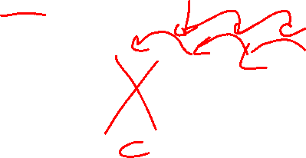
Linear Probing: Delete is Hard (Example 2)
Suppose we insert A, B, C, D, and E in that order, where A,B,E all map to 3 and C,D map to 5.
How should we delete B?
Before:
A
B
C
D
E
0
1
2
3
4
5
6
7
8
9
We need future probing to work correctly, so we must fill in the hole.
We cannot move C or D over because they map to an index later in the probe path
After:
A
E
C
D
0
1
2
3
4
5
6
7
8
9

Slide 9
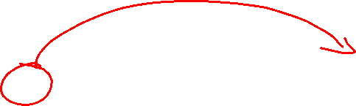
Linear Probing: Delete is Hard (Example 3)
Suppose we insert A, B, C, D, and E in that order, where A,B,E map to 8 and C,D map to 0.
How should we delete B?
Before:
C
D
E
A
B
0
1
2
3
4
5
6
7
8
9
We cannot move C or D over because they map to an index later in the probe path, even though the index number happens to be smaller. E moves to a larger index because it’s earlier in its probe path
After:
C
D
A
E
0
1
2
3
4
5
6
7
8
9

Slide 10


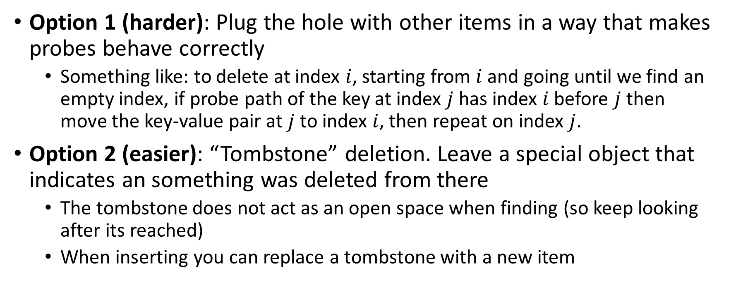
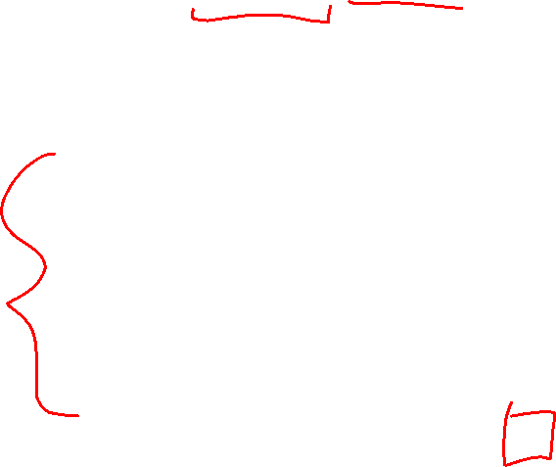
Linear Probing: Delete
Option 1 (harder): Plug the hole with other items in a way that makes probes behave correctly
Something like: to delete at index $i$, starting from $i$ and going until we find an empty index, if probe path of the key at index $j$ has index $i$ before $j$ then move the key-value pair at $j$ to index $i$, then repeat on index $j$.
Option 2 (easier): “Tombstone” deletion. Leave a special object that indicates an something was deleted from there
The tombstone does not act as an open space when finding (so keep looking after its reached)
When inserting you can replace a tombstone with a new item
$$k,v$$
$$k,v$$
$$k,v$$
$$k,v$$
0
1
2
3
4
5
6
7
8
9

Slide 11
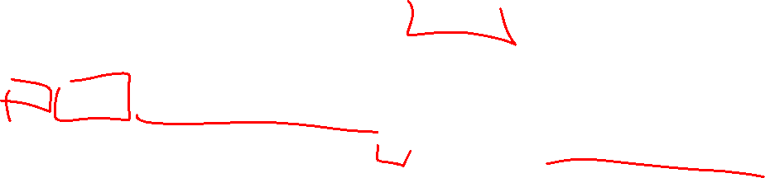
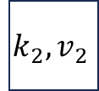
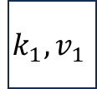
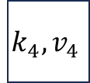

Linear Probing + Tombstone: Find
To find key k
Calculate i = h(k) % table.length
While table[i] has a key other than k, set i = (i+1) % table.length
If you come across k return table[i]
If you come across an empty index, the find was unsuccessful
Tombstones do not count as empty!
$$k_{1},v_{1}$$
$$k_{2},v_{2}$$
$$k_{3},v_{3}$$
$$k_{4},v_{4}$$
0
1
2
3
4
5
6
7
8
9

Slide 12
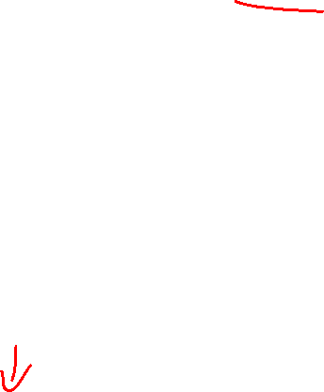
Linear Probing + Tombstone: Insert
To insert k,v
Calculate i = h(k) % table.length
While table[i] has a key other than k, set i = (i+1) % table.length
If table[i] has a tombstone, set dest = i
That is where we will insert if the find is unsuccessful
If you come across k, set table[i] = k,v
If you come across an empty index, the find was unsuccessful
Set table[x] = k,v if we saw a tombstone
Set table[x] = k,v otherwise
$$k_{1},v_{1}$$
$$k_{2},v_{2}$$
$$k_{3},v_{3}$$
$$k_{4},v_{4}$$
0
1
2
3
4
5
6
7
8
9

Slide 13
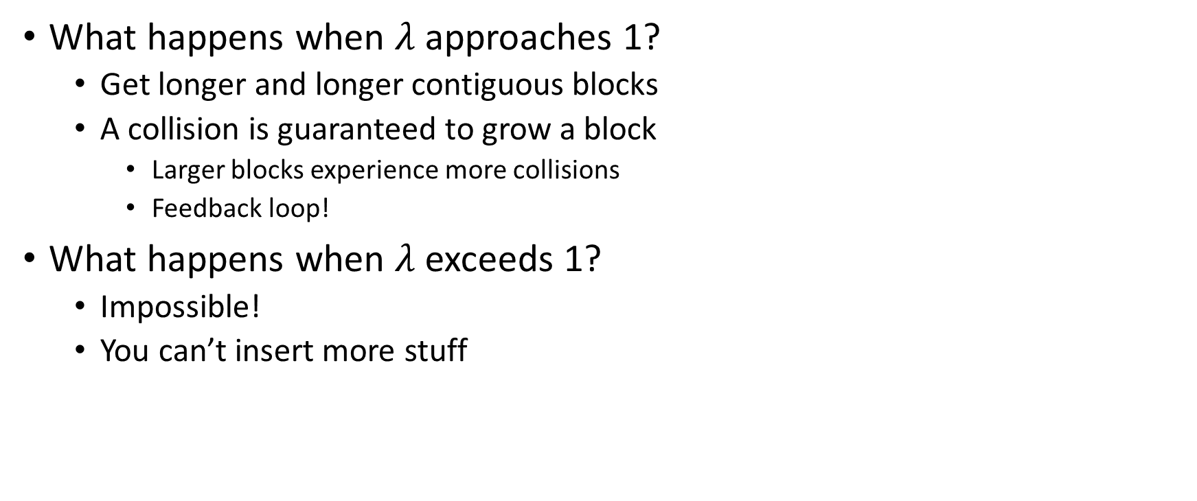
Downsides of Linear Probing
What happens when $λ$ approaches 1?
Get longer and longer contiguous blocks
A collision is guaranteed to grow a block
Larger blocks experience more collisions
Feedback loop!
What happens when $λ$ exceeds 1?
Impossible!
You can’t insert more stuff

Slide 14
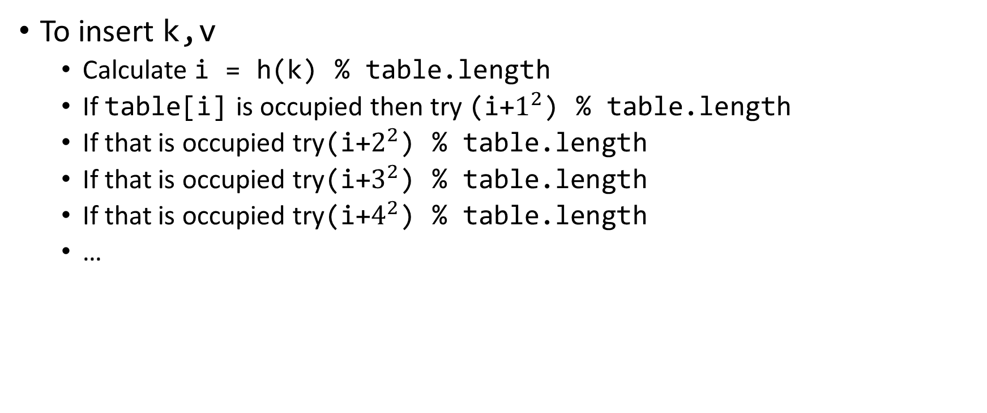
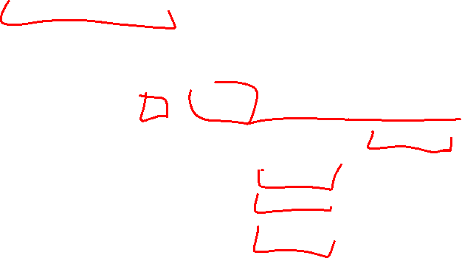
Quadratic Probing: Insert Procedure
To insert k,v
Calculate i = h(k) % table.length
If table[i] is occupied then try (i+$1^{2}$) % table.length
If that is occupied try(i+$2^{2}$) % table.length
If that is occupied try(i+$3^{2}$) % table.length
If that is occupied try(i+$4^{2}$) % table.length
…
0
1
2
3
4
5
6
7
8
9

Slide 15
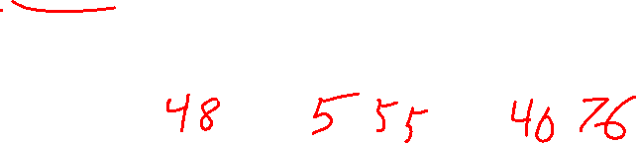
Quadratic Probing: Example
Insert:
76
40
48
5
55
47
0
1
2
3
4
5
6

Slide 16
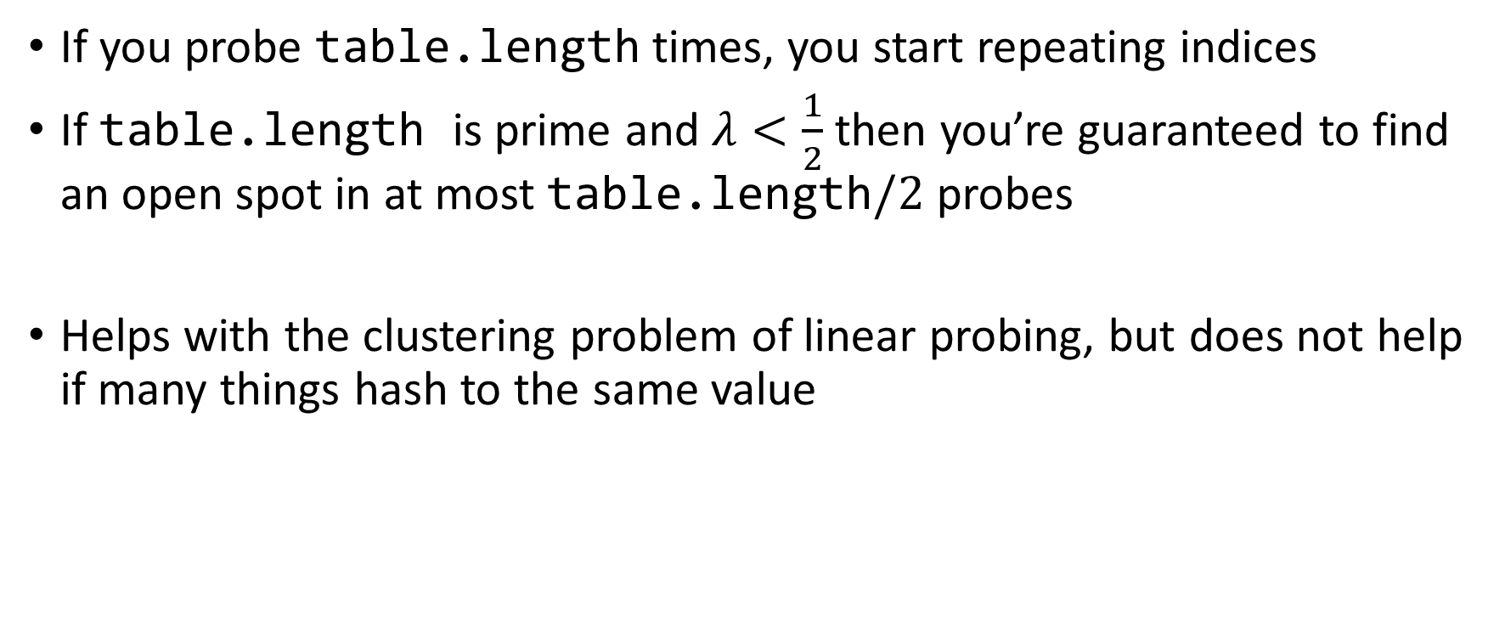

Using Quadratic Probing
If you probe table.length times, you start repeating indices
If table.length is prime and $λ<\frac{1}{2}$ then you’re guaranteed to find an open spot in at most table.length$/2$ probes
Helps with the clustering problem of linear probing, but does not help if many things hash to the same value

Slide 17

Double Hashing: Insert Procedure
Given h and g are both good hash functions
To insert k,v
Calculate i = h(k) % table.length
If table[i] is occupied then try (i+g(k)) % table.length
If that is occupied try (i+2*g(k)) % table.length
If that is occupied try (i+3*g(k)) % table.length
If that is occupied try (i+4*g(k)) % table.length
…
0
1
2
3
4
5
6
7
8
9

Slide 18
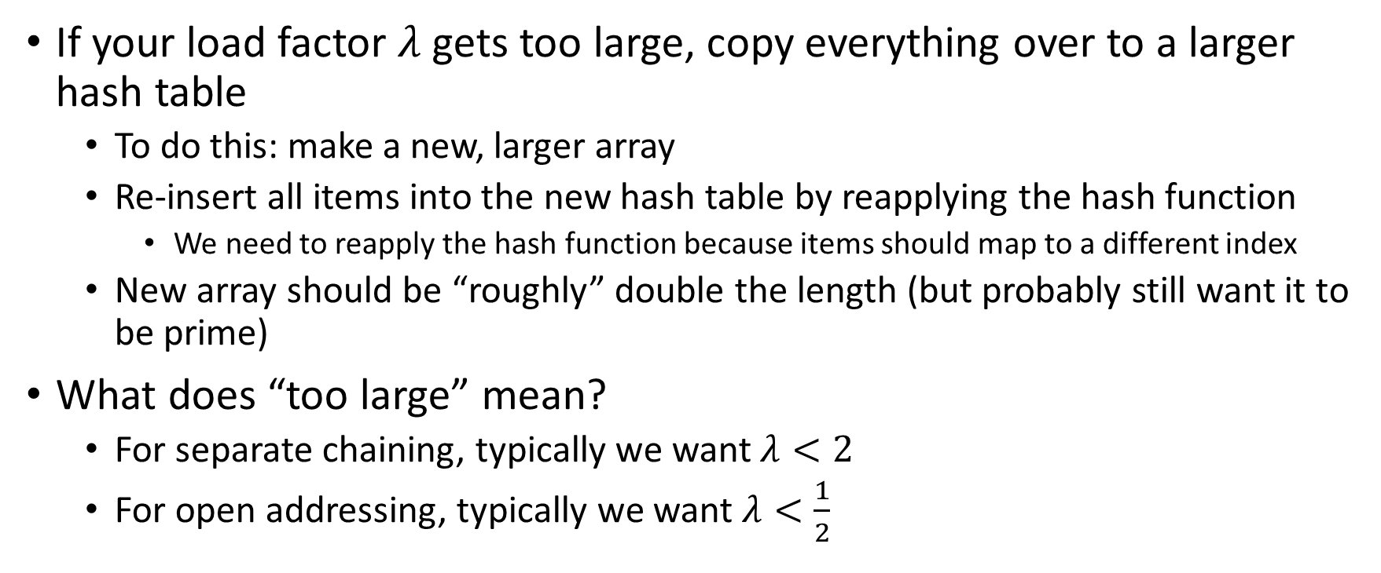
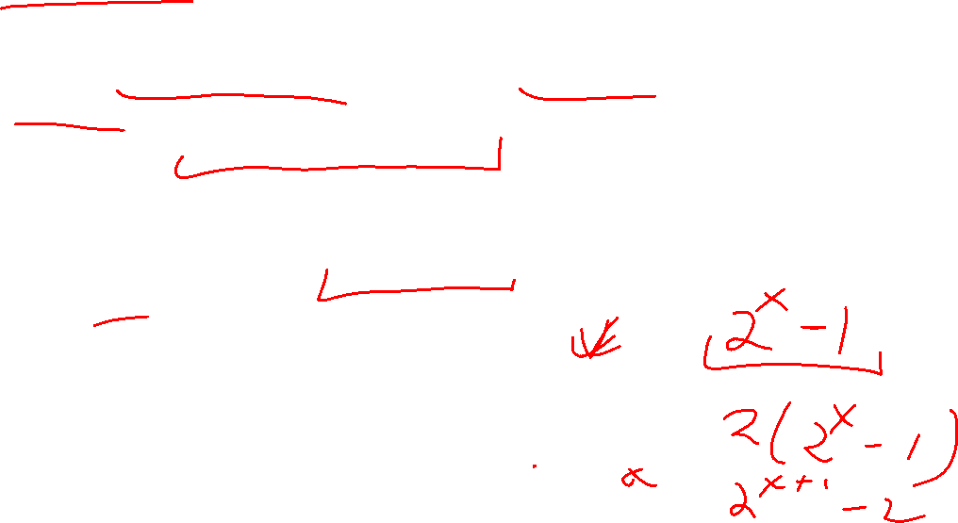
Rehashing
If your load factor $λ$ gets too large, copy everything over to a larger hash table
To do this: make a new, larger array
Re-insert all items into the new hash table by reapplying the hash function
We need to reapply the hash function because items should map to a different index
New array should be “roughly” double the length (but probably still want it to be prime)
What does “too large” mean?
For separate chaining, typically we want $λ<2$
For open addressing, typically we want $λ<\frac{1}{2}$

Slide 19
Sorting
Rearrangement of items into some defined sequence
Usually: reordering a list from smallest to largest according to some metric
Why sort things?
Enable things like binary search
It makes some algorithms faster
Nicer for human algorithms too
Data organization

Slide 20
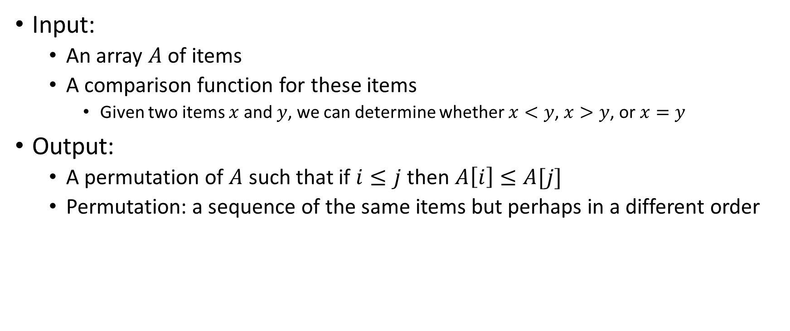
More Formal Definition
Input:
An array $A$ of items
A comparison function for these items
Given two items $x$ and $y$, we can determine whether $x<y$, $x>y$, or $x=y$
Output:
A permutation of $A$ such that if $i≤j$ then $A\left[i\right]≤A[j]$
Permutation: a sequence of the same items but perhaps in a different order

Slide 21
Sorting “Landscape”
There is no singular best algorithm for sorting
Some are faster, some are slower
Some use more memory, some use less
Some are super extra fast if your data matches particular assumptions
Some have other special properties that make them valuable
No sorting algorithm can have only all the “best” attributes

Slide 22
Insertion Sort
Idea: Maintain a sorted list prefix, extend that prefix by “inserting” the next element
Sorted Prefix
3
5
7
8
10
12
9
2
4
6
1
11
3
5
7
8
10
9
12
2
4
6
1
11
3
5
7
8
9
10
12
2
4
6
1
11
Sorted Prefix
3
5
7
8
9
10
12
2
4
6
1
11

Slide 23
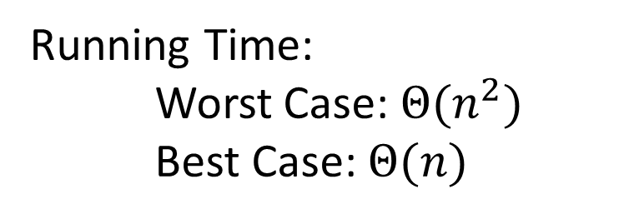
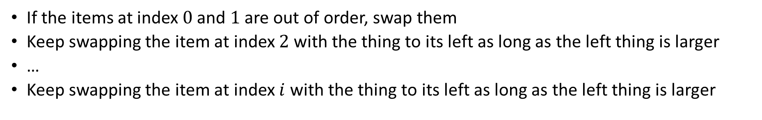
Insertion Sort - Summary
If the items at index $0$ and $1$ are out of order, swap them
Keep swapping the item at index $2$ with the thing to its left as long as the left thing is larger
…
Keep swapping the item at index $i$ with the thing to its left as long as the left thing is larger
for (i=1; i<a.length; i++){
prev = i-1;
while(a[i] < a[prev] && prev > -1){
temp = a[i];
a[i] = a[prev];
a[prev] = a[i];
i--;
prev--;
}
}
Running Time:
Worst Case: $Θ(n^{2})$
Best Case: $Θ(n)$
10
77
5
15
2
22
64
41
18
19
30
21
3
24
23
33
0
1
2
3
4
5
6
7
8
9
10
11
12
13
14
15

Slide 24

Aside: Bubble Sort – we won’t cover it
"the bubble sort seems to have nothing to recommend it, except a catchy name and the fact that it leads to some interesting theoretical problems” –Donald Knuth, The Art of Computer Programming

Slide 25
Heap Sort
Idea: Build a maxHeap, repeatedly extract the max element from the heap to build sorted list Right-to-Left
10
9
0
6
Max Heap Property: Each node is larger than its children
8
1
7
5
2
2
3
4
5
6
4
1
3
7
8
9
10
9
6
8
7
5
2
4
1
3
0
1
2
3
4
5
6
7
8
9

Slide 26

Building a Heap From “Scratch”
Suppose we had $n$ items and wanted to “heapify” them
5
6
10
3
15
8
7
14
2
1
5
1
2
3
4
5
6
7
8
9
10
Violate Heap Property!
0
6
10
3
1
15
8
2
7
Two ways for “fix” the heap:
Percolate Up
Percolate Down
3
4
5
6
14
2
1
7
8
9

Slide 27
Floyd’s buildHeap method
Working towards the root, one row at a time, percolate down
buildHeap(){
for(int i = size; i>0; i--){
percolateDown(i);
}
}

Slide 28
Floyd’s buildHeap method (Percolate 15)
Suppose we had $n$ items and wanted to “heapify” them
5
6
10
3
15
8
7
14
2
1
Violate Heap Property!
Nodes bigger than a child
5
1
2
3
4
5
6
7
8
9
10
0
6
10
buildHeap(){
for(int i = size; i>0; i--){
percolateDown(i);
}
}
3
1
15
8
2
7
3
4
5
6
14
2
1
7
8
9

Slide 29
Floyd’s buildHeap method (Percolate 3)
Suppose we had $n$ items and wanted to “heapify” them
Violate Heap Property!
Nodes bigger than a child
5
5
6
10
3
1
8
7
14
2
15
0
1
2
3
4
5
6
7
8
9
10
6
10
3
1
8
2
7
buildHeap(){
for(int i = size; i>0; i--){
percolateDown(i);
}
}
1
3
4
5
6
14
2
15
7
8
9

Slide 30
Floyd’s buildHeap method (Percolate 10)
Suppose we had $n$ items and wanted to “heapify” them
5
5
6
10
2
1
8
7
14
3
15
Violate Heap Property!
0
1
2
3
4
5
6
7
8
9
10
6
10
2
1
8
2
7
buildHeap(){
for(int i = size; i>0; i--){
percolateDown(i);
}
}
1
3
4
5
6
14
3
15
7
8
9

Slide 31
Floyd’s buildHeap method (Percolate 6)
Suppose we had $n$ items and wanted to “heapify” them
5
5
6
7
2
1
8
10
14
3
15
Violate Heap Property!
0
1
2
3
4
5
6
7
8
9
10
6
7
2
1
8
2
10
buildHeap(){
for(int i = size; i>0; i--){
percolateDown(i);
}
}
1
3
4
5
6
14
3
15
7
8
9

Slide 32
Floyd’s buildHeap method (Percolate 5)
Suppose we had $n$ items and wanted to “heapify” them
5
5
1
7
2
6
8
10
14
3
15
Violate Heap Property!
0
1
2
3
4
5
6
7
8
9
10
1
7
2
1
8
2
10
buildHeap(){
for(int i = size; i>0; i--){
percolateDown(i);
}
}
6
3
4
5
6
14
3
15
7
8
9

Slide 33
Floyd’s buildHeap method (Done)
Suppose we had $n$ items and wanted to “heapify” them
1
1
2
7
3
6
8
10
14
5
15
Violate Heap Property!
0
1
2
3
4
5
6
7
8
9
10
2
7
3
1
8
2
10
buildHeap(){
for(int i = size; i>0; i--){
percolateDown(i);
}
}
6
3
4
5
6
14
5
15
7
8
9

Slide 34
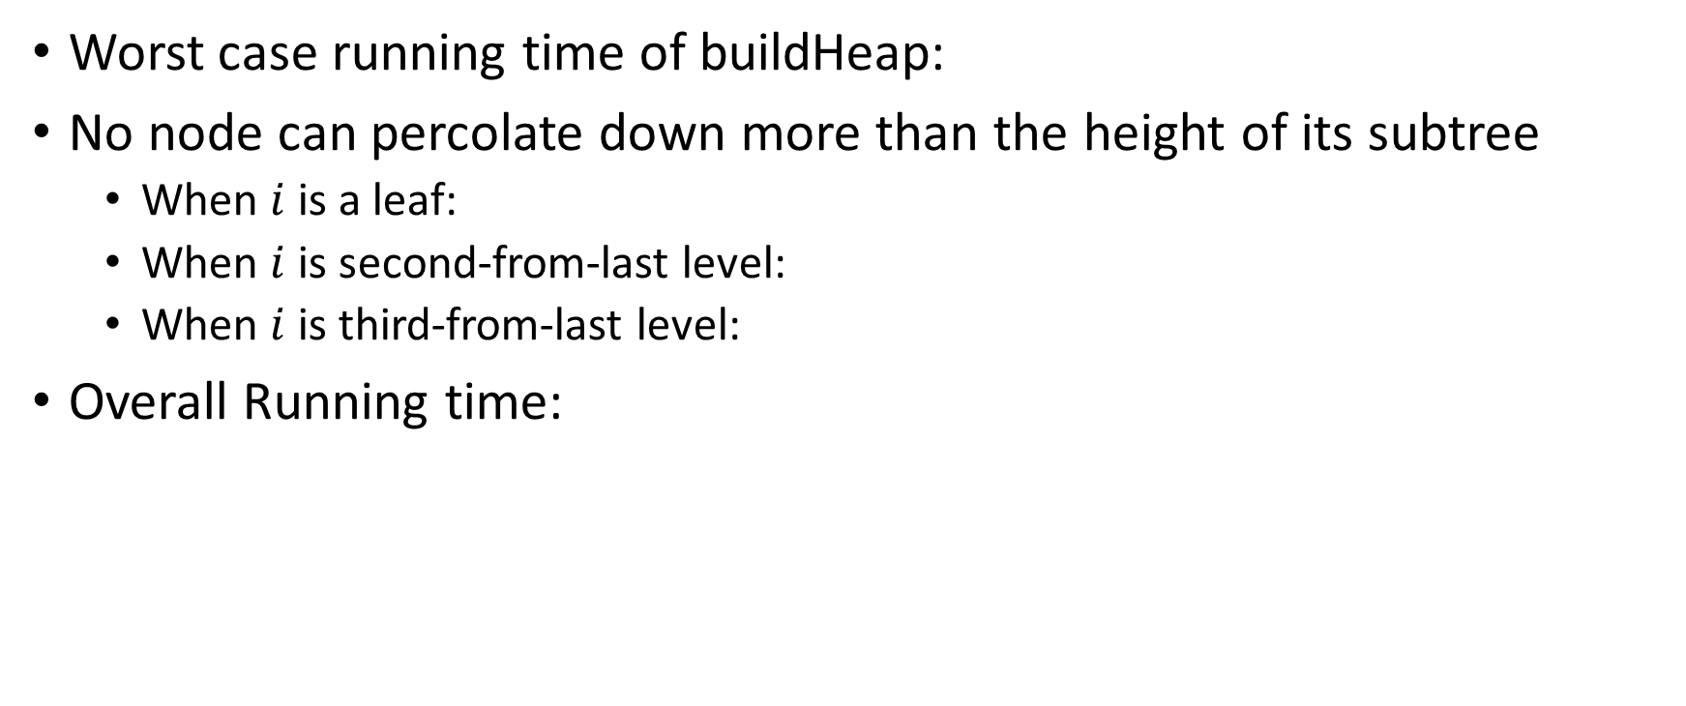
How long did this take?
Worst case running time of buildHeap:
No node can percolate down more than the height of its subtree
When $i$ is a leaf:
When $i$ is second-from-last level:
When $i$ is third-from-last level:
Overall Running time:
buildHeap(){
for(int i = size; i>0; i--){
percolateDown(i);
}
}

Slide 35
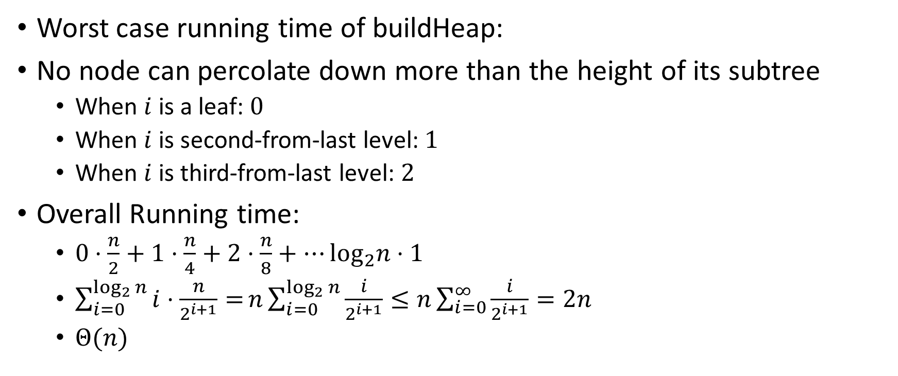
How long did this take? (Answers)
Worst case running time of buildHeap:
No node can percolate down more than the height of its subtree
When $i$ is a leaf: $0$
When $i$ is second-from-last level: $1$
When $i$ is third-from-last level: $2$
Overall Running time:
$0⋅\frac{n}{2}+1⋅\frac{n}{4}+2⋅\frac{n}{8}+…\log_{2}n⋅1$
$\sum_{i=0}^{\log_{2}{n}}{i⋅\frac{n}{2^{i+1}}=}n\sum_{i=0}^{\log_{2}{n}}{\frac{i}{2^{i+1}}}≤n\sum_{i=0}^{∞}{\frac{i}{2^{i+1}}}=2n$
$Θ(n)$
buildHeap(){
for(int i = size; i>0; i--){
percolateDown(i);
}
}

Slide 36
Heap Sort (Example)
Idea: Build a maxHeap, repeatedly extract the max element from the heap to build sorted list Right-to-Left
10
9
0
6
Max Heap Property: Each node is larger than its children
8
1
7
5
2
2
3
4
5
6
4
1
3
7
8
9
10
9
6
8
7
5
2
4
1
3
0
1
2
3
4
5
6
7
8
9

Slide 37
Heap Sort (First Extract)
Remove the Max element (i.e. the root) from the Heap: replace with last element, call percolateDown(root)
3
9
6
8
7
5
2
4
1
0
1
2
3
4
5
6
7
8
9
3
9
0
6
8
1
7
5
2
2
3
4
5
6
4
1
Percolate Down(node): if node satisfies heap property, done. Else swap with largest child and repeat on that subtree
7
8

Slide 38
Heap Sort (Percolate Down, Swap 1)
Remove the Max element (i.e. the root) from the Heap: replace with last element, call percolateDown(root)
9
3
6
8
7
5
2
4
1
0
1
2
3
4
5
6
7
8
9
9
3
0
6
8
1
7
5
2
2
3
4
5
6
4
1
Percolate Down(node): if node satisfies heap property, done. Else swap with largest child and repeat on that subtree
7
8

Slide 39
Heap Sort (Percolate Down, Swap 2)
Remove the Max element (i.e. the root) from the Heap: replace with last element, call percolateDown(root)
9
8
6
3
7
5
2
4
1
0
1
2
3
4
5
6
7
8
9
9
8
0
6
3
1
7
5
2
2
3
4
5
6
4
1
Percolate Down(node): if node satisfies heap property, done. Else swap with largest child and repeat on that subtree
7
8

Slide 40
Heap Sort (Percolate Down, Swap 3)
Remove the Max element (i.e. the root) from the Heap: replace with last element, call percolateDown(root)
9
8
6
4
7
5
2
3
1
0
1
2
3
4
5
6
7
8
9
9
8
0
6
4
1
7
5
2
2
3
4
5
6
3
1
Percolate Down(node): if node satisfies heap property, done. Else swap with largest child and repeat on that subtree
7
8

Slide 41
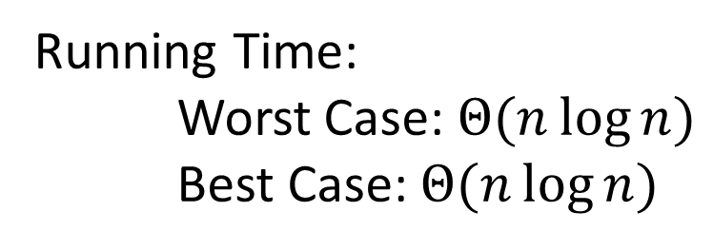
Heap Sort - Summary
Build a max heap
Call extract
Put that at the end of the array
myHeap = buildMaxHeap(a);
for (int i = a.length-1; i>=0; i--){
item = myHeap.extract();
a[i] = item;
}
Running Time:
Worst Case: $Θ(n\log{n})$
Best Case: $Θ(n\log{n})$

Slide 42
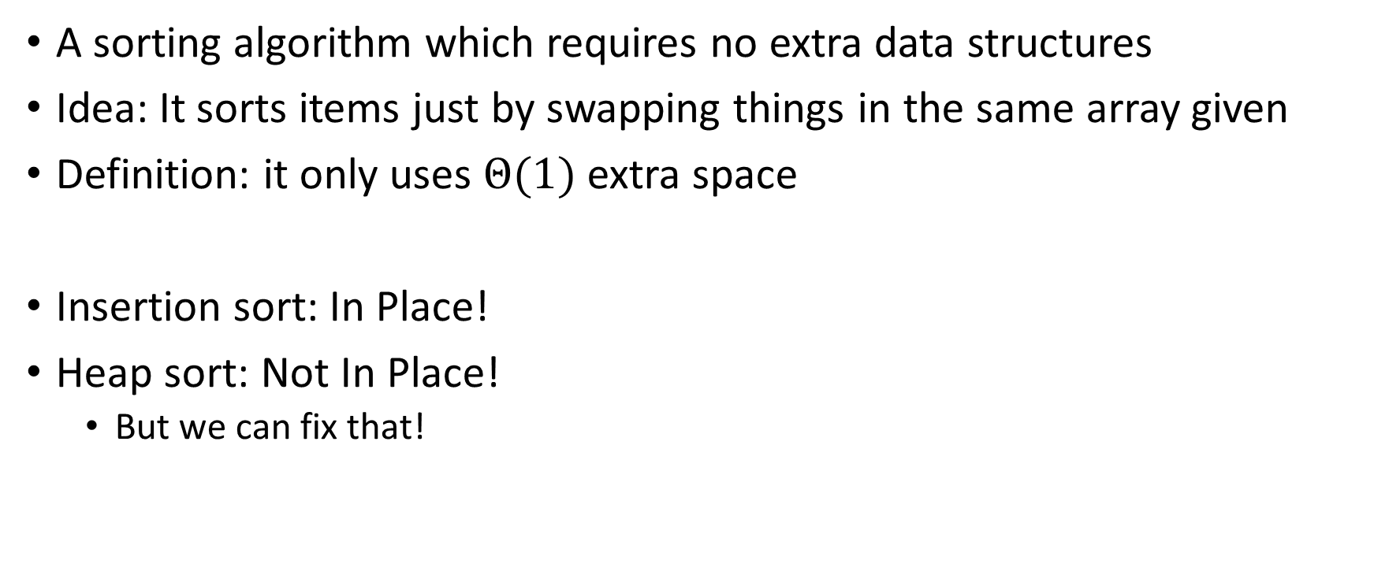
“In Place” Sorting Algorithm
A sorting algorithm which requires no extra data structures
Idea: It sorts items just by swapping things in the same array given
Definition: it only uses $Θ(1)$ extra space
Insertion sort: In Place!
Heap sort: Not In Place!
But we can fix that!

Slide 43
In Place Heap Sort
Idea: When extracting an element from the heap, swap it with the last item of the heap then “pretend” the heap is one item shorter
10
9
6
8
7
5
2
4
1
3
0
1
2
3
4
5
6
7
8
9
10
9
0
6
8
1
7
5
2
2
3
4
5
6
4
1
3
7
8
9

Slide 44
In Place Heap Sort (First Extract)
Idea: When extracting an element from the heap, swap it with the last item of the heap then “pretend” the heap is one item shorter
3
9
6
8
7
5
2
4
1
10
0
1
2
3
4
5
6
7
8
9
3
9
0
6
8
1
7
5
2
2
3
4
5
6
4
1
7
8

Slide 45
In Place Heap Sort (First Percolate Down)
Idea: When extracting an element from the heap, swap it with the last item of the heap then “pretend” the heap is one item shorter
9
8
6
4
7
5
2
3
1
10
0
1
2
3
4
5
6
7
8
9
9
8
0
6
4
1
7
5
2
2
3
4
5
6
3
1
7
8

Slide 46
In Place Heap Sort (Second Extract)
Idea: When extracting an element from the heap, swap it with the last item of the heap then “pretend” the heap is one item shorter
1
8
6
4
7
5
2
3
9
10
0
1
2
3
4
5
6
7
8
9
1
8
0
6
4
1
7
5
2
2
3
4
5
6
3
7

Slide 47
In Place Heap Sort (Second Percolate Down)
Idea: When extracting an element from the heap, swap it with the last item of the heap then “pretend” the heap is one item shorter
1
8
6
4
7
5
2
3
9
10
0
1
2
3
4
5
6
7
8
9
8
7
0
6
4
1
1
5
2
2
3
4
5
6
3
7

Slide 48
In Place Heap Sort (Third Extract)
Idea: When extracting an element from the heap, swap it with the last item of the heap then “pretend” the heap is one item shorter
3
8
6
4
7
5
2
8
9
10
0
1
2
3
4
5
6
7
8
9
3
7
0
6
4
1
1
5
2
2
3
4
5
6

Slide 49
In Place Heap Sort (Third Percolate Down)
Idea: When extracting an element from the heap, swap it with the last item of the heap then “pretend” the heap is one item shorter
3
8
6
4
7
5
2
8
9
10
0
1
2
3
4
5
6
7
8
9
7
4
0
6
3
1
1
5
2
2
3
4
5
6

Slide 50
In Place Heap Sort - Summary
Build a heap using the same array (Floyd’s build heap algorithm works)
Call extract
Put that at the end of the array
buildHeap(a);
for (int i = a.length-1; i>=0; i--){
temp=a[i]
a[i] = a[0];
a[0] = temp;
percolateDown(0);
}
Running Time:
Worst Case: $Θ(n\log{n})$
Best Case: $Θ(n\log{n})$

