Slide 1
Lecture 4: Gale–Shapley analysis
Glenn Sun

Slide 2
Announcements
HW1 due Friday @ 11:59pm!
HW1 LaTeX template fix: Check Ed!
Continue to get those Concept Checks in on time, please 🙂

Slide 3
Review of Gale–Shapley

Slide 4
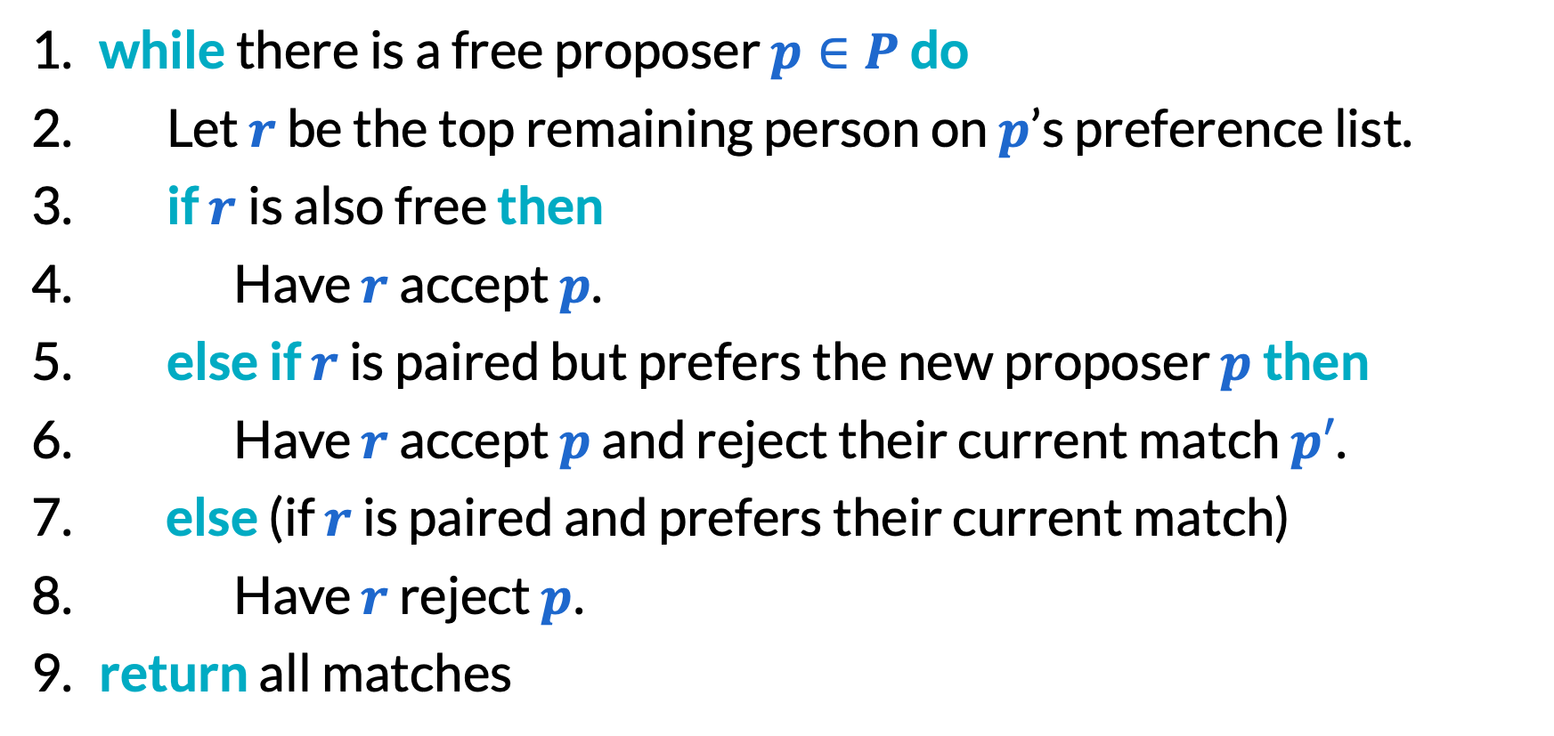
Gale–Shapley algorithm
​while there is a free proposer $p∈P$ do
Let $r$ be the top remaining person on $p$’s preference list.
​if $r$is also free then
Have $r$ accept $p$.
​else if $r$ is paired but prefers the new proposer $p$ then
Have $r$ accept $p$ and reject their current match $p′$.
​else (if $r$ is paired and prefers their current match)
Have $r$ reject $p$.
​return all matches

Slide 5
Proposer optimality
Proposer optimality theorem: The Gale–Shapley algorithm always finds the unique stable matching that is both best for proposers and worst for receivers.
“best”: Every proposer is happier in this matching than any other stable matching (or equally as happy).
“worst”: Similar.

Slide 6
Proofs with while loops

Slide 7
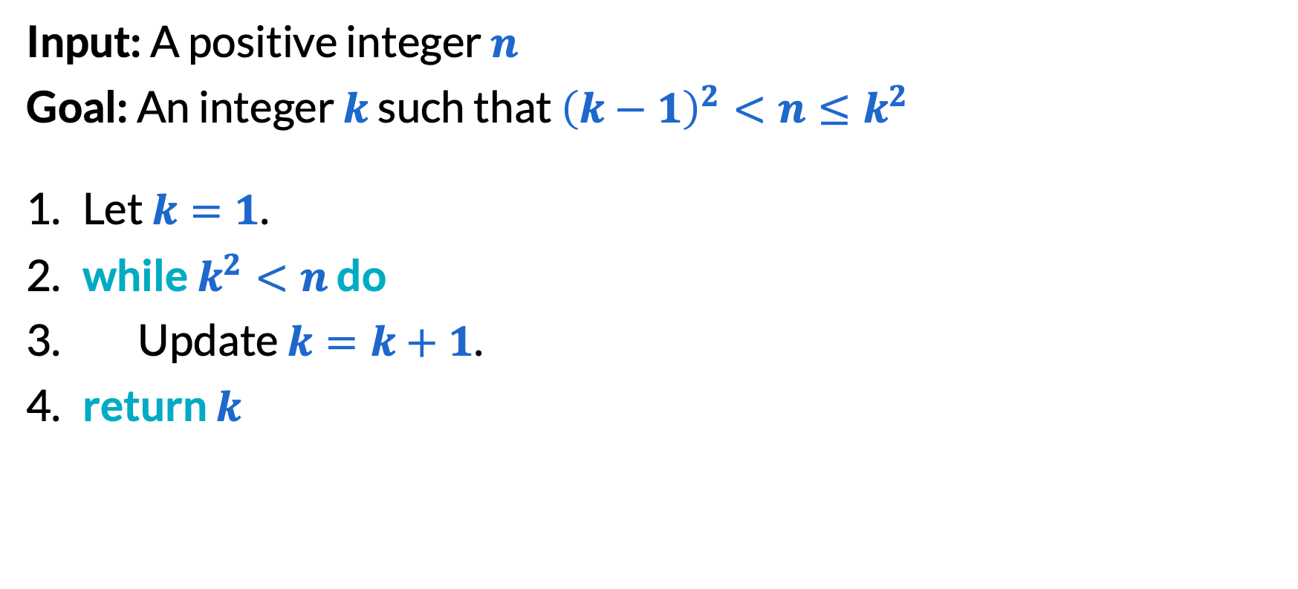
Proofs with while loops (1/4)
Input: A positive integer $n$
Goal: An integer $k$ such that ${\left(k−1\right)}^{2}<n≤k^{2}$
Let $k=1$.
​while $k^{2}<n$ do
Update $k=k+1$.
​return $k$

Slide 8
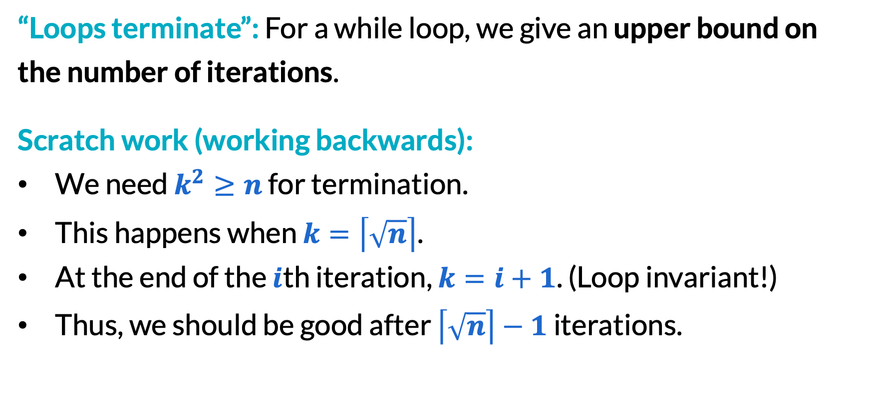
Proofs with while loops (2/4)
“Loops terminate”: For a while loop, we give an upper bound on the number of iterations.
Scratch work (working backwards):
We need $k^{2}≥n$ for termination.
This happens when $k=\left\lceil \sqrt{n}\right\rceil$.
At the end of the $i$th iteration, $k=i+1$. (Loop invariant!)
Thus, we should be good after $\left\lceil \sqrt{n}\right\rceil −1$ iterations.

Slide 9
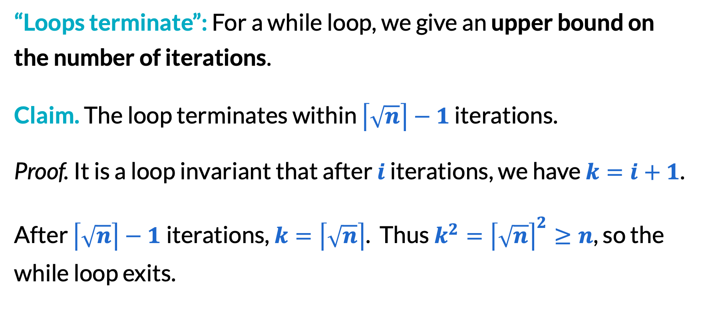
Proofs with while loops (3/4)
“Loops terminate”: For a while loop, we give an upper bound on the number of iterations.
Claim. The loop terminates within $\left\lceil \sqrt{n}\right\rceil −1$ iterations.
Proof. It is a loop invariant that after $i$ iterations, we have $k=i+1$.
After $\left\lceil \sqrt{n}\right\rceil −1$iterations, $k=\left\lceil \sqrt{n}\right\rceil$. Thus $k^{2}={\left\lceil \sqrt{n}\right\rceil }^{2}≥n$, so the while loop exits.

Slide 10
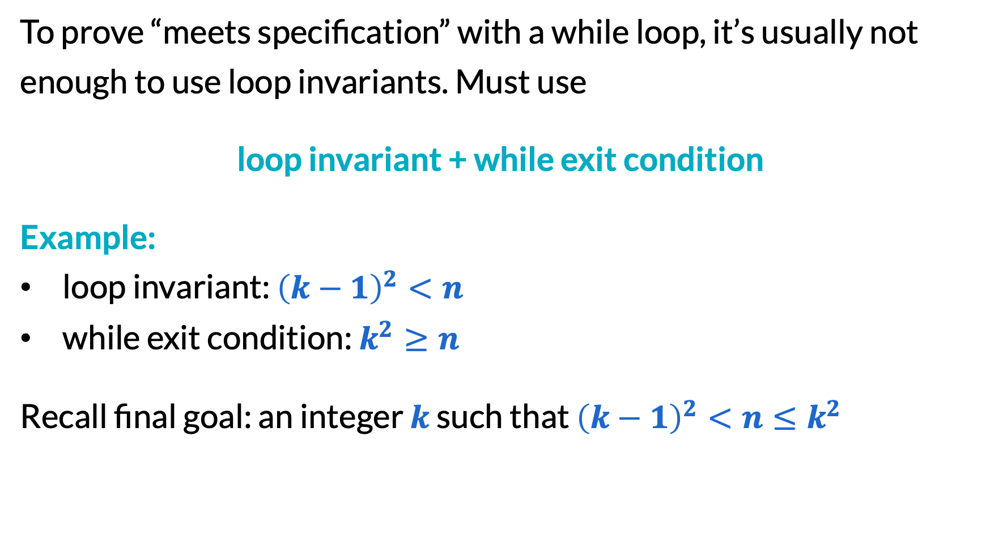
Proofs with while loops (4/4)
To prove “meets specification” with a while loop, it’s usually not enough to use loop invariants. Must use
loop invariant + while exit condition
Example:
loop invariant: ${\left(k−1\right)}^{2}<n$
while exit condition: $k^{2}≥n$
Recall final goal: an integer $k$ such that ${\left(k−1\right)}^{2}<n≤k^{2}$

Slide 11
Proving Gale–Shapley correct

Slide 12
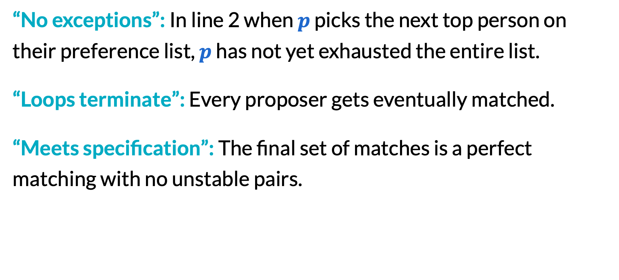
Three requirements for correctness
“No exceptions”: In line 2 when $p$ picks the next top person on their preference list, $p$ has not yet exhausted the entire list.
“Loops terminate”: Every proposer gets eventually matched.
“Meets specification”: The final set of matches is a perfect matching with no unstable pairs.

Slide 13
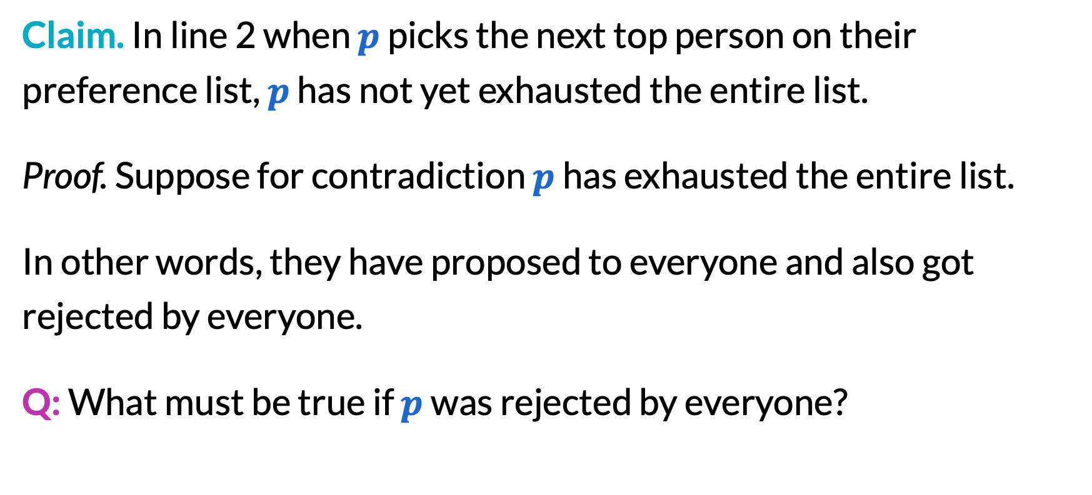
Proving no exceptions (1/7)
Claim. In line 2 when $p$ picks the next top person on their preference list, $p$ has not yet exhausted the entire list.
Proof. Suppose for contradiction $p$ has exhausted the entire list.
In other words, they have proposed to everyone and also got rejected by everyone.
Q: What must be true if $p$ was rejected by everyone?

Slide 14
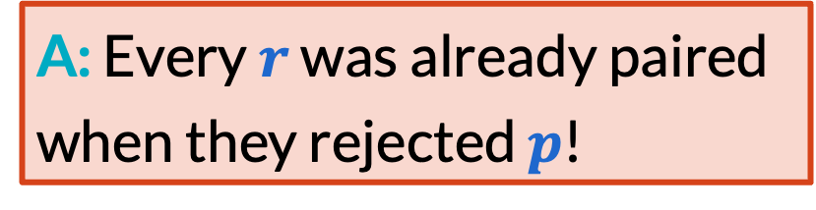

Proving no exceptions (2/7)
​​while there is a free proposer $p∈P$ do
Let $r$ be the top remaining person on $p$’s preference list.
​if $r$is also free then
Have $r$ accept $p$.
​else if $r$ is paired but prefers the new proposer $p$ then
Have $r$ accept $p$ and reject their current match $p′$.
​else (if $r$ is paired and prefers their current match)
Have $r$ reject $p$.
​return all matches
A: Every $r$ was already paired when they rejected $p$!

Slide 15
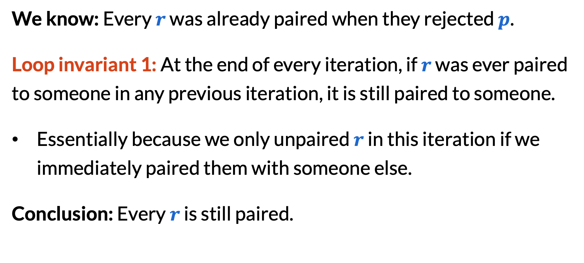
Proving no exceptions (3/7)
We know: Every $r$ was already paired when they rejected $p$.
Loop invariant 1: At the end of every iteration, if $r$ was ever paired to someone in any previous iteration, it is still paired to someone.
Essentially because we only unpaired $r$ in this iteration if we immediately paired them with someone else.
Conclusion: Every $r$ is still paired.

Slide 16

Proving no exceptions (4/7)
We know: Every $r$ is still paired.

Slide 17
Proving no exceptions (5/7)
Loop invariant 2: After every iteration, each person is matched to at most one other person.

Slide 18

Proving no exceptions (6/7)
But $\left|P\right|=\left|R\right|=n$(equal number of proposers and receivers).

Slide 19

Proving no exceptions (7/7)
Every proposer must be paired, contradiction with $p$ being free.

Slide 20
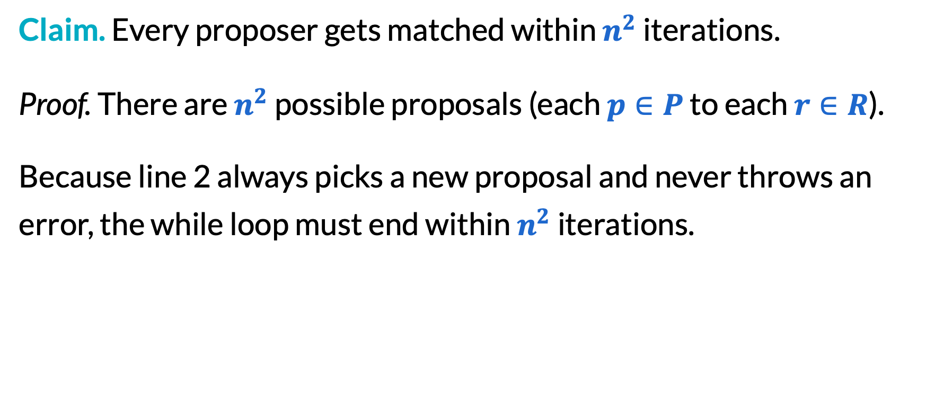
Proving loops terminate
Claim. Every proposer gets matched within $n^{2}$ iterations.
Proof. There are $n^{2}$ possible proposals (each $p∈P$ to each $r∈R$).
Because line 2 always picks a new proposal and never throws an error, the while loop must end within $n^{2}$ iterations.

Slide 21
Proving perfect matching (1/5)
Remember, when there is a while loop, correctness should use both a loop invariant and the while exit condition.
Claim. The output is a perfect matching.
Proof. Very similar to before — in following slides.

Slide 22

Proving perfect matching (2/5)
While exit condition: Every $p$ is paired.

Slide 23
Proving perfect matching (3/5)
Loop invariant 2: After every iteration, each person is matched to at most one other person.

Slide 24
Proving perfect matching (4/5)
But $\left|P\right|=\left|R\right|=n$(equal number of proposers and receivers).

Slide 25
Proving perfect matching (5/5)
Thus, everyone is paired with exactly one other, so this is a perfect matching.

Slide 26
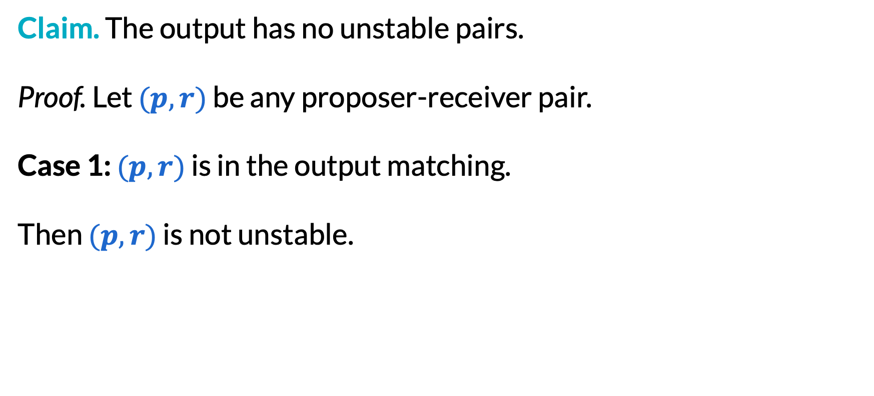
Proving no unstable pairs (1/5)
Claim. The output has no unstable pairs.
Proof. Let $(p,r)$ be any proposer-receiver pair.
Case 1: $(p,r)$ is in the output matching.
Then $(p,r)$ is not unstable.

Slide 27
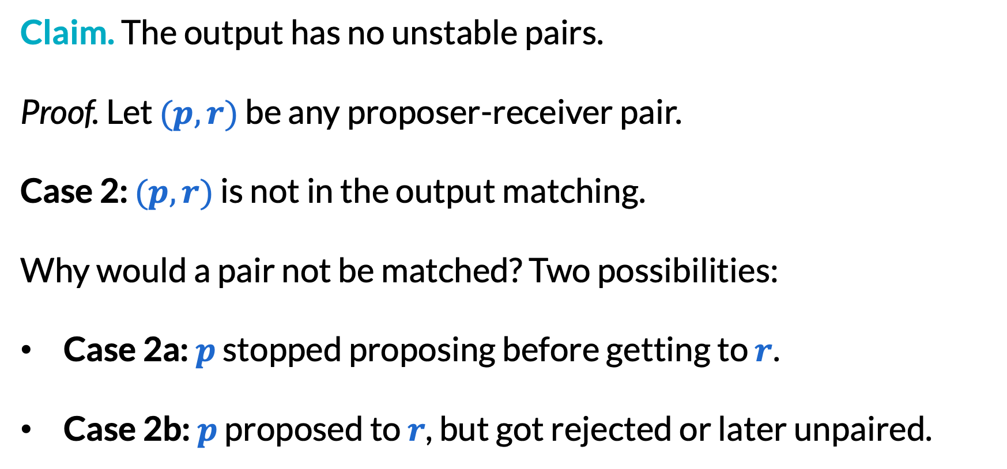
Proving no unstable pairs (2/5)
Claim. The output has no unstable pairs.
Proof. Let $(p,r)$ be any proposer-receiver pair.
Case 2: $(p,r)$ is not in the output matching.
Why would a pair not be matched? Two possibilities:
Case 2a: $p$ stopped proposing before getting to $r$.
Case 2b: $p$ proposed to $r$, but got rejected or later unpaired.

Slide 28
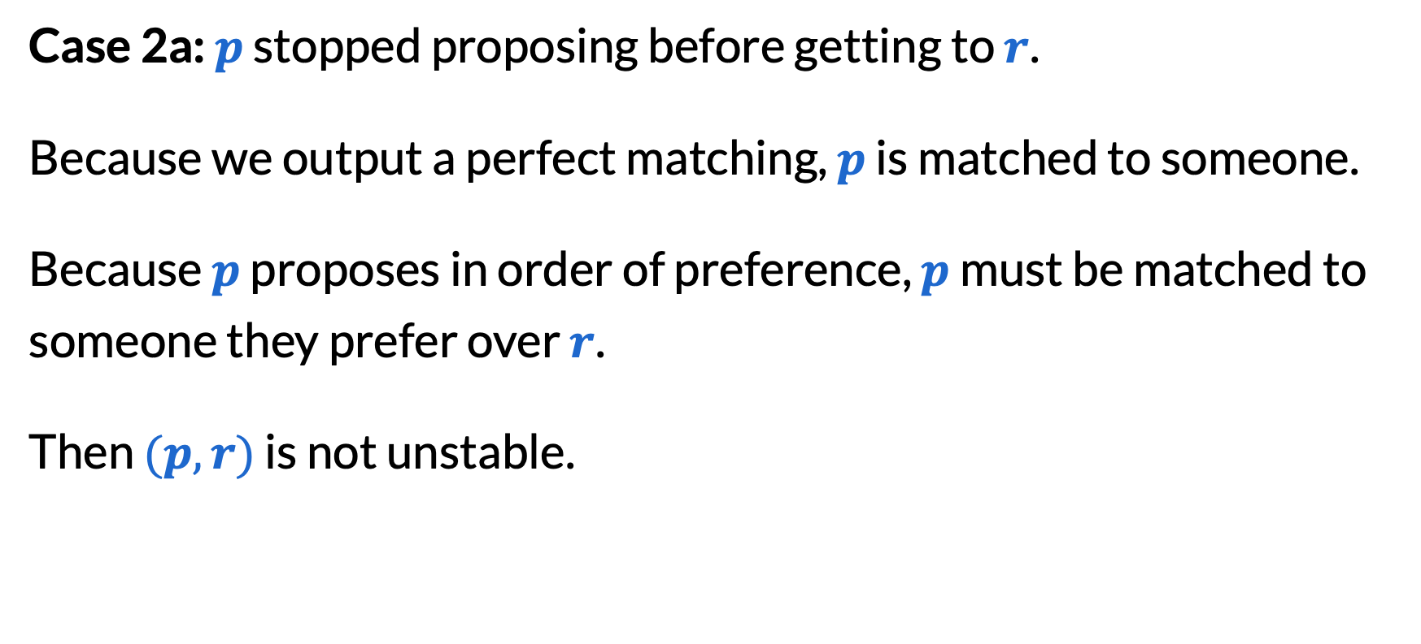
Proving no unstable pairs (3/5)
Case 2a: $p$ stopped proposing before getting to $r$.
Because we output a perfect matching, $p$ is matched to someone.
Because $p$ proposes in order of preference, $p$ must be matched to someone they prefer over $r$.
Then $(p,r)$ is not unstable.

Slide 29
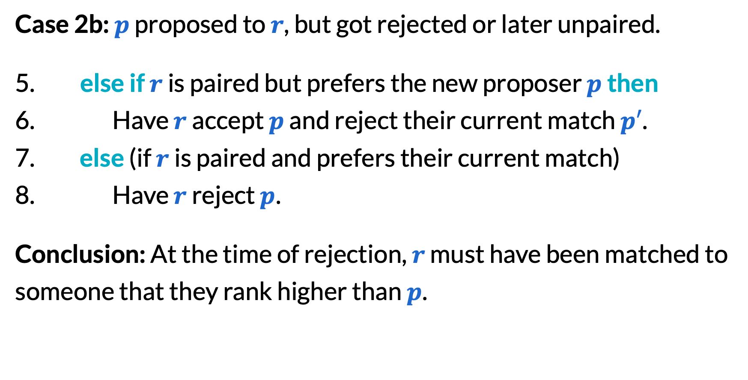
Proving no unstable pairs (4/5)
Case 2b: $p$ proposed to $r$, but got rejected or later unpaired.
​else if $r$ is paired but prefers the new proposer $p$ then
Have $r$ accept $p$ and reject their current match $p′$.
​else (if $r$ is paired and prefers their current match)
Have $r$ reject $p$.
Conclusion: At the time of rejection, $r$ must have been matched to someone that they rank higher than $p$.

Slide 30
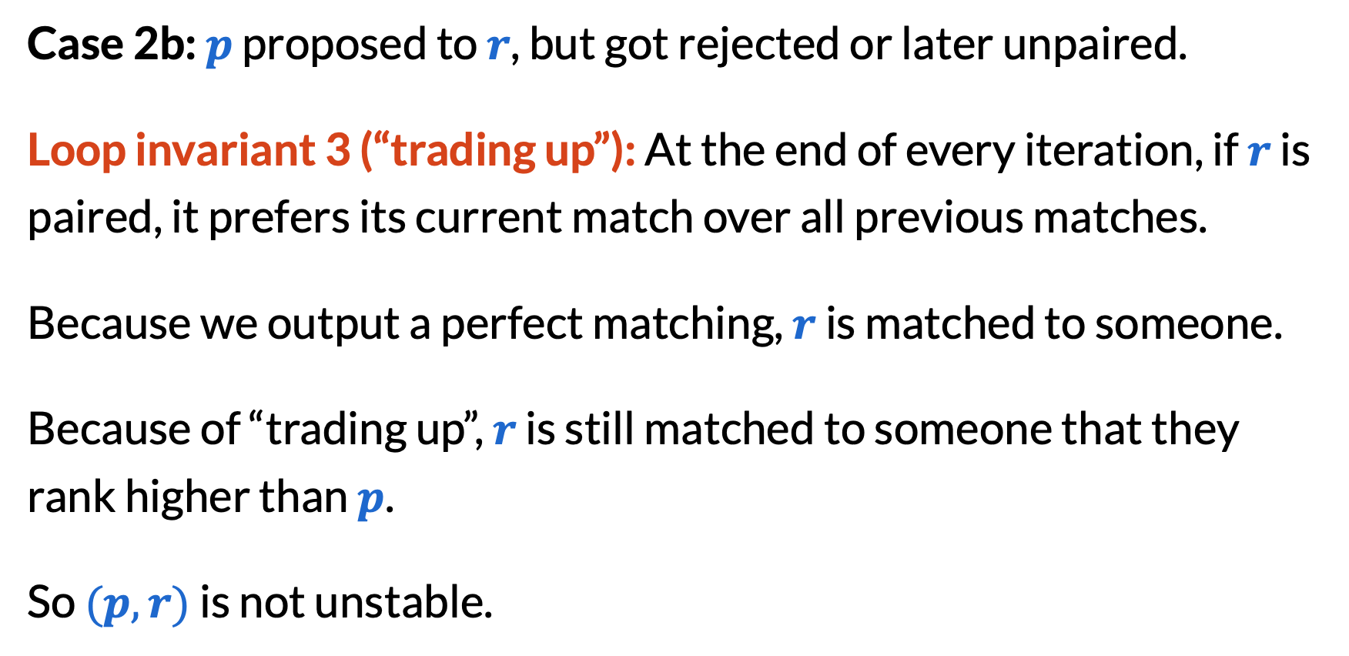
Proving no unstable pairs (5/5)
Case 2b: $p$ proposed to $r$, but got rejected or later unpaired.
Loop invariant 3 (“trading up”): At the end of every iteration, if $r$ is paired, it prefers its current match over all previous matches.
Because we output a perfect matching, $r$ is matched to someone.
Because of “trading up”, $r$ is still matched to someone that they rank higher than $p$.
So $(p,r)$ is not unstable.

Slide 31
What’s next?
We proved correctness. What other questions can we ask?
How fast is the algorithm? —wait for Friday!
What about many-to-one matchings? —on your HW2!
Which stable matching does it produce? —our next topic
Can people gain advantage by lying on their preferences lists? What about “stable roommates” (matching within one group)? etc. —if we have time

Slide 32
Proposer optimality/receiver pessimality

Slide 33
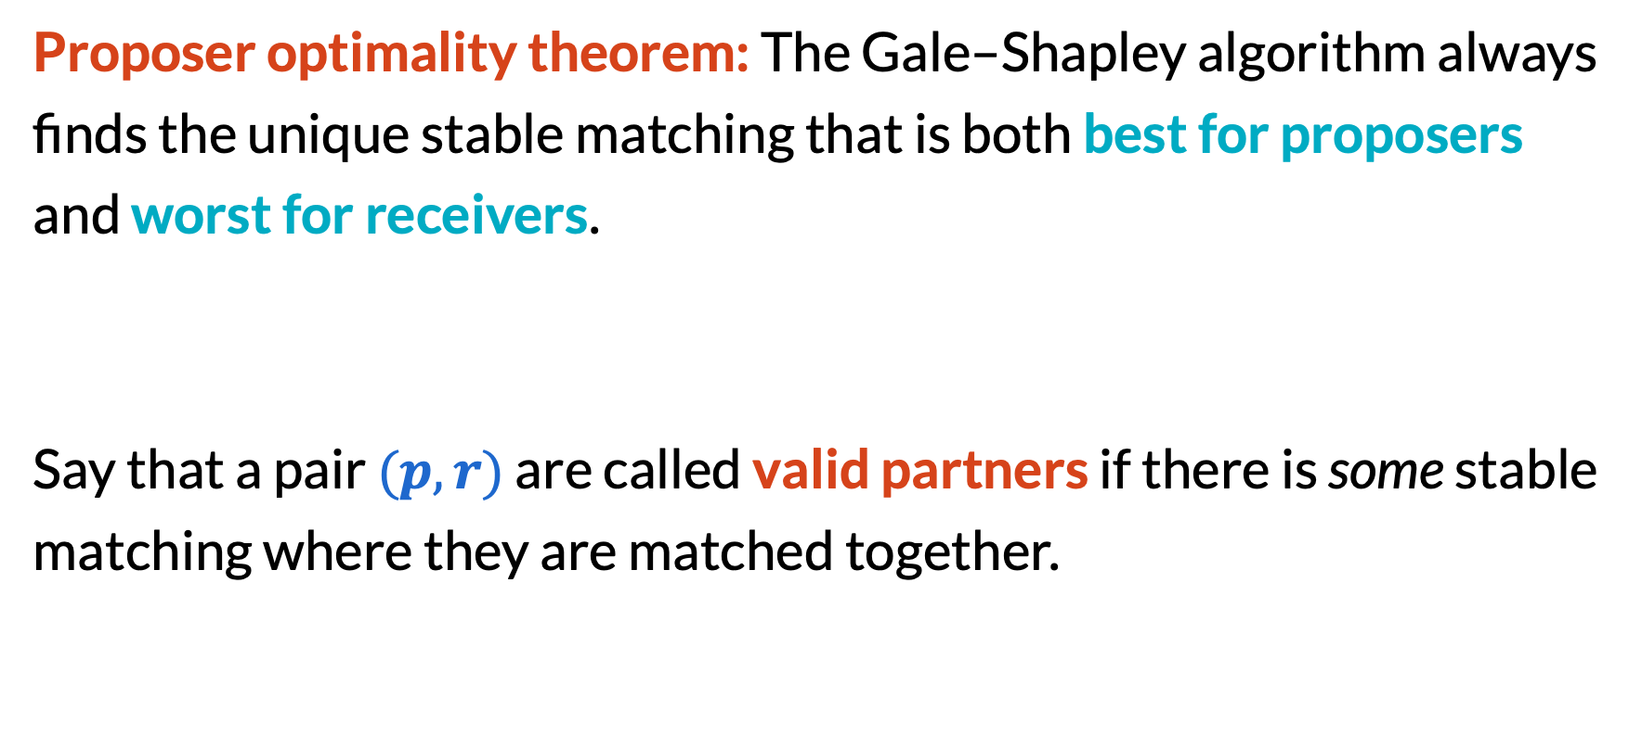
Proposer optimality theorem
Proposer optimality theorem: The Gale–Shapley algorithm always finds the unique stable matching that is both best for proposers and worst for receivers.
Say that a pair $(p, r)$ are called valid partners if there is some stable matching where they are matched together.

Slide 34
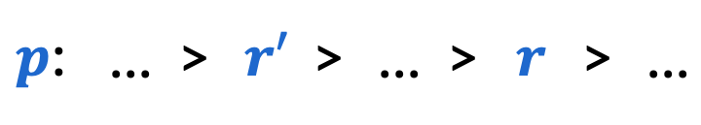
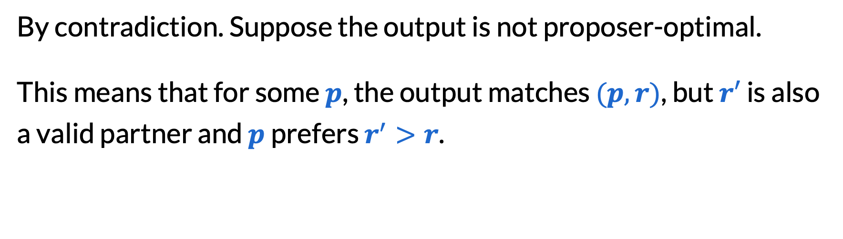
Proof of proposer optimality (1/3)
By contradiction. Suppose the output is not proposer-optimal.
This means that for some $p$, the output matches $(p, r)$, but $r′$ is also a valid partner and $p$ prefers $r^{′}>r$.
$p$: | … | > | $$r′$$ | > | … | > | $$r$$ | > | …

Slide 35
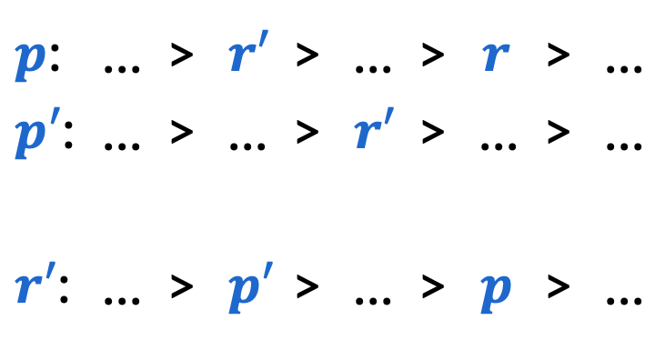
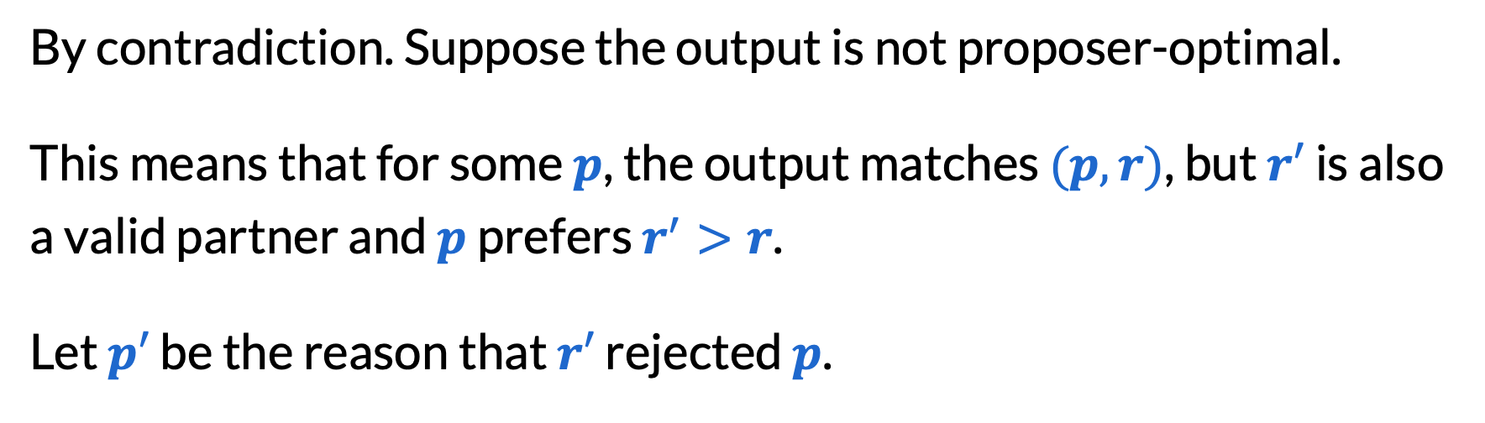
Proof of proposer optimality (1/3)
By contradiction. Suppose the output is not proposer-optimal.
This means that for some $p$, the output matches $(p, r)$, but $r′$ is also a valid partner and $p$ prefers $r^{′}>r$.
Let $p′$ be the reason that $r′$ rejected $p$.
$p$: | … | > | $$r′$$ | > | … | > | $$r$$ | > | …
$p′$: | … | > | … | > | $$r′$$ | > | … | > | …
$r′$: | … | > | $$p′$$ | > | … | > | $$p$$ | > | …

Slide 36
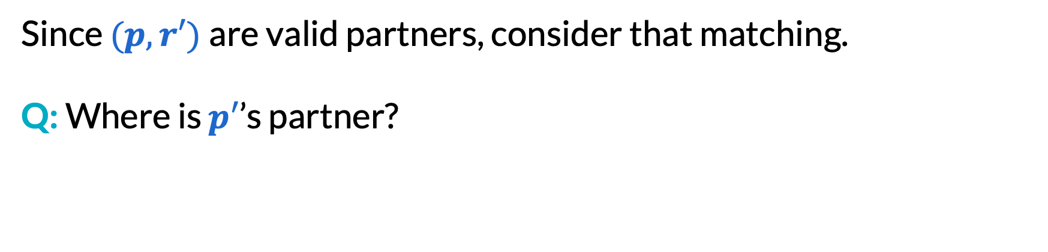
Proof of proposer optimality (2/3)
Since $(p,r′)$are valid partners, consider that matching.
Q: Where is $p′$’s partner?
$p$: | … | > | $$r′$$ | > | … | > | $$r$$ | > | …
$p′$: | … | > | … | > | $$r′$$ | > | … | > | …
$r′$: | … | > | $$p′$$ | > | … | > | $$p$$ | > | …

Slide 37
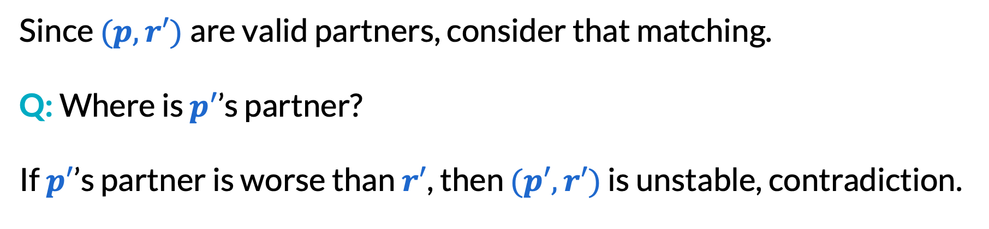
Proof of proposer optimality (2/3)
Since $(p,r′)$are valid partners, consider that matching.
Q: Where is $p′$’s partner?
If $p′$’s partner is worse than $r′$, then $(p′,r′)$ is unstable, contradiction.
$p$: | … | > | $$r′$$ | > | … | > | $$r$$ | > | …
$p′$: | … | > | … | > | $$r′$$ | > | … | > | …
$r′$: | … | > | $$p′$$ | > | … | > | $$p$$ | > | …

Slide 38
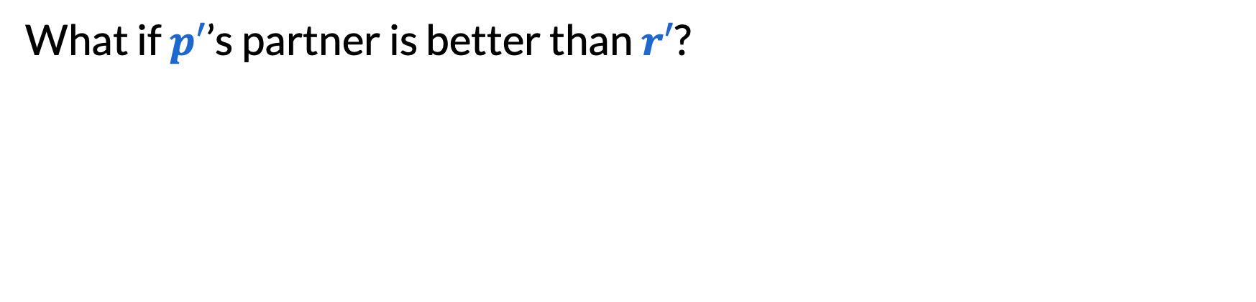
Proof of proposer optimality (3/3)
What if $p′$’s partner is better than $r′$?
$p$: | … | > | $$r′$$ | > | … | > | $$r$$ | > | …
$p′$: | … | > | … | > | $$r′$$ | > | … | > | …
$r′$: | … | > | $$p′$$ | > | … | > | $$p$$ | > | …

Slide 39
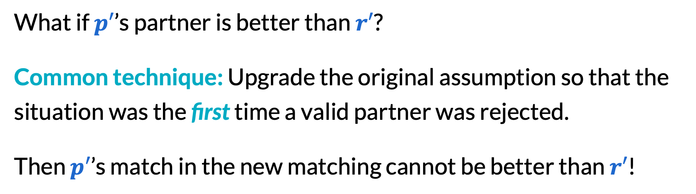
Proof of proposer optimality (3/3)
What if $p′$’s partner is better than $r′$?
Common technique: Upgrade the original assumption so that the situation was the first time a valid partner was rejected.
Then $p′$’s match in the new matching cannot be better than $r′$!
$p$: | … | > | $$r′$$ | > | … | > | $$r$$ | > | …
$p′$: | … | > | … | > | $$r′$$ | > | … | > | …
$r′$: | … | > | $$p′$$ | > | … | > | $$p$$ | > | …

Slide 40
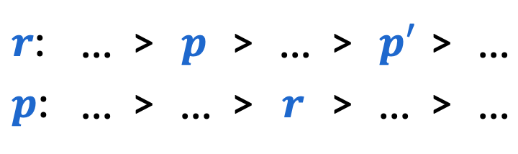
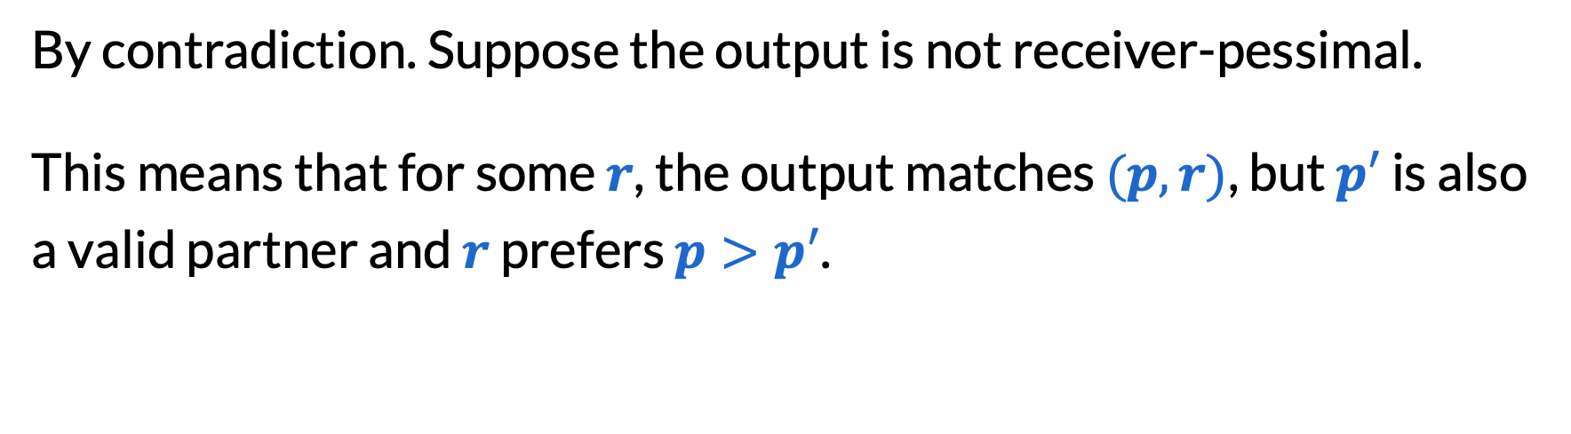
Proof of receiver pessimality (1/2)
By contradiction. Suppose the output is not receiver-pessimal.
This means that for some $r$, the output matches $(p, r)$, but $p′$ is also a valid partner and $r$ prefers $p>p′$.
$r$: | … | > | $$p$$ | > | … | > | $$p′$$ | > | …
$p$: | … | > | … | > | $$r$$ | > | … | > | …

Slide 41
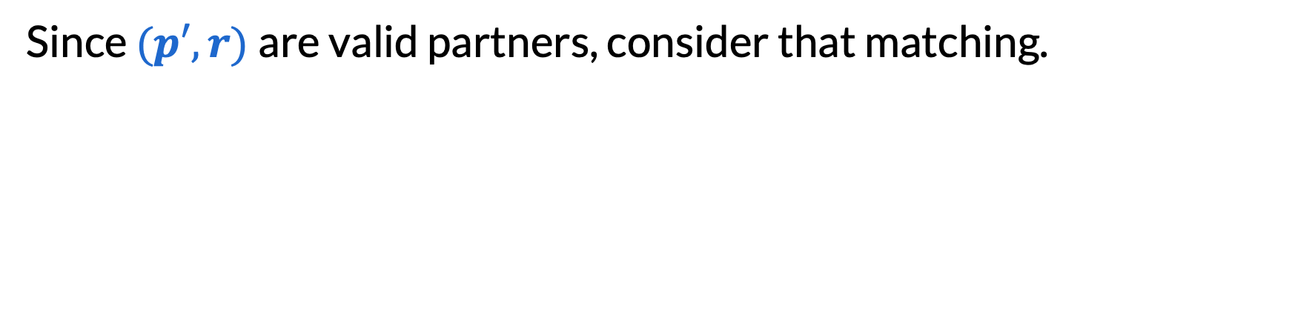
Proof of receiver pessimality (2/2)
Since $(p′,r)$are valid partners, consider that matching.
$r$: | … | > | $$p$$ | > | … | > | $$p′$$ | > | …
$p$: | … | > | … | > | $$r$$ | > | … | > | …

Slide 42
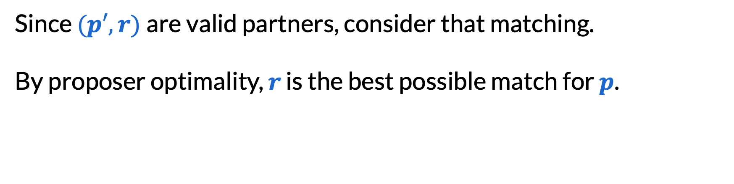
Proof of receiver pessimality (2/2)
Since $(p′,r)$are valid partners, consider that matching.
By proposer optimality, $r$ is the best possible match for $p$.
$r$: | … | > | $$p$$ | > | … | > | $$p′$$ | > | …
$p$: | … | > | … | > | $$r$$ | > | … | > | …

Slide 43
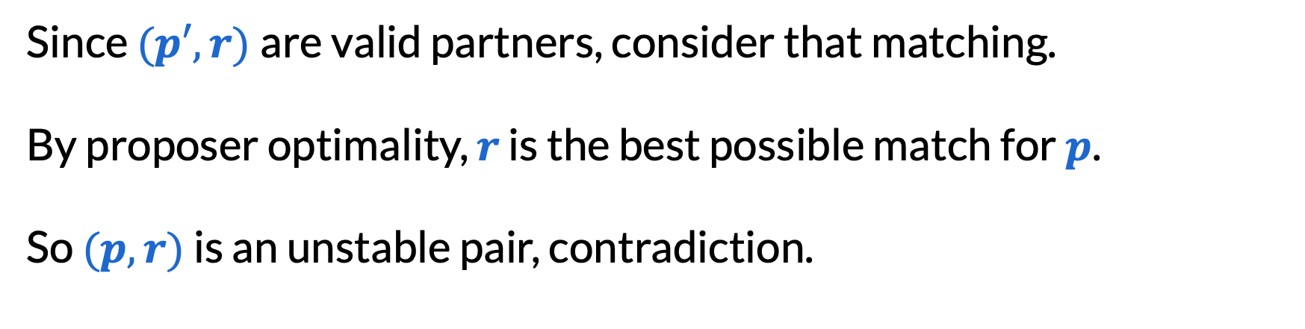
Proof of receiver pessimality (2/2)
Since $(p′,r)$are valid partners, consider that matching.
By proposer optimality, $r$ is the best possible match for $p$.
So $(p,r)$ is an unstable pair, contradiction.
$r$: | … | > | $$p$$ | > | … | > | $$p′$$ | > | …
$p$: | … | > | … | > | $$r$$ | > | … | > | …

Slide 44
Miscellaneous notes (just for fun)

Slide 45
Lying can help receivers (1/2)
Proposers
Receivers’ true prefs
1: | A | > | B | > | C
2: | B | > | A | > | C
3: | A | > | B | > | C
A: | 2 | > | 1 | > | 3
B: | 1 | > | 2 | > | 3
C: | 1 | > | 2 | > | 3
With true preferences, A gets their second choice.

Slide 46
Lying can help receivers (2/2)
Proposers
Receivers’ true prefs
With A lying
1: | A | > | B | > | C
2: | B | > | A | > | C
3: | A | > | B | > | C
A: | 2 | > | 1 | > | 3
B: | 1 | > | 2 | > | 3
C: | 1 | > | 2 | > | 3
A: | 2 | > | 3 | > | 1
B: | 1 | > | 2 | > | 3
C: | 1 | > | 2 | > | 3
With true preferences, A gets their second choice.
When A lies about second/third choices, A gets their top choice!
(Lying does not help proposers because of proposer optimality.)

Slide 47

Stable roommates problem (1/2)
One group of $2n$ people and preferences over all $2n−1$ others.
1: | 2 | > | 3 | > | 4
2: | 3 | > | 1 | > | 4
3: | 1 | > | 2 | > | 4
4: | 1 | > | 2 | > | 3
(1, 2) and (3, 4)
(2, 3) unstable
(1, 3) and (2, 4)
(1, 2) unstable
(1, 4) and (2, 3)
(1, 3) unstable

Slide 48
Stable roommates problem (2/2)
Stable solution may not always exist.
Irving’s algorithm (1985) extends Gale–Shapley to determine if a stable solution exists, and if so, find it!

Slide 49
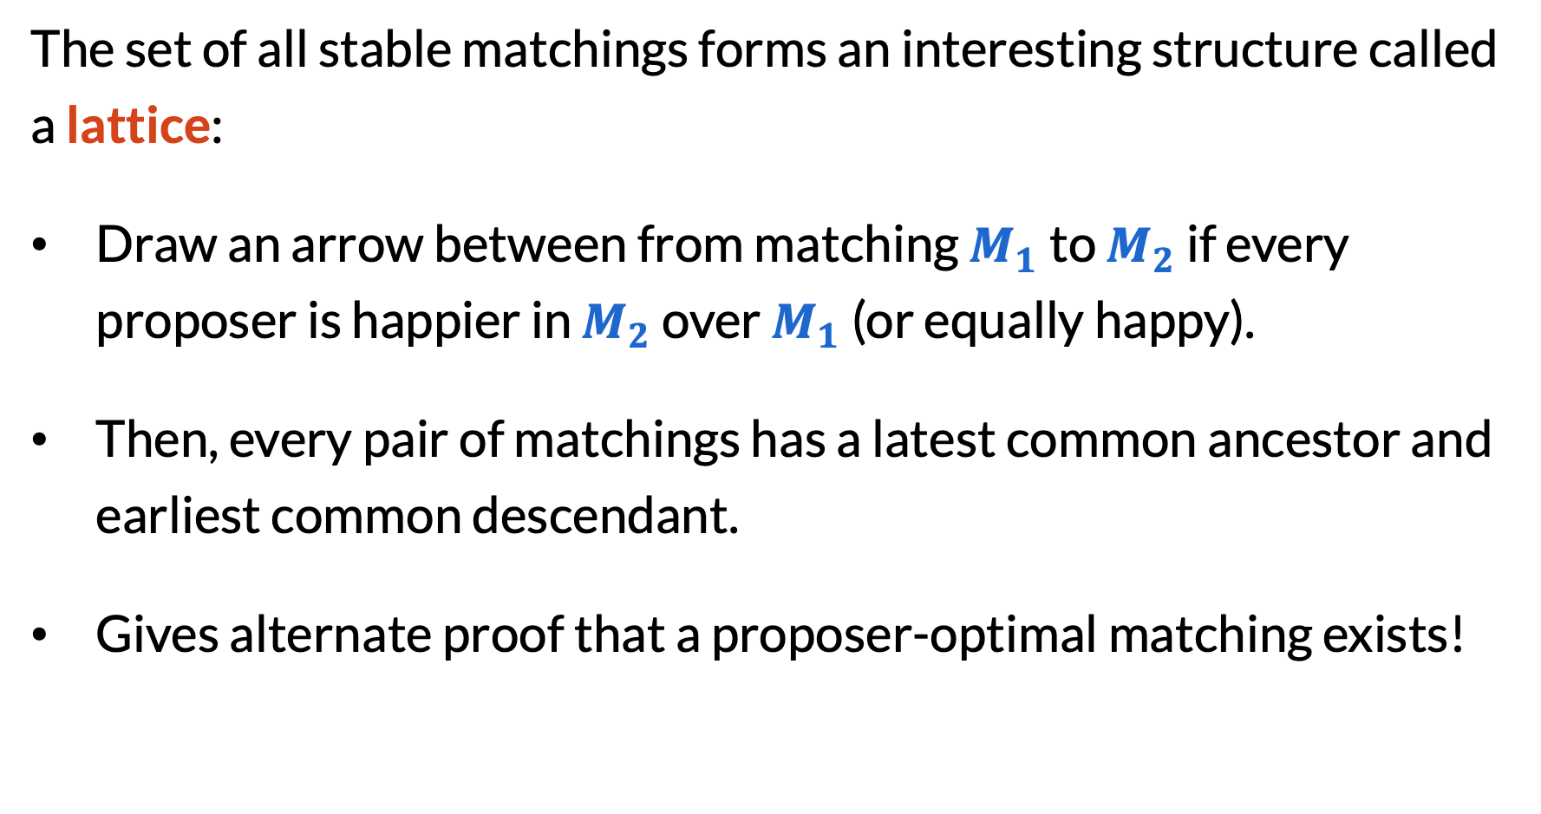
Characterizing all stable matchings (1/2)
The set of all stable matchings forms an interesting structure called a lattice:
Draw an arrow between from matching $M_{1}$ to $M_{2}$ if every proposer is happier in $M_{2}$ over $M_{1}$ (or equally happy).
Then, every pair of matchings has a latest common ancestor and earliest common descendant.
Gives alternate proof that a proposer-optimal matching exists!

Slide 50
Characterizing all stable matchings (2/2)
receiver-optimal
proposer-optimal

Slide 51
Final reminders
HW1 due Friday @ 11:59pm.
I have OH now-12:30pm:
Meet at front of classroom, we’ll walk over together
CSE (Allen) 214 if you’re coming later
Nathan has online OH 12–1pm:
Link on Canvas/course website
https://washington.zoom.us/my/nathanbrunelle

