Slide 1
Lecture 8: Sorting as a Subroutine
Nathan Brunelle

Slide 2
Homeworks
HW 1 feedback released yesterday
HW 2 out, due Friday (today) 11:59pm.

Slide 3
Divide and Conquer Review

Slide 4
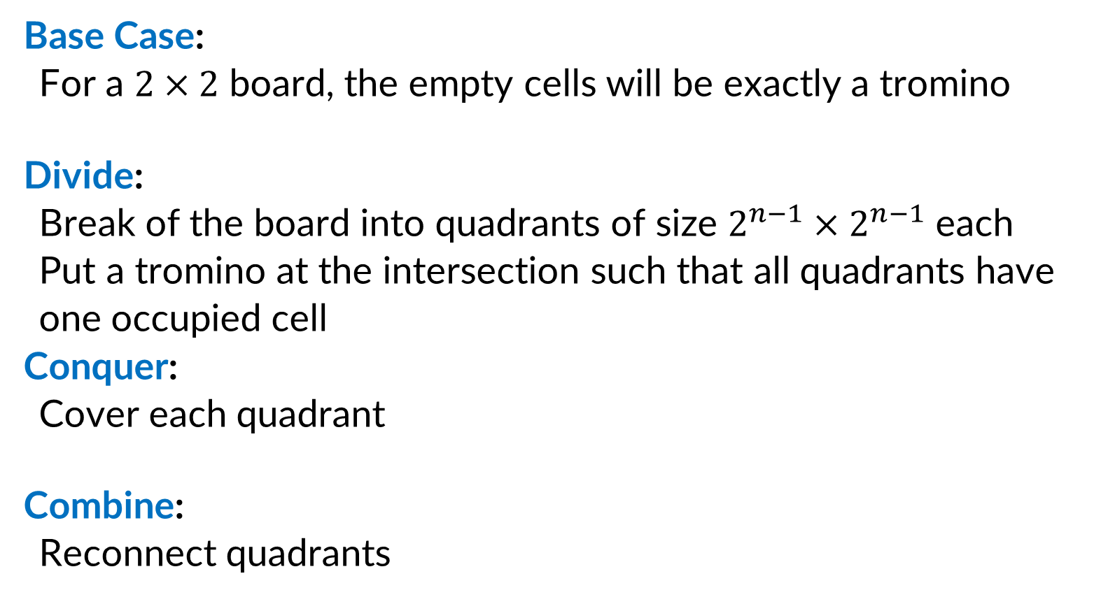
Divide and Conquer (Trominoes)
Base Case:
For a $2×2$ board, the empty cells will be exactly a tromino
Divide:
Break of the board into quadrants of size $2^{n−1}×2^{n−1}$ each
Put a tromino at the intersection such that all quadrants have one occupied cell
Conquer:
Cover each quadrant
Combine:
Reconnect quadrants

Slide 5
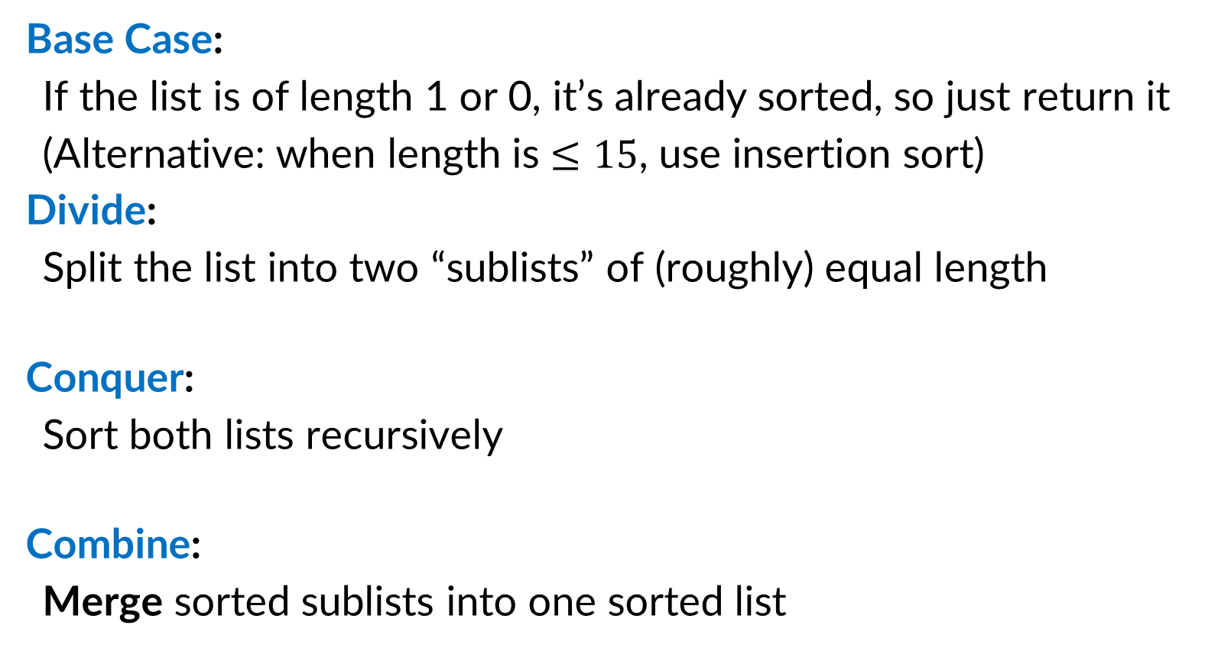
Divide and Conquer (Merge Sort)
Base Case:
If the list is of length 1 or 0, it’s already sorted, so just return it
(Alternative: when length is $≤15$, use insertion sort)
Divide:
Split the list into two “sublists” of (roughly) equal length
Conquer:
Sort both lists recursively
Combine:
Merge sorted sublists into one sorted list
5
5
8
2
9
4
1
2
5
8
1
4
9
2
5
8
1
4
9
1
2
4
5
8
9

Slide 6







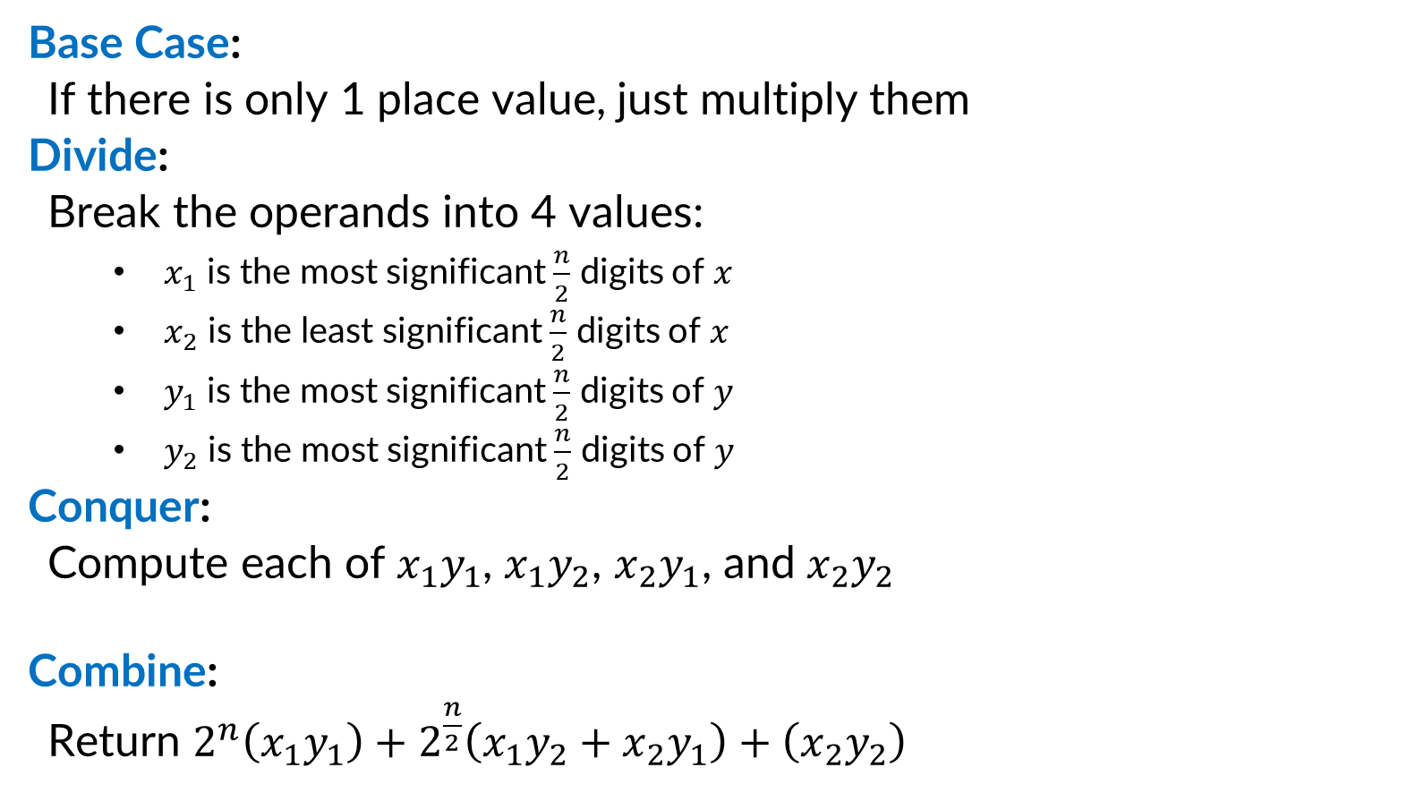









Divide and Conquer (Integer Multiplication)
Base Case:
If there is only 1 place value, just multiply them
Divide:
Break the operands into 4 values:
$x_{1}$ is the most significant $\frac{n}{2}$ digits of $x$
$x_{2}$ is the least significant $\frac{n}{2}$ digits of $x$
$y_{1}$ is the most significant $\frac{n}{2}$ digits of $y$
$y_{2}$ is the most significant $\frac{n}{2}$ digits of $y$
Conquer:
Compute each of $x_{1}y_{1}$, $x_{1}y_{2}$, $x_{2}y_{1}$, and $x_{2}y_{2}$
Combine:
Return $2^{n}\left(x_{1}y_{1}\right)+2^{\frac{n}{2}}\left(x_{1}y_{2}+x_{2}y_{1}\right)+\left(x_{2}y_{2}\right)$
$$x_{1}$$
$$x_{2}$$
$$×$$
$$y_{1}$$
$$y_{2}$$
$$x_{1}y_{1}$$
$$x_{1}y_{2}$$
$$x_{2}y_{1}$$
$$x_{2}y_{2}$$
$$x_{1}y_{1}$$
$$+$$
$$x_{1}y_{2}$$
$$+$$
$$x_{2}y_{1}$$
$$+$$
$$x_{2}y_{2}$$

Slide 7





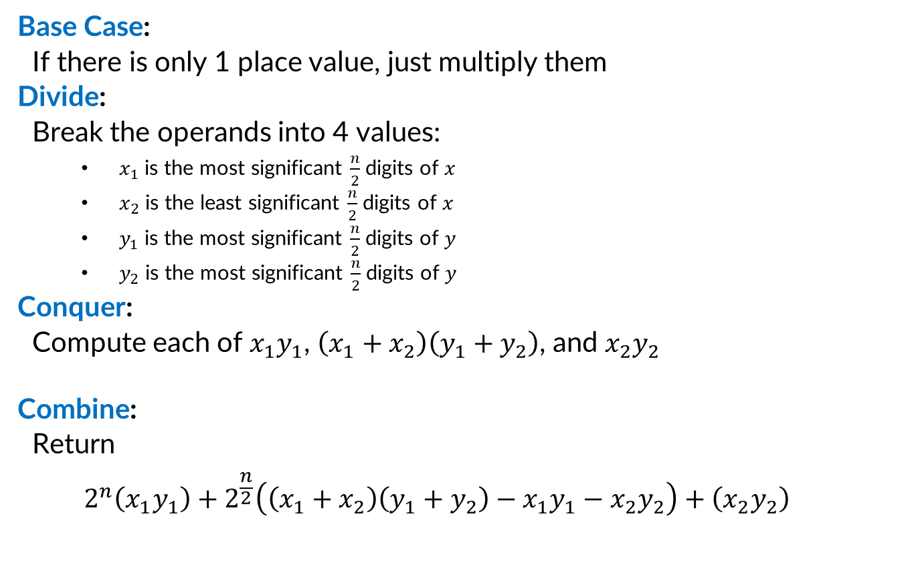








Divide and Conquer (Karatsuba Method)
Base Case:
If there is only 1 place value, just multiply them
Divide:
Break the operands into 4 values:
$x_{1}$ is the most significant $\frac{n}{2}$ digits of $x$
$x_{2}$ is the least significant $\frac{n}{2}$ digits of $x$
$y_{1}$ is the most significant $\frac{n}{2}$ digits of $y$
$y_{2}$ is the most significant $\frac{n}{2}$ digits of $y$
Conquer:
Compute each of $x_{1}y_{1}$, $\left(x_{1}+x_{2}\right)\left(y_{1}+y_{2}\right)$, and $x_{2}y_{2}$
Combine:
Return
$$2^{n}\left(x_{1}y_{1}\right)+2^{\frac{n}{2}}\left(\left(x_{1}+x_{2}\right)\left(y_{1}+y_{2}\right)−x_{1}y_{1}−x_{2}y_{2}\right)+\left(x_{2}y_{2}\right)$$
$$x_{1}$$
$$x_{2}$$
$$×$$
$$y_{1}$$
$$y_{2}$$
$$x_{1}y_{1}$$
$$x_{1}y_{2}$$
$$\left(x_{1}+x_{2}\right)$$
$$\left(y_{1}+y_{2}\right)$$
$$x_{2}y_{2}$$
$$x_{1}y_{1}$$
$$+$$
$$\left(x_{1}+x_{2}\right)$$
$$\left(y_{1}+y_{2}\right)$$
$$−$$
$$x_{1}y_{1}$$
$$−$$
$$x_{2}y_{2}$$
$$+$$
$$x_{2}y_{2}$$

Slide 8
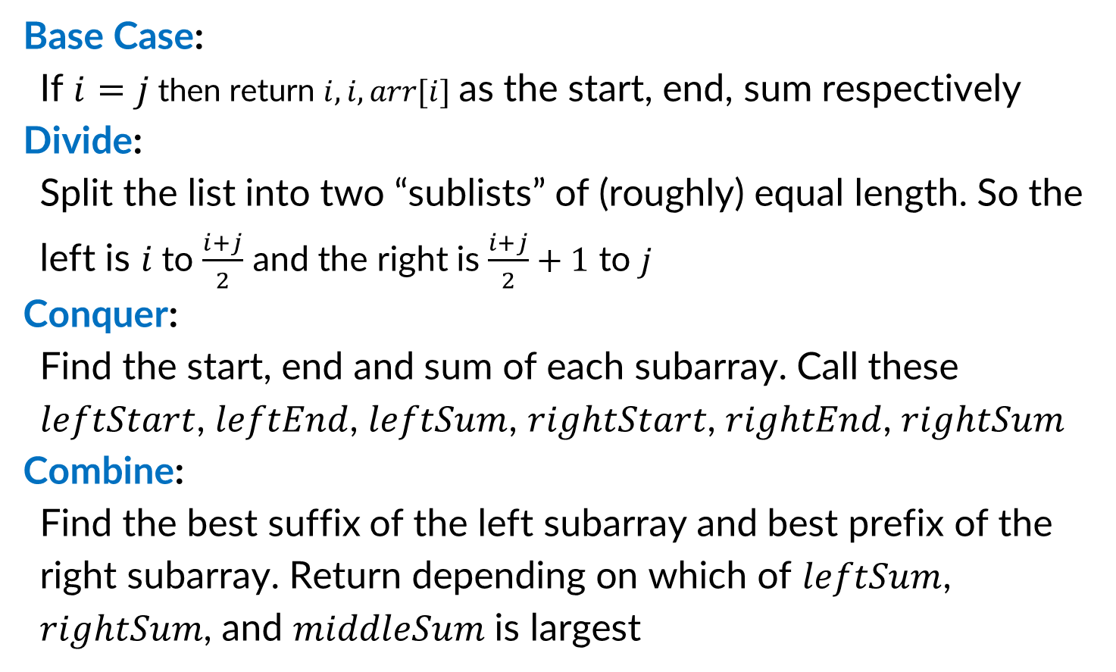
Maximum Sum Subarray (D&C from reading)
Base Case:
If $i=j$ then return $i, i, arr[i]$ as the start, end, sum respectively
Divide:
Split the list into two “sublists” of (roughly) equal length. So the left is $i$ to $\frac{i+j}{2}$ and the right is $\frac{i+j}{2}+1$ to $j$
Conquer:
Find the start, end and sum of each subarray. Call these $leftStart$, $leftEnd$, $leftSum$, $rightStart$, $rightEnd$, $rightSum$
Combine:
Find the best suffix of the left subarray and best prefix of the right subarray. Return depending on which of $leftSum$, $rightSum$, and $middleSum$ is largest
3
3
-5
1
3
-2
3
4
-8
6
0
1
2
3
4
5
6
7
8
Left Solution
Right Solution
3
-5
1
3
-2
3
4
-8
6
0
1
2
3
4
5
6
7
8
Left Solution
Right Solution
3
-5
1
3
-2
3
4
-8
6
0
1
2
3
4
5
6
7
8
Best Suffix
Best Prefix

Slide 9
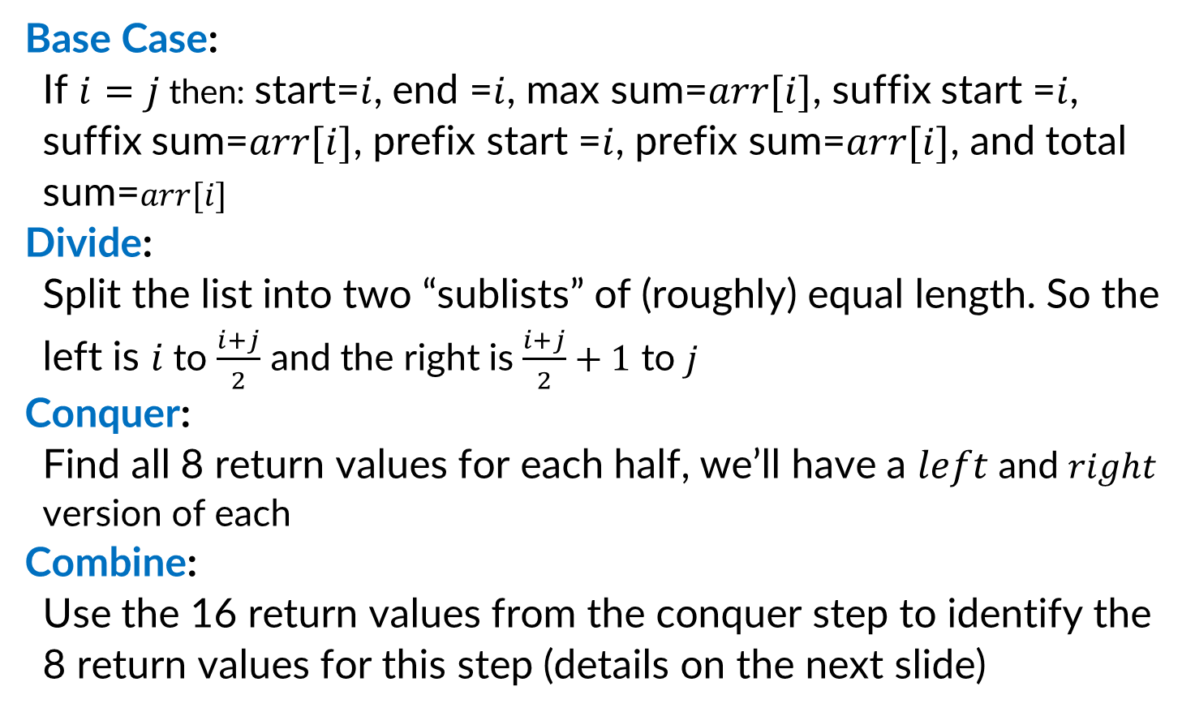
Maximum Sum Subarray (Improved D&C)
Base Case:
If $i=j$ then: start=$i$, end =$i$, max sum=$arr[i]$, suffix start =$i$, suffix sum=$arr[i]$, prefix start =$i$, prefix sum=$arr[i]$, and total sum=$arr[i]$
Divide:
Split the list into two “sublists” of (roughly) equal length. So the left is $i$ to $\frac{i+j}{2}$ and the right is $\frac{i+j}{2}+1$ to $j$
Conquer:
Find all 8 return values for each half, we’ll have a $left$ and $right$ version of each
Combine:
Use the 16 return values from the conquer step to identify the 8 return values for this step (details on the next slide)
3
3
-5
1
3
-2
3
4
-8
6
0
1
2
3
4
5
6
7
8
Left Solution
Right Solution
3
-5
1
3
-2
3
4
-8
6
0
1
2
3
4
5
6
7
8
Best Prefix
Best Suffix
Best Prefix
Best Suffix
Max Sum Subarray
3
-5
1
3
-2
3
4
-8
6
0
1
2
3
4
5
6
7
8
Best Prefix
Best Suffix

Slide 10
The “Technique of Computing More”
Sometimes, it’s helpful to perform more tasks in your combine and conquer algorithm. We’ll see 2 examples: 1) More tasks give better running time 2) More tasks enable correctness

Slide 11
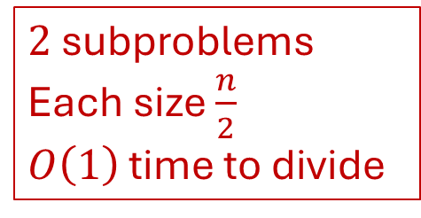
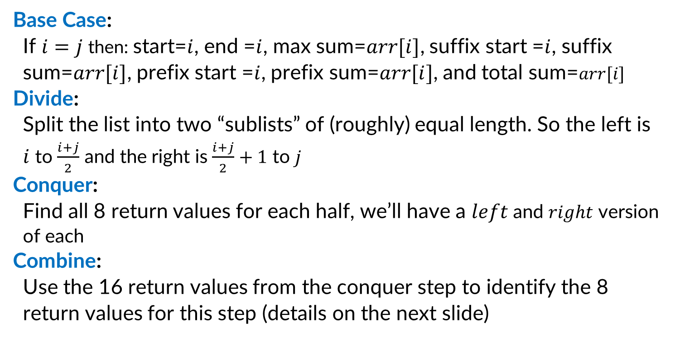
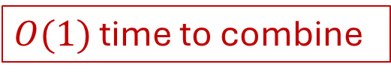
Running Time (Improved D&C)
Base Case:
If $i=j$ then: start=$i$, end =$i$, max sum=$arr[i]$, suffix start =$i$, suffix sum=$arr[i]$, prefix start =$i$, prefix sum=$arr[i]$, and total sum=$arr[i]$
Divide:
Split the list into two “sublists” of (roughly) equal length. So the left is $i$ to $\frac{i+j}{2}$ and the right is $\frac{i+j}{2}+1$ to $j$
Conquer:
Find all 8 return values for each half, we’ll have a $left$ and $right$ version of each
Combine:
Use the 16 return values from the conquer step to identify the 8 return values for this step (details on the next slide)
$2$ subproblems
Each size $\frac{n}{2}$
$O\left(1\right)$ time to divide
$O(1)$ time to combine
Overall: $T\left(n\right)=2T\left(\frac{n}{2}\right)+1$

Slide 12
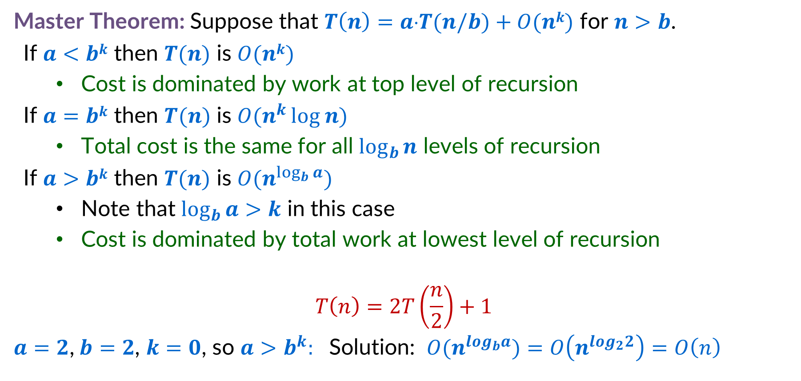
Improved D&C Recurrence Solution
Master Theorem: Suppose that $T\left(n\right)=a⋅T(n/b)+O(nk)$ for $n>b$.
If $a<bk$ then $T(n)$ is $O(nk)$
Cost is dominated by work at top level of recursion
If $a=bk$ then $T(n)$ is $O(n^{k }log n)$
Total cost is the same for all $\log_{b}{n}$ levels of recursion
If $a>bk$ then $T(n)$ is $O(n^{\log_{b}{a}})$
Note that $\log_{b}{a>k}$ in this case
Cost is dominated by total work at lowest level of recursion
$$T\left(n\right)=2T\left(\frac{n}{2}\right)+1$$
$a=2$,$b=2$, $k=0$, so $a>b^{k}:$ Solution: $O(n^{log_{b}a})$ $=O\left(n^{log_{2}2}\right)=O\left(n\right)$

Slide 13
Binary Tree Diameter

Slide 14
Binary Trees – Vocab Review
1
Nodes: Objects in the tree (labelled 1-8 here). They contain a value and may have a link to up to two other nodes
Child Node: a node linked to by some other node, that node is called its “parent”. E.g. 4 is the child of 2
Sibling Nodes: two nodes that share a parent. E.g. 2 and 3 are siblings
Root Node: The unique node which has no parent. Node 1 is the root
Leaf Nodes: Nodes that have no children. 5,6,7, and 8 here
2
3
4
5
6
7
8

Slide 15
Binary Tree Height - Definition
1
Distance: The distance between two nodes is the number of links you must follow to get from one to the other. E.g. the distance from 2 to 8 is 2, the distance from 2 to 6 is 3.
Height: The height of a binary tree is the largest distance from the root to some leaf. The height of this tree is 3 (1 is 3 away from 7)
2
3
4
5
6
7
8

Slide 16
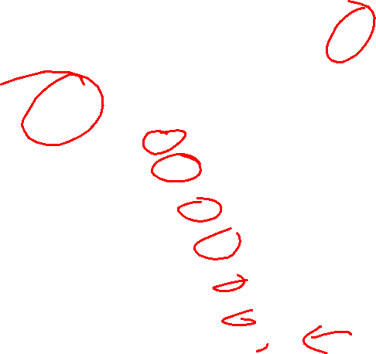
Binary Tree Diameter - Definition
1
Diameter: The maximum distance between two nodes in a binary tree. The diameter of this tree is 5, because 7 is distance 5 from node 6.
2
3
4
5
6
7
8

Slide 17
Binary Tree Diameter – Incorrect Algorithm
0
8
Base Case:
If the current node is a leaf, the diameter is 0
Divide:
Split the tree into the left subtree and the right subtree
Conquer:
Find the diameter of each subtree
Combine:
Return the diameter of the left subtree + the diameter of the right subtree + 1
2
3
4
5
6
7
8
2
3
2
2
4
5
6
7
8
1
2
5
3
4
5
6
7
8

Slide 18
Incorrect Algorithm - Counterexample
1
Diameter of the left subtree: 0
Diameter of the right subtree: 0
Diameter of the whole tree: 2
2
3
Diameter ended up being: the distance to a left leaf + distance to a right leaf

Slide 19
Incorrect Algorithm - Counterexample
1
Diameter of the left subtree: 6
Diameter of the right subtree: 0
Diameter of the whole tree: 6
2
3
4
5
6
7
8
9
Diameter ended up being: The diameter of a subtree

Slide 20
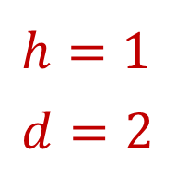
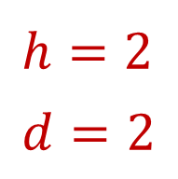
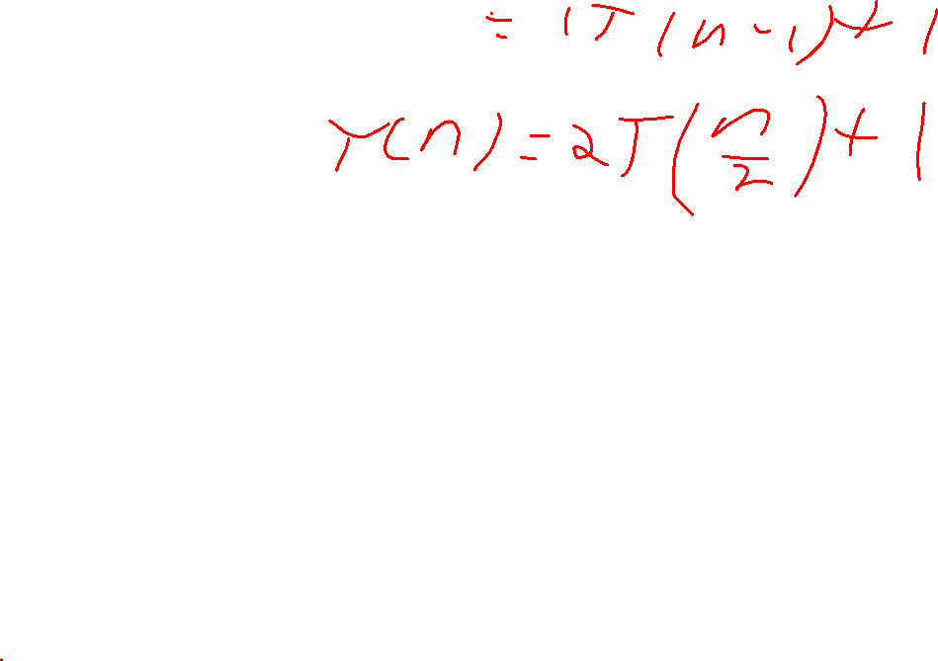
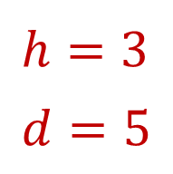
Binary Tree Diameter – Correct Algorithm
Base Case:
If the node is null the diameter and height are -1.
Divide:
Split the tree into the left subtree and the right subtree
Conquer:
Find the diameter and height of each subtree
Combine:
Height = 1 + max(left height, right height)
Diameter = max(left diameter,
right diameter,
left height + right height +2)
2
3
4
5
6
7
8
2
3
$$h=2 \\ d=2$$
4
5
6
$$h=1 \\ d=2$$
7
8
$$h=3 \\ d=5$$
1
2
3
4
5
6
7
8

Slide 21

Closest Pair of Tomatoes
2
5
4
6
7
3

Slide 22
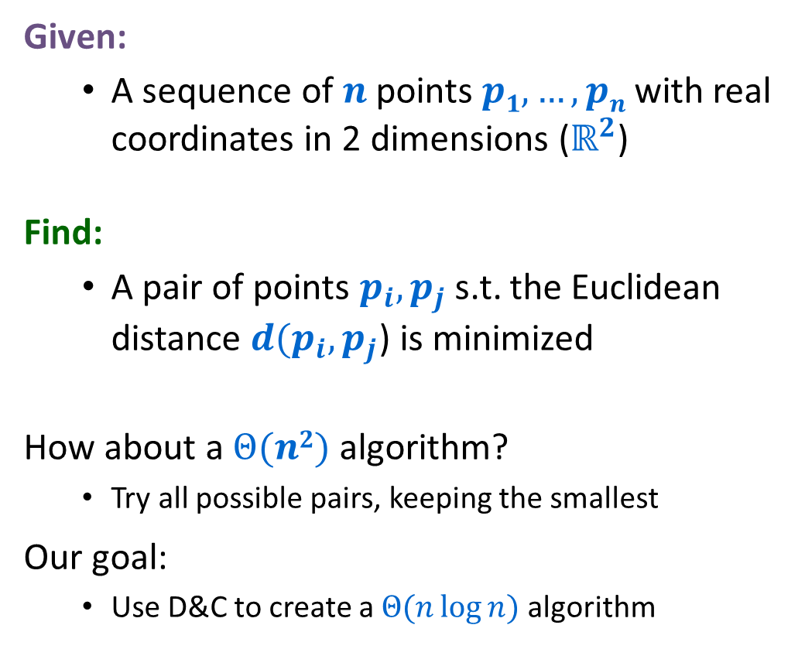
Closest Pair of Points
Given:
A sequence of $n$ points $p1,…,pn$with real coordinates in 2 dimensions ($ℝ^{2}$)
Find:
A pair of points $p_{i},p_{j}$ s.t. the Euclidean distance ${d(p}_{i},p_{j}$) is minimized
How about a $Θ(n2)$ algorithm?
Try all possible pairs, keeping the smallest
Our goal:
Use D&C to create a $Θ(n\log{n})$ algorithm

Slide 23
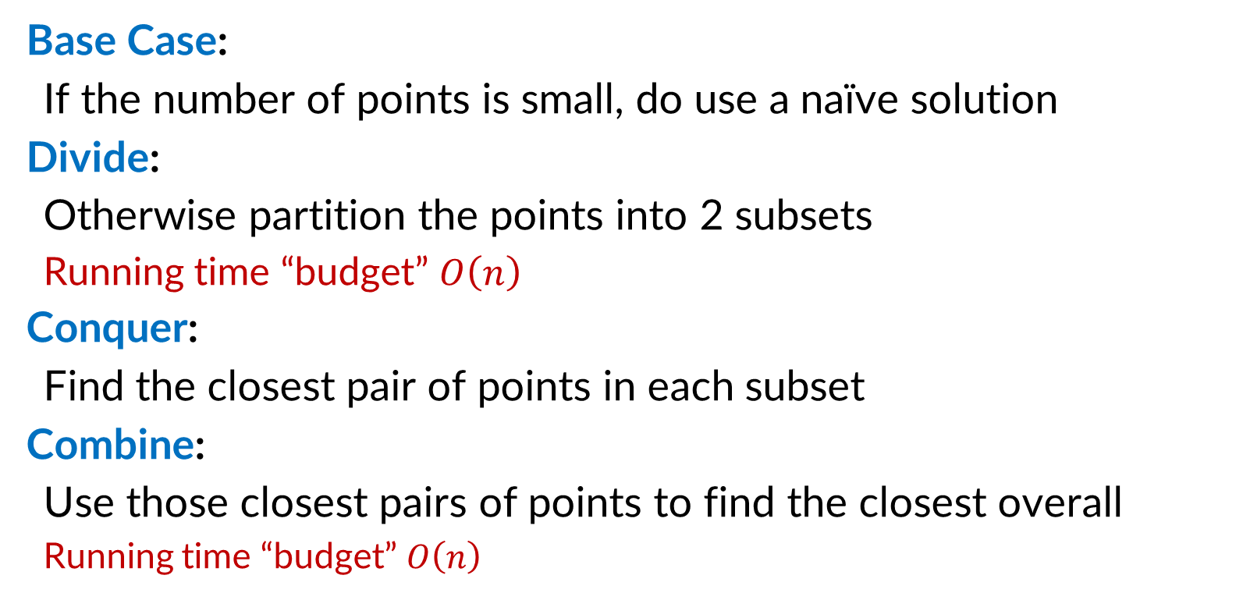
Closest Pair of Point D&C Idea
To get $Θ(n log n)$, we will aim for $T\left(n\right)=2T\left(\frac{n}{2}\right)+n$
Base Case:
If the number of points is small, do use a naïve solution
Divide:
Otherwise partition the points into 2 subsets
Running time “budget” $O\left(n\right)$
Conquer:
Find the closest pair of points in each subset
Combine:
Use those closest pairs of points to find the closest overall
Running time “budget” $O\left(n\right)$

Slide 24
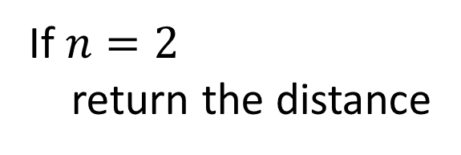
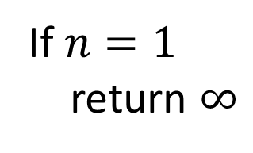
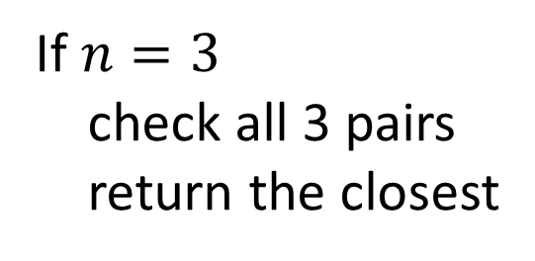
Closest Pair: Base Cases
If $n=1$
return $∞$
If $n=2$
return the distance
If $n=3$
check all 3 pairs
return the closest

Slide 25
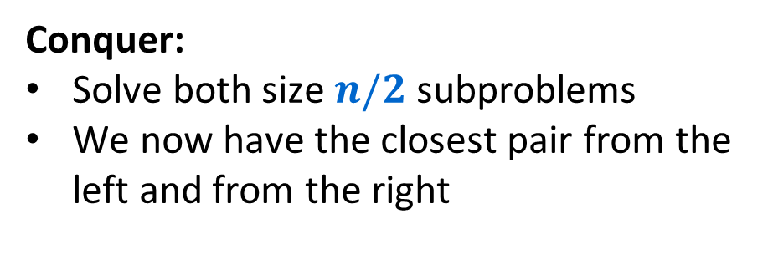
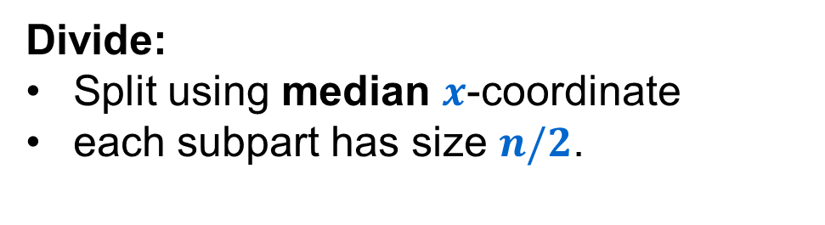
Closest Pair: First Idea
Divide:
Split using median $x$-coordinate
each subpart has size $n/2$.
Conquer:
Solve both size $n/2$ subproblems
We now have the closest pair from the left and from the right
Combine:
Return the closer of the left pair and the right pair

Slide 26

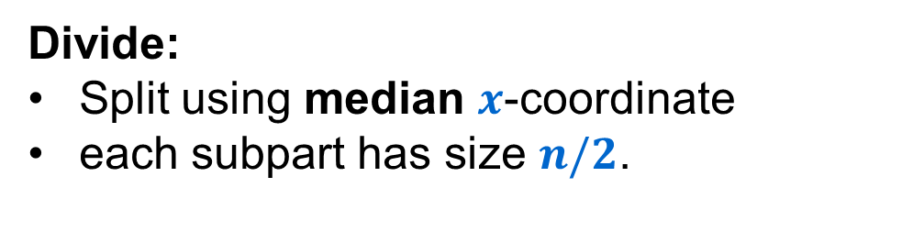
Closest Pair: First Idea - Problem
Divide:
Split using median $x$-coordinate
each subpart has size $n/2$.
Conquer:
Solve both size $n/2$ subproblems
We now have the closest pair from the left and from the right
Combine:
Find the closest pair crossing the middle
Return the closest of the left, right, and crossing pairs

Slide 27
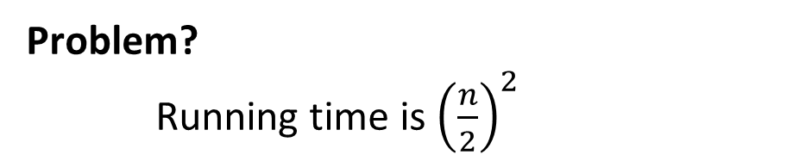
Finding the Closest Crossing Pair – 1st Idea
Combine:
Find the closest pair crossing the middle
Return the closest of the left, right, and crossing pairs
Procedure:
For each point on the left, find its closest point on the right
Save the closest seen as the crossing pair
Problem?
Running time is ${\left(\frac{n}{2}\right)}^{2}$

Slide 28

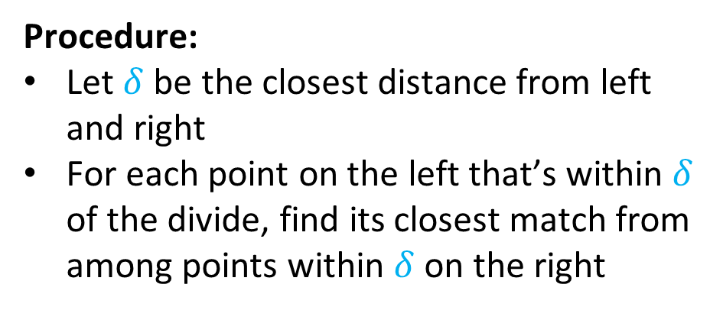


Finding the Closest Crossing Pair – 2nd Idea
$$δ$$
$$δ$$
Combine:
Find the closest pair crossing the middle
Return the closest of the left, right, and crossing pairs
$$δ$$
Observation:
We only care about crossing pairs that might be closer than left and right
Ignore points too far from the divide
Procedure:
Let $δ$ be the closest distance from left and right
For each point on the left that’s within $δ$ of the divide, find its closest match from among points within $δ$ on the right

Slide 29
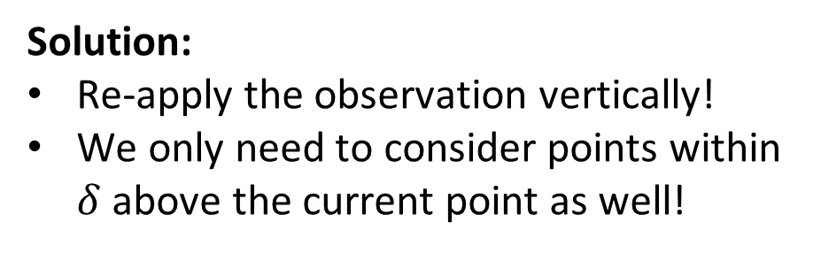
Problem with the 2nd Idea
$$δ$$
$$δ$$
Combine:
Find the closest pair crossing the middle
Return the closest of the left, right, and crossing pairs
$$δ$$
Observation:
We only care about crossing pairs that might be closer than left and right
Ignore points too far from the divide
Problem:
We could still exceed our budget!
Solution:
Re-apply the observation vertically!
We only need to consider points within $δ$ above the current point as well!

Slide 30

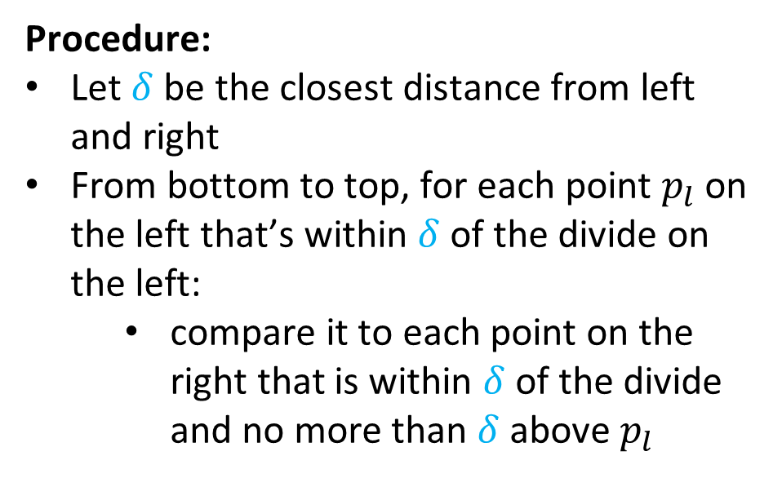

Finding the Closest Crossing Pair – 3rd Idea
$$δ$$
$$δ$$
Combine:
Find the closest pair crossing the middle
Return the closest of the left, right, and crossing pairs
$$δ$$
Procedure:
Let $δ$ be the closest distance from left and right
From bottom to top, for each point $p_{l}$ on the left that’s within $δ$ of the divide on the left:
compare it to each point on the right that is within $δ$ of the divide and no more than $δ$ above $p_{l}$
$$δ$$
This will only fit within our budget if we compare each $p_{l}$ to a constant number of other points

Slide 31
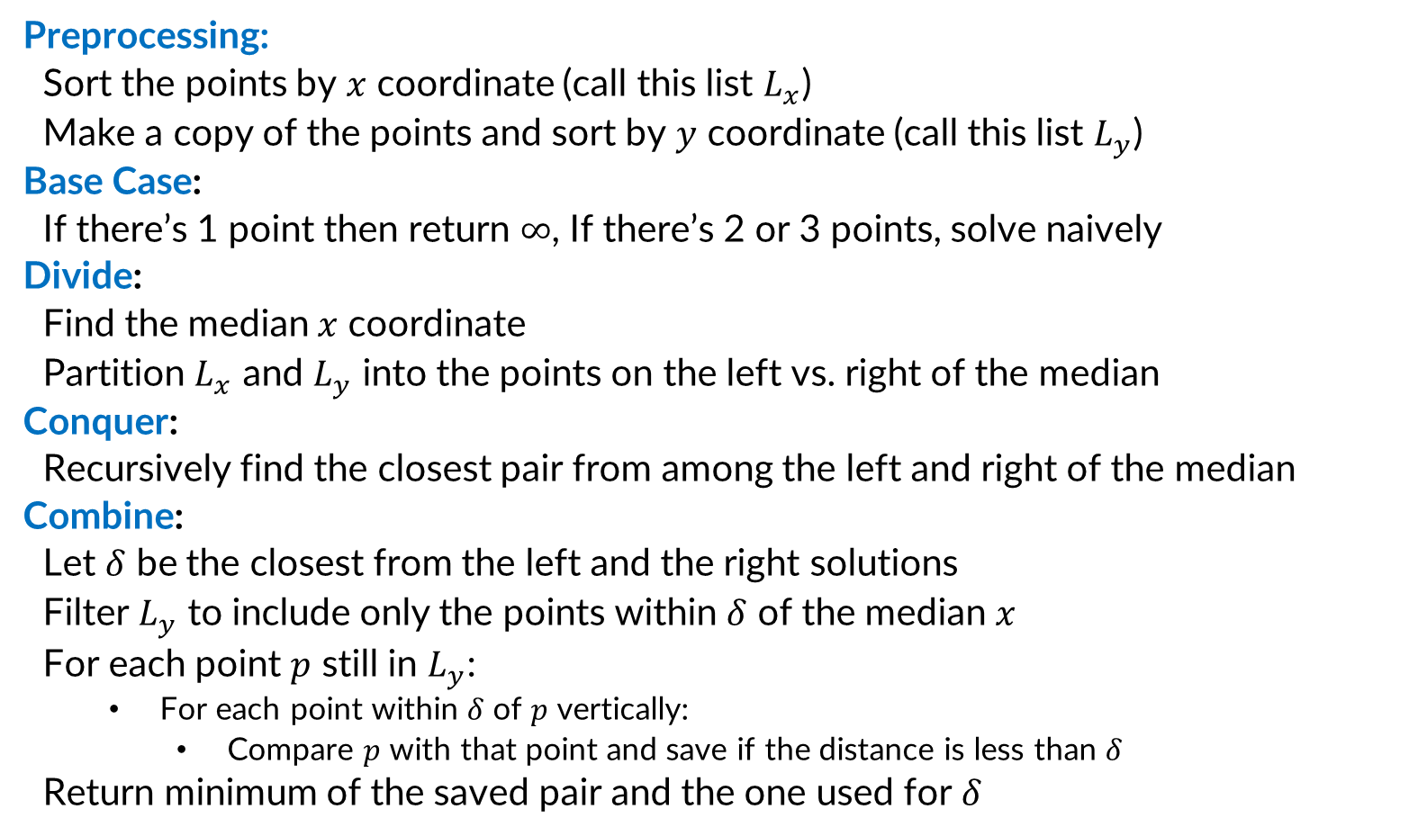
Divide and Conquer (Closest Pair of Points)
Preprocessing:
Sort the points by $x$ coordinate (call this list $L_{x}$)
Make a copy of the points and sort by $y$ coordinate (call this list $L_{y}$)
Base Case:
If there’s 1 point then return $∞$, If there’s 2 or 3 points, solve naively
Divide:
Find the median $x$ coordinate
Partition $L_{x}$ and $L_{y}$ into the points on the left vs. right of the median
Conquer:
Recursively find the closest pair from among the left and right of the median
Combine:
Let $δ$ be the closest from the left and the right solutions
Filter $L_{y}$ to include only the points within $δ$ of the median $x$
For each point $p$ still in $L_{y}$:
For each point within $δ$ of $p$ vertically:
Compare $p$ with that point and save if the distance is less than $δ$
Return minimum of the saved pair and the one used for $δ$

Slide 32
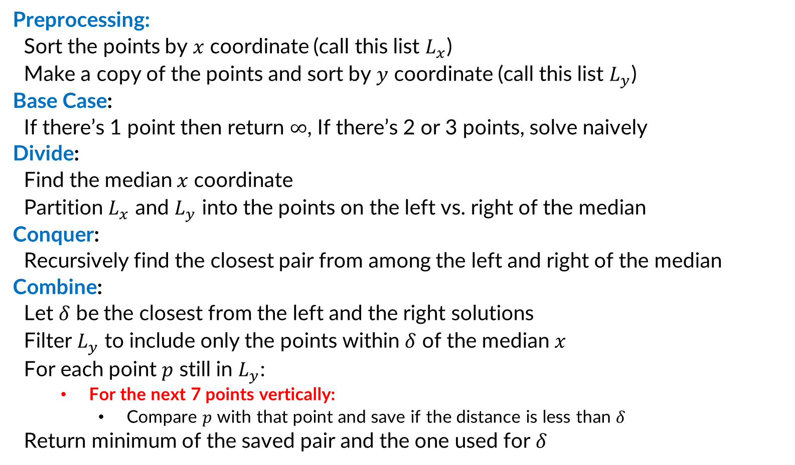
Surprisingly, This works!
Preprocessing:
Sort the points by $x$ coordinate (call this list $L_{x}$)
Make a copy of the points and sort by $y$ coordinate (call this list $L_{y}$)
Base Case:
If there’s 1 point then return $∞$, If there’s 2 or 3 points, solve naively
Divide:
Find the median $x$ coordinate
Partition $L_{x}$ and $L_{y}$ into the points on the left vs. right of the median
Conquer:
Recursively find the closest pair from among the left and right of the median
Combine:
Let $δ$ be the closest from the left and the right solutions
Filter $L_{y}$ to include only the points within $δ$ of the median $x$
For each point $p$ still in $L_{y}$:
For the next 7 points vertically:
Compare $p$ with that point and save if the distance is less than $δ$
Return minimum of the saved pair and the one used for $δ$

Slide 33



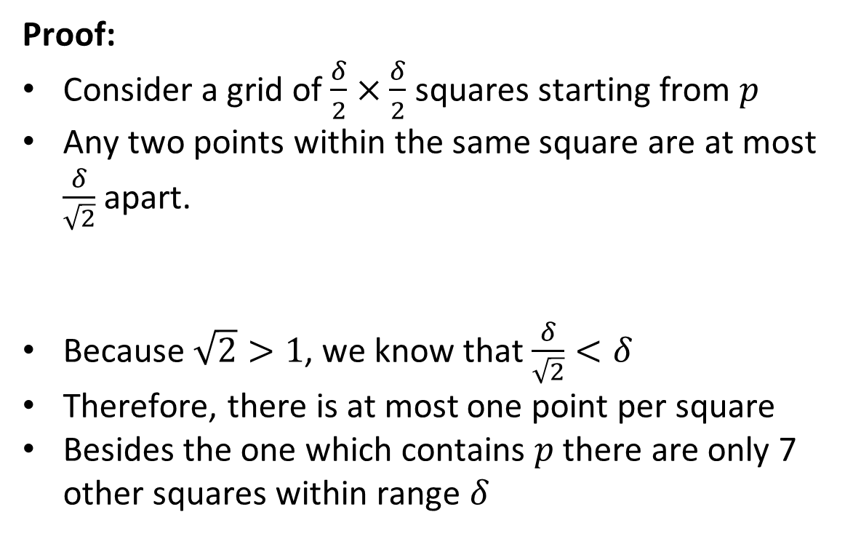





Why is 7 enough?
$$δ$$
$$δ$$
Claim:
For any point $p$ in the “strip”, the 8th point above it is guaranteed to be more than $δ$ away.
Proof:
Consider a grid of $\frac{δ}{2}×\frac{δ}{2}$ squares starting from $p$
Any two points within the same square are at most $\frac{δ}{\sqrt{2}}$ apart.
Because $\sqrt{2}>1$, we know that $\frac{δ}{\sqrt{2}}<δ$
Therefore, there is at most one point per square
Besides the one which contains $p$ there are only 7 other squares within range $δ$
$$\frac{δ}{2}$$
$$δ/2$$
$$\frac{δ}{2}$$
$$δ/2$$
$$\frac{δ}{\sqrt{2}}$$

Slide 34
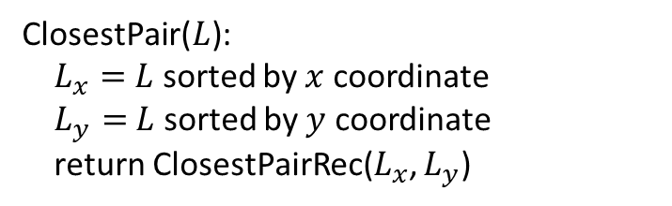
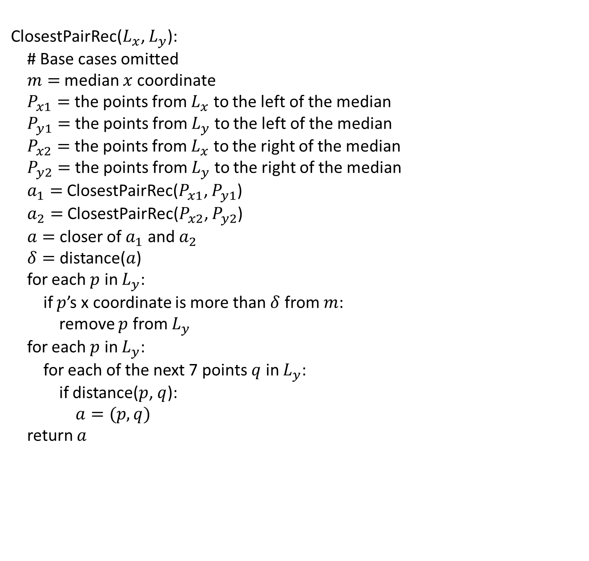
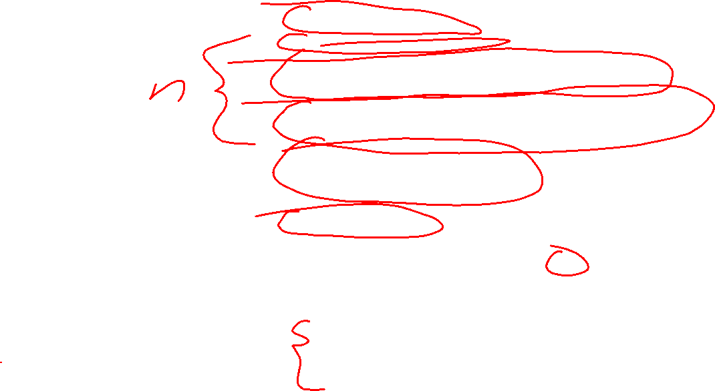
Full Algorithm
ClosestPairRec($L_{x}$, $L_{y}$):
# Base cases omitted
$m=$ median $x$ coordinate
$P_{x1}=$ the points from $L_{x}$ to the left of the median
$P_{y1}=$ the points from $L_{y}$ to the left of the median
$P_{x2}=$ the points from $L_{x}$ to the right of the median
$P_{y2}=$ the points from $L_{y}$ to the right of the median
$a_{1}=$ ClosestPairRec($P_{x1}$, $P_{y1}$)
$a_{2}=$ ClosestPairRec($P_{x2}$, $P_{y2}$)
$a=$ closer of $a_{1}$ and $a_{2}$
$δ=$ distance($a$)
for each $p$ in $L_{y}$:
if $p$’s x coordinate is more than $δ$ from $m$:
remove $p$ from $L_{y}$
for each $p$ in $L_{y}$:
for each of the next 7 points $q$ in $L_{y}$:
if distance($p$, $q$):
$a=(p,q)$
return $a$
ClosestPair($L$):
$L_{x}=$ $L$ sorted by $x$ coordinate
$L_{y}=$ $L$ sorted by $y$ coordinate
return ClosestPairRec($L_{x}$, $L_{y}$)

