Slide 1
Lecture 14: Intro to Dynamic Programming
Nathan Brunelle

Slide 2
Algorithmic Paradigms
Divide-and-conquer: Break up a problem into sub-problems (each typically a constant factor smaller), solve each sub-problem independently, and combine solution to sub-problems to form solution to original problem.
Dynamic programming: Break up a problem into a series of overlapping sub-problems, and build up solutions to larger and larger sub-problems.
Greedy: Build up a solution incrementally, myopically optimizing some local criterion.
Notes:
overlapping sub-problem = sub-problem whose results can be reused several times

Slide 3
Algorithm Design Techniques
Dynamic Programming:
Technique for making building solution to a problem based on solutions to smaller subproblems (recursive ideas).
The subproblems just have to be smaller, but don’t need to be a constant-factor smaller like divide and conquer.
Useful when the same subproblems show up over and over again
The final solution is simple iterative code when the following holds:
The parameters to all the subproblems are predictable in advance

Slide 4
Dynamic Programming History
Bellman. [1950s] Pioneered the systematic study of dynamic programming.
Etymology
Dynamic programming = planning over time.
Secretary of Defense was hostile to mathematical research.
Bellman sought an impressive name to avoid confrontation.
"it's impossible to use dynamic in a pejorative sense"
"something not even a Congressman could object to"
Reference: Bellman, R. E. Eye of the Hurricane, An Autobiography.

Slide 5


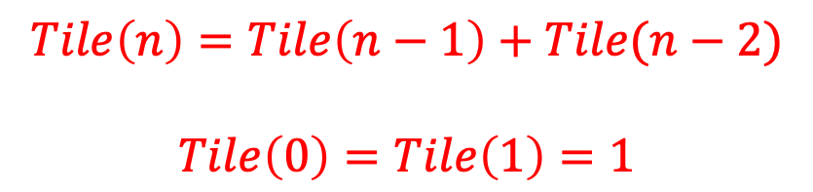

How many ways are there to tile a $2×n$ board with dominoes?
Two ways to fill the final column:
$$Tile\left(n\right)=Tile\left(n−1\right)+Tile(n−2)$$
$$Tile\left(0\right)=Tile\left(1\right)=1$$
$$n−1$$
$$n−2$$

Slide 6

How to compute $Tile(n)$?
Tile(n):
if n < 2:
return 1
return Tile(n-1)+Tile(n-2)
Running Time?

Slide 7
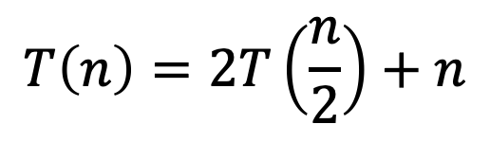
Recursion Tree
Tile(5)
Tile(4)
Tile(3)
Tile(3)
Tile(2)
Tile(2)
Tile(1)
Tile(2)
Tile(1)
Tile(1)
Tile(0)
Tile(1)
Tile(0)
Tile(1)
Tile(0)
Many redundant calls!
Run time: $Ω(2^{n})$
Better way: Use Memory!

Slide 8
Recursion Tree Redundancy
Tile(5)
Tile(4)
Tile(3)
Tile(3)
Tile(2)
Tile(2)
Tile(1)
Tile(2)
Tile(1)
Tile(1)
Tile(0)
Tile(1)
Tile(0)
Tile(1)
Tile(0)
Many redundant calls!
Run time: $Ω(2^{n})$
Better way: Use Memory!

Slide 9

Computing $Tile(n)$ with Memory
Initialize Memory M
Tile(n):
if n < 2:
return 1
if M[n] is filled:
return M[n]
M[n] = Tile(n-1)+Tile(n-2)
return M[n]
M
0
1
2
3
4
5
6
Technique: “memoization” (note no “r”)

Slide 10
Computing $Tile(n)$ with Memory - “Top Down”
Initialize Memory M
Tile(n):
if n < 2:
return 1
if M[n] is filled:
return M[n]
M[n] = Tile(n-1)+Tile(n-2)
return M[n]
M
1
0
1
1
2
2
3
3
5
4
8
5
13
6

Slide 11
Computing $Tile(n)$ with Memory - “Top Down”
Initialize Memory M
Tile(n):
if n < 2:
return 1
if M[n] is filled:
return M[n]
M[n] = Tile(n-1)+Tile(n-2)
return M[n]
M
1
0
1
1
2
2
3
3
5
4
8
5
13
6
Recursive calls happen in a predictable order

Slide 12
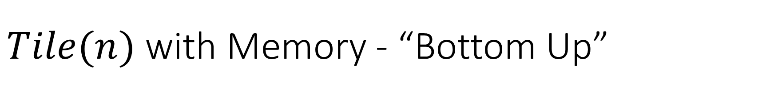
$Tile(n)$ with Memory - “Bottom Up”
Tile(n):
Initialize Memory M
M[0] = 1
M[1] = 1
for i = 2 to n:
M[i] = M[i-1] + M[i-2]
return M[n]
M
0
1
2
3
4
5
6

Slide 13

Better $Tile(n)$ with Memory - “Bottom Up”
Tile(n):
M[0] = 1
M[1] = 1
answer = -1
for i = 2 to n:
answer = M[0]+M[1]
M[0] = M[1]
M[1] = answer
return M[1]
M
0
1
Observation: We only need to remember the last two subproblems!

Slide 14

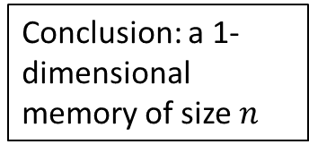

Four Steps to Dynamic Programming
Formulate the answer with a recursive structure
What are the options for the last choice?
For each such option, what does the subproblem look like? How do we use it?
Choose a memory structure.
Figure out the possible values of all parameters in the recursive calls.
How many subproblems (options for last choice) are there?
What are the parameters needed to identify each?
How many different values could there be per parameter?
Specify an order of evaluation. (Optional)
Want to guarantee that the necessary subproblem solutions are in memory when you need them.
With this step: a “Bottom-up” (iterative) algorithm
Without this step: a “Top-down” (recursive) algorithm
See if there’s a way to save space (Optional)
Is it possible to reuse some memory locations?
$$n−1$$
M
$$n−2$$
0
1
Conclusion: a 1-dimensional memory of size $n$
2
3
4
5
M
6
0
1
2
3
4
5
6
M
0
1

Slide 15
Top-Down DP Idea
def myDPalgo(problem):
if mem[problem] not blank: // Check if we’ve solved this already
return mem[problem]
if baseCase(problem): // Check if this is a base case
solution = solve(problem)
mem[problem] = solution // Always save your solution before returning
return solution
for subproblem of problem:
subsolutions.append(myDPalgo(subproblem)) // solve each subproblem
solution = selectAndExtend(subsolutions) // Pick the subproblem to use
mem[problem] = solution // Always save your solution before returning
return solution

Slide 16
Bottom-Up DP Idea
def myDPalgo(problem):
for each baseCase: // Identify which subproblems are base cases
solution = solve(baseCase)
mem[baseCase] = solution // Save the solution for reuse
for each subproblem in bottom-up order:
// The order should be chosen so that every subsolution is
// guaranteed to already be in memory when it’s needed
solution = selectAndExtend(subsolutions)
mem[subproblem] = solution // Save the solution for reuse
return mem[problem]

Slide 17
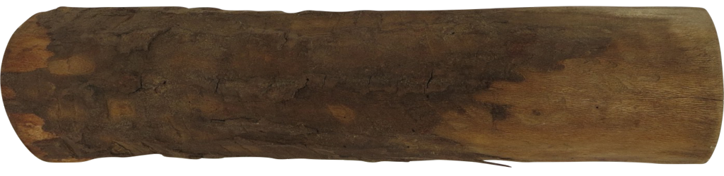
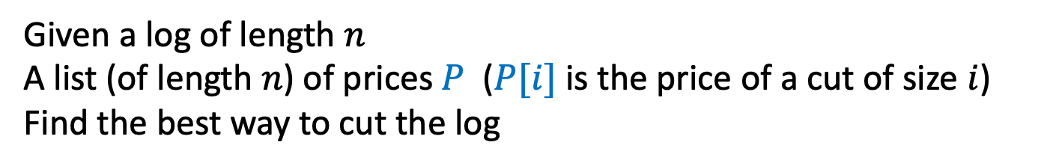
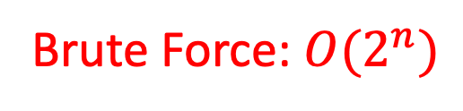
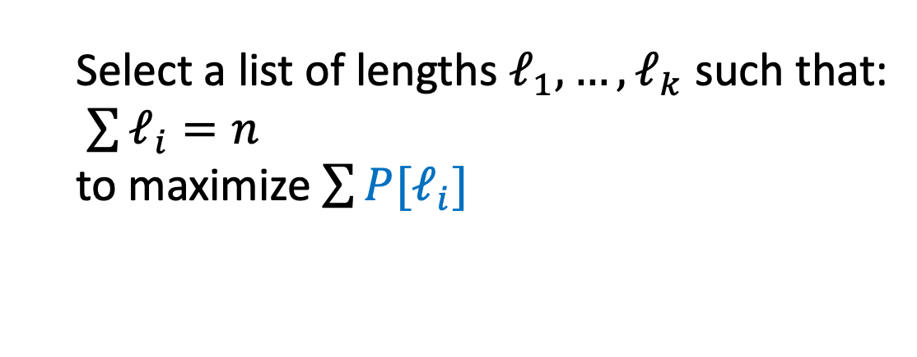
Log Cutting
Given a log of length $n$
A list (of length $n$) of prices $P$ ($P[i]$ is the price of a cut of size $i$)
Find the best way to cut the log
Price:
1
5
8
9
10
17
17
20
24
30
Length:
1
2
3
4
5
6
7
8
9
10
Select a list of lengths $ℓ_{1}, …, ℓ_{k}$ such that:
$\sum{ℓ_{i}=n}$
to maximize $\sum{{P[ℓ}_{i}]}$
Brute Force: $O(2^{n})$

Slide 18
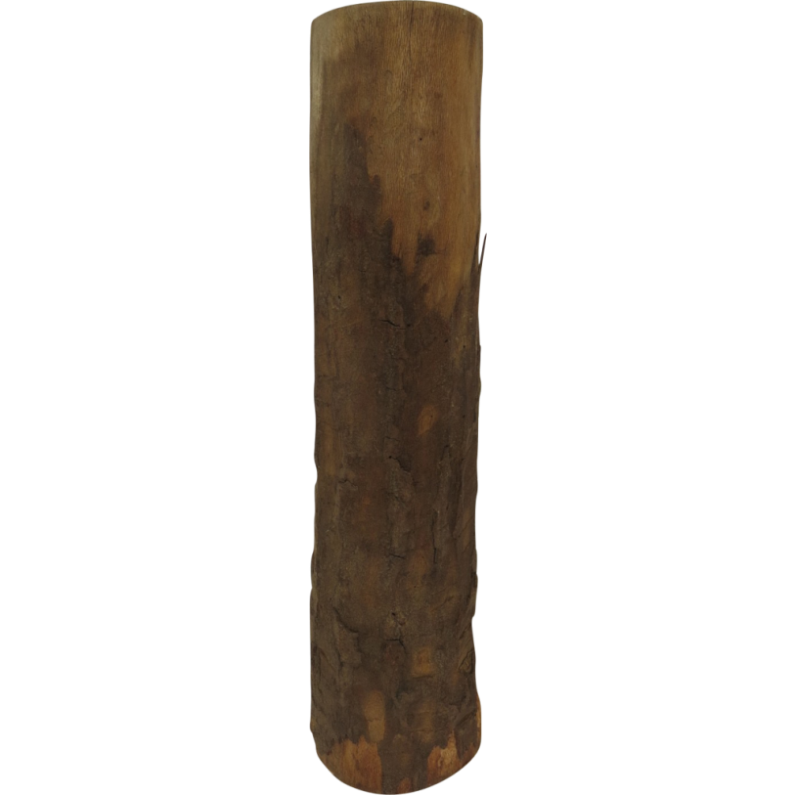
Greedy won’t work – Idea 1
Greedy algorithms (next unit) build a solution by picking the best option “right now”
Select the most profitable cut first
1
18
24
36
50
50
Greedy: Lengths: 5, 1
Profit: 51
Price:
Length:
1
2
3
4
5
6
Better: Lengths: 2, 4
Profit: 54

Slide 19
Greedy won’t work – Idea 2
Greedy algorithms (next unit) build a solution by picking the best option “right now”
Select the “most bang for your buck”
(best price / length ratio)
1
18
24
36
50
50
Greedy: Lengths: 5, 1
Profit: 51
Price:
Length:
1
2
3
4
5
6
Better: Lengths: 2, 4
Profit: 54

Slide 20
DP’s Four Steps – Log Cutting – Step 1
Formulate the answer with a recursive structure
What are the options for the last choice?
For each such option, what does the subproblem look like? How do we use it?
Choose a memory structure.
Figure out the possible values of all parameters in the recursive calls.
How many subproblems (options for last choice) are there?
What are the parameters needed to identify each?
How many different values could there be per parameter?
Specify an order of evaluation. (Optional)
Want to guarantee that the necessary subproblem solutions are in memory when you need them.
With this step: a “Bottom-up” (iterative) algorithm
Without this step: a “Top-down” (recursive) algorithm
See if there’s a way to save space (Optional)
Is it possible to reuse some memory locations?

Slide 21

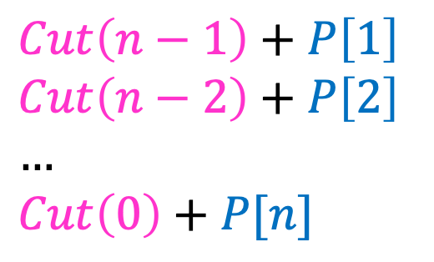


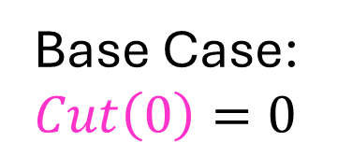

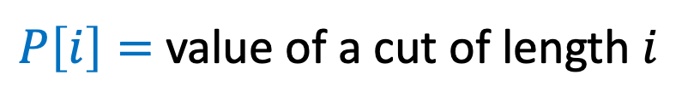
1. Identify Recursive Structure
$P\left[i\right]=$ value of a cut of length $i$
$Cut(n)=$ value of best way to cut a log of length $n$
$Cut\left(n−1\right)+P\left[1\right]$
$Cut\left(n−2\right)+P\left[2\right]$
$…$
$Cut\left(0\right)+P[n]$
Base Case:
$Cut\left(0\right)=0⁡$
$Cut\left(n\right)=max⁡$
$$Cut(n−ℓ_{k})$$
$$ℓ_{k}$$
best way to cut a log of length $n−ℓ_{k}$
Last Cut

Slide 22



DP’s Four Steps – Log Cutting – Step 2
$$Cut(n−ℓ_{k})$$
$$ℓ_{k}$$
Formulate the answer with a recursive structure
What are the options for the last choice?
For each such option, what does the subproblem look like? How do we use it?
Choose a memory structure.
Figure out the possible values of all parameters in the recursive calls.
How many subproblems (options for last choice) are there?
What are the parameters needed to identify each?
How many different values could there be per parameter?
Specify an order of evaluation. (Optional)
Want to guarantee that the necessary subproblem solutions are in memory when you need them.
With this step: a “Bottom-up” (iterative) algorithm
Without this step: a “Top-down” (recursive) algorithm
See if there’s a way to save space (Optional)
Is it possible to reuse some memory locations?
best way to cut a
log of length $n−ℓ_{k}$
Last
Cut

Slide 23

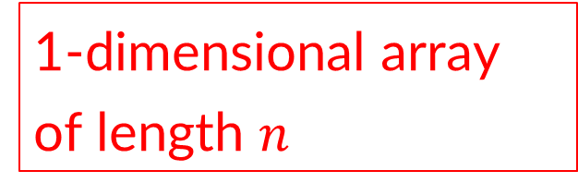

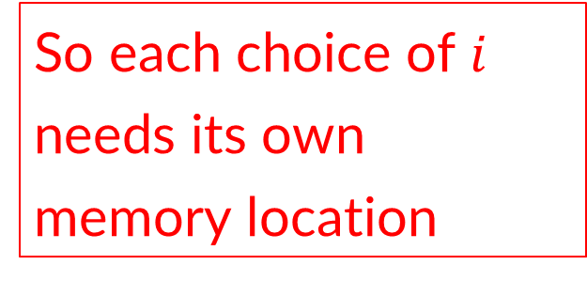

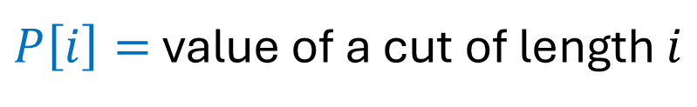
2. Design You Memory
Must store solutions to each $Cut(i)$
$P\left[i\right]=$ value of a cut of length $i$
$Cut(n)=$ value of best way to cut a log of length $n$
So each choice of $i$ needs its own memory location
$Cut\left(n−1\right)+P\left[1\right]$
$Cut\left(n−2\right)+P\left[2\right]$
$…$
$Cut\left(0\right)+P[n]$
$Cut\left(n\right)=max⁡$
1-dimensional array of length $n$
$$Cut(n−ℓ_{k})$$
$$ℓ_{k}$$
best way to cut a log of length $n−ℓ_{k}$
Last Cut

Slide 24
Generic Top-Down Dynamic Programming Soln
mem = {}
def myDPalgo(problem):
if mem[problem] not blank:
return mem[problem]
if baseCase(problem):
solution = solve(problem)
mem[problem] = solution
return solution
for subproblem of problem:
subsolutions.append(myDPalgo(subproblem))
solution = OptimalSubstructure(subsolutions)
mem[problem] = solution
return solution

Slide 25


Log Cutting Top-Down
$Cut\left(n−1\right)+P\left[1\right]$
$Cut\left(n−2\right)+P\left[2\right]$
$…$
$Cut\left(0\right)+P[n]$
mem = [-1 for value in P]
def cut_log(n, P):
if mem[n] < 0:
return mem[n]
if n == 0:
solution = 0
mem[n] = solution
return solution
subsolutions = []
for i from 1 to n:
subsolutions.append(cut_log(n-i,P)+P[i])
solution = max(subsolutions)
mem[n] = solution
return solution
$Cut\left(n\right)=max⁡$

Slide 26
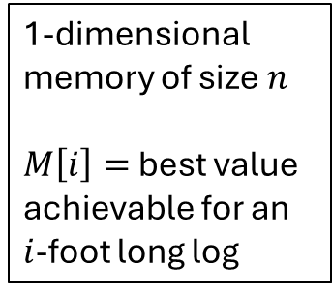
DP’s Four Steps – Log Cutting – Step 3
$$Cut(n−ℓ_{k})$$
$$ℓ_{k}$$
Formulate the answer with a recursive structure
What are the options for the last choice?
For each such option, what does the subproblem look like? How do we use it?
Choose a memory structure.
Figure out the possible values of all parameters in the recursive calls.
How many subproblems (options for last choice) are there?
What are the parameters needed to identify each?
How many different values could there be per parameter?
Specify an order of evaluation. (Optional)
Want to guarantee that the necessary subproblem solutions are in memory when you need them.
With this step: a “Bottom-up” (iterative) algorithm
Without this step: a “Top-down” (recursive) algorithm
See if there’s a way to save space (Optional)
Is it possible to reuse some memory locations?
best way to cut a
log of length $n−ℓ_{k}$
Last
Cut
M
1-dimensional memory of size $n$
$M\left[i\right]=$ best value achievable for an $i$-foot long log
0
1
2
3
4
5
6

Slide 27

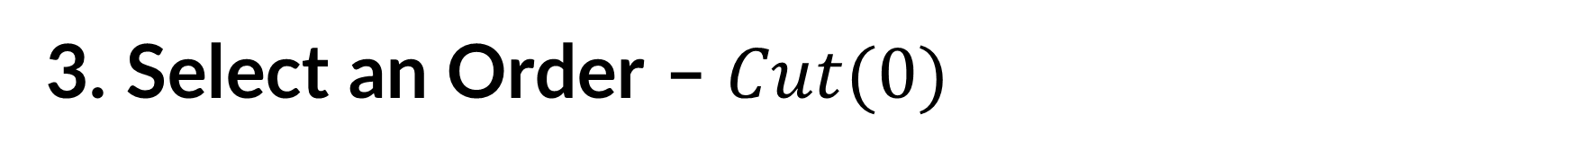
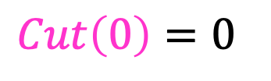
3. Select an Order – $Cut(0)$
Solve Smallest subproblem first
$Cut\left(0\right)=0⁡$
$Cut(i)$:
0
Length:
0
1
2
3
4
5
6
7
8
9
10
0

Slide 28
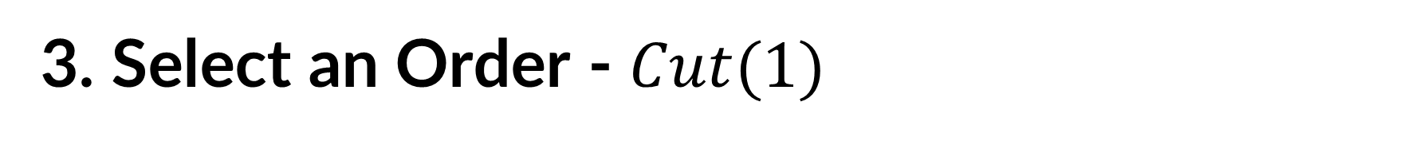

3. Select an Order - $Cut(1)$
Solve Smallest subproblem first
$Cut\left(1\right)=Cut\left(0\right)+P[1]⁡$
$Cut(i)$:
0
Length:
0
1
2
3
4
5
6
7
8
9
10
1

Slide 29
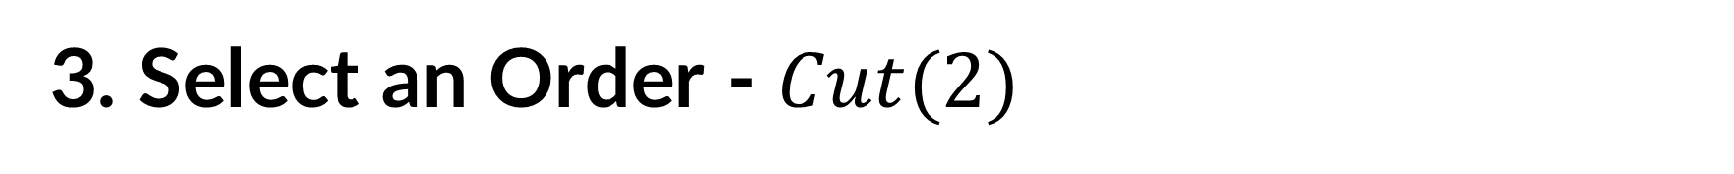
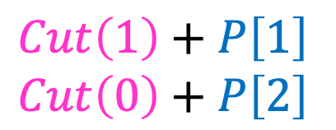

3. Select an Order - $Cut(2)$
Solve Smallest subproblem first
$Cut\left(1\right)+P\left[1\right]$
$Cut\left(0\right)+P\left[2\right]$
$Cut\left(2\right)=max⁡$
$Cut(i)$:
0
Length:
0
1
2
3
4
5
6
7
8
9
10
2

Slide 30
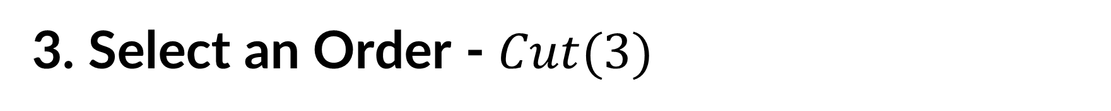
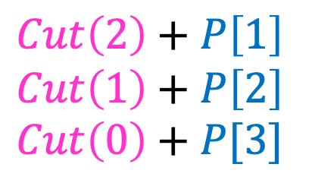

3. Select an Order - $Cut(3)$
Solve Smallest subproblem first
$Cut\left(2\right)+P\left[1\right]$
$Cut\left(1\right)+P\left[2\right]$
$Cut\left(0\right)+P[3]$
$Cut\left(3\right)=max⁡$
$Cut(i)$:
0
Length:
0
1
2
3
4
5
6
7
8
9
10
3

Slide 31
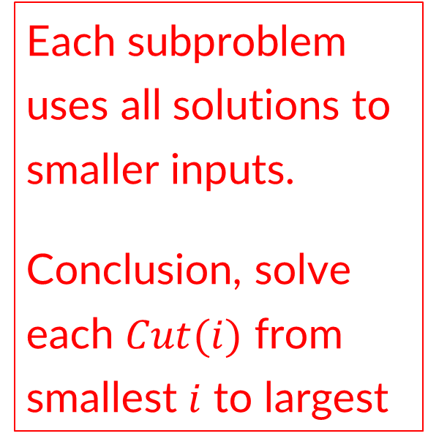
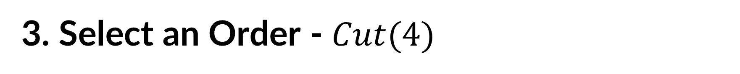
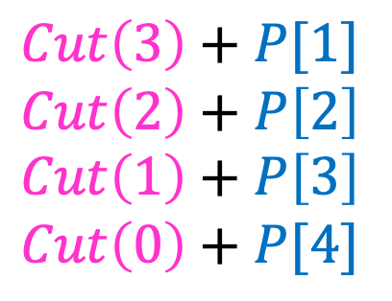

3. Select an Order - $Cut(4)$
Each subproblem uses all solutions to smaller inputs.
Conclusion, solve each $Cut(i)$ from smallest $i$ to largest
Solve Smallest subproblem first
$Cut\left(3\right)+P[1]$
$Cut\left(2\right)+P\left[2\right]$
$Cut\left(1\right)+P\left[3\right]$
$Cut\left(0\right)+P[4]$
$Cut\left(4\right)=max⁡$
$Cut(i)$:
0
Length:
0
1
2
3
4
5
6
7
8
9
10
4

Slide 32
DP’s Four Steps – Log Cutting – Step 4
$$Cut(n−ℓ_{k})$$
$$ℓ_{k}$$
Formulate the answer with a recursive structure
What are the options for the last choice?
For each such option, what does the subproblem look like? How do we use it?
Choose a memory structure.
Figure out the possible values of all parameters in the recursive calls.
How many subproblems (options for last choice) are there?
What are the parameters needed to identify each?
How many different values could there be per parameter?
Specify an order of evaluation. (Optional)
Want to guarantee that the necessary subproblem solutions are in memory when you need them.
With this step: a “Bottom-up” (iterative) algorithm
Without this step: a “Top-down” (recursive) algorithm
See if there’s a way to save space (Optional)
Is it possible to reuse some memory locations?
best way to cut a
log of length $n−ℓ_{k}$
Last
Cut
M
1-dimensional memory of size $n$
$M\left[i\right]=$ best value achievable for an $i$-foot long log
0
1
2
3
4
5
M
6
0
1
2
3
4
5
6

Slide 33

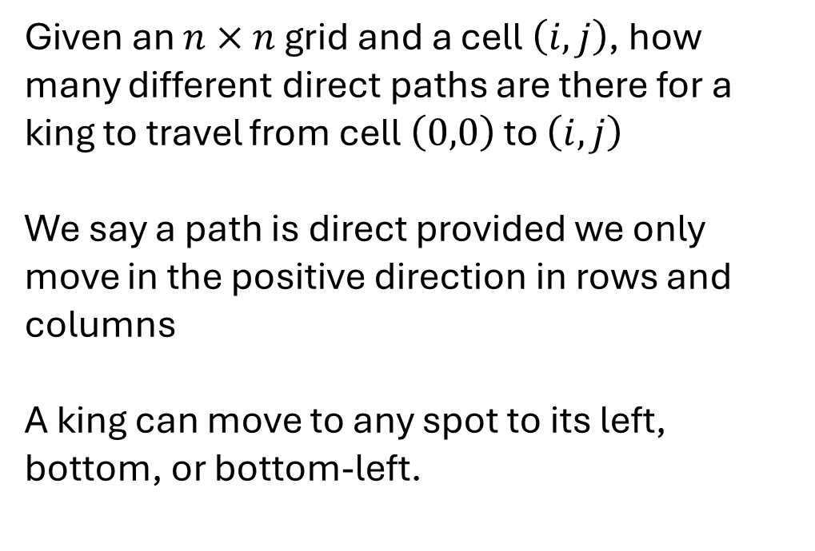

King Paths
0
1
2
3
4
5
6
7
0
1
Given an $n×n$ grid and a cell $\left(i,j\right)$, how many different direct paths are there for a king to travel from cell $\left(0,0\right)$ to $\left(i,j\right)$
We say a path is direct provided we only move in the positive direction in rows and columns
A king can move to any spot to its left, bottom, or bottom-left.
2
3
4
5
$$(i,j)$$
6
7

Slide 34
DP’s Four Steps – King Paths – Step 1
Formulate the answer with a recursive structure
What are the options for the last choice?
For each such option, what does the subproblem look like? How do we use it?
Choose a memory structure.
Figure out the possible values of all parameters in the recursive calls.
How many subproblems (options for last choice) are there?
What are the parameters needed to identify each?
How many different values could there be per parameter?
Specify an order of evaluation. (Optional)
Want to guarantee that the necessary subproblem solutions are in memory when you need them.
With this step: a “Bottom-up” (iterative) algorithm
Without this step: a “Top-down” (recursive) algorithm
See if there’s a way to save space (Optional)
Is it possible to reuse some memory locations?

Slide 35
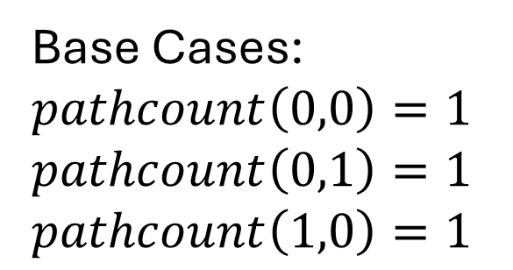
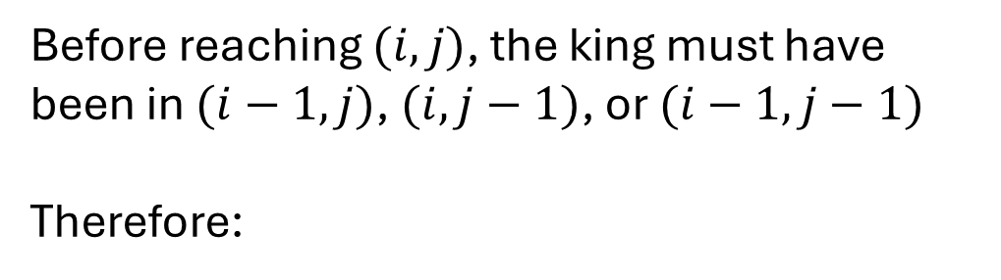
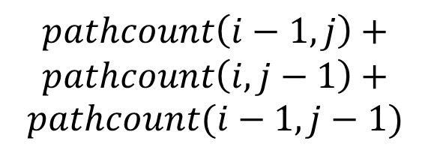

King Paths – last choices
0
1
2
3
4
5
6
7
0
1
Before reaching $(i,j)$, the king must have been in $(i−1,j)$, $(i,j−1)$, or $(i−1,j−1)$
Therefore:
2
3
4
$$pathcount\left(i,j\right)=$$
$$pathcount\left(i−1,j\right)+$$
$$pathcount\left(i,j−1\right)+$$
$$pathcount(i−1,j−1)$$
5
$$(i,j)$$
6
Base Cases:
$pathcount\left(0,0\right)=1$
$pathcount\left(0,1\right)=1$
$pathcount\left(1,0\right)=1$
7

Slide 36
DP’s Four Steps – King Paths – Step 2
Formulate the answer with a recursive structure
What are the options for the last choice?
For each such option, what does the subproblem look like? How do we use it?
Choose a memory structure.
Figure out the possible values of all parameters in the recursive calls.
How many subproblems (options for last choice) are there?
What are the parameters needed to identify each?
How many different values could there be per parameter?
Specify an order of evaluation. (Optional)
Want to guarantee that the necessary subproblem solutions are in memory when you need them.
With this step: a “Bottom-up” (iterative) algorithm
Without this step: a “Top-down” (recursive) algorithm
See if there’s a way to save space (Optional)
Is it possible to reuse some memory locations?

Slide 37
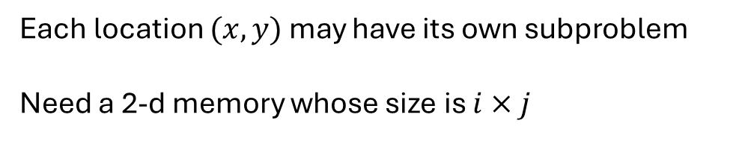
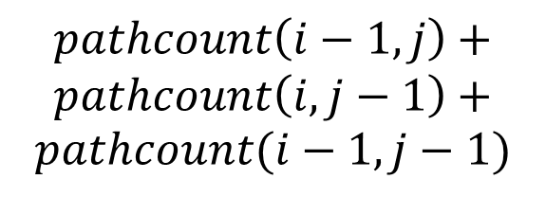

King Paths – Memory
0
1
2
3
4
5
6
7
0
$$pathcount\left(i,j\right)=$$
$$pathcount\left(i−1,j\right)+$$
$$pathcount\left(i,j−1\right)+$$
$$pathcount(i−1,j−1)$$
1
2
3
Each location $(x,y)$ may have its own subproblem
Need a 2-d memory whose size is $i×j$
4
5
$$(i,j)$$
6
7

Slide 38

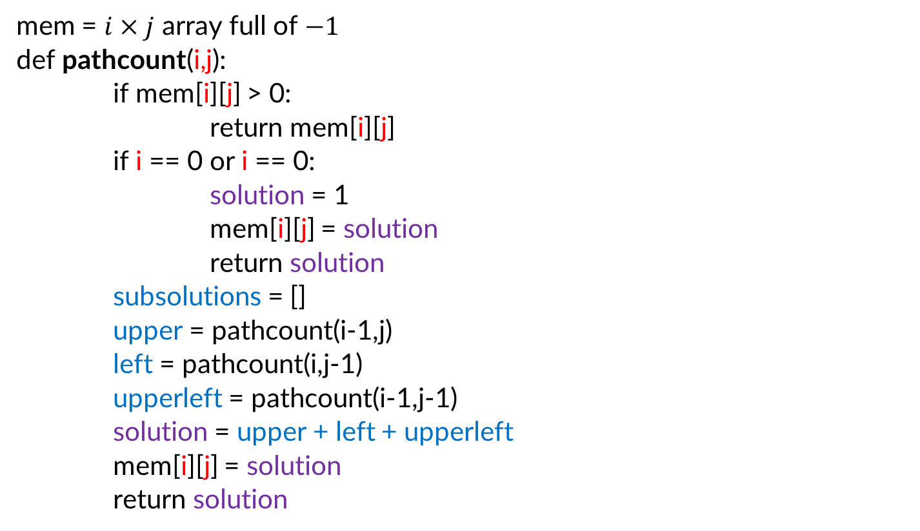
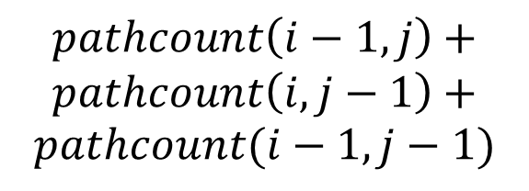
King Paths Top-Down
mem = $i×j$ array full of $−1$
def pathcount(i,j):
if mem[i][j] > 0:
return mem[i][j]
if i == 0 or i == 0:
solution = 1
mem[i][j] = solution
return solution
subsolutions = []
upper = pathcount(i-1,j)
left = pathcount(i,j-1)
upperleft = pathcount(i-1,j-1)
solution = upper + left + upperleft
mem[i][j] = solution
return solution
$$pathcount\left(i−1,j\right)+$$
$$pathcount\left(i,j−1\right)+$$
$$pathcount(i−1,j−1)$$
$$pathcount\left(i,j\right)=$$

Slide 39


DP’s Four Steps – King Paths – Step 3
Formulate the answer with a recursive structure
What are the options for the last choice?
For each such option, what does the subproblem look like? How do we use it?
Choose a memory structure.
Figure out the possible values of all parameters in the recursive calls.
How many subproblems (options for last choice) are there?
What are the parameters needed to identify each?
How many different values could there be per parameter?
Specify an order of evaluation. (Optional)
Want to guarantee that the necessary subproblem solutions are in memory when you need them.
With this step: a “Bottom-up” (iterative) algorithm
Without this step: a “Top-down” (recursive) algorithm
See if there’s a way to save space (Optional)
Is it possible to reuse some memory locations?
$$i$$
$$j$$

Slide 40
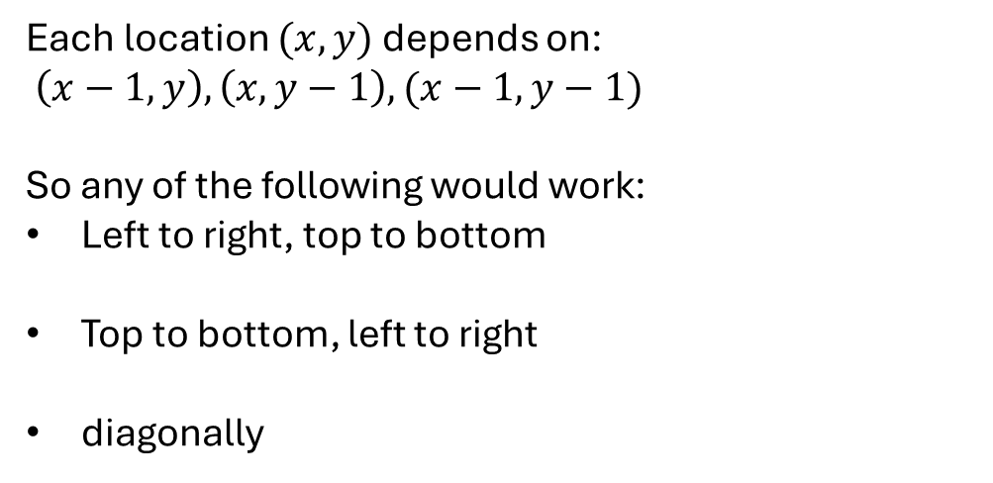
King Paths – Order
0
1
2
3
4
5
6
7
0
$$pathcount\left(i,j\right)=$$
$$pathcount\left(i−1,j\right)+$$
$$pathcount\left(i,j−1\right)+$$
$$pathcount(i−1,j−1)$$
1
2
3
Each location $(x,y)$ depends on:
$\left(x−1,y\right),\left(x,y−1\right),(x−1,y−1)$
So any of the following would work:
Left to right, top to bottom
Top to bottom, left to right
diagonally
4
5
$$(i,j)$$
6
7
or

Slide 41
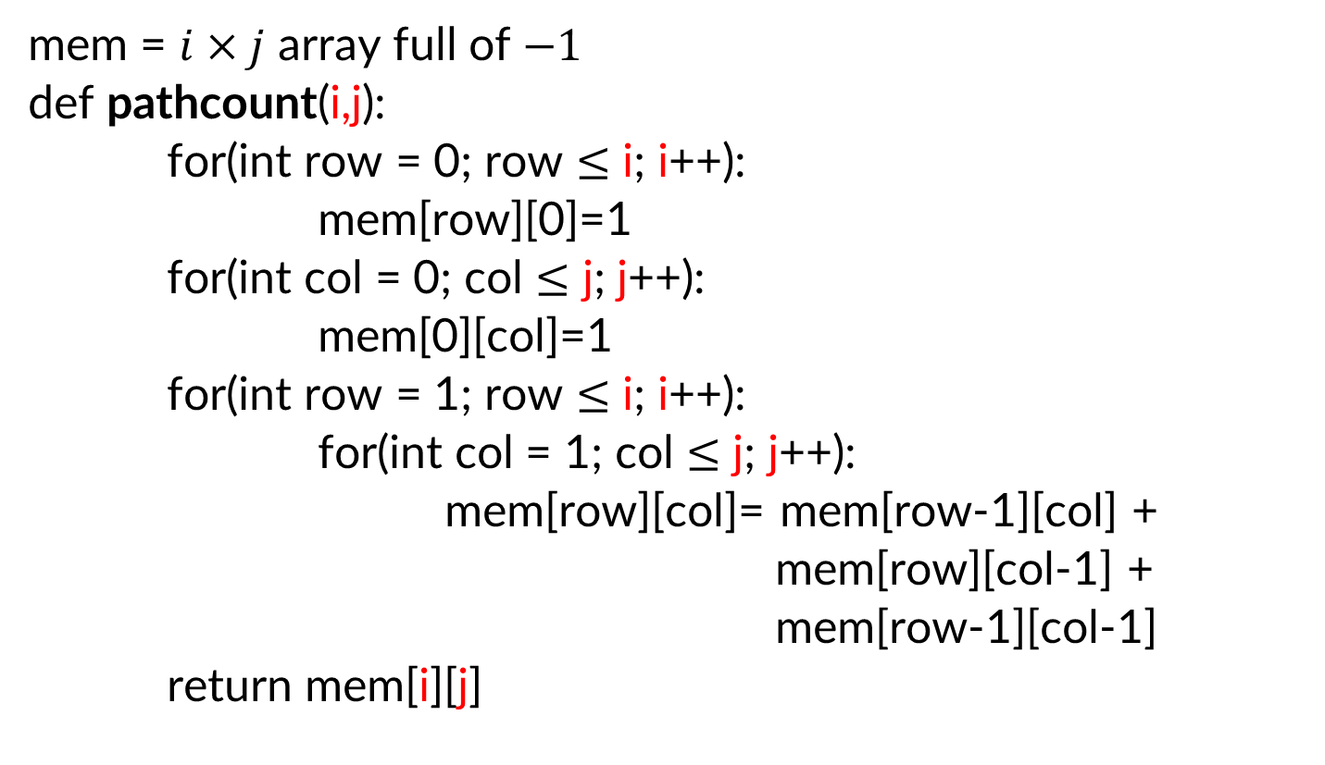
King Paths Bottom-up
mem = $i×j$ array full of $−1$
def pathcount(i,j):
for(int row = 0; row $≤$ i; i++):
mem[row][0]=1
for(int col = 0; col $≤$ j; j++):
mem[0][col]=1
for(int row = 1; row $≤$ i; i++):
for(int col = 1; col $≤$ j; j++):
mem[row][col]= mem[row-1][col] +
mem[row][col-1] +
mem[row-1][col-1]
return mem[i][j]
$$pathcount\left(i−1,j\right)+$$
$$pathcount\left(i,j−1\right)+$$
$$pathcount(i−1,j−1)$$
$$pathcount\left(i,j\right)=$$

Slide 42
Final reminders
HW3 resubmissions due Wednesday @ 11:59pm.
HW4 due Wednesday @ 11:59pm.
I have OH now-12:30pm:
Meet at front of classroom, we’ll walk over together
CSE (Allen) 434 if you’re coming later
Glenn has online OH 12–1pm:
https://washington.zoom.us/my/nathanbrunelle

