Slide 1
Lecture 10: Directed graphs
Glenn Sun

Slide 2
Plan for today
Today, we’ll take a deeper dive into directed graphs.
We’ll talk about two important algorithms: topological sort and strongly connected components
We’ll apply them to decide a common problem: whether a collection of constraints can all be satisfied.

Slide 3
Topological sort

Slide 4
Prerequisites planning, again
Input: A list of courses and prerequisites
Goal: Determine if it is possible to take all courses, and if so, a possible order to take them in.
3
5
1
1
2
4
3
5
4
2

Slide 5
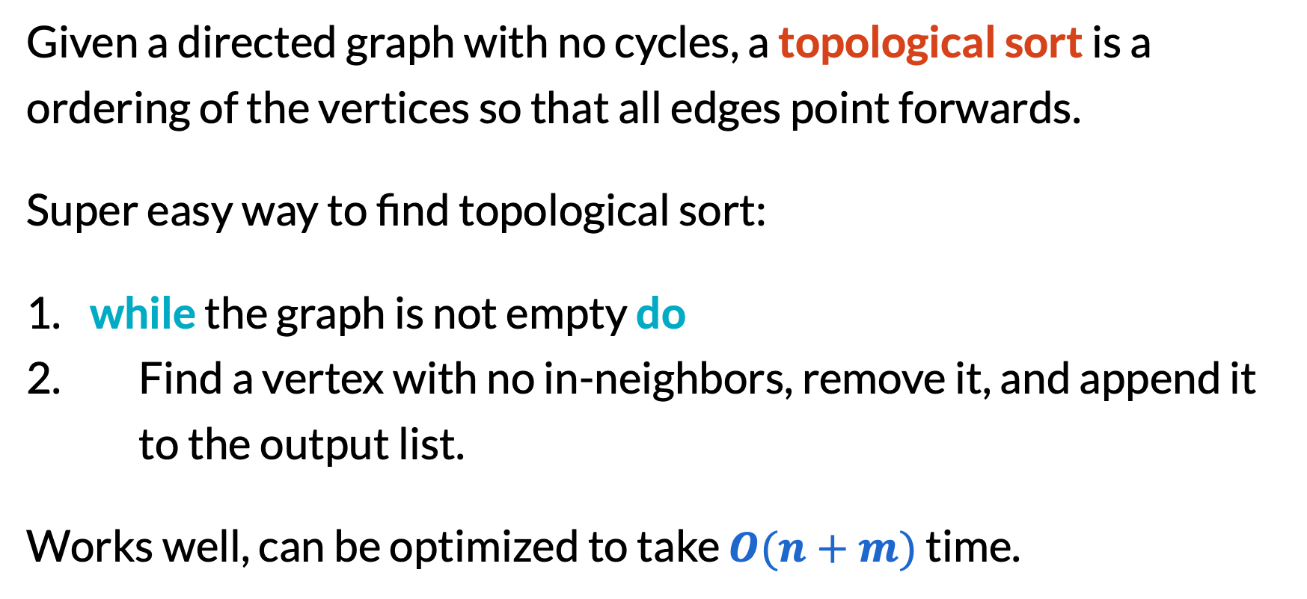
Topological sort
Given a directed graph with no cycles, a topological sort is a ordering of the vertices so that all edges point forwards.
Super easy way to find topological sort:
​while the graph is not empty do
Find a vertex with no in-neighbors, remove it, and append it to the output list.
Works well, can be optimized to take $O(n+m)$ time.

Slide 6
Correctness of topological sort algorithm
Q: (soundness) Why is there always a vertex with no in-neighbors?
A: If every vertex had an in-neighbor, following them would eventually find you a cycle.
3
1
4
2

Slide 7
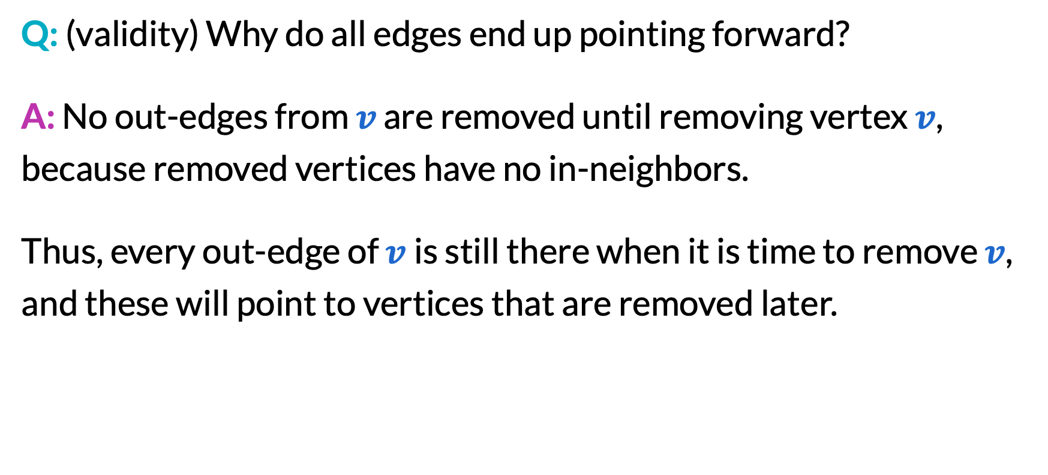
Correctness of topological sort algorithm
Q: (validity) Why do all edges end up pointing forward?
A: No out-edges from $v$ are removed until removing vertex $v$, because removed vertices have no in-neighbors.
Thus, every out-edge of $v$is still there when it is time to remove $v$, and these will point to vertices that are removed later.
1
2
4
3
5

Slide 8
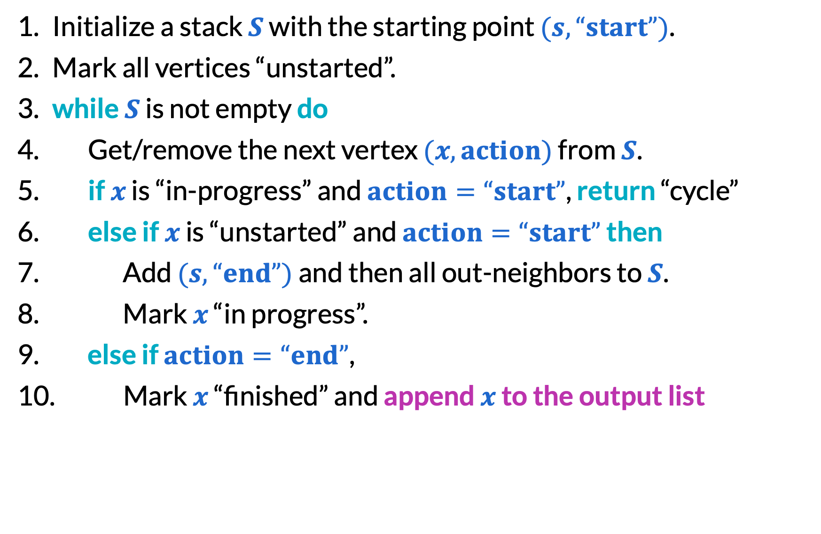
Topological sort via DFS
Initialize a stack $S$ with the starting point $(s,“start”)$.
Mark all vertices “unstarted”.
​while $S$ is not empty do
Get/remove the next vertex $(x,action)$ from $S$.
​if $x$ is “in-progress” and $action=“start”$, return “cycle”
​else if $x$ is “unstarted” and $action=“start”$ then
​Add $(s,“end”)$ and then all out-neighbors to $S$.
Mark $x$ “in progress”.
​else ​if $action=“end”$,
Mark $x$ “finished” and append $x$ to the output list

Slide 9
Topological sort via DFS
3
5
1
4
2
Vertices sorted by finish time are a reverse topological sort!

Slide 10
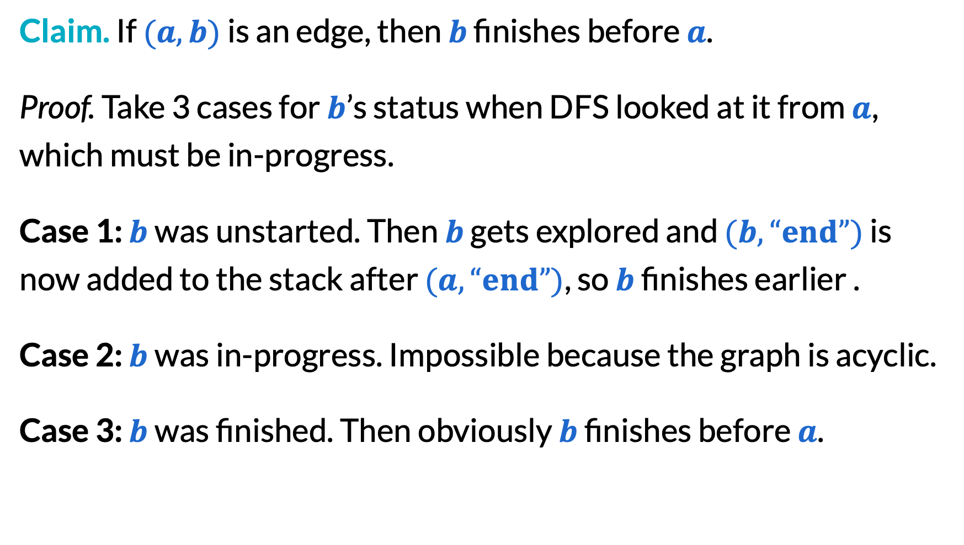
Topological sort via DFS
Claim. If $(a, b)$ is an edge, then $b$ finishes before $a$.
Proof. Take 3 cases for $b$’s status when DFS looked at it from $a$, which must be in-progress.
Case 1: $b$ was unstarted. Then $b$ gets explored and $(b,“end”)$ is now added to the stack after $(a,“end”)$, so $b$ finishes earlier .
Case 2: $b$ was in-progress. Impossible because the graph is acyclic.
Case 3: $b$ was finished. Then obviously $b$ finishes before $a$.

Slide 11
Strongly connected components

Slide 12
Strongly connected graphs
An undirected graph is “connected” if you can go from any vertex to any other vertex. What does this look like in directed graphs?
3
3
5
5
1
1
4
4
2
2
❌
✅

Slide 13
Strongly connected graphs
Because directed graphs can still look “connected” in the English sense without satisfying the definition, we use the phrase “strongly connected” to avoid ambiguity.
To summarize:
A directed graph is strongly connected if you can go from any vertex to any other vertex.
A strongly connected component is a maximal strongly connected subgraph.

Slide 14
Strongly connected components
1
789
3
8
5
2345
1
9
6
4
7
2
6
“condensation graph”

Slide 15
Condensation graph
The condensation graph has a vertex for every SCC, and an edge between SCCs if at least one analogous edge exists in the original.
Theorem. Condensation graphs are acyclic.
Proof. If there were a cycle, you could go from any vertex to any other vertex in the cycle, so the SCCs were not maximal.
1
789
2345

Slide 16
Kosaraju’s algorithm
Main idea:
Traverse the condensation graph with BFS/DFS in reverse topological order.
We will discover all of the last SCC and then get stuck.
Thus, every time we get stuck, output all newly discovered vertices as an SCC!
1
789
2345
6

Slide 17
Kosaraju’s algorithm
Second key idea: When running DFS with finish times, the list of nodes sorted by finish time is exactly a reverse topological order of the condensation graph!
The previous analysis for DAGs shows that the only edges that can point backwards are those that make cycles. Only edges in the same SCC can make cycles, so we are good!
1
789
2345
6

Slide 18
Kosaraju’s algorithm
Run DFS with finish times, record vertices in order of finishing.
Initialize an empty list of SCCs.
Mark all vertices as unseen again.
​for all vertices in order of finishing do
Run BFS/DFS, mark discovered vertices seen, and add this group to the list of SCCs.
​return all SCCs

Slide 19
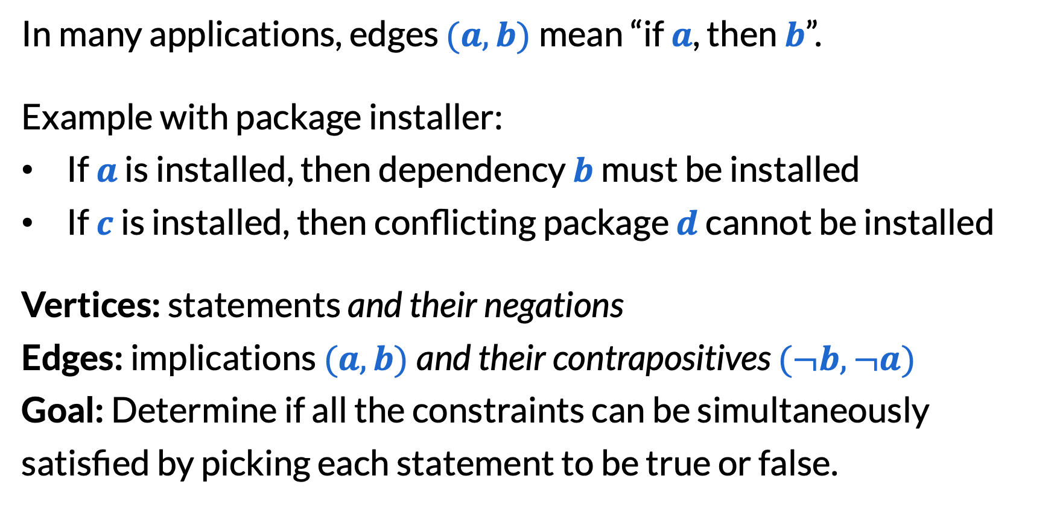
2SAT
In many applications, edges $(a,b)$mean “if $a$, then $b$”.
Example with package installer:
If $a$ is installed, then dependency $b$ must be installed
If $c$ is installed, then conflicting package $d$ cannot be installed
Vertices: statements and their negations
Edges: implications $(a,b)$and their contrapositives $(¬b,¬a)$
Goal: Determine if all the constraints can be simultaneously satisfied by picking each statement to be true or false.

Slide 20
2SAT example
Four constraints (and their contrapositives):
If 1 is true, then 3 is true
If 1 is true, then 3 is false
If 2 is true, then 3 is false
if 2 is false, then 1 is true
Q: Can this be satisfied? If so, how?
A: Take 2 true, 1 and 3 false
¬2
1
3
¬3
¬1
2

Slide 21
2SAT example
Four constraints (and their contrapositives):
If 1 is true, then 3 is true
If 1 is true, then ¬3 is true
If 2 is true, then ¬3 is true
if ¬2 is true, then 1 is true
Q: Can this be satisfied? If so, how?
A: Take 2, ¬1, and ¬3 all true.
¬2
1
3
¬3
¬1
2

Slide 22
Cycles in implication graphs
When edges meant prerequisites, a cycle meant “impossible to satisfy requirements”.
Q: When edges mean implication, in general, what does a cycle mean?
A: Either all are true, or all are false.
¬3
¬1
2

Slide 23
SCCs in implication graphs
all false
By the last slide, every SCC must be either all true or all false too!
Furthermore, because we included every contrapositive edge, the SCCs come in pairs.
One SCC is all true ↔ the opposite SCC is all false
¬2
1
3
¬3
¬1
2
all true

Slide 24
Algorithm for deciding 2SAT
Find all SCCs, and return “impossible” if any SCC contains both a statement and its negation (such as both 1 and ¬1).
​for all SCCs in reverse topological order of the condensation graph do
​if the opposite SCC has not been seen yet then
Decide the entire SCC to be true.

Slide 25
2SAT example, continued
¬2
safe to make these false, because they aren’t implied by anything
1
3
¬3
¬1
safe to make these true, because they don’t imply anything
2

Slide 26
2SAT example, continued
F
safe to make these false, because they’re all implied by false things
safe to make these true, because they only imply things already true
T

Slide 27
2SAT algorithm correctness, more formally
Need to show:
If the constraints are not satisfiable, we say “impossible”.
If the constraints are satisfiable, we output a valid assignment.

Slide 28
2SAT algorithm correctness, more formally
If the constraints are not satisfiable, we say “impossible”.
Contrapositive is easier: If we output an assignment, then the constraints are satisfiable. In fact, our assignment satisfies them.
Constraints inside SCCs: These are set to “true implies true” or “false implies false”, so all good.
Constraints between SCCs: Because we assign the start of the topological order to false and the end to true, there is never “true implies false”, so all good!

Slide 29
2SAT algorithm correctness, more formally
If the constraints are satisfiable, we output a valid assignment.
We don’t output “impossible” because satisfiable constraints would never force an SCC to have both a variable and its negation.
So we output an assignment. By the same reasoning as before, the assignment must be valid.

Slide 30
3
8
1
789
5
1
9
2345
4
7
2
6
6

Slide 31
3
8
5
1
9
4
7
2
6

Slide 32
4
8
2
5
6
1
7
3
3
2
5
9
2
6
4
3
5

Slide 33
1
2
7
4
3
6
8
5
9

Slide 34
Final reminders
HW3 due Friday @ 11:59pm.
HW1 resubmissions due tonight @ 11:59pm.
I have OH now-12:30pm:
Meet at front of classroom, we’ll walk over together
CSE (Allen) 214 if you’re coming later
Nathan has online OH 12–1pm:
https://washington.zoom.us/my/nathanbrunelle

