Slide 1
Lecture 15: Dynamic Programming – Adding Parameters
Nathan Brunelle

Slide 2

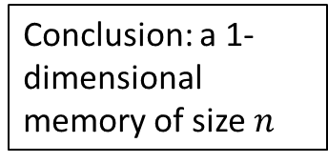

Four Steps to Dynamic Programming
Formulate the answer with a recursive structure
What are the options for the last choice?
For each such option, what does the subproblem look like? How do we use it?
Choose a memory structure.
Figure out the possible values of all parameters in the recursive calls.
How many subproblems (options for last choice) are there?
What are the parameters needed to identify each?
How many different values could there be per parameter?
Specify an order of evaluation. (Optional)
Want to guarantee that the necessary subproblem solutions are in memory when you need them.
With this step: a “Bottom-up” (iterative) algorithm
Without this step: a “Top-down” (recursive) algorithm
See if there’s a way to save space (Optional)
Is it possible to reuse some memory locations?
$$n−1$$
M
$$n−2$$
0
1
Conclusion: a 1-dimensional memory of size $n$
2
3
4
5
M
6
0
1
2
3
4
5
6
M
0
1

Slide 3
Top-Down DP Idea
def myDPalgo(problem):
if mem[problem] not blank: // Check if we’ve solved this already
return mem[problem]
if baseCase(problem): // Check if this is a base case
solution = solve(problem)
mem[problem] = solution // Always save your solution before returning
return solution
for subproblem of problem:
subsolutions.append(myDPalgo(subproblem)) // solve each subproblem
solution = selectAndExtend(subsolutions) // Pick the subproblem to use
mem[problem] = solution // Always save your solution before returning
return solution

Slide 4
Bottom-Up DP Idea
def myDPalgo(problem):
for each baseCase: // Identify which subproblems are base cases
solution = solve(baseCase)
mem[baseCase] = solution // Save the solution for reuse
for each subproblem in bottom-up order:
// The order should be chosen so that every subsolution is
// guaranteed to already be in memory when it’s needed
solution = selectAndExtend(subsolutions)
mem[subproblem] = solution // Save the solution for reuse
return mem[problem]

Slide 5
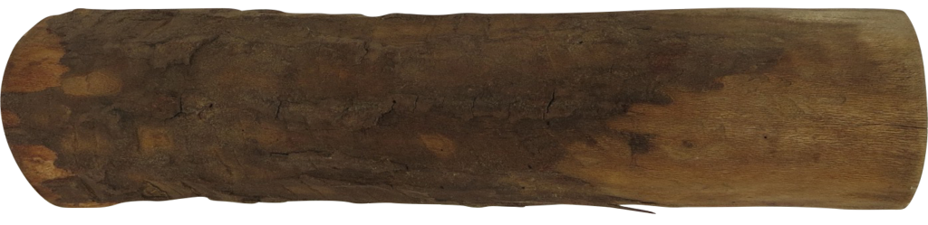
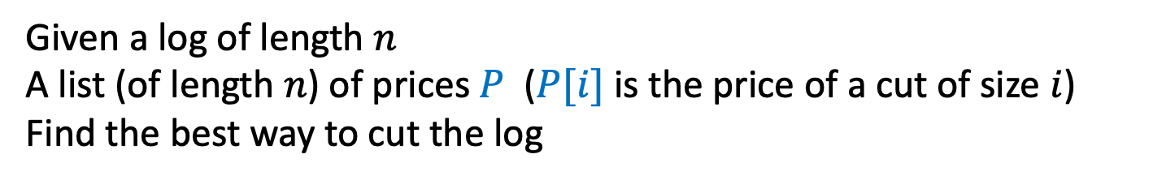
Log Cutting
Given a log of length $n$
A list (of length $n$) of prices $P$ ($P[i]$ is the price of a cut of size $i$)
Find the best way to cut the log
Price:
1
5
8
9
10
17
17
20
24
30
Length:
1
2
3
4
5
6
7
8
9
10

Slide 6
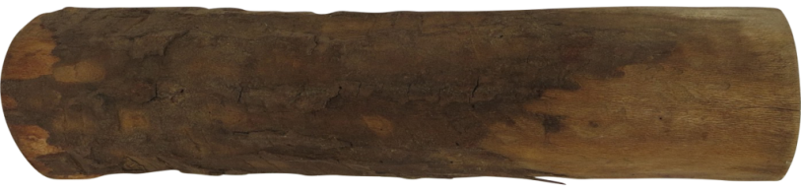

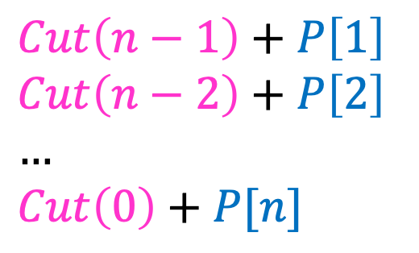


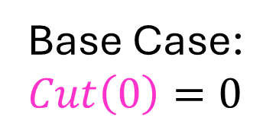

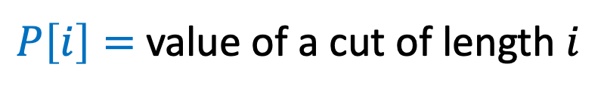
1. Identify Recursive Structure
$P\left[i\right]=$ value of a cut of length $i$
$Cut(n)=$ value of best way to cut a log of length $n$
$Cut\left(n−1\right)+P\left[1\right]$
$Cut\left(n−2\right)+P\left[2\right]$
$…$
$Cut\left(0\right)+P[n]$
Base Case:
$Cut\left(0\right)=0⁡$
$Cut\left(n\right)=max⁡$
$$Cut(n−ℓ_{k})$$
$$ℓ_{k}$$
best way to cut a log of length $n−ℓ_{k}$
Last Cut

Slide 7
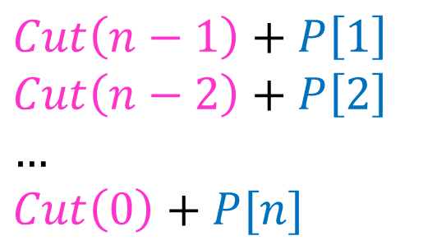

Log Cutting Top-Down
$Cut\left(n−1\right)+P\left[1\right]$
$Cut\left(n−2\right)+P\left[2\right]$
$…$
$Cut\left(0\right)+P[n]$
mem = [-1 for value in P]
def cut_log(n, P):
if mem[n] < 0:
return mem[n]
if n == 0:
solution = 0
mem[n] = solution
return solution
subsolutions = []
for i from 1 to n:
subsolutions.append(cut_log(n-i,P)+P[i])
solution = max(subsolutions)
mem[n] = solution
return solution
$Cut\left(n\right)=max⁡$

Slide 8
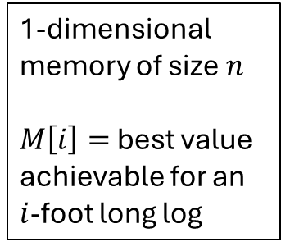



DP’s Four Steps – Log Cutting – Step 3
$$Cut(n−ℓ_{k})$$
$$ℓ_{k}$$
Formulate the answer with a recursive structure
What are the options for the last choice?
For each such option, what does the subproblem look like? How do we use it?
Choose a memory structure.
Figure out the possible values of all parameters in the recursive calls.
How many subproblems (options for last choice) are there?
What are the parameters needed to identify each?
How many different values could there be per parameter?
Specify an order of evaluation. (Optional)
Want to guarantee that the necessary subproblem solutions are in memory when you need them.
With this step: a “Bottom-up” (iterative) algorithm
Without this step: a “Top-down” (recursive) algorithm
See if there’s a way to save space (Optional)
Is it possible to reuse some memory locations?
best way to cut a
log of length $n−ℓ_{k}$
Last
Cut
M
1-dimensional memory of size $n$
$M\left[i\right]=$ best value achievable for an $i$-foot long log
0
1
2
3
4
5
6

Slide 9
DP’s Four Steps – Log Cutting – Step 4
$$Cut(n−ℓ_{k})$$
$$ℓ_{k}$$
Formulate the answer with a recursive structure
What are the options for the last choice?
For each such option, what does the subproblem look like? How do we use it?
Choose a memory structure.
Figure out the possible values of all parameters in the recursive calls.
How many subproblems (options for last choice) are there?
What are the parameters needed to identify each?
How many different values could there be per parameter?
Specify an order of evaluation. (Optional)
Want to guarantee that the necessary subproblem solutions are in memory when you need them.
With this step: a “Bottom-up” (iterative) algorithm
Without this step: a “Top-down” (recursive) algorithm
See if there’s a way to save space (Optional)
Is it possible to reuse some memory locations?
best way to cut a
log of length $n−ℓ_{k}$
Last
Cut
M
1-dimensional memory of size $n$
$M\left[i\right]=$ best value achievable for an $i$-foot long log
0
1
2
3
4
5
M
6
0
1
2
3
4
5
6

Slide 10
Log Cutting Bottom-Up
def cutLog(n, P):
mem = array of length n
mem[0] = 0 // Solution for base case
for (int i = 1; i <=n; i++): // For each subproblem I
best = -1
for(int length = 1; length <= i; length++): // For each choice of the last cut
best = max(best, P[length] + mem[i-length]);
mem[i] = best // Save the solution for reuse
return mem[n]

Slide 11
DP Running Time
Bottom-Up DP:
Done just as you would with any other iterative code
Sum up the total work done across all iterations of the loops
Top-Down DP:
Because of memorization, each subproblem is only solved once
All subsequence uses for it will be a constant time look up
To find running time: sum together the non-recursive work across all subproblems

Slide 12
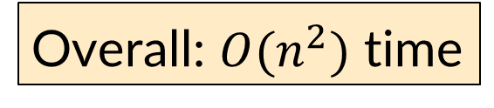
Log Cutting Bottom-Up Running Time
Iterates n times
def cutLog(n, P):
mem = array of length n
mem[0] = 0 // Solution for base case
for (int i = 1; i <=n; i++): // For each subproblem I
best = -1
for(int length = 1; length <= i; length++): // For each choice of the last cut
best = max(best, P[length] + mem[i-length]);
mem[i] = best // Save the solution for reuse
return mem[n]
Iterates i times
O(1)
Overall: $O(n^{2})$ time

Slide 13
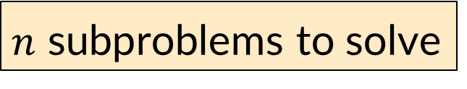
Log Cutting Top-Down Running Time
$n$ subproblems to solve
mem = [-1 for value in P]
def cut_log(n, P):
if mem[n] < 0:
return mem[n]
if n == 0:
solution = 0
mem[n] = solution
return solution
subsolutions = []
for i from 1 to n:
subsolutions.append(cut_log(n-i,P)+P[i])
solution = max(subsolutions)
mem[n] = solution
return solution
Each takes linear non-recursive work
Overall: $O(n^{2})$ time

Slide 14
How to find the cuts?
This procedure told us the profit, but not the cuts themselves
Idea: remember the choice that you made, then backtrack

Slide 15
Log Cutting Bottom-Up Recording Choices
def cutLog(n, P):
mem = array of length n
choices = array of length n
mem[0] = 0 // Solution for base case
choices[0] = 0
for (int i = 1; i <=n; i++): // For each subproblem I
best = -1
for(int length = 1; length <= i; length++): // For each choice of the last cut
if(best < P[length] + mem[i-length]):
best = P[length] + mem[i-length]
choices[i] = length
mem[i] = best // Save the solution for reuse
return mem[n], choices
Every time we find a better solution, remember which choice made it happen.

Slide 16
Log Cutting Top-Down recording Choices
mem = [-1 for value in P]
choices = [-1 for value in P]
def cutLog(n, P):
if mem[n] < 0:
return mem[n]
if n == 0:
mem[n] = 0
choices[n] = 0
return 0
for(int length = 1; length <= i; length++):
if(mem[n] < cutLog(n-i,P)+P[i]):
mem[n] = cutLog(n-i,P)+P[i]
choices[n] = length
return mem[n]
Every time we find a better solution, remember which choice made it happen.

Slide 17
Remember the choice made
Initialize Memory C, Choices
Cut(n):
C[0] = 0
for i=1 to n:
best = 0
for j = 1 to i:
if best < C[i-j] + P[j]:
best = C[i-j] + P[j]
Choices[i]=j
C[i] = best
return C[n]
Gives the size of the last cut

Slide 18
Reconstruct the Cuts
Backtrack through the choices
Choices:
0
1
1
2
4
3
4
1
2
4
3
Length:
0
1
2
3
4
5
6
7
8
9
10
1
2
6
7
Example to demo Choices[] only. Profit of 20 is not optimal!

Slide 19
Backtracking Pseudocode
i = n // starting with the whole log
while i > 0: // until we’ve used the whole log
print(choices[i]) // see what the last length was
i = i – choices[i] // repeat for the subproblem

Slide 20
Our Example: Getting Optimal Solution
i | 0 | 1 | 2 | 3 | 4 | 5 | 6 | 7 | 8 | 9 | 10
mem[i] | 0 | 1 | 5 | 8 | 10 | 13 | 17 | 18 | 22 | 25 | 30
choice[i] | 0 | 1 | 2 | 3 | 2 | 2 | 6 | 1 | 2 | 3 | 10
If n were 5
Best score is 13
Cut at Choice[n]=2, then cut at Choice[n-Choice[n]]= Choice[5-2]= Choice[3]=3
If n were 7
Best score is 18
Cut at 1, then cut at 6

Slide 21

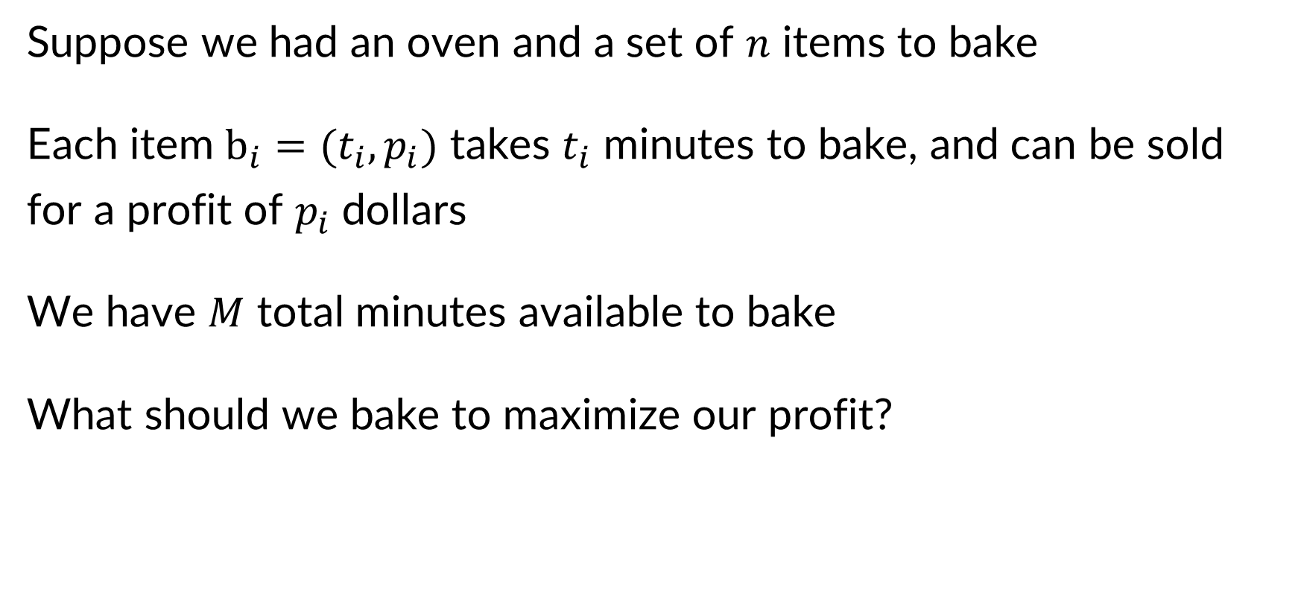

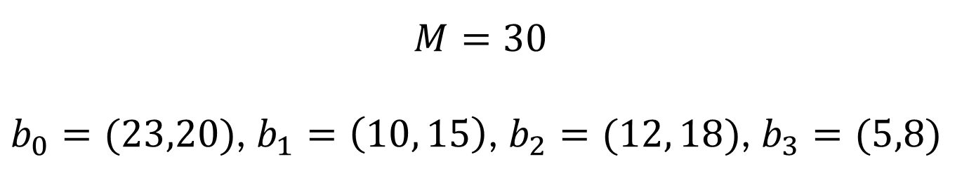
Oven Allocation (aka subset sum)
Suppose we had an oven and a set of $n$ items to bake
Each item $b_{i}=(t_{i},p_{i})$ takes $t_{i}$ minutes to bake, and can be sold for a profit of $p_{i}$ dollars
We have $M$ total minutes available to bake
What should we bake to maximize our profit?
Best solution: $b_{1},b_{2},b_{3}$
Uses 27 minutes
Earns $41
$$M=30$$
$b_{0}=(23,20)$, $b_{1}=\left(10, 15\right)$, $b_{2}=(12, 18)$, $b_{3}=(5,8)$

Slide 22
Four Steps – Oven Allocation Step 1
Formulate the answer with a recursive structure
What are the options for the last choice?
For each such option, what does the subproblem look like? How do we use it?
Choose a memory structure.
Figure out the possible values of all parameters in the recursive calls.
How many subproblems (options for last choice) are there?
What are the parameters needed to identify each?
How many different values could there be per parameter?
Specify an order of evaluation. (Optional)
Want to guarantee that the necessary subproblem solutions are in memory when you need them.
With this step: a “Bottom-up” (iterative) algorithm
Without this step: a “Top-down” (recursive) algorithm
See if there’s a way to save space (Optional)
Is it possible to reuse some memory locations?

Slide 23






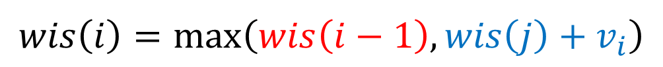
Comparison to Weighted Interval Scheduling
Oven allocation looks similar to weighted interval scheduling, except tasks do not have predefined start and end times
Choices: Include/exclude the last event
If we exclude: subproblem is second-to-last event
If we include: subproblem is latest compatible event $j$
$$v_{0}=3$$
$$v_{1}=4$$
$$v_{2}=4$$
$$v_{3}=7$$
$$v_{4}=2$$
$$v_{5}=1$$
Time
0
1
2
3
4
5
6
7
8
9
10
$$wis\left(i\right)=\max\left(wis\left(i−1\right),wis\left(j\right)+v_{i}\right)$$

Slide 24




Oven Allocation – First attempt
Let’s try to adapt the weighted interval scheduling approach
Choices: Include/exclude the last item
If we exclude: subproblem is ??
If we include: subproblem is ??
$$v_{0}=3$$
$$v_{1}=4$$
$$v_{2}=4$$
$$v_{3}=7$$
$$v_{4}=2$$
Problem: selecting an item does not eliminate any others, it only reduces the amount of time
$$v_{5}=1$$
Time
0
1
2
3
4
5
6
7
8
9
10

Slide 25

Oven Allocation – Recursive Structure (Almost)
Problems identified by 2 parameters! The “last” item, and the time remaining
Choices: Include/exclude the last item (For now, assume sufficient time for $b_{i}$)
If we exclude: subproblem is defined by item $i−1$ AND by $m$
If we include: subproblem is defined by item $i−1$ AND by $m−t_{i}$
$$v_{0}=3$$
$$v_{1}=4$$
$$v_{2}=4$$
$$v_{3}=7$$
$$v_{4}=2$$
$$v_{5}=1$$
Time
0
1
2
3
4
5
6
7
8
9
10
$$oven\left(i,m\right)=\max\left(oven\left(i−1,m\right),oven\left(i−1,m−t_{i}\right)+p_{i}\right)$$

Slide 26









Oven Allocation – Recursive Structure (almost) Example
$$oven\left(5,10\right)=\max\left(oven\left(4,10\right),oven\left(4,7\right)+1\right)$$
If we exclude: 10 minutes left, $0 earned
Both cases: no longer considering item 5
If we include: 7 minutes left, $1 earned
$$v_{5}=1$$
$$v_{0}=3$$
$$v_{0}=3$$
$$v_{1}=4$$
$$v_{1}=4$$
$$v_{2}=4$$
$$v_{2}=4$$
$$v_{3}=7$$
$$v_{3}=7$$
$$v_{4}=2$$
$$v_{4}=2$$
Time
Time
0
1
2
3
4
5
6
7
8
9
10
0
1
2
3
4
5
6
7
8
9
10

Slide 27
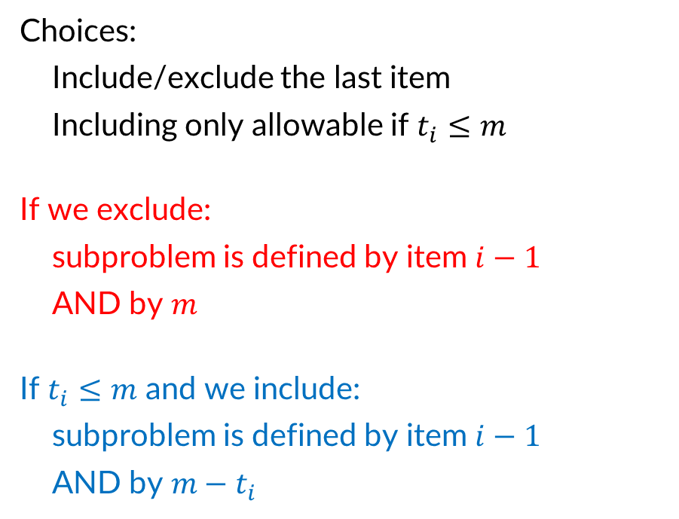
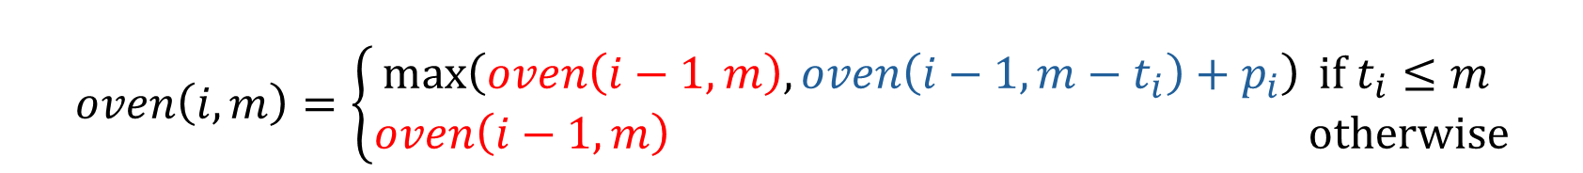
Oven Allocation – Full Recursive Structure
$$oven\left(i,m\right)=\left\{\begin{aligned}\max\left(oven\left(i−1,m\right),oven\left(i−1,m−t_{i}\right)+p_{i}\right) if t_{i}≤m \\ oven\left(i−1,m\right) otherwise\end{aligned}\right.$$
Choices: Include/exclude the last item Including only allowable if $t_{i}≤m$
If we exclude: subproblem is defined by item $i−1$ AND by $m$
If $t_{i}≤m$ and we include: subproblem is defined by item $i−1$ AND by $m−t_{i}$
$$v_{0}=3$$
$$v_{1}=4$$
$$v_{2}=4$$
$$v_{3}=7$$
$$v_{4}=2$$
$$v_{5}=1$$
Time
0
1
2
3
4
5
6
7
8
9
10

Slide 28
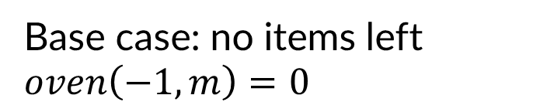
Oven Allocation – Base Case
$$oven\left(i,m\right)=\left\{\begin{aligned}\max\left(oven\left(i−1,m\right),oven\left(i−1,m−t_{i}\right)+p_{i}\right) if t_{i}≤m \\ oven\left(i−1,m\right) otherwise\end{aligned}\right.$$
Base case: no items left
$oven\left(−1,m\right)=0$
Time
0
1
2
3
4
5
6
7
8
9
10

Slide 29
Four Steps – Oven Allocation Step 2
Formulate the answer with a recursive structure
What are the options for the last choice?
For each such option, what does the subproblem look like? How do we use it?
Choose a memory structure.
Figure out the possible values of all parameters in the recursive calls.
How many subproblems (options for last choice) are there?
What are the parameters needed to identify each?
How many different values could there be per parameter?
Specify an order of evaluation. (Optional)
Want to guarantee that the necessary subproblem solutions are in memory when you need them.
With this step: a “Bottom-up” (iterative) algorithm
Without this step: a “Top-down” (recursive) algorithm
See if there’s a way to save space (Optional)
Is it possible to reuse some memory locations?

Slide 30
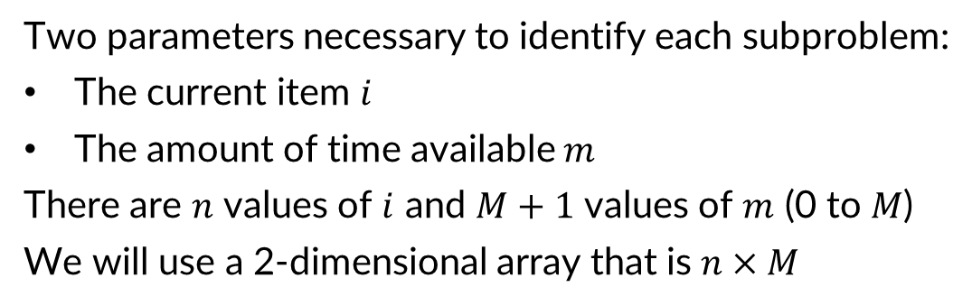


Oven Allocation – Memory Structure
$$oven\left(i,m\right)=\left\{\begin{aligned}\max\left(oven\left(i−1,m\right),oven\left(i−1,m−t_{i}\right)+p_{i}\right) if t_{i}≤m \\ oven\left(i−1,m\right) otherwise\end{aligned}\right.$$
Two parameters necessary to identify each subproblem:
The current item $i$
The amount of time available $m$
There are $n$ values of $i$ and $M+1$ values of $m$ (0 to $M$)
We will use a 2-dimensional array that is $n×M$
$$v_{0}=3$$
$M+1$ columns
$$v_{1}=4$$
$$v_{2}=4$$
$$v_{3}=7$$
$$v_{4}=2$$
$n$ rows
$$v_{5}=1$$
Time
0
1
2
3
4
5
6
7
8
9
10

Slide 31
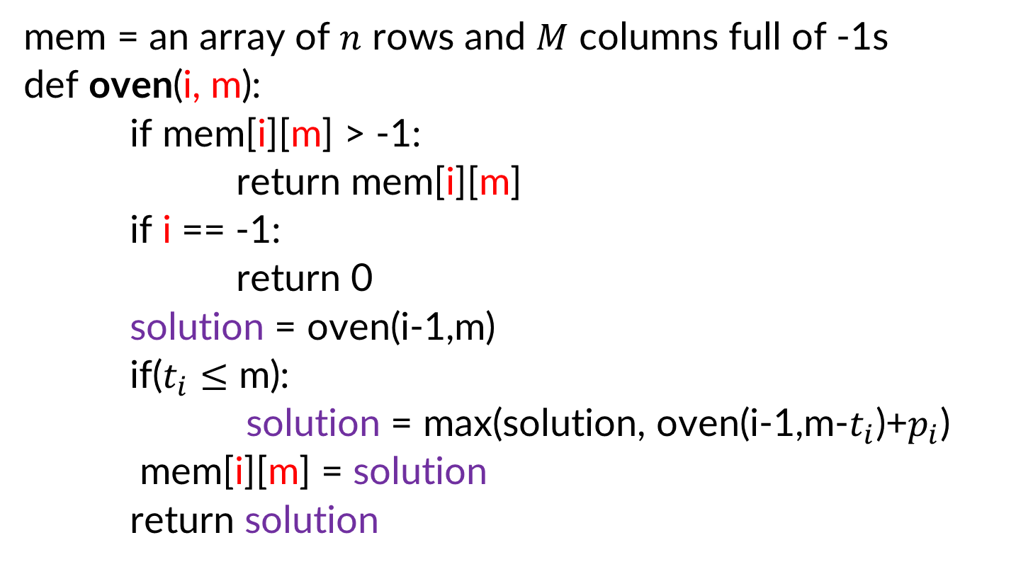
Oven Allocation Top-Down
mem = an array of $n$ rows and $M$ columns full of -1s
def oven(i, m):
if mem[i][m] > -1:
return mem[i][m]
if i == -1:
return 0
solution = oven(i-1,m)
if($t_{i}≤$ m):
solution = max(solution, oven(i-1,m-$t_{i}$)+$p_{i}$)
mem[i][m] = solution
return solution

Slide 32
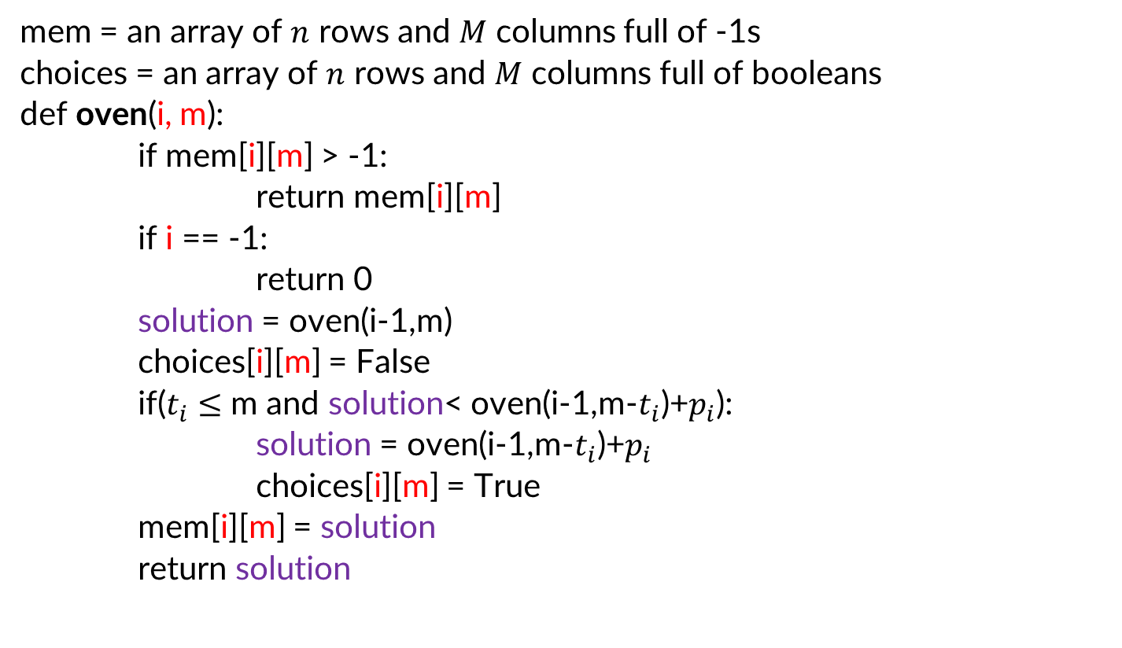
Oven Allocation Top-Down with choices
mem = an array of $n$ rows and $M$ columns full of -1s
choices = an array of $n$ rows and $M$ columns full of booleans
def oven(i, m):
if mem[i][m] > -1:
return mem[i][m]
if i == -1:
return 0
solution = oven(i-1,m)
choices[i][m] = False
if($t_{i}≤$ m and solution< oven(i-1,m-$t_{i}$)+$p_{i}$):
solution = oven(i-1,m-$t_{i}$)+$p_{i}$
choices[i][m] = True
mem[i][m] = solution
return solution

Slide 33




Oven Allocation Example
0
$$oven\left(i,m\right)=\left\{\begin{aligned}\max\left(oven\left(i−1,m\right),oven\left(i−1,m−t_{i}\right)+p_{i}\right) if t_{i}≤m \\ oven\left(i−1,m\right) otherwise\end{aligned}\right.$$
1
2
mem
$$+v_{3}$$
3
4
$$+v_{4}$$
$$+v_{4}$$
5
+$v_{5}$
$$v_{0}=3$$
0
1
2
3
4
5
6
7
8
9
10
$$v_{1}=4$$
0
$$v_{2}=4$$
$$v_{3}=7$$
1
choices
$$v_{4}=2$$
2
$$v_{5}=1$$
3
Time
4
0
1
2
3
4
5
6
7
8
9
10
5
0
1
2
3
4
5
6
7
8
9
10

Slide 34
Oven Allocation Example - complete
0
0
0
0
3
3
3
3
3
3
3
0
0
0
3
4
4
7
7
7
$$oven\left(i,m\right)=\left\{\begin{aligned}\max\left(oven\left(i−1,m\right),oven\left(i−1,m−t_{i}\right)+p_{i}\right) if t_{i}≤m \\ oven\left(i−1,m\right) otherwise\end{aligned}\right.$$
1
2
0
4
4
8
11
mem
$$+v_{3}$$
3
4
8
11
4
$$+v_{4}$$
8
$$+v_{4}$$
11
5
+$v_{5}$
11
$$v_{0}=3$$
0
1
2
3
4
5
6
7
8
9
10
$$v_{1}=4$$
0
F
F
F
T
T
T
T
T
T
T
$$v_{2}=4$$
1
F
F
F
F
T
T
T
T
T
$$v_{3}=7$$
choices
$$v_{4}=2$$
2
F
T
F
T
T
$$v_{5}=1$$
3
F
F
F
Time
4
F
F
0
1
2
3
4
5
6
7
8
9
10
5
F
0
1
2
3
4
5
6
7
8
9
10

Slide 35
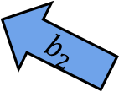
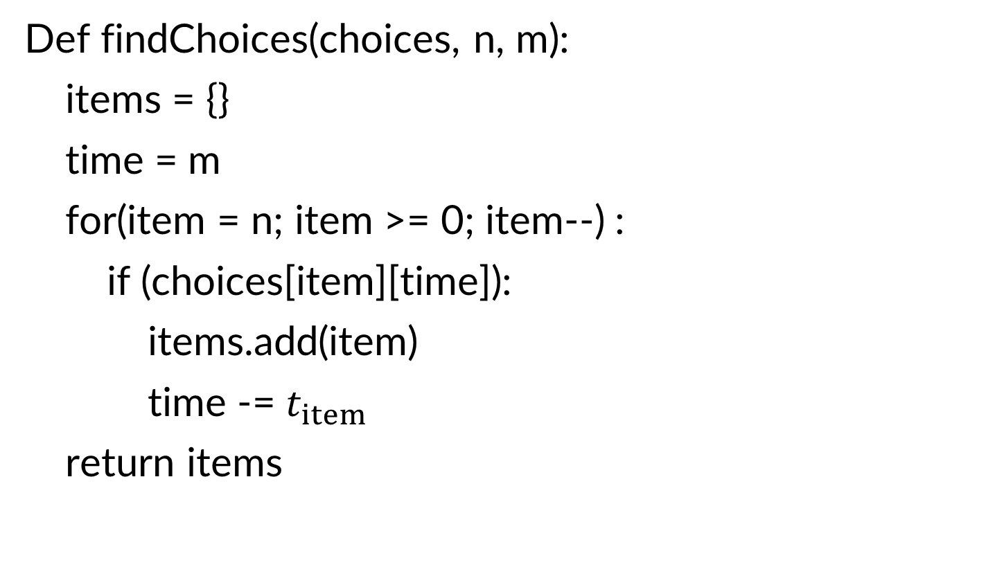

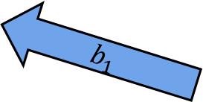
Using Choices
Def findChoices(choices, n, m):
items = {}
time = m
for(item = n; item >= 0; item--) :
if (choices[item][time]):
items.add(item)
time -= $t_{item}$
return items
$$b_{0}$$
0
F
F
F
T
T
T
T
T
T
T
$$b_{1}$$
1
F
F
F
F
T
T
T
T
T
$$b_{2}$$
2
F
T
F
T
T
3
F
F
F
4
F
F
5
F
0
1
2
3
4
5
6
7
8
9
10

Slide 36
Four Steps – Oven Allocation Step 3
Formulate the answer with a recursive structure
What are the options for the last choice?
For each such option, what does the subproblem look like? How do we use it?
Choose a memory structure.
Figure out the possible values of all parameters in the recursive calls.
How many subproblems (options for last choice) are there?
What are the parameters needed to identify each?
How many different values could there be per parameter?
Specify an order of evaluation. (Optional)
Want to guarantee that the necessary subproblem solutions are in memory when you need them.
With this step: a “Bottom-up” (iterative) algorithm
Without this step: a “Top-down” (recursive) algorithm
See if there’s a way to save space (Optional)
Is it possible to reuse some memory locations?

Slide 37
Selecting an order
0
$$oven\left(i,m\right)=\left\{\begin{aligned}\max\left(oven\left(i−1,m\right),oven\left(i−1,m−t_{i}\right)+p_{i}\right) if t_{i}≤m \\ oven\left(i−1,m\right) otherwise\end{aligned}\right.$$
1
2
mem
$$+v_{3}$$
3
4
$$+v_{4}$$
$$+v_{4}$$
5
+$v_{5}$
0
1
2
3
4
5
6
7
8
9
10
Each subproblem needs only cells in the row above it, and to its left.
Sufficient to fill in top to bottom, left to right

Slide 38
Four Steps – Oven Allocation Step 4
Formulate the answer with a recursive structure
What are the options for the last choice?
For each such option, what does the subproblem look like? How do we use it?
Choose a memory structure.
Figure out the possible values of all parameters in the recursive calls.
How many subproblems (options for last choice) are there?
What are the parameters needed to identify each?
How many different values could there be per parameter?
Specify an order of evaluation. (Optional)
Want to guarantee that the necessary subproblem solutions are in memory when you need them.
With this step: a “Bottom-up” (iterative) algorithm
Without this step: a “Top-down” (recursive) algorithm
See if there’s a way to save space (Optional)
Is it possible to reuse some memory locations?

Slide 39
Can we save space?
0
$$oven\left(i,m\right)=\left\{\begin{aligned}\max\left(oven\left(i−1,m\right),oven\left(i−1,m−t_{i}\right)+p_{i}\right) if t_{i}≤m \\ oven\left(i−1,m\right) otherwise\end{aligned}\right.$$
1
2
mem
$$+v_{3}$$
3
4
$$+v_{4}$$
$$+v_{4}$$
5
+$v_{5}$
0
1
2
3
4
5
6
7
8
9
10
Each subproblem needs only cells in the row above it
Two rows are enough: the current one, and the one with subproblem solutions

Slide 40
Final reminders
HW3 resubmissions due Wednesday @ 11:59pm.
HW4 due Wednesday @ 11:59pm.
I have OH now-12:30pm:
Meet at front of classroom, we’ll walk over together
CSE (Allen) 434 if you’re coming later
Glenn has online OH 12–1pm

