Slide 1
Lecture 12: Pathfinding
Glenn Sun

Slide 2
Logistics
Quiz on Friday in class
Practice quiz posted on course website
Special concept check quiz for Wednesday
HW 4 dates adjusted
New due date:
New resubmission date:

Slide 3
Wrapping up Prim’s algorithm

Slide 4
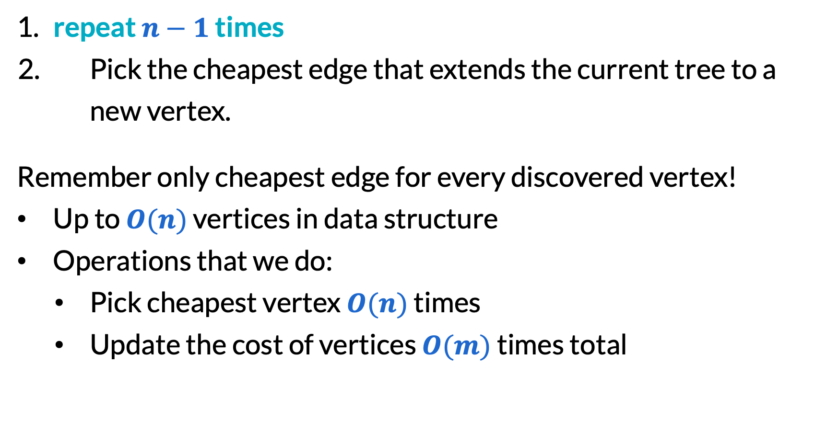
Prim’s algorithm
​repeat $n−1$ times
Pick the cheapest edge that extends the current tree to a new vertex.
Remember only cheapest edge for every discovered vertex!
Up to $O(n)$ vertices in data structure
Operations that we do:
Pick cheapest vertex ​$O(n)$ times
Update the cost of vertices $O(m)$ times total

Slide 5
Priority queues
A priority queue is an abstract data type similar to a queue, but allows you to get the highest priority elements first.
It supports:
add an element at a given priority
make a whole priority queue from a given list with priorities
extract the highest (minimum) priority element
peek the highest (minimum) priority element (without deleting)
decrease the priority of a given element to a new priority

Slide 6
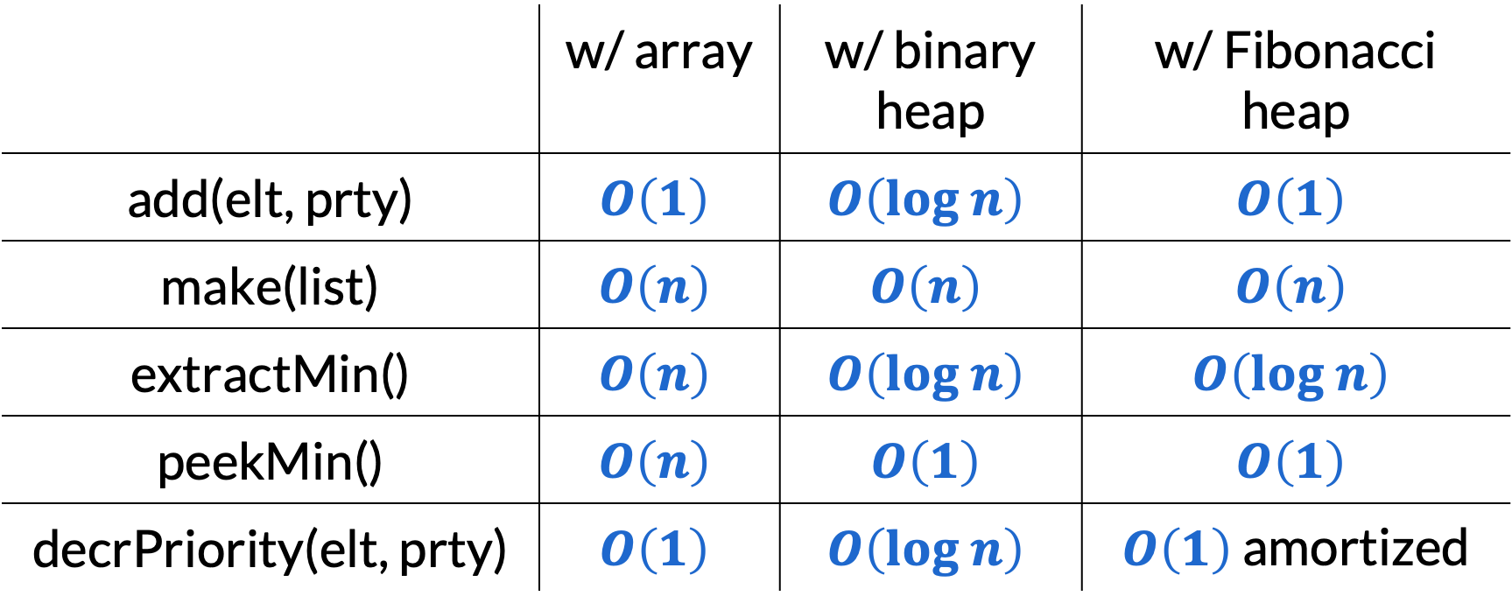
Priority queues
(last lecture)
(from 373)
(just FYI)
 | w/ array | w/ binary heap | w/ Fibonacci heap
add(elt, prty) | $$O\left(1\right)$$ | $$O\left(log n\right)$$ | $$O\left(1\right)$$
make(list) | $$O\left(n\right)$$ | $$O\left(n\right)$$ | $$O\left(n\right)$$
extractMin() | $$O\left(n\right)$$ | $$O\left(log n\right)$$ | $$O\left(log n\right)$$
peekMin() | $$O\left(n\right)$$ | $$O\left(1\right)$$ | $$O\left(1\right)$$
decrPriority(elt, prty) | $$O\left(1\right)$$ | $$O\left(log n\right)$$ | $O\left(1\right)$ amortized

Slide 7
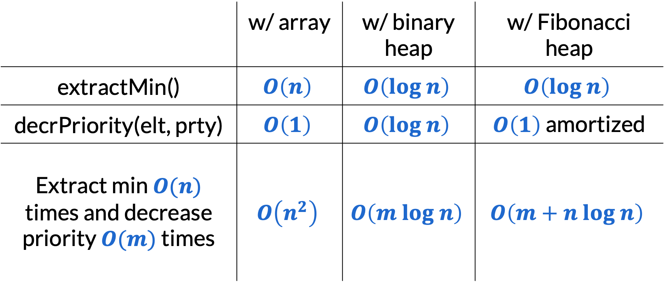

Running time of Prim’s
As always, assuming $n≤m≤n^{2}$:
 | w/ array | w/ binary heap | w/ Fibonacci heap
extractMin() | $$O\left(n\right)$$ | $$O\left(log n\right)$$ | $$O\left(log n\right)$$
decrPriority(elt, prty) | $$O\left(1\right)$$ | $$O\left(log n\right)$$ | $O\left(1\right)$ amortized
Extract min $O(n)$ times and decrease priority $O(m)$ times | $$O\left(n^{2}\right)$$ | $$O\left(m log n\right)$$ | $$O\left(m+n log n\right)$$

Slide 8
Dijkstra’s algorithm

Slide 9
Emergency snow network
A city has a network of roads of various lengths.
Goal: Find a minimum length network to plow that ensures that the fire department can reach everyone as fast as possible.
4
8
2
🏘️
🏢
🏥
🏠
5
6
1
7
3
3
2
📚
5
🏡
🚒
🛒
9
🏚️

Slide 10








Dijkstra’s algorithm is basically BFS
2
$$a$$
$$a$$
$$s$$
$$s$$
3
1
4
1
$$t$$
$$t$$
$$b$$
$$b$$

Slide 11

A larger example
4
8
2
C
G
E
A
5
6
1
7
3
3
2
H
5
D
$$s$$
B
9
F

Slide 12
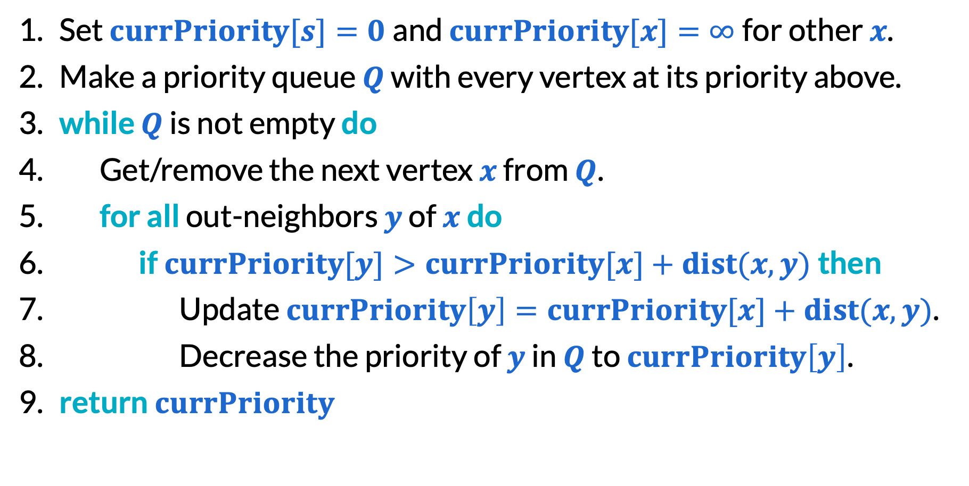
Dijkstra’s algorithm
Set $currPriority[s]=0$and $currPriority[x]=∞$for other $x$.
Make a priority queue $Q$ with every vertex at its priority above.
​while $Q$ is not empty do
Get/remove the next vertex $x$ from $Q$.
​for all out-neighbors $y$ of $x$do
​if $currPriority[y]>currPriority[x]+dist(x, y)$then
Update $currPriority\left[y\right]=currPriority[x]+dist(x, y)$.
Decrease the priority of $y$ in $Q$ to $currPriority\left[y\right]$.
​return $currPriority$

Slide 13
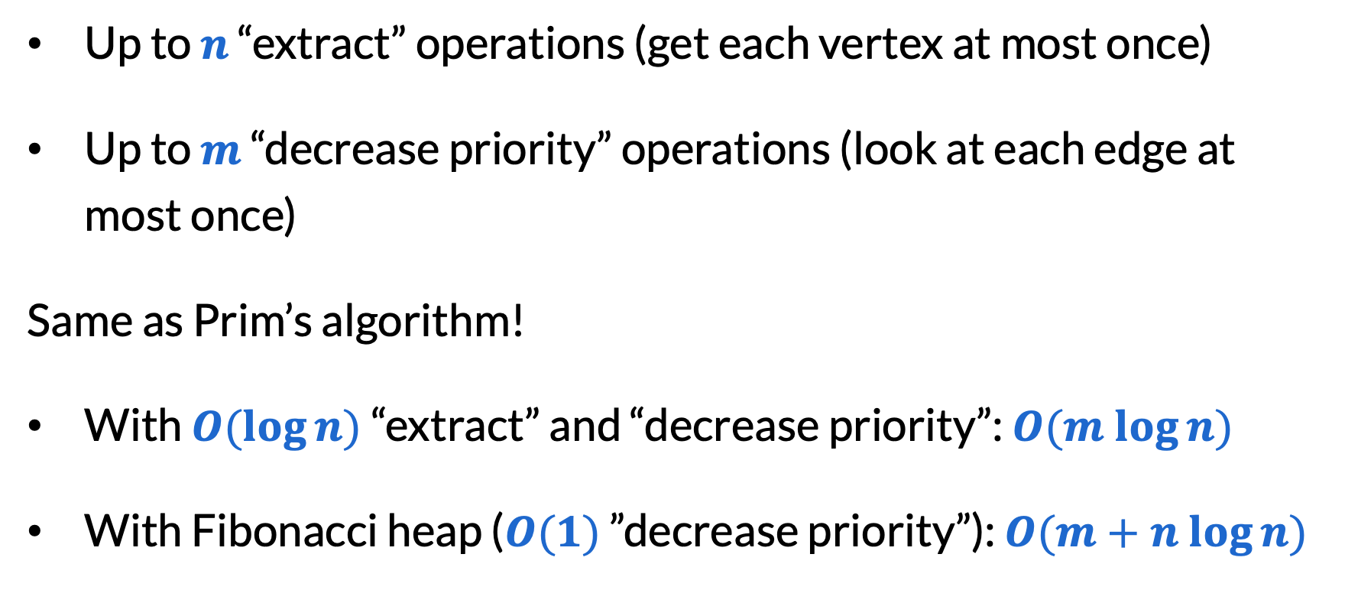
Running time of Dijkstra’s
Up to $n$ “extract” operations (get each vertex at most once)
Up to $m$ “decrease priority” operations (look at each edge at most once)
Same as Prim’s algorithm!
With $O(log⁡n)$“extract” and “decrease priority”: $O(m log⁡n)$
With Fibonacci heap ($O(1)$ ”decrease priority”): $O(m+n log⁡n)$

Slide 14
Shortest s-t path
Dijkstra’s algorithm can be used to:
Compute the distance of every vertex from a given point
Compute the distance between two points
Just break upon finding the desired point
No asymptotic improvement in running time

Slide 15
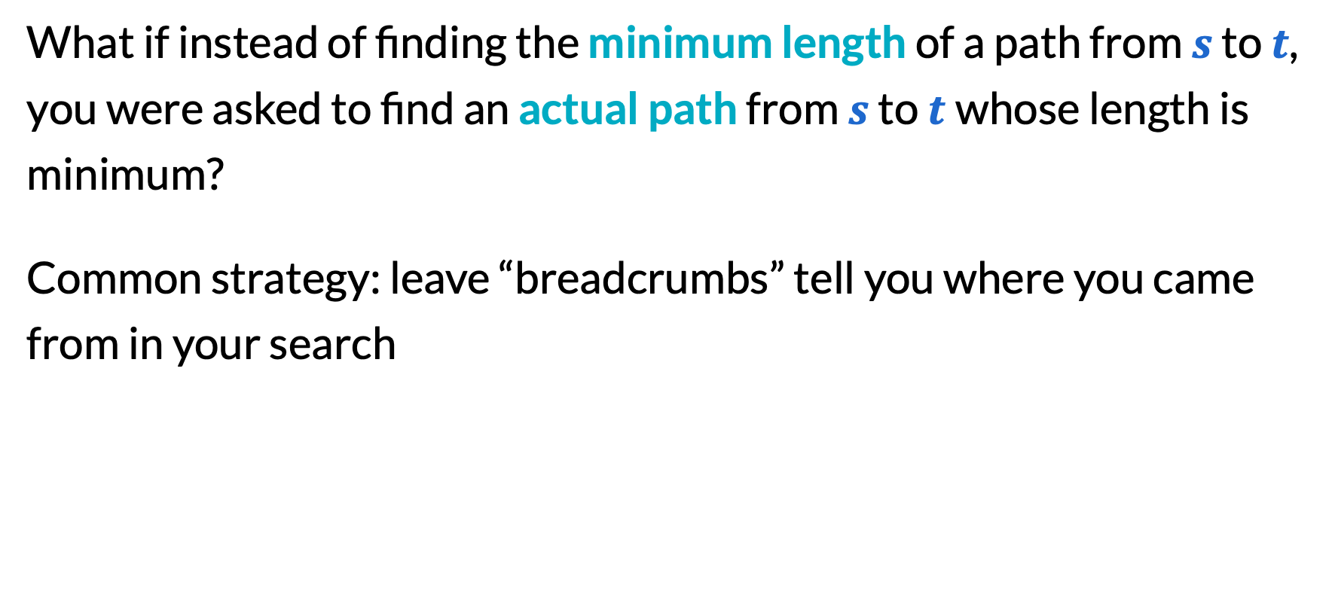
Leaving crumbs to trace the solution
What if instead of finding the minimum length of a path from $s$ to $t$, you were asked to find an actual path from $s$ to $t$whose length is minimum?
Common strategy: leave “breadcrumbs” tell you where you came from in your search

Slide 16


Leaving crumbs to trace the solution
4
8
2
B
G
D
$$s$$
5
6
1
7
3
3
2
$$t$$
5
C
F
A
9
E

Slide 17
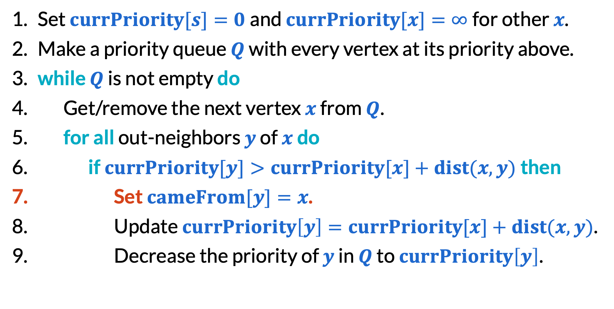
Leaving crumbs to trace the solution
Set $currPriority[s]=0$and $currPriority[x]=∞$for other $x$.
Make a priority queue $Q$ with every vertex at its priority above.
​while $Q$ is not empty do
Get/remove the next vertex $x$ from $Q$.
​for all out-neighbors $y$ of $x$do
​if $currPriority[y]>currPriority[x]+dist(x, y)$then
Set $cameFrom[y]=x$.
Update $currPriority\left[y\right]=currPriority[x]+dist(x, y)$.
Decrease the priority of $y$ in $Q$ to $currPriority\left[y\right]$.

Slide 18
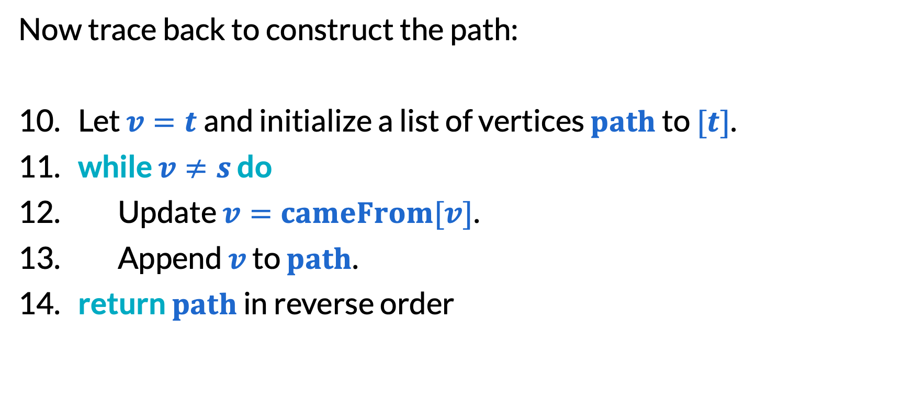
Leaving crumbs to trace the solution
Now trace back to construct the path:
Let $v=t$and initialize a list of vertices $path$ to $[t]$.
​while $v≠s$ do
Update $v=cameFrom[v]$.
Append $v$ to $path$.
​return $path$ in reverse order

Slide 19
A* search and heuristic algorithms

Slide 20
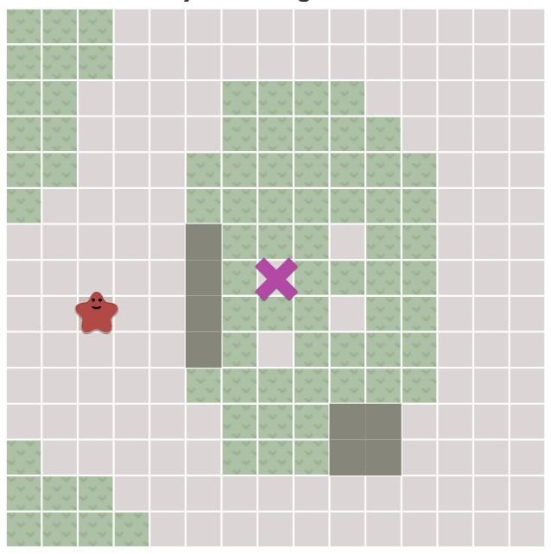
Pathfinding on a grid
Suppose a video character is moving through a 2D area represented by a grid of tiles:
Dirt tiles: fast to walk on, 1 sec/tile
Tall grass: slow to walk through: 2 sec/tile
Boulders: impassible objects
Maybe more
graphics: Amit Patel

Slide 21
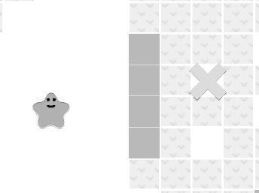



Pathfinding on a grid
Idea #1: Dijkstra’s algorithm on a grid
1
1
1
1.5
2
2
1
1
1
$$∞$$
2
$$∞$$
$$∞$$

Slide 22

Dijkstra’s for pathfinding
Use the “breadcrumbs” modification we discussed earlier.
Works okay! Guaranteed to find solution in $O(n)$time, where $n$ is the number of pixels in the grid.

Slide 23
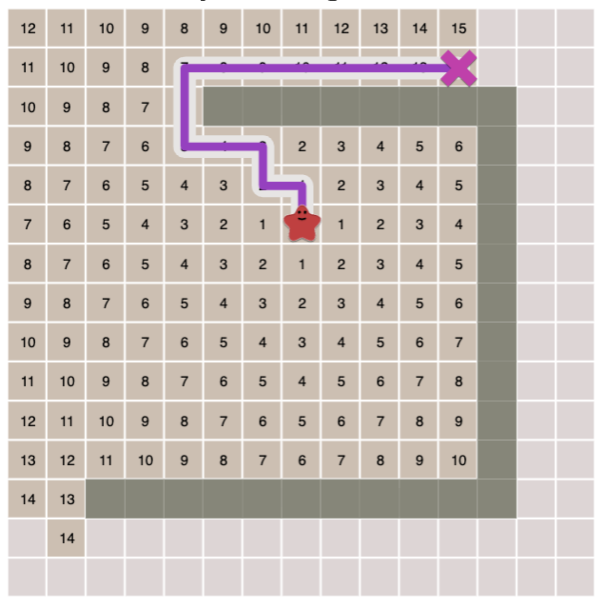
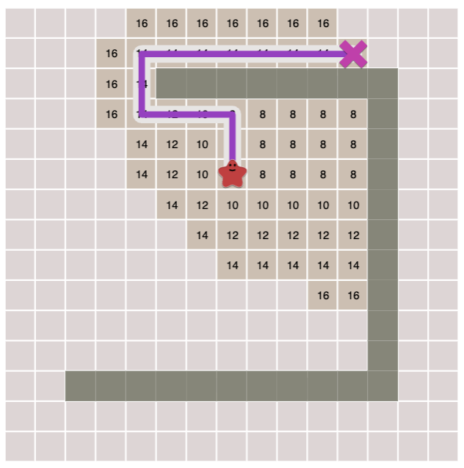
Dijkstra’s for pathfinding
Dijkstra’s is not ideal though, because breadth-first is a bad search strategy in 2D.
wasted search area
better!

Slide 24
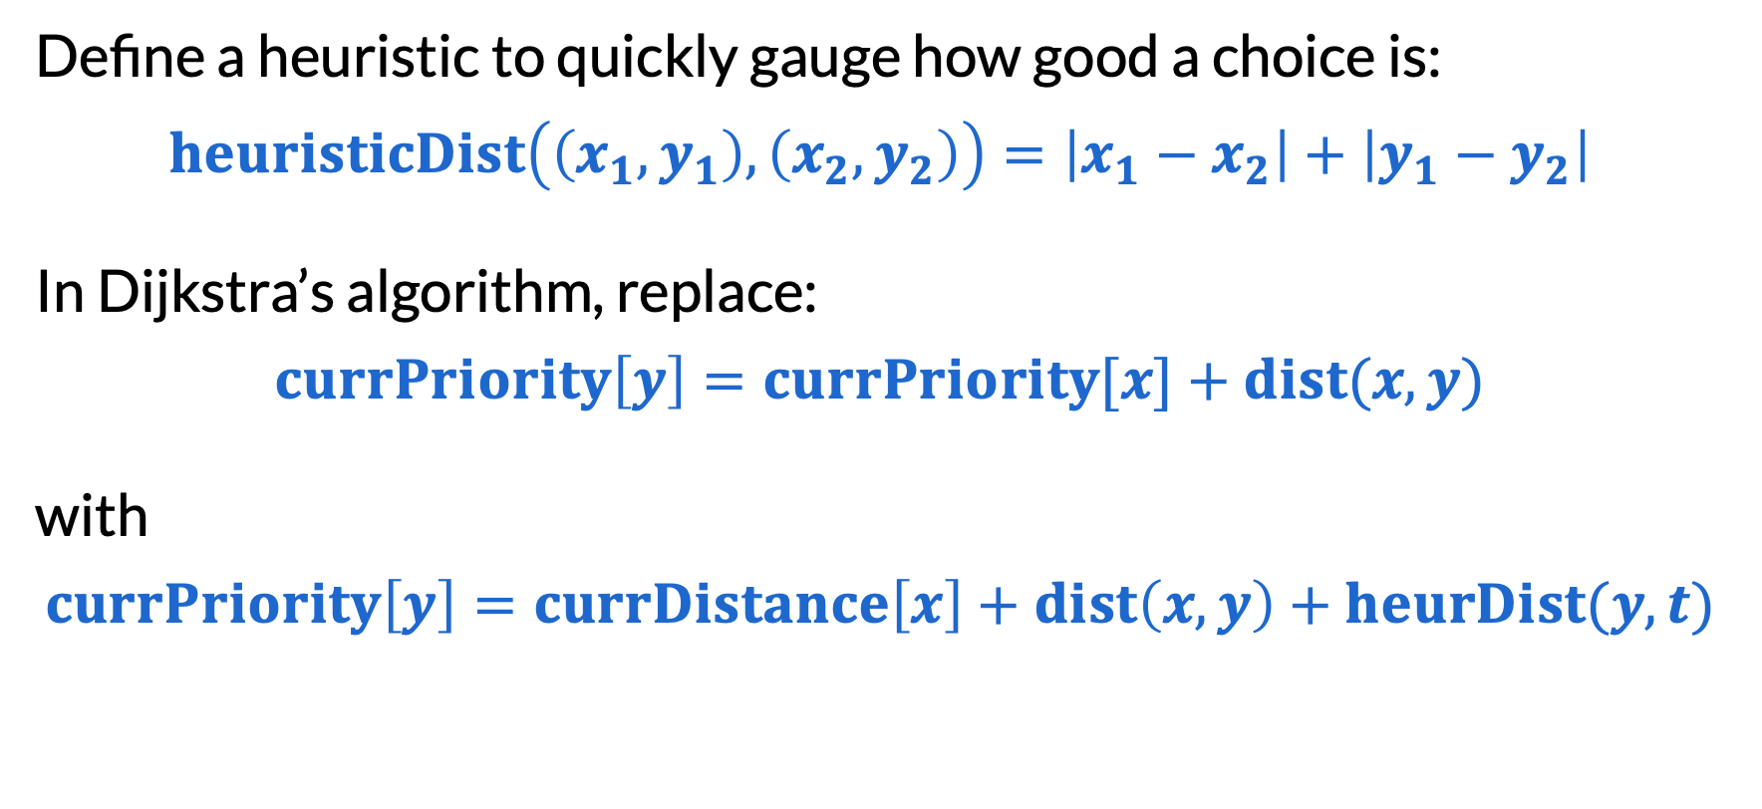
A* search
Define a heuristic to quickly gauge how good a choice is:
$$heuristicDist\left(\left(x_{1},y_{1}\right),\left(x_{2},y_{2}\right)\right)=\left|x_{1}−x_{2}\right|+\left|y_{1}−y_{2}\right|$$
In Dijkstra’s algorithm, replace:
$$currPriority\left[y\right]=currPriority[x]+dist(x, y)$$
with
$$currPriority\left[y\right]=currDistance\left[x\right]+dist\left(x, y\right)+heurDist(y,t)$$
goal

Slide 25
A* search is not asymptotically better
Sometimes, algorithms are not designed to be asymptotically better. Small improvements for a particular application matter!
But is A* search still correct for shortest paths?
Theorem. If the heuristic only ever underestimates distance, A* search still produces the shortest path!

Slide 26
Final reminders
Fill out concept check for Wednesday review topics!
I have OH now-12:30pm:
Meet at front of classroom, we’ll walk over together
CSE (Allen) 214 if you’re coming later
Nathan has online OH 12–1pm:
https://washington.zoom.us/my/nathanbrunelle

