Slide 1
Lecture 7: Computing More
Nathan Brunelle

Slide 2
Homeworks
HW 1 feedback expected Thursday (tomorrow)
HW 2 out, due Friday 11:59pm.

Slide 3
Divide and Conquer Review

Slide 4
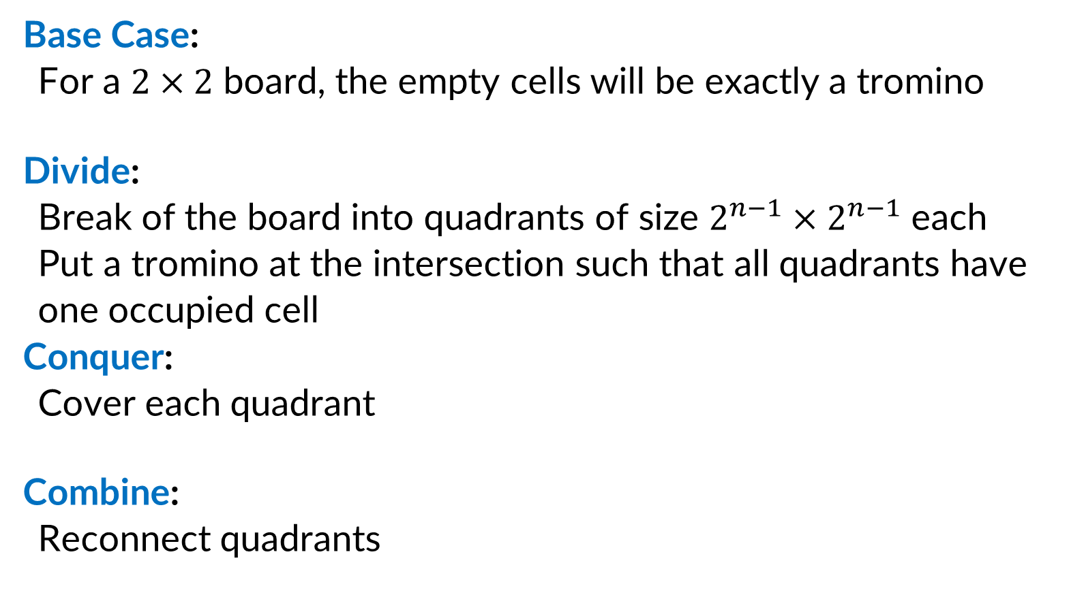
Divide and Conquer (Trominoes)
Base Case:
For a $2×2$ board, the empty cells will be exactly a tromino
Divide:
Break of the board into quadrants of size $2^{n−1}×2^{n−1}$ each
Put a tromino at the intersection such that all quadrants have one occupied cell
Conquer:
Cover each quadrant
Combine:
Reconnect quadrants

Slide 5
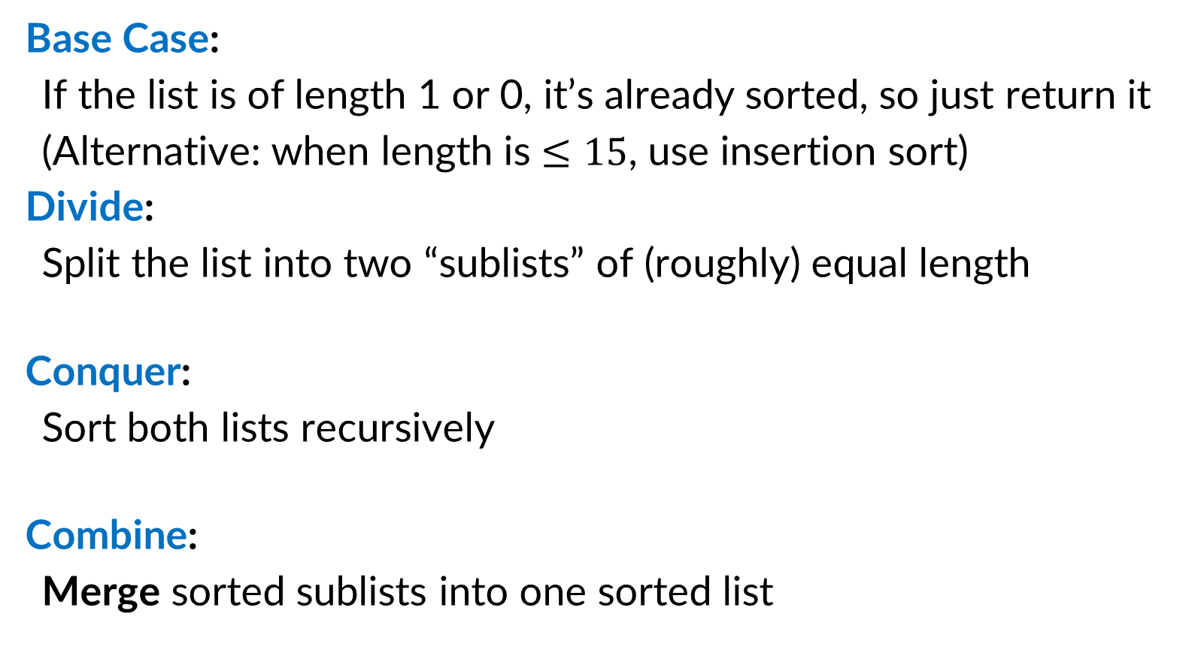
Divide and Conquer (Merge Sort)
Base Case:
If the list is of length 1 or 0, it’s already sorted, so just return it
(Alternative: when length is $≤15$, use insertion sort)
Divide:
Split the list into two “sublists” of (roughly) equal length
Conquer:
Sort both lists recursively
Combine:
Merge sorted sublists into one sorted list
5
5
8
2
9
4
1
2
5
8
1
4
9
2
5
8
1
4
9
1
2
4
5
8
9

Slide 6







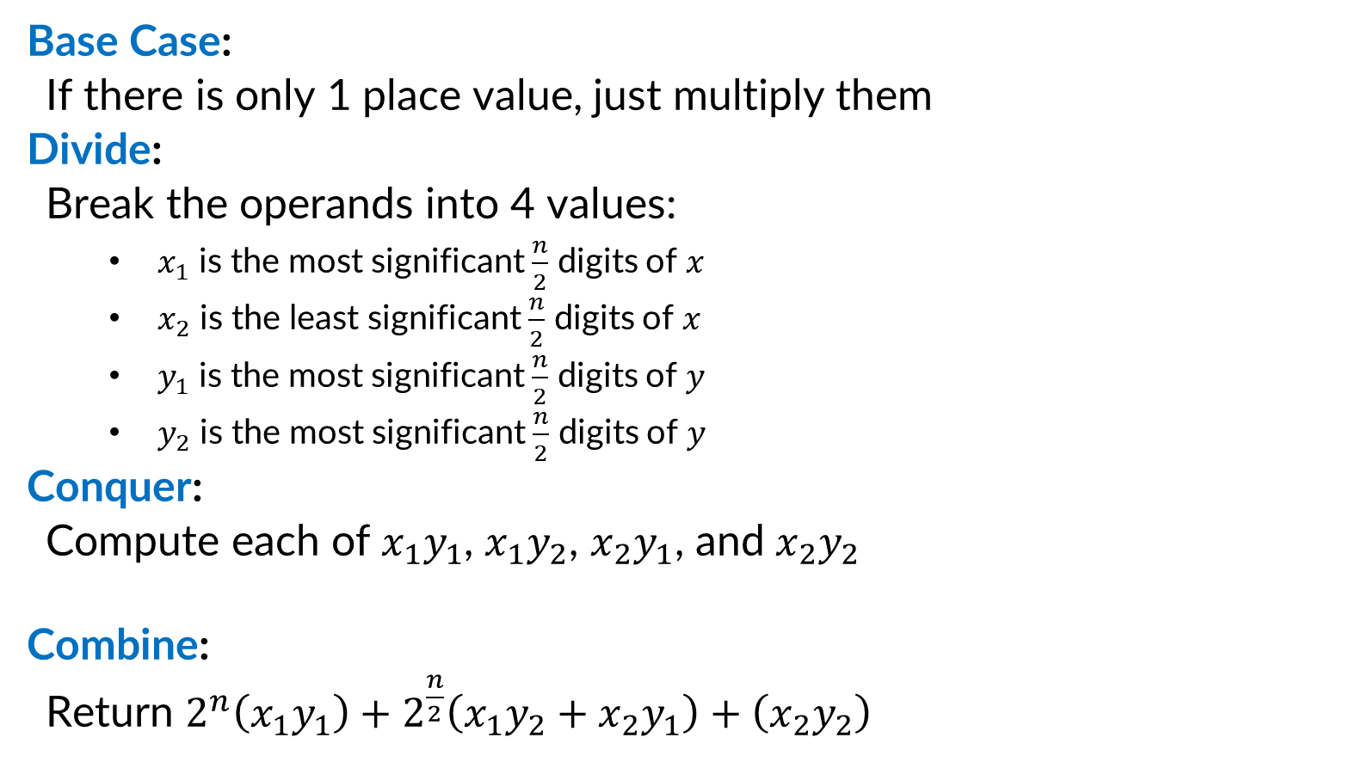









Divide and Conquer (Integer Multiplication)
Base Case:
If there is only 1 place value, just multiply them
Divide:
Break the operands into 4 values:
$x_{1}$ is the most significant $\frac{n}{2}$ digits of $x$
$x_{2}$ is the least significant $\frac{n}{2}$ digits of $x$
$y_{1}$ is the most significant $\frac{n}{2}$ digits of $y$
$y_{2}$ is the most significant $\frac{n}{2}$ digits of $y$
Conquer:
Compute each of $x_{1}y_{1}$, $x_{1}y_{2}$, $x_{2}y_{1}$, and $x_{2}y_{2}$
Combine:
Return $2^{n}\left(x_{1}y_{1}\right)+2^{\frac{n}{2}}\left(x_{1}y_{2}+x_{2}y_{1}\right)+\left(x_{2}y_{2}\right)$
$$x_{1}$$
$$x_{2}$$
$$×$$
$$y_{1}$$
$$y_{2}$$
$$x_{1}y_{1}$$
$$x_{1}y_{2}$$
$$x_{2}y_{1}$$
$$x_{2}y_{2}$$
$$x_{1}y_{1}$$
$$+$$
$$x_{1}y_{2}$$
$$+$$
$$x_{2}y_{1}$$
$$+$$
$$x_{2}y_{2}$$

Slide 7

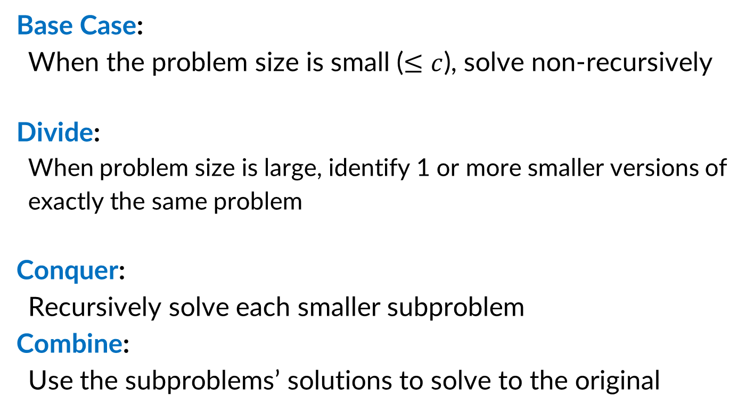
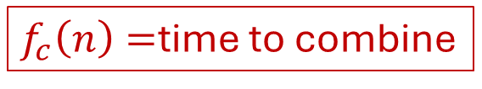

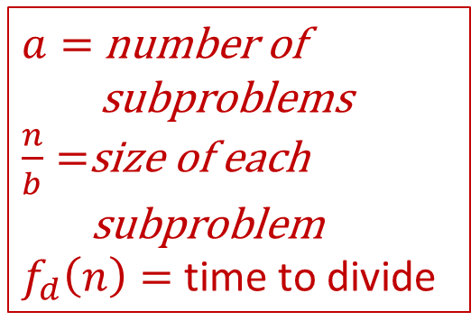
Divide and Conquer (Running Time)
$$T\left(c\right)=k$$
Base Case:
When the problem size is small ($≤c$), solve non-recursively
Divide:
When problem size is large, identify 1 or more smaller versions of exactly the same problem
Conquer:
Recursively solve each smaller subproblem
Combine:
Use the subproblems’ solutions to solve to the original
$a=$ number of
subproblems
$\frac{n}{b}=$size of each
subproblem
$f_{d}\left(n\right)=$ time to divide
$$a⋅T\left(\frac{n}{b}\right)$$
$f_{c}\left(n\right)=$time to combine
Overall: $T\left(n\right)=aT\left(\frac{n}{b}\right)+f\left(n\right)$ where $f\left(n\right)=f_{d}\left(n\right)+f_{c}(n)$

Slide 8
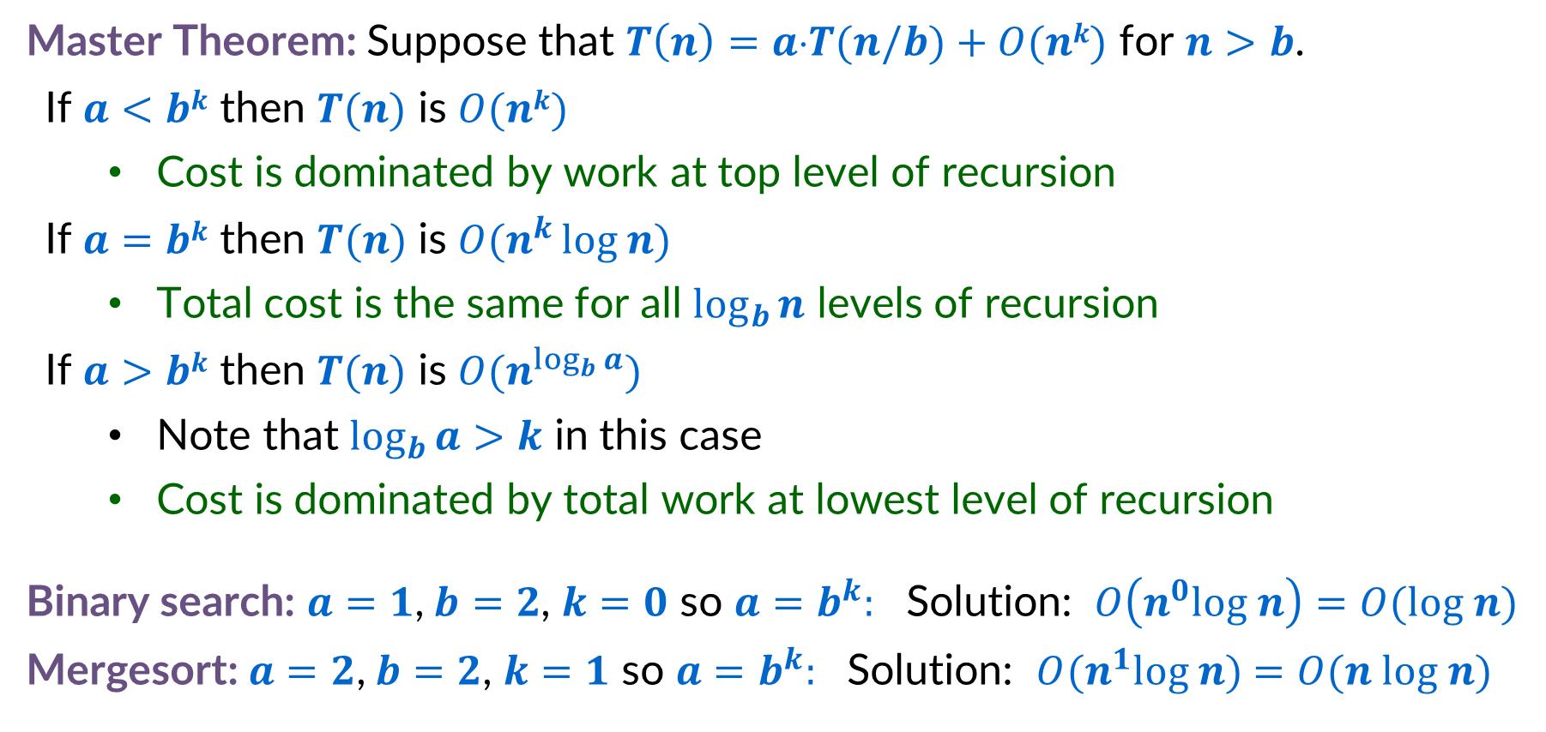
Master Theorem
Master Theorem: Suppose that $T\left(n\right)=a⋅T(n/b)+O(nk)$ for $n>b$.
If $a<bk$ then $T(n)$ is $O(nk)$
Cost is dominated by work at top level of recursion
If $a=bk$ then $T(n)$ is $O(n^{k }log n)$
Total cost is the same for all $\log_{b}{n}$ levels of recursion
If $a>bk$ then $T(n)$ is $O(n^{\log_{b}{a}})$
Note that $\log_{b}{a>k}$ in this case
Cost is dominated by total work at lowest level of recursion
Binary search: $a=1$,$b=2$, $k=0$ so $a=b^{k}:$ Solution: $O\left(n^{0}log n\right)=O(log n)$
Mergesort: $a=2$,$b=2$, $k=1$ so $a=b^{k}:$ Solution: $O(n^{1}log n)$ $=O(n log n)$

Slide 9
Integer Multiplication

Slide 10
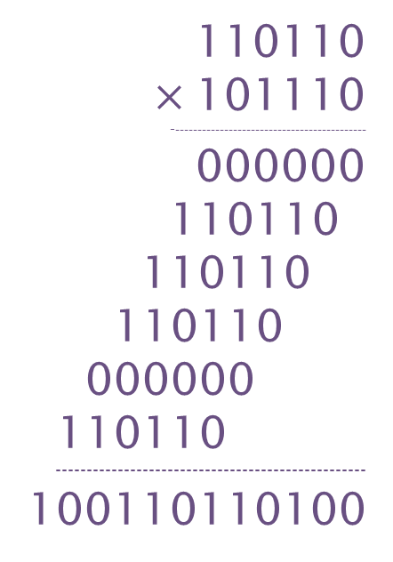
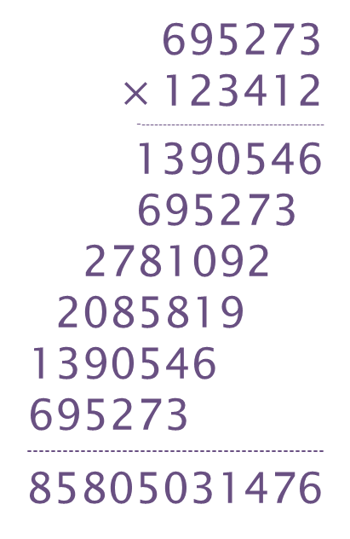
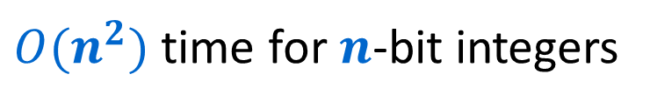
Schoolbook Integer Multiplication
695273
$×$123412
--------------------------------------------
1390546
695273
2781092
2085819
1390546
695273
--------------------------------------------------
85805031476
110110
$×$101110
--------------------------------------------
000000
110110
110110
110110
000000
110110
--------------------------------------------------
100110110100
Elementary school algorithm
$O(n^{2})$ time for $n$-bit integers
Decimal
Binary

Slide 11






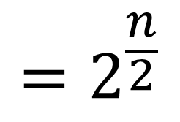


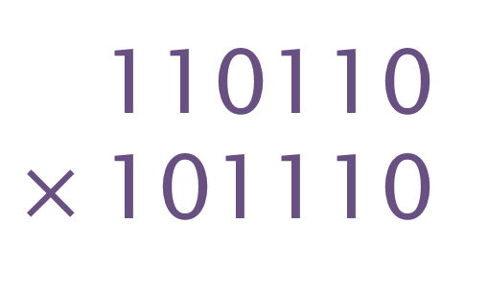
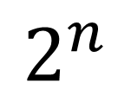





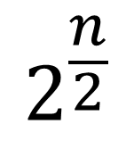

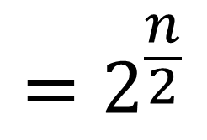


Divide and Conquer method
$$=2^{\frac{n}{2}}$$
110110
$×$101110
$$x_{1}$$
+
$$x_{2}$$
$$x_{1}$$
$$x_{2}$$
$$=2^{\frac{n}{2}}$$
$$y_{1}$$
$$y_{2}$$
$$y_{1}$$
+
$$y_{2}$$
$$2^{n}$$
( )
+
$$x_{1}$$
$$×$$
$$y_{1}$$
$$2^{\frac{n}{2}}$$
( )
+
$$x_{1}$$
$$×$$
$$y_{2}$$
+
$$x_{2}$$
$$×$$
$$y_{1}$$
( )
$$x_{2}$$
$$×$$
$$y_{2}$$

Slide 12
Divide and Conquer (Integer Multiplication)
Base Case:
If there is only 1 place value, just multiply them
Divide:
Break the operands into 4 values:
$x_{1}$ is the most significant $\frac{n}{2}$ digits of $x$
$x_{2}$ is the least significant $\frac{n}{2}$ digits of $x$
$y_{1}$ is the most significant $\frac{n}{2}$ digits of $y$
$y_{2}$ is the most significant $\frac{n}{2}$ digits of $y$
Conquer:
Compute each of $x_{1}y_{1}$, $x_{1}y_{2}$, $x_{2}y_{1}$, and $x_{2}y_{2}$
Combine:
Return $2^{n}\left(x_{1}y_{1}\right)+2^{\frac{n}{2}}\left(x_{1}y_{2}+x_{2}y_{1}\right)+\left(x_{2}y_{2}\right)$
$$x_{1}$$
$$x_{2}$$
$$×$$
$$y_{1}$$
$$y_{2}$$
$$x_{1}y_{1}$$
$$x_{1}y_{2}$$
$$x_{2}y_{1}$$
$$x_{2}y_{2}$$
$$x_{1}y_{1}$$
$$+$$
$$x_{1}y_{2}$$
$$+$$
$$x_{2}y_{1}$$
$$+$$
$$x_{2}y_{2}$$

Slide 13
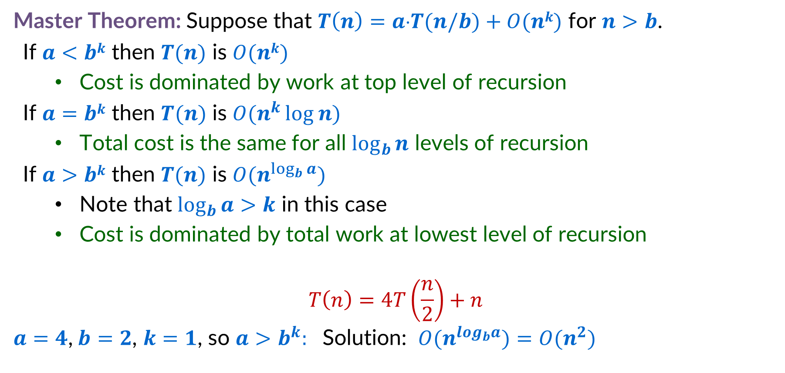
Integer Multiplication Recurrence Solution
Master Theorem: Suppose that $T\left(n\right)=a⋅T(n/b)+O(nk)$ for $n>b$.
If $a<bk$ then $T(n)$ is $O(nk)$
Cost is dominated by work at top level of recursion
If $a=bk$ then $T(n)$ is $O(n^{k }log n)$
Total cost is the same for all $\log_{b}{n}$ levels of recursion
If $a>bk$ then $T(n)$ is $O(n^{\log_{b}{a}})$
Note that $\log_{b}{a>k}$ in this case
Cost is dominated by total work at lowest level of recursion
$$T\left(n\right)=4T\left(\frac{n}{2}\right)+n$$
$a=4$,$b=2$, $k=1$, so $a>b^{k}:$ Solution: $O(n^{log_{b}a})$ $=O(n^{2})$

Slide 14
Improving the algorithm

Slide 15
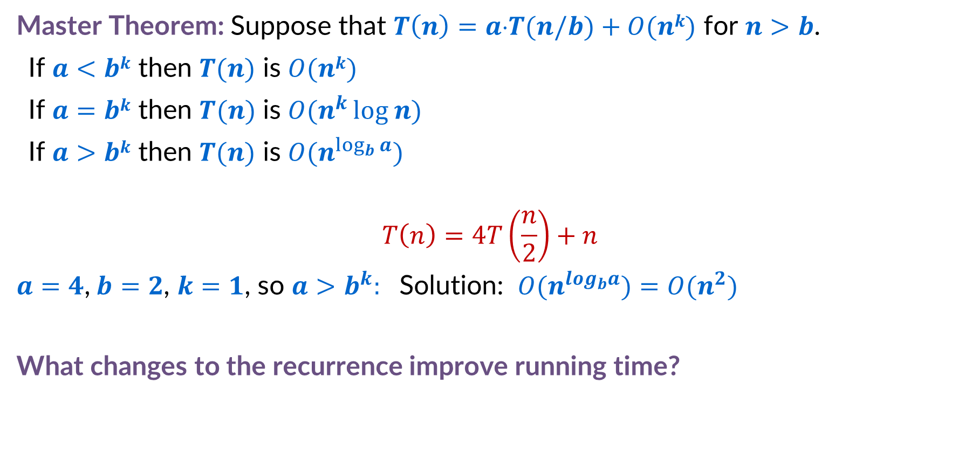
Ways to reduce running time
Master Theorem: Suppose that $T\left(n\right)=a⋅T(n/b)+O(nk)$ for $n>b$.
If $a<bk$ then $T(n)$ is $O(nk)$
If $a=bk$ then $T(n)$ is $O(n^{k }log n)$
If $a>bk$ then $T(n)$ is $O(n^{\log_{b}{a}})$
$$T\left(n\right)=4T\left(\frac{n}{2}\right)+n$$
$a=4$,$b=2$, $k=1$, so $a>b^{k}:$ Solution: $O(n^{log_{b}a})$ $=O(n^{2})$
What changes to the recurrence improve running time?

Slide 16
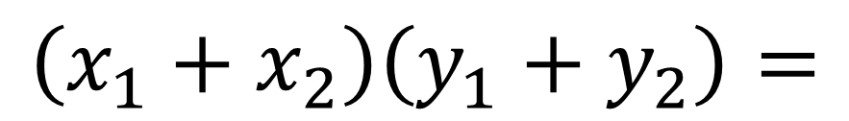
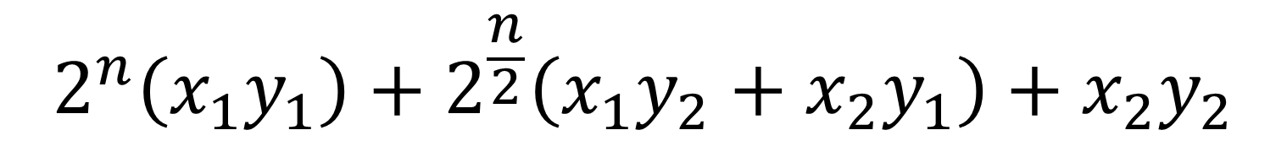
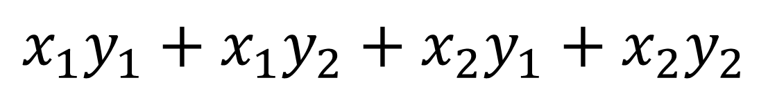
Karatsuba Method
Can’t avoid these
$$2^{n}\left(x_{1}y_{1}\right)+2^{\frac{n}{2}}\left(x_{1}y_{2}+x_{2}y_{1}\right)+x_{2}y_{2}$$
Can we do this with one multiplication?
$$\left(x_{1}+x_{2}\right)\left(y_{1}+y_{2}\right)=$$
$$x_{1}y_{1}+x_{1}y_{2}+x_{2}y_{1}+x_{2}y_{2}$$
$$x_{1}y_{2}+x_{2}y_{1}=\left(x_{1}+x_{2}\right)\left(y_{1}+y_{2}\right)−x_{1}y_{1}−x_{2}y_{2}$$
Two multiplications
One multiplication

Slide 17





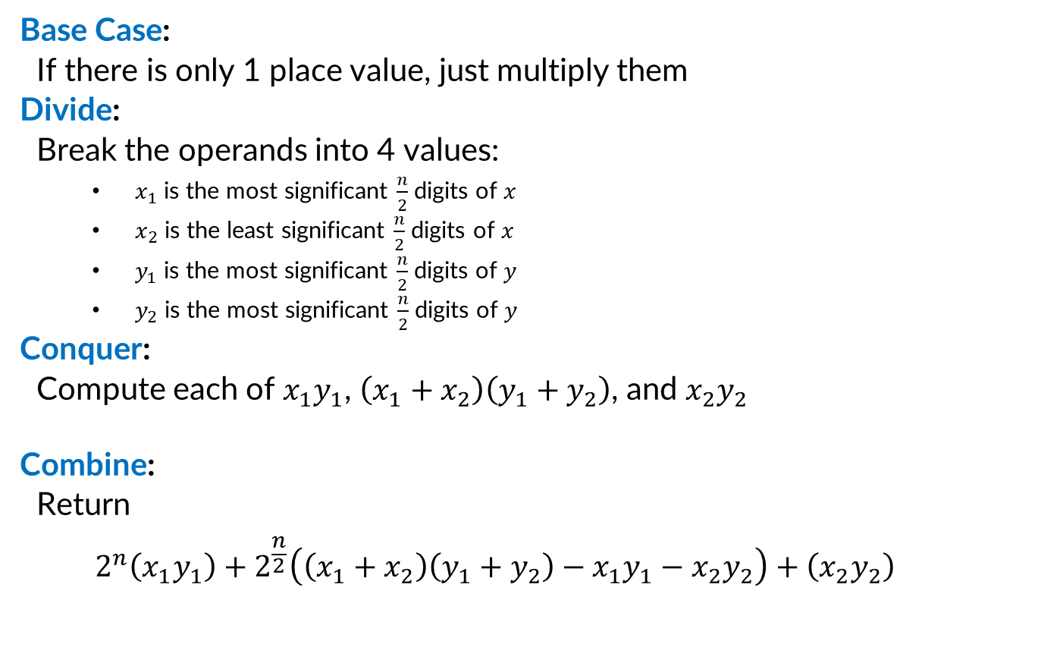








Divide and Conquer (Karatsuba Method)
Base Case:
If there is only 1 place value, just multiply them
Divide:
Break the operands into 4 values:
$x_{1}$ is the most significant $\frac{n}{2}$ digits of $x$
$x_{2}$ is the least significant $\frac{n}{2}$ digits of $x$
$y_{1}$ is the most significant $\frac{n}{2}$ digits of $y$
$y_{2}$ is the most significant $\frac{n}{2}$ digits of $y$
Conquer:
Compute each of $x_{1}y_{1}$, $\left(x_{1}+x_{2}\right)\left(y_{1}+y_{2}\right)$, and $x_{2}y_{2}$
Combine:
Return
$$2^{n}\left(x_{1}y_{1}\right)+2^{\frac{n}{2}}\left(\left(x_{1}+x_{2}\right)\left(y_{1}+y_{2}\right)−x_{1}y_{1}−x_{2}y_{2}\right)+\left(x_{2}y_{2}\right)$$
$$x_{1}$$
$$x_{2}$$
$$×$$
$$y_{1}$$
$$y_{2}$$
$$x_{1}y_{1}$$
$$x_{1}y_{2}$$
$$\left(x_{1}+x_{2}\right)$$
$$\left(y_{1}+y_{2}\right)$$
$$x_{2}y_{2}$$
$$x_{1}y_{1}$$
$$+$$
$$\left(x_{1}+x_{2}\right)$$
$$\left(y_{1}+y_{2}\right)$$
$$−$$
$$x_{1}y_{1}$$
$$−$$
$$x_{2}y_{2}$$
$$+$$
$$x_{2}y_{2}$$

Slide 18
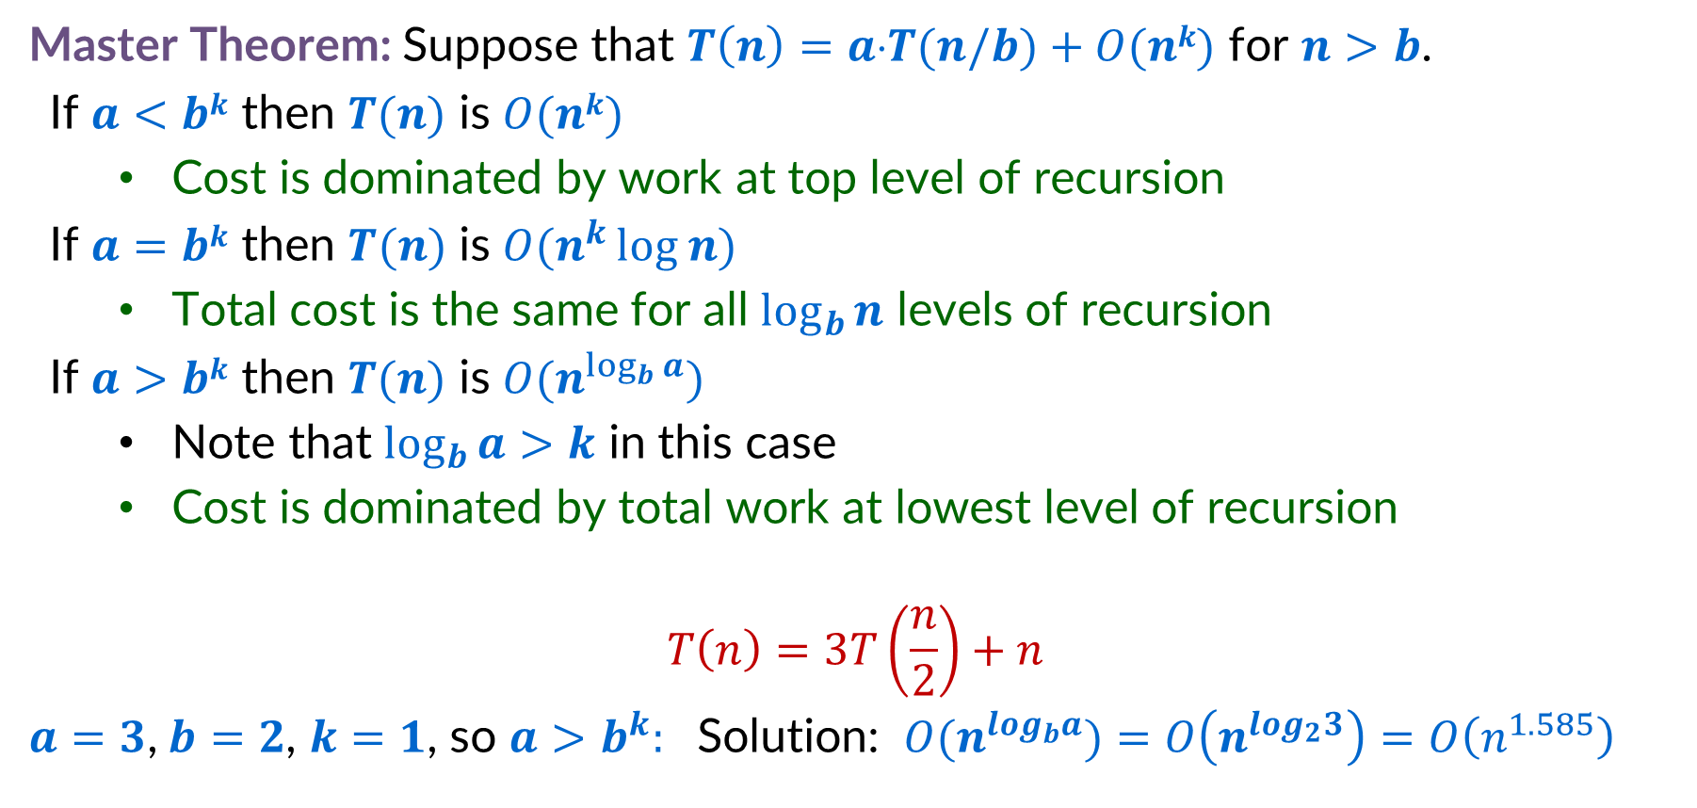
Karatsuba Method Recurrence Solution
Master Theorem: Suppose that $T\left(n\right)=a⋅T(n/b)+O(nk)$ for $n>b$.
If $a<bk$ then $T(n)$ is $O(nk)$
Cost is dominated by work at top level of recursion
If $a=bk$ then $T(n)$ is $O(n^{k }log n)$
Total cost is the same for all $\log_{b}{n}$ levels of recursion
If $a>bk$ then $T(n)$ is $O(n^{\log_{b}{a}})$
Note that $\log_{b}{a>k}$ in this case
Cost is dominated by total work at lowest level of recursion
$$T\left(n\right)=3T\left(\frac{n}{2}\right)+n$$
$a=3$,$b=2$, $k=1$, so $a>b^{k}:$ Solution: $O(n^{log_{b}a})$ $=O\left(n^{log_{2}3}\right)=O\left(n^{1.585}\right)$

Slide 19
The “Technique of Computing More”
Sometimes, it’s helpful to perform more tasks in your combine and conquer algorithm. We’ll see 2 examples: 1) More tasks give better running time 2) More tasks enable correctness

Slide 20
Maximum Sum Subarray

Slide 21
Maximum Sum Subarray - Problem
Given an array of integers, find the contiguous subarray with the maximum sum, then return:
The start index of that subarray
The end index of that subarray
The sum of the elements in that subarray
Solution
So return 2, 6, 9
3
-5
1
3
-2
3
4
-8
6
0
1
2
3
4
5
6
7
8

Slide 22
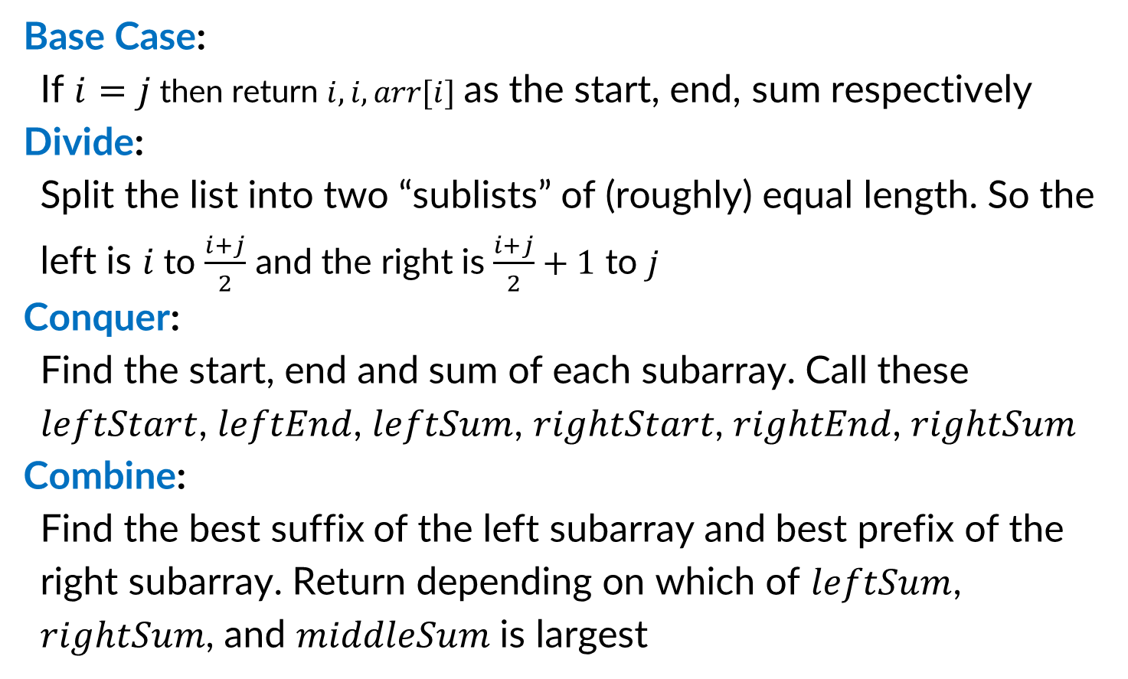
Maximum Sum Subarray (D&C from reading)
Base Case:
If $i=j$ then return $i, i, arr[i]$ as the start, end, sum respectively
Divide:
Split the list into two “sublists” of (roughly) equal length. So the left is $i$ to $\frac{i+j}{2}$ and the right is $\frac{i+j}{2}+1$ to $j$
Conquer:
Find the start, end and sum of each subarray. Call these $leftStart$, $leftEnd$, $leftSum$, $rightStart$, $rightEnd$, $rightSum$
Combine:
Find the best suffix of the left subarray and best prefix of the right subarray. Return depending on which of $leftSum$, $rightSum$, and $middleSum$ is largest
3
3
-5
1
3
-2
3
4
-8
6
0
1
2
3
4
5
6
7
8
Left Solution
Right Solution
3
-5
1
3
-2
3
4
-8
6
0
1
2
3
4
5
6
7
8
Left Solution
Right Solution
3
-5
1
3
-2
3
4
-8
6
0
1
2
3
4
5
6
7
8
Best Suffix
Best Prefix

Slide 23
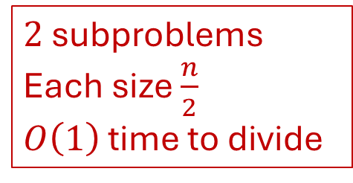
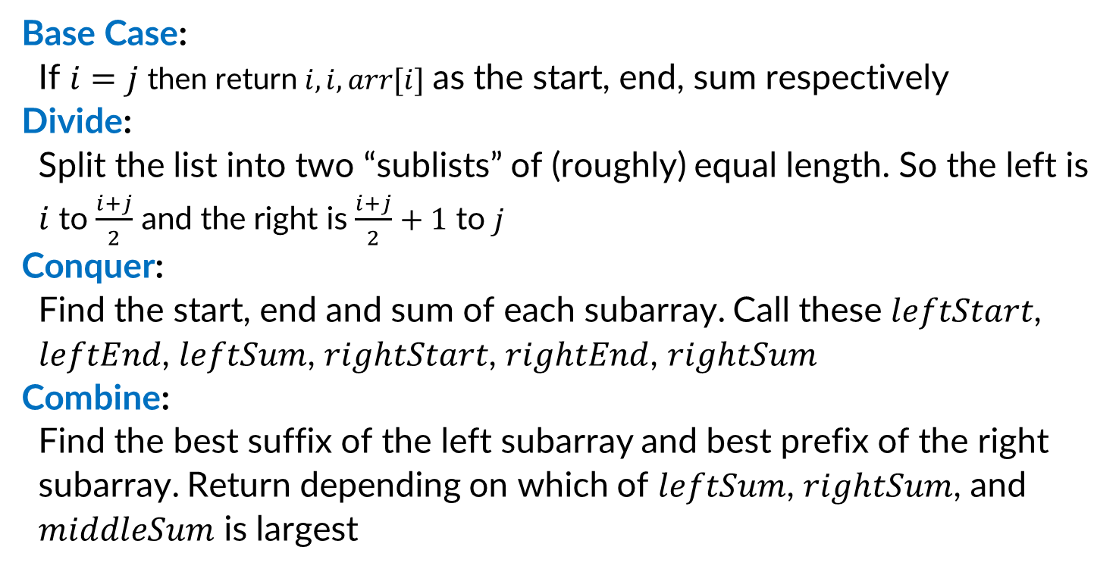
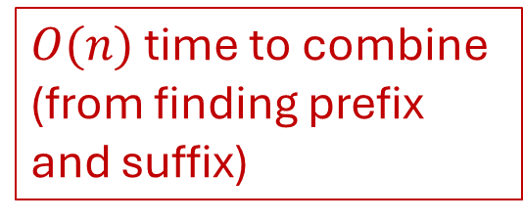
Running Time (D&C from reading)
Base Case:
If $i=j$ then return $i, i, arr[i]$ as the start, end, sum respectively
Divide:
Split the list into two “sublists” of (roughly) equal length. So the left is $i$ to $\frac{i+j}{2}$ and the right is $\frac{i+j}{2}+1$ to $j$
Conquer:
Find the start, end and sum of each subarray. Call these $leftStart$, $leftEnd$, $leftSum$, $rightStart$, $rightEnd$, $rightSum$
Combine:
Find the best suffix of the left subarray and best prefix of the right subarray. Return depending on which of $leftSum$, $rightSum$, and $middleSum$ is largest
$2$ subproblems
Each size $\frac{n}{2}$
$O\left(1\right)$ time to divide
$O(n)$ time to combine
(from finding prefix and suffix)
Overall: $T\left(n\right)=2T\left(\frac{n}{2}\right)+n$

Slide 24
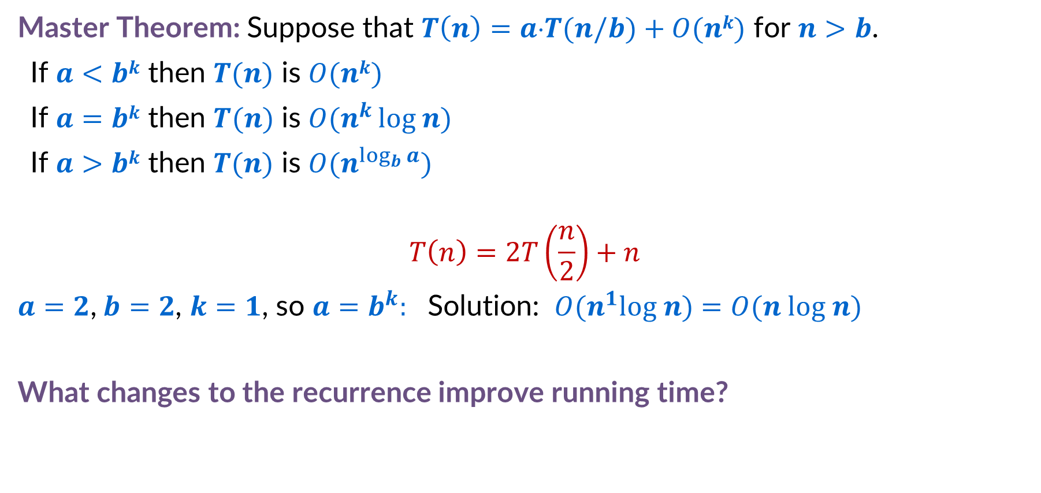
Reducing the Maximum Sum Subarray Running Time
Master Theorem: Suppose that $T\left(n\right)=a⋅T(n/b)+O(nk)$ for $n>b$.
If $a<bk$ then $T(n)$ is $O(nk)$
If $a=bk$ then $T(n)$ is $O(n^{k }log n)$
If $a>bk$ then $T(n)$ is $O(n^{\log_{b}{a}})$
$$T\left(n\right)=2T\left(\frac{n}{2}\right)+n$$
$a=2$,$b=2$, $k=1$, so $a=b^{k}:$ Solution: $O(n^{1}log n)$ $=O(n log n)$
What changes to the recurrence improve running time?

Slide 25
The Technique of Computing More
In general: it’s worthwhile to offload tasks onto subproblems if it can asymptotically reduce the time spent in dividing + combining
All the information needed to find the best suffix to the left and best prefix to the right are already present in the subproblem.
Can we save time if we have the subproblems return those values?
Left Solution
Right Solution
3
-5
1
3
-2
3
4
-8
6
0
1
2
3
4
5
6
7
8
Best Suffix
Best Prefix

Slide 26
Maximum Sum Subarray – New Problem
Given an array of integers, find the contiguous subarray with the maximum sum, then return:
The start index of that subarray
The end index of that subarray
The sum of the elements in that subarray
The start index of the best suffix of that subarray
The sum of the elements in that suffix
The end index of the best prefix of that subarray
The sum of the elements in that prefix
The sum of the entire subarray
Max Sum Subarray
3
-5
1
3
-2
3
4
-8
6
0
1
2
3
4
5
6
7
8
Best Suffix
Best Prefix

Slide 27
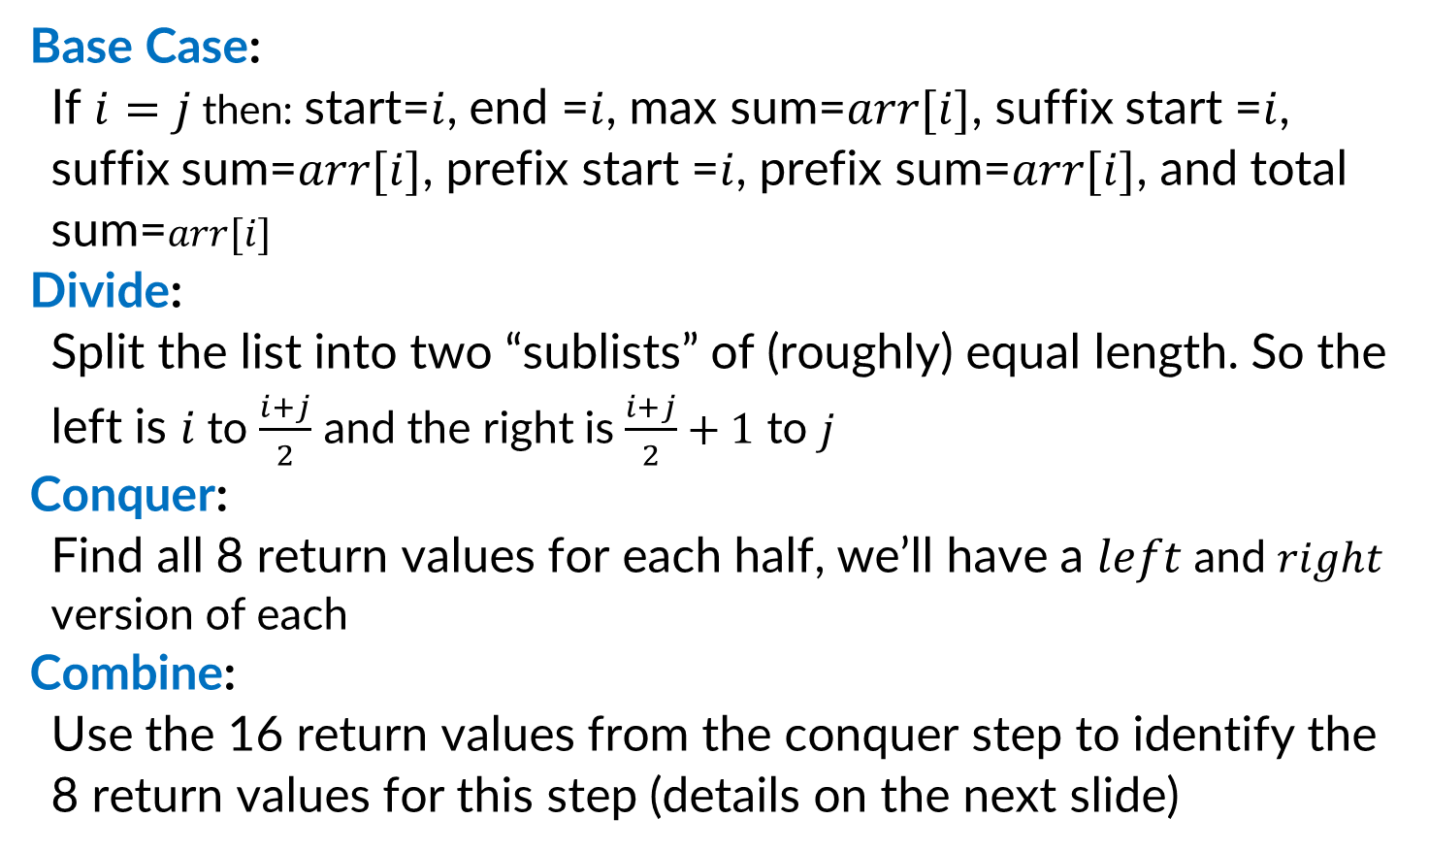
Maximum Sum Subarray (Improved D&C)
Base Case:
If $i=j$ then: start=$i$, end =$i$, max sum=$arr[i]$, suffix start =$i$, suffix sum=$arr[i]$, prefix start =$i$, prefix sum=$arr[i]$, and total sum=$arr[i]$
Divide:
Split the list into two “sublists” of (roughly) equal length. So the left is $i$ to $\frac{i+j}{2}$ and the right is $\frac{i+j}{2}+1$ to $j$
Conquer:
Find all 8 return values for each half, we’ll have a $left$ and $right$ version of each
Combine:
Use the 16 return values from the conquer step to identify the 8 return values for this step (details on the next slide)
3
3
-5
1
3
-2
3
4
-8
6
0
1
2
3
4
5
6
7
8
Left Solution
Right Solution
3
-5
1
3
-2
3
4
-8
6
0
1
2
3
4
5
6
7
8
Best Prefix
Best Suffix
Best Prefix
Best Suffix
Max Sum Subarray
3
-5
1
3
-2
3
4
-8
6
0
1
2
3
4
5
6
7
8
Best Prefix
Best Suffix

Slide 28
Improve D&C Combine Step
Finding the Max Sum Subarray (range and sum):
Use the same process as before!
It will be one of: Left Solution, Right Solution, or Suffix+Prefix
Finding the Best Prefix (end and sum):
It will be one of: Left prefix, entire left + right prefix
Finding the Best Suffix (start and sum):
It will be one of: right suffix, entire right + left suffix
Left Solution
Right Solution
Max Sum Subarray
3
-5
1
3
-2
3
4
-8
6
3
-5
1
3
-2
3
4
-8
6
0
1
2
3
4
5
6
7
8
0
1
2
3
4
5
6
7
8
Best Prefix
Best Suffix
Best Prefix
Best Suffix
Best Suffix
Best Prefix

Slide 29
Finding the best prefix - Justification
Finding the Best Prefix (end and sum):
It will be one of: Left prefix, entire left + right prefix
Proof:
Case 1: The best prefix is entirely on the left. In this case the answer will match the best prefix of the left subproblem
Case 2: The best prefix has at least one element from the right. In this case we must take the entire left half, then add in the best prefix from the right
3
-5
1
3
-2
3
4
-8
6
3
-5
1
3
-2
3
4
-8
6
0
1
2
3
4
5
6
7
8
0
1
2
3
4
5
6
7
8
Best Prefix
Best Prefix
Best Prefix

Slide 30
Finding the best suffix - Justification
Finding the Best Suffix (start and sum):
It will be one of: right suffix, entire right + left suffix
Proof:
Case 1: The best suffix is entirely on the right. In this case the answer will match the best suffix of the right subproblem
Case 2: The best suffix has at least one element from the left. In this case we must take the entire right half, then add in the best suffix from the left
3
-5
1
3
-2
3
4
-8
6
3
-5
1
3
-2
3
4
-8
6
0
1
2
3
4
5
6
7
8
0
1
2
3
4
5
6
7
8
Best Suffix
Best Suffix
Best Suffix

Slide 31
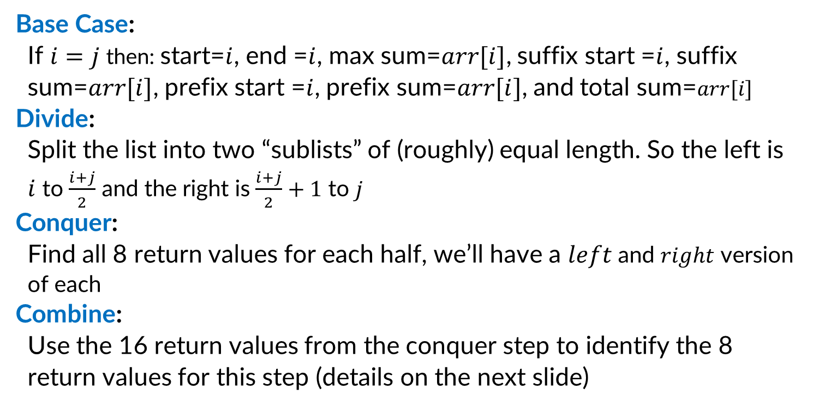
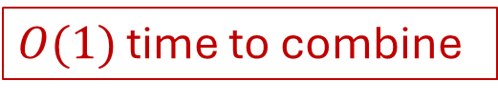
Running Time (Improved D&C)
Base Case:
If $i=j$ then: start=$i$, end =$i$, max sum=$arr[i]$, suffix start =$i$, suffix sum=$arr[i]$, prefix start =$i$, prefix sum=$arr[i]$, and total sum=$arr[i]$
Divide:
Split the list into two “sublists” of (roughly) equal length. So the left is $i$ to $\frac{i+j}{2}$ and the right is $\frac{i+j}{2}+1$ to $j$
Conquer:
Find all 8 return values for each half, we’ll have a $left$ and $right$ version of each
Combine:
Use the 16 return values from the conquer step to identify the 8 return values for this step (details on the next slide)
$2$ subproblems
Each size $\frac{n}{2}$
$O\left(1\right)$ time to divide
$O(1)$ time to combine
Overall: $T\left(n\right)=2T\left(\frac{n}{2}\right)+1$

Slide 32
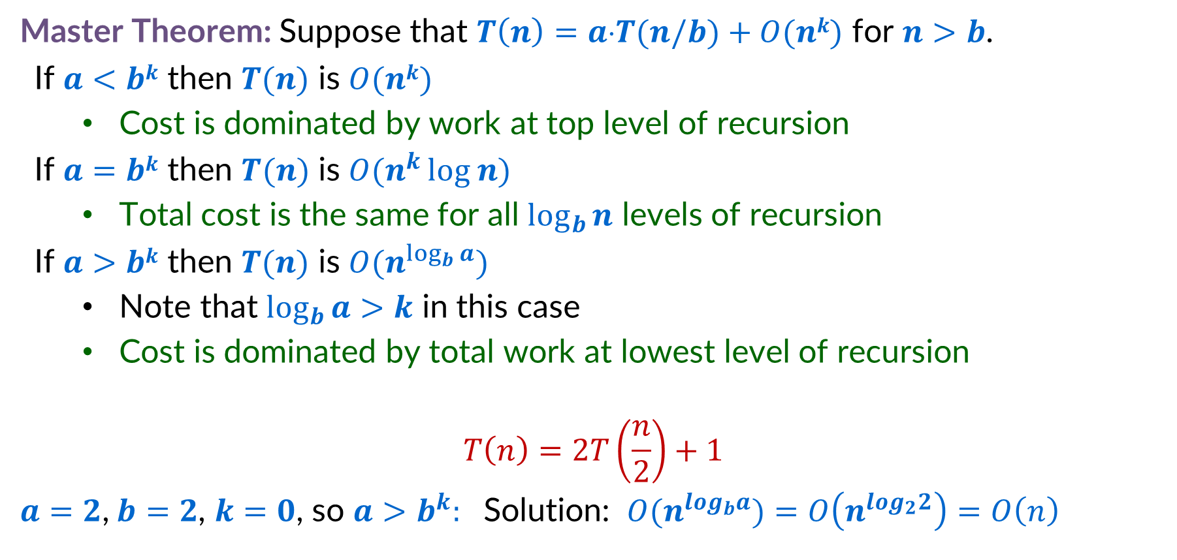
Improved D&C Recurrence Solution
Master Theorem: Suppose that $T\left(n\right)=a⋅T(n/b)+O(nk)$ for $n>b$.
If $a<bk$ then $T(n)$ is $O(nk)$
Cost is dominated by work at top level of recursion
If $a=bk$ then $T(n)$ is $O(n^{k }log n)$
Total cost is the same for all $\log_{b}{n}$ levels of recursion
If $a>bk$ then $T(n)$ is $O(n^{\log_{b}{a}})$
Note that $\log_{b}{a>k}$ in this case
Cost is dominated by total work at lowest level of recursion
$$T\left(n\right)=2T\left(\frac{n}{2}\right)+1$$
$a=2$,$b=2$, $k=0$, so $a>b^{k}:$ Solution: $O(n^{log_{b}a})$ $=O\left(n^{log_{2}2}\right)=O\left(n\right)$

Slide 33
Binary Tree Diameter

Slide 34
Binary Trees – Vocab Review
1
Nodes: Objects in the tree (labelled 1-8 here). They contain a value and may have a link to up to two other nodes
Child Node: a node linked to by some other node, that node is called its “parent”. E.g. 4 is the child of 2
Sibling Nodes: two nodes that share a parent. E.g. 2 and 3 are siblings
Root Node: The unique node which has no parent. Node 1 is the root
Leaf Nodes: Nodes that have no children. 5,6,7, and 8 here
2
3
4
5
6
7
8

Slide 35
Binary Tree Height - Definition
1
Distance: The distance between two nodes is the number of links you must follow to get from one to the other. E.g. the distance from 2 to 8 is 2, the distance from 2 to 6 is 3.
Height: The height of a binary tree is the largest distance from the root to some leaf. The height of this tree is 3 (1 is 3 away from 7)
2
3
4
5
6
7
8

Slide 36
Binary Tree Diameter - Definition
1
Diameter: The maximum distance between two nodes in a binary tree. The diameter of this tree is 5, because 7 is distance 5 from node 6.
2
3
4
5
6
7
8

Slide 37
Binary Tree Diameter – Incorrect Algorithm
0
8
Base Case:
If the current node is a leaf, the diameter is 0
Divide:
Split the tree into the left subtree and the right subtree
Conquer:
Find the diameter of each subtree
Combine:
Return the diameter of the left subtree + the diameter of the right subtree + 1
2
3
4
5
6
7
8
2
3
2
2
4
5
6
7
8
1
2
5
3
4
5
6
7
8

Slide 38
Incorrect Algorithm - Counterexample
1
Diameter of the left subtree: 0
Diameter of the right subtree: 0
Diameter of the whole tree: 2
2
3
Diameter ended up being: the distance to a left leaf + distance to a right leaf

Slide 39
Incorrect Algorithm - Counterexample
1
Diameter of the left subtree: 6
Diameter of the right subtree: 0
Diameter of the whole tree: 6
2
3
4
5
6
7
8
9
Diameter ended up being: The diameter of a subtree

Slide 40
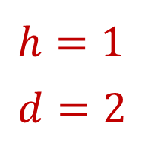
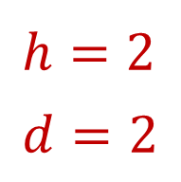
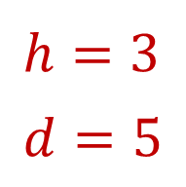
Binary Tree Diameter – Correct Algorithm
Base Case:
If the node is null the diameter and height are -1.
Divide:
Split the tree into the left subtree and the right subtree
Conquer:
Find the diameter and height of each subtree
Combine:
Height = 1 + max(left height, right height)
Diameter = max(left diameter,
right diameter,
left height + right height +2)
2
3
4
5
6
7
8
2
3
$$h=2 \\ d=2$$
4
5
6
$$h=1 \\ d=2$$
7
8
$$h=3 \\ d=5$$
1
2
3
4
5
6
7
8

