Slide 1
Lecture 18: Greedy algorithms
Glenn Sun

Slide 2
What is greedy?

Slide 3
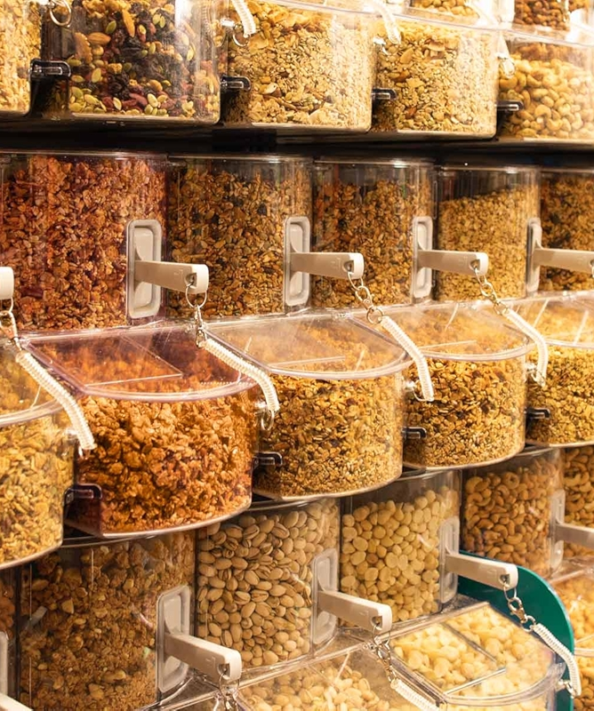
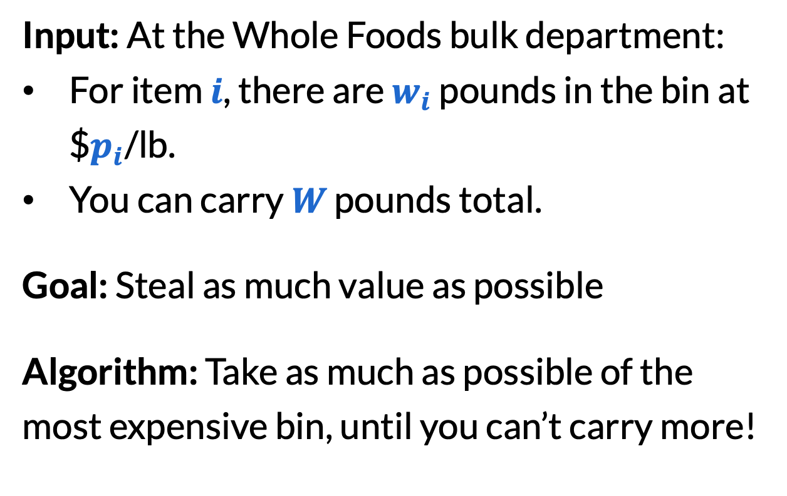
Whole Foods thief (“fractional knapsack”)
Input: At the Whole Foods bulk department:
For item $i$, there are $w_{i}$ pounds in the bin at $$p_{i}$/lb.
You can carry $W$ pounds total.
Goal: Steal as much value as possible
Algorithm: Take as much as possible of the most expensive bin, until you can’t carry more!

Slide 4
Whole Foods thief
Algorithm: Take as much as possible of the most expensive bin, until you can’t carry more!
Why does it work? Suppose another solution didn’t do this and look at the first time our solutions differed, in order of price.
Available: | 2 lbs | 3 lbs | 1 lb | 5 lbs
 | $5/lb | $4/lb | $3/lb | $3/lb
We picked: | 2 lbs | 3 lbs | 1 lb | 2 lbs
Other solution: | 2 lbs | 3 lbs | 0 lb | 3 lbs

Slide 5
Whole Foods thief
The other solution must have taken less of this item, because we took the maximum possible.
In the other solution, they could’ve picked this, and then picked less of something else later.
Available: | 2 lbs | 3 lbs | 1 lb | 5 lbs
 | $5/lb | $4/lb | $3/lb | $3/lb
We picked: | 2 lbs | 3 lbs | 1 lb | 2 lbs
Other solution: | 2 lbs | 3 lbs | 0 lb | 3 lbs

Slide 6
Whole Foods thief
Making this change can only improve the other solution (or stay the same quality), because later items are cheaper (or same price).
Because every other solution can only get better by becoming ours, our solution must be optimal!
Available: | 2 lbs | 3 lbs | 1 lb | 5 lbs
 | $5/lb | $4/lb | $3/lb | $3/lb
We picked: | 2 lbs | 3 lbs | 1 lb | 2 lbs
Other solution: | 2 lbs | 3 lbs | 1 lb | 2 lbs

Slide 7
Exchange argument
This kind of argument is called an exchange argument.
To show that your solution is optimal,
Consider a different solution. Usually, it helps to consider the first time that it differs.
Show that you can change the other solution to be more like yours, while improving or maintaining the quality.
Conclude that yours is optimal!

Slide 8
What is greedy?
Greedy algorithms solve optimization problems by:
Making a small choice that is “locally optimal”
Repeating this on the remaining subproblem
If the locally optimal choice must occur in some globally optimal solution, then greedy will always find the global optimum!
Today and Friday: When greedy is optimal
Monday: Greedy algorithms that are not optimal but useful

Slide 9
More examples

Slide 10
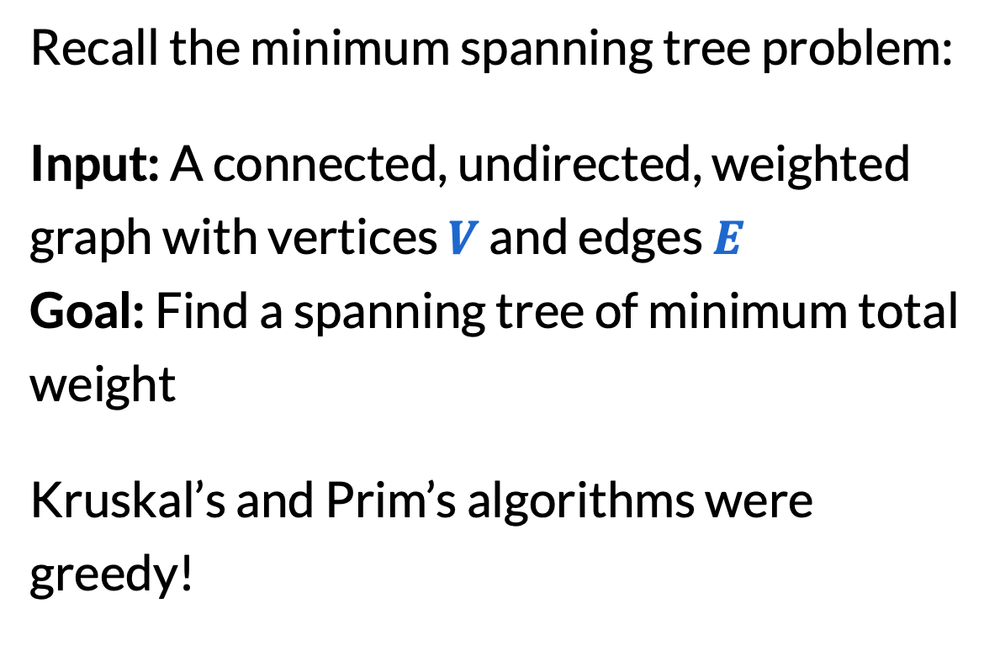
Kruskal’s/Prim’s algorithms
Recall the minimum spanning tree problem:
Input: A connected, undirected, weighted graph with vertices $V$ and edges $E$
Goal: Find a spanning tree of minimum total weight
Kruskal’s and Prim’s algorithms were greedy!

Slide 11
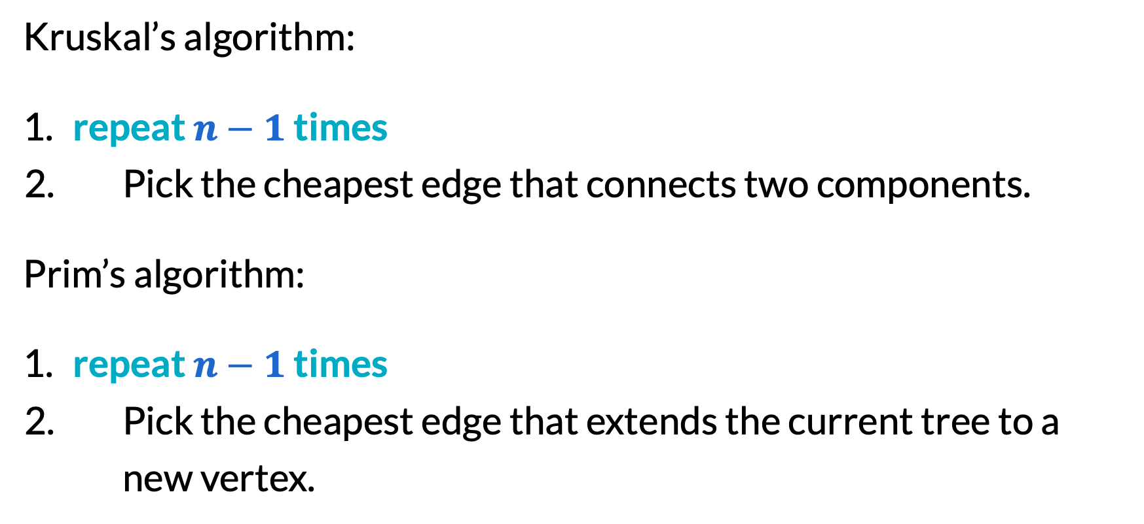
Kruskal’s/Prim’s algorithms
Kruskal’s algorithm:
​repeat $n−1$ times
Pick the cheapest edge that connects two components.
Prim’s algorithm:
​repeat $n−1$ times
Pick the cheapest edge that extends the current tree to a new vertex.

Slide 12
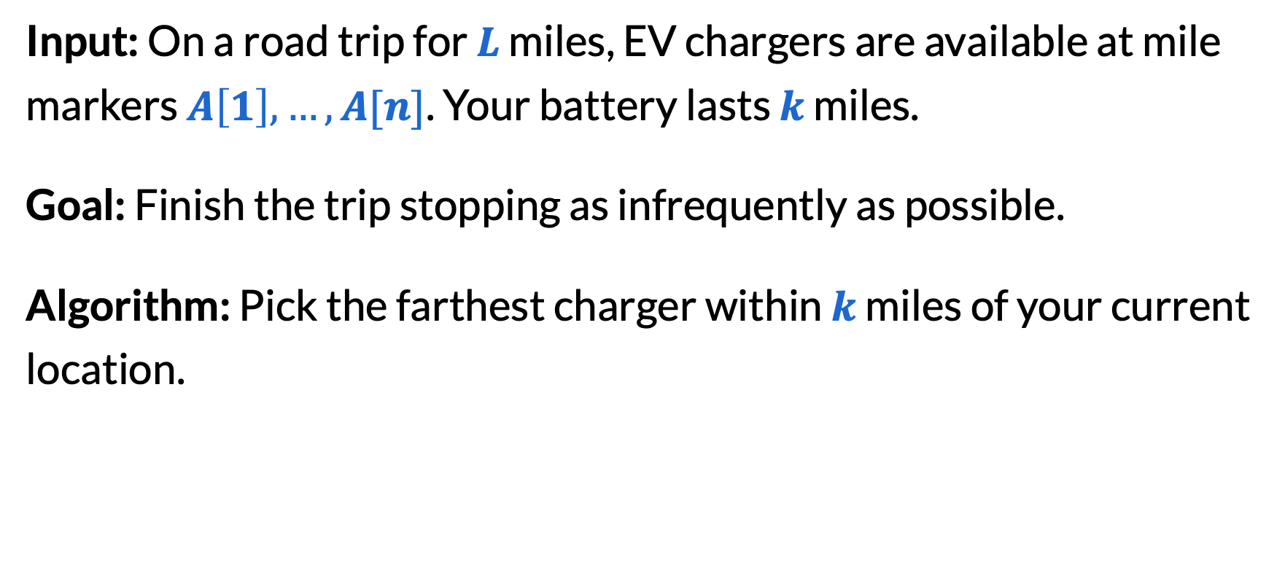
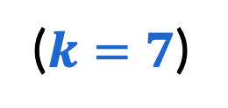
EV charging
Input: On a road trip for $L$ miles, EV chargers are available at mile markers $A\left[1\right],…,A[n]$. Your battery lasts $k$ miles.
Goal: Finish the trip stopping as infrequently as possible.
Algorithm: Pick the farthest charger within $k$ miles of your current location.
You: 🚗
3
5
9
11
16
($k=7$)

Slide 13

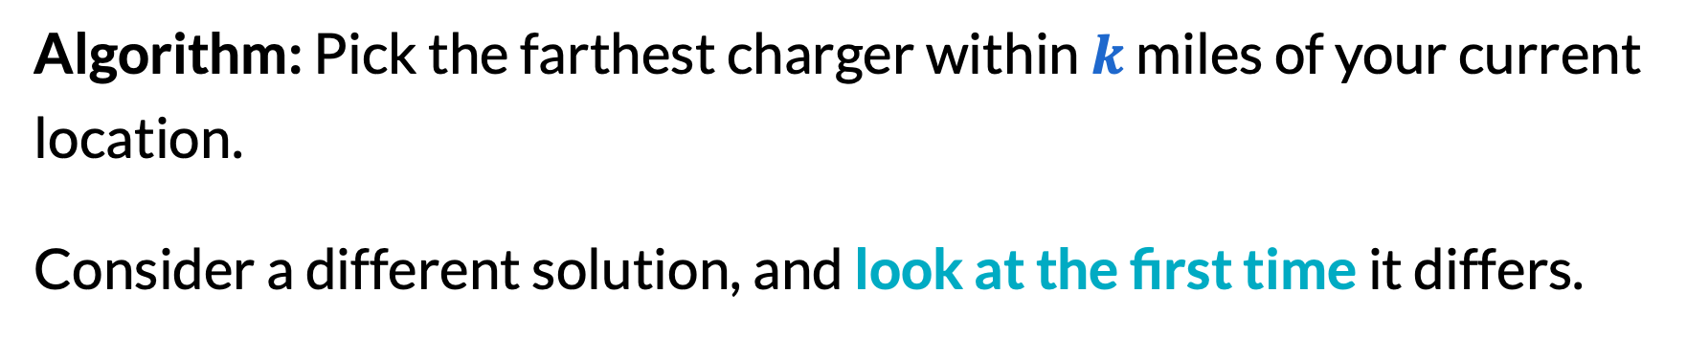
EV charging
Algorithm: Pick the farthest charger within $k$ miles of your current location.
Consider a different solution, and look at the first time it differs.
You: 🚗
Other: 🚙
3
5
9
11
16
($k=7$)

Slide 14
EV charging
The other charger must be closer than the one we picked.
Since the other solution was the same until this point, they could’ve picked this (i.e. driven to the charger we picked).
This can only improve the other solution. Thus, we were optimal!
You: 🚗
Other: 🚙
3
5
9
11
16

Slide 15
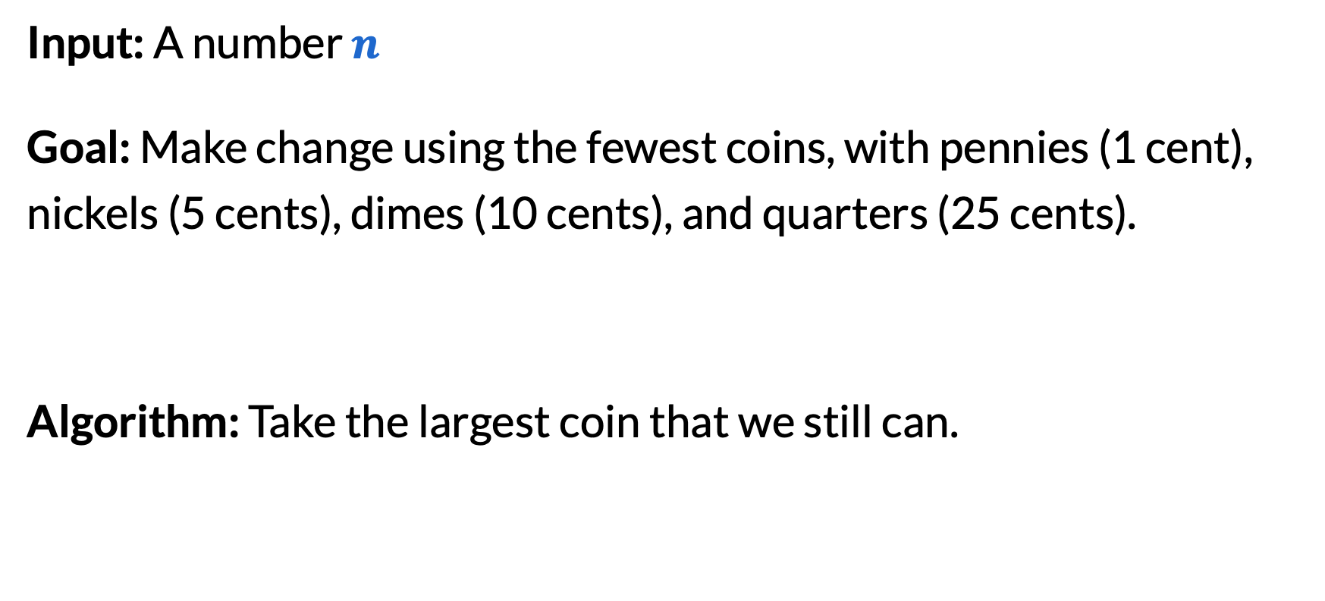
Making change
Input: A number $n$
Goal: Make change using the fewest coins, with pennies (1 cent), nickels (5 cents), dimes (10 cents), and quarters (25 cents).
Algorithm: Take the largest coin that we still can.

Slide 16
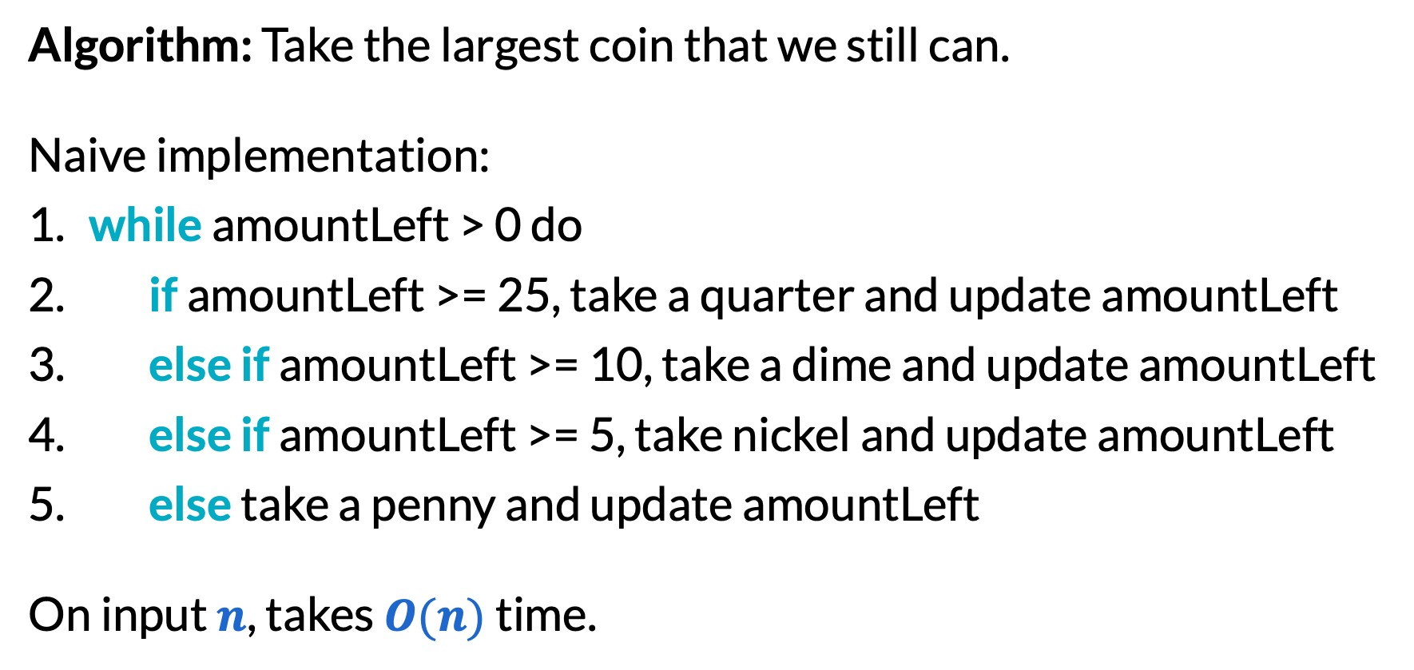
Running time for making change
Algorithm: Take the largest coin that we still can.
Naive implementation:
​while amountLeft > 0 do
​if amountLeft >= 25, take a quarter and update amountLeft
​else if amountLeft >= 10, take a dime and update amountLeft
​else if amountLeft >= 5, take nickel and update amountLeft
​else take a penny and update amountLeft
On input $n$, takes $O(n)$ time.

Slide 17
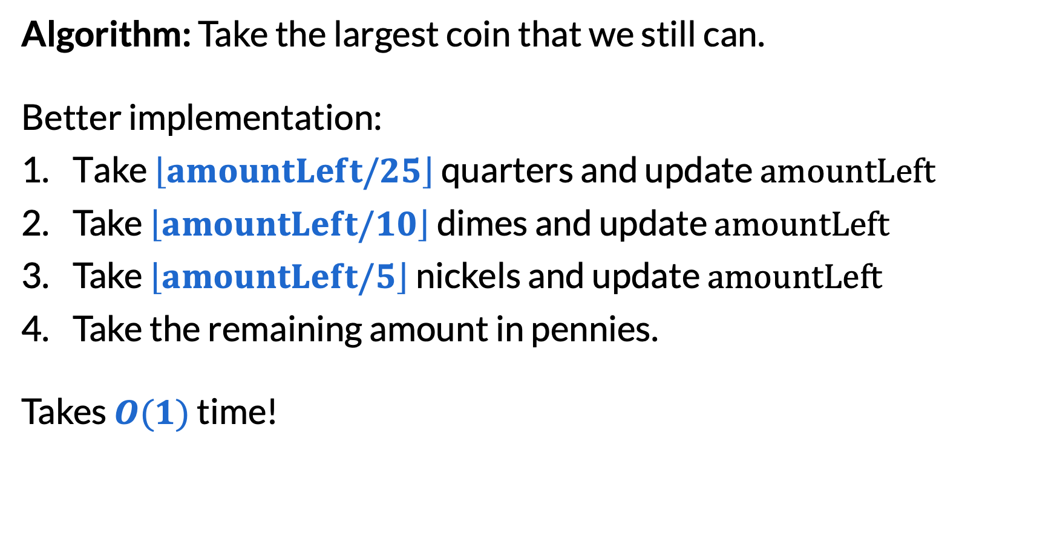
Running time for making change
Algorithm: Take the largest coin that we still can.
Better implementation:
Take $\left\lfloor amountLeft/25\right\rfloor$ quarters and update $amountLeft$
Take $\left\lfloor amountLeft/10\right\rfloor$ dimes and update $amountLeft$
Take $\left\lfloor amountLeft/5\right\rfloor$ nickels and update $amountLeft$
Take the remaining amount in pennies.
Takes $O(1)$ time!

Slide 18
Different exchange argument for change
An optimal solution uses no more than 4 pennies:
If there are 5 pennies, swap with 1 nickel.
An optimal solution uses no more than 1 nickel:
If there are 2 nickels, swap with 1 dime.
An optimal solution uses no more than 2 dimes:
If there are 3 dimes, swap with 1 quarter and 1 nickel.

Slide 19
Greedy with other coin values
Does the greedy algorithm work with the following coin values?
Q: 1 cent, 2 cents, 4 cents, 8 cents, 16 cents?
A: Yes! Even easier exchange argument:
Q: 1 cent, 10 cents, 11 cents?
A: No. For 20 cents, greedy gives (11 cents) + 9 * (1 cent), using 10 coins. Optimal is 2 * (10 cents), using 2 coins.

Slide 20
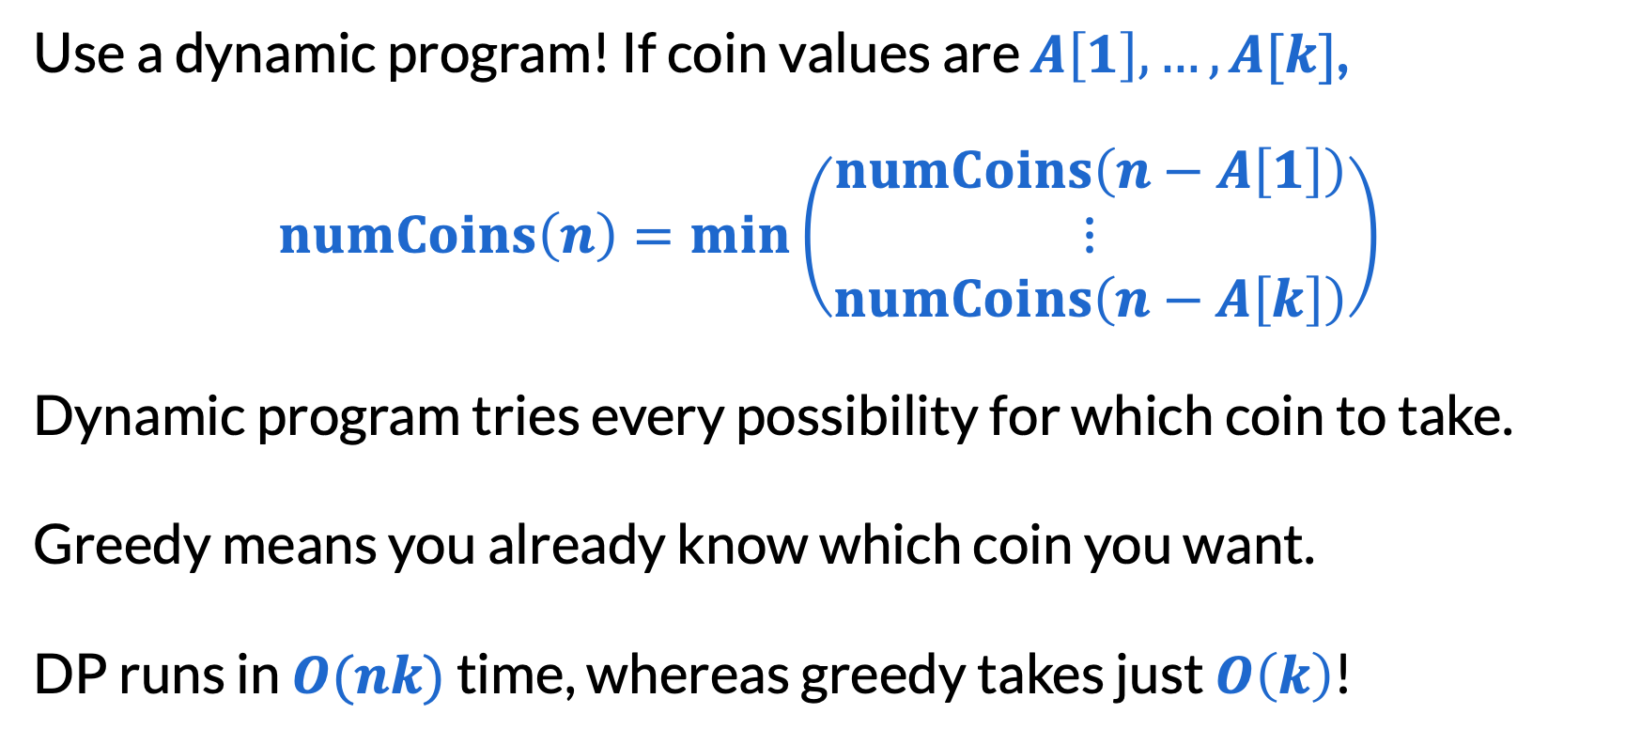
Making change with general coin values
Use a dynamic program! If coin values are $A\left[1\right],…,A[k]$,
$$numCoins\left(n\right)=\min\left(\begin{matrix}numCoins\left(n−A\left[1\right]\right) \\ ⋮ \\ numCoins\left(n−A\left[k\right]\right)\end{matrix}\right)$$
Dynamic program tries every possibility for which coin to take.
Greedy means you already know which coin you want.
DP runs in $O(nk)$ time, whereas greedy takes just $O\left(k\right)$!

Slide 21
Meeting scheduler
Input: List of time intervals (booking requests for a meeting room)
Output: Maximum number of meetings that can be booked
1 | 2 | 3 | 4 | 5 | 6 | 7 | 8 | 9 | 10 | 11 | 12 | 13 | 14 | 15

Slide 22
Lots of greedy options!
Things we could try:
Pick the shortest meeting
Pick the meeting that conflicts with the fewest other meetings
Pick the meeting that would start first
Pick the meeting that would end first
(…that doesn’t conflict with meetings we’ve already picked.)
Q: Can you eliminate any of these by finding counterexamples?

Slide 23
Counterexamples
Pick the shortest meeting
1 | 2 | 3 | 4 | 5 | 6 | 7 | 8 | 9 | 10

Slide 24
Counterexamples
Pick the meeting that conflicts with the fewest other meetings
1 | 2 | 3 | 4 | 5 | 6 | 7 | 8 | 9 | 10

Slide 25
Counterexamples
Pick the meeting that would start first
1 | 2 | 3 | 4 | 5 | 6 | 7 | 8 | 9 | 10

Slide 26
Counterexamples
Pick the meeting that would end first
Actually seems to work…

Slide 27
Our greedy solution
Algorithm: Pick the meeting that would end first.
1 | 2 | 3 | 4 | 5 | 6 | 7 | 8 | 9 | 10 | 11 | 12 | 13 | 14 | 15

Slide 28
Exchange argument for meeting scheduler
Suppose another schedule was different and look at the first time our schedules differed.
⭐ | ⭐ | ⭐ |  | ⭐ | ⭐ | ⭐ |  |  | ⭐ | ⭐ | ⭐
 |  |  |  |  |  |  |  |  |  |  |  | ⭐ | ⭐ | ⭐
1 | 2 | 3 | 4 | 5 | 6 | 7 | 8 | 9 | 10 | 11 | 12 | 13 | 14 | 15
 | us
⭐ | other
same until here, different here

Slide 29
Exchange argument for meeting scheduler
In the ⭐ solution, we could’ve picked our solution instead:
Compatible with previous picks because previous are same
Compatible with future picks because finishes earliest
⭐ | ⭐ | ⭐ |  | ⭐ | ⭐ | ⭐
 |  |  |  |  |  |  |  |  |  | ⭐
 |  |  |  |  |  |  |  |  |  |  |  | ⭐ | ⭐ | ⭐
1 | 2 | 3 | 4 | 5 | 6 | 7 | 8 | 9 | 10 | 11 | 12 | 13 | 14 | 15
 | us
⭐ | other

Slide 30
Exchange argument for meeting scheduler
In the ⭐ solution, we could’ve picked our solution instead:
Compatible with previous picks because previous are same
Compatible with future picks because finishes earliest
Because this process can transform any solution into ours while maintaining (or increasing) the number of meetings, our solution must be optimal!

Slide 31
Final reminders
I have OH now-12:30pm:
Meet at front of classroom, we’ll walk over together
CSE (Allen) 214 if you’re coming later
Nathan has online OH 12–1pm:
https://washington.zoom.us/my/nathanbrunelle

